Slide 1
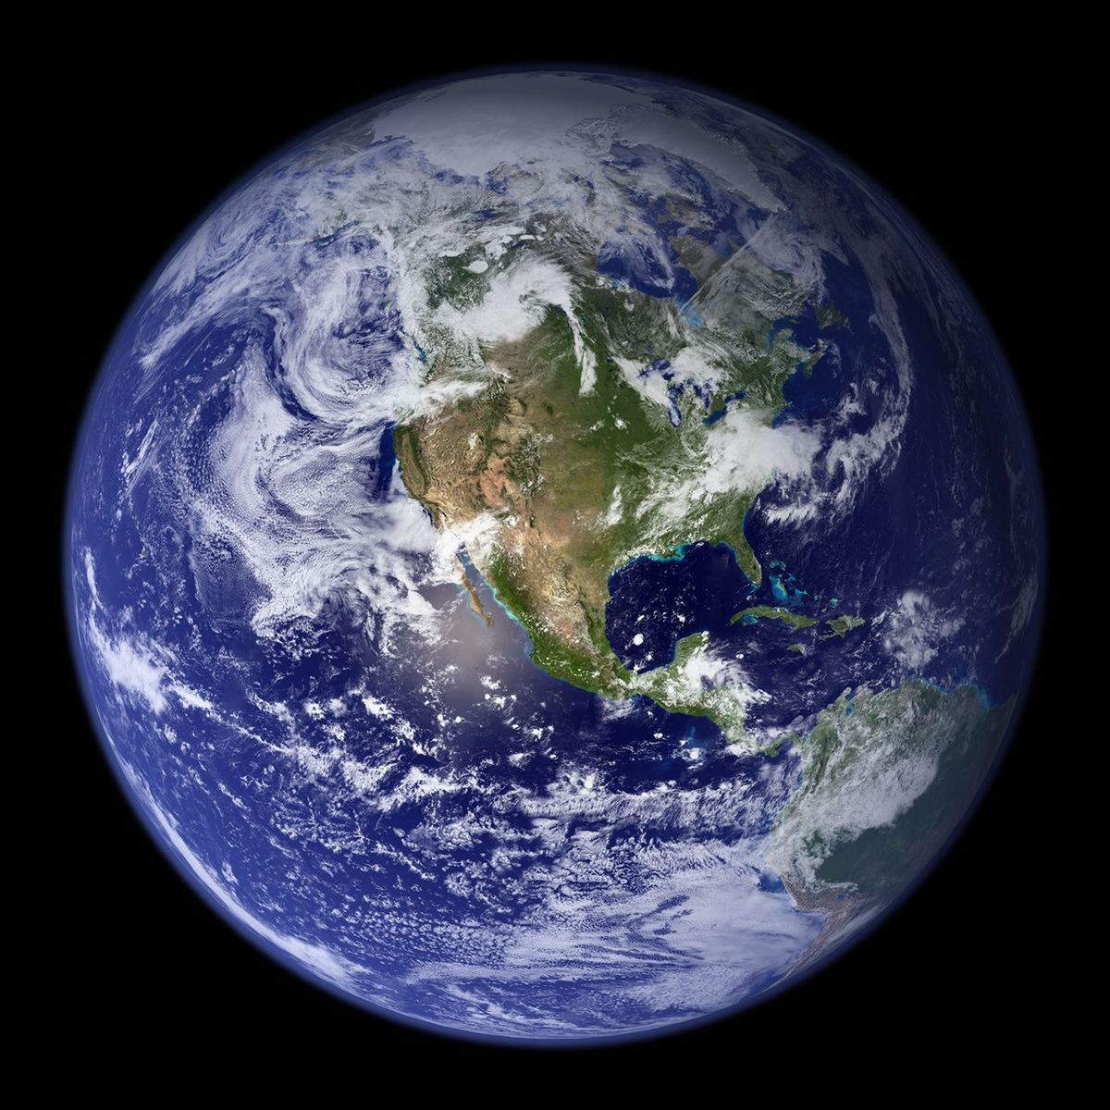
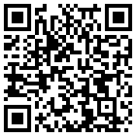

Investigating equatorial waves with high-density ROMEX GNSS-RO observations
Lina Lucas¹, Phoebe Noble^{1,2}, Timothy Banyard¹, Corwin Wright¹, William Randel³, Neil Hindley¹
^{[1]} University of Bath, UK, ^{[2]} Stockholm University, Sweden, ^{[3]} NSF National Center for Atmospheric Research, USA

Slide 2
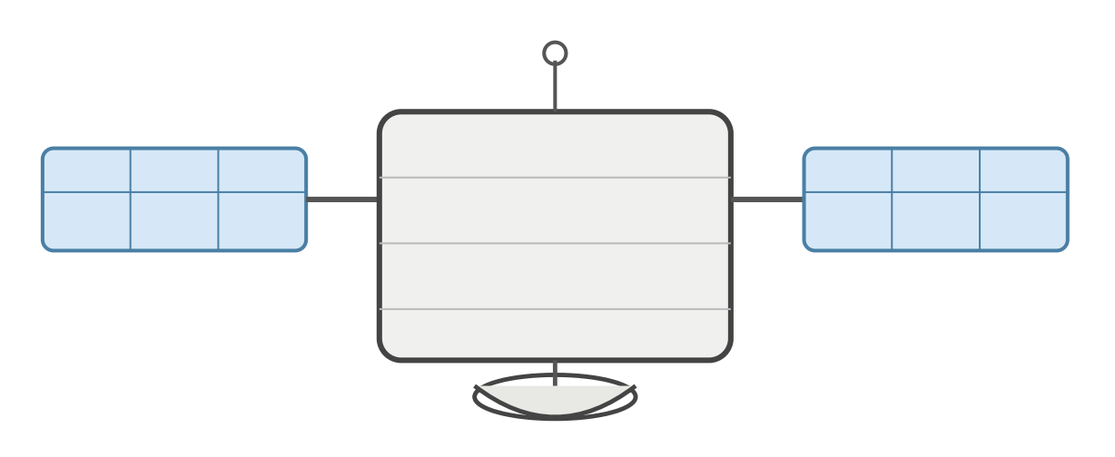

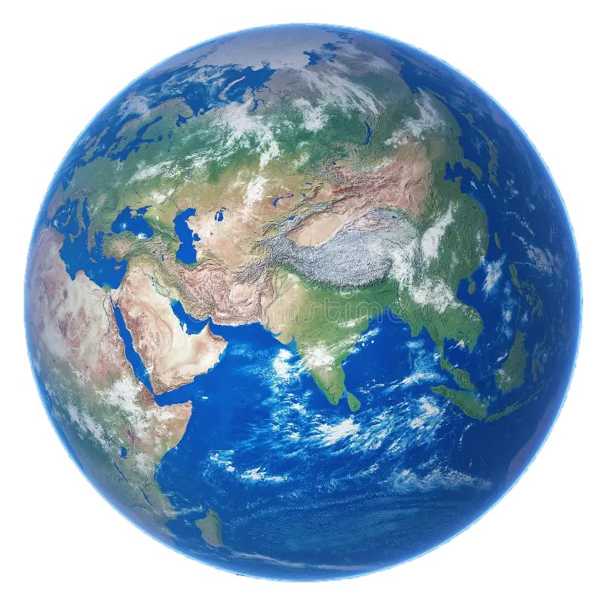
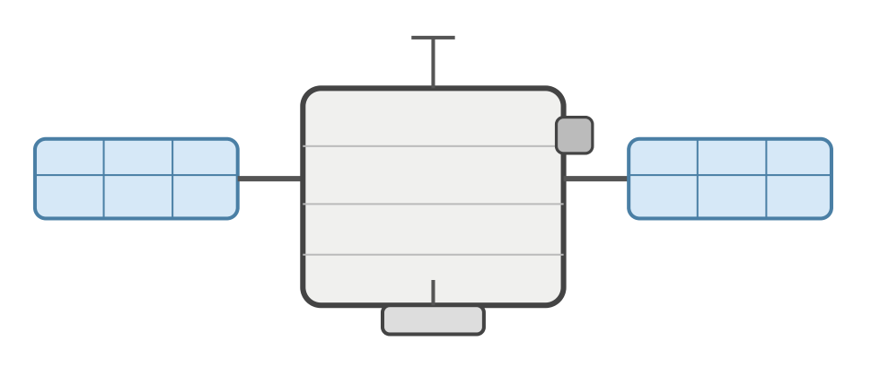
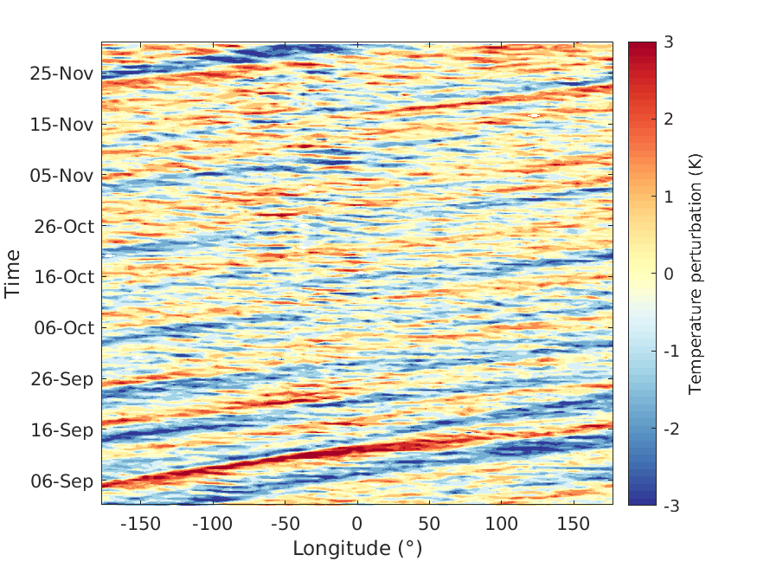
ROMEX
Mystery waves
8-hourly
ROMEX
High-density GNSS-RO
~ 35,000 profiles/day
Unique community-available collection
Come to our
presentation!

Slide 3
Investigating equatorial waves with high-density ROMEX GNSS-RO observations
Lina Lucas¹, Phoebe Noble^{1,2}, Timothy Banyard¹, Corwin Wright¹, William Randel³, Neil Hindley¹
^{[1]} University of Bath, UK, ^{[2]} Stockholm University, Sweden, ^{[3]} NSF National Center for Atmospheric Research, USA

Slide 4
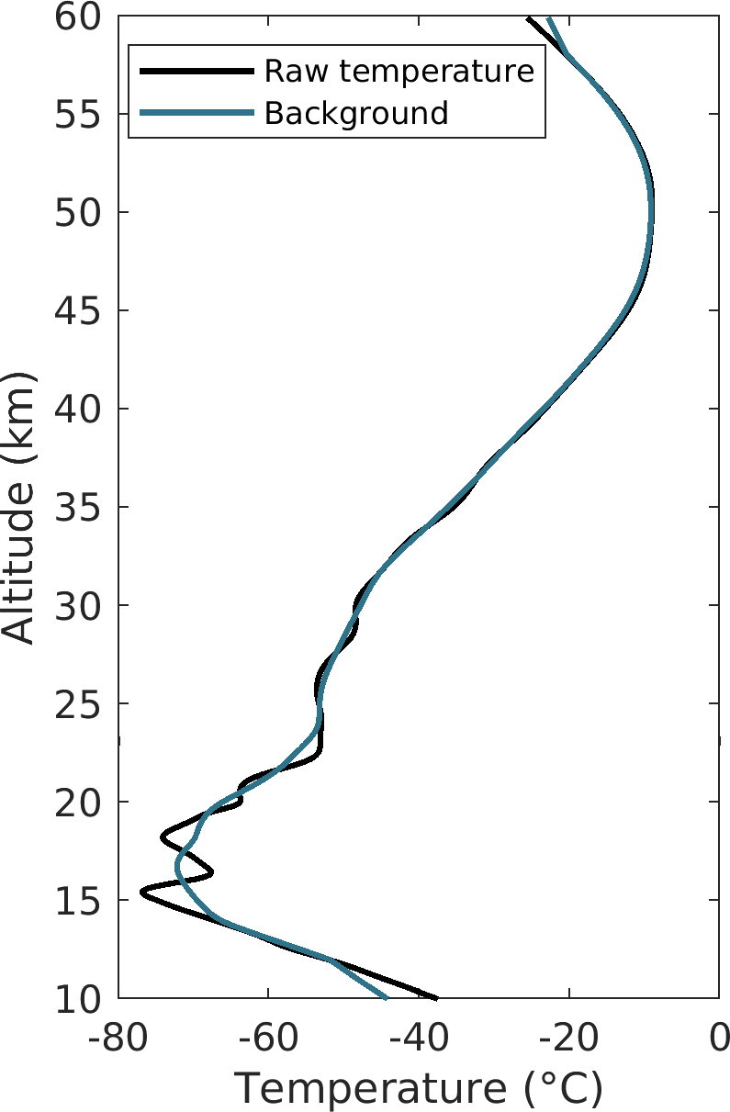
GNSS-Radio Occultation
GNSS radio signals are refracted as they pass through the atmosphere
A Low-Earth Orbit (LEO) satellite records the bending angle → temperature profiles
100 m vertical resolution, global coverage, all-weather, day and night
GNSS
LEO

Slide 5
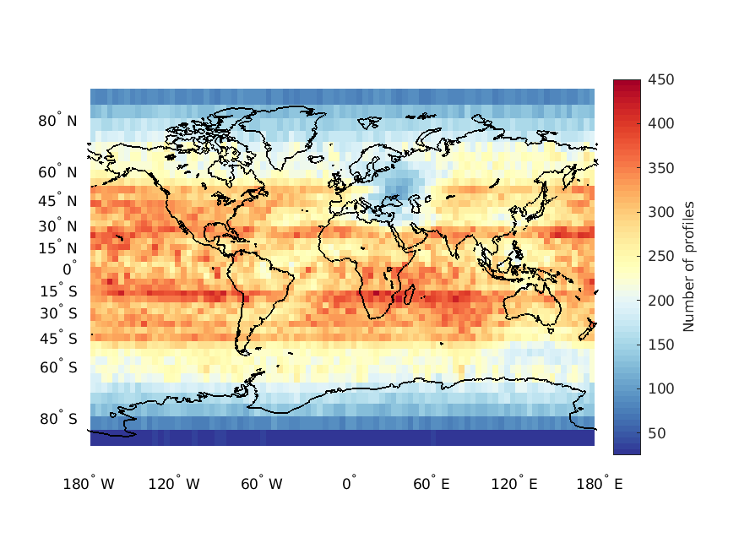
The ROMEX dataset
Combines 15 different GNSS-RO satellite missions (inc. commercial)
Higher spatial density than any prior dataset
Period: September-November 2022
~ 30,000 – 40,000 profiles per day
Enables resolution of smaller atmospheric scales

Slide 6
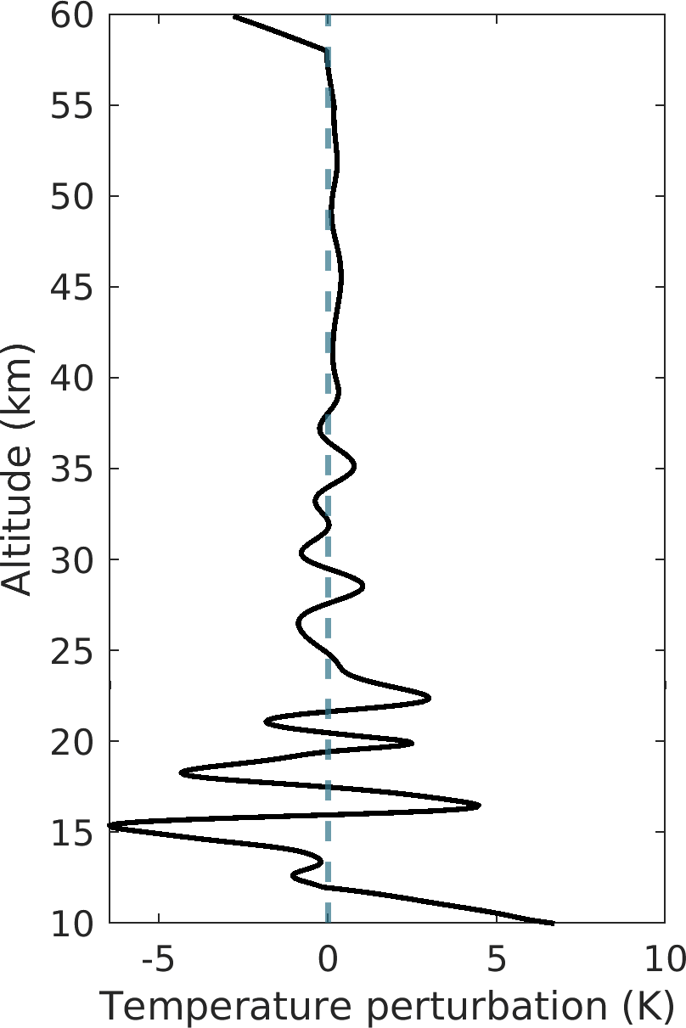
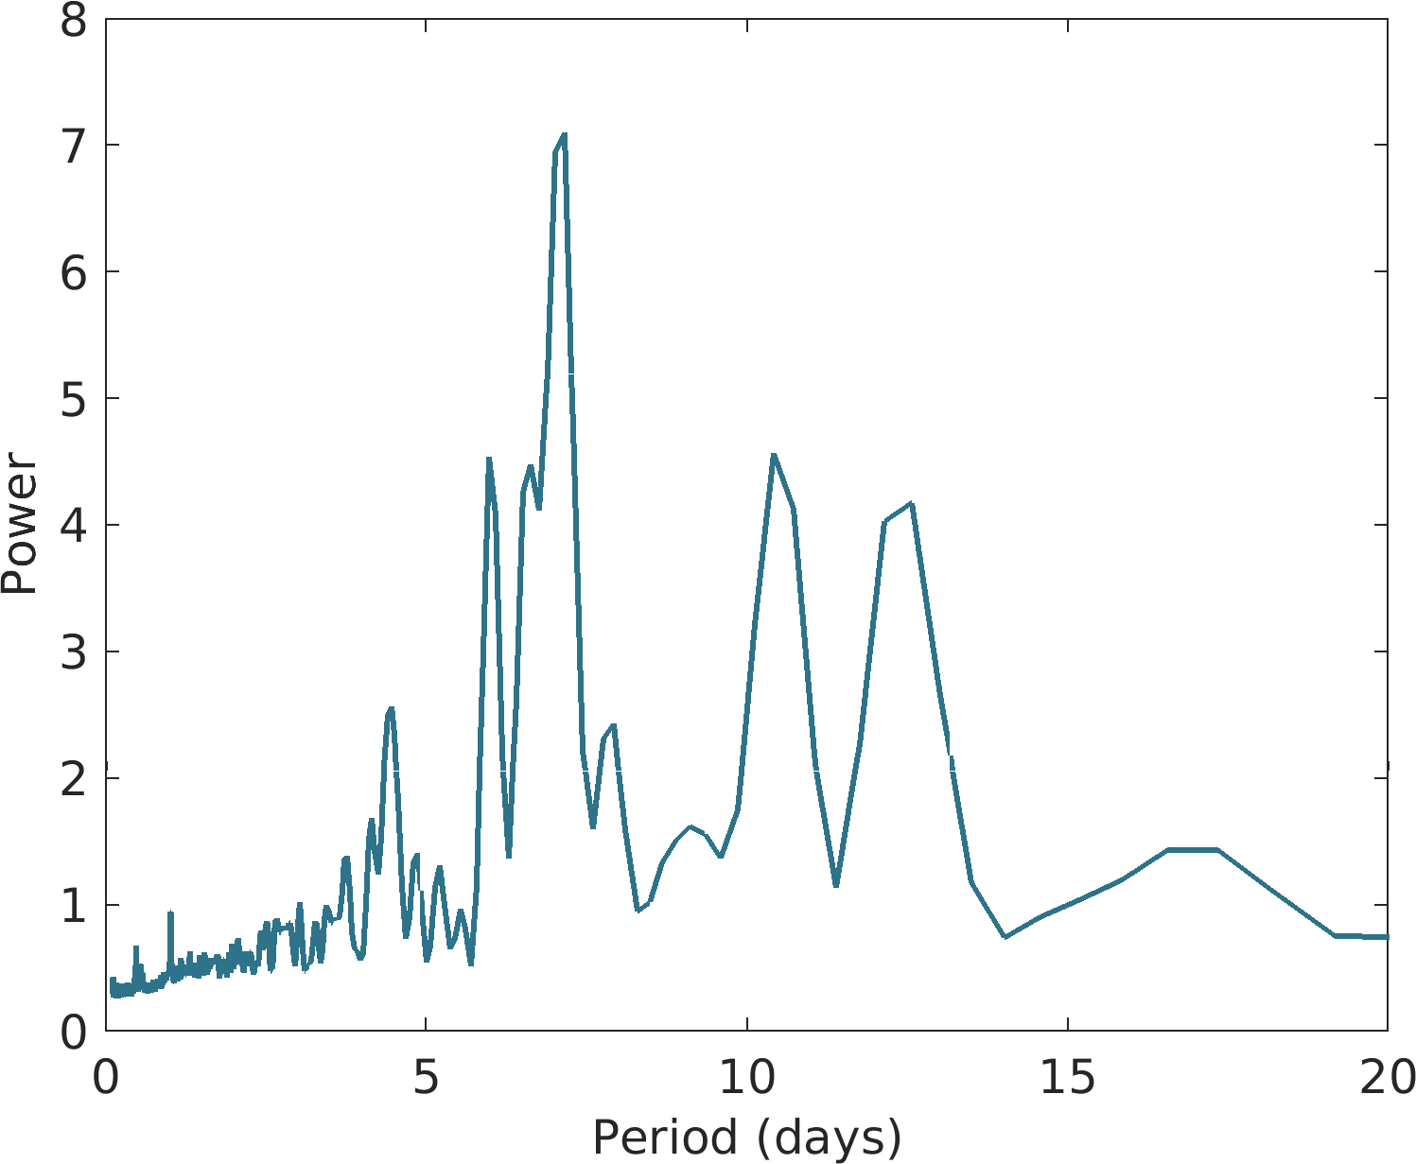
Isolating equatorial wave signals
Background T̄(z)
Savitzky-Golay filter 25 km window
Temperature perturbations
T′(z) = T(z) − T̄(z)
isolate wave signals
Wave analysis
T′(z) used to identify equatorial waves
Lomb-Scargle at 25km

Slide 7
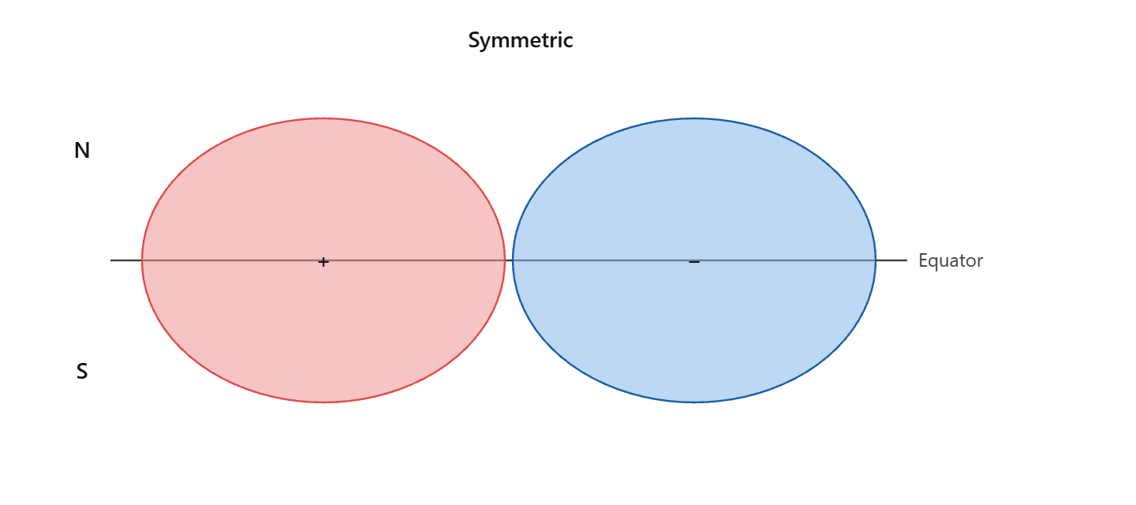
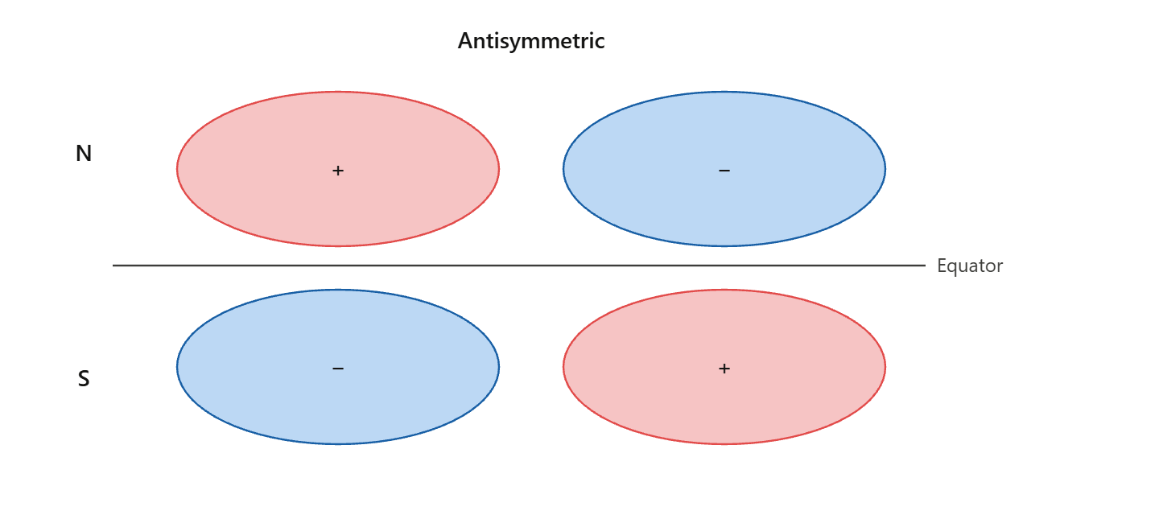
Equatorial waves
Trapped near the equator by Coriolis force → equatorial waveguide
Drive the QBO, modulate convection, couple troposphere to stratosphere
Classified by temperature symmetry about the equator: symmetric or antisymmetric
Symmetric | Antisymmetric
Kelvin waves Equatorial Rossby waves (ER) Inertia-Gravity waves (WIG/EIG) | Mixed-Rossby Gravity waves (MRG) Inertia-Gravity waves (WIG/EIG)

Slide 8
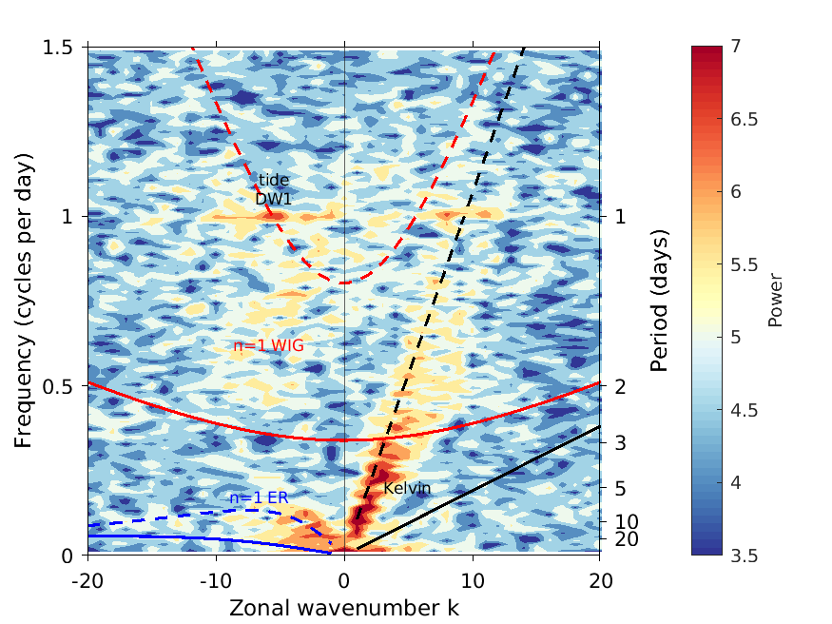
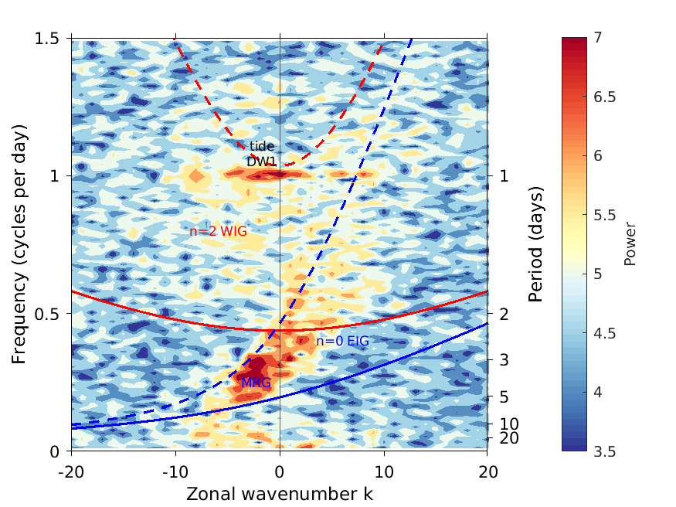
Equatorial Waves: Wheeler-Kiladis
Symmetric
Antisymmetric
: D=250m fast/deep waves
: D=8m slow/shallow waves
D = equivalent depth
n = meridional mode number
Notes:
Longitude → zonal wavenumber
Time → frequency
4 Lat, 5 Lon

Slide 9
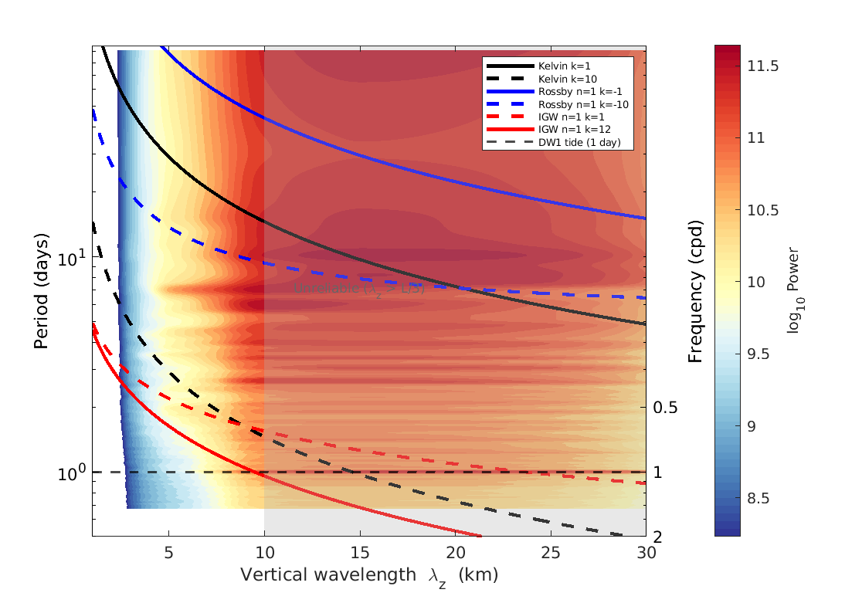
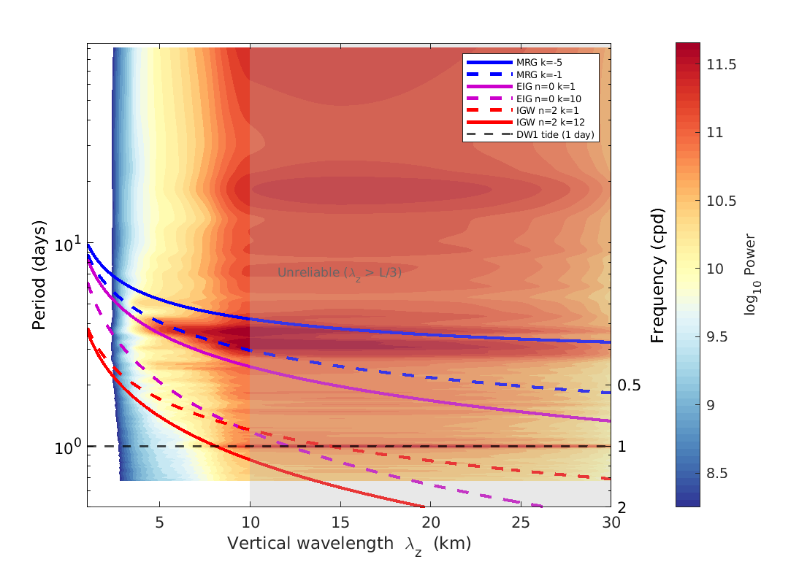
Identifying periods of equatorial waves
Symmetric
Antisymmetric

Slide 10
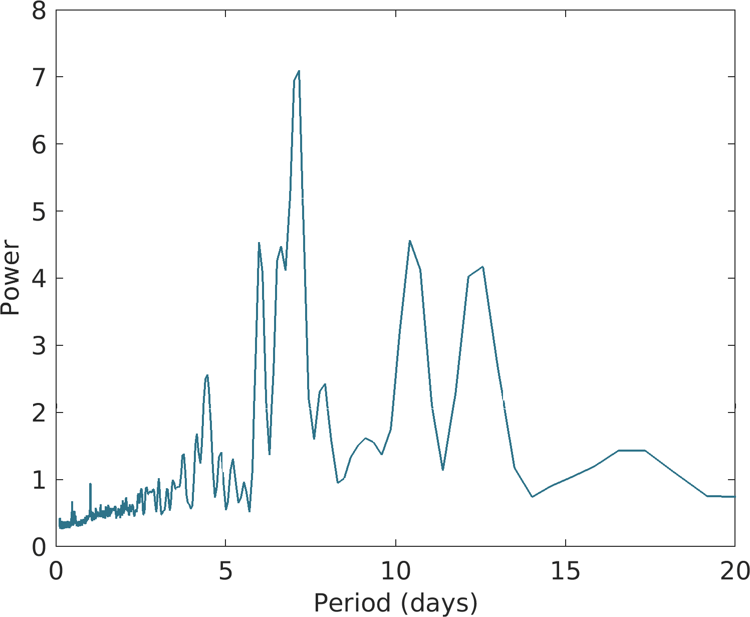
Kelvin
ER
MRG
Tide
Mystery waves

Slide 11
Mystery Waves
Mystery waves
Wavenumber: ~ 3-4
Period: ~ 2 days
Westward propagating
: eastward propagating
: westward propagating

Slide 12
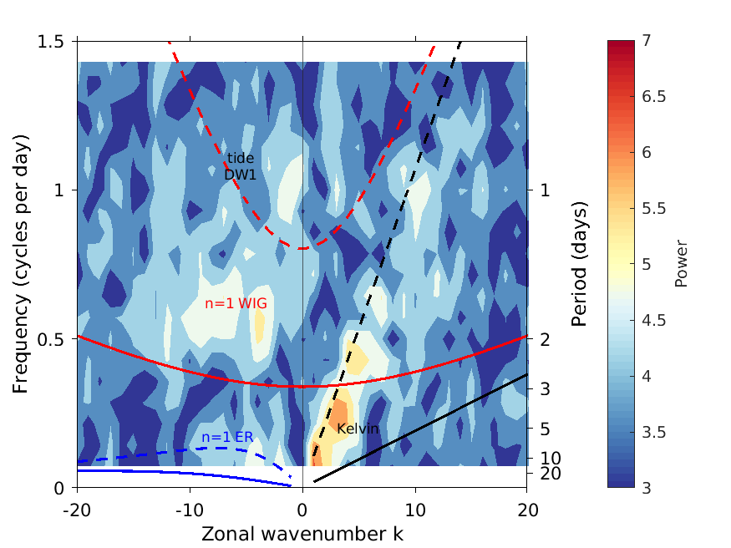
Mystery Waves
Mystery Waves
Wavenumber: ~ 3-4
Period: ~ 2 days
Westward propagating
Inertia-Gravity waves?
1.11.2022 – 15.11.2022

Slide 13
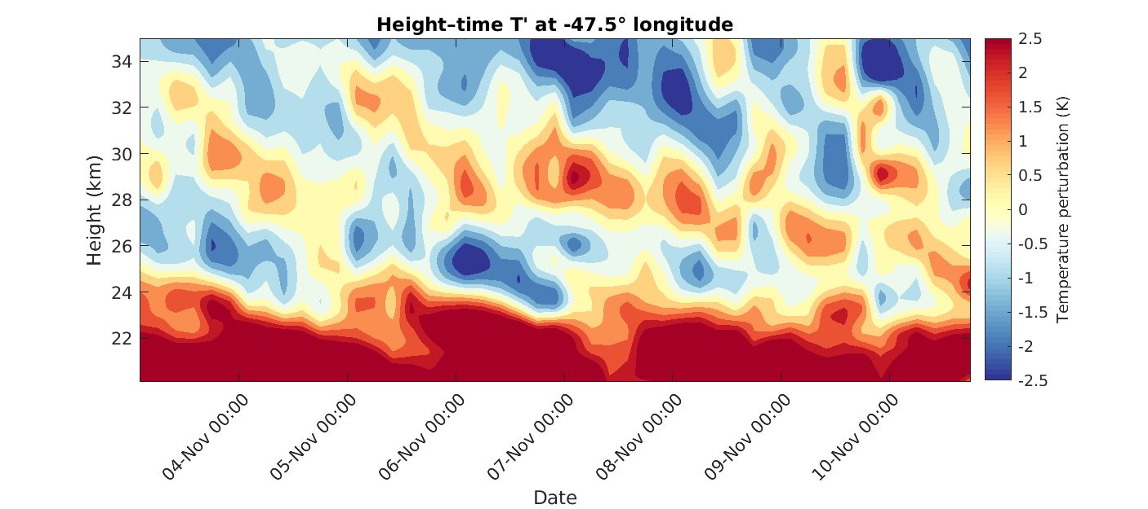
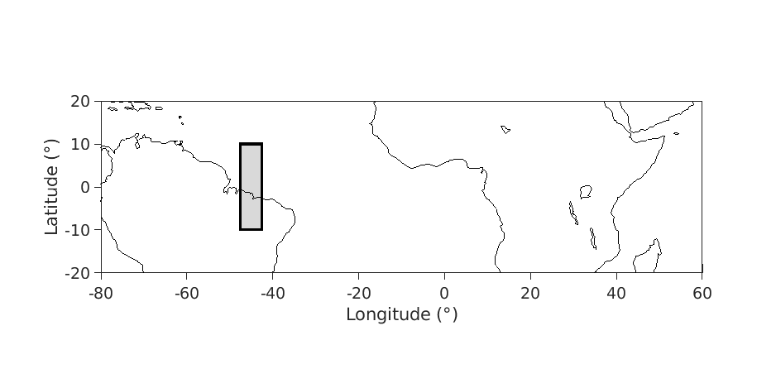
Mystery Waves
Wavenumber: ~ 3-4
Period: ~ 2 days
Westward propagating
Inertia-Gravity waves?
Vertical wavelength: ~ 6-8km
Upward phase velocity: ~ 4-8km/day
Amplitude: ~1-2K

Slide 14
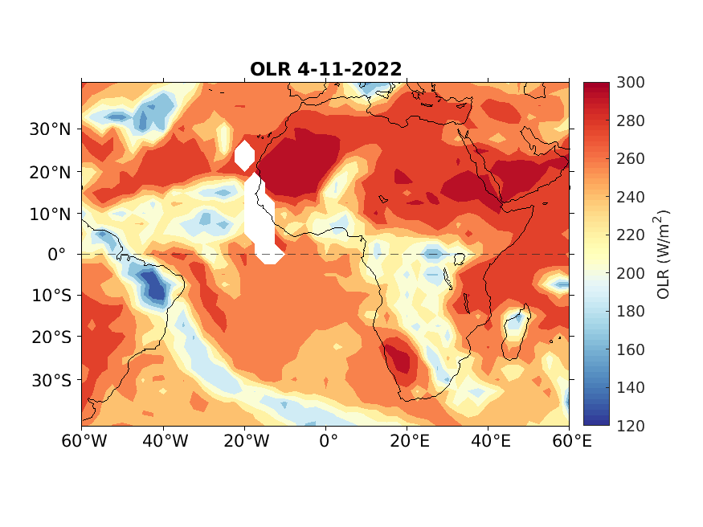
Origin of Mystery Waves
Inertia gravity waves are induced by deep convection (Andrews et al., 1987)
Persistent MCS over Central Africa as wave source
~ 2-day period from quasi-2-day convective disturbances driven by boundary layer recovery (Yu et al., 2021)
Excites westward inertia-gravity waves (equivalent depth 12–50 m) (Takayabu et al., 1994)

Slide 15
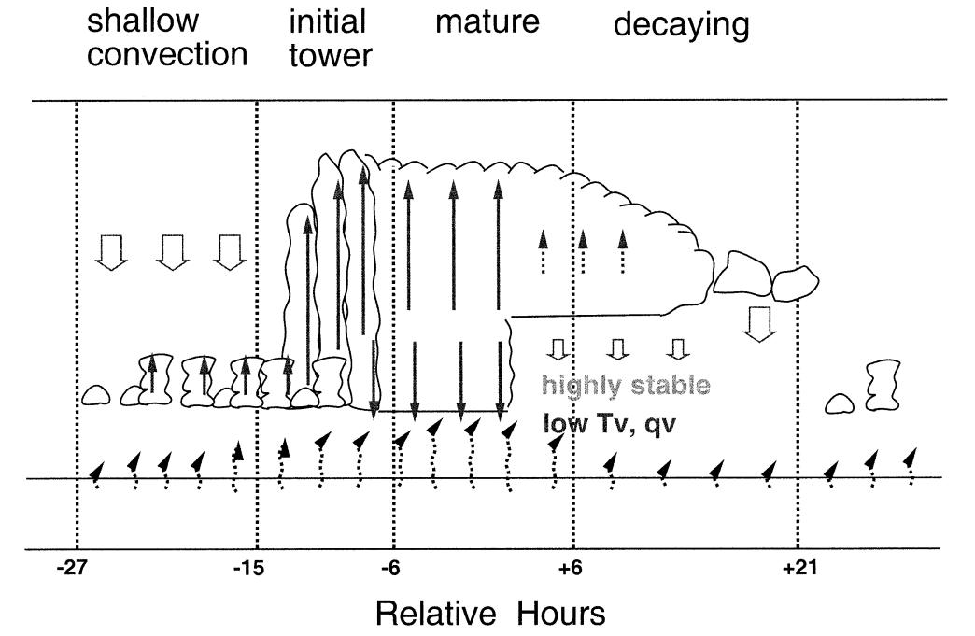
Life Cycle 2-day Wave
From: (Takayabu et al., 1996)

Slide 16
References
https://science.nasa.gov/earth/earth-observatory/the-blue-marble-true-color-global-imagery-at-1km-resolution/
https://www.dreamstime.com/illustration/earth-isolated-planet.html
Andrews, David G., Conway B. Leovy, and James R. Holton. Middle atmosphere dynamics. Vol. 40. Academic press, 1987.
Yu, Hungjui, Kristen L. Rasmussen, and Hung‐Chi Kuo. "Quasi‐2‐Day and diurnal cloud variation timescales over convectively active regions." Journal of Geophysical Research: Atmospheres 126.21 (2021): e2021JD035426.
Takayabu, Yukari N. "Large-scale cloud disturbances associated with equatorial waves Part I: Spectral features of the cloud disturbances." Journal of the Meteorological Society of Japan. Ser. II 72.3 (1994): 433-449.
Takayabu, Yukari N., K. M. Lau, and C. H. Sui. "Observation of a quasi-2-day wave during TOGA COARE." Monthly weather review 124.9 (1996): 1892-1913.

