Slide 1
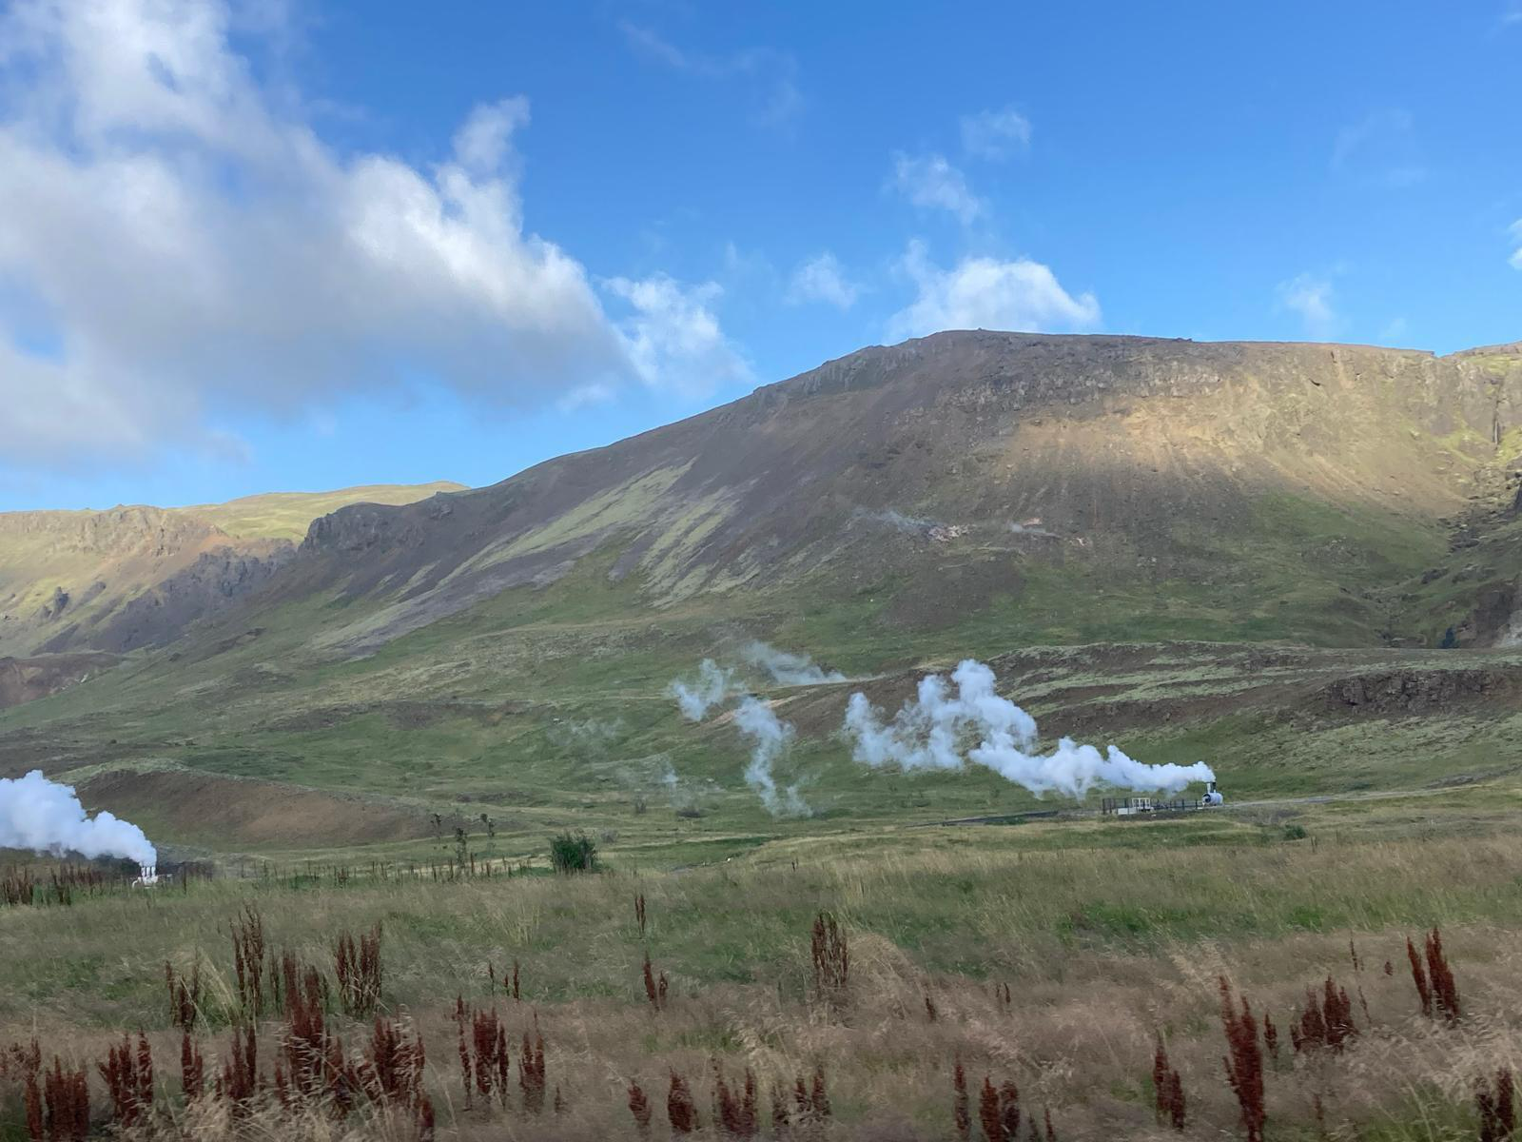


Warming enhances nitrogen priming of N₂O emissions in subarctic soils under high nitrogen availability
Reporter: Jinyuan Yu
Time: 2026.03.13
Notes:
Good afternoon everyone.
Today I will present our recent study that’s Warming enhances nitrogen priming of N₂O emissions in subarctic soils under high nitrogen availability

Slide 2
Contents
1
Background
2
Why do this?
3
How do this?
4
Conclusion

Slide 3
Background
Question: How warming interacts with C and N availability to regulate microbial CO₂, N₂O production and C,N priming in a subarctic grassland ecosystem?
High-latitude soils store large amounts of carbon and nitrogen and play an important role in the global climate system
Climate warming may stimulate microbial activity and accelerate soil C and N cycling, potentially increasing greenhouse gas emissions (CO₂,N₂O)
Under warming, microbial responses depend not only on temperature, but also on resource availability
Notes:
To begin with, I would like to briefly explain why this question How warming interacts with C and N availability to regulate microbial CO₂, N₂O production and C,N priming in a subarctic grassland ecosystem? is important.
Subarctic soils are like a giant natural freezer, storing a huge proportion of global carbon and nitrogen.
However, climate warming is melting this freezer. As temperatures rise, soil microbes become active, and start consuming this stored C and N, releasing greenhouse gases like $CO_2$ and $N_2O$.
While we know warming increases these emissions, microbial behavior also effected by C,N availability especially in the resource limited subarctic area , so microbial responses may depend not only on temperature itself, but also on resource availability.
Finally, if we can answer this question, we may better predict the impact of climate warming on the soil carbon cycle, nitrogen cycle, and greenhouse gas emissions
为了更准确地预测气候变暖对土壤碳循环、氮循环以及温室气体排放的影响
To understand this indirect effect on native soil pools, we experimentally added fresh C and N substrates to simulate source limitation. These additions allowed us to test whether microbes consumed only the added substrates or also changed native soil pools that produced more greenhouse gas, that is, priming.

Slide 4
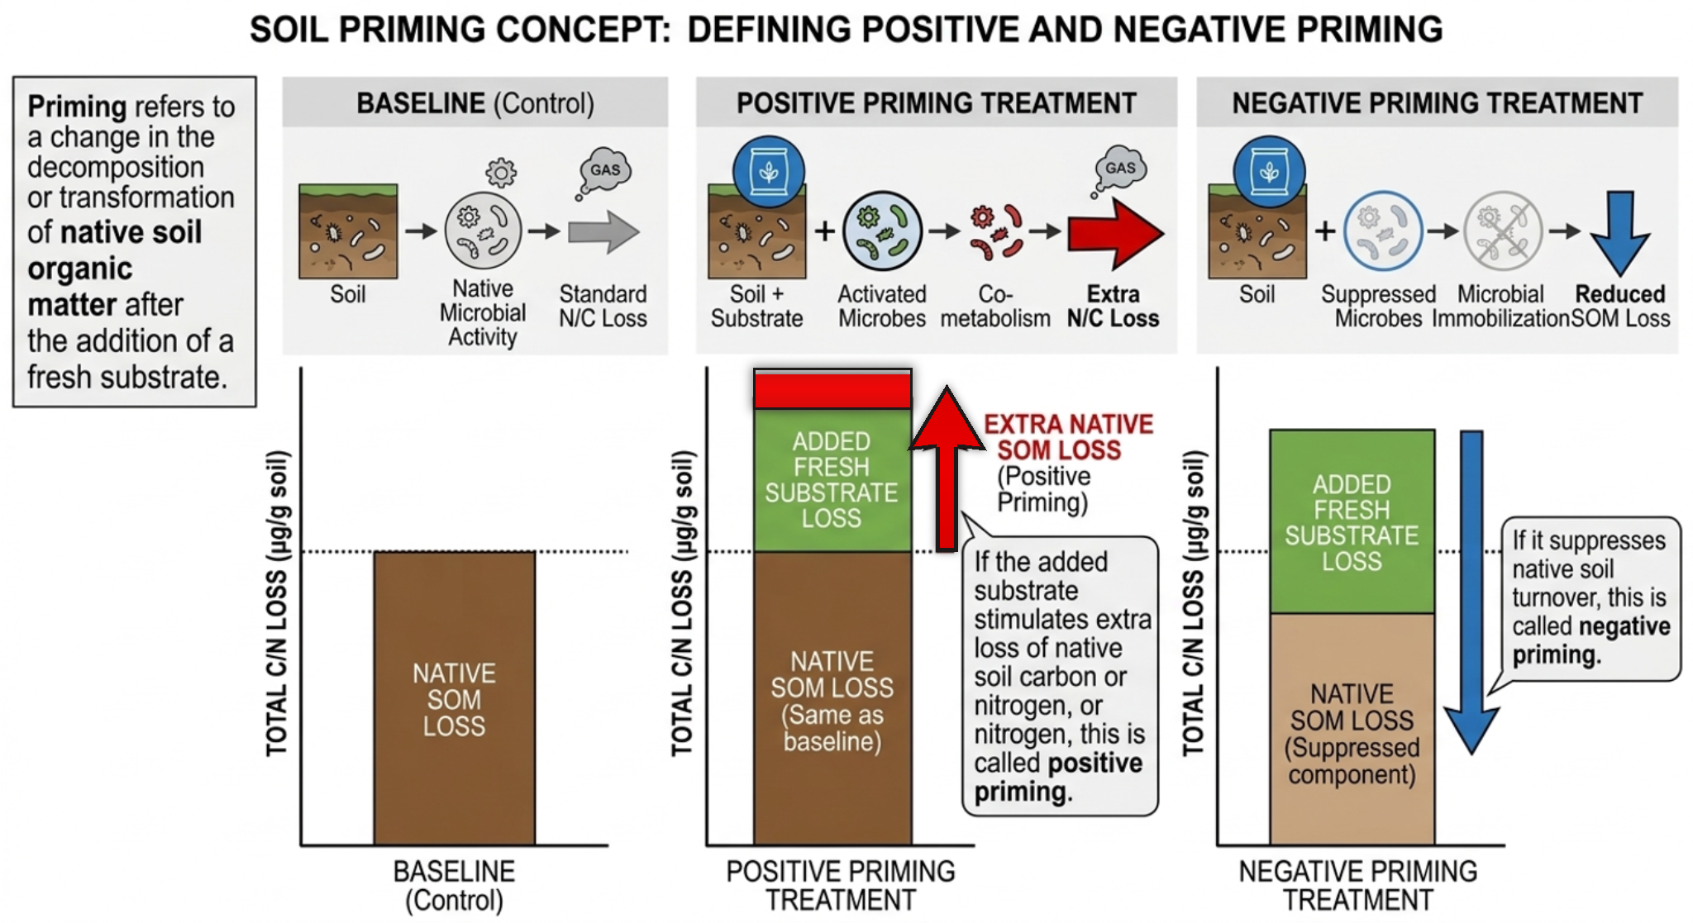
Background
Priming effect
Notes:
To understand this indirect effect on native soil pools, we experimentally added fresh C and N substrates to simulate source limitation. These additions allowed us to test whether microbes consumed only the added substrates or also changed native soil pools that produced more greenhouse gas, that is, priming.
Priming refers to a change in the decomposition or transformation of native soil organic matter after the addition of a fresh substrate.
If the added substrate stimulates extra loss of native soil carbon or nitrogen, this is called positive priming. If it suppresses native soil turnover, this is called negative priming.
In our study, this concept is important because we are not only interested in how microbes use the added C and N, but also in whether these additions change native soil organic matters.

Slide 5
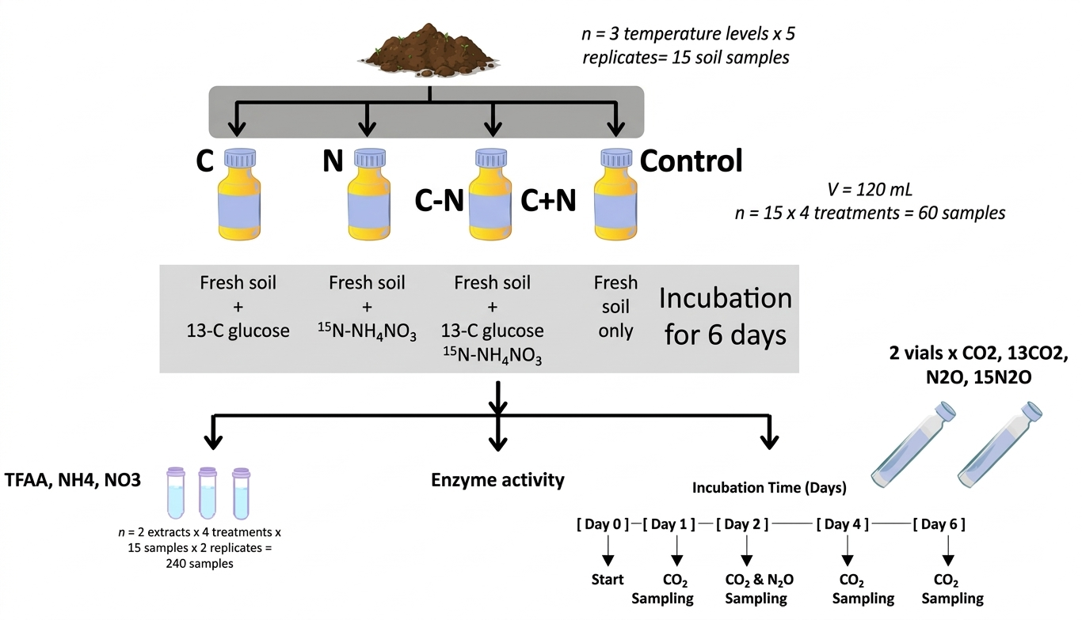
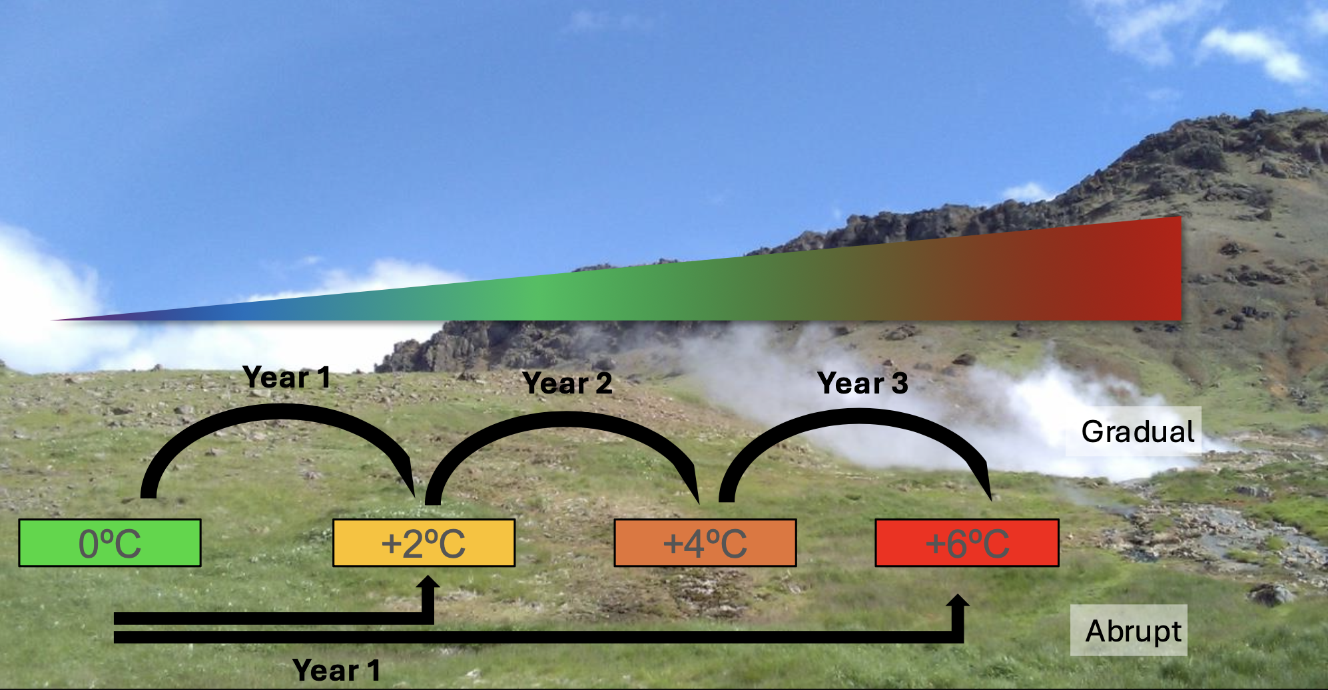
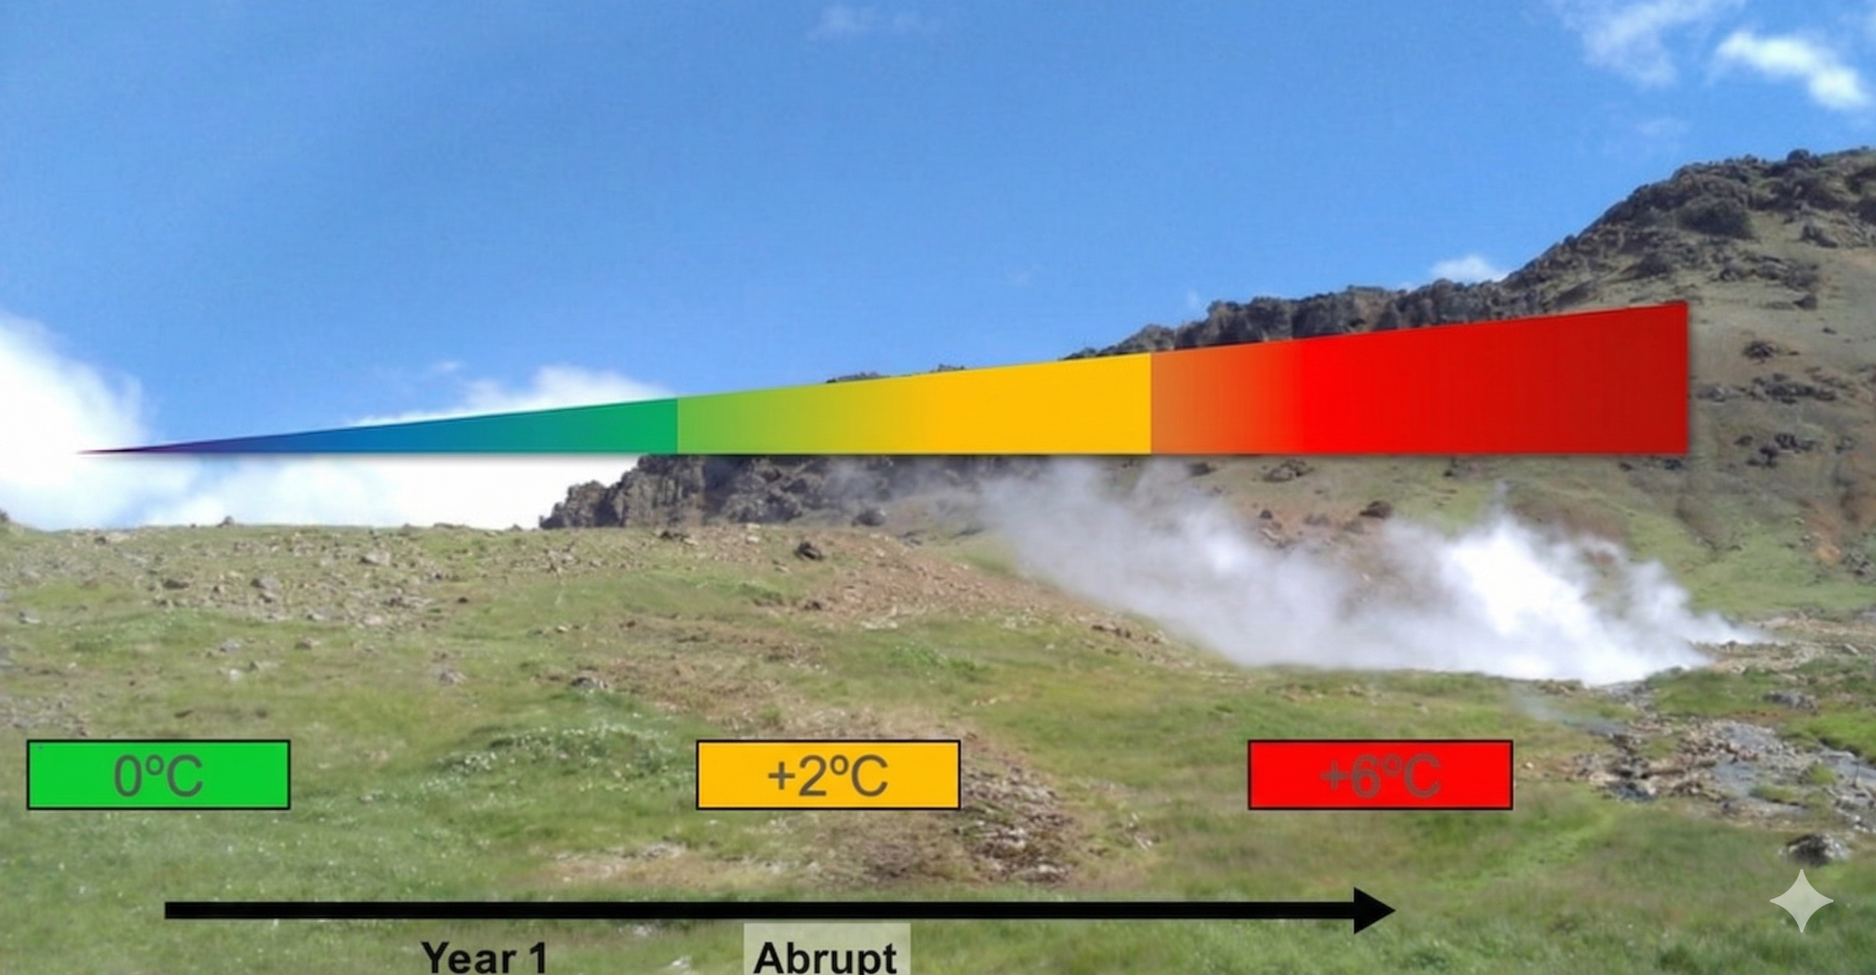
Experimental Design
Warming gradient
Incubation
Icelandic subarctic grassland along a natural warming gradient
C+N
3 Temperature levels
+0º, +2º, +6ºC
4 Treatments
6-day Incubation
Control, C+, N+, C+N
Notes:
In our study, we designed a highly controlled incubation experiment using a natural warming gradient.
We collected soils from a Iceland subarctic grassland with a natural temperature gradient (+0, plus2, and +6 degrees)
We then applied four substrate treatments: a water control, a carbon addition with 13C-labeled glucose, a nitrogen addition with 15N-labeled ammonium nitrate, and a combined carbon plus nitrogen treatment.
The isotope labels allowed us not only to measure total gas production, but also to trace the source of co2/n2o.
This is especially important for quantifying priming effects.
We also sampled CO₂ over six days to track the dynamic trend of continuous microbial respiration, whereas we measured N₂O only on day two to capture its peak emission pulse.
I will first show how warming and substrate additions changed the background soil resource pools.

Slide 6
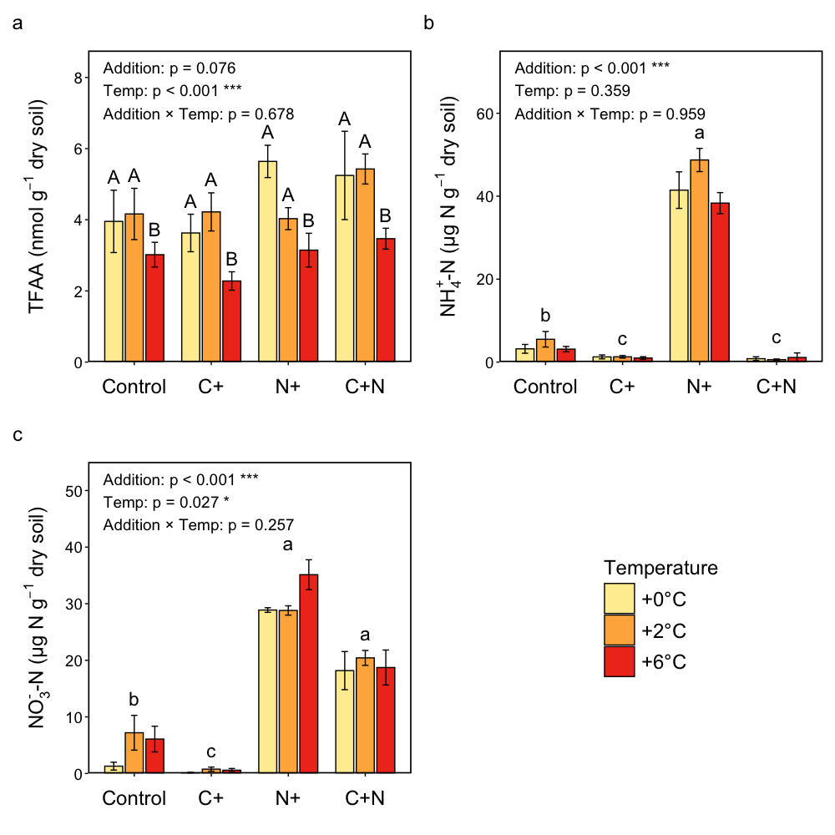
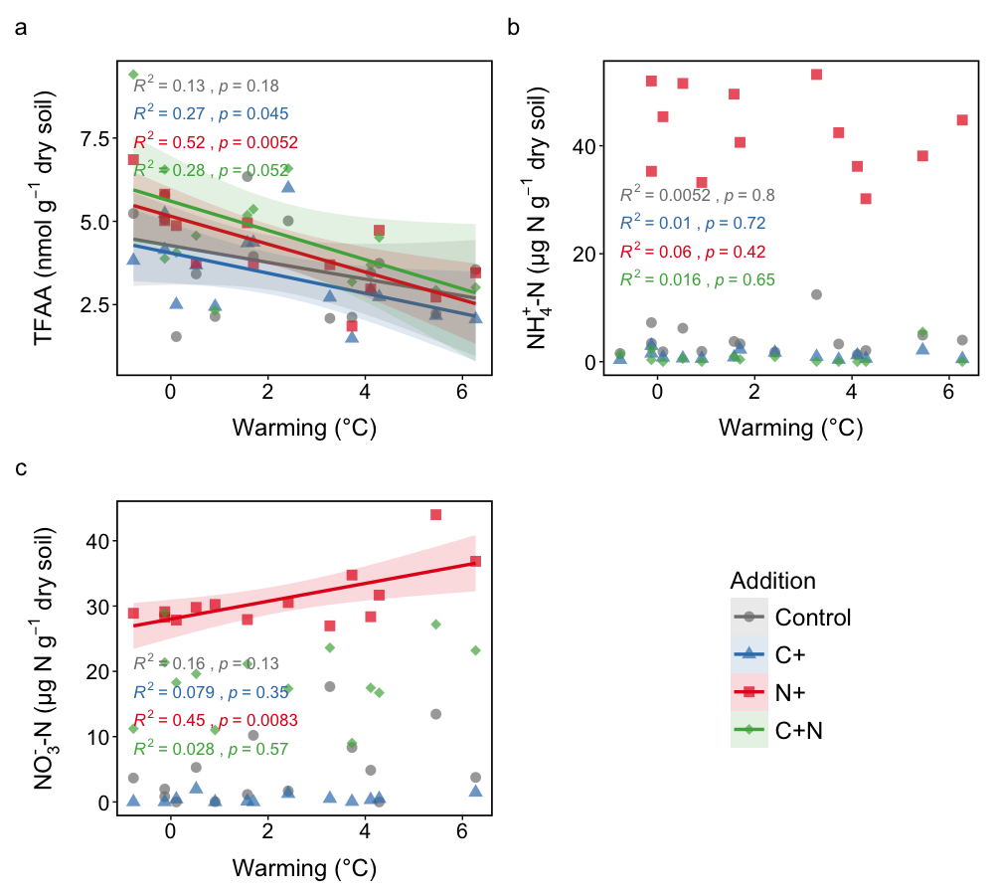
Results—1. Background N pool
*Capital letter represented the difference between different temperature, small letter represented the difference between different addition
Addition:
N addition —— Carbon-limited
Microbes prefer to uptake NH₄ ⁺ than NO₃⁻
5
Warming: Temperature↑ TFAA↓
Notes:
I will first show how warming and substrate additions changed the background soil resource pools.
First, the Warming effect, we can see that in figure a， TFAA, which represents organic nitrogen compounds, decreased significantly with temperature. This is because microbial turnover became faster according to warming, and tfaa was been consumed more quickly
Second, the Addition effect，ammonium and nitrate responded mainly due to substrate addition. Look at the difference between the N-only treatment and the C+N treatment in pic b. The large accumulation of ammonium in the N-only treatment indicates that microbial nitrogen immobilization is highly Carbon-limited ，but when we adding Carbon，microbes fully consumed the ammonium, dropping it to near zero. They used the carbon energy to immobilize this nitrogen.
However, why the NO_3 (nitrate Figure C) didn’t drop to zero in the C+N treatment? This shows microbial prefer to uptake more ammonium than nitrate. Because When we provided both Carbon and Nitrogen, the microbes selectively consumed all the easy-to-use $NH_4^ first. Once their nitrogen demand was satisfied by the ammonium, they left the remaining NO_3 in the soil.
升温会系统性改变氮循环关键通量（矿化、硝化），从而为N₂O变化提供底物端驱动
The right side line plot is the change of n pool along the warming gradient,
TFAA generally declined along the warming gradient which related to the bar plot。
Warming significantly increases NO3− accumulation only under N+ treatment. That‘s because warming increase the microbe nitrification，and the supply of nitrogen is huge, and the demand or consumption is as not fast as it’s being made , causing a large amount of the NO₃⁻
Now, these shifts in background nitrogen pools help us understand the next results。

Slide 7
Results—2. CO₂ response
CO₂ response
Strongest in C+N
Driven by labile C supply
Lowest cumulation in N-only addition
CO₂ Priming effect
Positive priming occurred mainly in C+ containing
Strongest under C+N addition
N+ remained close to zero
No warming effect of C priming
6
Notes:
On the previous page, we discussed whether nitrogen in the soil was “immobilized”. On this page, we examined greenhouse gas, together with isotope partitioning between 13CO2 and 15N₂O, to see if the nitrogen that wasn't immobilized, and how much of them turned into greenhouse gases and escaped.
Here we use the isotopic 13c and n15 to distinguish the source of co2 and n2o emission.
Let's first look at cumulative CO_2 flux on the right. Cumulative CO₂ was driven mainly by carbon availability. Both C+ and especially C+N strongly increased CO₂ accumulation, whereas N+ alone are close to the control
CO₂ was followed over six days because it showed continuous temporal dynamics during incubation, especially in first 4 days..
In the bar chart below. The red line represents our Control baseline. In the C+ and C+N treatments. This solid part represents 12CO_2, which comes entirely from native soil organic matter. Because this solid portion significantly exceeds the red line, we have clear evidence of a positive CO_2 priming effect. In short, fresh carbon—especially when combined with nitrogen—not only increase direct respiration but also accelerated the decomposition of native soil carbon.
Now, let‘s turn to the N_2O response on the right. The C-only treatment fell below the control baseline, indicating negative priming. This suggests that when added fresh carbon, they reduced the native-soil N loss, most likely because carbon stimulated microbial N demand and promoted N retention rather than N loss.
In contrast, the N-only treatment showed the strongest positive priming, especially at +6°C. This indicates that once mineral N was abundant, warming strongly increased microbial N transformations and promoted N loss as N₂O gas.
The combined C+N treatment also showed positive priming, but generally less strongly than N+ alone. This matches the N pool results from the previous slide, where C+N had lower NH4+ and NO3− than N，The microbes used the carbon to immobilize the nitrogen into their biomass, so decreased the N_2O leak.

Slide 8
Results—3. CH₄ response
CH₄ response
Driven by labile C supply
Lowest uptake to N-only addition
CH₄ Priming effect
Positive priming happened in N+ addition
Negative priming mainly occurred in C+ containing
No warming effect
7
Notes:
Here let look at the ch4 uptake, microbes are actively consuming it from the atmosphere—as shown by the negative fluxes. This is entirely similar with the logic of the CO2 emissions. Adding carbon greatly promotes the soil’s uptake of methane.

Slide 9
Results—4. N₂O response
N₂O Priming effect
N+ and C+N caused positive priming
Warming combined with N+ significantly increased N₂O priming
C+ caused negative priming
N₂O response
Strongest in N+
Also Enhanced by warming in N+
Less sensitive to warming in C+N+
8
8
Notes:
Now, let‘s turn to the N_2O response on the right. The C-only treatment fell below the control baseline, indicating negative priming. This suggests that when added fresh carbon, they reduced the native-soil N loss, most likely because carbon stimulated microbial N demand and promoted N retention rather than N loss.
In contrast, the N-only treatment showed the strongest positive priming, especially at +6°C. This indicates that once mineral N was abundant, warming strongly increased microbial N transformations and promoted N loss as N₂O gas.
The combined C+N treatment also showed positive priming, but generally less strongly than N+ alone. This matches the N pool results from the previous slide, where C+N had lower NH4+ and NO3− than N，The microbes used the carbon to immobilize the nitrogen into their biomass, so decreased the N_2O leak.

Slide 10
Summary
Warming significantly increases the microbial turnover rate and organic carbon consumption
Under carbon-limited conditions, microorganisms prefer to assimilate NH₄+ rather than NO₃-
Carbon addition increase CO₂ priming,
But warming did not significantly influence this response
Under high nitrogen availability, warming strongly enhanced N₂O priming and caused native soil nitrogen loss,
While carbon addition partly buffered this effect
Warming significantly enhanced native soil N loss under high N availability, but had no significant effect on CO₂ priming
In the future warming, if the system is in a nitrogen-rich state (due to nitrogen deposition, fertilization, enhanced nitrogen mineralization, etc.), the risk of N₂O may be amplified.
Notes:
To sum up
In the future warming, if the system is in a nitrogen-rich state (due to nitrogen deposition, fertilization, enhanced nitrogen mineralization, etc.), the risk of N₂O may be amplified.

Slide 11
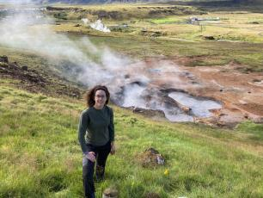

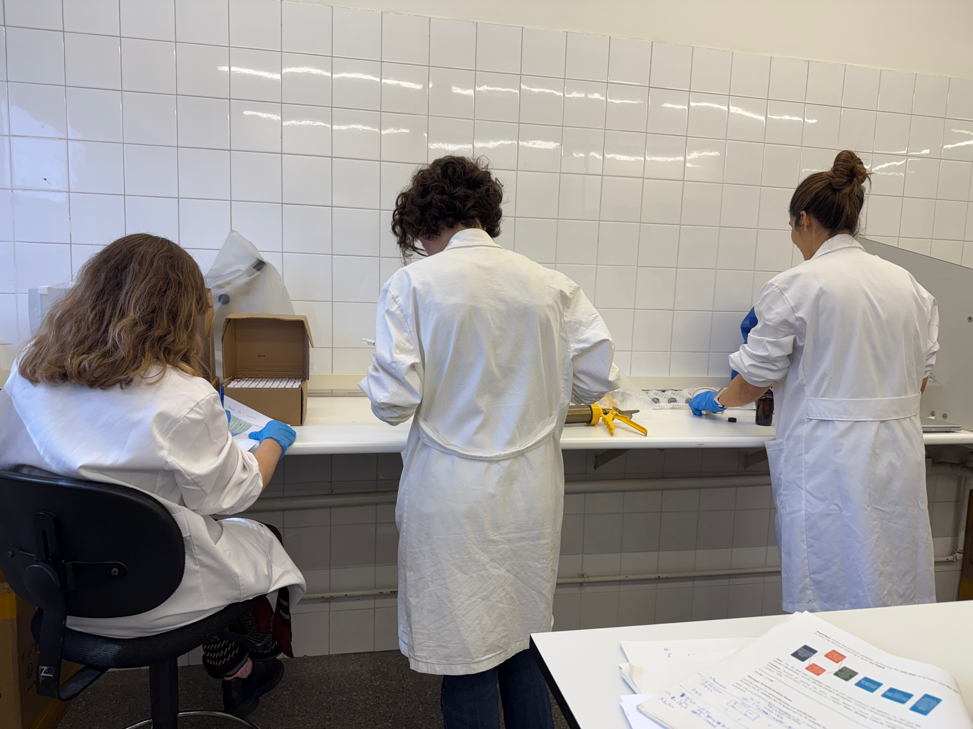
Supervisor:
Sara Marañón
Colleagues:
Ana Zevenhuizen
Martina Gonzalez
Notes:
Good afternoon everyone.
Today I will present our recent study that’s Warming enhances nitrogen priming of N₂O emissions in subarctic soils under high nitrogen availability

Slide 12
Thank you

