Slide 1
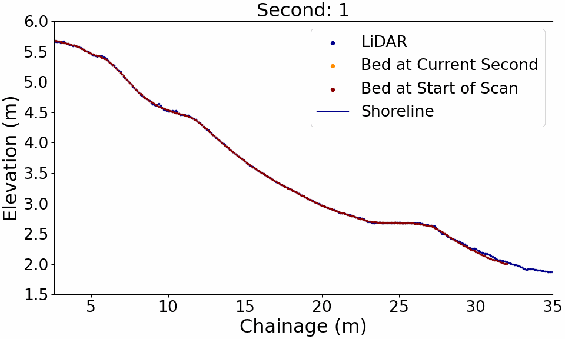

Slide 2
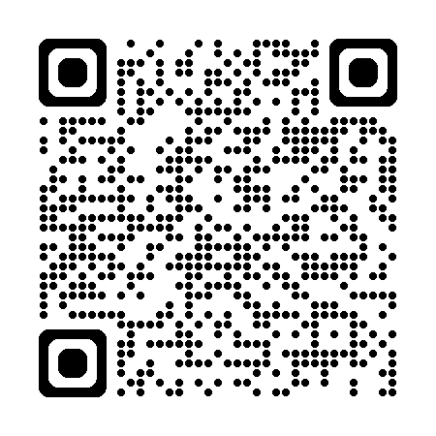
The poster and full scan animation at a higher DPI can be viewed here: https://drive.google.com/drive/u/1/folders/1XMFQRnHZQnN0eIm1l4tyiqt01DK4ibFC

