Slide 1

Wind erosion characteristics of loose subsoil of Mollisols: a wind tunnel assessment
Yanyan Xu, Bao Liu, Yanru Wen^{1*}, Karl Auerswald, Zhenghu Ge, Donglai Gao, Xinhua Peng, Ting-yong Li, Huimin Dai, Wenbin Wu
¹State Key Laboratory of Efficient Utilization of Arable Land in China, the Institute of Agricultural Resources and Regional Planning, Chinese Academy of Agricultural Sciences, Beijing, China

Slide 2

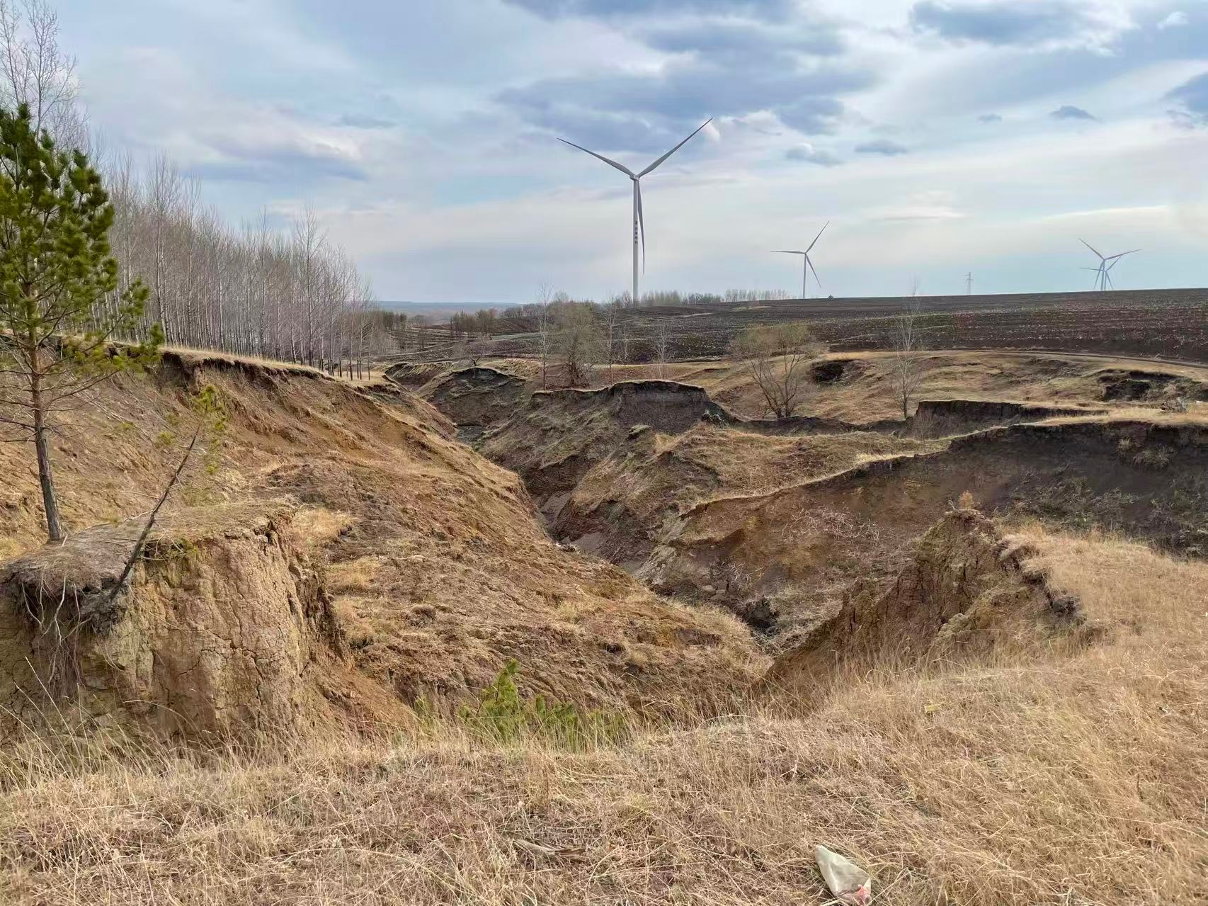
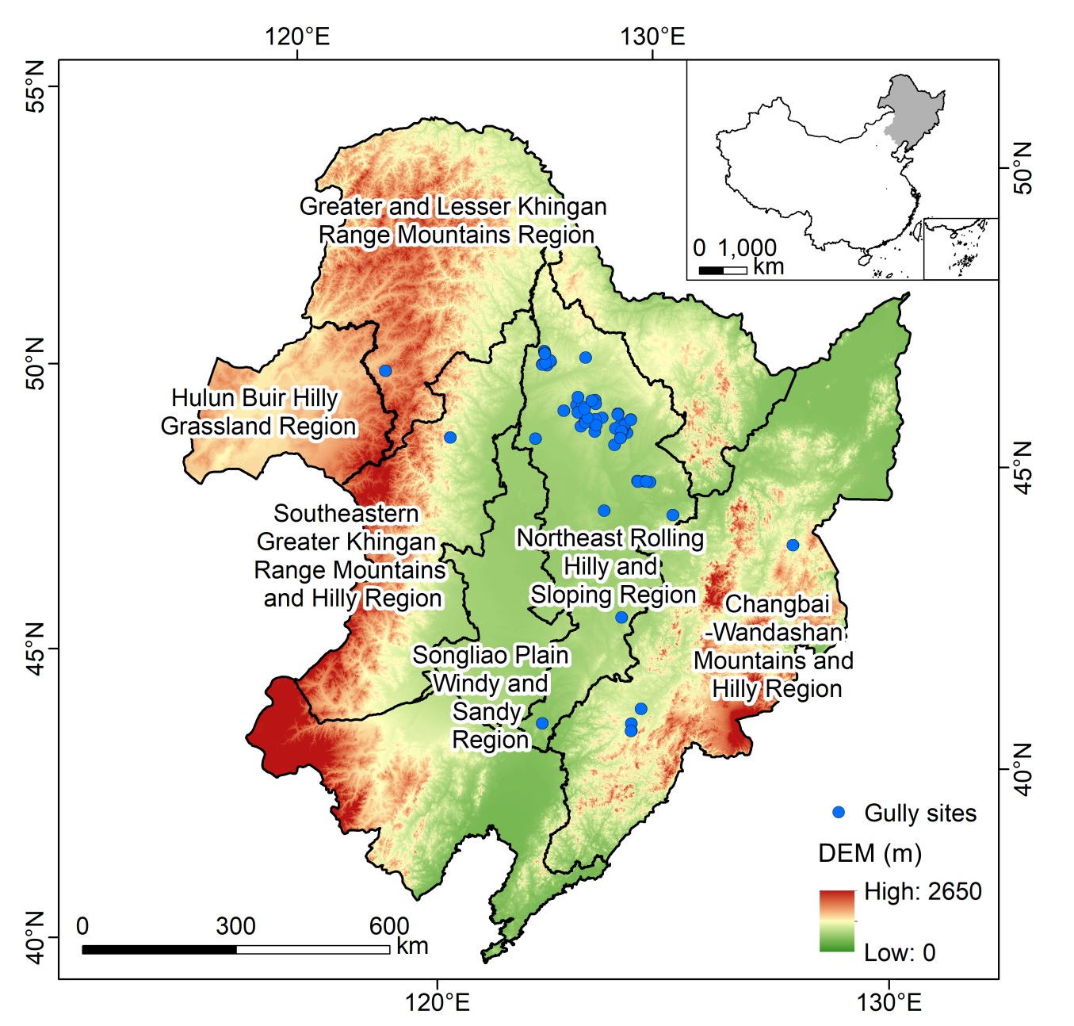
1
Co-occurrence of water-wind erosion
~67,000 gullies
Active gullies
trigger for
Wind erosion?

Slide 3
Study area
Wind: High-intensity wind erosion occurs primarily from March to May, with maximum wind velocity up to 16.5 m s⁻¹
Water: mean annual precipitation is 530 mm

Slide 4
Experimental design
Samples: subsurface from 30-70 cm
Aggregate size: >2000, 850-2000, 250-850, 53-850, <53 μm
Wind speed: 10, 12, 14, 16 and 18 m s⁻¹
75 wind tunnel experments

Slide 5
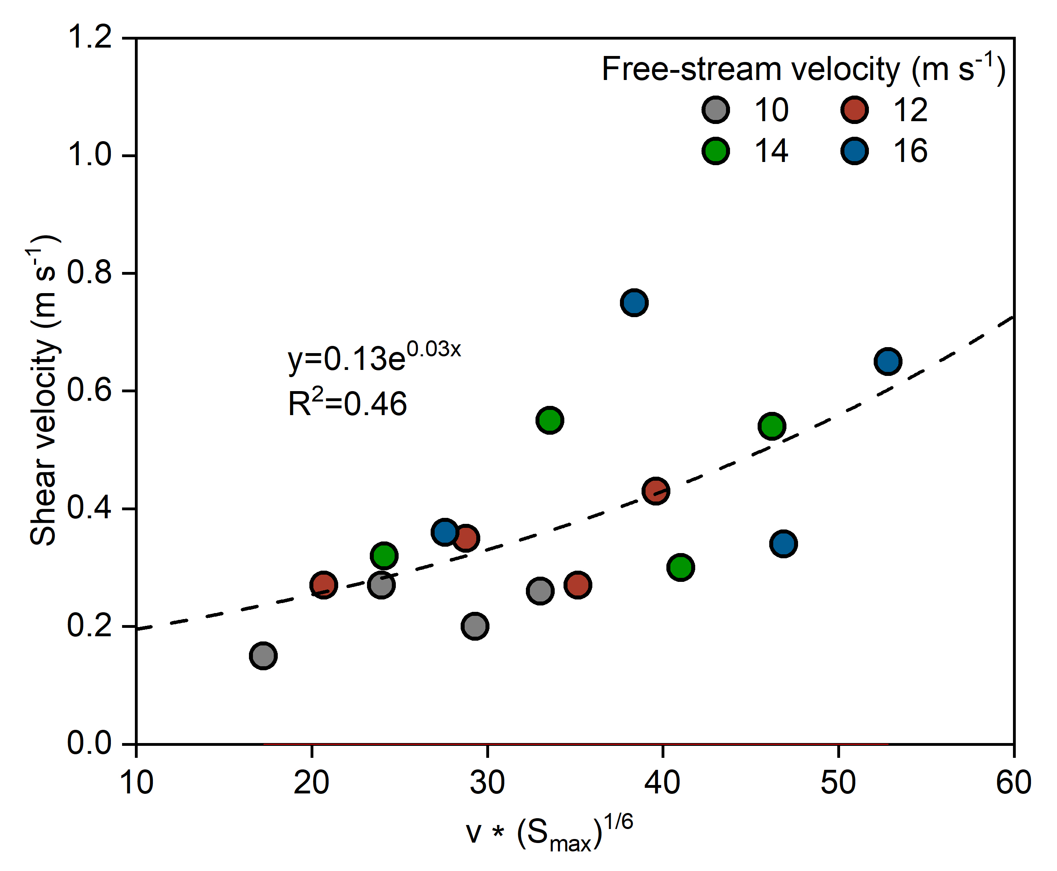
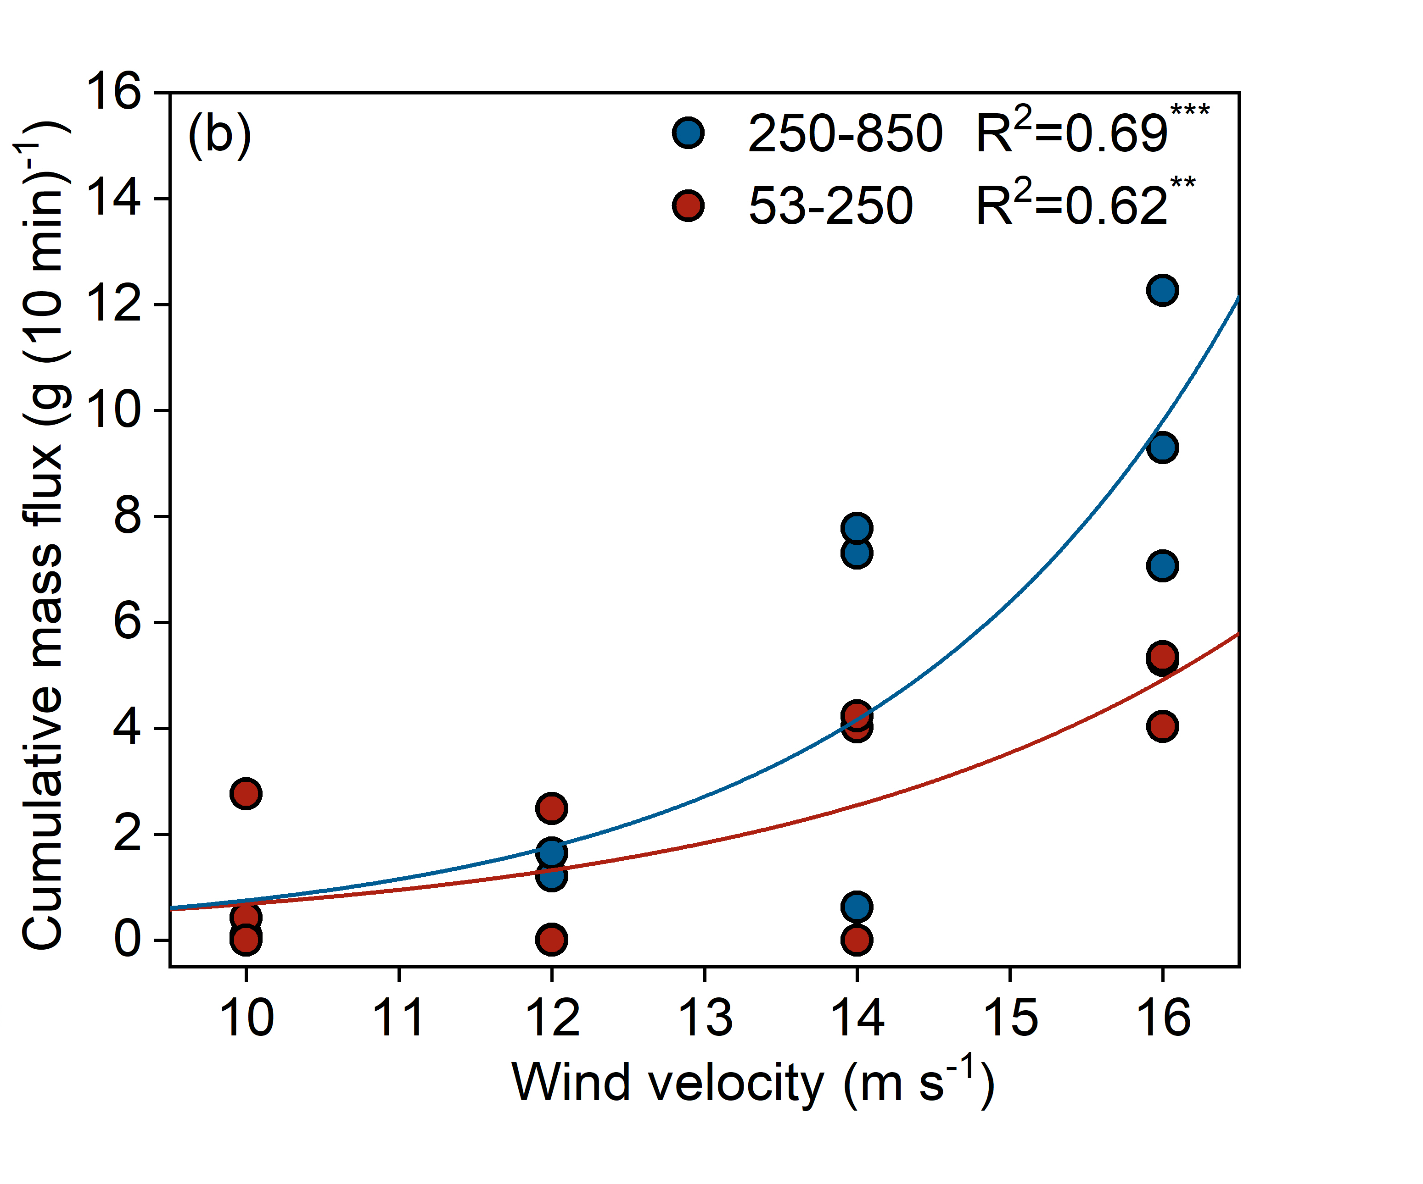
2
Shear velocity depended on free wind and max. aggregate size
Twice mass for 250-850 μm than 53-250 μm at 16 m s⁻¹

Slide 6
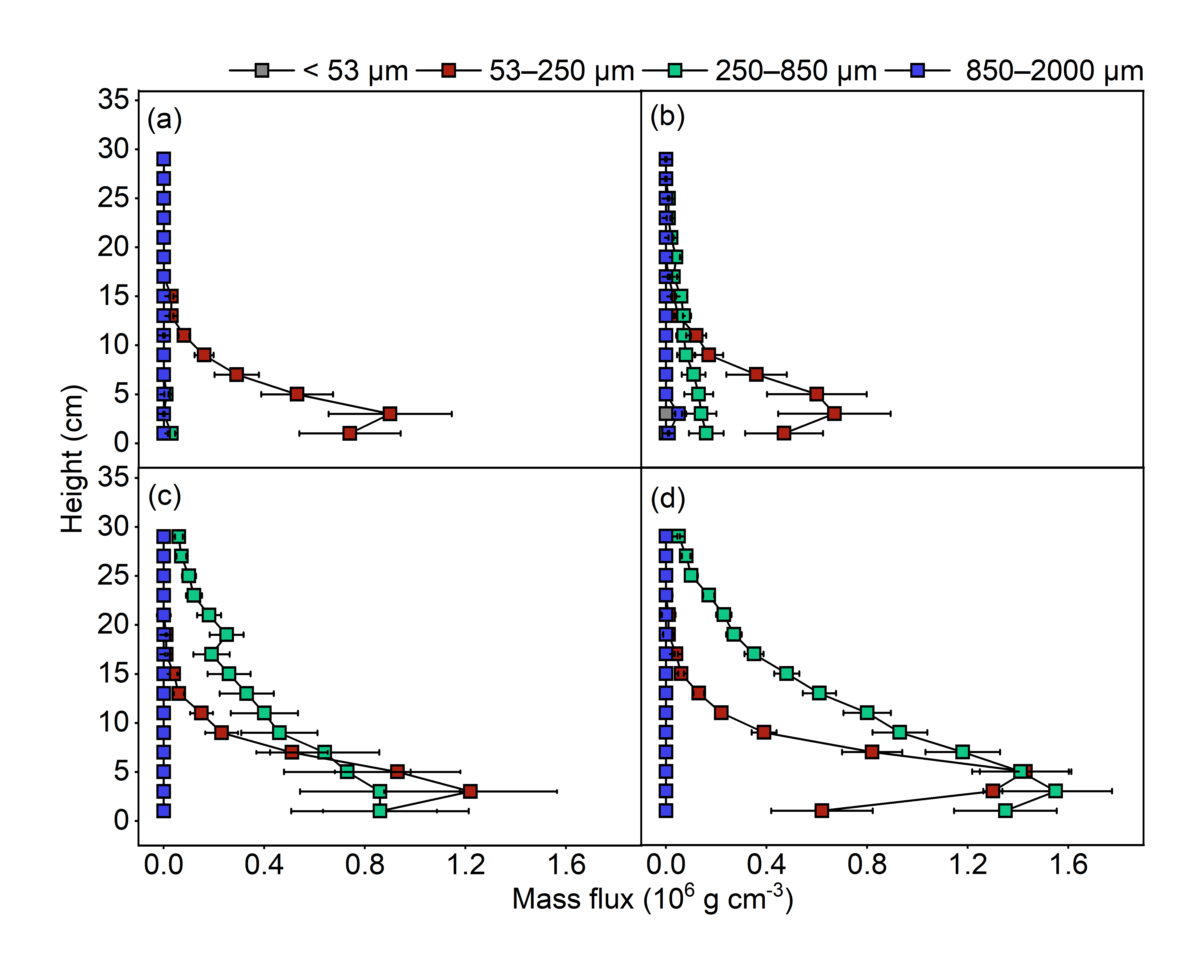
Vertical distribution of mass flux
Medium-sized fractions (53–850 μm) show the highest sensitivity;
A pronounced peak at 3-5 cm at a certain height above the surface.

Slide 7
Take home messages
Severe gullies exposes loose subsurface materials that significantly increase wind erosion risk.
Recommendations: reduce subsoil exposure through gully stabilization and temporary covers.
Increase surface roughness and residue retention during windy spring to safeguard soil resources.

Slide 8




3
Yanru Wen
Post-doc researcher in Department of Environment, Ghent University, Belgium, with Prof. Wim Cornelis
Research associate in IARRP-CAAS, Beijing, China
Interests
Gully erosion process and dynamics
Gully mapping and its prediction
E: yanru.wen@ugent.be
Researchgate: Yanru Wen
Wechat: 19211081622
Whats app: 0032 497782396
Academic platform
微信公众号：
耕地侵蚀数智守望

