Slide 1

Facies analysis provides new insights into event bed deposition in a hadal trench environment
Abstract
Mishelle Muthre, Jean-Noël Proust, Charlotte Pizer, Ken Ikehara, J-J. Steven Huang, Hajime Naruse, Michael Strasser

Slide 2

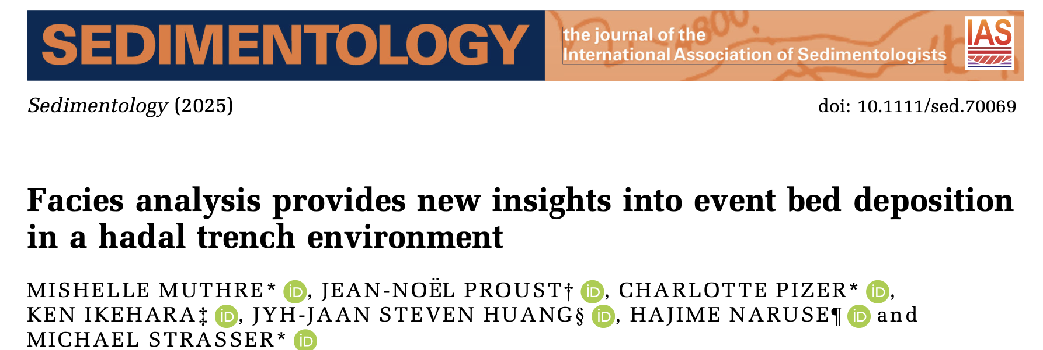

Slide 3
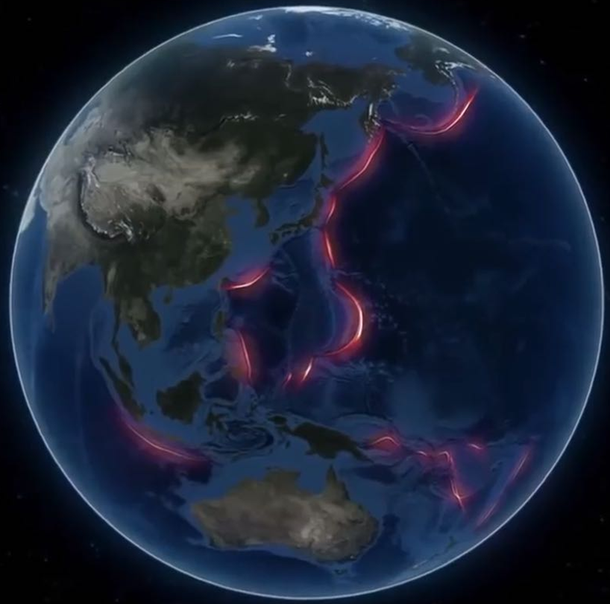
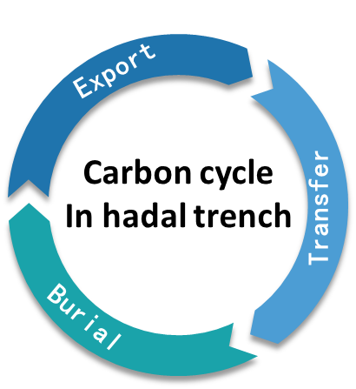
Hadal trenches
Exceptional archives of sediment delivery to the deep ocean inc. extreme events and carbon transfer
(e.g., Kioka et al., 2019; Chu et al., 2023)
But depositional processes + relative timing within event beds are poorly constrained
Japan Trench
Distribution of hadal trenches in the Western Pacific ocean

Slide 4
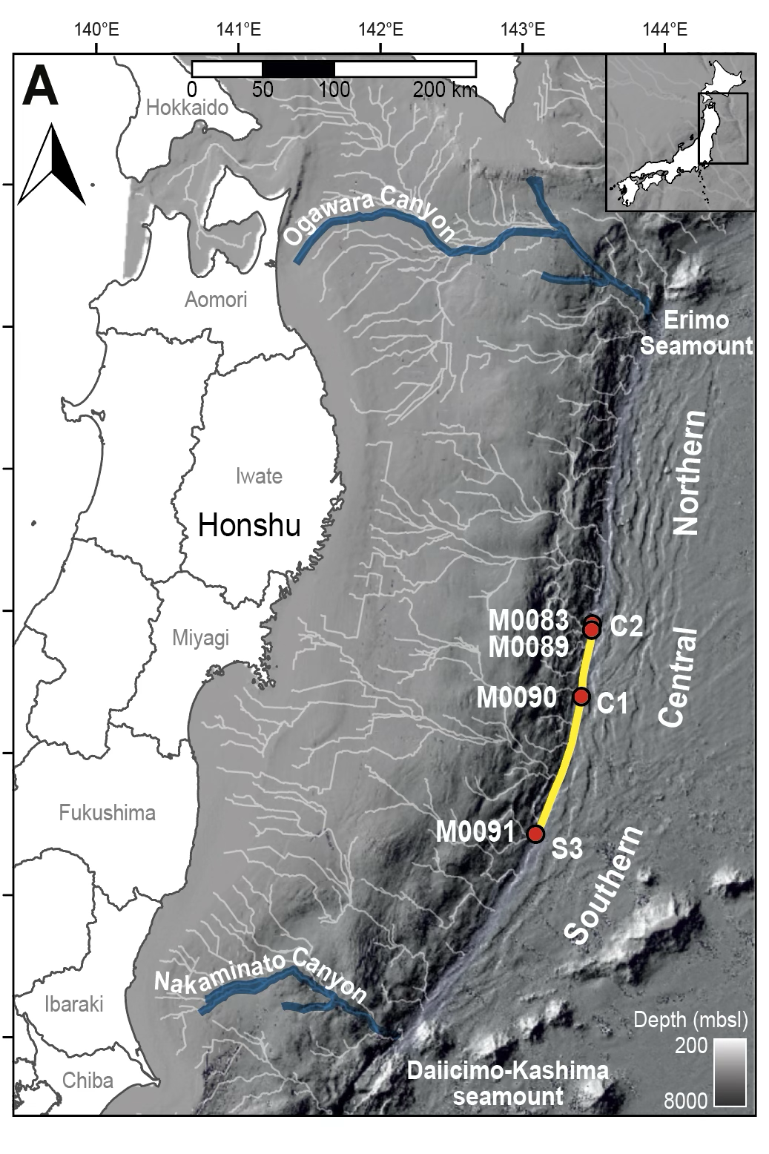
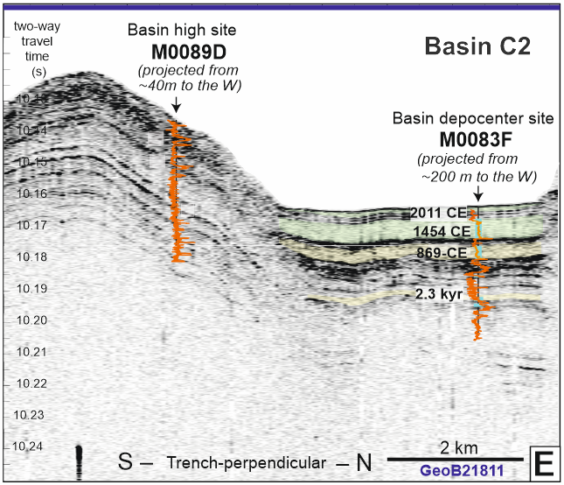
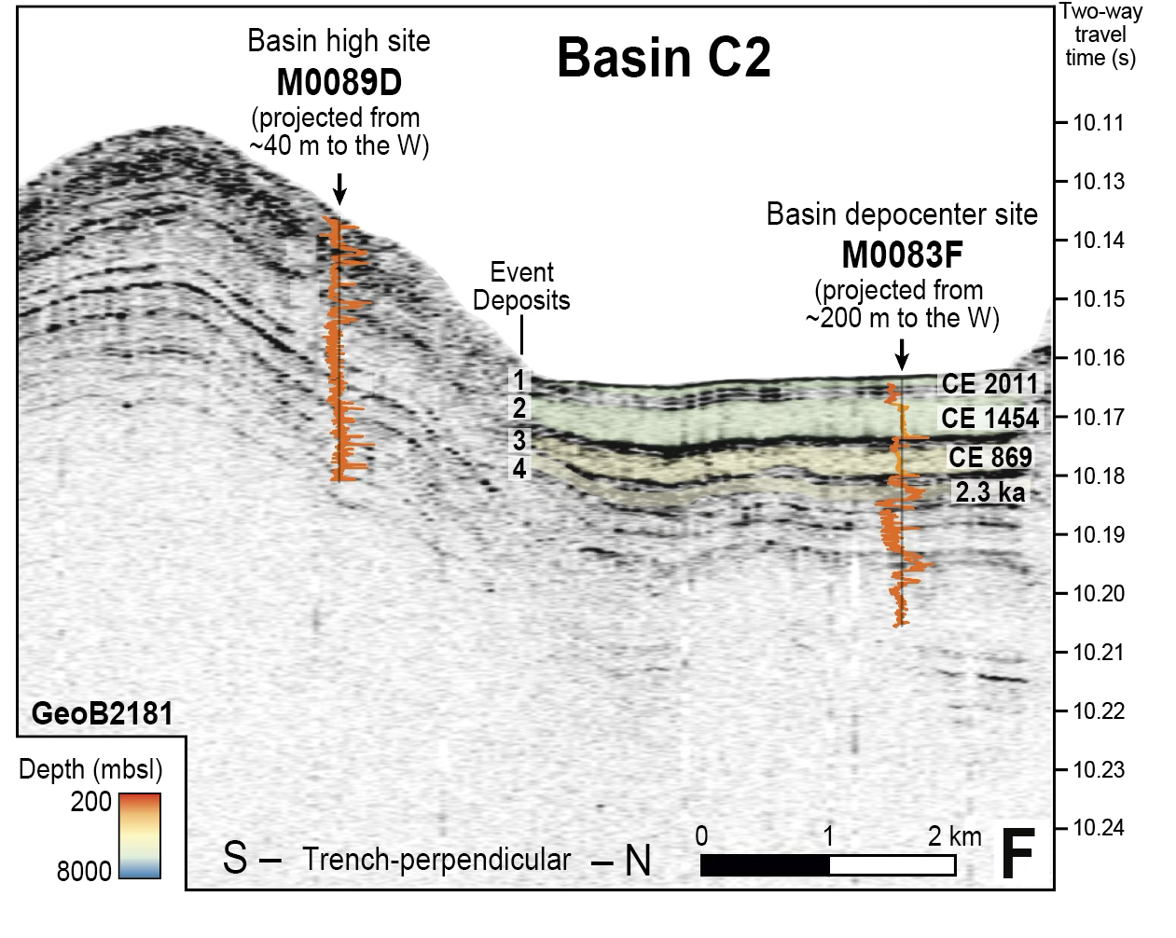

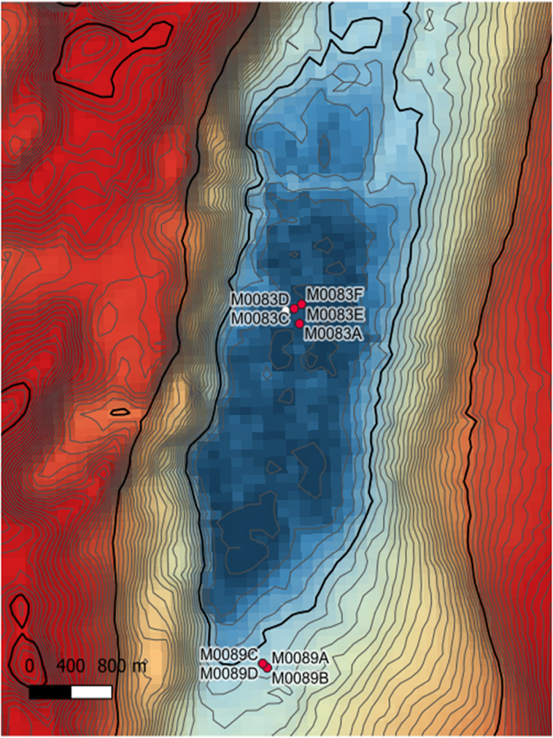
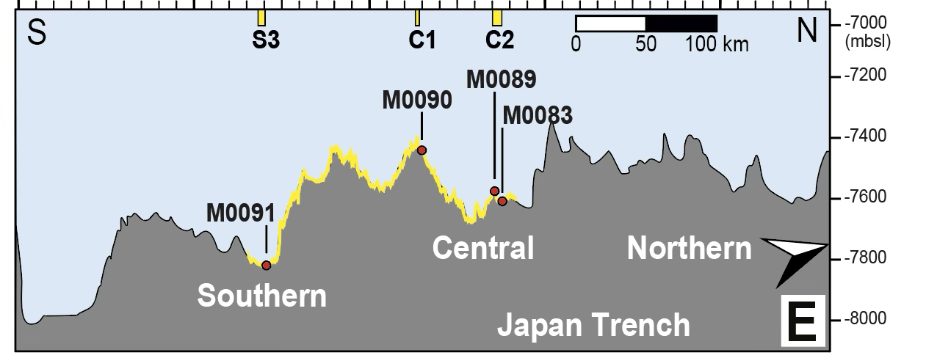
Event beds in the Japan Trench: earthquake-triggered
North
Trench
physiography
Sediment cores from IODP Exp. 386 (Strasser et al., 2024)
Shaking in earthquakes → surficial sediment remobilization → downslope turbidity current → deposition in trench basins

Slide 5

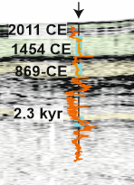
Event beds in the Japan Trench: earthquake-triggered
-IODP Exp.386 dataset (giant piston cores, >20m)
-Thick units in depocenter, thin units in basin highs
-Lateral variability in deposition from same hydrodynamic flow
-Association of at least 4 topmost beds with historical earthquakes (Event beds 1–4) in the southern–central Japan Trench
Goal: Systematic, facies-based framework to identify internal characteristics of event beds
Basin
high
Basin
depocenter
Event bed 1
Event bed 2
Event bed 3
Event bed 4
Trench
physiography

Slide 6
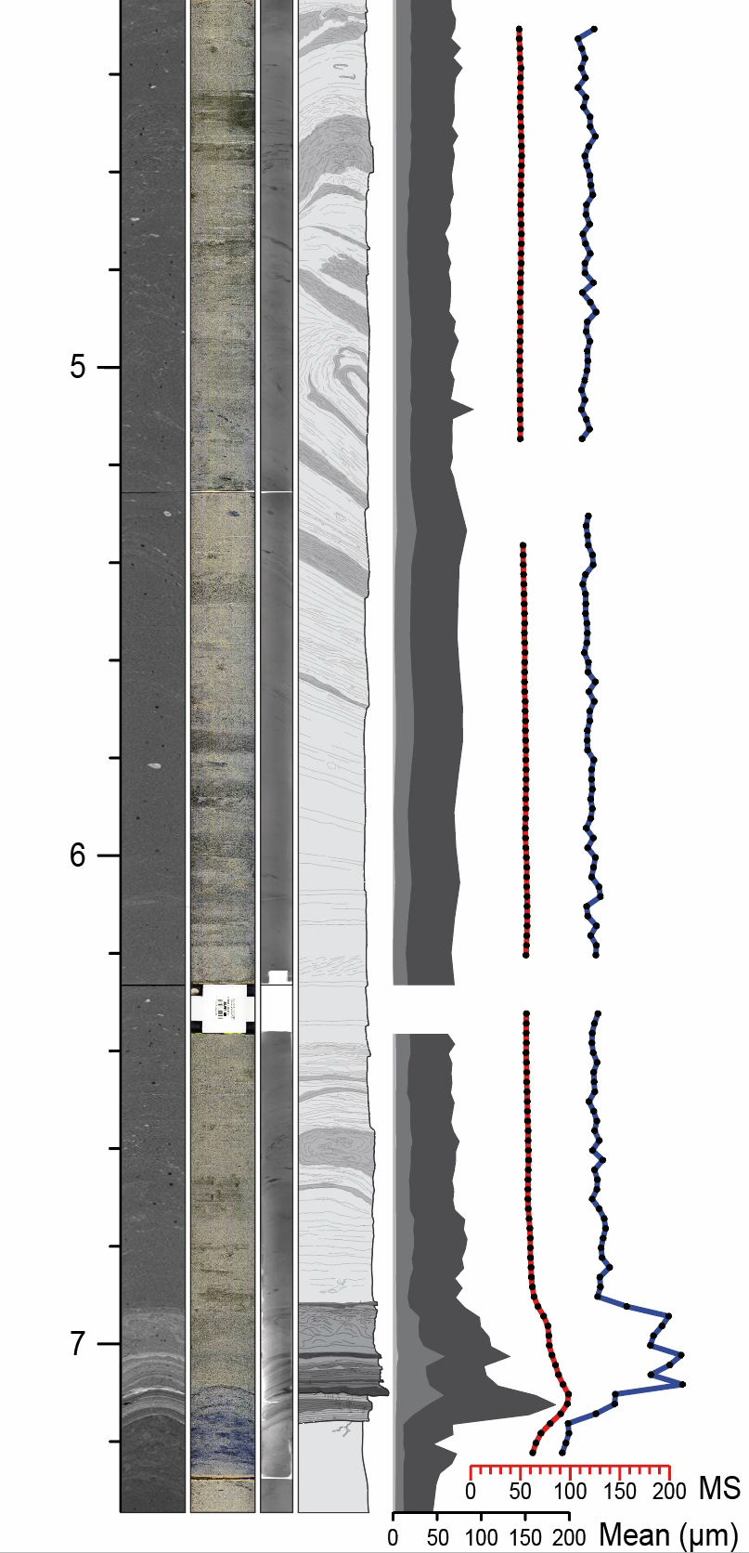
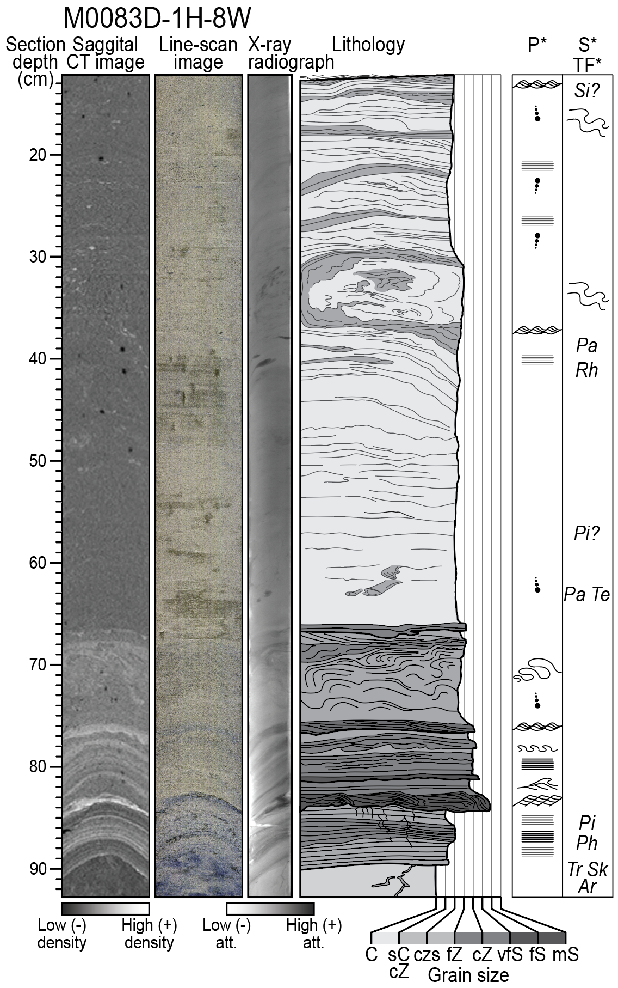
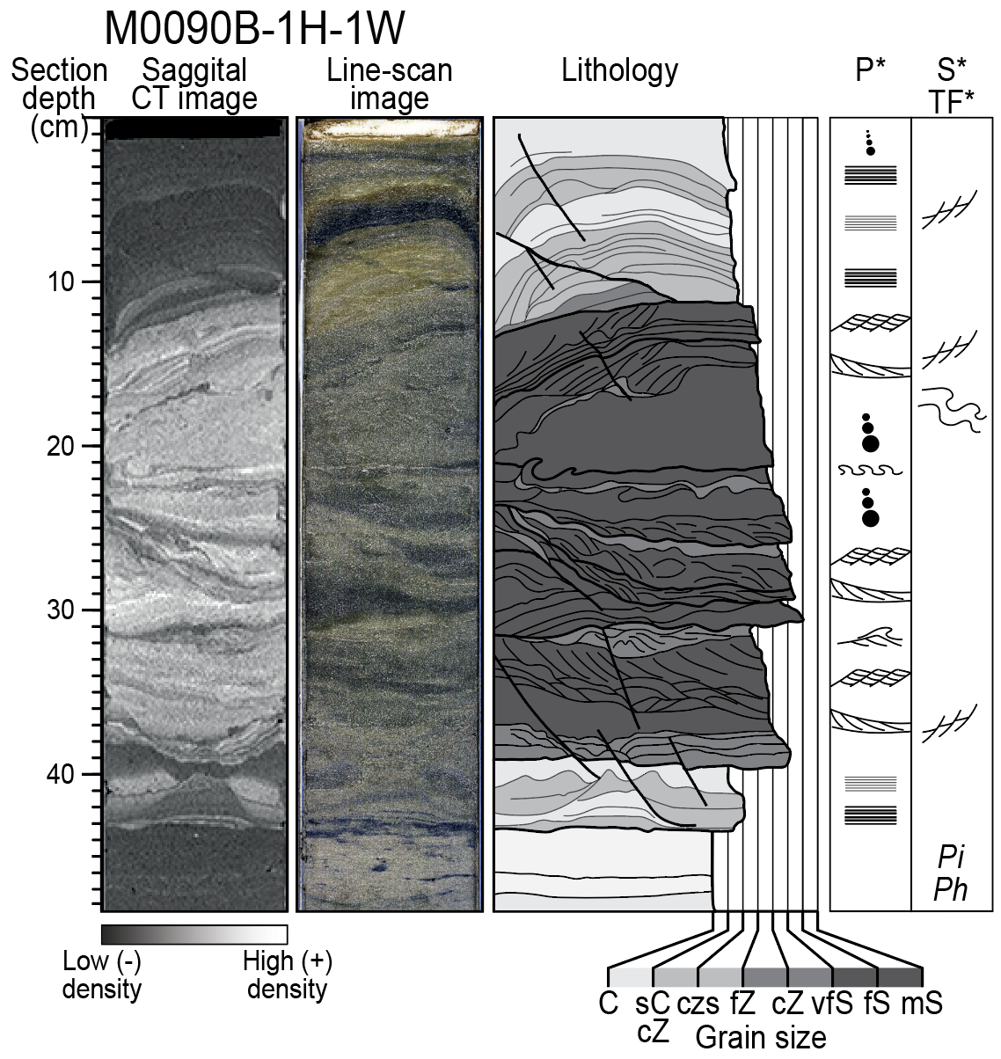
Event beds in the Japan Trench: basin highs vs. depocenters
Example Event bed 2:
CE1454 Kyotoku
Basin depocenter
thick, fine-graded tops
Basin high thin, fine tops and thick,
coarse-grained bases

Slide 7
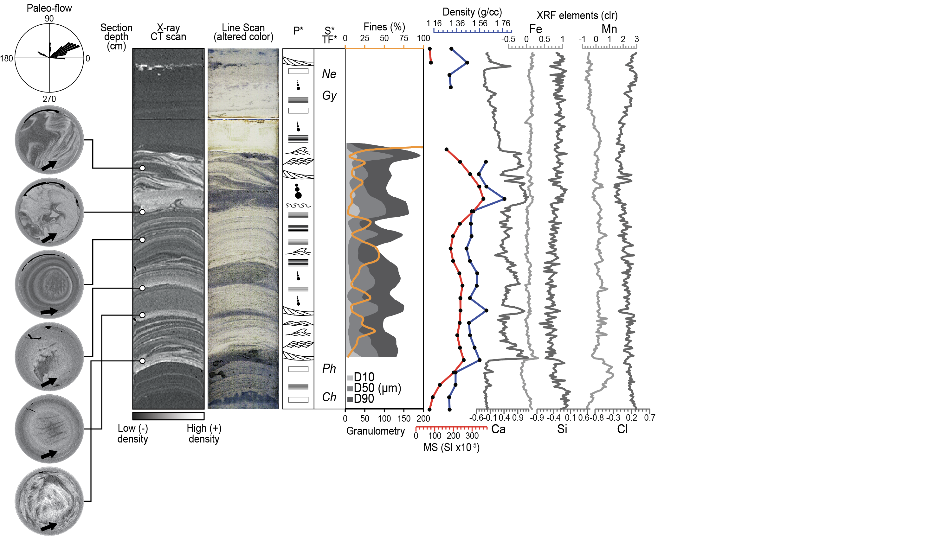
Goal: Systematic, facies-based framework to identify event-internal characteristics of event beds
The facies-based framework: physical, chemical and biogenic
Visual core description + sedimentary logging
-High-resolution imaging:
-X-ray radiography
-X-ray computed tomography -Grain-size measurements
-XRF geochemistry
-Bioturbation observations
(e.g., trace fossils)
Resolves sedimentary structures—physical, chemical, and biogenic characteristics
Example Event bed 3: CE 869 Jogan

Slide 8
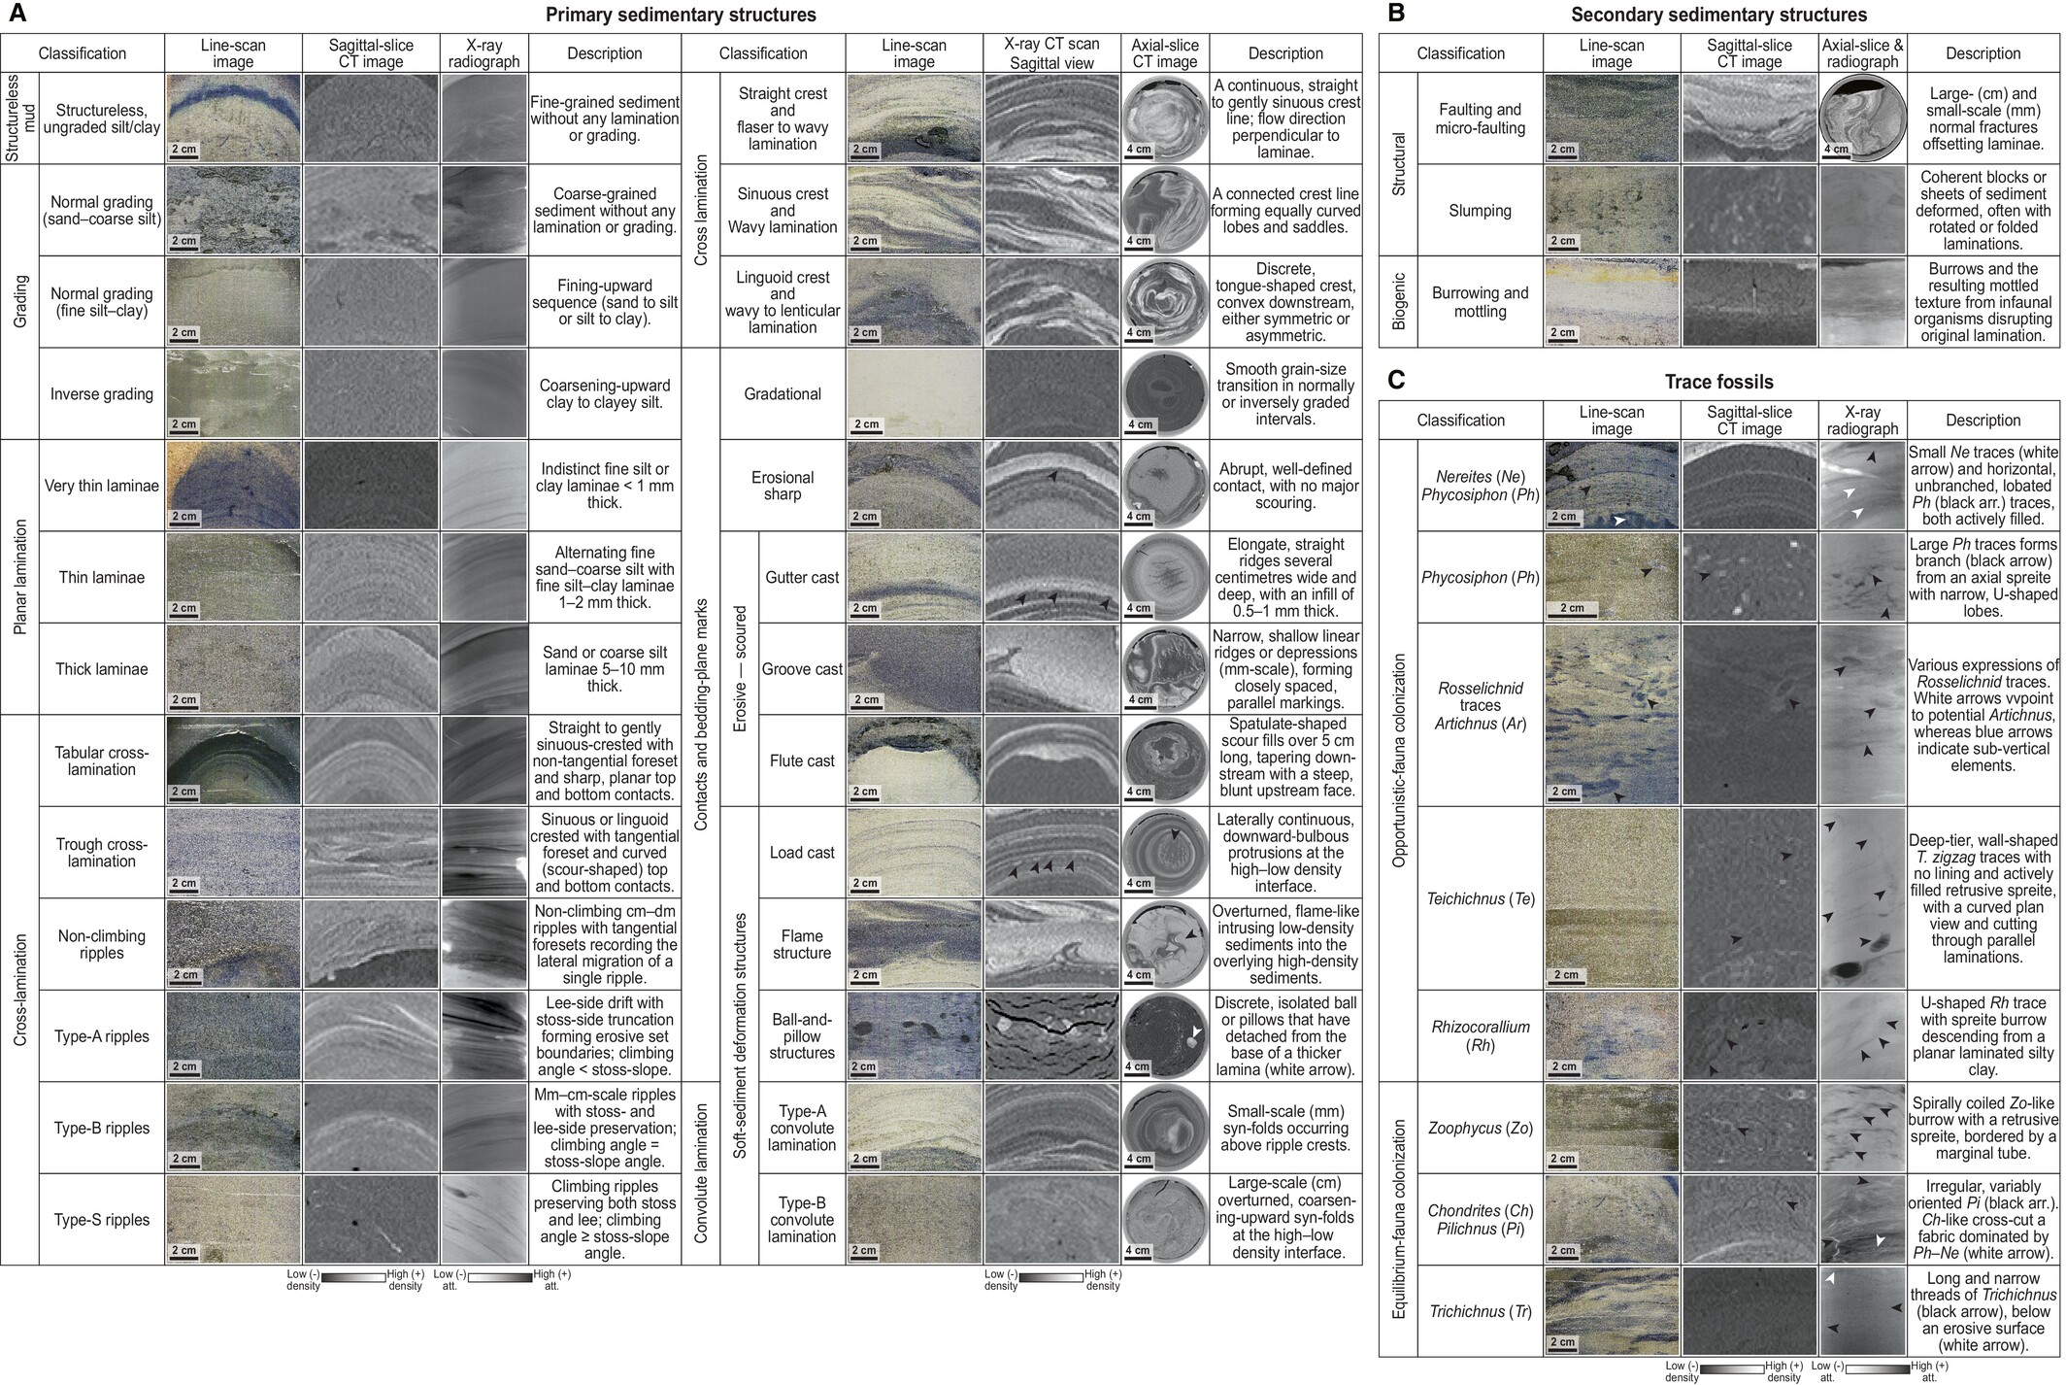
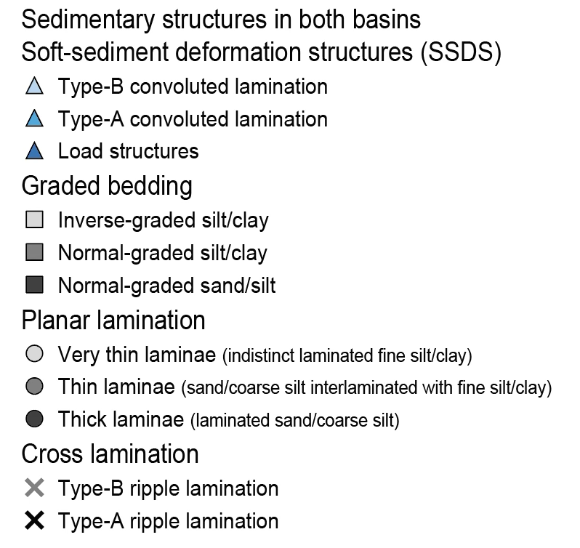
The facies-based framework: physical, chemical and biogenic

Slide 9
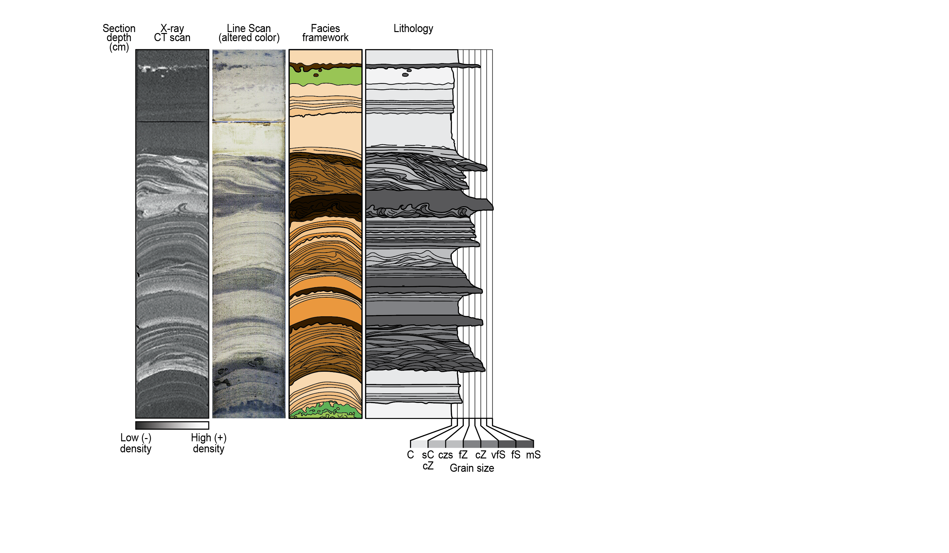
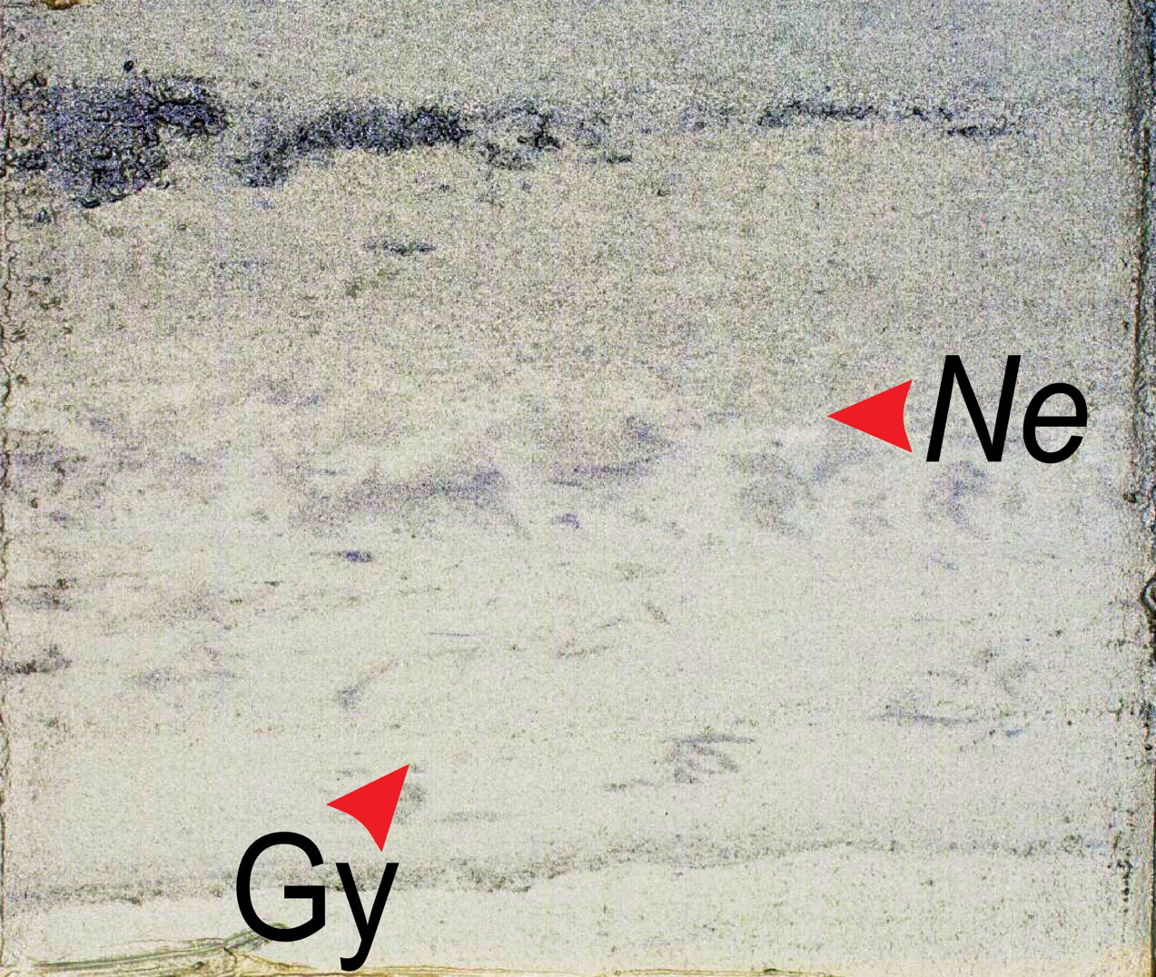
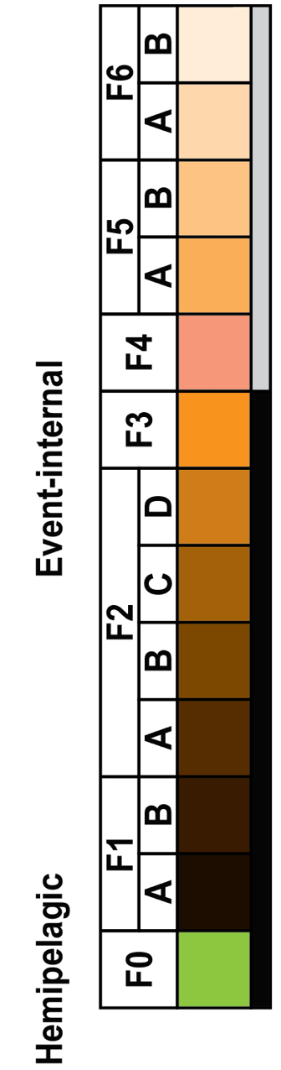
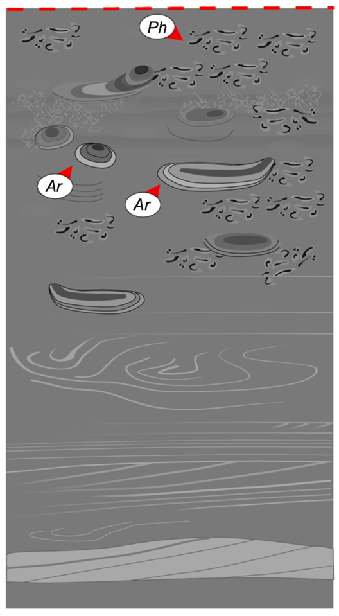
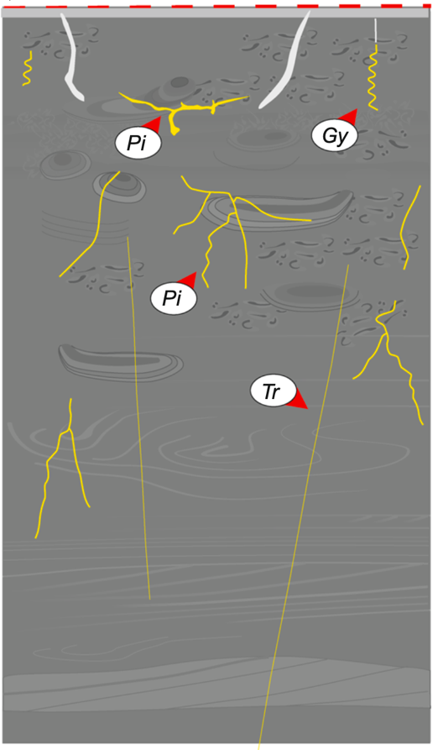

Goal: Systematic, facies-based framework to identify event-internal characteristics of event beds
The facies-based framework: six event-internal + one hemipelagic
Stable seafloor
= time
Cross-cutting of
opportunistic- and equilibrium-fauna colonization
Opportunistic fauna
Equilibrium fauna
(Hovikoski et al., 2025)
Example Event bed 3: CE 869 Jogan

Slide 10
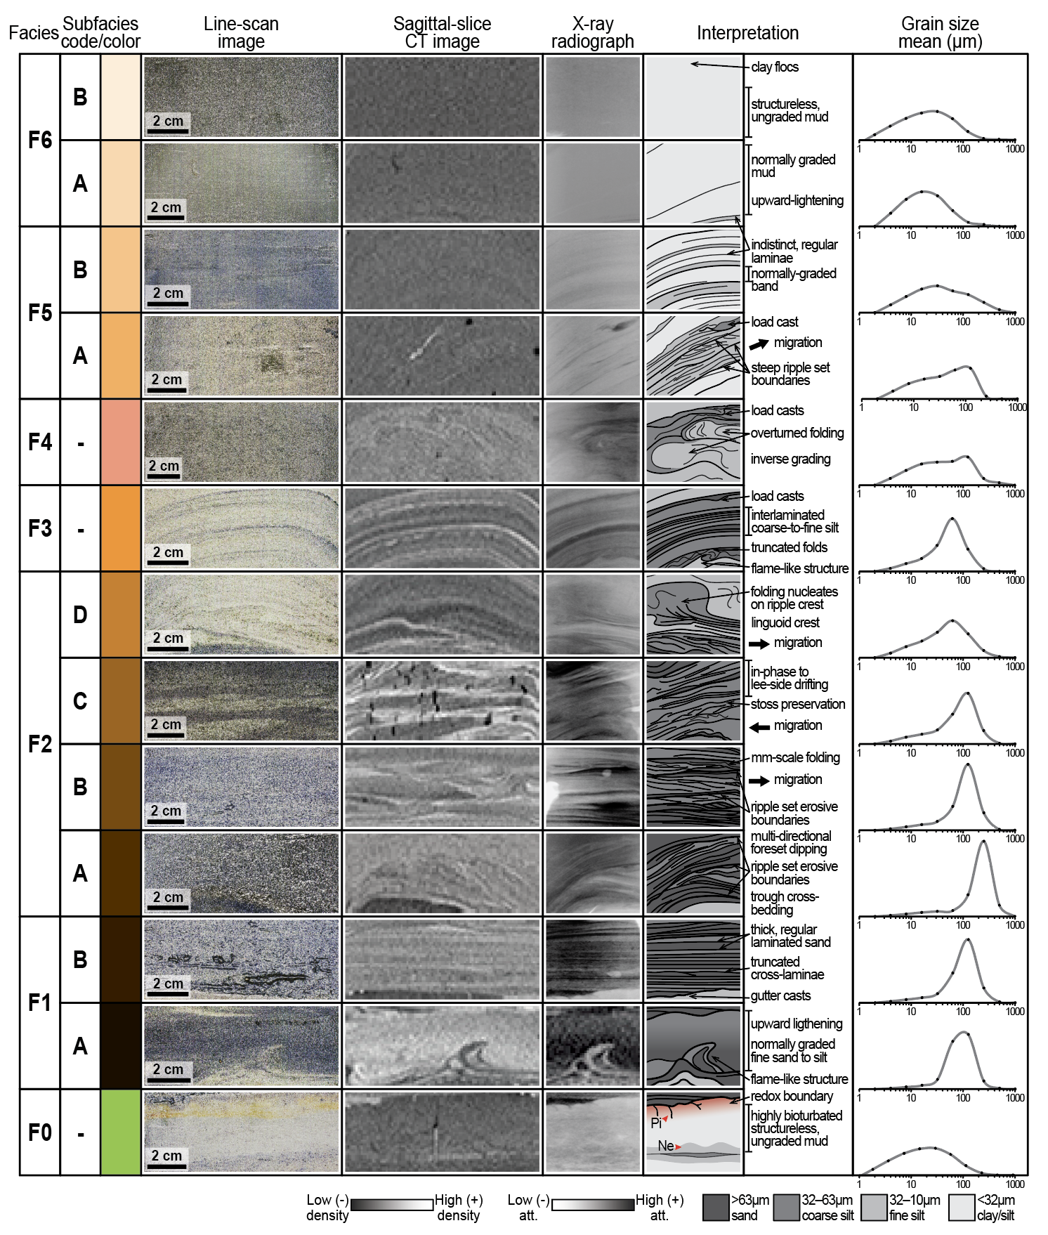
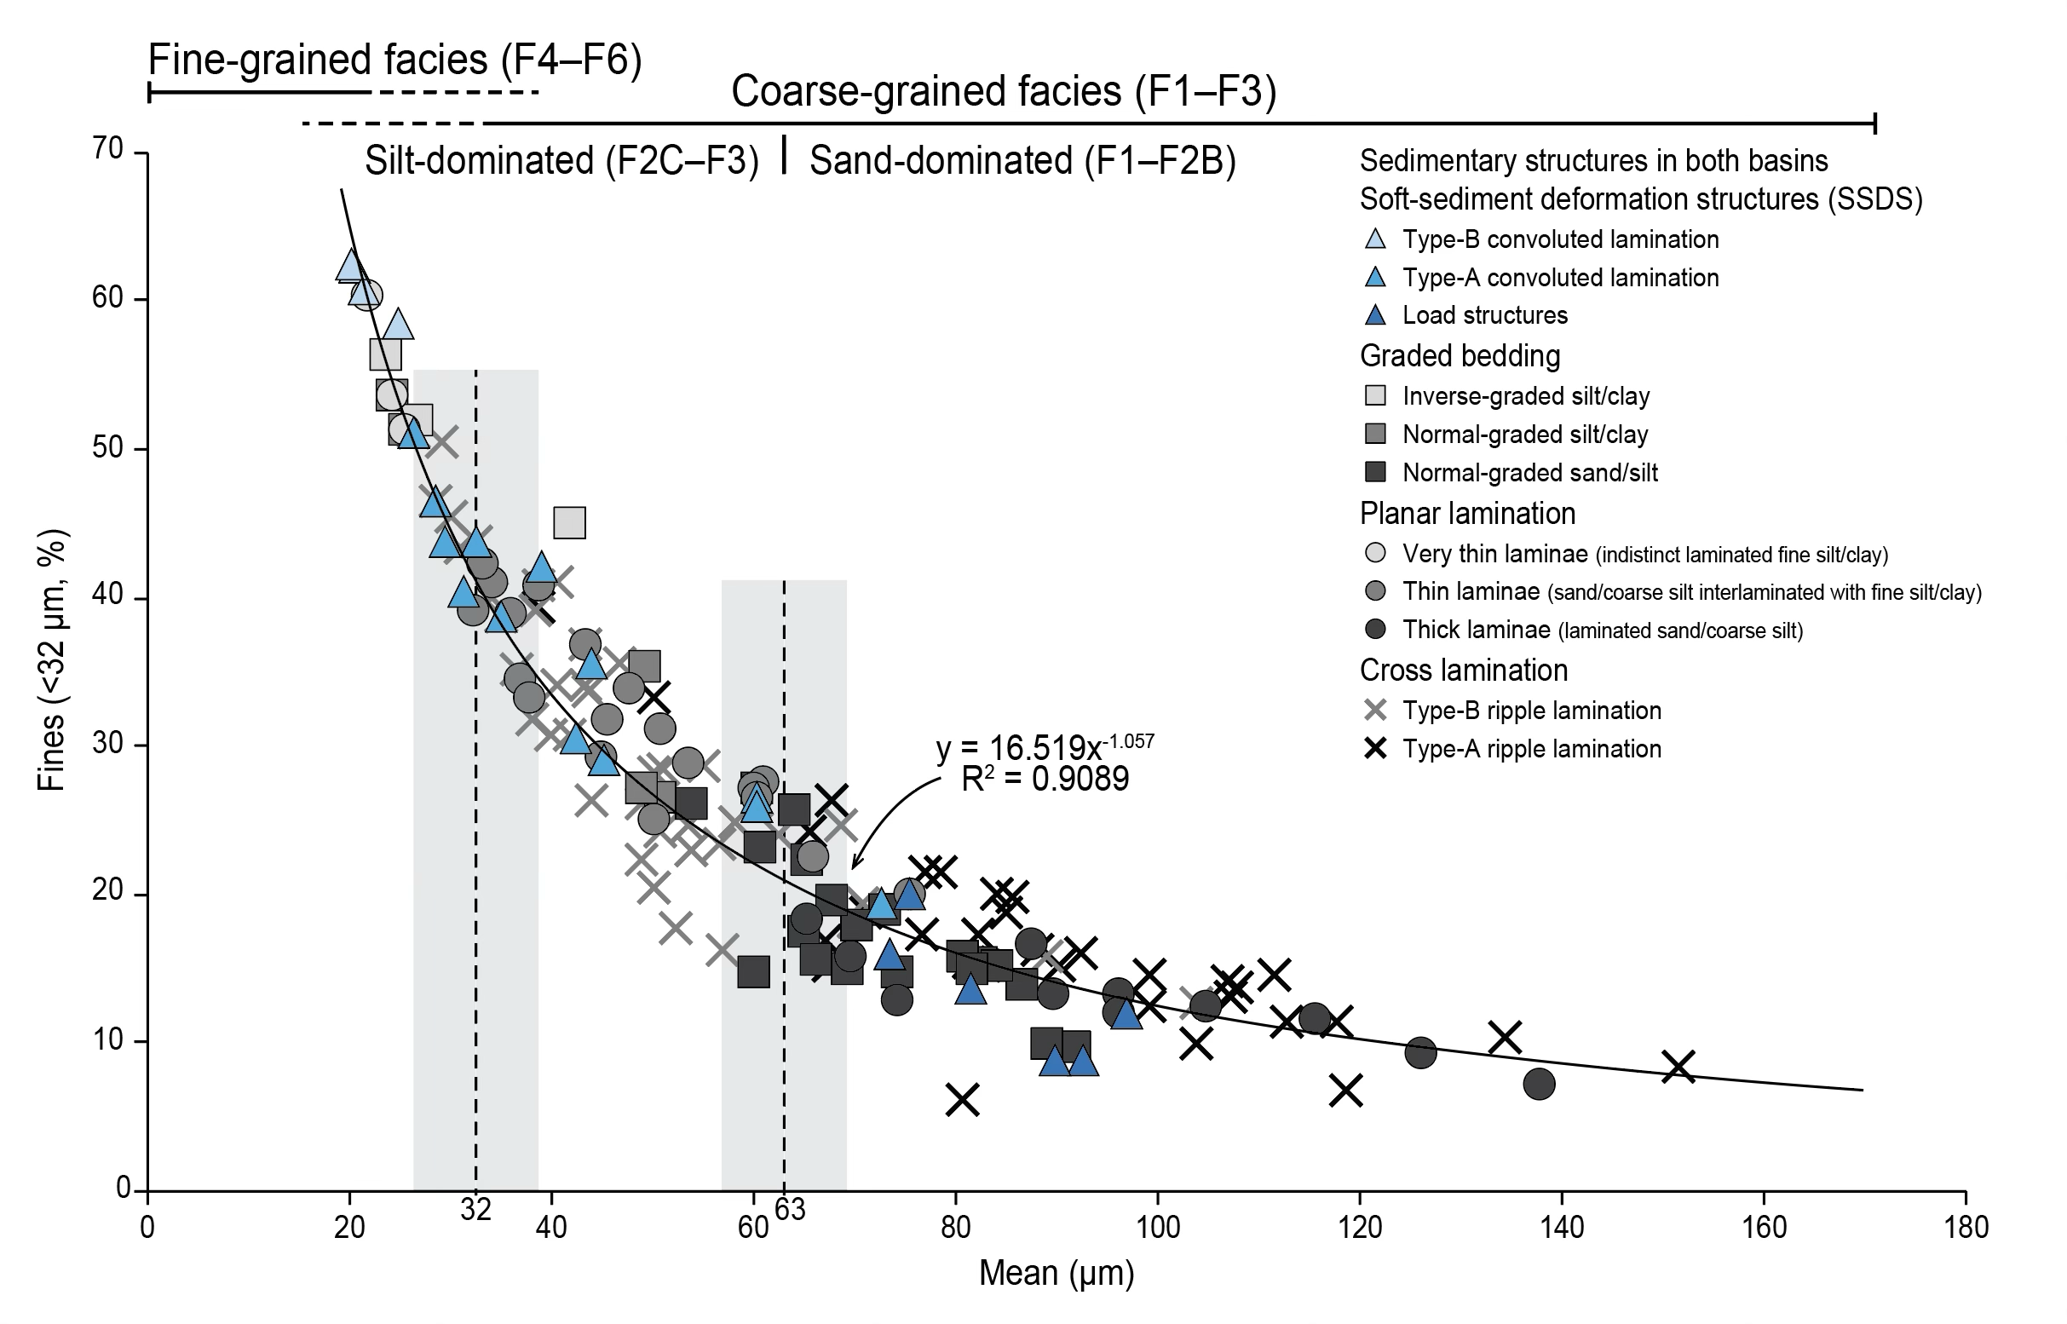
The facies-based framework: six event-internal + one hemipelagic
-Key boundary at 32µm: F1–F3 (>32µm), F4–F6 (<32µm)
-Hemipelagic F0, bounds event beds
-Event-internal facies (F1–F6) in fining-upward sequence
Process-based interpretation:
-F1–F3: higher energy, traction/bedload
-F4–F6: lower energy, cohesive settling/suspension-load

Slide 11
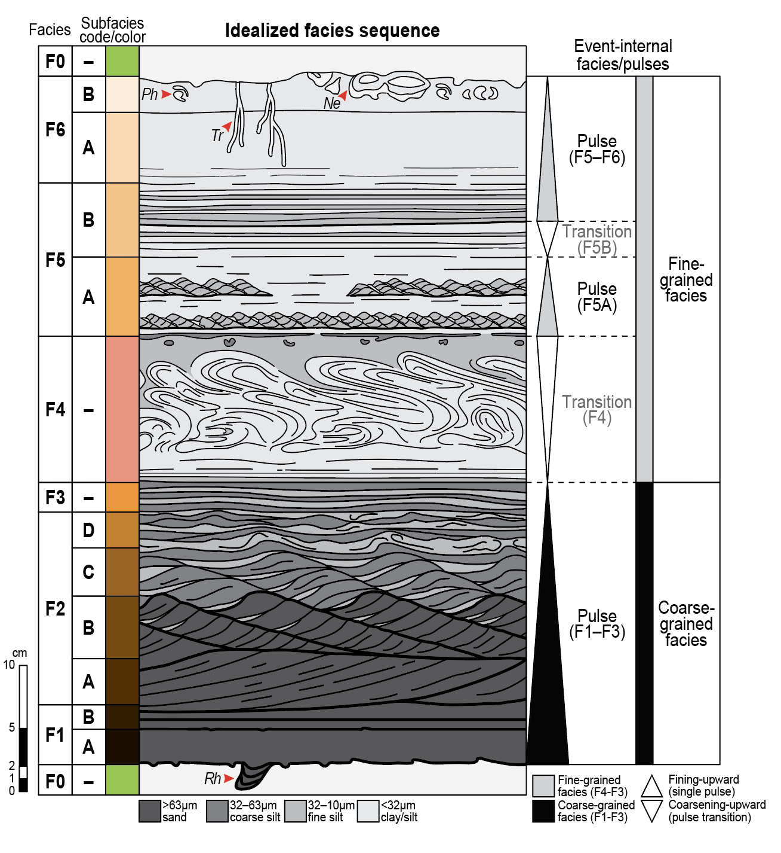
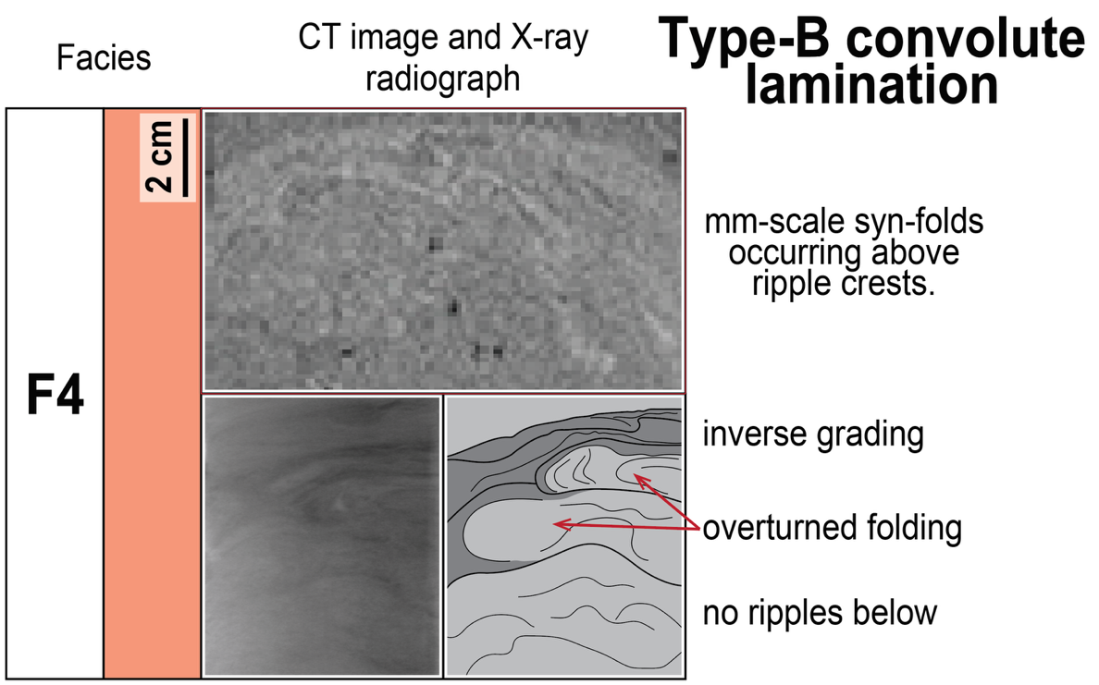
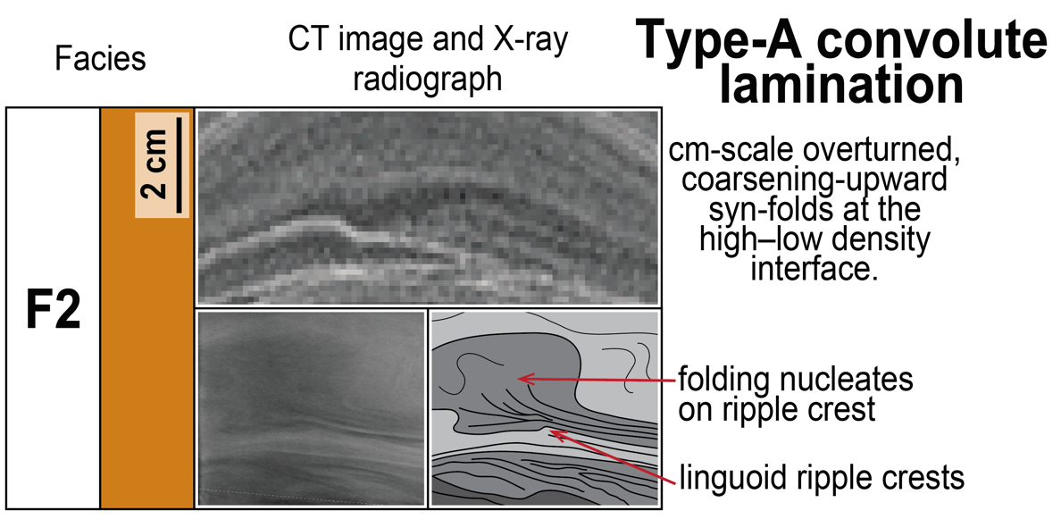
The idealized facies sequence: facies + pulses
-Fining-upward sequence
-Pulses from coarse to fine-grained facies
-Transitional facies F4: distinguishing two types of convolute lamination
Pulse:
-Single, incomplete facies sequence
-Coarse- (F1–F3) and/or fine-grained (F4–F6) facies
-Fines upwards

Slide 12
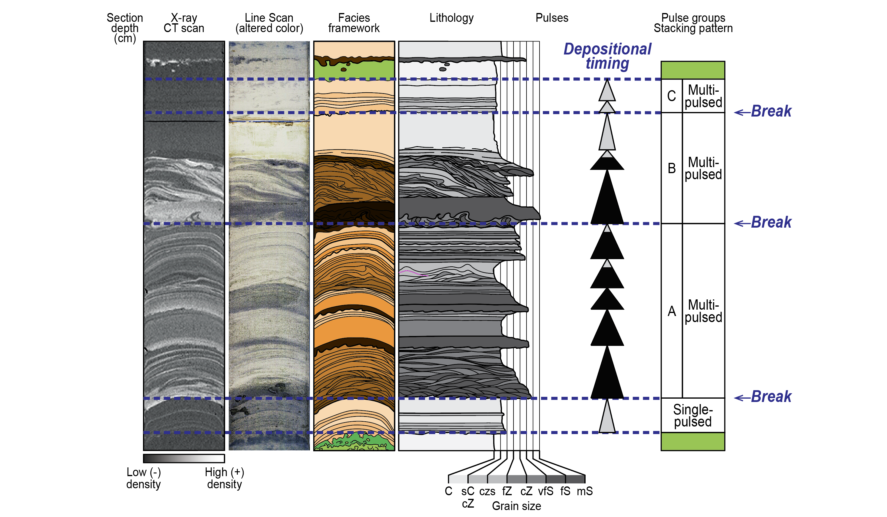
Event-bed architecture: pulses and stacking patterns

Slide 13
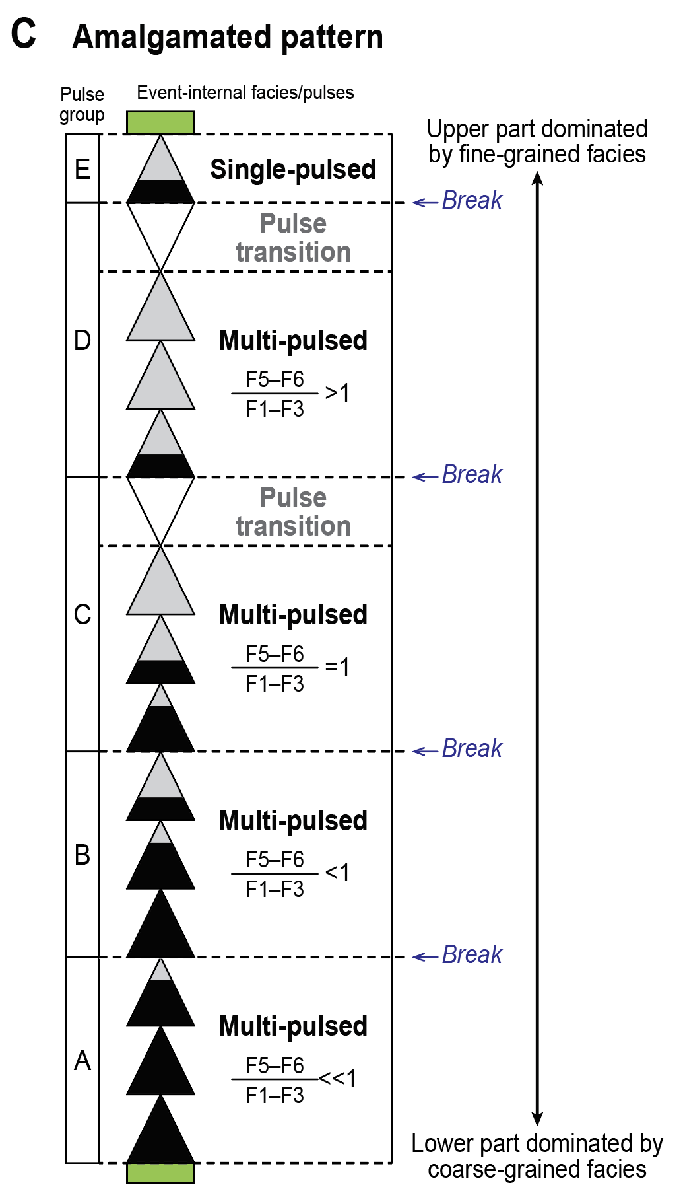
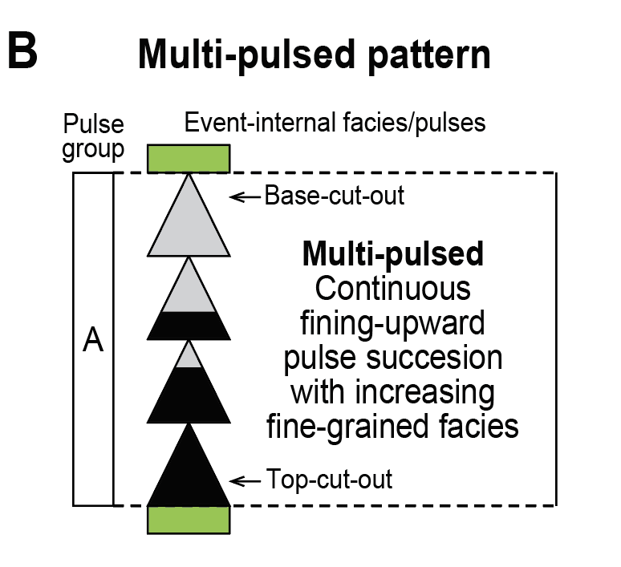
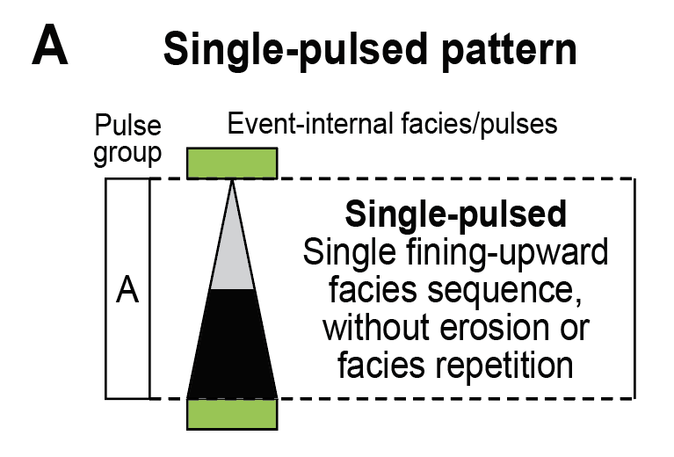
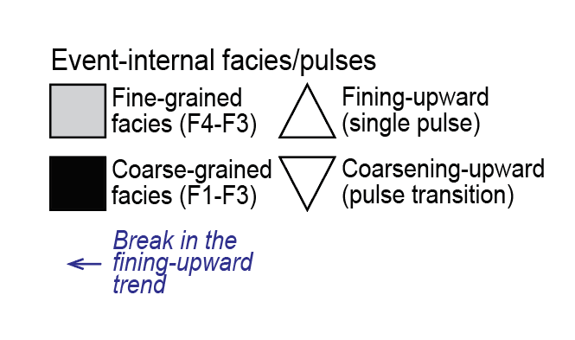
Event-bed architecture: stacking patterns
-Stacking hierarchy: pulses and pulse groups
-Stacking patterns: single-pulsed, multi-pulsed, amalgamated (breaks in the fining-upward trend)
-Event beds mainly record multiple flow episodes

Slide 14
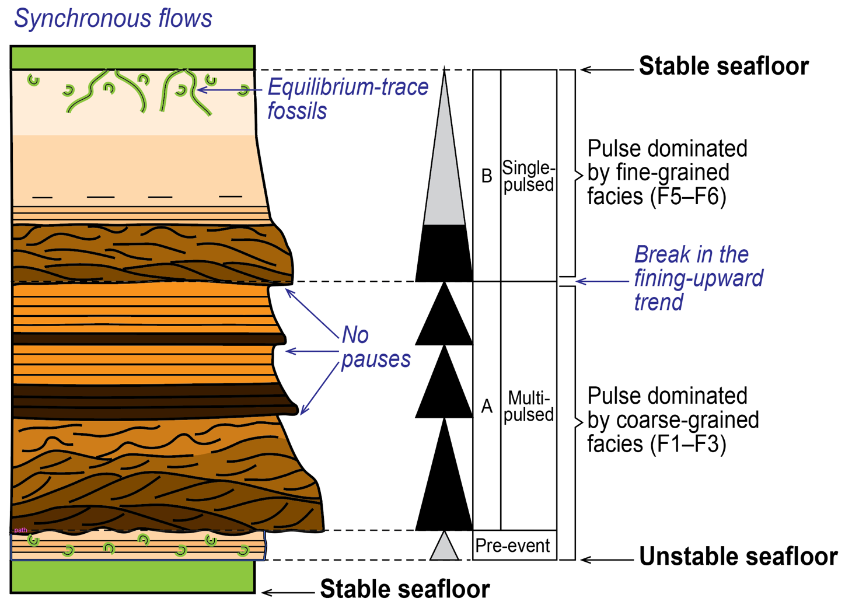
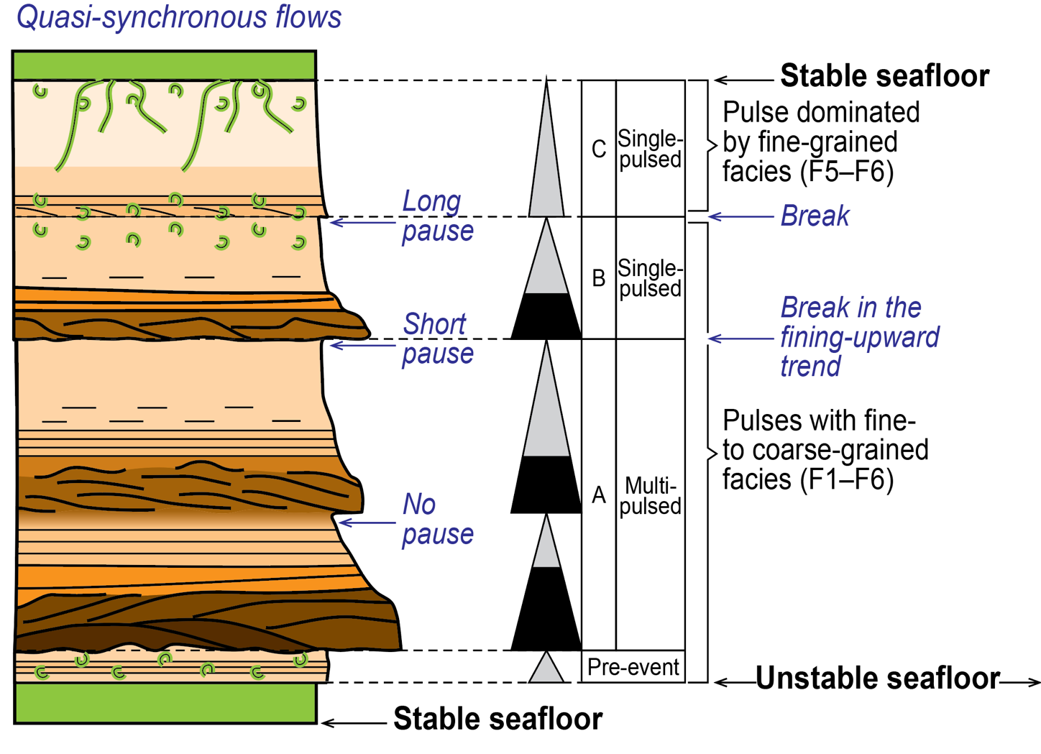
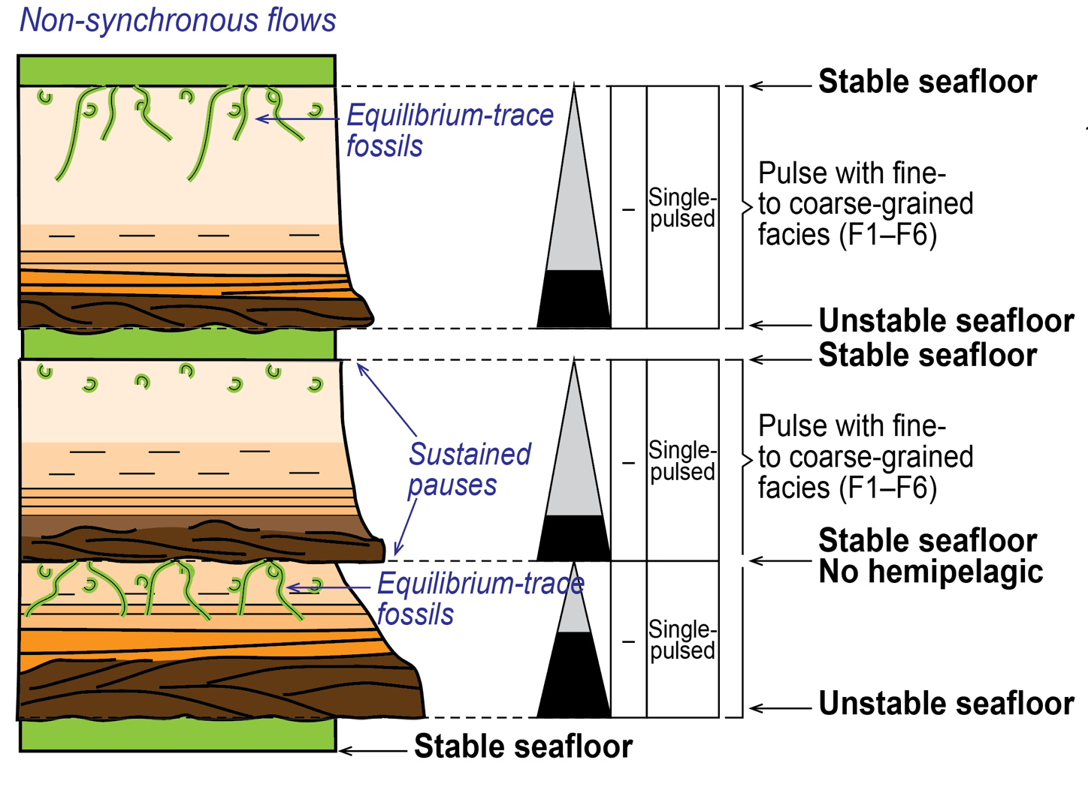
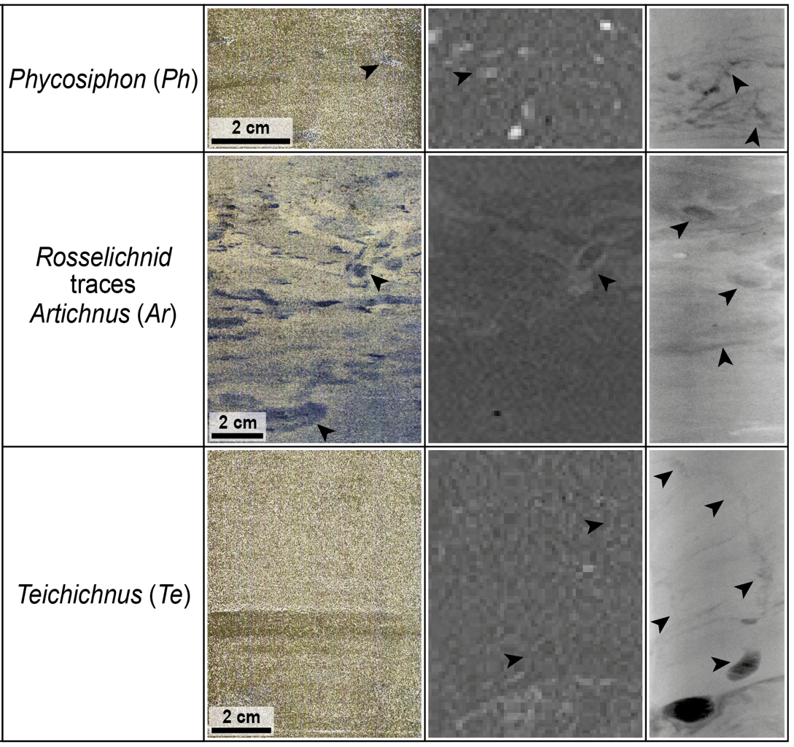
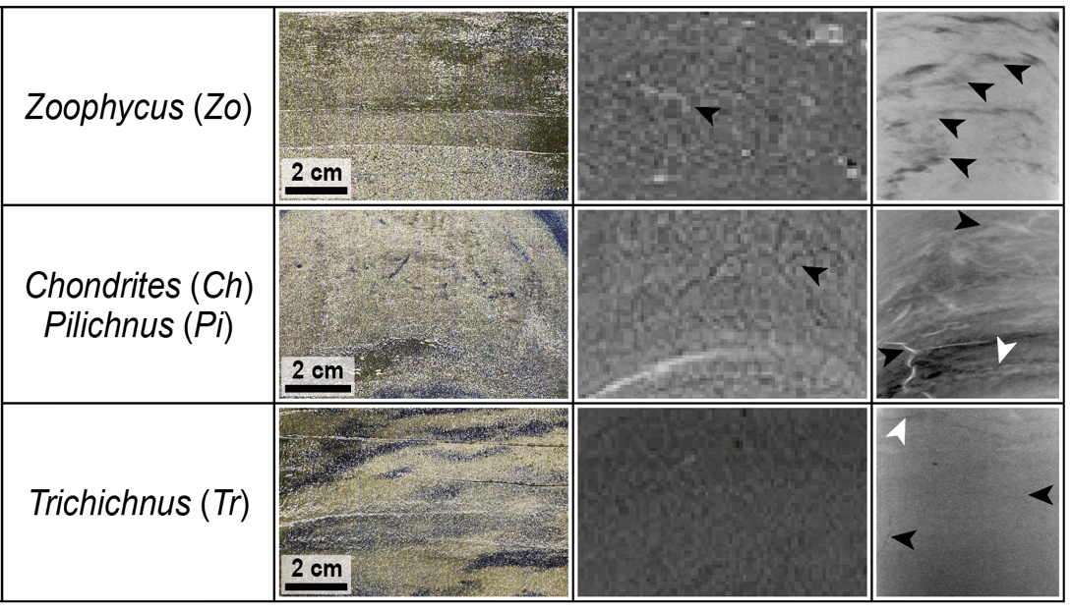
Relative depositional timing within event beds
Lack of bioturbation or lack of F6
→ indicate no pauses, rapid emplacement (synchronous flows)
Opportunistic trace fossils, or F6
→ indicate pauses during deposition (quasi-synchronous flows)
Equilibrium trace fossils, or F0
→ indicate re-establishment of the background conditions

Slide 15
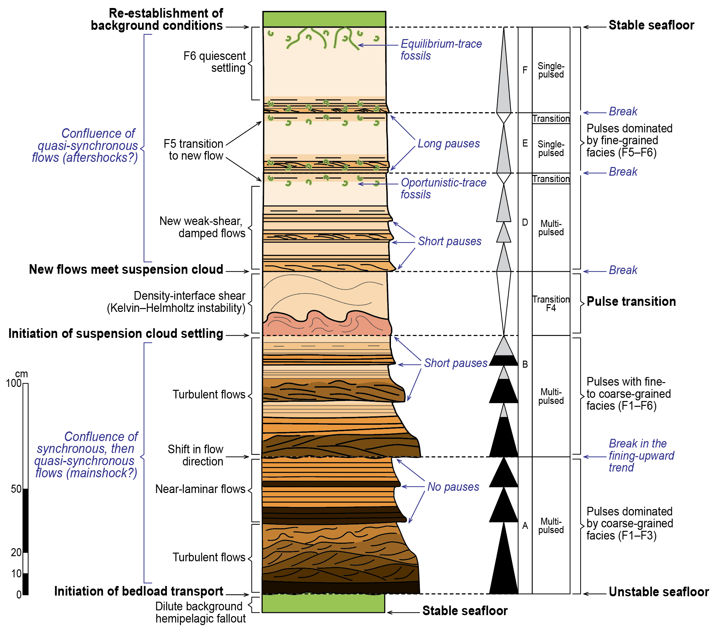
Conceptual model for event bed deposition
Implications:
-Mechanism to interpret complex event beds and intra-event depositional timing
-Value for understanding how a single event (e.g., mainshock-aftershock sequences) is recorded through space and time in the deep ocean

Slide 16
Thank you!
Check out the paper for more lovely examples…
Chu, M., et al., 2023. Earthquake-enhanced dissolved carbon cycles in ultra-deep ocean sediments. Nat Commun 14, 5427. https://doi.org/10.1038/s41467-023-41116-w
Hovikoski, J., et al., 2025. Bioturbation in the hadal zone. Nat Commun 16, 1401. https://doi.org/10.1038/s41467-025-56627-x
Muthre, M., et al., 2025. Facies analysis provides new insights into event bed deposition in a hadal trench environment. Sedimentology sed.70069. https://doi.org/10.1111/sed.70069
Kioka, A., et al, 2019. Event Stratigraphy in a Hadal Oceanic Trench: Frontiers in Earth Science 7, 319. https://doi.org/10.3389/feart.2019.00319
Strasser, M., et al., 2024. Japan Trench event stratigraphy. Marine Geology 107387. https://doi.org/10.1016/j.margeo.2024.107387

Slide 17
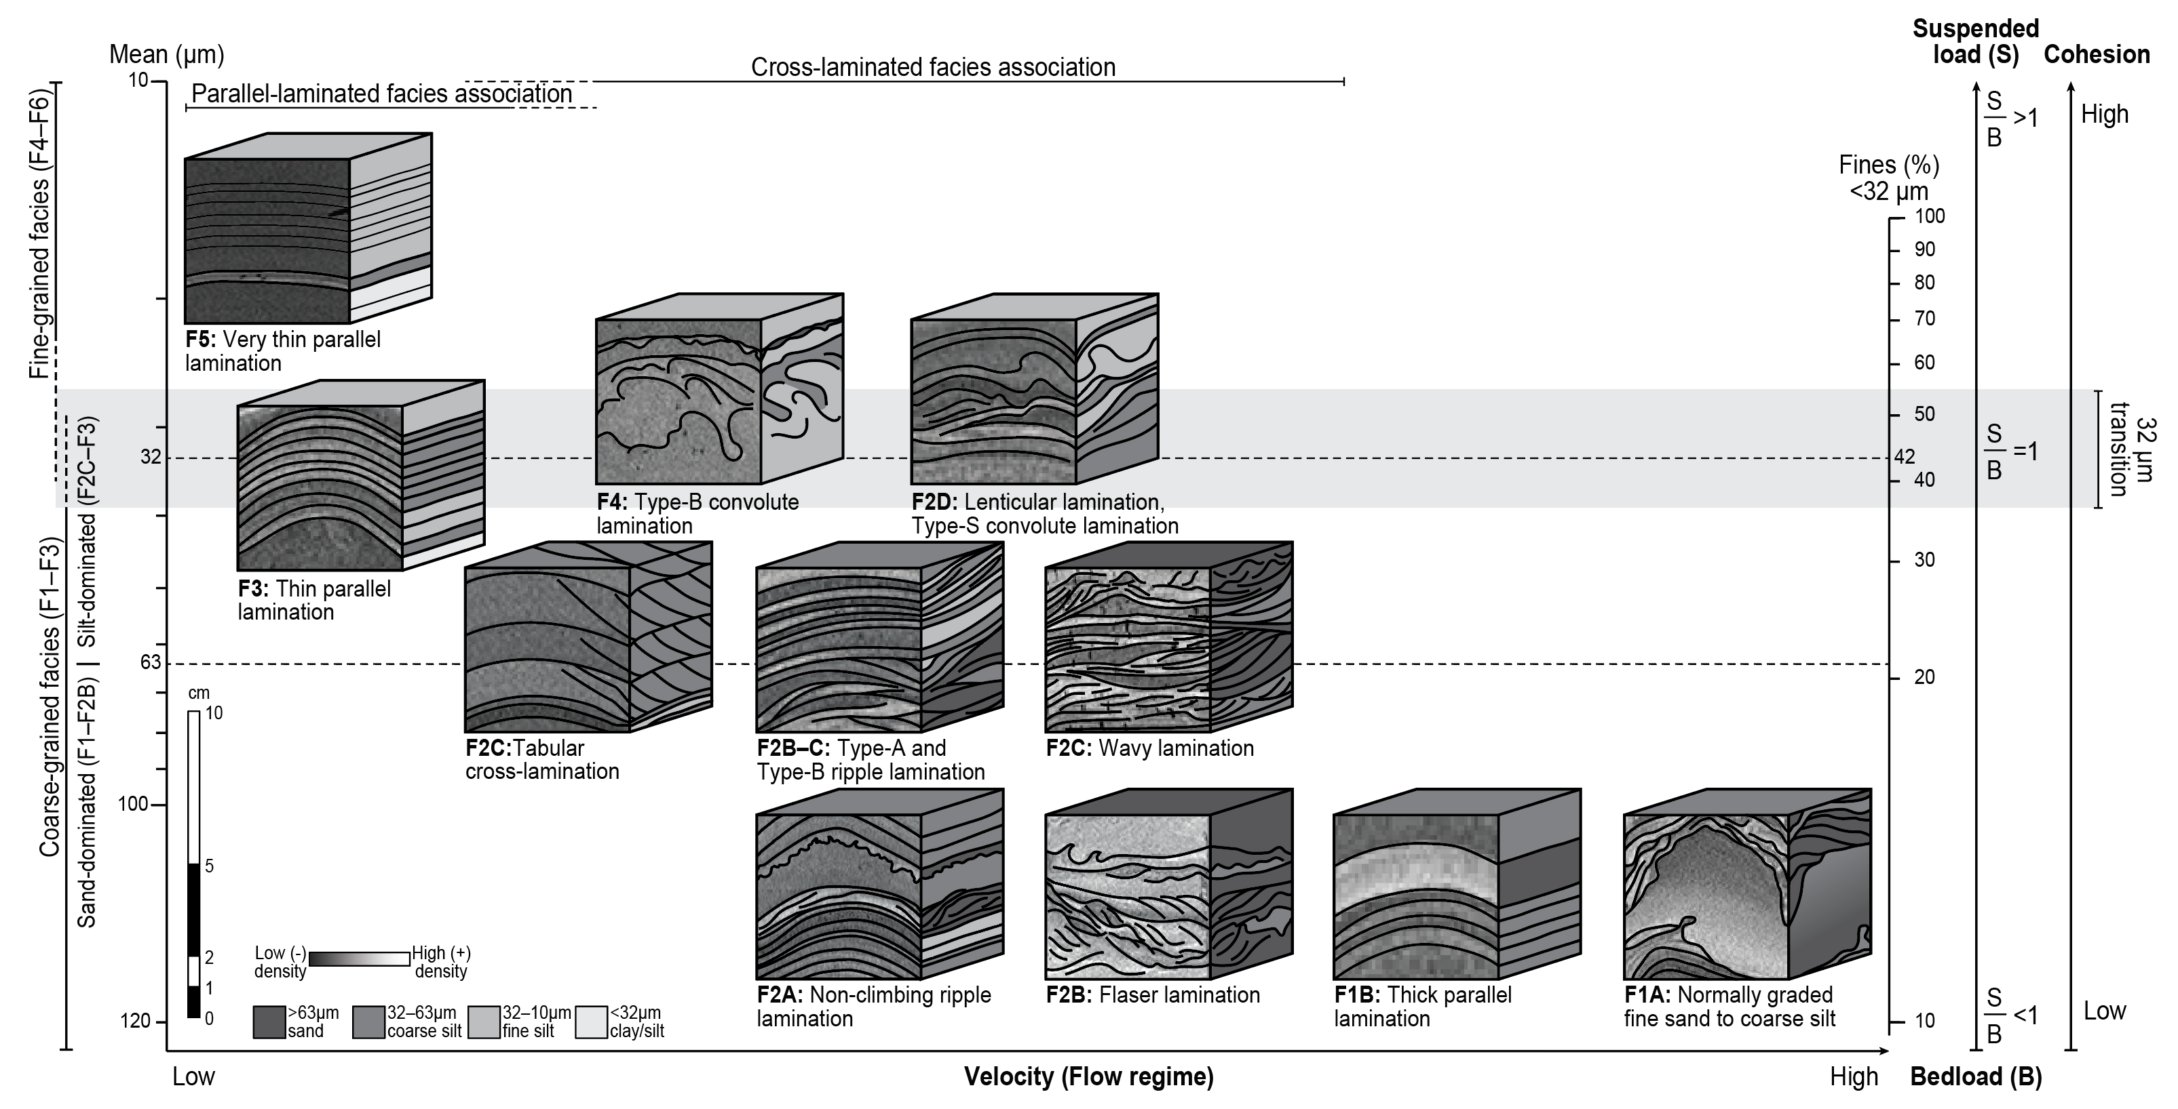
Sediment structures → hydrodynamic interpretation

Slide 18
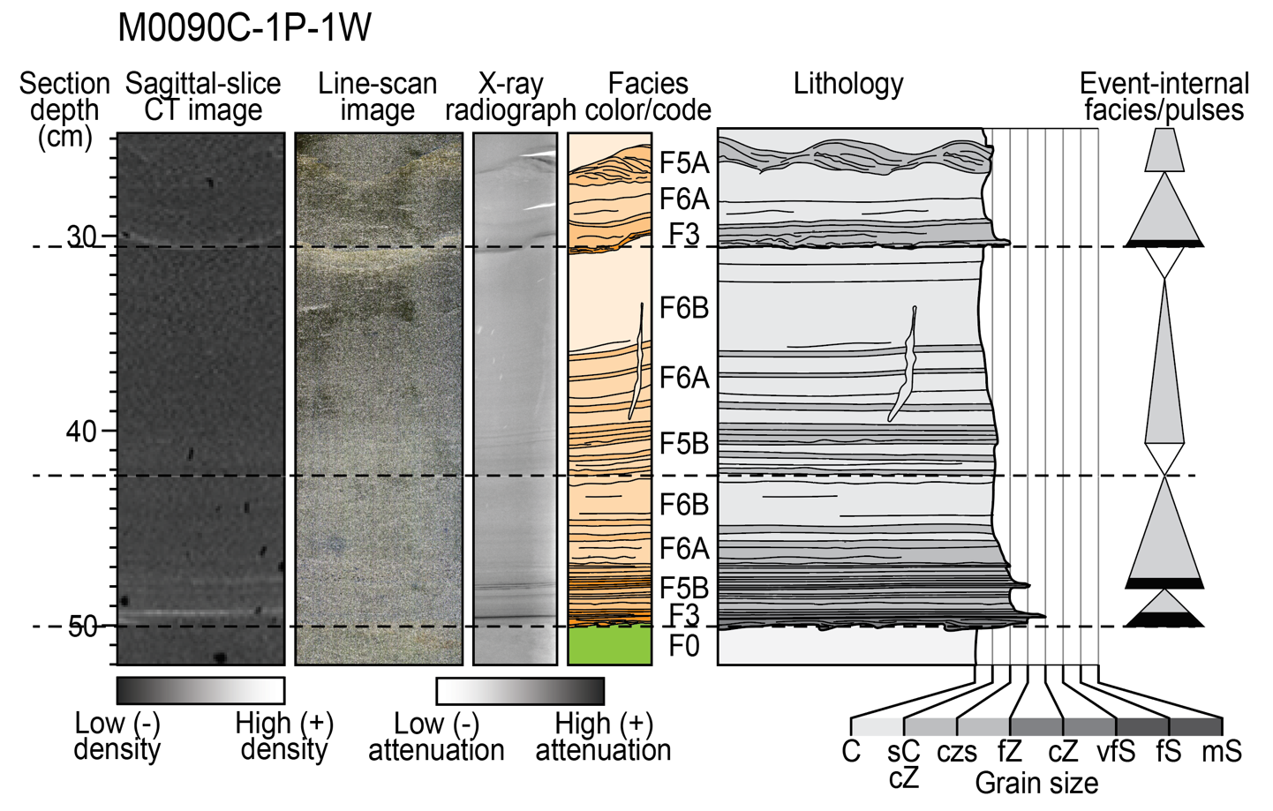
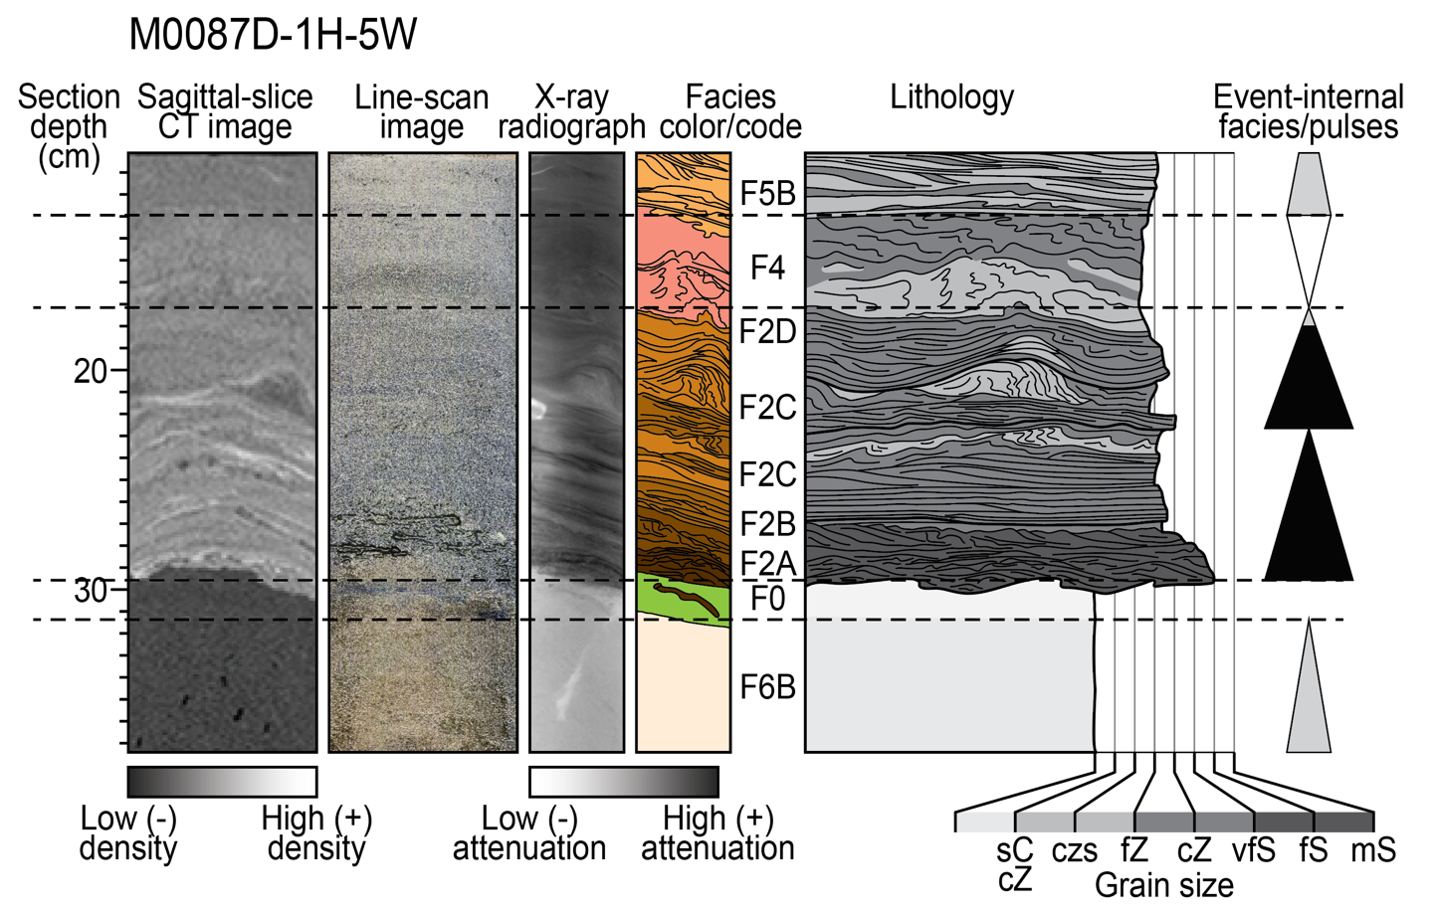
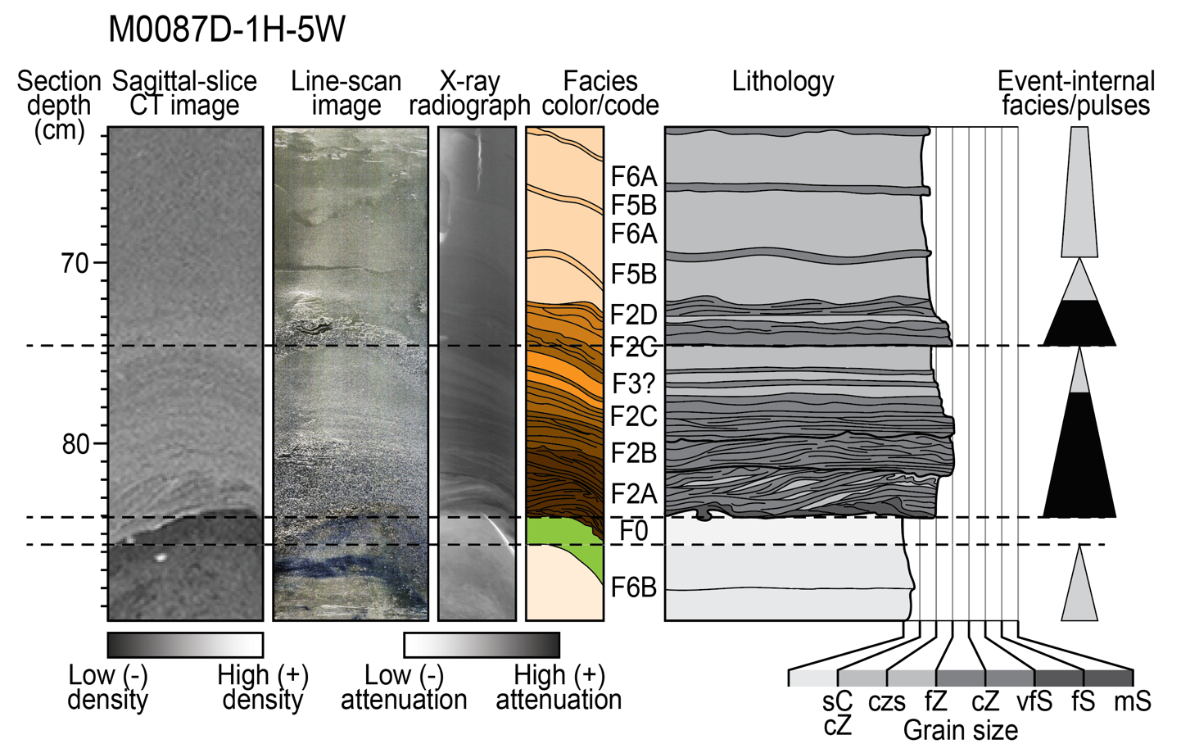
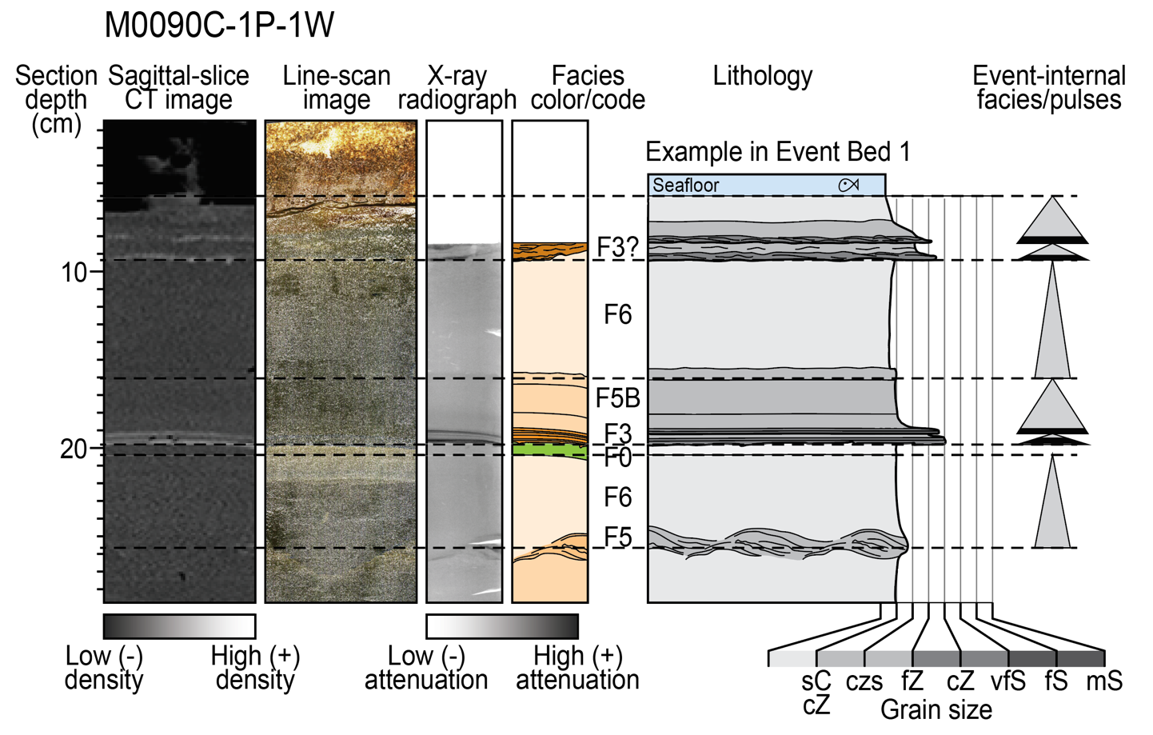
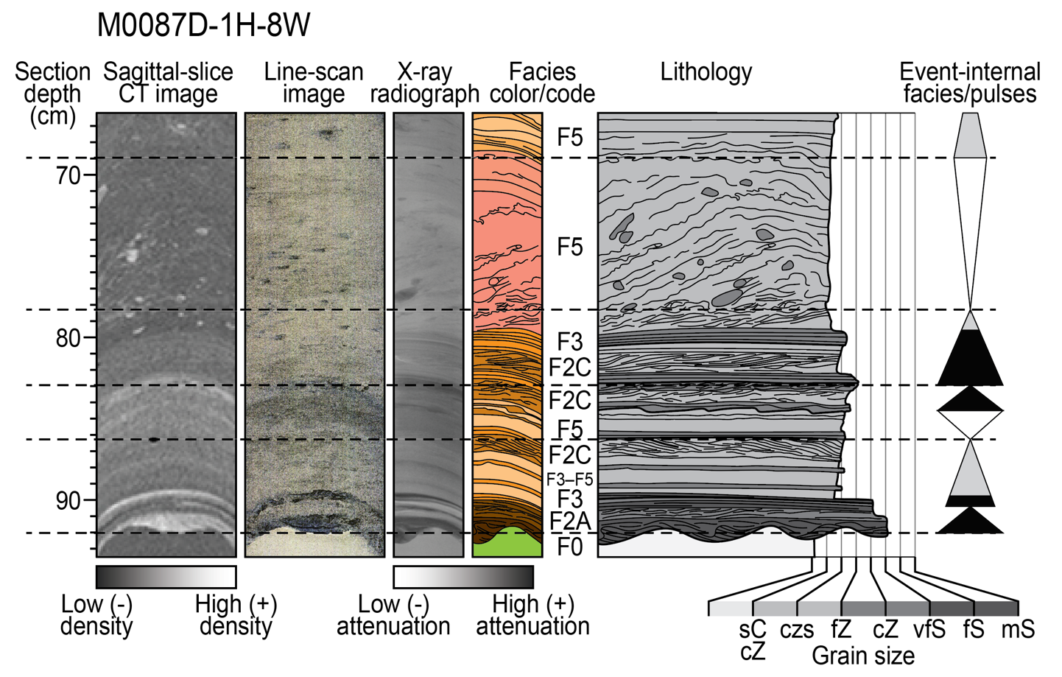
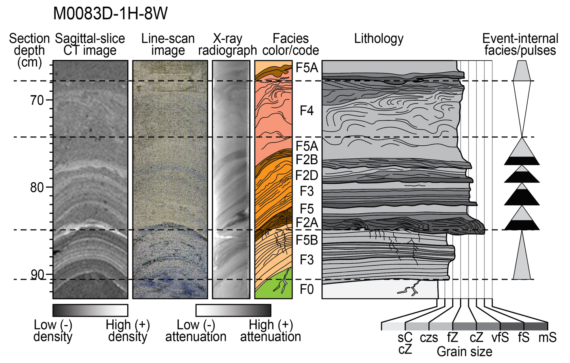
More examples of event beds

Slide 19
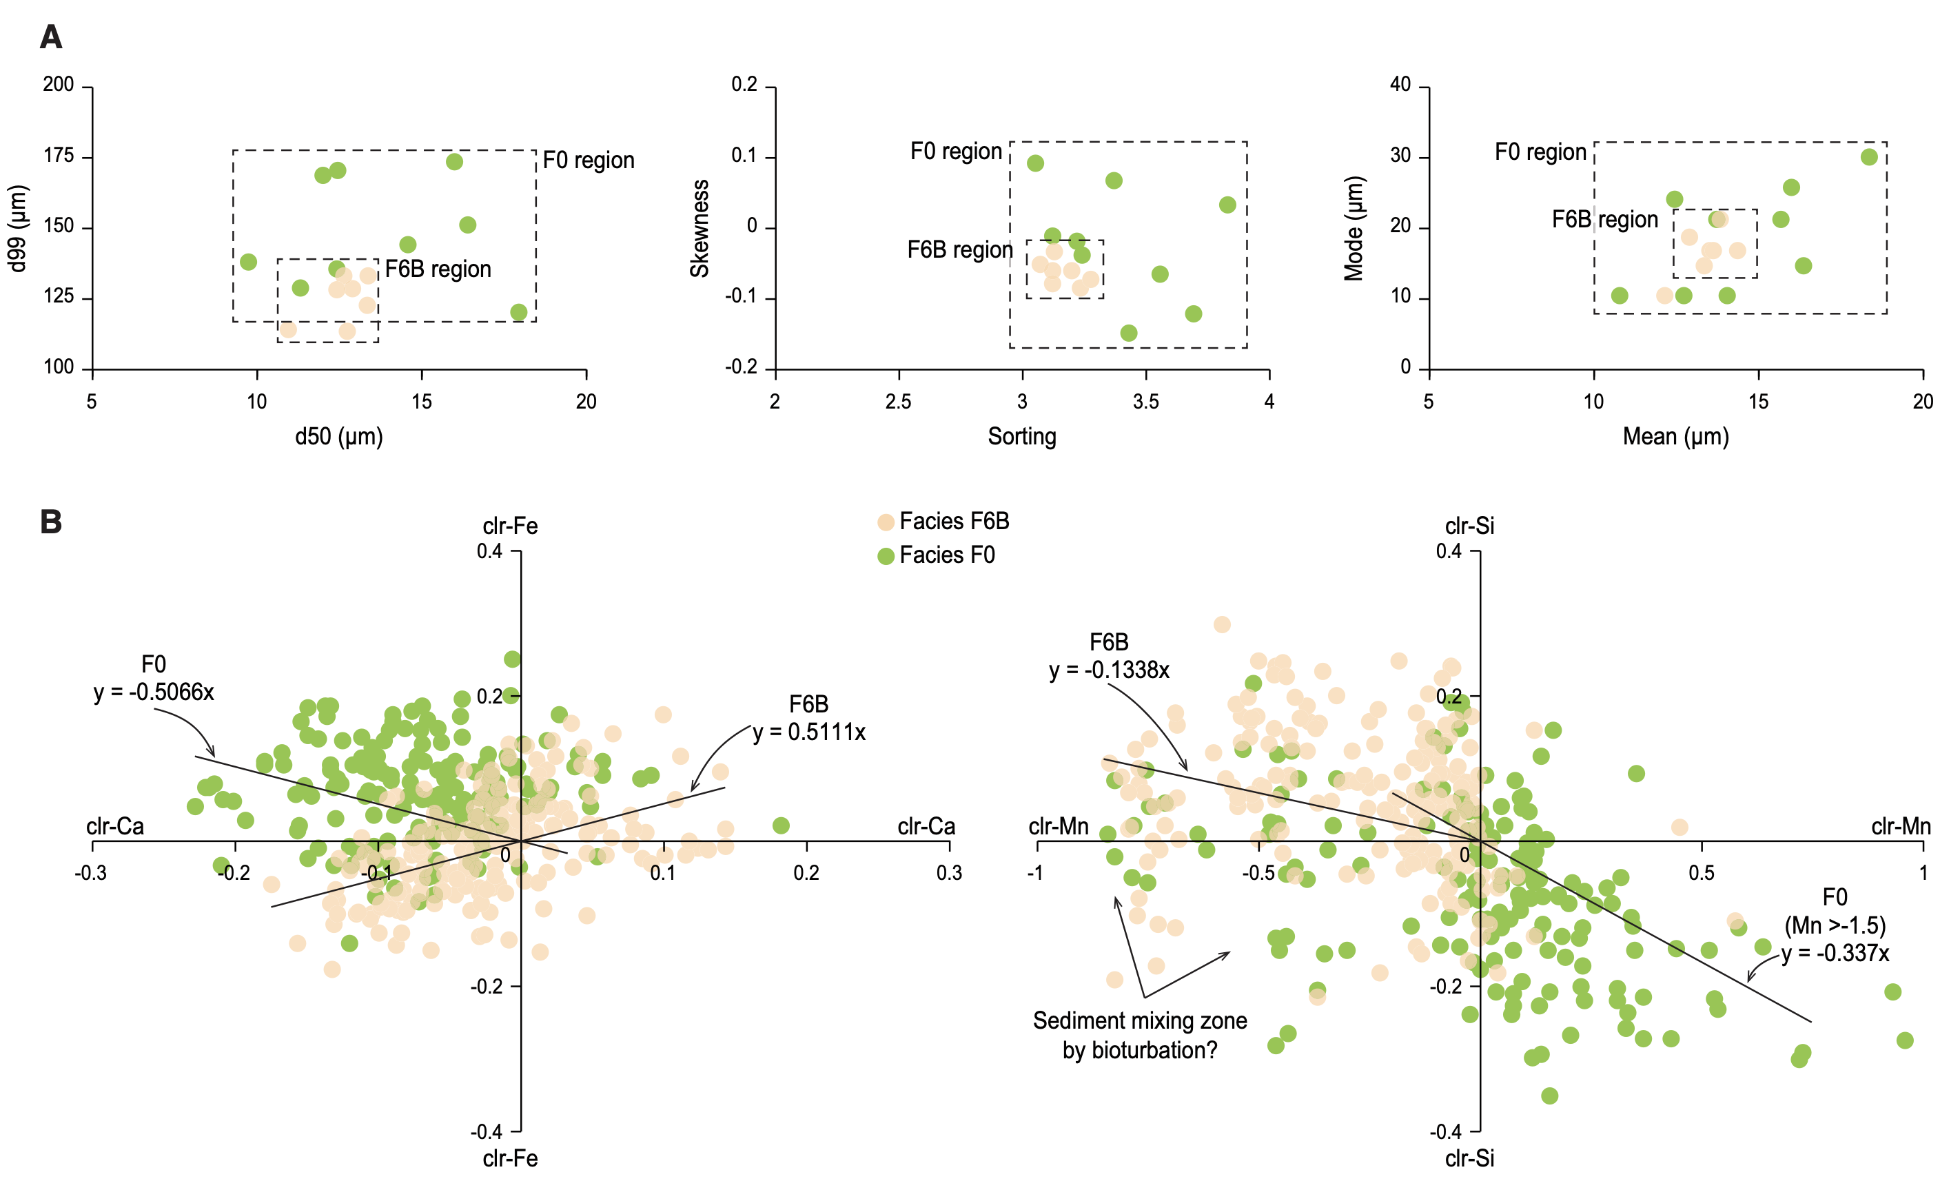
Use of grain size and elemental composition to distinguish hemipelagic (F0) and uppermost turbidite tail (F6)
-F0 less Ca, more Fe
-F0 more Mn, less Si

