Slide 1
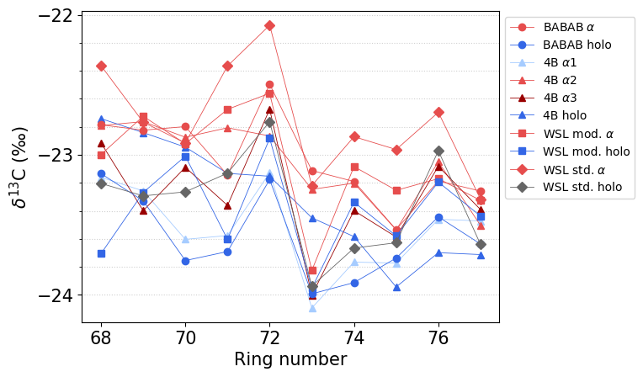
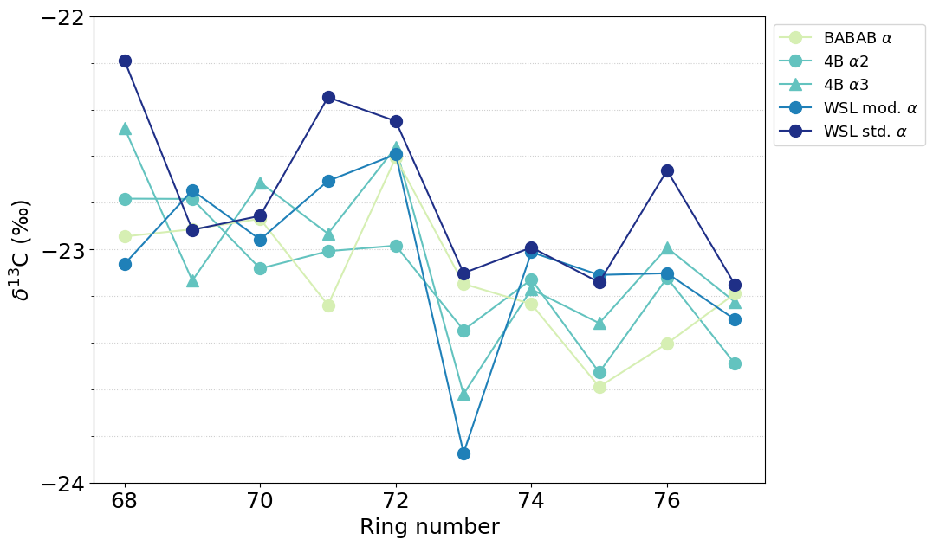
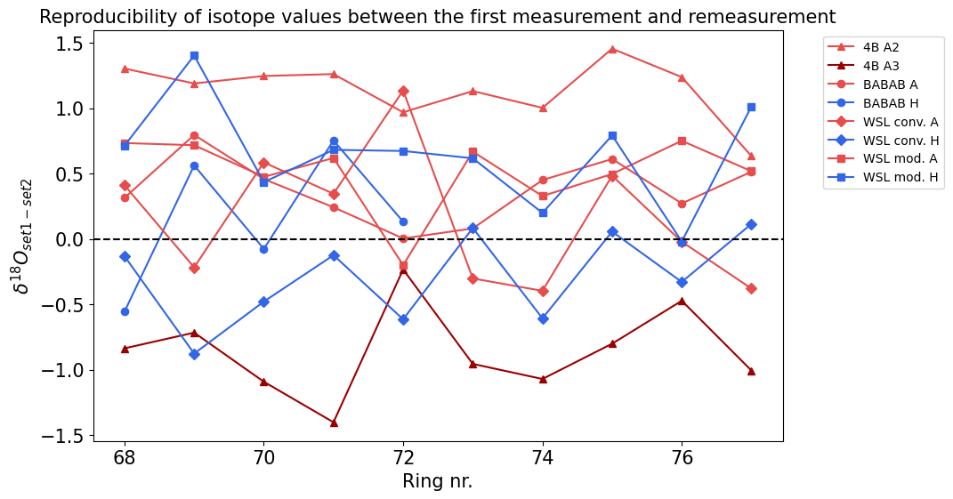
Supplementary Material for “Combined wood cellulose extraction method for ¹⁴C and stable isotope analysis”
Kozue Ando¹, Simona Staub², Giulia Guidobaldi², Daniel Nievergelt², Matthias Saurer², Loïc Schneider², Anne Verstege², Michael Friedrich^{1, 3}, Patrick Fonti², Frederick Reinig⁴, Lukas Wacker¹, and Kerstin Treydte²
1 ETH Zurich, Laboratory of Ion Beam Physics, Zurich, Switzerland | 3 University of Hohenheim, Hohenheim Gardens, Stuttgart, Germany
2 Swiss Federal Research Institute WSL, Birmensdorf, Switzerland | 4 Johannes Gutenberg University, Mainz, Germany
Stable Isotope
δ¹³C
δ¹⁸O

Slide 2
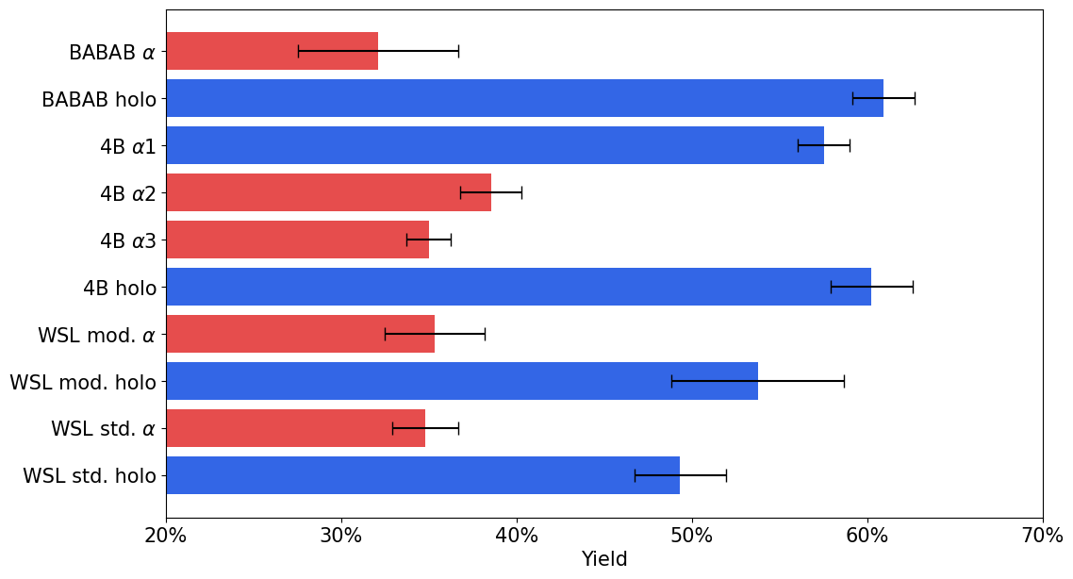
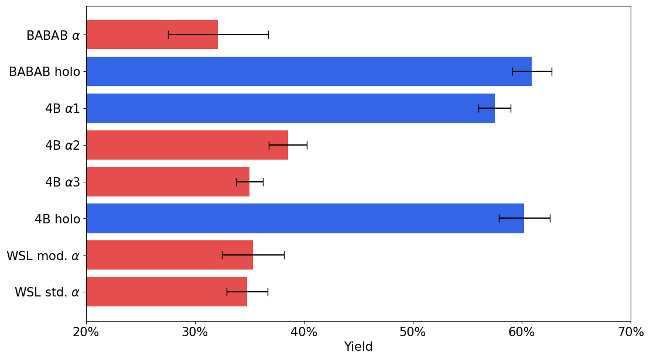
Supplementary Material for “Combined wood cellulose extraction method for ¹⁴C and stable isotope analysis”
Kozue Ando¹, Simona Staub², Giulia Guidobaldi², Daniel Nievergelt², Matthias Saurer², Loïc Schneider², Anne Verstege², Michael Friedrich^{1, 3}, Patrick Fonti², Frederick Reinig⁴, Lukas Wacker¹, and Kerstin Treydte²
1 ETH Zurich, Laboratory of Ion Beam Physics, Zurich, Switzerland | 3 University of Hohenheim, Hohenheim Gardens, Stuttgart, Germany
2 Swiss Federal Research Institute WSL, Birmensdorf, Switzerland | 4 Johannes Gutenberg University, Mainz, Germany
Yield
α cellulose method
holoellulose method

Slide 3
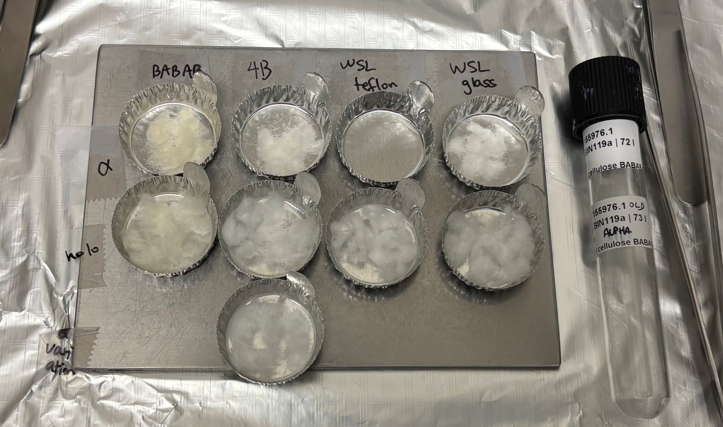
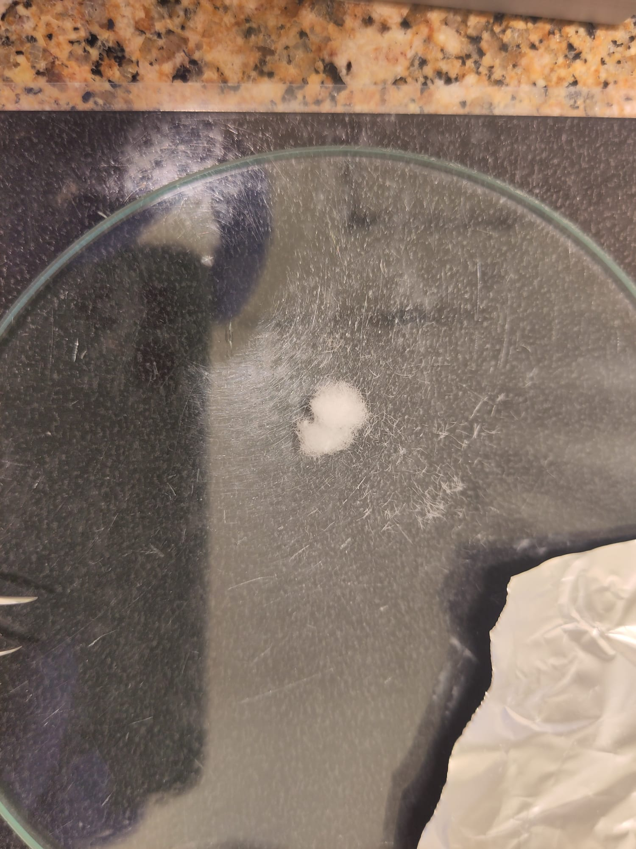
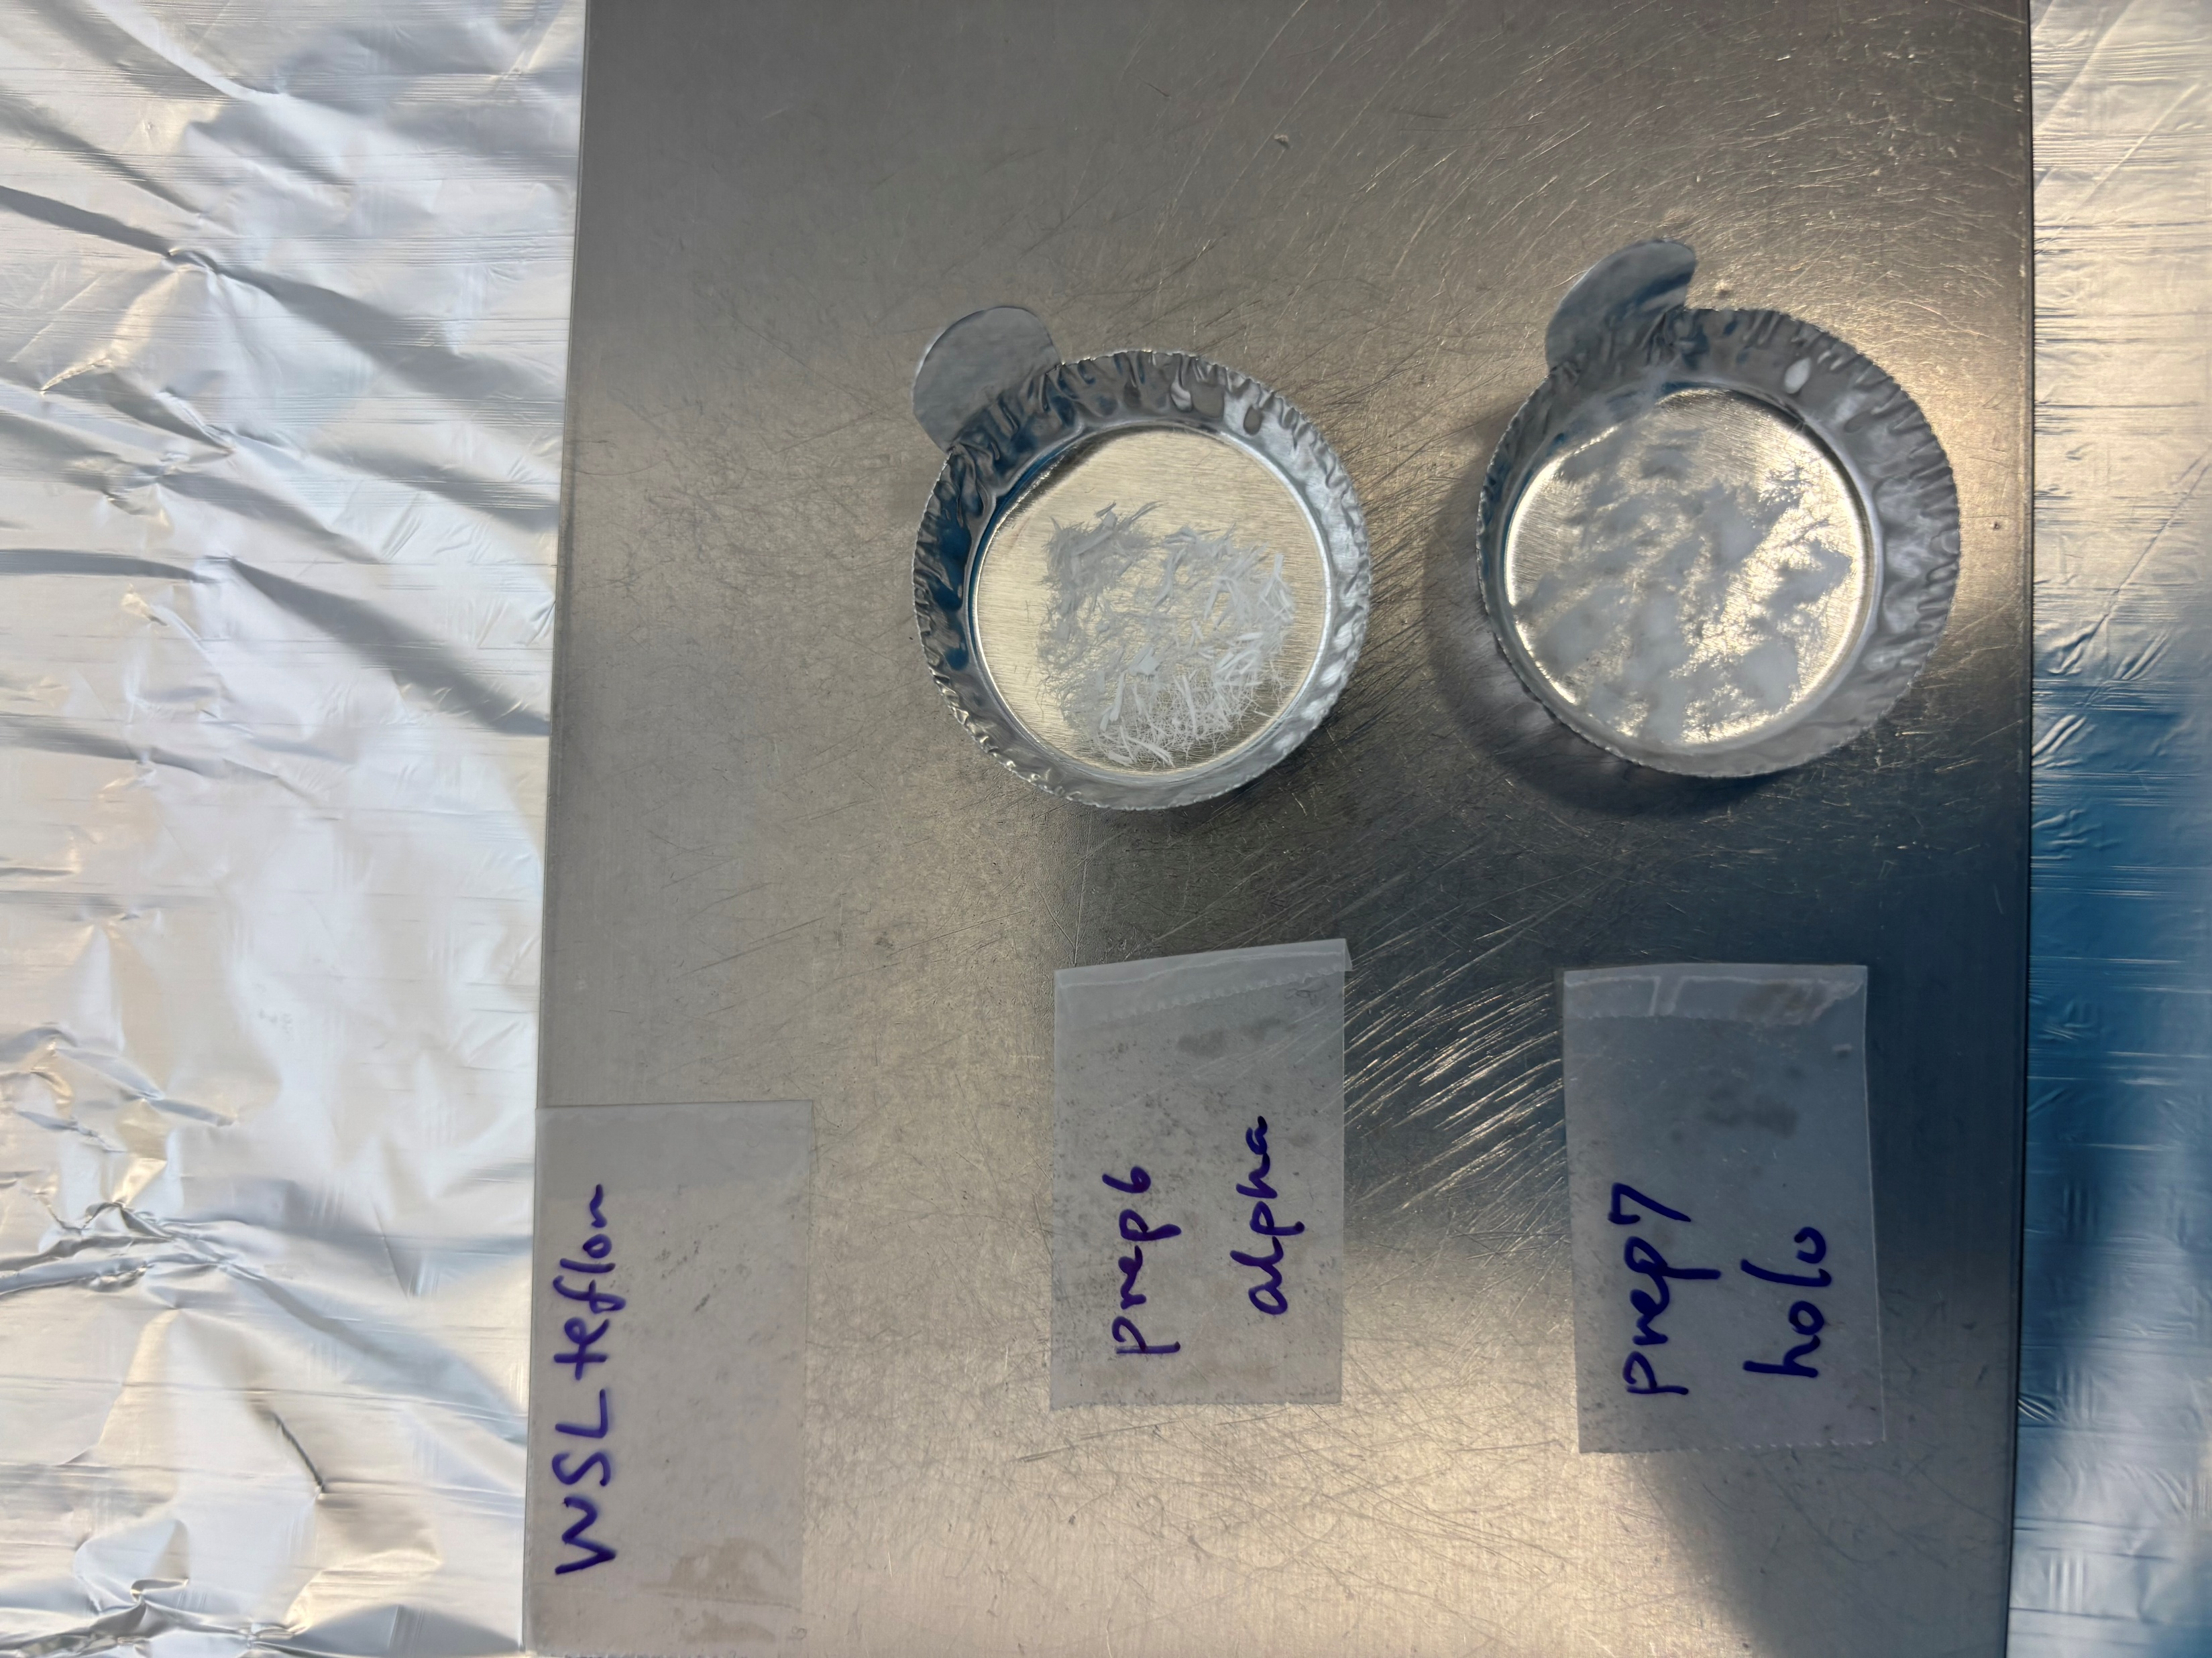
Supplementary Material for “Combined wood cellulose extraction method for ¹⁴C and stable isotope analysis”
Kozue Ando¹, Simona Staub², Giulia Guidobaldi², Daniel Nievergelt², Matthias Saurer², Loïc Schneider², Anne Verstege², Michael Friedrich^{1, 3}, Patrick Fonti², Frederick Reinig⁴, Lukas Wacker¹, and Kerstin Treydte²
1 ETH Zurich, Laboratory of Ion Beam Physics, Zurich, Switzerland | 3 University of Hohenheim, Hohenheim Gardens, Stuttgart, Germany
2 Swiss Federal Research Institute WSL, Birmensdorf, Switzerland | 4 Johannes Gutenberg University, Mainz, Germany
Cellulose difference among methods
BABAB
4B
WSL modified
WSL standard
α cellulose
α2
α3
holocellulose
α1
holo
Most similar to standard method for ¹⁴C analysis cellulose extraction
(added a homogenization step)
Standard method for stable isotope analysis cellulose extraction
All pictures apart from 4B α3 were taken under a same light condition
4B α1 : produced holocellulose. Decided based on the yield and the final texture of the cellulose fiber

