Slide 1
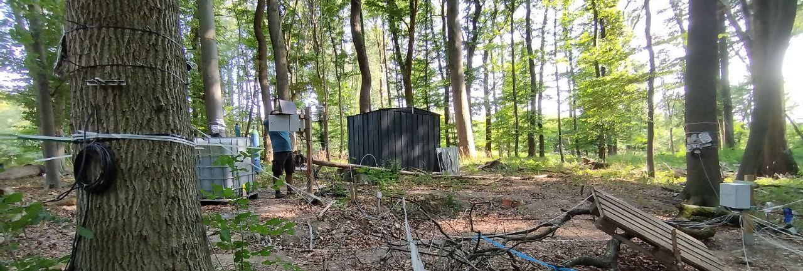
A multi-method approach to quantify hydraulic redistribution
Ramona Riedel¹, Alberto Iraheta¹, Malkin Gerchow¹, Clara Rohde², Johannes Hoppenbrock³, Aljoscha Gildemeister¹, Maren Dubbert², Matthias Bückner⁴, and Matthias Beyer¹
¹ Institut für Geoökologie, Technische Universität Braunschweig, Braunschweig, Germany | ² Leibnitz Centre for Agricultural Landscape Research (ZALF), Müncheberg, Germany | ³ Institut für Geophysik und Extraterrestrische Physik, Technische Universität Braunschweig, Braunschweig, Germany | ⁴ Institut für Geowissenschaften, Christian-Albrechts-Universität zu Kiel, Kiel, Germany Contact: Ramona Riedel, ramona.riedel@tu-braunschweig.de

Slide 2
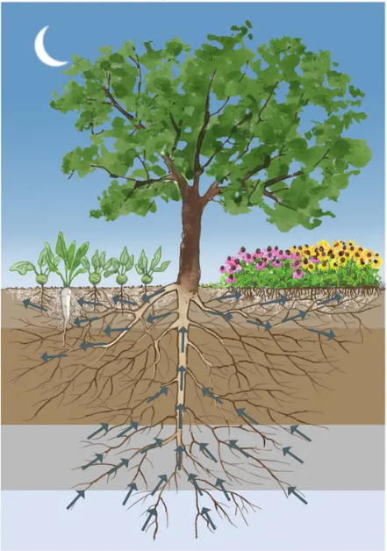
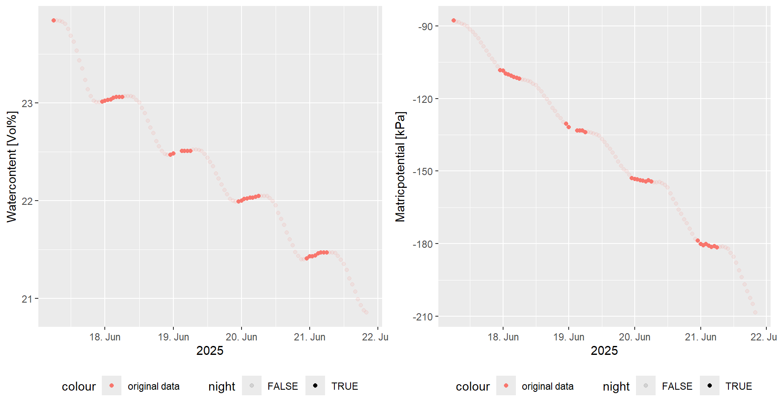
Hydraulic Redistribution and Hydraulic Lift (HL)
©Christine Faltermayr
EGU26 | Ramona Riedel | Poster Supplementary Material
Notes:
Passive, gradient driven
Almost no quantification
Disentangling from other processes
Forest scale

Slide 3
Hydraulic Redistribution and Hydraulic Lift (HL)
What role does HL play in Central European forests?
©Christine Faltermayr
EGU26 | Ramona Riedel | Poster Supplementary Material
Notes:
Passive, gradient driven
Almost no quantification
Disentangling from other processes
Forest scale

Slide 4



Research Questions & Hypotheses
Is it really Hydraulic Lift?
What quantities? Is it relevant on the Ecosystem scale?
EGU26 | Ramona Riedel | Poster Supplementary Material
Notes:
Other possible processes:
Water (vapor) transport
Temperature effects

Slide 5
Monitoring Setup
Plots
Plots
1
2
3
Infiltration tube
15 cm
25 cm
35 cm
15 cm
25 cm
35 cm
15 cm
25 cm
35 cm
Geophysical transect(s)
1
1
15 cm
25 cm
35 cm
15 cm
25 cm
35 cm
15 cm
25 cm
35 cm
2
Subplots
2
15 cm
25 cm
35 cm
15 cm
25 cm
35 cm
15 cm
25 cm
35 cm
Control
3
Water content (SWC)
Matric potential (SMP)
Cut roots
EGU26 | Ramona Riedel | Poster Supplementary Material
Notes:
Installed June 2024
15 cm & Control 3 installed June 2025

Slide 6

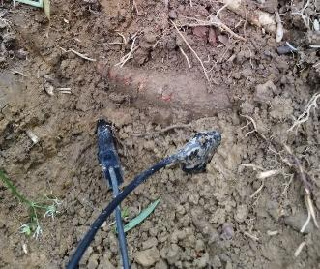
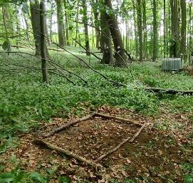

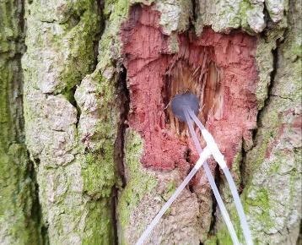
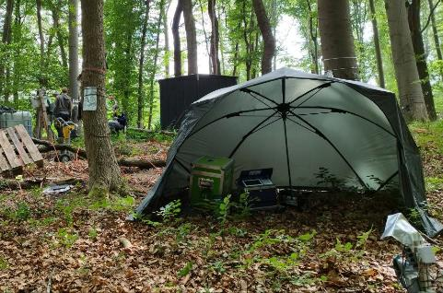
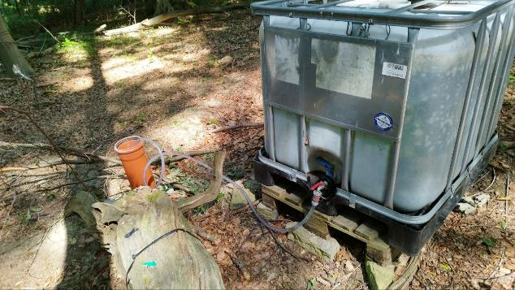
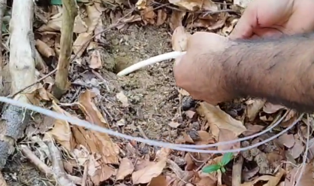
Methods
Soil water
D 18O
Geo-physics
Mo-dels
Plant water status
Soil water monitoring
Control plots (roots cut)
In situ isotope measurements
Deuterium Tracer
(deep infiltration)
Geophysical monitoring
In situ isotope measurements
EGU26 | Ramona Riedel | Poster Supplementary Material

Slide 7
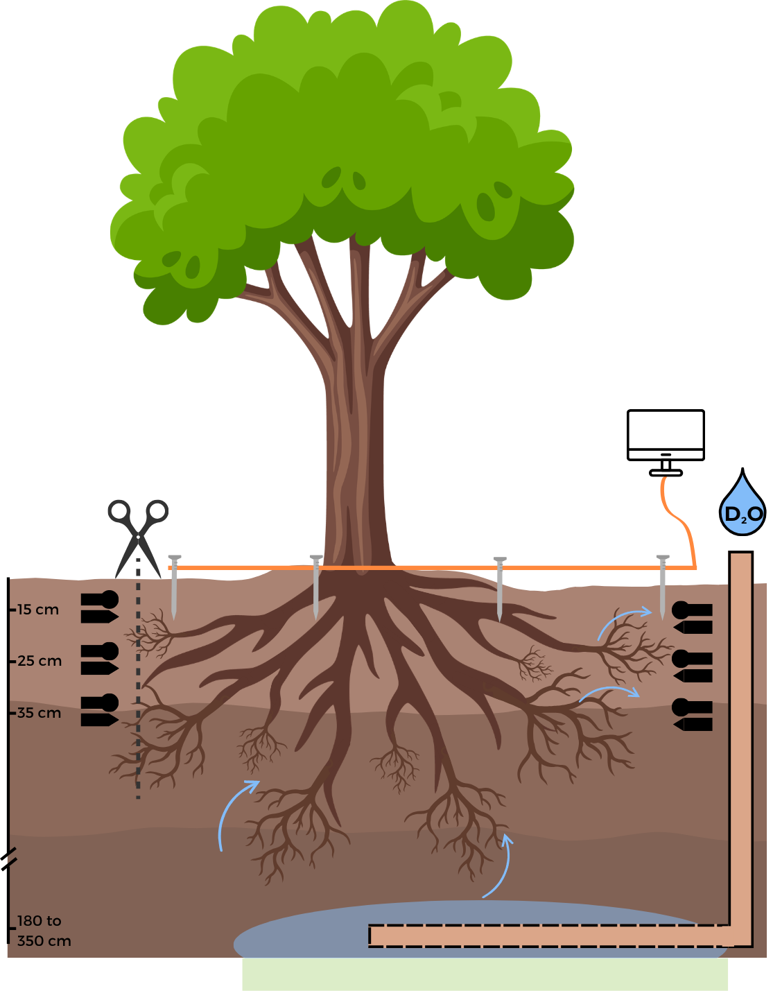
Methods
Destructive & continuous in situ isotope measurements
Geophysical measurements
Control plot (roots cut)
Soil Water Content (SWC) and Soil Matric Potential (SMP) monitoring
Deep D2O-infiltration experiments
EGU26 | Ramona Riedel | Poster Supplementary Material

Slide 8
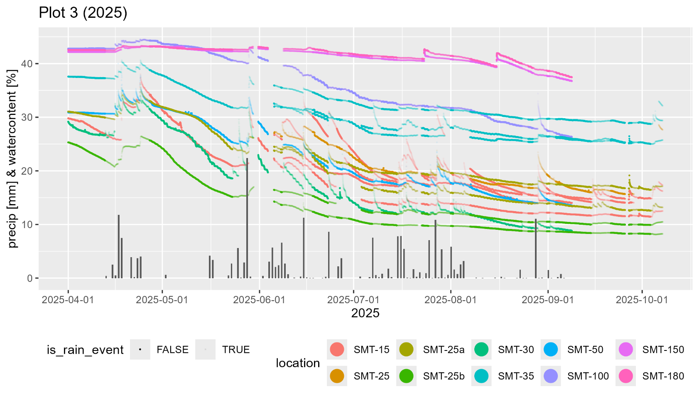
Methods – Analysis of SWC and SMP
Focus on vegetation period (Apr - Nov)
Remove periods influenced by rain events (+ 48 h after detected rain event)
EGU26 | Ramona Riedel | Poster Supplementary Material
Notes:
Focus on dry periods with „ripples
730 nights during vegetation period (2023-2025)
~ 300 could be analyzed (without rain & enough data points)
“

Slide 9
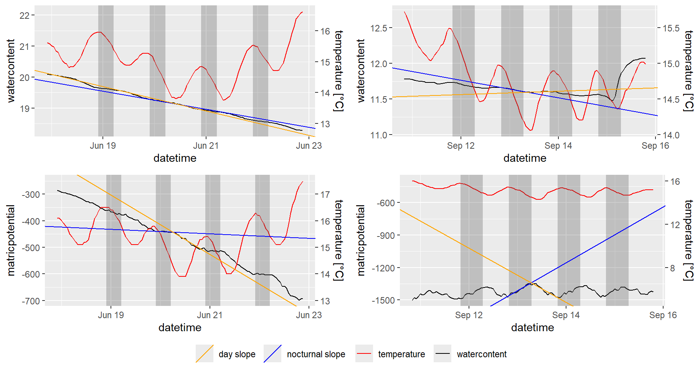
Methods – Analysis of SWC and SMP
Fit linear models to day and night branches of SWC/SMP time series
EGU26 | Ramona Riedel | Poster Supplementary Material
Notes:
Automated analysis of night and day time slopes in SWC & SMP

Slide 10
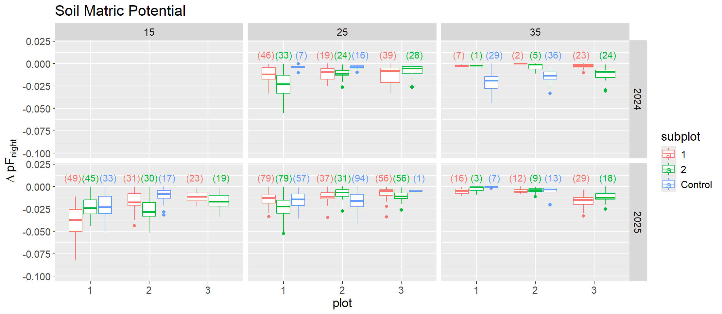
Results SMP
HL?
In 2024 in 25 cm depth observed pattern is as expected with HL
But:
Control plots do not always consistently show less increases in SMP (nor SWC) during night
(pF)
cm
cm
cm
EGU26 | Ramona Riedel | Poster Supplementary Material
Notes:
Nocturnal changes in SMP not consistent (neither years, nor (sub-)plots)
Limited to nights with decrease during day and increase during night
Same in SWC

Slide 11
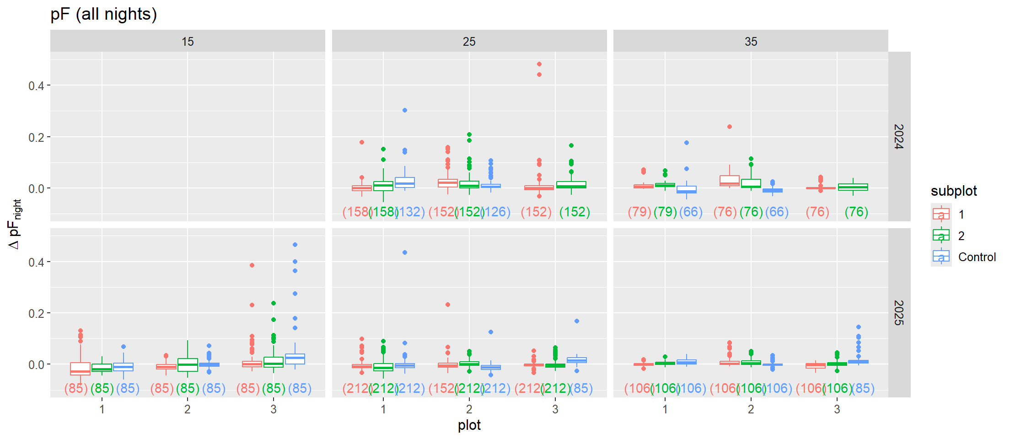
Results SMP
During most nights in Apr-Nov, SMP (& SMP, here not shown) continue to decline
EGU26 | Ramona Riedel | Poster Supplementary Material
Notes:
Mostly still decline during nights!

Slide 12




Nocturnal changes in soil water
Nocturnal Changes | Processes | Detection Methods
 | HR Condensation | SWC & SMP↑ Isotopes Stronger cooling ≈> ↑ Hydrus model
 | Evaporation RWU | ↑VPD? Stem water content dynamics
 | Redistribution within the soil | Hydrus Model
EGU26 | Ramona Riedel | Poster Supplementary Material
Notes:
240 times SMP & SWC sensor pairs increase at the same night in same plot (out of 1998 times in total from data 2023 - 2025)

Slide 13

Hydraulic Lift?
Nocturnal Changes | Processes | Detection Methods | Preliminary Results
 | HR | SWC & SMP↑ Isotopes | 12 % of nights show simultaneous increase in SWC & SMP
EGU26 | Ramona Riedel | Poster Supplementary Material
Notes:
(12 %) 240 times SMP & SWC sensor pairs increase at the same night in same plot (out of 1998 times in total with ☾↑ detected from data 2023 - 2025)

Slide 14
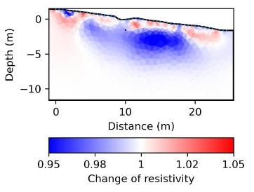
Tracer Experiment – Geophysical monitoring
Subsurface distribution of the tracer within few hours
Lateral spread approx. 10 m
(Fig. by Johannes Hoppenbrock)

Slide 15
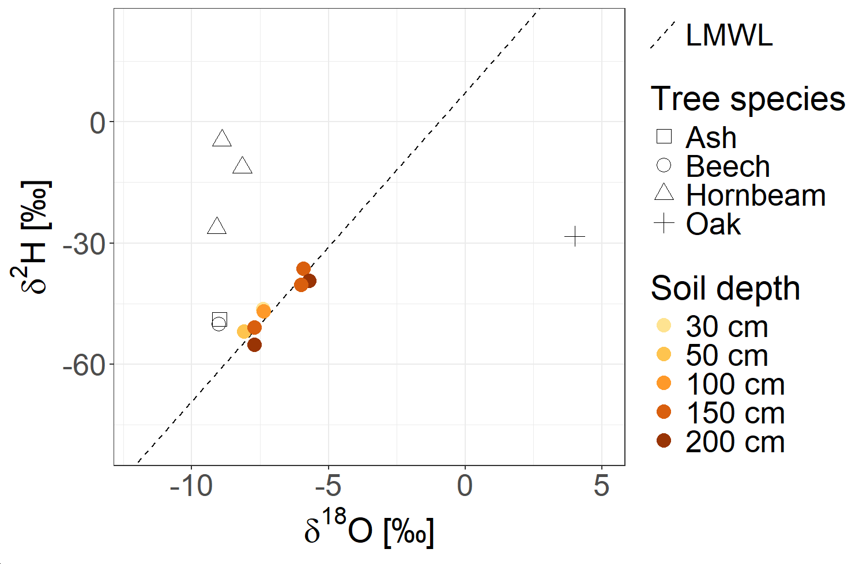
Isotopes: Tracer experiments
Only some Hornbeams took up tracer in 2024
Ash and beech measurements probably compromised by condensation issues
Tracer in top soil?
Tracer not yet found
Natural abundance
Tracer!
Organic contamination
EGU26 | Ramona Riedel | Poster Supplementary Material
Notes:
Natürliche Abundanzen auswerten

Slide 16
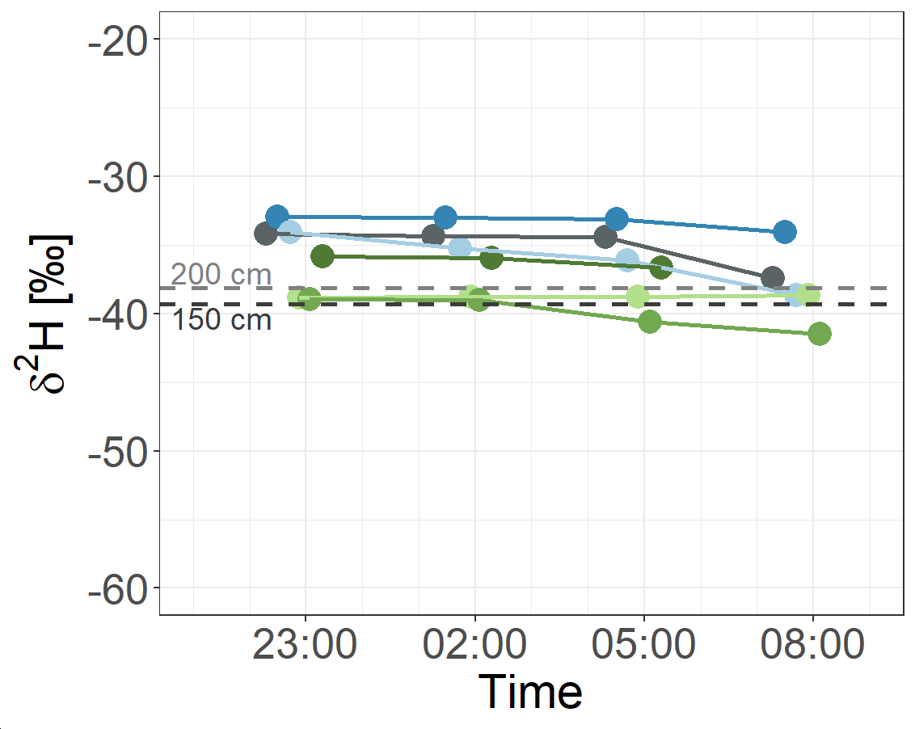
Isotopes: Natural abundance
2024
Tracer in top soil?
Tracer not yet found
Natural abundance
Topsoils (30cm) show slight decrases over night in multiple occasions
Approaching values in 150 cm and 200 cm depth
(M.Sc. Aljoscha Gildemeister)
EGU26 | Ramona Riedel | Poster Supplementary Material
Notes:
Natürliche Abundanzen auswerten

Slide 17
Nocturnal changes in soil water
Nocturnal Changes | Processes | Detection Methods
 | HR Condensation | SWC & SMP↑ Isotopes Stronger cooling ≈> ↑ Hydrus model
 | Evaporation RWU | ↑VPD? Stem water content dynamics
 | Redistribution within the soil | Hydrus Model
EGU26 | Ramona Riedel | Poster Supplementary Material
Notes:
240 times SMP & SWC sensor pairs increase at the same night in same plot (out of 1998 times in total from data 2023 - 2025)

Slide 18

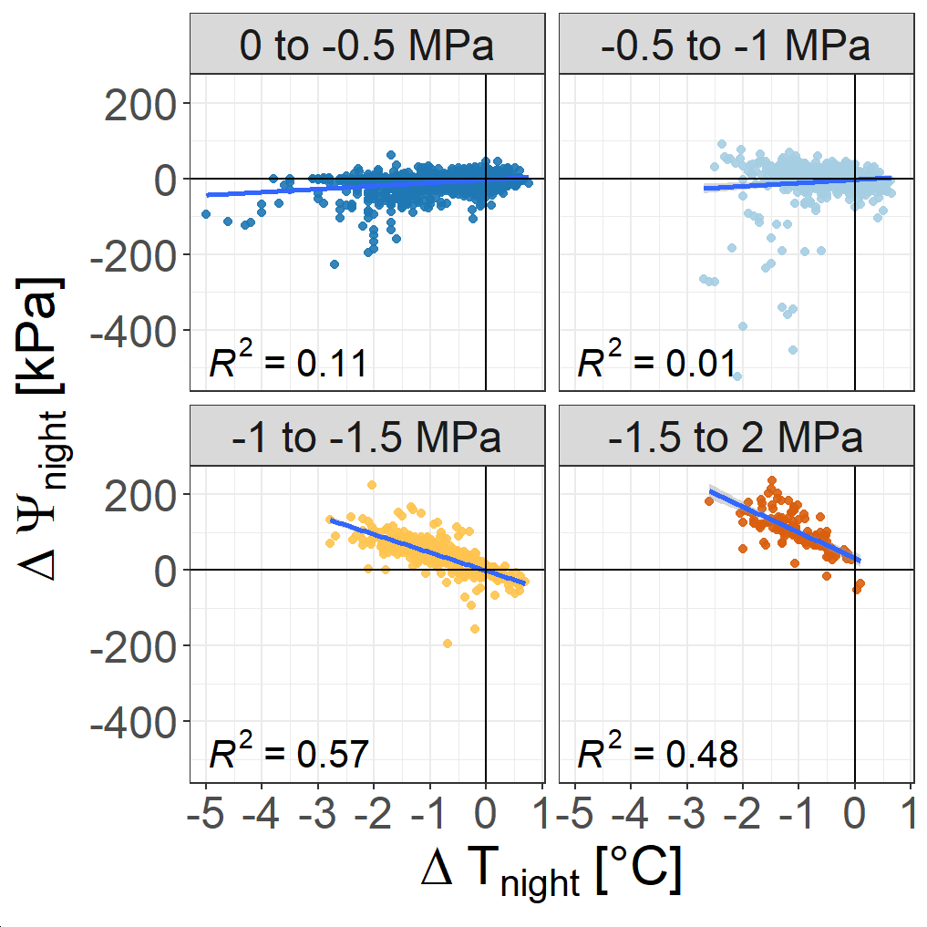
Condensation?
While there is no correlation between nighttime changes in soil temperature and soil water content…
… Nighttime changes in soil matric potential Ψ seem to be correlated to decreases in soil temperature when soil gets drier.
EGU26 | Ramona Riedel | Poster Supplementary Material
Notes:
Stronger increase in SMP with temperature increase. More pronounced when drier.
Hydrus

Slide 19


Conclusion and Outlook
No clear evidence for HL, but some indications:
Water from HL could cause depleation of nighttime δ2H signatures
Some Control plots show less nighttime increases
It is not yet possible to determine if HR is occurring in small amounts (☾↑SWC < 0.05 %) or if observed nighttime changes are due to other processes.
Temperature changes interfere with measurements of matric potential and water content as well as vapor isotope analysis and need to be accounted for
Next steps:
remove temperature effect on continuous in situ isotope data of 2025
modelling HR scenarios
high resolution geophysical monitoring
EGU26 | Ramona Riedel | Poster Supplementary Material
Notes:
Soil water
☾↑ SWC < 0.05 %
12% SMP & SWC sensor pairs increase at the same night in same plot
Disentangling multiple processes
HL probably only in small amounts – if at all
Isotopes
Tracer too deep
natural abundances

Slide 20
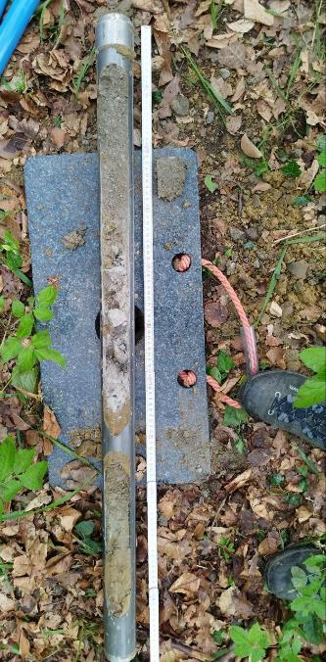
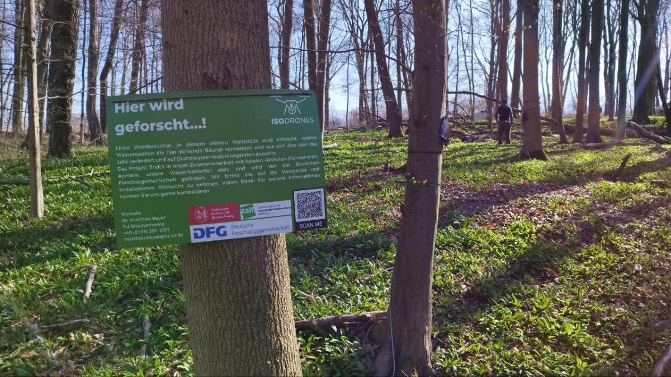
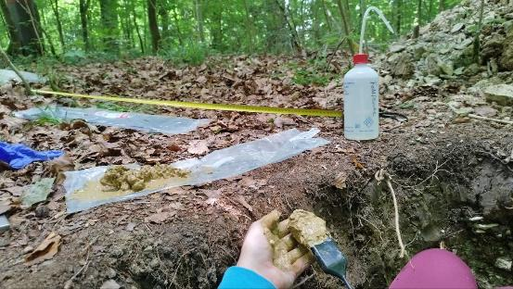
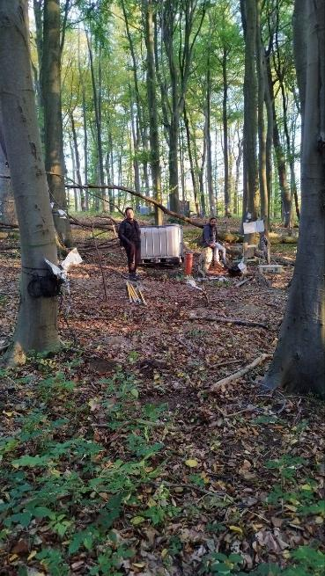
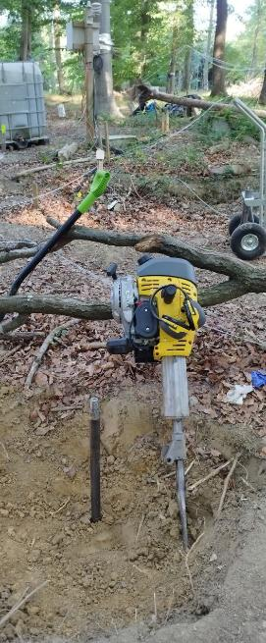

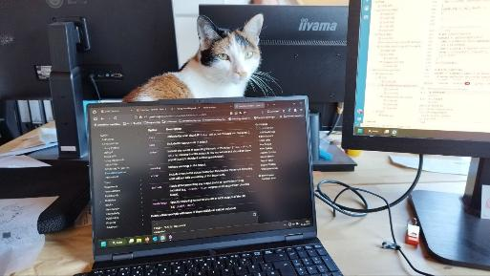
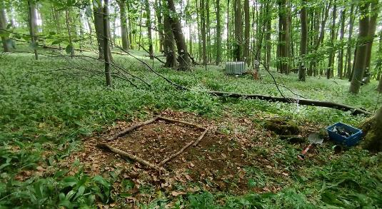



Discussion
www.isodrones.com
Isodrones Project
Isodrones
EGU26 | Ramona Riedel | Poster Supplementary Material

Slide 21
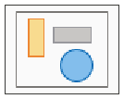
Appendix
EGU26 | Ramona Riedel | Poster Supplementary Material

Slide 22
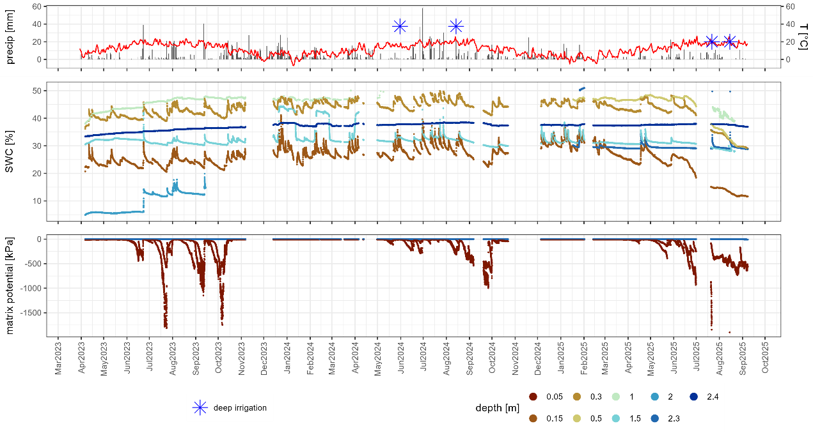
Longterm Monitoring
EGU26 | Ramona Riedel | Poster Supplementary Material

Slide 23
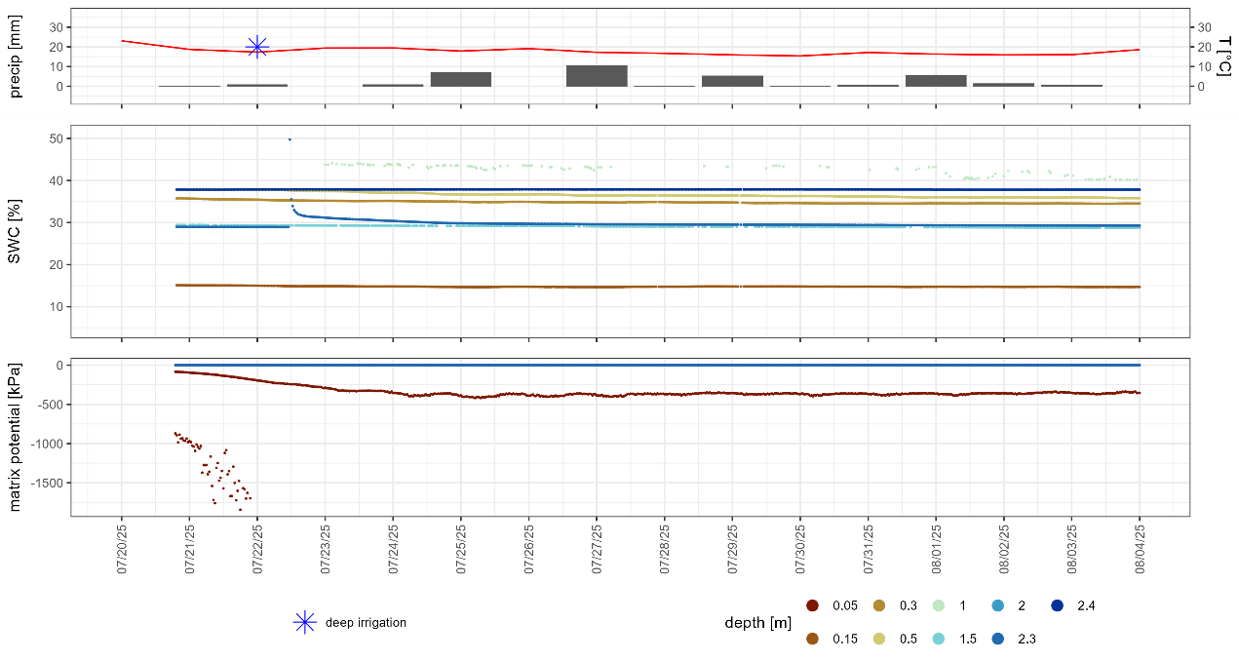
Infiltration experiment
EGU26 | Ramona Riedel | Poster Supplementary Material

Slide 24
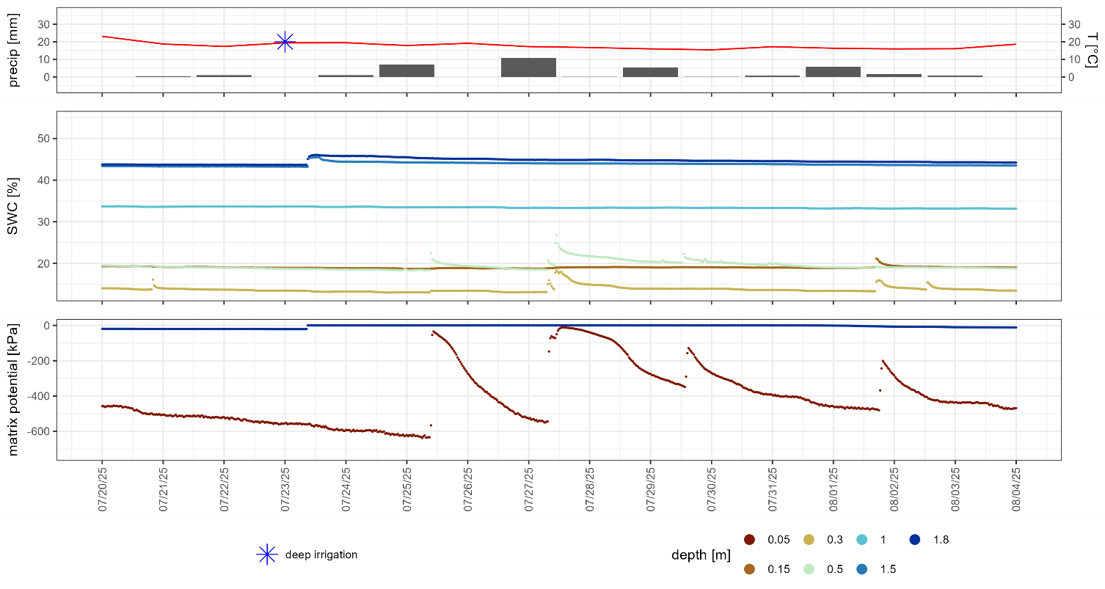
Infiltration experiment
EGU26 | Ramona Riedel | Poster Supplementary Material

Slide 25
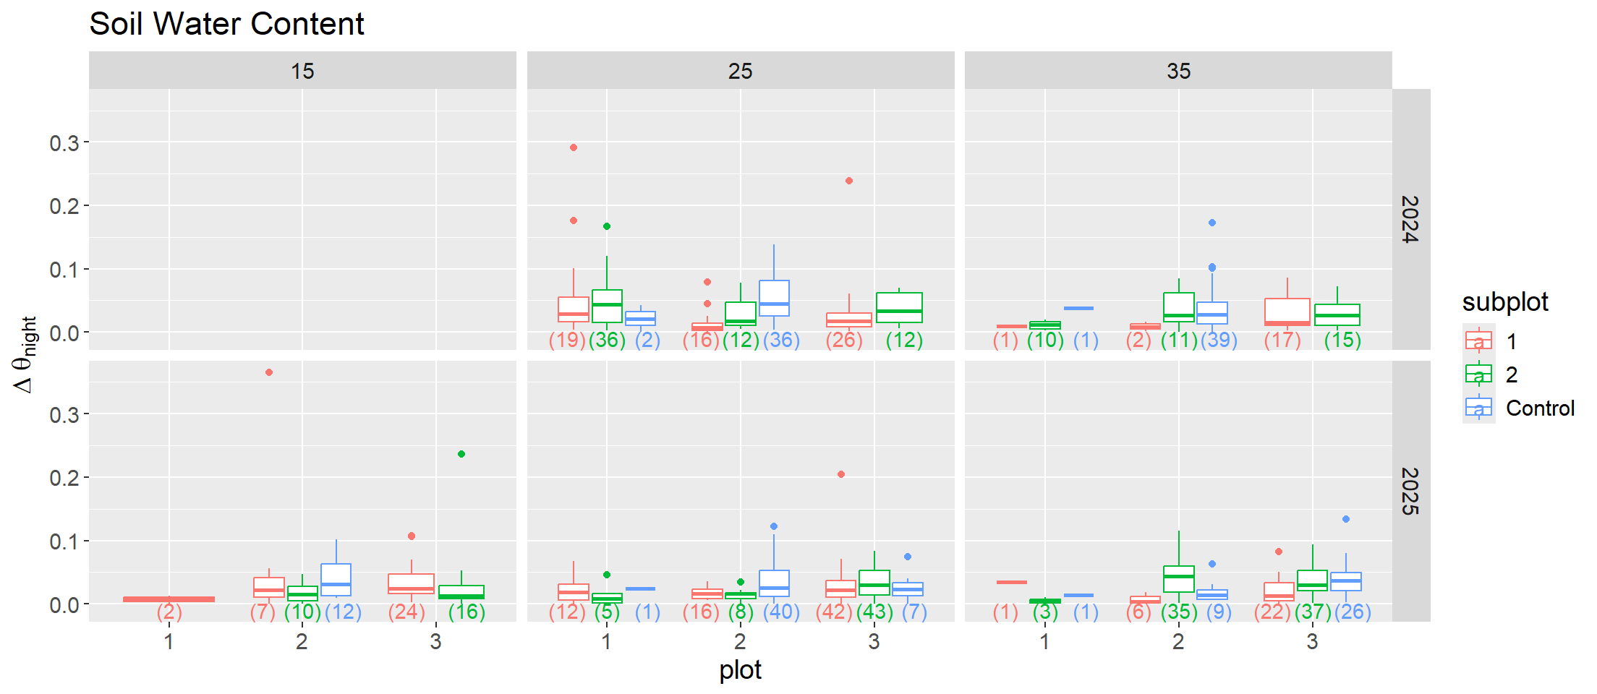
Results SWC
EGU26 | Ramona Riedel | Poster Supplementary Material

Slide 26
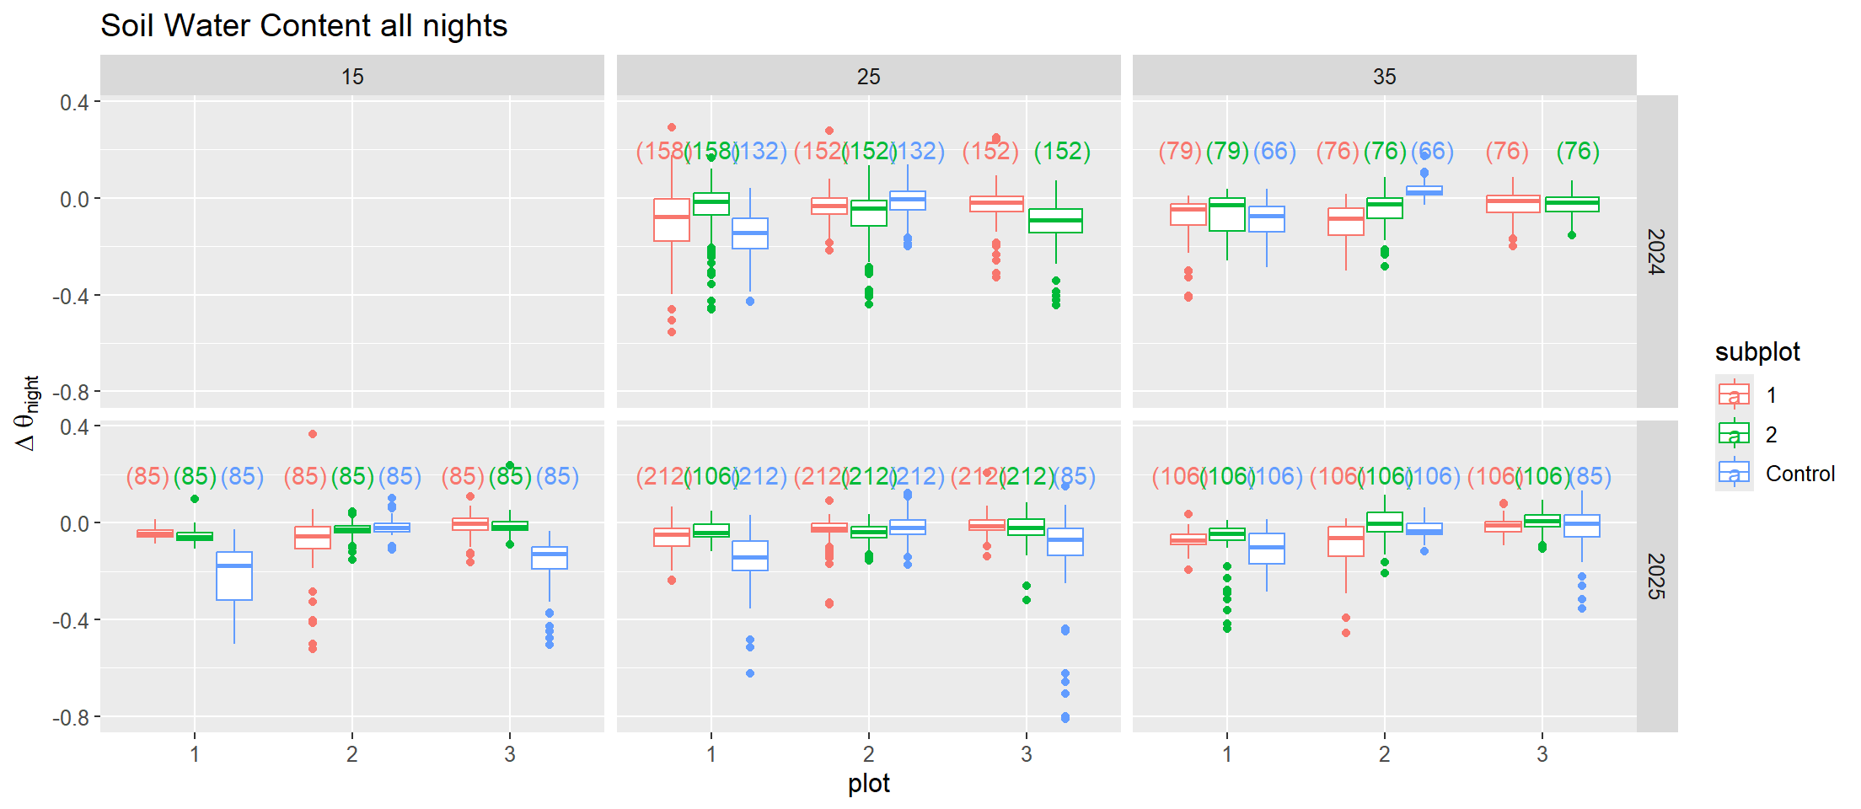
Results SWC
EGU26 | Ramona Riedel | Poster Supplementary Material

