Slide 1
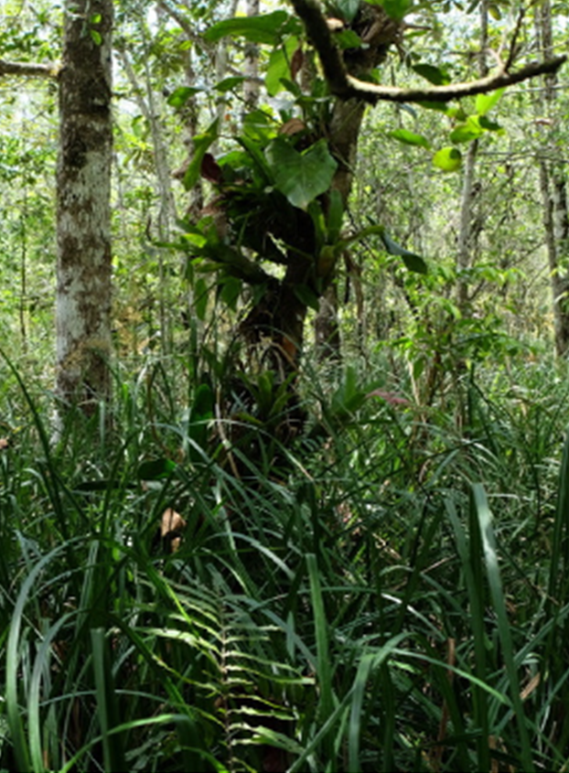



Biomarker approaches for determining past changes in peatland vegetation, pH and biogeochemistry: How they inform the future of tropical peatlands

Slide 2
R. D. Pancost¹, M. Vreeken¹, P. Prokopiou¹, Y. Zhang¹, M. N. Jenkins¹, T. A. Halamka¹, R. Roberts¹, S. Humphreys², A. Oakeshott¹, S. Rangdale², S. M. K. Cheung¹, N. Sneddon-Jenkins¹, R. H. Peel¹, F Ring-Hrubesh¹, J. C. Benavides Duque³, P. Alarcon-Prado^{1,3}, F. Kansiime⁴, E. Kayendeke⁴, C. Kagaba⁵, G. Imani⁶, M. M. Mbula⁷, E. Bahati⁶, B. D. A. Naafs², A. V. Gallego-Sala⁸, C. Bryce¹
¹ School of Earth Sciences, University of Bristol, UK
² School of Chemistry, University of Bristol, UK
³ Department of Ecology and Territory, Pontificia Universidad Javeriana, Colombia
⁴ Department of Environmental Management, Makerere University, Uganda
⁵ Wetlands Management Department, Ministry of Water and Environment, Uganda
⁶Official University of Bukavu, South Kivu, DR Congo,
⁷Higher Institute of Agronomic Studies of Bengamisa, DR Congo
⁸ School of Geography, University of Exeter, UK
CERES – Climate, Energy and Carbon in the Earth System (UKRI)
BACC – Bacterial Response to Climate Change (Leverhulme)

Slide 3
SUPPLEMENTARY INFORMATION PART 1: An introduction to biomarkers
(slides with red titles are from presentation and slides with blue titles are supplementary info)

Slide 4
UTILITY OF LIPIDS AS BIOMARKERS (ANIMATED SLIDE)
OH
OH
OH
Bacteriohopanepolyol
NH₂
OH
OH
OH
1. Structural variability is pronounced, diagnostic for many organisms and reflects adaptations to the environment
2. C, H and N isotopic compositions allow biological source to be linked to geochemical processes
3. Structural and isotopic variability is preserved
4. Lipids are cool

Slide 5
SOME “DIAGNOSTIC” COMPOUNDS: AMINO-BACTERIOHOPANEPOLYOLS (BHPS)
Aminotriol:
Aminotetrol:
Aminopentol:
Ubiquitous & not diagnostic
Type II methanotrophs
(α-Proteobacteria)^{2,3}
Serine Pathway¹
Type I methanotrophs (γ-Proteobacteria)^{2,3}
Ribulose monophosphate Pathway (RuMP).¹
Great Review: Kusch, S. and Rush, D., 2022. Revisiting the precursors of the most abundant natural products on Earth: A look back at 30+ years of bacteriohopanepolyol (BHP) research and ahead to new frontiers. Organic Geochemistry, 172, p.104469.

Slide 6
ISOTOPIC TRACING OF SOURCES (ANIMATED SLIDE)
More
¹³C
0 ‰
Carbonate
Carbon in Ocean-Atmosphere
-8 ‰
CO_{2(aq)}
-20 ‰
C₄ Plants
δ¹³C
values
The bacterial hopane δ¹³C value will reflect the mixture of heterotrophs and methanotrophs
-22 ‰
Algae/Aquatic Plants
-23 ‰
Carbohydrates
-26 ‰
C₃ Plants
Heterotrophic Bacteria
-28 ‰
Lipids
Less
¹³C
-60 ‰
Methane
Methanotrophic Bacteria

Slide 7
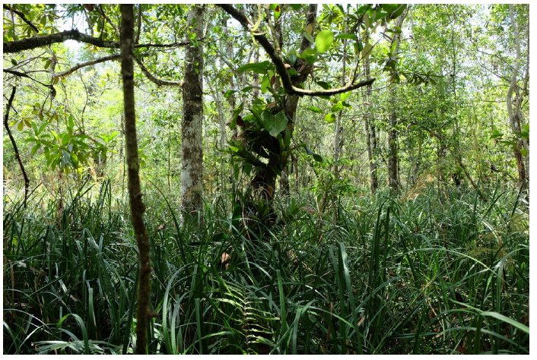
MANY PROXIES FOR PALAEOCLIMATE IN PEATLANDS – BUT ALSO PALAEOECOLOGY AND ENVIRONMENT
Temperature
Hydroclimate
δ²H
Vegetation
pH
Microbiology

Slide 8
MANY PROXIES FOR PALAEOCLIMATE IN PEATLANDS – BUT ALSO PALAEOECOLOGY AND ENVIRONMENT
Temperature
Hydroclimate
δ²H
Vegetation
pH
Reviews on peat biomarker proxies:
Naafs, B.D.A., Inglis, G.N., Blewett, J., McClymont, E.L., Lauretano, V., Xie, S., Evershed, R.P. and Pancost, R.D., 2019. The potential of biomarker proxies to trace climate, vegetation, and biogeochemical processes in peat: A review. Global and Planetary Change, 179, pp.57-79.
Pancost, R.D., 2024. Biomarker carbon and hydrogen isotopes reveal changing peatland vegetation, hydroclimate and biogeochemical tipping points. Quaternary Science Reviews, 339, p.108828.
Microbiology

Slide 9
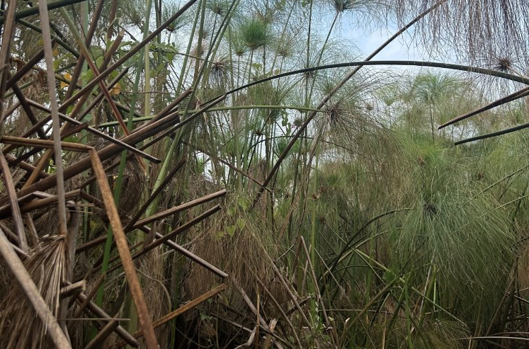
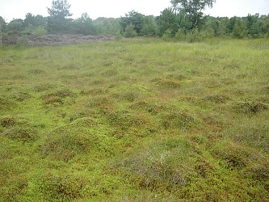
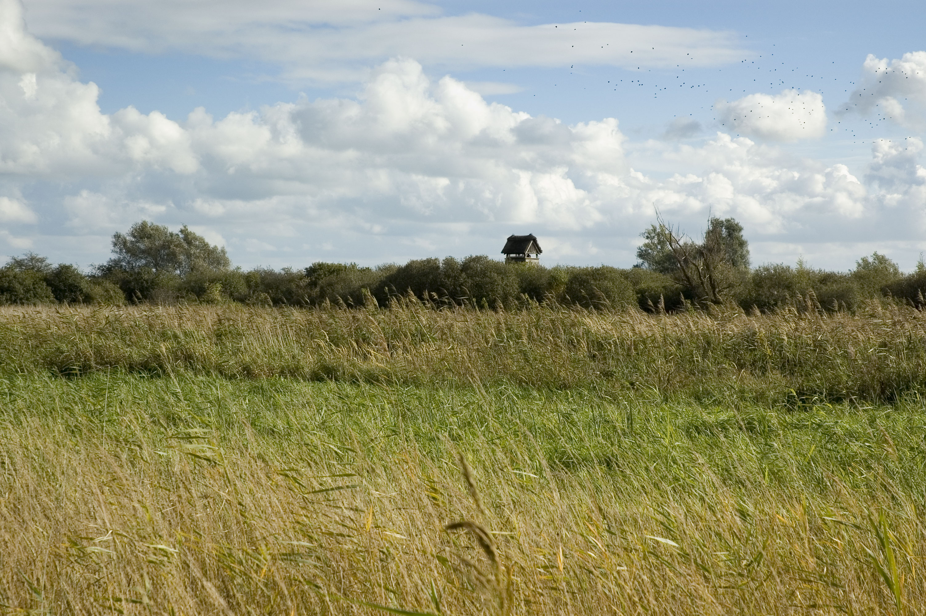
PEATLANDS ARE INCREDIBLY DIVERSE – ARE THESE PROXIES WIDELY APPLICABLE?
Global Occurrence and Temperature Range: Tropical Peat is more productive with more intense degradation
Incredibly diverse nutrient status, hydrology and vegetation (and OM content)
Huge pH range (2.5 to 7)
Ombrotrophic Bog
pH: 3.5 to 5
Nutrient Poor
Sphagnum
Temperate Fen
pH: 4.5 to 7
Nutrient poor or rich
Sedges or Reeds
Tropical Forest Swamps
5 to 6.5
Nutrient poor or rich
Wide variety of shrubs, palms, trees
Tropical Sedge Swamp
pH 5 to 6.5
Nutrient poor or rich
C₄ or C₃ Sedges

Slide 10
MANY PROXIES FOR PALAEOCLIMATE IN PEATLANDS – BUT ALSO PALAEOECOLOGY AND ENVIRONMENT
Temperature
Previous work on pH proxies in peat:
Naafs, B. D. A., Inglis, G. N., Zheng, Y., Amesbury, M. J., Biester, H., Bindler, R., ... & Pancost, R. D. (2017). Introducing global peat-specific temperature and pH calibrations based on brGDGT bacterial lipids, Geochim. Cosmochim. Ac., 208, 285–301.
Inglis, G.N., Naafs, B.D.A., Zheng, Y., McClymont, E.L., Evershed, R.P. and Pancost, R.D., 2018. Distributions of geohopanoids in peat: Implications for the use of hopanoid-based proxies in natural archives. Geochimica et Cosmochimica Acta, 224, pp.249-261.
Hydroclimate
Vegetation
pH
Microbiology

Slide 11

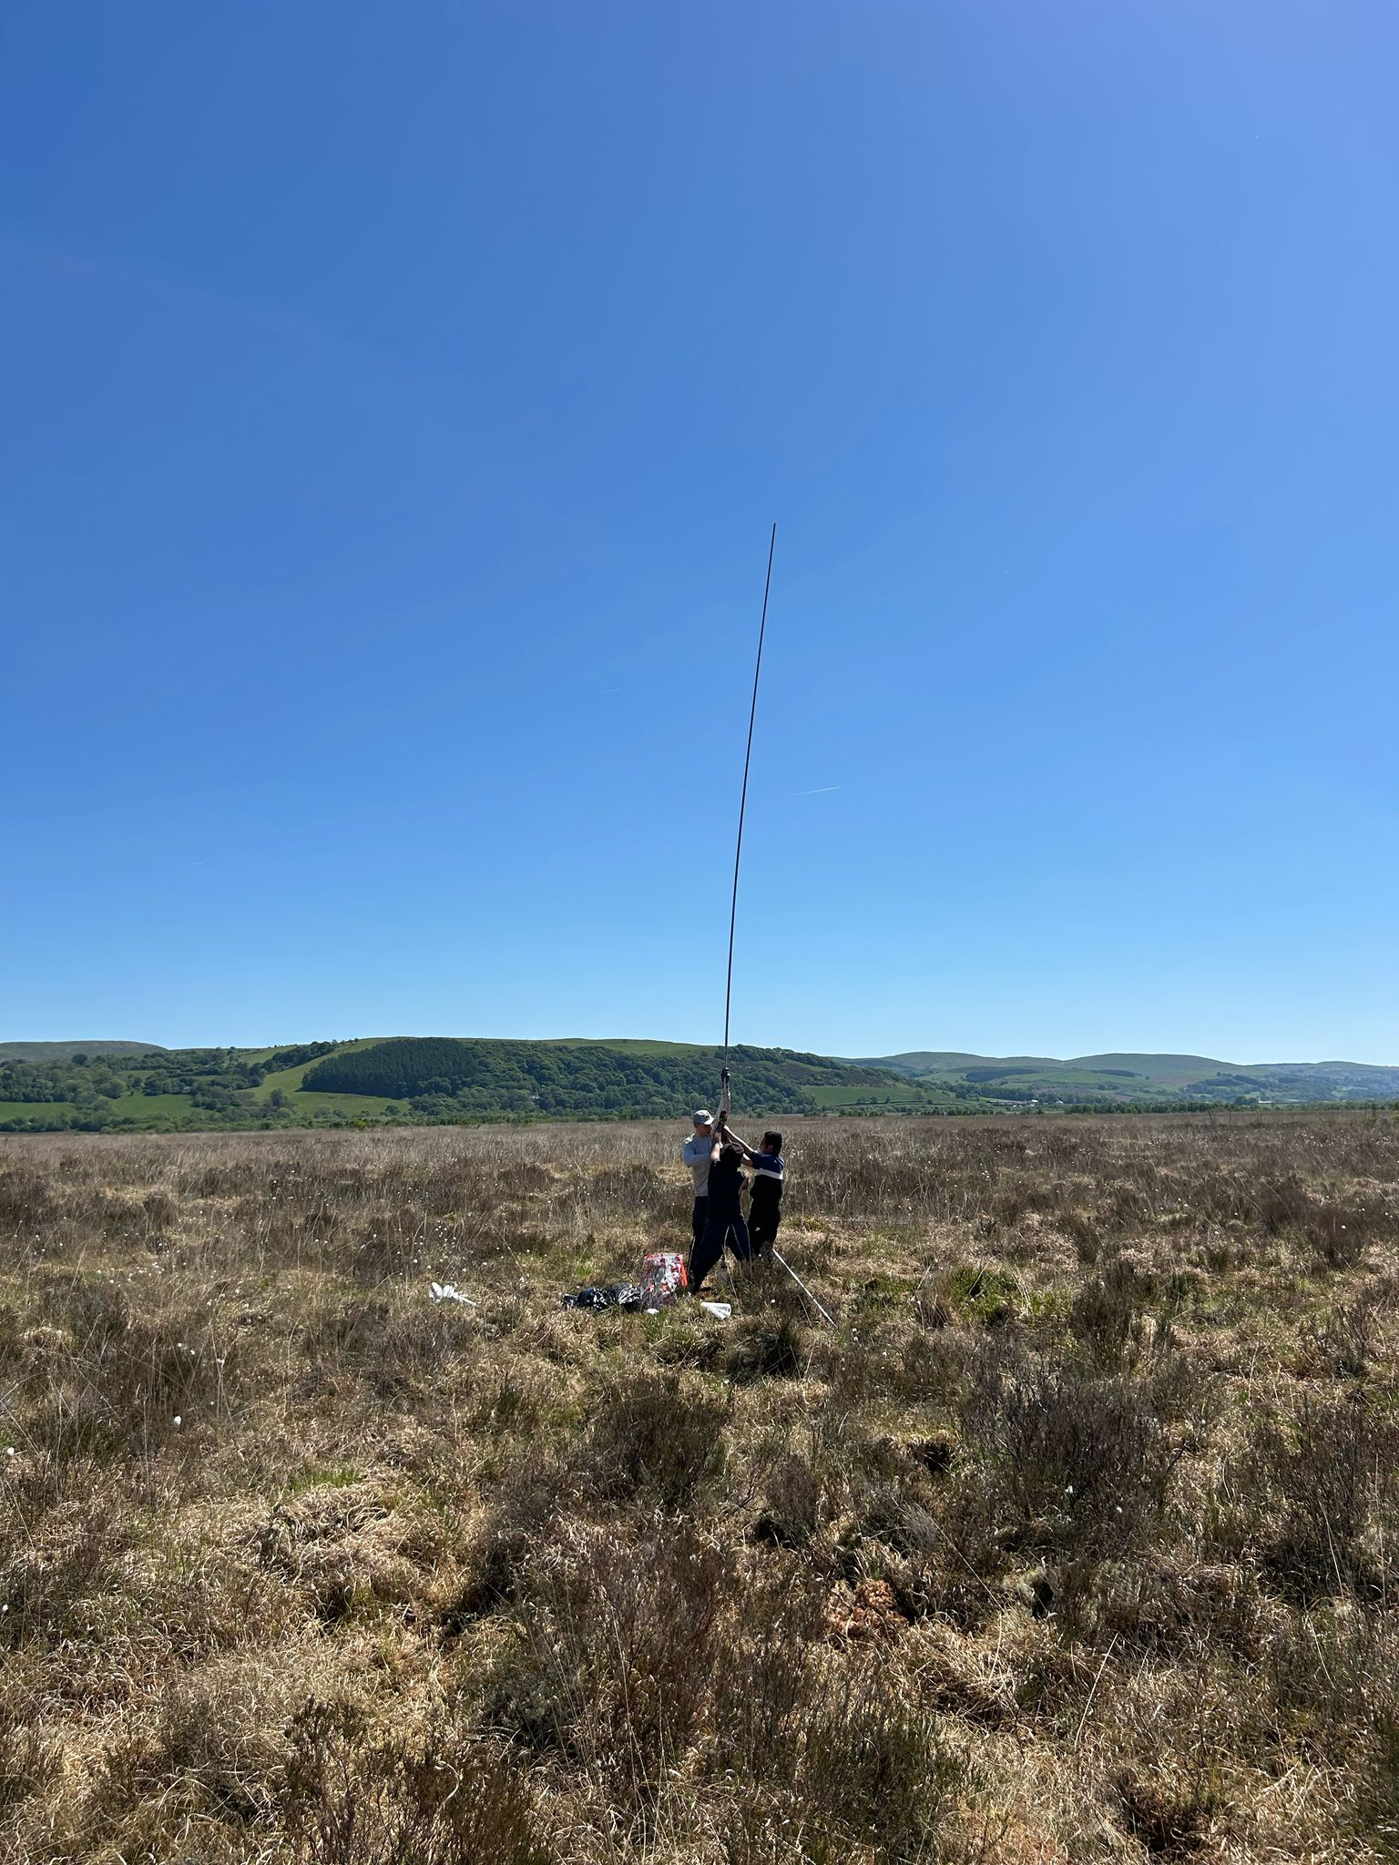

HOPANE STEREOCHEMISTRY PH PROXY
Acid catalysed?

Slide 12
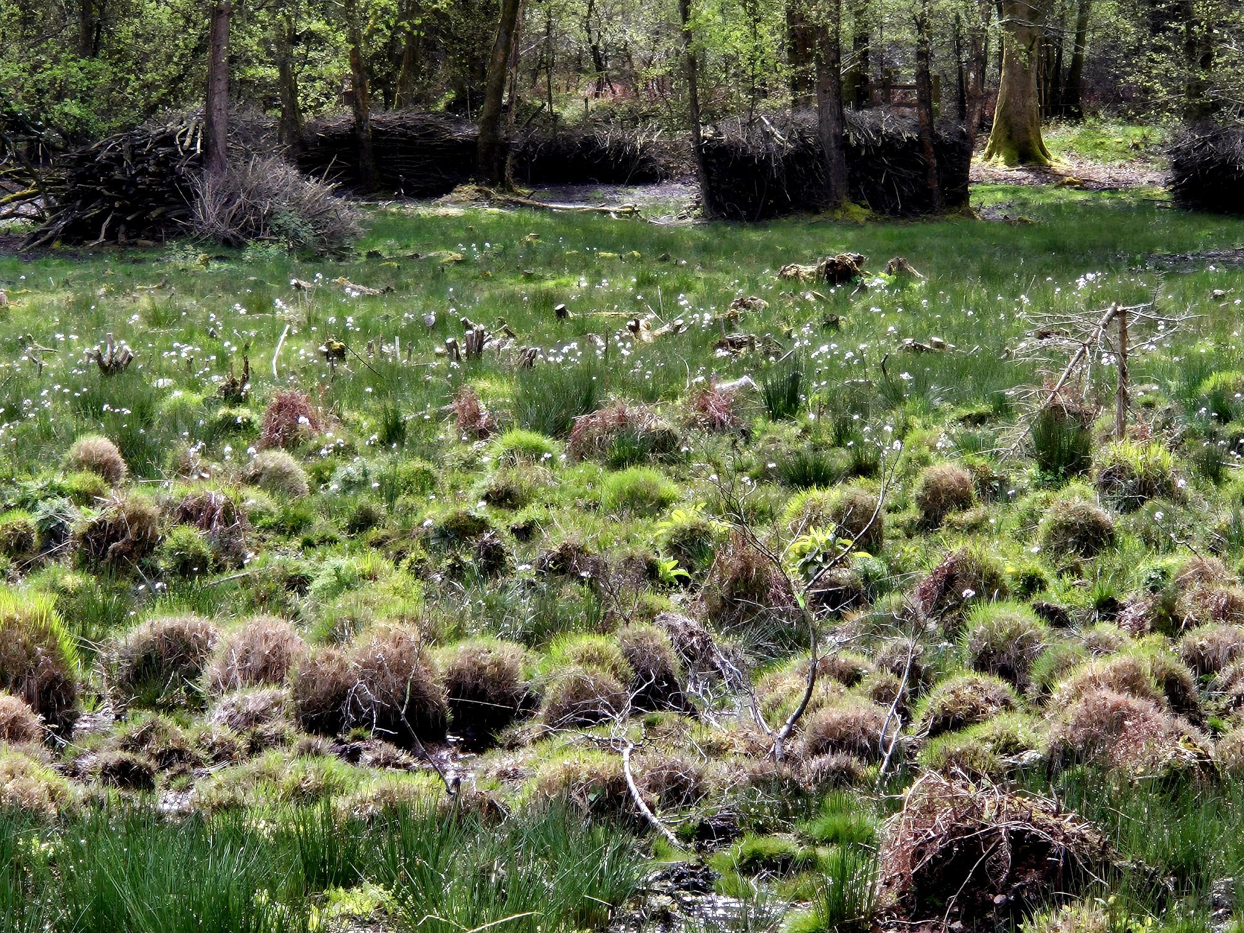
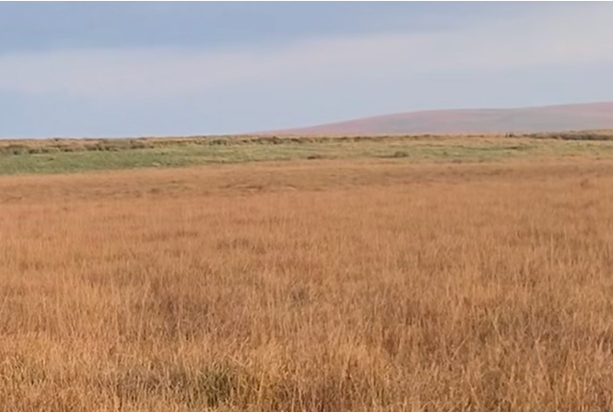
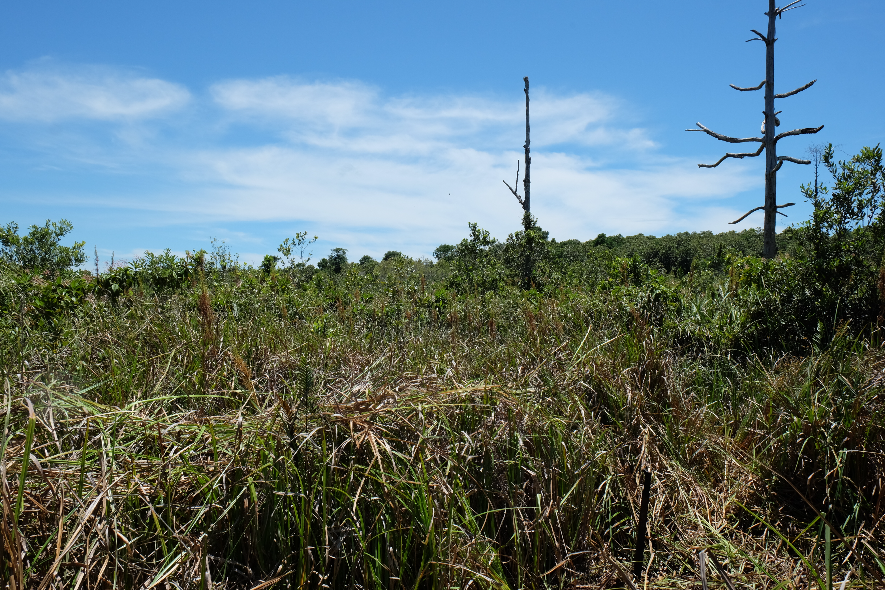
BACTERIAL GDGT CYCLISATION PH PROXY
More rings at higher pH
(although that is not what is expected nor observed in culture, suggesting that this represents a change in the bacterial community rather than an adaptation)

Slide 13
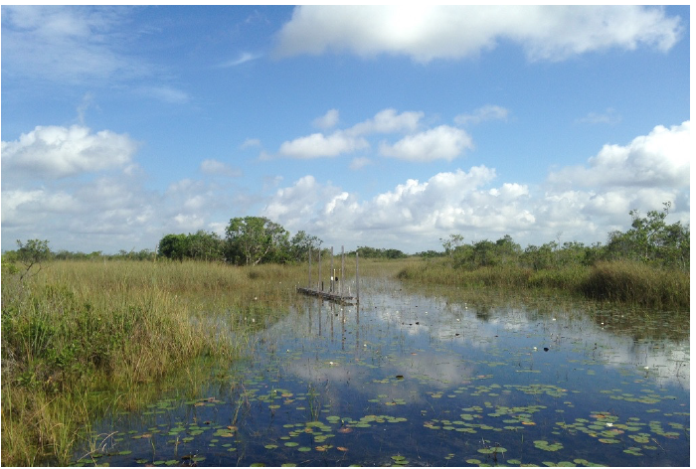

PH ALSO GOVERNS METHANE CYCLING MICROBIAL COMMUNITY
More methanotrophy at higher pH

Slide 14
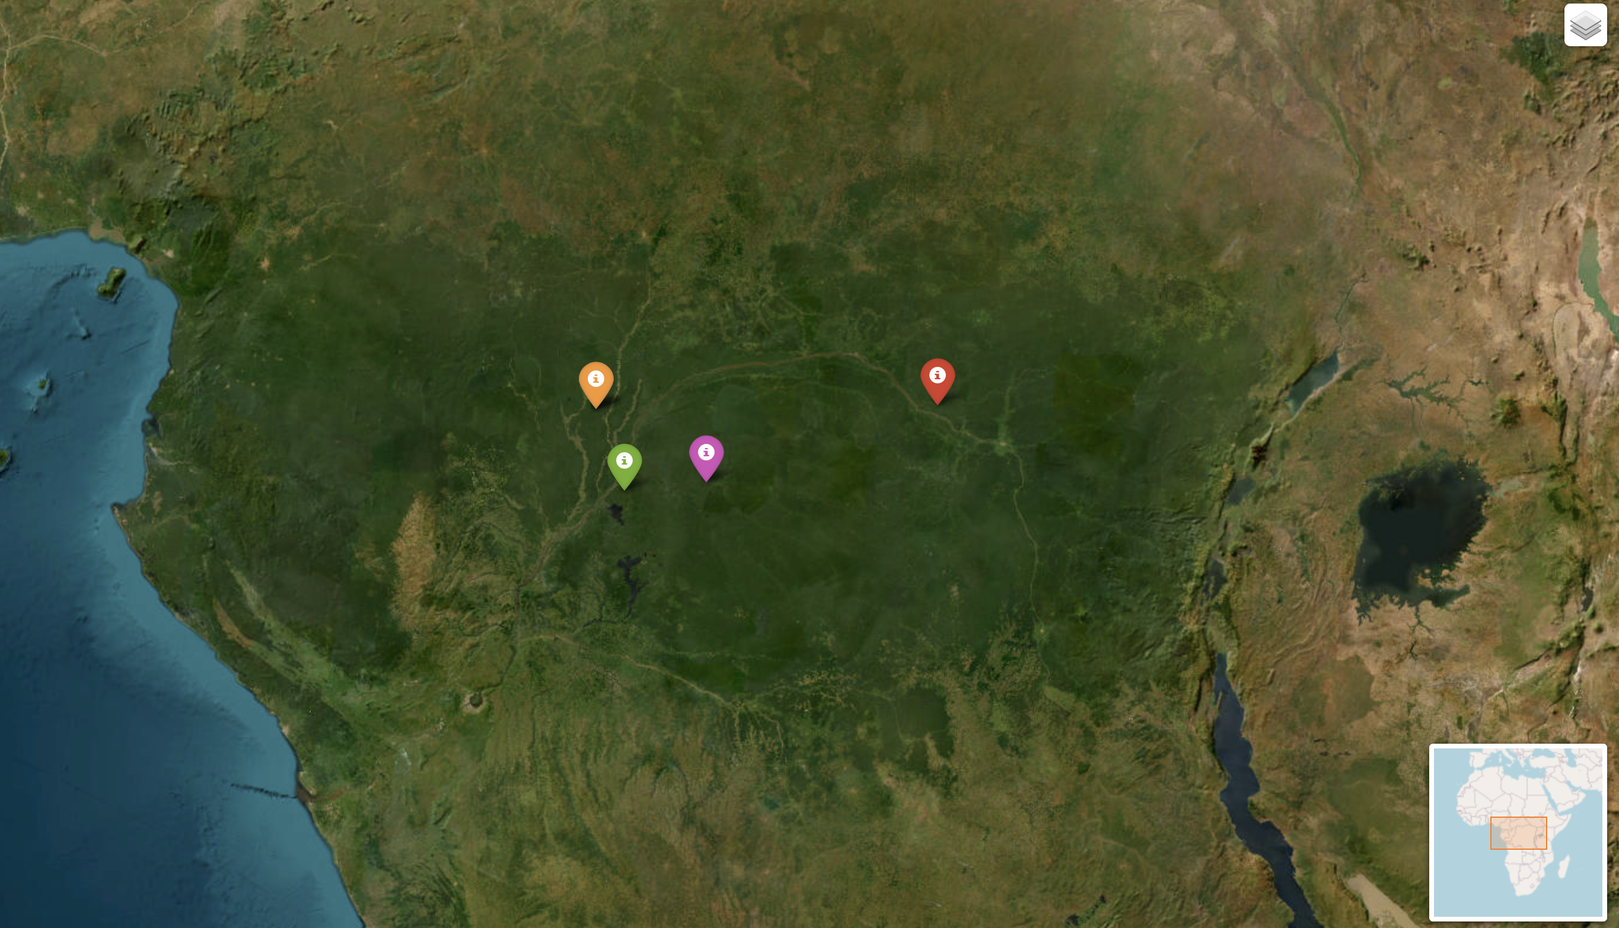

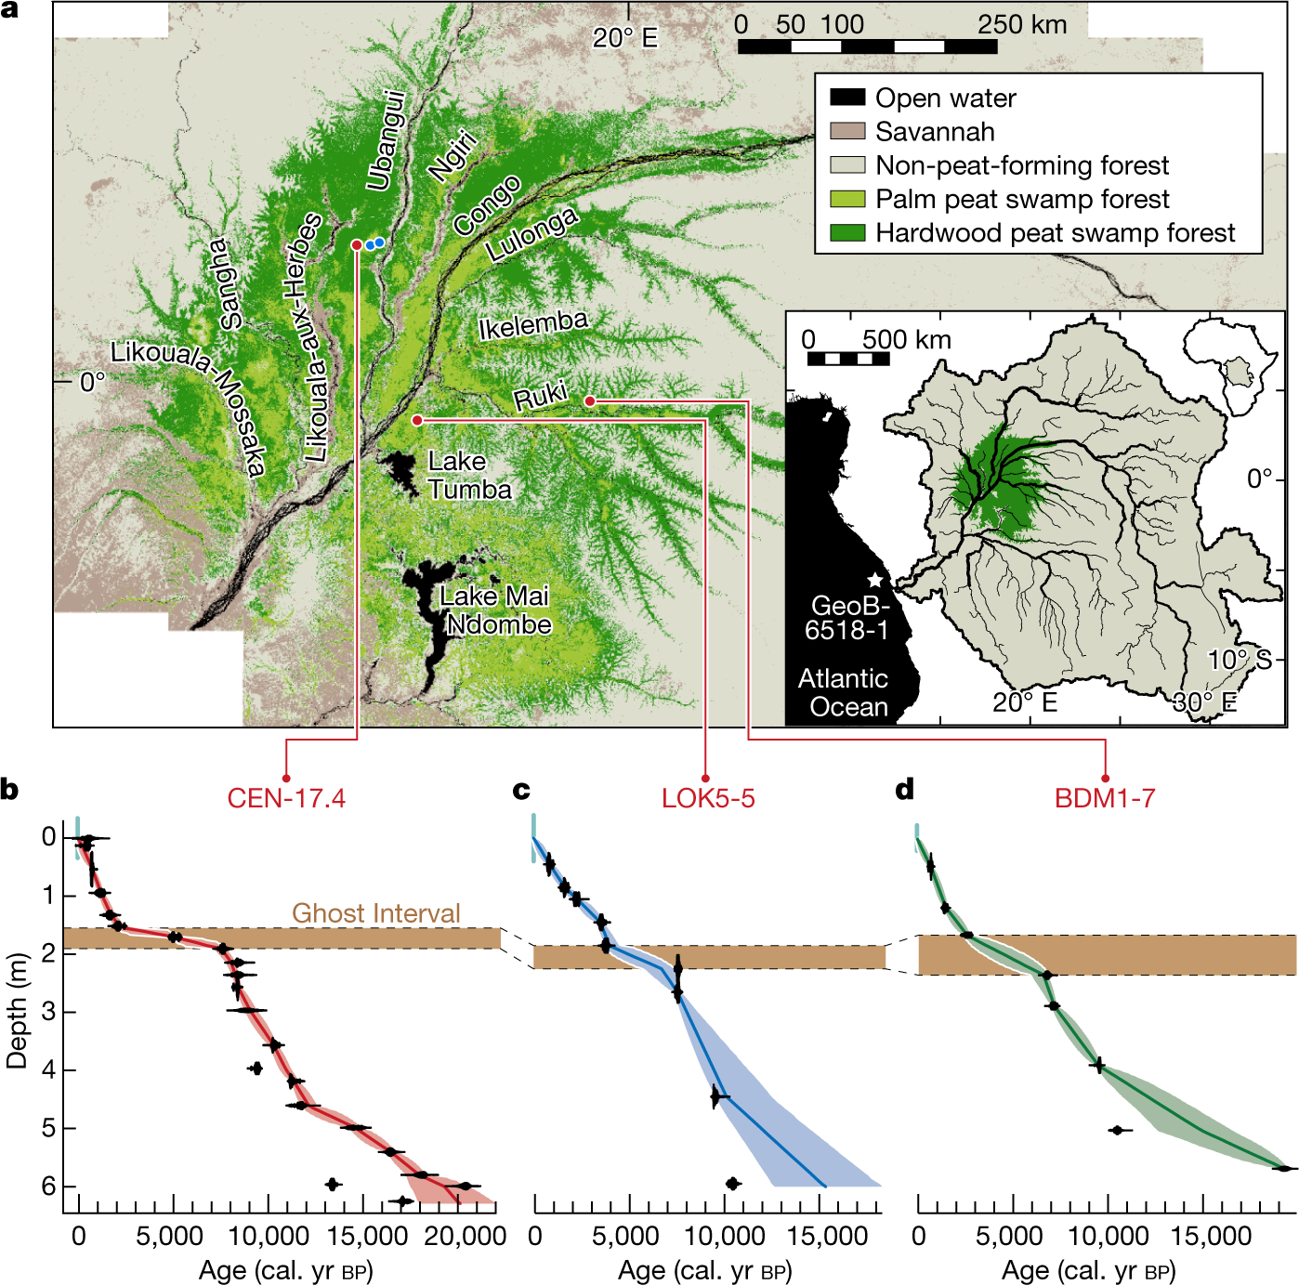
PUTTING THE PROXIES INTO PRACTICE: DRYING-INDUCED ‘GHOST INTERVAL’ OF THE DR CONGO
Bomboma
Garcin, Y., Schefuß, E., Dargie, G.C. et al. (2022) Hydroclimatic vulnerability of peat carbon in the central Congo Basin. Nature 612, 277–282 (2022).

Slide 15

PUTTING THE PROXIES INTO PRACTICE: DRYING-INDUCED ‘GHOST INTERVAL’ OF THE DR CONGO

Slide 16




CONCLUSIONS
Lipid biomarkers are increasingly used to reconstruct past climate in peat archives.
And yet, there is untapped utility, especially in their capacity to reconstruct the peatland ecological and environmental response to climate change.
THANKS
To the Bristol colleagues who did this work and kept the labs running.
And to the global collaborators who indulged in some rather esoteric fundamental science and who I now hope to work with on answering their questions.

