Slide 1
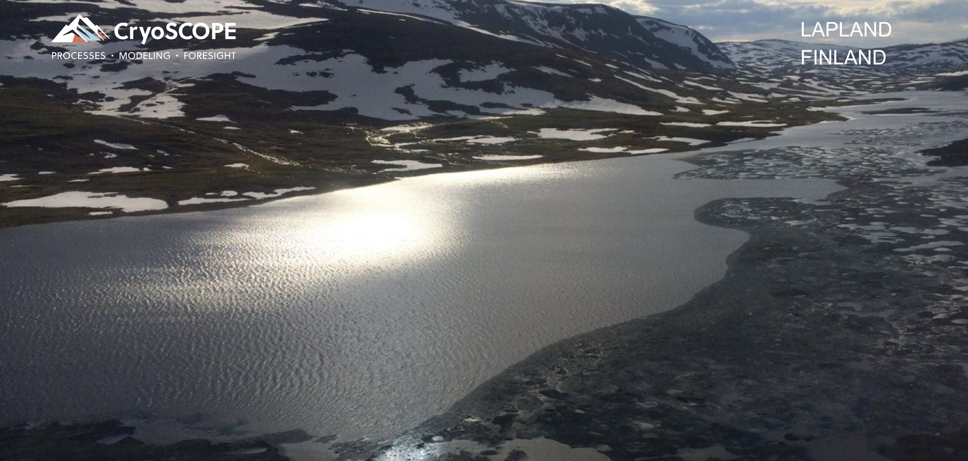
Streamflow prediction - Iceland
Golda Prakasam, Mikko Strahlendorff

Slide 2
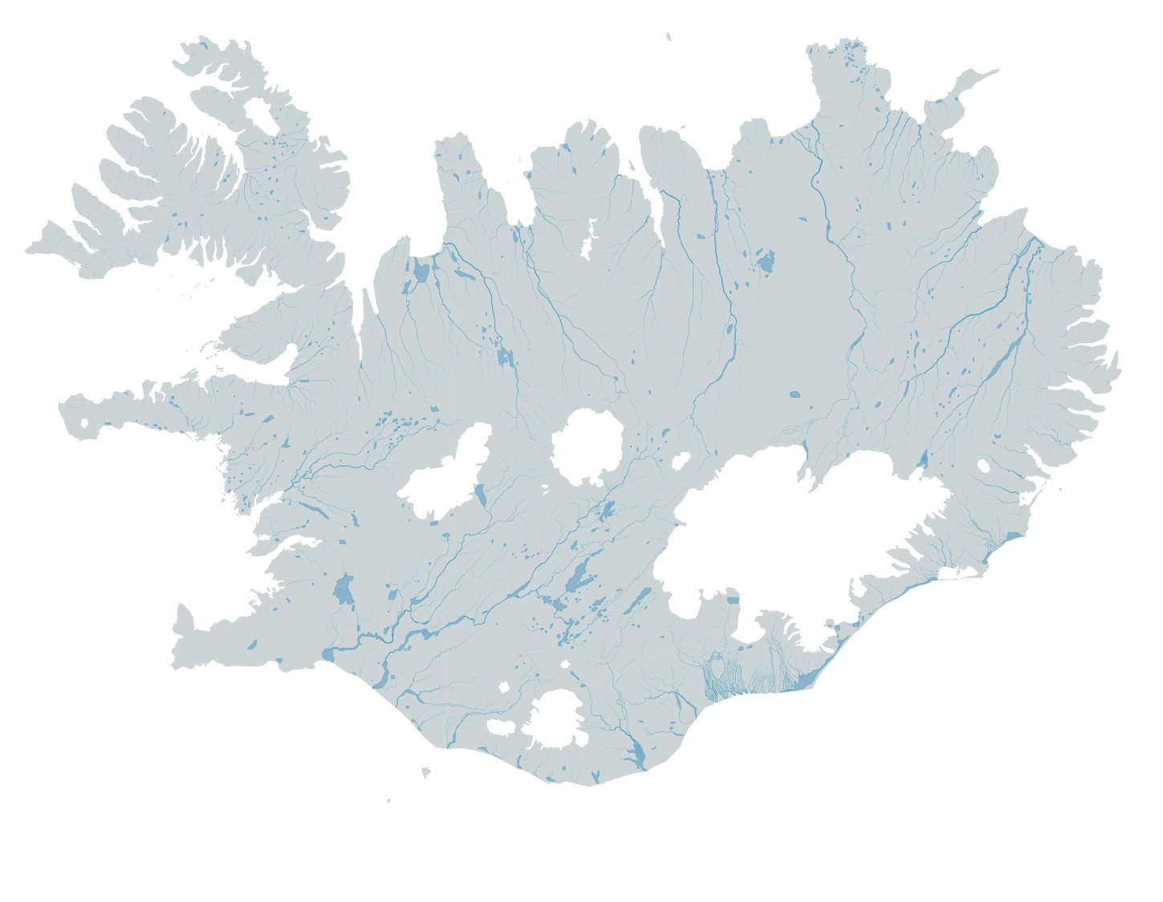
Energy system in Iceland …
…from the perspective of resource forecasting
Hydrological model
Production model
Economic model
100% renewable sources +80% power intensive load No interconnections
Annual variability high + Climate in change
More glacier melt observed since 1995
opportunities for increased production,
but less seasonal snow
more challenges in timing of water availability
Forecasting needs to improve and extend over the winter season
Climate
data
7 MW
14 MW
28 MW
63 MW
37 MW
Inflow
data
150 MW
690 MW
East
South
Generation data
L
H
423 MW
940 MW
175 MW
V
Economic figures
89 MW
2 MW
Hydro
Wind
Geothermal
Transmission
L: Langjökull
H: Hofsjökull
V: Vatnajökull
Installed Power 2650 MW
Source Orkustofnun, National Energy Authority
Notes:
Hydropower is very important

Slide 3
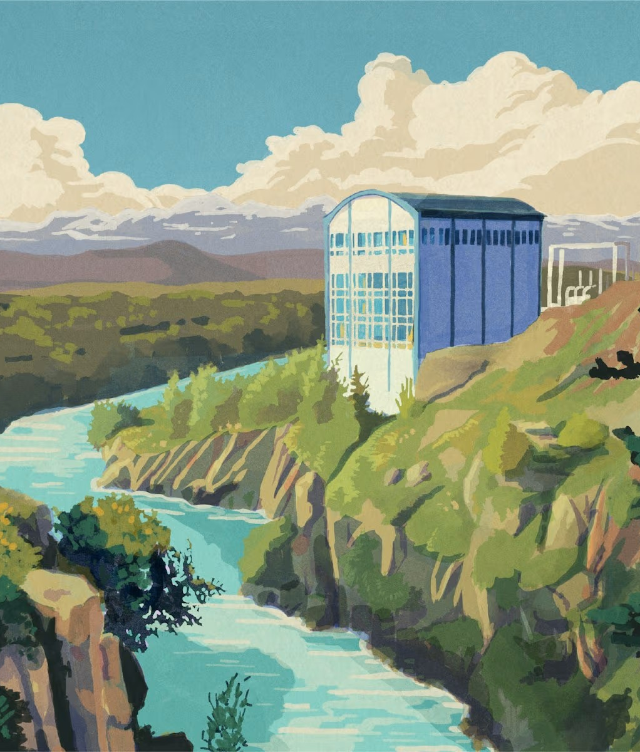

Seasonal forecast flow
Obs timeseries
Machine Learning
(XGBoost)
ML-downscaler
(here inflow location)
Higher resolution ML-forecasts
Daily
ERA5/-land,
EO, EO stats &
model parameters
Bias-adjusted seasonal forecasts
Seasonal forecasts daily data monthly updated
© Mikko Strahlendorff
Picture credit Landsvirkjun

Slide 4
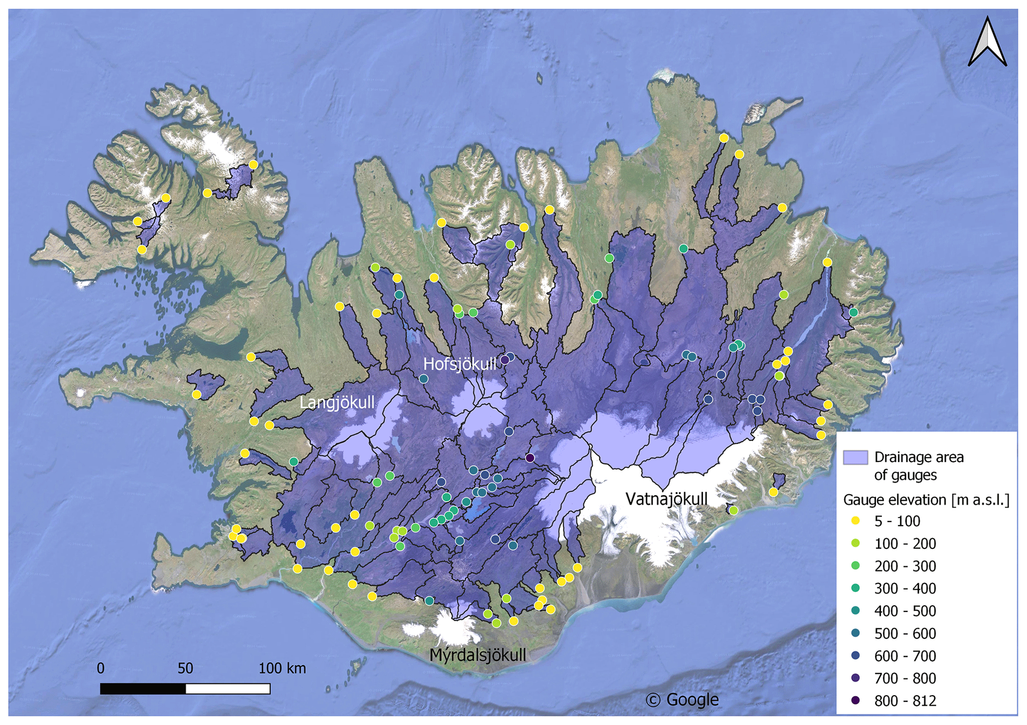
Dataset for Iceland:
ML-training ready!
Obs timeseries
Machine Learning
(XGBoost)
LamaH-Ice: LArge-SaMple DAta for Hydrology and Environmental Sciences for Iceland (Dataset used)
Daily
ERA5/-land,
EO, EO stats &
model parameters
Research paper/data- LamaH-Ice
“Cold-region watersheds, glacierized ones, are poorly represented in large-sample hydrology (LSH) datasets”
- Watershed characteristics
Daily and hourly hydro-meteor. timeseries (incl. ERA5-Land)
target: daily observed streamflow (qobs) from 107 river basins

Slide 5
Copied from Research Paper

Slide 6
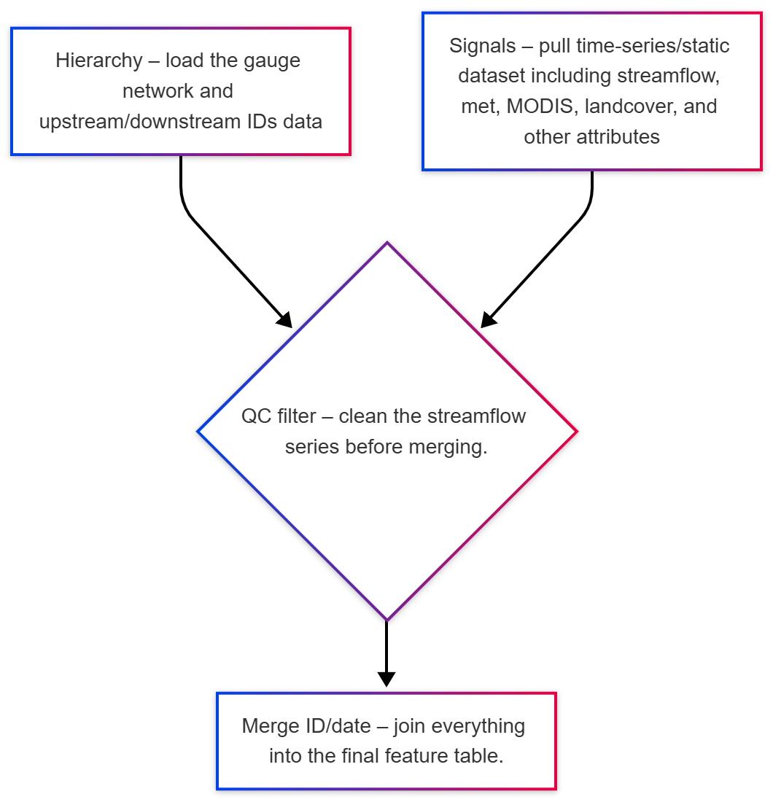
Streamflow Training data generation
Data preprocessing
qobs – target name for streamflow feature engineering produces columns like q_lag1, q_up_lag1 (previous days discharge, upstream) Saved as CSV for time series for each gauge ID

Slide 7
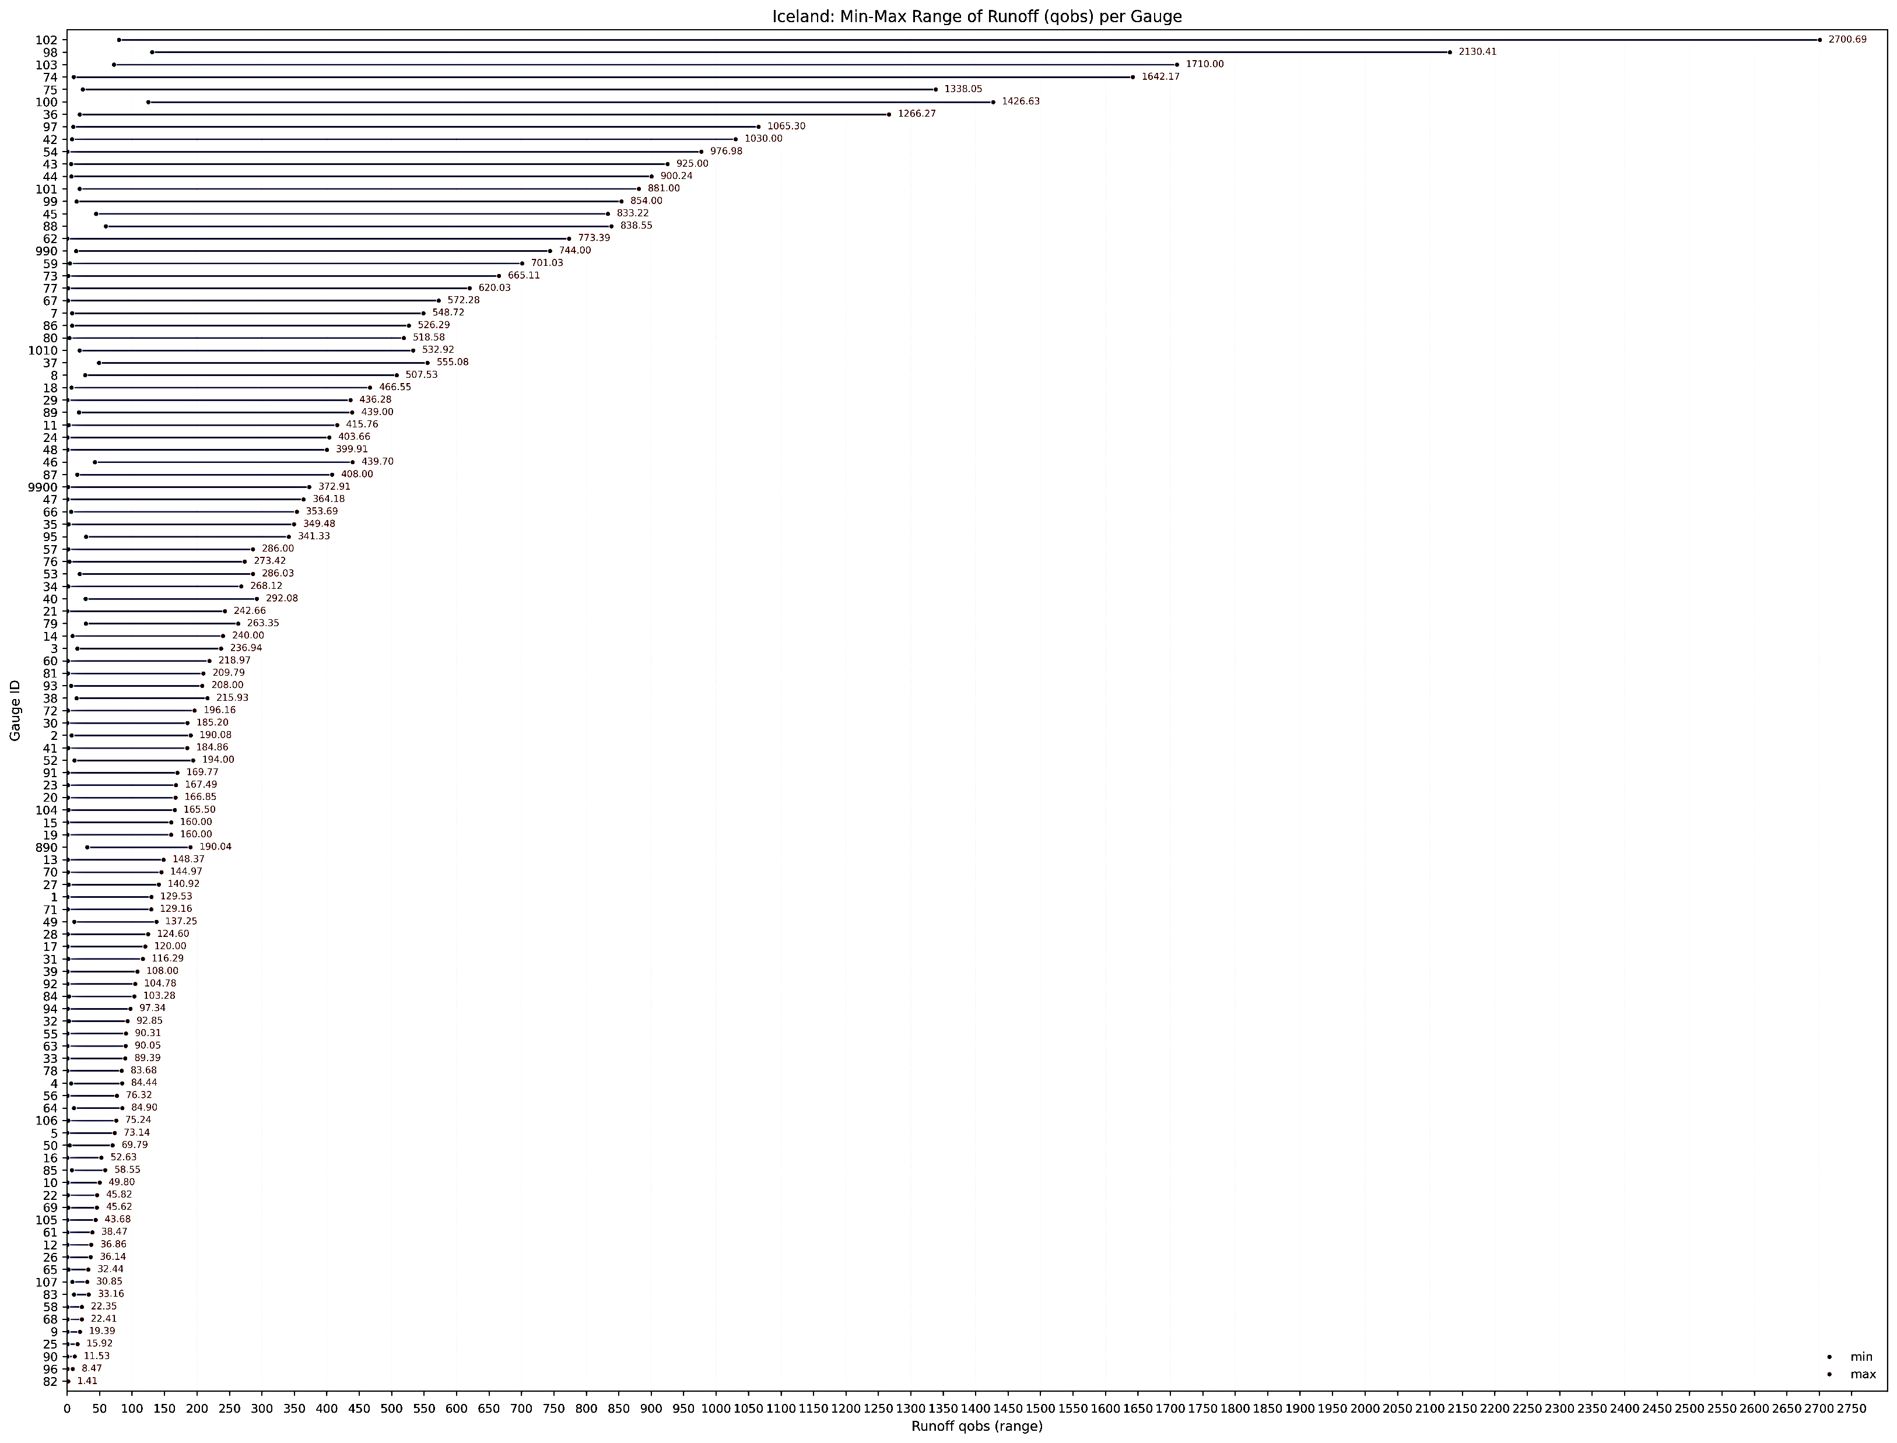
Training
Training data assembly
  Loads all data per ID CSVs
  Splits rows into train/validation periods vs 2014‑2018
    Train data period: 2000‑2013
    Validation period: 2014‑2018
  separates predictors from labels.
  Cleans both train and eval data:
    removes datetime columns
    replaces inf
    enforces numeric labels
    and drops rows without valid features
  Fits xgb.XGBRegressor with Optuna tuned hyperparameters, using the cleaned train set and eval set.
Runoff range (by ID)

Slide 8
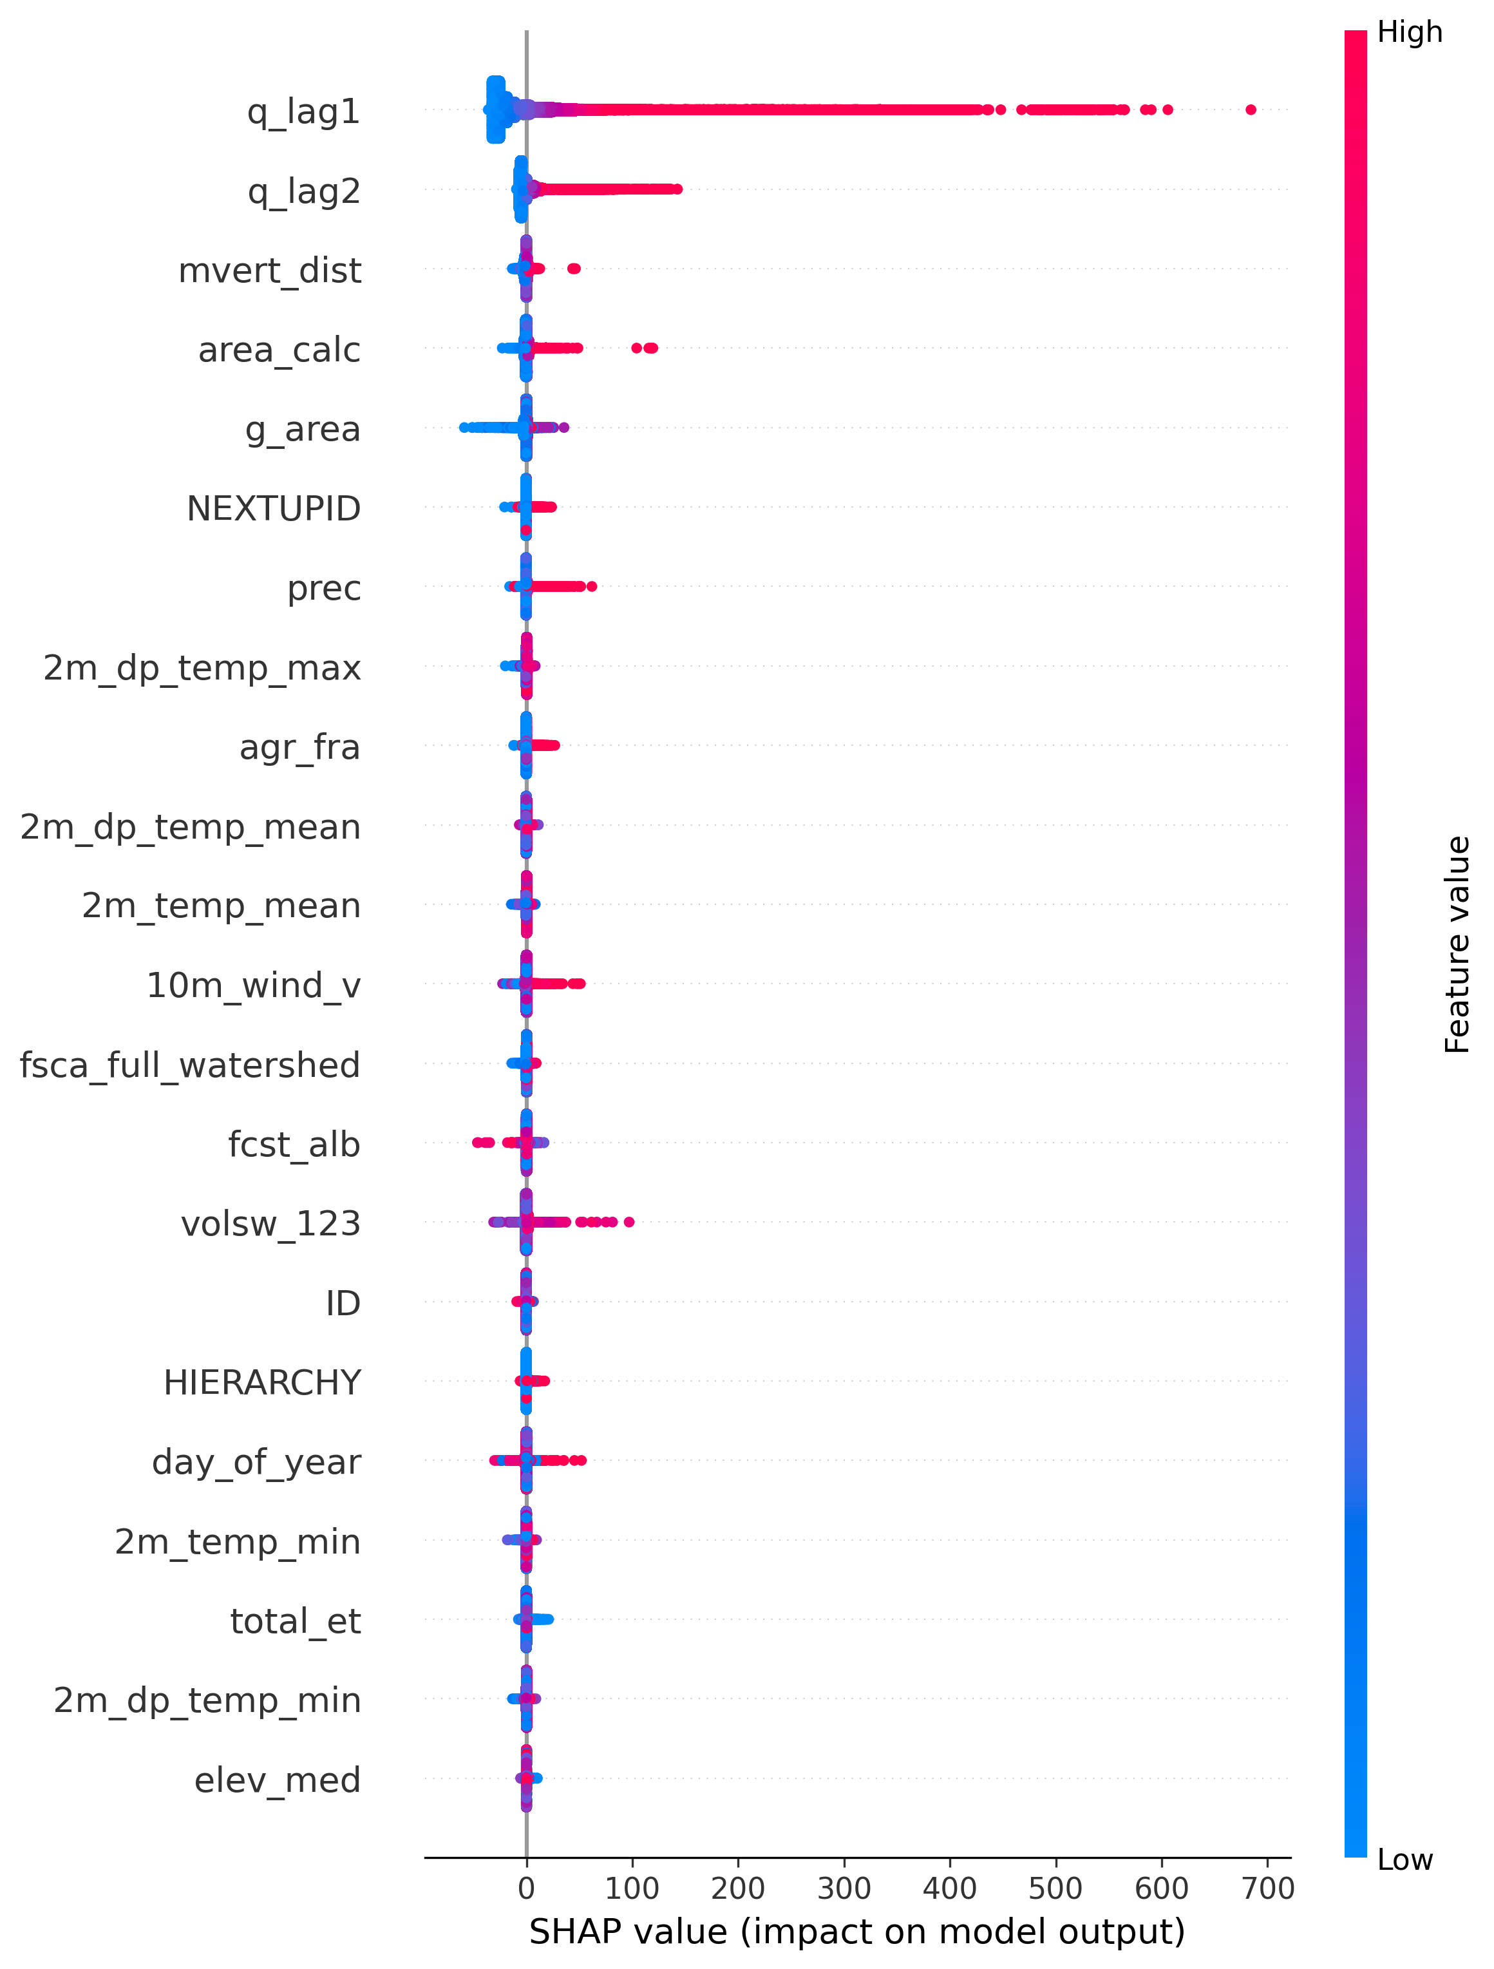
Evaluation/Performance matrices
Testing
Generates predictions for train and test periods.
Plots feature importance (XGBoost) with SHAP >>> diagnostics for deeper explainability & feature selection.
Error matrices :
  RMSE Root mean squared error
  MAE Mean absolut errot
  relative errors
  bias (%)
  R² Pearsons correlation
  NSE Nash-Sutcliffe Efficiency
  KGE Kling-Gupta Efficiency
Calculated performance for aggregate and per-gauge
Overall results are below
rmse | rel_rmse | Mae | rel_mae | mape_pct | bias_pct | R2 | nse | kge
7.313103 | 0.190114 | 1.777477 | 0.046208 | 15090995 | 0.33517 | 0.988485 | 0.988485 | 0.993258

Slide 9
Performance Matrices result
ID | rmse | rel_rmse | mae | rel_mae | mape_pct | bias_pct | r2 | nse | kge
1 | 4.943578 | 0.478842 | 2.383007 | 0.230821 | 24.65996 | 2.455732 | 0.704257 | 0.704257 | 0.820153
2 | 3.062786 | 0.095051 | 1.425469 | 0.044238 | 4.546479 | 0.614403 | 0.953923 | 0.953923 | 0.974753
3 | 3.508553 | 0.081576 | 1.233635 | 0.028683 | 2.555821 | -0.34841 | 0.97688 | 0.97688 | 0.983766
4 | 2.258064 | 0.102675 | 1.237325 | 0.056261 | 5.806046 | 2.834391 | 0.944909 | 0.944909 | 0.956087
5 | 2.099874 | 0.318539 | 0.951717 | 0.14437 | 31.50396 | 8.727093 | 0.830352 | 0.830352 | 0.881128
7 | 4.500814 | 0.107675 | 2.926494 | 0.070012 | 7.08917 | 0.061531 | 0.810558 | 0.810558 | 0.886358
8 | 1.944407 | 0.029005 | 1.033499 | 0.015417 | 1.468228 | -0.07364 | 0.968927 | 0.968927 | 0.982177
9 | 0.50548 | 0.240806 | 0.21843 | 0.104058 | 15.8928 | 4.739337 | 0.957092 | 0.957092 | 0.922544
11 | 7.315949 | 0.236722 | 2.120813 | 0.068623 | 6.530228 | 0.42541 | 0.935302 | 0.935302 | 0.962623
12 | 0.903546 | 0.241267 | 0.313753 | 0.083779 | 9.349457 | 1.25302 | 0.869718 | 0.869718 | 0.889964
13 | 1.672062 | 0.331809 | 0.651737 | 0.129333 | 14.86895 | 2.353922 | 0.738671 | 0.738671 | 0.840688
14 | 2.242231 | 0.104057 | 1.011165 | 0.046926 | 4.528107 | 0.708444 | 0.835954 | 0.835954 | 0.868769
15 | 3.273231 | 0.308349 | 1.02733 | 0.096778 | 17.55627 | -0.10224 | 0.93894 | 0.93894 | 0.961272
17 | 1.283286 | 0.225566 | 0.461308 | 0.081085 | 7.957392 | -0.8566 | 0.928436 | 0.928436 | 0.953539
18 | 5.627633 | 0.116401 | 1.723614 | 0.035651 | 2.900838 | -0.76119 | 0.985912 | 0.985912 | 0.965114
20 | 1.767282 | 0.162622 | 0.697852 | 0.064215 | 6.189387 | 0.251808 | 0.948439 | 0.948439 | 0.968809
21 | 5.342066 | 0.442214 | 1.526758 | 0.126384 | 14.00264 | -0.47153 | 0.907664 | 0.907664 | 0.926751
23 | 3.354205 | 0.249577 | 1.265759 | 0.094181 | 7.851876 | -0.51951 | 0.925854 | 0.925854 | 0.951828
24 | 8.409282 | 0.393922 | 2.335899 | 0.109422 | 10.87729 | 0.363438 | 0.896262 | 0.896262 | 0.936163
26 | 0.627073 | 0.107905 | 0.286206 | 0.04925 | 4.808454 | -0.21798 | 0.801869 | 0.801869 | 0.825983
27 | 2.684464 | 0.208218 | 0.860464 | 0.066741 | 5.318481 | -1.38875 | 0.927089 | 0.927089 | 0.939071
28 | 2.804662 | 0.195144 | 1.073315 | 0.07468 | 7.586524 | 1.243648 | 0.932099 | 0.932099 | 0.963991
30 | 1.897947 | 0.245409 | 0.645189 | 0.083424 | 7.992184 | -0.57501 | 0.915266 | 0.915266 | 0.941155
31 | 1.741684 | 0.128777 | 0.746873 | 0.055222 | 5.371693 | 0.950407 | 0.971117 | 0.971117 | 0.979921
32 | 1.350711 | 0.133751 | 0.539146 | 0.053388 | 4.899309 | 0.756548 | 0.952043 | 0.952043 | 0.974226
33 | 2.085744 | 0.276834 | 0.780983 | 0.103658 | 14.5553 | 3.73313 | 0.947993 | 0.947993 | 0.954769
34 | 6.519778 | 0.2871 | 1.947449 | 0.085756 | 9.060705 | -1.17124 | 0.941379 | 0.941379 | 0.929476
36 | 6.268414 | 0.070897 | 2.82503 | 0.031952 | 3.176296 | 0.785483 | 0.961643 | 0.961643 | 0.97782
37 | 4.415686 | 0.05326 | 1.794577 | 0.021645 | 1.982931 | 0.437238 | 0.912428 | 0.912428 | 0.955374
38 | 3.16125 | 0.084704 | 1.394274 | 0.037359 | 3.491022 | 0.499119 | 0.954783 | 0.954783 | 0.965375
39 | 0.966205 | 0.332461 | 0.278841 | 0.095946 | 11.18834 | 3.988056 | 0.870458 | 0.870458 | 0.896151
BY ID

Slide 10
Performance Matrices result
ID | rmse | rel_rmse | mae | rel_mae | mape_pct | bias_pct | r2 | nse | kge
40 | 5.961365 | 0.087997 | 2.53447 | 0.037412 | 3.31187 | -0.83894 | 0.957582 | 0.957582 | 0.960046
41 | 3.93156 | 0.108599 | 1.658141 | 0.045802 | 4.941119 | 0.045942 | 0.983144 | 0.983144 | 0.982751
45 | 11.3262 | 0.056256 | 5.695241 | 0.028288 | 2.710486 | 0.406536 | 0.986194 | 0.986194 | 0.989591
46 | 4.177363 | 0.043456 | 1.957633 | 0.020365 | 1.78251 | 0.598063 | 0.989873 | 0.989873 | 0.985245
48 | 6.871385 | 0.244229 | 1.95808 | 0.069596 | 8.227804 | 0.846624 | 0.955782 | 0.955782 | 0.974416
50 | 2.152085 | 0.178481 | 1.291579 | 0.107116 | 11.96159 | 8.219821 | 0.928038 | 0.928038 | 0.91304
56 | 1.863375 | 0.373497 | 0.648461 | 0.129978 | 21.04985 | 1.67747 | 0.913348 | 0.913348 | 0.9479
58 | 0.608519 | 0.319436 | 0.185789 | 0.097528 | 8.762607 | 1.096112 | 0.877901 | 0.877901 | 0.902783
59 | 5.774551 | 0.076823 | 3.140741 | 0.041783 | 5.05788 | 1.291203 | 0.981491 | 0.981491 | 0.983304
60 | 7.022208 | 0.138423 | 3.4764 | 0.068527 | 17.36274 | 1.957418 | 0.966858 | 0.966858 | 0.970187
61 | 0.848745 | 0.277102 | 0.356549 | 0.116408 | 13.2202 | 1.914835 | 0.904152 | 0.904152 | 0.933341
63 | 3.543828 | 0.554373 | 1.157873 | 0.18113 | 14.48634 | 5.05447 | 0.83191 | 0.83191 | 0.899065
64 | 1.312302 | 0.031352 | 0.624465 | 0.014919 | 1.51083 | -0.37002 | 0.85051 | 0.85051 | 0.921092
66 | 5.397588 | 0.104813 | 2.252619 | 0.043742 | 4.509475 | 0.071029 | 0.968992 | 0.968992 | 0.97362
67 | 8.536363 | 0.359119 | 2.383438 | 0.10027 | 10.04659 | -0.84694 | 0.891307 | 0.891307 | 0.904507
68 | 0.173512 | 0.148512 | 0.093379 | 0.079925 | 7.788738 | -0.06901 | 0.733857 | 0.733857 | 0.83417
70 | 2.082104 | 0.131388 | 0.838835 | 0.052933 | 5.23414 | 0.633831 | 0.959433 | 0.959433 | 0.978621
71 | 2.42103 | 0.273106 | 1.168178 | 0.131777 | 28.84817 | 10.94771 | 0.862186 | 0.862186 | 0.874342
72 | 3.463376 | 0.144059 | 1.26211 | 0.052497 | 5.304924 | 1.001949 | 0.971065 | 0.971065 | 0.980946
73 | 0.861587 | 0.101085 | 0.395977 | 0.046458 | 4.391123 | 0.249054 | 0.944639 | 0.944639 | 0.934393
74 | 55.43553 | 0.630339 | 11.83067 | 0.134523 | 10.36339 | -2.01238 | 0.713603 | 0.713603 | 0.65208
75 | 15.51746 | 0.13151 | 8.928761 | 0.075671 | 7.19691 | 0.781503 | 0.936766 | 0.936766 | 0.963
76 | 11.63904 | 0.186754 | 6.325167 | 0.10149 | 9.291904 | -0.09955 | 0.841889 | 0.841889 | 0.898288
77 | 5.779531 | 0.10559 | 1.910956 | 0.034913 | 3.358736 | 0.050215 | 0.978323 | 0.978323 | 0.980886
78 | 1.282602 | 0.779835 | 0.500559 | 0.304345 | 2.42E+09 | 2.567545 | 0.411586 | 0.411586 | 0.710073
79 | 7.95942 | 0.069842 | 4.833354 | 0.042411 | 4.015332 | -0.67771 | 0.813302 | 0.813302 | 0.875865
80 | 2.364362 | 0.131744 | 0.978517 | 0.054524 | 5.301343 | 0.103443 | 0.970611 | 0.970611 | 0.980613
81 | 5.803852 | 0.115082 | 3.272478 | 0.064888 | 8.046111 | 0.714919 | 0.969415 | 0.969415 | 0.954859
82 | 0.324117 | 0.745934 | 0.130687 | 0.300768 | 34.72168 | 14.25694 | -2.5802 | -2.5802 | -0.18544
83 | 1.126984 | 0.042632 | 0.632817 | 0.023938 | 2.373137 | -0.56598 | 0.777315 | 0.777315 | 0.833903
84 | 1.432196 | 0.130697 | 0.581652 | 0.05308 | 4.641618 | 0.885708 | 0.940336 | 0.940336 | 0.955146
85 | 0.625606 | 0.061662 | 0.331894 | 0.032713 | 3.137721 | -2.0297 | 0.49038 | 0.49038 | 0.775729
86 | 9.049135 | 0.098646 | 3.699146 | 0.040325 | 3.919163 | 0.245068 | 0.958836 | 0.958836 | 0.976849
90 | 0.214698 | 0.44549 | 0.175283 | 0.363706 | 56.01575 | 12.15859 | 0.490332 | 0.490332 | 0.68319
BY ID

Slide 11
Performance Matrices result
ID | rmse | rel_rmse | mae | rel_mae | mape_pct | bias_pct | R2 | nse | KGE
91 | 1.349619 | 0.123316 | 0.576204 | 0.052648 | 5.263917 | 1.068957 | 0.955 | 0.955 | 0.974882
92 | 1.919036 | 0.229092 | 0.590654 | 0.070512 | 6.602796 | -0.54516 | 0.935592 | 0.935592 | 0.952951
93 | 2.181192 | 0.087321 | 0.879629 | 0.035215 | 3.344417 | -0.00787 | 0.975564 | 0.975564 | 0.987262
94 | 1.479993 | 0.164148 | 0.625302 | 0.069353 | 6.931131 | 1.925361 | 0.958823 | 0.958823 | 0.971491
95 | 2.108132 | 0.050444 | 0.671482 | 0.016067 | 1.45163 | 0.338001 | 0.859052 | 0.859052 | 0.924774
96 | 0.320651 | 0.248928 | 0.145772 | 0.113166 | 15.39209 | 0.608692 | 0.715628 | 0.715628 | 0.855128
97 | 34.06879 | 0.411739 | 9.397872 | 0.113578 | 8.923307 | -0.50952 | 0.686791 | 0.686791 | 0.746434
98 | 23.22644 | 0.06082 | 11.33785 | 0.029689 | 2.689032 | 0.500823 | 0.931102 | 0.931102 | 0.962635
102 | 35.32662 | 0.09848 | 22.6128 | 0.063038 | 6.065948 | 0.047269 | 0.800078 | 0.800078 | 0.877679
104 | 2.481444 | 0.106408 | 0.912055 | 0.03911 | 3.886188 | 0.779973 | 0.98709 | 0.98709 | 0.98896
105 | 0.578139 | 0.217302 | 0.273196 | 0.102685 | 38.73749 | 1.627135 | 0.966018 | 0.966018 | 0.976205
106 | 4.210897 | 0.298486 | 1.943936 | 0.137794 | 12.7347 | 1.743197 | 0.825557 | 0.825557 | 0.908061
890 | 3.7855 | 0.094942 | 1.442883 | 0.036188 | 3.137029 | 0.498394 | 0.405404 | 0.405404 | 0.677877
1010 | 16.58554 | 0.178838 | 9.630648 | 0.103845 | 9.819437 | 0.984454 | 0.930554 | 0.930554 | 0.958999
9900 | 17.19977 | 0.172657 | 12.0206 | 0.120667 | 14.47854 | 1.545527 | 0.881704 | 0.881704 | 0.937634
BY ID

Slide 12
Streamflow delta training for simpler production
Data preprocessing
Autoregression method “qobs_delta” – target name for streamflow feature engineering produces columns like qobs_delta_lag1, qobs_delt_lag2 (previous days discharge change) Saved as CSV for time series for each gauge ID

Slide 13
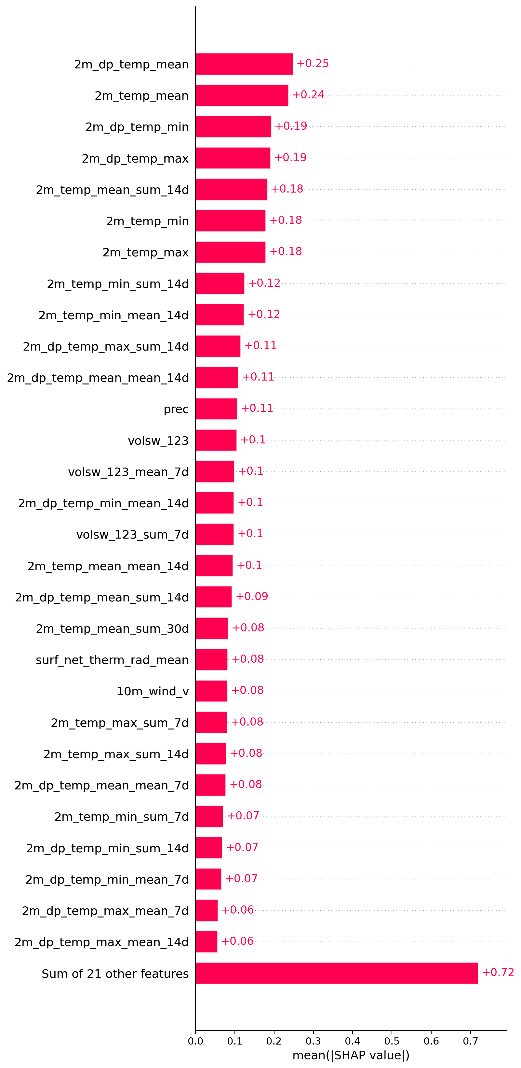
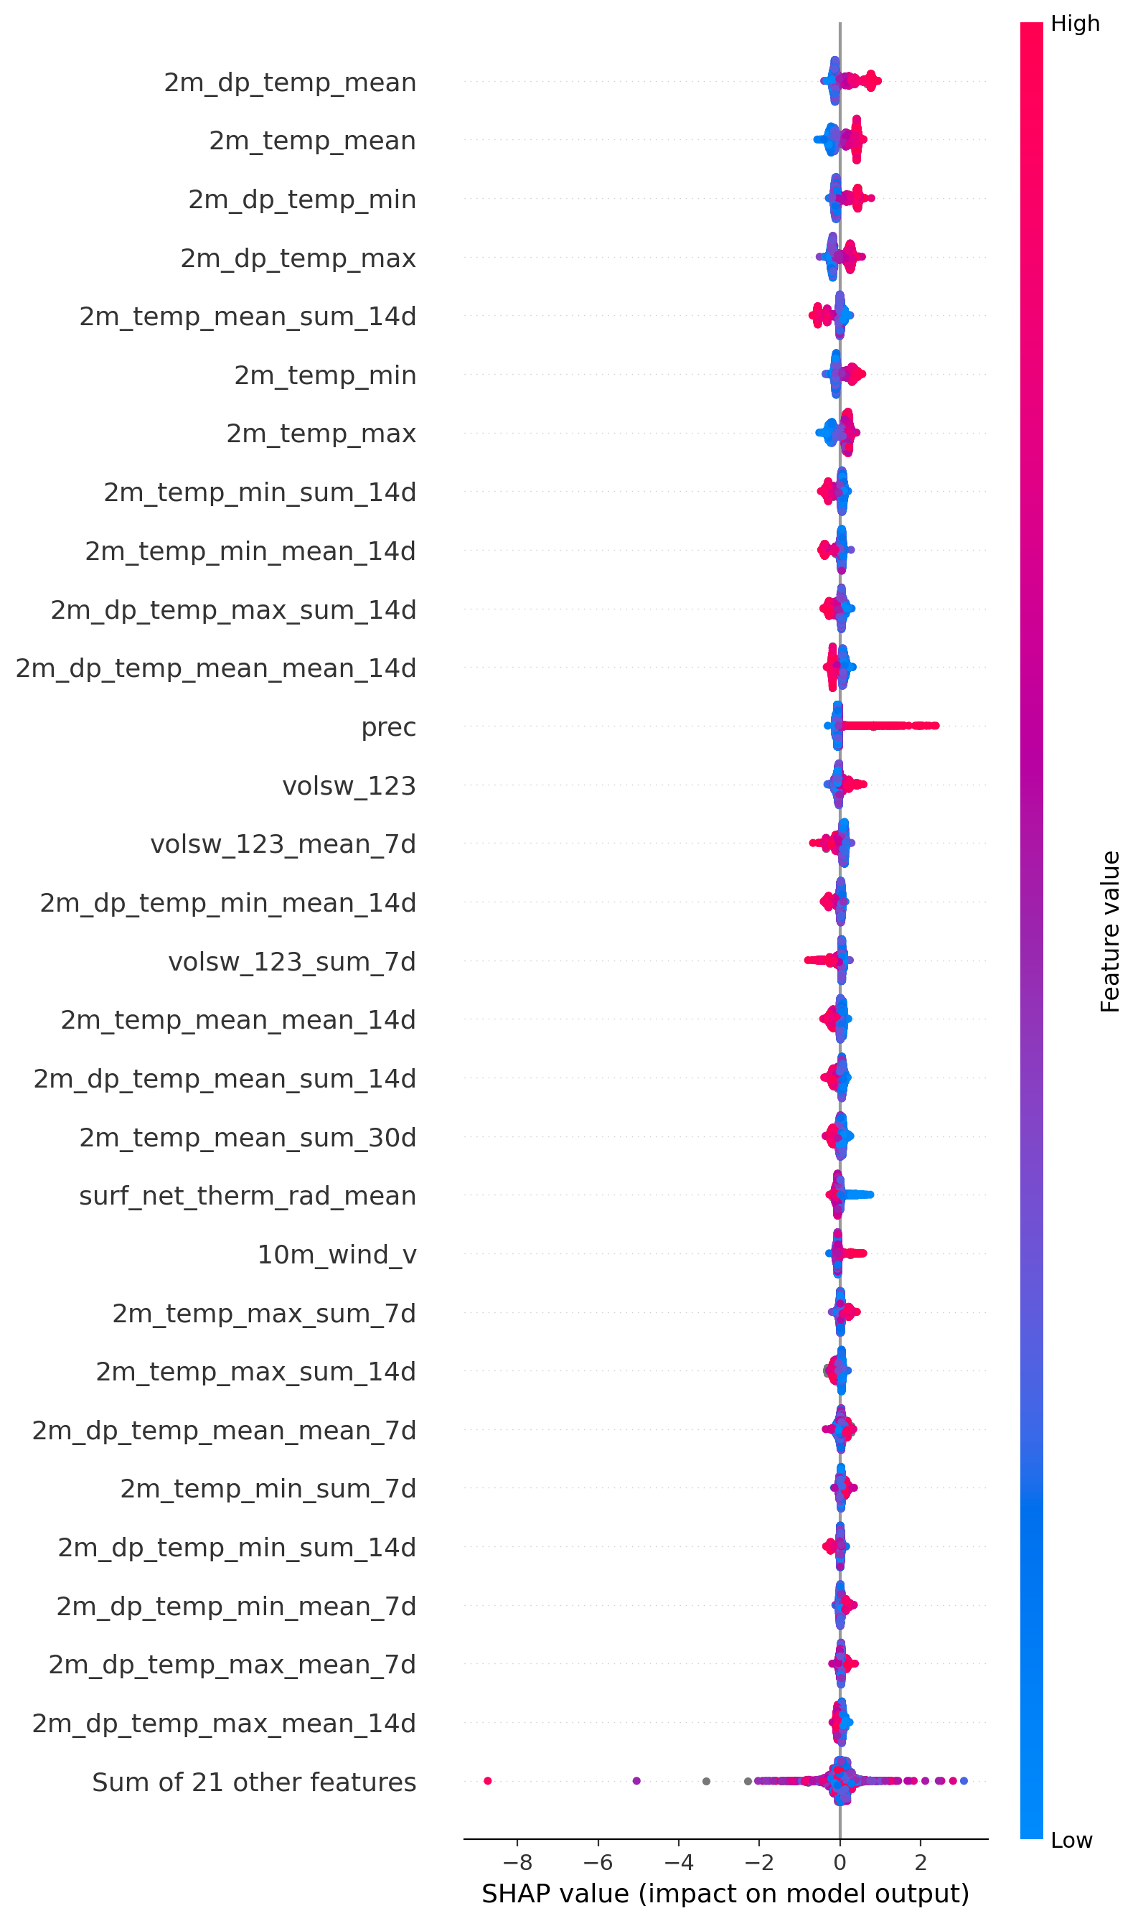
Feature importance q_delta
Plots feature importance (XGBoost) with SHAP >>> diagnostics for deeper explainability & feature selection.
Compared to model with lags, much more varied feature importance and SHAP
Feature engineering by reducing features used is likely to decrease quality

Slide 14
Evaluation/Performance matrices 215-day forecast
Error matrices :
  RMSE Root mean squared error
  MAE Mean absolute error
  NSE Nash-Sutcliffe Efficiency
  KGE Kling-Gupta Efficiency
Calculated performance for aggregate and per-gauge
Overall results are below
Lags improve forecasts significantly
 | Target | Description | RMSE | MAE | NSE | KGE
Training | qobs_delta | In-sample fit rows: predicted delta vs observed delta. | 10.08737169 | 2.226514607 | 0.094178
Training validation | qobs_delta | Validation subset used for early-stopping selection. | 8.366692949 | 1.723871334 | 0.057934
Evaluation- Autoregression (qobs_delta) | qobs_delta | Recursive rollout (first 215 days): predicted delta vs observed delta. | 6.09632865 | 1.749251953 | 0.034046
Evaluation Autoregression qobs (streamflow) | qobs | Recursive rollout (first 215 days): reconstructed discharge (q_hat) vs observed qobs. | 54.10155872 | 32.99315653 | 0.516773 | 0.342582

Slide 15
Performance Matrices of 215-day forecasts– per ID
ID | qobs_delta RMSE | qobs_delta MAE | qobs_delta NSE | qobs KGE | qobs RMSE | qobs MAE | qobs NSE | qobs RMSE
71 | 0.724156531 | 0.440048003 | -0.552982113 | 0.573091824 | 4.091928998 | 3.586236191 | 0.637904079 | 4.091928998
106 | 3.736499272 | 1.774810504 | 0.134677602 | 0.759312006 | 4.963836886 | 3.504907169 | 0.609245578 | 4.963836886
1010 | 16.78846325 | 8.820559937 | -8.2914E-05 | 0.226622846 | 59.54757113 | 45.60291971 | 0.321795663 | 59.54757113
76 | 11.87255608 | 7.010061019 | 0.087334933 | 0.424573253 | 22.80797021 | 15.46078662 | 0.308566941 | 22.80797021
79 | 5.549452005 | 2.795702103 | 0.056455459 | 0.604865115 | 9.367610149 | 6.785892293 | 0.073636262 | 9.367610149
102 | 30.68948724 | 20.52406504 | 0.017003121 | 0.185167846 | 78.46941935 | 55.51249828 | -0.022974736 | 78.46941935
1 | 3.686793264 | 1.787374053 | 0.097908075 | 0.349808054 | 6.426316054 | 4.77293213 | -0.105137686 | 6.426316054
97 | 10.3522755 | 6.081003477 | 0.093080129 | 0.153182006 | 41.17982861 | 32.10118563 | -0.232333066 | 41.17982861
46 | 3.353976442 | 1.123312218 | 0.017903323 | 0.063849176 | 56.36830326 | 36.7399062 | -0.323556268 | 56.36830326
72 | 3.820025143 | 1.400843553 | 0.028058049 | -0.325621325 | 36.4069812 | 21.77282658 | -0.414237741 | 36.4069812
70 | 2.427604488 | 1.043160408 | -0.015206293 | -0.061776714 | 21.50775464 | 18.9559749 | -0.591472613 | 21.50775464
45 | 7.084524446 | 2.84486807 | 0.012836448 | -0.350310904 | 143.9704065 | 90.81447778 | -0.593633282 | 143.9704065
75 | 17.28021651 | 10.13051844 | 0.067944017 | 0.005699623 | 82.2699736 | 62.66240773 | -0.645153452 | 82.2699736
48 | 4.8855004 | 1.51007243 | 0.028870134 | -0.648505554 | 57.1068702 | 38.89911923 | -0.7829377 | 57.1068702
77 | 5.57305091 | 2.15177858 | 0.015806315 | -0.944031965 | 97.10951274 | 67.44143634 | -1.082239686 | 97.10951274
93 | 1.855449231 | 0.70736371 | 0.094161598 | -0.322916684 | 26.74572783 | 19.9494763 | -1.168794453 | 26.74572783
104 | 2.067504534 | 0.786910259 | -0.000274279 | -0.985316198 | 40.89583647 | 27.70027664 | -1.455787508 | 40.89583647
86 | 7.047994726 | 2.58748118 | 0.055825792 | -0.250574656 | 72.03847892 | 57.63254175 | -1.583549818 | 72.03847892
3 | 3.139427638 | 1.063522848 | 0.029990639 | -0.879139483 | 50.25243818 | 35.15239885 | -1.602204931 | 50.25243818
38 | 2.650049248 | 1.099841597 | 0.087008105 | -0.022560587 | 22.36227963 | 16.69503415 | -1.650456779 | 22.36227963
36 | 5.40416086 | 2.115571356 | 0.047264529 | -0.636139527 | 65.13203868 | 48.60440499 | -1.652520326 | 65.13203868
37 | 3.951432032 | 1.358937388 | 0.07328309 | 0.163471083 | 20.12582759 | 16.76084207 | -1.797378254 | 20.12582759
98 | 16.26484643 | 6.080541242 | 0.018054587 | -0.37460282 | 140.5455574 | 114.0341242 | -2.004568447 | 140.5455574
40 | 5.721263493 | 1.958043914 | 0.064619583 | -0.434476894 | 52.93273959 | 40.17177221 | -2.07038871 | 52.93273959

Slide 16
Conclusions
Universal streamflow model is feasible,
  More complicated production with lags needed!
    quality drop is big without lags!
Next steps
  prepare aggregating ERA5-Land bias-adjusted seasonal forecasts for ML inference production -> 6-month streamflow probabilities

