Slide 1



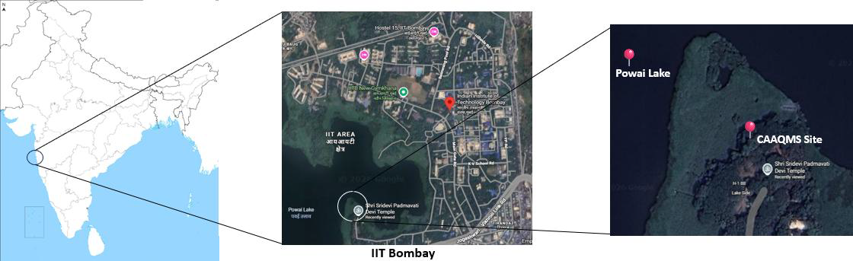
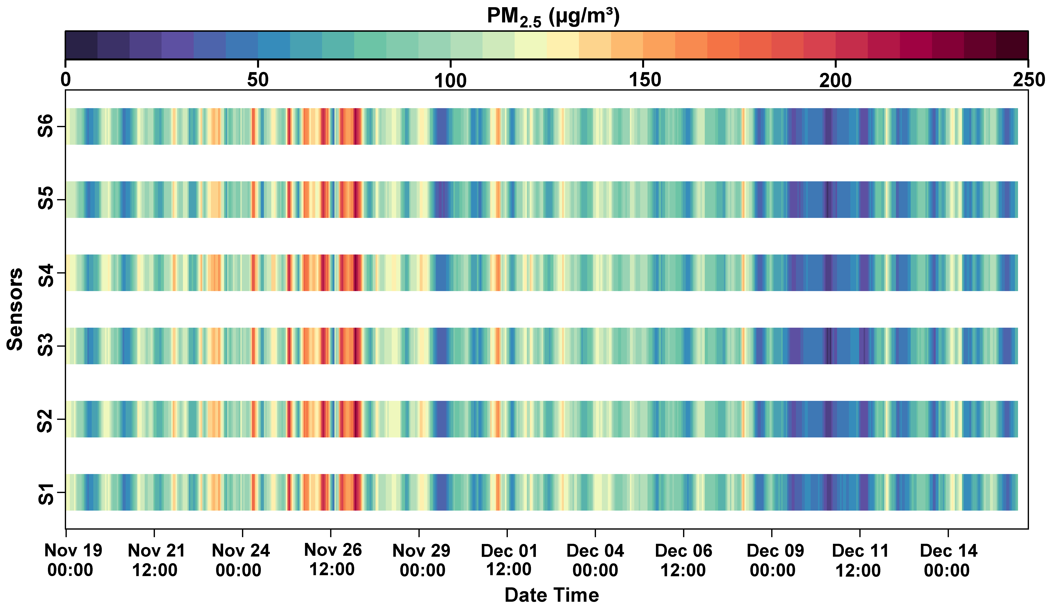
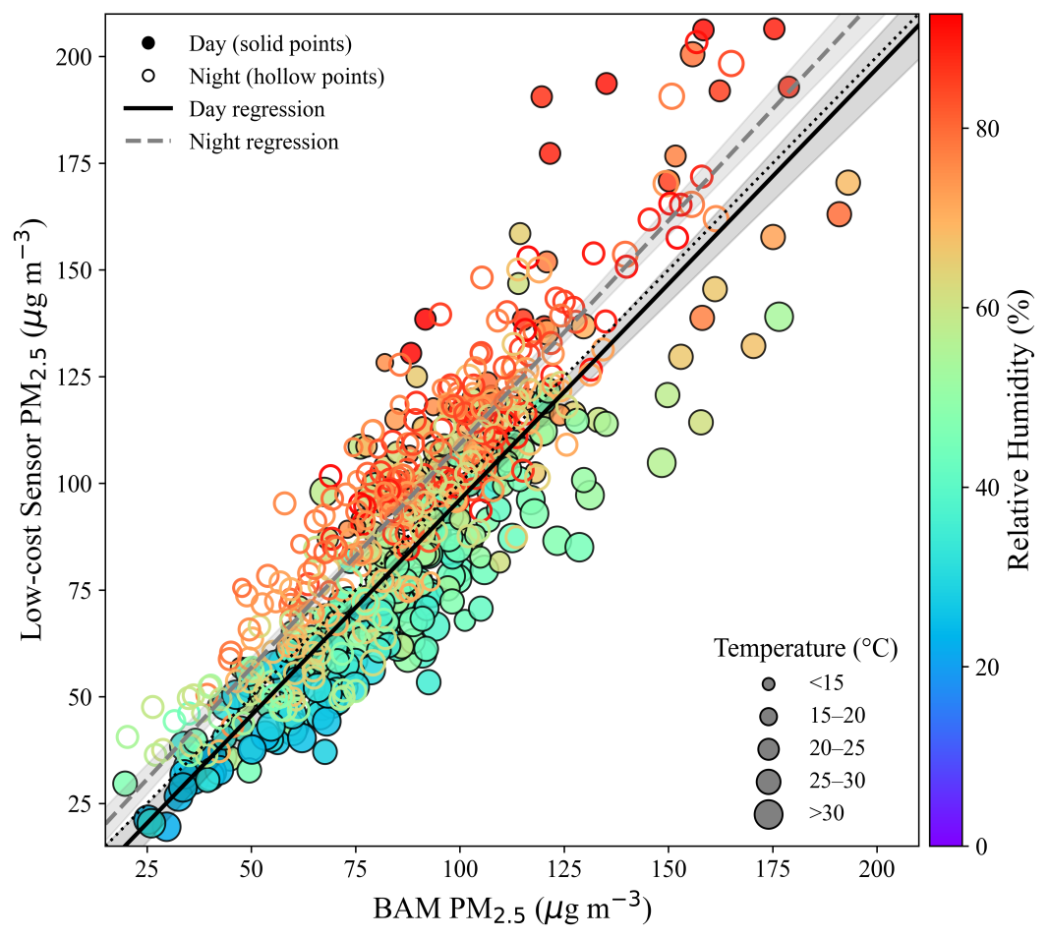
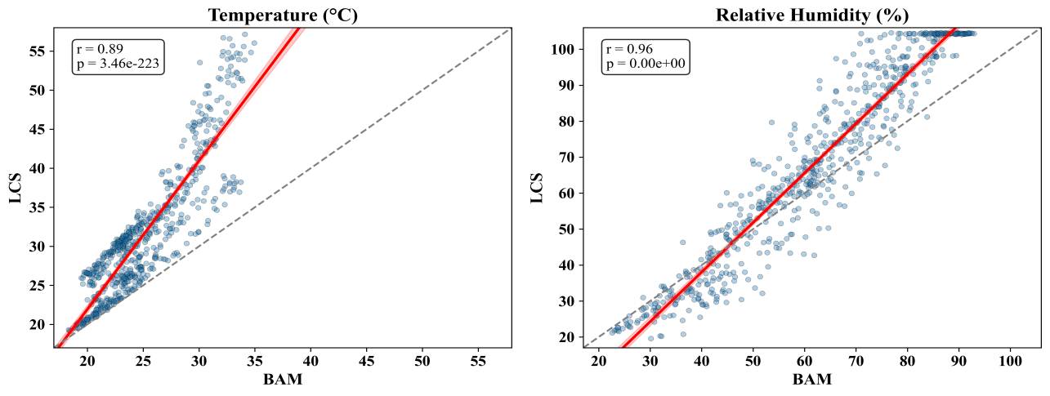
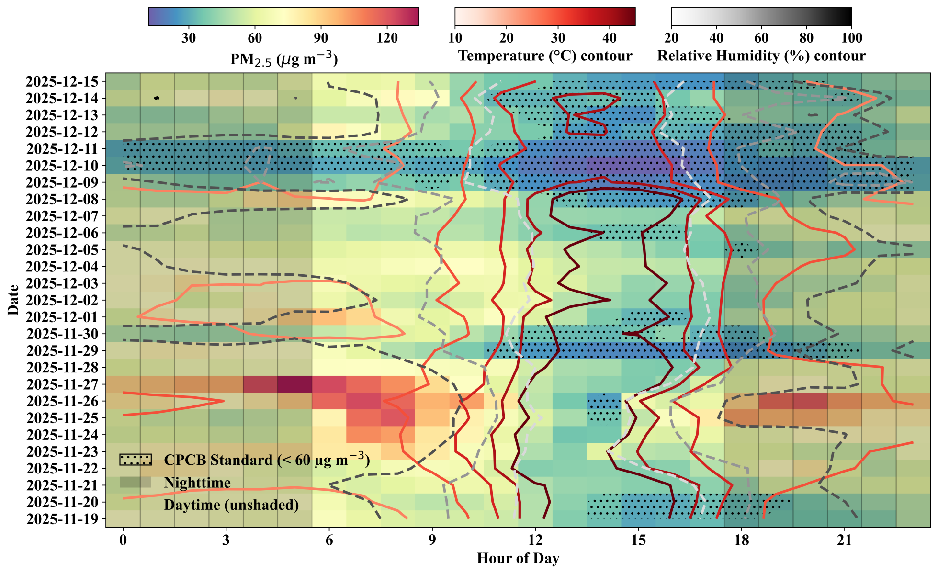

Meteorological Modulation of Diurnal PM_{2.5} Variability: Performance of Low-Cost Sensors
at an Urban Background Site in Mumbai
Mansi Pathak¹ and Harish C. Phuleria^{1,2}
¹Environmental Science and Engineering Department, Indian Institute of Technology Bombay, Mumbai−400 076, India
²Centre for Climate Studies, Indian Institute of Technology Bombay, Mumbai−400 076, India
1. Introduction
3. Methodology
Urban air pollution monitoring networks often have limited spatial coverage.
Low-cost sensors (LCS) enable high-resolution monitoring but are influenced by meteorological conditions.
Optical PM sensors are particularly sensitive to relative humidity and temperature due to hygroscopic particle growth.
Need of this study: Field evaluation of LCS performance under real urban micro-environment conditions.
Six co-located ATMOS sensors deployed for 27 days during November and December.
Continuous monitoring of:
PM_{2.5}
Temperature
Relative humidity, from LCS and BAM (CAAQMS reference station)
Data analysis included:
Precision analysis
Day vs Night comparison
Meteorological regime classification
Bias evaluation (LCS – BAM)
2. Study Area
Mumbai, India's financial capital and economic hub, located on the west coast is home to a population of over 20 million.
City area of 603 km² and is ranked the fifth most polluted city in the world (World Air Quality Index Ranking/IQAir).
The climate of the city is tropical, with elevated humidity levels and substantial rainfall during the southwest monsoon season: June to September, followed by Winters: December to February; Summers: March to May; Post monsoon: October and November.
Urban background site at IIT Bombay CAAQMS
Influenced by:
  Nearby traffic emissions
  Lake-induced humidity variability
  Complex urban boundary layer dynamics (Korhale et al., 2023 )
Figure 1. Study Area Map of the CAAQMS site in Mumbai.
4. Result and Discussion
ATMOS low-cost sensors showed strong agreement with BAM for meteorological parameters, with Pearson correlation coefficients of 0.89 for temperature and 0.96 for relative humidity.
For PM_{2.5}, the day time correlation coefficients: 0.87 and night-time correlation coefficients: 0.91
Systematic bias was observed in PM_{2.5} measurements from LCS under varying temperature–humidity regimes.
During daytime conditions (06:00–18:00 LT) characterized by lower relative humidity (≤70%) and higher temperatures (>20°C), LCS consistently underestimated PM_{2.5} concentrations compared to BAM.
Under nighttime conditions (18:00–06:00 LT) with elevated relative humidity (>70%) and lower temperatures (<20°C), LCS overestimated PM_{2.5} levels.
Optimal agreement between LCS and BAM was observed within a temperature range of 15–25°C and relative humidity range of 30–60%.
Hourly PM_{2.5} time series from LCS indicated episodic daytime enhancements (100–130 µg m⁻³) on certain days, coinciding with very high relative humidity (>80%).
Figure 2. Precision among 6 co-located LCS during 19 November-14 December, 2026 at CAAQMS, IIT Bombay.
Figure 3. Scatter plot between Day vs Night, meteorologically segregated PM_{2.5} from LCS and BAM during 19 November-14 December, 2026 at CAAQMS, IIT Bombay.
Figure 4. Diurnal heat map of PM_{2.5}, temperature and humidity from LCS during 19 November-14 December, 2026 at CAAQMS, IIT Bombay.
5. Conclusions
6. Acknowledgements
Meteorological conditions significantly influence LCS PM_{2.5} measurements.
Humidity effects dominate temperature effects.
Regime-specific calibration improves sensor reliability.
LCS are suitable for dense monitoring networks and exposure studies.
I thank my Supervisor, Prof. Harish C. Phuleria for his constructive feedback and comments and my labmates. I acknowledge IITB for providing IPDF fellowship, EGU2026 for providing opportunity to present this work.
7. References
Kang, Ye, et al. "Performance evaluation of low-cost air quality sensors: A review." Science of The Total Environment 818 (2022): 151769.
Korhale, Nikhil, et al. "Multi-year observations of particulate matter and gases over Mumbai: Spatio-temporal variation, oxidation ratios, and secondary aerosols." Atmospheric Pollution Research 14.12 (2023): 101917.

