Slide 1
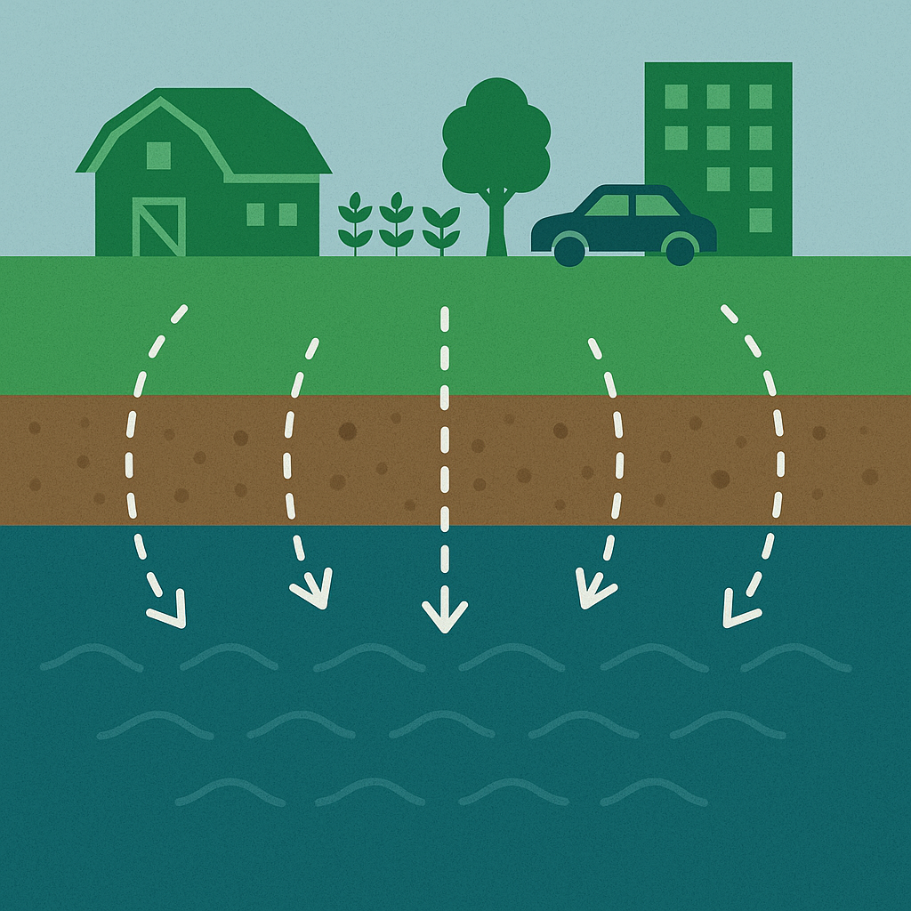




Modelling nutrient emissions into waterbodies caused by various land-use
Samaneh Alighanbari^{1,2},
David Styles^{2,3} , Eoghan Clifford^{1,2}
¹ School of Engineering, Civil Engineering, University of Galway, Galway, Ireland, H91 HX31
² Ryan Institute, University of Galway, Ireland
³ School of Biological & Chemical Sciences, University of Galway, Galway, Ireland, H91 HX31

Slide 2



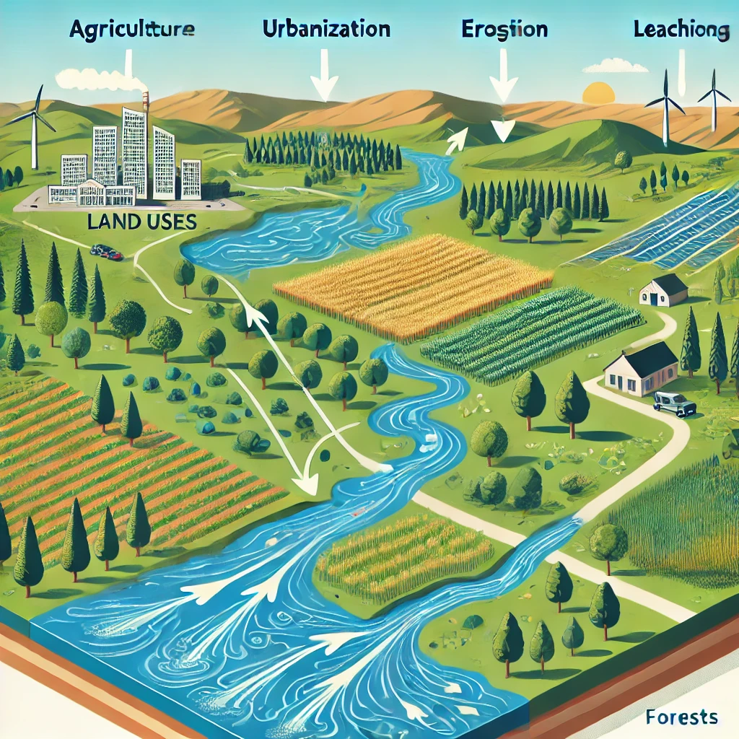


Key Aims Of The Project
Development of Catchment Model
Integration of Environmental Metrics
Collaboration with Stakeholders
Scenario Development and Validation
Knowledge Transfer and Dissemination
LandingZoNES
Notes:
LandingZoNES will develop an Integrated Land Use Model framework for Ireland that enables policy makers, researchers and industry stakeholders to consider the overall sustainability of alternative land use planning scenarios.

Slide 3
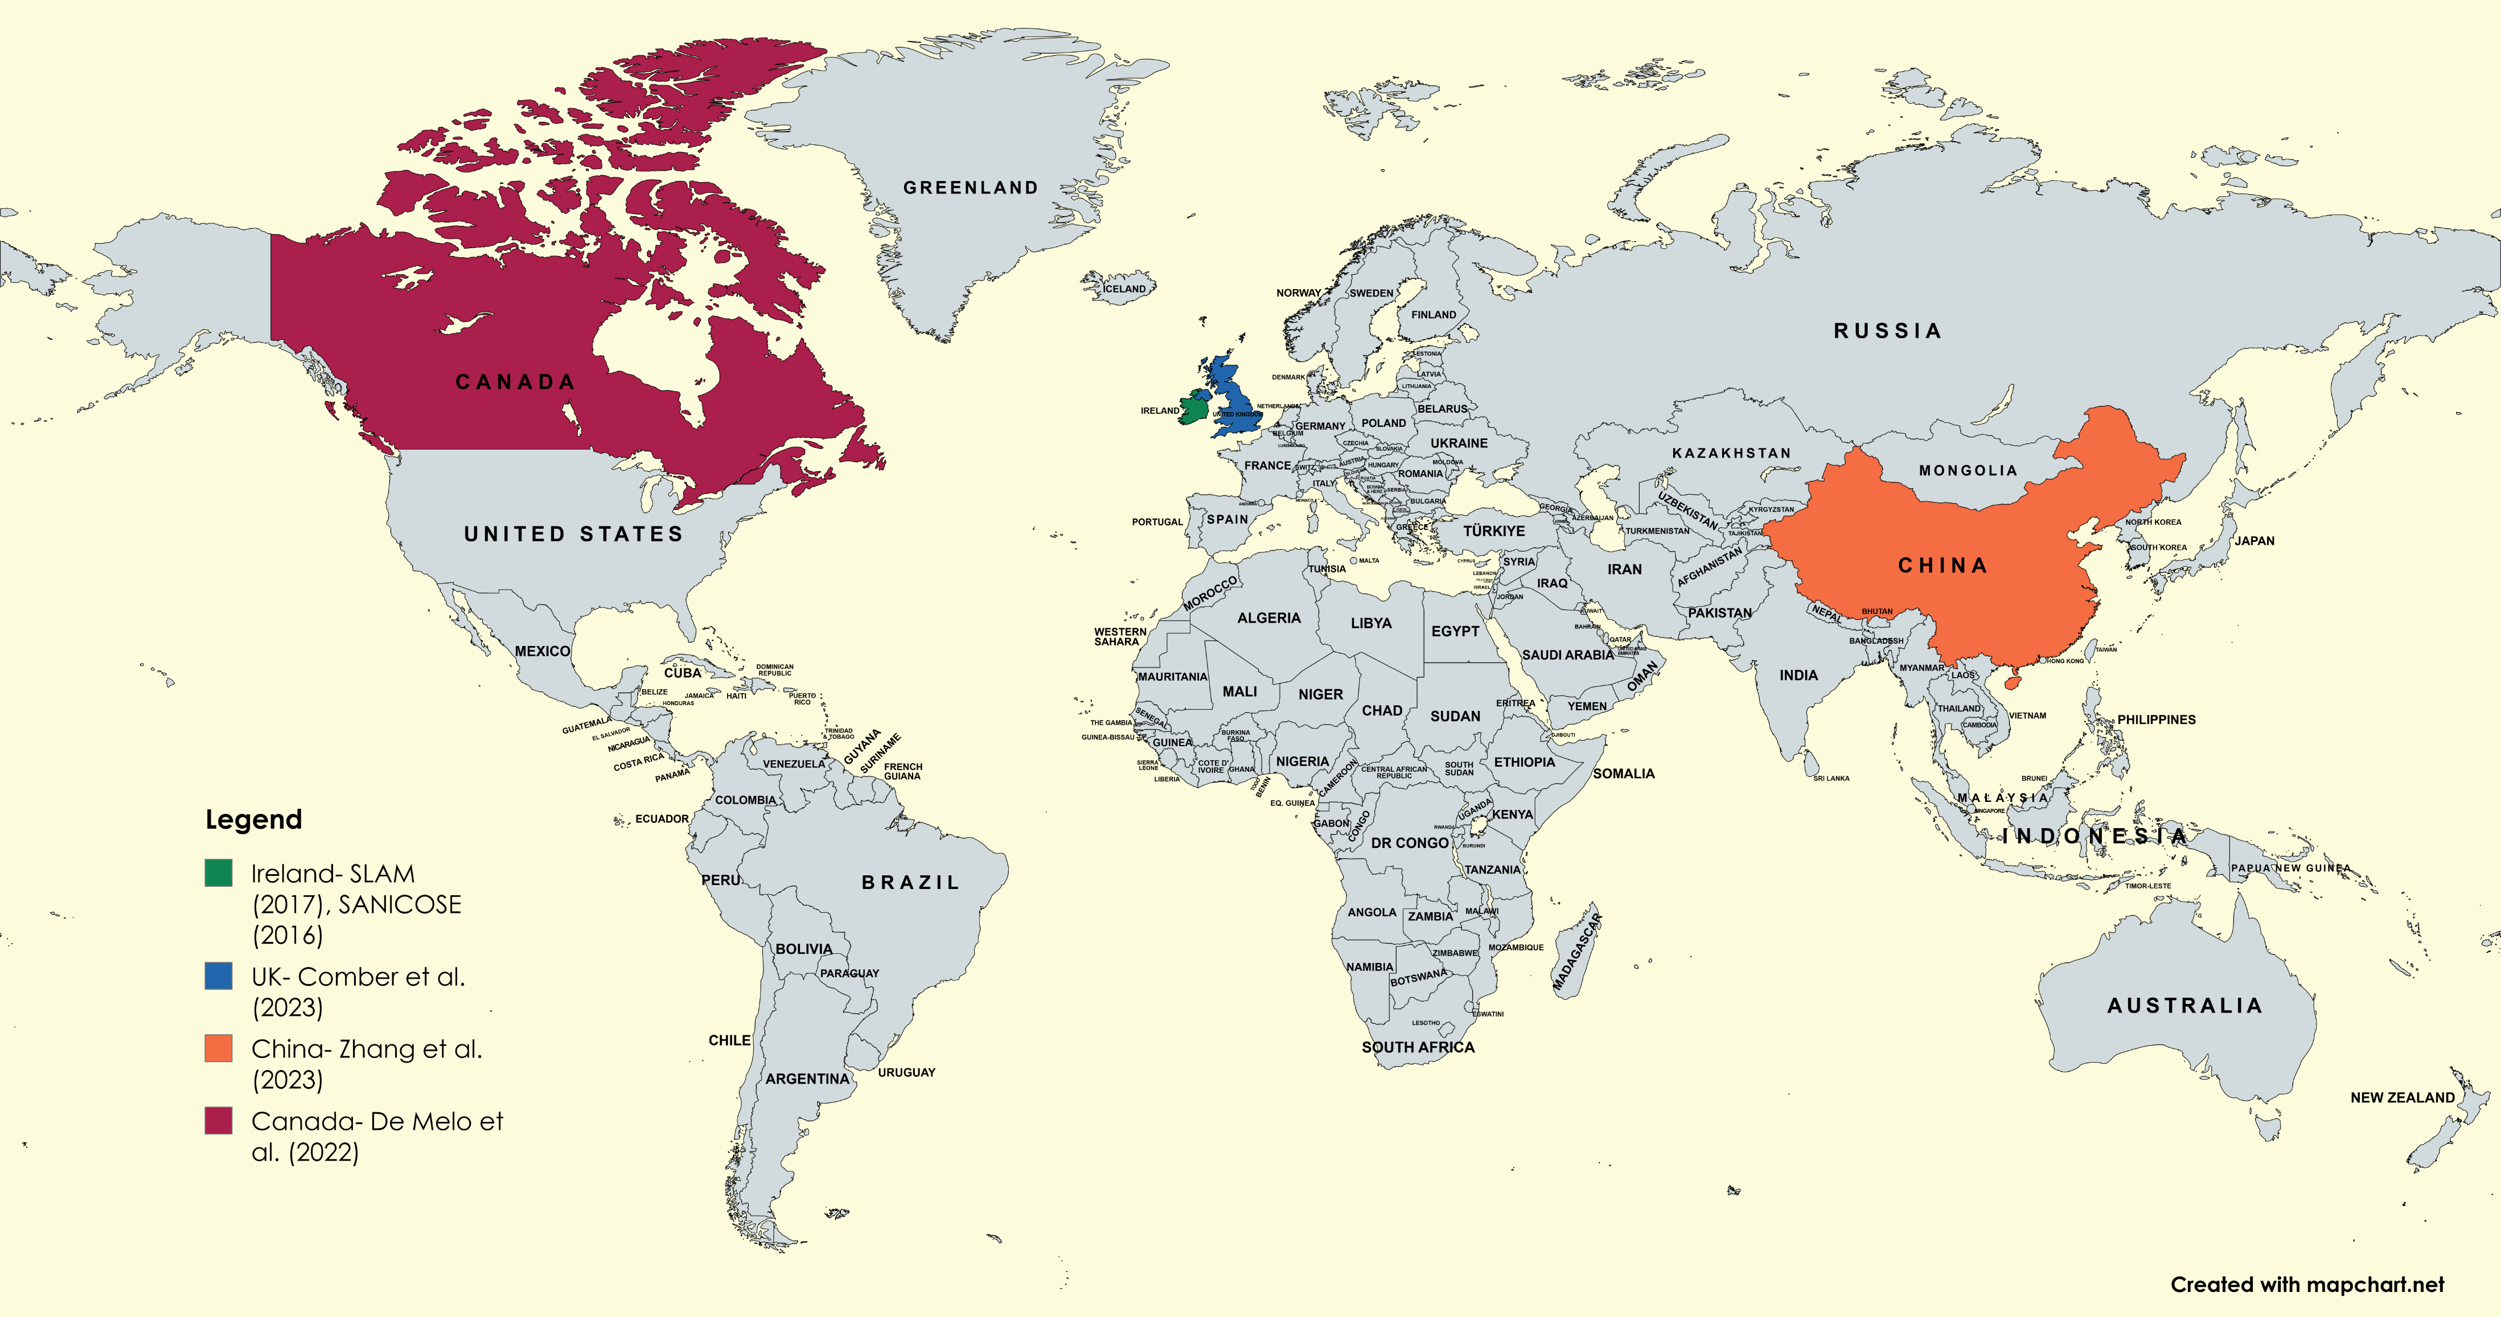
Global Background
1. Gill et al. (2016) – SANICOSE
Modelled nutrient emissions from over 500,000 septic tanks, highlighting soil and distance-to-water impacts
2. Mockler et al. (2017) – SLAM
Developed a national model to apportion N & P loads from multiple sources across all Irish catchments.
De Melo et al. (2022)
Analysed 18 Canadian rivers to link nutrient export patterns with land use, climate, and hydrology.
Comber et al. (2023)
Reviewed phosphorus pollution in UK peatlands and proposed paludiculture as a mitigation strategy.
Zhang et al. (2023)
Developed seasonal export coefficients to model nitrogen pollution in a semiarid irrigated watershed in China.

Slide 4



Methodology Overview
First Stage- ✅Completed
Second Stage- 🔄In Progress
Third Stage- 🔄In Progress
Analyse nutrient loss from various land uses
Utilize previous work and up-to-date data
Calculate N & P loads using land cover data and Export Rate Coefficients.
Investigate how soil types and topography affect nutrient movement using ArcGIS
Integrate hydrological modelling tools (e.g., SWAT) to simulate nutrient movement from soil to water
Validate models using existing water quality data
Simulate future land use scenarios using validated models
Model various land-use change scenarios and evaluate impacts on water quality
Analyse nutrient cycling and changes: phosphorus and nitrogen
Notes:
The work is structured in three stages: First, national-scale load estimation using land cover and export coefficients; second, catchment modelling using SWAT+; and third, scenario analysis linking both approaches.

Slide 5
Research Progress
National Modelling
S-EC framework developed and applied
National nutrient load estimates completed (NLC 2018 ,CLC 2012, CLC 2018 and LPIS 2024)
Results benchmarked against SLAM (Mockler et al., 2017)
Export coefficients compiled from a large body of international studies
Systematic screening applied for relevance to Irish conditions
Paper on S-EC framework and scenario analysis ready for submission
Catchment Modelling (SWAT+)
SWAT+ model established (203 subbasins, 15,000 HRUs)
Climate data integrated and refined
SWAT+ calibration and scenario analysis in progress
Notes:
At national scale, the S-EC framework has been developed and applied using multiple land-cover datasets, and results have been benchmarked against SLAM. At catchment scale, the SWAT+ model has been established, with calibration and scenario analysis currently in progress.

Slide 6
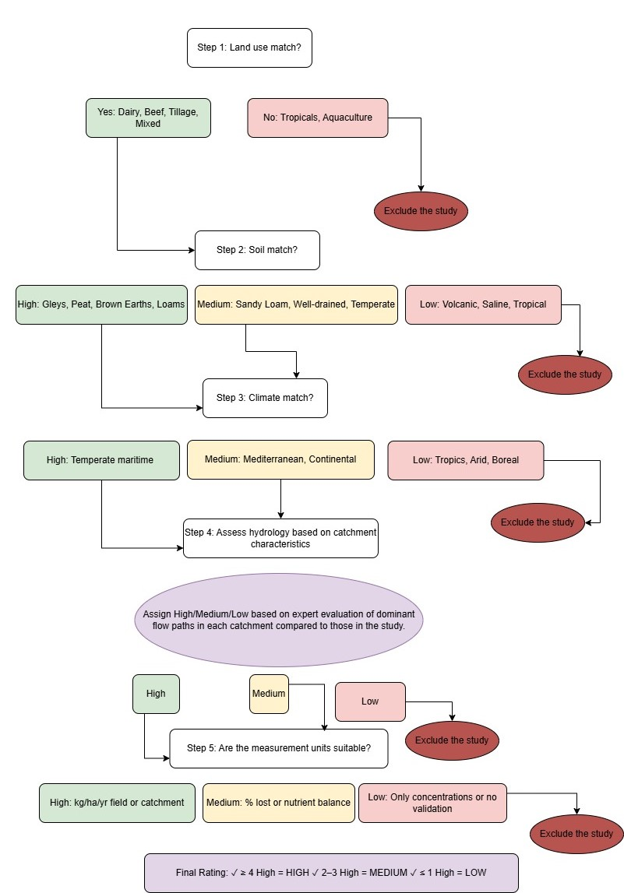
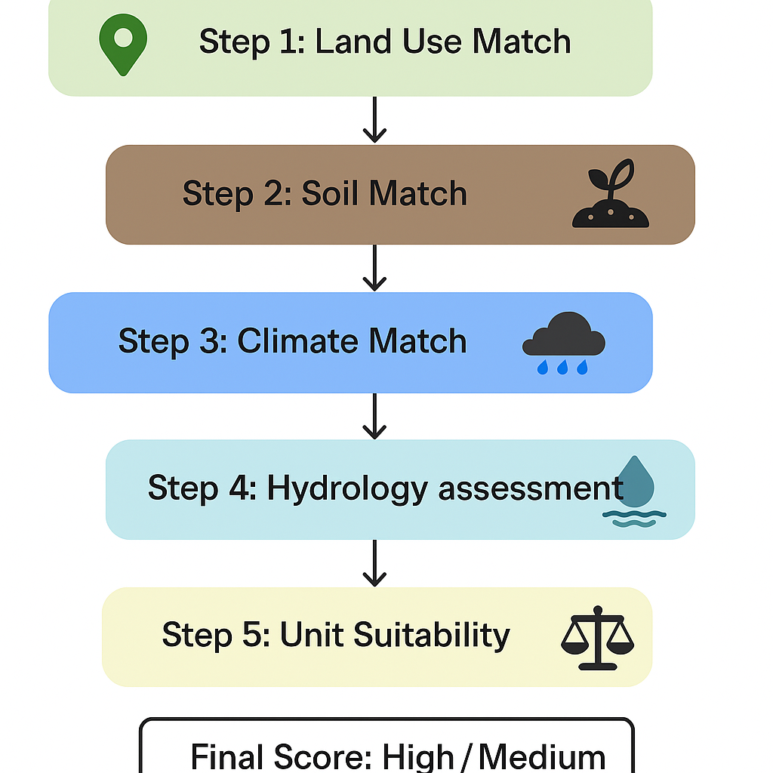

Decision Tree-Agriculture

Slide 7
Assessing Data Transferability: High, Medium, Low
Classification | Criteria Applied | Implication
High🟩 | 80%-100% of the Steps | Direct use in national and catchment modeling
Medium🟨 | 50%-79% of the steps | Used with caution or adjustment
Low🟥 | <50% of the steps | Excluded unless no alternative is available

Slide 8
Comparison After The Systematic Methodology
The range of Export rate Coefficients Before the systematic methodology
The range of Export rate Coefficients After the systematic methodology
Land Use Category | Export rate coefficients (kg N ha⁻¹ yr⁻¹) | Export rate coefficients (kg P ha⁻¹ yr⁻¹)
ARTIFICIAL SURFACES | 5-10 | 1.4-1.5
Pasture | 0-152 | 0.065-3.6
Arable | 7.7-21.85 | 0.013-1.71
FOREST, WOODLAND AND SCRUB | 0.34 – 7.89 | 0.031 – 0.56
Peatlands | 0-40 | 0-3.9
Land Use Category | Export rate coefficients (kg N ha⁻¹ yr⁻¹) | Export rate coefficients (kg P ha⁻¹ yr⁻¹)
ARTIFICIAL SURFACES | 5-10 | 0.85-2.15
Pasture | 7.8 – 20 | 0.068-1.01
Arable | 7.7-21.85 | 0.013 – 0.43
FOREST, WOODLAND AND SCRUB | 0.9-5.41 | 0.063 – 0.56
Peatlands | 2-4 | 0.05-0.9

Slide 9
S-ECs by alignment class

Slide 10
National Nutrient Loads: S-EC vs SLAM
N estimates are consistent across methods, while P shows greater sensitivity to model structure and land-cover representation.

Slide 11
Owenavorragh (Catchment) → Local-scale response
Catchment vs National Scenario Responses
Scenarios modify pasture, arable and forestry only — other land uses remain constant
National
→ National-scale response
Scenario | %ΔN | %ΔP
SI_SG | −17% | −17%
CN_SG | −13% | −2%
BE_SG | +34% | +13%
Scenario | %ΔN | %ΔP
SI_SG | -27% | -19%
CN_SG | -8% | -5%
BE_SG | -8% | -9%

Slide 12
Why do scenarios behave differently at catchment vs national scale?
Land use | National | Catchment (Owenavorragh)
Agriculture – Pasture | 63% | 71%
Agriculture – Arable | 5% | 17%
Forestry – Coniferous, Broadleaved, Mixed | 7% | 4%
Moors & heathland | 6% | 0.13%
Transitional woodland–shrub | 7% | 2%
Peatlands | 7% | 0.02%
Urban / Artificial | 6% | 6%
📊 Next Approach:
Allocate “available agricultural land” to appropriate NLC categories
Assign screened export coefficients (S-ECs) at catchment scale for Downscaling the scenarios at catchment level

Slide 13
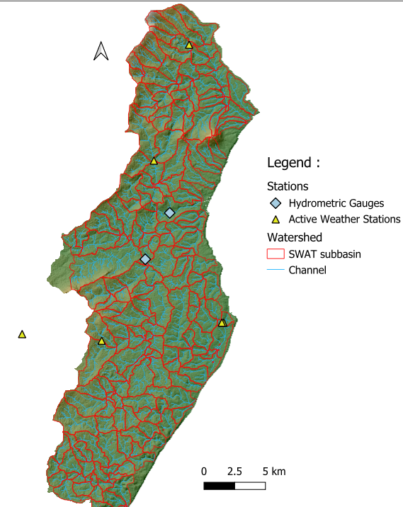
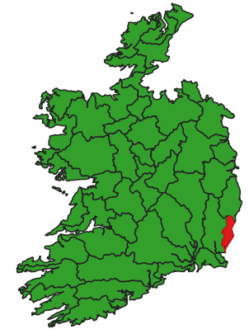
SWAT+ Modelling: Owenavorragh Catchment
🗺️ Model Development
SWAT+ model established for the Owenavorragh catchment
203 subbasins and 15,000 HRUs defined
Land use, soils, and climate inputs integrated
🧩Current Status
Model successfully executed (default run)
Initial calibration completed (Hydrology)
Climate data refined through weather station integration
Ongoing evaluation against observed discharge data (Met Éireann)
📊 Future work
Improve streamflow calibration
Extend to nutrient modelling (N and P)
Apply model for scenario analysis
SWAT+ enables the transition from static national estimates to dynamic, catchment-scale nutrient modelling.

Slide 14
Key Achievements to Date
S-EC Framework Development
Decision-tree for screening export coefficients
Applied consistently across land-use datasets
National Modelling & Validation
Estimated national N and P loads (NLC, CORINE, LPIS)
Strong agreement with SLAM for N
Identified high sensitivity of P to land-use representation
Scenario & Catchment Integration
Applied GOBLIN scenarios at national scale
Demonstrated scale-dependent responses (national vs catchment)
Developed SWAT+ model for Owenavorragh (baseline established)
KEY CONTRIBUTION
Linking national scenario modelling (GOBLIN) with catchment-scale processes (SWAT+) using S-ECs

Slide 15
Plans for Future
Scenario Downscaling
Reallocate “available agricultural land” to defined land-use classes
Apply S-ECs at catchment scale
Improve consistency between national and catchment modelling
SWAT+ Nutrient Modelling
Finalise hydrological calibration
Extend to N and P transport
Validate against observed water quality data.
Model Integration & Validation
Link S-EC framework with SWAT+ outputs
Compare static vs process-based estimates
Assess robustness of scenario responses across scales
This work solves the gap between national land-use scenarios and catchment-scale water quality modelling.
Core Objective

Slide 16
Impacts Of This Study
Comprehensive assessment of land use strategies.
More effective policies and practices for sustainable land management
National and hopefully international framework for modelling land use change impacts.
Notes:
The key objective of this work is to bridge national-scale scenario modelling with catchment-scale processes using a harmonised export coefficient framework.

Slide 17



Thank you for your attention
Samaneh Alighanbari
Supervisors:
Prof. Eoghan Clifford
Dr. David Styles

