Slide 1
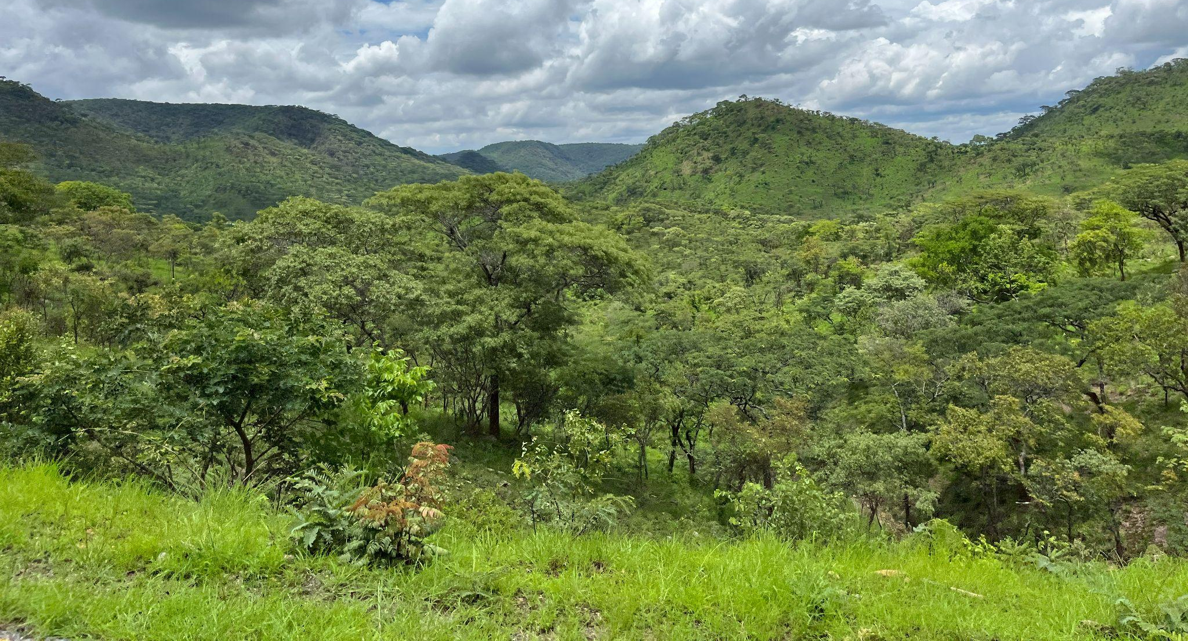








Global forest, non-forest and tree crop mapping at 10 m resolution using satellite embeddings
EGU26, 8th May 2026, Vienna, Austria
Daniel Paluba (CUNI)
Adam Hastie (CUNI), Yarin T. Puerta Quintana (CUNI),
Valerio Marsocci (ESA) & Katarína Onačillová (UPJŠ)
EO4Landscape research team

Slide 2
The importance of this work
One third of the Earth’s land surface; 35% of Europe’s land, but dynamically changing
New challenges & opportunities with new policies, e.g. the EUDR
EO-based forest products are being used as a baseline for various applications
differing accuracies, spatial resolutions,
temporal and spatial availability or transferability
Frequent confusion between forests and agricultural tree crops
Goals:
Create a global forest/non-forest (F/nF) map with a tree crop sub-class
& build a methodology for automatic forest cover classification
Test and validate the usability of satellite embeddings for this task with different machine learning approaches

Slide 3
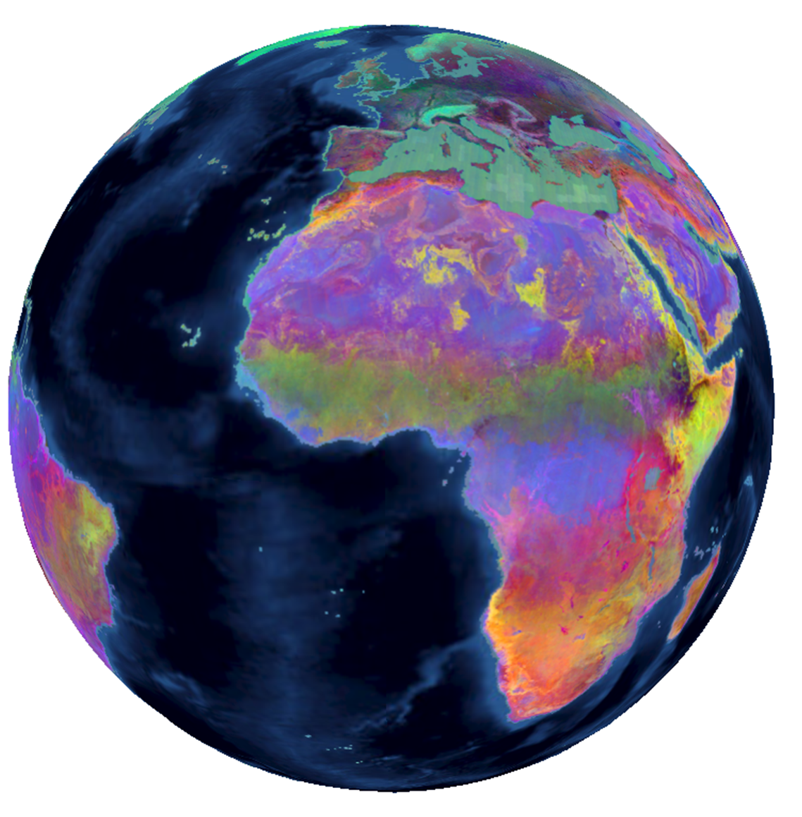
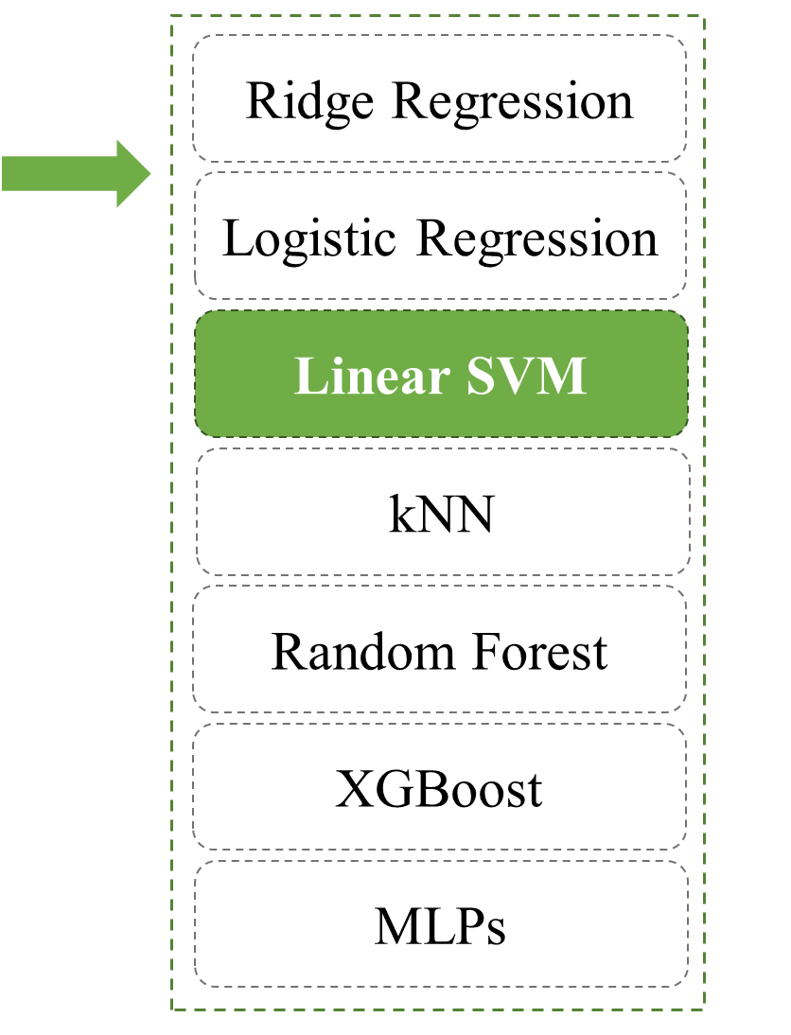
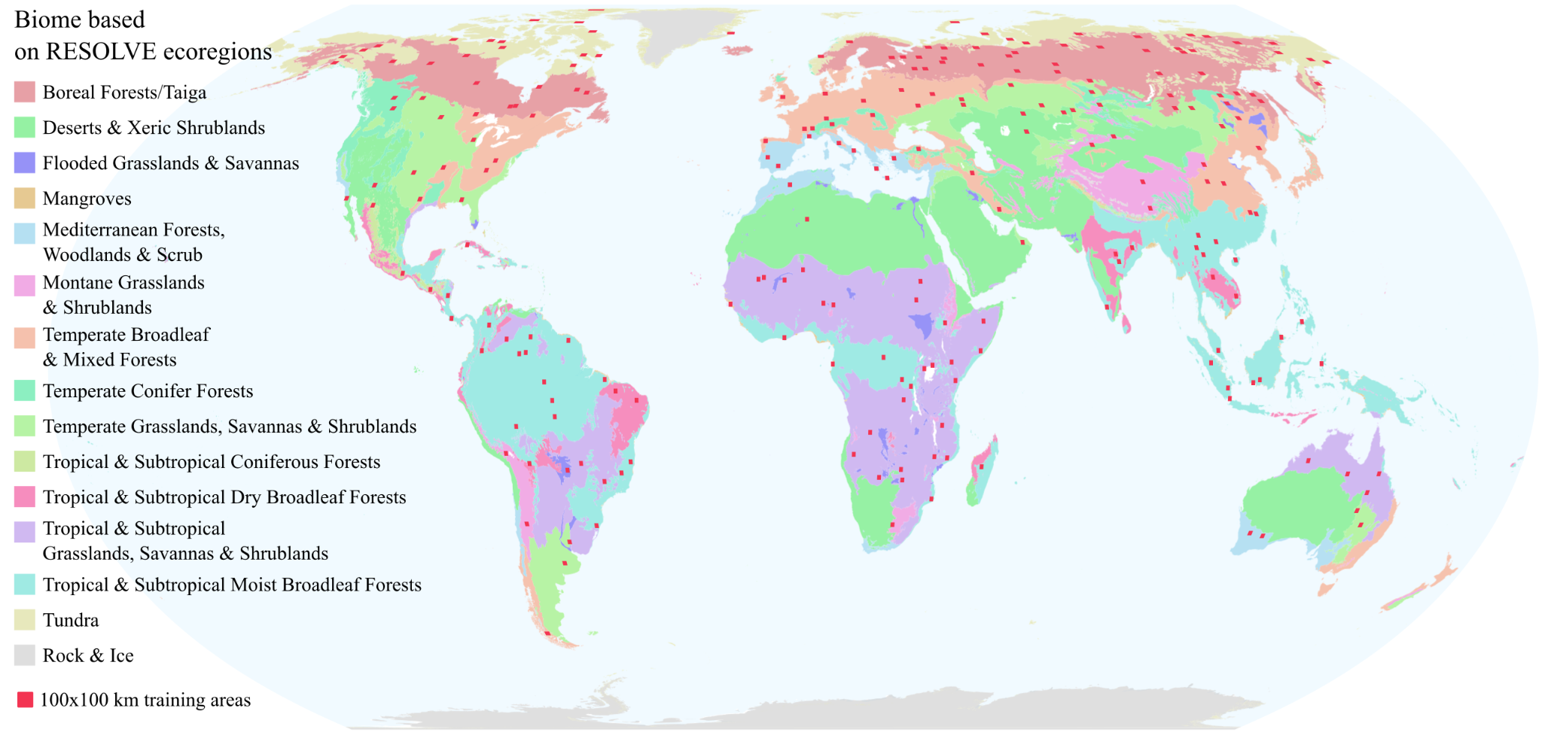
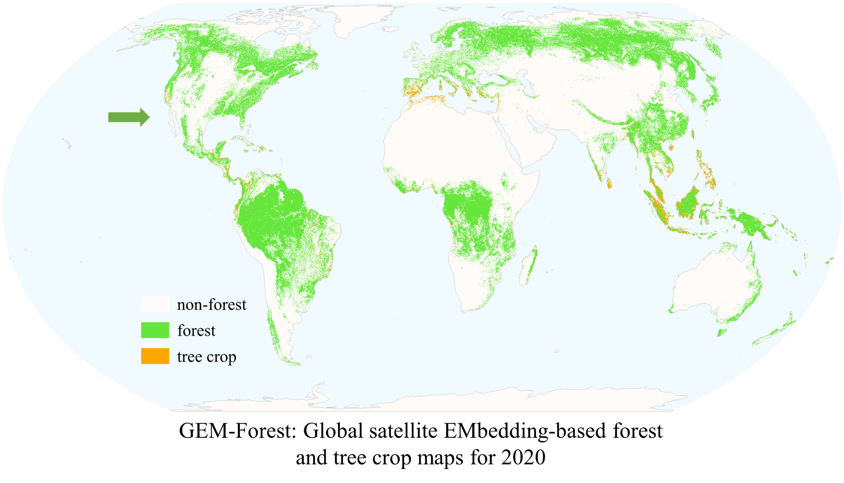

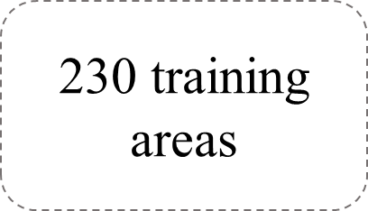
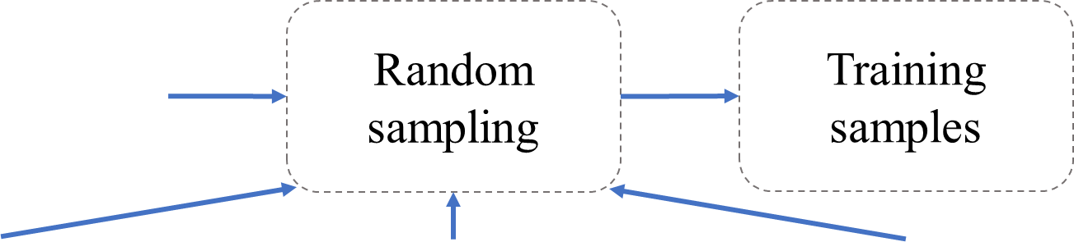
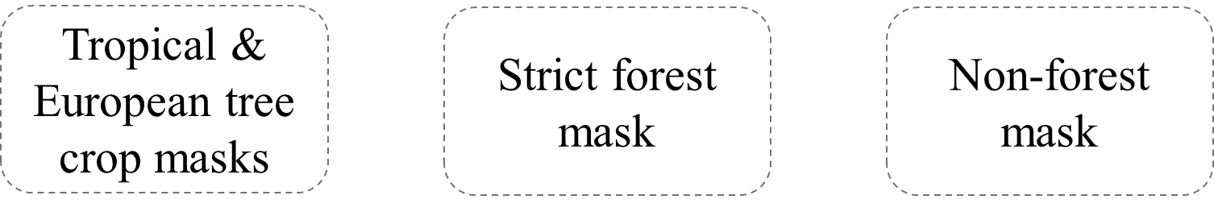
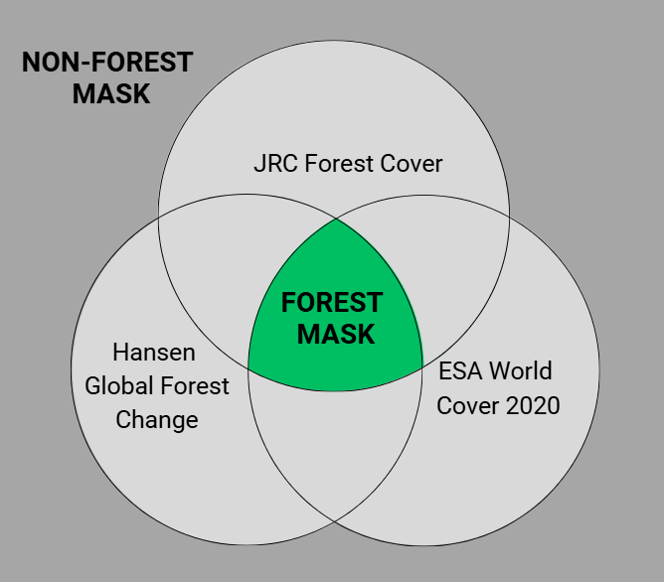
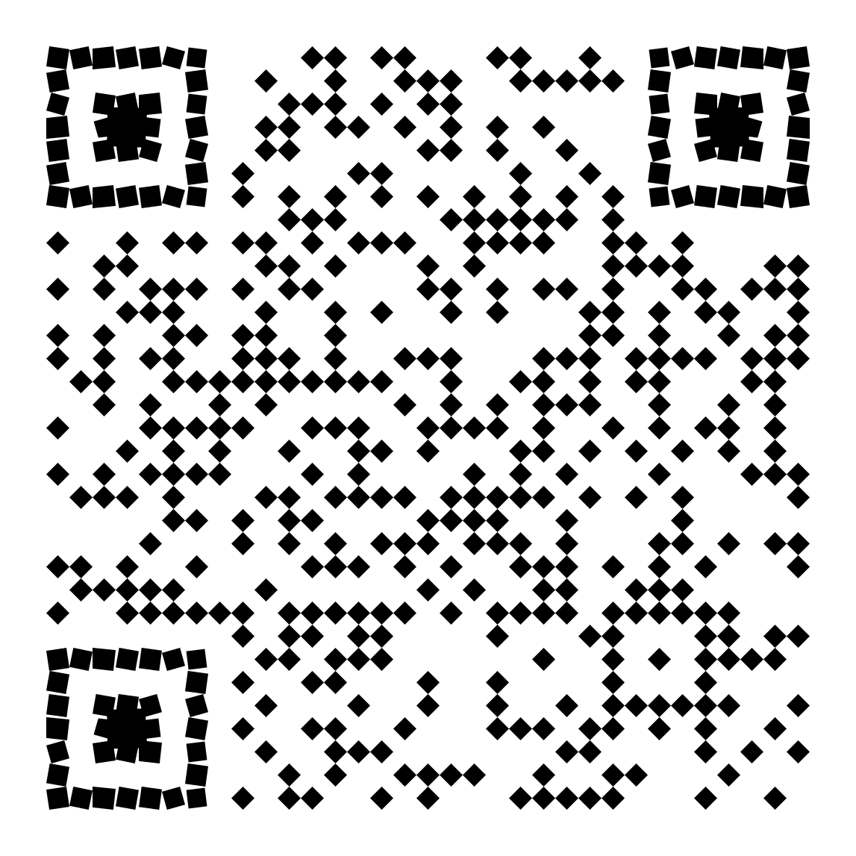
Methodological framework
AEF
Satellite
Embeddings v1 for 2020 (64D)
250 random F/nF points, 1000 tree crops / training area
42,684 training samples: ~14,000 forest ~27,000 non-forest & ~1,300 tree crop points
Distribution of 100x100 km training areas (red squares) over the world's biomes based on the RESOLVE ecoregions.
FAO
forest definition
Included tree crops: oil palm, rubber, coconut, other palms, olives & fruit trees (Europe)
Details in our preprint
Paluba et al. (2026):

Slide 4
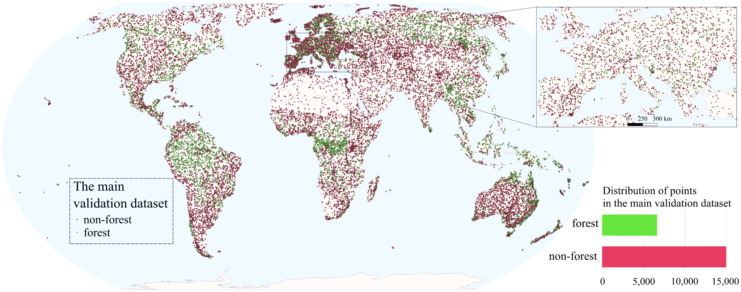
The main forest/non-forest validation dataset for 2020
Validation dataset for the global map of forest cover 2020, v.2 from JRC (Colditz et al. 2025) - 21k samples across the entire land area of the globe (except Antarctica). Prepared for JRC’s GFC2020 (Bourgoin et al. 2026).
35%/65% distribution for F/nF → representing the forest cover share over land

Slide 5
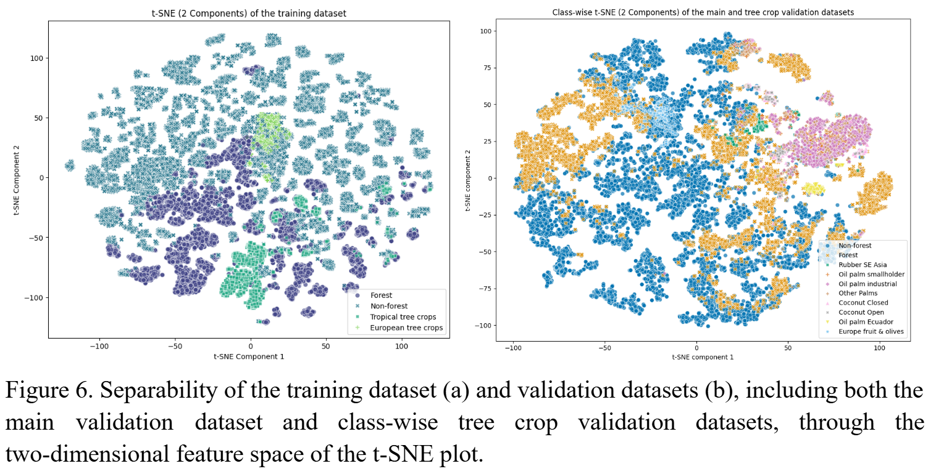
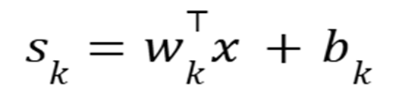
Results: Comparison of ML approaches
Consistently high performance: all models >90% overall accuracy (weighted F1 ~0.91–0.92), similar results for forest omission and commission errors (14-19%, 11-14%)
Non-linear more complex models (RF, XGB, MLP)
→ no signif. improvement over linear models, often worse
→ AEF patterns are predominantly linearly well separable
→ Errors from semantic (class) similarity, especially tree crops vs forests, transitional & sparse forests
Final selection → linear SVM with a simple
re-implementation of weights
t-SNE plot on training data
t-SNE plot on validation data

Slide 6
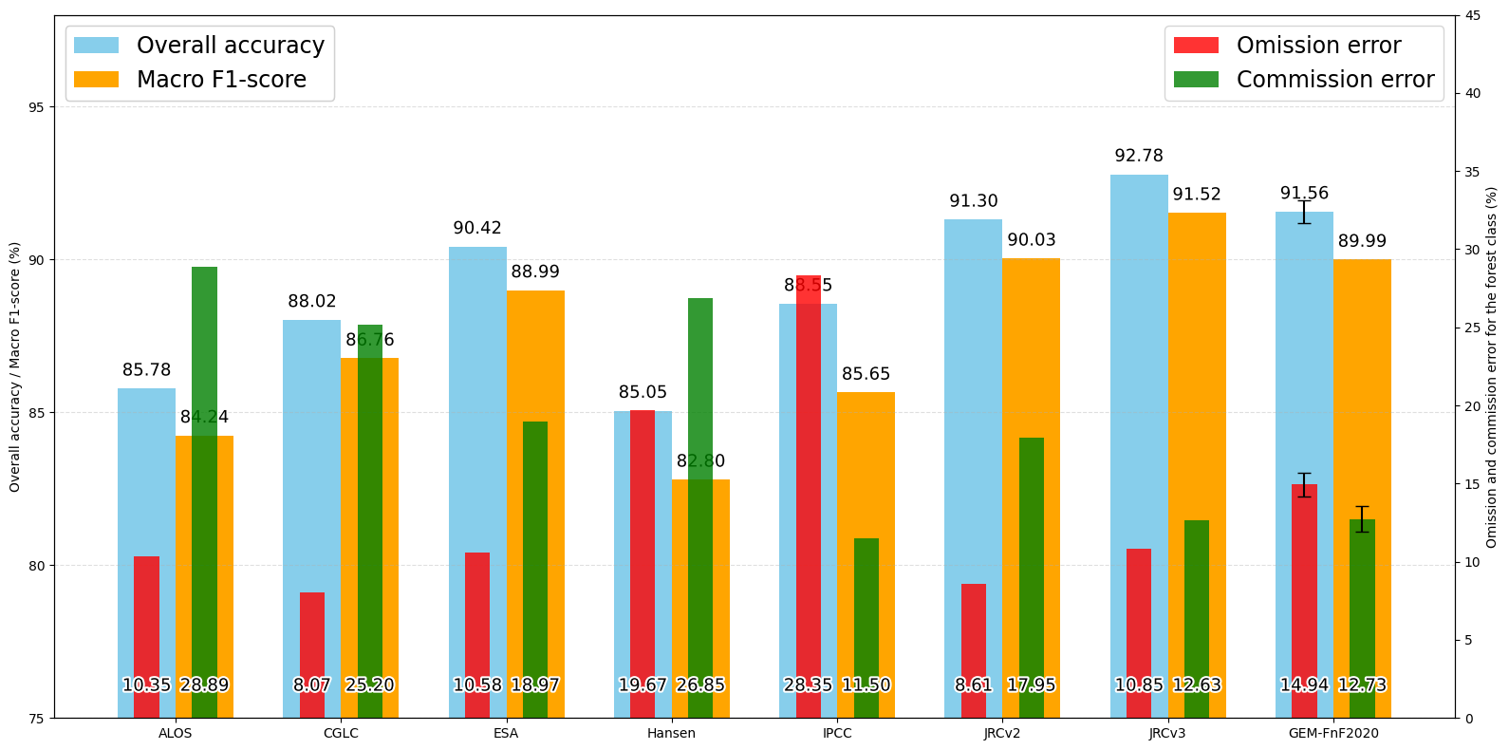
Global validation: Comparison to other global forest/tree cover datasets
Best-performing forest global products
Our dataset
2nd place
88.55
86.76
84.24
82.80
GFC2020 v2
GFC2020 v3

Slide 7
Validation of the tree crop sub-class
Oil palm:
1,905 points for 2021 (1,374 industrial, 531 smallholders) – Descals, 2024a v1.2
164 points unchanged between 2019–2021, Ecuador – Fundación EcoCiencia, 2025 v1.0
Rubber:
217 monoculture points, SE Asia, 2021 – Descals, 2024b; Sheil et al., 2025 v1.1
Coconut and other palms:
327 globally distributed points of closed and open plantations, 2020 – Descals, 2023
Expanded to include other palm species (non-coconut) for 2020 – Descals, 2023;
European olive groves and fruit orchards:
A validation dataset created based on CORINE Land Cover 2018 data, with subsequent validation using high-resolution imagery in Google Earth Pro.
Share with us your regional/global tree crop dataset.
We would be happy to test it on GEM-Forest!

Slide 8
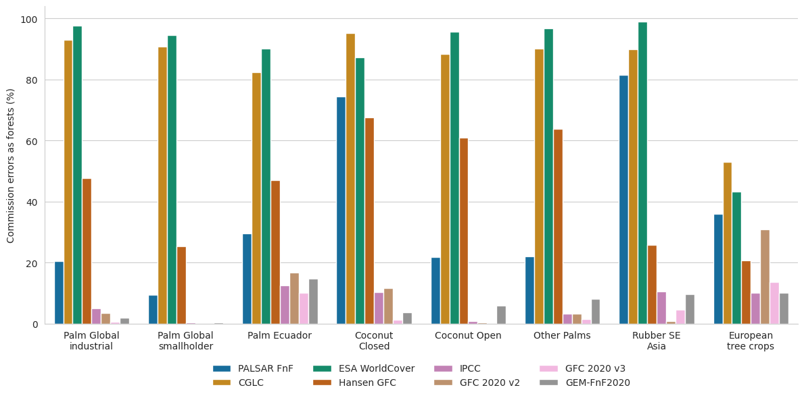
Percentage of tree crops classified as forests
Comparison to other global forest/tree cover layers
(>85% PA for most tree crops)

Slide 9
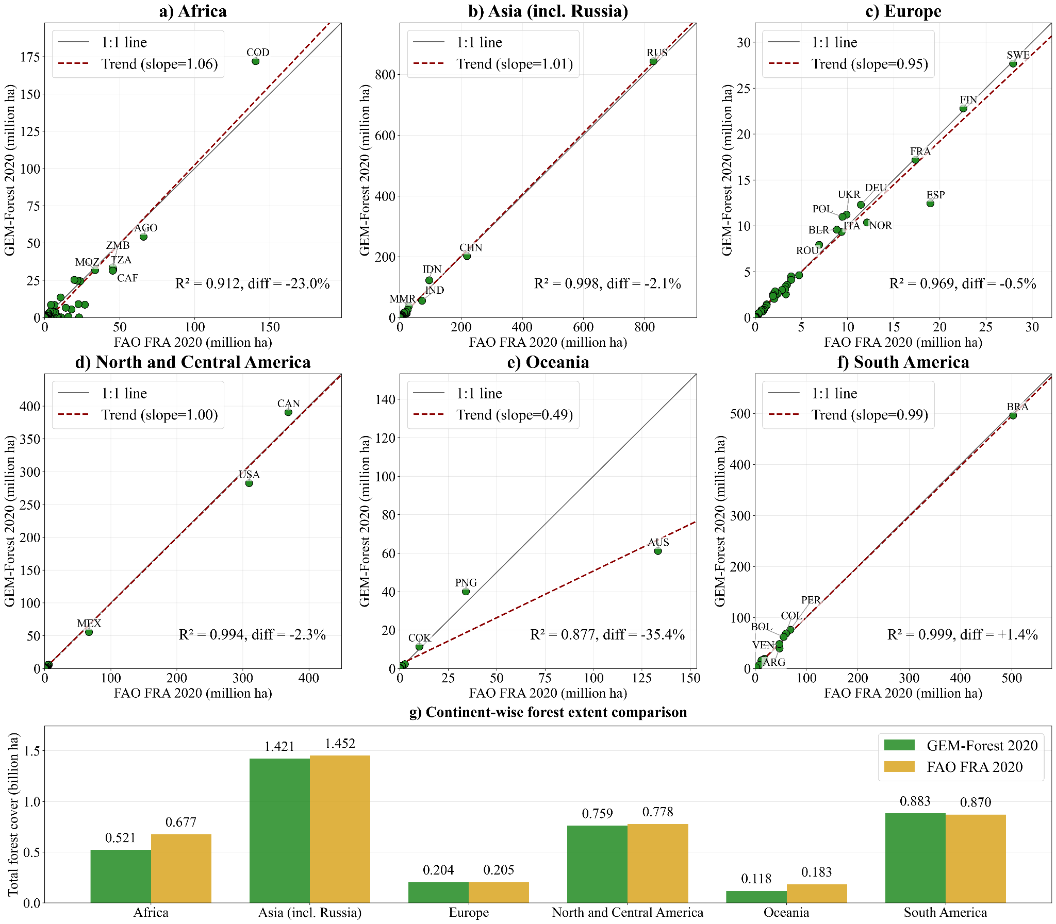
GEM-Forest vs FAO FRA
forest extents
FAO FRA 2020 (2025 report)
4,164 millions ha (Mha)
GEM-Forest
Mapped: 3,919 Mha (–5.9% underest.)
Sample-based: 4,021 ± 48 Mha
JRC’s GFC2020 v2:
Mapped: 4,562 Mha (+9.5% overest.)
Sample-based: 4,021 ± 83 Mha
Country- and continent-level GEM-Forest vs FAO FRA 2020 forest extent comparison

Slide 10
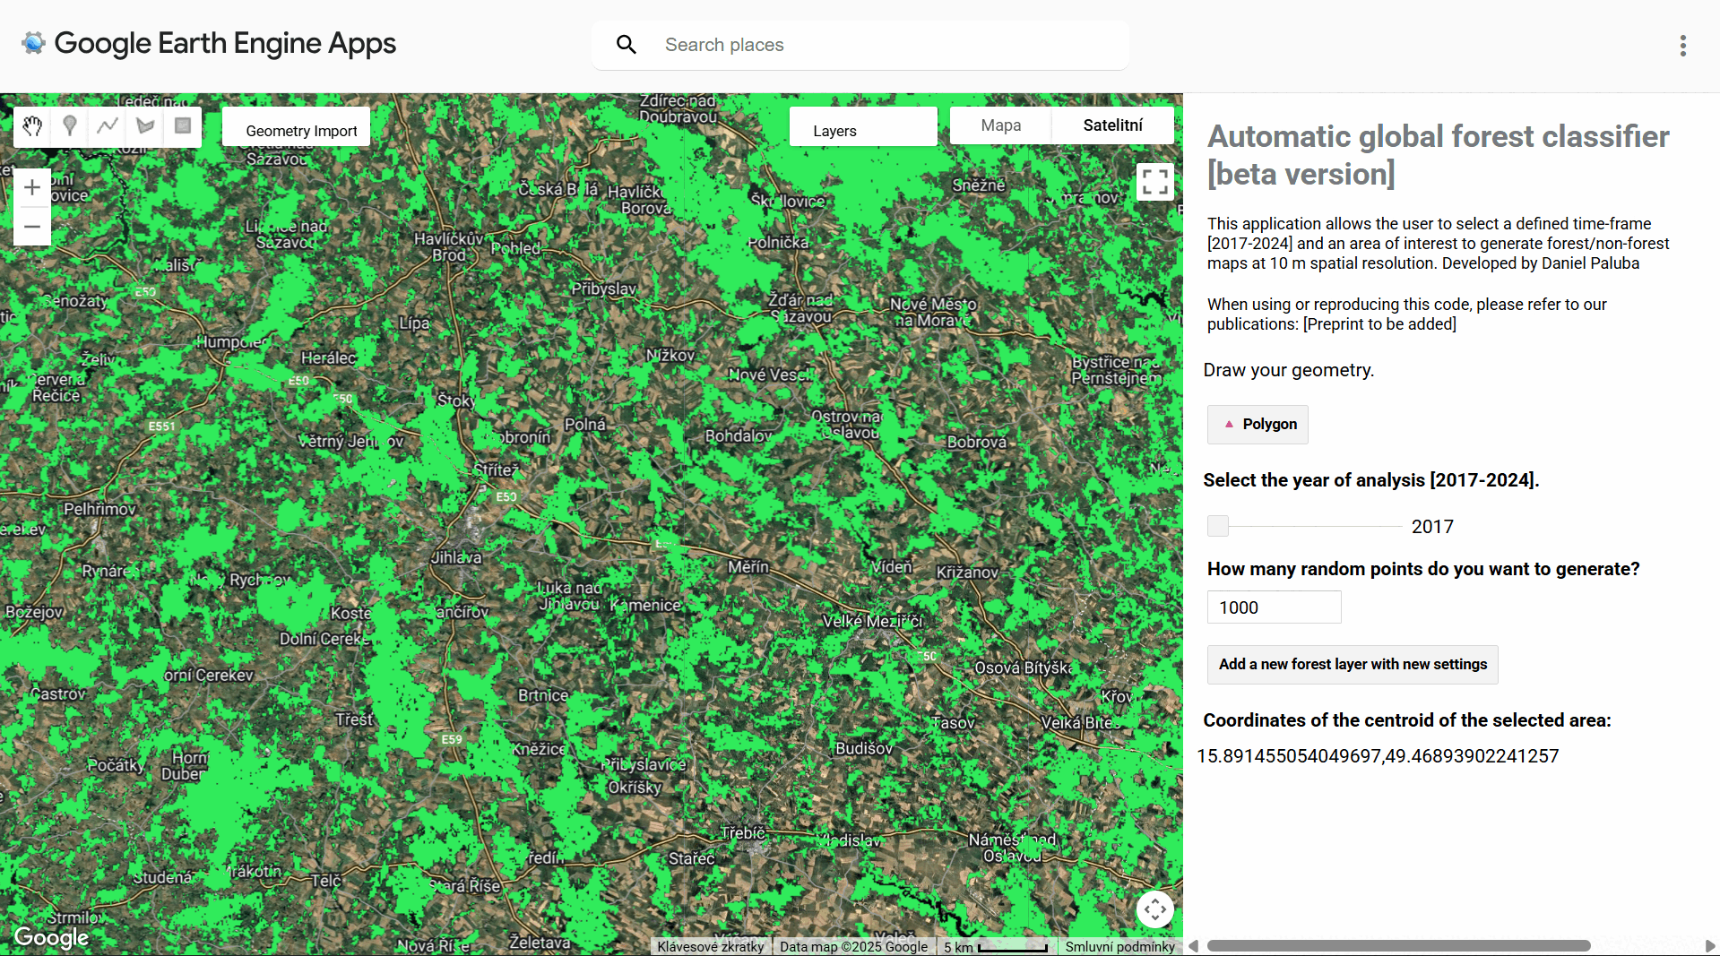
Temporal transferability test - bark beetle disturbance in Czechia (Vysočina region) between 2017 and 2024

Slide 11
Summary
Our results on Google Alpha Earth Foundation’s Satellite embeddings:
three classes globally: forest, non-forest, (selected) tree crops
  no coffee or cocoa in v1.0
simple, resource-efficient linear ML approaches with AEF can produce highly accurate global F/nF maps, often outperforming more complex algorithms
2nd best F/nF dataset for 2020 based on global validation
→ strong transferability and reproducibility potential for 2017-2025 → yearly change detection & support in policies, like the EUDR

Slide 12
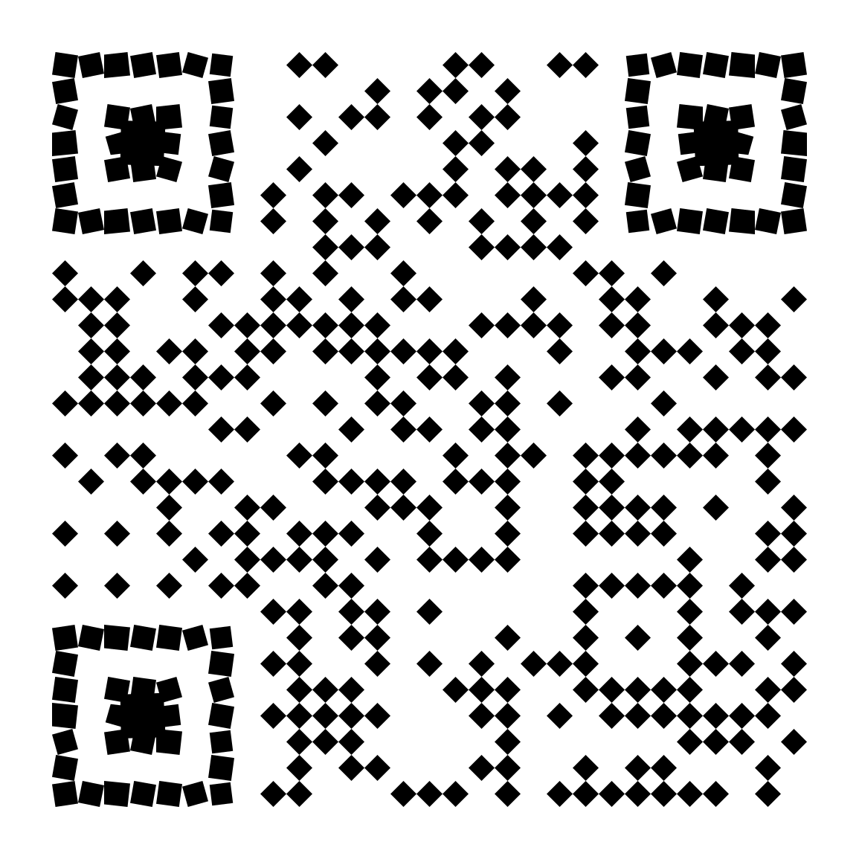


Materials and data availability
Preprint:
Preprint Paluba et al. (2026): GEM-Forest: A Global satellite
EMbedding–based map of forests and tree crops for 2020 https://doi.org/10.5194/egusphere-2026-1401 (preprint v2 is coming soon!)
Zenodo repository with 5x5° Cloud-optimized GeoTIFFs in 30°x30° bundles (WGS84) + training and validation data + trained model weights
https://doi.org/10.5281/zenodo.18921586
GEM-Forest GEE data explorer
GEE Asset and part of the Awesome GEE Community Catalog
In Desktop GIS via ArcGIS REST Service (like a WMS)
Zenodo with data & other links

Slide 13




This research was supported by the Johannes Amos Comenius Programme (P JAC),
project No. CZ.02.01.01/00/22_008/0004605, Natural and anthropogenic georisks.
Thank you
for your attention
daniel.paluba@natur.cuni.cz
@daniel-paluba
@palubad
More details:

