Slide 1






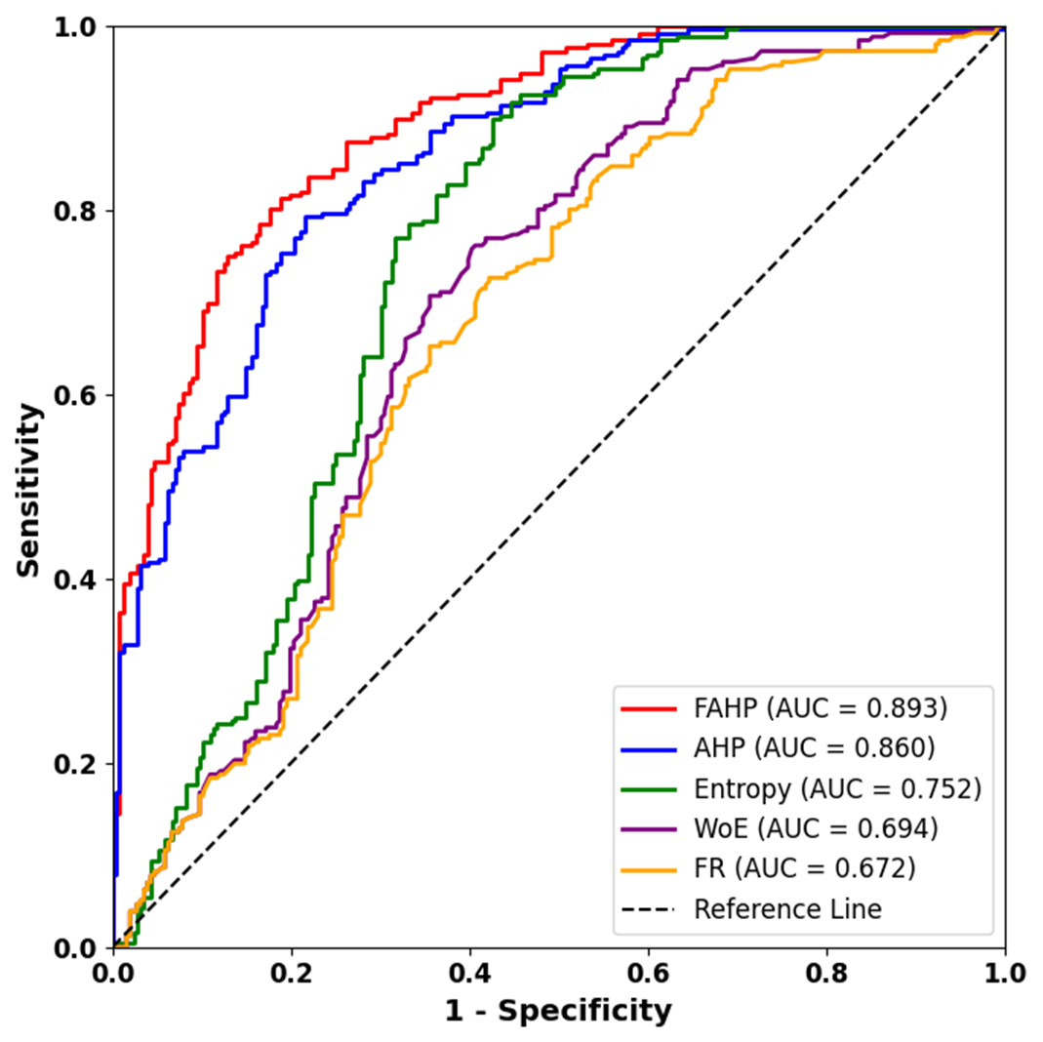
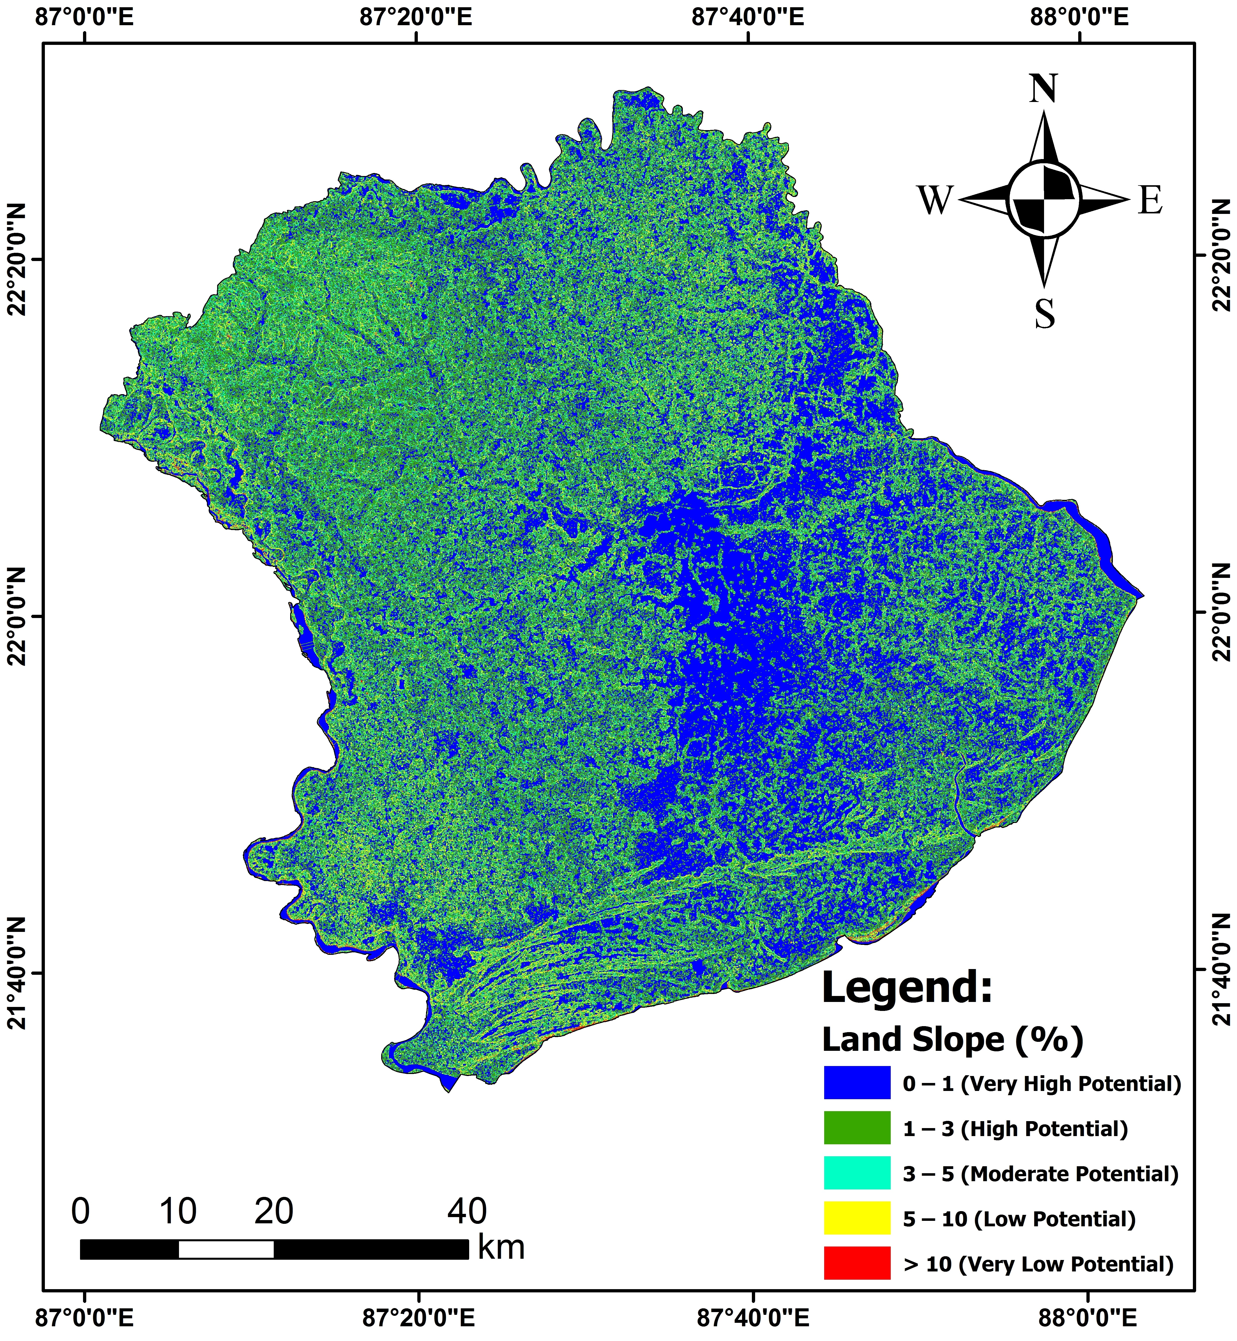
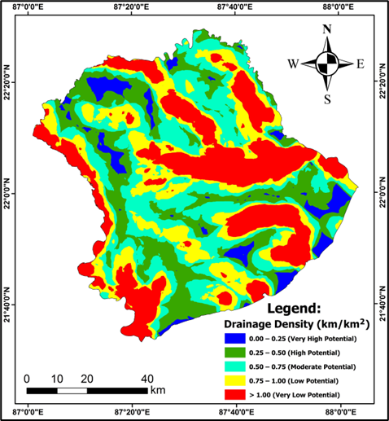
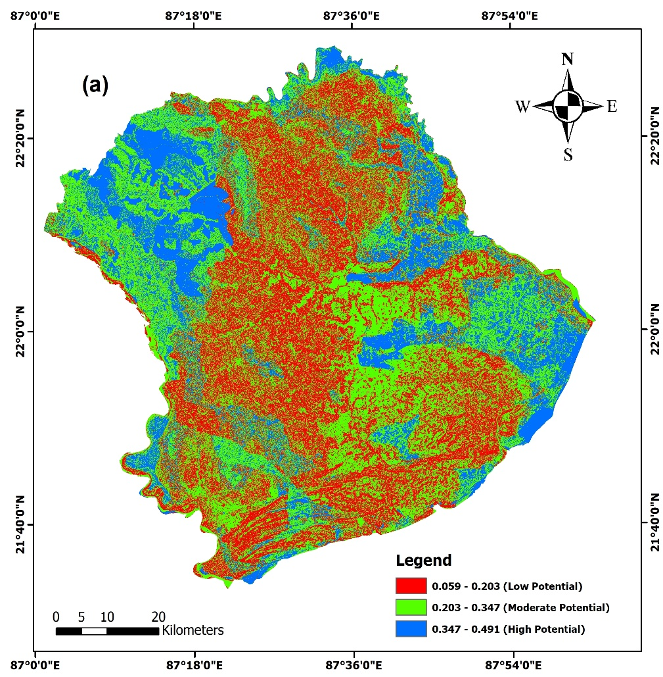
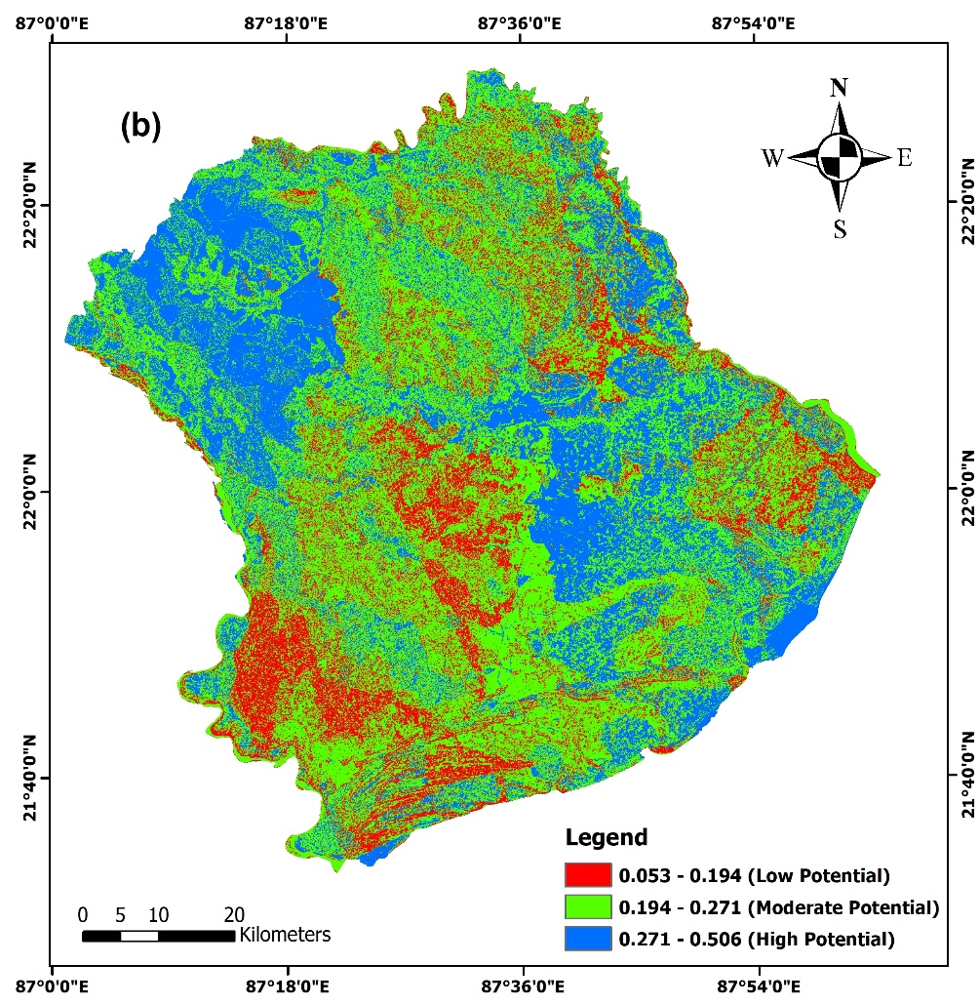
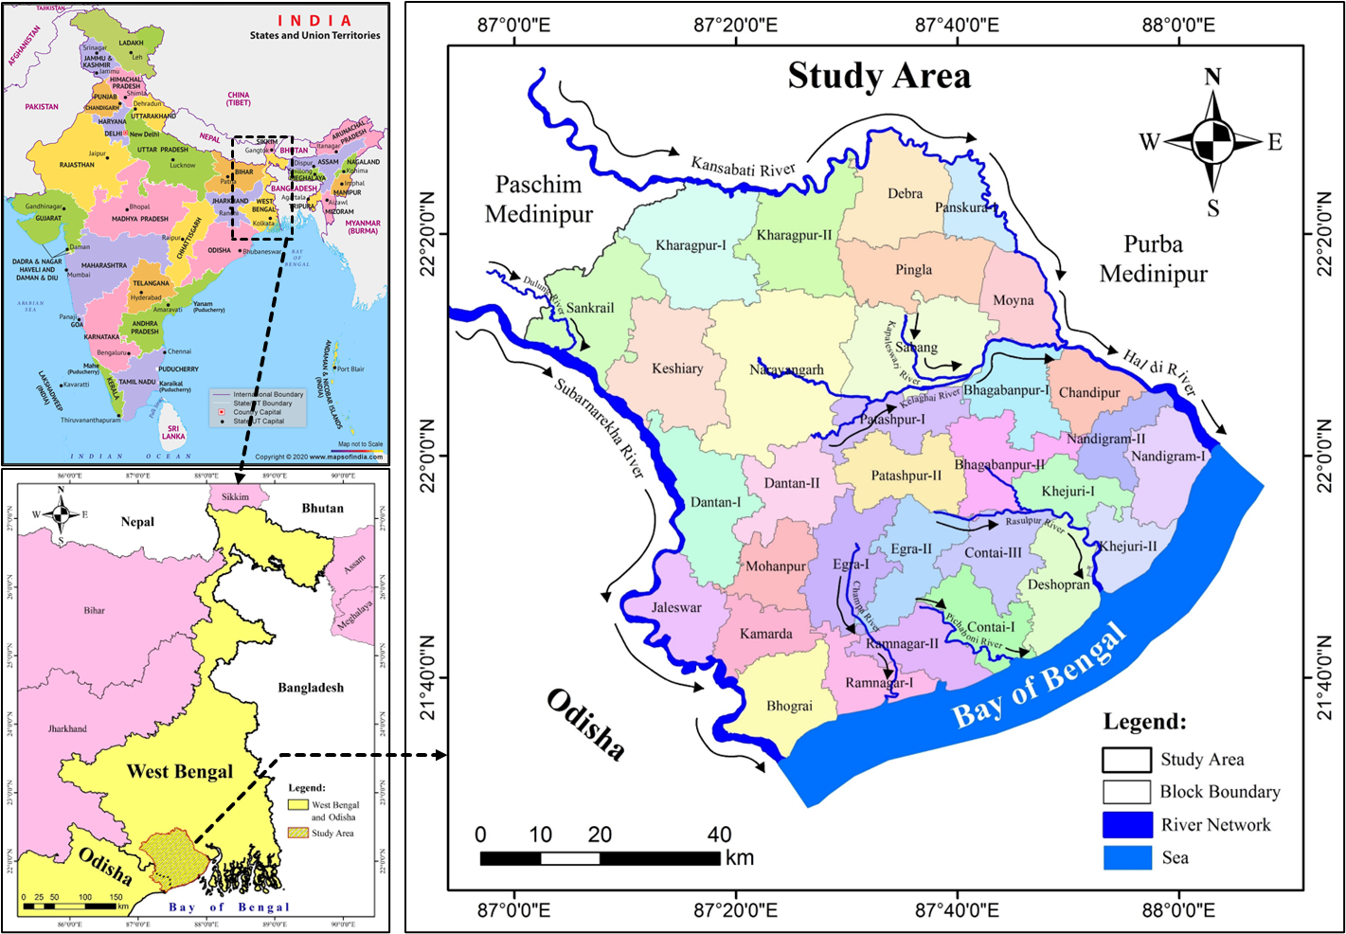
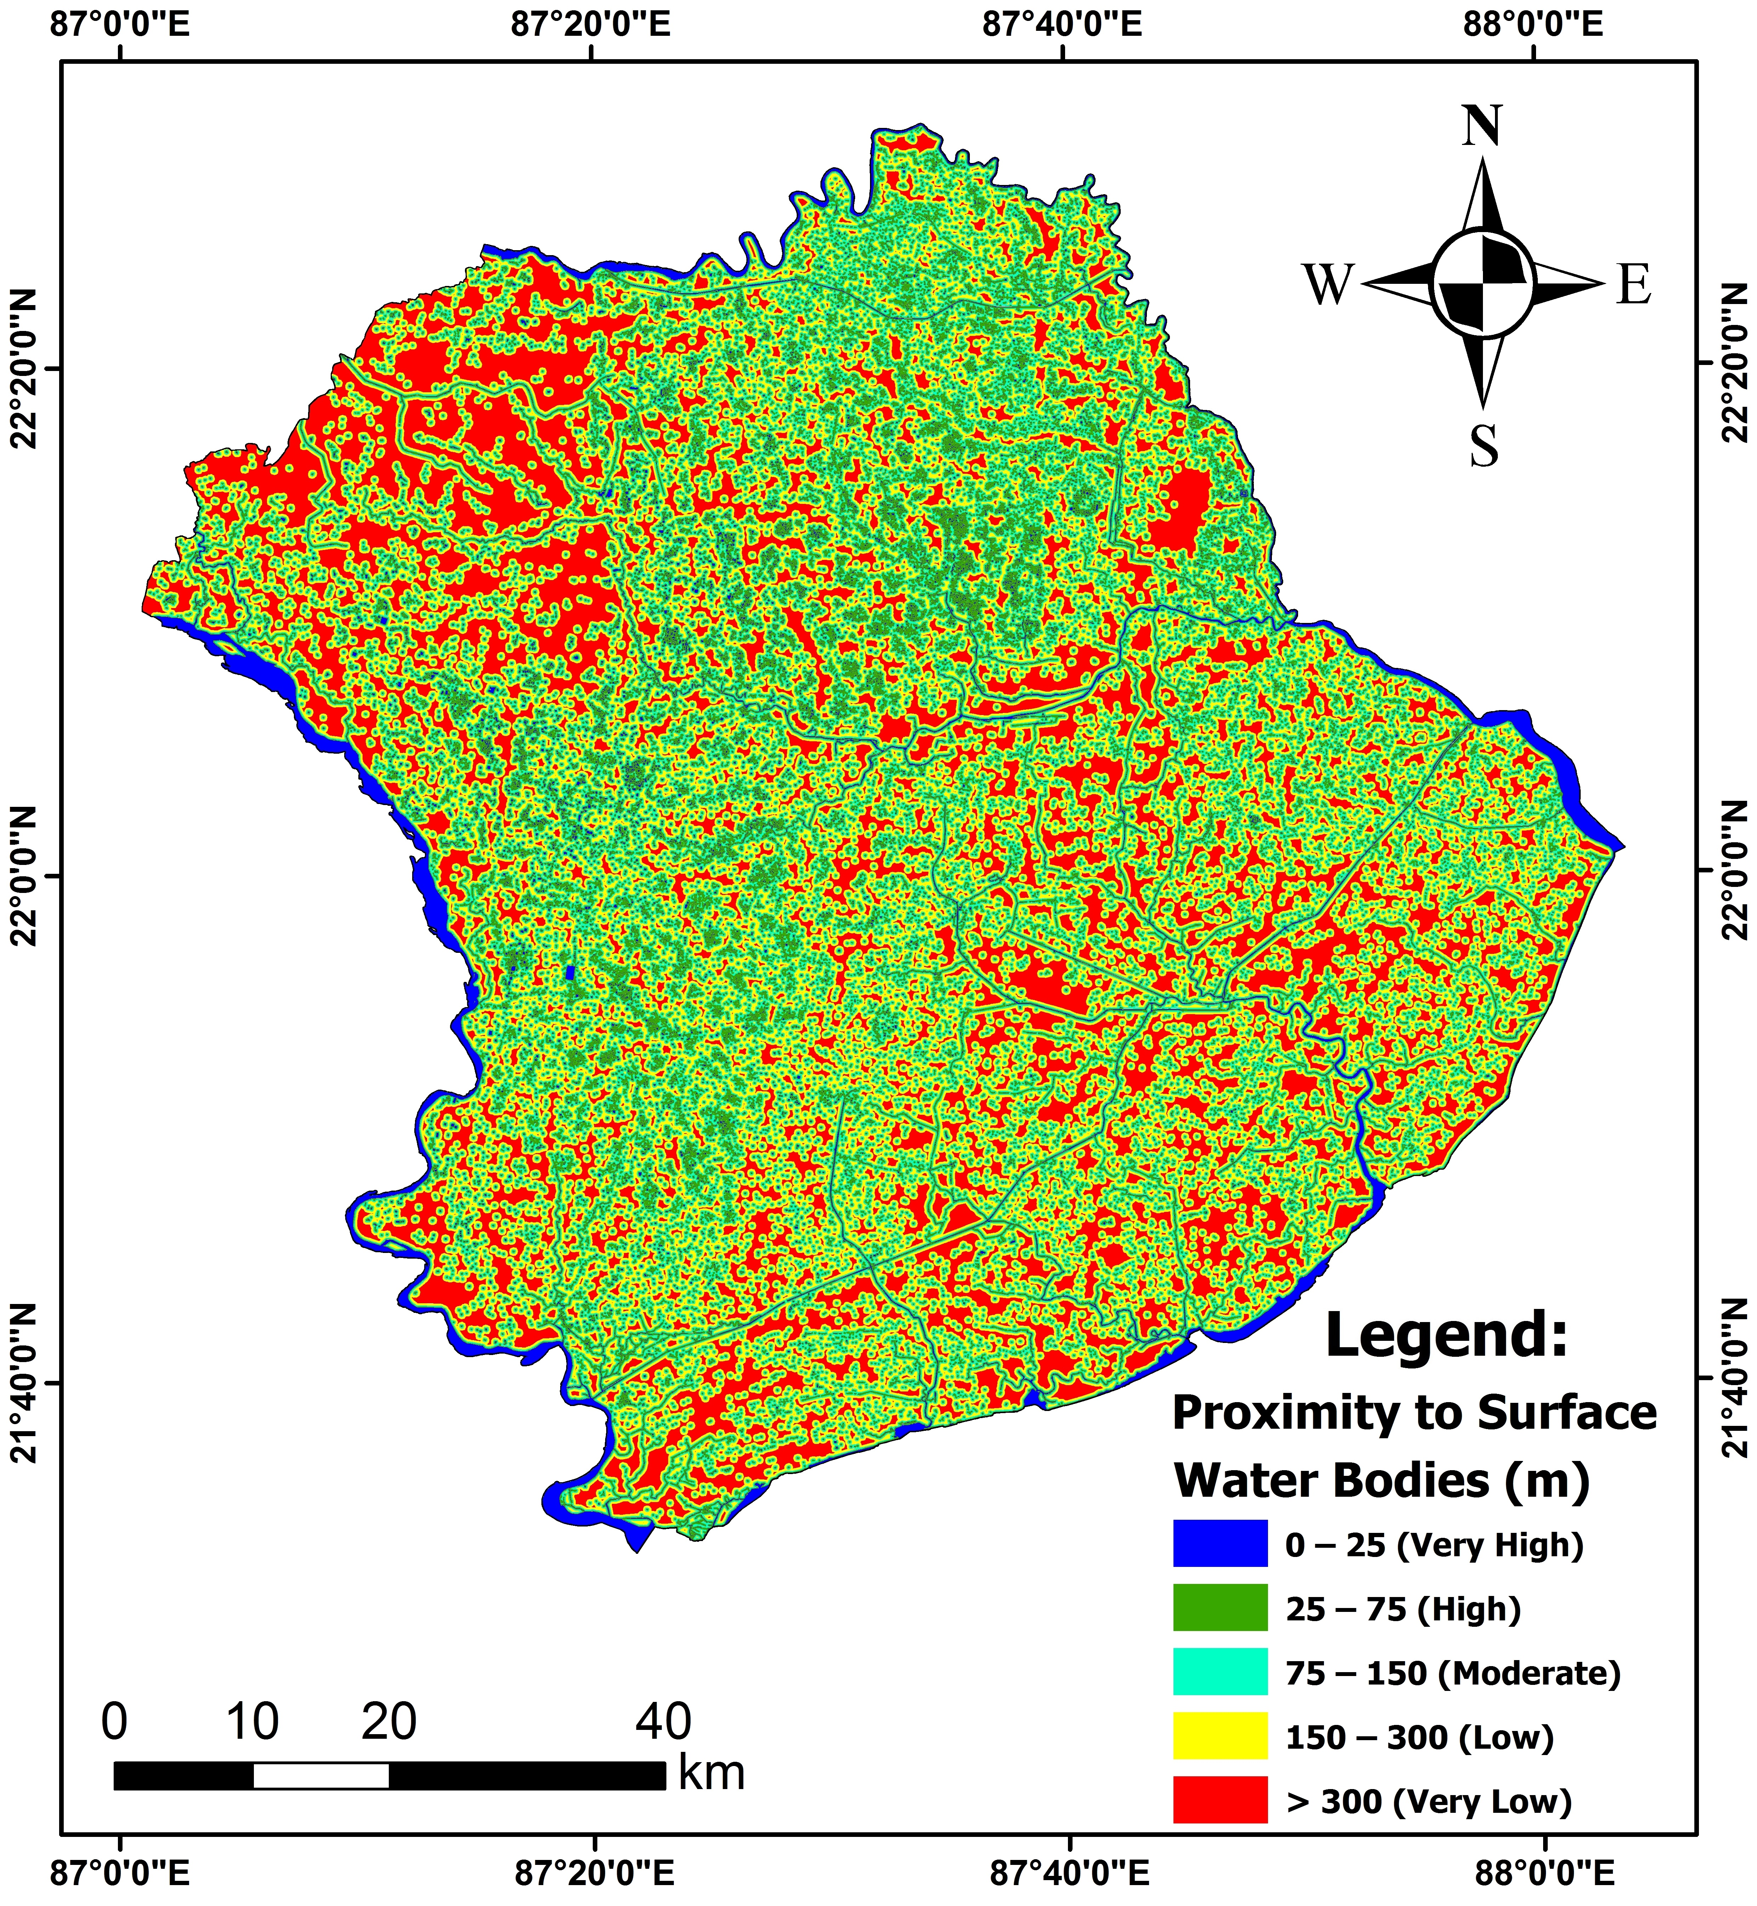
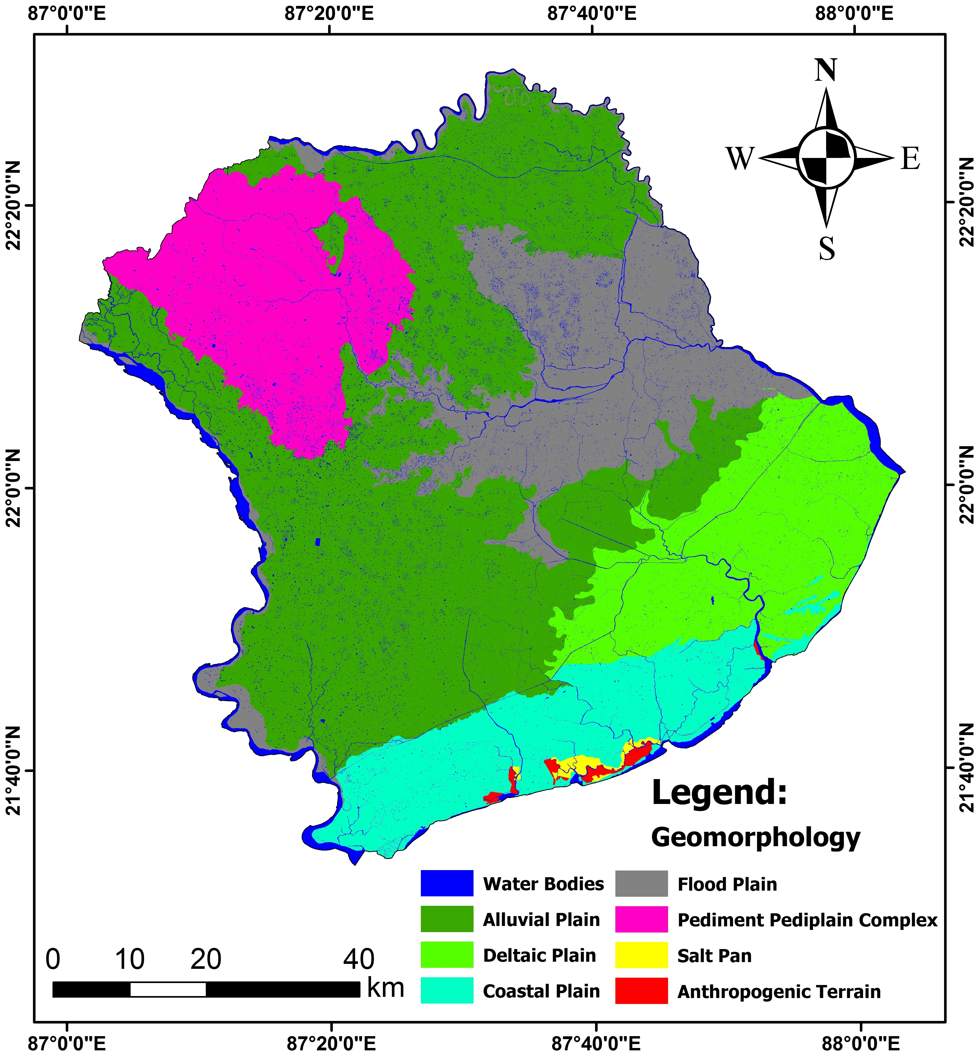
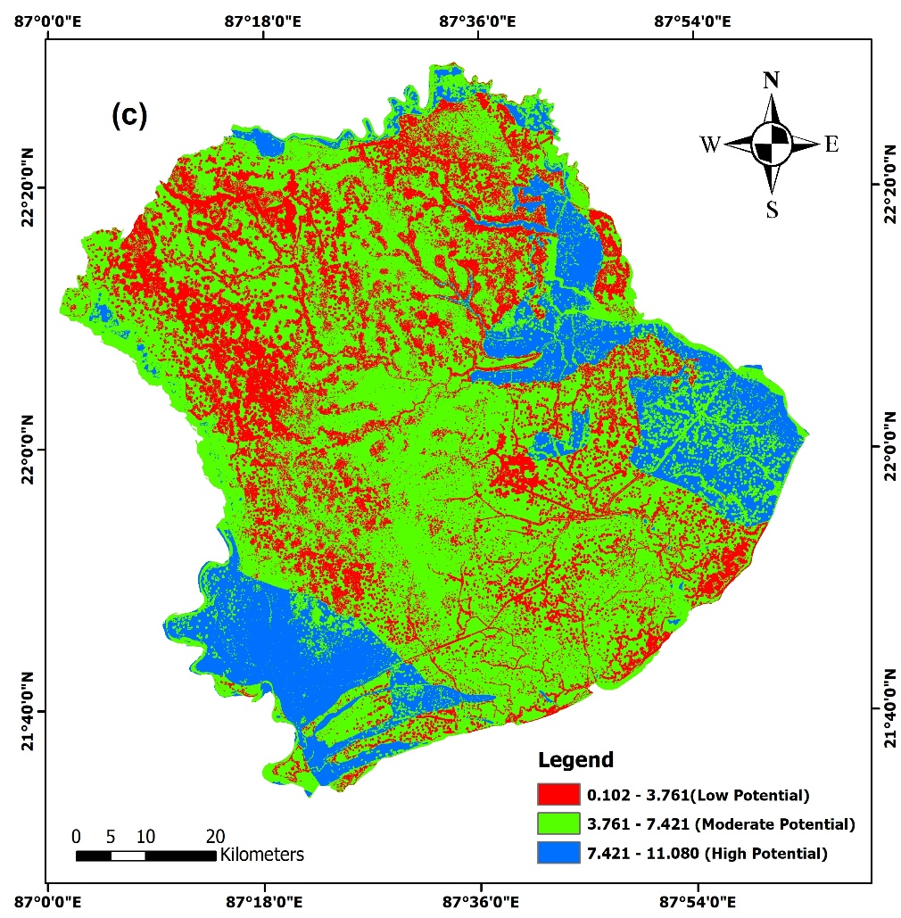
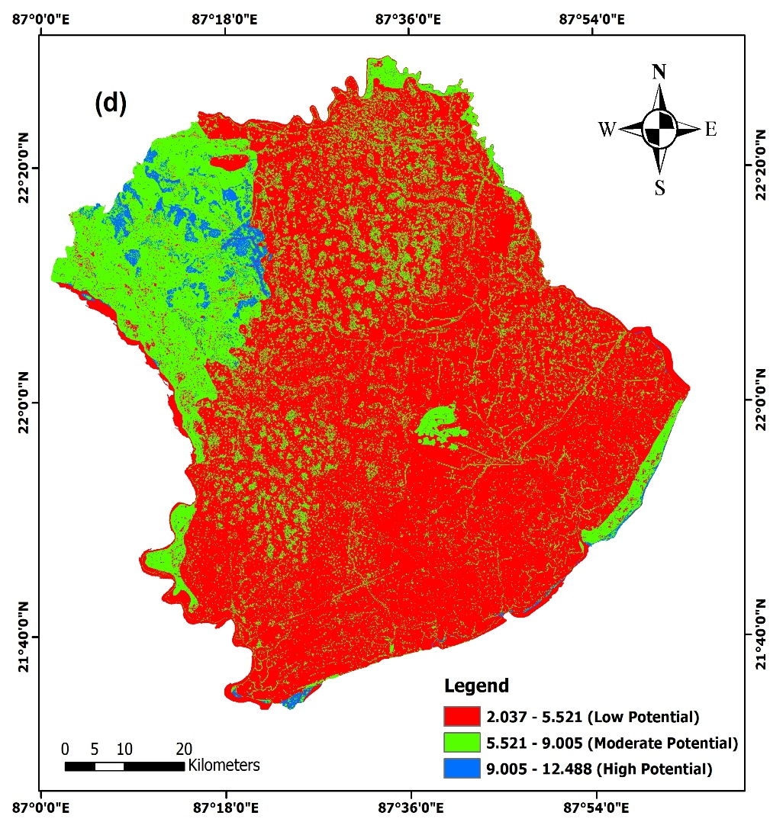
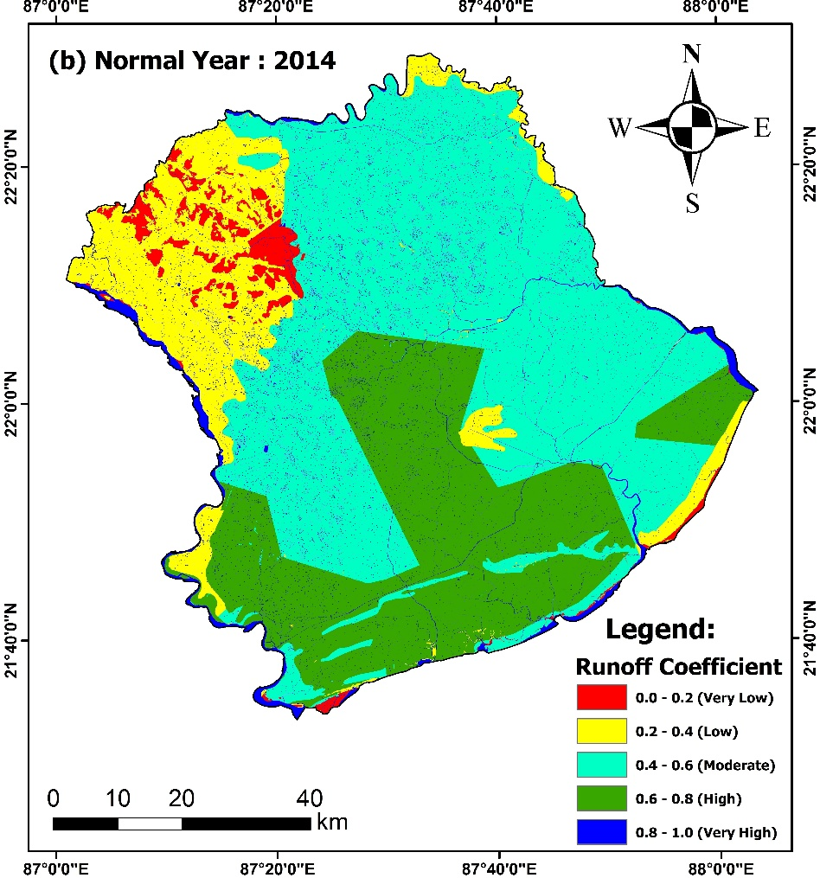
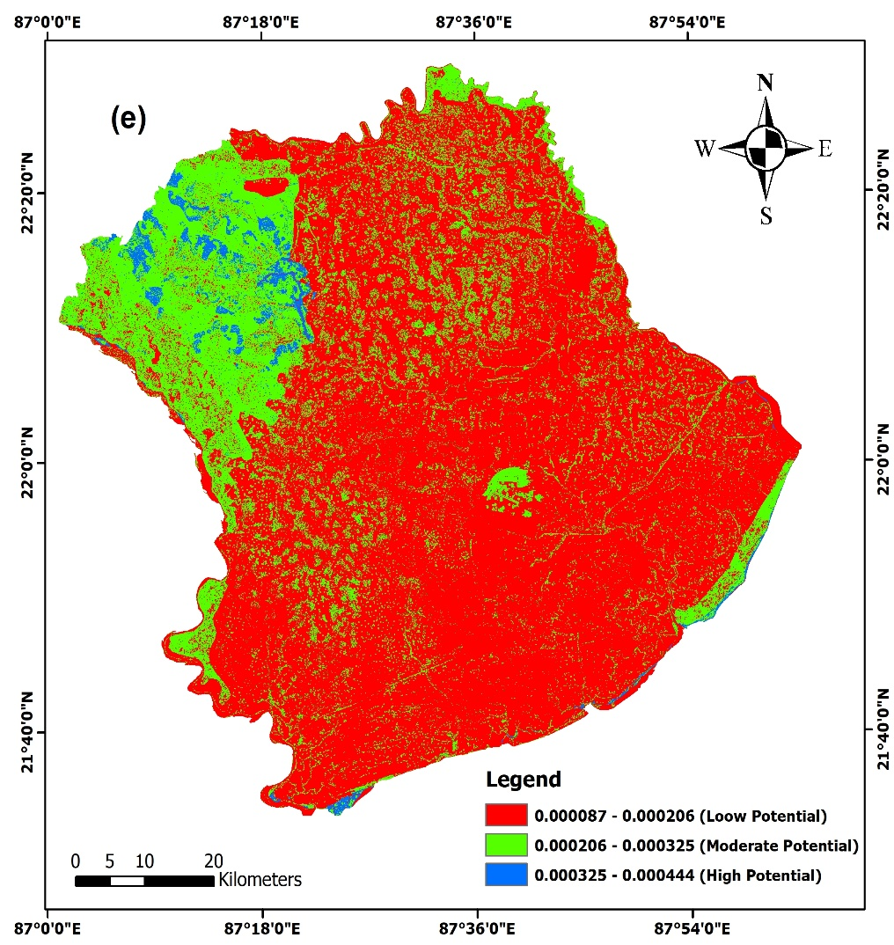
.
Comparative Evaluation of Multi-Criteria Decision Analysis Techniques for Groundwater Potential Mapping in a Coastal Alluvial Basin of Eastern India
Afrin Naz¹, Subhankar Ghosh¹ and Madan Kumar Jha¹
Indian Institute of Technology Kharagpur, West Bengal–721302, India
Background and Motivation
STEP 1: Generation of Thematic Layers
STEP 2: Calculation of Weights
Groundwater is a vital freshwater resource, but overexploitation has caused a significant decline in its levels worldwide, including in India.
As per CGWB (2019), West Bengal has a net groundwater potential of 39.64 km³ with 19.94 km³ annual extraction and 50.29% stage of development; 72 blocks are critical or semi-critical.
Per capita freshwater availability is projected to decline from 1820 m³ in 2001 to 1140 m³ in 2050.
Proximity to Surface Water Bodies
SRTM DEM
Runoff Coefficient(SCS –CN method)
Expert based techniques
Entropy Technique
((Singh et al., 2017)
Probabilistic Techniques
(Sahoo et al., 2015)
Geomorphology
Slope
Drainage Density
AHP
FAHP
FR
WoE
Pair wise comparison
Standardization of Weights
Overlay of well map
Generation of Thematic Layers in GIS
Normalization of weights
Estimation of Entropy Values
Calculation of FR and WoP
STEP 4: Validation of GWPZ Maps
STEP 3: Evaluation of five GIS-based MCDA Techniques in GWPZ
Observed Groundwater well location data
Integration of Thematic Layers in GIS
Fig. 5. Areas predicted by the AHP, FAHP, Entropy, FR, and WoE methods under different GWPZ classes.
Fig. 6. Validation of AHP, FAHP, Entropy, FR, and WoE techniques using the ROC plot
Objectives
To delineate groundwater potential zones using multiple techniques, viz., AHP, FAHP, Entropy, Frequency ratio and WoE.
To validate and compare MCDA techniques using the ROC-AUC plot to identify the most reliable approach for the GWP zones.
Validation of GWPZ map AHP, Fuzzy-AHP, Entropy, Frequency Ratio, and Weight of Evidence results, using Area Under the ROC Curve (AUC)
Calculation of Groundwater Potential Zones (GWPZ)
Generation of Groundwater Potential Maps (AHP, FAHP, Entropy, FR, and WoE)
Conclusions
The comparative evaluation indicates that the Fuzzy-AHP technique showed the highest proportion of GWPZ with a combined Moderate and High potential area of 85.35%, followed by AHP (77.53%) and Entropy (64.13%).
In contrast, WoE (31.75%) and FR (27.18%) classify substantially lower areas under favourable potential categories.
The ROC plot shows that the Fuzzy-AHP technique achieved the highest predictive accuracy (0.893), outperforming AHP (0.860), Entropy (0.752), WoE (0.694), and FR (0.672).
Materials and Methods
Fig. 2. Flowchart for GWPZ using AHP, FAHP, Entropy, FR, and WoE techniques.
The study area is located in the inter-basin of Haldi-Kansabati-Subarnarekha rivers in the southern coastal region of West Bengal, eastern India, and has an area of 6358 km². It lies within 21˚32΄44˝N−22˚29΄32˝N and 87˚00΄57˝E−88˚02΄54˝E.
Results and Discussion
(a)
(b)
Recommendation
Field Validation is recommended to verify high-potential zones and improve model reliability.
Integrating hydro-climatic variables and hybrid MCDA–ML approaches can enhance prediction accuracy.
(c)
(d)
Fig. 1. Location map of the study area.
References
Sahoo, S., Jha, M.K., Kumar, N., Chowdary, V.M. (2015). Evaluation of GIS-based multicriteria decision analysis and probabilistic modelling for exploring groundwater prospect. Environmental Earth Sciences, 74(3): 2223-2246.
Singh LK, Jha MK, Chowdary VM. Multi-criteria analysis and GIS modelling for identifying prospective water harvesting and artificial recharge sites for sustainable water supply. Journal of Cleaner Production. 2017 Jan 20; 142:1436-56.
Table 1. Data used in this study
Data Type | Data Interval | Period / Sites Resolution | Data Source
Rainfall | Daily | 1995–2024 | IMD (Pune, GoI), and DDA (GoWB)
Geomorphology | – | 1 : 50,000 | https://bhukosh.gsi.gov.in/Bhukosh/MapViewer.aspx
Soil Map | – | 1 : 5,00,000 | NBSSLUP (Kolkata, GoI)
Land-Use/Land-Cover | – | 2018–2023 (1 : 10,000) | https://bhuvan-app1.nrsc.gov.in/thematic/thematic/index.php
SRTM DEM | – | 2014 (30m×30m) | https://earthexplorer.usgs.gov/
Groundwater Observation Wells | Quarterly | 2001–2022 [256 sites] | CGWB (GoI, Kolkata), SWID (GoWB, Kolkata), and GWS&I (GoOD, Bhubaneswar)
(e)
Fig.3(a –e). Thematic layers: land slope(%), drainage density, proximity to surface water bodies, geomorphology, and Runoff Coefficient of the study area.
Fig. 4(a-e). GWP Zones map using AHP, Fuzzy-AHP, Entropy, FR, and WoE techniques.
Acknowledgements
Afrin Naz is thankful to CGWB, GWS&I and WRIDD for data support, and Ministry of Education, Govt. of India for providing MHRD Fellowship.

