Slide 1















Homogenization activities of ground-based aerosol optical depth measurements within WMO Filterradiometers Campaign (FRC-VI)
Natalia Kouremeti, Stelios Kazadzis, Julian Gröbner, Gregor Hülsen, Angelos Karanikolas, Miguel Huerta, and Saulius Nevas
&
FRC-VI participants
Notes:
Metrological Traceability : property of a measurement result whereby the result can be related to a reference through a documented unbroken chain of calibrations, each contributing to the measurement uncertainty
What it actually means:
an unbroken chain of comparisons going back to stated references acceptable to the parties, usually a national or international standard;
uncertainty of measurement; the uncertainty of measurement for each step in the traceability chain must be calculated or estimated according to agreed methods and must be stated so that an overall uncertainty for the whole chain may be calculated or estimated;
documentation; each step in the chain must be performed according to documented and generally acknowledged procedures; the results must be recorded;
competence; the laboratories or bodies performing one or more steps in the chain must supply evidence for their technical competence (e.g. by demonstrating that they are accredited);
reference to SI units; the chain of comparisons must, where possible, end at primary standards for the realisation of the SI units;
calibration intervals; calibrations must be repeated at appropriate intervals; the length of these intervals will depend on a number of variables (e.g. uncertainty required, frequency of use, way of use, stability of the equipment).

Slide 2
WMO Filterradiometers Campaign (FRC-VI)
The World Optical depth Research and Calibration Center (WORCC) at PMOD/WRC operates and maintains the World Meteorological Organization (WMO) AOD reference, known as GAWPFR-TRIAD. This reference consists of three Precision Filter Radiometer (PFR) instruments.
PMOD/WRC disseminates the GAWPFR-TRIAD scale through Filter Radiometer Campaigns (FRC) organized every 5 years on behalf of WMO.
GAWPFR-TRIAD
Calibration of filter-radiometers - not traceable to SI
WMO identified the need of reference for AOD measurements
FRC
Quantify differences between different International & National AOD networks
Assess uncertainties of measured AOD
Identify the origin of the difference
Test extrapolation methods of AOD outside the measured spectral region of the GAWPFR-TRIAD
Test transfer SI- traceable scale to other filter-radiometers
GAWPFR-TRIAD - Scale & Uncertainty
Overview of the FRC-VI
AOD comparison examples
Notes:
Metrological Traceability : property of a measurement result whereby the result can be related to a reference through a documented unbroken chain of calibrations, each contributing to the measurement uncertainty
What it actually means:
an unbroken chain of comparisons going back to stated references acceptable to the parties, usually a national or international standard;
uncertainty of measurement; the uncertainty of measurement for each step in the traceability chain must be calculated or estimated according to agreed methods and must be stated so that an overall uncertainty for the whole chain may be calculated or estimated;
documentation; each step in the chain must be performed according to documented and generally acknowledged procedures; the results must be recorded;
competence; the laboratories or bodies performing one or more steps in the chain must supply evidence for their technical competence (e.g. by demonstrating that they are accredited);
reference to SI units; the chain of comparisons must, where possible, end at primary standards for the realisation of the SI units;
calibration intervals; calibrations must be repeated at appropriate intervals; the length of these intervals will depend on a number of variables (e.g. uncertainty required, frequency of use, way of use, stability of the equipment).

Slide 3
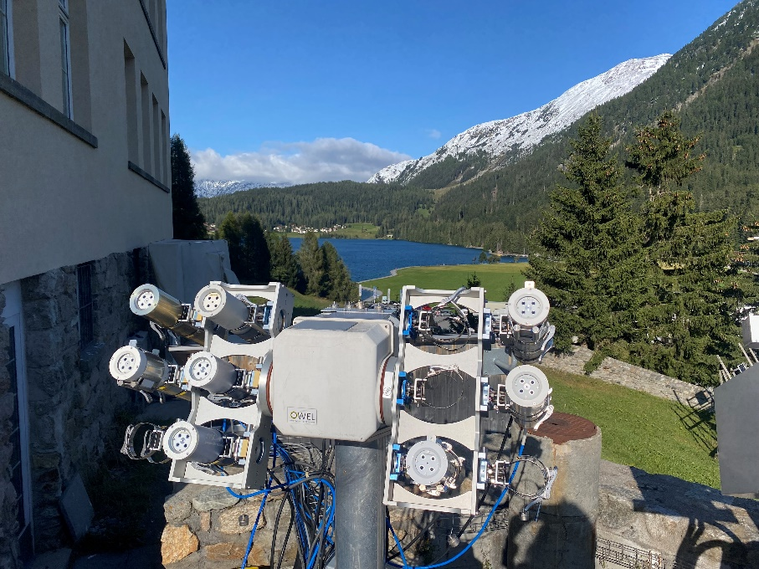
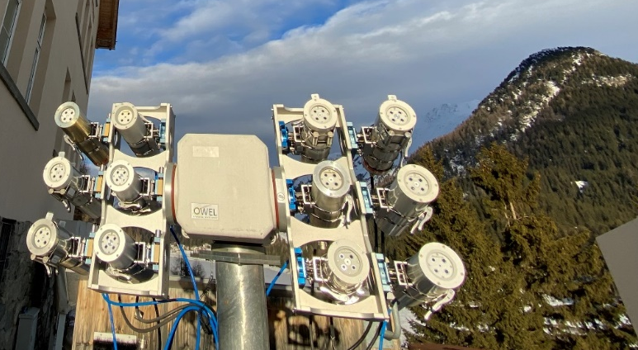
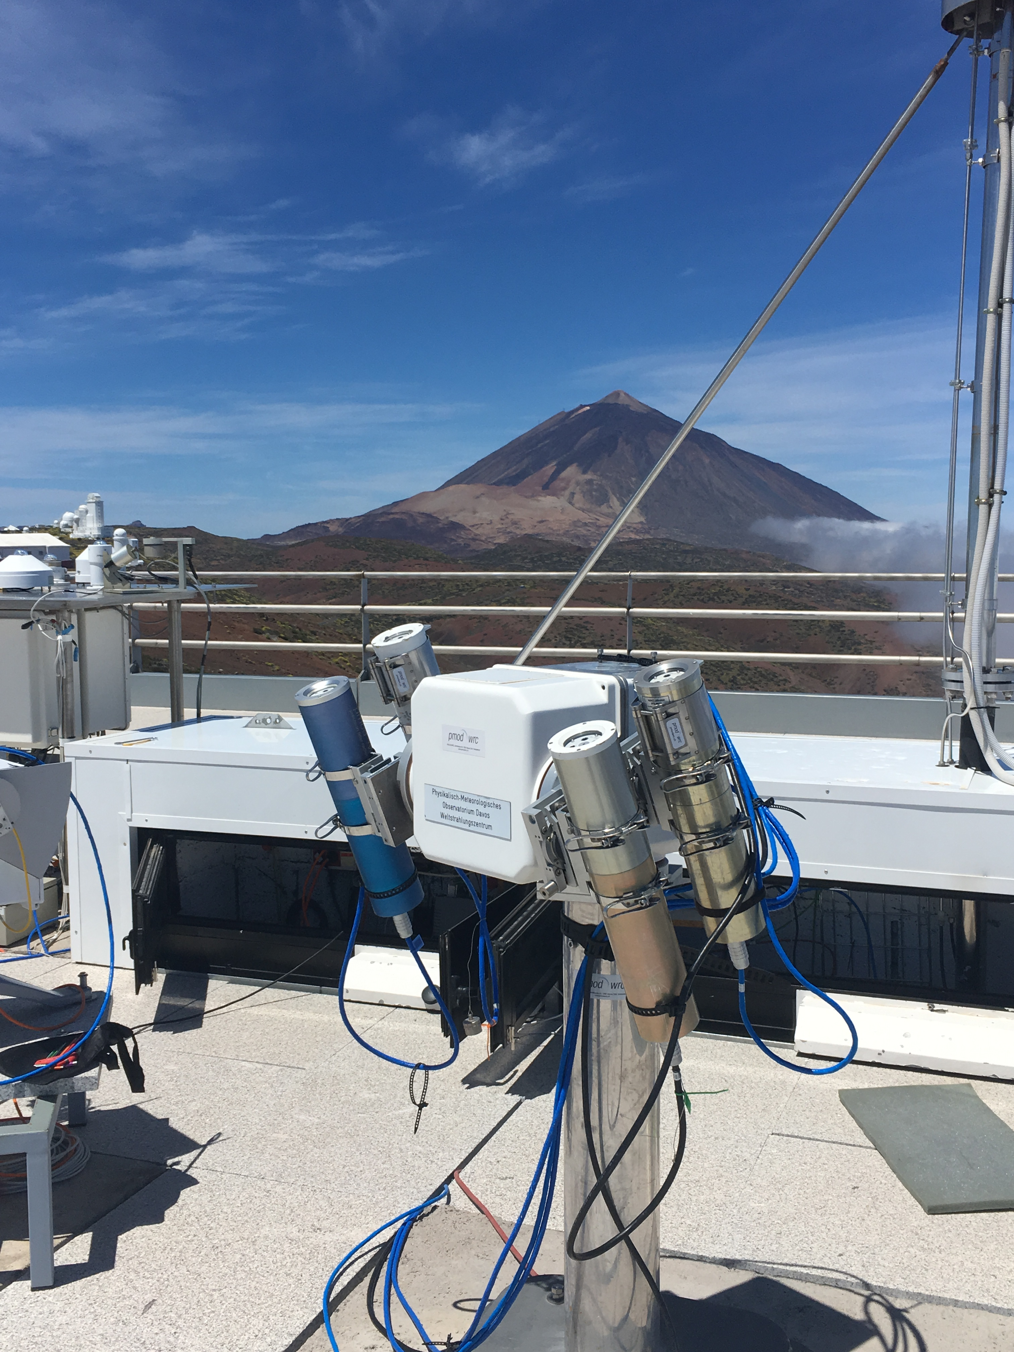
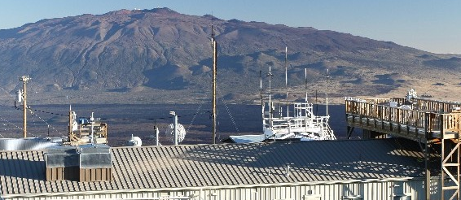
WMO AOD reference – GAWPFR_TRIAD at PMOD/WRC, Davos
PMOD/WRC, Davos (CH)
GAW-PFR-Triad = 3 PFR instruments
Almost identical spectral characteristics (wavelength, bandpass)
Well maintained
The scale is realized through signal comparison to Langley-transfer standards.
The stability and precision are assessed annually.
Pool of 9 traveling standards for deployment at the Langley calibration sites.
Service
&
Calibration
Service
&
Calibration
Izaña,Tenerife(ES)
Mauna-Loa, Hawaii (US)
Notes:
WORCC was established in 96 under the recommendations of Global Atmospheric Watch Program (GAW) & World Meteorological Organization (WMO) experts
In 2006 it was decided to be the primary WMO reference for AOD measurement
The main obligations of WORCC are
1. Develop accurate radiometric references for spectral solar radiometry used to determine optical depth.
For that the PFR and PSR have been developed at POMD/WRC
The primary obligation of WORCC is to maintain the WMO AOD Reference which is formed by 3 PFRs , operated at PMOD/WRC, DAVOS,CH
the internal stability of the PFR-TRIAD is continuous monitoter and its long term stability is is better that 1%
the PFR-Trad is calibrated through signal comparison to other PFR that have been calibrated at our primary calib sites IZO, MLO
The most relevant obligation to this work is the
Development of new methods for the determination of optical depth. “SI traceable AOD retrievals”
Mandate
Develop accurate radiometric references for spectral solar radiometry used to determine optical depth.
Develop procedures to ensure world-wide homogeneity of optical depth measurements by providing transfer standards for precision filter radiometry.
Develop and test new instrumentation and methods for the determination of optical depth.
Implement a network of Precision Filter Radiometers (PFR) at Global Atmosphere Watch (GAW) stations.
Develop relevant quality control procedures in cooperation with GAW Quality Assurance/Science Activity Centers.
Training of staff to operate PFRs.

Slide 4
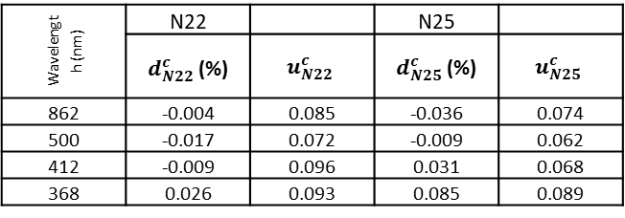
WMO AOD reference – GAWPFR_TRIAD N01, N22, N25
2025 (FRC-VI) status
Langley Location | PFR | Langley period | Installation
Izaña | N01 | 29.May & 30.May.2025
Izaña | N21 | 03.Jan to 27.May.2024 29.May & 30.May.2025 | Jul.2024
Izaña | N10 |  | 20-Jun
Izaña | N06 |  | 20-Jun
Mauna - Loa | N07 |  | 19-Sep
Izaña | N102 |  | 28-Sep
Wavelength (nm) | N22 |  | N25
 | $d_{N22}^{c}$ (%) | $$u_{N22}^{c}$$ | $d_{N25}^{c}$ (%) | $$u_{N25}^{c}$$
862 | -0.004 | 0.085 | -0.036 | 0.074
500 | -0.017 | 0.072 | -0.009 | 0.062
412 | -0.009 | 0.096 | 0.031 | 0.068
368 | 0.026 | 0.093 | 0.085 | 0.089
Covariance combined relative uncertainty (%,k=1) | 0.137 | 0.153 | 0.169 | 0.162
Notes:
Metrological Traceability : property of a measurement result whereby the result can be related to a reference through a documented unbroken chain of calibrations, each contributing to the measurement uncertainty
What it actually means:
an unbroken chain of comparisons going back to stated references acceptable to the parties, usually a national or international standard;
uncertainty of measurement; the uncertainty of measurement for each step in the traceability chain must be calculated or estimated according to agreed methods and must be stated so that an overall uncertainty for the whole chain may be calculated or estimated;
documentation; each step in the chain must be performed according to documented and generally acknowledged procedures; the results must be recorded;
competence; the laboratories or bodies performing one or more steps in the chain must supply evidence for their technical competence (e.g. by demonstrating that they are accredited);
reference to SI units; the chain of comparisons must, where possible, end at primary standards for the realisation of the SI units;
calibration intervals; calibrations must be repeated at appropriate intervals; the length of these intervals will depend on a number of variables (e.g. uncertainty required, frequency of use, way of use, stability of the equipment).

Slide 5

WMO AOD reference – GAWPFR-TRIAD
AOD Extrapolation
PFR wavelengths : 368 nm, 412 nm, 500nm, 862 nm
$$\log\left(τ\right)=−αx+b where x=log⁡(λ)$$
$$\log\left(τ\right)=a_{2}x^{2}−αx+b$$
QASUME – PFR : 2021-2024
At 340nm 0.0018 ± 0.0060 (k=2)
Notes:
Metrological Traceability : property of a measurement result whereby the result can be related to a reference through a documented unbroken chain of calibrations, each contributing to the measurement uncertainty
What it actually means:
an unbroken chain of comparisons going back to stated references acceptable to the parties, usually a national or international standard;
uncertainty of measurement; the uncertainty of measurement for each step in the traceability chain must be calculated or estimated according to agreed methods and must be stated so that an overall uncertainty for the whole chain may be calculated or estimated;
documentation; each step in the chain must be performed according to documented and generally acknowledged procedures; the results must be recorded;
competence; the laboratories or bodies performing one or more steps in the chain must supply evidence for their technical competence (e.g. by demonstrating that they are accredited);
reference to SI units; the chain of comparisons must, where possible, end at primary standards for the realisation of the SI units;
calibration intervals; calibrations must be repeated at appropriate intervals; the length of these intervals will depend on a number of variables (e.g. uncertainty required, frequency of use, way of use, stability of the equipment).

Slide 6
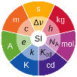

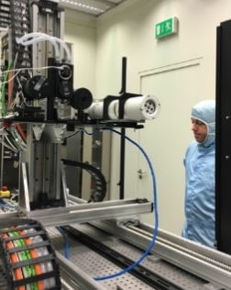
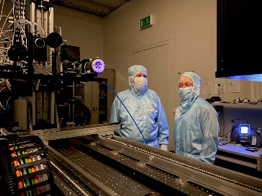
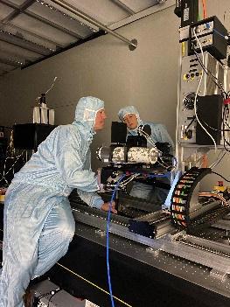


SI-traceable Solar irradiance
TUnable Lasers In Photometry (TULIP) setup
ps-OPO system
Fully automated system (230 nm to 2030 nm)
Wavelength scale: Laser Spectrum analyser (LSA)
Homogenized beam
Reference detector: 3-element trap detector and equipped with a calibrated aperture, giving an uncertainty better than 0.1 %
Calibration uncertainty < 0.3%
 | Change in responsivity (%) |  |  |  | Change in centroid wavelength (pm)
 | 863.0 | 500.8 | 412.0 | 367.6 | 863.0 | 500.8 | 412.0 | 367.6
2018 (-3 years) | 0.27 | 0.40 | 0.81 | 0.80 | -58 | 10 | 5 | 0
2021 | 0 | 0 | 0 | 0 | 0 | 0 | 0 | 0
2024 (+3 years) | -0.28 | -0.34 | -0.92 | -1.00 | 0 | 0 | 2 | -2
2026.Mar
19ENV04 MAPP Metrology for aerosol optical properties
Traceability of the GAW-PFR reference Precision FilterRadiometers to the SI
Notes:
In 2021, the calibration of the PFR was carried out at the TULIP setup, which had been upgraded by a ps-OPO system. The new ps-OPO system operates at 80 MHz repetition rate and 2.5 ps pulse duration.
It includes frequency doubling (SHG) and tripling units (THG) for the signal and idler beams enabling a hands-free operation over a spectral range from 230 nm to 2030 nm. The narrow bandwidth of the new laser system enables the wavelength of the output radiation to be measured directly by an LSA, which can be done with an uncertainty of a few pm. The output beam of the laser system is intensity stabilised throughout the whole spectral range by means of two LCD modulator-based laser power stabilisation systems that are put into the signal and idler beams of the ps-OPO. As the beams are modulated before being fed into the SHG and THG modules and the feedback signal for the stabilisers is collected from the beam shaping optics for the irradiance field preparation, the irradiance at the plane of measurements is stabilised throughout the whole spectral range of operations. The generated irradiances are a factor of 10 to 100 higher almost throughout the whole spectral range, except for the wavelength range between 480 nm and 560 nm, as compared to those provided by the fs-OPO system.
A homogeneous irradiance field for the measurements was generated by a micro-lens array.

Slide 7

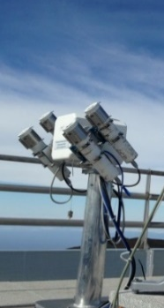
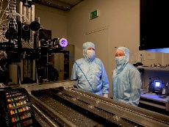
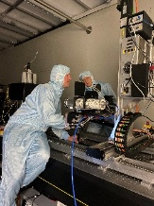


WMO AOD reference – GAWPFR-TRIAD
Langley Calibration
&
SI-Traceable Calibration
NMI
PTB
Primary Reference for AOD
ISO 17025 Accredited laboratory
Traveling standards
Langley PFRs
Field instruments
GAW-PFR Triad
Traceability of the GAW-PFR reference Precision FilterRadiometers to the SI
19ENV04 MAPP Metrology for aerosol optical properties
Notes:
Metrological Traceability : property of a measurement result whereby the result can be related to a reference through a documented unbroken chain of calibrations, each contributing to the measurement uncertainty
What it actually means:
an unbroken chain of comparisons going back to stated references acceptable to the parties, usually a national or international standard;
uncertainty of measurement; the uncertainty of measurement for each step in the traceability chain must be calculated or estimated according to agreed methods and must be stated so that an overall uncertainty for the whole chain may be calculated or estimated;
documentation; each step in the chain must be performed according to documented and generally acknowledged procedures; the results must be recorded;
competence; the laboratories or bodies performing one or more steps in the chain must supply evidence for their technical competence (e.g. by demonstrating that they are accredited);
reference to SI units; the chain of comparisons must, where possible, end at primary standards for the realisation of the SI units;
calibration intervals; calibrations must be repeated at appropriate intervals; the length of these intervals will depend on a number of variables (e.g. uncertainty required, frequency of use, way of use, stability of the equipment).

Slide 8










FRC-VI Participants
GAWPFR-T | WRC_WORCC_GAWPFR-T-N01 | PFR-98-N-001
GAWPFR-T | WRC_WORCC_GAWPFR-T-N22 | PFR-98-N-022
GAWPFR-T | WRC_WORCC_GAWPFR-T-N25 | PFR-98-N-025
PFR | WRC_WORCC_PFR#SI-N01 | PFR-98-N-001
QASUME | WRC_WCCUV_QASUME-UV | QASUME1
QASUME | WRC_WCCUV_QASUME-IR | QASUME-IR
PFR | CH_PMOD_PFR#L-N06 | PFR-98-N-006
PFR | CH_PMOD_PFR#L-N07 | PFR-98-N-007
PFR | CH_PMOD_PFR#L-N10 | PFR-98-N-010
PFR | CH_PMOD_PFR-N102 | PFR-19-N-102
PFR | CH_PMOD_PFR-N103 | PFR-19-N-103
PFR | DE_DWD_PFR | PFR-19-N-128
PFR | DE_DWD_PFR-F | PFR-19-F-108
PFR | FI_FMI_PFR | PFR-99-N-031
PFR | SE_SMHI_PFR | PFR-05-N-035
CIMEL | CH_PMOD_CE | #943
CIMEL | ES_AEMET_CE | #1091
CIMEL | ES_GOA.UVa_CE | #942
CIMEL | FR_LOA.UoL_CE | #1144
CW193 | CN_CMA_CW193 | CW193
CW193 | CN_CMA_CW193 | CW193
POM | ES_UV_POM | PS1805105
POM | IT_CNR.ISAC_POM | PS1107111
POM | JP_JMA_POM | PS2509103
SP02 | ES_CIEMAT_SP02-L | #1089
MFRSR | US_NOAA_MFR#8 | MFR#648
MFRSR | US_NOAA_MFR#9 | MFR#649
SSIM | DE_PTB_SSIM | SolarSIM-D2 160
BTS | CH_PMOD_BTS | #
BTS | ES_CIEMAT_BTS | #63920
CAS | DE_PTB_CAS | #187814211
CAS | DE_PTB_CAS-IR | #634814214
CAS | DE_PTB_CAS-VisNIR | #190214211
HSR1 | US_NOAA_HSR1 | HSR1-012
PSR | CH_PMOD_PSR#09 | PSR#009
PSR | DE_DWD_PSR#04 | PSR#004
CLT | ES_AEMET_CLT | -
CLT | CH_PMOD_CLT | -
MTS | CY_ECOE_MTS | -
30 instruments
to be compared
WMO AOD reference: GAWPFR-TRIAD
&
QASUME - UV&IR
Notes:
Metrological Traceability : property of a measurement result whereby the result can be related to a reference through a documented unbroken chain of calibrations, each contributing to the measurement uncertainty
What it actually means:
an unbroken chain of comparisons going back to stated references acceptable to the parties, usually a national or international standard;
uncertainty of measurement; the uncertainty of measurement for each step in the traceability chain must be calculated or estimated according to agreed methods and must be stated so that an overall uncertainty for the whole chain may be calculated or estimated;
documentation; each step in the chain must be performed according to documented and generally acknowledged procedures; the results must be recorded;
competence; the laboratories or bodies performing one or more steps in the chain must supply evidence for their technical competence (e.g. by demonstrating that they are accredited);
reference to SI units; the chain of comparisons must, where possible, end at primary standards for the realisation of the SI units;
calibration intervals; calibrations must be repeated at appropriate intervals; the length of these intervals will depend on a number of variables (e.g. uncertainty required, frequency of use, way of use, stability of the equipment).

Slide 9
FRC-VI Preliminary Results
Notes:
Metrological Traceability : property of a measurement result whereby the result can be related to a reference through a documented unbroken chain of calibrations, each contributing to the measurement uncertainty
What it actually means:
an unbroken chain of comparisons going back to stated references acceptable to the parties, usually a national or international standard;
uncertainty of measurement; the uncertainty of measurement for each step in the traceability chain must be calculated or estimated according to agreed methods and must be stated so that an overall uncertainty for the whole chain may be calculated or estimated;
documentation; each step in the chain must be performed according to documented and generally acknowledged procedures; the results must be recorded;
competence; the laboratories or bodies performing one or more steps in the chain must supply evidence for their technical competence (e.g. by demonstrating that they are accredited);
reference to SI units; the chain of comparisons must, where possible, end at primary standards for the realisation of the SI units;
calibration intervals; calibrations must be repeated at appropriate intervals; the length of these intervals will depend on a number of variables (e.g. uncertainty required, frequency of use, way of use, stability of the equipment).

Slide 10
FRC-VI Preliminary Results
Notes:
Metrological Traceability : property of a measurement result whereby the result can be related to a reference through a documented unbroken chain of calibrations, each contributing to the measurement uncertainty
What it actually means:
an unbroken chain of comparisons going back to stated references acceptable to the parties, usually a national or international standard;
uncertainty of measurement; the uncertainty of measurement for each step in the traceability chain must be calculated or estimated according to agreed methods and must be stated so that an overall uncertainty for the whole chain may be calculated or estimated;
documentation; each step in the chain must be performed according to documented and generally acknowledged procedures; the results must be recorded;
competence; the laboratories or bodies performing one or more steps in the chain must supply evidence for their technical competence (e.g. by demonstrating that they are accredited);
reference to SI units; the chain of comparisons must, where possible, end at primary standards for the realisation of the SI units;
calibration intervals; calibrations must be repeated at appropriate intervals; the length of these intervals will depend on a number of variables (e.g. uncertainty required, frequency of use, way of use, stability of the equipment).

Slide 11
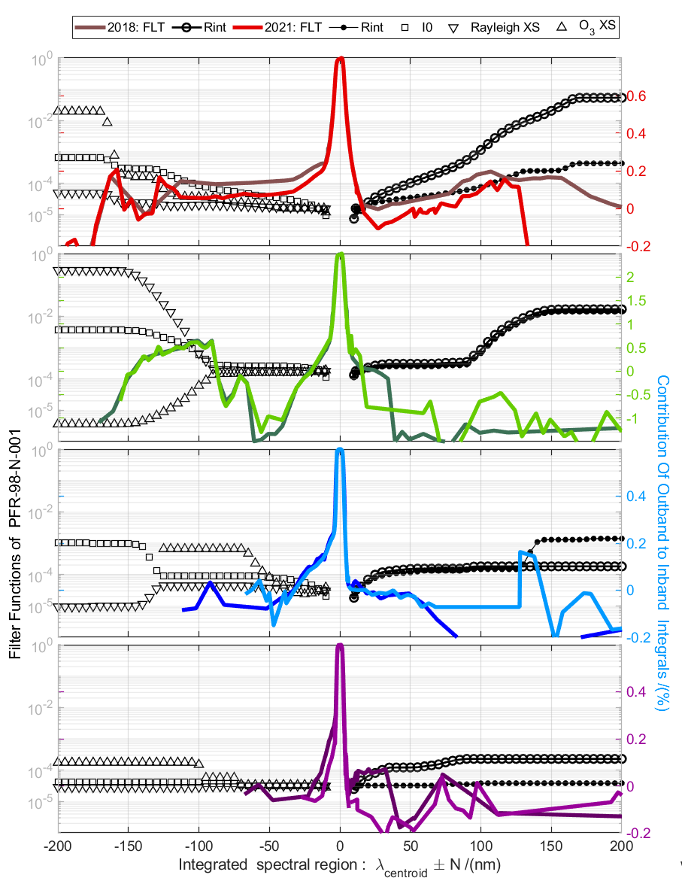
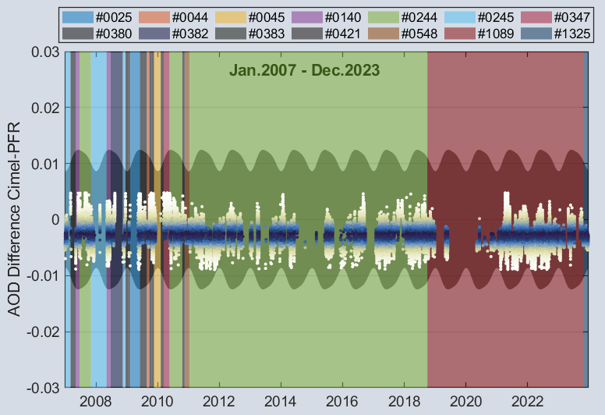
Stray Light
Notes:
Metrological Traceability : property of a measurement result whereby the result can be related to a reference through a documented unbroken chain of calibrations, each contributing to the measurement uncertainty
What it actually means:
an unbroken chain of comparisons going back to stated references acceptable to the parties, usually a national or international standard;
uncertainty of measurement; the uncertainty of measurement for each step in the traceability chain must be calculated or estimated according to agreed methods and must be stated so that an overall uncertainty for the whole chain may be calculated or estimated;
documentation; each step in the chain must be performed according to documented and generally acknowledged procedures; the results must be recorded;
competence; the laboratories or bodies performing one or more steps in the chain must supply evidence for their technical competence (e.g. by demonstrating that they are accredited);
reference to SI units; the chain of comparisons must, where possible, end at primary standards for the realisation of the SI units;
calibration intervals; calibrations must be repeated at appropriate intervals; the length of these intervals will depend on a number of variables (e.g. uncertainty required, frequency of use, way of use, stability of the equipment).

Slide 12
Stray Light
Notes:
Metrological Traceability : property of a measurement result whereby the result can be related to a reference through a documented unbroken chain of calibrations, each contributing to the measurement uncertainty
What it actually means:
an unbroken chain of comparisons going back to stated references acceptable to the parties, usually a national or international standard;
uncertainty of measurement; the uncertainty of measurement for each step in the traceability chain must be calculated or estimated according to agreed methods and must be stated so that an overall uncertainty for the whole chain may be calculated or estimated;
documentation; each step in the chain must be performed according to documented and generally acknowledged procedures; the results must be recorded;
competence; the laboratories or bodies performing one or more steps in the chain must supply evidence for their technical competence (e.g. by demonstrating that they are accredited);
reference to SI units; the chain of comparisons must, where possible, end at primary standards for the realisation of the SI units;
calibration intervals; calibrations must be repeated at appropriate intervals; the length of these intervals will depend on a number of variables (e.g. uncertainty required, frequency of use, way of use, stability of the equipment).

Slide 13





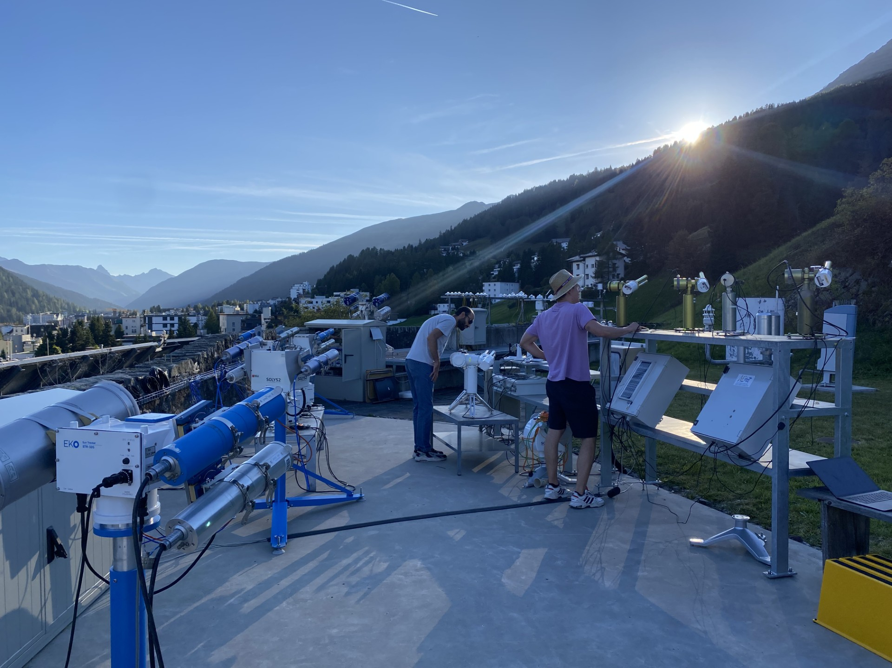



FRC-VI Conclusions
AOD retrievals based on Langley & SI- traceable calibration agree within 0.01 in AOD in the wavelength range 340 nm – 1024 nm
AOD extrapolation of the reference instruments provides accurate results in the range 340 nm – 1024 nm under the studied aerosol load and aerosol type
Distinguish impact of calibration & wavelength mismatches in the observed AOD differences
WMO report of FRC-VI
Filter data
Request final version from participants
Many thanks to the FRC-VI participants
&
Thank you for your attention!
Notes:
Metrological Traceability : property of a measurement result whereby the result can be related to a reference through a documented unbroken chain of calibrations, each contributing to the measurement uncertainty
What it actually means:
an unbroken chain of comparisons going back to stated references acceptable to the parties, usually a national or international standard;
uncertainty of measurement; the uncertainty of measurement for each step in the traceability chain must be calculated or estimated according to agreed methods and must be stated so that an overall uncertainty for the whole chain may be calculated or estimated;
documentation; each step in the chain must be performed according to documented and generally acknowledged procedures; the results must be recorded;
competence; the laboratories or bodies performing one or more steps in the chain must supply evidence for their technical competence (e.g. by demonstrating that they are accredited);
reference to SI units; the chain of comparisons must, where possible, end at primary standards for the realisation of the SI units;
calibration intervals; calibrations must be repeated at appropriate intervals; the length of these intervals will depend on a number of variables (e.g. uncertainty required, frequency of use, way of use, stability of the equipment).

Slide 14
WMO AOD reference – Calibration activities @Langley sites
~20 years
Mauna Loa, USA
Izaña, Spain

Slide 15
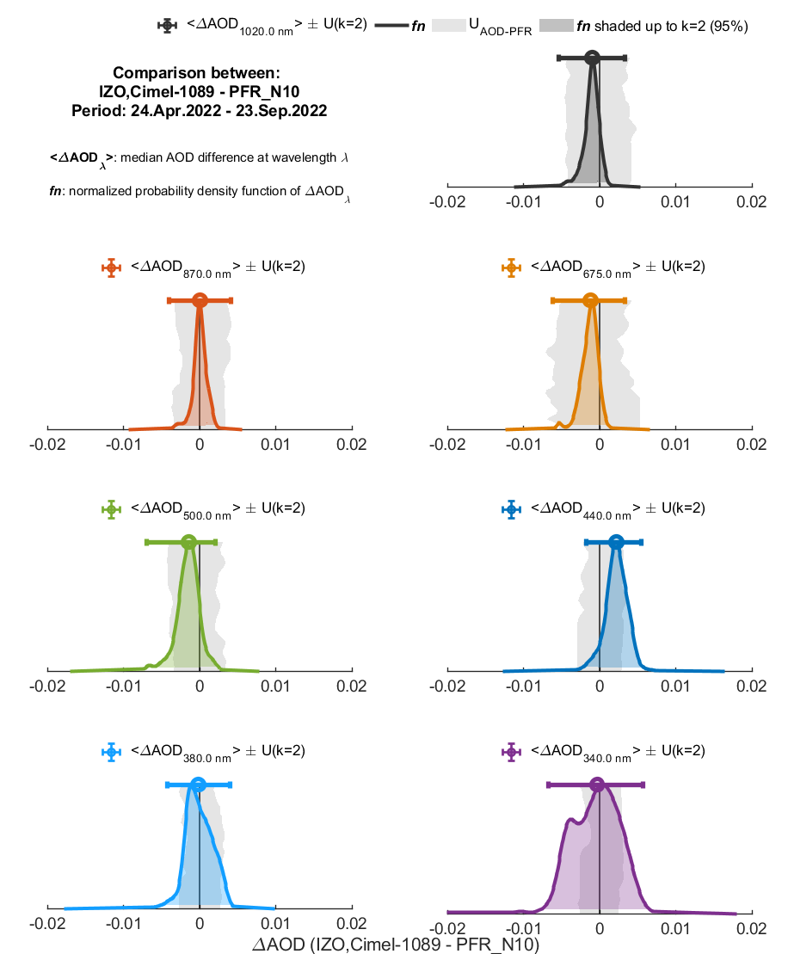
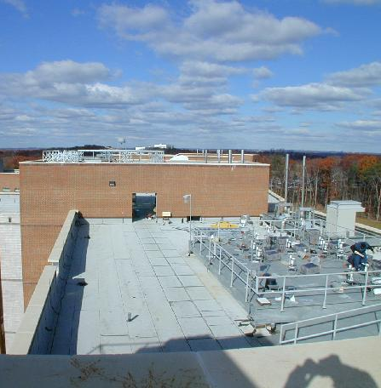
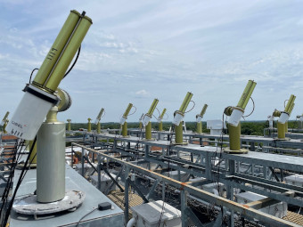




WMO AOD reference – Calibration activities
Aerosol, Clouds and Trace Gases Research Infrastructure (ACTRIS) - Centre for Aerosol Remote Sensing (CARS)
Izaña, Spain
PFR AOD uncertainty
calibration, signal, pressure, airmass, O₃, NO₂
Work in progress
Revise uncertainties of PFR for the extrapolated wavelength 340 nm(Monte Carlo approach on linear fit - add 2nd order fit)
Optimize PFR operation in OHP, VLD
Filter out not representative data (lev15) of master-Cimel calibration. (AOD crossing, triplet variability )
AERONET -Europe
calibration transfer facilities
OHP, France
Goddard Space Flight Center, USA
Valladolid, Spain

Slide 16
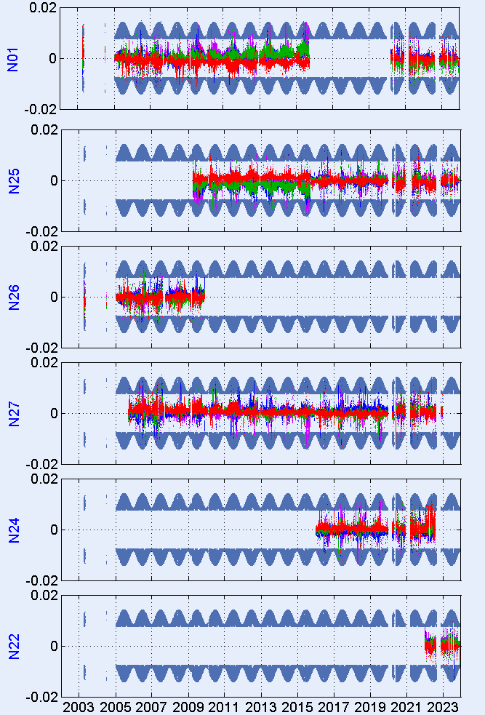
GAW_PFR-Triad – WMO AOD reference
GAW-PFR-Triad calibration stability better than 1%

Slide 17
WMO AOD reference – GAW-PFR_TRIAD
AOD Extrapolation - Validation against QASUME
Notes:
Metrological Traceability : property of a measurement result whereby the result can be related to a reference through a documented unbroken chain of calibrations, each contributing to the measurement uncertainty
What it actually means:
an unbroken chain of comparisons going back to stated references acceptable to the parties, usually a national or international standard;
uncertainty of measurement; the uncertainty of measurement for each step in the traceability chain must be calculated or estimated according to agreed methods and must be stated so that an overall uncertainty for the whole chain may be calculated or estimated;
documentation; each step in the chain must be performed according to documented and generally acknowledged procedures; the results must be recorded;
competence; the laboratories or bodies performing one or more steps in the chain must supply evidence for their technical competence (e.g. by demonstrating that they are accredited);
reference to SI units; the chain of comparisons must, where possible, end at primary standards for the realisation of the SI units;
calibration intervals; calibrations must be repeated at appropriate intervals; the length of these intervals will depend on a number of variables (e.g. uncertainty required, frequency of use, way of use, stability of the equipment).

