Slide 1









urbisphere - ASSURE (Bristol): Across-Scale processeS in URban Environments
Supplementary Material
(based on another overview talk given at International Conference on Urban Climate 12, Rotterdam, 7-11 July 2025. Includes notes.)
Janet Barlow, Sue Grimmond, Joern Birkmann, Matteo Carpentieri, Andreas Christen, Nek Chrysoulakis, Omduth Coceal, James Matthews, Marco Placidi, Alan Robins, Dudley Shallcross, Stefan Thor Smith, Maarten van Reeuwijk, and Zheng-Tong Xie
Notes:
[00:30]
Thank co-authors

Slide 2
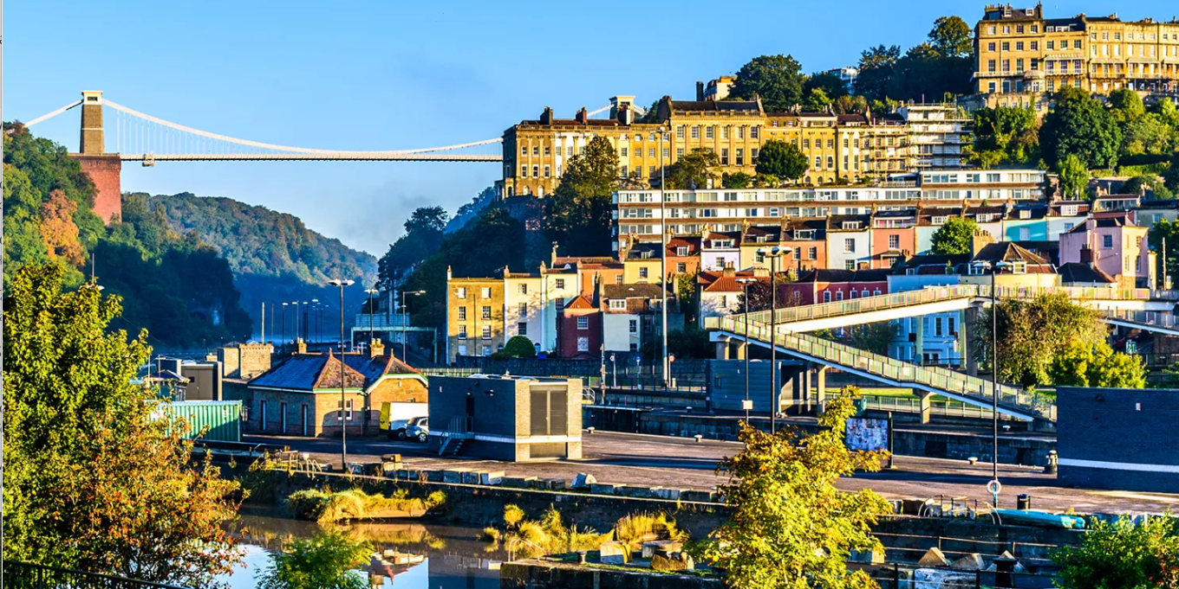
How does heterogeneity of form and/or function affect urban climate?
How do we measure and model it?
GETTY IMAGES
Notes:
[01:30]
We are all familiar with simple conceptual models of urban areas and their impact on the atmosphere – the street canyon, the homogeneous neighbourhood, Monin-Obukhov theory, the flat city. However, our own lived experience is that cities are not like that – they are messy, complex, and definitely not always flat. Human activities add more messiness to the picture
Q1 so how does heterogeneity of form and/or function affect urban climate?
This heterogeneity exists on all scales, from house to house, street to street, and vertically. It challenges our established methodologies of measurement and modelling.
For instance, this picture is Bristol in the UK, and this urban scene is within one gridbox of a weather forecast model.
Q2 Even if we can model temperature, how do we measure it to evaluate the model?
These questions led us to the project I shall describe today
Picture credit: Getty Images
https://www.thetimes.com/travel/destinations/uk-travel/england/best-things-to-do-bristol-ld50x6k2c

Slide 3
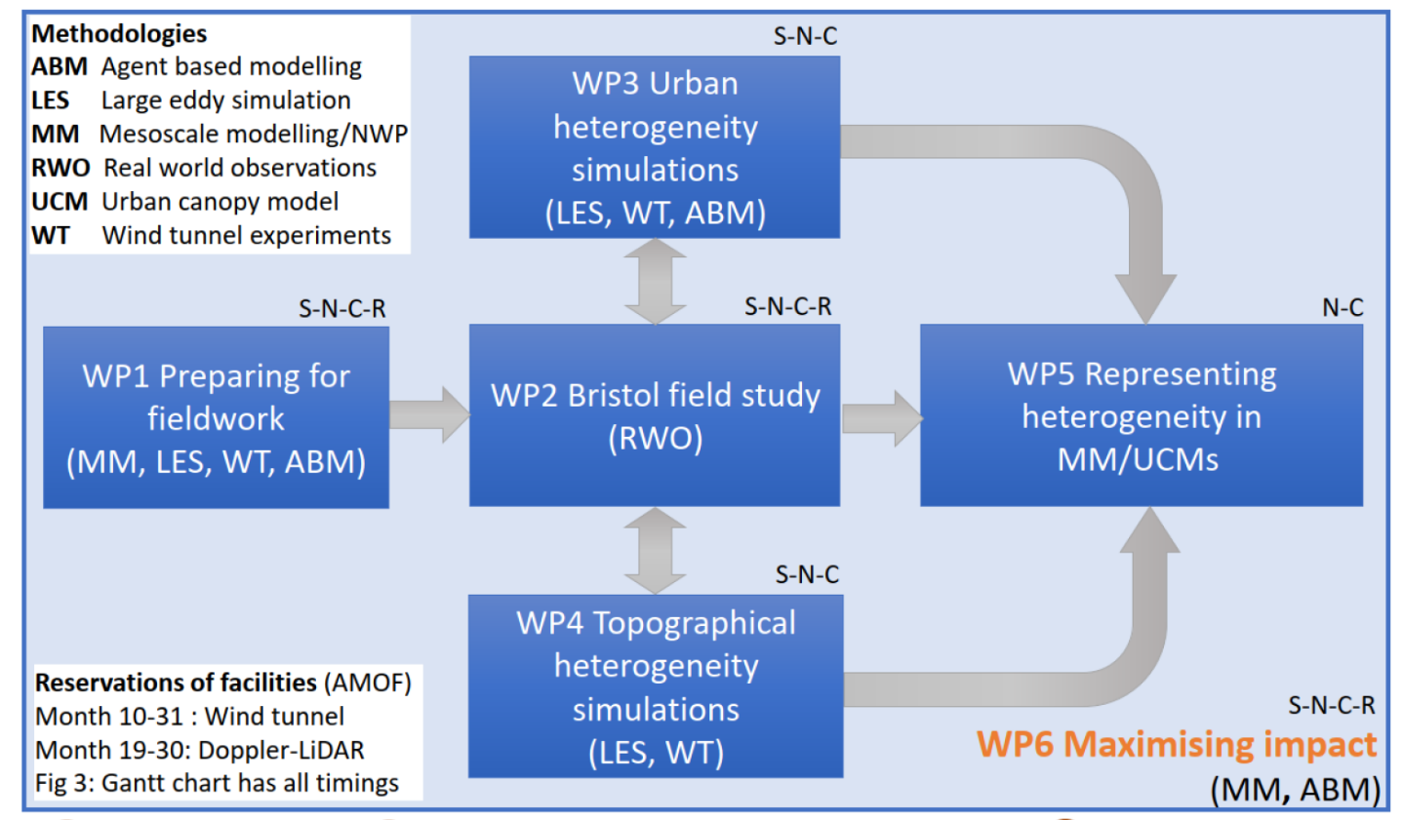





ASSURE: Across-Scale processeS in URban Environments
How does heterogeneity affect urban climate?
form
function
How do we measure and model it?
Today: update, halfway through project
Notes:
[02:00]
This was the motivation for the ASSURE project, funded by the UKRI. The work is done in collaboration with the urbisphere project, funded by ERC
We chose to combine a range of methodologies to tackle two areas of heterogeneity: urban landuse, and topography
We are about halfway through, with a few talks and posters at this conference – this is my focus today, mesoscale modelling will be reported at a future meeting

Slide 4
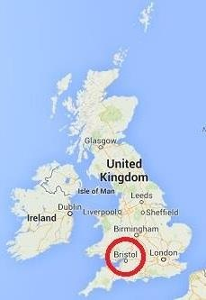
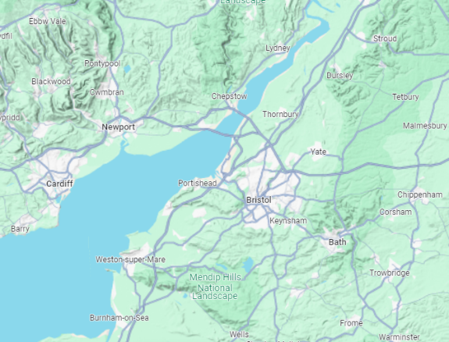
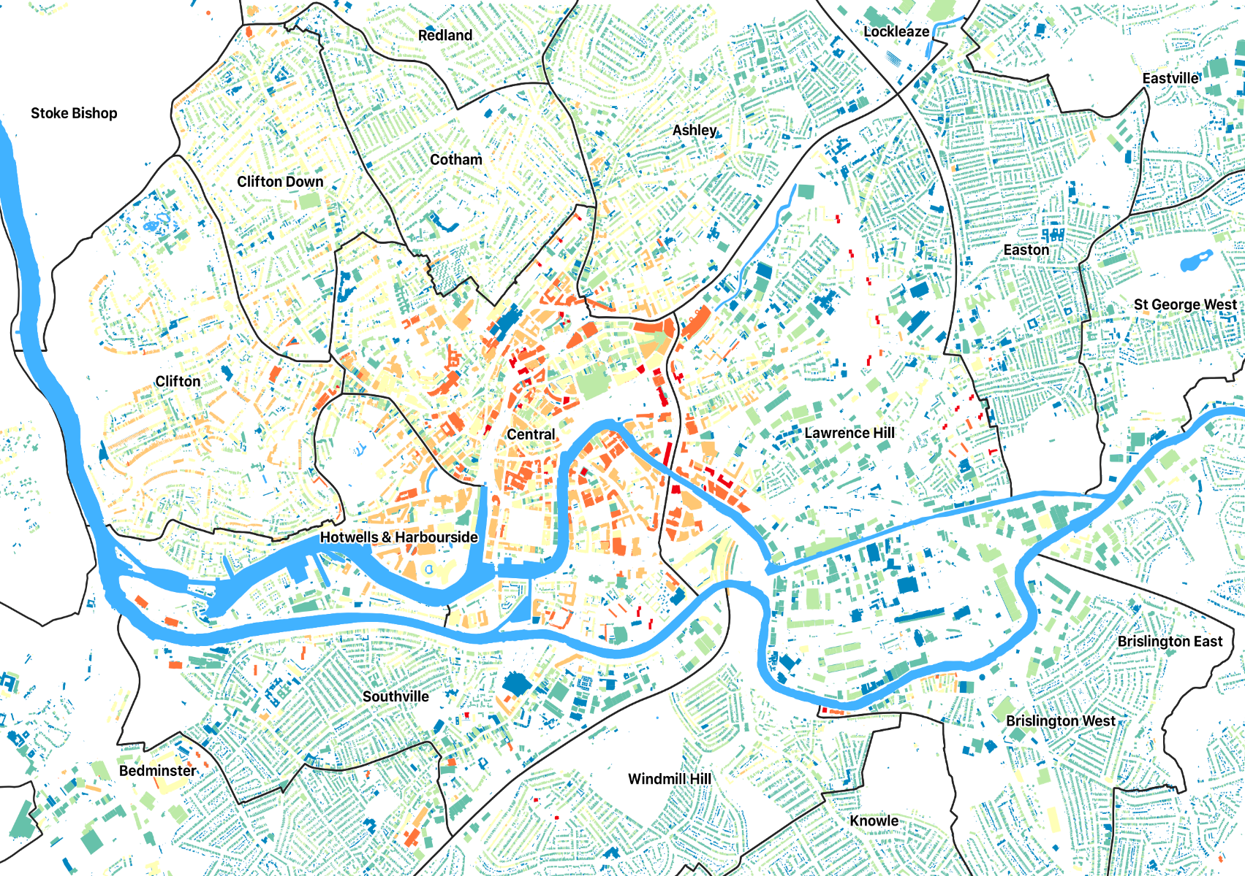
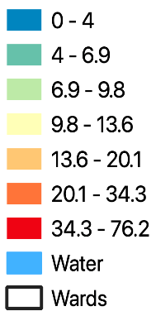
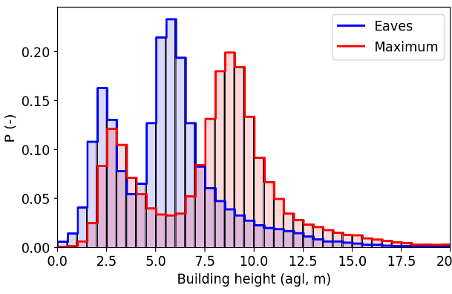
Bristol field study
  Bristol residential neighbourhoods dominated by terraced houses of varying ages
MONDAY Denise HERTWIG, 402, poster E20, 18:30
Bldg. eaves height (m)
Bristol Channel
Bristol chosen as study site:
  Medium-sized city
  Topography
  Engaged stakeholders
  Representative land-use heterogeneity
Notes:
[03:00]
Let me take you to Bristol!...(map1), (map2) – it is near the coast
(map 3) it has residential neighbourhoods, very typical urban form in UK, terraced houses – this work by Denise Hertwig shows the height distribution, higher in the city centre – you can catch her at her poster today - and many water surfaces to add to the heterogeneity
So – this is why Bristol was chosen as a study site (see box)

Slide 5
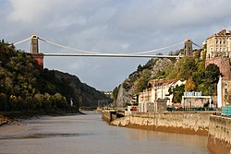
Bristol field study
River Avon Gorge
Bldg. eaves height (m)
Bristol chosen as study site:
  Medium-sized city
  Topography
  Representative land-use heterogeneity
  Engaged stakeholders
Notes:
[03:30]
- And just to point out that the first photo you saw is here, Avon Gorge, around 100 m deep on the edge of the city centre, which is in a valley

Slide 6
1. How do orography, coastal distance, and LCZ influence spatial temperature differences?
GETTY IMAGES
Notes:
[04:15]
I will now highlight some of our activities using three questions – and some progress towards the answers
(1) Firstly, how do orography, etc……temperature differences?

Slide 7

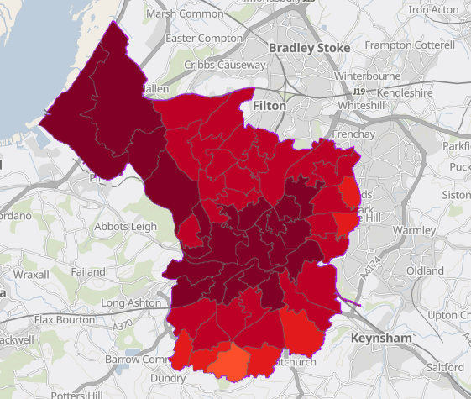
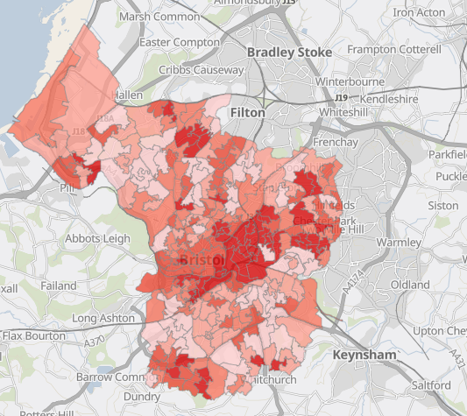


Planning for future heatwaves in Bristol
  Keep Bristol Cool Tool website link
Average no. summer nights above 20 ˚ C
Heat Vulnerability Index
Met Office UKCP (UK Climate Projections) for 2070s (2.2km resolution)
Risk due to age, deprivation, indoor/outdoor exposure
Thanks to Ben Smallwood, Bristol City Council
Notes:
[05:15]
- Our partner, BCC, did some work prior to the project on planning for future heatwaves…they collaborated with the MO, who provided climate projections like this (left side)…this shows “tropical night” >20degC
Topography influence the night temps, being at the coast is not necessarily cooler…
Fairly high resolution for climate projections!
The council combined this data with other risk factors to give (right side) a heat vulnerability index…you can access other scenarios on their website

Slide 8
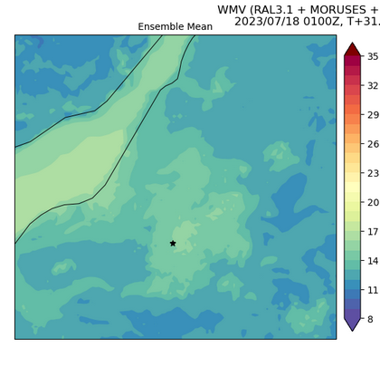
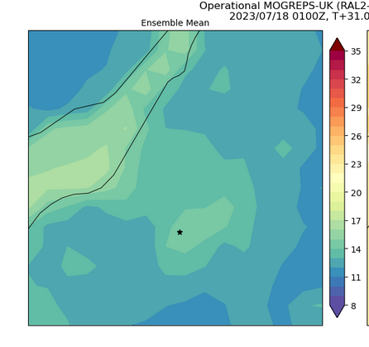
Increasing NWP resolution – resolving smaller scales of heterogeneity
WMV (300 m)
MOGREPS (2.2 km)
Bristol
Bristol
Regional scale – UK Met Office testbed (summer 2023)
Focus on evaluation of urban-scale NWP with sensor network
Wessex Model Variable Resolution (300 m)
WMV has higher temperatures at the city centre cf. MOGREPS (2.2km)
MONDAY Russell GLAZER, 692, 16:45, Room Mees1 (PM5) talk
Notes:
[06:00]
One of the modelling aims is to do high resolution simulations with the MO Unified Model - here is an example of Bristol’s heat island, on the right 2.2km same as the climate projections – and a 300m resolution ensemble run as part of a Testbed in 2023, on the left, that we are analysing.
It is clear that more scales of heterogeneity in the temperature field are resolvable, including higher temperatures.
Russel will be talking later today about similar work he has done for Berlin, and will do for Bristol
Met Office Global and Regional Ensemble Prediction System (MOGREPS)

Slide 9
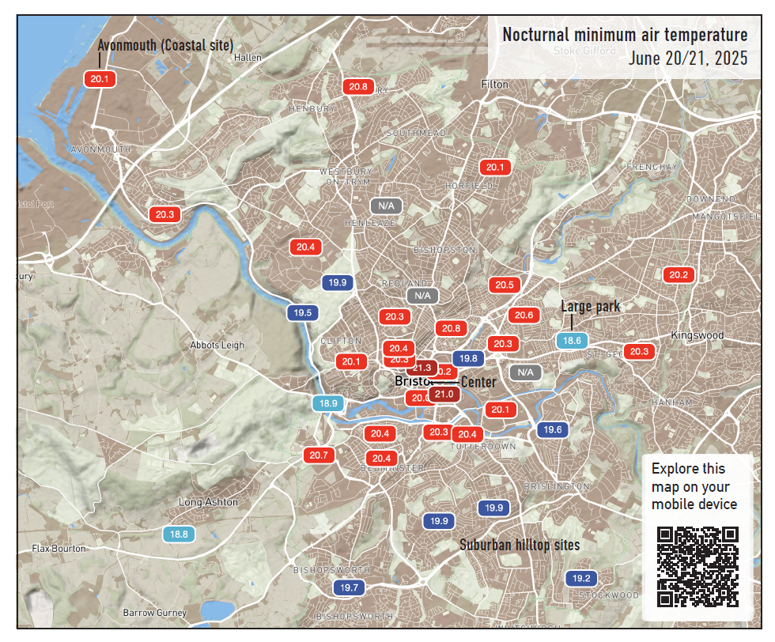

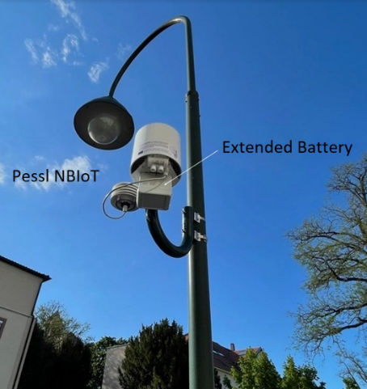
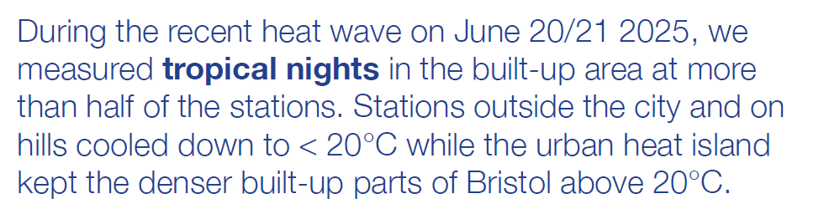
Sensor network
39 weather stations
T, RH, precipitation
1 minute resolution
MONDAY
Matthias ZEEMAN, 899, talk, 12:00
Andreas CHRISTEN, 930, poster E46, 18:30
Notes:
[07:00]
How can we evaluate such simulations? Well we established a sensor network in Bristol, led by Andreas Christen at UoF. Lampposts, sensors…we already heard from Matthias Zeeman about it at the conference.
Right side, example of a “tropical night” in the recent heatwave, red is >20 Tmin – orography plays a stronger role in cooling the air than proximity to the sea.
You can meet Andreas at his poster later today, to see other examples from the year of data so far

Slide 10
2. How does boundary layer structure evolve across the city?
GETTY IMAGES
Notes:
[07:15]
- Our second question is…

Slide 11
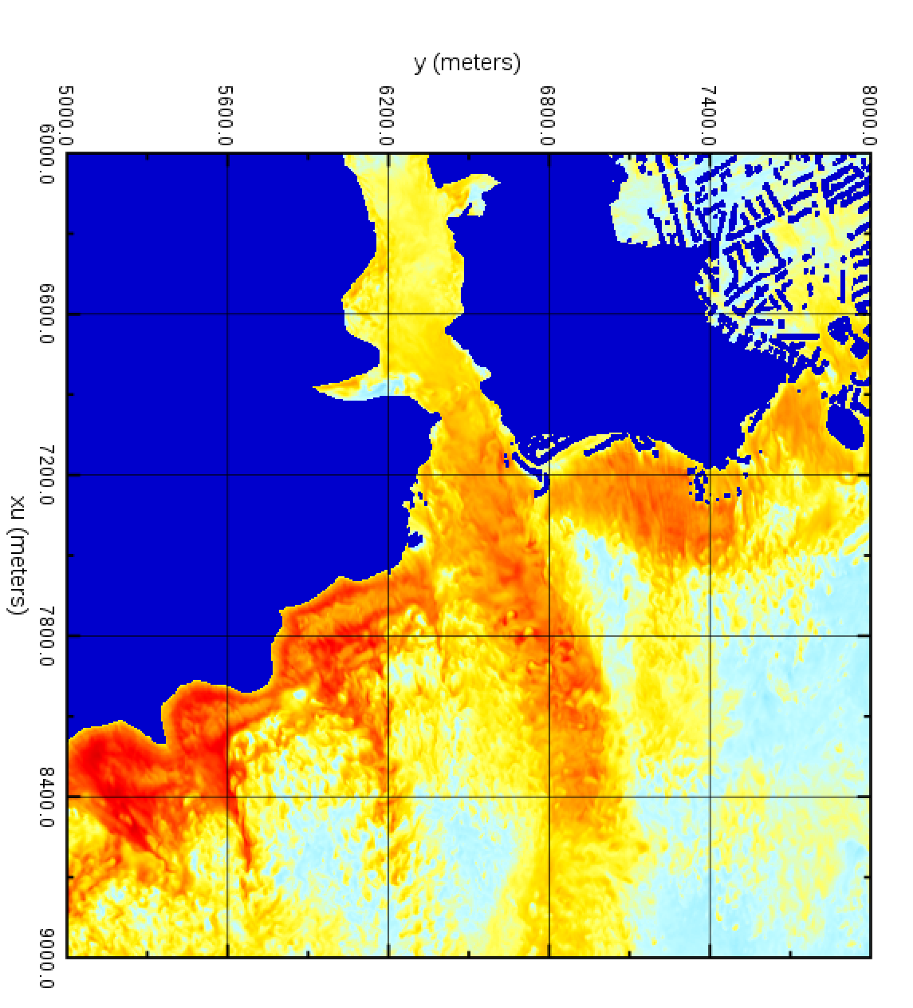
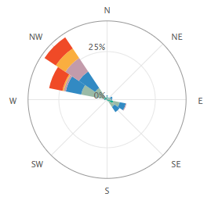
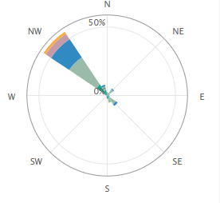
Gorge channels flow – LES and observations
×
×
North wind
Bridge
Instantaneous u component @70.5 m
Thanks to Clifton Suspension Bridge Trust
Thanks to ChangChang Wang, Uni of Southampton
Notes:
[08:15]
The first scale of topographic heterogeneity we are studying is the Avon Gorge – approximately 100m high, and 200m wide. This is definitely not resolved in mesoscale model simulations, thus the Uni of Southampton have done 5m resolution LES – right side, northerly wind, a plane just under the height of the Bridge
It can be seen that the Gorge channels flow, causing a jet to a distance of around 1.5km; this is a feature that is difficult to parametrise in NWP at typical 1.5km resolution
LES gives us insights into spatial flow patterns at different incident wind angles, which helps to interpret observations;
(CLICK) in partnership, we have access to long-term weather station data, 2 AWS on either side of bridge; the wind roses show here for instance that the channelled flow is not uniform across the Gorge.

Slide 12




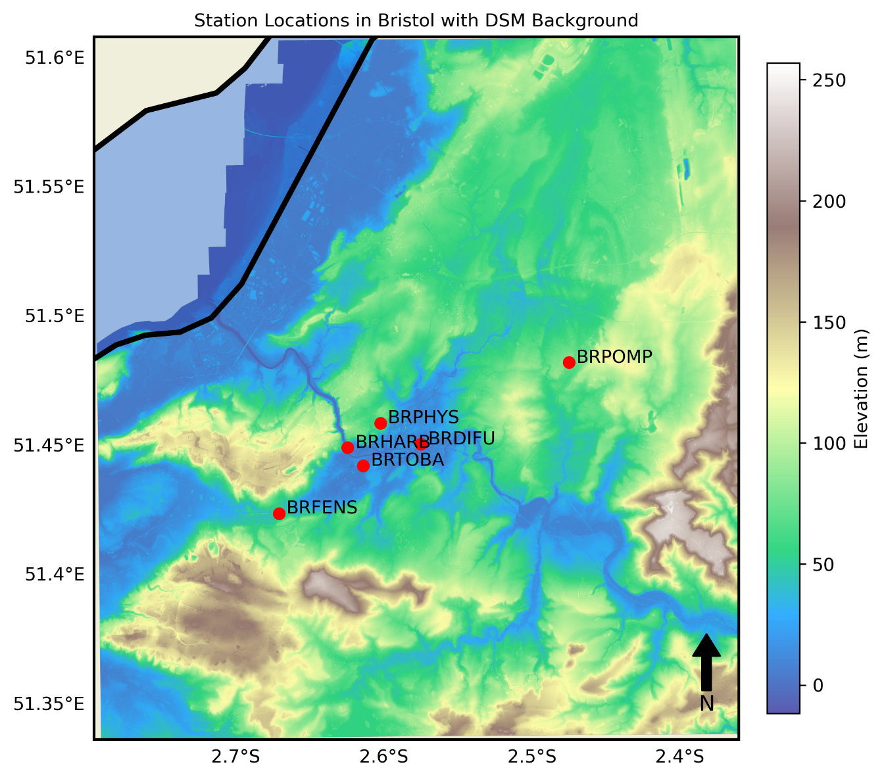
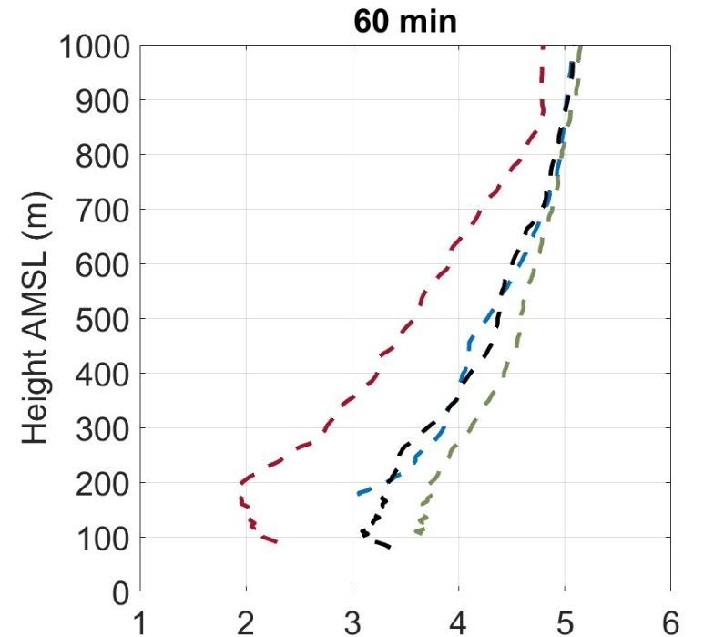
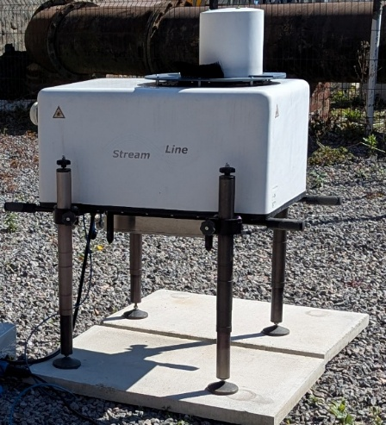

Remote sensing network > 1 year
5x CL61 ceilometers, Halo Photonics Doppler lidars
Virtual Doppler Lidar – using LES to optimise measurements:
Scanning Cone
THURSDAY
Jonnathan CESPEDES, 902, talk, 15:15
THURSDAY
Vero ESCOBAR-RUIZ, 774, poster B5, 18:00
Notes:
[09:15]
The second scale of orographic heterogeneity is that of the valley in which Bristol city centre sits, you can see this clearly in this beautiful topographic map – here’s the Gorge, city centre.
We installed a transect of remote sensing sites in line with the prevailing SW wind, ceilometers and DWLs for more than one year, a couple are still installed
JC has recently joined us and is working on this dataset – he is talking about his analysis of DWL data from Paris on Thursday, and will be doing similar analyses for Bristol.
The heterogeneity of the flow challenges some of the assumptions used in using DWLs to measure wind profiles – VER has been simulating a VDL using LES – essentially a forward model for the instrument. She has been exploring a range of scan types and sampling times at each site, to select the most accurate approach. Here are the wind profiles at different sites, influenced by the topography – this will inform the analysis JC does of the field data. She is giving a poster on Thursday too.

Slide 13
3. How does building heterogeneity affect pollution dispersion?
GETTY IMAGES
Notes:
[09:30] Finally, our third question is…

Slide 14
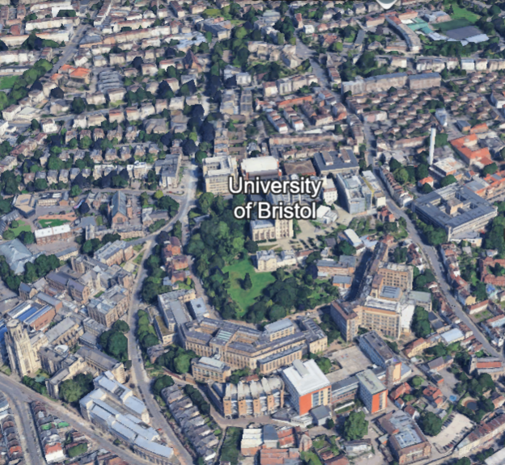
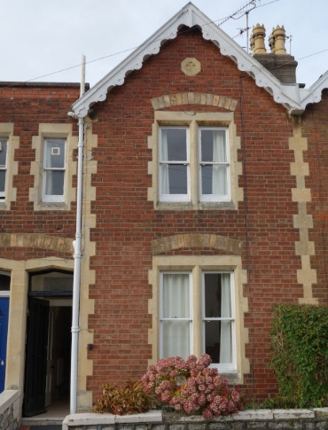
Smaller, shorter
residential buildings
SPHERE house
Indoor measurements
How does urban heterogeneity affect pollution dispersion?
Larger, taller
University buildings
Notes:
[10:15]
To tackle this question, we selected the campus of our academic partner the Uni of Bristol.
(CLICK) this line forms a boundary between the larger…and smaller…(CLICK, CLICK) – it could be seen as a rough to smooth transition which will influence pollution dispersion
(CLICK) in doing the experiment here we take advantage of the pre-existing SPHERE house…

Slide 15
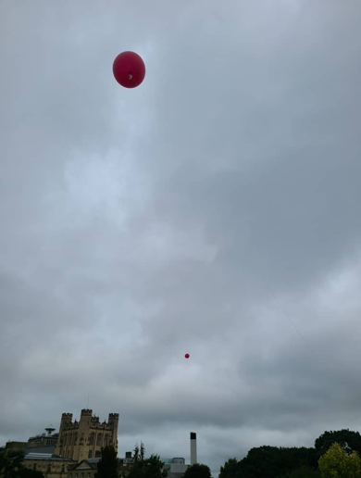
Tracer release experiments
sample
source 1
source 2
velocity
Doppler wind lidar
BRPHYS
Tethersondes
(wind vector, temperature)
SE
FRIDAY
James Matthews,
720, talk, 12:15
Notes:
[11:00]
So James Matthews of Uni of Bristol has taken the lead in designing and executing tracer gas dispersion experiments – this shows the set-up for an experiment with SE flow across that rough-to-smooth transition….(go through elements)
He will go through some of the results of this and other Bristol tracer experiments on friday

Slide 16
LES of flow and dispersion
(d)
2.0
10⁻²
1.0
10⁻⁴
Y/D_{BrU}
C*
10⁻⁶
0
10⁻⁸
-1.0
2.0
1.0
0
-1.0
U₀
x₀
X/D_{BrU}
(a)
u/U₀
1.0
Normalised
instantaneous
velocity
z/H_{b}
10
0.5
0
0
C*
(b)
10⁻²
Normalised
concentration
10⁻⁴
(c)
10⁻⁶
2
Mean building height
z/H_{b}
1
SD of building height
0
-1.0
-0.5
0
0.5
1.0
1.5
2.0
x/D_{BrU}
WEDNESDAY
ChangChang Wang, 766, talk, 17:00
Notes:
[11:45]
Our colleagues in Southampton are helping us again in interpreting the field measurements using Large Eddy Simulation
Changchang Wang will be giving a talk on this on Wednesday – she simulated a SE’ly flow and here are cross-sections of the u, C*, showing how the buildings, particularly the larger ones, can influence the lofting or trapping of the pollution; the decrease in building height across the transition can be seen here in black. She is working on finding more general formulations for the decay of pollution with distance, amongst other things

Slide 17
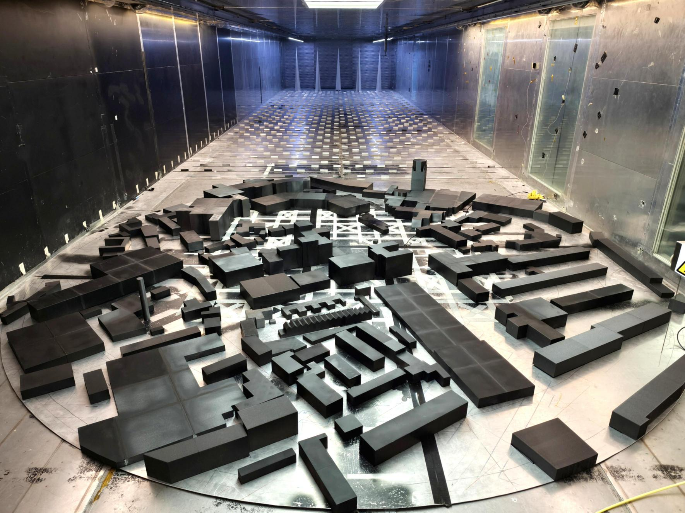
Wind tunnel modelling
SW
Looking upstream
South
North
FRIDAY
Matteo CARPENTIERI, 1014, talk, 12:00
Notes:
[12:15]
And finally, Matteo C of the Uni of Surrey EnFlo lab will be talking on Friday about the windtunnel modelling of the same site – you can see the model on the right with its upstream ABL generation and simplified buildings
The team, principally Dianfang Bi, have investigated the impact on the plume extent by small changes in source location and wind direction; left, slight change in source location (CLICK), particularly large buildings having an influence.

Slide 18
Conclusions
Heterogeneity is complex….but effects can be separated out (e.g., model topography/land-use)
Integrate methodologies across scales
Generalise wherever possible (e.g., rough-smooth transition, valley flow)
Next Steps
Mesoscale modelling – parametrising heterogeneity
Parametrising anthropogenic activities
Further integration of observations
Thanks to
The Fieldwork Crew (Dana Looschelders, Marvin Plein, Jonas Brandes, Svenja Ludwig, Lisa Winkler, Matthew Paskin, Russel Glazer, Tiancheng Ma, William Morrison, Matt Clements, Changchang Wang, Dianfang Bi, Ashriah Andani, Ed Aldred, Dudley Shallcross, Anwar Khan, Justin Tabbett, Dimitris Tsirantonakis)
Partners: Ben Smallwood (Bristol City Council), Clark Wiltshire (Harbour), Nick Hall (Digital Futures Institute), Hilary Norley (Pomphrey Hill Sports Pavillion), School of Physics, Barbara Brooks (AMOF), James McGregor/Jeremy Price (Met Office), Andrew Hughes (Fenswood Farm)
All administrative support staff everywhere! Contact me: J.f.barlow@reading.ac.uk
MONDAY
Jingzi Huang, 540, talk, 16:30
GETTY IMAGES
Notes:
[13:00]
so, not many conclusions at this stage – apart from the general:
The modelling work comes next – how might we param this? Jingzi is working on this, and will be talking later about his approach, applied to London
Including Anthro; and of course further integration of observations I haven’t had time to describe today
Of course, many thanks to the many people who made the field work happen – I will single out Dana Looschelders who made an impressive contribution in getting equipment from Germany to the UK and back again, not an easy task.

Slide 19
Publications thus far:
van Reeuwijk, M., Huang, J. Multi-scale Analysis of Flow over Heterogeneous Urban Environments. Boundary-Layer Meteorol 191, 47 (2025). https://doi.org/10.1007/s10546-025-00941-w
Klippel, K, Goulart, E.V., Auerswald, T, Galvão, E, Marques Ciarelli, P, Costa Reis Jr., N, Coceal, O. (2025) Spatial patterns of probability distributions for concentration fluctuations at the street network scale, Building and Environment, 285(A), 1 November 2025, 113491. https://doi.org/10.1016/j.buildenv.2025.113491
Ding, SS., Placidi, M., Carpentieri, M. et al. Neutrally- and stably-stratified boundary layers adjustments to a step change in surface roughness. Exp Fluids 64, 86 (2023). https://doi.org/10.1007/s00348-023-03626-7
Ding S-S, Carpentieri M, Robins A, Placidi M. Statistical properties of neutrally and stably stratified boundary layers in response to an abrupt change in surface roughness. Journal of Fluid Mechanics. 2024;986:A4. https://doi.org/10.1017/jfm.2024.329
Ding S-S, Carpentieri M, Robins A, Placidi M. Predicting internal boundary layer growth following a roughness change in thermally neutral and stable boundary layers. Journal of Fluid Mechanics. 2025;1016:R4. https://doi.org/10.1017/jfm.2025.10293
Iacobello, G, Placidi, M, Ding, S-S, and Carpentieri, M (2025) Meas. Sci. Technol., 36, 016026. https://doi.org/10.1088/1361-6501/ad9046
Overview paper in preparation - contact Prof Janet Barlow: J.f.barlow@reading.ac.uk
GETTY IMAGES

