Slide 1

Simplifying Mapping for Building Exposure using OpenStreetMap Tools
Doren Calliku, Danijel Schorlemmer, Laurens J.N. Oostwegel, Pablo de la Mora Lobaton, Chengzhi Rao, Tara Evaz Zadeh, and Lars Lingner pomodoro@gfz.de
Vienna, 05 June 2026

Slide 2
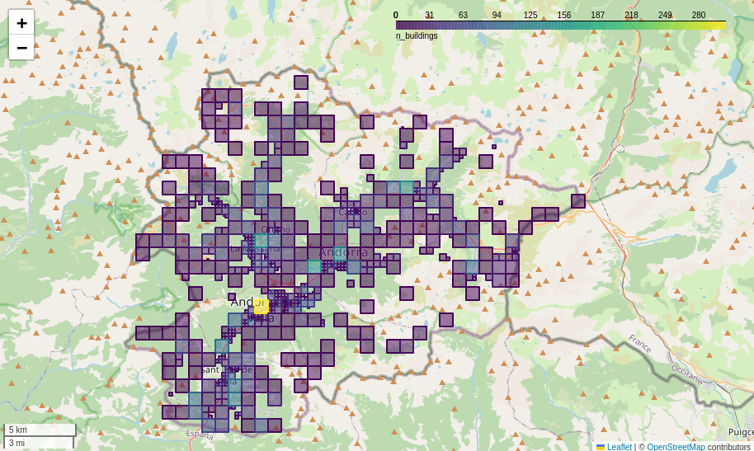
Estimated exposure
A map of the tiles where there are buildings expected based on OSM and other sources in the database, with specifications on the type of buildings that can be found.

Slide 3
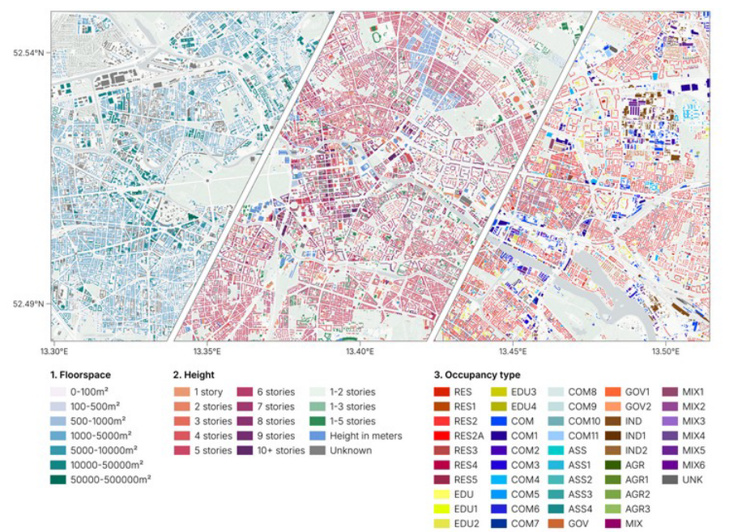
Estimated exposure
A map of the tiles where there are buildings expected based on OSM and other sources in the database, with specifications on the type of buildings that can be found.
This is how you can translate that information (this is Berlin)! Oostwegel, L.J.N., Schorlemmer, D. & Guéguen, P. From Footprints to Functions: A Comprehensive Global and Semantic Building Footprint Dataset.

Slide 4
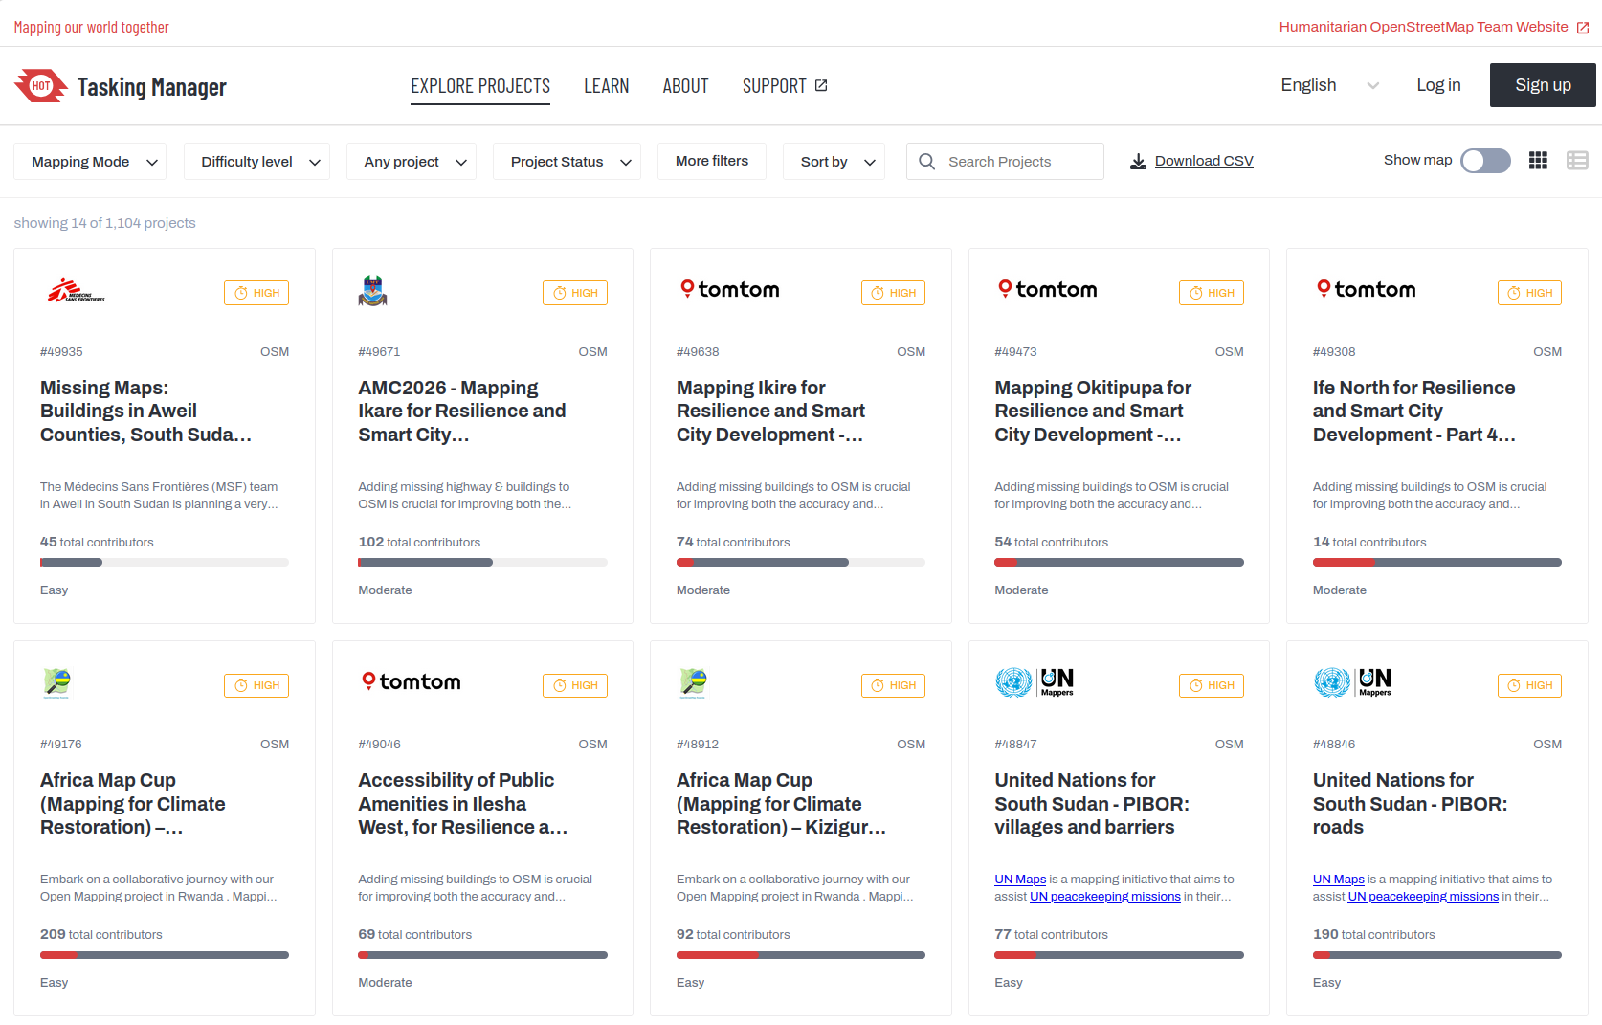
Data or Validata
Open-source communities have developed quite the toolkit to be able to map quickly and with precision the type of exposure with world-wide coverage. tasks.hotosm.org/explore

Slide 5
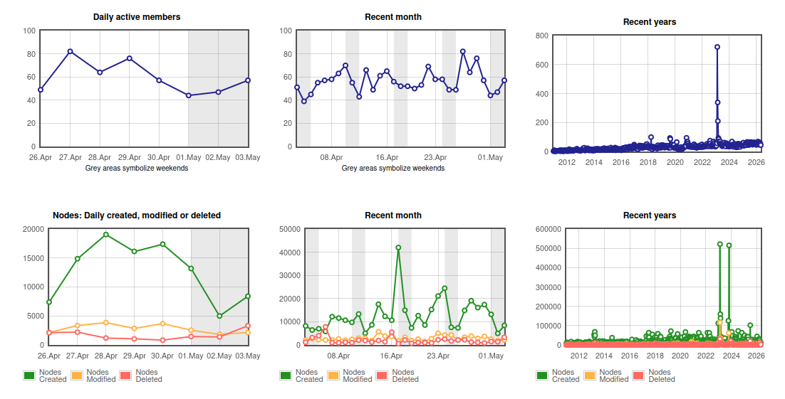
Data or Validata
Open-source communities have developed quite the toolkit to be able to map quickly and with precision the type of exposure with world-wide coverage.
tasks.hotosm.org/explore
Data after earthquake response for Türkiye - you can see the spikes for both earthquakes (Izmir, Kahramanmaras).
osmstats.neis-one.org/?item=countries&country=Turkey

Slide 6
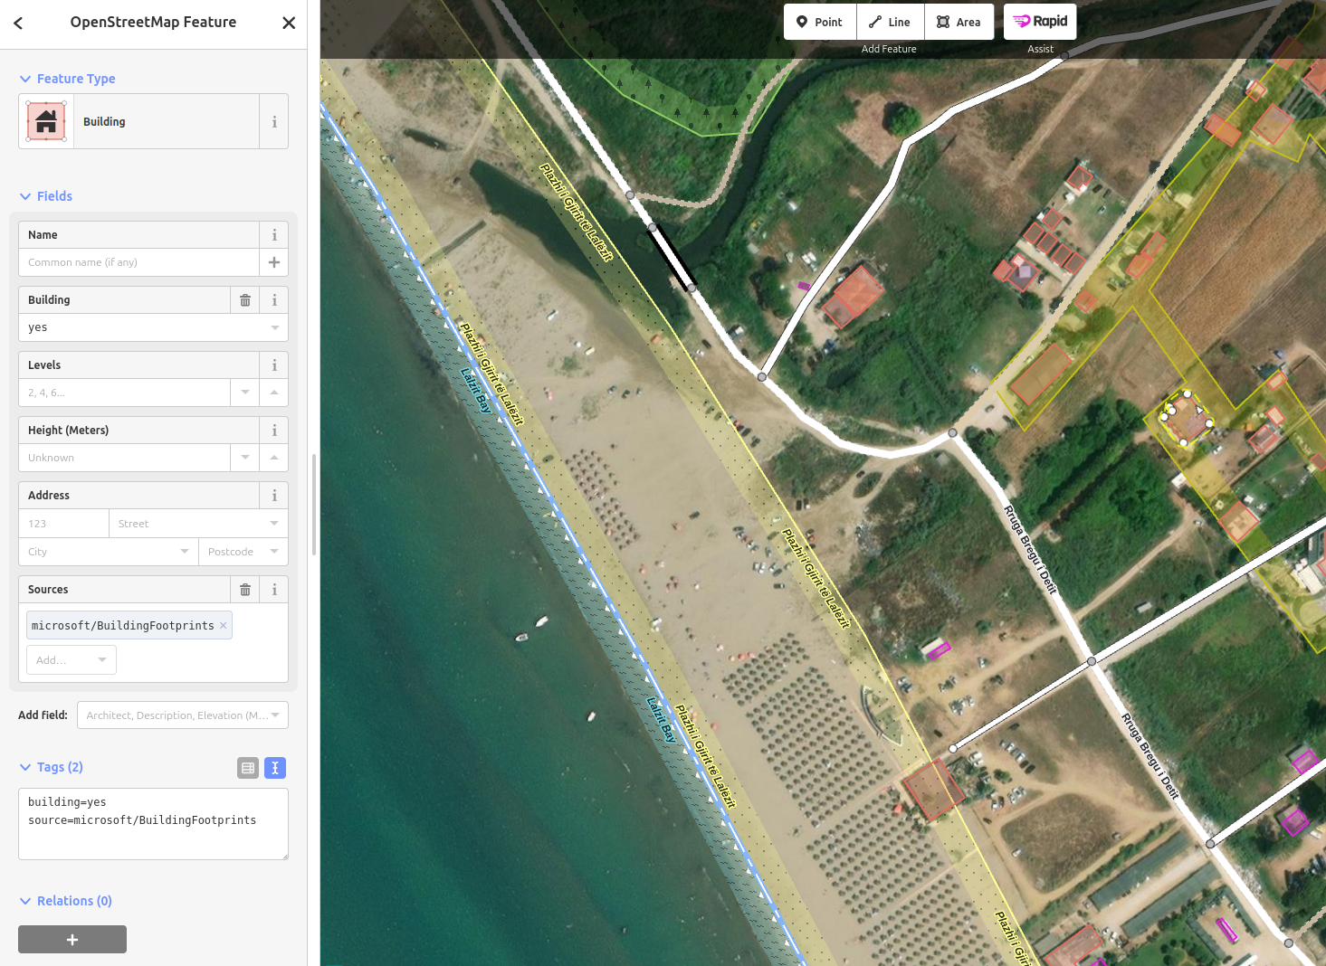
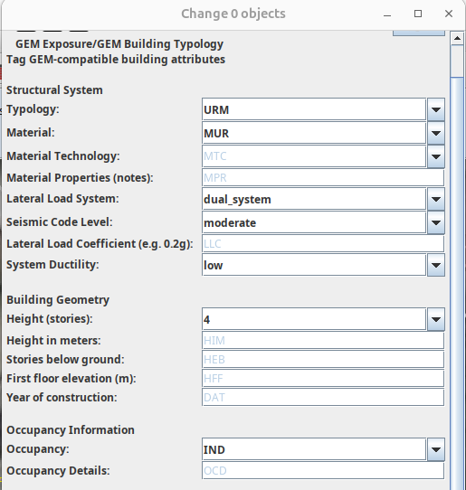
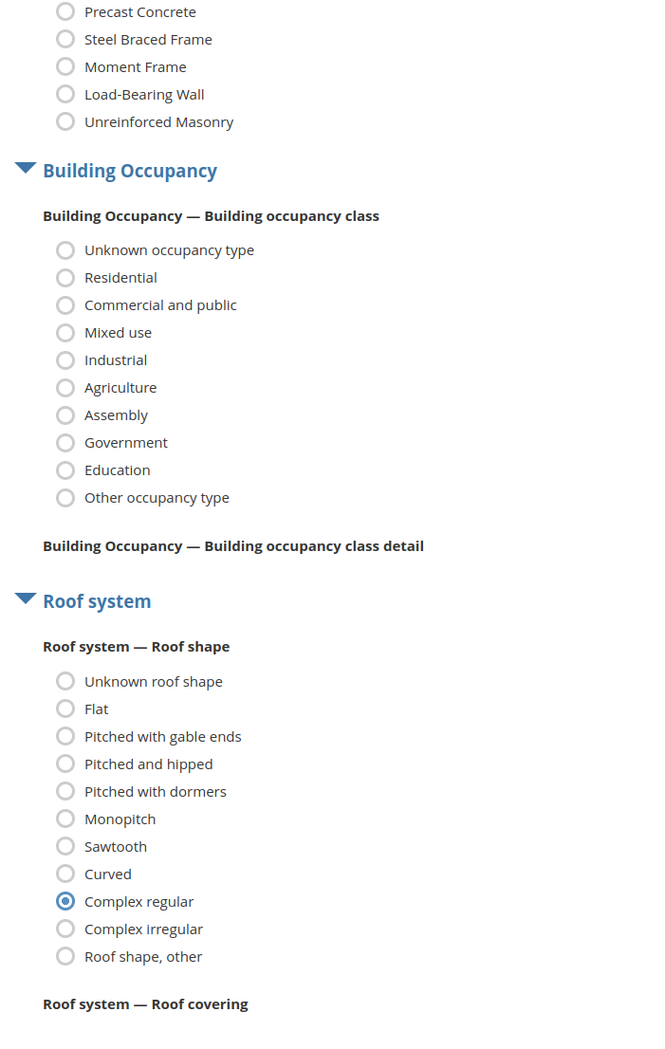
Taxonomies to tools
openstreetmap.org/edit
rapideditor.org/edit

Slide 7
Longer Presentation

Slide 8
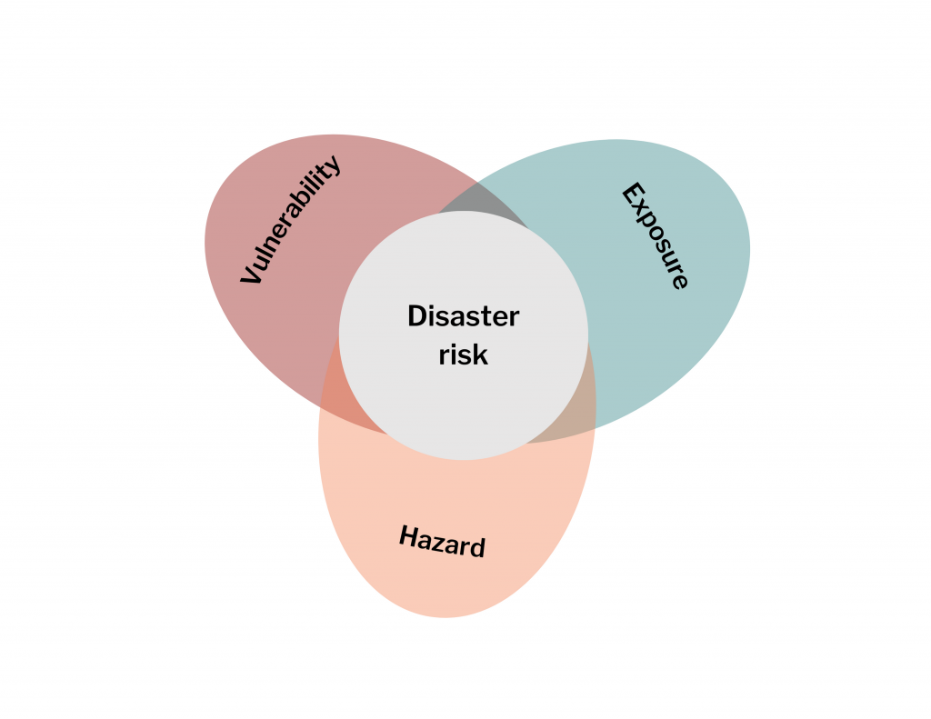
Defining risk
Exposure:
People, buildings, or systems that could be affected.
Vulnerability:
How likely the exposed element is to suffer damage.
Hazard:
A potentially damaging event or condition.
Risk:
It arises when hazard, exposure, and vulnerability come together.

Slide 9
Defining risk
Example: Find the respective concept below.
I’m out in the open, walking through town under the blazing sun.
A heatwave in Mostar, temperatures soaring to dangerous levels.
I haven’t had water, there’s no shade, and I’m sensitive to high heat.
At 36°C, the hazard exists, and I’m exposed, but I might manage to find a place to get water. Risk is moderate.
At 44°C, the hazard is extreme, and I’m exposed, and I might not manage to keep cool. Risk is critical.

Slide 10
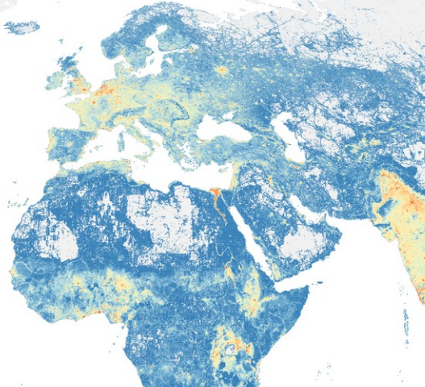
Defining risk
Nr. of buildings based on the Global Dynamic Exposure project data. (Exposure)
Hint: Number of buildings depends on the type of building per region.

Slide 11
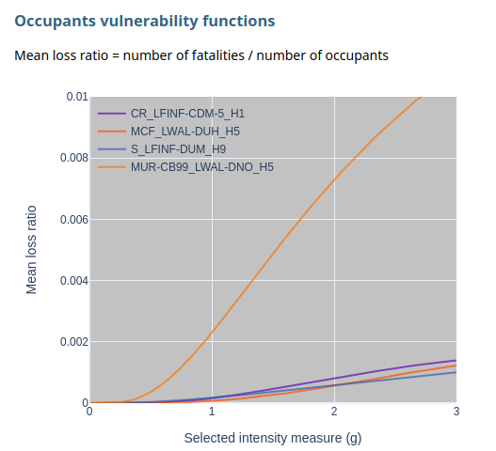
Defining risk
Nr. of buildings based on the Global Dynamic Exposure project data. (Exposure)
Hint: Number of buildings depends on the type of building per region.
How masonry buildings with light walls create more vulnerability than others. (Vulnerability)
Hint: MUR+LWAL= masonry building with light walls.

Slide 12
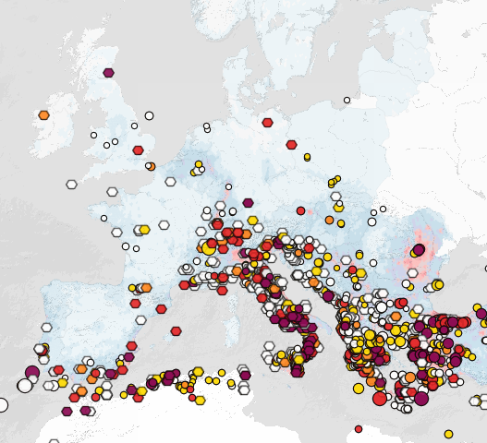
Defining risk
Nr. of buildings based on the Global Dynamic Exposure project data. (Exposure)
Hint: Number of buildings depends on the type of building per region.
How masonry buildings with light walls create more vulnerability than others. (Vulnerability)
Hint: MUR+LWAL= masonry building with light walls.
Earthquake database NCEI, as shown in EFEHR, up to 2021. (Hazard)
Hint: Risk is also dependent on potential hazard - see Romania.

Slide 13
Quick look at GDE (GDE Docs / Python)

Slide 14
Estimated exposure
A map of the tiles where there are buildings expected based on OSM and other sources in the database, with specifications on the type of buildings that can be found.

Slide 15
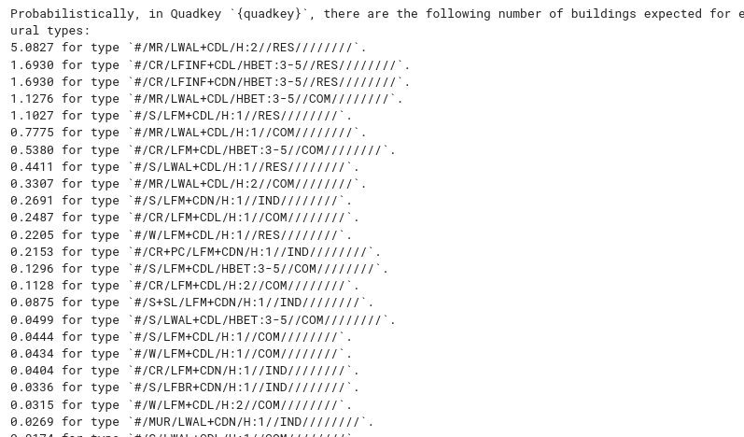
Estimated exposure
A map of the tiles where there are buildings expected based on OSM and other datasets, with specifications on the type of buildings that can be found.
Depending on the granularity of the information (per country, city, neighborhood), the estimated exposure has a certain level of confidence.

Slide 16
Estimated exposure
A map of the tiles where there are buildings expected based on OSM and other sources in the database, with specifications on the type of buildings that can be found.
This is how you can translate that information (this is Berlin)!

Slide 17
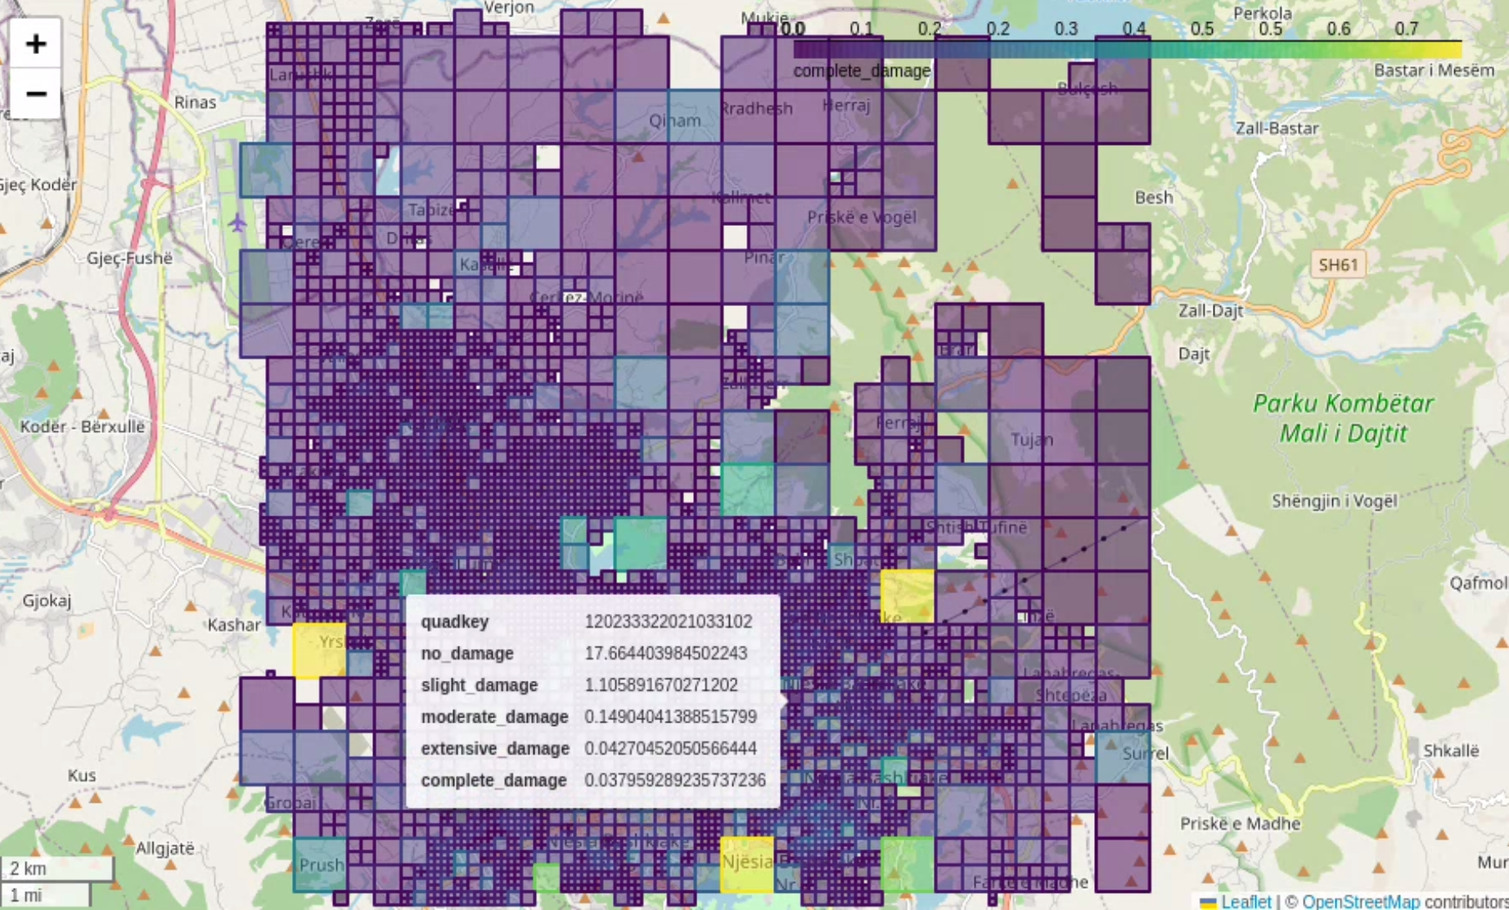
Loss-Calculator
Using this estimated exposure, with the existing vulnerability functions, and with a proper ground motion information, one can get a risk estimation for a scenario.

Slide 18
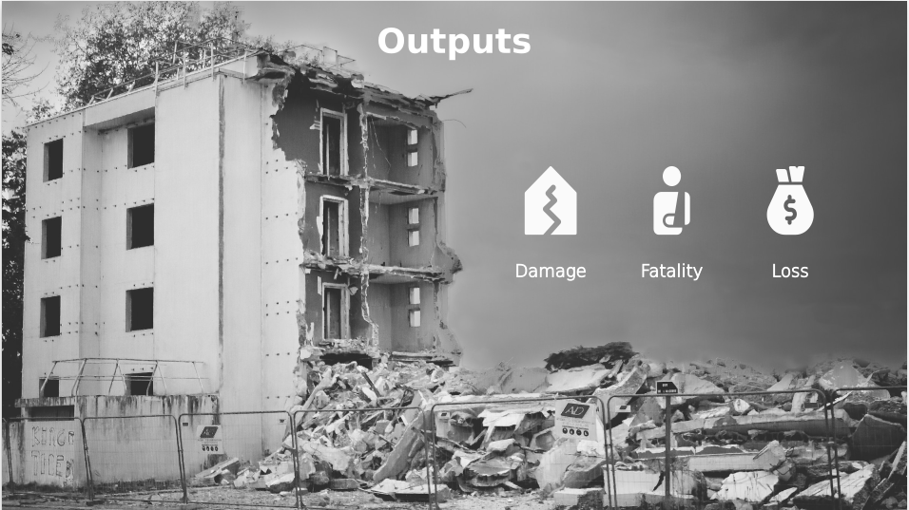
Loss-Calculator
Using this estimated exposure, with the existing vulnerability functions, and with a proper ground motion information, one can get a risk estimation for a scenario.
These estimations can already provide some priority areas where more can be done to support the existing infrastructure.

Slide 19
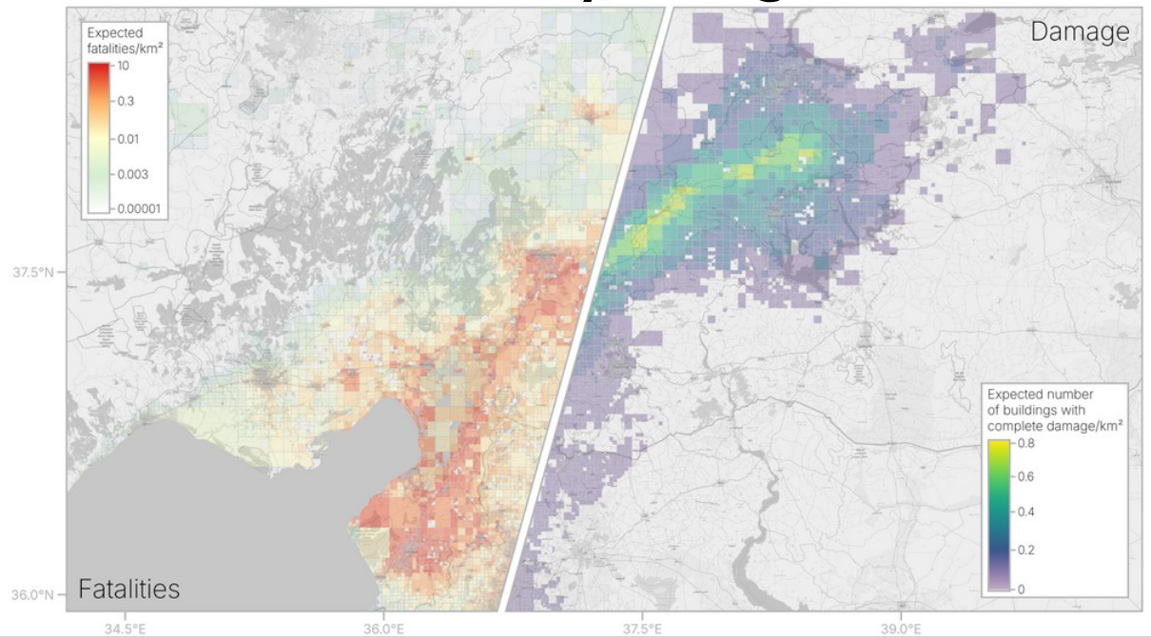
Loss-Calculator
Using this estimated exposure, with the existing vulnerability functions, and with a proper ground motion information, one can get a risk estimation for a scenario.
Making these estimations can be used in another context, for example estimating the damage done by the earthquake in Turkey in 2023 both in terms of fatalities and buildings with complete damage.

Slide 20
Various taxonomies

Slide 21
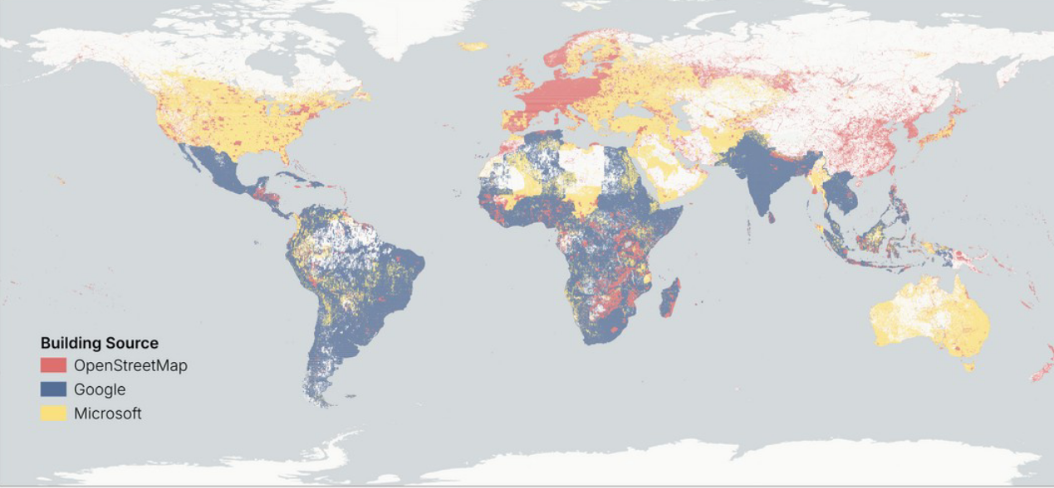
Various sources of information
We use several types of datasets that have slightly different definitions of buildings. Among the sources are OSM, exposure distributions (GEM, Hazus), building stock information, census data, and 3D information.

Slide 22
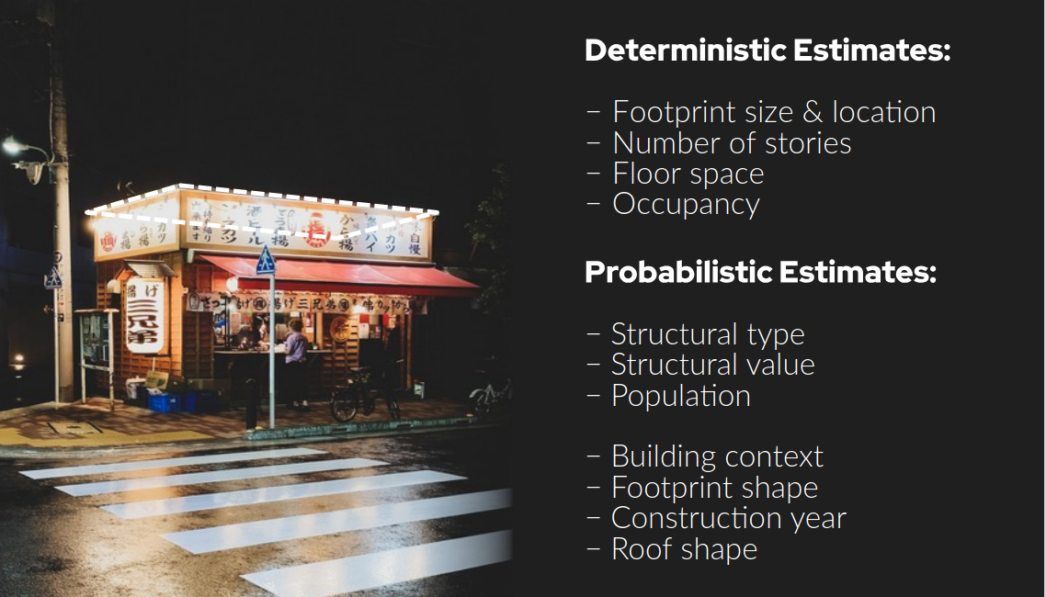
Various sources of information
We use several types of datasets that have slightly different definitions of buildings. Among the sources are OSM, exposure distributions (GEM, Hazus), building stock information, census data, and 3D information.
Each dataset has a different description, so a shared language needs to be set. Out of all possible key:tag values, the ones that provide more value to the exposure assessment are prioritized.

Slide 23
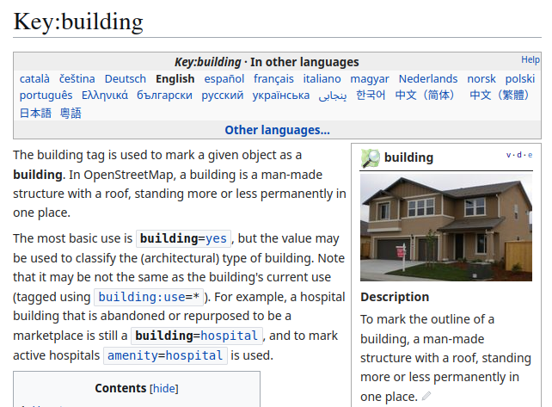
OSM taxonomy
The definition is quite inclusive. The initial proposal was provided in 2008, and since then it has developed to be the most used tag in OSM.

Slide 24
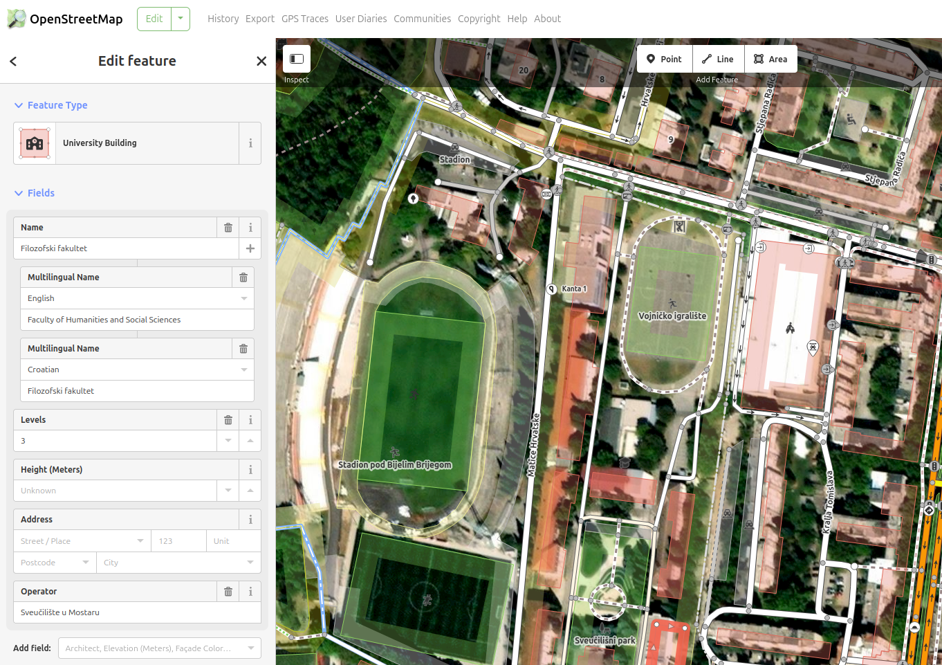
OSM taxonomy
The definition is quite inclusive. The initial proposal was provided in 2008, and since then it has developed to be the most used tag in OSM.
The editing is done through several editors that get their supported values through presets, but a user can define their own suggested values too.
github.com/openstreetmap/id-tagging-schema

Slide 25
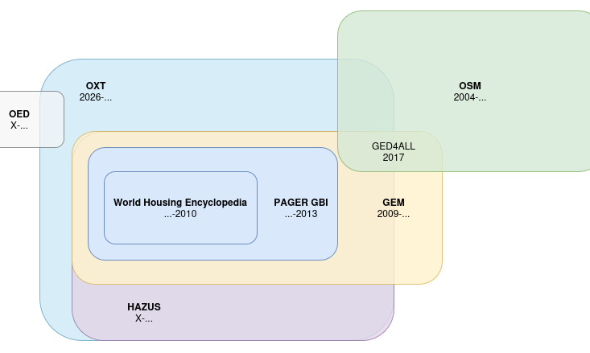
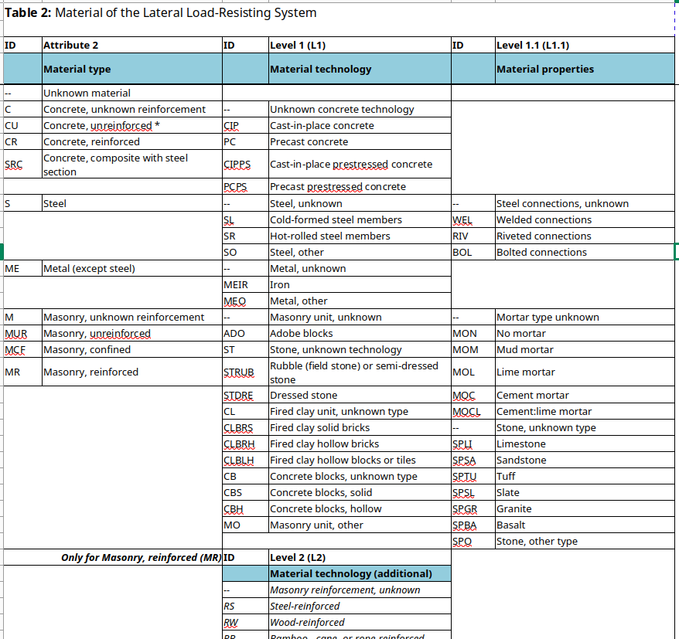
Exposure taxonomies
The community during the years has produced multiple definitions of the built environment that are parallel to the documentation patterns.

Slide 26
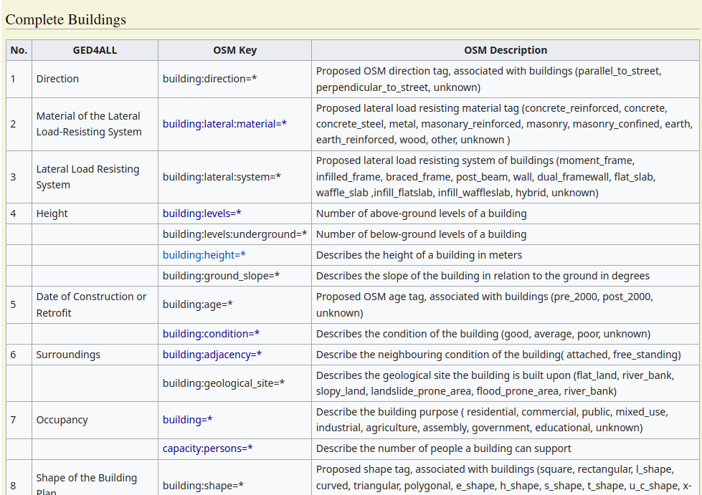
Finding a middle ground
https://wiki.openstreetmap.org/wiki/GED4ALL

Slide 27
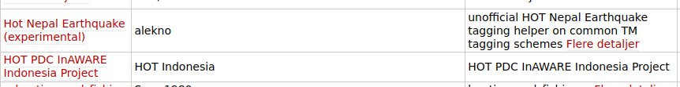

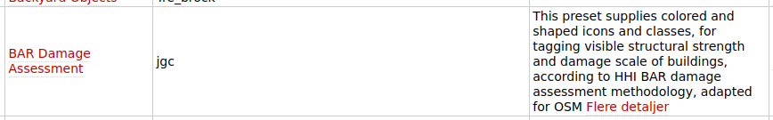
Finding a middle ground
Several initiatives have created their own presets for mapping in case of disasters, and these presets can be found online.
https://josm.openstreetmap.de/wiki/Da%3APresets
https://wiki.openstreetmap.org/wiki/GED4ALL

Slide 28
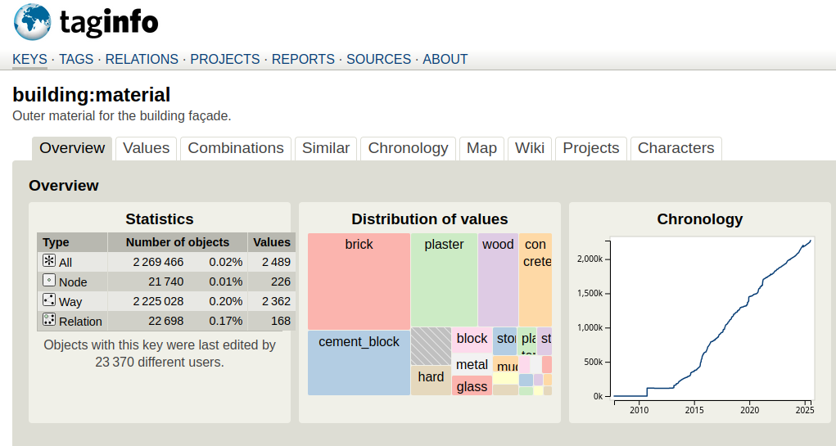
Finding a middle ground
https://taginfo.openstreetmap.org/keys/building:material
https://wiki.openstreetmap.org/wiki/GED4ALL

Slide 29
Extending taxonomies

Slide 30
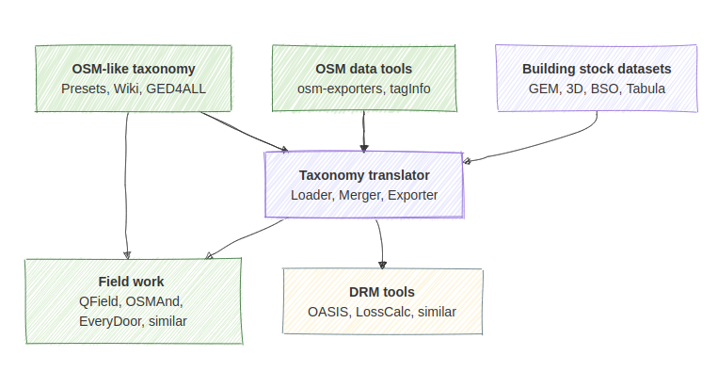
An extended taxonomy
1. Start with baseline taxonomy
2. Handle conflict when merge
3. Have multiple export types
4. Decide on scope

Slide 31
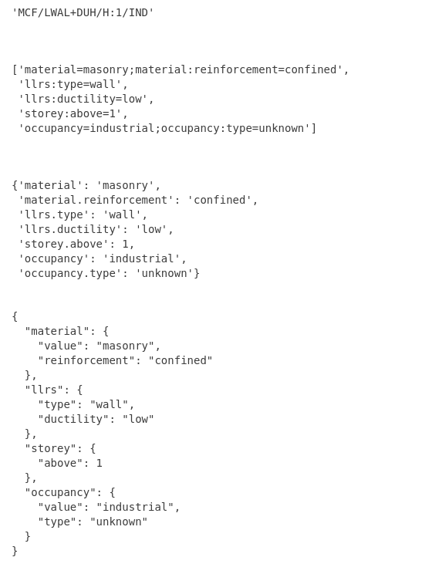
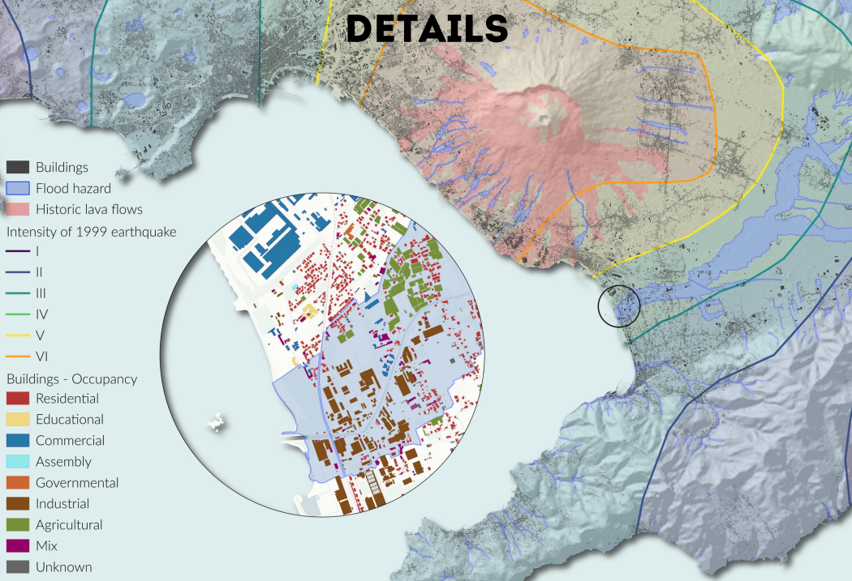
Translation gem2osm

Slide 32
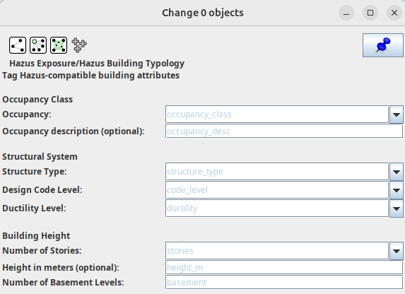
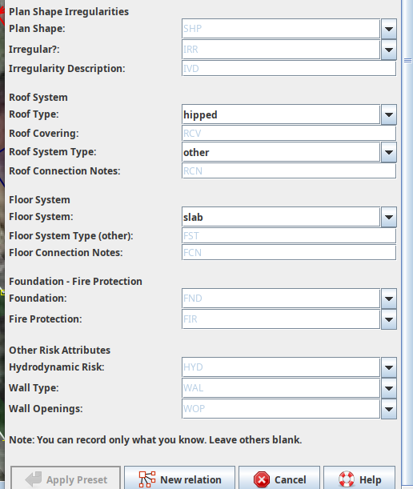
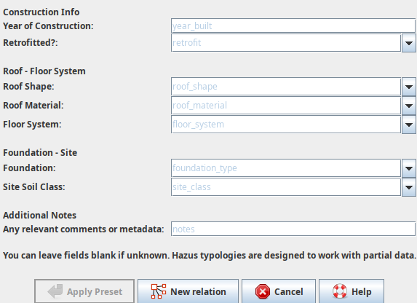
Translating taxonomies to exports

Slide 33
Using the infrastructure
Export the taxonomy as:
- PRESET.xml for JOSM, OsmAnd
- PRESET.json for iDEditor
- PRESET.yaml for EveryDoor
- qgis project for QField
- hard-coded values for StreetComplete
Wiki and forum usage:
- Proposals for new relevant fields.
- Integration with vulnerability functions.
- Exposure can be part of the discussion.
Tasking Manager for data collection and fieldwork.

Slide 34
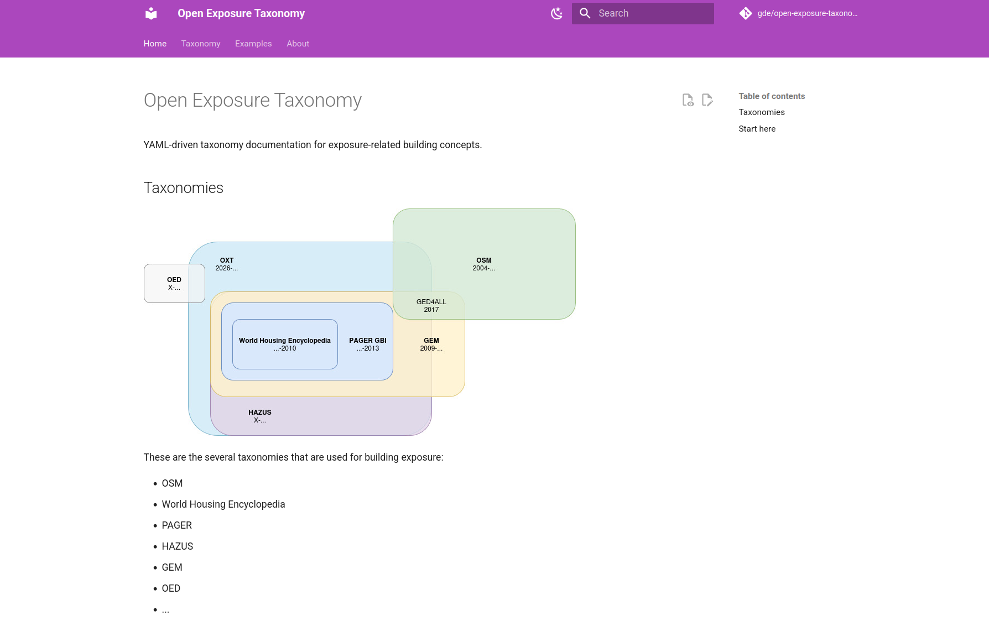
Documentation
Open Documentation.

Slide 35
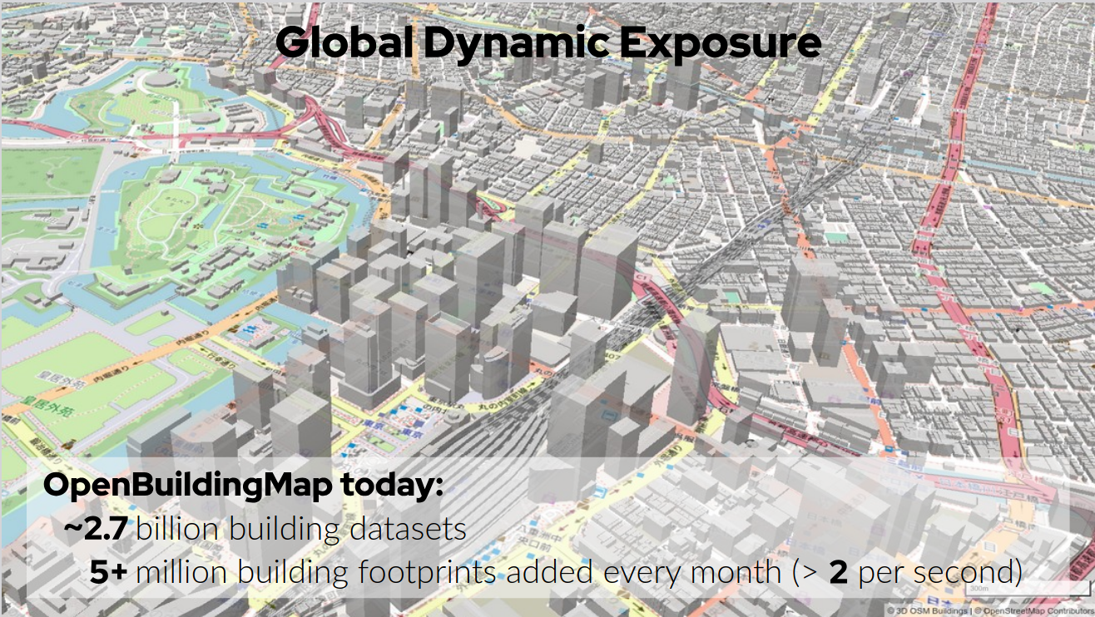
Using the infrastructure
Export the taxonomy as:
- PRESET.xml for JOSM, OsmAnd
- PRESET.json for iDEditor
- PRESET.yaml for EveryDoor
- qgis project for QField
- hard-coded values for StreetComplete
Wiki and forum usage:
- Proposals for new relevant fields.
- Integration with vulnerability functions.
- Exposure can be part of the discussion.
Tasking Manager for data collection and fieldwork.

Slide 36
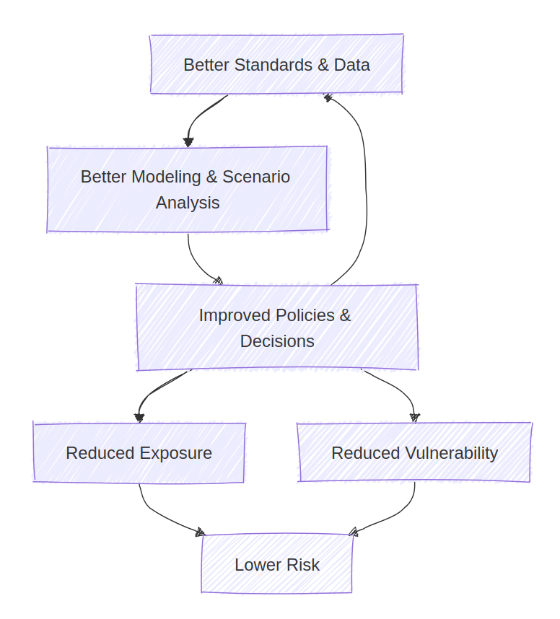
What is the added value?
Disaster risk management agencies run scenario-based models and prioritize interventions (area with oldest buildings gets a firefighting station to increase readiness).
Humanitarian and development organizations transfer knowledge between different events to improve impact for countries with lack of proper infrastructure.
Building codes change based on accepted risk for an area, given exposure, vulnerability, hazards.
Cities improve their urban planning through integrating more rich information (roof shape, orientation -> energy).
Insurance and reinsurance companies evaluate risk and create pricing models.

Slide 37
References
Schorlemmer, Danijel; Oostwegel, Laurens J.N.; Lingner, Lars; Evaz Zadeh, Tara (2024): A model of European buildings. V. 23/07. GFZ Data Services. https://doi.org/10.5880/GFZ.2.6.2023.011
Yepes-Estrada, C., Calderon, A., Costa, C., Crowley, H., Dabbeek, J., Hoyos, M., Martins, L., Paul, N., Rao, A., Silva, V. (2023). Global Building Exposure Model for Earthquake Risk Assessment. Earthquake Spectra. doi:10.1177/87552930231194048
Oostwegel, L.J.N., Schorlemmer, D. & Guéguen, P. From Footprints to Functions: A Comprehensive Global and Semantic Building Footprint Dataset. Sci Data 12, 1699 (2025). https://doi.org/10.1038/s41597-025-06132-z
OpenStreetMap contributors. OpenStreetMap. https://www.openstreetmap.org
Humanitarian OpenStreetMap Team (HOT). https://www.hotosm.org
Global Earthquake Model Foundation (GEM). https://www.globalquakemodel.org
OASIS Loss Modelling Framework. https://oasislmf.org
PAGER. USGS

