Slide 1



Integrated Modeling of the Water–Food–Ecosystem Nexus in the Upper Main Catchment under Future Climate and Socioeconomic Scenarios
Sreya Prakash, Sawparnika Ayyappan Preetha Kumari, Jingshui Huang
Chair of Hydrology and River Basin Management
Technical University of Munich
EGU26-21523, Vienna, 06.05.2026

Slide 2


Explore the Research
Background
Methodology
Calibration
Climate & Hydrology
Agricultural Productivity
Ecosystem Health
Irrigation Intervention
Nexus Synthesis

Slide 3
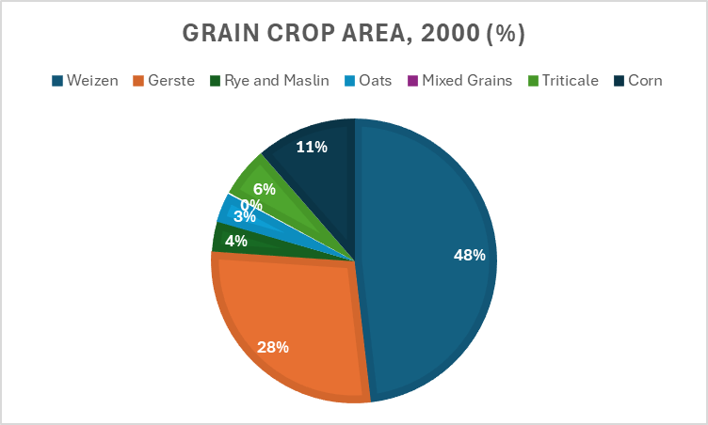

STUDY AREA
MATERIALS
Upper Main Catchment, Bavaria
Representative temperate rainfed basin critical for food security.
Geological constituents and aquifers
Notes:
The study is conducted in the Upper Main Catchment in Bavaria, Germany, which is a predominantly agricultural region supporting regional food production.
The land use is largely rainfed, making it particularly sensitive to changes in climate and water availability. Over 67% of agricultural area is cereal
From a physical perspective, the catchment is characterized by Luvisols and Cambisols, which are heavy soils prone to waterlogging and associated aeration stress, especially under high moisture conditions.
Hydrologically, the basin exhibits a pluvial–nival regime, with precipitation ranging from approximately 700 to 1500 mm annually, resulting in strong seasonal variability in flow.
These characteristics make the catchment highly relevant for assessing climate-driven impacts on water, agriculture, and ecosystem processes.

Slide 4
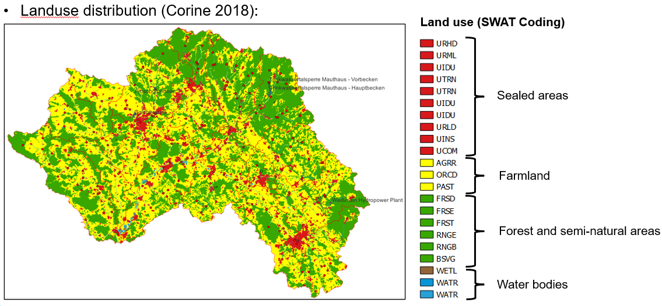
STUDY AREA
MATERIALS
Historical precipitation and flow regime.
Landuse Distribution from Corine (2018) used for model delineation. The AGRR is further discretized to different crop types based on data from InVeKoS.
Notes:
The study is conducted in the Upper Main Catchment in Bavaria, Germany, which is a predominantly agricultural region supporting regional food production.
The land use is largely rainfed, making it particularly sensitive to changes in climate and water availability. Over 67% of agricultural area is cereal
From a physical perspective, the catchment is characterized by Luvisols and Cambisols, which are heavy soils prone to waterlogging and associated aeration stress, especially under high moisture conditions.
Hydrologically, the basin exhibits a pluvial–nival regime, with precipitation ranging from approximately 700 to 1500 mm annually, resulting in strong seasonal variability in flow.
These characteristics make the catchment highly relevant for assessing climate-driven impacts on water, agriculture, and ecosystem processes.

Slide 5
STUDY AREA
MATERIALS
Data Sources
Notes:
The study is conducted in the Upper Main Catchment in Bavaria, Germany, which is a predominantly agricultural region supporting regional food production.
The land use is largely rainfed, making it particularly sensitive to changes in climate and water availability. Over 67% of agricultural area is cereal
From a physical perspective, the catchment is characterized by Luvisols and Cambisols, which are heavy soils prone to waterlogging and associated aeration stress, especially under high moisture conditions.
Hydrologically, the basin exhibits a pluvial–nival regime, with precipitation ranging from approximately 700 to 1500 mm annually, resulting in strong seasonal variability in flow.
These characteristics make the catchment highly relevant for assessing climate-driven impacts on water, agriculture, and ecosystem processes.

Slide 6
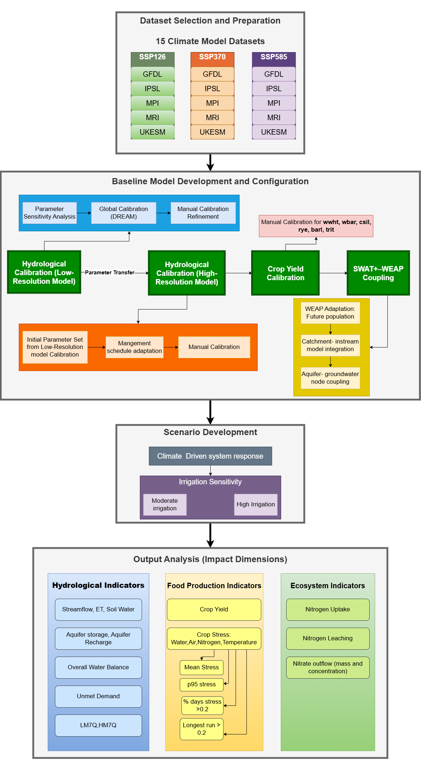
COMPOSITE MODELING FRAMEWORK
Notes:
The study is conducted in the Upper Main Catchment in Bavaria, Germany, which is a predominantly agricultural region supporting regional food production.
The land use is largely rainfed, making it particularly sensitive to changes in climate and water availability. Over 67% of agricultural area is cereal
From a physical perspective, the catchment is characterized by Luvisols and Cambisols, which are heavy soils prone to waterlogging and associated aeration stress, especially under high moisture conditions.
Hydrologically, the basin exhibits a pluvial–nival regime, with precipitation ranging from approximately 700 to 1500 mm annually, resulting in strong seasonal variability in flow.
These characteristics make the catchment highly relevant for assessing climate-driven impacts on water, agriculture, and ecosystem processes.

Slide 7
COMPOSITE MANAGEMENT SCHEDULE
Notes:
The study is conducted in the Upper Main Catchment in Bavaria, Germany, which is a predominantly agricultural region supporting regional food production.
The land use is largely rainfed, making it particularly sensitive to changes in climate and water availability. Over 67% of agricultural area is cereal
From a physical perspective, the catchment is characterized by Luvisols and Cambisols, which are heavy soils prone to waterlogging and associated aeration stress, especially under high moisture conditions.
Hydrologically, the basin exhibits a pluvial–nival regime, with precipitation ranging from approximately 700 to 1500 mm annually, resulting in strong seasonal variability in flow.
These characteristics make the catchment highly relevant for assessing climate-driven impacts on water, agriculture, and ecosystem processes.

Slide 8
COMPOSITE MANAGEMENT SCHEDULE
Custom decision table for stress-based nitrogen fertilizer application for barley
Description of Moderate Irrigation and High Irrigation Conceptual Sensitivity Scenarios
Notes:
The study is conducted in the Upper Main Catchment in Bavaria, Germany, which is a predominantly agricultural region supporting regional food production.
The land use is largely rainfed, making it particularly sensitive to changes in climate and water availability. Over 67% of agricultural area is cereal
From a physical perspective, the catchment is characterized by Luvisols and Cambisols, which are heavy soils prone to waterlogging and associated aeration stress, especially under high moisture conditions.
Hydrologically, the basin exhibits a pluvial–nival regime, with precipitation ranging from approximately 700 to 1500 mm annually, resulting in strong seasonal variability in flow.
These characteristics make the catchment highly relevant for assessing climate-driven impacts on water, agriculture, and ecosystem processes.

Slide 9
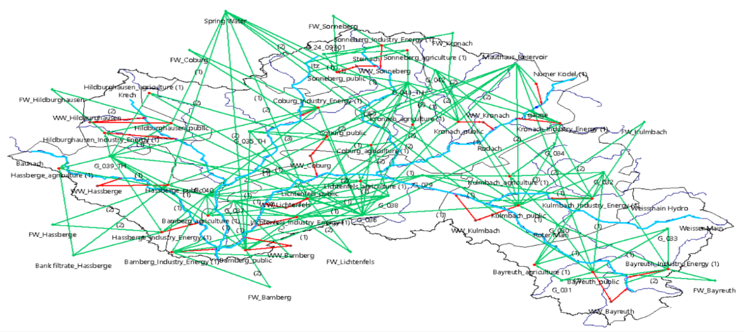
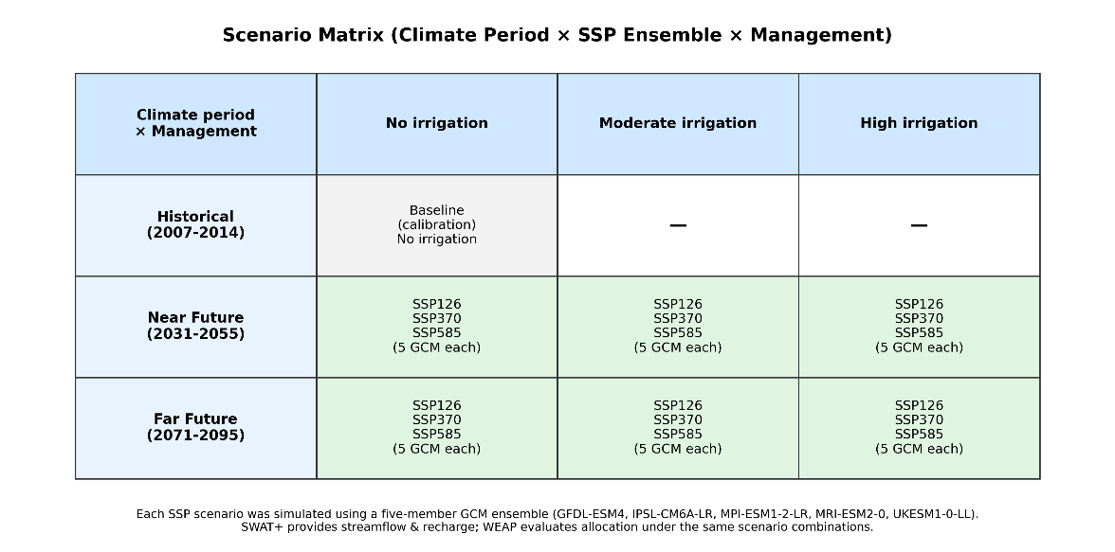
COMPOSITE MANAGEMENT SCHEDULE
WEAP Model Configuration with river network, groundwater storage nodes, demand sites, transmission links
Scenario Matrix across climate evaluation period, SSP ensemble and management scenario
Notes:
The study is conducted in the Upper Main Catchment in Bavaria, Germany, which is a predominantly agricultural region supporting regional food production.
The land use is largely rainfed, making it particularly sensitive to changes in climate and water availability. Over 67% of agricultural area is cereal
From a physical perspective, the catchment is characterized by Luvisols and Cambisols, which are heavy soils prone to waterlogging and associated aeration stress, especially under high moisture conditions.
Hydrologically, the basin exhibits a pluvial–nival regime, with precipitation ranging from approximately 700 to 1500 mm annually, resulting in strong seasonal variability in flow.
These characteristics make the catchment highly relevant for assessing climate-driven impacts on water, agriculture, and ecosystem processes.

Slide 10
HYDROLOGICAL CALIBRATION
WATER
Streamflow calibration parameters with change type used, default values, starting values from coarse-resolution model and final calibrated values
Notes:
The objective of this step is to ensure that the model adequately captures the physical hydrological behavior of the catchment.
A total of 17 parameters were calibrated, combining global optimization using the DREAM algorithm with subsequent manual refinement.
The model achieves an NSE of 0.65 and a logNSE of 0.74, indicating a good representation of both peak flows and low-flow conditions.
While some peak flows are slightly overestimated, the model successfully captures the timing and overall variability of discharge.

Slide 11
CROP YIELD CALIBRATION
FOOD
Crop yield calibration parameters with default values and final calibrated values
Notes:
Crop yield calibration was performed against observed regional statistics for the dominant crops in the basin.
The model shows good agreement across all crops, with low bias ranging from approximately minus 8.7 percent to plus 0.5 percent.
Slight underestimation is observed for winter wheat, silage maize, and triticale.
For maize and triticale in particular, parameter adjustments beyond the default SWAT+ ranges were required to better represent local conditions.
Overall, the model captures crop productivity reliably, providing a strong basis for subsequent nutrient and ecosystem simulations. This is critical, as biomass controls nutrient uptake and directly influences nitrate dynamics in the system.

Slide 12
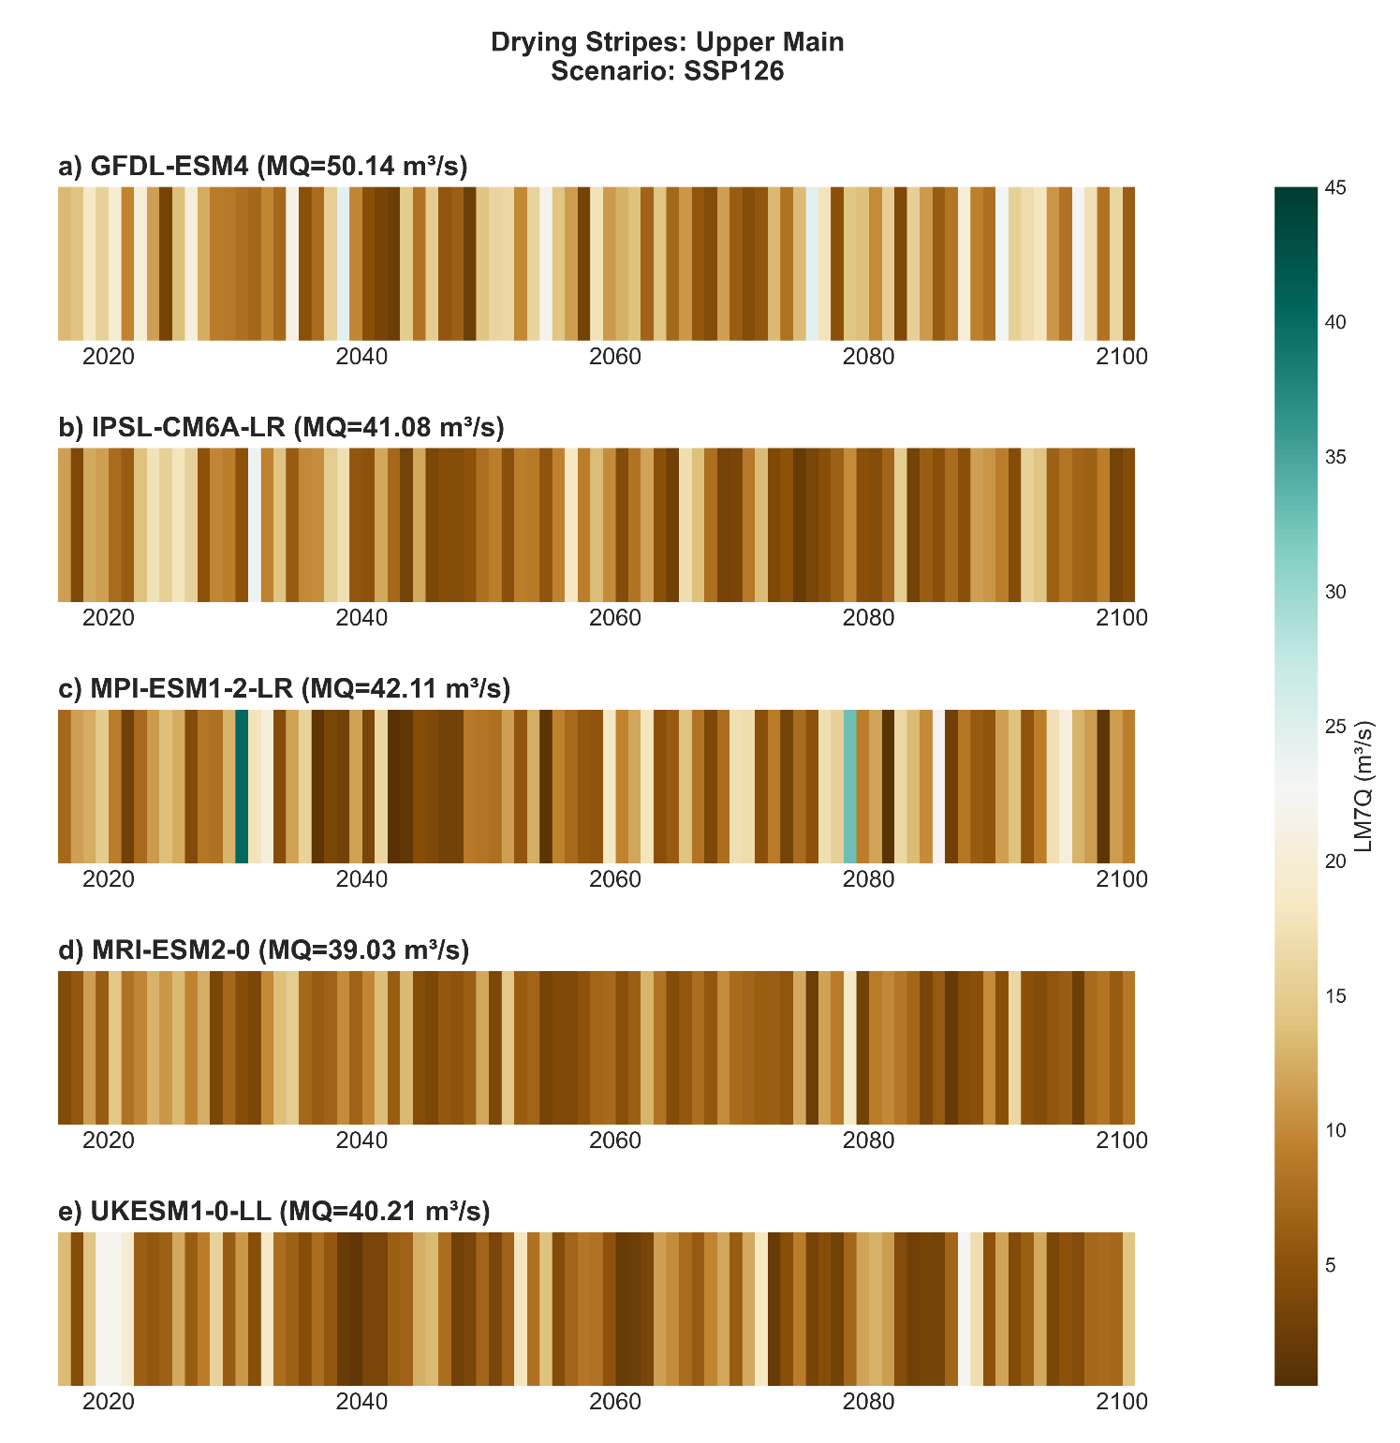
HYDROLOGICAL SYSTEM RESPONSE
WATER
Annual 7-day minimum discharge (LM7Q)- SSP126
Notes:
The objective of this step is to ensure that the model adequately captures the physical hydrological behavior of the catchment.
A total of 17 parameters were calibrated, combining global optimization using the DREAM algorithm with subsequent manual refinement.
The model achieves an NSE of 0.65 and a logNSE of 0.74, indicating a good representation of both peak flows and low-flow conditions.
While some peak flows are slightly overestimated, the model successfully captures the timing and overall variability of discharge.

Slide 13
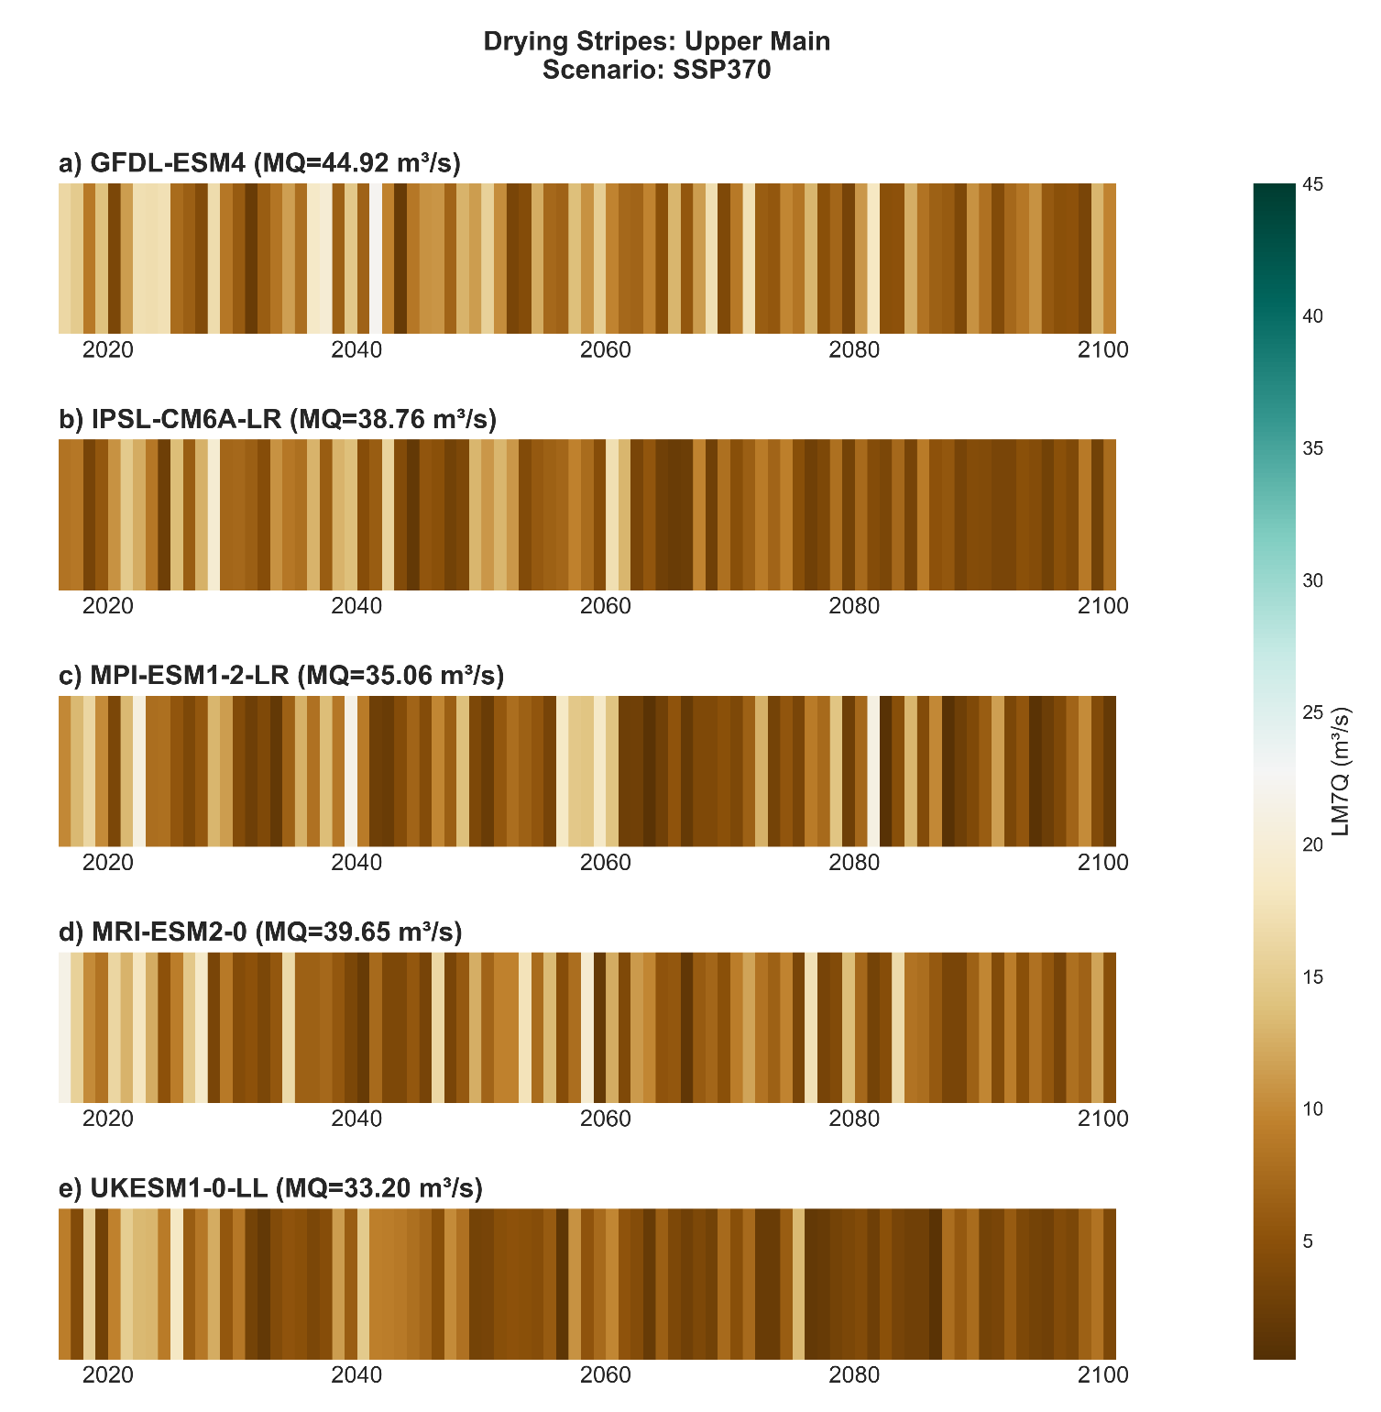
HYDROLOGICAL SYSTEM RESPONSE
WATER
Annual 7-day minimum discharge (LM7Q)- SSP370
Notes:
The objective of this step is to ensure that the model adequately captures the physical hydrological behavior of the catchment.
A total of 17 parameters were calibrated, combining global optimization using the DREAM algorithm with subsequent manual refinement.
The model achieves an NSE of 0.65 and a logNSE of 0.74, indicating a good representation of both peak flows and low-flow conditions.
While some peak flows are slightly overestimated, the model successfully captures the timing and overall variability of discharge.

Slide 14
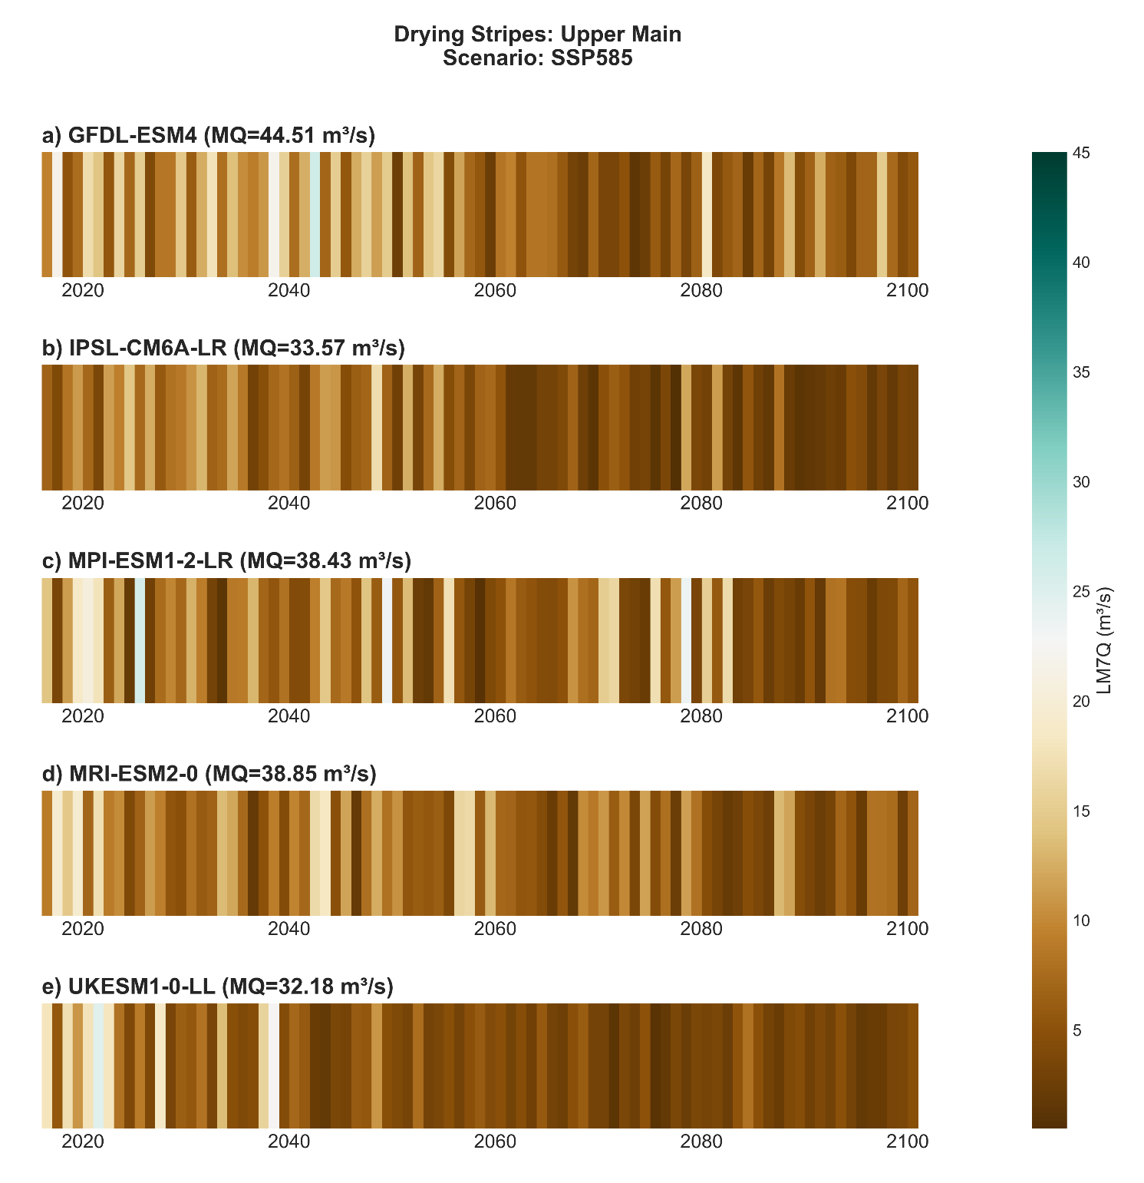
HYDROLOGICAL SYSTEM RESPONSE
WATER
Annual 7-day minimum discharge (LM7Q)- SSP585
Notes:
The objective of this step is to ensure that the model adequately captures the physical hydrological behavior of the catchment.
A total of 17 parameters were calibrated, combining global optimization using the DREAM algorithm with subsequent manual refinement.
The model achieves an NSE of 0.65 and a logNSE of 0.74, indicating a good representation of both peak flows and low-flow conditions.
While some peak flows are slightly overestimated, the model successfully captures the timing and overall variability of discharge.

Slide 15
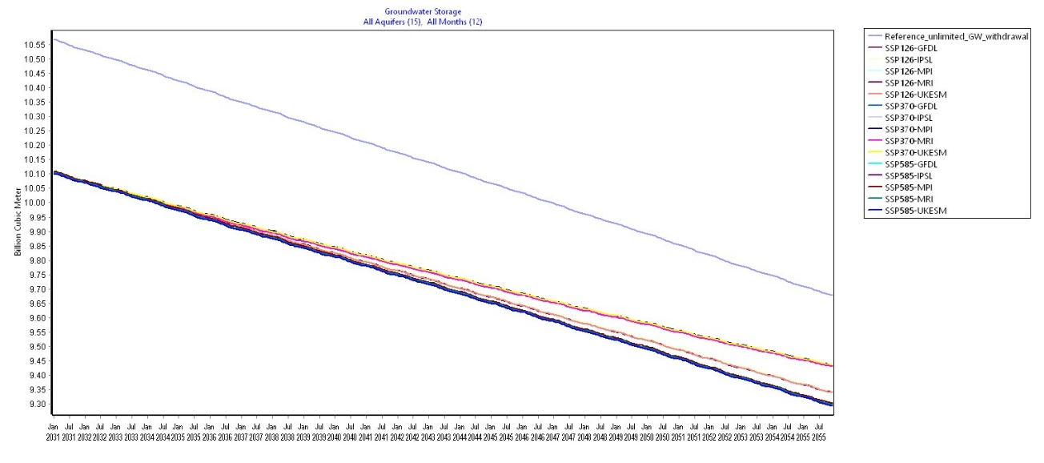
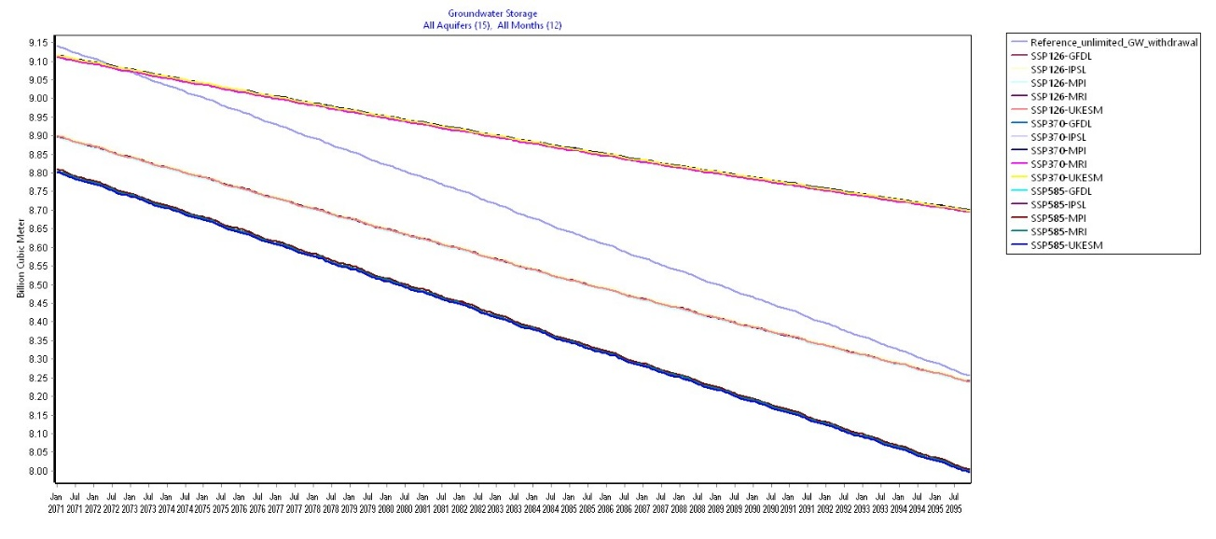
WATER ALLOCATION RESPONSE
WATER
Catchment groundwater storage for the near-future period under future climate scenarios, after competing user abstractions
Catchment groundwater storage for the far-future period under future climate scenarios, after competing user abstractions
Notes:
The objective of this step is to ensure that the model adequately captures the physical hydrological behavior of the catchment.
A total of 17 parameters were calibrated, combining global optimization using the DREAM algorithm with subsequent manual refinement.
The model achieves an NSE of 0.65 and a logNSE of 0.74, indicating a good representation of both peak flows and low-flow conditions.
While some peak flows are slightly overestimated, the model successfully captures the timing and overall variability of discharge.

Slide 16
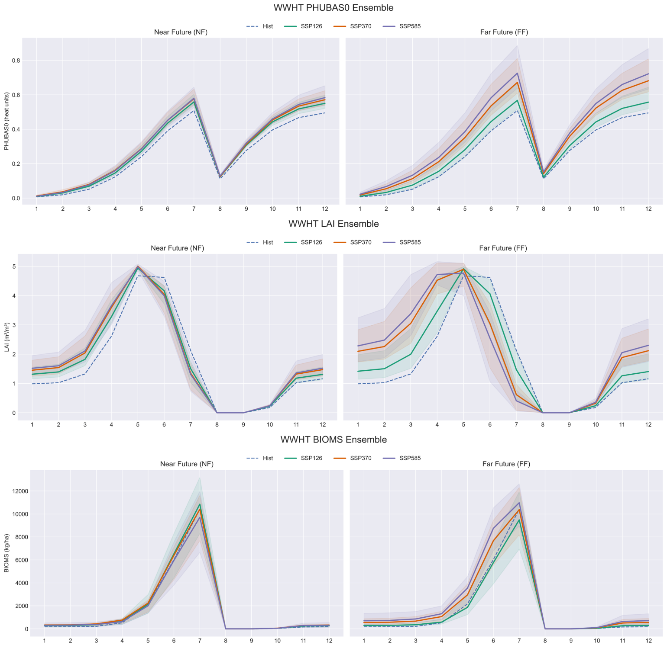
PHENOLOGICAL ADAPTATION
FOOD
Mechanistic Monthly Mean Growth Shifts for wwht: base Plant Heat Unit (PHU) accumulation, Leaf Area Index (LAI), Biomass accumulation
Notes:
Crop yield calibration was performed against observed regional statistics for the dominant crops in the basin.
The model shows good agreement across all crops, with low bias ranging from approximately minus 8.7 percent to plus 0.5 percent.
Slight underestimation is observed for winter wheat, silage maize, and triticale.
For maize and triticale in particular, parameter adjustments beyond the default SWAT+ ranges were required to better represent local conditions.
Overall, the model captures crop productivity reliably, providing a strong basis for subsequent nutrient and ecosystem simulations. This is critical, as biomass controls nutrient uptake and directly influences nitrate dynamics in the system.

Slide 17
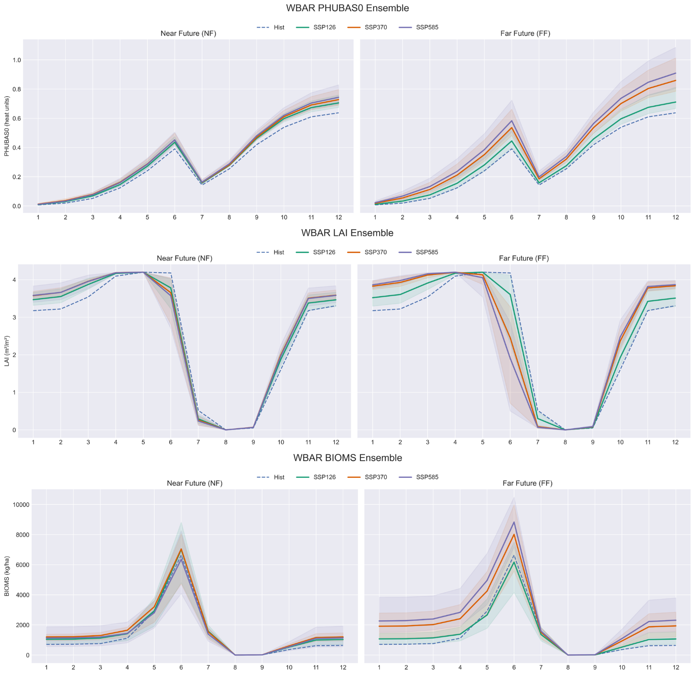
PHENOLOGICAL ADAPTATION
FOOD
Mechanistic Monthly Mean Growth Shifts for wbar: base Plant Heat Unit (PHU) accumulation, Leaf Area Index (LAI), Biomass accumulation
Notes:
Crop yield calibration was performed against observed regional statistics for the dominant crops in the basin.
The model shows good agreement across all crops, with low bias ranging from approximately minus 8.7 percent to plus 0.5 percent.
Slight underestimation is observed for winter wheat, silage maize, and triticale.
For maize and triticale in particular, parameter adjustments beyond the default SWAT+ ranges were required to better represent local conditions.
Overall, the model captures crop productivity reliably, providing a strong basis for subsequent nutrient and ecosystem simulations. This is critical, as biomass controls nutrient uptake and directly influences nitrate dynamics in the system.

Slide 18
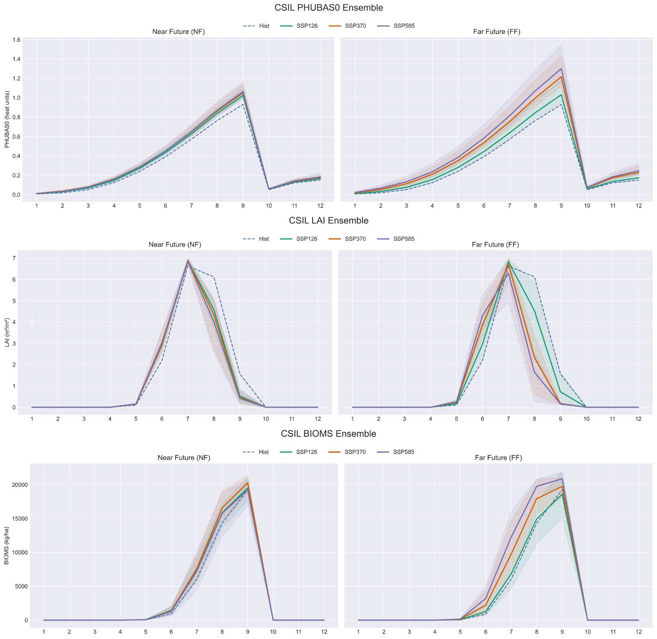
PHENOLOGICAL ADAPTATION
FOOD
Mechanistic Monthly Mean Growth Shifts for csil: base Plant Heat Unit (PHU) accumulation, Leaf Area Index (LAI), Biomass accumulation
Notes:
Crop yield calibration was performed against observed regional statistics for the dominant crops in the basin.
The model shows good agreement across all crops, with low bias ranging from approximately minus 8.7 percent to plus 0.5 percent.
Slight underestimation is observed for winter wheat, silage maize, and triticale.
For maize and triticale in particular, parameter adjustments beyond the default SWAT+ ranges were required to better represent local conditions.
Overall, the model captures crop productivity reliably, providing a strong basis for subsequent nutrient and ecosystem simulations. This is critical, as biomass controls nutrient uptake and directly influences nitrate dynamics in the system.

Slide 19
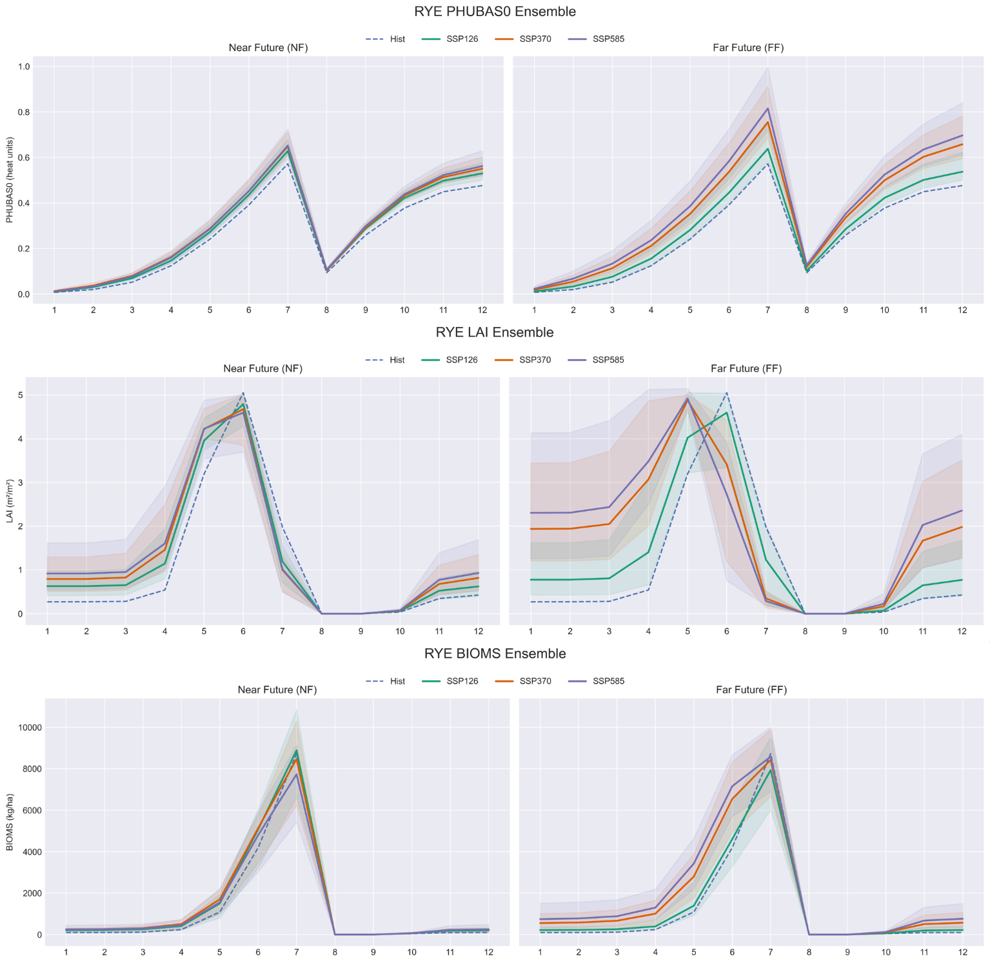
PHENOLOGICAL ADAPTATION
FOOD
Mechanistic Monthly Mean Growth Shifts for rye: base Plant Heat Unit (PHU) accumulation, Leaf Area Index (LAI), Biomass accumulation
Notes:
Crop yield calibration was performed against observed regional statistics for the dominant crops in the basin.
The model shows good agreement across all crops, with low bias ranging from approximately minus 8.7 percent to plus 0.5 percent.
Slight underestimation is observed for winter wheat, silage maize, and triticale.
For maize and triticale in particular, parameter adjustments beyond the default SWAT+ ranges were required to better represent local conditions.
Overall, the model captures crop productivity reliably, providing a strong basis for subsequent nutrient and ecosystem simulations. This is critical, as biomass controls nutrient uptake and directly influences nitrate dynamics in the system.

Slide 20
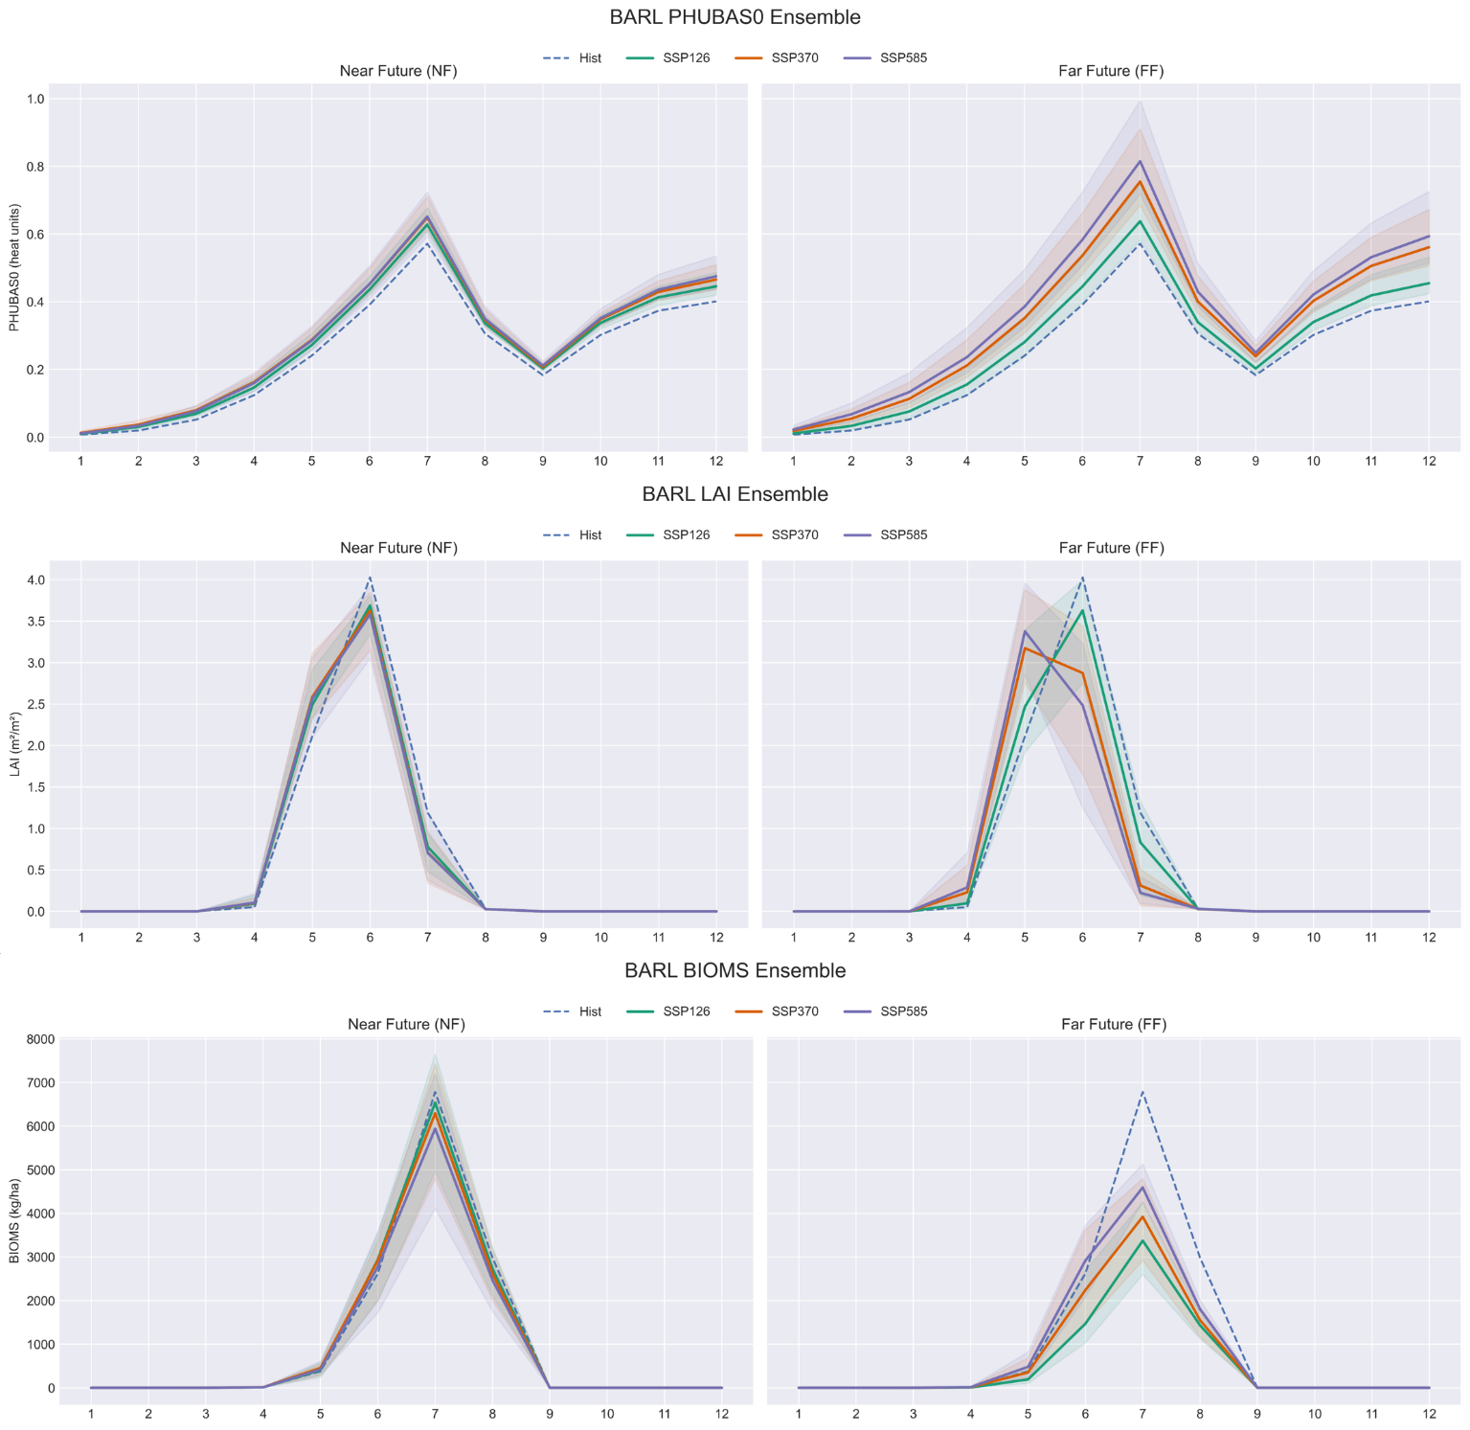
PHENOLOGICAL ADAPTATION
FOOD
Mechanistic Monthly Mean Growth Shifts for barl: base Plant Heat Unit (PHU) accumulation, Leaf Area Index (LAI), Biomass accumulation
Notes:
Crop yield calibration was performed against observed regional statistics for the dominant crops in the basin.
The model shows good agreement across all crops, with low bias ranging from approximately minus 8.7 percent to plus 0.5 percent.
Slight underestimation is observed for winter wheat, silage maize, and triticale.
For maize and triticale in particular, parameter adjustments beyond the default SWAT+ ranges were required to better represent local conditions.
Overall, the model captures crop productivity reliably, providing a strong basis for subsequent nutrient and ecosystem simulations. This is critical, as biomass controls nutrient uptake and directly influences nitrate dynamics in the system.

Slide 21
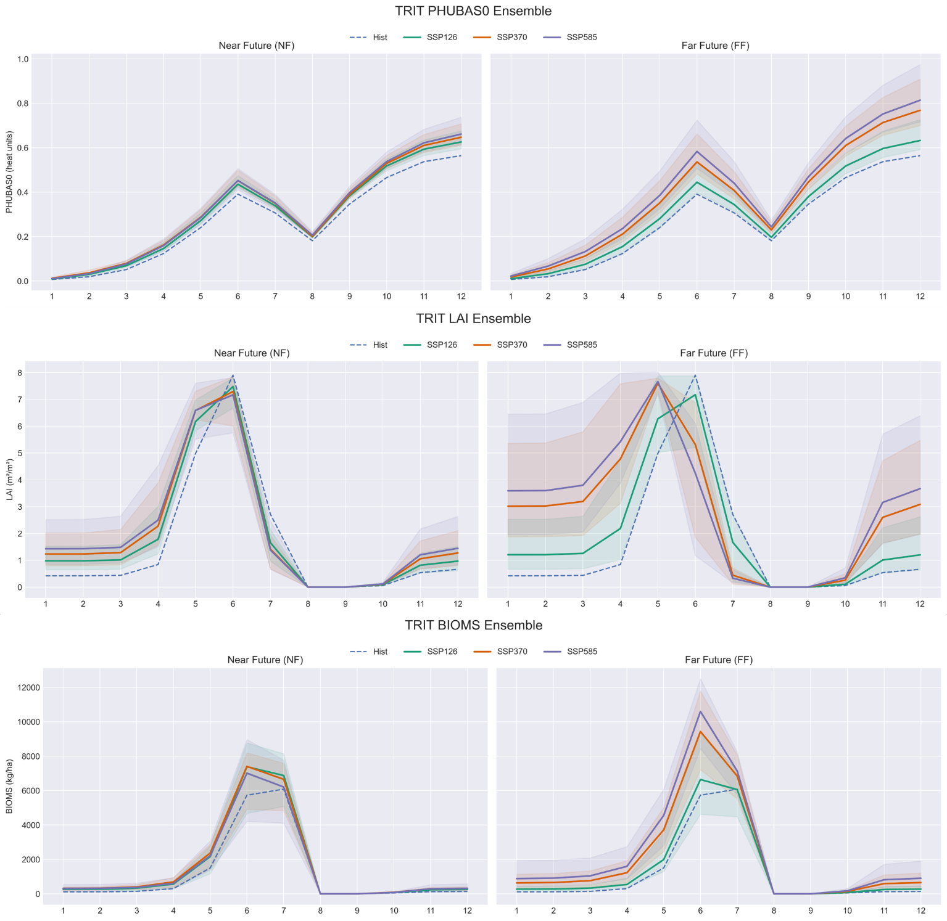
PHENOLOGICAL ADAPTATION
FOOD
Mechanistic Monthly Mean Growth Shifts for trit: base Plant Heat Unit (PHU) accumulation, Leaf Area Index (LAI), Biomass accumulation
Notes:
Crop yield calibration was performed against observed regional statistics for the dominant crops in the basin.
The model shows good agreement across all crops, with low bias ranging from approximately minus 8.7 percent to plus 0.5 percent.
Slight underestimation is observed for winter wheat, silage maize, and triticale.
For maize and triticale in particular, parameter adjustments beyond the default SWAT+ ranges were required to better represent local conditions.
Overall, the model captures crop productivity reliably, providing a strong basis for subsequent nutrient and ecosystem simulations. This is critical, as biomass controls nutrient uptake and directly influences nitrate dynamics in the system.

Slide 22
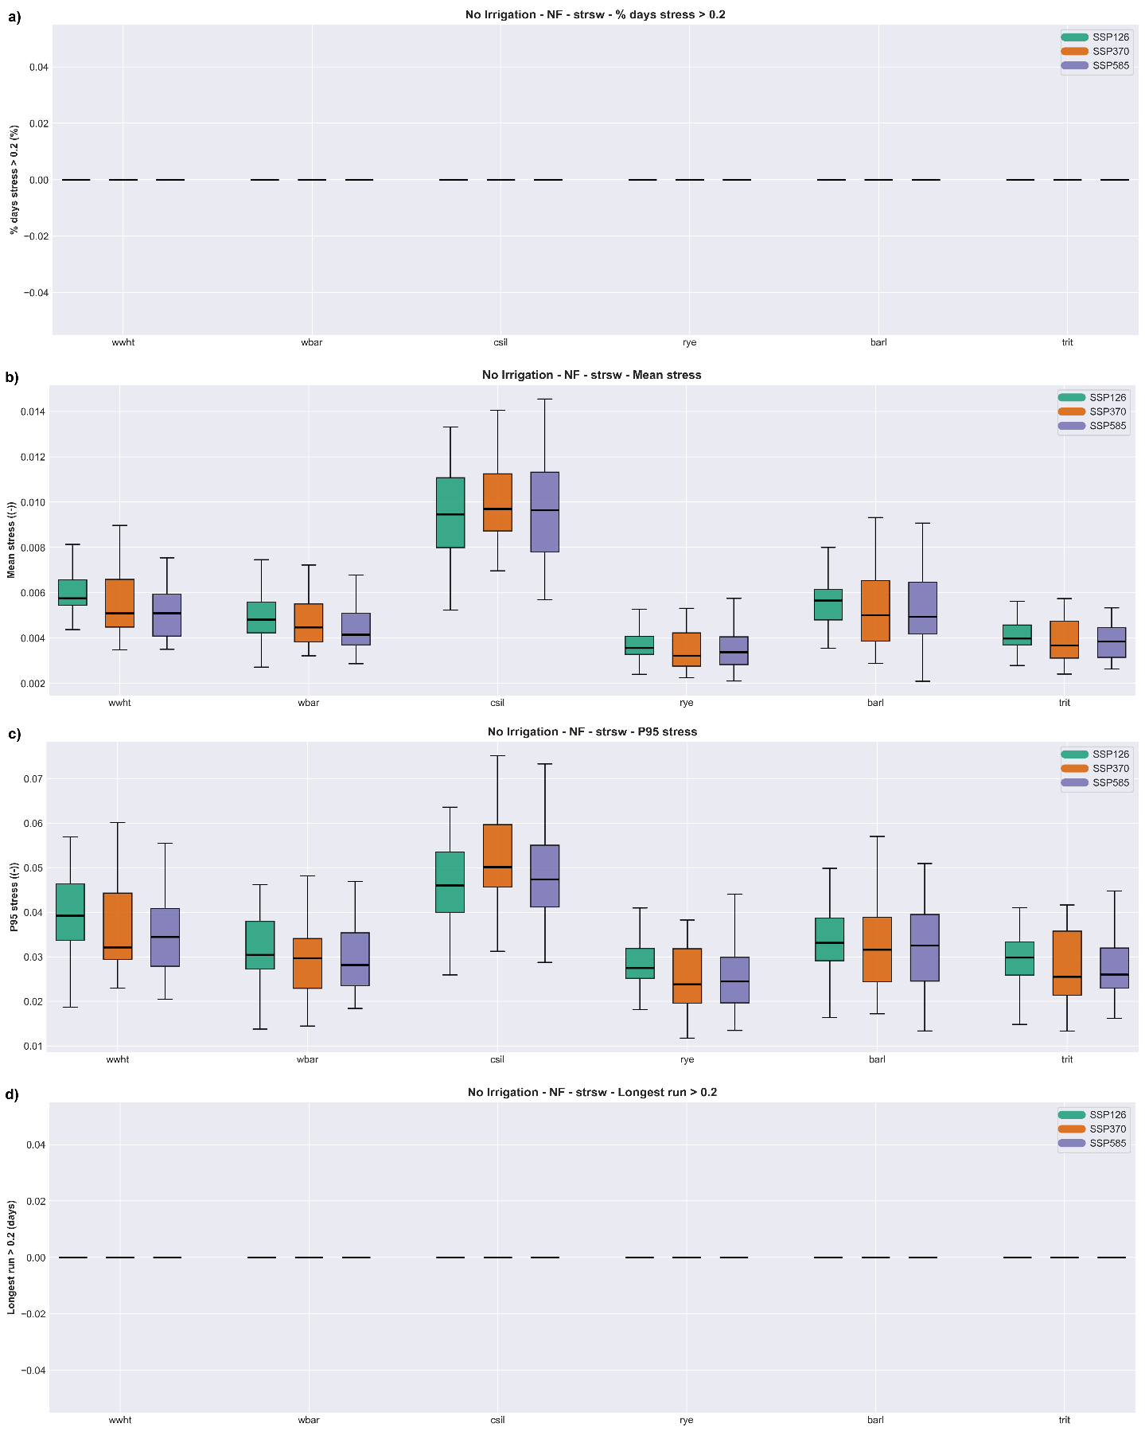
CROP STRESS METRICS
FOOD
Crop water stress metrics under future climate scenarios in the near-future: a) Percentage days above threshold 0.2, b) Mean stress, c) P95 stress, d) Longest run above threshold 0.2
Notes:
Crop yield calibration was performed against observed regional statistics for the dominant crops in the basin.
The model shows good agreement across all crops, with low bias ranging from approximately minus 8.7 percent to plus 0.5 percent.
Slight underestimation is observed for winter wheat, silage maize, and triticale.
For maize and triticale in particular, parameter adjustments beyond the default SWAT+ ranges were required to better represent local conditions.
Overall, the model captures crop productivity reliably, providing a strong basis for subsequent nutrient and ecosystem simulations. This is critical, as biomass controls nutrient uptake and directly influences nitrate dynamics in the system.

Slide 23
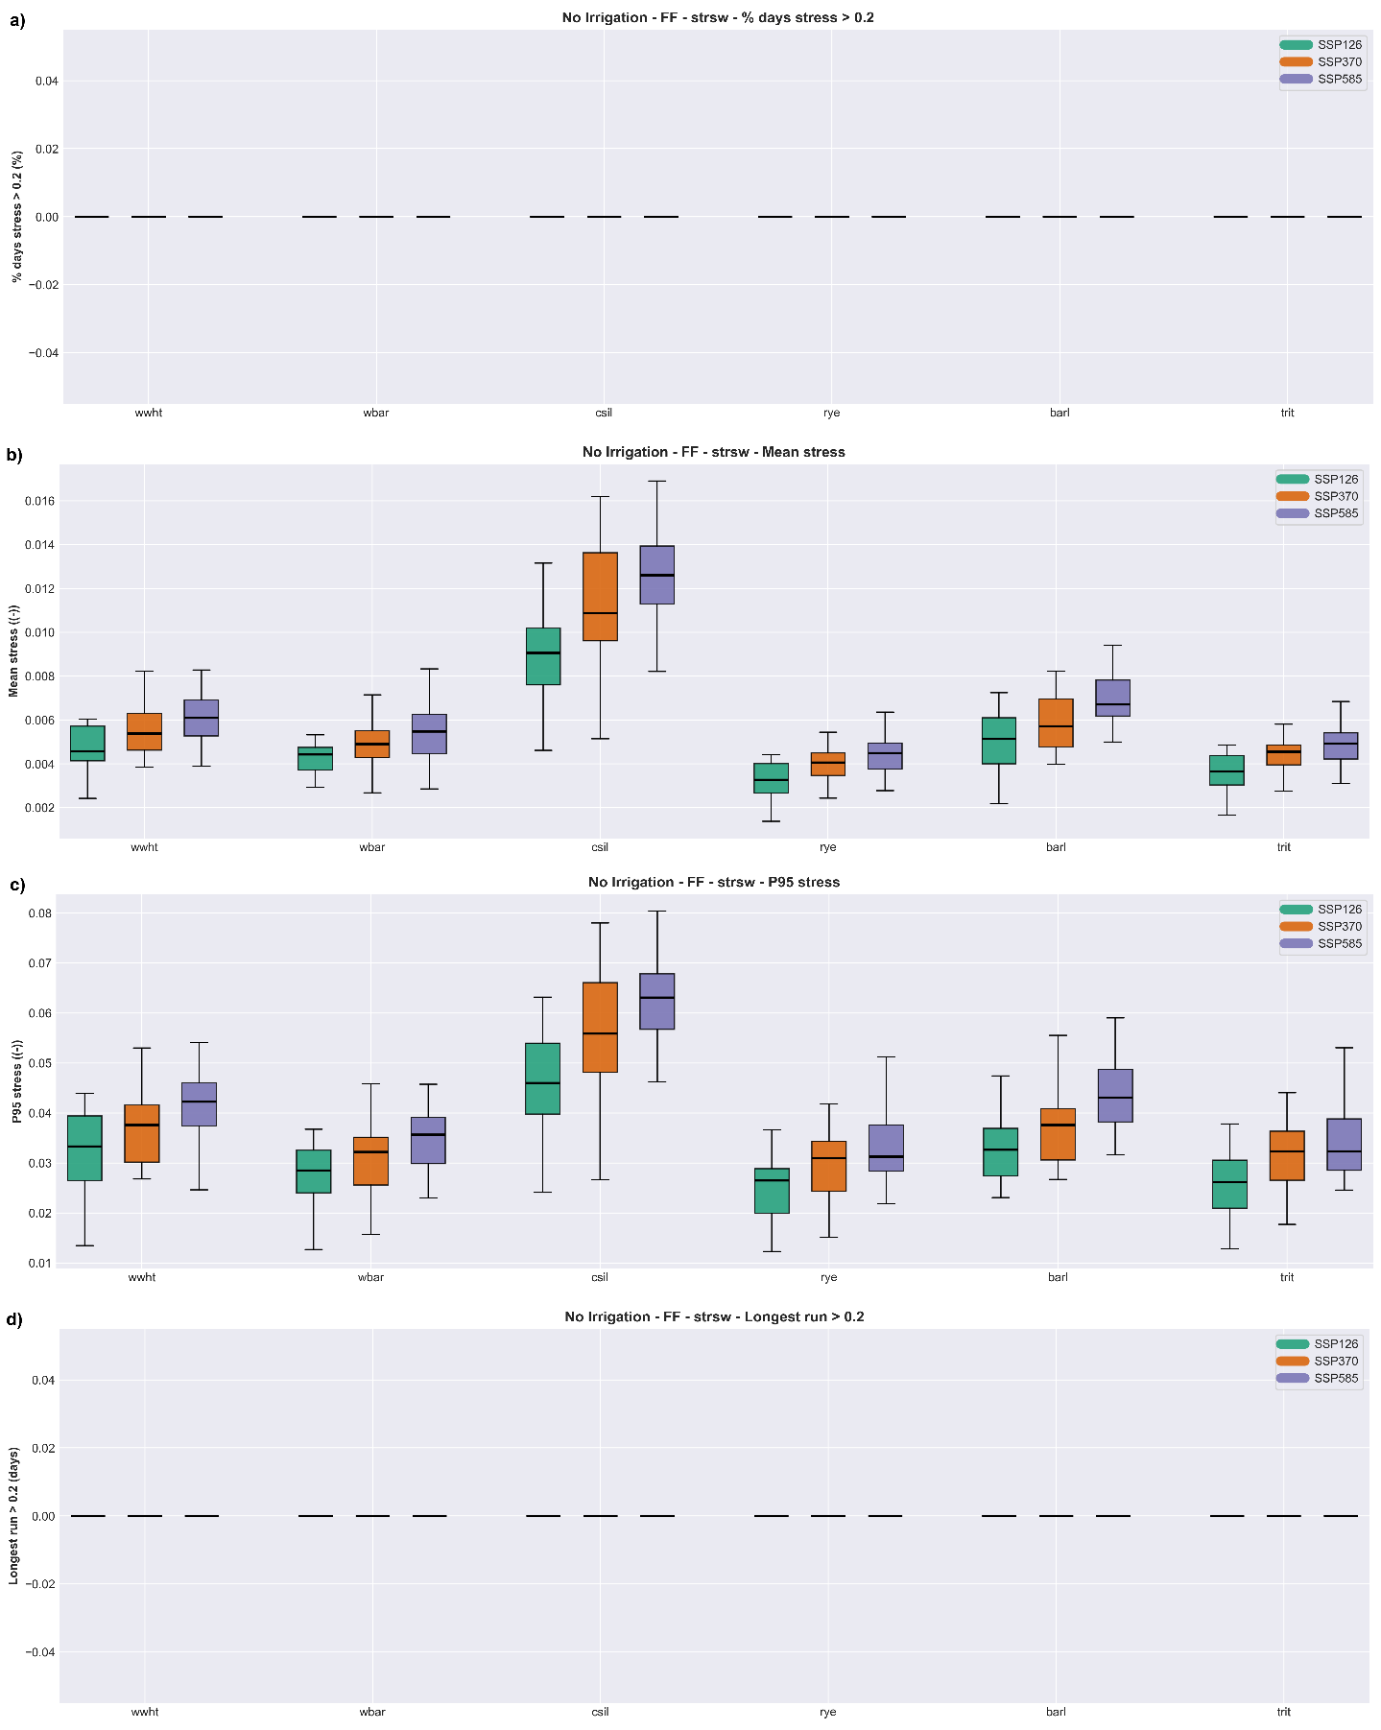
CROP STRESS METRICS
FOOD
Crop water stress metrics under future climate scenarios in the far-future: a) Percentage days above threshold 0.2, b) Mean stress, c) P95 stress, d) Longest run above threshold 0.2
Notes:
Crop yield calibration was performed against observed regional statistics for the dominant crops in the basin.
The model shows good agreement across all crops, with low bias ranging from approximately minus 8.7 percent to plus 0.5 percent.
Slight underestimation is observed for winter wheat, silage maize, and triticale.
For maize and triticale in particular, parameter adjustments beyond the default SWAT+ ranges were required to better represent local conditions.
Overall, the model captures crop productivity reliably, providing a strong basis for subsequent nutrient and ecosystem simulations. This is critical, as biomass controls nutrient uptake and directly influences nitrate dynamics in the system.

Slide 24
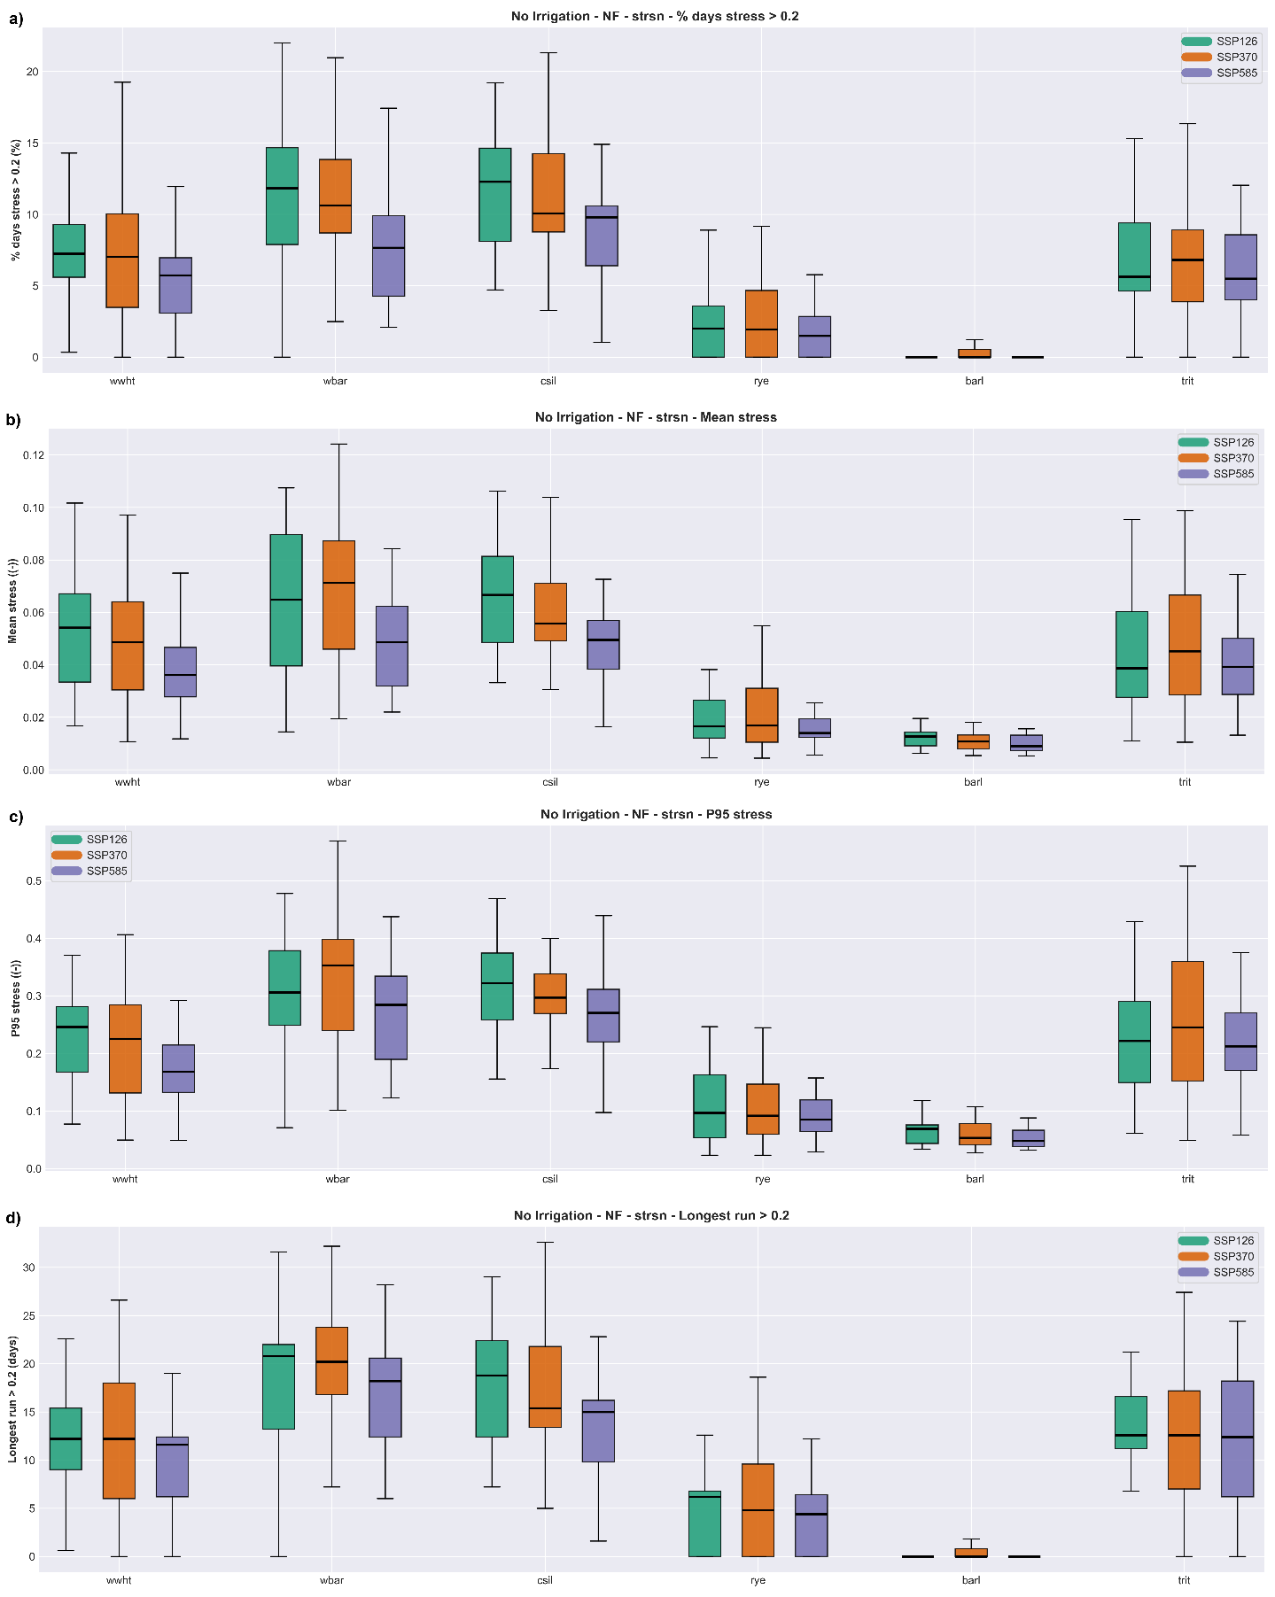
CROP STRESS METRICS
FOOD
Crop nitrogen stress metrics under future climate scenarios in the near-future: a) Percentage days above threshold 0.2, b) Mean stress, c) P95 stress, d) Longest run above threshold 0.2
Notes:
Crop yield calibration was performed against observed regional statistics for the dominant crops in the basin.
The model shows good agreement across all crops, with low bias ranging from approximately minus 8.7 percent to plus 0.5 percent.
Slight underestimation is observed for winter wheat, silage maize, and triticale.
For maize and triticale in particular, parameter adjustments beyond the default SWAT+ ranges were required to better represent local conditions.
Overall, the model captures crop productivity reliably, providing a strong basis for subsequent nutrient and ecosystem simulations. This is critical, as biomass controls nutrient uptake and directly influences nitrate dynamics in the system.

Slide 25
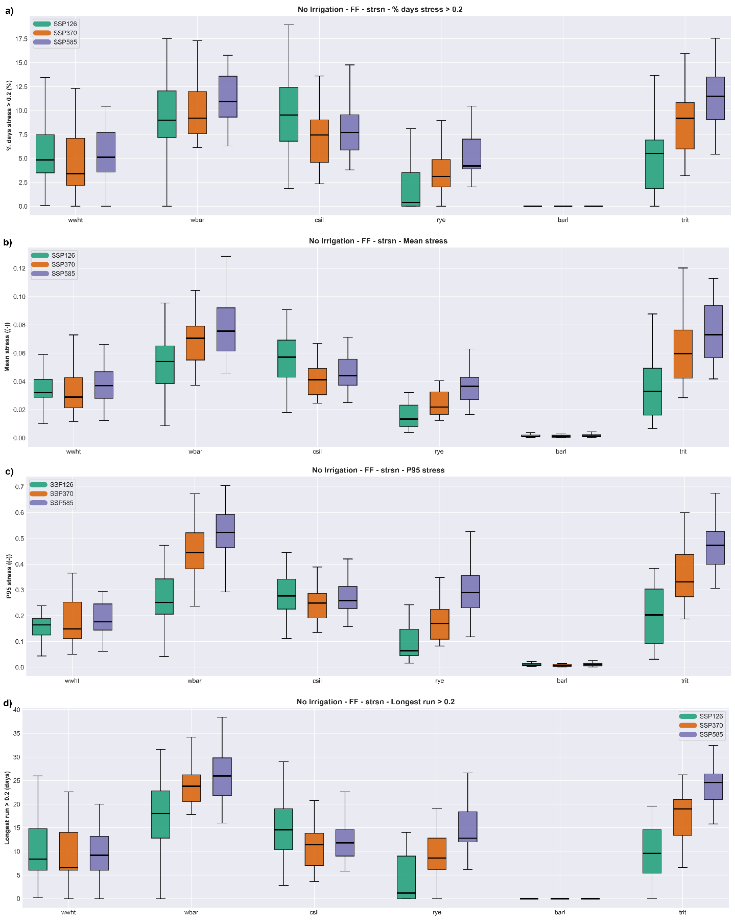
CROP STRESS METRICS
FOOD
Crop nitrogen stress metrics under future climate scenarios in the far-future: a) Percentage days above threshold 0.2, b) Mean stress, c) P95 stress, d) Longest run above threshold 0.2
Notes:
Crop yield calibration was performed against observed regional statistics for the dominant crops in the basin.
The model shows good agreement across all crops, with low bias ranging from approximately minus 8.7 percent to plus 0.5 percent.
Slight underestimation is observed for winter wheat, silage maize, and triticale.
For maize and triticale in particular, parameter adjustments beyond the default SWAT+ ranges were required to better represent local conditions.
Overall, the model captures crop productivity reliably, providing a strong basis for subsequent nutrient and ecosystem simulations. This is critical, as biomass controls nutrient uptake and directly influences nitrate dynamics in the system.

Slide 26
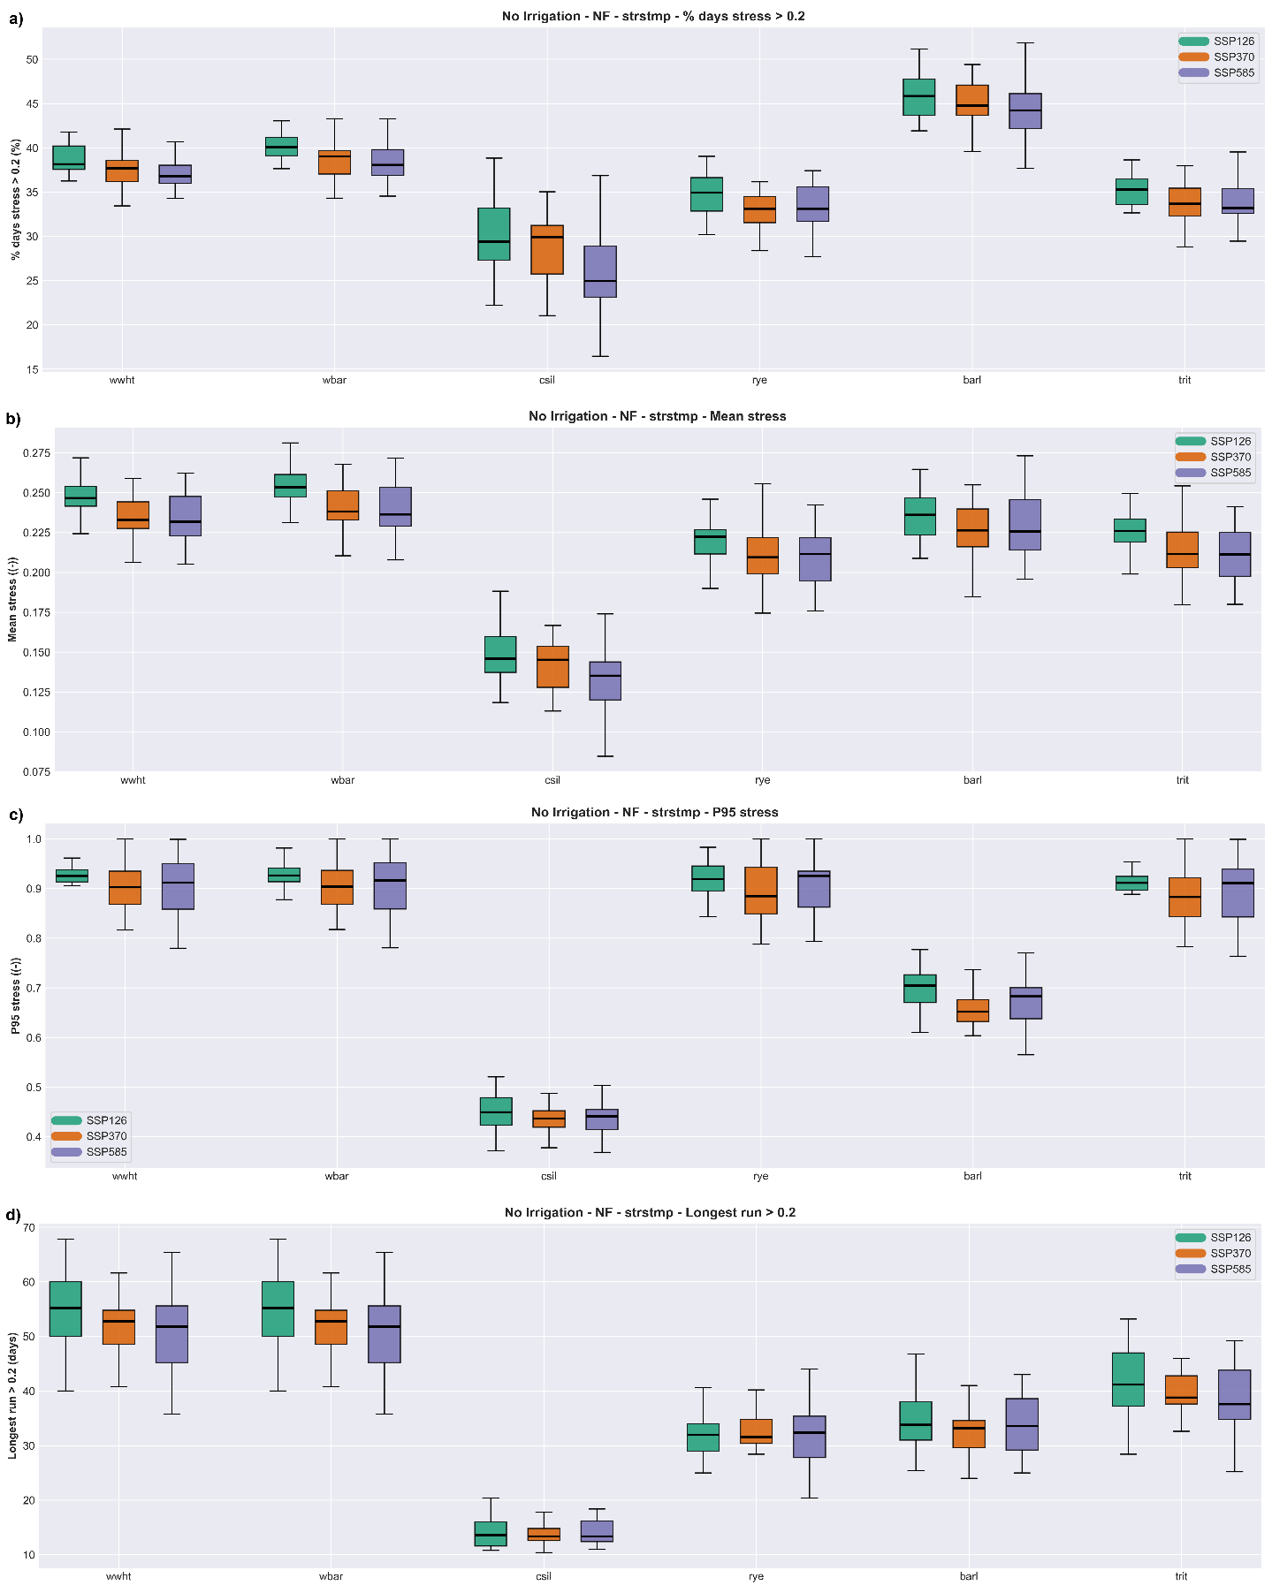
CROP STRESS METRICS
FOOD
Crop temperature stress metrics under future climate scenarios in the near-future: a) Percentage days above threshold 0.2, b) Mean stress, c) P95 stress, d) Longest run above threshold 0.2
Notes:
Crop yield calibration was performed against observed regional statistics for the dominant crops in the basin.
The model shows good agreement across all crops, with low bias ranging from approximately minus 8.7 percent to plus 0.5 percent.
Slight underestimation is observed for winter wheat, silage maize, and triticale.
For maize and triticale in particular, parameter adjustments beyond the default SWAT+ ranges were required to better represent local conditions.
Overall, the model captures crop productivity reliably, providing a strong basis for subsequent nutrient and ecosystem simulations. This is critical, as biomass controls nutrient uptake and directly influences nitrate dynamics in the system.

Slide 27
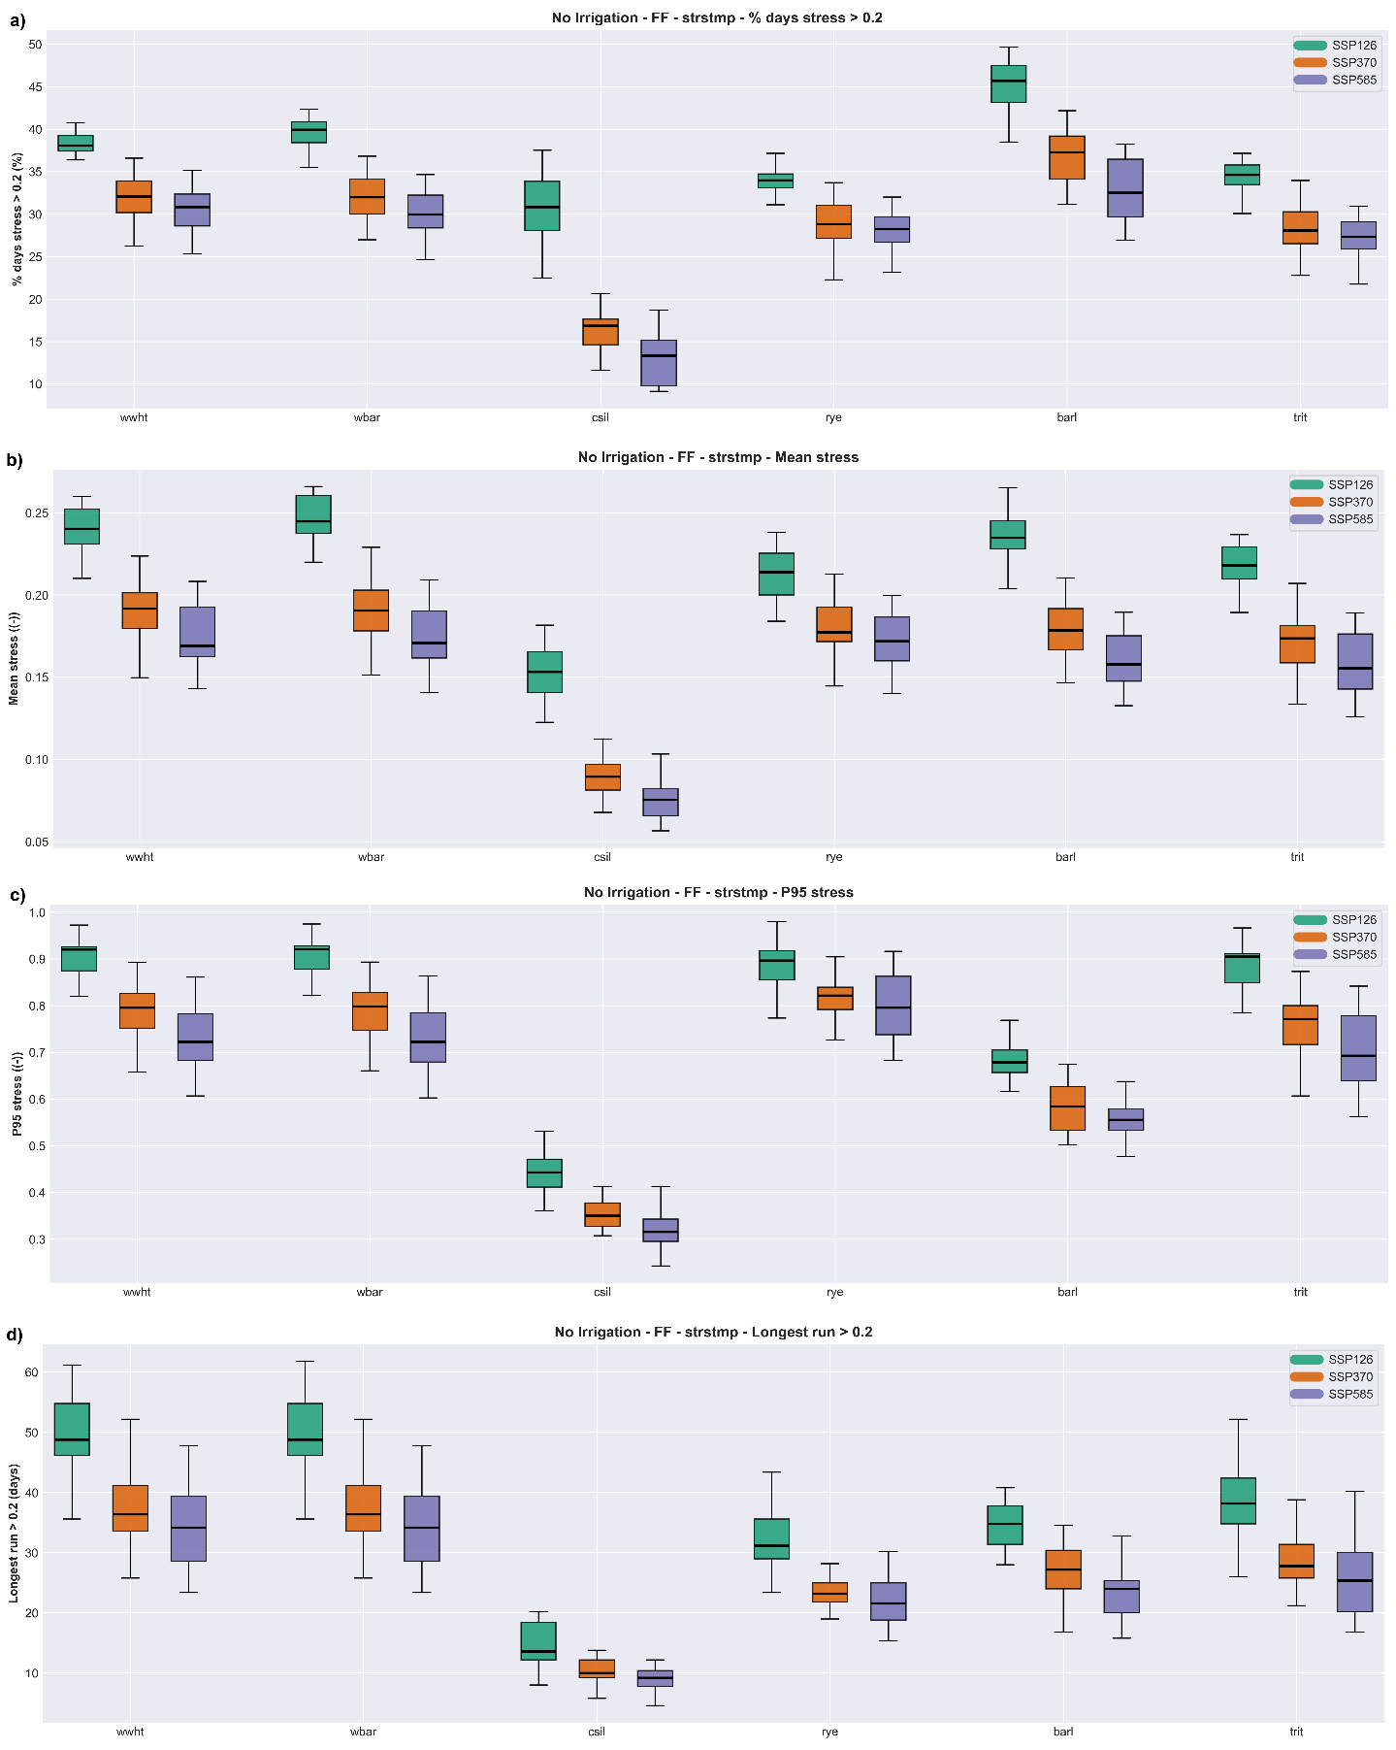
CROP STRESS METRICS
FOOD
Crop temperature stress metrics under future climate scenarios in the far-future: a) Percentage days above threshold 0.2, b) Mean stress, c) P95 stress, d) Longest run above threshold 0.2
Notes:
Crop yield calibration was performed against observed regional statistics for the dominant crops in the basin.
The model shows good agreement across all crops, with low bias ranging from approximately minus 8.7 percent to plus 0.5 percent.
Slight underestimation is observed for winter wheat, silage maize, and triticale.
For maize and triticale in particular, parameter adjustments beyond the default SWAT+ ranges were required to better represent local conditions.
Overall, the model captures crop productivity reliably, providing a strong basis for subsequent nutrient and ecosystem simulations. This is critical, as biomass controls nutrient uptake and directly influences nitrate dynamics in the system.

Slide 28
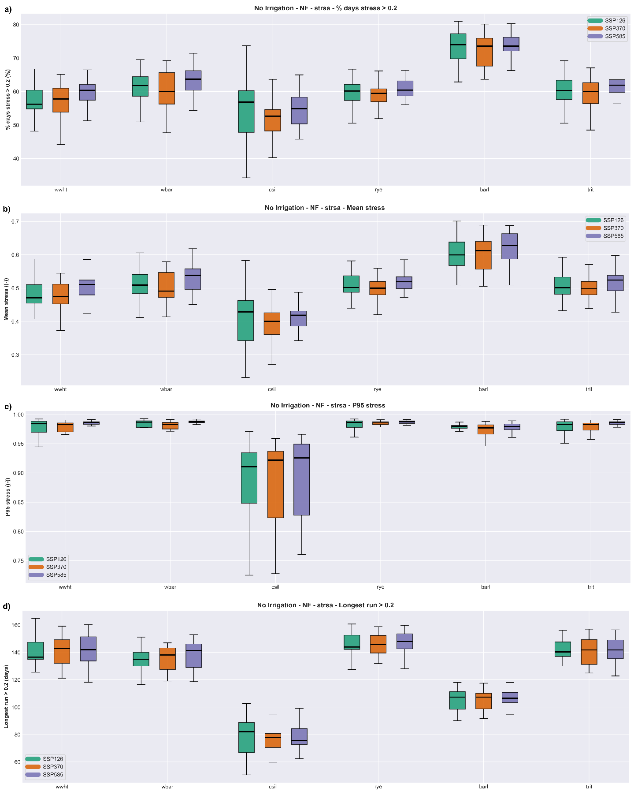
CROP STRESS METRICS
FOOD
Crop aeration stress metrics under future climate scenarios in the near-future: a) Percentage days above threshold 0.2, b) Mean stress, c) P95 stress, d) Longest run above threshold 0.2
Notes:
Crop yield calibration was performed against observed regional statistics for the dominant crops in the basin.
The model shows good agreement across all crops, with low bias ranging from approximately minus 8.7 percent to plus 0.5 percent.
Slight underestimation is observed for winter wheat, silage maize, and triticale.
For maize and triticale in particular, parameter adjustments beyond the default SWAT+ ranges were required to better represent local conditions.
Overall, the model captures crop productivity reliably, providing a strong basis for subsequent nutrient and ecosystem simulations. This is critical, as biomass controls nutrient uptake and directly influences nitrate dynamics in the system.

Slide 29
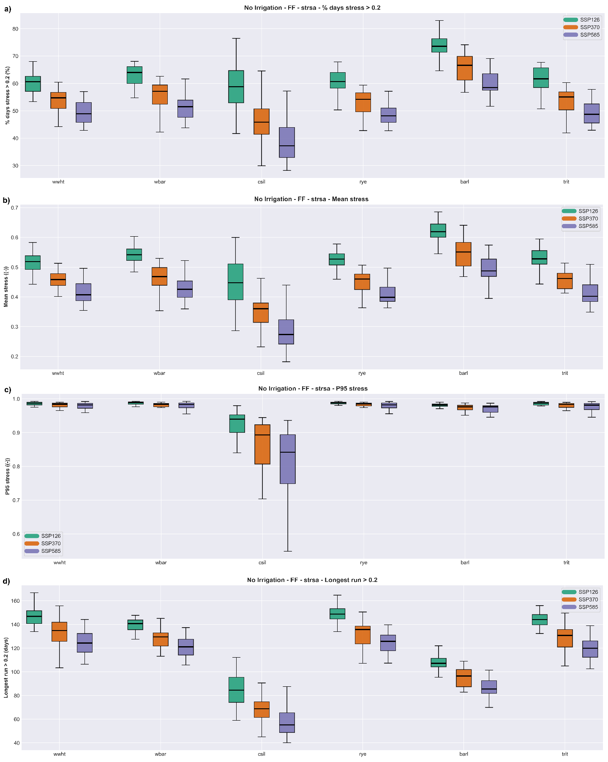
CROP STRESS METRICS
FOOD
Crop aeration stress metrics under future climate scenarios in the far-future: a) Percentage days above threshold 0.2, b) Mean stress, c) P95 stress, d) Longest run above threshold 0.2
Notes:
Crop yield calibration was performed against observed regional statistics for the dominant crops in the basin.
The model shows good agreement across all crops, with low bias ranging from approximately minus 8.7 percent to plus 0.5 percent.
Slight underestimation is observed for winter wheat, silage maize, and triticale.
For maize and triticale in particular, parameter adjustments beyond the default SWAT+ ranges were required to better represent local conditions.
Overall, the model captures crop productivity reliably, providing a strong basis for subsequent nutrient and ecosystem simulations. This is critical, as biomass controls nutrient uptake and directly influences nitrate dynamics in the system.

Slide 30
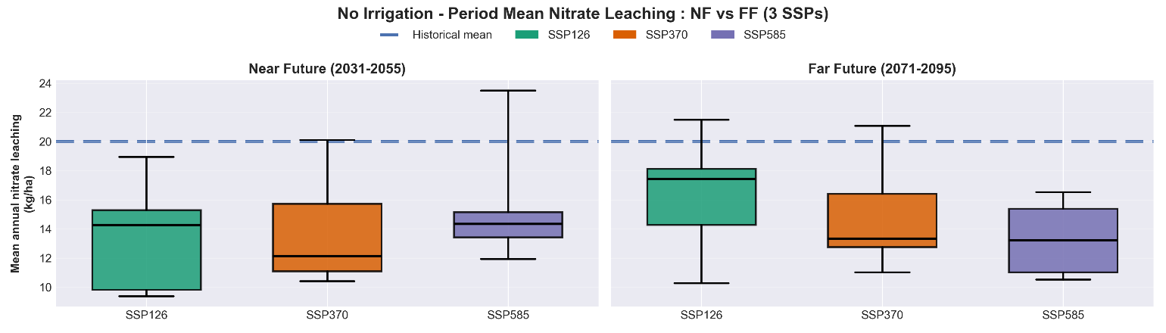
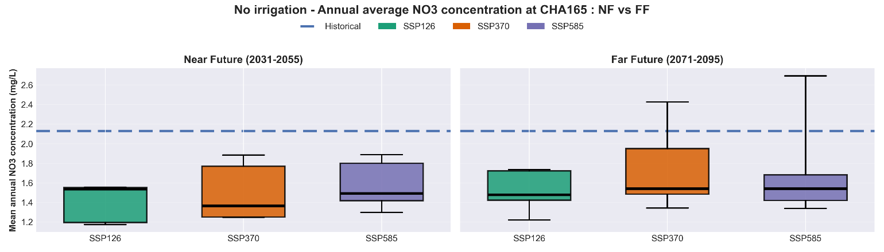
TRANSPORT LIMITATION OF NITRATE
ECOSYSTEM
Average annual nitrate leaching under future climate scenarios
Average annual downstream export nitrate concentration under future climate scenarios
Notes:
More N parked in the soil…..ready for episodic driftoffs
“We observe a clear reduction in aquifer recharge under future scenarios, particularly during the summer months.”
“This directly translates into reduced nitrate leaching, highlighting that nitrate transport is strongly controlled by water availability.”
“While the seasonal pattern remains similar, the magnitude of leaching decreases, indicating a shift toward more transport-limited conditions.”

Slide 31
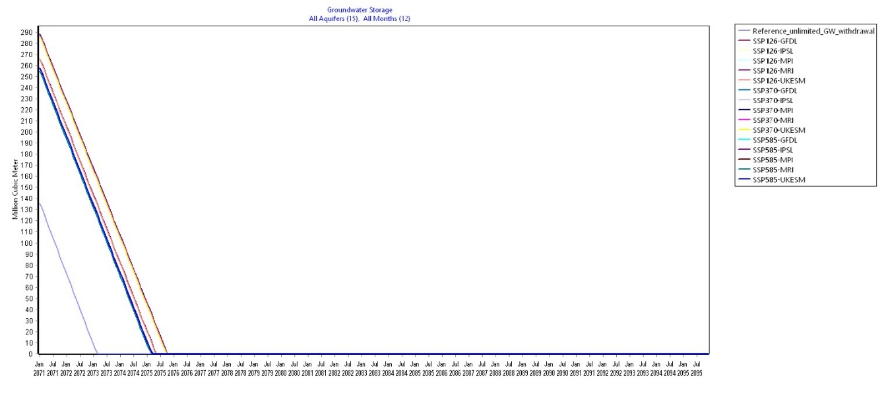
IRRIGATION: WATER ALLOCATION RESPONSE
WATER
High Irrigation: Groundwater storage (MCM) under future climate scenarios in the far-future. Complete dry-out by 2070.
Notes:
The objective of this step is to ensure that the model adequately captures the physical hydrological behavior of the catchment.
A total of 17 parameters were calibrated, combining global optimization using the DREAM algorithm with subsequent manual refinement.
The model achieves an NSE of 0.65 and a logNSE of 0.74, indicating a good representation of both peak flows and low-flow conditions.
While some peak flows are slightly overestimated, the model successfully captures the timing and overall variability of discharge.

Slide 32
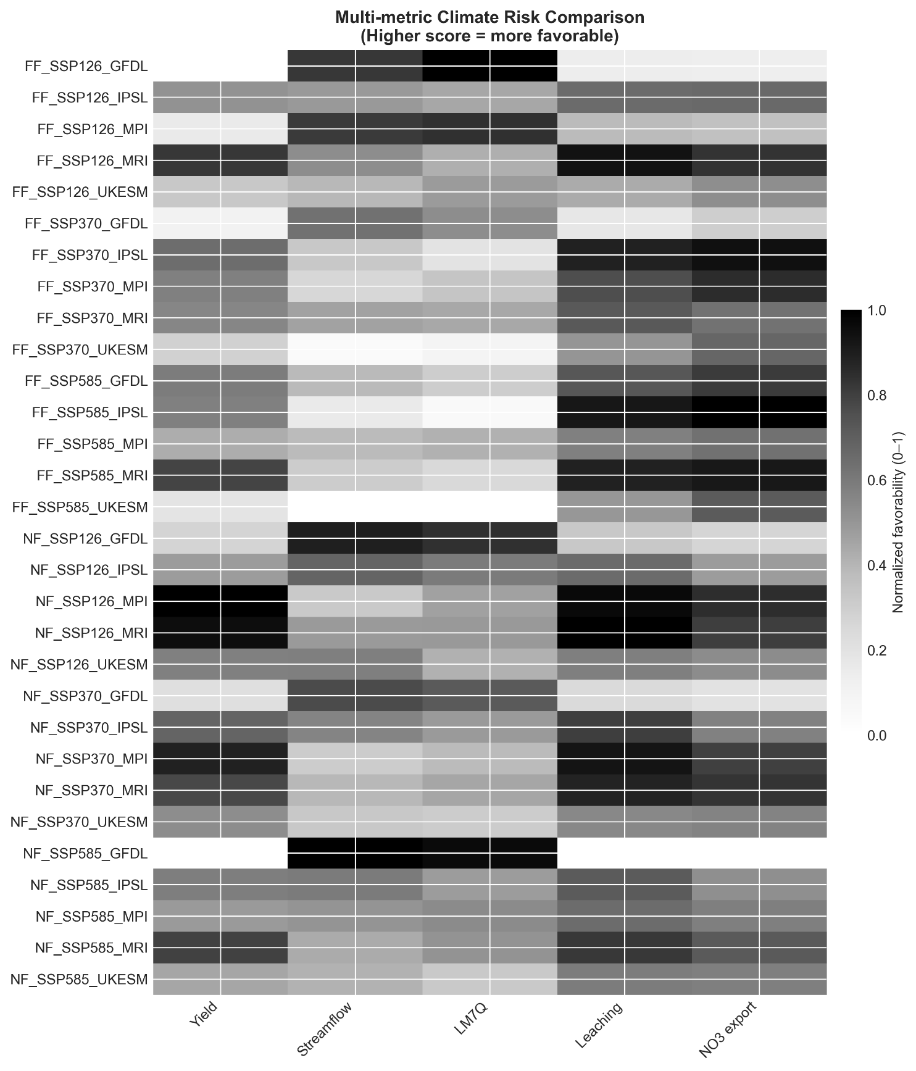
NEXUS TRADE-OFFS
NEXUS PERSPECTIVE
Representative temperate rainfed basin critical for food security.
Notes:
The study is conducted in the Upper Main Catchment in Bavaria, Germany, which is a predominantly agricultural region supporting regional food production.
The land use is largely rainfed, making it particularly sensitive to changes in climate and water availability. Over 67% of agricultural area is cereal
From a physical perspective, the catchment is characterized by Luvisols and Cambisols, which are heavy soils prone to waterlogging and associated aeration stress, especially under high moisture conditions.
Hydrologically, the basin exhibits a pluvial–nival regime, with precipitation ranging from approximately 700 to 1500 mm annually, resulting in strong seasonal variability in flow.
These characteristics make the catchment highly relevant for assessing climate-driven impacts on water, agriculture, and ecosystem processes.

Slide 33
Contact Author:
Sreya Prakash
Technical University of Munich
sreya.prakash@tum.de
Notes:
The study is conducted in the Upper Main Catchment in Bavaria, Germany, which is a predominantly agricultural region supporting regional food production.
The land use is largely rainfed, making it particularly sensitive to changes in climate and water availability. Over 67% of agricultural area is cereal
From a physical perspective, the catchment is characterized by Luvisols and Cambisols, which are heavy soils prone to waterlogging and associated aeration stress, especially under high moisture conditions.
Hydrologically, the basin exhibits a pluvial–nival regime, with precipitation ranging from approximately 700 to 1500 mm annually, resulting in strong seasonal variability in flow.
These characteristics make the catchment highly relevant for assessing climate-driven impacts on water, agriculture, and ecosystem processes.

