Slide 1


CLIMATE FINANCE COMMITTED TO PAKISTAN UNDER THE USD 100 BILLION GOAL OF THE COPENHAGEN ACCORD.
Khadija Irfan
Weather and Cimate Services, Pakistan

Slide 2
WHAT AND HOW OF CLIMATE FINANCE
WHAT
Financial assistance aimed at addressing the causes and consequences of climate change
Impacts of climate change are being disproportionality faced by developing countries, to combat which finance is needed
Under the UNFCCC’s principle of common but differentiated responsibilities (CBDR), the major emitter and the wealthier must provide the finance.
HOW
The 2009 Copenhagen Accord formally quantified the finance that should move from developed to developing world (Pauw et al. 2019).
Provided a figure
Laid out a timeline
Proposed a Delivery Channel
The goal was met in
USD 100 Billion
By the Year
2022
•Developed to underdeveloped
•Resourceful to Resource scarce
•Using bilateral and multilateral arrangements
2020
2 years later than the intended timeline with provision of USD 115 billion
PER ANNUM

Slide 3
THE DILEMMA OF DEFINITION
•Lack of agreed upon definition creates ambiguity over what qualifies as climate finance.
•COP negotiations gradually shaped key attributes of climate finance flows.
•Key principles stipulated in the Cancun Agreement 2010 and Paris Agreement 2015:
Balance between adaptation and mitigation finance
Support aligned with developing countries’ needs and priorities
Consider grant based resources
Finance should be predictable and adequate
•This research evaluates finance committed to Pakistan against these characteristics using metrics

Slide 4
METHODOLOGY
Dataset on Development Finance for Climate and Environment maintained by the Organization of Economic Cooperation and Development (OECD).
Consolidated, annual, activity-level data, from bilateral and multilateral resources.
Following metrices used for assessment:
Characteristics | Metrices | Approach referenced in
Financial assistance provided to Pakistan throughout the delivery of global USD 100 billion goal and its adequacy | Total finance committed to Pakistan between 2010 and 2022 | (OXFAM, 2024) (Savvidou et al. 2021) (Atteridge & Cannales, 2017) (Mohan, 2023)
Extent of adaptation –mitigation balance in financial commitments and predictability | %age share of adaptation and mitigation financing- each year and aggregated | (Savvidou et al. 2021)
Dominant financial instrument and suitability as per country needs | Debt and grant share of the aggregate | (Atteridge & Cannales, 2017) (OXFAM, 2022)
Alignment with country needs and priorities | Assessing sectoral allocation of committed finances | (Iacobuţă et al., 2022) (Mohan, 2023) (Atteridge et al., 2017)

Slide 5
CLIMATE FINANCE COMMITTED TO PAKISTAN UNDER THE ACCORD.
Pakistan, climatically vulnerable and economically developing country - thus a rightful recipient of climate finance.
USD 12.53 Billion
2010
2022
Over a span of 13 years

Slide 6
PROVIDERS OF CLIMATE FINANCE
PROVIDER TYPE | AMOUNT (2010-2022)
Multilateral Devlopment Banks | 8.64
Bilateral Donors | 3.53
Multilateral Agencies | 0.35
Private Organizations | 0.01
Asian Development Bank
Word Bank
Australia
Austria
Belgium
Canada
EU Institutions (excl. EIB)
France
Untied States
United Kingdom etc.
Adaptation Fund
Food and Agriculture Organisation
GEF Special Climate Change Trust Fund (SCCF)
Global Environment Facility General Trust Fund
Green Climate Fund etc.
Bill & Melinda Gates Foundation
Bloomberg Foundation
Children's Investment Fund Foundation
Laudes Foundation etc.

Slide 7
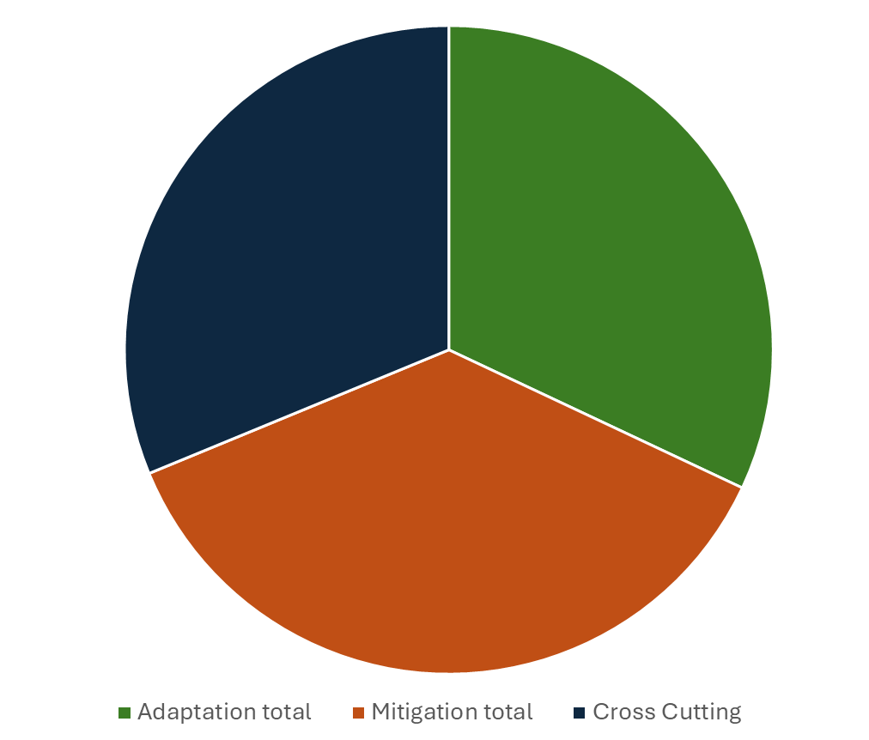
BALANCE BETWEEN ADAPTATION AND MITIGATION
CROSS CUTTING
USD 3.91 Billion
ADAPTATION
USD 4.01 Billion
Focused on both adaptation and mitigation
MITIGATION
USD 4.61 Billion
BALANCED AGGREGATED COMMITMENTS

Slide 8
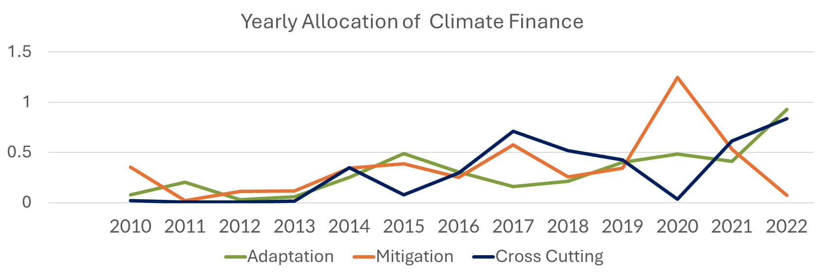
ADAPTATION VS MITIGATION OVER THE YEARS
Overall balance observed, but adaptation vs. mitigation shares fluctuate significantly year to year
YEARLY FLOWS REMAIN UNPREDICTABLE

Slide 9
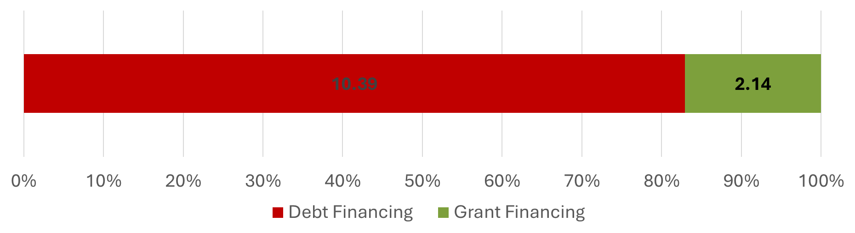
DOMINANT FINANCIAL INSTRUMENT
Debt financing is popularly exercised by the donors
Legal debt incurred
No legal debt incurred
GRANTS NOT PRIORITISED

Slide 10
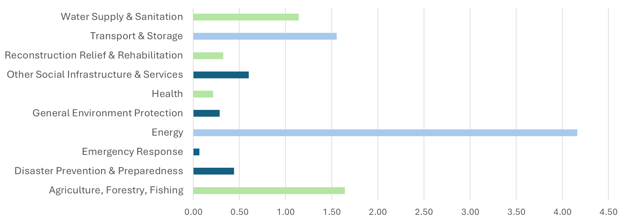
SECTORAL COVERAGE

Slide 11
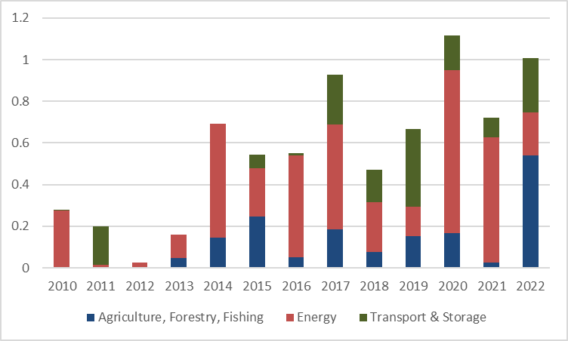
SECTORAL COVERAGE
A comparison of the most funded sectors:
Energy sector has been consistently financed
Funding to trasnport sector increased since 2017
Finance to agriculture sector has been inconsistent despite its importance in economy and labour

Slide 12
WIDENING INEQUALITIES
The observed trends suggest that climate finance provisions to Pakistan diverge from the key characteristics outlined in international climate negotiations.
Heavy reliance on debt-based instruments – antagonistic to country needs + reinforces dependency and neo-colonial dynamics (Zylinsky, 2024)
Annual flows are unpredictable and inadequate, in terms of sum and category, making planning at recipient’s level difficult
2022 floods - USD 30 Billion in loss and damage experience - roughly equivalent to the year’s export credit
US$348 billion needed for adaptation and mitigation by 2030 - World Bank (2022) estimates
Scale of provisions is not meeting the scale of needs
Undermines CBDR and the principles of equity and climate justice
Insufficient finance limits ability to adapt - worsening impacts and widening inequalities.
Notes:
Exports for 2022 - USD USD 31.7 billion

Slide 13
THANK YOU FOR YOUR ATTENTION
Reachable at: khadija.irfan96@gmail.com

