Slide 1


Segmentation Model Benchmarking: A Strategic Prerequisite for Robust Geospatial Foundation Models
Segmentation Model Benchmarking as a Strategic Gate for Geospatial Foundation Models
Mehran Alizadeh PIRBASTI | Gavin McArdle | Vahid Akbari
School of Computer Science, University College Dublin, Ireland
Division of Computing Science and Mathematics, University of Stirling, Scotland

Slide 2
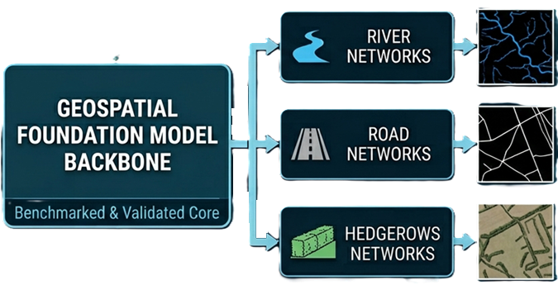
1
Benchmark Before Scale
1 BENCHMARK
2 SELECT
3 SCALE
Core claim
Large-scale pretraining is too expensive to run on the wrong base architecture.
Benchmarking is the screening layer.
EGU26 | ESSI1.11 | Segmentation Model Benchmarking | Mehran Alizadeh Pirbasti

Slide 3
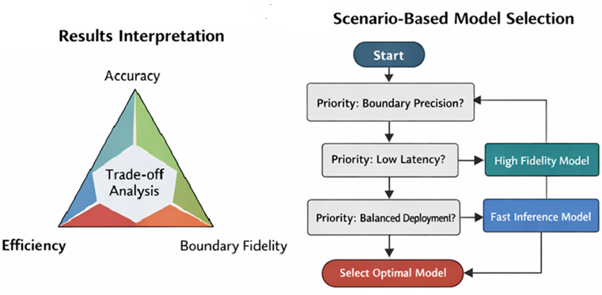
Why this matters
Feel the cost of choosing the wrong architecture
2
Expensive mistake
If the base architecture is weak, scaling multiplies compute waste rather than generalization.
Earth observation is heterogeneous
Sensors, bands, resolutions, and geographies interact with inductive bias. There is no free lunch.
Thin structures expose failure
Gaps, false bridges, and edge drift are mission-critical errors that broad land-cover benchmarks often hide.
EGU26 | ESSI1.11 | Segmentation Model Benchmarking | Mehran Alizadeh Pirbasti

Slide 4
Frozen protocol
A visual protocol slide
that shows fairness at a glance
3
Data
Augment
416×416 patches 8,400 train 1,800 val 1,800 test
crop 256 flips rotations coarse dropout
Optimization
SAME RECIPE FOR ALL
Loss
AdamW 1e-4 LR cosine annealing 100 epochs
0.3 Dice 0.4 Focal 0.3 BCE
Metrics
IoU Dice BF1 Latency
Reproducibility
seed 42 same software same GPU class
Metric rationale
Overlap metrics measure region correctness. BF1 is included because thin-object tasks fail first at the boundary.
EGU26 | ESSI1.11 | Segmentation Model Benchmarking | Mehran Alizadeh Pirbasti

Slide 5
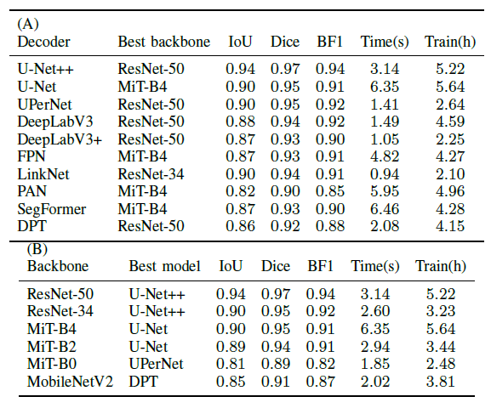
Model universe
4
Decoder families
U-Net, U-Net++, DeepLabV3, DeepLabV3+, FPN, LinkNet, PAN, UPerNet, SegFormer, DPT
Backbone families
ResNet-50, ResNet-34, MiT-B4, MiT-B2, MobileNetV2
Design principle
Canonical pairs and controlled hybrids are both included. The point is to isolate architecture–backbone trade-offs under one recipe.
EGU26 | ESSI1.11 | Segmentation Model Benchmarking | Mehran Alizadeh Pirbasti

Slide 6
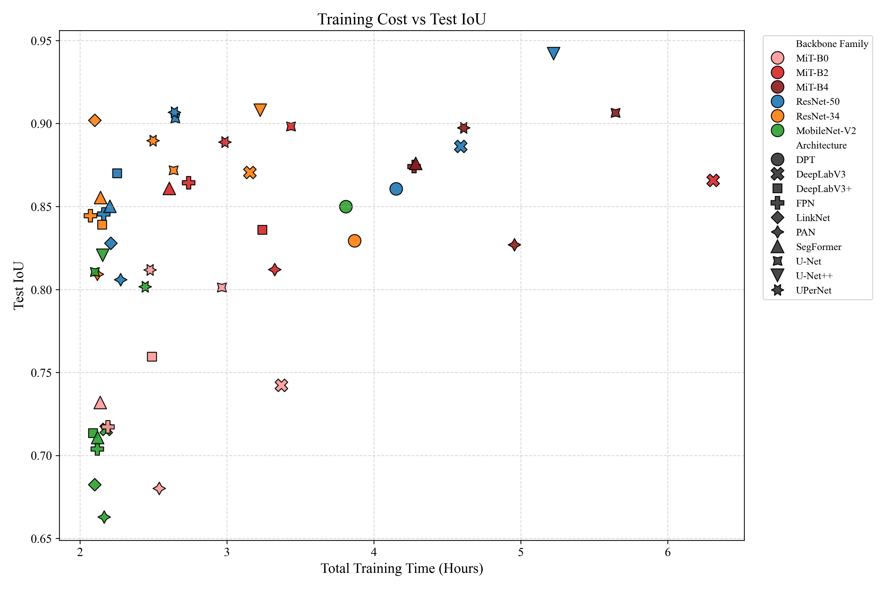
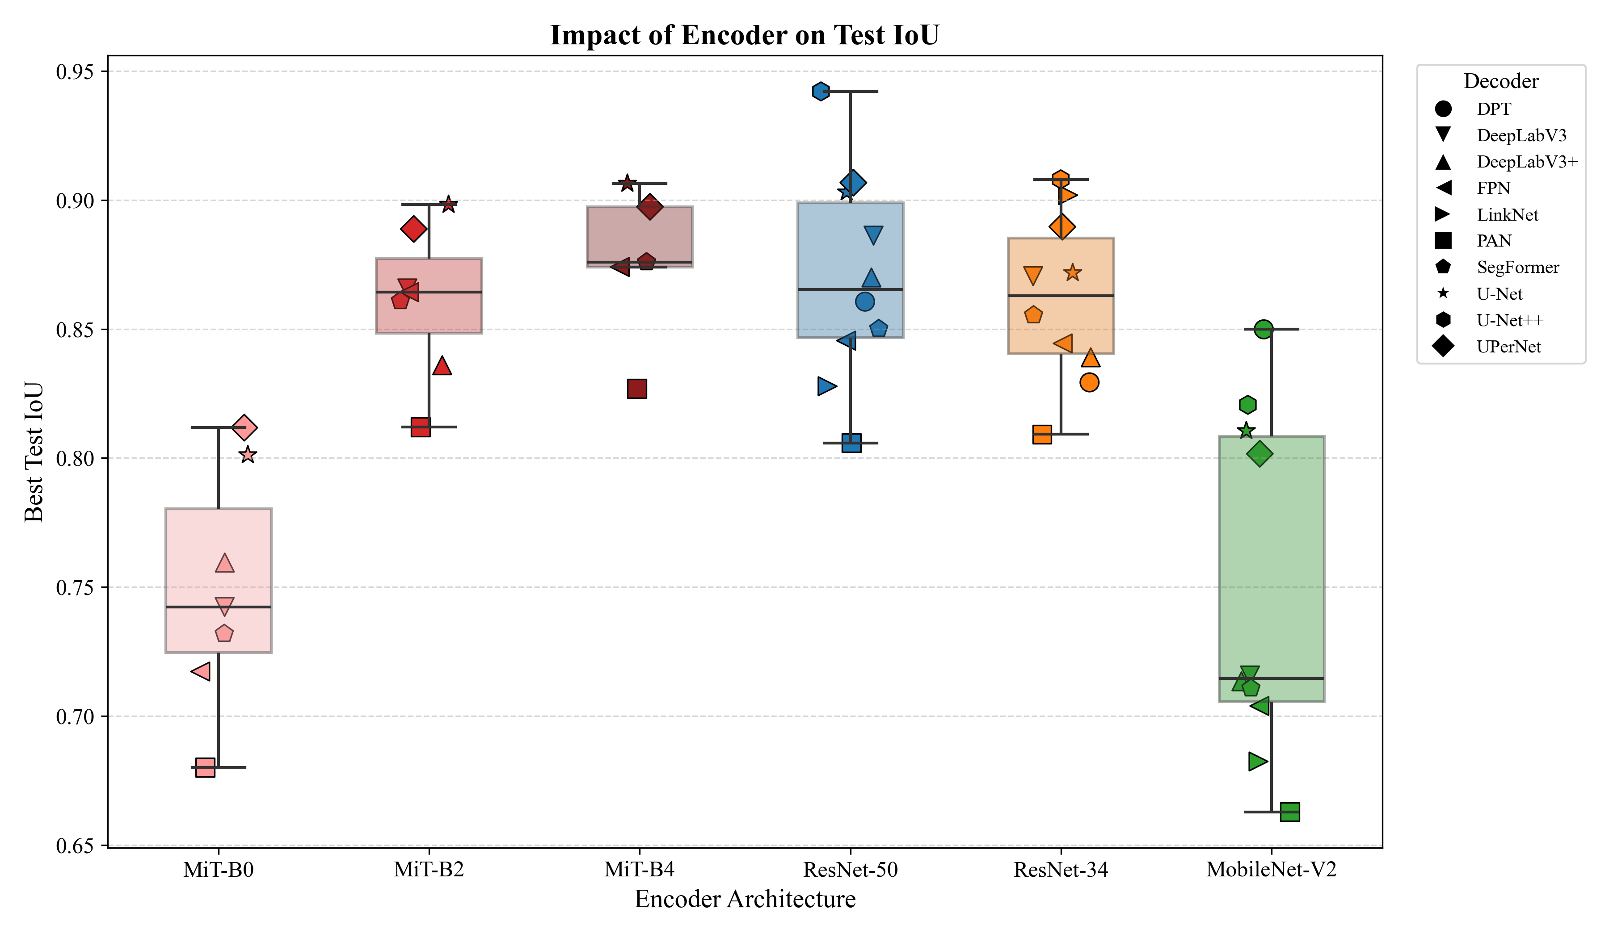
Trade-off landscape
Turn the leaderboard into a single visual
5
Best absolute model
Best balanced choice
Best fast choice
Best hybrid model
U-Net++ / ResNet-50
IoU 0.94 | BF1 0.94
UPerNet / ResNet-50
strong boundary with 1.41 s latency
LinkNet / ResNet-34
0.94 s latency with IoU 0.90
U-Net / MiT-B4
competitive accuracy, but costly
Takeaway: choose by operating point, not by architecture fashion.
EGU26 | ESSI1.11 | Segmentation Model Benchmarking | Mehran Alizadeh Pirbasti

Slide 7
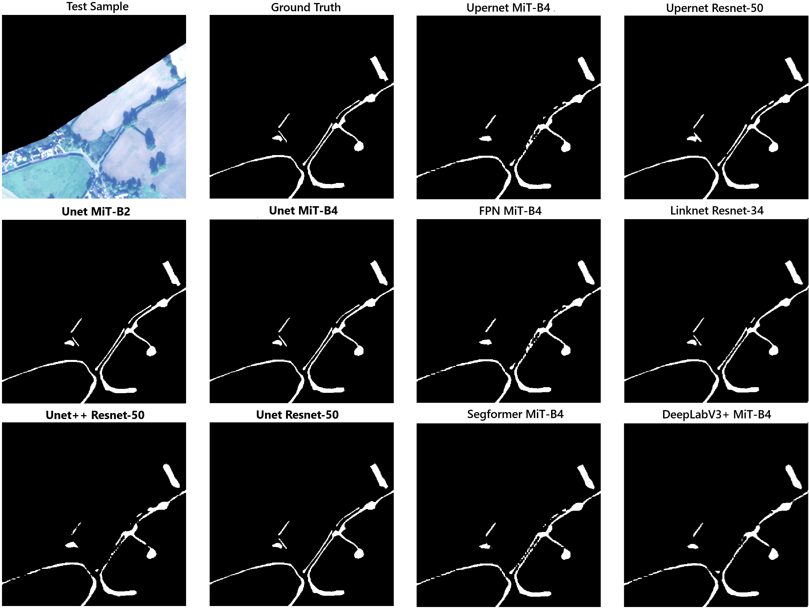
Qualitative behavior
what the metrics cannot say on their own
6
Conservative precision
Example tendency: U-Net++ ResNet-50
Strong edges when detected, but more thin misses and fragmentation.
Balanced high-fidelity
Example tendency: U-Net MiT-B4 and UPerNet MiT-B4
Cleaner continuity with credible boundary placement.
Expansive / over-connected
Example tendency: FPN MiT-B4 and LinkNet ResNet-34
Good continuity, but thicker predictions and more false bridges.
EGU26 | ESSI1.11 | Segmentation Model Benchmarking | Mehran Alizadeh Pirbasti

Slide 8

Three takeaways
8
1
Benchmark before scale
2
Use boundary-aware evaluation for thin structures
3
Pick different winners for accuracy, balance, and speed
Final message
Benchmark is not the end of the FM pipeline. It is the gate that makes the rest of the pipeline scientifically defensible.
Q&A
DOI and abstract
Mehran Alizadeh Pirbasti | mehran.alizadehpirbasti@ucdconnect.ie
EGU26 | ESSI1.11 | Segmentation Model Benchmarking | Mehran Alizadeh Pirbasti

