Slide 1



Unsupervised Manifold Learning
Validating Unconditional Flow Matching for Soil Carbon Data Topology
Vinicius do Carmo Melicio, Vitor Hugo Miranda Mourão, Luis Gustavo Barioni, and João Paulo Gois

Slide 2
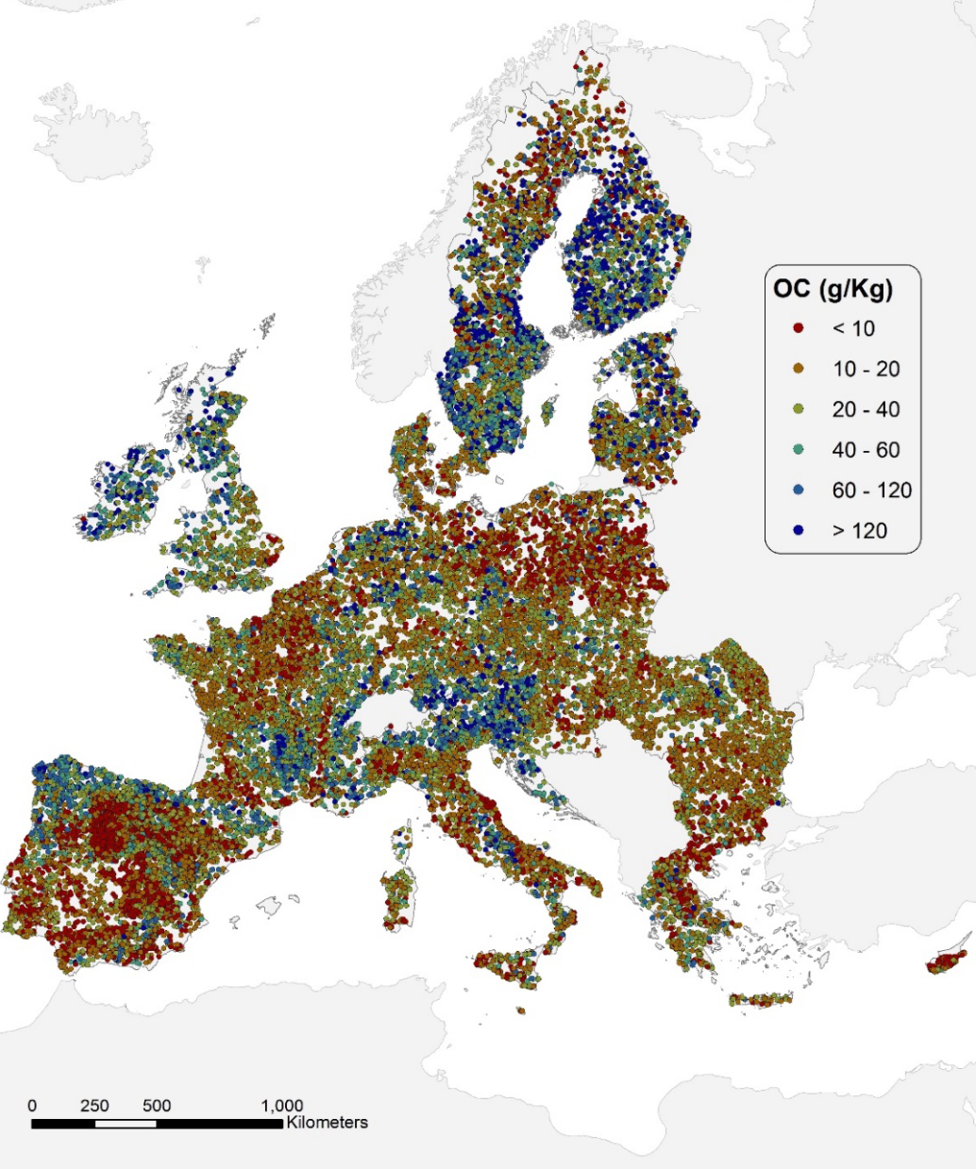
Dataset Overview: LUCAS 2015
Core Features (9 Dimensions)
pH (CaCl2)
pH (H2O)
EC
OC
CaCO3
P
N
K
Elevation
21,859
21,782
Total Samples with Core Features
Samples with VNIR-SWIR (4k Dims)
4,260
4,257
Samples including Texture (Clay, Sand, Silt)
Complete Samples: Core + Texture + VNIR-SWIR
We evaluated 4 data variants for comprehensive model benchmarking.

Slide 3






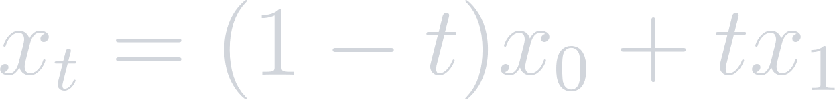

Understanding Flow Matching
Velocity Field
t = 0
t = 0.5
t = 1
Source (Noise) p₀ = N(0,I)
Probability Path
Target (Data) p₁ = q
We train a neural ODE to learn a deterministic mapping from noise to the data distribution along a linear path

Slide 4
Model Benchmarking
Evaluation Metrics (AUC-ROC)
0.5512 ± 0.0091
Mean AUC Across 100 Iterations using XGBoost
70%
Train
15%
Val
15%
Test
100x Monte Carlo CV

Slide 5
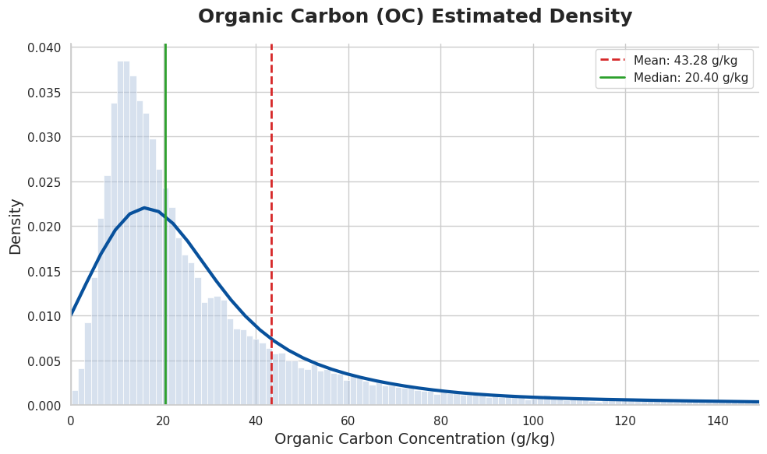
Challenges: Soil Complexity
Extreme Skewness

Slide 6
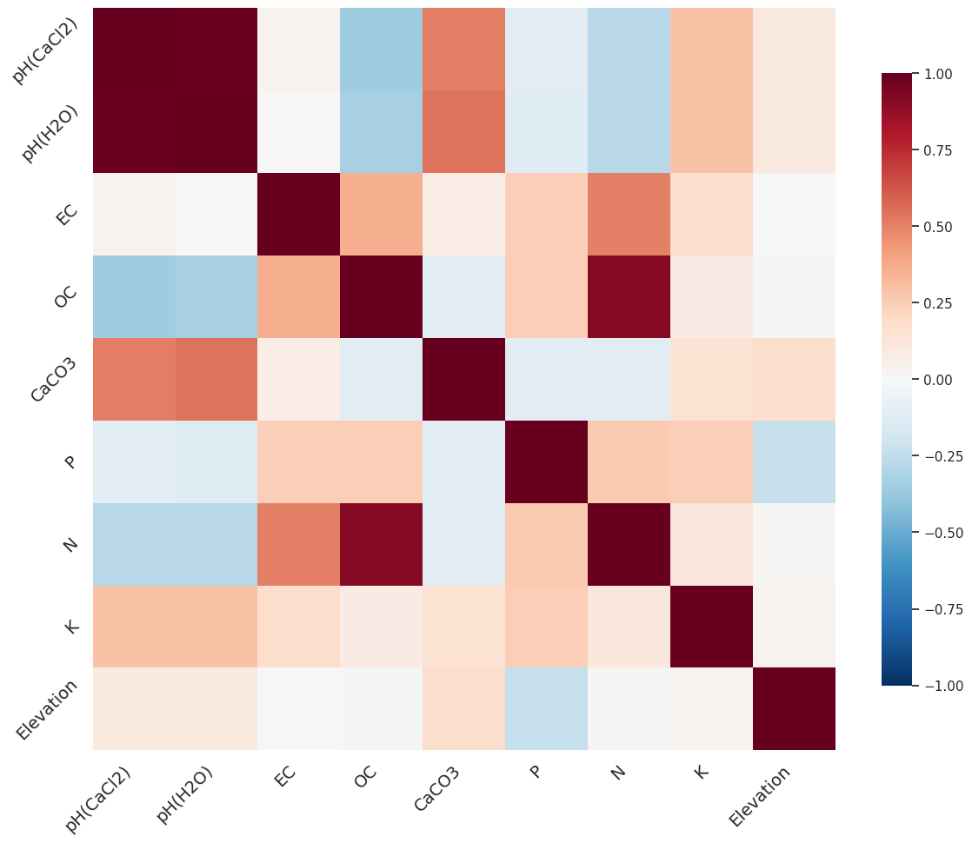
Challenges: Soil Complexity
Joint Distribution Fidelity

Slide 7
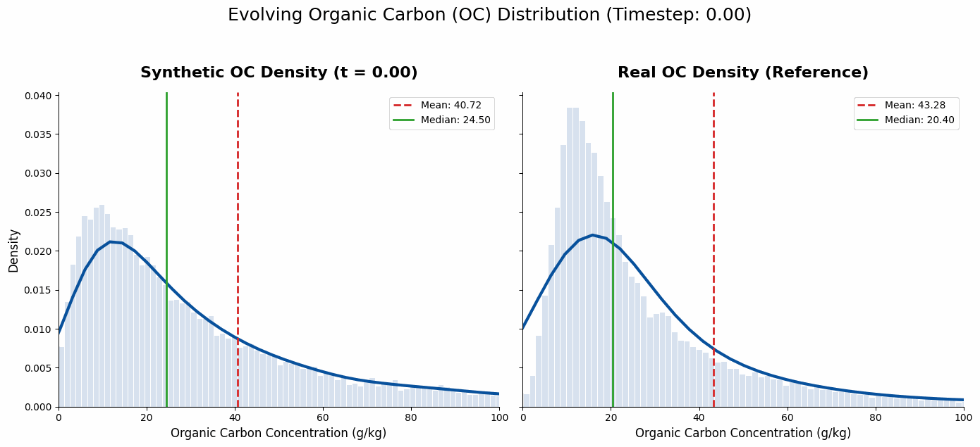
Challenges: Soil Complexity
Extreme Skewness

Slide 8
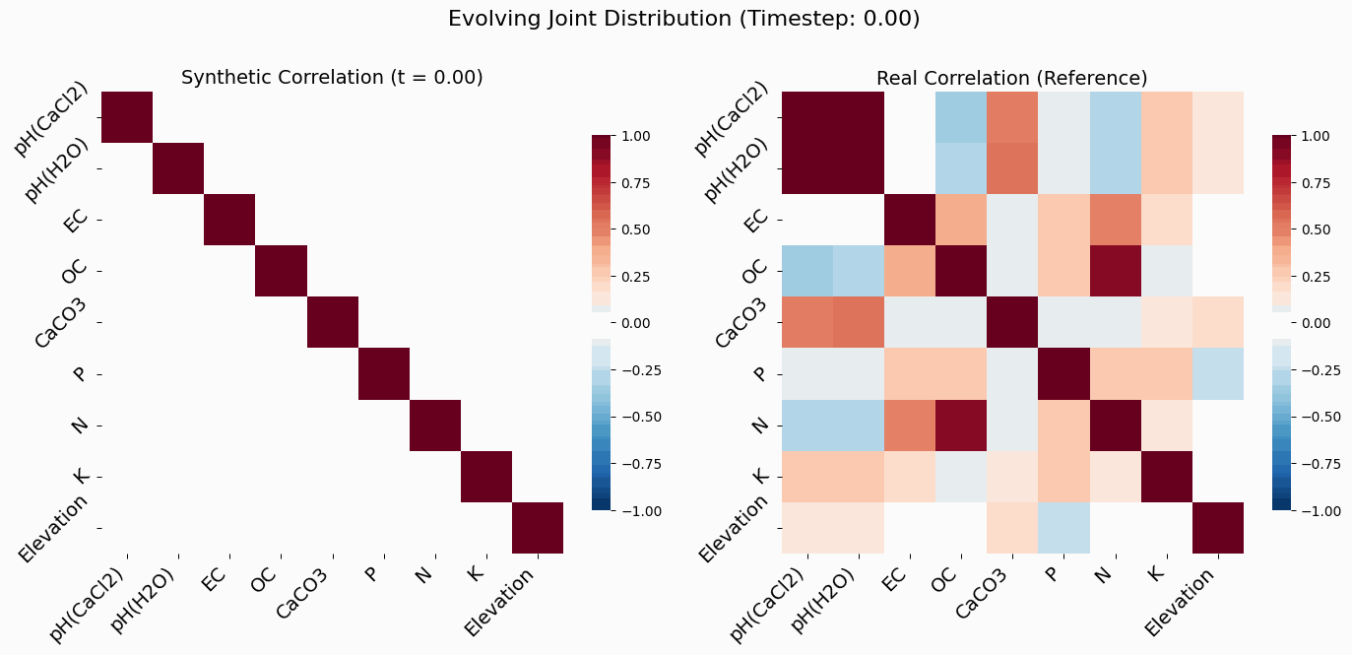
Challenges: Soil Complexity
Joint Distribution Fidelity

Slide 9
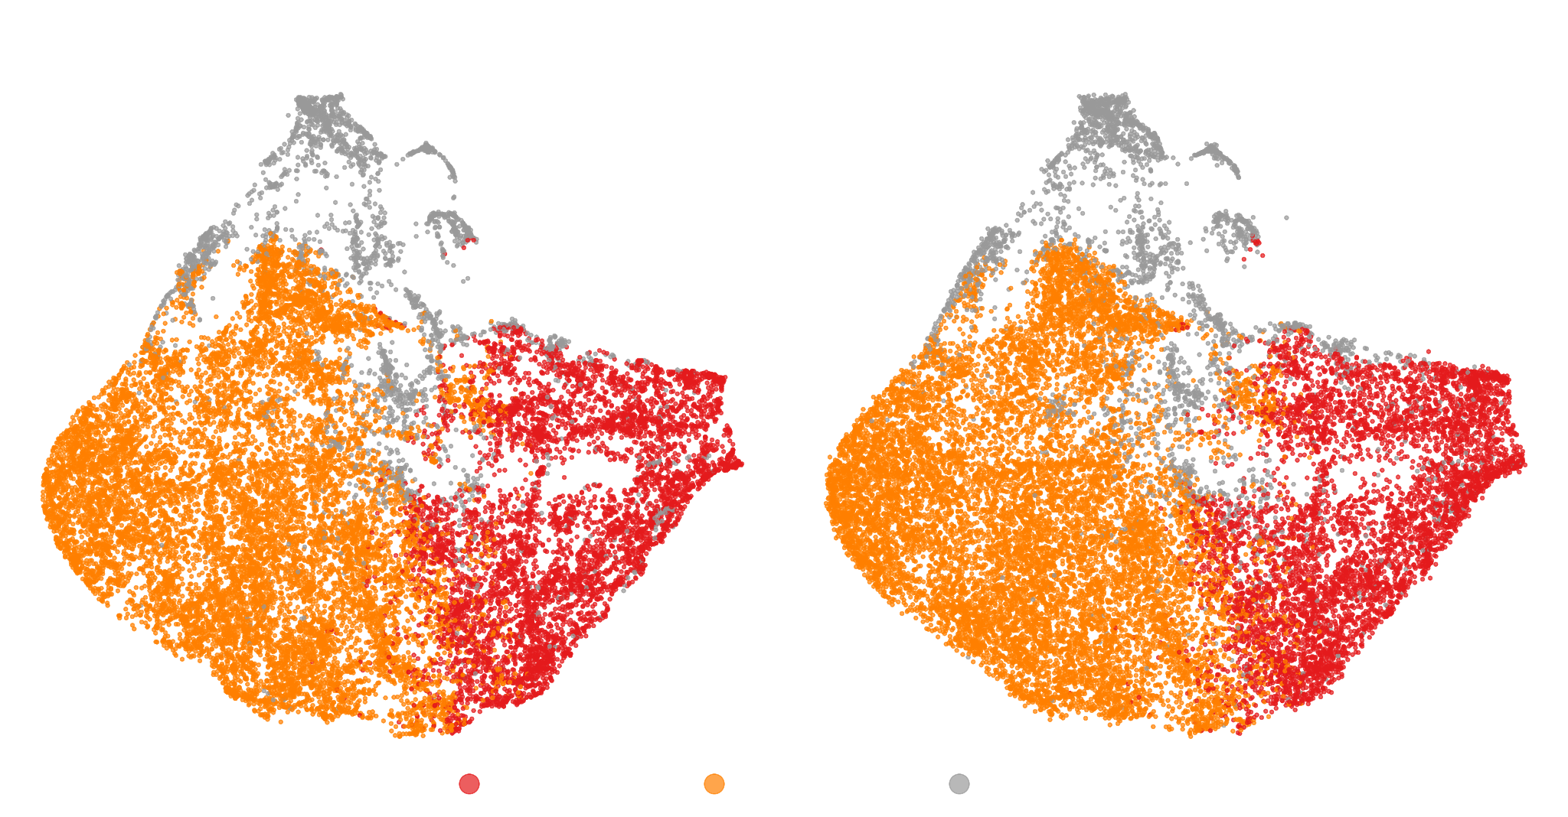
Gaussian Mixture Model Clustering
UMAP visualization for K=3

Slide 10
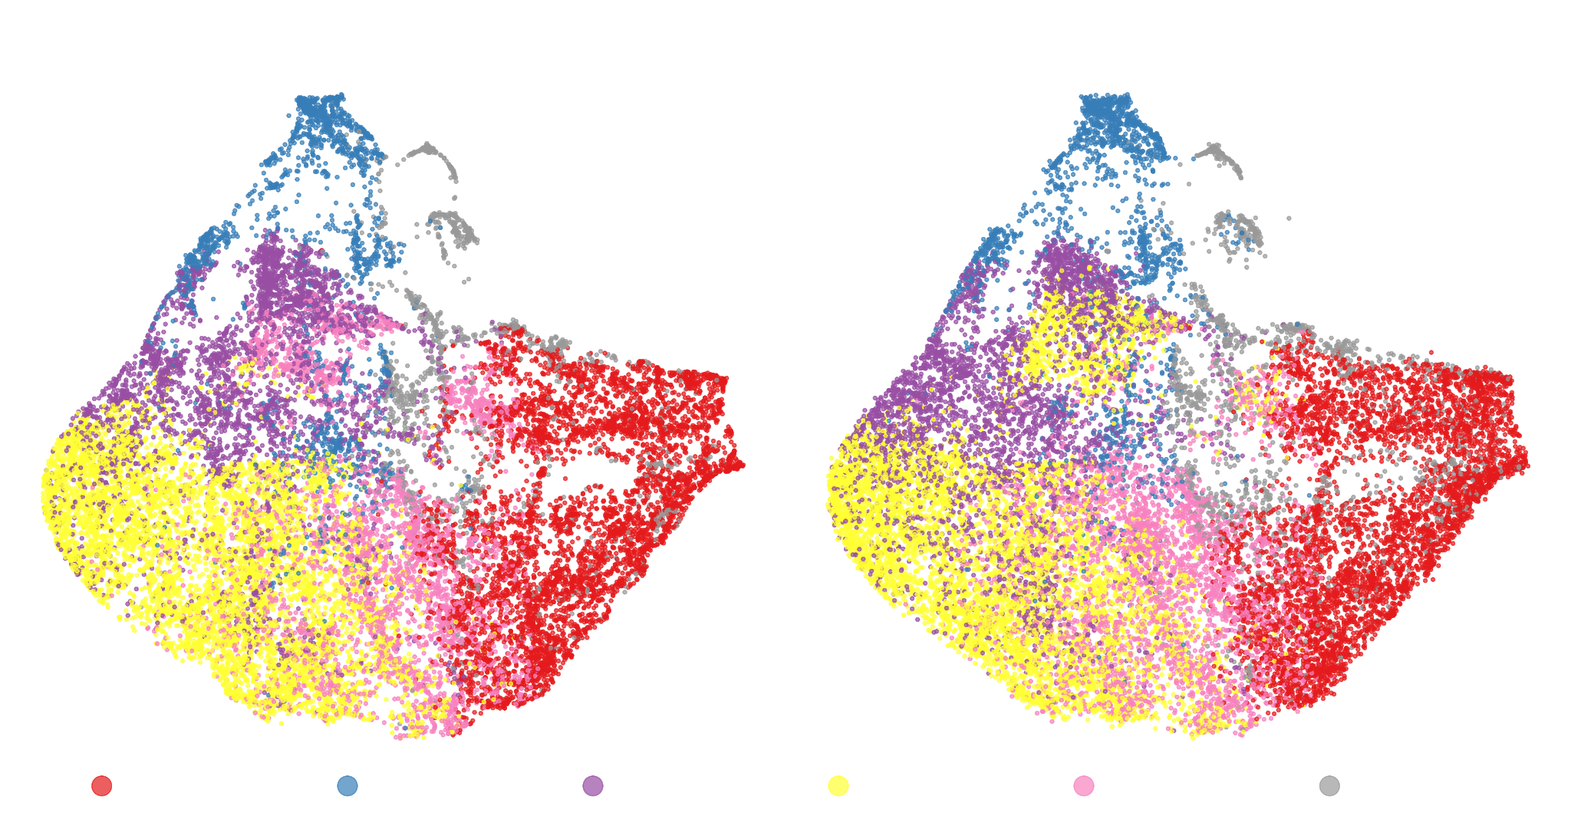
Gaussian Mixture Model Clustering
UMAP visualization for K=6

Slide 11
Thank you!
vinicius.melicio@colaborador.embrapa.br
Vinicius do Carmo Melicio, Vitor Hugo Miranda Mourão, Luis Gustavo Barioni, and João Paulo Gois

