Slide 1
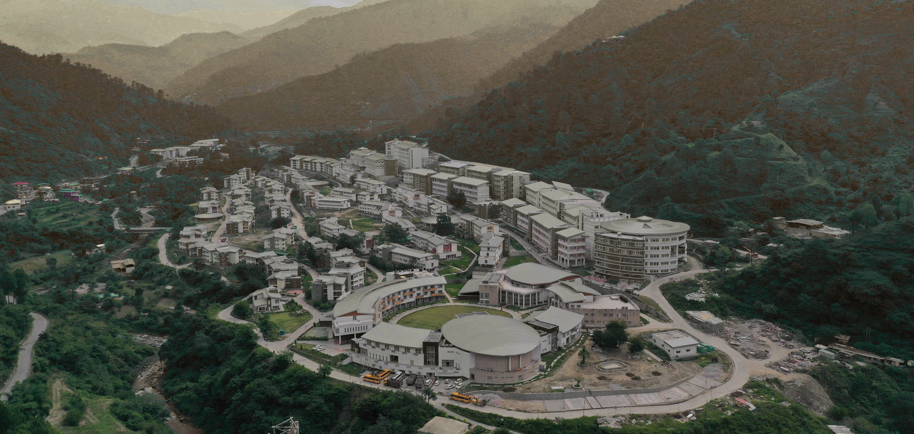


PROBABILISTIC FRAMEWORK FOR ENHANCED LANDSLIDE SUSCEPTIBILITY MAPPING FOR RAINFALL-INDUCED LANDSLIDES
Presented By :
Tanvi Chauhan
PhD Scholar
School of Civil and Environmental Engineering
Supervisor: Dr. K. V. Uday
Associate Professor, IIT Mandi
Co-Supervisor: Prof. Vikas Thakur
Dean, NTNU Norway
Indian Institute of Technology Mandi | 6 May 2026

Slide 2
OVERVIEW
Landslides: Background
2023 Monsoon Event (Himachal Pradesh)
Motivation for the study
Implementation
Objective
Result
Methodology
Conclusion
IIT Mandi| 2026

Slide 3
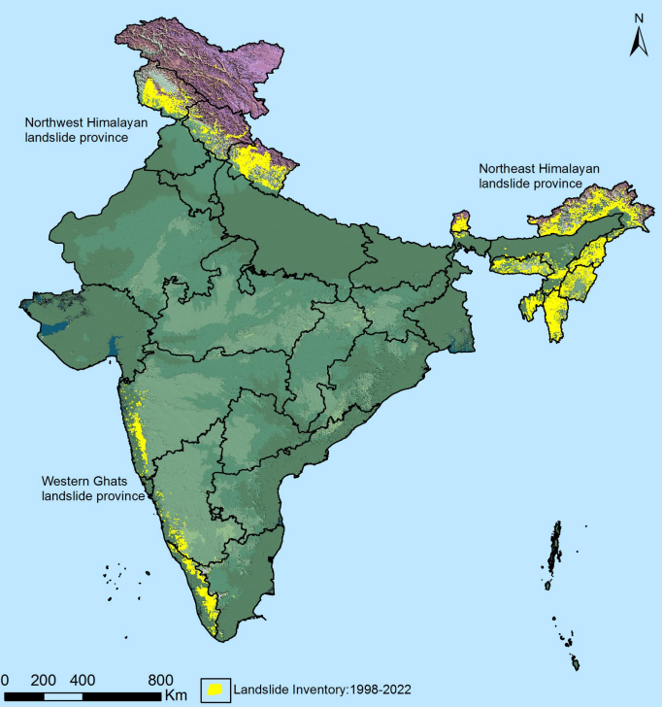
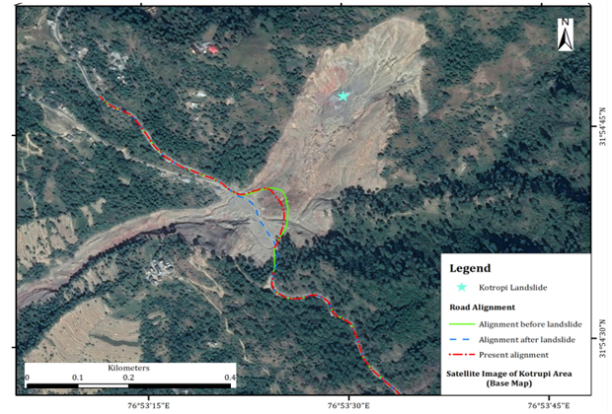
LANDSLIDES: BACKGROUND
• India ranked 1st with the highest potential frequency of fatal landslides.
• 12% of the Indian landmass is highly susceptible to landslides.
IIT Mandi| 2026

Slide 4
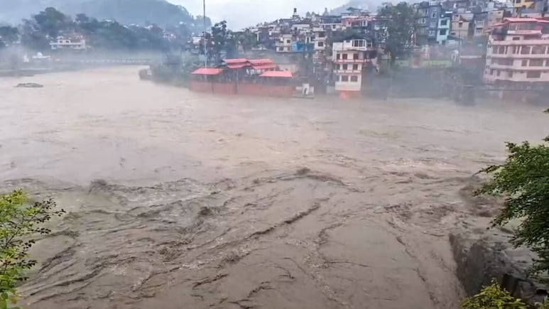
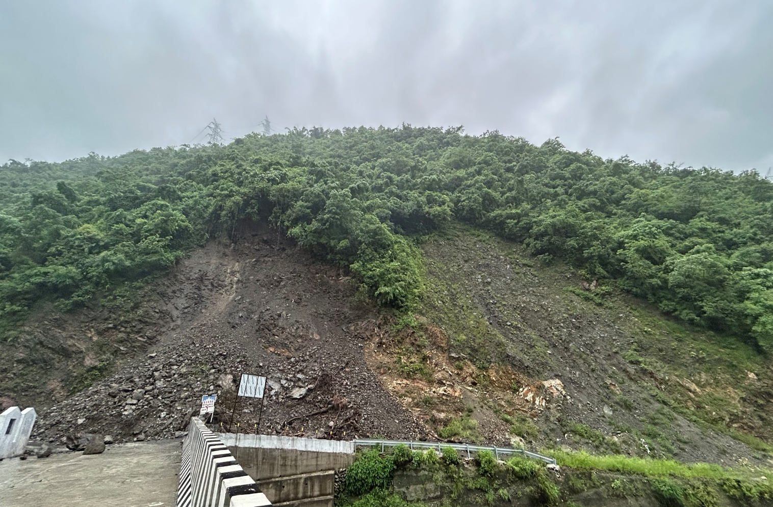




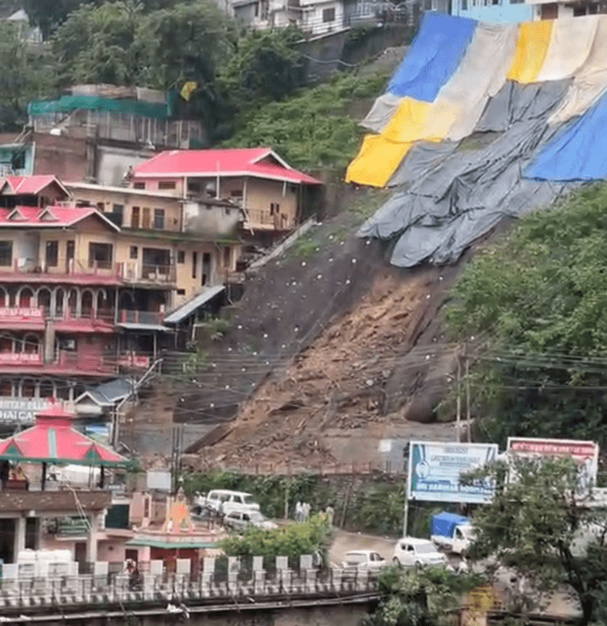
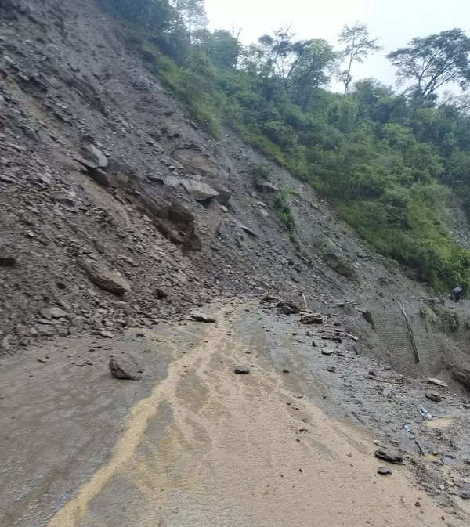
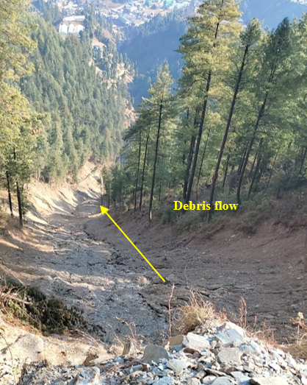

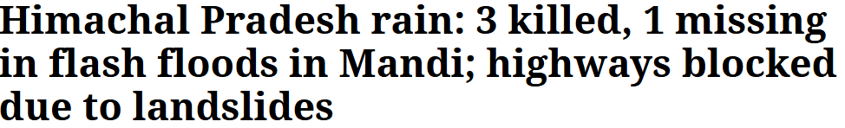


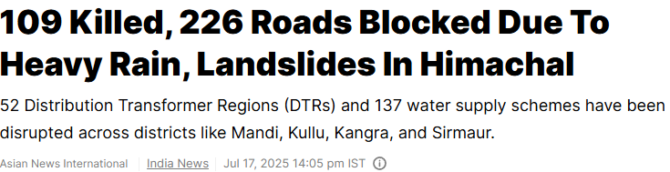
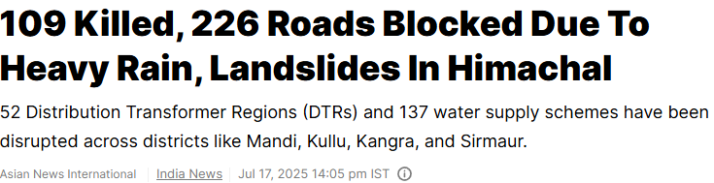
Source: https://www.ndtv.com
Source: www.thenewzradar.com
Source: https://www.ndtv.com/topic/mandi-landslide
Notes:
Climate changes: Alteration of rainfall patterns
Population surge: Increasing demands for infrastructure development in landslide-prone areas
road cuts: Expose the slopes directly to the environment, making it more vulnerable for failure.

Slide 5
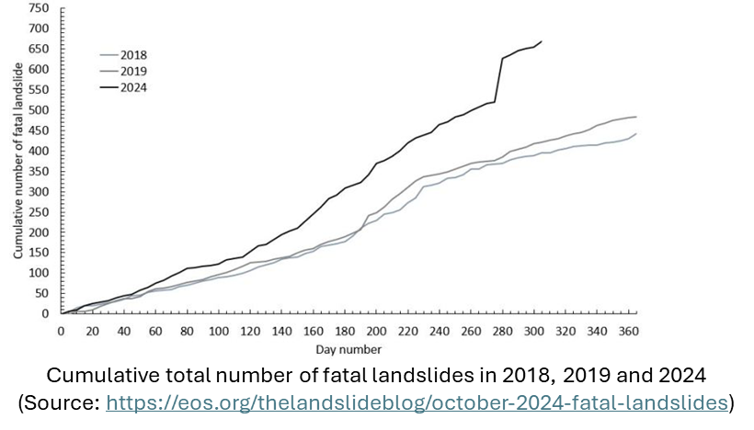
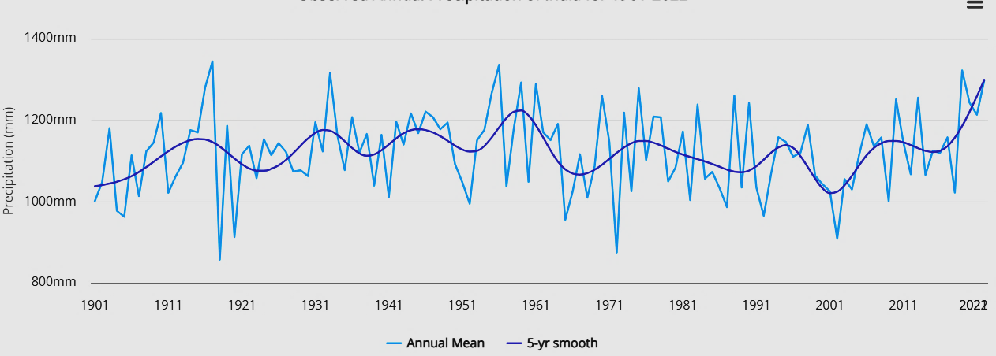
Motivation for study
Annual precipitation in India for 1901-2022 (https://climateknowledgeportal.worldbank.org/country/india/climate-data-historical)
Need for an accurate LSM assessment in Hilly terrain
Notes:
Climate changes: Alteration of rainfall patterns
Population surge: Increasing demands for infrastructure development in landslide-prone areas
road cuts: Expose the slopes directly to the environment, making it more vulnerable for failure.

Slide 6
Objective
Develop a local-scale, probabilistic landslide susceptibility framework that integrates qualitative and quantitative assessments, utilising natural and anthropogenic factors in machine learning, and evaluate its transferability across multiple landslide events.
IIT Mandi| 2026
Existing LSM approaches fail to capture local-scale variability and anthropogenic impacts, especially in Himalayan terrains
There is a need for an integrated, transferable framework that integrates natural and human-induced factors across multiple landslide events.

Slide 7
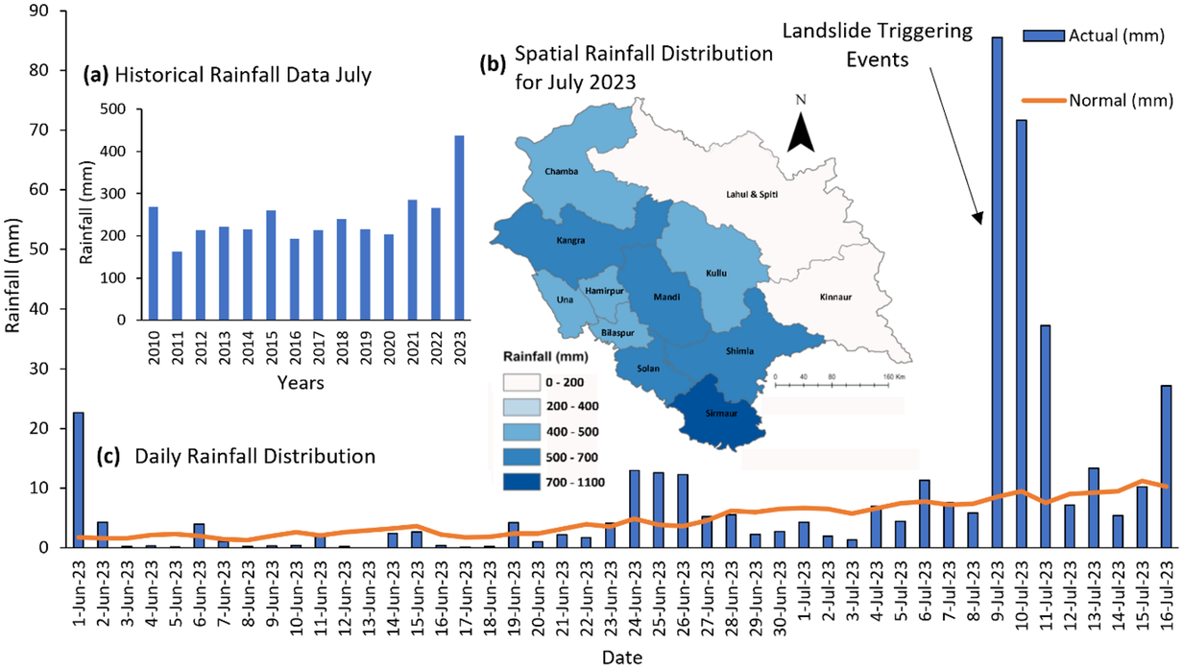
Event: 2023 Monsoon in H.P.
The 2023 monsoon was marked by 1334.9 mm of record-breaking rainfall (IMD)
In the 2023 monsoons, 43 flash floods reported in H.P. (Tiwari et al. 2024)
5400 hillslope landslides and road cut slope failures (Sana et al. 2024)
Historic, Spatial, and Seasonal Rainfall Patterns in H.P. (Sana et al. 2024)

Slide 8
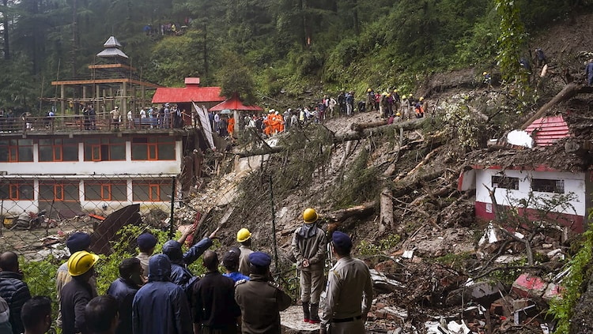
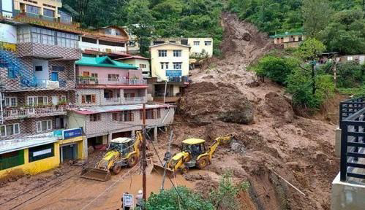
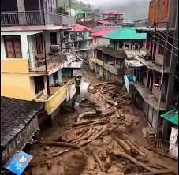
2023 Monsoon Impact in H.P.
IIT Mandi| 2026
Shimla Summer Hill Landslide 2023
(https://www.indiatoday.in)
Massive landslide in Anni near Bus stand
Shamti Landslide, Solan
Kullu Sainj Area (Pre and Post monsoon)
(Sana et al. 2024)
Thunag Debris Flow

Slide 9
METHODOLOGY
Desk study
Site Investigation
Data Acquisition & Preprocessing
Qualitative Assessment
Geology
Geomorphology (DEM, Slope, Aspect, Curvature)
Anthropogenic factors
(Roads, NDVI, LULC)
LHEF for LHZ
IIT Mandi| 2026
Quantitative ML Assessment
Inventory
Validation
POF
Ground Truth Validation
Calibrated localized LSM
Site specific Recommendations
Notes:
Address the gaps missed while Quantitative assessment filled by site visit detailed assessment

Slide 10
STUDY AREA
IIT Mandi| 2026
Site investigations for Qualitative assessment

Slide 11
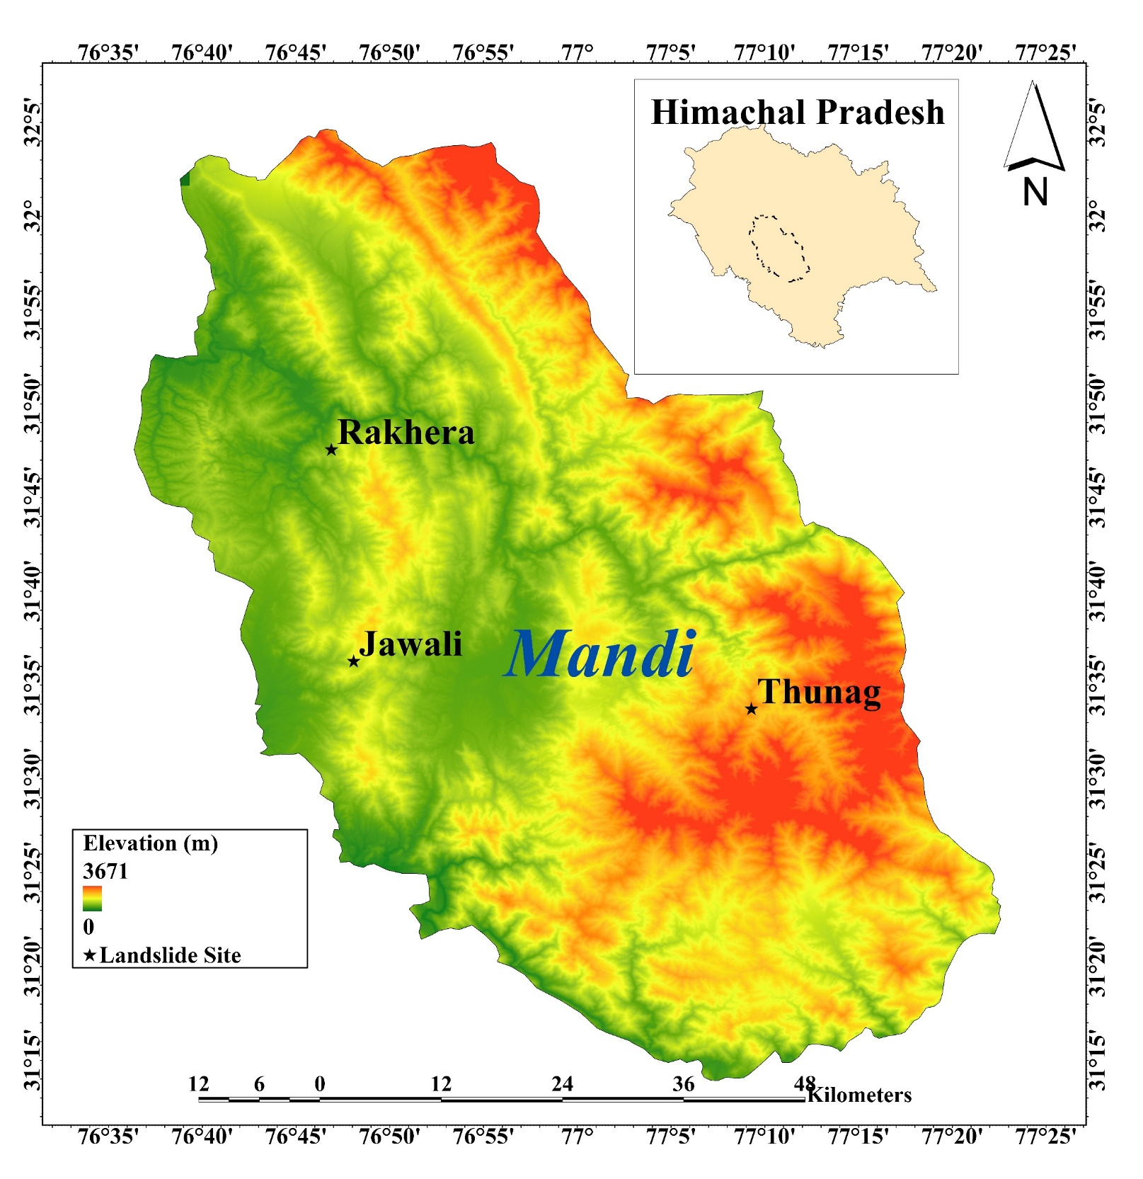
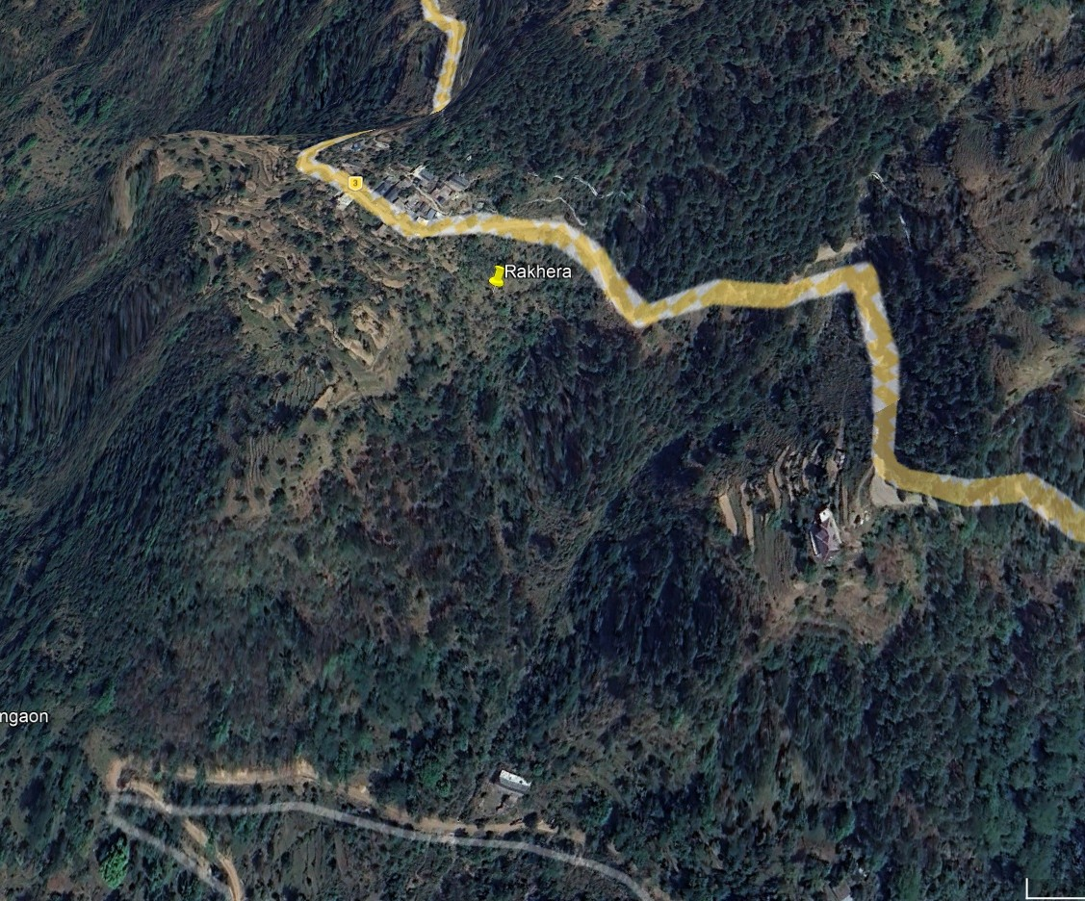
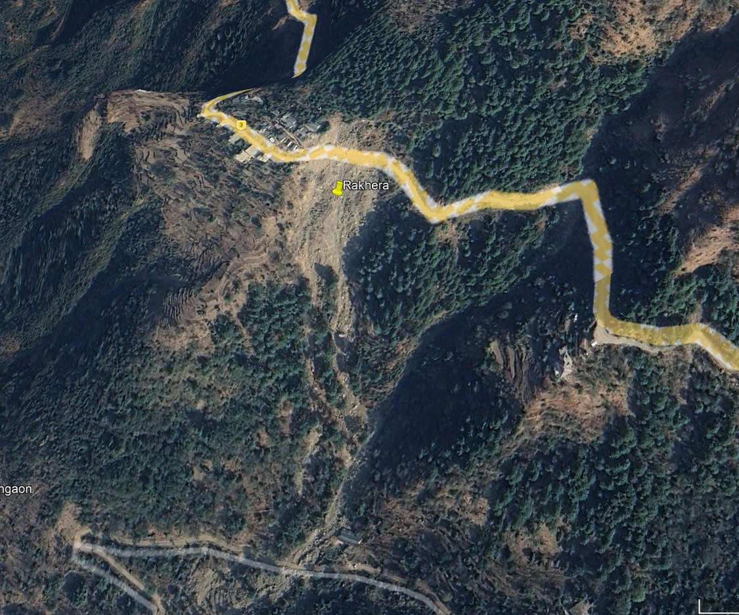
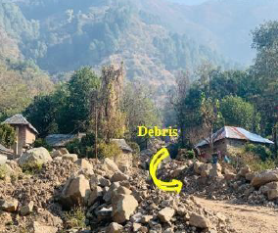
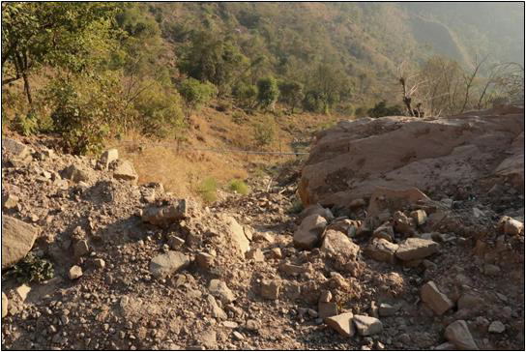
Landslide site 1
IIT Mandi| 2026

Slide 12
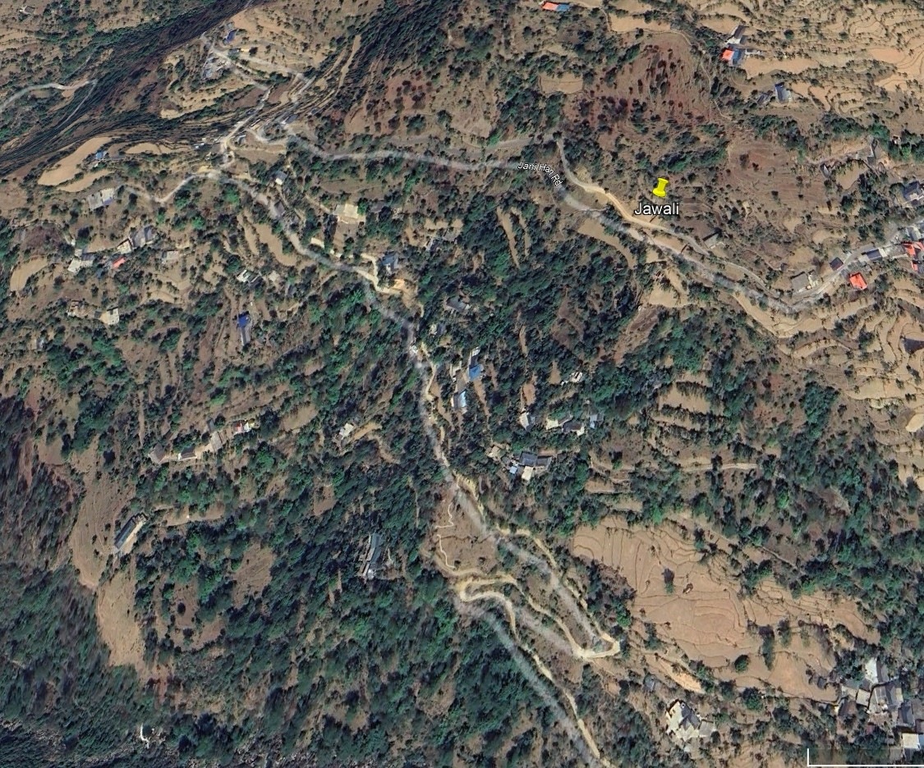
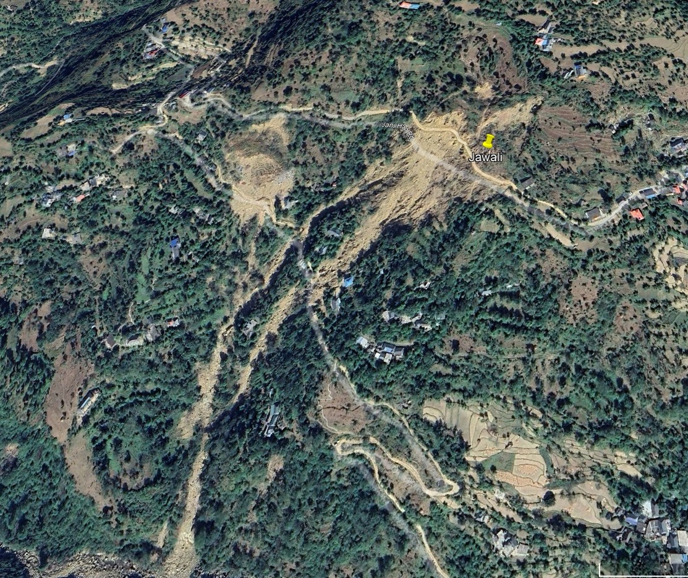
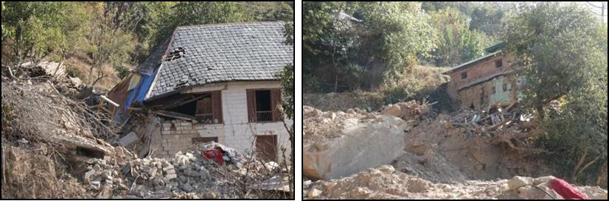
Landslide site 2
IIT Mandi| 2026

Slide 13
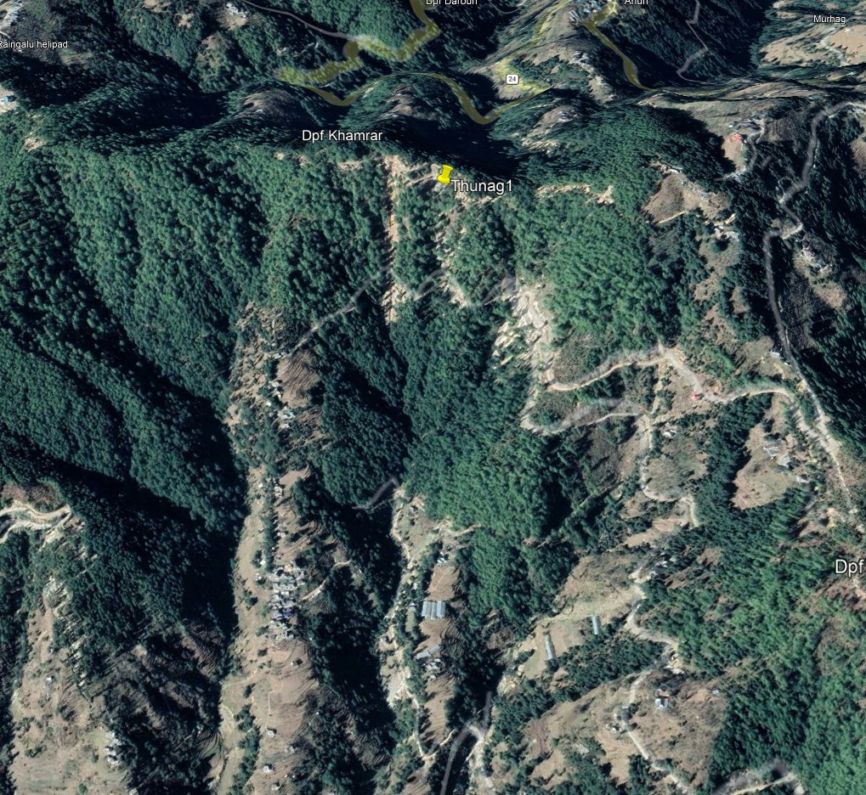
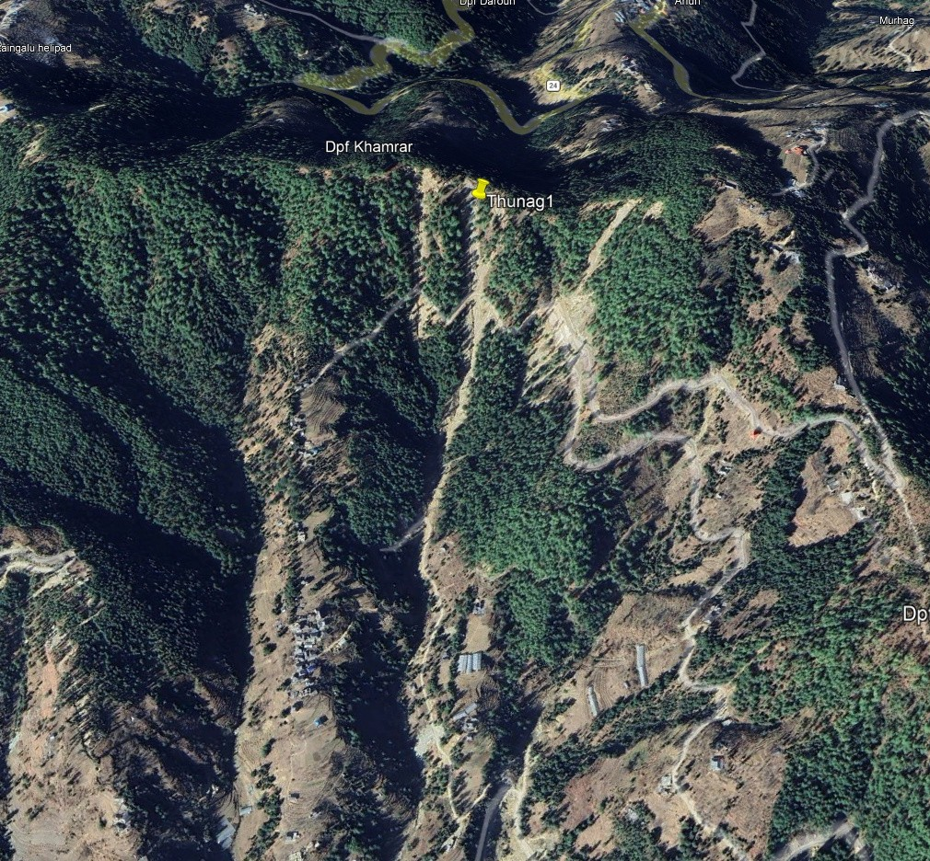
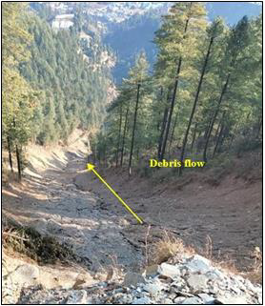
Landslide site 3
IIT Mandi| 2026

Slide 14
Qualitative analysis
Landslide Hazard Evaluation based on Total Estimated Hazard
Parameter | Thunag | Rakhera | Jalanal
Lithology | 2.0 | 1.0 | 1.3
Structure | 1.5 | 0.8 | 0.6
Slope | 1.7 | 1.2 | 1.2
Land Use | 1.5 | 1.2 | 1.2
Hydrology | 0.5 | 1.0 | 0.8
Relative Relief | 0.6 | 0.6 | 1
Total Score | 7.8 (Very High Hazard zone) | 5.8 (Moderate Hazard zone) | 6.1 (High Hazard Zone)
LHEF (Anbalagan 1992)
IIT Mandi| 2026

Slide 15
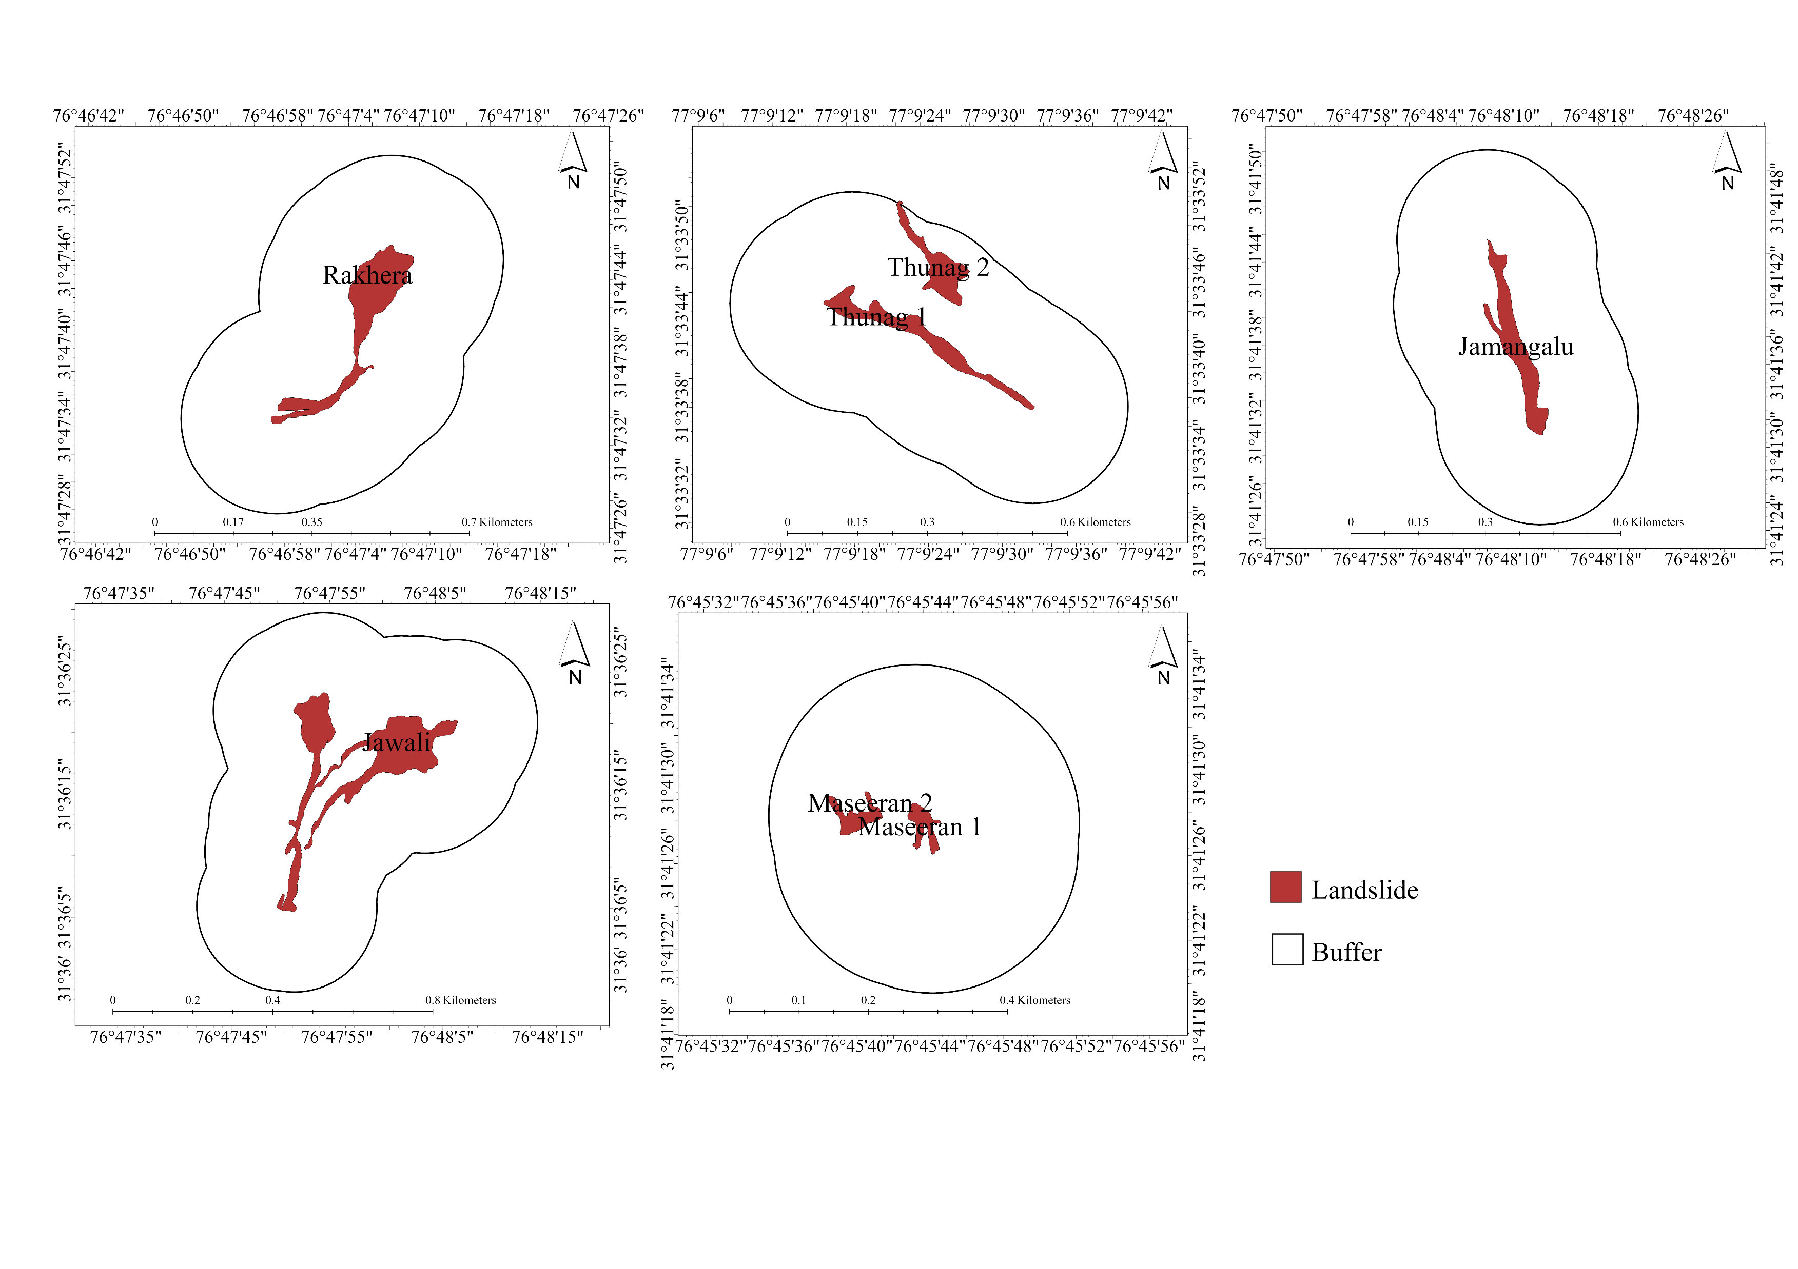
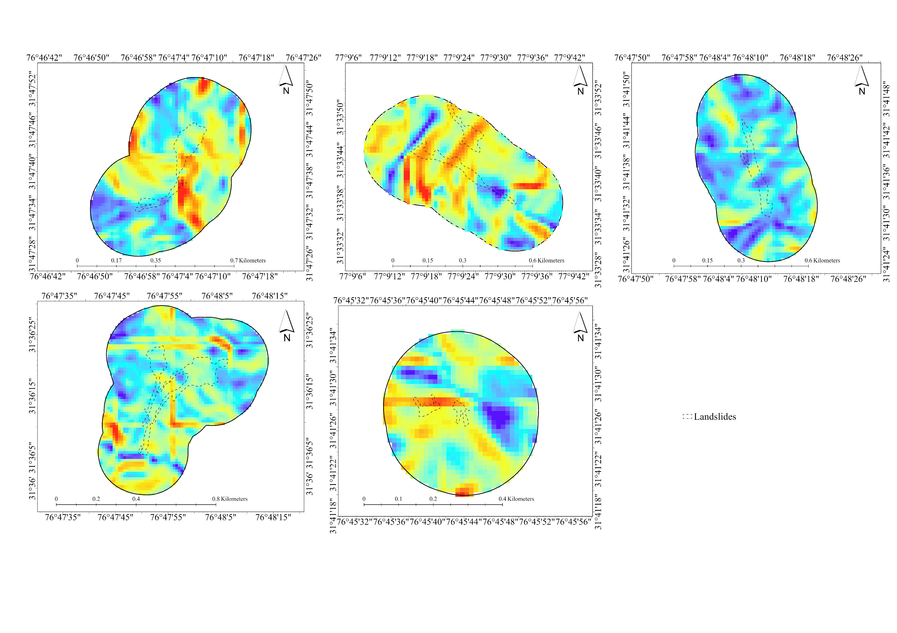
Quantitative analysis
Landslide Inventory
Slope
CF: Elevation, Slope, Aspect, Curvature, LULC 2023, NDVI, Distance to roads, Distance to rivers.

Slide 16
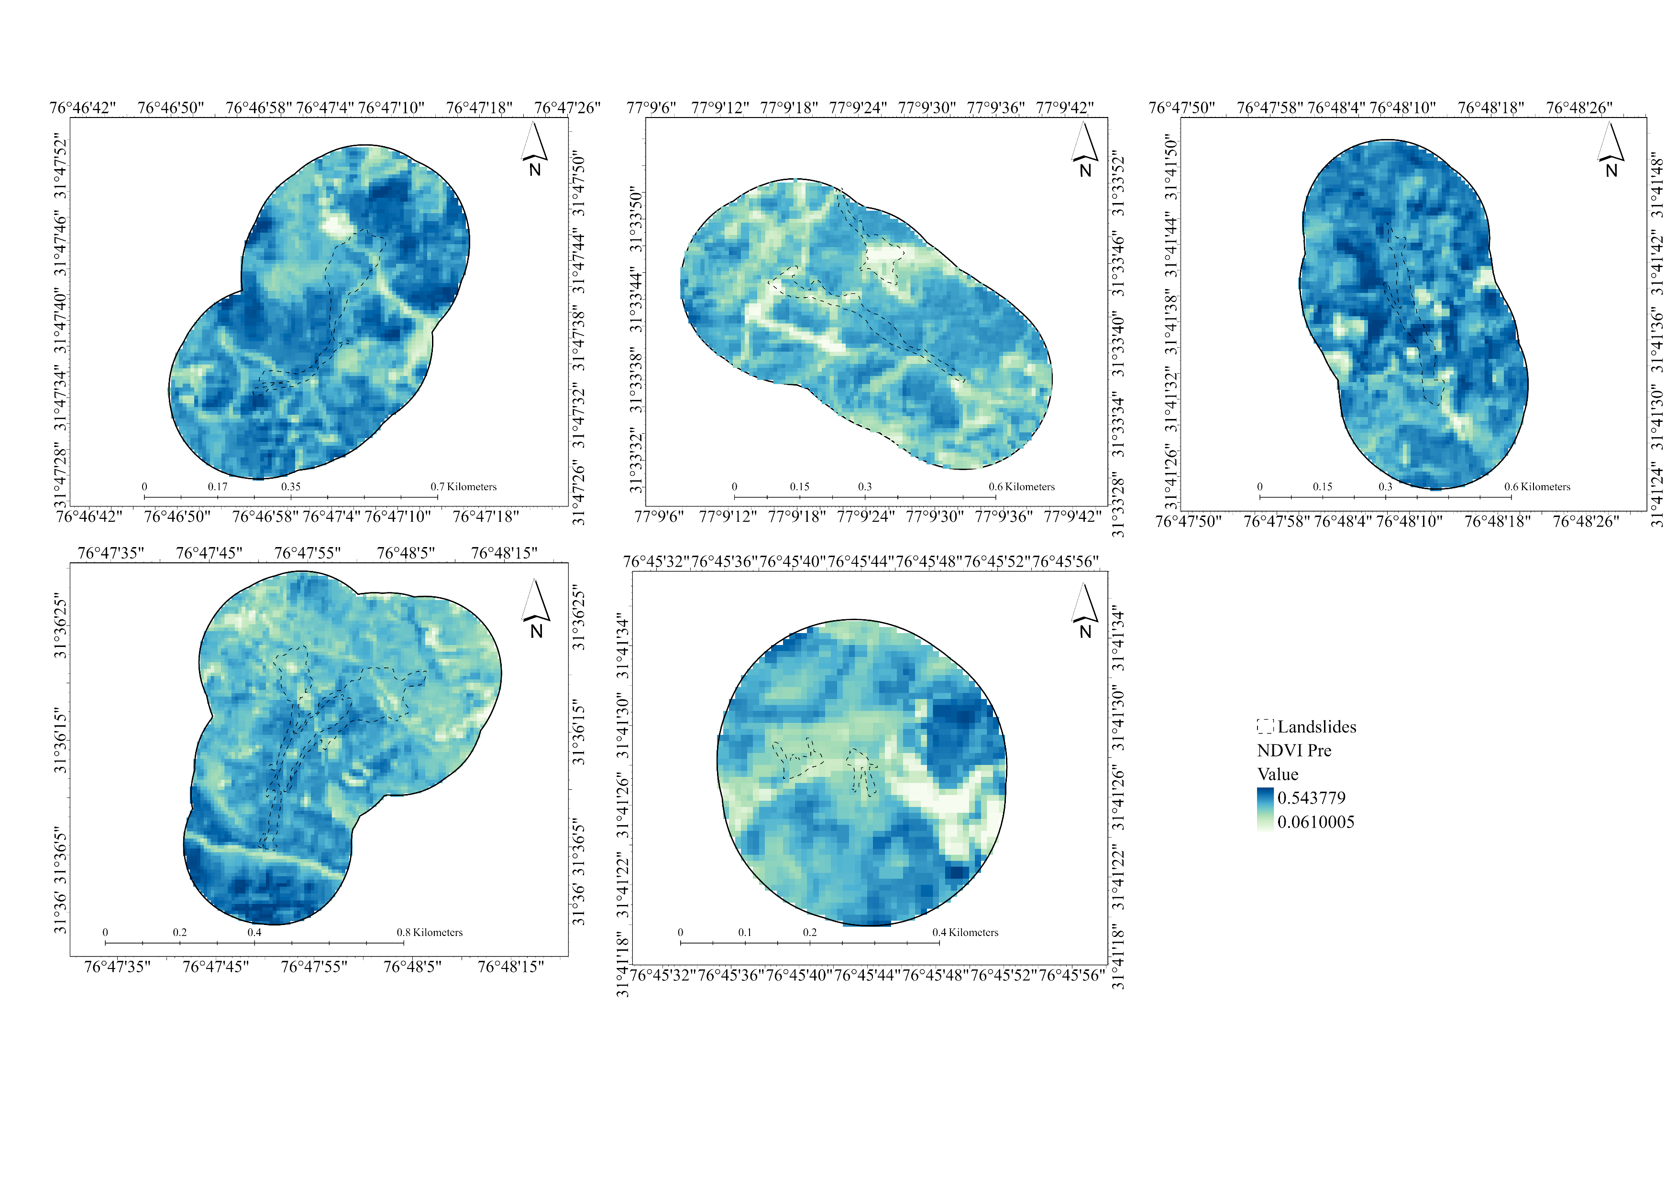
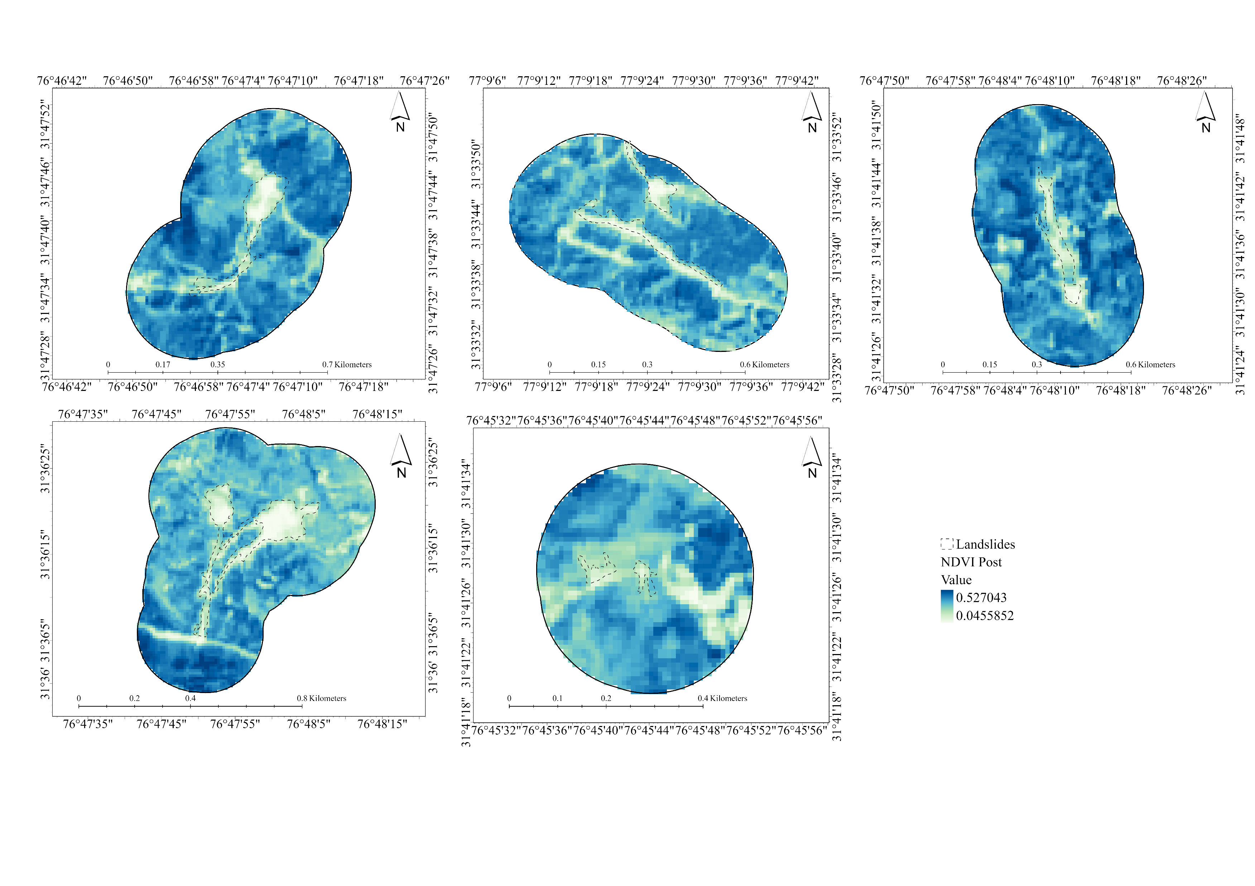
Pre-NDVI
Post-NDVI
Multi-source geospatial CF, including topographic, geological, hydrological, vegetation, and anthropogenic parameters were prepared in GIS.
Random Forest (RF) and XGBoost (XGB) models were trained using cross-site validation:
Train (T+R) → Test (J)
Train (T+J) → Test (R)
Train (R+J) → Test (T)

Slide 17
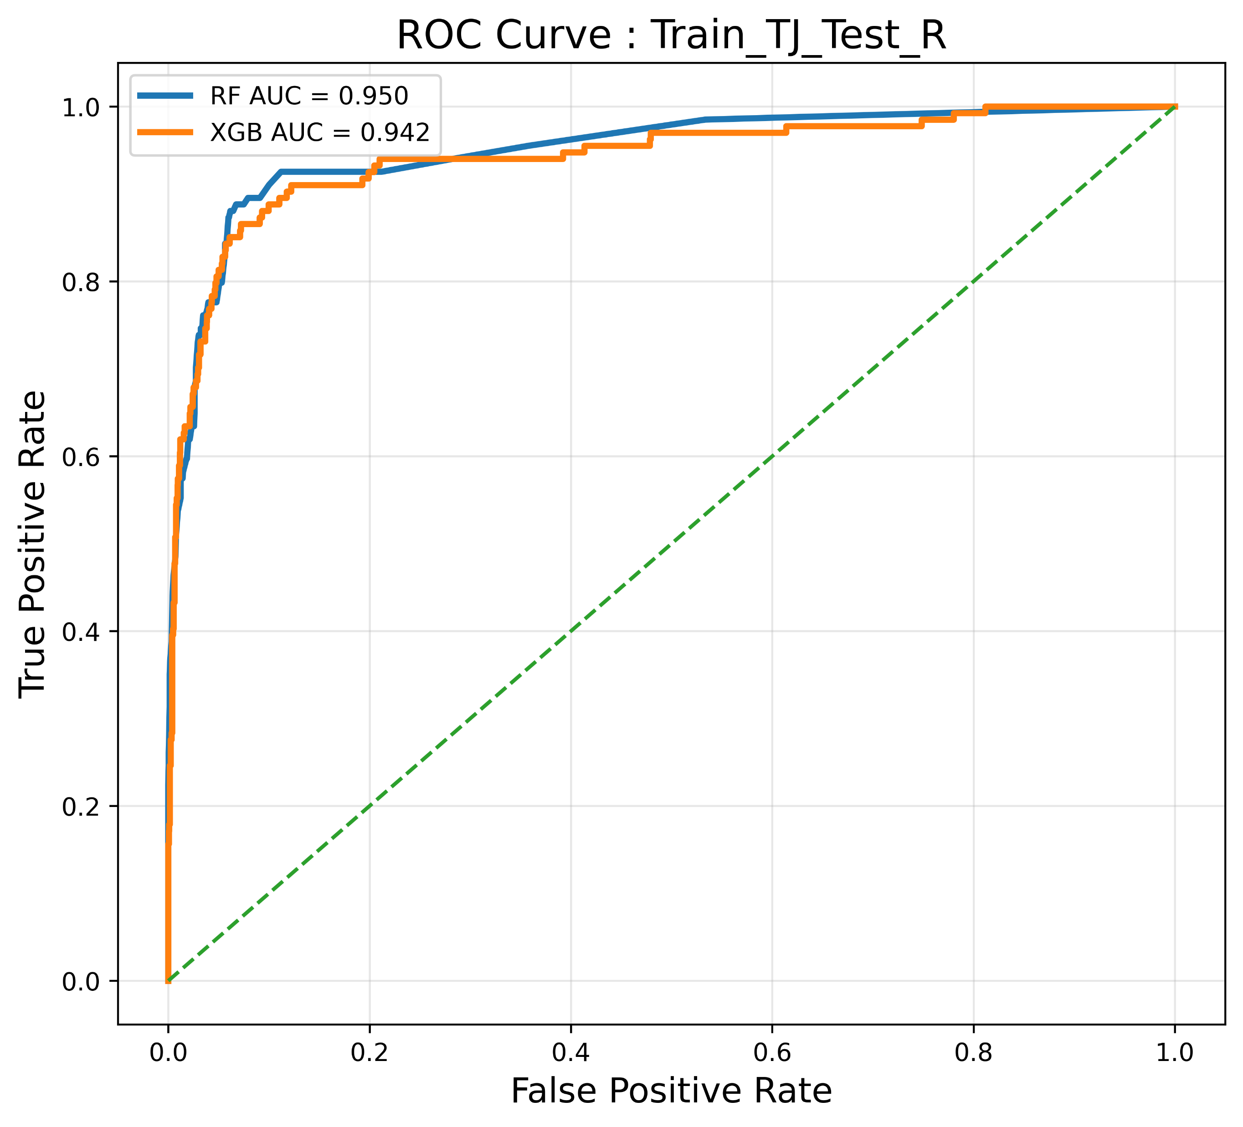
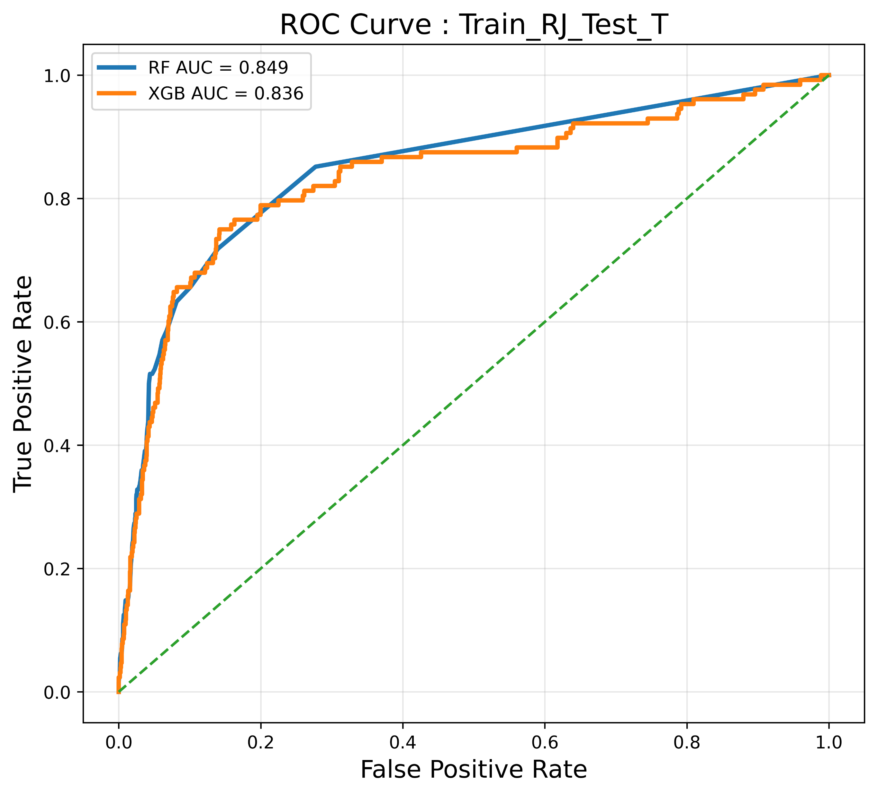
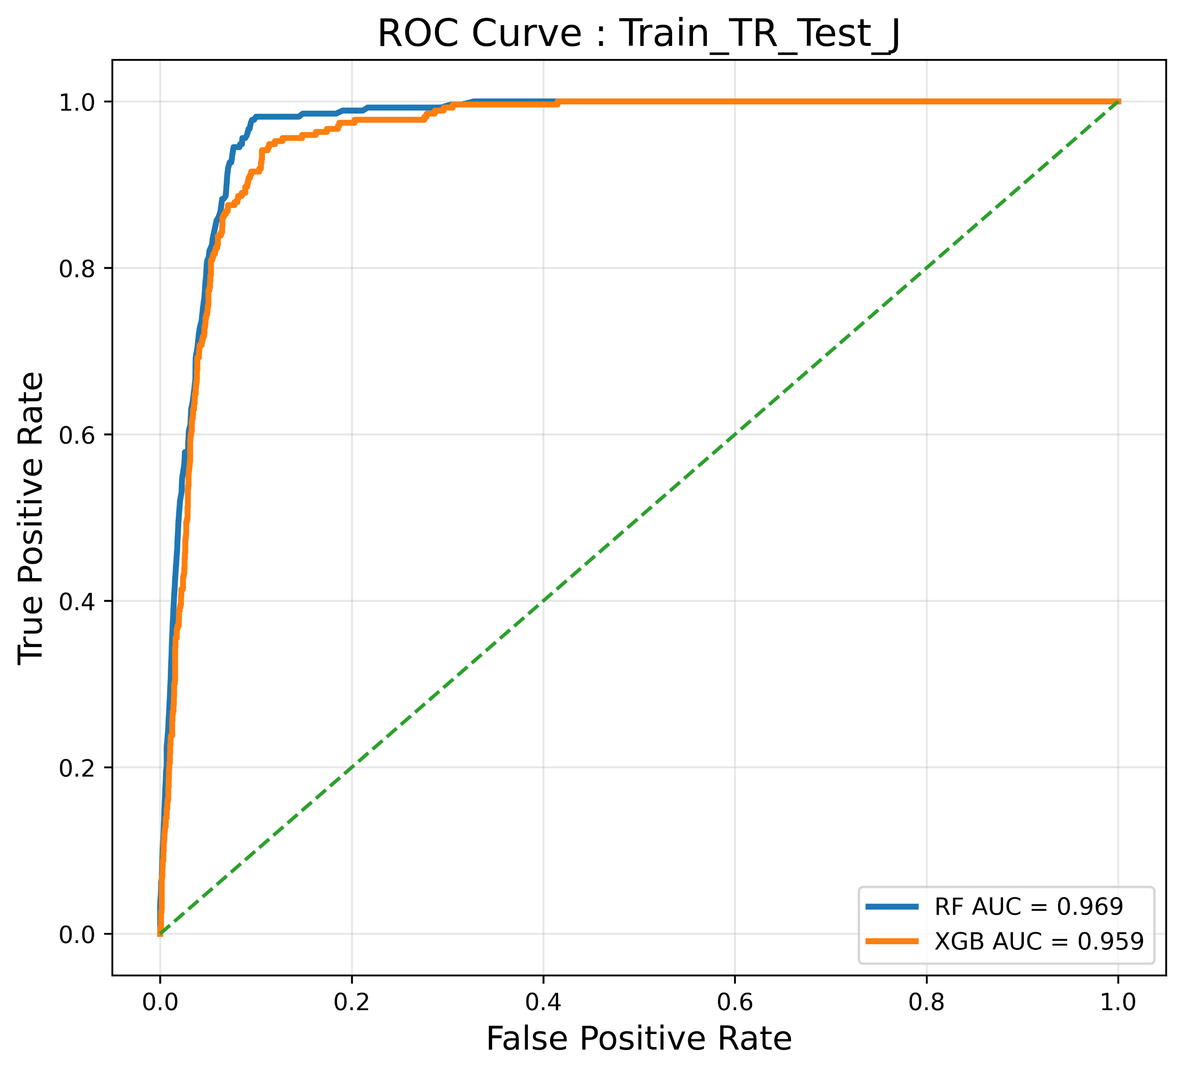
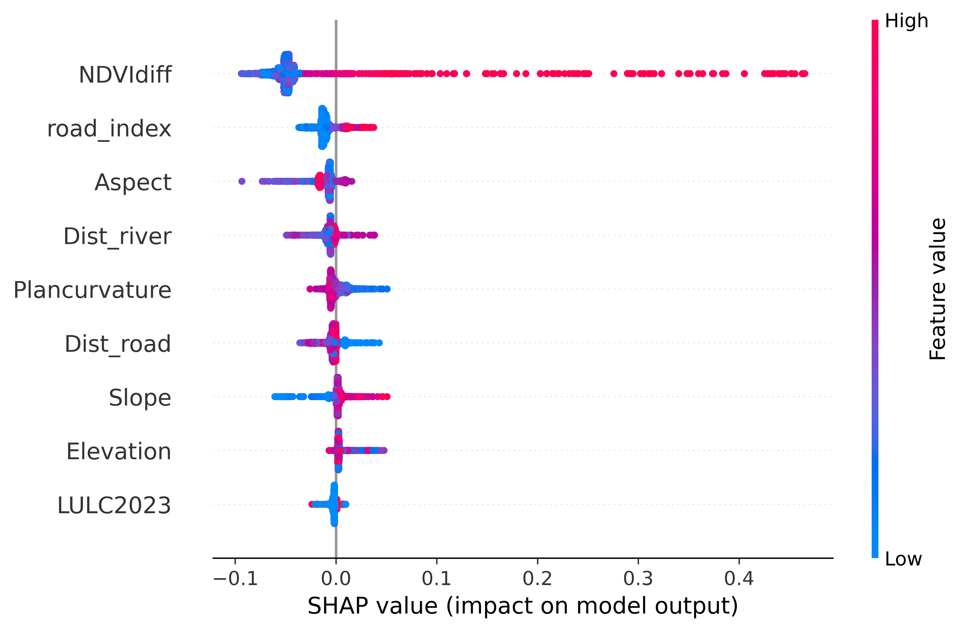
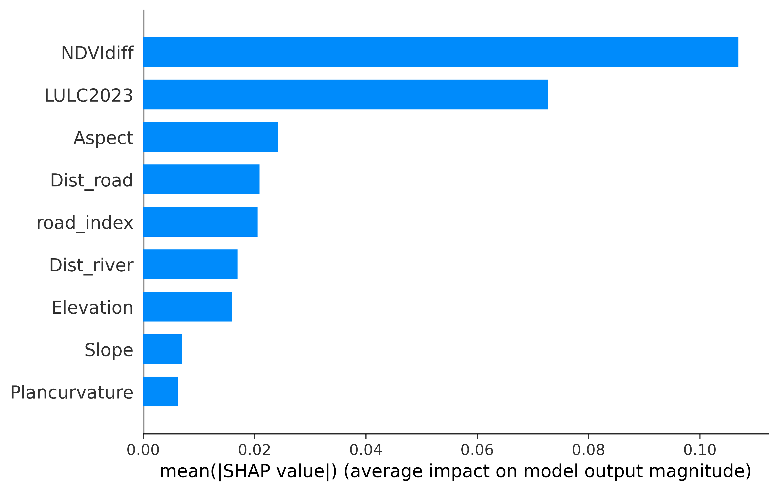
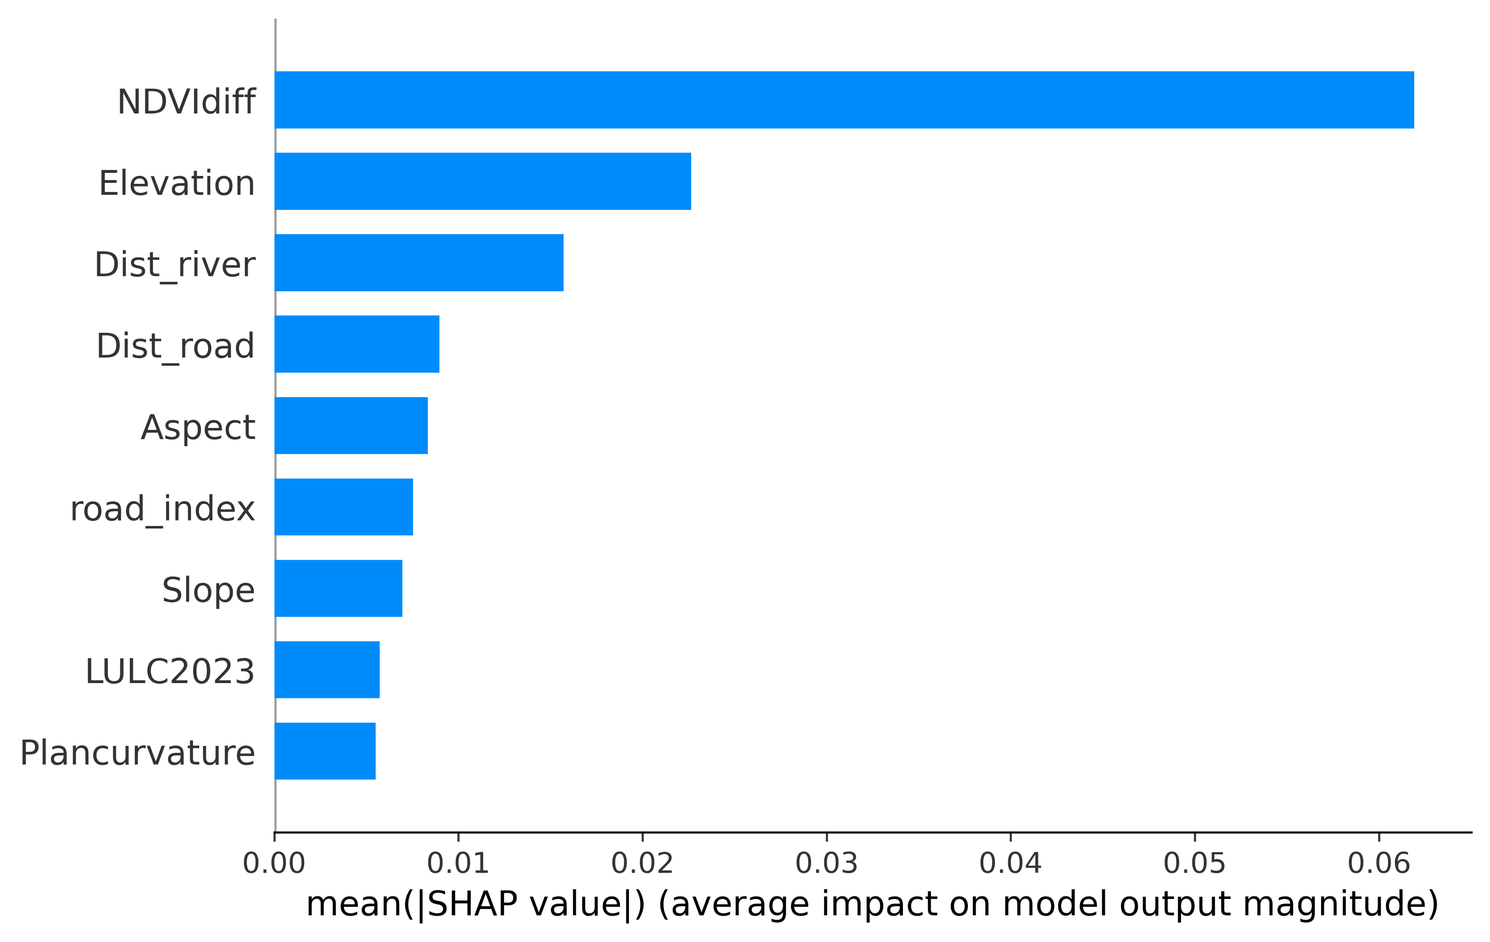
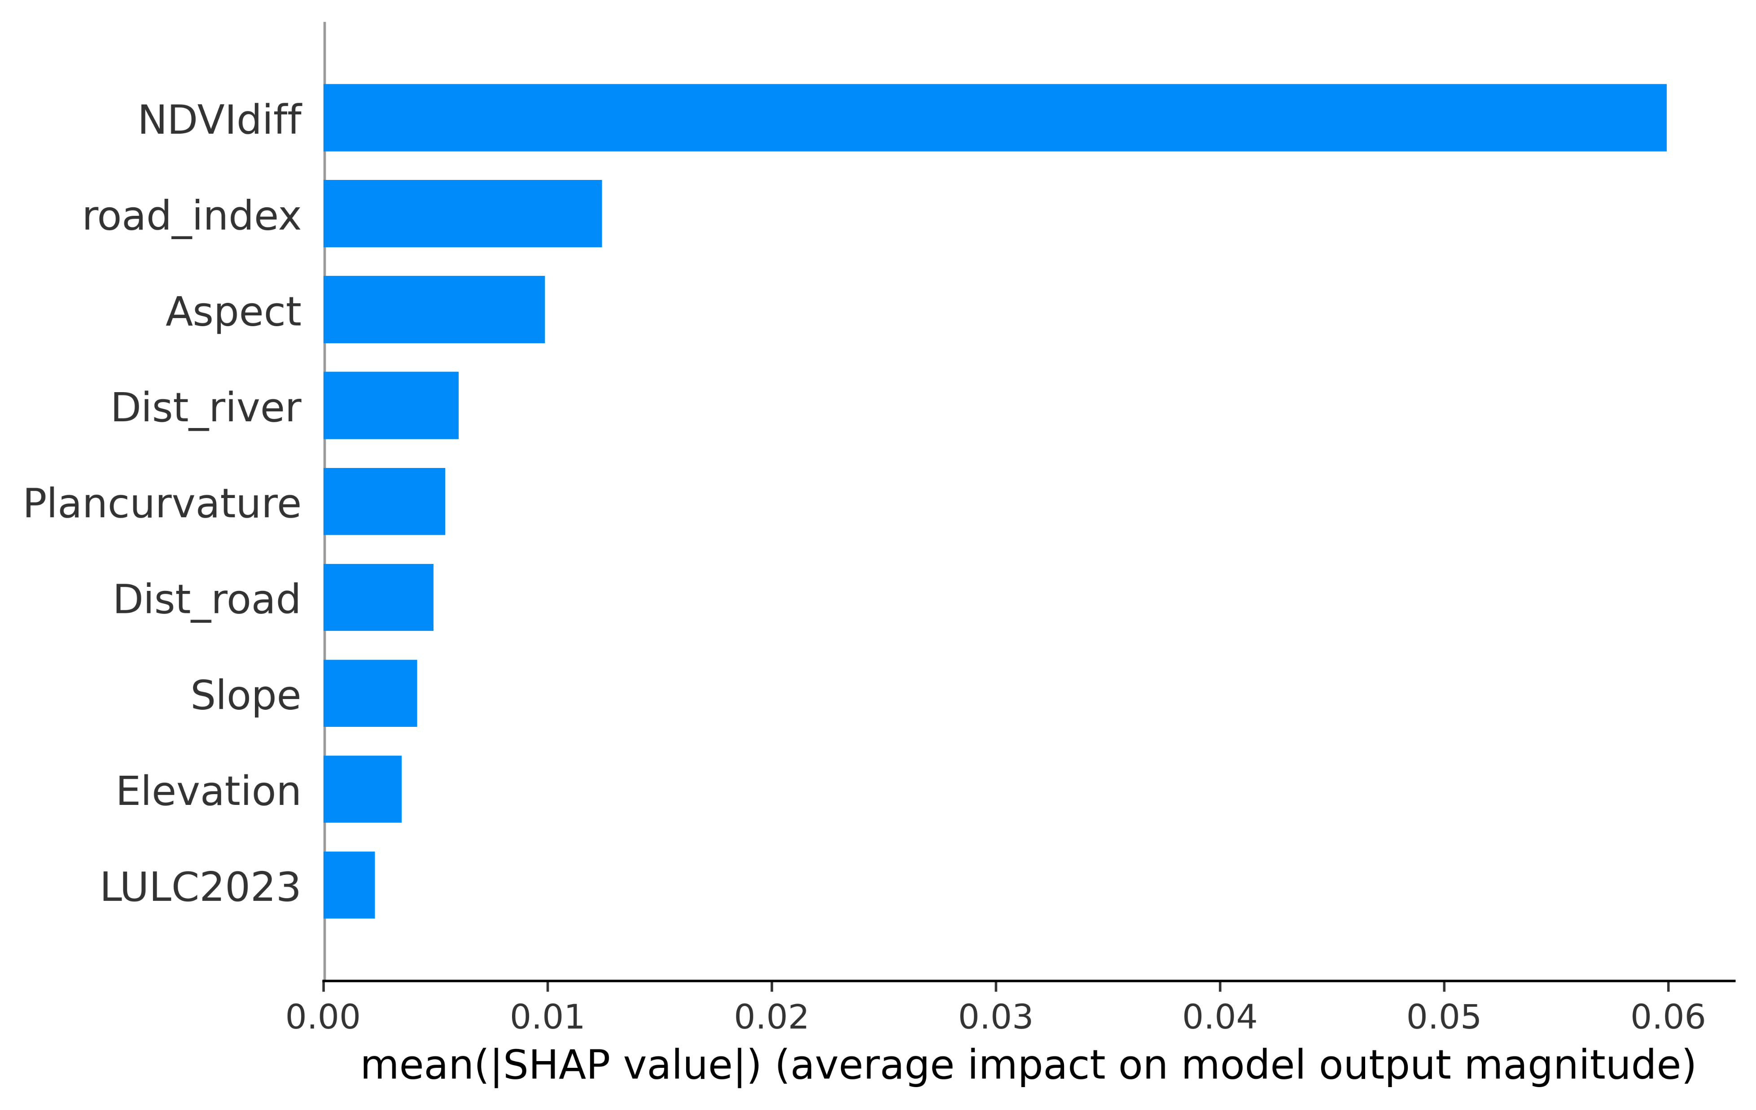
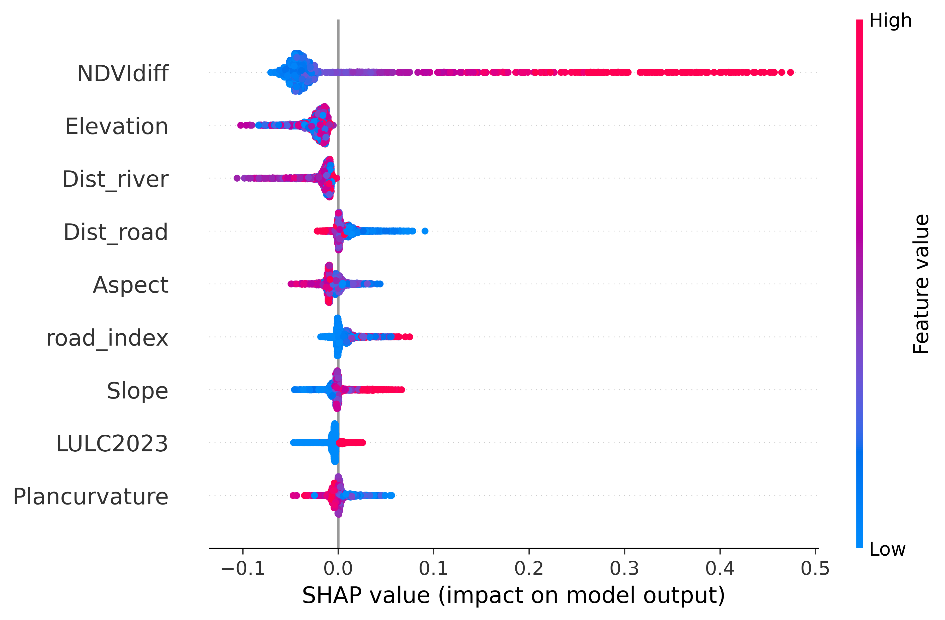
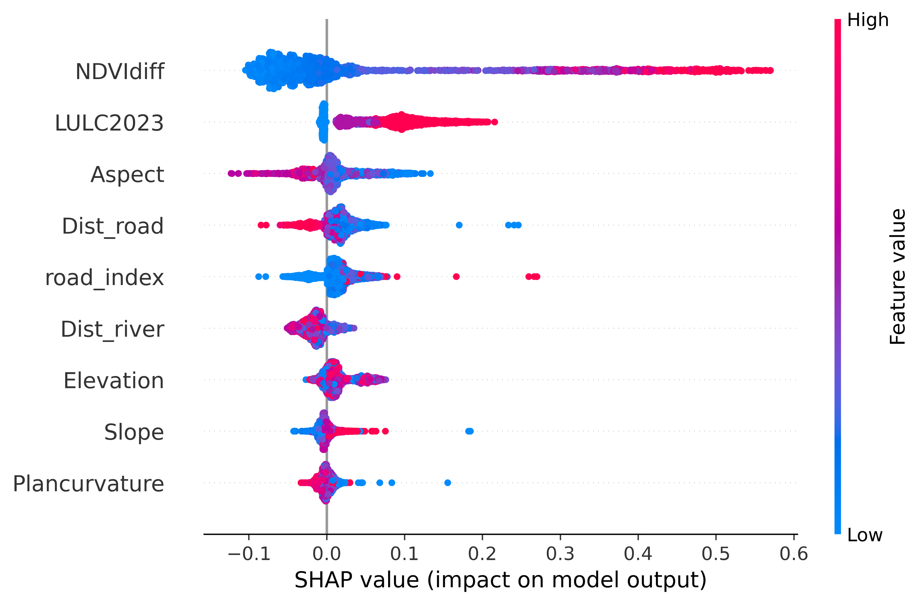
Results
IIT Mandi| 2026

Slide 18
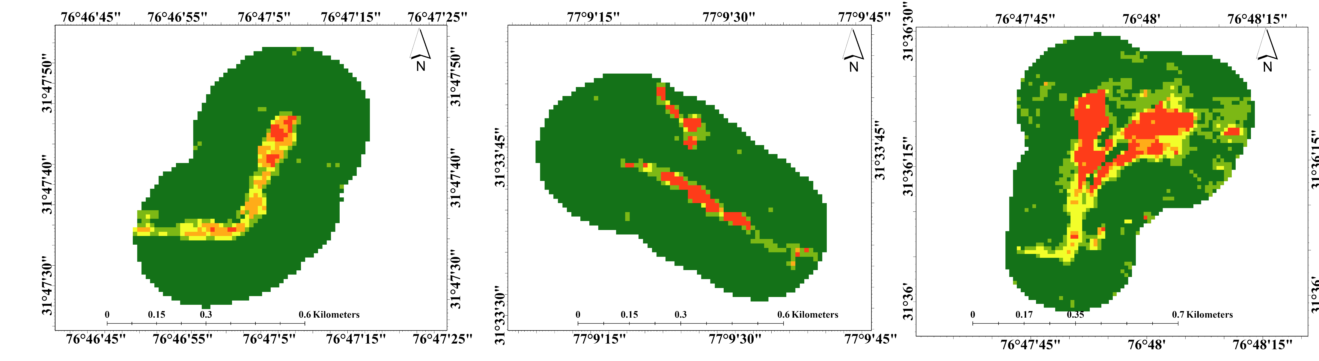
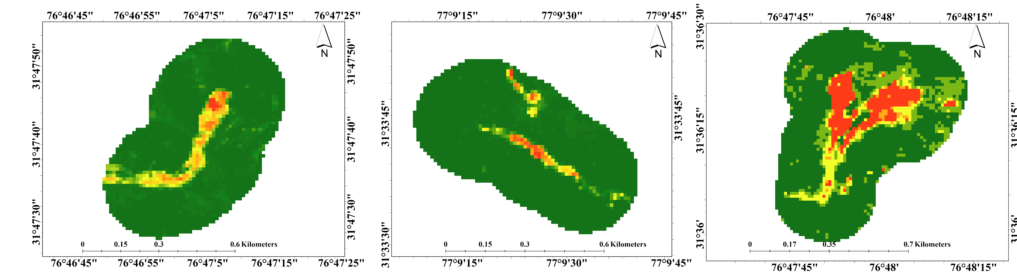
Results
RF
Z | PoF Range | Anbalagan Equivalent | Description
I | 0.00 - 0.20 | < 3.5 | VLH
II | 0.21 - 0.40 | 3.5 - 5.0 | LH
III | 0.41 - 0.60 | 5.1 - 6.0 | MH
IV | 0.61 - 0.80 | 6.1 - 7.5 | HH
V | 0.81 - 1.00 | > 7.5 | VHH
XGB
IIT Mandi| 2026

Slide 19
Key Findings
RF and XGBoost showed strong cross-site prediction capability with high ROC–AUC values: Train (T+R) - Test (J): RF = 0.969, XGB = 0.959
Train (T+J) - Test (R): RF = 0.950, XGB = 0.942
Lower performance for Train (R+J) - Test (T) (RF = 0.849, XGB = 0.836) indicates reduced generalisation in highly disturbed anthropogenic terrains.
SHAP analysis identified NDVI difference as the dominant controlling factor, followed by road influence, distance to road, and drainage proximity.
Results suggest that landslides in the study area are controlled more by anthropogenic disturbance and vegetation degradation than by terrain geometry alone.
ML-derived Probability of Failure (PoF) was calibrated with Anbalagan (1992) LHEF hazard classes to identify technogenic omission zones and improve hazard interpretation.
IIT Mandi| 2026

Slide 20
Site-specific Recommendations
Site | Hazard Level | Key Field Observation | Specific Recommendation
Thunag | VHH | Muck dumping & Road construction | Controlled muck disposal, Breast walls, and Bio-fencing.
Rakhera | MH | Toe erosion & Catchment discharge | Check dams in the catchment, Toe-protection (Gabions), and Lined chutes for drainage.
Jalanal | HH | Weathered sandstone & Erosion | Shotcreting or Geomeshes to prevent surface weathering, and Horizontal drains.
IIT Mandi| 2026

Slide 21
THANK YOU
Presented By : Tanvi Chauhan

