Slide 1




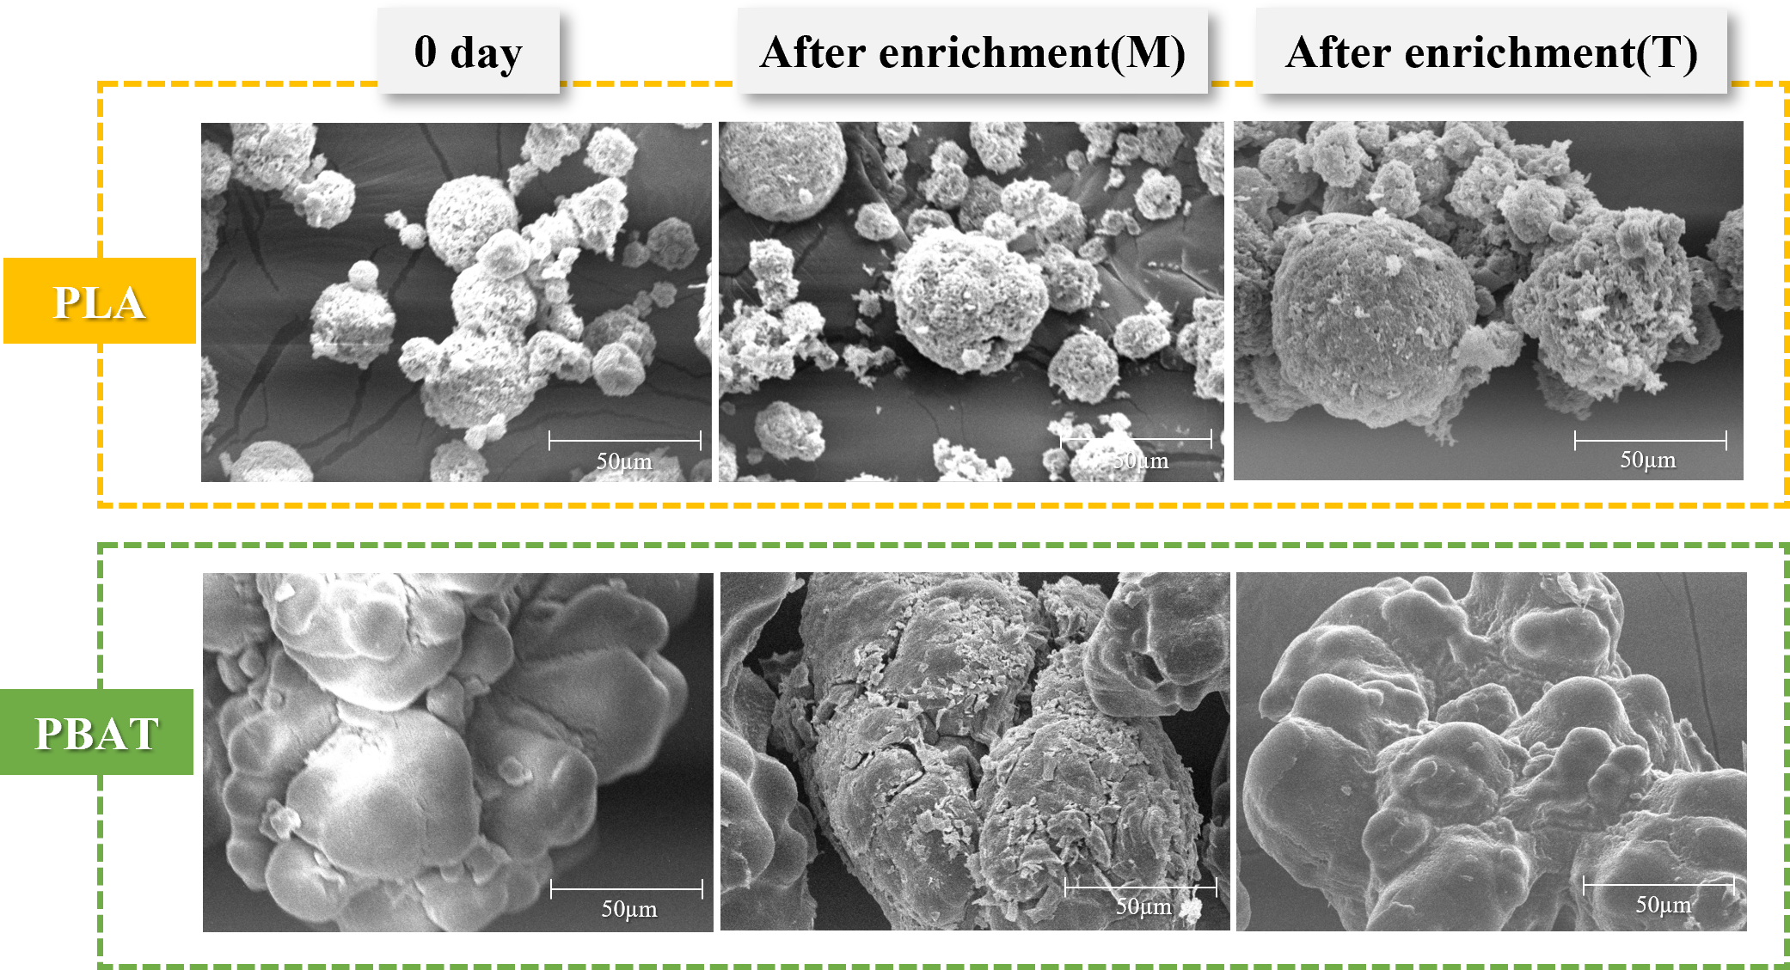


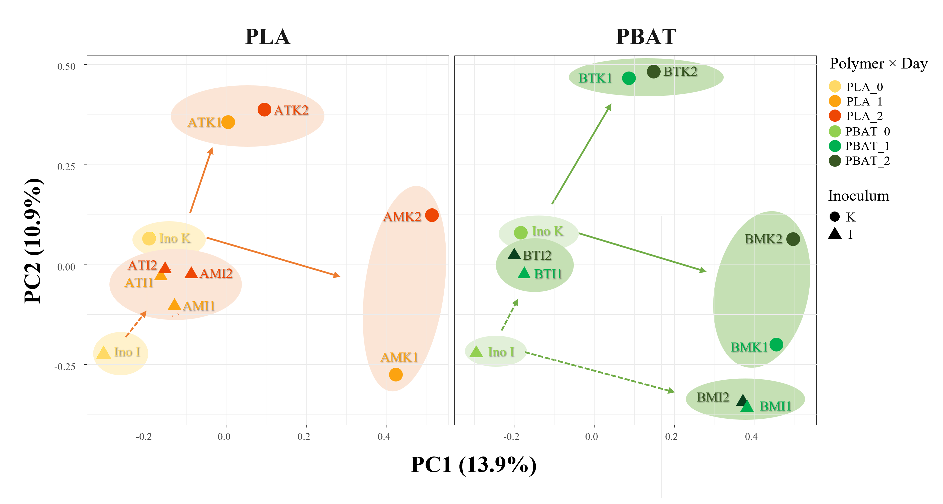
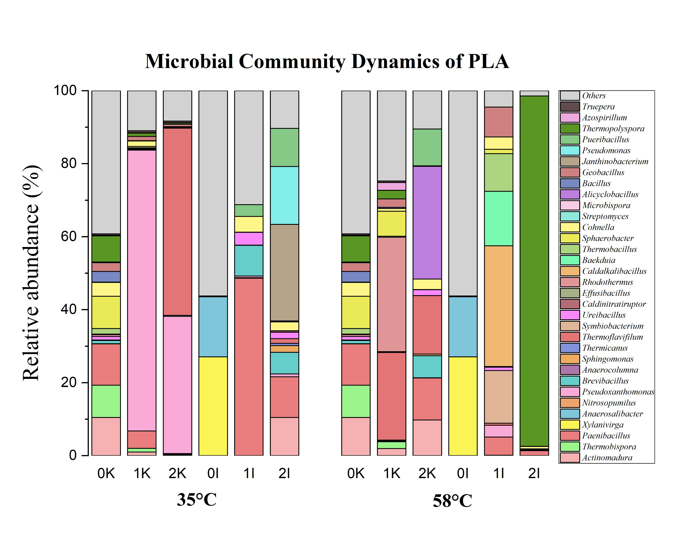
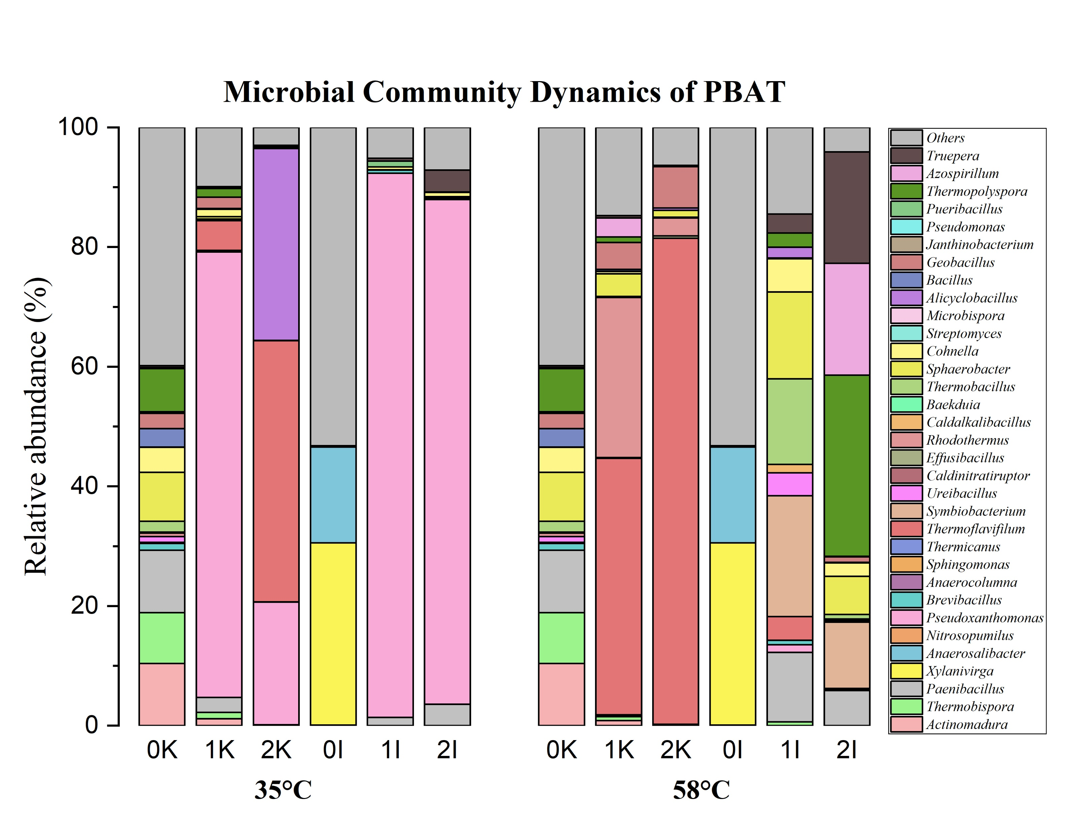



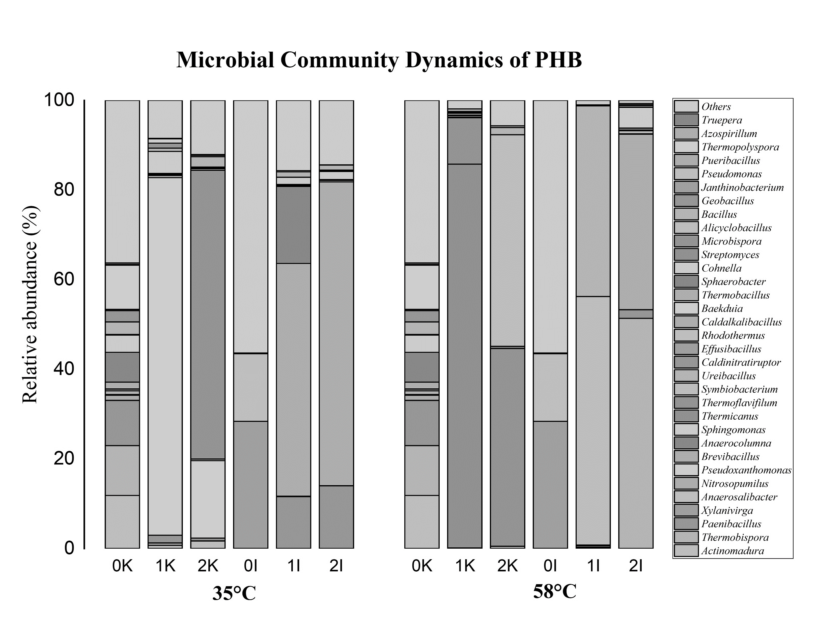

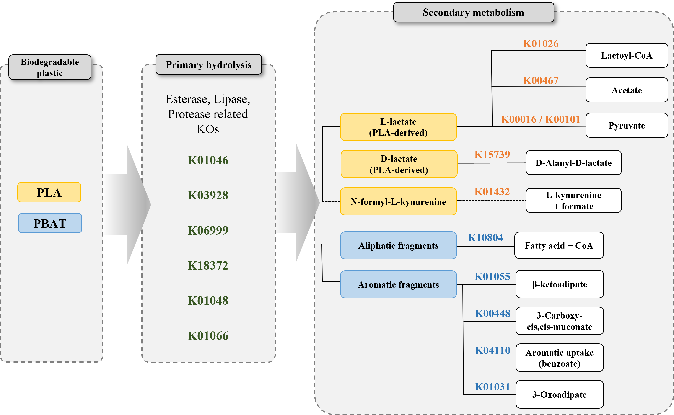
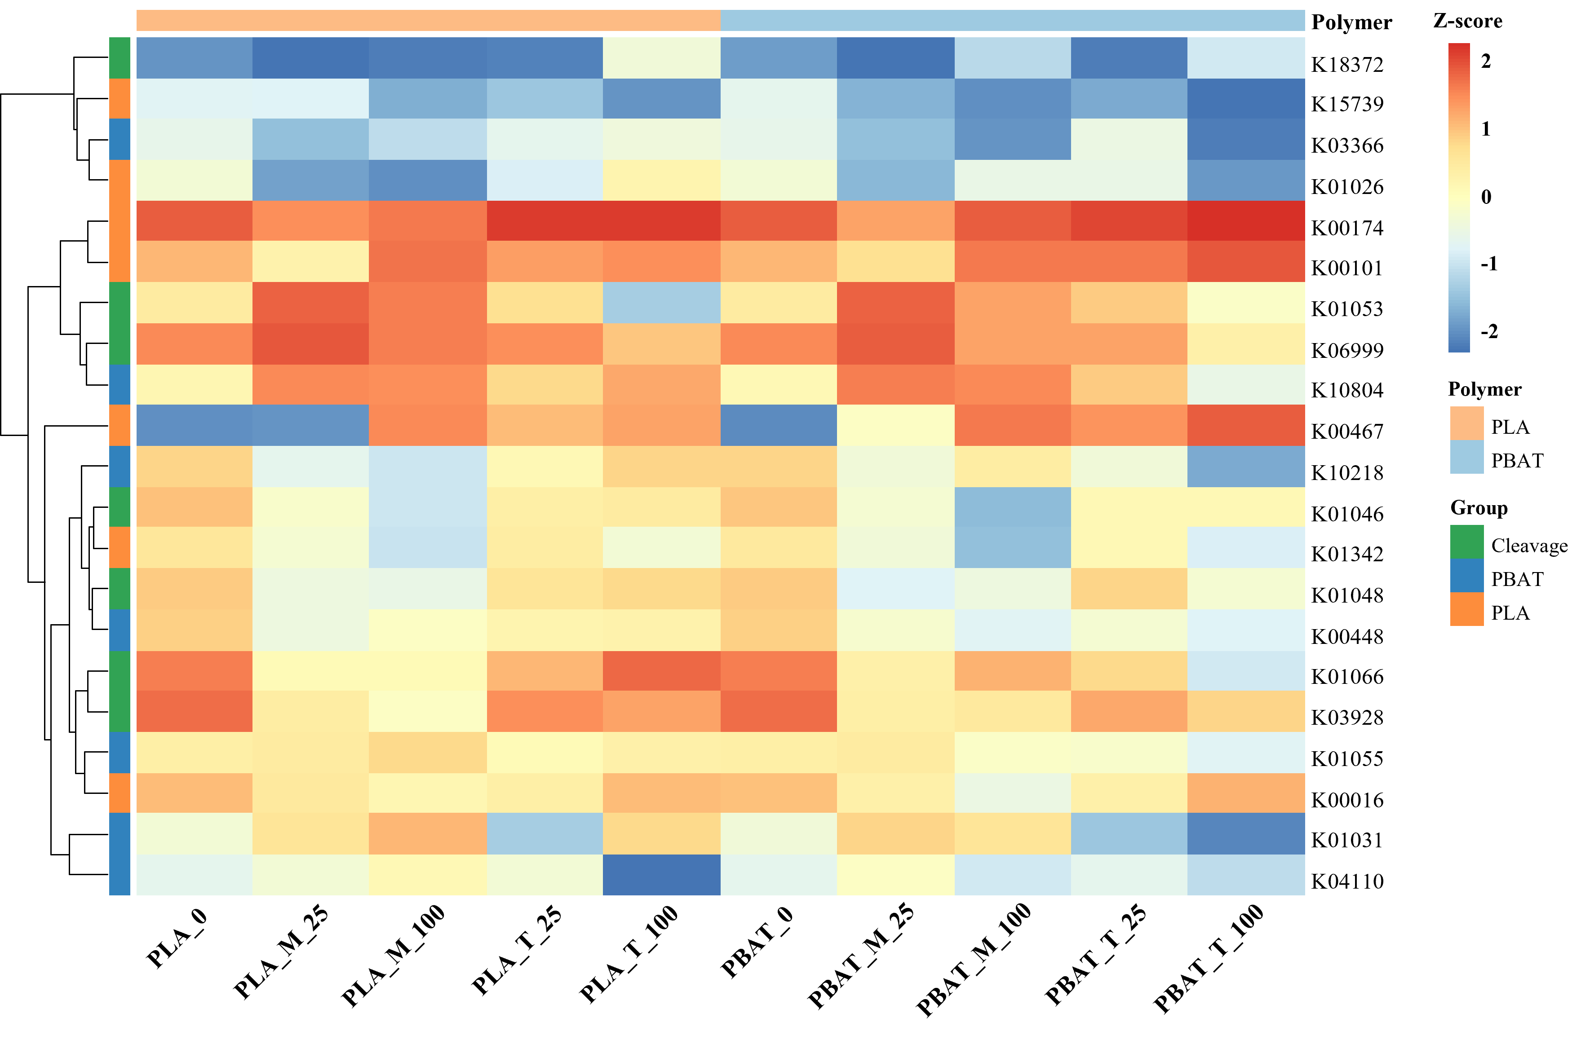
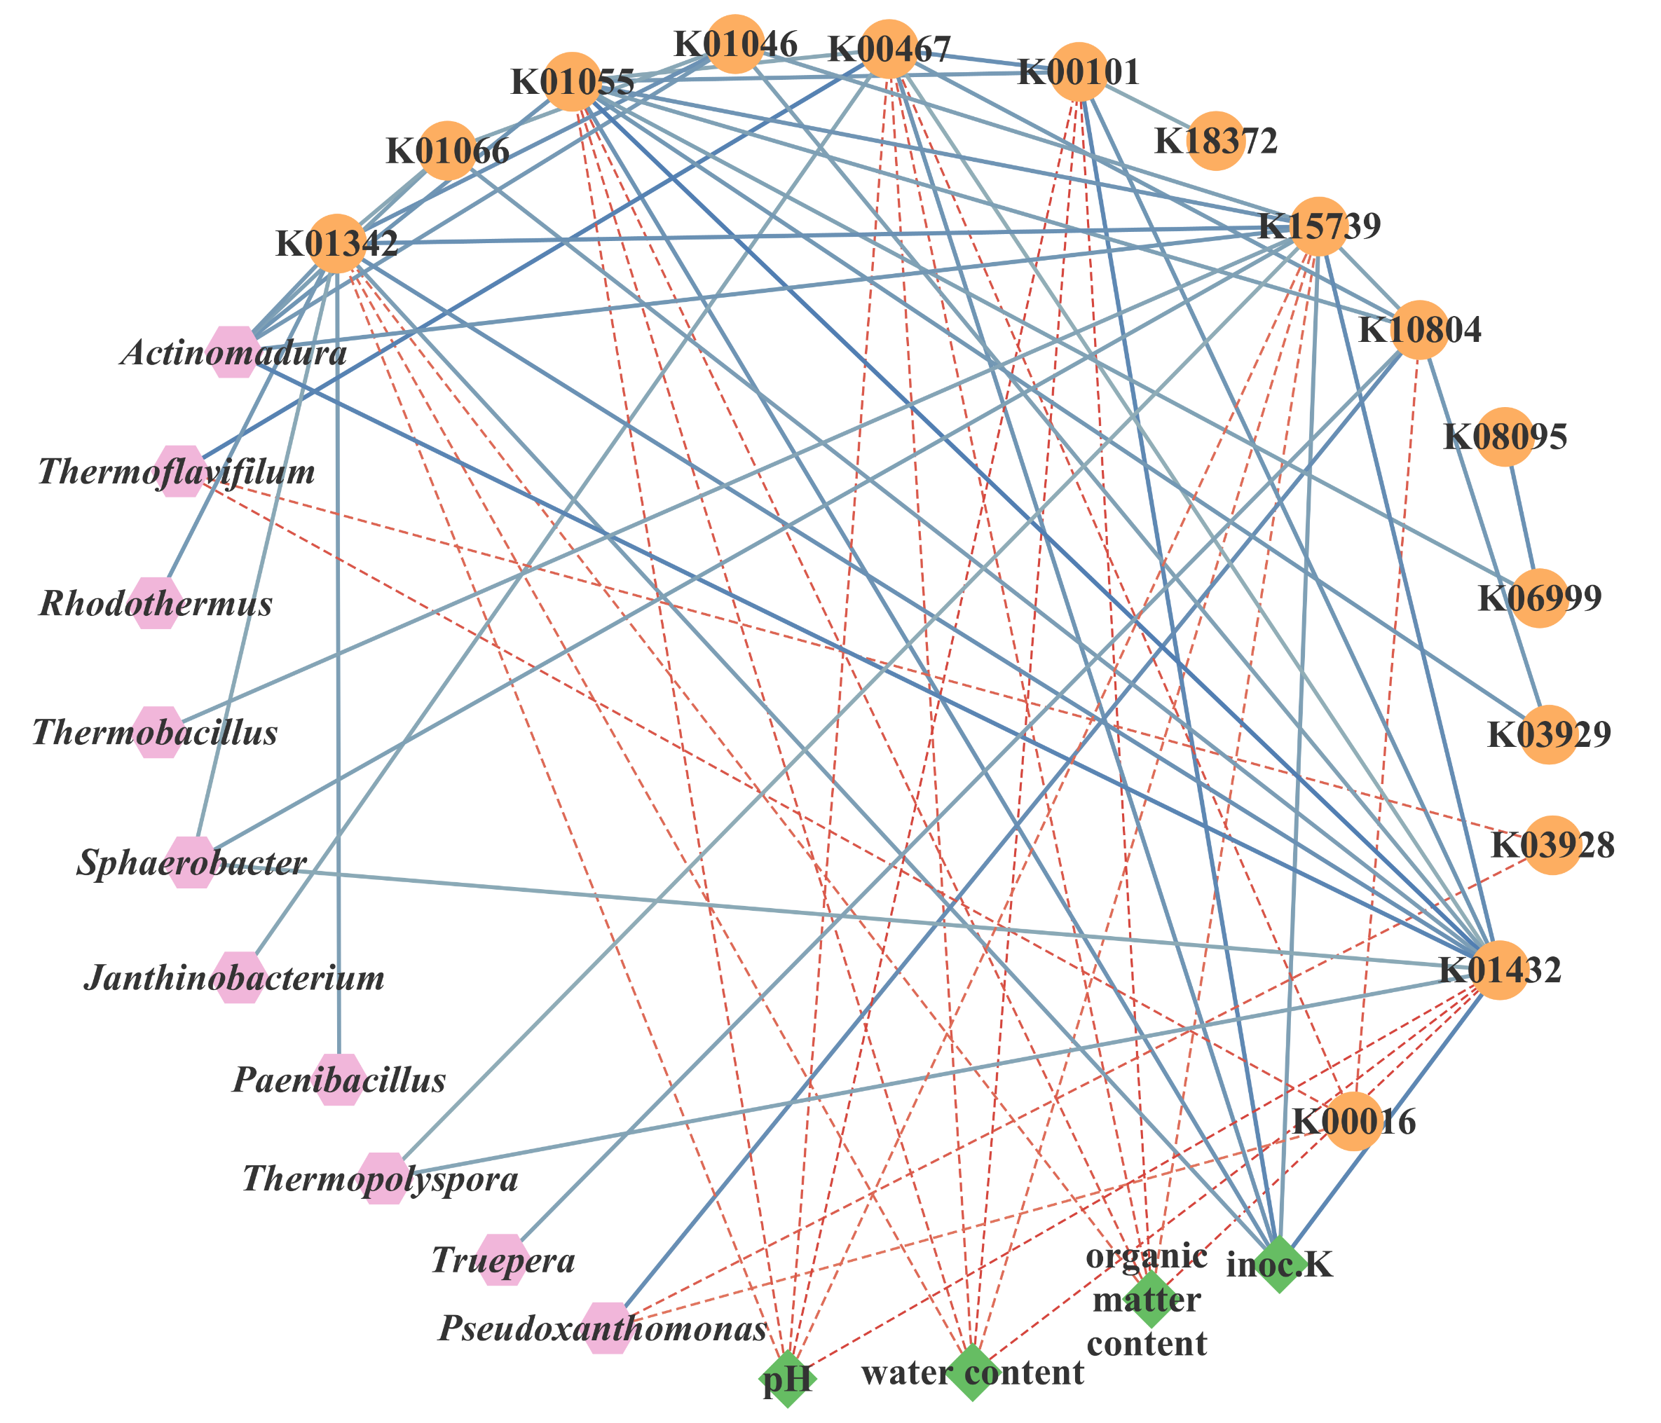
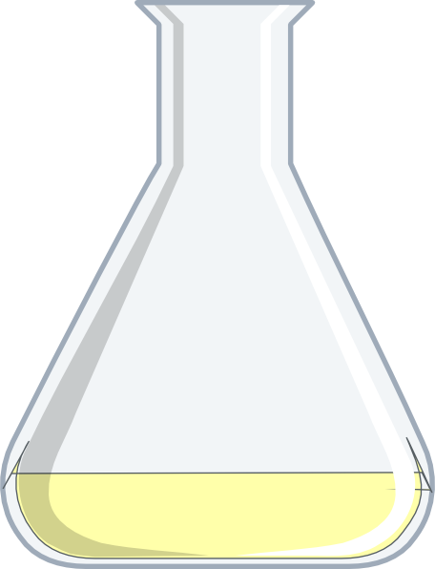
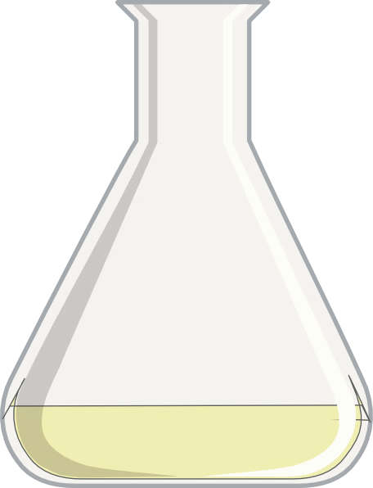
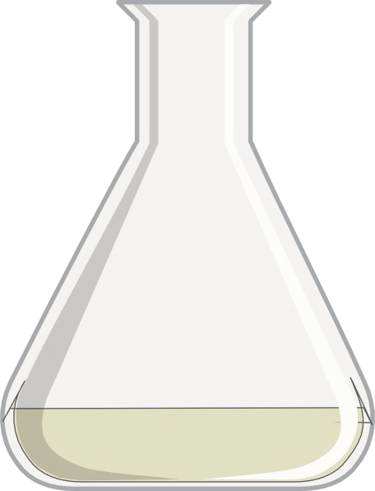
Network-Based Exploration of Candidate Biodegradable Plastic-Degrading Bacteria
Using Metagenomic and Functional Gene Data from Enrichment Cultures
Subin Hwang, Soo Yeon Lee, Ian Cho, Kyung-Suk Cho*
Abstract ID:
EGU26-21930
Department of Environmental Science & Engineering, Ewha Womans University
Presenting author email: emfpd03@naver.com, *Corresponding email: kscho@ewha.ac.kr
Background and Objective
Results
involved in biodegradable plastic degradation
Intro 01
Emergence of Biodegradable Plastics and limitations of conventional approaches
1
Degradation of PLA and PBAT
2
Microbial Dynamics Analysis
Conventional petroleum-based plastics – causing persistent environmental pollution
A need of degrader resources applicable across diverse plastic types and environmental conditions
Community Structure – PCoA
Community composition – Relative abundance
PLA
PBAT
Conventional approaches based on strain isolation followed by degradation activity tests are
:
Biodegradable plastics have been proposed as sustainable alternatives to mitigate the these issues
labor-intensive
time-consuming
⇨ Limits efficient screening and isolation of target degraders
Intro 02
Objective of this study
Clear separation along temperature (35℃ vs. 58℃)
⇨ Temperature = primary driver of community structure
Pronounced structural changes under thermophilic conditions
Distinct clustering by inoculum (K vs. I)
⇨ inoculum-dependent community trajectories
To address these limitations, we propose a network-based analytical framework that integrates:
Selective enrichment of specific taxa during cultivation
Metagenomic information based on microbial community dynamics
Predicted functional gene information
Surface morphology : smooth → rough, cracked, and fragmented
Observed in both PLA and PBAT
Indicates active microbial degradation
⇨ Physical evidence supporting biodegradation
PLA : gradual shift in dominant genera across enrichment stages
PBAT: strong dominance of specific genera under thermophilic conditions
“
Identify candidate bacteria contributing to biodegradable plastic degradation
”
Dominant genera in Mesophilic condition
  Pseudoxanthomonas, Thermoflavifilum, Paenibacillus (in inoc.I)
Dominant genera in Thermophilic condition
- Thermoflavifilum, Thermopolyspora,
Rhodothermus, Symbiobacterium
Materials and methods
3
Predicted functional gene
4
Network Analysis
01
Enrichment Culture Conditions
Proposed pathway
Relative abundance of functional gene
Network Analysis
Mesophilic condition
MSM-TE medium
Sampling : 3 time points
Pseudoxanthomonas ↔ K10804
  PBAT degradation-associate gene
  Suggests involvement in degradation product assimilation
Thermoflavifilum ↔ K00467
  Lactate → acetate conversion pathway
  Indicates role in secondary metabolism of PLA-derived intermediates
Paenibacillus ↔ K01342
  Potential role in initial polymer breakdown
Inoculum
Biodegradable plastic
Incubation temperature
10%
10%
Compost K
(Biodegradability test-completed compost)
Compost I
(Commercial chicken manure compost)
PLA & PBAT
0.5 g (1% w/v)
Used as sole carbon sources
Mesophilic
(35℃)
Thermophilic
(58 ℃)
0 day
1st subculture
(25 days)
2nd subculture
(100 days)
Step 1: Primary hydrolysis ⇨ polymer breakdown
Step 2: Intermediate formation (lactate, fragments)
Step 3: Secondary metabolism
Primary hydrolysis genes: relatively stable
Secondary metabolism genes: significantly shifted
Enriched pathways: - lactate metabolism
          - aromatic compound degradation
Thermophilic condition
 Strong correlations between dominant genera and biodegradation-related genes
Thermopolyspora ↔ K01432 / K15739
  Aromatic compound degradation
  Secondary metabolism of degradation intermediates
02
Microbial Community Analysis
DNA was extracted from enrichment cultures
Bacterial communities were analyzed using 16s rRNA gene amplicon sequencing (V3-V4 region)
Community diversity: beta diversity for PCoA
Conclusions
Acknowledgments
03
Functional Gene Prediction
Functional profiles were predicted using PICRUSt2
Gene abundances were annotated at the KEGG Orthology (KO) level
Biodegradation-related functional genes were selected for analysis
Biodegradable plastics (PLA and PBAT) were effectively degraded by enriched microbial communities under both mesophilic and thermophilic conditions
Under mesophilic conditions, Pseudoxanthomonas and Thermoflavifilum were dominant and positively correlated with biodegradation-related genes (K10804, K00467), suggesting their role in intermediate metabolism. Paenibacillus showed positive correlations with primary hydrolysis genes (K01342), indicating its potential involvement in initial polymer breakdown
Under thermophilic conditions, Thermoflavifilum and Thermopolyspora were dominant and positively associated with secondary metabolism genes (K00467, K01432, K15739), suggesting thermophilic-specific degradation pathways. These results indicate that plastic degradation is driven by interactions between microbial taxa and multiple functional genes
⇨ This study identifies key candidate degraders and provides insights into microbial and functional networks involved in biodegradable plastic degradation
This research was supported by Particulate Matter Management Specialized Graduate Program through the Korea Environmental Industry & Technology Institute (KEITI) funded by the Ministry of Climate, Energy and Environment (MCEE) and the Ministry of Trade, Industry and Energy (RS-2025-07902968) of the Republic of Korea.
04
Network Analysis
Co-occurrence network analysis based on Pearson correlation (p<0.05)
The network was used to identify candidate degraders

