Slide 1










Concurrent multiple abiotic and biotic stress interactions in maize: impacts and mechanisms
(MultiStress Research Unit 6101)
SUPPLEMENT ad:
A new crop science and modelling approach to improve the mechanistic understanding and quantification of multiple stress interactions in maize
Supplementary material at PICO session BG 3.22
EGU2026, 07 May , VIENNA
Reimund P. Rötter (on behalf of the MultiStress RU Team)
(University of Göttingen)¹
Notes:
Folie 0: Purpose of this presentation is to introduce participants to the MultiStress Research Unit and its combined experim & modelling approach
→ aim: to sketch how to improve mechanistic understanding of multiple stress interactions, utilize and integrate new insights to develop a new process-based (MultiStress) crop model for maize, and to make this fit and utilze it for supporting ideotype design of multistress tolerant maize cultivars – for temperate and tropical zones.
Focus here: on crop model improvement – and integration of knowledge – especially to integrate genetics into CSM to understand genotype response to concomitant (abiotic+biotic ) stresses
The MultiStress RU aims to achieve its goal by
Systematically investigating the interactions of concomitant abiotic (drought, N deficit) with biotic (fungal disease and cornborere) under field conditions – for a range of temperate and tropical maize hybrids – at two contrasting sites – Göttingen /Central Europe and Siaya /West Kenya – 3 field seasons – with similar experim. setup - under ROUTS
Integration of the new knowledge gained trough applying transcriptomics, metabolomics and ecophysiological measurennts - from genome to field scale – target to the needs of crop model improvement /renewal of crop modelling approaches
While the study crop is maize, this approach may also be interesting and applicable for WHEAT – which ist still globally the most important crop for human nutrition – whereby compared to maize, the focus could be more on wheat quality (as affected by multiple stressors)
---- background info
While in October 25 we had successfully defended our full proposal for implementing a Research Unit on multistress in maize (with a research site in KE and in Germany , before Xmas we received the official funding approval from DFG with official confirmation of nearly 5. 4 Mio research funds for the next 4 years – till 3/2030.

Slide 2
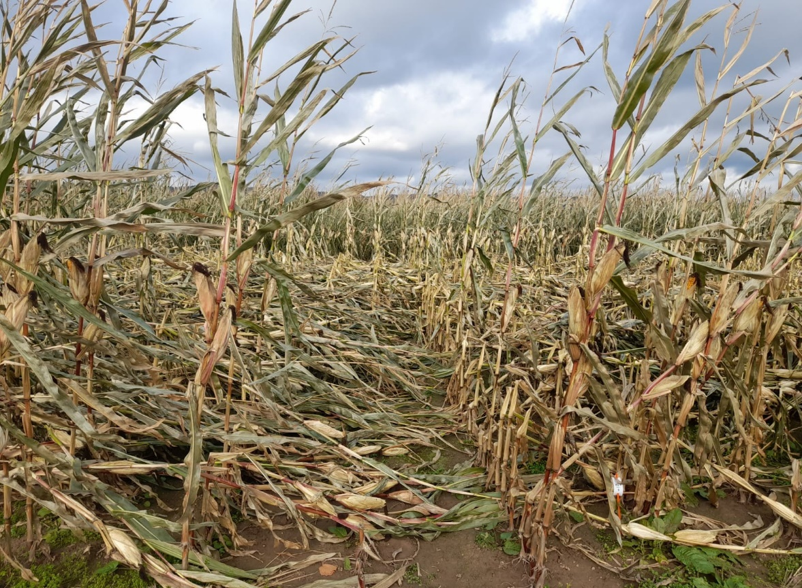
Why is this important ?
Climate crisis everywhere
Need to address fundamental research questions
Notes:
Folie 2:
WHY IS THIS IMPORTANT ?
Climate crisis has arrived EVERYWHERE – with more frequent and severe extreme weather events (such as DROUGHT, HEAT, FLOODING..) ;
but global warming also has led to more frequent DISEASE OUTBREAKS and INSECT ATTACKS ---
so that farmers face multiple stress situations in the field - with several abiotic and biotic stresses occurring simultaneously /or subsequently
– this is a situation faced for long by African smallholder farmers - yet has now also become COMMON for farmers in temperate zones.
=> THIS inevitably leads to massive crop yield losses, threatening global food security !!
==> One science-based solution is to breed multistress resilient crop cultivars - HOWEVER, before we can do so , WE need to address several fundamental and exciting research questions!!
WHY Maize ? – is globally the most important crop for animal feed and human nutrition (No. 1 in terms of production 1.1 billion metric tons – and soon also in cultivation area by 2030 – overtaking wheat) -- is cultivated in both temperate and tropical regions – moreover, maize is a well researched crop / a good model crop for studying multiple stress interactions and the genetics of stress adaptation,
…..because many candidate genes stress tolerance /resistance have already been identified; also a good model for ecophysiological measurements

Slide 3


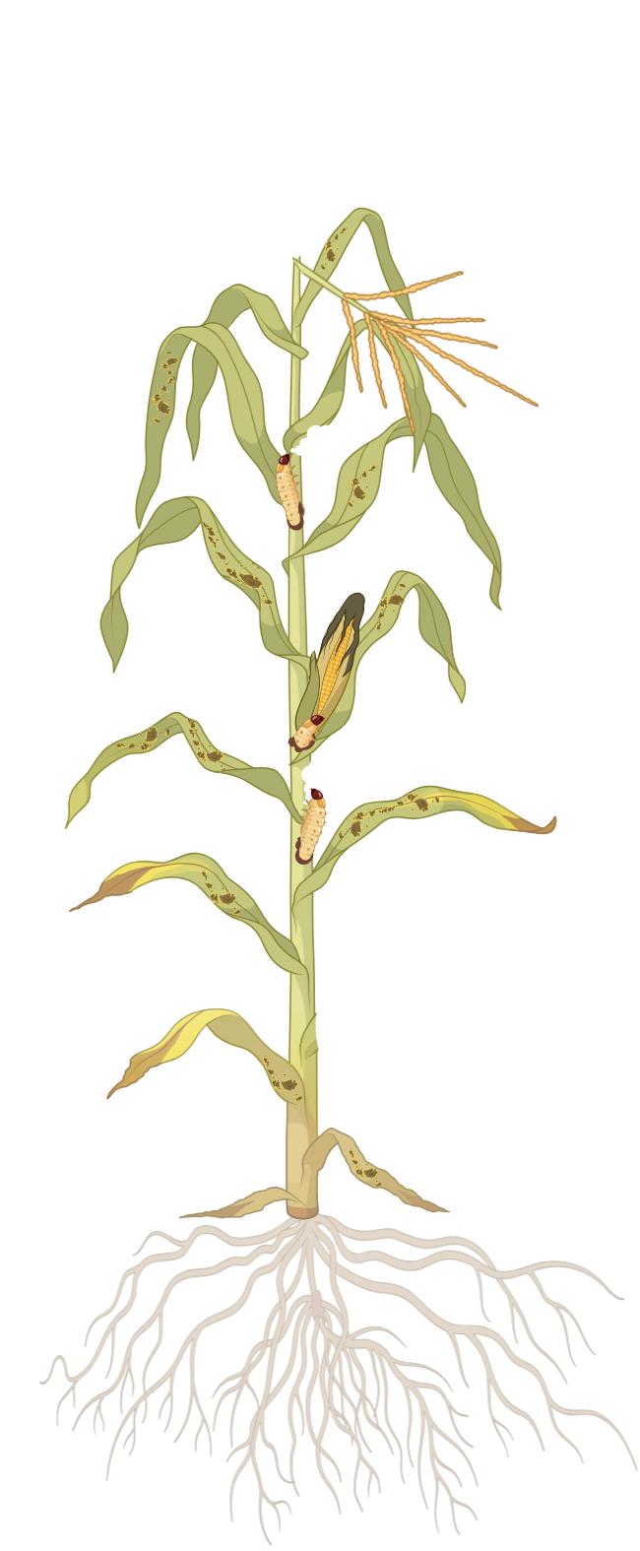


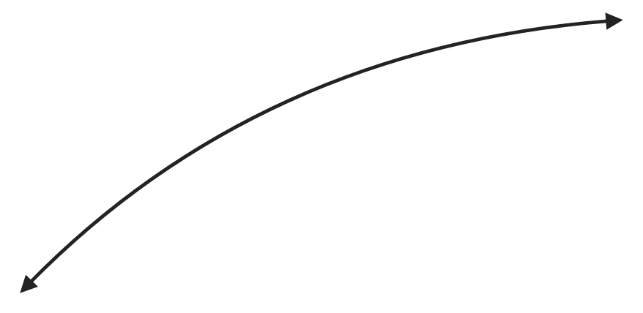

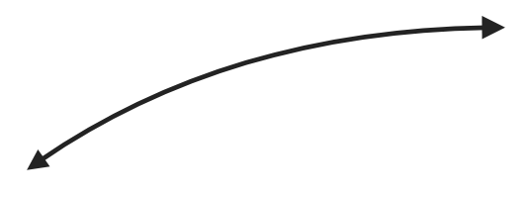
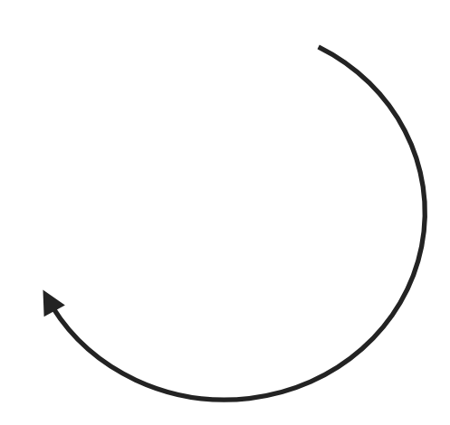

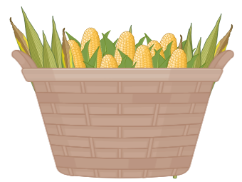


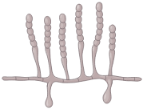





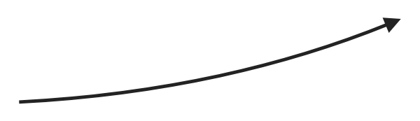
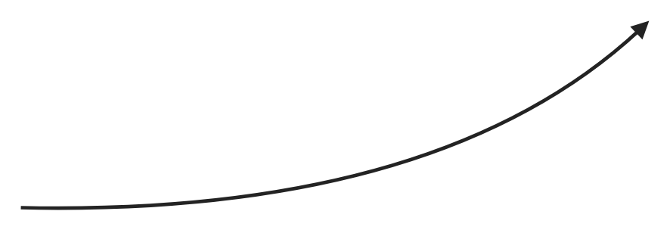


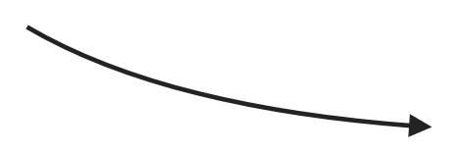
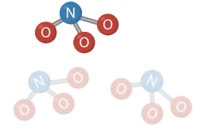
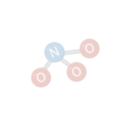
Research questions
Multi-stressed maize
How do concomitant multiple stresses interact under field conditions?
Do impacts play out differently in temp. and tropical zones?
Do studied stressors interact in a non-additive way ?
What are the underlying mechanisms & what to integrate?
Can we formalize new experimental know- ledge in crop models?
Setosphaeria infection severity
Impact on
yield and quality
Stem borer infestation and damage
Genotypic
defence and tolerance mechanisms and growth response
Stem borer
larvae
Whole crop harvest
Setosphaeria
Water deficit
Nitrogen deficit
Representation in MultiStress Model
Notes:
Folie 3:
A number of research questions to be posed to fill severe knowledge gaps
1) The BASIC research question is: HOW do combined multiple stresses INTERACT under field conditions? -- while much research has been done on dual or multiple stress interactions in the lab (e.g. by some of the reveiwers here), KNOWLEDGE on concomitant multiple (ABIOTIC + BIOTIC) interactions UNDER FIELD CONDITIONS does NO EXIST !
We aim to CHANGE THAT !!
2) related question – regarding maize: DO multistress interactions and their impacts play out differently in TEMP and TROPICAL zones ?
3) DO the stressors (that cause with massive yield losses: N deficit , Water deficit ( I + II) , stemborer (IV) or the foliar disease Setosph turc. (V) – interact in a NON-ADDITIVE way ? ---- Are IMPACTS on yield and quality (III + VII) synergistic or antagonistic ?
4) and very IMPORTANT: WHAT are the underlying mechanisms --- i.e. what information from the genetic, biochemical up to ecophysiologcial do we need to integrate to gain a mechanistic understanding at field scale ?
5) Finally, CAN we formalize /incorporate new knowledge gained from the RU’s experiments into a process-based crop model – fit for model-aided ideotype design ?
=> This PICTURE and what I have said illustrates that the TOPIC is indeed VERY COMPLEX,…i requires an INTERDISCIPLINARY SYSTEMS approach --- HENCE,
CANNOT be tackled in a SINGLE project ---but requires the framework of a RESEARCH UNIT!

Slide 4
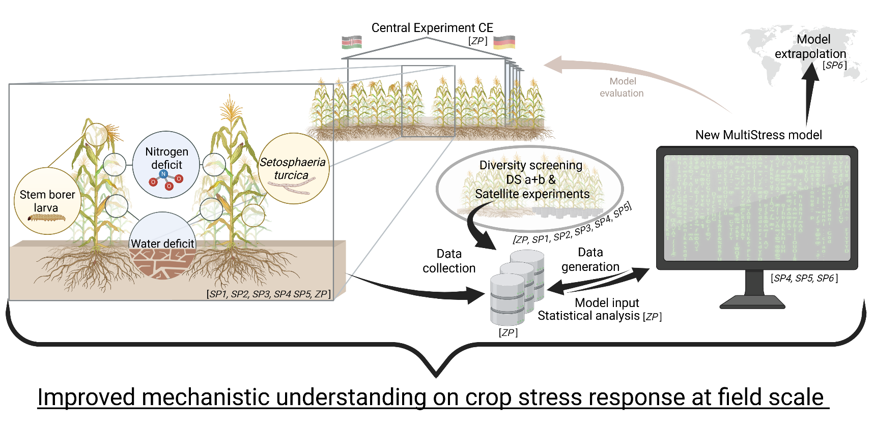
Three main components of the RU
Component 1
Component 2
Component 3
Notes:
Folie 5:
So, HOW do we aim to answer these research questions /test the hypotheses?
CENTRAL EXPERIMENTS consist of 3 years of field experiments on the interactions of multiple abiotic (drought, nitrogen deficit) and biotic stressors (stem borer and Setosphaeria turcica) and their impacts on maize - for different (6 ) genotypes- under field conditions (rain-out shelters) BOTH under temperate (DE) and tropical (KE) conditions;
broad genetic DIVERSITY SCREENING experiments (DS a+b) with production and selection of (2 sets x 100) experimental hybrids (DSa during 1.5 yars) - and their evaluation in the field (2 years), ADJACENT to The CE (in DE and KE)
The third component comprises modelling and quantitative analyses: incl. statistical analysis of RU’s experimental data, and develop/evaluation/application of a mechanistic or process-based crop simulation model of stress interactions and their impacts
=> By linking these three components we WILL obtain a new mechanistic understanding of multiple stress interactions at the field scale – and apply it to extrapolate it to similar environments and for guiding further experimentation

Slide 5
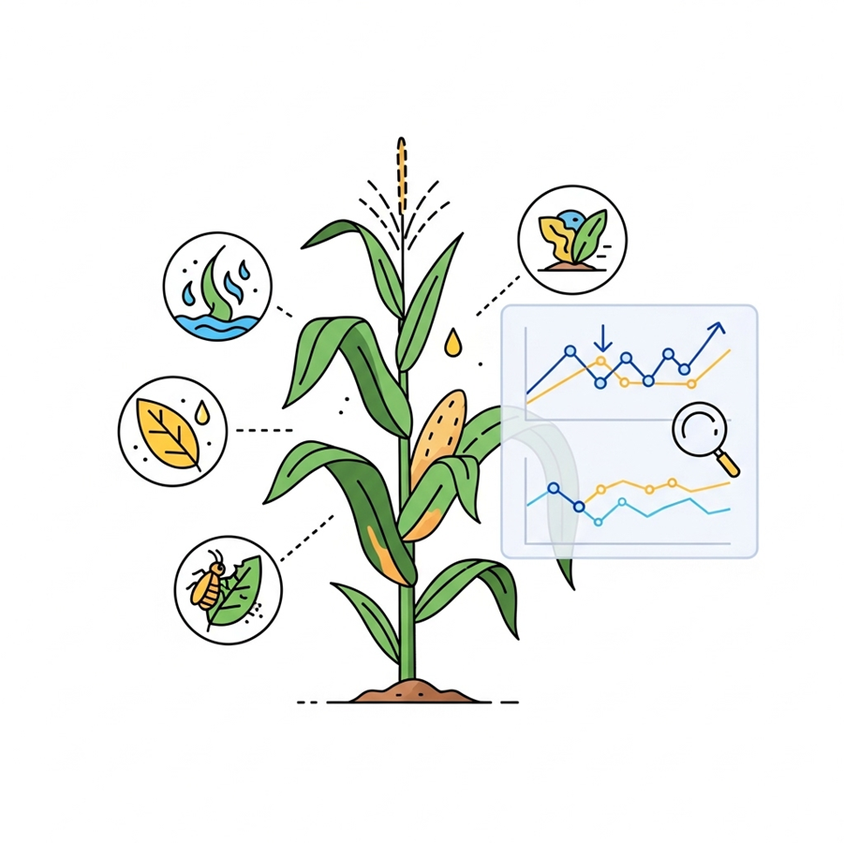
Overall objectives and basic hypotheses
Objective 1: To systematically analyse combined multiple abiotic and biotic stress interactions in maize in temperate and tropical zones under field conditions.
Two hypotheses:
a. Impact of combined stress interactions on crop growth, etc. is non-additive.
b. Severity of combined impacts varies with Genotype (G), Environment (E), and (G x E) - is higher in tropical than in temperate zones
Objective 2:
To improve crop simulation routines, develop new algorithms for combined abiotic+biotic stress, and integrate these into a novel crop modelling platform
Hypothesis:
c. By integrating deepened mechanistic understanding from G x E multiple stress trials we can improve the predictive skill of crop simulation models
Notes:
Folie 4:
The RU has 2 overall objectives and 3 basic hypotheses
OBJECTIVE 1
To systematically analyse interactions in maize between combined multiple abiotic and biotic stresses and their impacts - under temperate and tropical environmental conditions.
Connected to this are two basic hypotheses:
H1 the IMPACT of combined stress interactions on crop growth & other variables, is usually non-additive ---
H2 The SEVERITY of combined impacts varies with Genotype (G), Environment (E), and (G x E) --- we hypothesize that the severity is higher under tropical than temperate conditions (higher temperatures, lower soil fertility etc.)
OBJECTIVE 2
To utilize new experimental findings
to improve existing agro-ecophysiological models and databases, develop new algorithms, and combine these in a specific modelling platform --- THE FIRST OF ITS KIND -- enabling REALISTÌC explorations of effective adaptation options
H 3: By integrating deepened mechanistic understanding from the CE's multiple stress trials we will improve the predictive skill of crop simulation models
THIS proposed research is very important and long overdue …...........

Slide 6
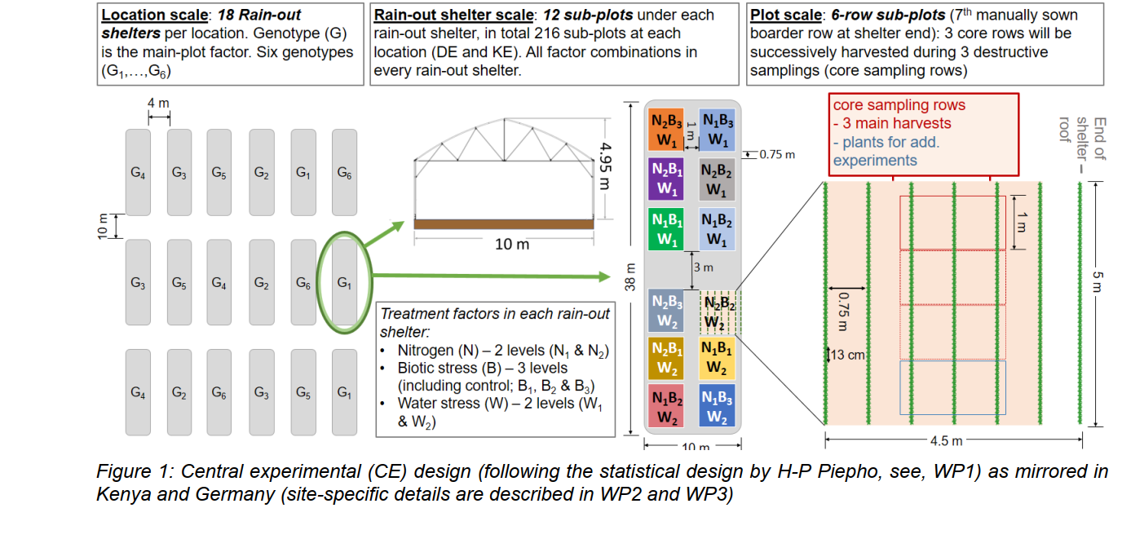
Experimentation (CE)

Slide 7
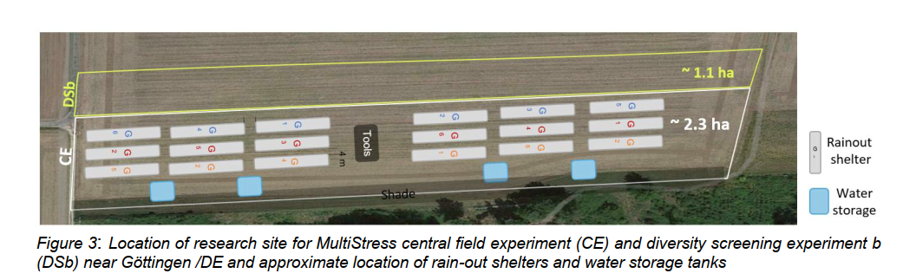
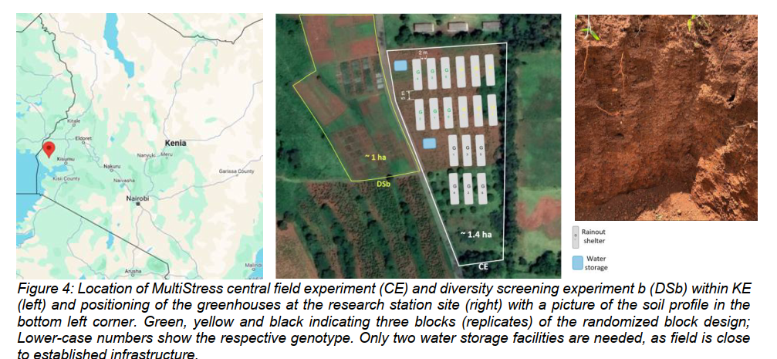
Experimentation (CE)

Slide 8
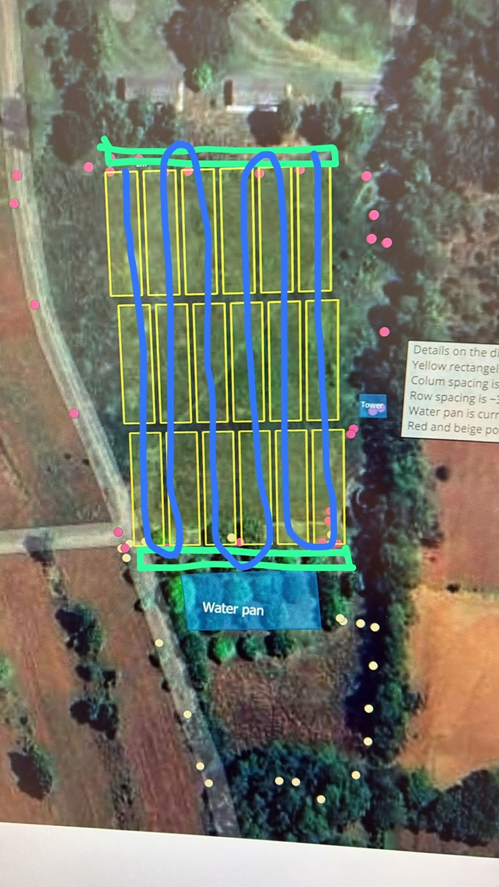
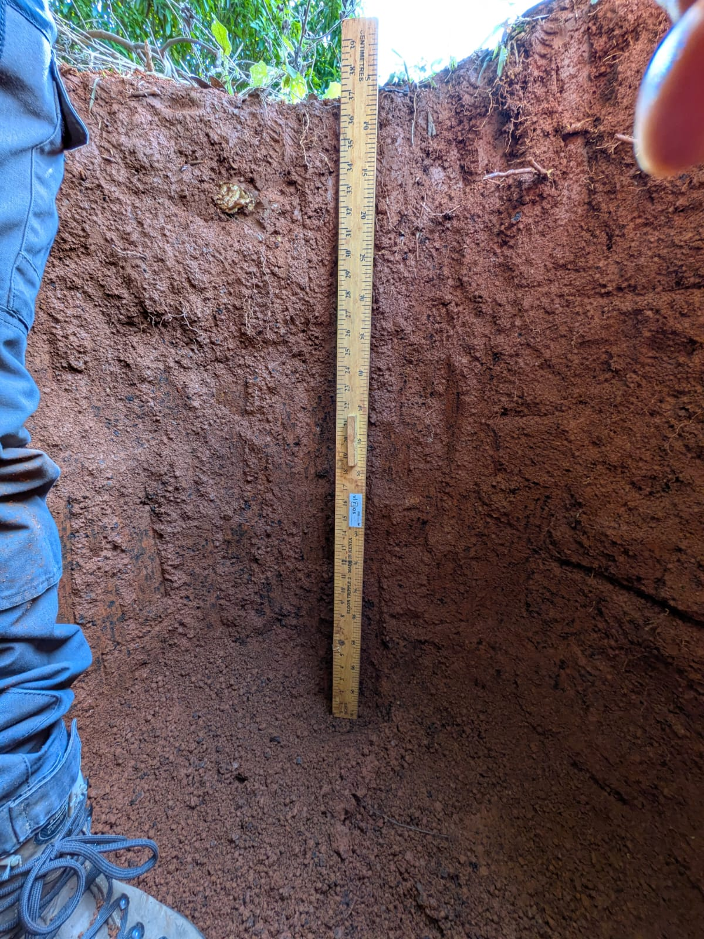
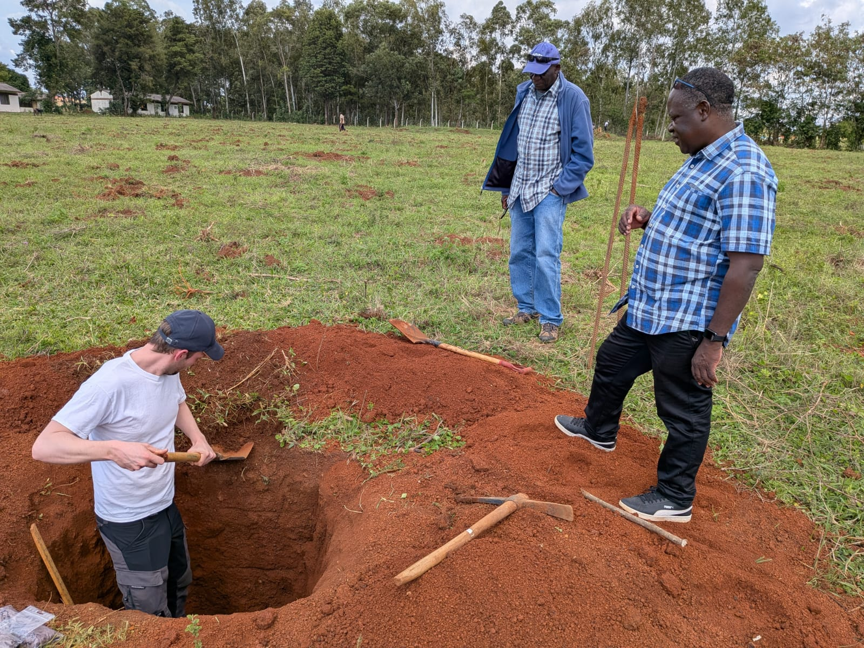
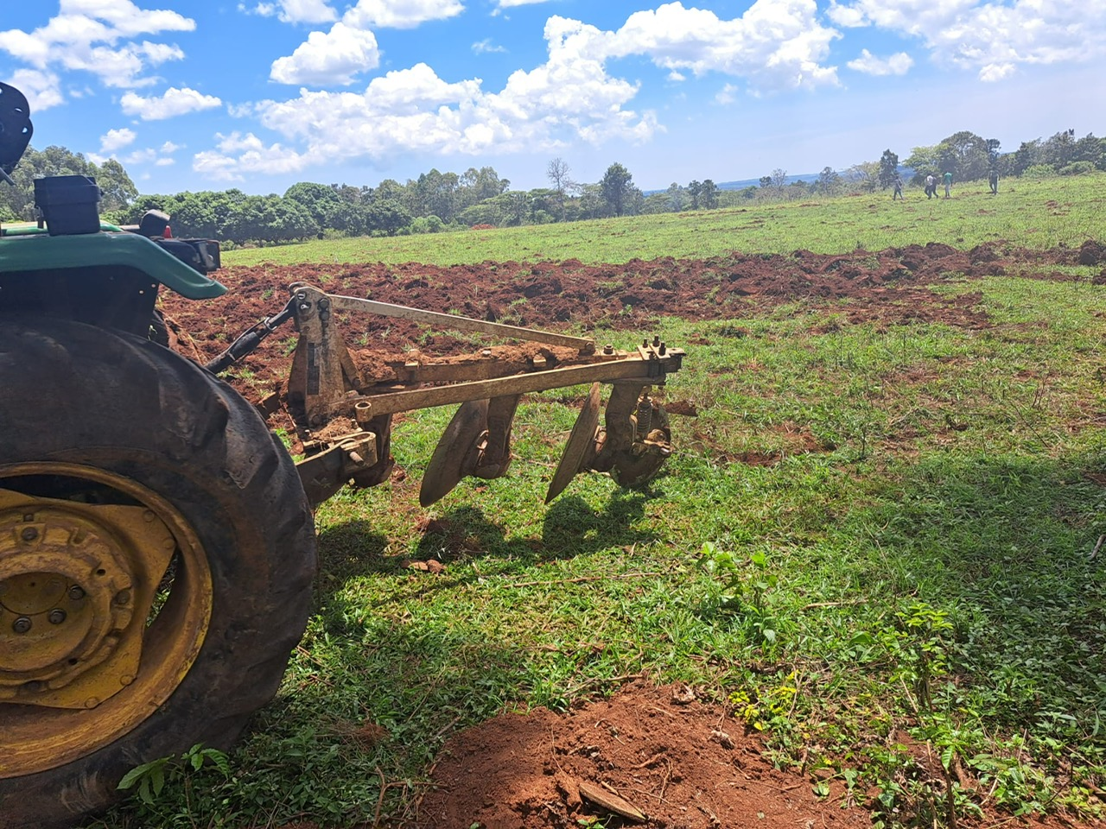
Research site : Siaya, JOOUST Campus, Kenya

Slide 9
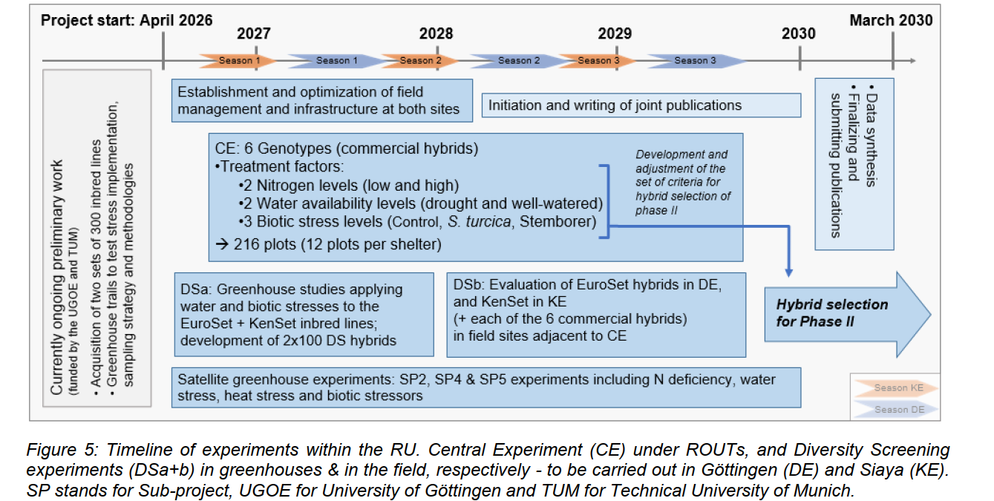
Various Experiments (with timeline)

Slide 10
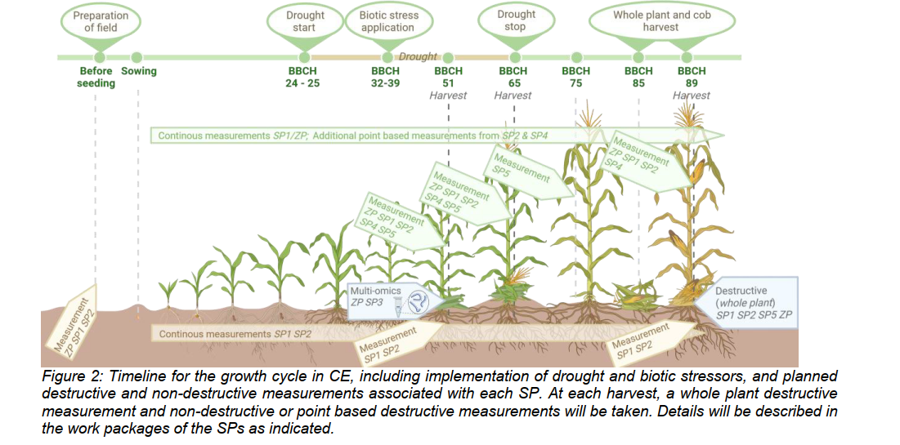

Slide 11






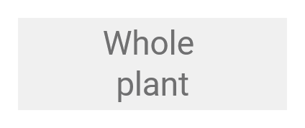












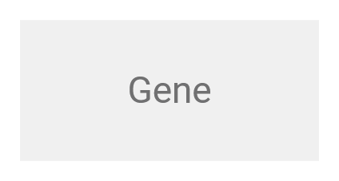



Mechanistic understanding
MultiStress model
SP1, SP2, SP4, SP6, ZP
SP1​, SP2, SP4, SP5, ZP
Mechanistic understanding
Level of organisation
SP1, SP2​, SP4, SP5, ZP
SP2, SP4, ZP​
SP3
Phase 1
Knowledge gains through experimentation
→ From genetic to field level
Notes:
Folie 6:
Each SP incl. ZP will contribute new insights /KNOWLEDGE from different organizational levels, WHICH - once integrated across scales – WILL RESULT in IMPROVED mechanistic understanding of crop responses to combined ((abiotic + biotic) multiple stresses (at the field scale),
The contributions of the various SP to this knowledge generation (and integration in form of the MULTISTRESS MODEL) will be shown in detail in the subsequent presentations.......

Slide 12
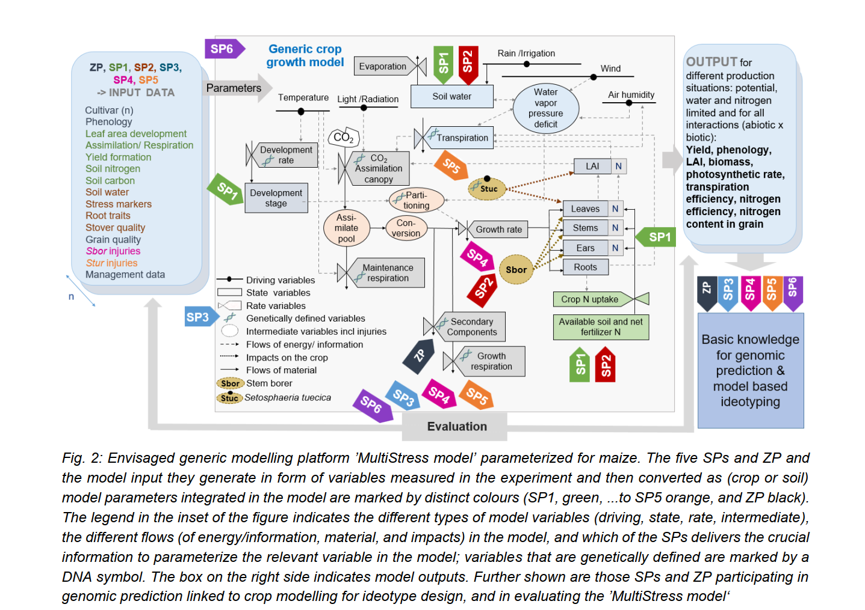
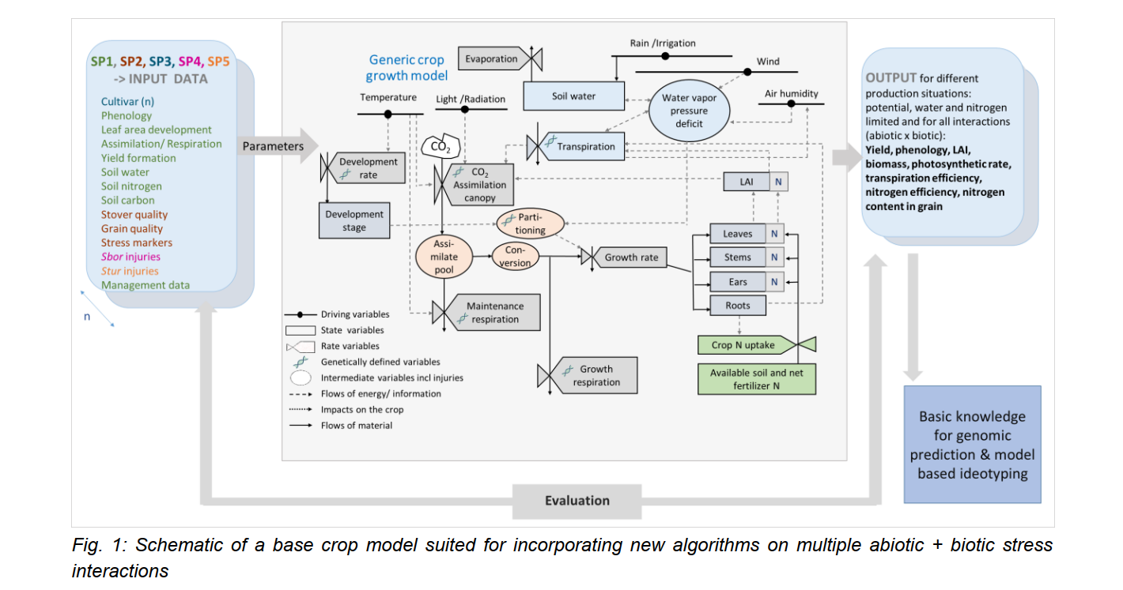
SP 6: Developing the MultiStress model
Starting with a base model – e.g. iCROP-SSM
Notes:
Underlying slide -----base crop moden (iCROP-SSM nby Soltani) ----overly shows New elements or routines that we add to re the routines indicated in orange and red

Slide 13
Three main components of the RU
The envisaged MultiStress Model
Component 1
Component 2
Component 3
Notes:
Folie 5:
So, HOW do we aim to answer these research questions /test the hypotheses?
CENTRAL EXPERIMENTS consist of 3 years of field experiments on the interactions of multiple abiotic (drought, nitrogen deficit) and biotic stressors (stem borer and Setosphaeria turcica) and their impacts on maize - for different (6 ) genotypes- under field conditions (rain-out shelters) BOTH under temperate (DE) and tropical (KE) conditions;
broad genetic DIVERSITY SCREENING experiments (DS a+b) with production and selection of (2 sets x 100) experimental hybrids (DSa during 1.5 yars) - and their evaluation in the field (2 years), ADJACENT to The CE (in DE and KE)
The third component comprises modelling and quantitative analyses: incl. statistical analysis of RU’s experimental data, and develop/evaluation/application of a mechanistic or process-based crop simulation model of stress interactions and their impacts
=> By linking these three components we WILL obtain a new mechanistic understanding of multiple stress interactions at the field scale – and apply it to extrapolate it to similar environments and for guiding further experimentation

Slide 14







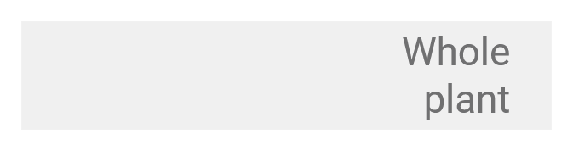













Vision
MultiStress model
Level of organisation
Mechanistic understanding
Model aided ideotyp design
Level of organisation
Phase 1
Knowledge gains through experimentation
Diversity of genotypes and stress responses
Phase 2
Notes:
Folie 11:
Here I present how we envision Phase 2 of the RU , built on the major novelties generated in Phase 1
In PHASE 1, we have gained systems understanding of multistress interactions at field-scale
by generating novel knowledge at different organizational levels from experimentation (CE and DS)
and its integration and formalization in the new process-based Multistress model – the first of its kind
PLUS we have established a NEW HUB for experimental analysis and modelling– operated by a next generation of scientists --
In PHASE 2
we aim to design maize-ideotypes for future environmental stress scenarios a prerequisite for breeding
Based on a much broader diversity of genotypes, we aim (i) to further improve the MultiStress crop model and, define localized environmental stress scenarios, (ii) to apply the model to design , for each environmental stress scenario, resilient maize ideotypes, (iii) and use the CE infrastructure for advancing the mechanistic understanding beyond knowledge gained in Phase 1 (–e.g. refining understanding on mucilage production, and of phenol production)
To this end, at each research site, we will have : 5 environ stress scenarios x 1 control x 3 Reps (= 18 ROUTS) --- in each ROUT will be 12 diverse genotypes tested against the scenarios to investigate specific stress responses ;
WITH THIS I CONCLUDE - Thank you for your attention, and I now hand over to my dear colleague Hans-Peter for presenting the ZP !!

Slide 15
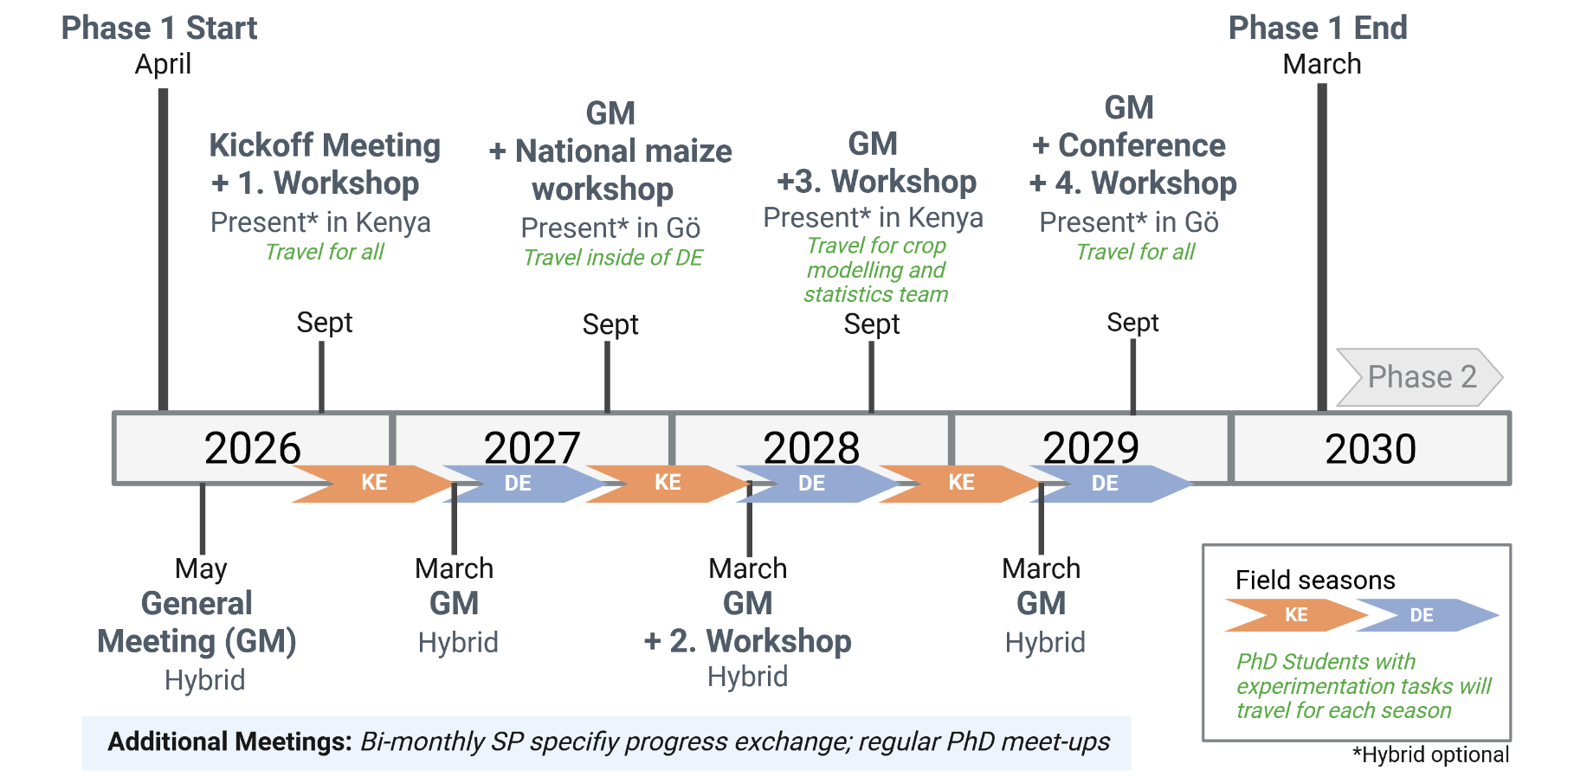
Timeline
Notes:
Folie 9
Timeline for the implementation shows that the envisaged start by 1 April 2026 and ending 31 March 2030, Phase 1 lasts 4 years
There will be four major RU workshops (including a national maize wsh) and a final conference, -- as well as – regular meetings of the general assembly (1st one -- 1 month after start in May 26 – and then in 6 monthly intervals (General Assembly) till the 8th and last is held in Sep 2029
PLUS bi-monthy SP – as well as regular PhD meetings
= > HIGHLIGHT the set-up of the alternating 2 x 3 field seasons (Oct-Feb in Kenya (ORANGE) and April – Sep in Germany (BLUE) sets the structure for the RU#s workshops and meetings
=> HIGHLIGHT This structure fosters internal coherence, between SPs and between DE and KE teams --- and thus creates the TEAM spirit needed to accomplish the project goals ,
FOUR workshops will have different topics – the first one in sep/oct 2026 with a focus on TEAM BUILDING ,
data management and statistical evaluation of field experiments ---- will be part of each annual meeting --- same applies To sessions on early career Gender equality and diversity

Slide 16
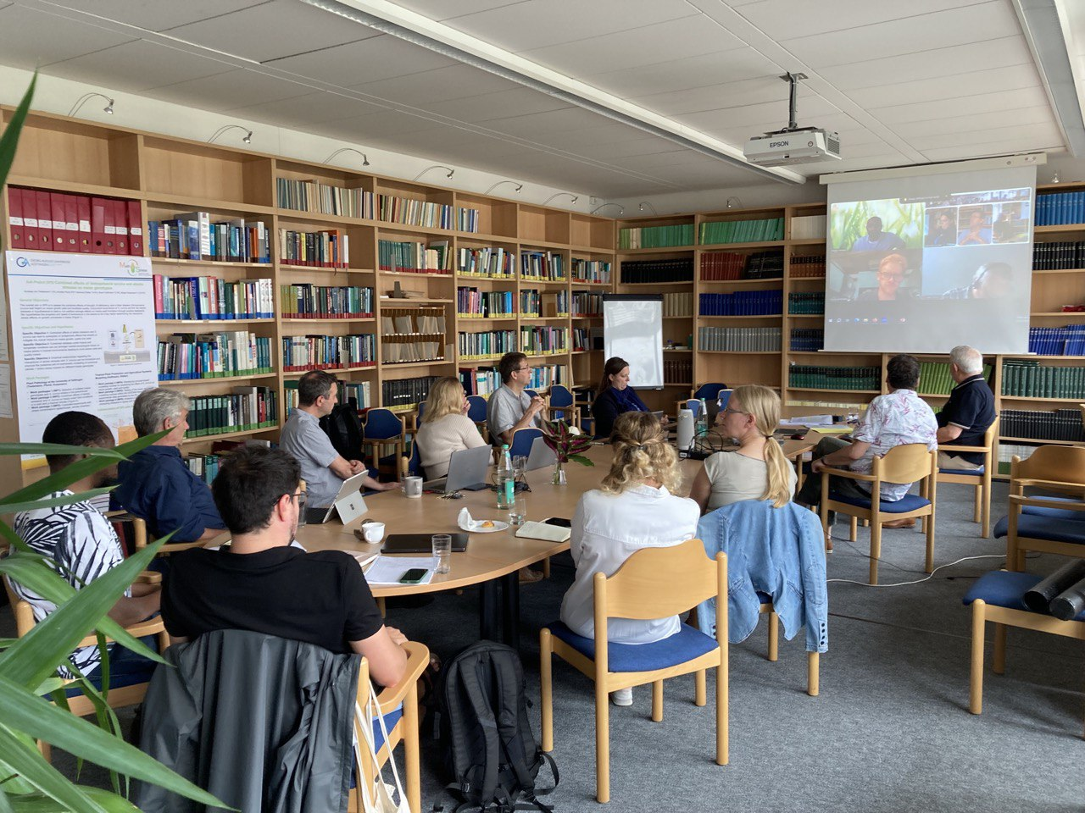
Objectives of the COP
To coordinate, tailor and harmonize RU activities
To monitor and report project progress
To organize RU specific training activities
To implement measures for gender equity, diversity and early careers
To provide efficient/targeted communication
Notes:
Folie 7:
BUT before doing this, I present to you the Coordination Project COP
The COP has 5 major objectives --- the usual objectives for a coordination unit of a large collaborative project
Ad 4) President Schöllmerich already mentioned the extension of the contract of three female early career researchers which were recruited as applicants in MultiStress RU (Annette, Irsa and Ilka ) - due to their high qualifications and competences From earlier experience at UGOE, Michaela Dippold is shining example of how a collaborative project can serve as career accelerator from postdoc to full Professor.
Ad 5) the last - providing efficient communication – is the bread and butter of the COP

Slide 17
Collaboration
Scientific Advisory Board
(C Messina, CC Schön, M Ouzunova,
D Vetterlein, T Turlings)
Scientific Steering Committee
Speaker & SP/ZP representatives & 2 PhD representatives &
Admin coordinator: N.N.
Project management & Admin support
UGOE: ZVW, CBL
COP: Coordination, dissemination, training
Speaker, admin coordination, secretary
CoPas
JOOUST
AGRA
UNIMI
CIMMYT
SP1
SP2
SP3
SP4
SP5
SP6
ZP
Overview of how the collaboration in MultiStress RU will be managed
Notes:
Folie 8
HERE is a brief Overview of how the collaboration in the RU will be managed:
To accomplish its tasks, the coordination unit ((that provides overarching coordination including dissemination and training activities), will be supported, regarding the day to day management – BY THE the central admin / and the Campus Centre of Biodiversity and sustainable land use (CBL) of the UGOE
Regarding important decisions (RU wide issues) the CU is supported by the Scientific Steering Committee – who will consult with / be supported by an independent high level SAC (3-5 senior experts), for guidance on strategic issues ---
I Want to HIGHLIGHT that
(1) the SAC members , namely CC Schön ( TUM), M Ouzunova (KWS), Doris Vetterlein (UFZ Halle) and Charlie Messina (Uni Florida ) are fully integrated in the national and international maize research communities ---
(2) Also the four CoPas (JOOUST, AGRA –CIMMYT and UNIMI) - are well networked in the communities in KE, Europe and in GLobal maize research
The coordination team /unit interacts with all SPs, the ZP (which is also led by the speaker) and the CoPas – same is true for the ZP

Slide 18
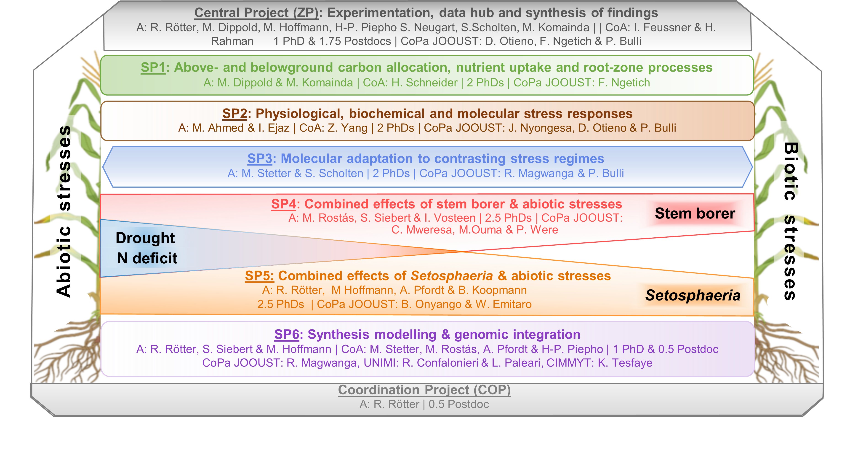
Set-up of the RU
Notes:
Here I conclude the overview by presenting te Set-up of the RU – ----NOTE: the design of the central experiment (CE ) will be presented in the subsequent presentation on the Central Project by Hans-Peter. Piepho
Here we see -- Embtraced by the ZP (on top) and the COP (at the bottom),
We will have 6 thematic subprojects (SP1-6) that generate new mechanistic knowledge across different organizational levels and integrate that new knowledge into a process-based MultiStress crop model (…the first of ist kind)
XXX
This picture shows – embedded between the Central Project (ZP) and the Coordination Project (COP) --- there are 6 thematic subprojects, SP1 to SP6, ranging from studying above- and belowground processes, crop stress reponses, molecular adaptation and the ombined effects of abiotoc stresses with stemborer (in SP4) and Setosphaeria turc (in SP5) till teh synthesis MultiStress modelling (– which also integrates genetic info ) in SP6
----These subprojects 1-6 + ZP closely interact /build on each other = > as will be shown in detail in the presentations that follow

Slide 19
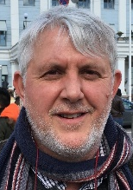
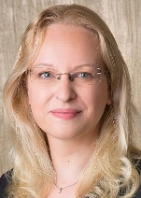
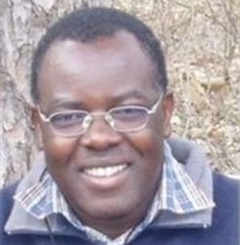
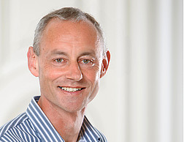
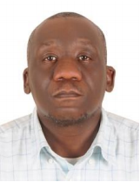
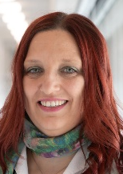
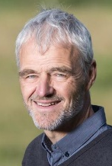
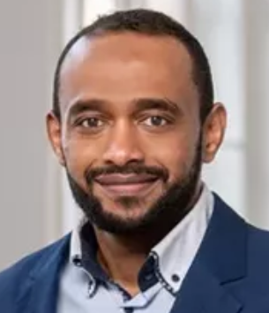
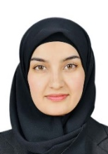
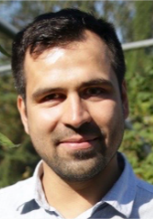
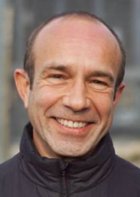
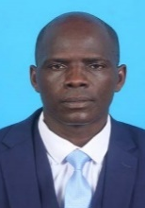
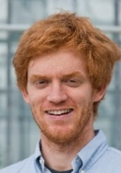
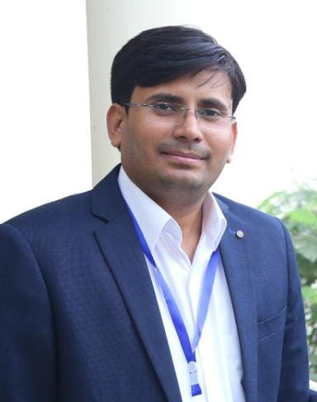
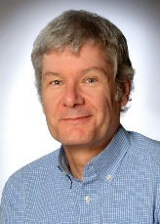
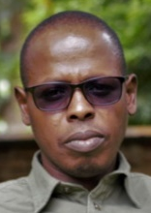
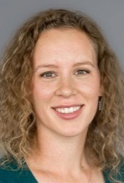
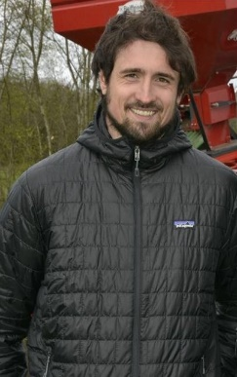

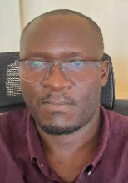















This is us:
The multidisciplinary international MultiStress team
Notes:
Folie 10:
The international and multidisciplinary MultiStress team (15+5+14) is the Foundation of the RU –and is BUILT on a strong European – African partnership – especially between German Universities and the JOOUST in Siaya /Kenya,
without which this RU would NOT BE POSSIBLE !!
-
The MultiStress team’s expertise - and not only the research infrastructure such as ROUTs and modern lab facilities --- is mirrored by JOOUST team in KENYA - (represented here by Prof Otieno)
-> There is a MOU between UGOE and JOOUST
-> And the Access Benefit Sharing – contract – will be signed during first 3 months of the RUs implementation

Slide 20
SP6: Integrating genetics into crop growth models to understand genotype response to combined (abiotic + biotic) stresses & synthesis
Munir Hoffmann (A)¹, Reimund Rötter (A)¹, Stefan Siebert (A)², Hans-Peter Piepho (CoA)³, Annette Pfordt (CoA)⁴, Michael Rostas (CoA)⁵, Markus Stetter (CoA)⁶, Richard Magwanga(CoPa)⁷, Roberto Confalonieri (CoPa)⁸, Livia Paleari (CoPa)⁸, Fasil Rettie (CoPa)⁹, Kindie Tesfaye (CoPa)¹⁰
MultiStress model
Mechanistic understanding
Level of organisation
Phase 1
Knowledge gains through experimentation
1Division of Tropical Plant Production and Agricultural Systems Modelling, University of Göttingen (UGOE); 2Agronomy, UGOE; 3Biostatistics, University of Hohenheim; 4Plant Pathology and Crop Protection, UGOE; 5 Agricultural Entomology, UGOE; 6Institute for Plant Sciences, University of Cologne, Germany; 7Jaramogi Oginga Odinga University of Science and Technology, Kenya; 8 UNIMI, Italy, 9 CIMMYT;10 AGRA Nairobi, Kenya
Notes:
General objective:
To develop the MultiStress mechanistic model that (I) integrates new algorithms for metabolic activity and biotic interactions, (II) link model parameterization with genetic information, (III) test the project’s key hypotheses, and (IV) ultimately predict genotype–environment–stress interactions under diverse conditions.
Hypothesis:
Only by linking genetic, physiological, and field-level processes
through mechanistic crop modelling
can we understand (better predict) crop responses to combined abiotic and biotic stresses — beyond what single-scale approaches allow.

Slide 21





Problem statement
A standard crop model - SSM-iCrop -
Climate
Precipitation
Radiation
Temperature
Wind
Humidity
Phenology
Carbon allocation
Leaves (updates LAI)
Stem
Roots
Storage organ
Maintenance Respiration
Light interception /LAI based
Photosynthesis
Growth rate / Respiration
Limited by potential demand for water and nitrogen/supply
Transpiration
Fertiliser
N-Uptake
Irrigation
Evaporation
Runoff
Soil
Infiltration
NH4 Volatilisation
Mineralisation
Leaching
Plant available water capacity
Organic Carbon/fractions
Initial water and mineral nitrogen
Available soil water
Available soil mineral nitrogen
Drainage
Soltani et al., 2020
Notes:
Here I added some animation, so that the components appear with the SPs

Slide 22
Three main components of the RU
The envisaged MultiStress Model
Component 1
Component 2
Component 3
Notes:
Folie 5:
So, HOW do we aim to answer these research questions /test the hypotheses?
CENTRAL EXPERIMENTS consist of 3 years of field experiments on the interactions of multiple abiotic (drought, nitrogen deficit) and biotic stressors (stem borer and Setosphaeria turcica) and their impacts on maize - for different (6 ) genotypes- under field conditions (rain-out shelters) BOTH under temperate (DE) and tropical (KE) conditions;
broad genetic DIVERSITY SCREENING experiments (DS a+b) with production and selection of (2 sets x 100) experimental hybrids (DSa during 1.5 yars) - and their evaluation in the field (2 years), ADJACENT to The CE (in DE and KE)
The third component comprises modelling and quantitative analyses: incl. statistical analysis of RU’s experimental data, and develop/evaluation/application of a mechanistic or process-based crop simulation model of stress interactions and their impacts
=> By linking these three components we WILL obtain a new mechanistic understanding of multiple stress interactions at the field scale – and apply it to extrapolate it to similar environments and for guiding further experimentation

Slide 23
Work packages
WP2: Link to genetics
Validation of crop parameter prediction using independent genotypes
Identification of gene clusters & physiological traits
Trait-to-parameter mapping
SP3
Phenology
Limited by potential demand for water and nitrogen/supply
Light interception /LAI based
Growth rate / Respiration
Photosynthesis
Maintenance Respiration
Carbon allocation
Leaves (updates LAI)
Stem
Roots
Storage organ
Metabolites
N-Uptake
Transpiration
Notes:
Here I added some animation, so that the components appear with the SPs

Slide 24
Work packages
WP3: Test the main RU hypotheses in a simulation setting
Non-additive effects of combined stresses on maize growth and yield
2. Higher severity of combined stress effects in tropical than in temperate regions
ZP
ZP

Slide 25





Work packages
WP4: Assess ex-ante impact of ‘environmental stress scenarios’
ZP
Diverse set of in silico
genotypes (G)
Environmental stress scenarios (E): climate
(2041-2060) - soil - biotic stress interactions
G x E

Slide 26


Composition of SP6
Applicants (Germany)
Co-Applicants
(Germany)
A: Dr. Hoffmann
TROPAGS
A: Prof. Rötter
TROPAGS
A: Prof. Siebert
Agronomy
CoA: Prof. Rostás
Entomology
CoA: Prof. Piepho
Biostatistics UH
CoA: Prof. Stetter
Genomics
CoA: Dr. Pfordt
Plant Pathology
PhD students
Collaboration
Partners
PhD 6.1
(= PhD 4.3)
Modelling impacts of stem borer larvae on maize under drought and nutrient deficiency
PhD 6.2
(= PhD 5.3)
Development of a generic modelling framework for assessing impacts of combined abiotic + biotic stresses on maize in different environments
CoPa: Dr. Magwanga
JOOUST - Kenya
CoPa: Dr. Paleari
UNIMI - Italy
CoPa: Prof. Confalonieri
UNIMI - Italy
CoPa: Dr. Rettie
CIMMYT
CoPa: Dr. Tesfaye
AGRA
Notes:
Needs to be updated

Slide 27
ZP: Experimentation, data hub and synthesis of findings
Hans-Peter Piepho (A)¹ , Reimund Rötter (A)², Michaela Dippold (A)³, Martin Komainda (A)⁴, Munir Hoffmann (A)², Stefan Scholten (A)⁵, Susanne Neugart (A)⁶, Ivo Feußner (CoA)⁷, Habib Ur-Rahman (CoA)¹, Dennis Otieno ⁸, Felix Ngetich ⁸, Peter Bulli (CoPa)⁸
MultiStress model
Mechanistic understanding
Level of organisation
1Biostatistics, University of Hohenheim, 2Division of Tropical Plant Production and Agricultural Systems Modelling, University of Göttingen (UGOE); 3Geo-Bioshpere Interactions, University of Tübingen; 4Institute of Grassland, UGOE; 5Crop Plant Genetics, UGOE; 6Quality and Sensory of Plant Products, UGOE; 7Department for Plant Biochemistry, UGOE; 8Jaramogi Oginga Odinga University of Science and Technology, Kenya

Slide 28
Integration & Synthesis
SP1: Above & belowground resource allocation ​
SP2: Physiological, biochemical and molecular stress responses​
SP3: Molecular adaptation to stress regimes
Objectives:
To generate new empirical knowledge on stress interactions and their impact for different genotypes under temperate and tropical conditions
Data hub
Statistical support, CE coordination, hybrid phenotypes, metabolic stress response, data facilitation
ZP: Experimentation, data hub and synthesis of findings
WP1
WP2
WP3
WP4
WP5
WP6
COP: Coordination project
Statistical support, CE coordination, hybrid phenotypes, metabolic stress response, data facilitation, model support
SP4: Stem borer & abiotic stresses interaction
SP5: Setosphaeria &
abiotic stresses interaction
SP6: Synthesis modelling & integration of genetics
Notes:
Synergize: This term implies that the combined effort of the interconnected subparts produces a quality output that is greater than the sum of their individual effects. It highlights the efficiency and effectiveness achieved through coordination.
Integrate: This word suggests the seamless combination of subparts into a coherent and functional whole, ensuring streamlined processes and scientifically sound outcomes.

Slide 29
Work packages
WP1: Experimental data analysis, synthesis & statistical modelling support (Piepho)
Analysis
G × N × B × W =
G + N + B + W + G.N + G.B + G.W + N.B + N.W + B.W +
G.N.B + G.N.W + G.B.W + N.B.W + G.N.B.W
G = Genotype
N = Nitrogen
B = Biotic stress
W = Water stress
Support
Year | Country | Topic
2026 | KE Present | Design of experiments, determination of sample size (number of replications and of sub-samples)
2028 | DE Hybrid | Basic statistical analysis, linear models, linear mixed models, mean comparisons, regression
2028 | KE Hybrid | Advanced statistical modelling: repeated measures, spatial analysis
2029 | DE Present | Advanced statistical modelling: analysis over years, analysis over locations
Table 1: Envisioned topics for the four statistics workshops

Slide 30



Work packages
W2&3: Field experiments (general layout) (Komainda, Rötter, Dippold, Ur- Rahman, Bulli & Otieno)
Siaya/West Kenya
Waake near Göttingen/Central Germany

Slide 31

Work packages
WP4: Field evaluations of Experimental/DS hybrids (DSb) (Scholten)
Selection of 2 x 100 hybrids based on genotypic, transcriptomic and physiological data on stress response
Test yield and basic agronomic traits
Lattice design
(3 replicates)

Slide 32
Work packages
WP5: Applying metabolomics to understand the effects of plant stress responses (Neugart; CoA Feußner)
Untargeted metabolite fingerprinting
Targeted metabolite profiling e.g. phenolic compounds, carbohydrates, phytohormones, (apo)carotenoids and chlorophylls
- Own metabolite analysis platform -
Metabolite identified from cluster 1:
Syringin
1200
800
Relative intensity
400
0
CL13Δcum1- cum1 -
HA
CL13
CL13Δ
cum1
Djamei et al. (2011) Nature 478:395-8
Mock
Notes:
In WP5 we will make use of our own metabolite analysis platform which offers various targeted and untargeted metabolite analysis workflows. The example below shows an untargeted metabolite fingerprinting analysis of corn plants that were infected with different U. maydis strains. Our cluster analysis displays defined metabolic changes of corn leaves infected with a wildtype strain vs. mutant strains lacking an effector as well as the corresponding controls.

Slide 33


Work packages
WP6: Data management platform and data policy (Hoffmann)
Standardized data workflow
Pre-sampling stage
Data collection stage in the field/lab
Internal data quality assurance and data storage
Internal data sharing between SPs
Dissemination of data after the project ends/Open Access
Cross Continental Data Policy
FAIR principles
Findability Accessibility Interoperability Reusability

Slide 34








Composition of ZP
Applicants (Germany)
PhD student
PhD ZP
Linking leaf stress responses to grain quality in maize genotypes across diverse environments
A: Prof. Piepho
Biostatistics UH
A: Prof. Dippold
Biochemistry of Agroecosystems
UT
A: Dr. Komainda
Institute of Grassland
A: Prof. Rötter
TROPAGS
A: Prof. Scholten
Crop Plant
Genetics
A: Prof. Neugart
Quality & Sensory
Analysis
A: Dr. Hoffmann
TROPAGS
Collaboration
Partners
(Kenya)
Co-Applicants
(Germany)
CoPa: Dr. Bulli
JOOUST - Kenya
CoPa: Prof. Otieno
JOOUST - Kenya
CoPa: Prof. Ngetich
JOOUST - Kenya
CoA: Prof. Feußner
Plant Biochemistry
CoA: Dr. Ur Rahman
TROPAGS
Notes:
Needs to be updated

Slide 35



SP1: Effects of stress x genotype interactions on biomass growth and root zone processes
Michaela Dippold (A)¹, Martin Komainda (A)², Hannah Schneider (CoA)³, Johannes Isselstein (CoA)², Dennis Otieno (CoPa)⁴, Felix Ngetich (CoPa)⁴, Peter Bulli (CoPa)⁴
MultiStress model
Mechanistic understanding
Level of organisation
Phase 1
Knowledge gains through experimentation
¹Geo-Bioshpere Interactions, University of Tübingen, Germany; ²Grassland Sciences, University of Göttingen, Germany; ³IPK Gatersleben, Gaterleben, Germany, ⁴Jaramogi Oginga Odinga University of Science and Technology (JOOUST), Kenya

Slide 36
SP2: Investigating the physiological, biochemical, and molecular responses of maize to concurrent biotic and abiotic stresses
Mutez Ahmed (A)¹, Irsa Ejaz (A)², Zhenyu Yang (CoA)^{1,}
Peter Bulli (CoPa)³, John Nyongesa (CoPa)³, Dennis Otieno (CoPa)³
MultiStress model
Mechanistic understanding
Level of organisation
Phase 1
Knowledge gains through experimentation
¹School of Life Sciences, Technical University of Munich, Germany; ²Agronomy, University of Göttingen, Germany; ³Jaramogi Oginga Odinga University of Science and Technology (JOOUST), Kenya

Slide 37

SP3: Molecular adaptation to contrasting stress regimes
Markus Stetter (A)¹, Stefan Scholten (A)², Peter Bulli (CoPa)³ and Richard Magwanga (CoPa)³
MultiStress model
Mechanistic understanding
Level of organisation
Phase 1
Knowledge gains through experimentation
¹Institute for Plant Sciences, University of Cologne, Germany, ²Crop Plant Genetics, Georg-August-University Göttingen, Germany
³Jaramogi Oginga Odinga University of Science and Technology (JOOUST), Kenya

Slide 38
SP4: Combined Effects of Stem Borers and Abiotic Stresses on Maize Commercial Hybrids
Michael Rostás (A)¹, Ilka Vosteen (A)¹, Stefan Siebert (A)²,
Pamela Were (CoPa)³, Collins Mweresa (CoPa)³, Matilda Ouma (CoPa)³
MultiStress model
Mechanistic understanding
Level of organisation
¹Agricultural Entomology, University of Göttingen, Germany; ²Agronomy, University of Göttingen, Germany; ³Jaramogi Oginga Odinga University of Science and Technology (JOOUST), Kenya
Notes:
Dear colleagues, It is my pleasure to introduce Subproject 4. Our focus is the assessment of how stem borers, together with abiotic stresses, impact commercial maize hybrids

Slide 39







SP5: Combined effects of Setosphaeria turcica and abiotic stresses on maize genotypes
Annette Pfordt (A)¹, Birger Koopmann (A)¹, Reimund Rötter (A)², Munir Hoffmann (A)², Benson Onyango (CoPa)³, Mary Orinda (CoPa)³, Dennis Otieno (CoPa)³, Kindie Tesfaye (CoPa)⁴
¹Plant Pathology and Crop Protection, Georg-August University of Goettingen, Germany; ²Tropical Plant Production and Agricultural Systems Modelling, Georg-August University of Goettingen, Germany; ³Biological Sciences, Jaramogi Oginga Odinga University of Science and Technology, Kenya, ⁴AGRA, Kenya

