Slide 1
Improvements to GMU iFLOOD Using Machine Learning for Real-Time Flood Modeling Corrections
P. J. Ruess, PhD

Slide 2
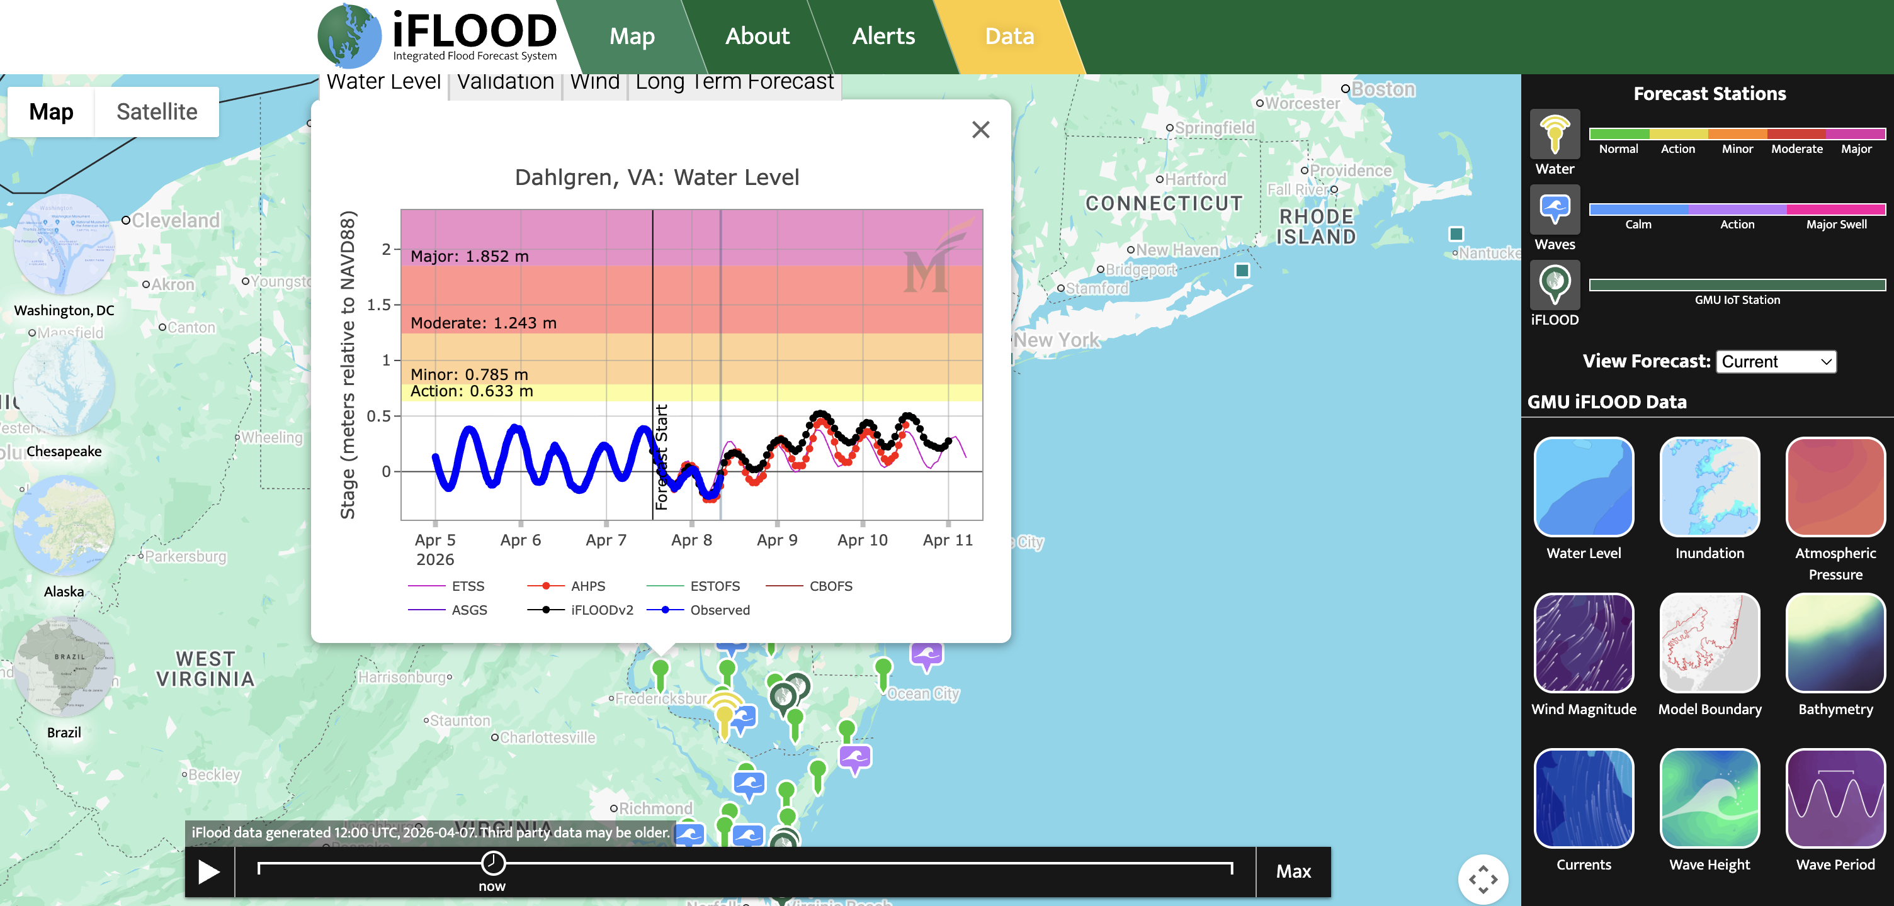
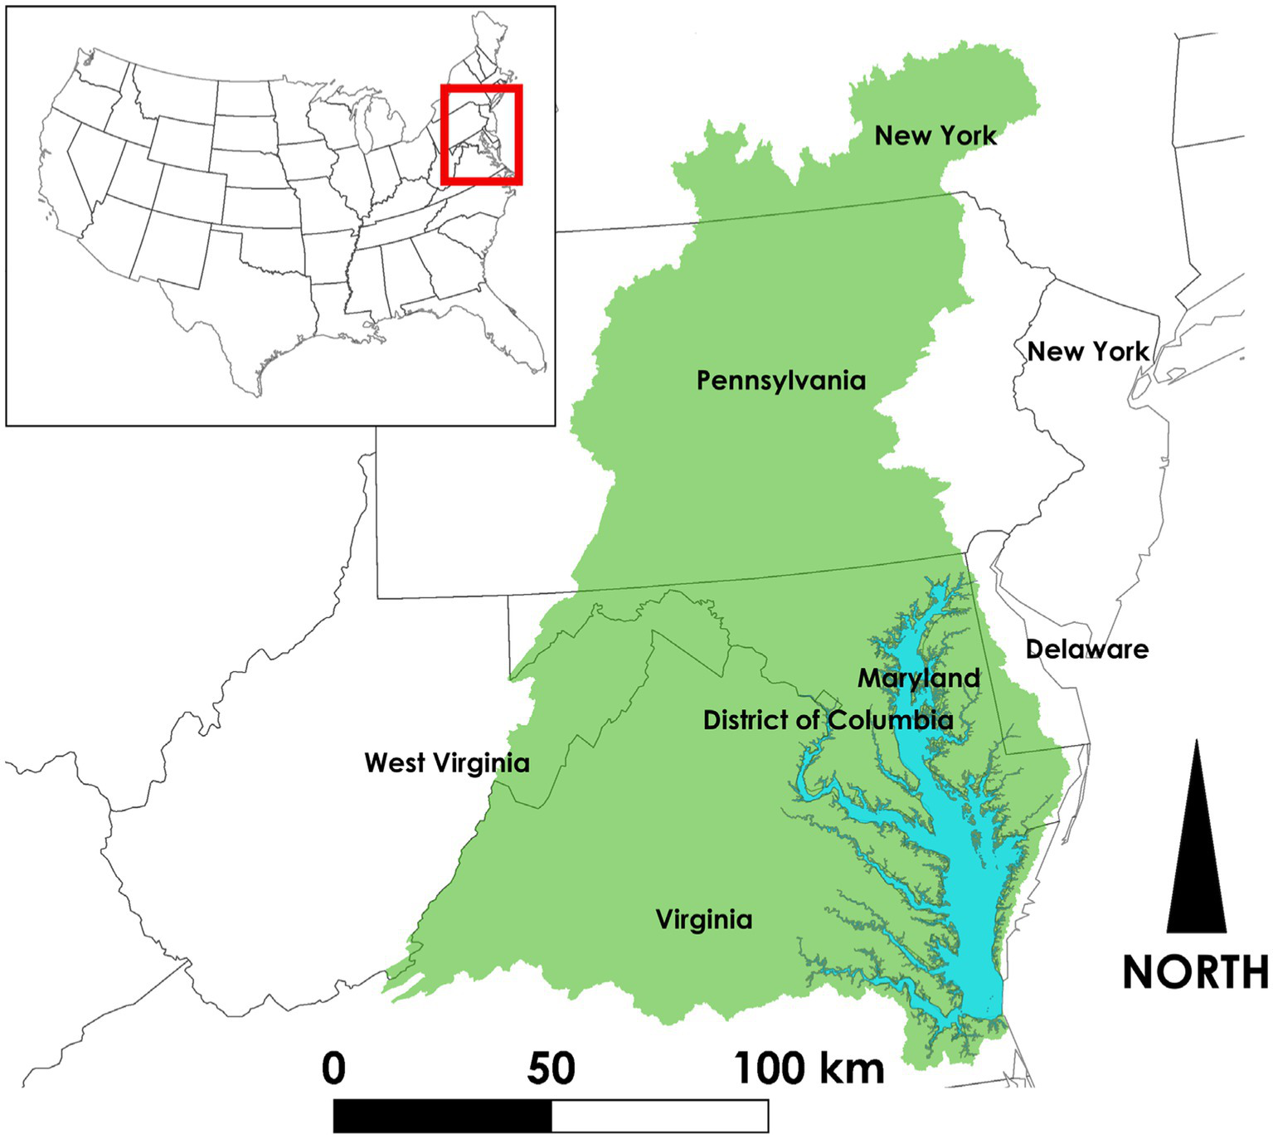
GMU iFLOOD: what is it?
https://iflood.vse.gmu.edu/
Chesapeake Bay
https://www.frontiersin.org/journals/water/articles/10.3389/frwa.2024.1269717/full
Notes:
“iFLOOD is a scientific experiment and educational tool to incorporate multi-scale and multi-temporal physical process for integrated total water predictions, including large scale oceanic process, estuarine hydrodynamics, riverine flows, urban runoff, and nearshore waves. It provides real time and future flooding forecasts based on a multi-model framework for the Chesapeake Bay and the National Capital Region.”
Past iFlood forecasts were never stored… Currently in process of running iFlood hindcasts on an HPC so I have a baseline model to compare to
In the meantime, focusing on exploring ML alternatives for improving tidal predictions

Slide 3
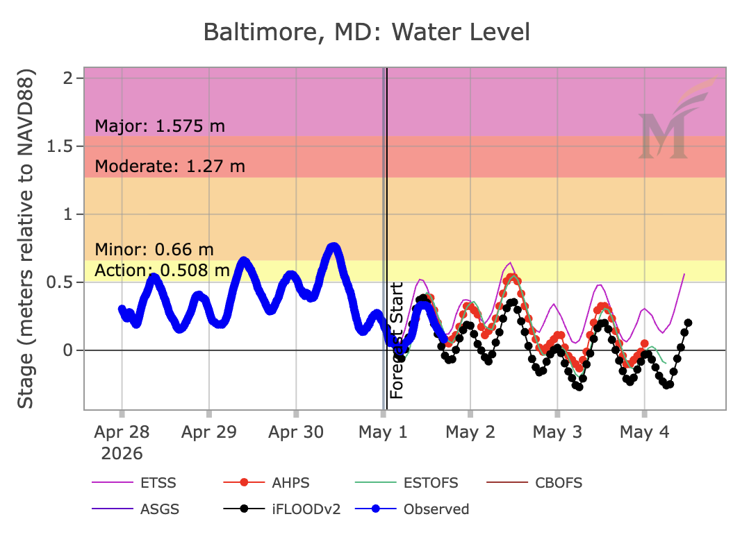
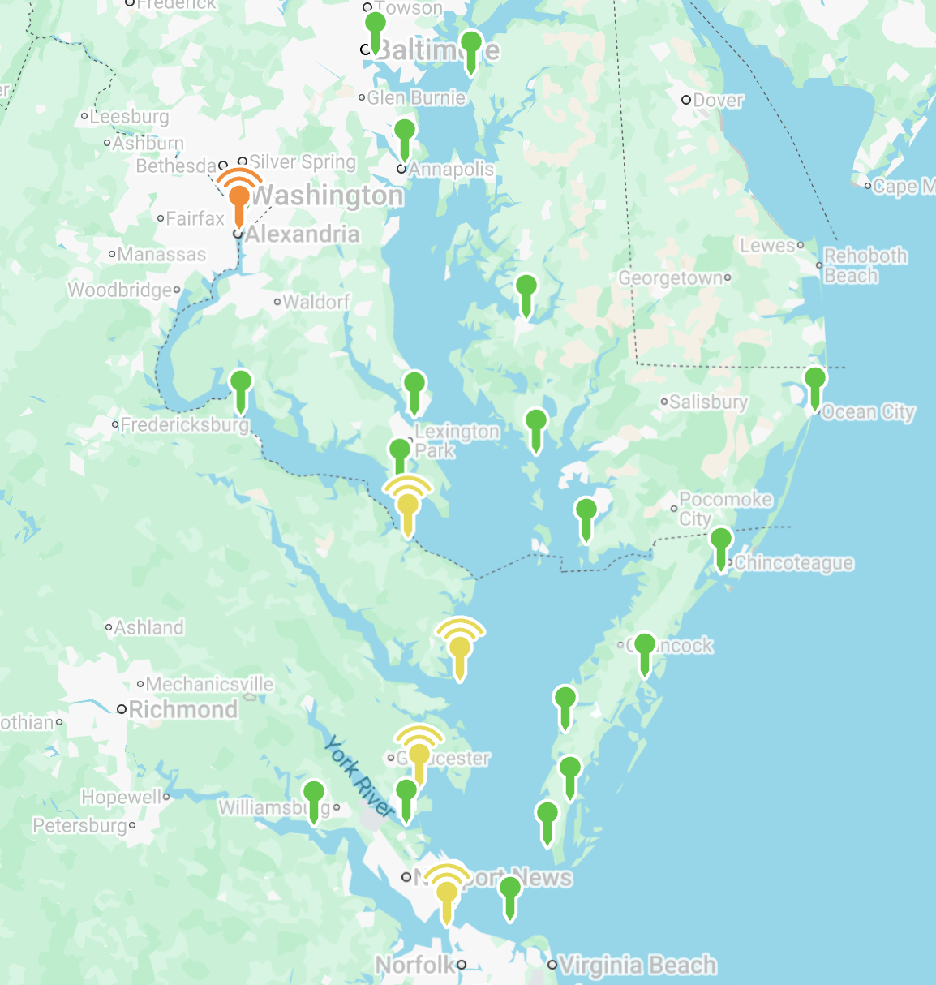
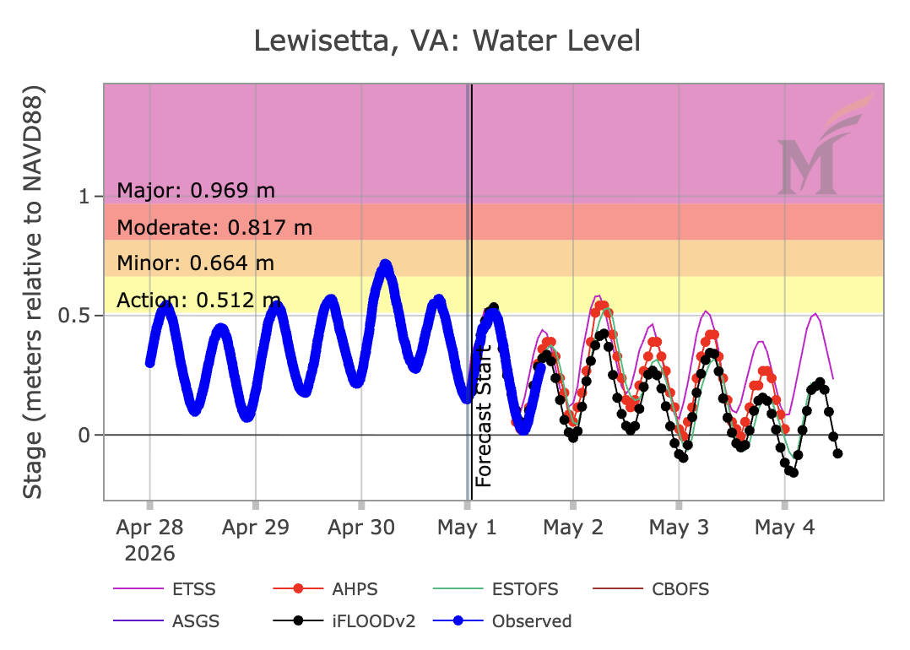
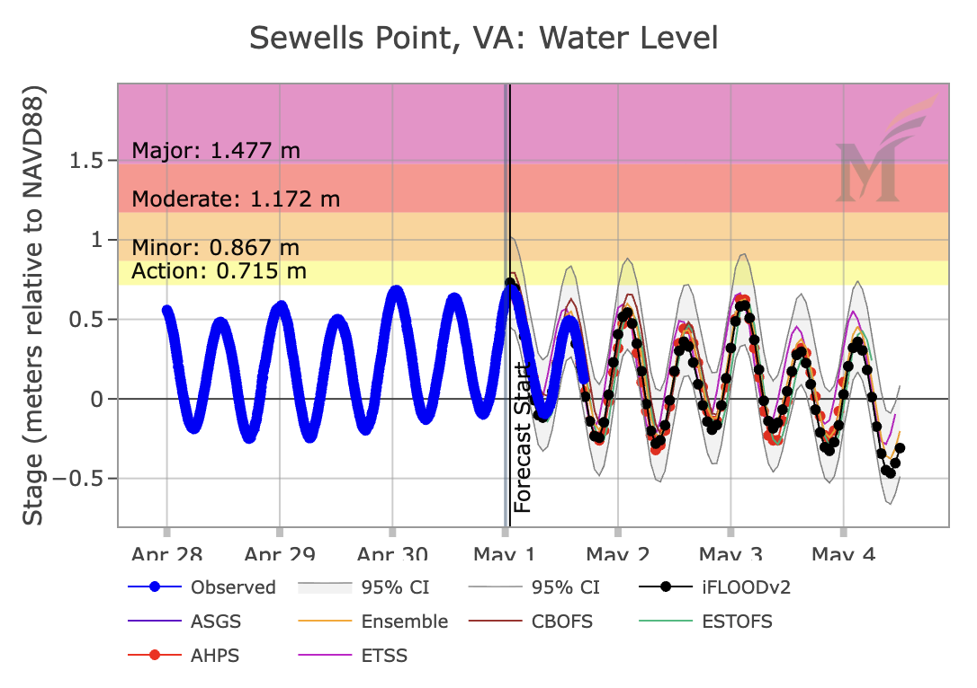
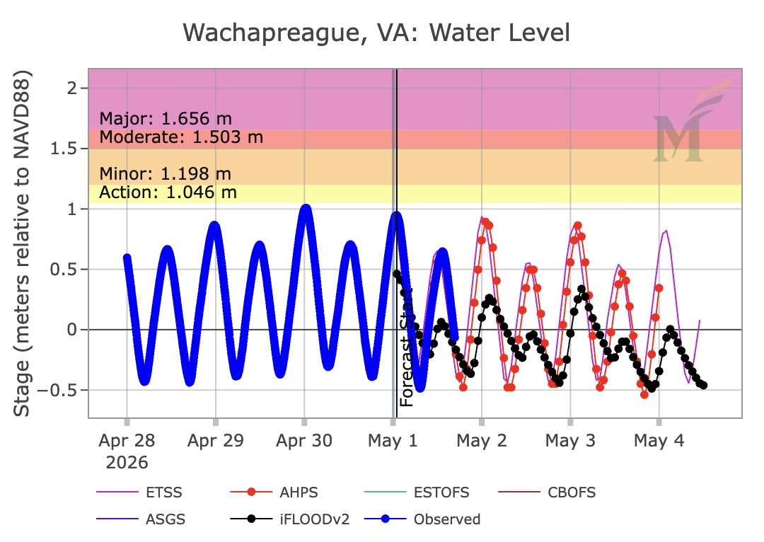
Preliminary Study Locations

Slide 4
LSTM model fits
Location | Loss Function | R² | RMSE | MAE | Max Error
Wachapreague | MSE | 0.76 | 0.22 | 0.16 | 1.32
Wachapreague | MAE | 0.78 | 0.21 | 0.16 | 1.36
Wachapreague | Stacked | 0.75 | 0.23 | 0.17 | 1.32
Sewell’s Point | MSE | 0.74 | 0.17 | 0.12 | 1.16
Sewell’s Point | MAE | 0.73 | 0.17 | 0.13 | 1.14
Sewell’s Point | Stacked | 0.68 | 0.19 | 0.14 | 1.15
Lewisetta | MSE | 0.49 | 0.24 | 0.18 | 1.35
Lewisetta | MAE | 0.57 | 0.15 | 0.11 | 0.88
Lewisetta | Stacked | 0.34 | 0.19 | 0.15 | 0.98
Baltimore | MSE | 0.27 | 0.23 | 0.18 | 1.19
Baltimore | MAE | 0.38 | 0.21 | 0.16 | 1.23
Baltimore | Stacked | -0.05 | 0.27 | 0.21 | 1.16

Slide 5
Come chat with me about…
Creating and iterating on machine learning models, especially LSTM
  Many slides about LSTMs generally
  Many slides about how I defined my model and its variants
Details about my currently trained models
  I have plots for all variants
General ways to improve tidal forecasting
  Especially in different settings (i.e., different parts of the bay)
Translating tidal outputs to flood extents and depths
Dr. P. J. Ruess
pruess@gmu.edu
Notes:
Generalized Extreme Value

