Slide 1

EGU26 -22907
Wildfire risk as a dynamic constraint shaping energetic landscapes under climate change
Mingyun Cho¹ · Yohan Choi¹ · Chan Park² ·
¹ Institute of Urban Science, University of Seoul, South Korea
² Department of Landscape Architecture, University of Seoul, South Korea
Abstract
QR Code
Session: NH7.2 · EGU General Assembly 2026, Vienna, 3–8 May 2026

Slide 2
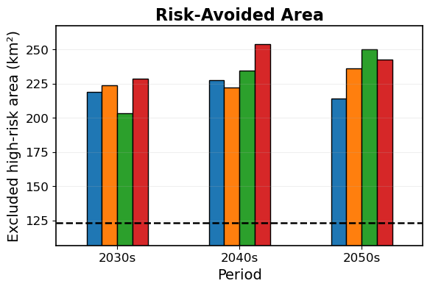
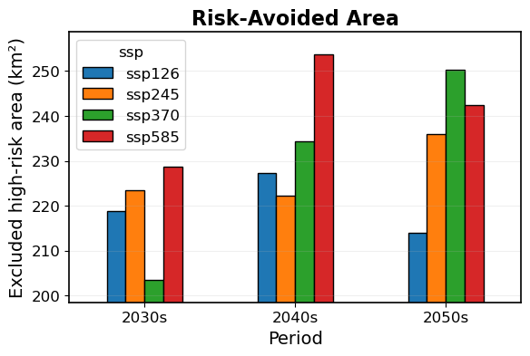

Motivation & Key Result
2-MIN SUMMARY
WHY THIS MATTERS
KEY RESULT / FINDING
Background / problem statement
Climate change is changing where energy can be produced.
Wildfire risk is growing and limiting land for solar energy.
Gap in current knowledge or method
Most studies assume land and climate stay the same.
Wildfire risk is not fully considered in energy planning.
Significance of addressing this gap
Including wildfire risk gives more realistic energy estimates.
It helps plan safer and more reliable energy locations.
Present(122.9)
Solar potential is not fixed — it changes with wildfire risk.

Slide 3
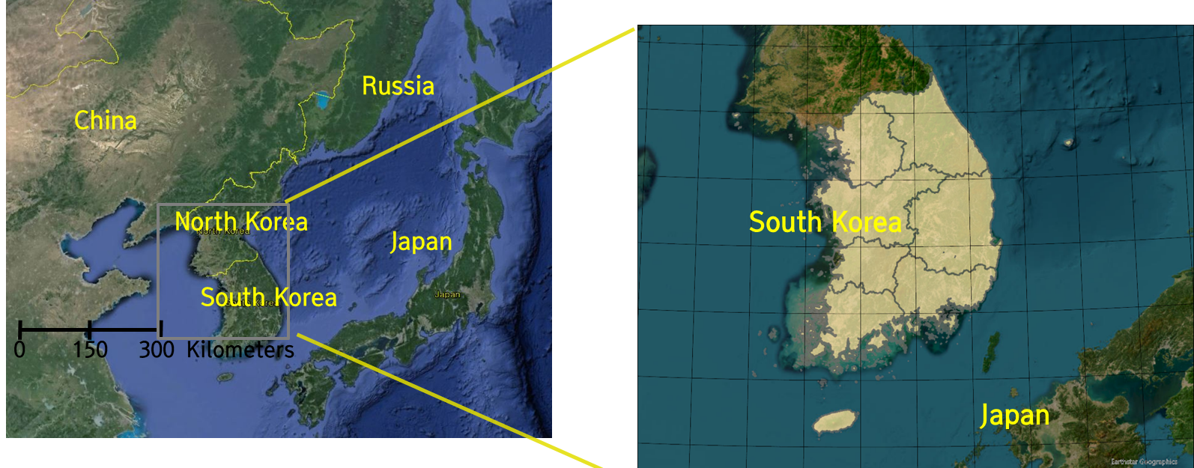
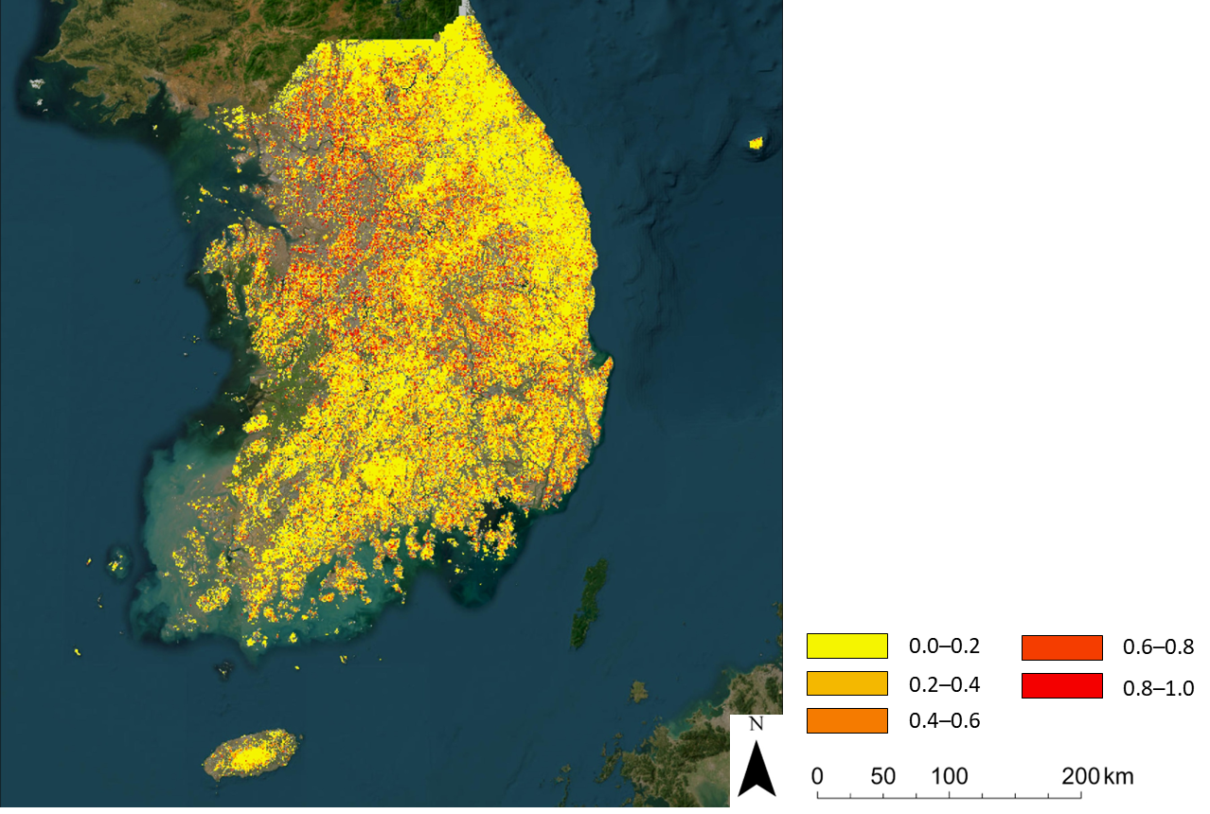
Data & Methods
[ Study area: South Korea ]
Ensemble Model: Wildfire
Environmental Variables (Independent Variables)
Climate
factor
Socio-economic factors
Environmental
factor
Cho and Park (2026)
    Scenarios : CMIP6
Stacking ensemble
SSPs Socioeconomic Pathway Scenarios
RF
XGBoost
LightGBM
ExtraTrees
Logistic
Wildfire Prediction model
Wildfire Risk
under climate change
Suitable Land for Solar Plant

Slide 4
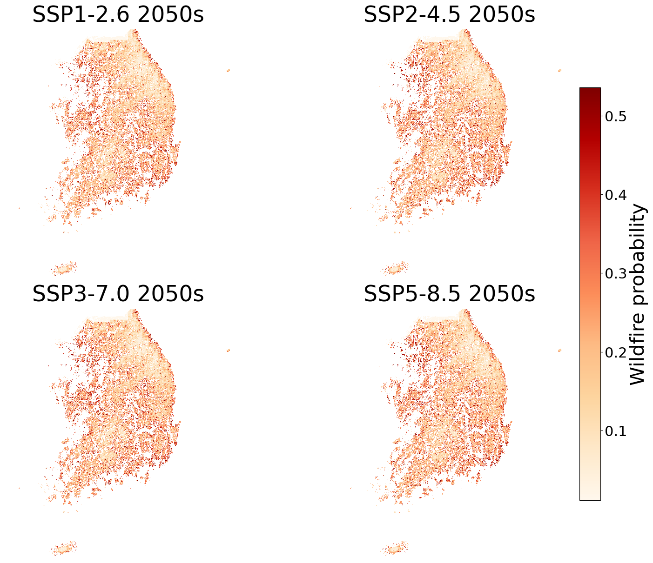
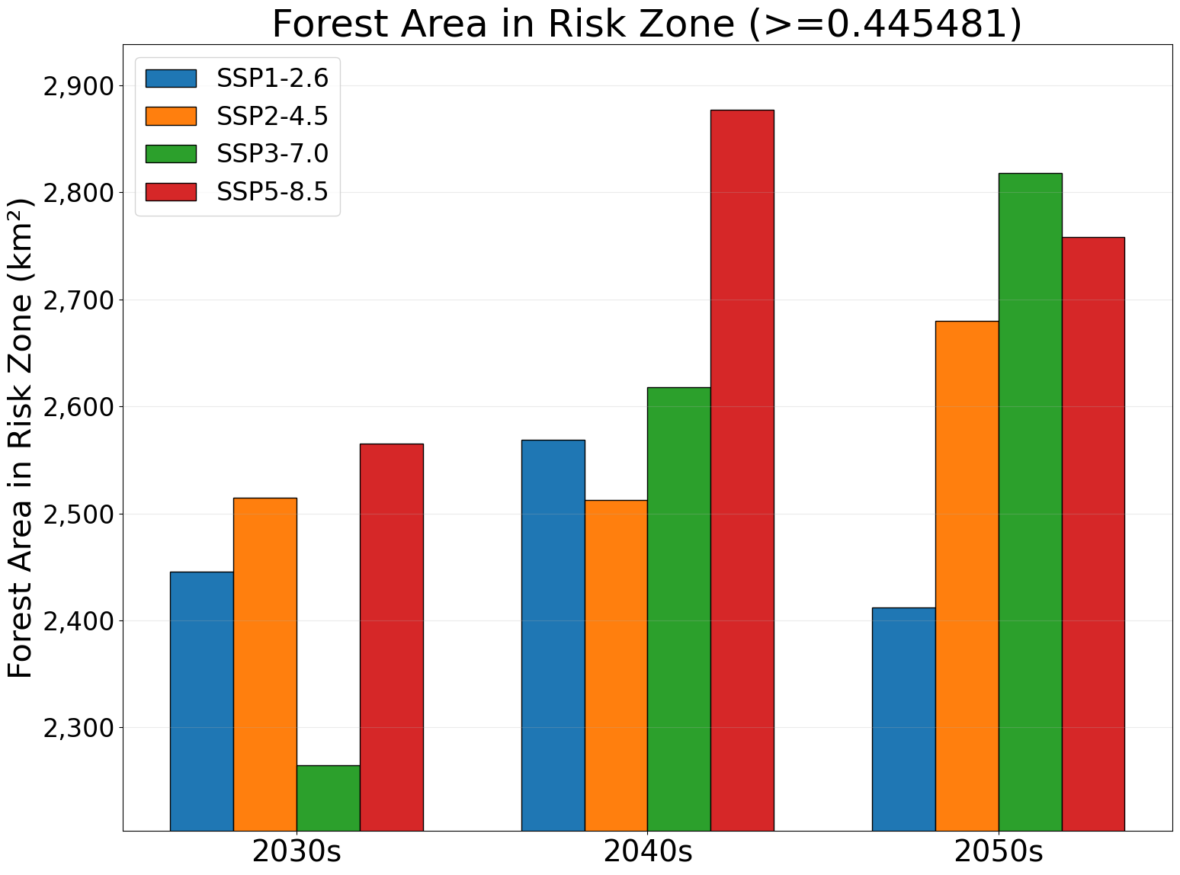
Results
TOUCHSCREEN DETAIL
Forest Area in Risk Zone (>= Optimized Threshold)
(km²)
Scenario | 2030s | 2040s | 2050s
Present | 1,494 (-)
SSP1-2.6 | 2,446(+951) | 2,569(+1,074) | 2,412(+917)
SSP2-4.5 | 2,515(+1,020) | 2,512(+1,017) | 2,680(+1,185)
SSP3-7.0 | 2,265(+770) | 2,618(+1,123) | 2,818(+1,323)
SSP5-8.5 | 2,565(+1,070) | 2,877(+1,382) | 2,758(+1,263)
Optimized Thredshold (Precision & Recall(F1) Curve) = 0.445481
High wildfire risk forest area consistently increases across all scenarios,
with the most pronounced expansion under SSP5-8.5.

Slide 5
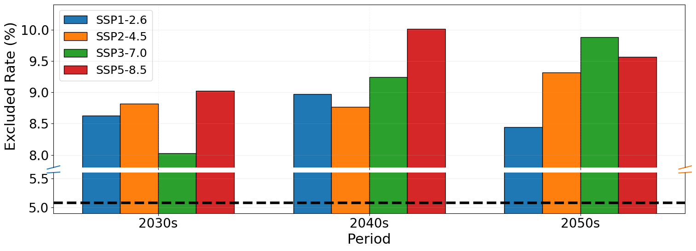
Results
TOUCHSCREEN DETAIL
Excluded area ratio by Wildfire Risk (>= Optimized Threshold)
= 0.445481
Present(5.08%)
Increasing wildfire risk under climate change
reduces ‘land’ and ‘solar potential’ .

Slide 6
Discussion & Conclusions
Main Conclusions
Wildfire risk is a significant and quantifiable constraint on solar energy land availability.
Ignoring wildfire dynamics leads to overestimation of future solar potential, with direct implications for energy policy.
Future work: Spatial optimization of solar siting accounting for wildfire-safe corridors.
Contact
lg2173@uos.ac.kr
ORCID: 0000-0003-4102-0430
Acknowledgements:
This work was supported by a National Research Foundation of Korea (NRF) grant funded by the Korea government (MSIT) (No. RS-2024-00452486).

Slide 7
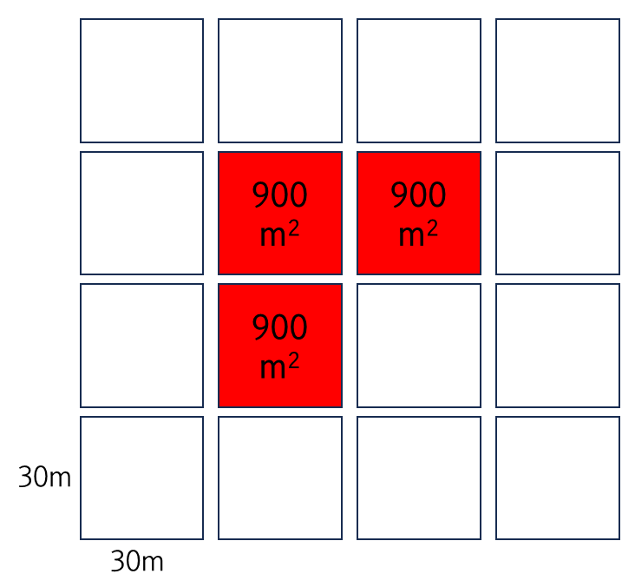
Definition of possible area for solar power plant
Definition of possible areas for solar power plant
Type : Land use
Bareland
Minimum area
Development excluded areas
Farmland
Physical stability
Ecological suitability
Land developability
Possible areas for
solar power plant
Areas excluded from development
Possible Land for solar power plant
Possible areas for solar power plant
Notes:
This slide defines the possible land area for solar power plants.
We first removed all development-restricted areas — covering physical stability, ecological suitability, and land developability — from the total land.
The remaining bareland and farmland with a minimum contiguous area of 900 square meters, derived from a 30-meter grid, form the basis of our solar land pool.
This gives us a clear, reproducible baseline for measuring how wildfire risk erodes available land.

Slide 8
Wildfire Prediction model (Model Input Variables)
Category | Variable |  | Description | Data source
Climate factors | Daily maximum temperature | TMAX | Daily maximum air temperature on the wildfire occurrence date (°C) | Korea Meteorological Administration (AWS)
 | Daily mean humidity | RHM | Daily mean relative humidity on the wildfire occurrence date (%)
 | Daily mean wind speed | WS | Daily mean wind speed on the wildfire occurrence date (m/s)
 | Daily precipitation | PRCP | Daily accumulated precipitation on the wildfire occurrence date (mm)
Socio-economic factors | Distance to cemetery | D_GR | Euclidean distance from each grid cell to the nearest cemetery | Ministry of Environment, Land Cover Map (2022)
 | Distance to farmland | D_FL | Euclidean distance from each grid cell to the nearest farmland
 | Distance to road | D_RD | Euclidean distance from each grid cell to the nearest road | National Transport Information Center (2024)
 | Distance to hiking trail | D_TR | Euclidean distance from each grid cell to the nearest hiking trail | Forest Spatial Information Service
 | Number of businesses | BIZ | Number of businesses per grid cell | Grid-based Statistics (KOSIS, 2022)
 | Population | POP | Population count per grid cell
Environ-mental factors | DEM | DEM | Elevation derived from a digital elevation model (m) | SRTM DEM
 | Slope | SLP | Slope derived from DEM (degrees)
 | TWI | TWI | Topographic Wetness Index representing potential soil moisture accumulation
 | Conifer forest ratio | CONIF | Proportion of coniferous forest within each grid cell | Forest Map (NIFoS, 2022)
Notes:
This table lists all 15 variables used as inputs to the wildfire prediction model.
They fall into three categories: climate, socio-economic, and environmental factors.
Climate variables — temperature, humidity, wind speed, and precipitation — capture the day-of-fire atmospheric conditions.
Socio-economic variables, such as distance to roads, farmland, and hiking trails, reflect human ignition risk.
Environmental variables — DEM, slope, TWI, and conifer ratio — capture topographic and vegetation characteristics linked to fire spread.
Together, these 15 variables allow the model to distinguish wildfire-prone from non-prone grid cells across South Korea.

Slide 9
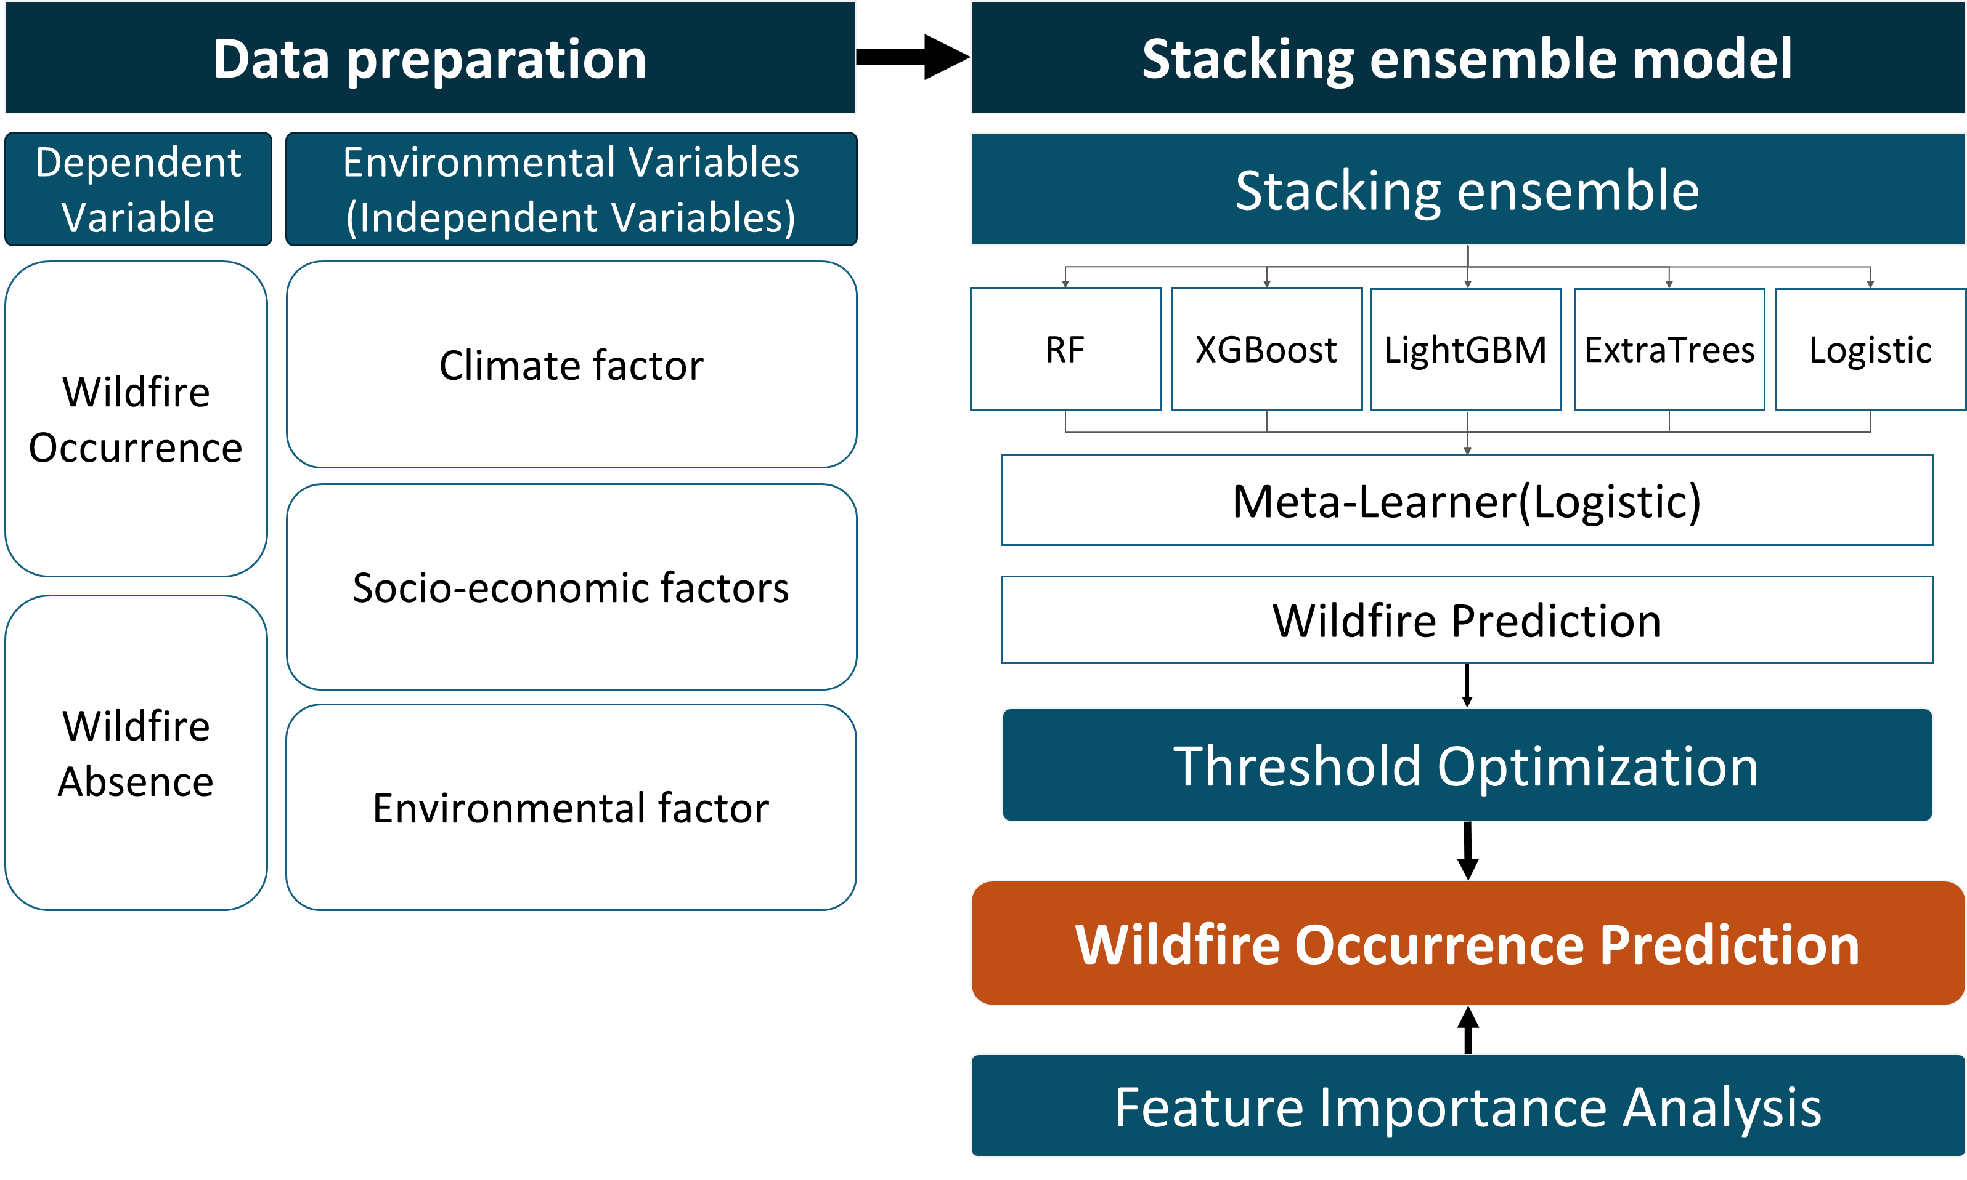
Wildfire Prediction model (Flow Chat)
Notes:
This flow chart summarizes the full modeling pipeline.
On the left, wildfire occurrence and absence records are paired with the 15 environmental variables.
These inputs feed into a stacking ensemble of four base learners — Random Forest, XGBoost, LightGBM, and ExtraTrees — whose predictions are combined by a logistic meta-learner.
The raw probability output then passes through threshold optimization to convert continuous scores into binary risk labels.
Finally, feature importance analysis reveals which variables drive the predictions most strongly.

Slide 10
Wildfire Prediction model (Stacking Ensemble Model)
Stacking Ensemble Model
Training data
RF
New
Training data
Meta Model
(Logistic)
XGBoost
Final
Prediction
LightGBM
ExtraTrees
Logistic
Notes:
Here we detail the stacking ensemble architecture.
In the first stage, all four base models — RF, XGBoost, LightGBM, and ExtraTrees — are trained on the original training data.
Their out-of-fold predictions form a new training set fed to the second-stage meta-learner, a logistic regression model.
This two-level design exploits the complementary strengths of each algorithm while reducing overfitting, ultimately producing more robust wildfire probability estimates than any single model alone.

Slide 11
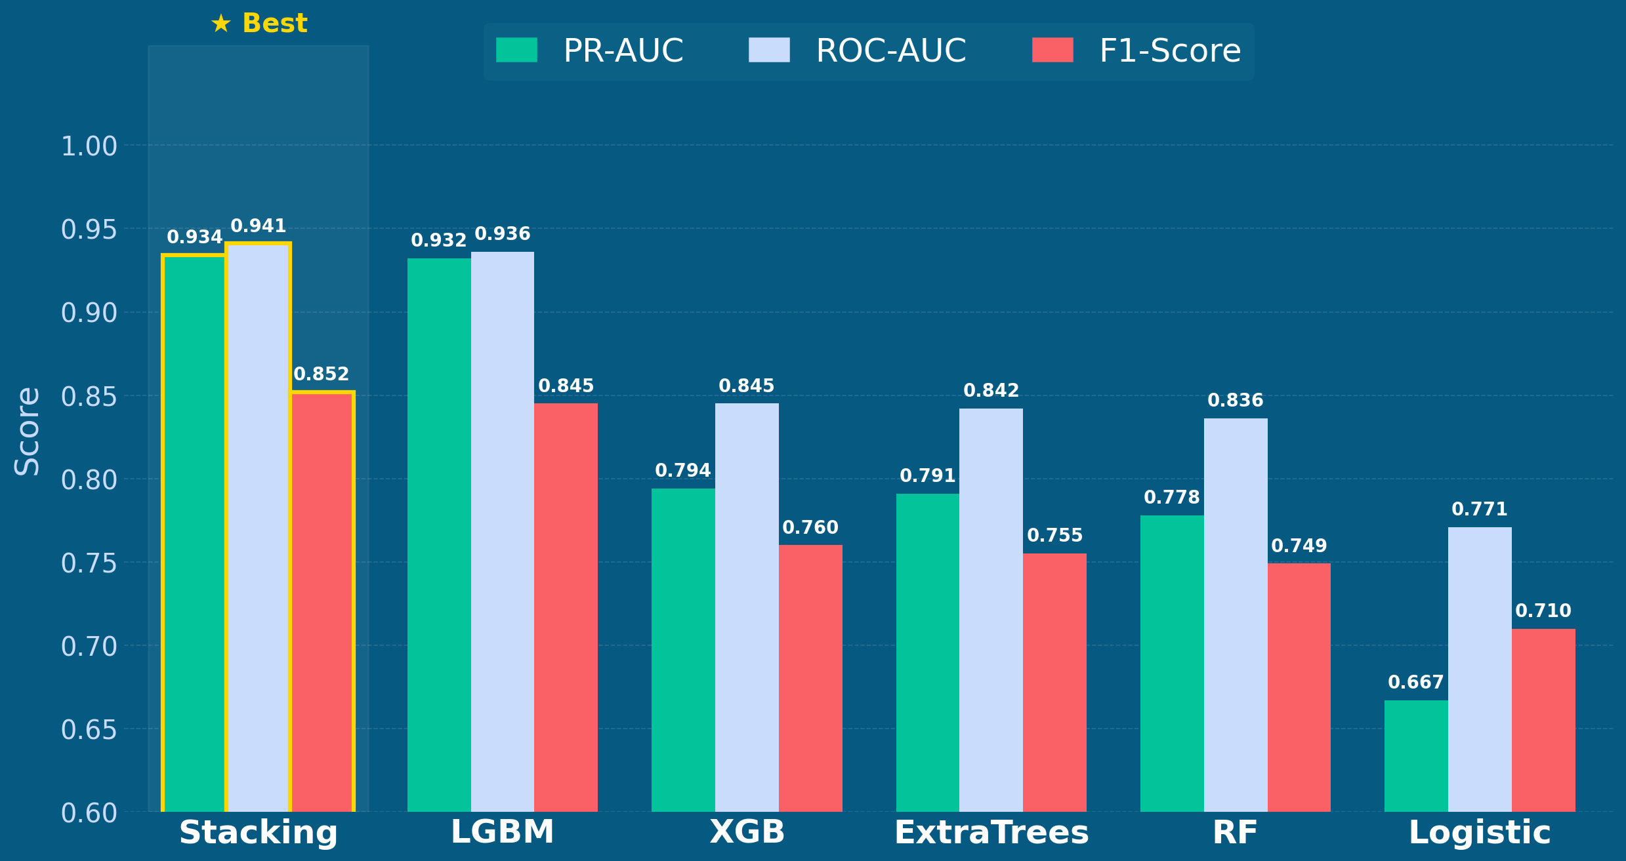
Wildfire Prediction model (Model Performance)
Notes:
This chart compares model performance across three metrics: PR-AUC, ROC-AUC, and F1-Score.
The stacking ensemble achieves the highest scores on all three — PR-AUC of 0.934, ROC-AUC of 0.941, and F1 of 0.852 — outperforming each individual base learner.
LightGBM comes closest with a PR-AUC of 0.932.
The consistent superiority of the ensemble validates our choice to combine models rather than rely on any single algorithm for downstream risk mapping.

Slide 12
Wildfire Prediction model (Feature Importance )
Feature | RF | ET | LGBM | XGBoost | Logistic | AvgRank
RHM relative humidity | 4(0.101) | 1(0.124) | 4(4914) | 5(0.068) | 4(0.484) | 3.4
TMAX daily maximum temperature | 5(0.098) | 2(0.123) | 2(5620) | 6(0.066) | 6(0.331) | 4
D_RD | 1(0.116) | 7(0.066) | 1(6913) | 2(0.115) | 10(0.098) | 4.4
D_FL | 2(0.115) | 3(0.112) | 7(4088) | 4(0.069) | 5(0.461) | 4.8
PRCP precipitation | 13(0.050) | 15(0.047) | 12(4176) | 7(0.048) | 11(0.087) | 10.8
.
.
.
Notes:
This table shows the top-ranked features by average rank across all five models.
Relative humidity ranks first overall, followed by daily maximum temperature — confirming that atmospheric dryness and heat are the primary drivers of wildfire occurrence.
Distance to road and distance to farmland also rank highly, reflecting the role of human activity in ignition.
Notably, precipitation ranks lowest among the top features, suggesting that day-of-fire dryness matters more than recent rainfall in South Korea's wildfire patterns.

Slide 13
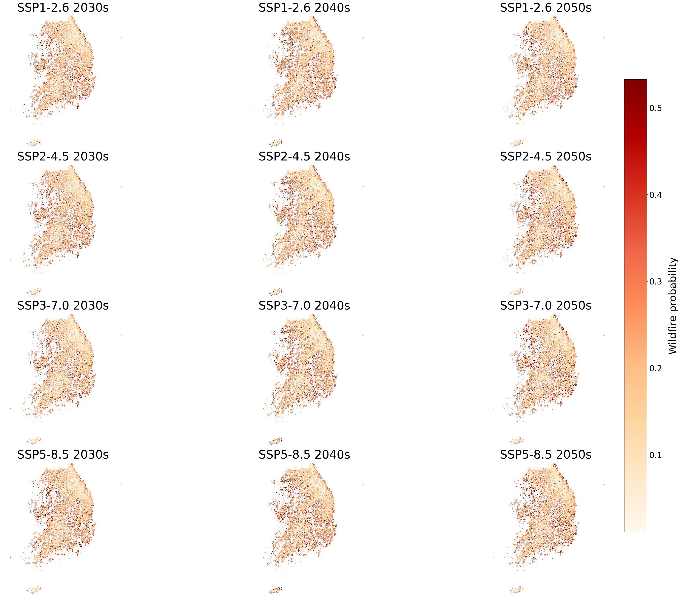
Wildfire area change by climate change
SSP1-2.6
SSP3-7.0
SSP3-4.5
SSP5-8.5
Notes:
These maps show spatial wildfire risk across South Korea for each SSP scenario and decade.
Under all four scenarios, high-risk areas concentrate in mountainous regions, particularly in the east and south.
SSP5-8.5 shows the most extensive risk expansion, especially by the 2040s, when large contiguous forest zones shift into high-risk status.
Even under the optimistic SSP1-2.6 scenario, risk areas grow noticeably relative to the baseline, indicating that some degree of wildfire intensification is unavoidable under any plausible climate trajectory.

Slide 14
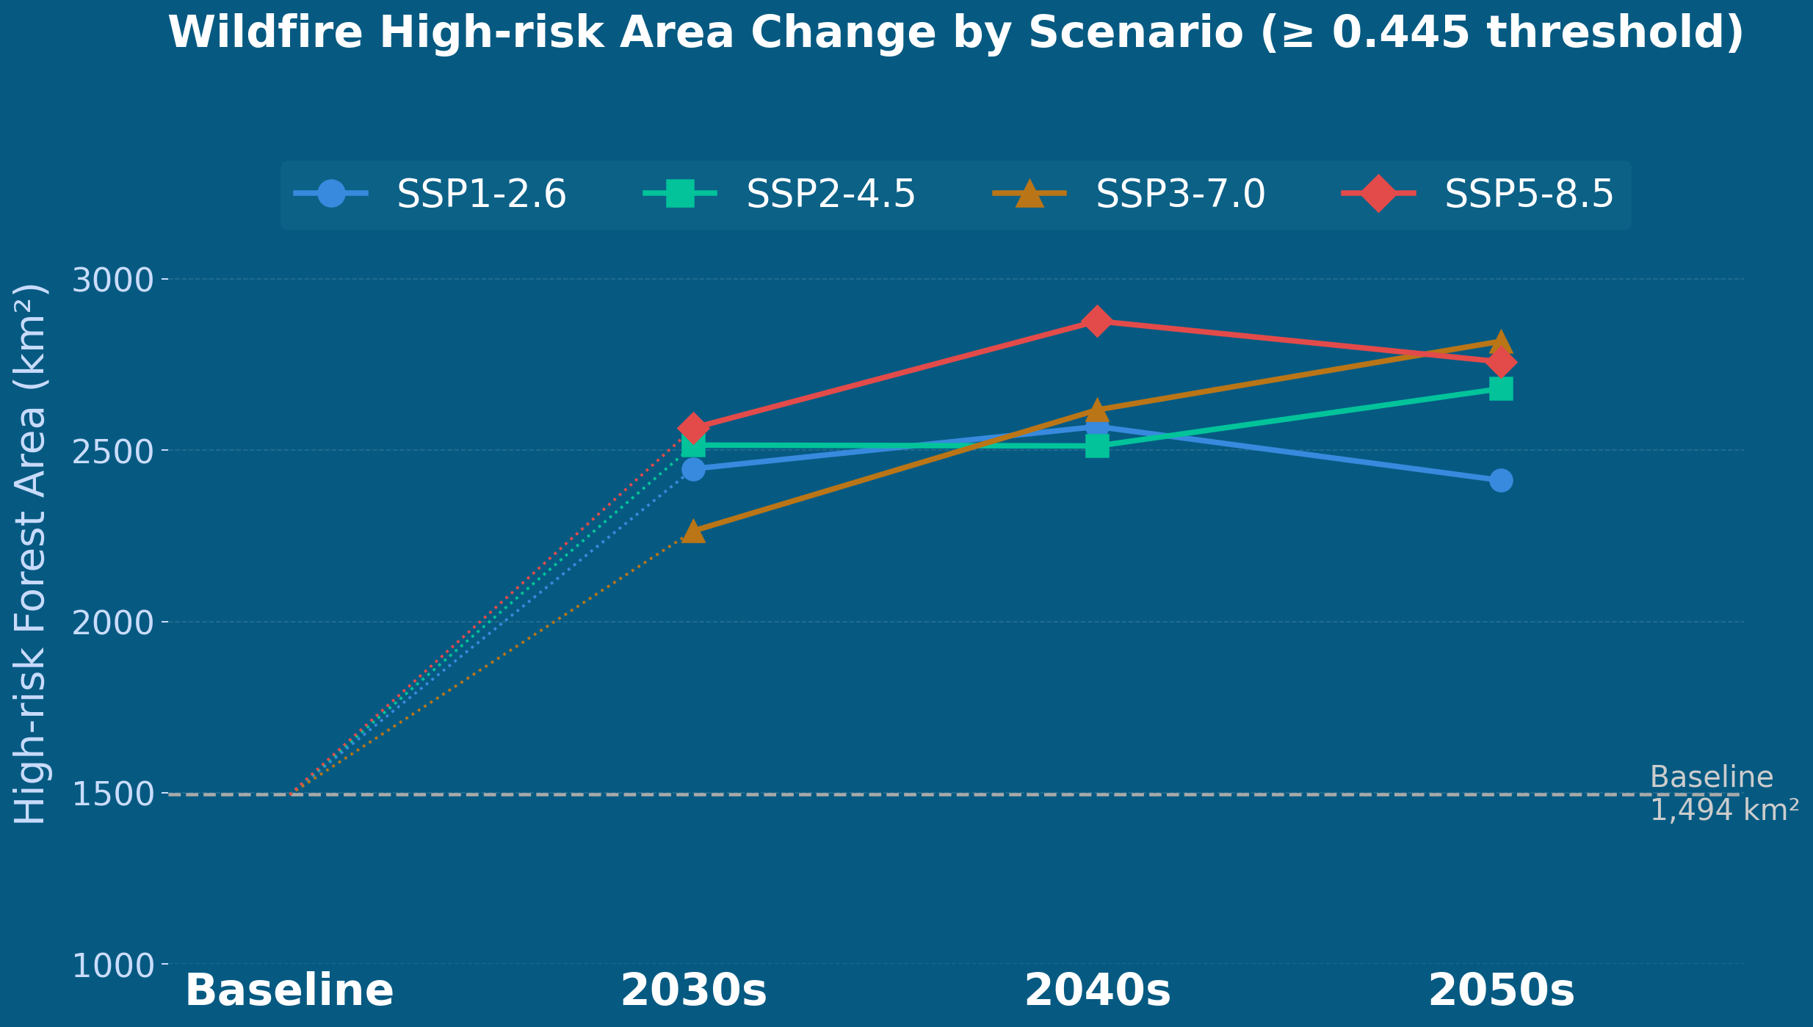
High-risked wildfire area change by climate change
Notes:
This line chart tracks the total high-risk forest area — defined by the optimized threshold of 0.445 — from the baseline through the 2030s, 2040s, and 2050s.
All four scenarios project a sharp jump from the baseline of 1,494 km² to roughly 2,300–2,900 km² in the 2030s.
SSP5-8.5 peaks around 2,877 km² in the 2040s before slightly declining, while SSP3-7.0 continues rising to 2,818 km² in the 2050s.
This convergence of high-emission scenarios in later decades signals that delayed mitigation does not significantly reduce near-term wildfire risk.

Slide 15
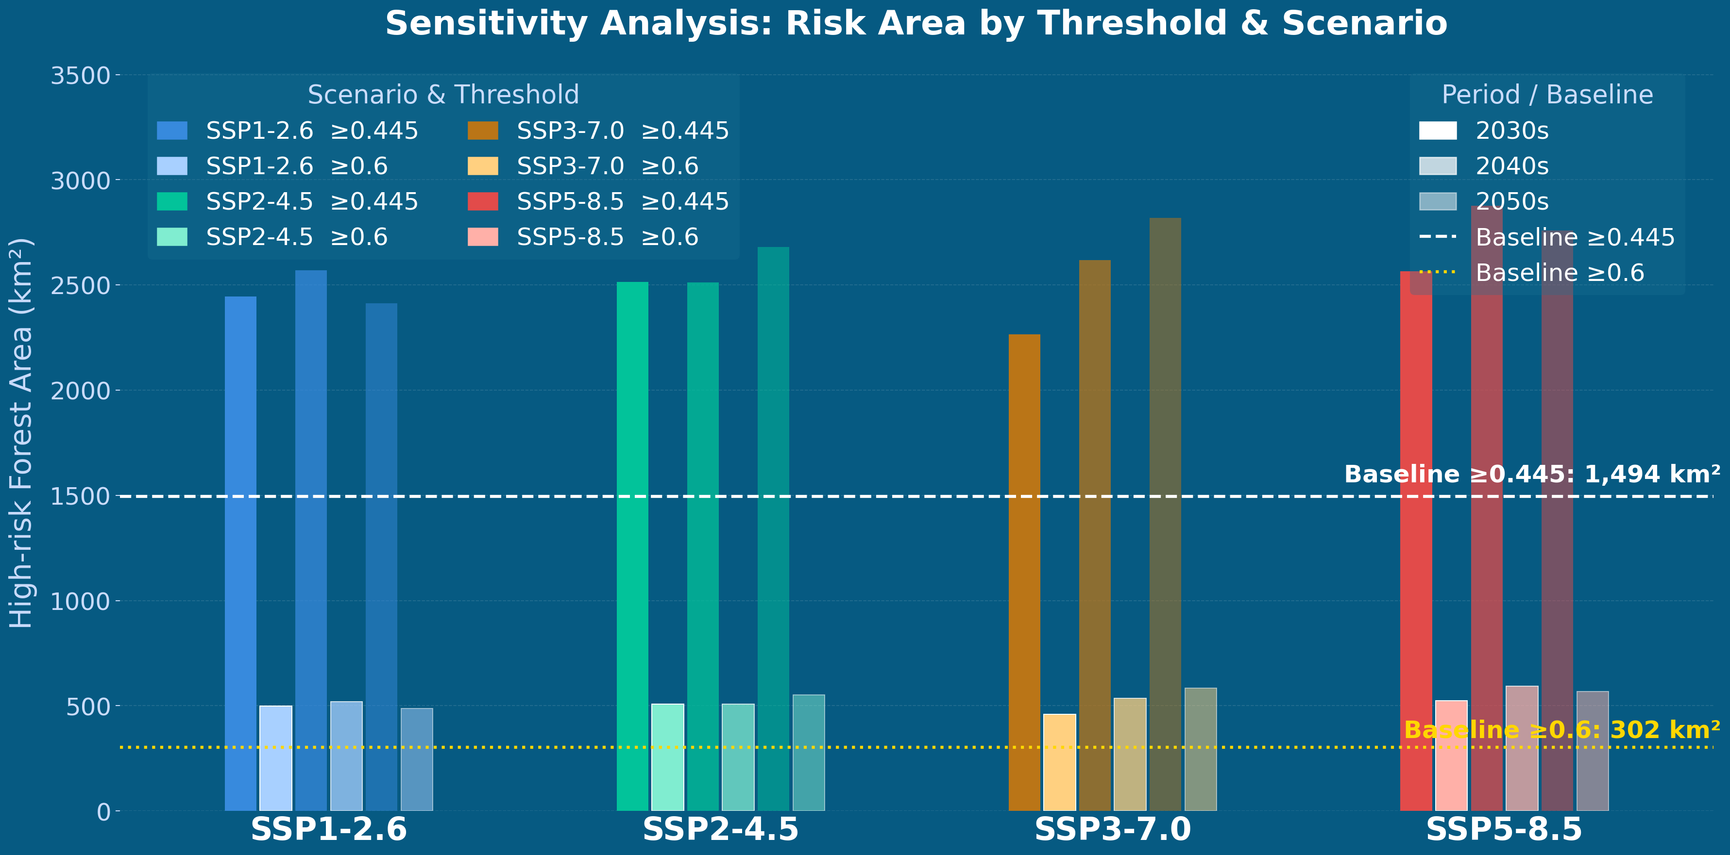
Sensitivity Analysis: Risk Area by Threshold
Notes:
This sensitivity analysis tests whether our main finding holds at a stricter threshold of 0.6.
At the optimized threshold of 0.445, the baseline is 1,494 km² and future projections reach up to 2,877 km².
At the stricter 0.6 threshold, the baseline drops to just 302 km², but the relative increase across scenarios is similarly pronounced.
This confirms that the direction and magnitude of wildfire risk expansion are robust across threshold choices, not an artifact of our specific cutoff.

Slide 16
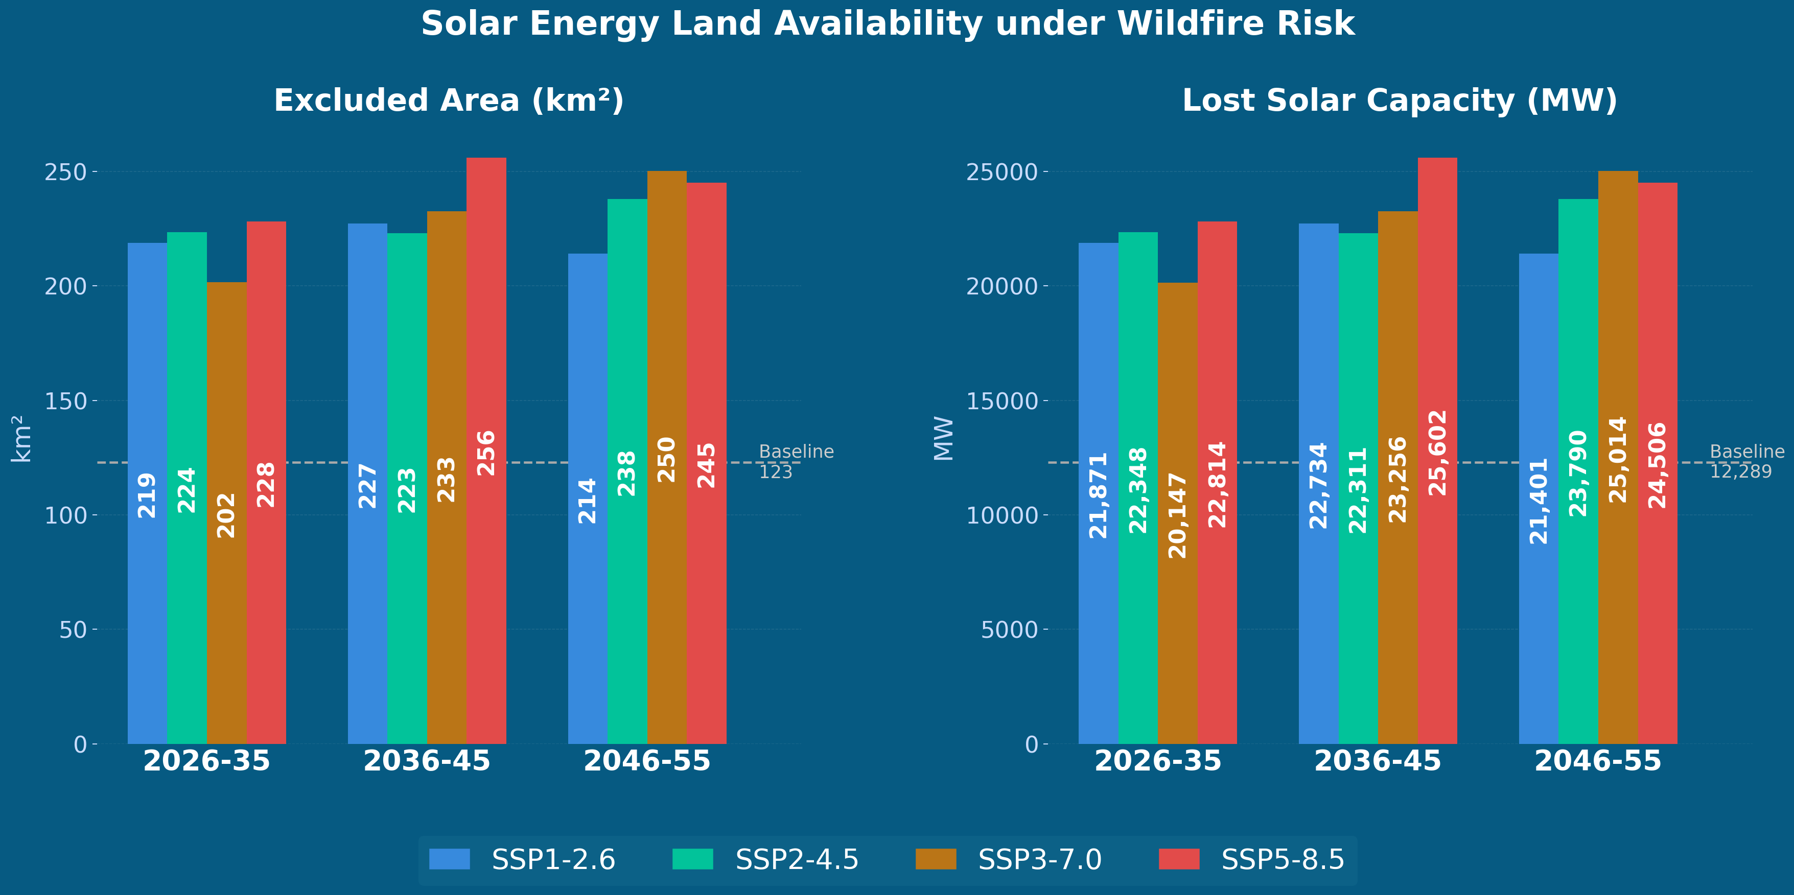
Solar Energy Land Availability
.
.
.
Notes:
The final slide quantifies the solar energy consequence of expanding wildfire risk.
The left panel shows that 200–260 km² of potential solar land is excluded due to wildfire risk in each period — consistently well above the 123 km² baseline.
The right panel translates this into lost solar capacity: up to 25,602 MW under SSP5-8.5 in the 2036–45 period, compared to a baseline of 12,289 MW.
These numbers make the policy implication concrete — ignoring wildfire dynamics in land suitability assessments leads to significant overestimation of deployable solar capacity, undermining national renewable energy targets.

