Slide 1
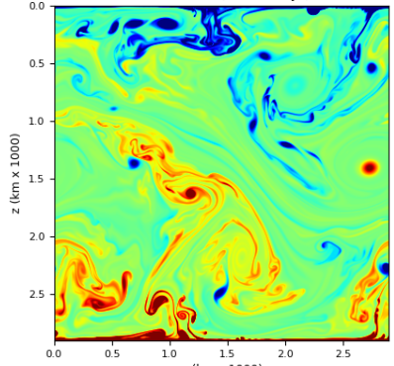
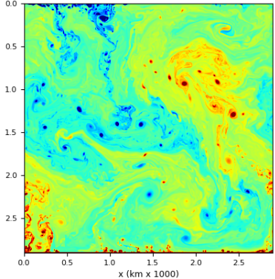
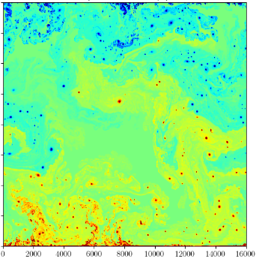
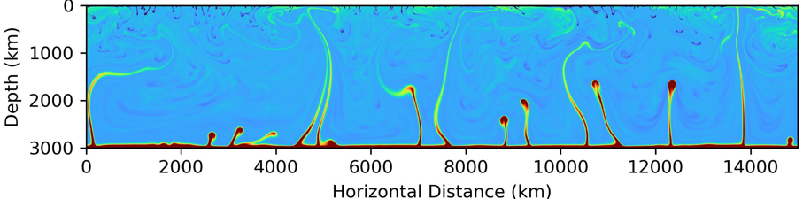
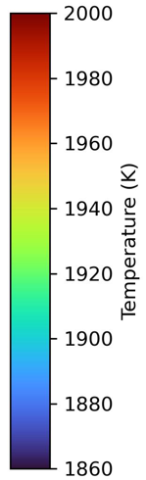
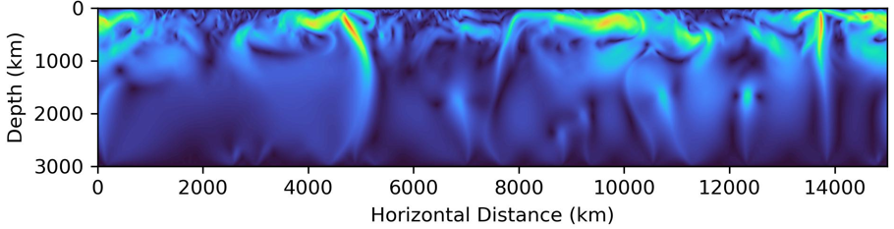
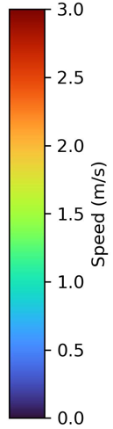
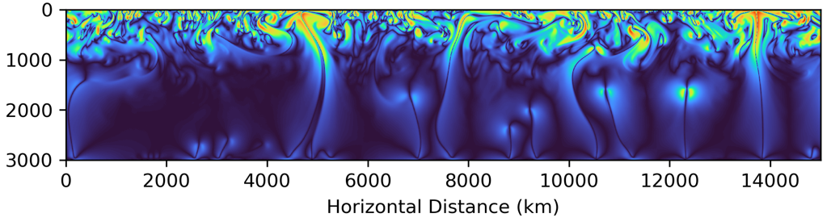
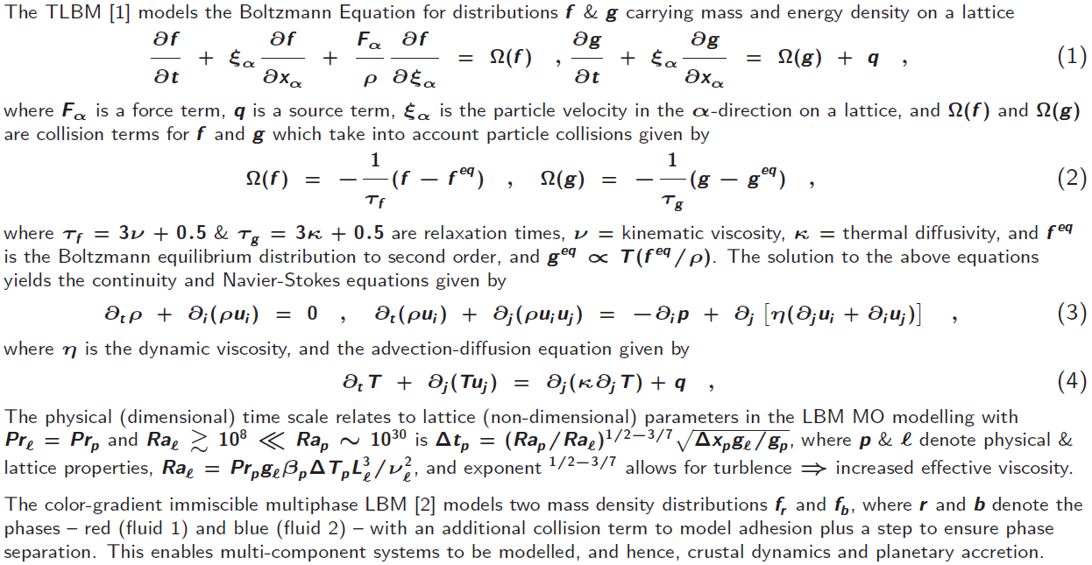

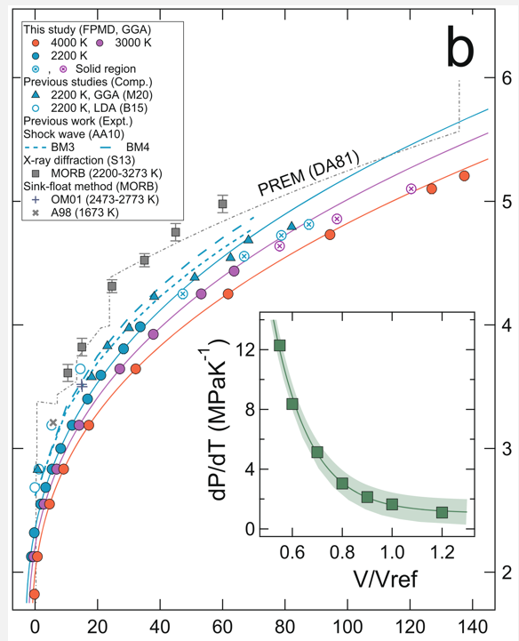
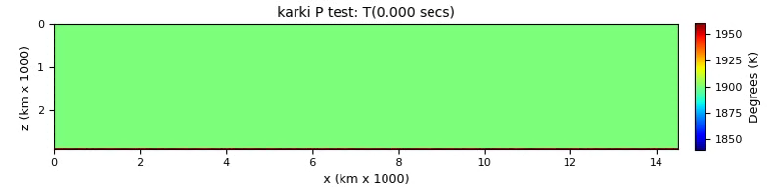
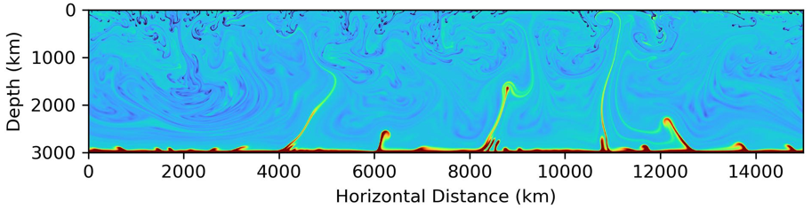
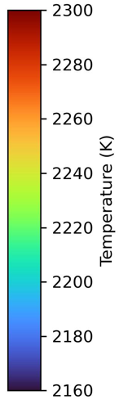
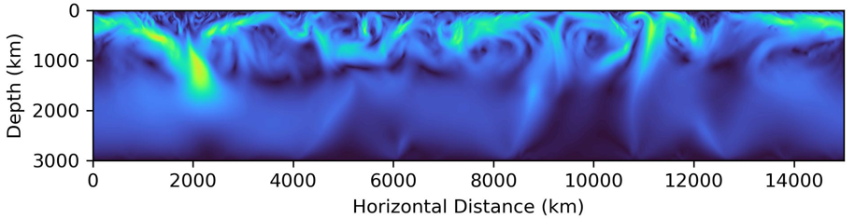
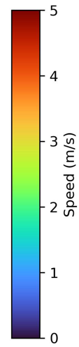
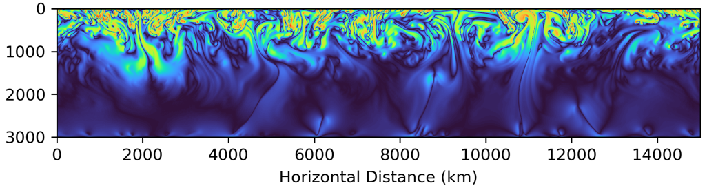
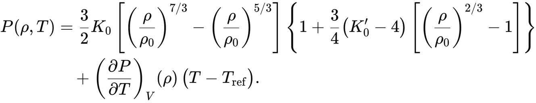
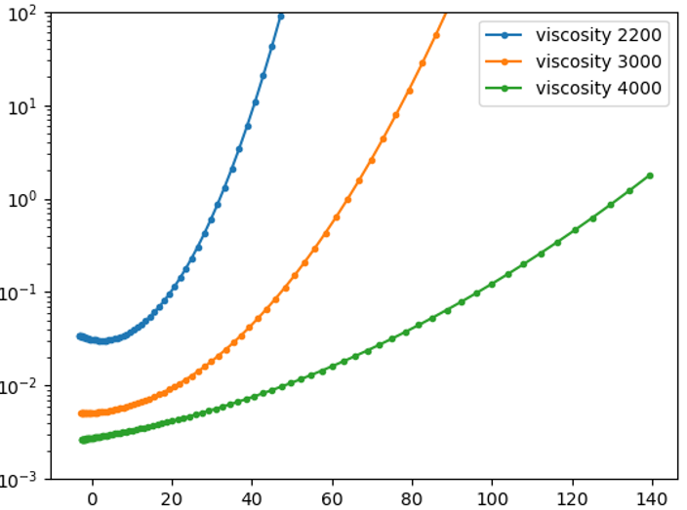
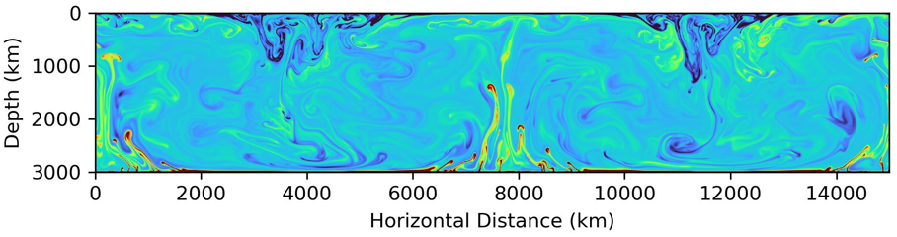
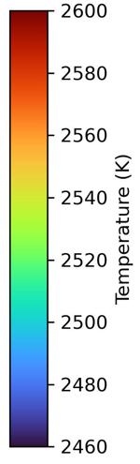
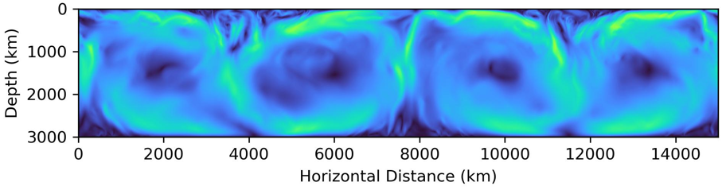
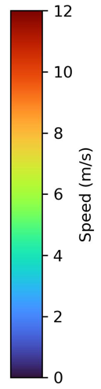
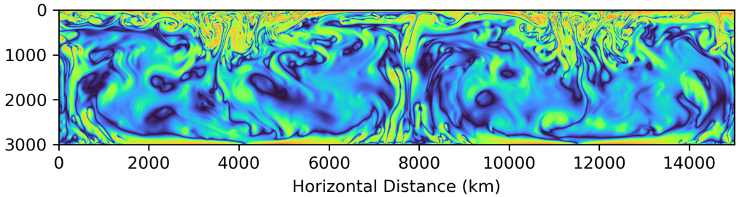
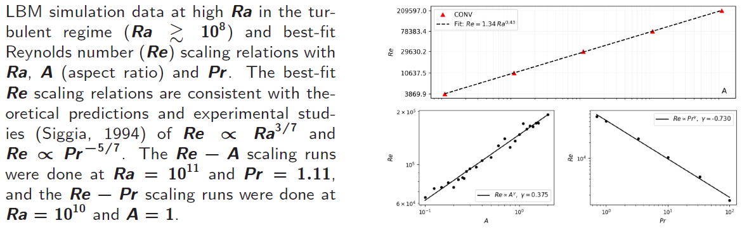

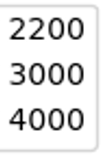
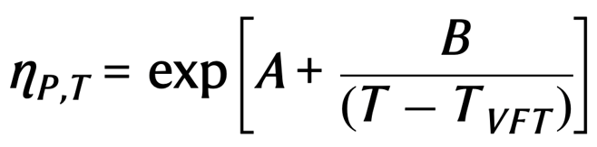
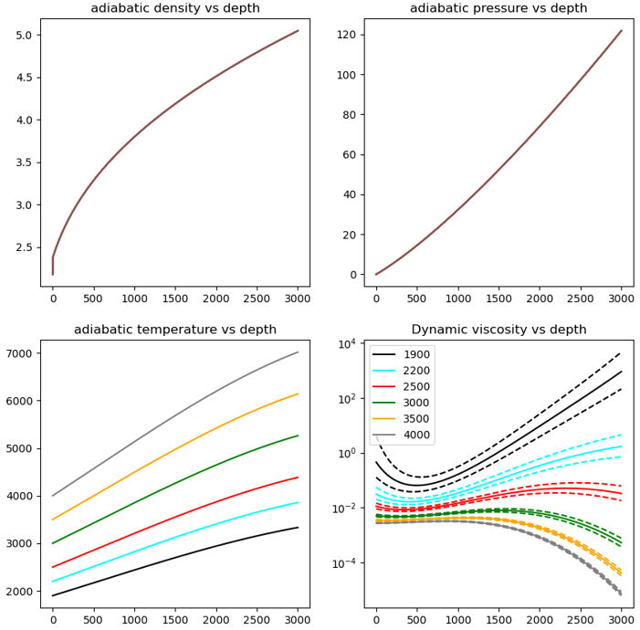
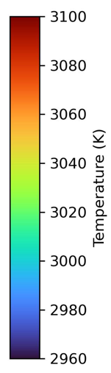
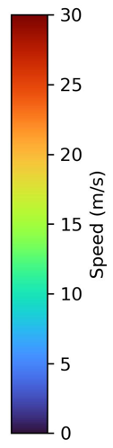
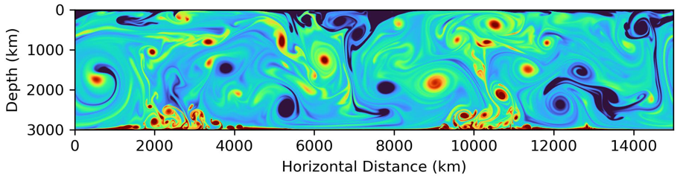
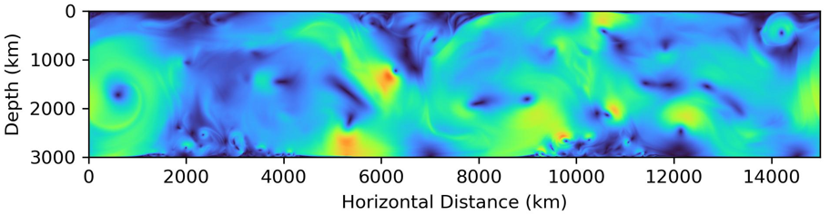
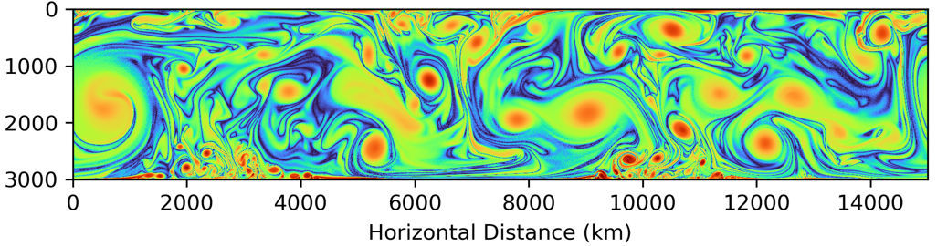
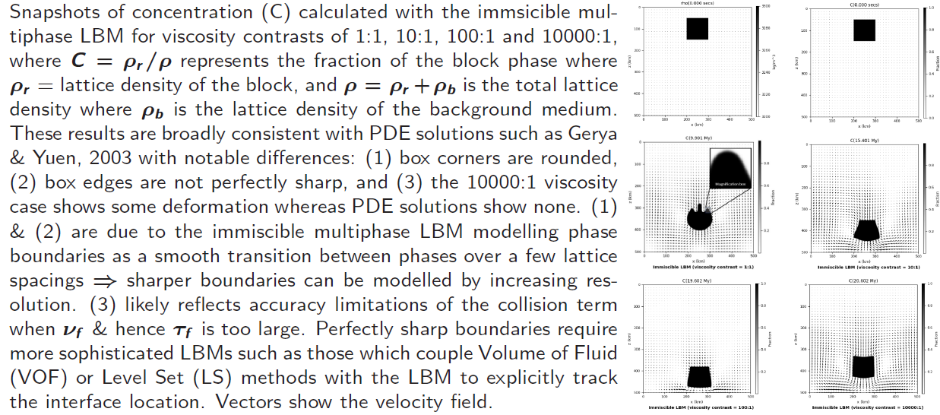
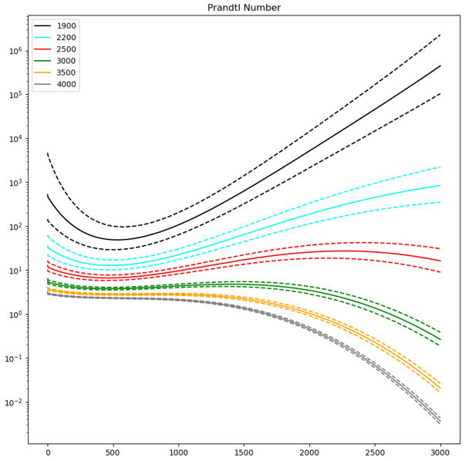
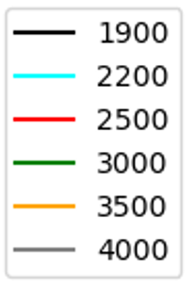

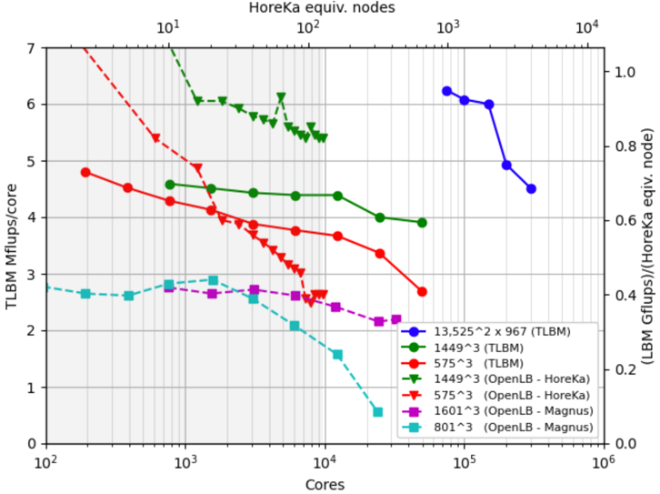



EGU26-2345
PICO|GD1.2
1. Early evolution of solid planets shaped by global MOs
Gabriele Morra, Leila Honarbakhsh, Peter Mora, Bijaya Karki and Colin Jackson
Introduction
High Ra sims to ${10}^{15}@<900 \text{core}\text{s}$
Numerical results of turbulent magma ocean convection
The early evolution of solid planets was shaped by global MOs.
Turbulent convection governs transport of heat, silicates and volatiles.
Ab-initio MD of silicate liquids ⇒ ν can vary by orders of magnitude with P & T ⇒ strongly stratified Pr ∈ [${10}^{−3}$, ${10}^{5}$].
We incorporate P-T dependent physical properties in a TLBM to explore their impact on the convective dynamics of MOs.
${Ra= 10}^{11}$ ${Ra= 10}^{13}$ ${Ra= 10}^{15}$
Real Rayleigh numbers of a MO convection are not achievable numerically but high Ra turbulent convection and correct T & P dependent Pr can be modelled.
Here we show how magma ocean dynamics is controlled by stratified Pr at a reference Rayleigh number of Ra = 10¹¹ resulting in colder adiabats having high velocities and strong vorticity at shallower depths < 1000 km.
1900 K adiabat (cold)
Temperature (K)
Speed (m/s)
Vorticity (1/s)
Thermal Lattice Boltzmann Method/TLBM
P and T dependent viscosity
Calculated pressure-density results of the model basaltic melt at 4000 K (red), 3000 K (purple), and 2200 K (cyan) with the 3rd and 4th order Birch Murnaghan Thermal EOS. The inset represents dP/dT as a function of volume ratio.
2200 K adiabat (cool)
Temperature (K)
Speed (m/s)
Vorticity (1/s)
ρ →
Pressure (GPa)
2500 K adiabat (warm)
Re scaling with Ra, Pr & aspect ratio (A)
Vogel-Fulcher-Tammann model of dynamic viscosity of basaltic
melt along different isotherms as a function of pressure in GPa.
Temperature (K)
Speed (m/s)
Vorticity (1/s)
Dynamic viscosity
Re →
Ra →
η
Re →
Re →
Pressure (GPa)
The model from Bajgain et al., 2022[4] is recalculated, using the Mie Grüneisen EOS over several adiabats. Kinematic viscosity is calculated as ν = η/ρ and finally, Pr is calculated as Pr = ν/κ.
3000 K adiabat (hot)
A →
Pr →
Adiabatic pressure
Temperature (K)
Speed (m/s)
Vorticity (1/s)
Multi-component sinking block tests
ρ
Adiabatic density
P
Adiabatic temperature
Prandtl number
K
η
Dynamic
viscosity
Pr
Depth (km)
Depth (km)
Temperature (K)
Velocity (m/s)
Depth (km)
Vorticity (1/s)
Publications and references
Conclusions
Performance and scaling of the TLBM
1. Mora, P., Morra, G., Yuen, D. & Honarbakhsh, L.(2026) Computational geodynamics to model mantle convection &magma oceans with the TLBM + strong scaling on exascale clusters, GJI, 30 pp, accepted.
2. Mora, P., Morra, G. & Yuen, D. (2021) Optimal surface tension isotropy in the Rothman-Keller colour gradient Lattice Boltzmann Method for multi-phase flow, Physical Review E, 103 (3), 033302, 19pp.
3. Morra, G., Honarbakhsh, L., Mora, P., Karki, B.B. and Jackson, C. (2025) Role of pressure and temperature-dependent viscosity and thermal diffusivity in magma ocean convection, AGU25, full paper in preparation.
4. Bajgain, S.K., Ashley, A.W., Mookherjee, M., Ghosh, D.B., and Karki, B.B. (2022) Insights into magma ocean dynamics from the transport properties of basaltic melt, Nature Communications, 13(1): 7590.
Realistic vertical profiles of MO viscosities result in stratified Pr ranging from 10 to 10⁶ for the 1900 K adiabatic profile which is close to the liquidus, down to low 10⁻³ to 1 for the 4000 K adiabatic profile.
MO convection results at Ra = 10¹¹ with the correct P-T dependent vertical profile of Pr show a transition between laminar and turbulent as Pr decreases.
For colder adiabats, high velocities and strong vorticity only happens at shallower depths < 1000 km, implying greater chemical equilibration.
Future efforts are required to test these results for higher Rayleigh numbers, asymptotically up to realistic regimes for magma ocean convection.
The TLBM written in Python with C kernels scales near linearly to 300 K cores with high performance.
This enables turbulent MO dynamics to be modeled to Ra ~ ${10}^{17}$.

Slide 2
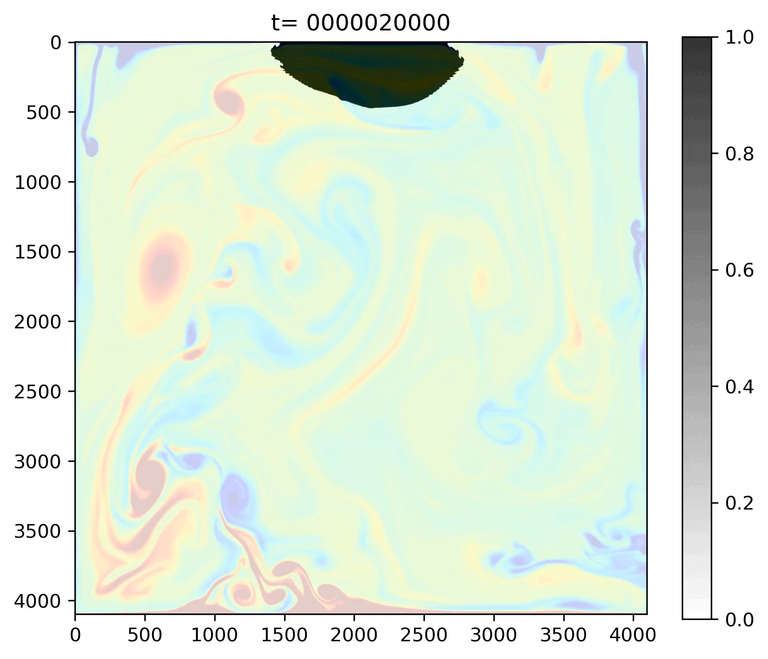
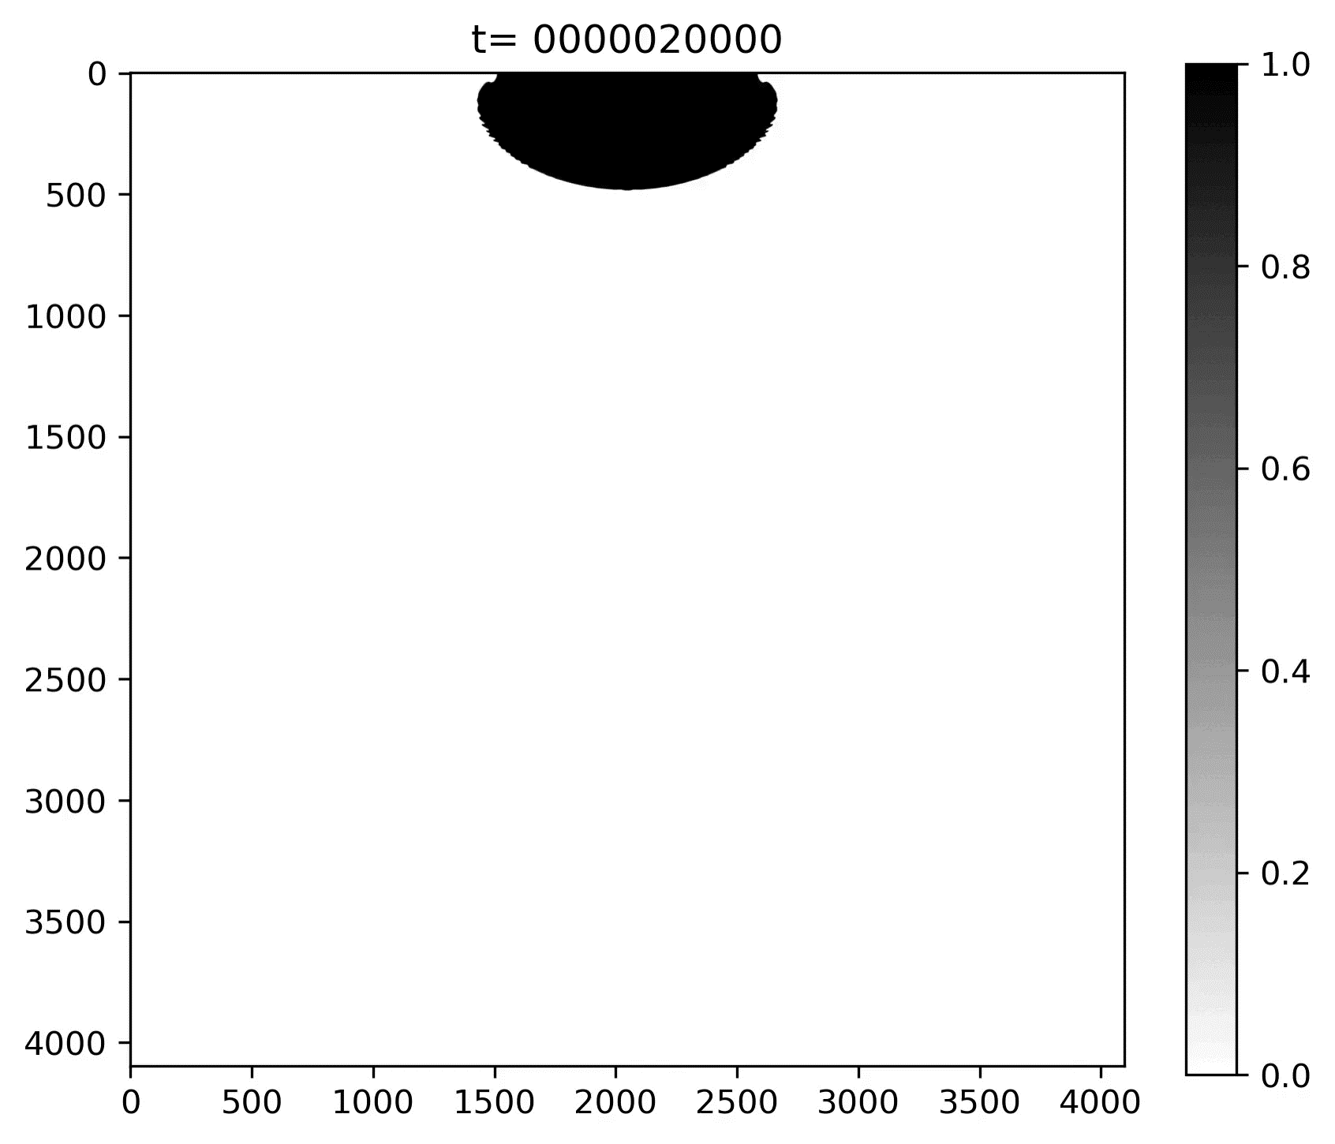
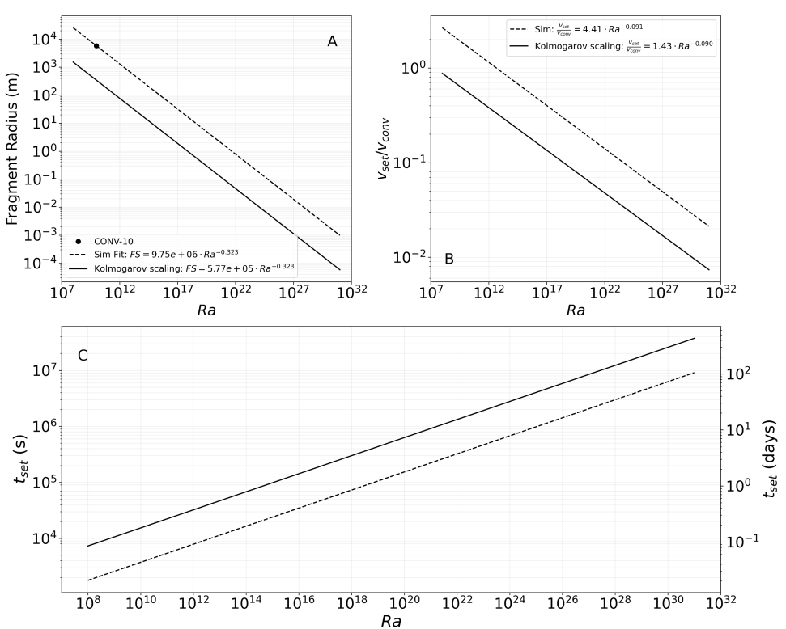
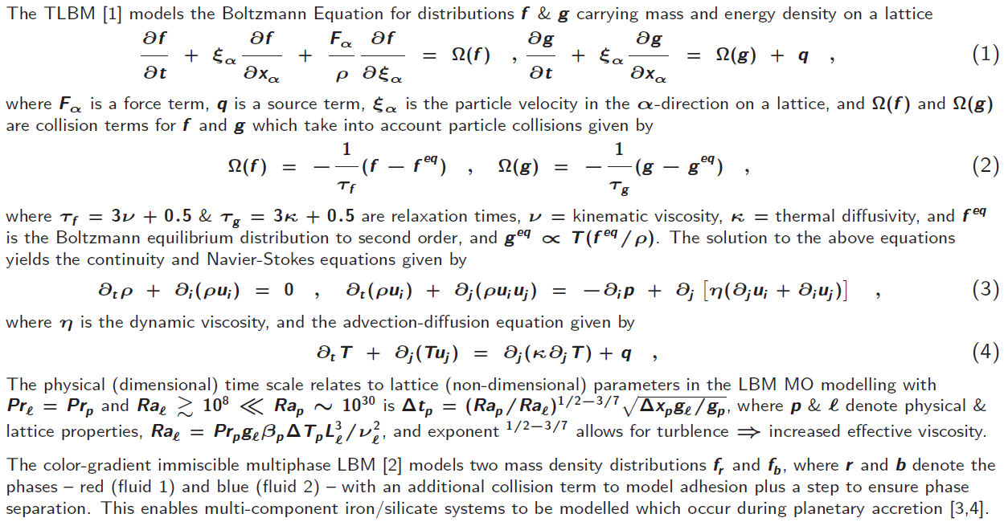
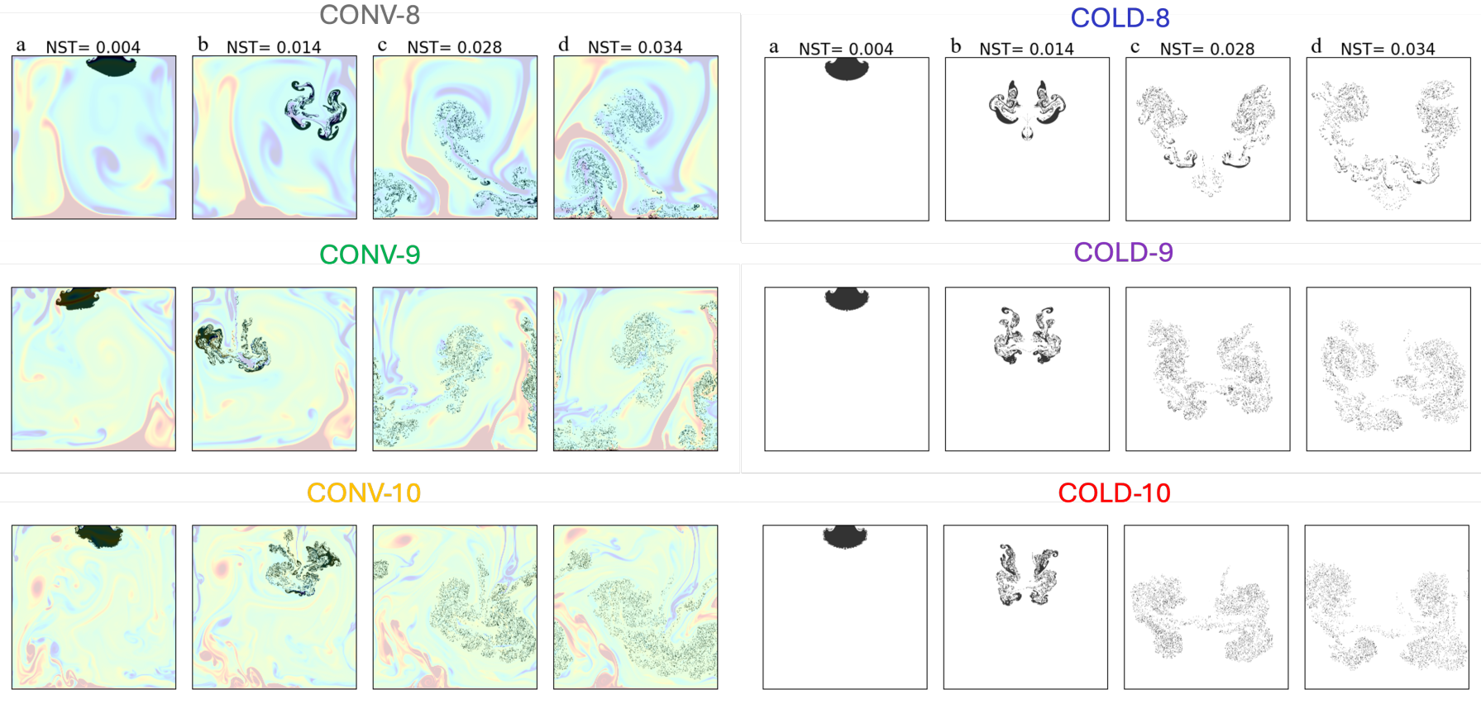
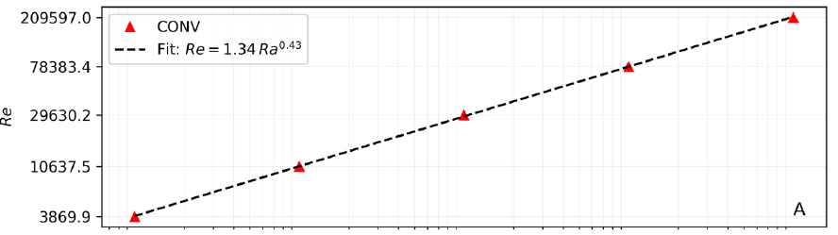
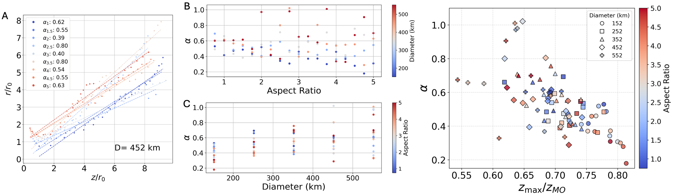
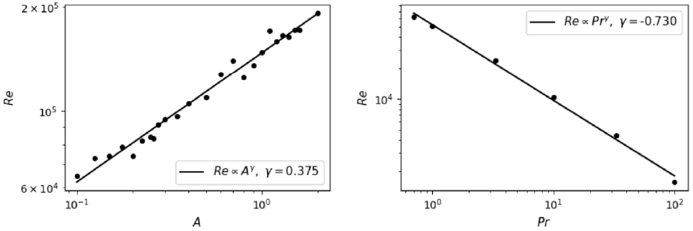
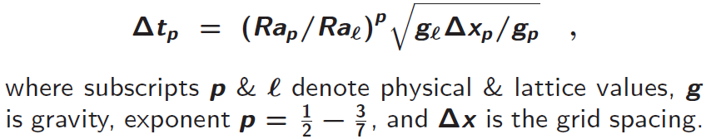
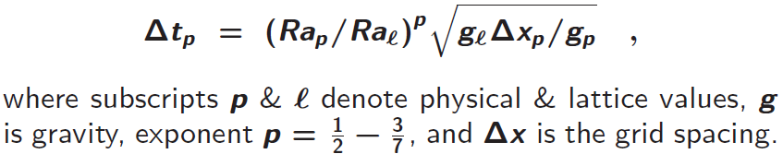
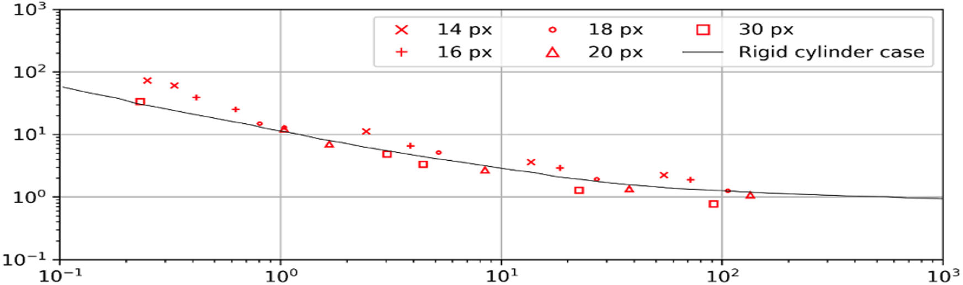




EGU26-2345
PICO|GD1.2
2. Iron-silicate interactions and iron settling during planetary accretion
Leila Honarbakhsh, Gabriele Morra, Peter Mora and Colin Jackson
Introduction
Benchmarks of sinking blocks
Fragment size, convection, settling time
During the late stages of planetary accretion, large iron rich impactors produced clouds of iron droplets which sank and mixed with silicates.
The descending droplets drag surrounding silicate material with them and this mixed metal-silicate cloud transported silicates & volatiles to the deep interior.
The efficiency that turbulence incorporates the surrounding fluid into the droplet clous is important for understanding the chemical formation of early Earth.
The dimensionless entrainment coefficient quantifies the efficiency of mixing.
We combined the multiphase and thermal Lattice Boltzmann Methods (LBMs), to model the segregation of impactors of various sizes and aspect ratios to study the effect of thermal convection, the spatial distribution of iron, the entrainment coefficient, and iron settling times during early Earth formation.
The Kolmogorov length scale FS ∼ $L_{0}{Re}^{−3/4}$and the scaling relation Re ∝ ${Ra}^{3/7}{Pr}^{−5/7}$, provide a theoretical relationship between fragment size & Ra in an MO of FS = $L_{0} {Ra}^{−0.323}$. Panel A plots this relationship and its projection from a LBM data point at ${Ra=10}^{10}$. For ${Ra  [10}^{27},{10}^{31}]$, the projection predicts FS $$ [1cm, 0.9mm]. Due to numerical limitations, our runs do not balance turbulent eddies with cohesive restoring forces so higher resolutions would be required to and obtain a better estimate of droplet size. The influence of thermal convection on iron fragment settling can be understood by comparing the convective velocity $V_{conv}$obtained from the turbulent regime scaling relation Re ∝ ${Ra}^{3/7}$, with the settling velocity $V_{set}$calculated by balancing drag and gravitational forces. Panel B shows $V_{set} /V_{conv}$ decreases with increasing turbulence (Ra) which implies that for real MOs with Ra ≳ ${10}^{27}$, the settling velocity is lower than the convective velocity, and hence, convection plays an increasingly important role in iron fragment settling. Panel C shows the settling time projections to higher Ra which and yields $t_{set }$≈ 110 days at realistic MO Rayleigh numbers.
Planetary accretion movies
Movies of a large iron rich impactor core breaking up into an iron droplet cloud in a silicate magma ocean with pre-existing thermal convection at ${Ra=10}^{10}$(CONV-10) and without thermal convection (COLD-10). Iron regions are depicted in black. Silicate regions are depicted as colours showing temperature from hot (red) to cold (blue) on the CONV-10 movie (left), and as white regions on the COLD-10 movie (right).
Immiscible thermal LBM theory
Iron-silicate interactions during planetary accretion
A
Using the TLBM combined with the immiscible multiphase LBM, we modelled iron-silicate segregation of 152 – 577 km diameter impactor cores in a 3000 km MO. Snapshots show 577 km diameter impactor core runs with pre-existing thermal convection at Ra = 10⁸ − 10¹⁰ (CONV-8–10), and without pre-existing convection (COLD-8–10), where NST is normalized time. Runs were at Pr = 1 and had Re up to 10⁴. We found that with increasing turbulence, the suspension pattern of iron fragments converges to a similar trend regardless of the presence of background thermal convection. However, by extrapolation to ${Ra=10}^{31}$, we find that thermal convection has a significant effect on iron fragment dynamics. Convective MO velocities are around 30 m/s which is consistent with other studies.
Fragment radius (m)
$V_{set} /V_{conv}$ →
Ra →
B
Ra →
C
$t_{set}$ (s)
$t_{set}$ (days)
Ra →
Entrainment coefficient
Benchmarks of Re scaling with Ra, A and Pr
We determined the entrainment coefficient α for an impactor with various diameters and aspect ratios in the range of 0.75 to 5. By establishing a linear fit line for the impactor's iron cloud growth versus penetration depth, we obtained entrainment coefficients within the range of 0.2 to 1, which can be compared to experimental results [7] which fall within a narrower range of 0.2 to 0.3.
LBM simulation data at high Ra in the turbulent regime (Ra ≳ ${10}^{8}$) and best-fit Reynolds number (Re) scaling relations with
Ra, A and Pr. The best-fit Re scaling relations are consistent with theoretical predictions and experimental studies
(Siggia, 1994[5]) of Re ∝ ${Ra}^{3/7}$and Re ∝ ${Pr}^{−5/7}$. The Re − A scaling runs were done at ${Ra=10}^{11}$and Pr = 1.11, and the Re − Pr scaling runs were done at ${Ra=10}^{11}$and A = 1.
The physical (dimensional) time scale of simulations in the turbulent regime is obtained rearranging the physical and lattice (dimensionless) Froude numbers, and allowing for the turbulent scaling of Re ∝ ${Ra}^{3/7}$ which leads to
Re →
Ra →
Ra
The snapshots show iron regions in black, with the colours in CONV plots depicting temperature of the silicate regions, and white in COLD plots depicting silicate regions.
Re →
Re →
A →
Pr →
Publications and references
Benchmarks of drag coefficient $C_{d}$ scaling with Re
1. Mora, P., Morra, G., Yuen, D. & Honarbakhsh, L. (2026) Computational geodynamics to model mantle convection &magma oceans with the TLBM + strong scaling on exascale clusters, GJI, 30 pp, accepted.
2. Mora, P., Morra, G. & Yuen, D. (2021) Optimal surface tension isotropy in the Rothman-Keller colour gradient Lattice Boltzmann Method for multi-phase flow, Physical Review E, 103 (3), 033302, 19pp.
3. Honarbakhsh, L., Morra, G., Mora, P. and Jackson, C. (2026) Iron-silicate segregation in a convecting magma ocean via the Thermal LBM: Implication on iron-silicate mixing, Journal of Geophysical Research, Planets, 44pp, 2nd revision submitted.
4. Honarbakhsh, L., Morra, G., Mora, P. and Jackson, C. (2026) Metal-Silicate Segregation During Planetary Accretion: Limited Iron Emulsification, Icarus, 39pp, submitted.
5. Siggia, E. (1994) High Rayleigh number convection, Annual Reviews of Fluid Mechanics, 26, 137–168.
6. Tritton, D. J. (2012) Physical fluid dynamics, Springer Science & Business Media.
7. Deguen, R., Olson, P. and Cardin, P. (2011) Experiments on turbulent metal-silicate mixing in a magma ocean, Earth and Planetary Science Letters, 310(3-4), 303-313.
We performed benchmarks of the drag coefficient $C_{d}$ of droplets versus Re. The plot shows our 2D LBM results as red symbols where the symbol depends on the droplet size, and analytical results from [6] for a rigid circular cylinder. The trend of the LBM results matches well with that of the analytical results, although with some scatter depending on droplet size.
Conclusions
Thermal convection only modestly influences the spatial distribution of iron droplets in MOs due to the breakup of iron rich impactors.
Vigorous thermal convection tends to confine fragments of smaller impactors to deeper regions, cf. fragments of larger impactors disperse throughout all depths.
The iron settling time is of order 30 days in the model where the smallest iron droplet size is around 10 km due to the resolution limits of modelling.
Based on the modelling results and the Kolmogorov length scale relation, the iron settling time is of order 110 days for fragment sizes in the range of cm to mm.
The model predicts entrainment coefficients in the range 0.2 to 1 which is comparable to experimental results of 0.2 to 0.3.
The multiphase TLBM provides a new tool to help improve understanding of iron fragment dispersion which is essential for constraining core-mantle volatile segregation and the resulting chemical evolution during magma ocean stages of early Earth.
$C_{d}$
Re

