Slide 1

Crustal deformation in eastern margin of Tibetan Plateau from a dense linear seismic array
Presenter: Tan Ping¹
Collaborators: Chen Yun²,Nie Shitan²
¹ Institute of Disaster Prevention, China
² Institute of Geology and Geophysics, Chinese Academy of Sciences
2026.5.5

Slide 2
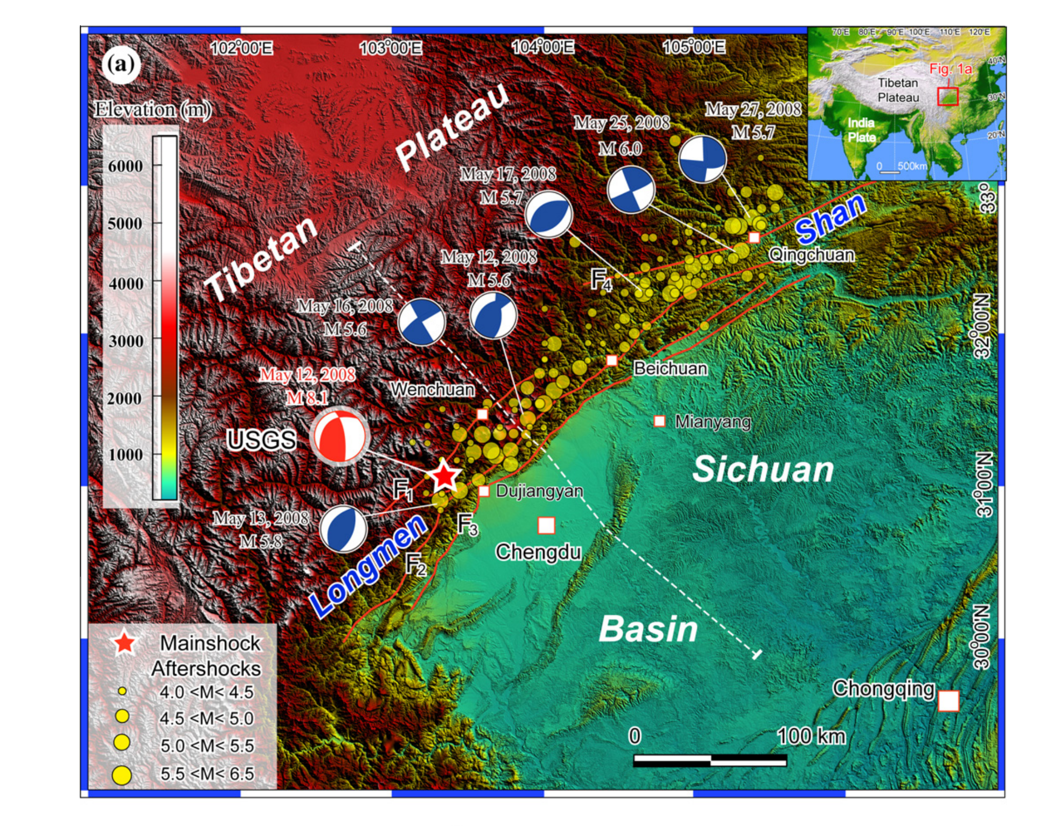
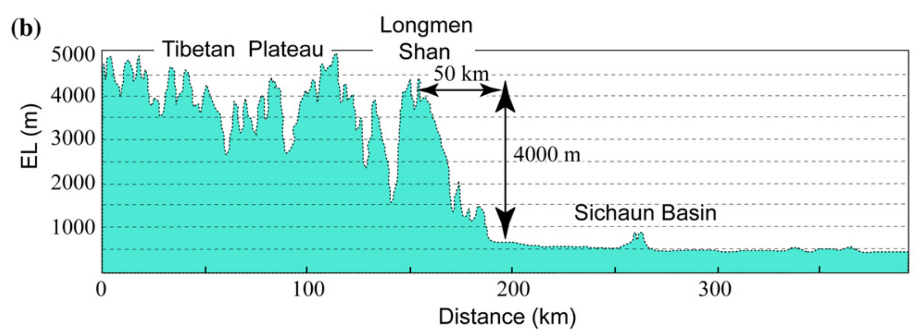
Key Scientific Questions
Fu et al., 2011, JAES
Topographic map of the eastern margin of the Tibetan Plateau

Slide 3
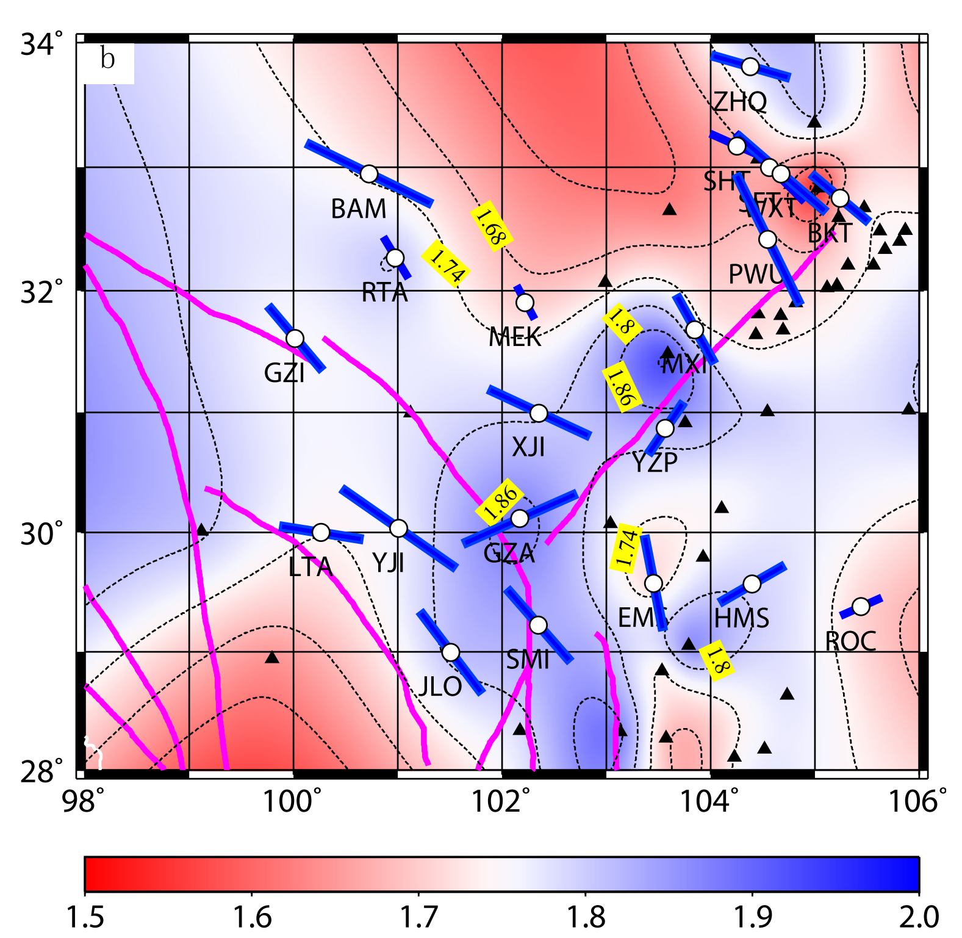
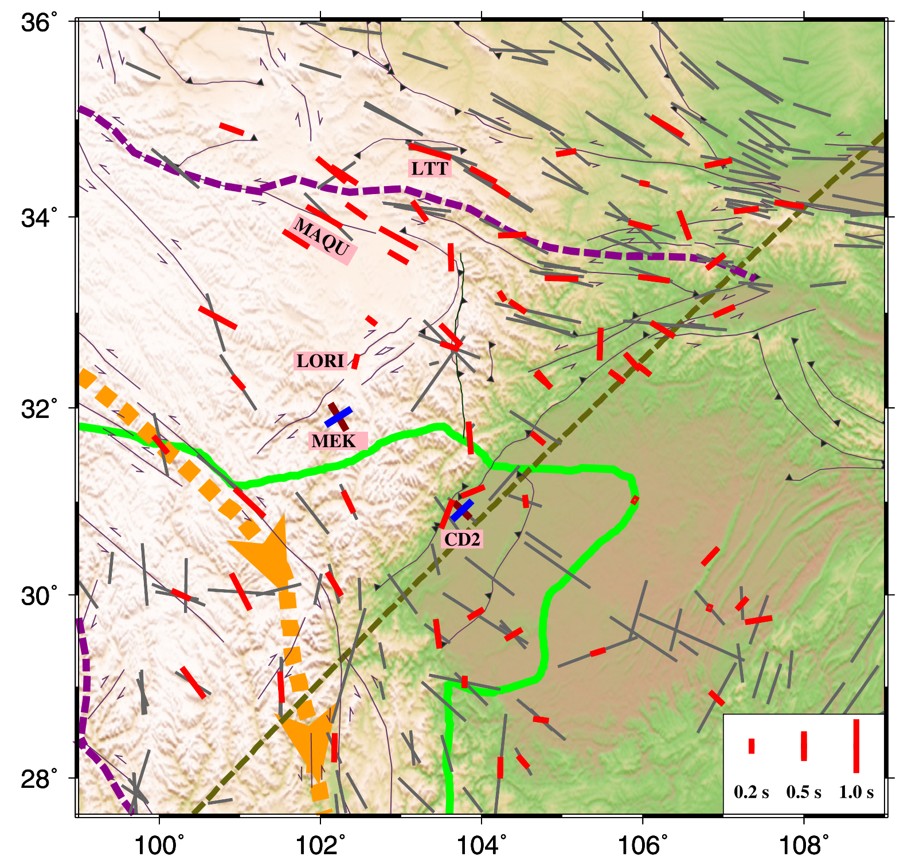
Key Scientific Questions
Sun et al., 2015, PEPI
Kong et al., 2016, EPSL
comparable delay times, propose the crustal anisotropy is attributed to the lower crustal flow
weak crustal anisotropy, suggest the absence of strong crustal flow

Slide 4
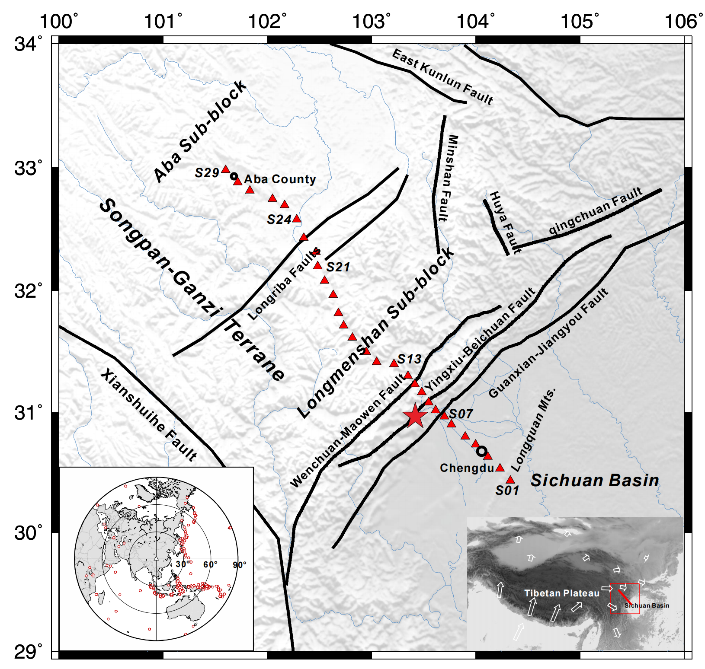
Data
Stations:
Sichuan basin to east Tibet
29 stations
station intervals: 10 km
RFs:
264 earthquakes, Ms>5.0, 30°-90°
1837 radial RFs
Distribution Map of Stations

Slide 5
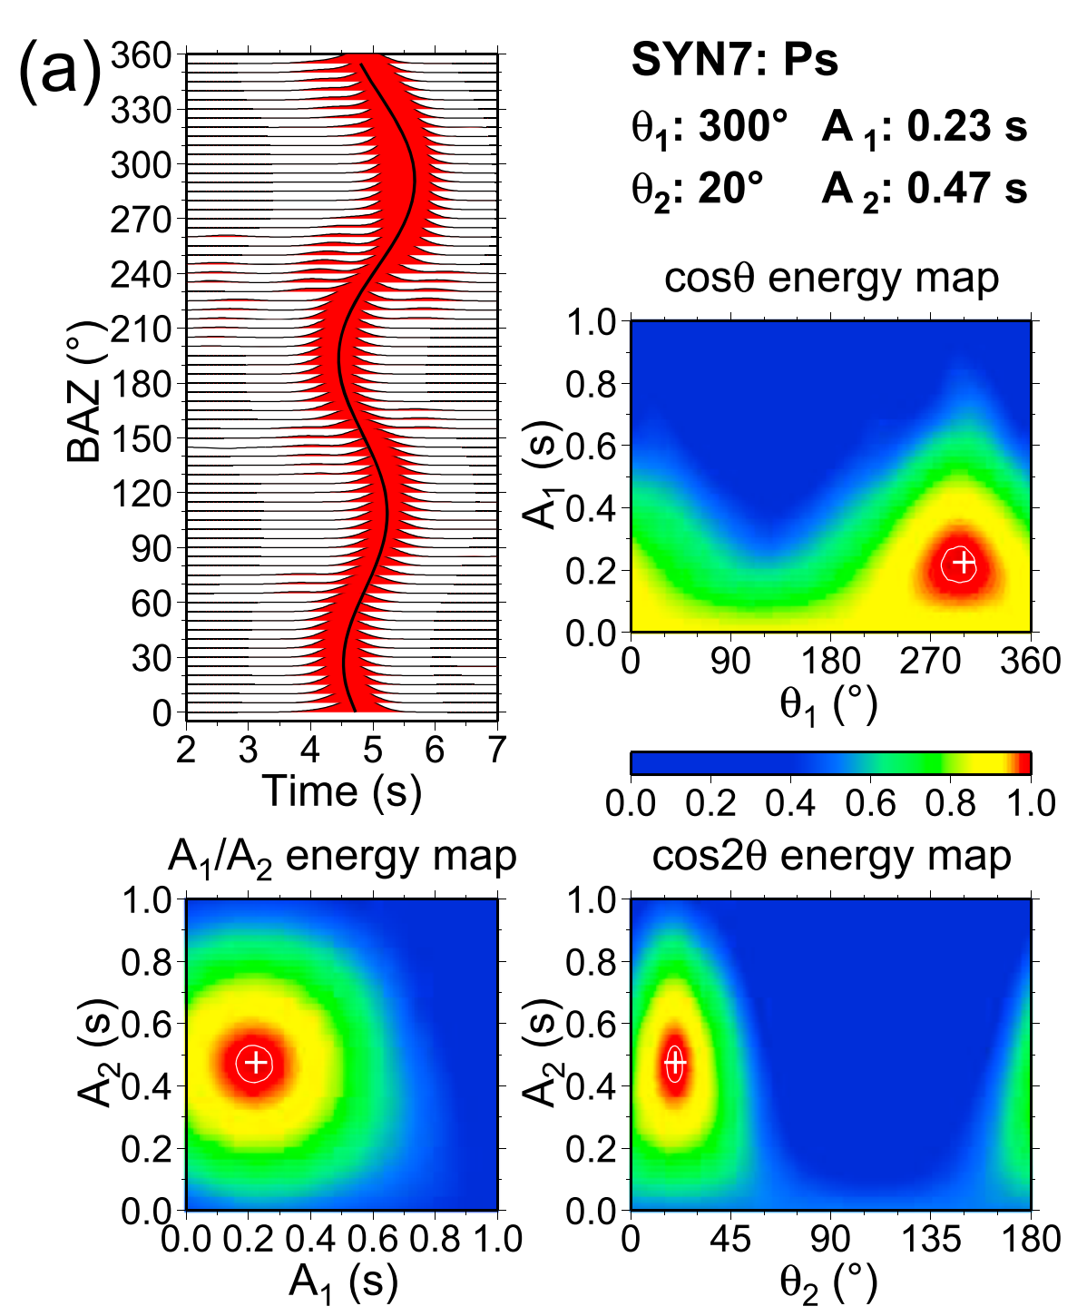
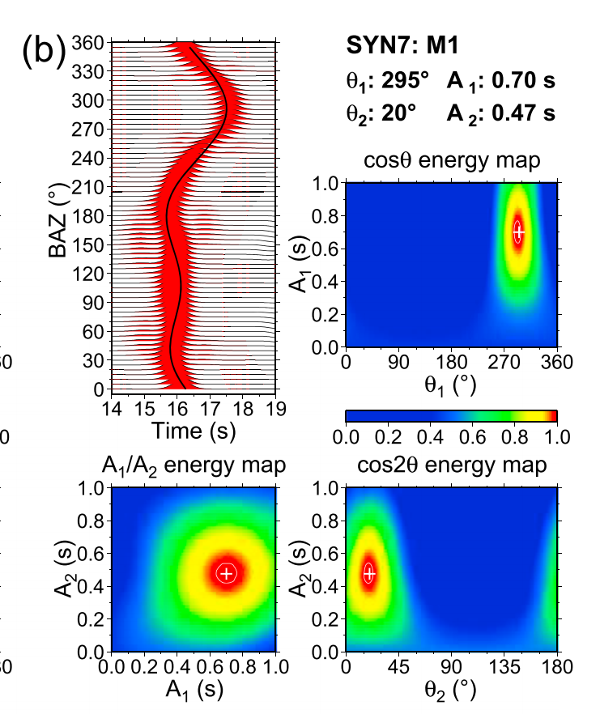
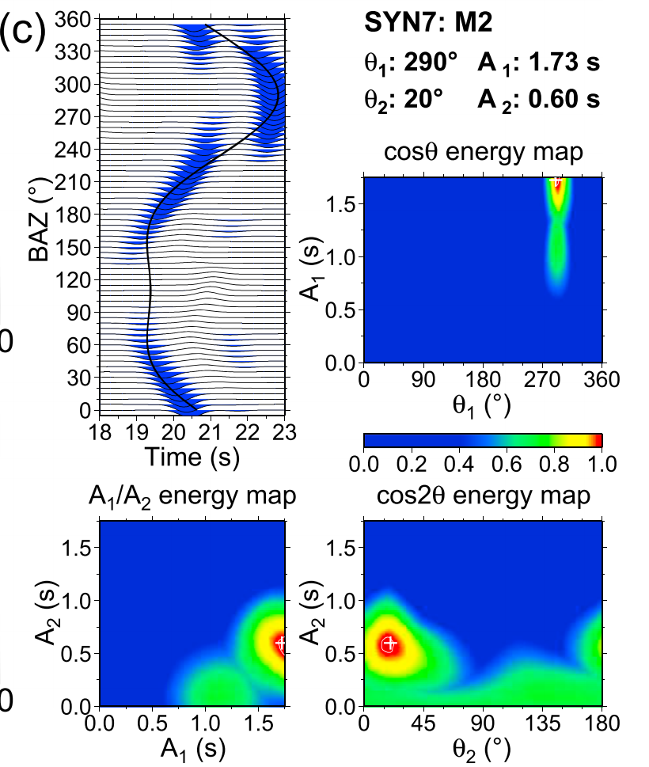

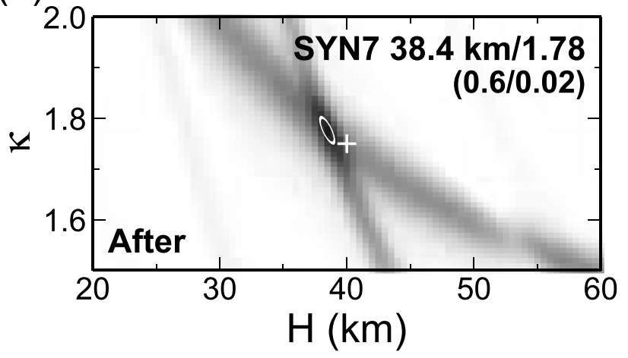
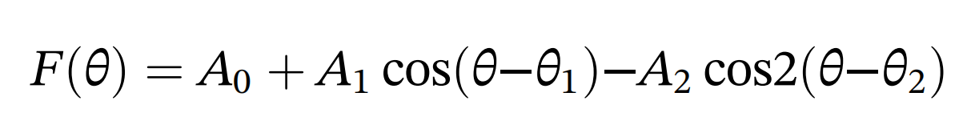
Method
Harmonic Fitting:
H‐κ‐c Stacking:
Li et al., 2019, JGR

Slide 6
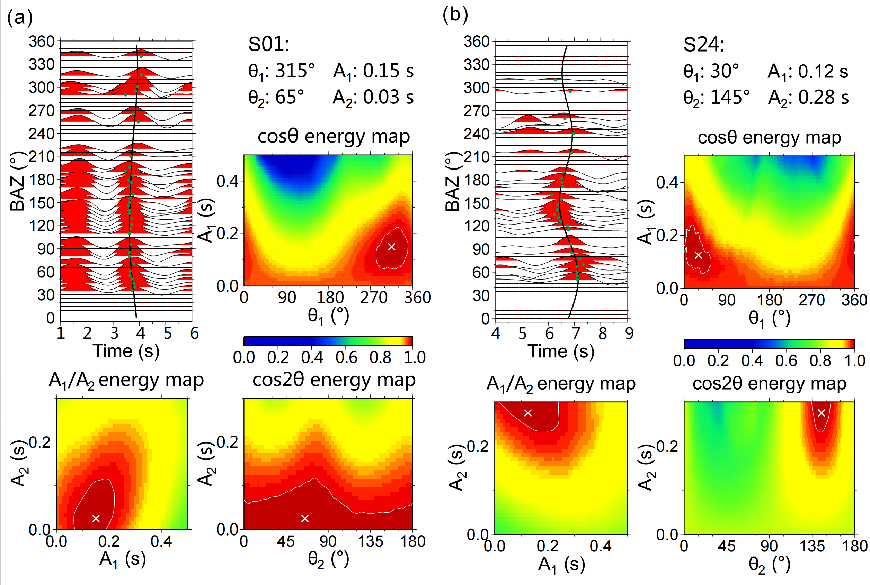
Result
Examples:
Sichuan basin
Songpan-Ganzi
terrane
delay time: 0.06 s, weak anisotropy
delay time: 0.56 s, strong anisotropy

Slide 7
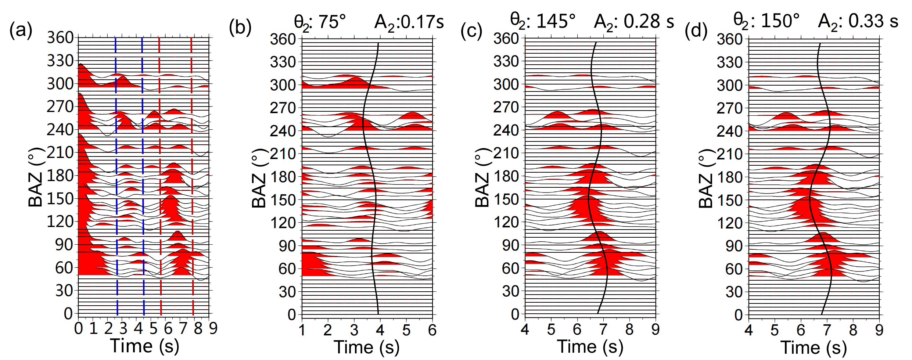
Result
Layer stripping method:
Double-layer anisotropy measurement at station S24

Slide 8
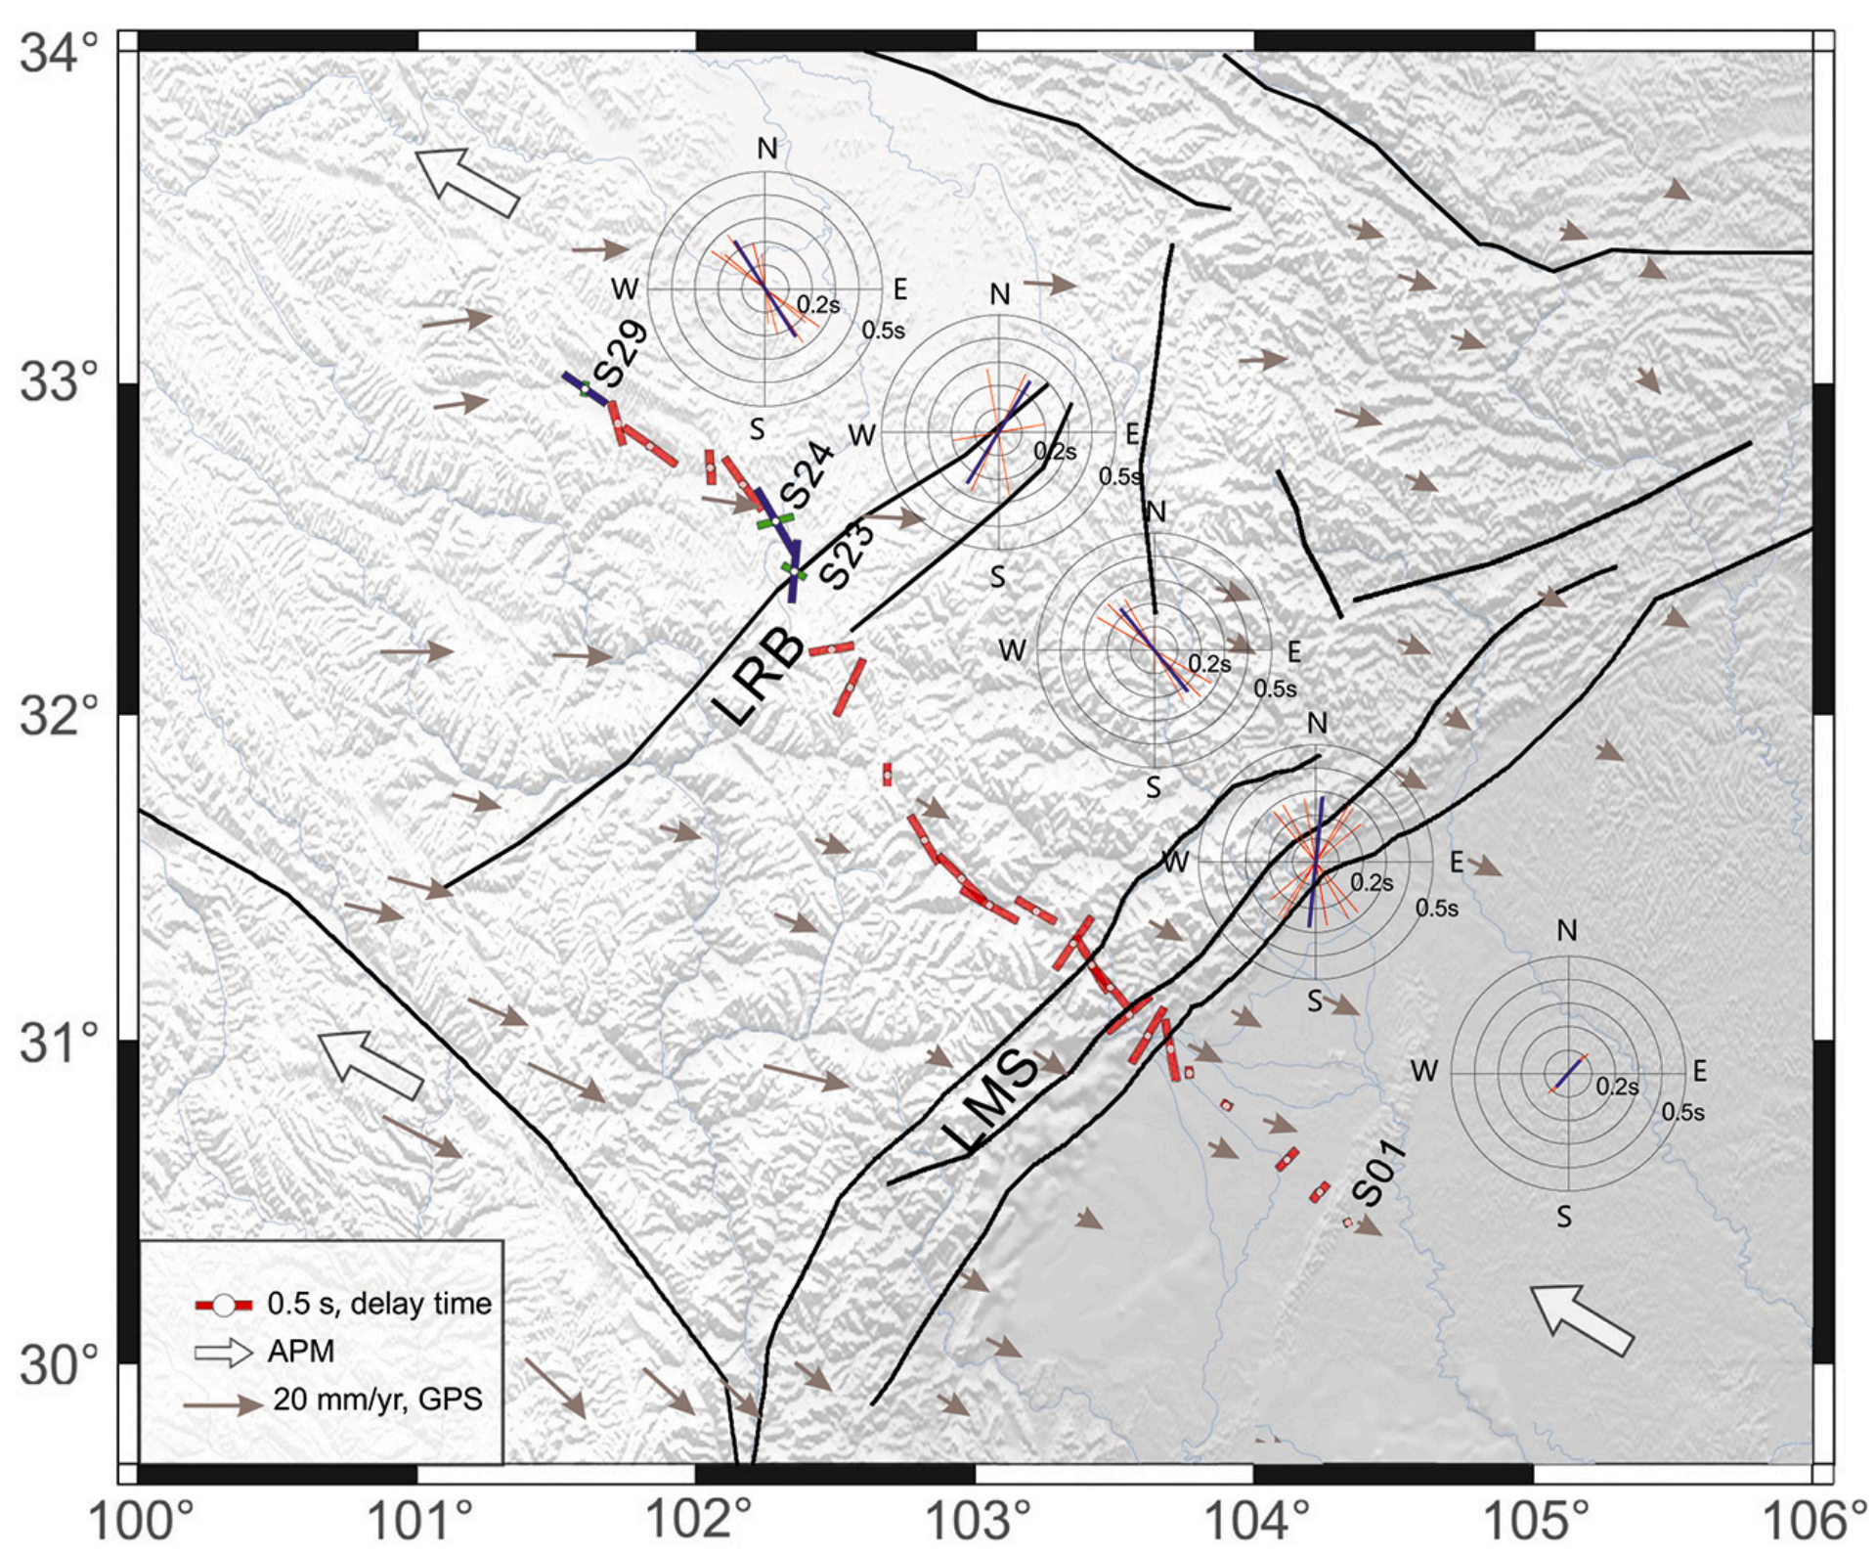
Result
δt varies from s less than 0.1 s to 0.56 s
Songpan-Ganzi terrane: 0.49 s
Sichuan basin: 0.14 s (a weak anisotropy)
FPDs:
Sichuan basin: NE-SW, parallel to the surface geological features
Crustal anisotropy of the entire array

Slide 9
Result
FPDs:
Songpan-Ganzi terrane: notable variations
Aba sub-block: dominant FPDs is NW-SE
Longriba faults: NE-SW
Longmenshan sub-block: all in the NW-SE
Longmenshan fault belt: mostly parallel to the strike of the fault
Crustal anisotropy of the entire array
Notes:
The measurements of the double-layer anisotropy from S24 and S29
located in the Aba sub-block are characterized by weak upper crustal
anisotropy but strong middle-lower crustal anisotropy, and exhibits
consistent FPDs of NW-SE. Station S23 located in the Longriba
faults reveal a weak upper crustal anisotropy and a strong nearly N-S
directed middle-lower crustal anisotropy, which indicated the crustal anisotropy in the Longriba faults also mainly come from the middle_x0002_lower crust.

Slide 10
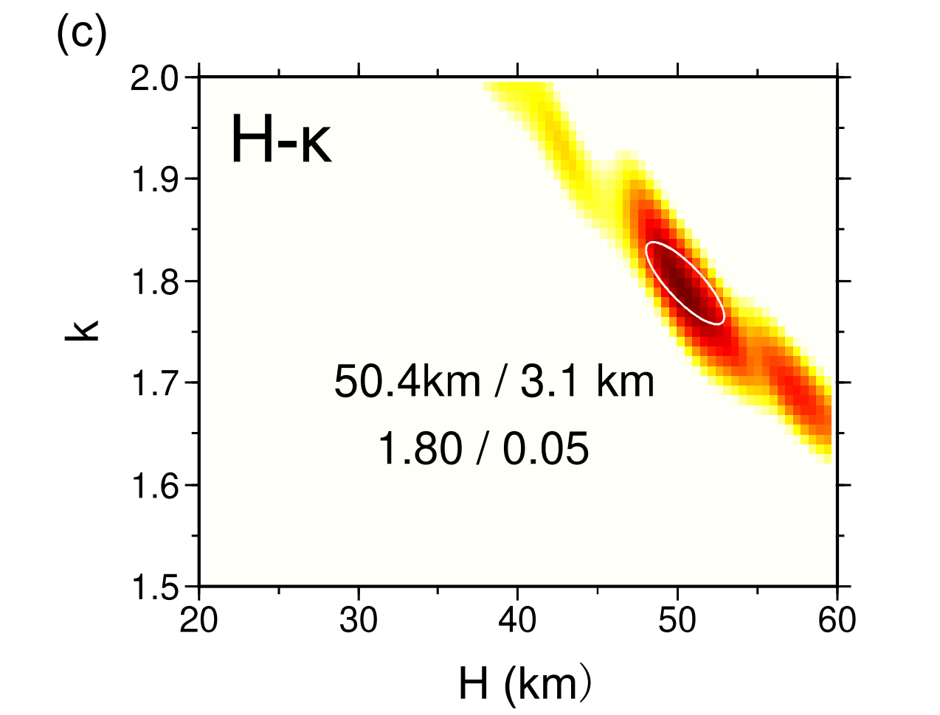
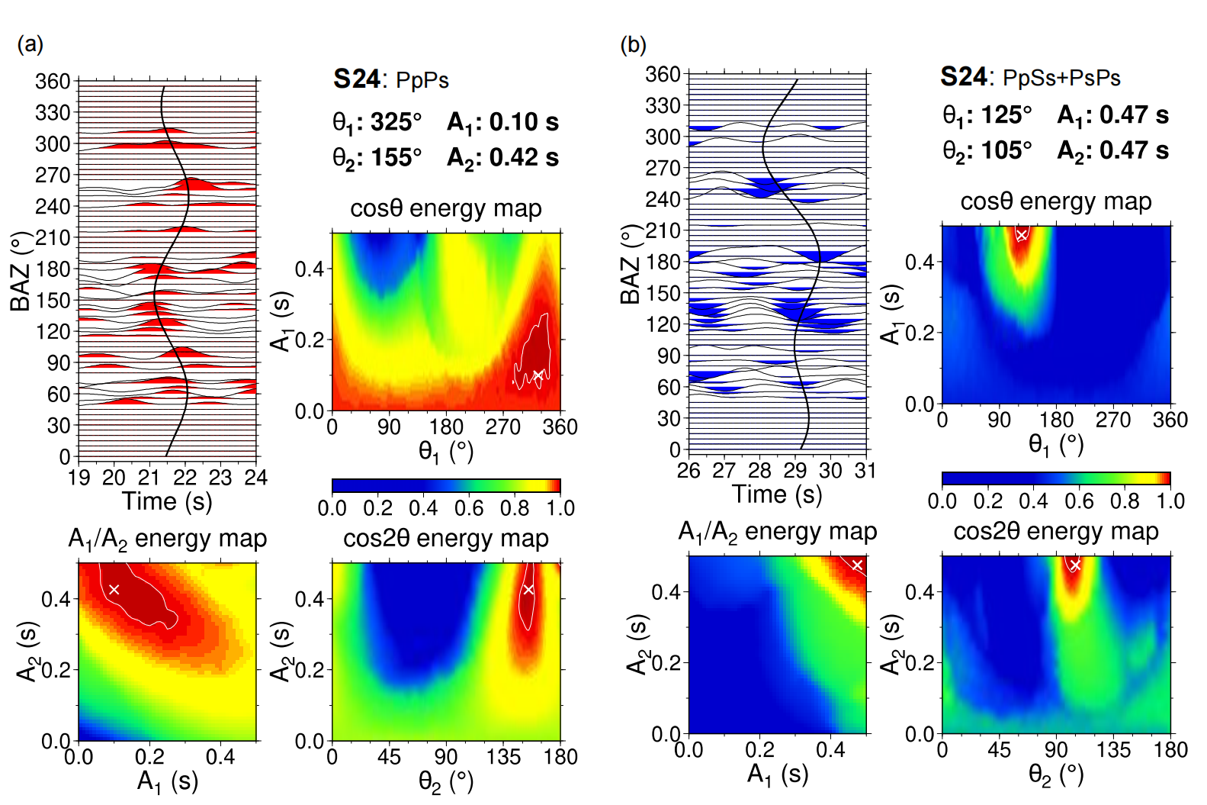
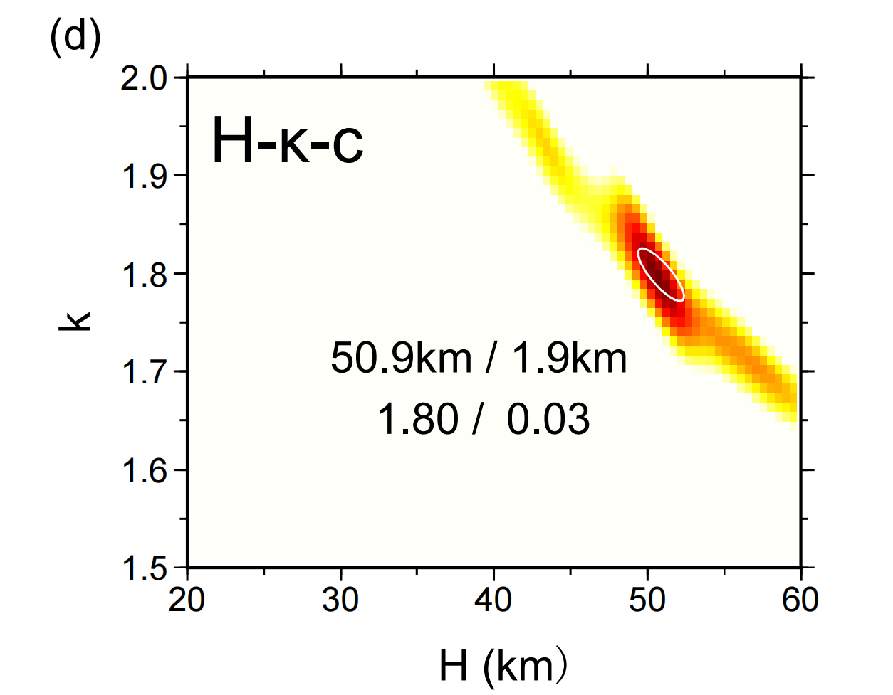
Result
H-κ and H-κ-c stacking result in S24
Notes:
The measurements of the double-layer anisotropy from S24 and S29
located in the Aba sub-block are characterized by weak upper crustal
anisotropy but strong middle-lower crustal anisotropy, and exhibits
consistent FPDs of NW-SE. Station S23 located in the Longriba
faults reveal a weak upper crustal anisotropy and a strong nearly N-S
directed middle-lower crustal anisotropy, which indicated the crustal anisotropy in the Longriba faults also mainly come from the middle_x0002_lower crust.

Slide 11
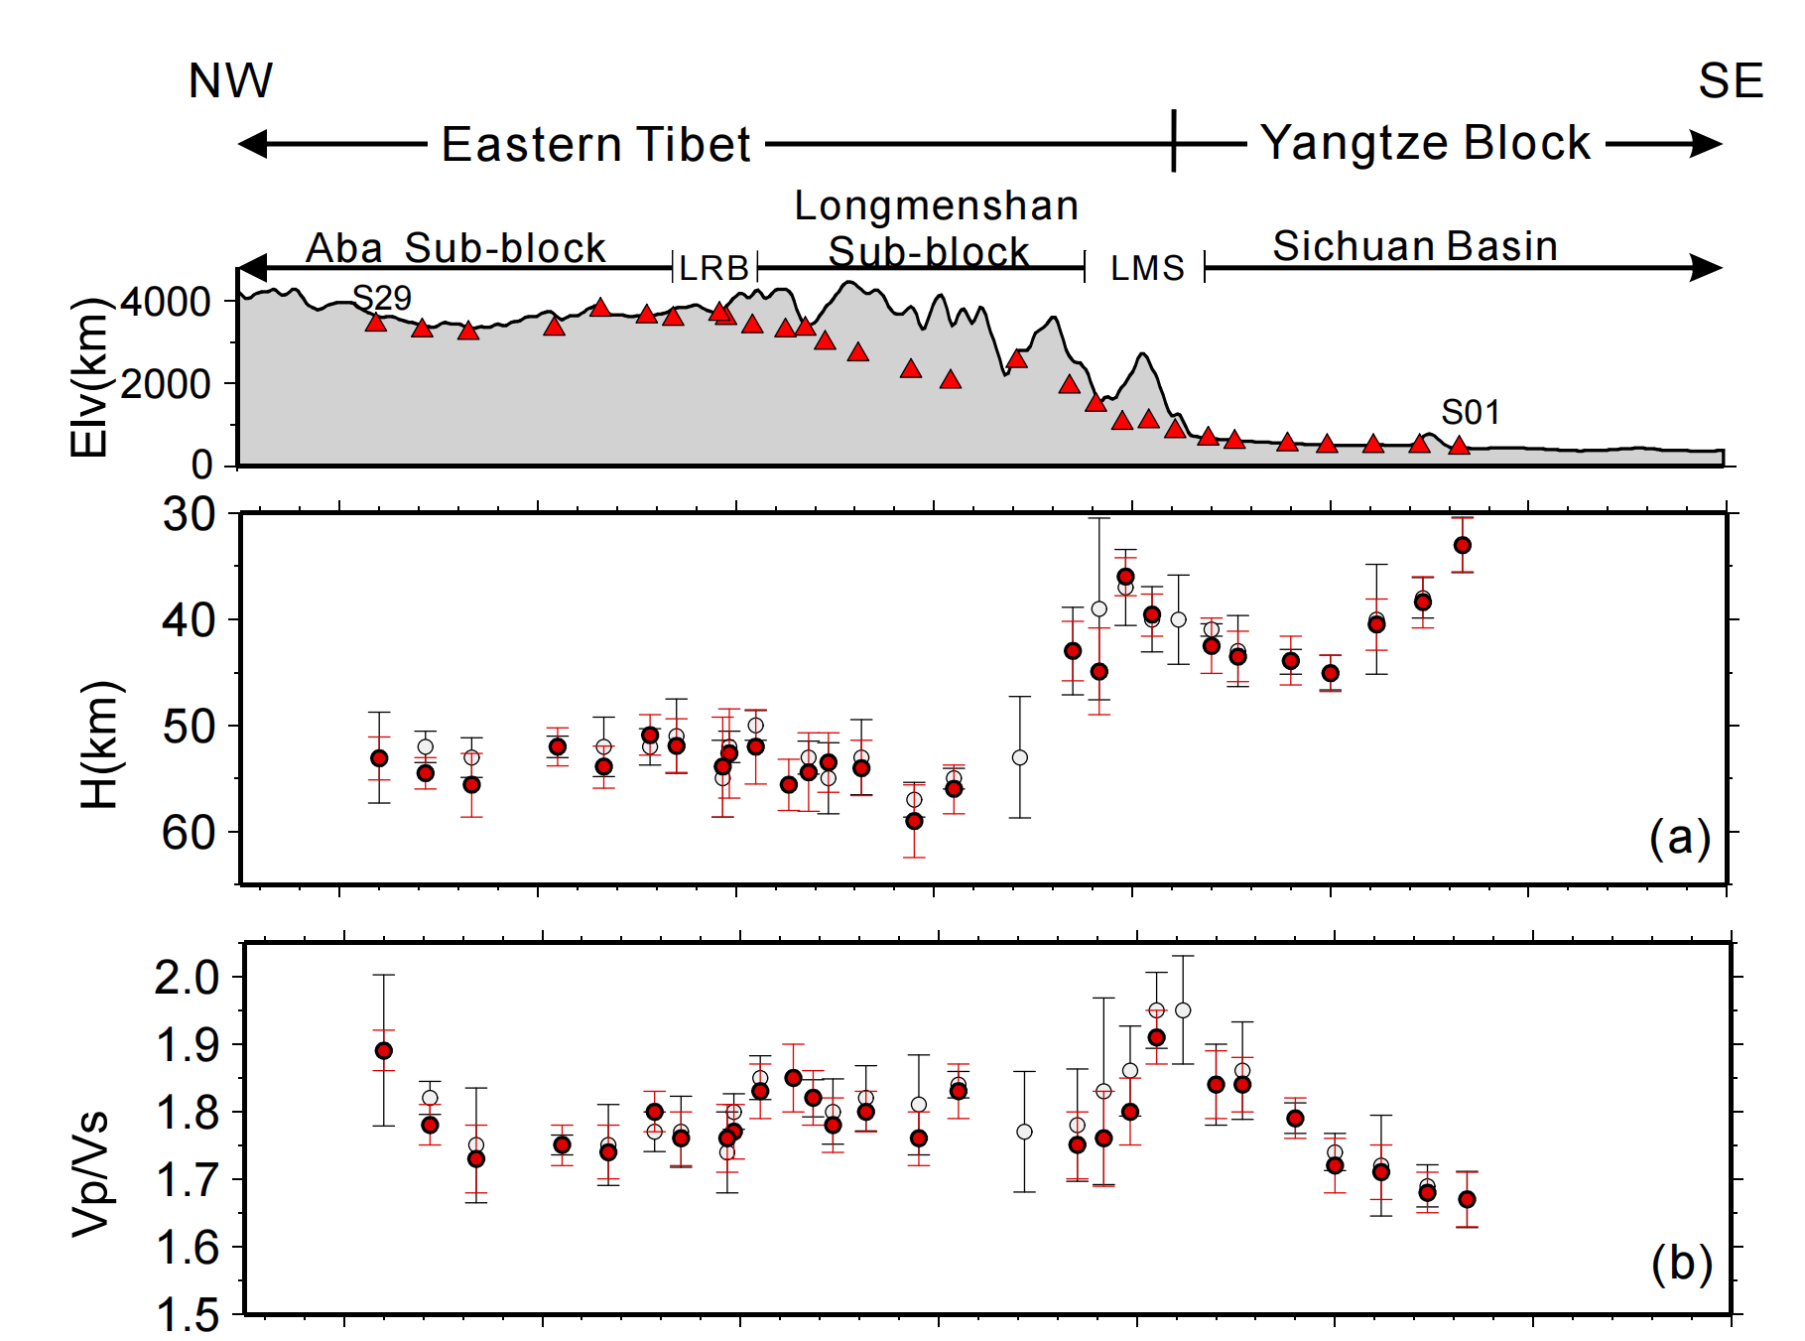
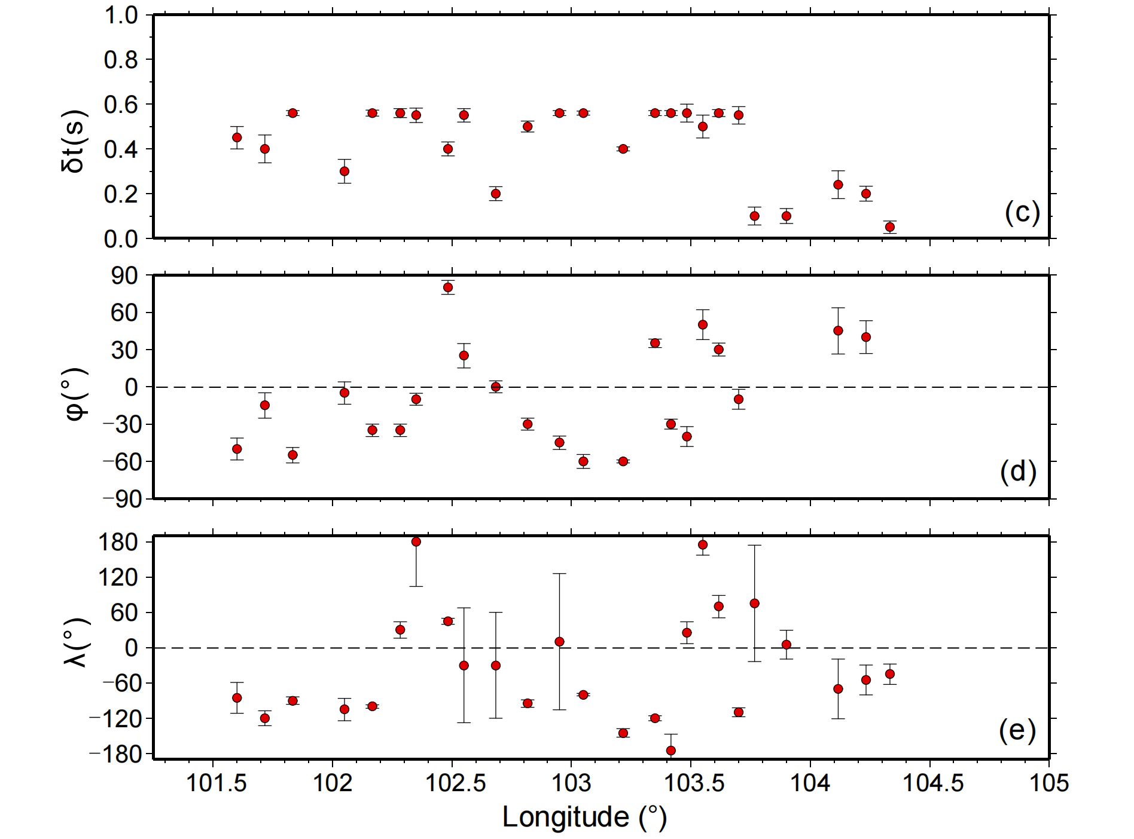

Result
δt
H
φ
$$κ$$
λ

Slide 12
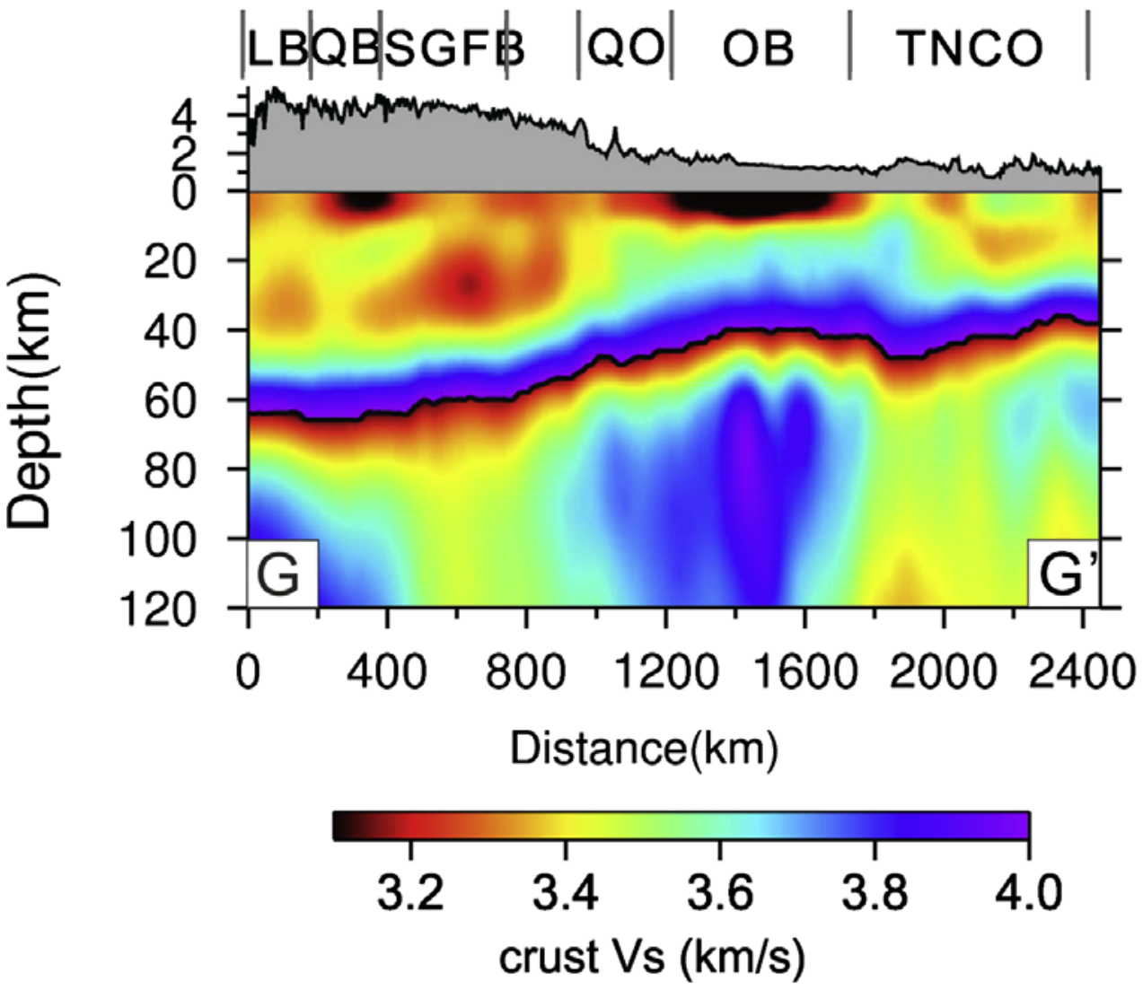
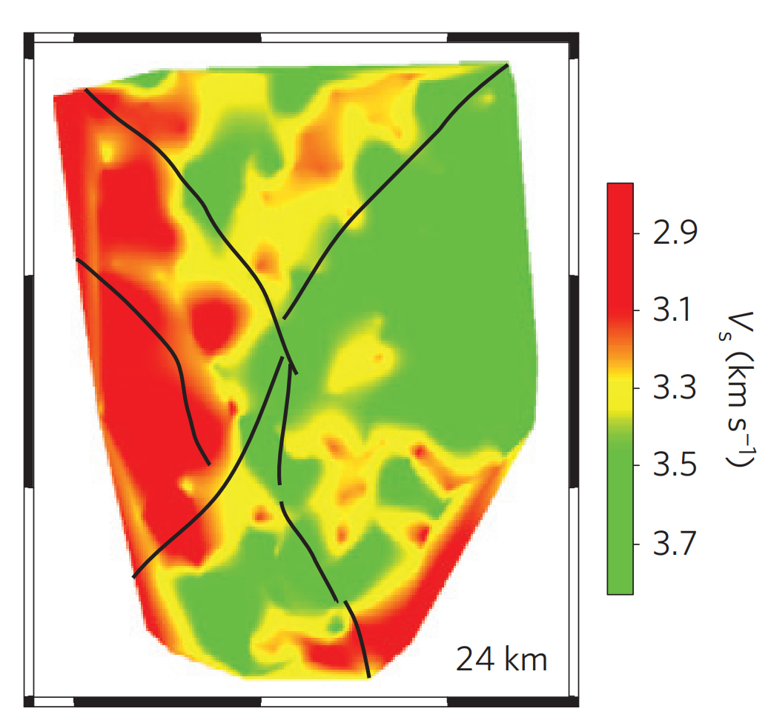
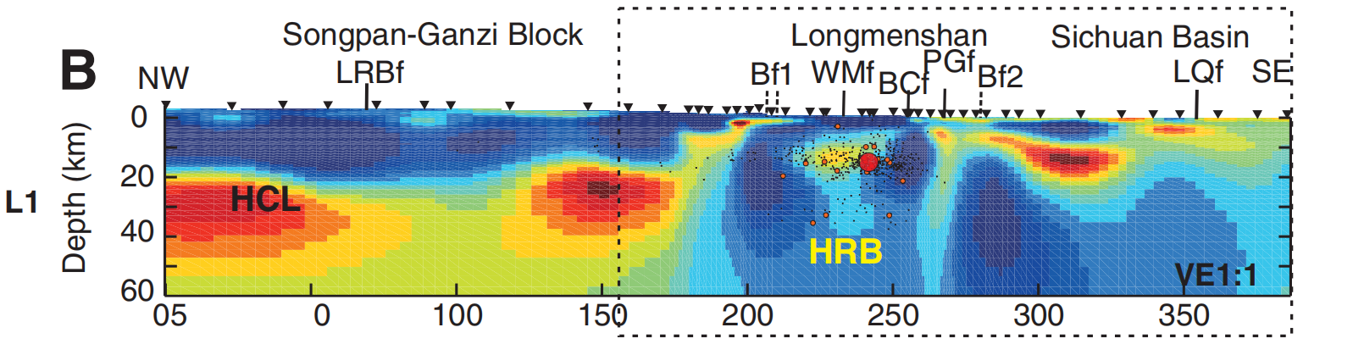
Discussion 1
Formation mechanisms of the Aba sub-block:
Bao et al., 2013, EPSL
Liu et al., 2014, Nature Geo.
Crustal anisotropy
Zhao et al., 2012, Geology

Slide 13
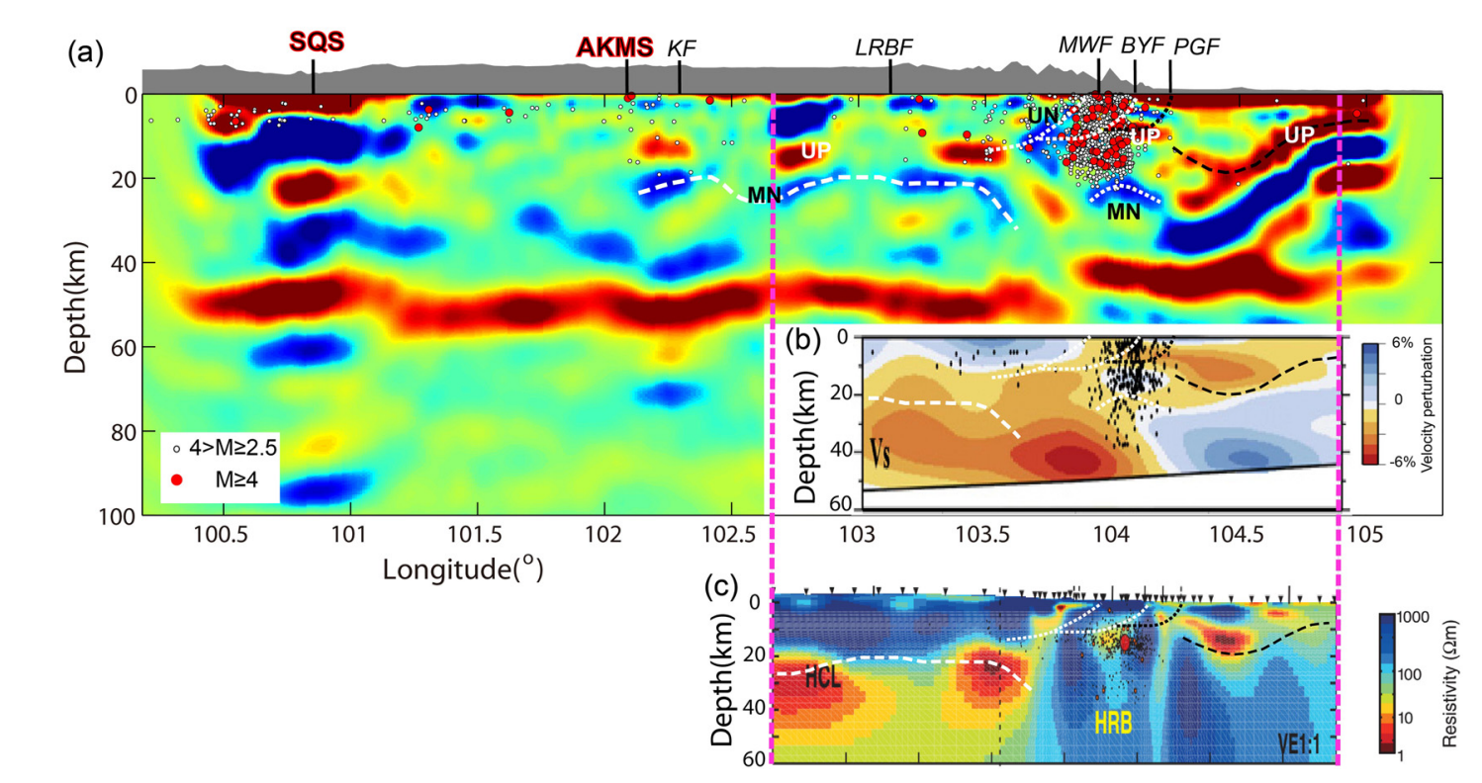
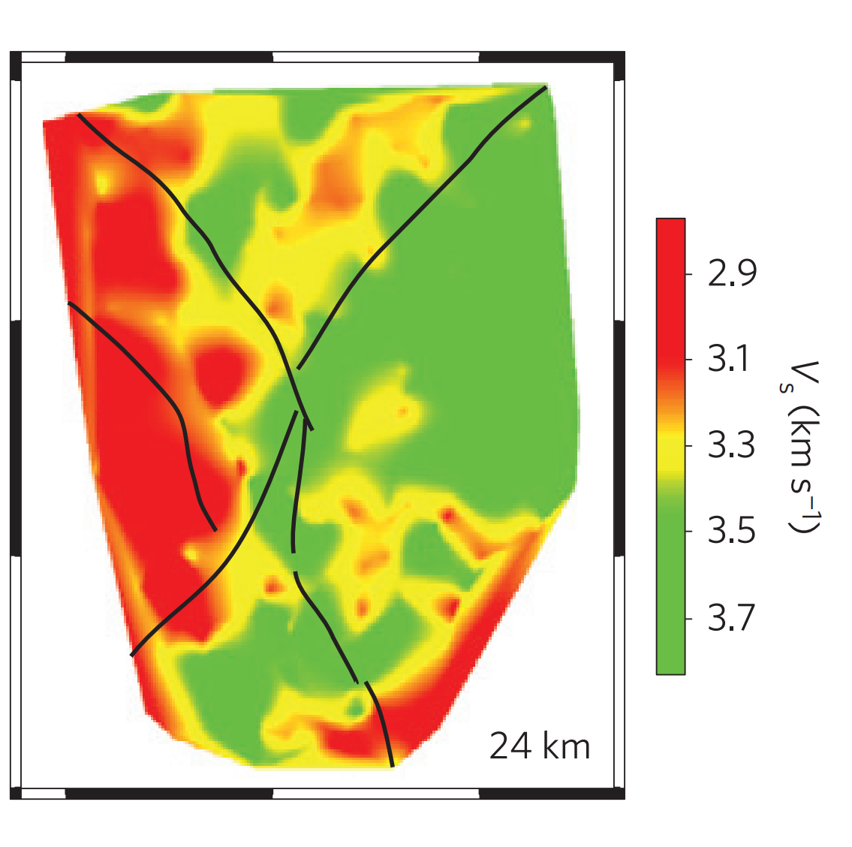
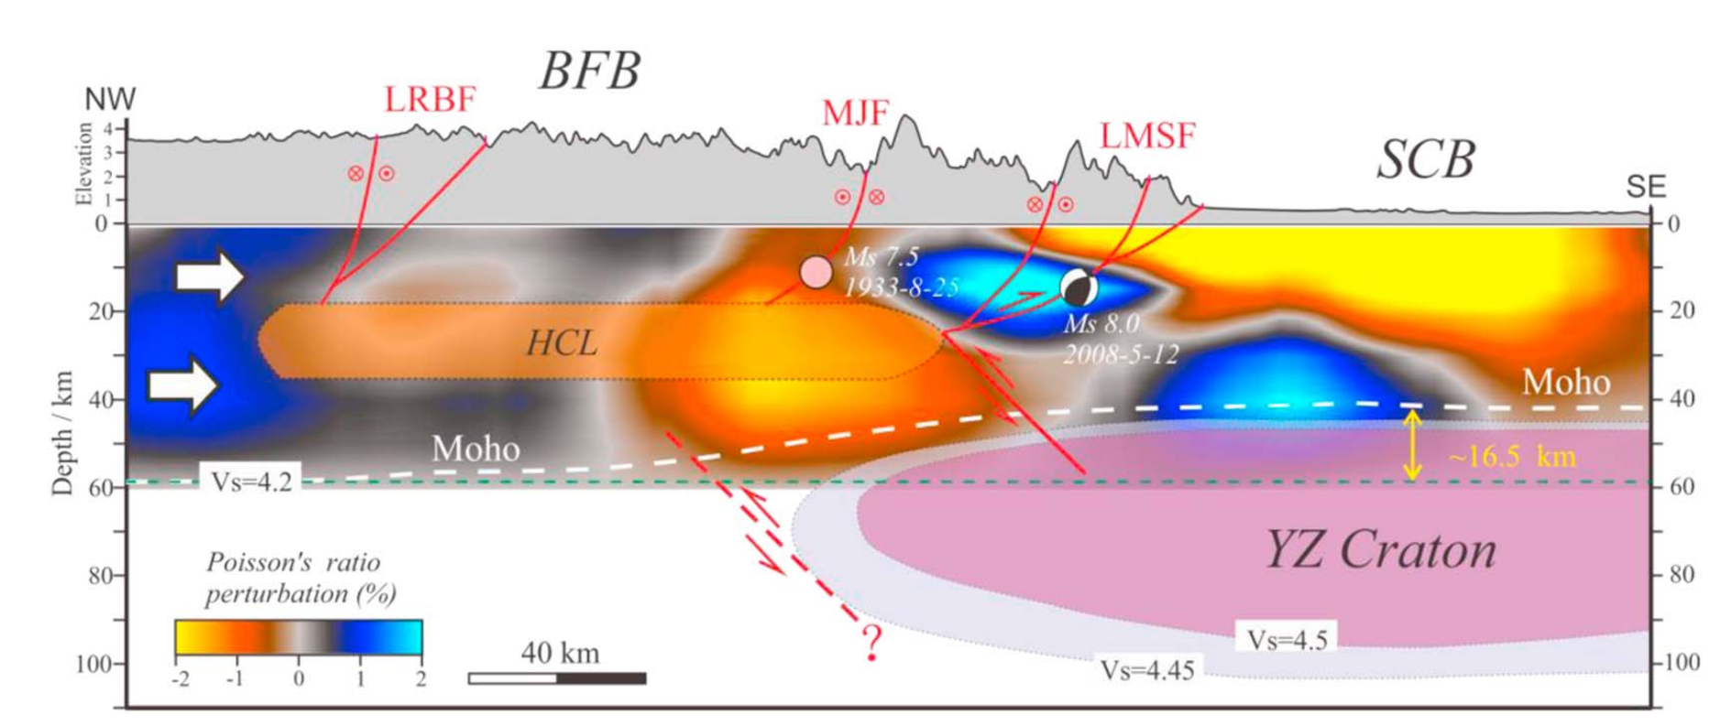
Discussion 2
The Longriba faults block the crustal flow from the plateau
Wang et al., 2018
EPSL
Wang et al., 2014
Tectonophysics
Zhao et al., 2012, Geology
Crustal anisotropy
Liu et al., 2014, Nature Geo.
Lu et al., 2019, Tectonics

Slide 14
Discussion 3
Formation mechanisms of the Longmenshan sub-block
Crustal anisotropy

Slide 15
Thank you for your attention and time.

