Slide 1
The Influence of Tropopause Potential Vorticity Circulation Forcing on the Development of the East Asian Cold Wave in December 2023
Yanxi Li^{a, c}, Guoxiong Wu^{a, c}, Yimin Liu^{a, c*}, Bian He^{a, c},
Jiangyu Mao^{b,c}, Chen Sheng^{b, c*}
ªNational Key Laboratory of Earth System Numerical Modeling and Application, Institute of Atmospheric Physics, Chinese Academy of Sciences, Beijing, 100029, China
^{b}State Key Laboratory of Numerical Modeling for Atmospheric Sciences and Geophysical Fluid Dynamics (LASG), Institute of Atmospheric Physics, Chinese Academy of Sciences, Beijing, 100029, China
^{c}University of Chinese Academy of Sciences, Beijing 100049, China
Notes:
Good morning/afternoon, everyone. I’m Yanxi Li from the Institute of Atmospheric Physics, Chinese Academy of Sciences. Today, I will present our recent work on The Influence of Tropopause Potential Vorticity Circulation Forcing on the Development of the East Asian Cold Wave in December 2023

Slide 2
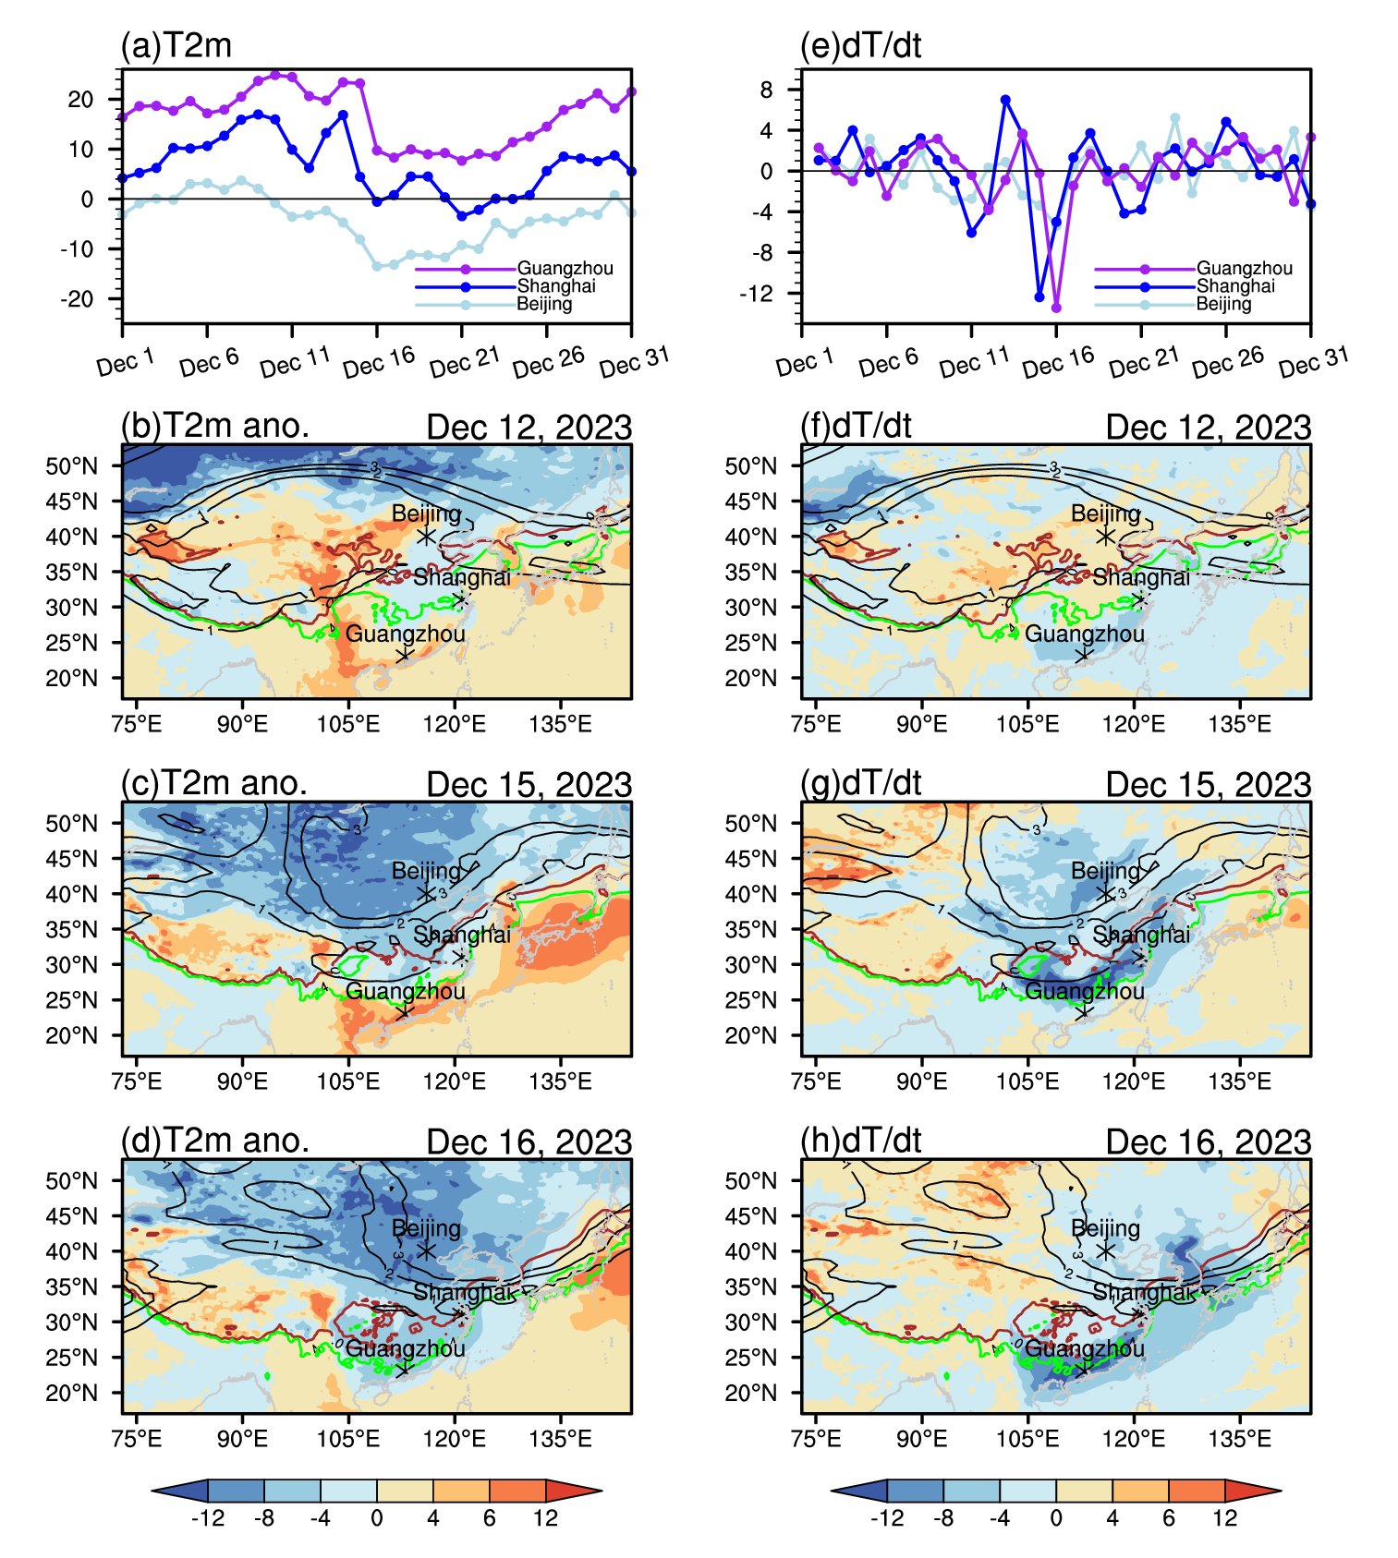
Motivation
In December 14 to 16, 2023, East Asia experienced a severe cold wave with record-breaking low temperatures.
Understanding the dynamic mechanisms behind such extreme events is critical for improving prediction.
This study investigates the role of tropopause potential vorticity circulation (PVC) forcing in triggering and amplifying the cold wave.
Notes:
Despite the global warming trend, East Asia has experienced several extreme cold waves in recent years.
In December 14 to 16, 2023, East Asia experienced a severe cold wave with record-breaking low temperatures.
Understanding the dynamic mechanisms behind such extreme events is critical for improving prediction.
While previous studies have linked cold waves to blocking highs and stratospheric polar vortex, the potential vorticity circulation across the boundary we proposed can further explained the mechanisms related this cold wave.

Slide 3
Data & Methodology
Data: ERA5 reanalysis, GSOD temperature data.
Key Concepts:
Potential Vorticity (PV):
PV substance (PVS):
PV Equation:
PVS Equation:
Effective PVS flux:
PVC:
In p- coordinate:
Notes:
We used ERA5 reanalysis data for circulation and PV fields, and surface temperature from NOAA GSOD.
Ertel potential vorticity is defined as the scalar product（点积） of the absolute vorticity vector（矢量） and the gradient vector（梯度矢量） of potential temperature, all divided by（除以） the density（密度）. PVS is defined as the PV per unit volume （每单位体积）.
The changes in PV and PVS can be written as follows. It is worth noting that (值得注意的是) these terms can be defined as an effective PVS flux. The effective PVS flux includes PVS flux, diabatic heating and friction.
PVC is defined as the time integration of effective PVS flux.
(Q1: The divergence of effective PVS flux includes the PVS advection, terms of diabatic heating and friction, so why PVC can be defined as a forcing?)

Slide 4
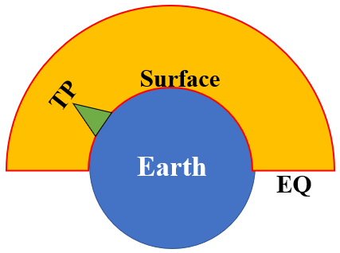
Data & Methodology
Key Concepts:
Cross- boundary PVC:
Upper Tropospheric Fronts (UTFs)
tropopause
Notes:
According to Gauss‘s divergence theorem, the volume integral of PVS in the troposphere of the Northern Hemisphere is equal to the surface integral of the inward PVC on each boundary. In this study, we focused on how the PVC across the tropopause impacts the cold wave.
What‘s more, gradients of PVS are defined as the upper tropospheric fronts. Zonal UTFs are located close to westerly jets, and meridional UTFs are close to north and south winds.

Slide 5
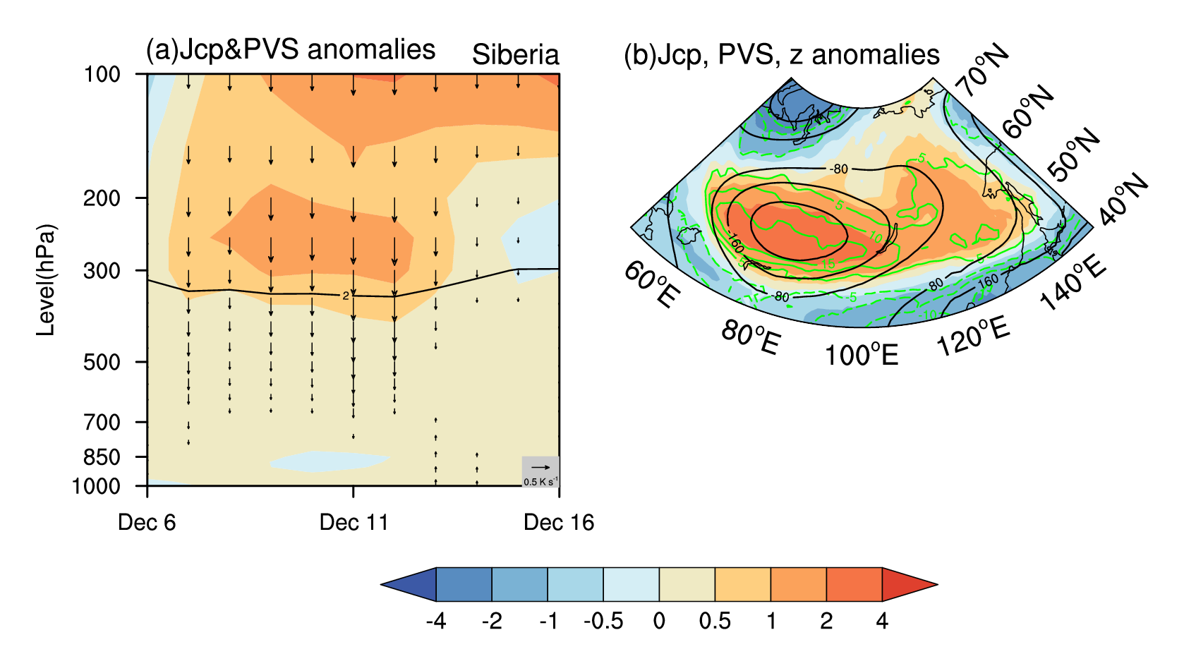
Precursor Signals
1–2 weeks before the cold wave outbreak, an anomalous positive PVS reservoir and downward PVC emerged in the lower stratosphere over Siberia.
Fig. 1 (a) The evolution of PV(shading) and vertical PVC (vector) anomalies over Siberia from Dec. 6 to 16. (b) The distributions of time- mean (between Dec. 7 and 12) of PV (shading), PVC (red and blue contour), and geopotential height anomaly (black contour) at 300 hPa. The black curve in (a) denotes the dynamic tropopause (2 PVU).
Notes:
Let me first show a striking（显著的） precursor signal. The evolution of PVS and vertical PVC anomalies averaged over the Siberia region shows a “Top-Down” PV forcing signal above and across the tropopause persisted from December 7 to 12 with a large anomaly located near 250 hPa over the region (48°–60°N and 60°–140°E) .A remarkable positive PVS reservoir accompanied by an abnormal downward PVC persisted just above the tropopause over Siberia and Middle Asia in early December, which may serve as a potential precursor signal for predicting the cold-wave outbreak.

Slide 6
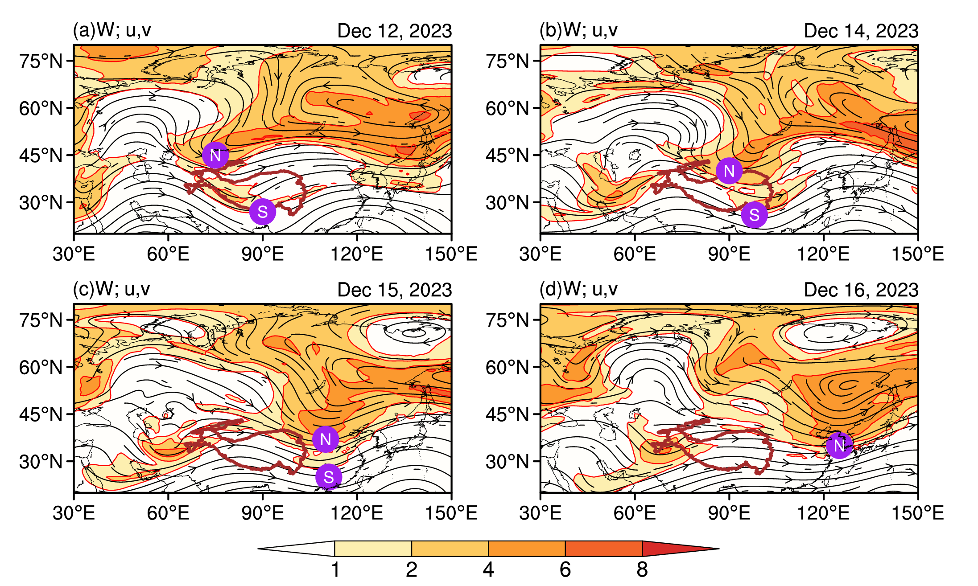
Circulation Evolution
Two distinct UTFs existed over Asia before the cold wave.
The northern UTF propagated faster than the southern UTF, merged into one and phase-locked over East Asia, deeping East Asian trough.
Fig. 2 Distributions of circulation (streamline) and PVS (shading) at 300 hPa on December 12 (a), 14 (b), 15 (c), and 16 (d), 2023. The circled “N” and “S” denote the northern and southern troughs, resp.
Notes:
Circulation at 300 hPa during the cold wave period was shown. On December 12, before the cold wave outbreak, a high-zonal PVS band located at 45°N extended from the west side of the Caspian Sea to the eastern part of Russia. Another high PVS band existed near 30°N, south of the Tibetan Plateau. From December 14 to 16, under the influence of the northwesterly airflow, the northern high PVS band gradually intruded southeastward from Central Asia into East Asia. Since the northern high PVS moved faster than the southern one, the two high PVS zonal bands gradually merged into one and phase-locked over East Asia on December 15, forming a strong East Asian trough with a well-organized.

Slide 7
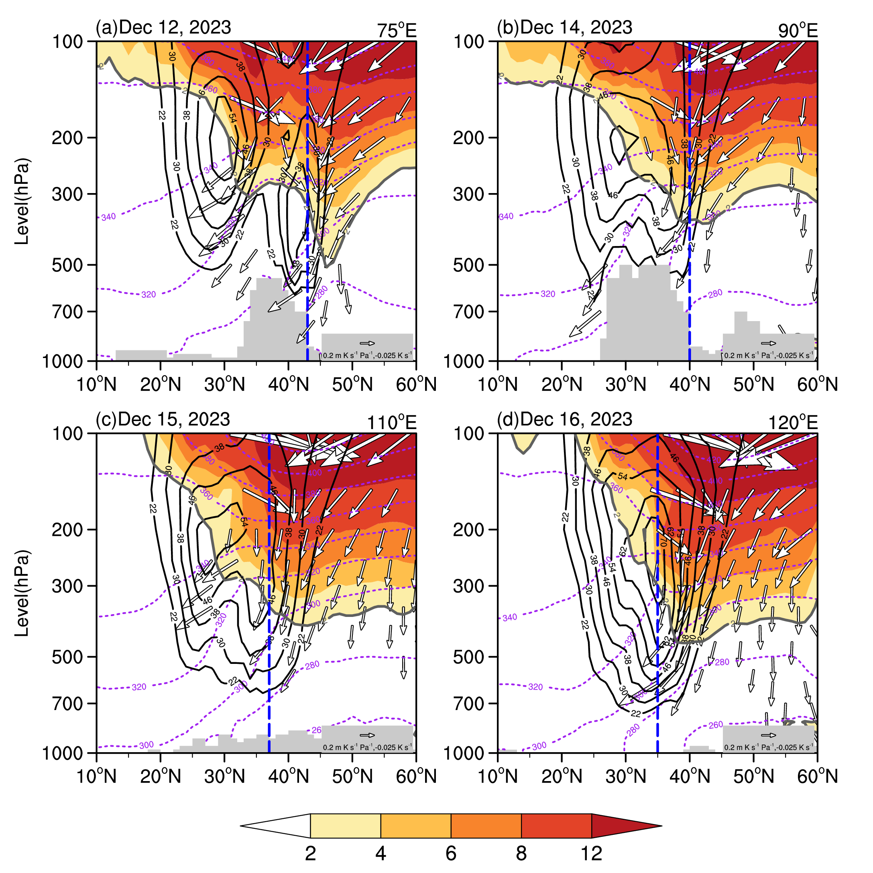
Tropopause PVC Forcing along UTFs
Two anomalous PVC convergence columns existed north of these two UTFs, corresponding to the high-PVS intrusion downward across the tropopause towards the mid-troposphere.
Fig. 3 Evolution of the distributions of PV (shading), PVC (vectors), zonal wind (black contour), and q (purple dotted contour) along (a) 75°E on Dec 12, (b) 90°E on Dec 14, (c) 110°E on Dec 15, and (d) 125°E on Dec 16.
Notes:
To understand the vertical structure, let's look at zonal sections along the moving trough. On December 12, along 75°E (Fig. 6a), two strong westerly jets were observed over the subtropics and mid-latitudes, accompanied by a prominent descent of the tropopause elevation on their northern sides. Two anomalous PVC convergence columns existed north of these two jets, corresponding to the high-PVS intrusion downward across the tropopause towards the mid-troposphere. Two zones with a strong meridional gradient of PVS, i.e., the UTFs, were located in the northern vicinity of the two jets. The northern jet, together with the northern UTF, gradually moved southward afterwards (Figs. 6b, 6c). By December 16, these two westerly jets merged over East Asia, forming a stronger jet associated with intensified baroclinity in the lower troposphere (Fig. 6d).
A stronger jet is associated with intensified baroclinity due to the thermal wind relationship. In the atmosphere, the vertical shear of the geostrophic wind is proportional to the horizontal temperature gradient. A stronger jet stream implies stronger vertical wind shear, which in turn reflects a larger horizontal temperature contrast across the jet axis. This temperature gradient is the very definition of baroclinicity—the state of having density surfaces sloping relative to pressure surfaces, which is essential for the conversion of available potential energy to kinetic energy in mid-latitude cyclones. Therefore, as the two westerly jets merge and strengthen (as in Fig. 6d), the enhanced horizontal temperature gradient in the lower troposphere intensifies the baroclinity, favoring stronger baroclinic instability and cyclogenesis.

Slide 8
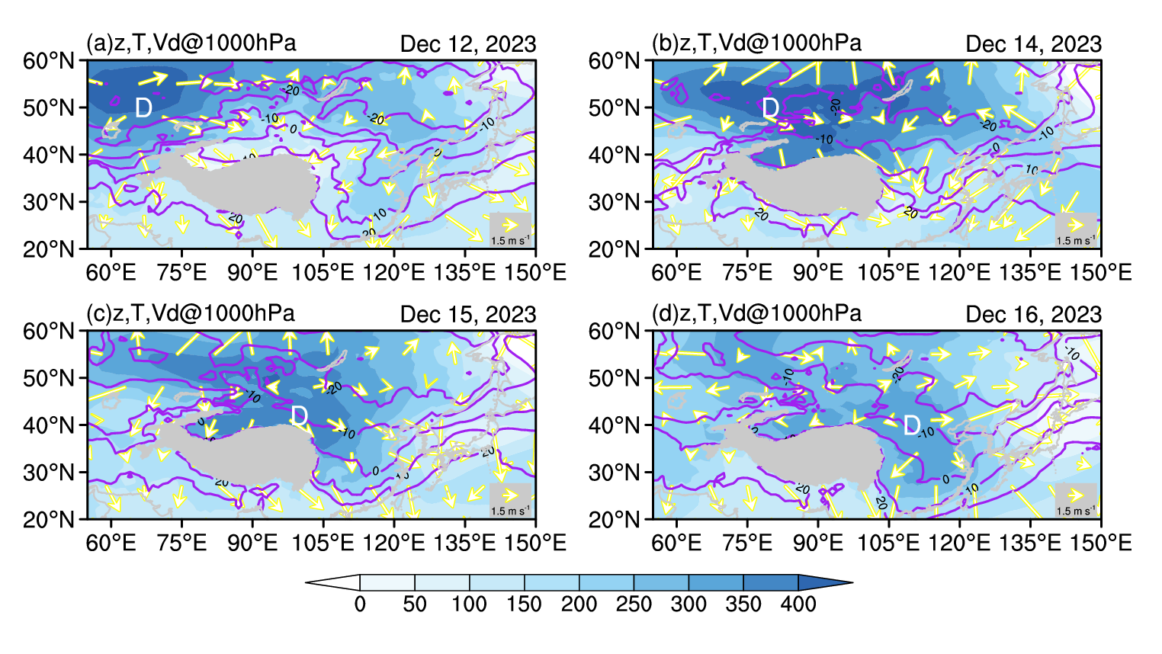
Surface Response
Subsidence occurred along the trough and to its west.
This subsidence extended downward to the surface, resulting in high pressure, divergent northerly winds, and cold advection.
Fig.4 Evolution of the distributions of geopotential height (shading), temperature (contour), and divergence wind (vectors) at 1000 hPa on December 12 (a), 14 (b), 15 (c), and 16 (d).
Notes:
the air descent behind the trough penetrated the entire troposphere and reached the Earth’s surface. This subsidence led to an increase in the surface pressure and horizontal wind divergence. On December 12, air divergence and subsidence mainly occurred in Central Asia (Fig. 9a). Accompanied by the southeastward-moving PVC convergence in the upper troposphere (Figs. 6 and 7), the high-pressure and divergence center also moved southeastward from December 14 to 15 (Figs. 10b, c). On December 16, the cold front reached southern China (Fig. 9d). During this course, the cold front associated with the high pressure intensified owing to the cold advection brought about by the abnormal northerly divergent wind, resulting in a strong decrease in the surface air temperature in East Asia, leading to the outbreak of the cold wave (Fig. 9).

Slide 9
Conclusions & References
Tropopause PVC forcing is a key driver of the December 2023 East Asian cold wave.
Phase-locking of northern and southern UTFs amplified East Asian trough.
Subsidence effectively links upper-level PVC forcing to surface cold air outbreaks.
Stratospheric PVS anomalies serve as early warning signals for cold waves.
Li Y, Wu G, Liu Y, et al. The Influence of Tropopause Potential Vorticity Circulation Forcing on the Development of the East Asian Cold Wave in December 2023[J]. 2025a. 38: 7695-7708.
Li Y, Wu G, Liu Y, et al. Potential Vorticity Circulation across the Boundary of the Northern Troposphere and Its Link with East Asian Summer Monsoon in July[J]. Journal of Climate, 2025b, 38: 781-795.

Slide 10
Thanks for your attention!

