Slide 1

Climate warming and heatwaves accelerate global lake deoxygenation
Yibo Zhang, Kun Shi, Yunlin Zhang, R. Iestyn Woolway, et al.
July 23, 2025

Slide 2
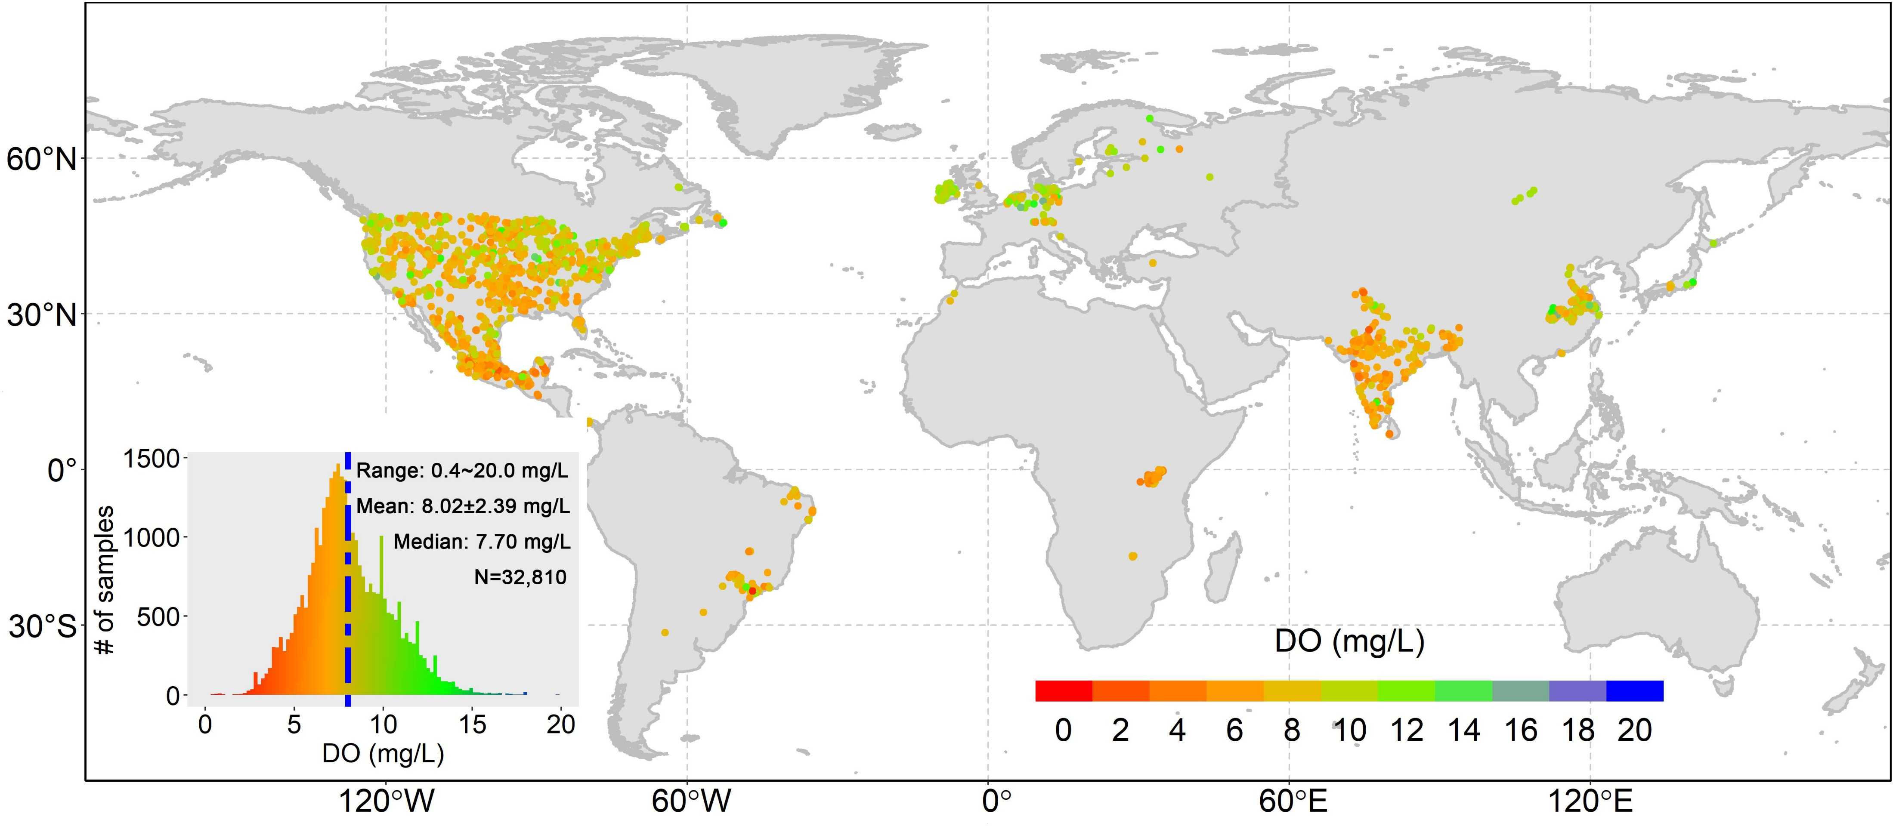
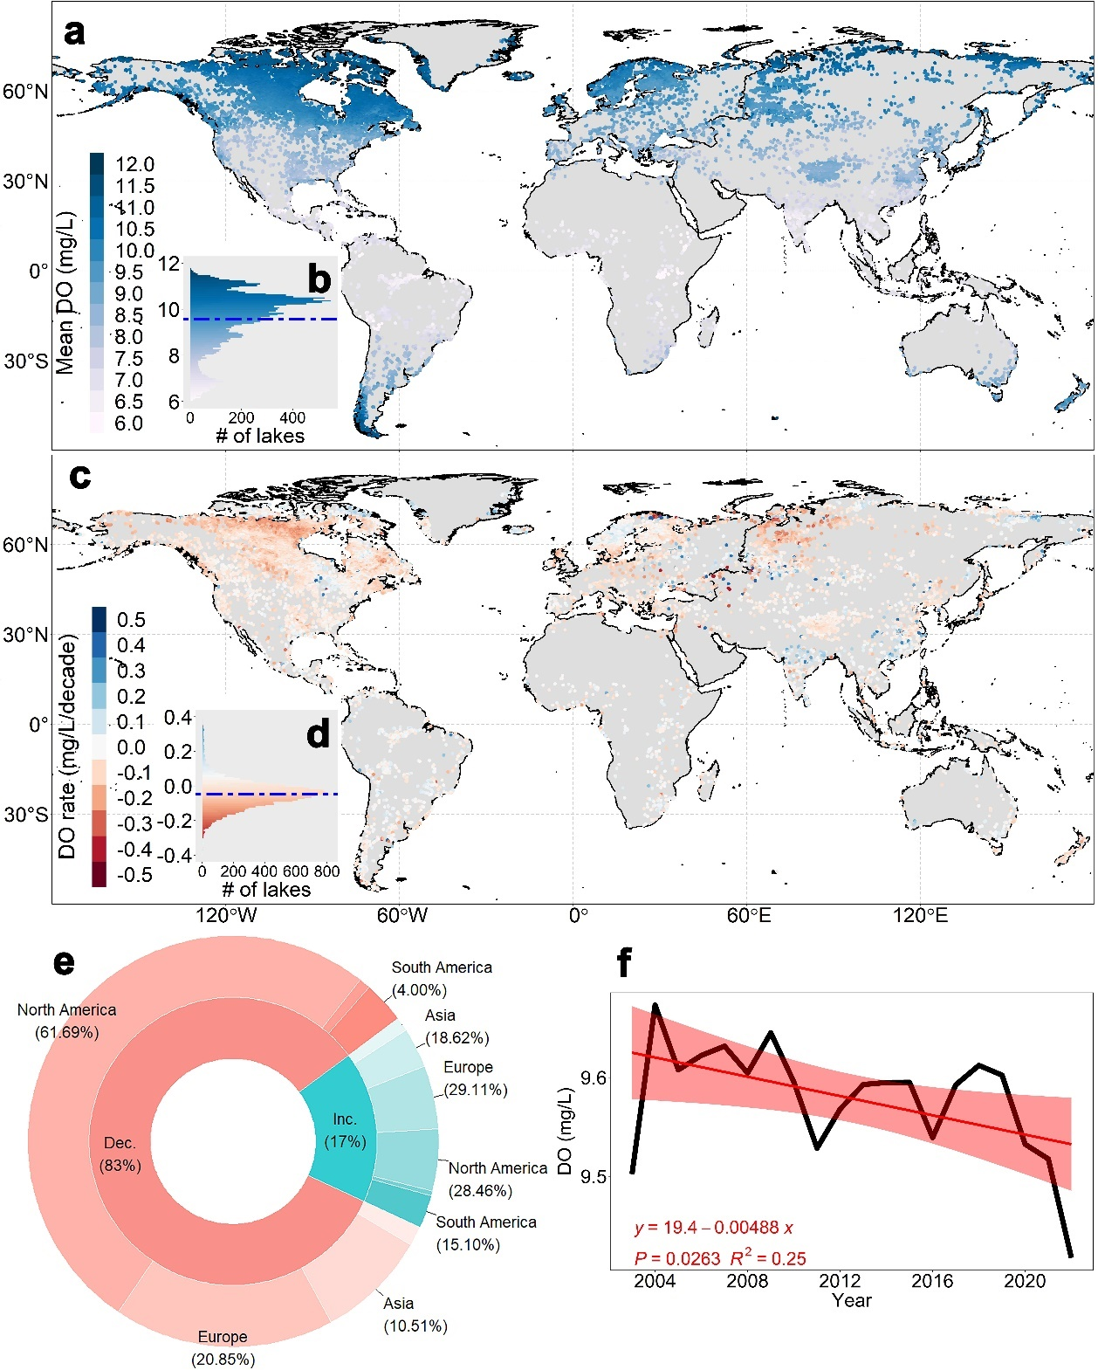
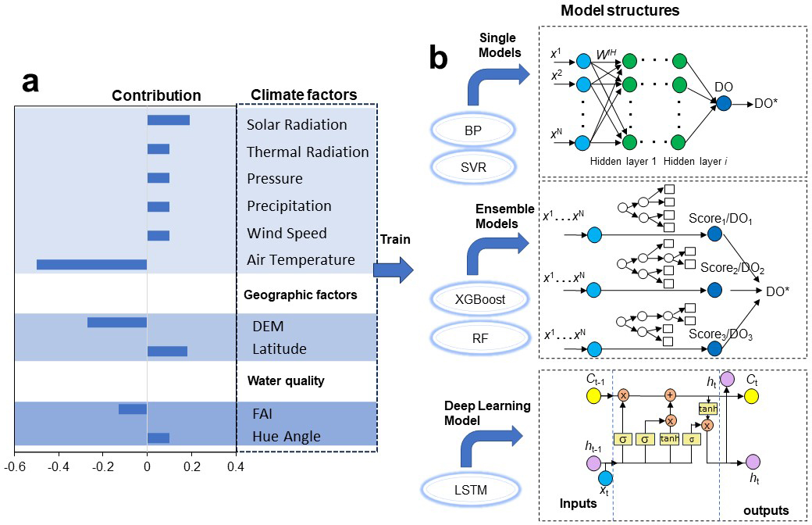
DO estimation
Compiled over 22,000 matched in situ samples
DO decreased in 83% of lakes. On average, DO dropped by 2% over the past 20 years.
Developed multiple AI methods for DO estimation
Notes:
To address theses gaps, we …; Finally, the best model was used for DO estimation.

Slide 3
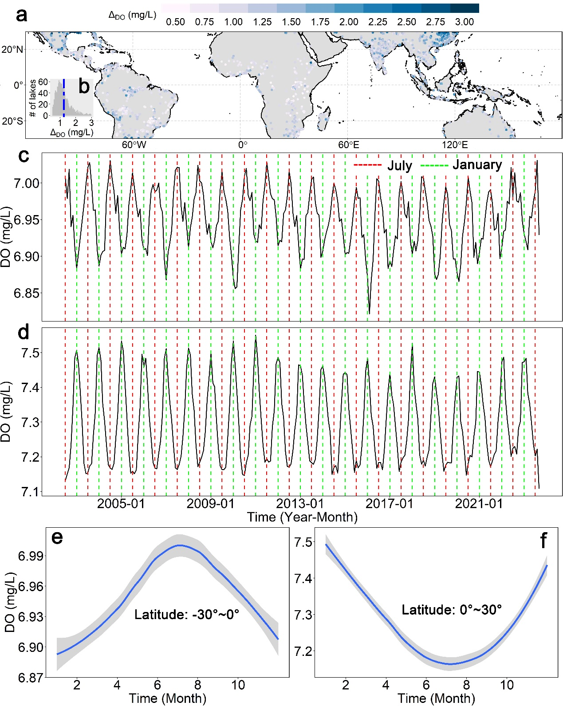
Seasonal Patterns
∆_{DO}: 0.3~4.6 mg/L
Mean：1.23 mg/L
Intra-annual DO variation were more pronounced than interannual trends, with variation ranging from 0.3 to 4.6 mg/L.
There were opposite seasonal cycles between hemispheres:
  In July, southern hemisphere lakes are colder with higher DO;
  In contrast, northern hemisphere lakes are warmer with lower DO.
South
North
Do seasonal variation in Low-Latitude Lakes
Notes:
基于以上模型，我们得到了溶氧的时空格局，空间上，溶氧均值为9.57 mg/L；时间上，平均变化速率为0.048 mg/L/10年，83%是上升的，17%湖泊是下降的，在过去20年，溶氧下降了2%。此外，我们把低纬度地区溶氧的年内变化也提出来，年内的变化相对年变化更明显，波动差从0.3到4.6不等，波动差均值为1.23 mg/L；南北半球季节波动节律正好相反，南半球7月温度低，溶氧高，北半球7月温度高，溶氧低。

Slide 4
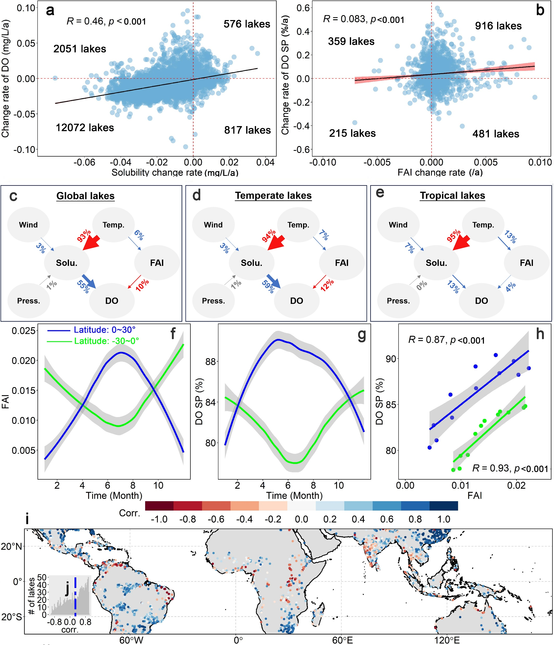
Impacts of Long-Term Climate Change on DO
We separated the effects of oxygen solubility and eutrophication on observed DO changes.
Solubility accounted for 55% of surface DO decline.
Increasing eutrophication contributed 10% to DO loss.
The contributions from solubility and eutrophication differ in temperate and tropical lakes.
Impacts of Long-Term Climate Change on DO

Slide 5
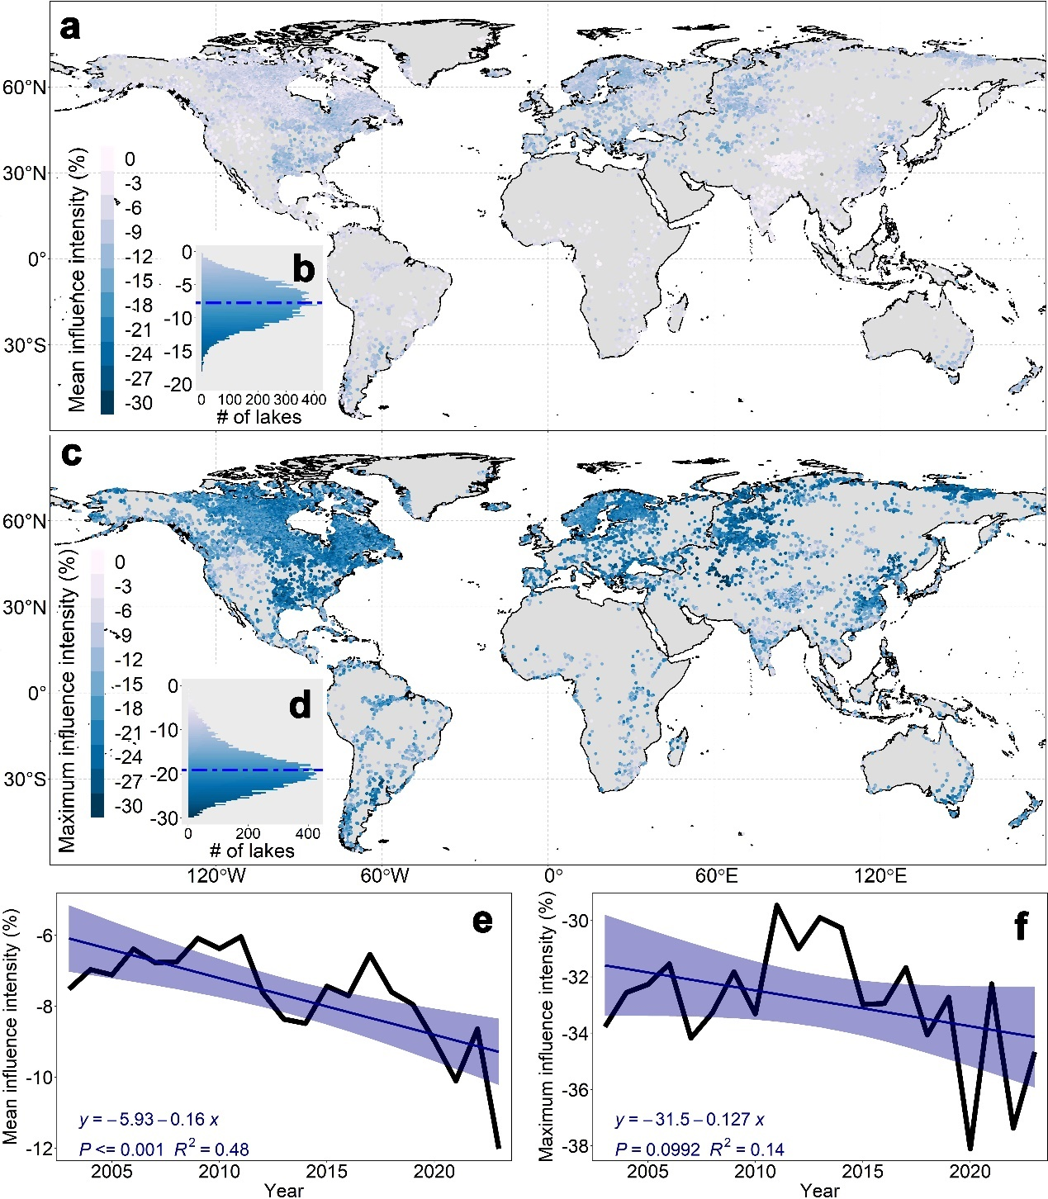
Impacts of Short-Term Heatwave on DO
Climate factors
Climate factors
Solar Radia
Thermal Radia
Pressure
Perception
Wind
Temperature
Solar Radia
Thermal Radia
Pressure
Perception
Wind
Climatological T.
S1
S2
Model Structure
Score₁/DO₁
Geographic factors
Geographic factors
DEM
Latitude
DEM
Latitude
Water color
Score₂/DO₂
Water color
FAI
Hue angle
FAI
Hue angle
DO_{S1}
DO_{S2}
Score₃/DO₃
Heatwave Impacts
Intensity=100*(DO_{S2}-DO_{S1})/DO_{S1}
Heatwaves cause an average decrease of 7.7% in DO concentration, with a mean maximum decline of 19.0%.
Both the average and maximum impact intensities show an increasing trend over time.
Compared actual DO values with DO under climatological mean temperatures to isolate heatwave effects.

Slide 6
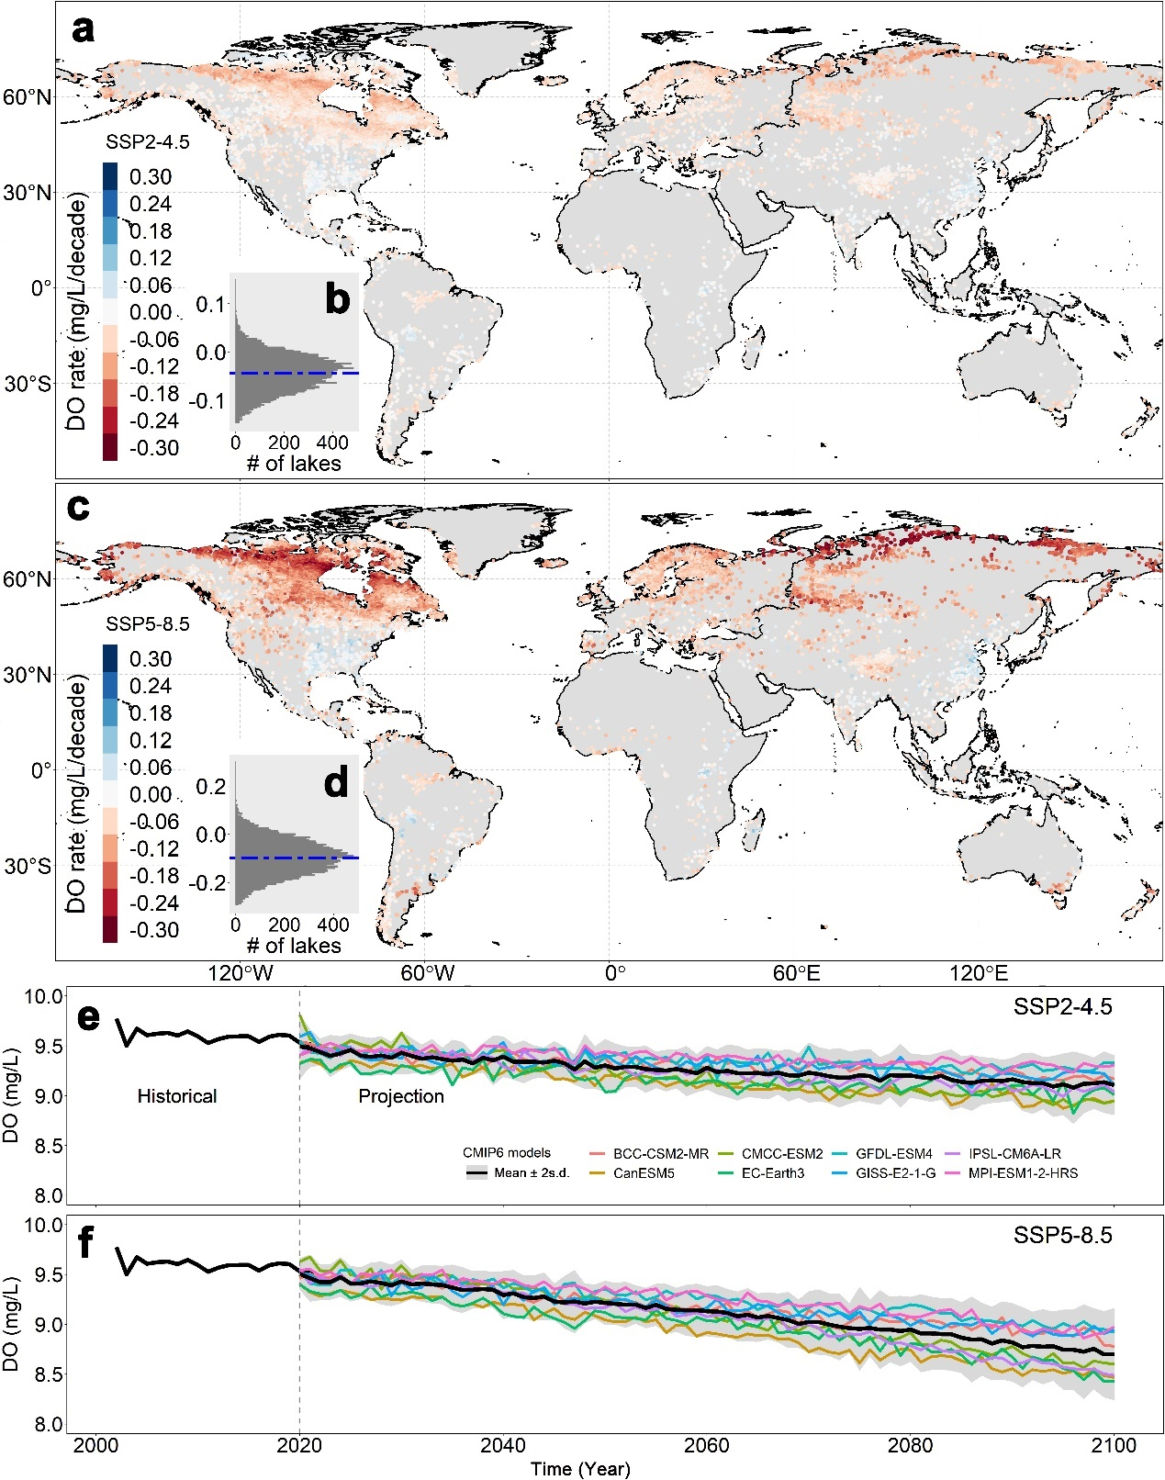
Future Predictions of DO
Mean: -0.043 mg/L/decade
Under SSP2-4.5, global lake DO is projected to decrease by 0.41 mg/L (4.3%) by the end of this century;
Under SSP5-8.5, the decrease could reach 0.86 mg/L (8.8%).
Mean: -0.097 mg/L/decade
9.11 mg/L
8.70 mg/L
DO Predictions under Future Scenarios
Notes:
Stress lake: 平均浓度小于6 mg/L

Slide 7




Sources
Notes:
The dataset is open for public. Thanks for your attention.

