Slide 1







Integrated workflow for earthquake stress modelling & seismicity analysis using Coulomb 4.0 and the ISC Earthquake Toolbox
Kostas Leptokaropoulos¹, Shinji Toda², Tom Garth³, Kaede Yoshizawa², Ross Stein⁴, Ryan Gallacher³, Volkan Sevilgen⁴, and Jian Lin⁵
1 2 3 4 5
EGU26-2544 | PICO | ESSI2.8
4th May 2026, |PICO Spot 1b

Slide 2
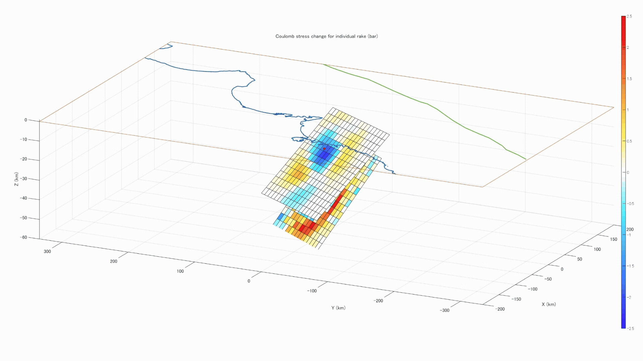
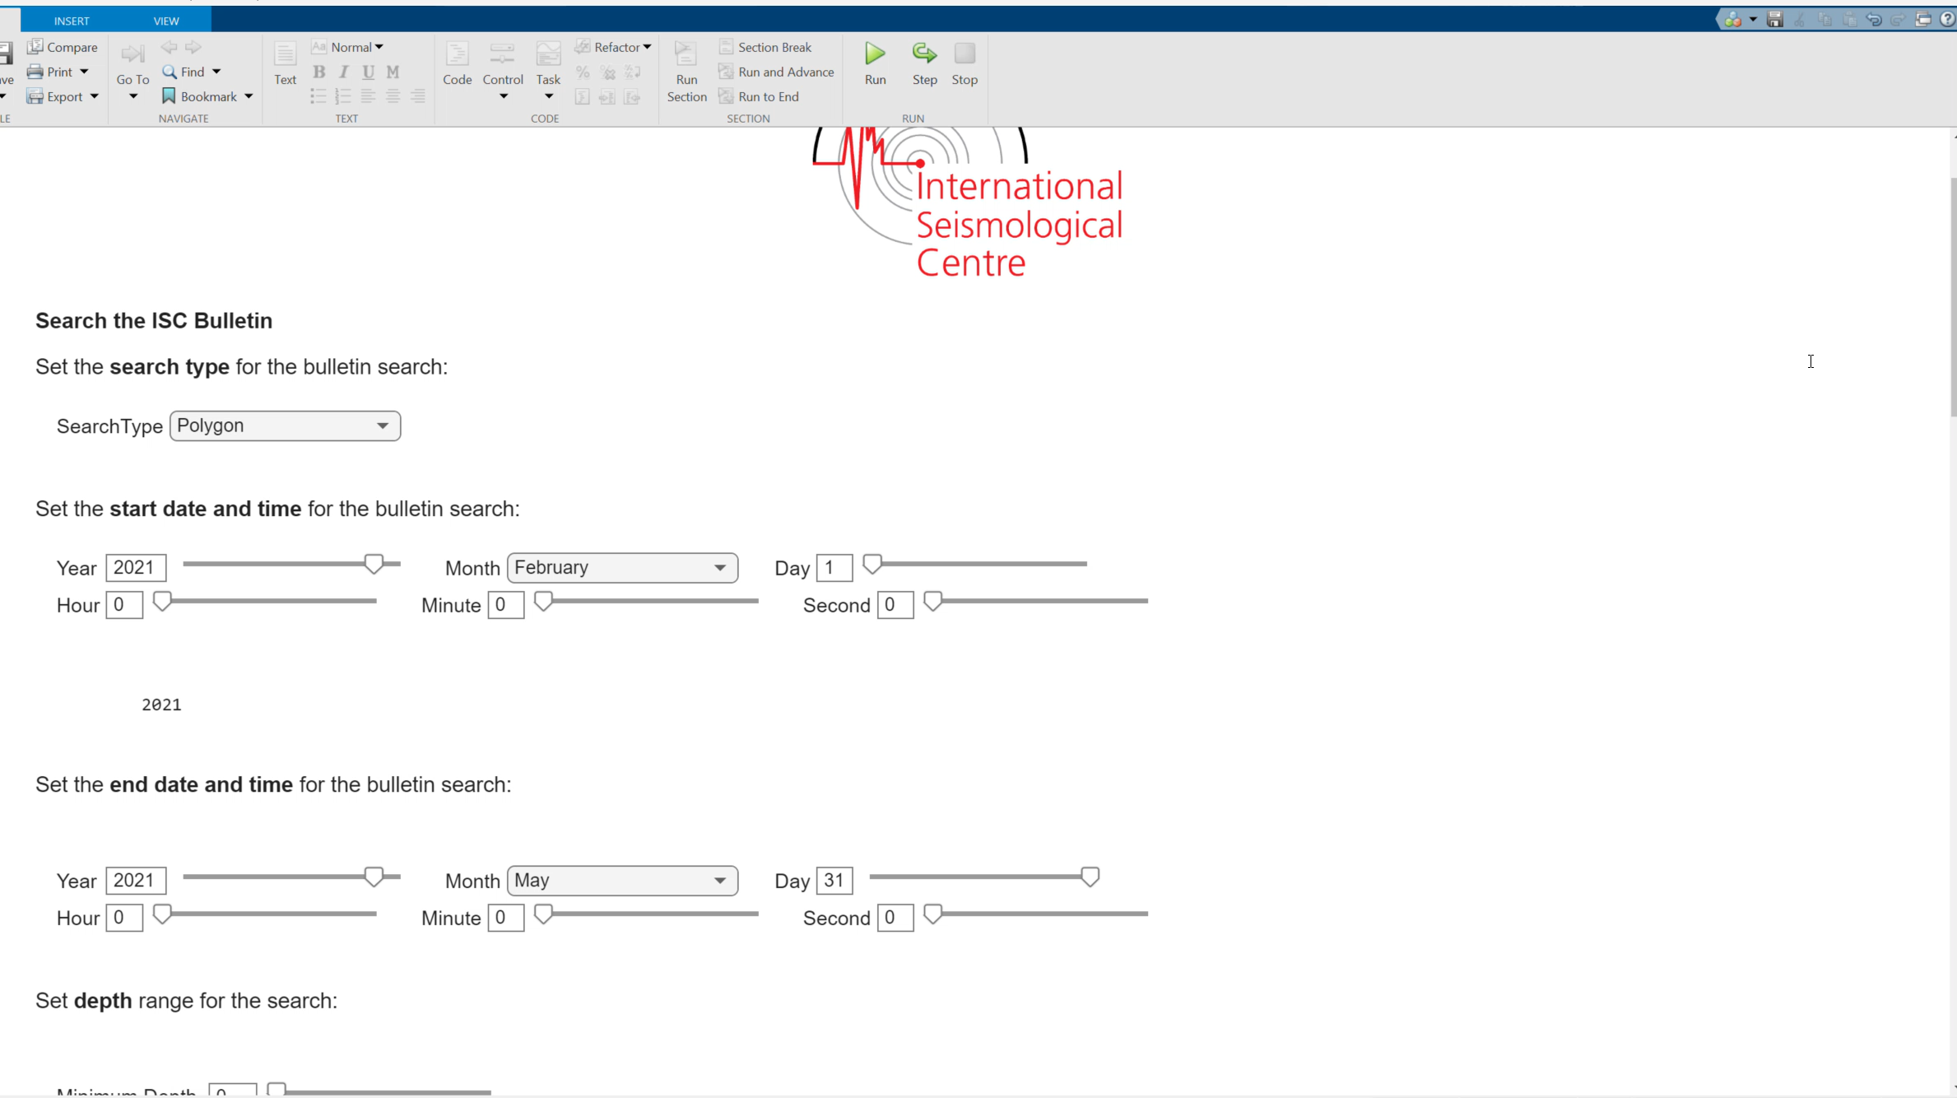


Coulomb 4.0 and the ISC Earthquake Toolbox
Coulomb:
ISC Toolbox:
Designed for interactive exploration and visualization of earthquake and volcanic processes.
Provides access to the global database of earthquake parametric data from the ISC Bulletin
Notes:
The software can easily incorporate ancillary data, it integrates the ISC earthquake toolbox and USGS finite fault models, and produces publication-ready graphics.
It encompasses detailed records and preview/filtering of earthquake epicentral locations and depths, phase arrival times, amplitudes, and earthquakes magnitudes from various sources worldwide.

Slide 3
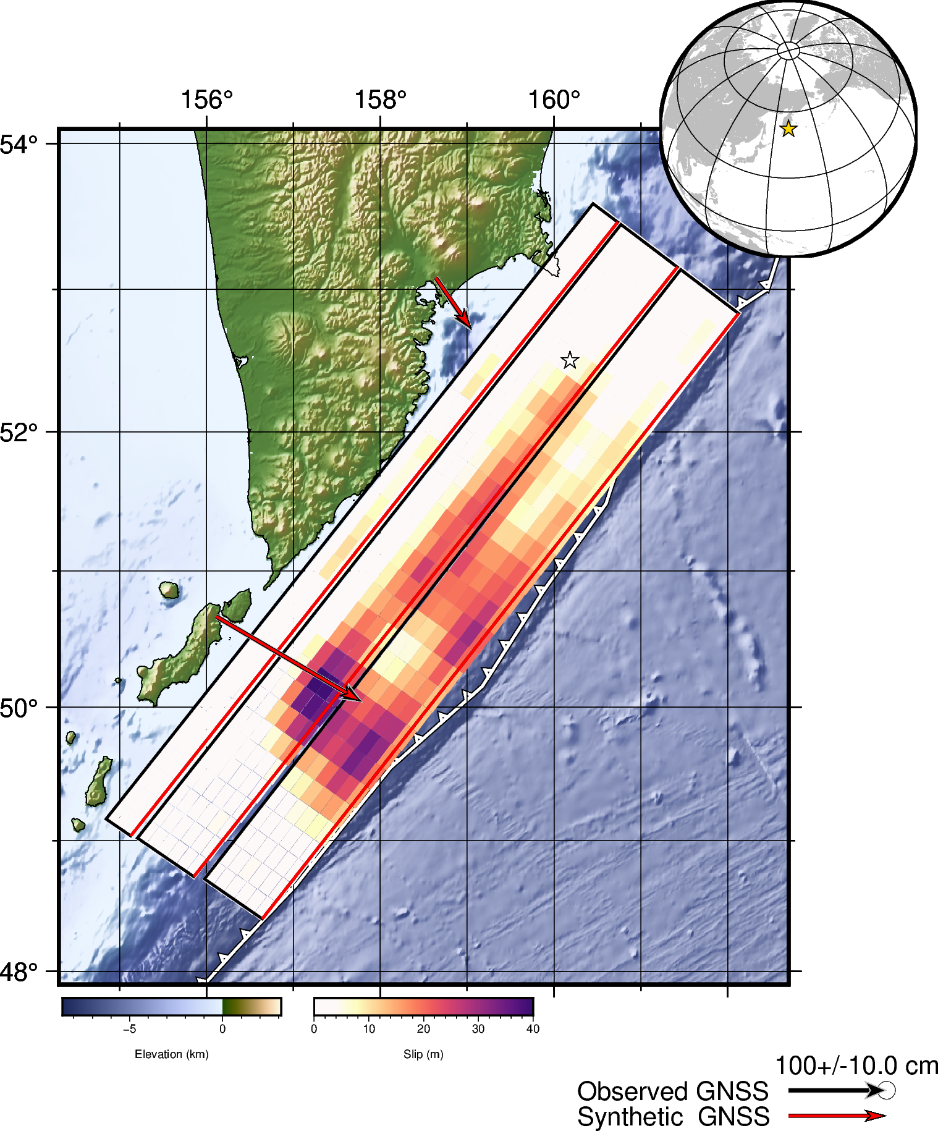
3
The ISC earthquake catalog for events with Mw ≥ 3.0 that occurred in the Kamchatka region during 2024–2025 was obtained using the ISC Earthquake Toolbox.
Number of Earthquakes Analyzed
Foreshock 1 → Foreshock 2: 199
Foreshock 2 → Mainshock: 617
Mainshock → Aftershock 1: 3,673
Aftershock 1 → Aftershock 2: 119
Aftershock２（Mw 7.8）
Aftershock１（Mw 7.4）
Foreshock２
（Mw 7.4）
Foreshock１
（Mw7.0）
Mainshock（Mw 8.8）
These earthquake catalogs were analyzed together with the three-dimensional ΔCFF field (CFF3D).
from USGS, modified

