Slide 1
Resilient Recovery:
Financing Nature-Based Coastal Solutions for Urban Infrastructure in Port Sudan
Mehad Ahmed Abdalla Ahmed
University of Khartoum
This work bridges coastal ecosystem monitoring with investable climate infrastructure by integrating Nature-based Sequestration metrics into financial systems. It operationalizes ecological data into on-chain, performance-based capital allocation, transforming mangroves in Port Sudan into measurable, investable assets.
The Context
The Challenge
Red Sea coastal ecosystems face intensifying climate stress, habitat degradation, and exposure, while blue carbon projects remain underfunded due to weak MRV transparency and delayed verification. Simultaneously, investors rely on static, non-responsive mechanisms that fail to reflect real-time ecological performance, limiting trust, scalability, and financial efficiency.
The Protocol (Integrated Solution)
The Bio-Financial Resilience Index (BFRI) establishes a seamless pipeline from off-chain sensing to on-chain execution, ensuring numerical stability and verifiable outcomes:
MRV Layer: GEE-based NDVI monitoring quantifies ecosystem health and carbon dynamics
Index Layer: BFRI integrates ecological, financial, and risk variables into a decision-grade metric
Execution Layer: Smart contracts enforce on-chain verification, triggering payouts only when resilience thresholds are met
This creates a transparent, automated, and scalable framework for climate finance.

Slide 2



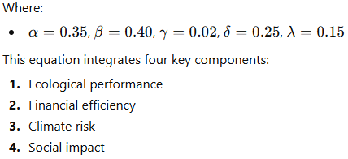
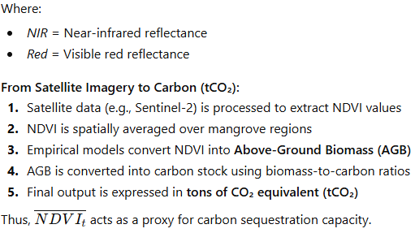
1-Mathematical Framework of BFRI
2-Methodology Breakdown
2-1 Methodology Breakdown
The core formulation of the BFRI is defined as:
The Normalized Difference Vegetation Index (NDVI) is a widely used remote sensing metric calculated as:

Slide 3


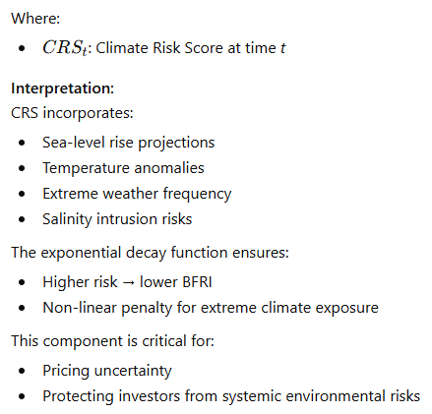
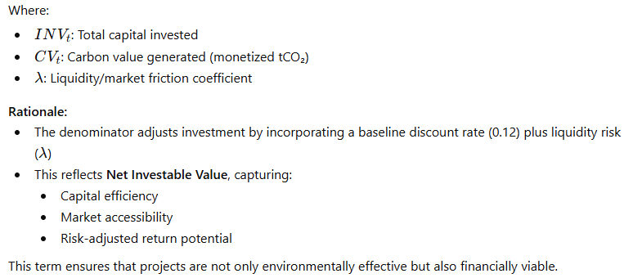
2-2 Financial Term: Investment Efficiency (Cost Term)
2-3 Risk Term: Climate Risk Score (CRS)

Slide 4

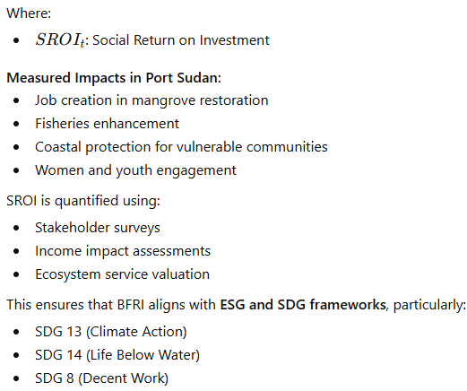

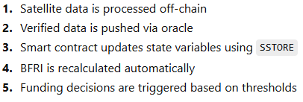
2-4 Social Impact Term: SROI
3. Technical Implementation: Smart Contracts on Ethereum
The BFRI system is deployed using Ethereum-based smart contracts, enabling decentralized and automated financial operations.
3.1 Architecture Overview
3.2 Smart Contract Workflow

Slide 5
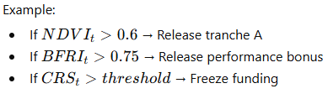

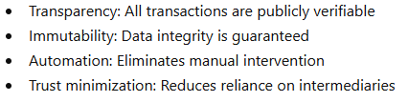
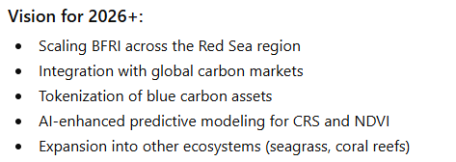
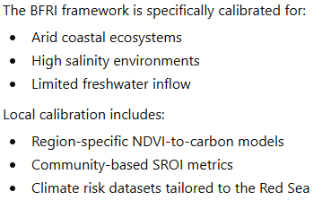
3-3 Automated Disbursement Logic
5. Conclusion and Vision (2026 and Beyond)
The BFRI framework represents a paradigm shift in climate finance by merging:
3.4 Advantages
4. Case Application: Mangroves in Port Sudan
Ultimately, BFRI aims to establish a new asset class—Blue Carbon Resilience Assets (BCRA)—bridging the gap between ecological sustainability and institutional investment.

Slide 6
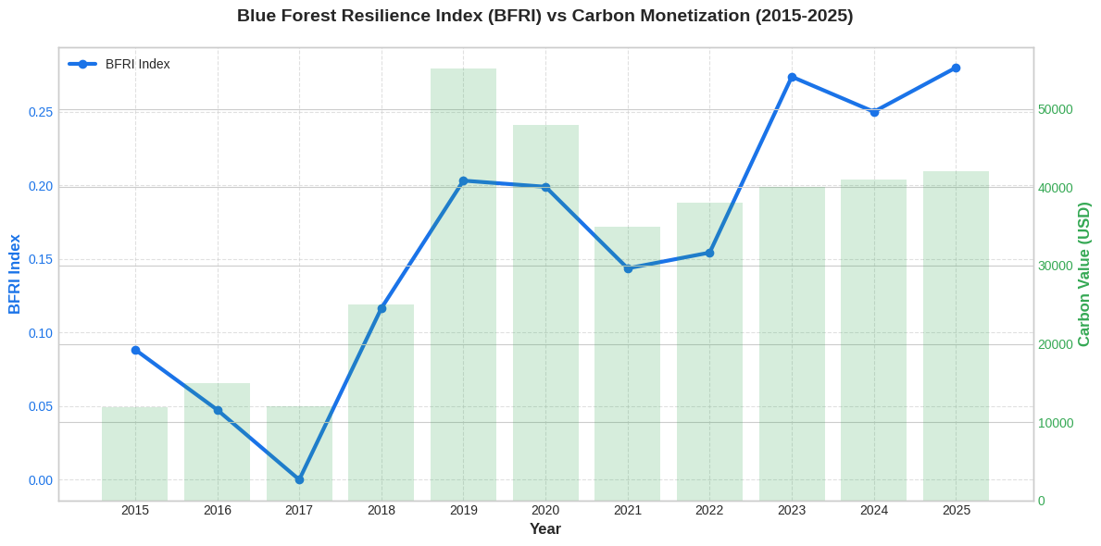
Correlation: The BFRI (blue line) acts as a leading indicator of carbon value, with increases in ecosystem resilience consistently preceding rises in monetized carbon (green bars), confirming a strong ecology–finance linkage.
Growth Story: From 2015–2025, improved resilience and data-driven transparency drive a +255% increase in carbon value, highlighting the financial impact of stable, high-quality ecosystems.
Conclusion: Higher BFRI scores generate premium carbon credits, demonstrating that ecosystem health is directly convertible into financial value — positioning nature as a measurable, investable asset.

Slide 7
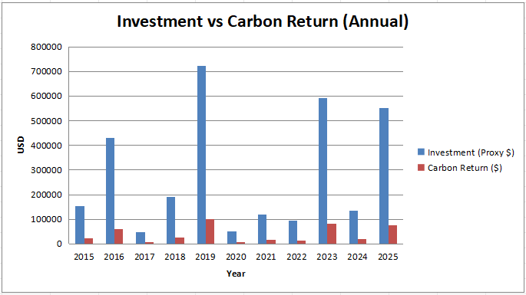
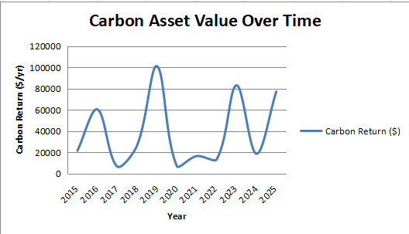
This chart visualizes the dynamic 'Carbon Asset Value Over Time' from 2015 to 2025, tracking the annual fluctuations in financial returns from carbon sequestration. The primary objective is to evaluate the long-term performance and resilience of the environmental assets, highlighting significant growth milestones such as the 2019 peak. By illustrating these trends, the chart provides stakeholders with a clear understanding of the asset’s yield potential and its behavior as a financial instrument influenced by ecological cycles. This data is essential for assessing the risk-return profile of blue carbon investments and ensuring informed decision-making for future scaling
This chart analyzes the annual 'Investment vs. Carbon Return' over a decade-long period (2015-2025). It illustrates the relationship between capital expenditure (blue bars) and the financial yields generated from carbon sequestration (red bars). The primary objective is to demonstrate the project's financial efficiency and the scalability of the Blue Carbon model. While investment levels vary based on expansion phases, the consistent generation of carbon returns underscores the economic viability of nature-based solutions. This data provides crucial evidence for investors on how capital infusion is successfully converted into high-value environmental assets and sustainable revenue streams.

Slide 8
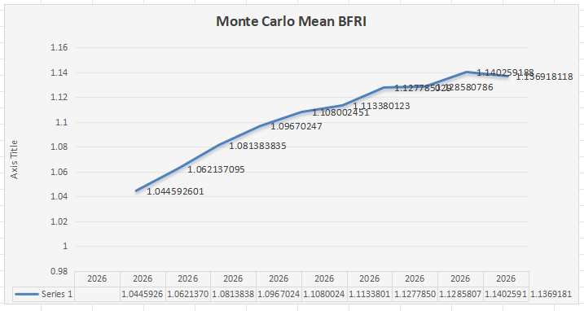
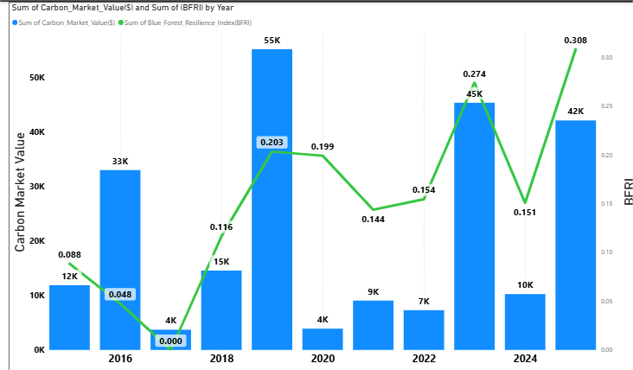
Predictive Value Context: The Monte Carlo simulation models the Predictive Value of coastal assets under the Bio Financial Resilience Index (BFRI) framework, incorporating stochastic climate variability to estimate future performance under uncertainty. The resulting trajectory reflects a risk-adjusted valuation approach, where environmental stressors are embedded into long-term asset resilience.
Mean Stochastic Growth Pattern: The graph demonstrates a clear Mean Stochastic Growth trend, with the BFRI increasing from approximately 1.04 to 1.14 over the simulation period. This upward movement, despite intermittent fluctuations, indicates strengthening system performance under probabilistic climate scenarios.
Resilience Trajectory Insight: The gradual rise in the index defines a positive Resilience Trajectory, suggesting that coastal ecosystems are enhancing their capacity to absorb shocks while maintaining economic and ecological functionality—an indicator of improving bio-economic resilience.
Executive Conclusion:
The simulation confirms a consistent upward resilience pathway, with risk-adjusted gains outweighing short-term stochastic volatility. This positions coastal assets as increasingly robust investment classes within climate-adaptive environmental finance frameworks.
Dynamic Correlation: The chart demonstrates a strong relationship between BFRI (green line) and Monetized Carbon Value (blue bars) from 2015–2025, linking ecological performance directly to financial outcomes.
Leading Indicator: Movements in BFRI consistently precede or mirror shifts in market value, confirming ecological resilience as the primary driver of carbon pricing.
2025 Peak: A BFRI of 0.308 aligns with ~$42K value, evidencing a resilience-driven premium achieved through sustained monitoring.

Slide 9
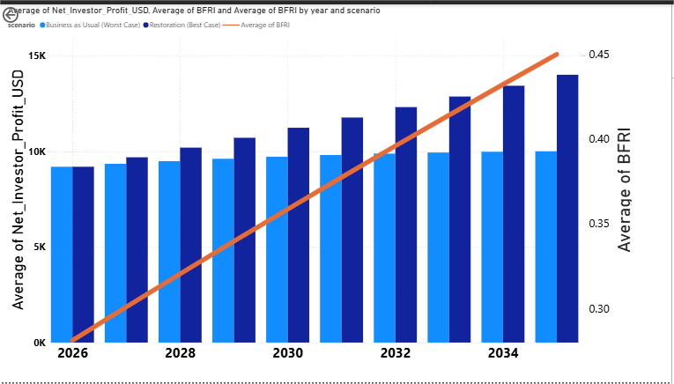
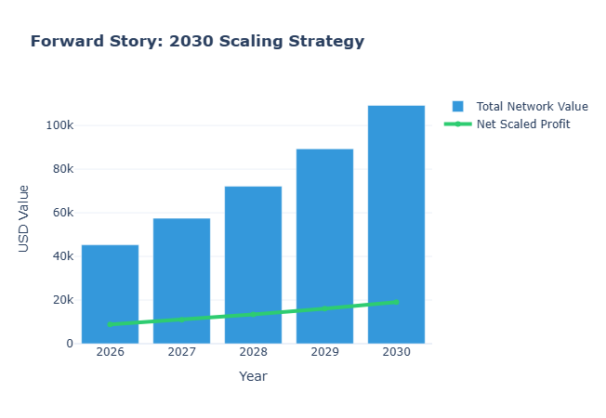
This chart illustrates a 10-year financial projection (2026-2035) comparing two primary scenarios. It demonstrates that the 'Restoration Scenario' (dark blue) significantly outperforms the 'Business as Usual' model (light blue) in terms of Net Investor Profit. Central to this projection is the 'Bio Financial Resilience Index' (BFRI), represented by the ascending orange line, which shows a direct correlation between ecosystem recovery and financial performance. The data proves that investing in nature-based solutions is not only environmentally vital but also economically superior, as higher ecological health directly translates into increased financial returns and long-term asset value.
This chart outlines the project’s strategic scaling trajectory toward 2030, highlighting the exponential growth in 'Total Network Value' (blue bars) compared to the steady rise in 'Net Scaled Profit' (green line). The primary objective of this visualization is to demonstrate the scalability of our Blue Finance model; as the project expands, the ecosystem's total valuation grows significantly, reflecting increased market confidence and the compounding value of restored natural assets. This trajectory proves that the framework is designed not only for immediate impact but for long-term market leadership in the nature-based solutions sector, transforming local restoration efforts into a high-value global financial network.

Slide 10
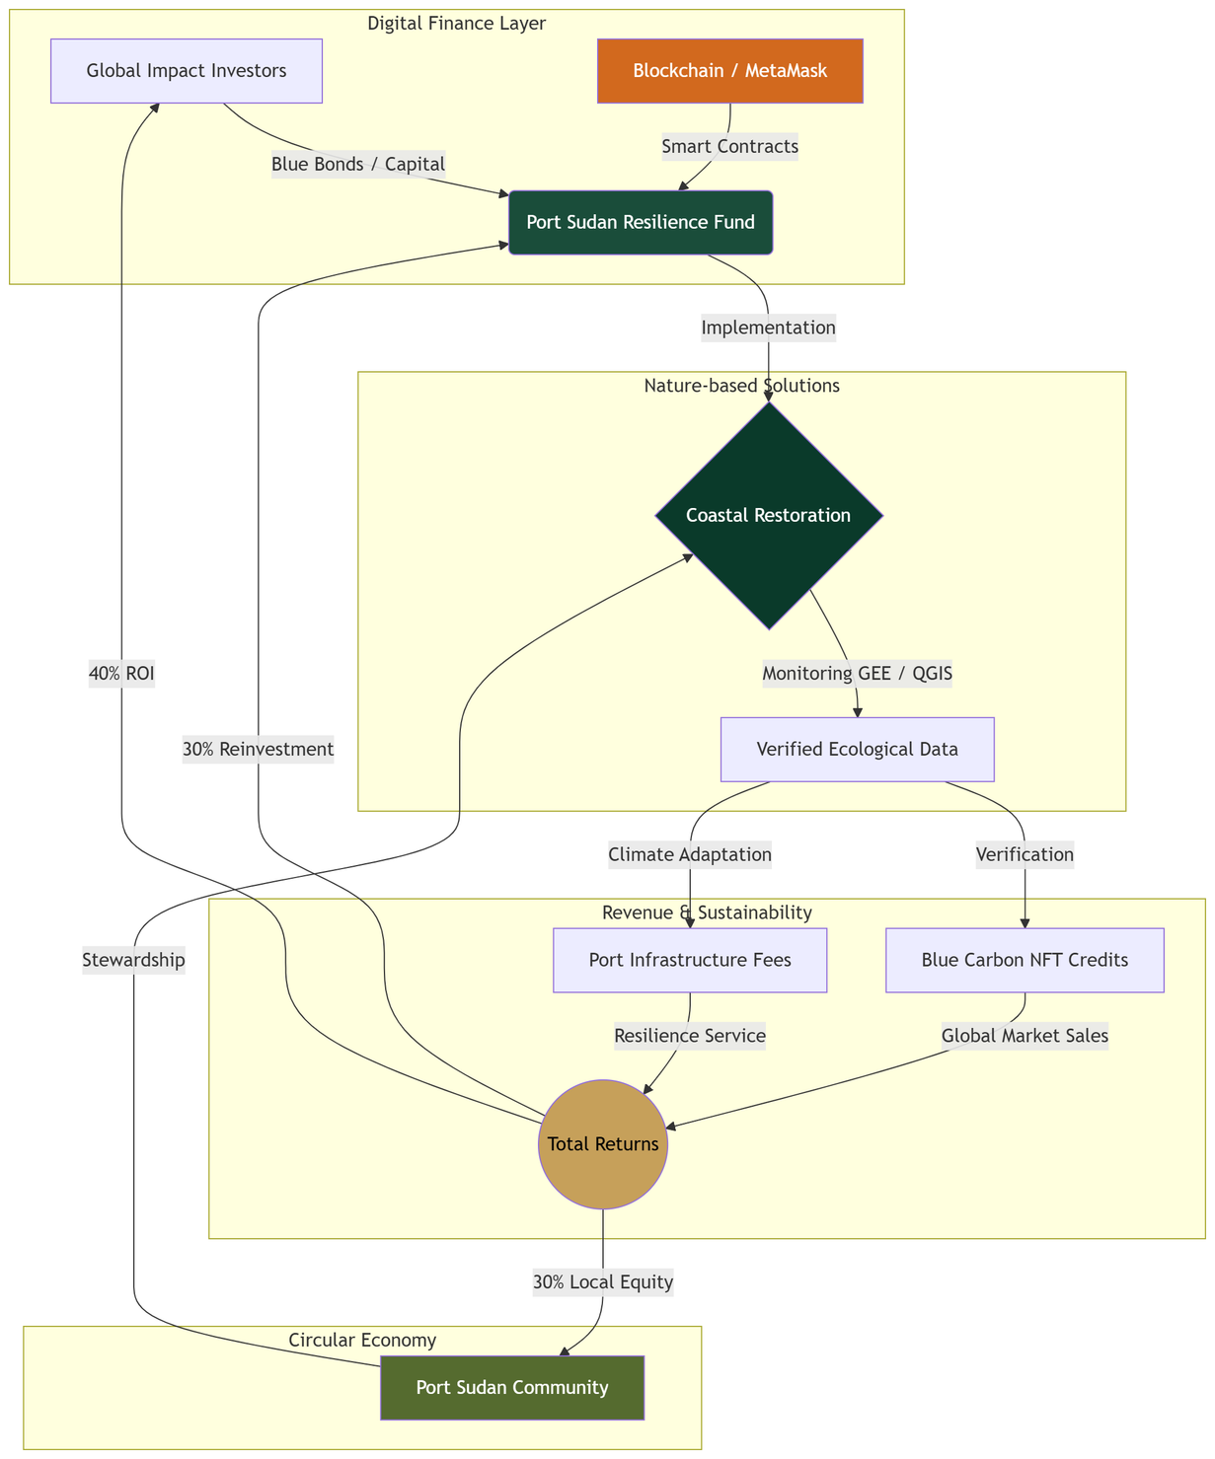
Integrated Blue Finance & Coastal Resilience Framework
The proposed framework represents a multi-layered ecosystem designed to bridge the gap between digital finance and coastal resilience. At its core, the model integrates a 'Digital Finance Layer' powered by blockchain and smart contracts to ensure transparent capital flow from global impact investors. This financial input directly funds 'Nature-based Solutions' (NbS), specifically coastal restoration in Port Sudan, where ecological health is monitored via Google Earth Engine (GEE) and GIS tools. The system creates a circular value chain where verified ecological data triggers the issuance of Blue Carbon Credits and 'Resilience Services.' These outputs generate diversified revenue streams—including port infrastructure fees and carbon market sales—which are then redistributed to ensure project scalability, investor ROI, and the socio-economic empowerment of the Port Sudan community. This holistic approach transforms environmental conservation from a cost center into a self-sustaining economic engine

Slide 11
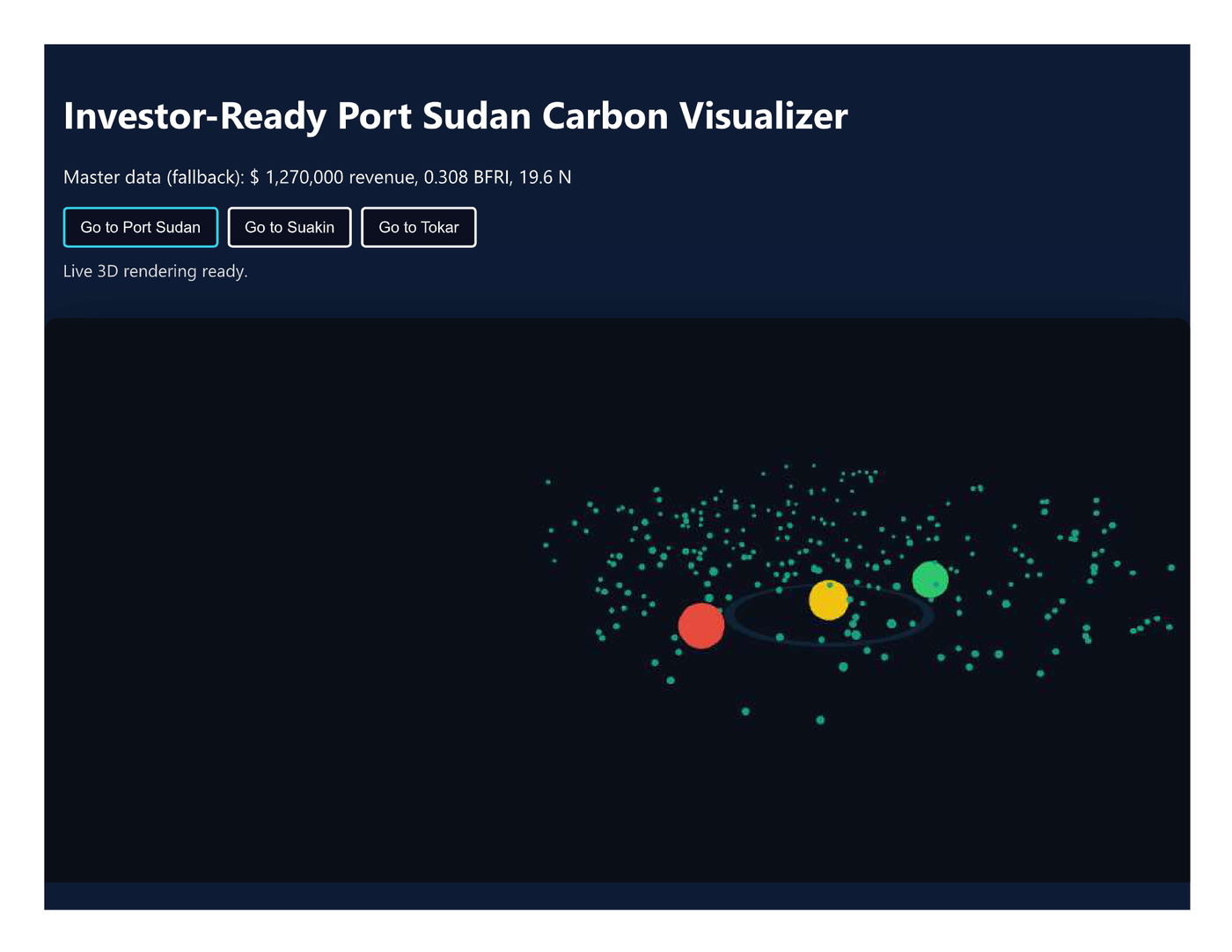
The Investor-Ready Port Sudan Carbon Visualizer is a real-time, 3D dashboard that maps Blue Carbon assets across Port Sudan, Suakin, and Tokar Basin. It transforms satellite-derived data into an interactive visual layer, highlighting high-value resilience zones and carbon potential.
Blockchain Integration:
Each data point — including BFRI scores, NDVI metrics, and revenue estimates — is securely anchored on-chain. This ensures full transparency, immutability, and auditability, giving investors confidence that all insights are verified and tamper-proof.
The Goal:
To bridge the gap between complex ecological data and financial decision-making — turning raw satellite signals into clear, trusted, investment-ready insights.
The result is a platform where global investors can identify, evaluate, and trust Blue Carbon opportunities in the Global South.

Slide 12
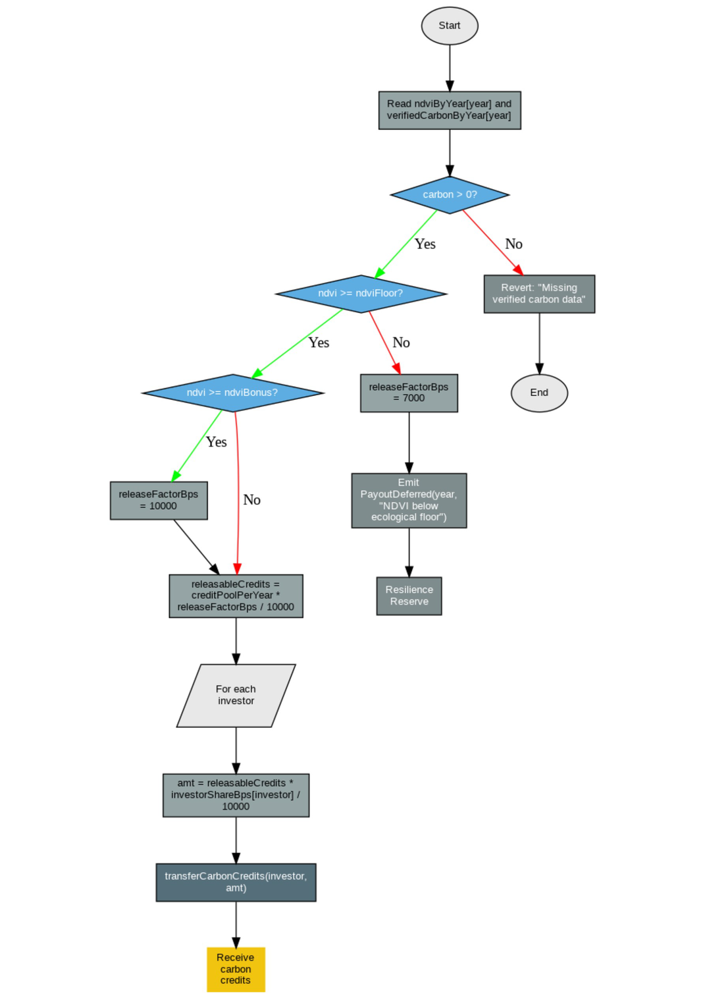
Smart Contract Execution Logic for Carbon Credit Issuance
Smart Contract Logic for Automated Blue Carbon Distribution
This flowchart illustrates the automated governance mechanism for carbon credit issuance within the project’s framework. The process integrates ecological data (NDVI) with financial triggers to ensure transparency and environmental integrity.
The logic operates through a hierarchical verification process:
Data Validation: The system ensures verified carbon data is present before execution.
Ecological Floor: If the NDVI falls below the pre-defined floor, credits are redirected to a Resilience Reserve, prioritizing ecosystem health over immediate liquidity.
Performance Bonus: Achieving a high NDVI triggers a bonus release factor (100%), incentivizing superior restoration outcomes.
Automated Distribution: Once the releasable credits are calculated, the smart contract executes an automated transfer to investors' wallets according to their predefined shares (BPS).
This model ensures a direct, immutable link between real-time nature recovery and financial instruments (Blue Finance).

Slide 13
Due Diligence Cover Note
Resilient Recovery: Financing Nature-Based Coastal Solutions for Urban Infrastructure in Port Sudan
Prepared for: EGU26 Scientific and Innovation Review
Prepared by: Mehad Ahmed Abdalla Ahmed
Date: 27/3/2026
contact: Mehadahmed54@gmail.com
1) Purpose of This Submission
This package provides an execution-ready, reproducible, and audit-friendly framework for financing mangrove-based blue carbon recovery in Port Sudan. The objective is to demonstrate that ecological restoration can be structured as a transparent, performance-linked climate investment with measurable environmental and financial outcomes.
2) What Is Included (Review Scope)
This dossier includes:
A validated historical baseline (2015–2025) for NDVI, carbon stock, and monetized carbon value.
The Bio-Financial Resilience Index (BFRI) methodology and calibrated parameterization.
Integrated project economics (OPEX, MRV, verification fees, net investor outcomes, social share).
Forward scenarios (2026–2035): Restoration vs Business as Usual.
Reproducible scripts, outputs, and chart assets aligned with the poster and presentation narrative.
Smart-contract execution logic for performance-triggered disbursement.
3) Key Findings Relevant to Investors and Reviewers
Historical carbon value increased from USD 11,876.63 (2015) to USD 42,110.67 (2025).
Carbon stock increased from 139.73 tCO2 to 495.42 tCO2 over the baseline period.
BFRI indicates improved resilience-to-finance coupling, with historical peak in 2025.
In the 2035 scenario comparison:
Restoration: BFRI ~0.544, Net Investor Profit ~USD 14,018
BAU: BFRI ~0.355, Net Investor Profit ~USD 10,013
The design includes a protocol-defined 10% community share, strengthening social license and long-term project stability.

Slide 14
4) Governance and Transparency Architecture
The project uses an outcome-based structure where payments are contingent on verified performance:
Environmental observations and MRV evidence are produced and documented.
Verification outputs are hashed for immutability and audit traceability.
Oracle-fed smart-contract logic evaluates pre-defined thresholds.
Funding is released only when environmental and verification conditions are met; otherwise held in escrow.
This architecture is designed to reduce information asymmetry, improve trust, and align capital with verified impact.
5) Reproducibility and Audit Controls
The package is reproducible within minutes via included scripts:
build_blue_carbon_master_excel.py
generate_future_scenarios_2026_2035.py
plot_bfri_trend.py
A dedicated Runbook.md defines:
environment requirements,
exact run commands,
expected outputs,
validation checkpoints,
assumptions and boundaries.
A Data Dictionary and file index are included to support immediate technical review.
6) Key Assumptions and Limitations
Scenario projections are model-based and should be interpreted as decision-support, not deterministic forecasts.
Future OPEX behavior is represented using a historically grounded ratio approach.
Climate risk and social return terms are proxy-based composites derived from available data.
Deployment-grade investment decisions should include local legal, institutional, and field verification layers.
7) Why This Is Investment-Ready
This model is investment-ready because it combines:
Scientific measurability (remote sensing and quantified environmental indicators),
Financial traceability (explicit cost stack and net return logic),
Operational reproducibility (scripted workflow and audit trail),
Governance credibility (on-chain verification and conditional disbursement),
Social durability (structured community benefit allocation).
Together, these elements create a scalable blueprint for blue economy financing in climate-vulnerable coastal regions.
8) Requested Engagement
We welcome:
technical validation feedback,
pilot structuring partnerships,
co-development with climate funds, public agencies, and MRV providers,
evaluation for phased deployment in the wider Red Sea coastline.
Primary contact: Mehad Ahmed Abdalla Ahmed
Email: Mehadahmed54@gmail.com
Institution/Project: Resilient Recovery: Financing Nature-Based Coastal Solutions for Urban Infrastructure in Port Sudan

Slide 15
Runbook: Reproduce Port Sudan BFRI and 2035 Scenarios (10 Minutes)
Project
Resilient Recovery: Financing Nature-Based Coastal Solutions for Urban Infrastructure in Port Sudan
Version: EGU26 Submission Pack
Owner: Mehad Ahmed Abdalla Ahmed
Last Updated: 27/3/2026
1) Objective
This runbook reproduces two core outputs used in the EGU26 presentation:
Historical BFRI results (2015–2025)
Future scenarios (2026–2035) including:
Restoration (Best Case)
Business as Usual (Worst Case)
Net Investor Profit, community share, and delta metrics
2) Required Inputs
Source dataset:
Port_Sudan_Refined_Financials_2026.csv
Python scripts:
build_blue_carbon_master_excel.py
generate_future_scenarios_2026_2035.py
plot_bfri_trend.py
3) Environment Requirements
Python 3.9+
Packages:
pandas
numpy
matplotlib
openpyxl
Install (if needed):
pip install pandas numpy matplotlib openpyxl

Slide 16
Data Dictionary and File Index (EGU26)
A) Core Data
Port_Sudan_Refined_Financials_2026.csv: Primary observed dataset (2015–2025) with ecological and financial fields.
Port_Sudan_Blue_Carbon_Master_Model_2026.xlsx: Integrated analytics workbook (Master Integrated, Verification, Scaling, and Assumptions).
B) Reproducibility Scripts
build_blue_carbon_master_excel.py: Builds the integrated Excel model.
generate_future_scenarios_2026_2035.py: Generates Restoration vs BAU scenarios.
plot_bfri_trend.py: Creates high-resolution BFRI graphics.
C) Visual Assets
BFRI_trend_2015_2025.png: High-resolution trend line chart.
blockchain_flowchart.svg: MRV to Smart Contract flow diagram.
D) Methods and Formula References
BFRI_formula.md: Formal equations and variable definitions.
runbook.md: Step-by-step reproducibility guide (10-minute execution).

Slide 17



Thank
You.
Let’s Connect With Us
mehadahmed54@gmail.com
+20 1276540472
LinkedIn : Mehad Ahmed

