Slide 1


A nondimensional atlas for potential
Evaporation and the Bouchet-Morton complementary relationship
Separating definition choices from land- atmosphere adjustment
Justin C. Pettijohn | EGU26 HS2.2.5 New Developments in Hydrological Synthesis
Virtual presentation | Wed 06 May 2026 | 09:05 CEST
Material from Pettijohn in press, Advances in Water Resources

Slide 2
SET-UP
CR theory recap: three evaporation rates
E + E_{pa} = 2 E_{p0}
drying surface: actual E falls, near-surface air dries/warms, apparent potential rises
actual
evaporation
E_{pa}
apparent
potential
E_{p0}
wet-
environment
E
from land surface
from drying air state
benchmark
wet surface
drying surface / warmer, drier air
dry limit
Problem: curve shape can reflect both physics and definition choices.

Slide 3
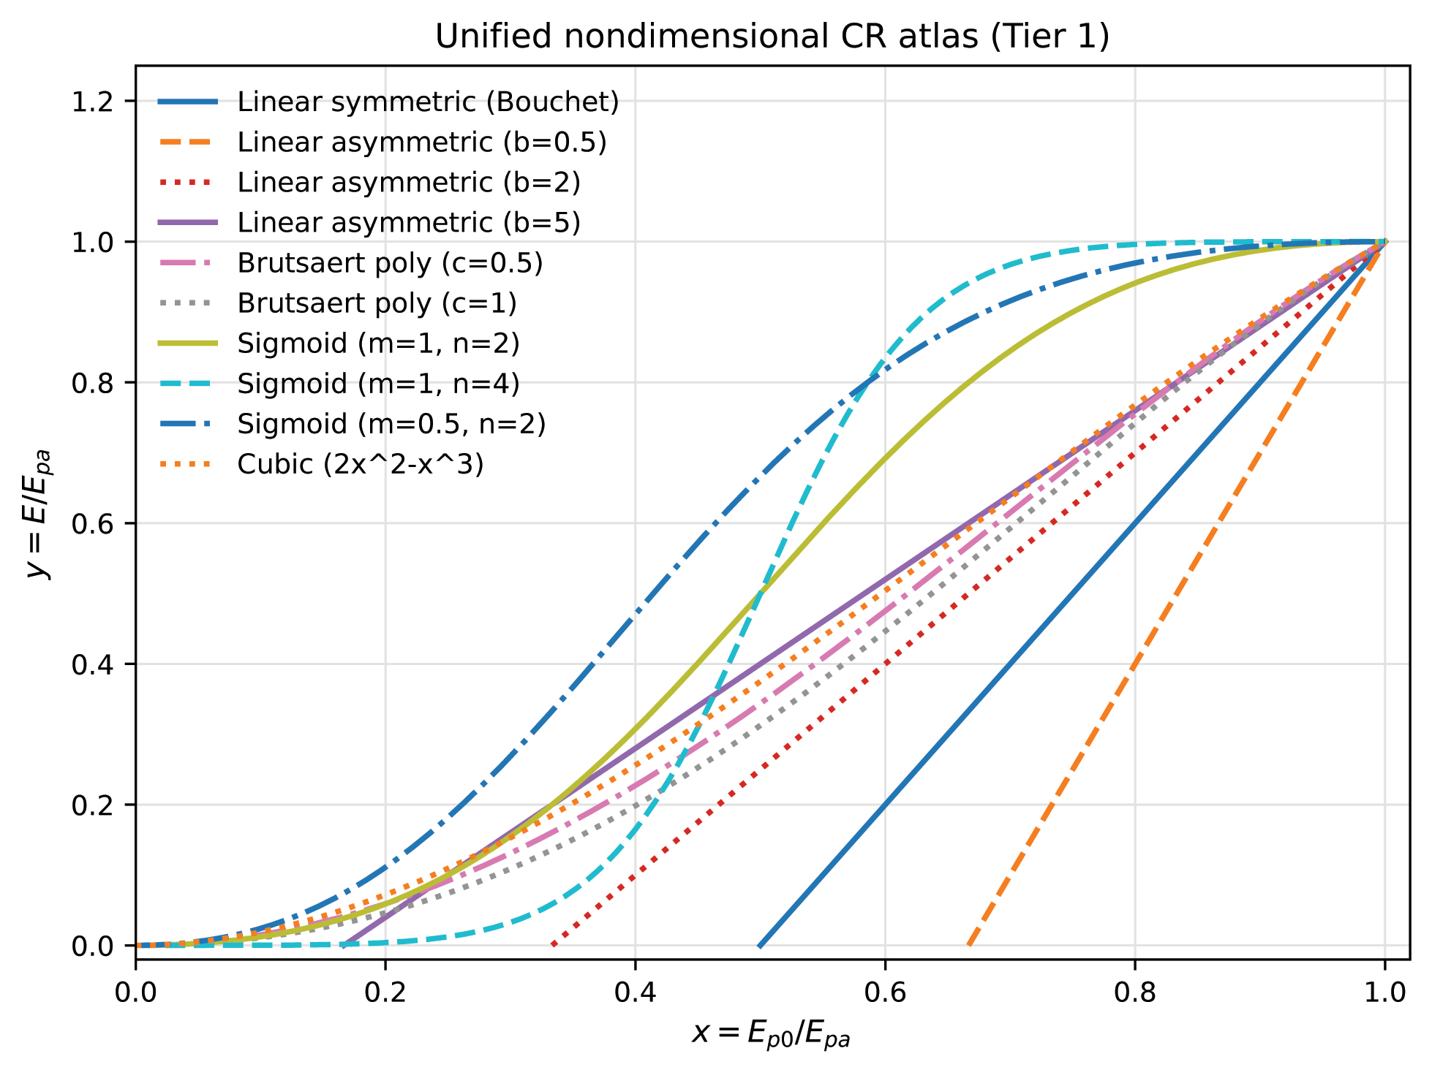
Unifying move: put CR families on common axes
TIER 1
Fig. 1 from Pettijohn (2026) in press., Advances in Water Resources
Common axes
x = Eₚ₀ / Eₚₐ
y = E / Eₚₐ
•
same wet / dry endpoint logic
•
explicit admissible domain
•
geometry becomes comparable
Descriptors: wet-limit slope,
dry-end location, curvature
Major CR families remain geometrically distinct after nondimensionalization.

Slide 4
Workflow: separate definition from mechanism
FRAMEWORK
1
Definition set
2
CR families
compute E, Eₚₐ, and Eₚ₀ consistently
place candidate curves on the same x–y axes
3
Mixed-layer lab
4
Atlas overlay
generate controlled drying trajectories
interpret shape after the coordinate audit
Definition remapping is evaluated before physical interpretation.

Slide 5
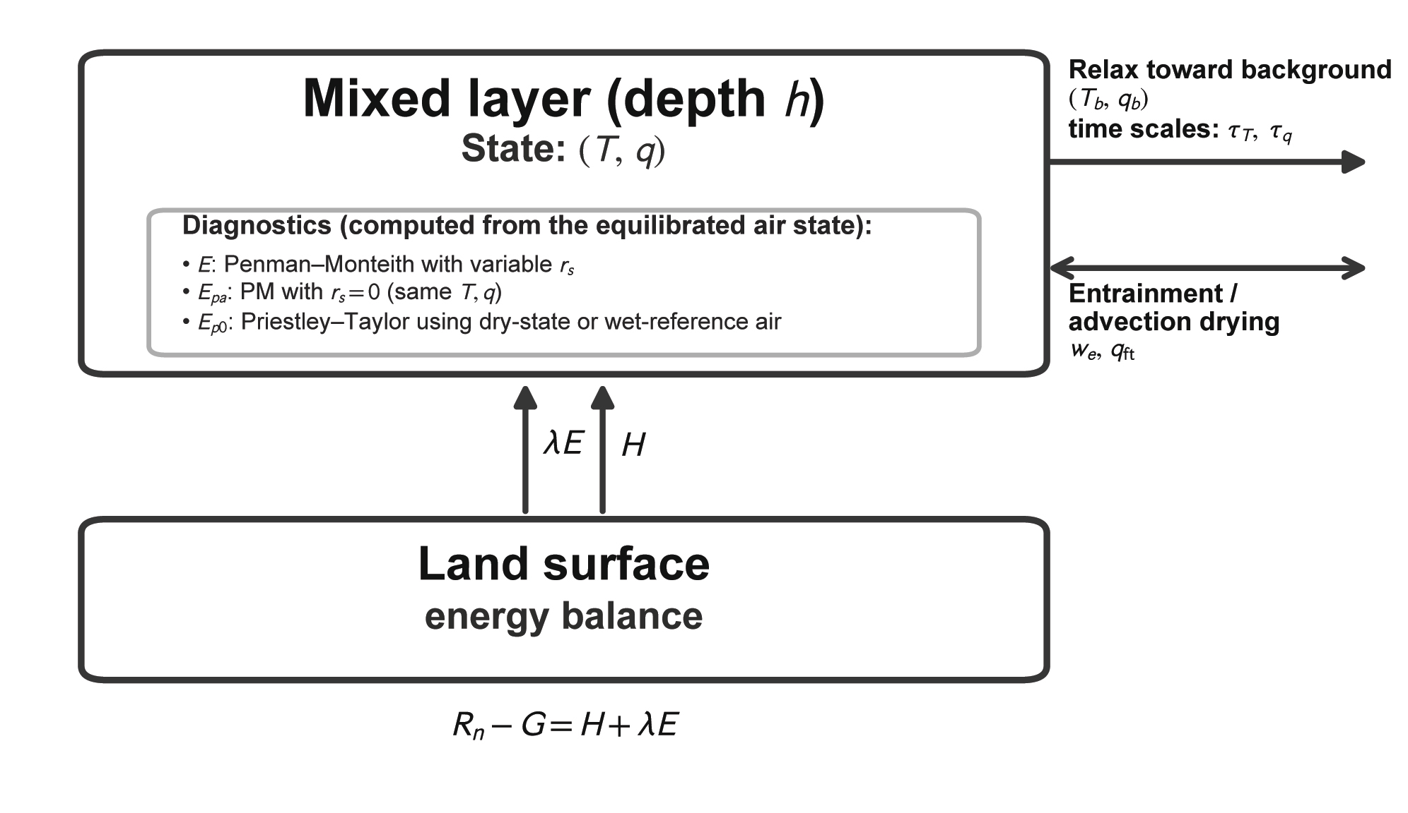
Controlled numerical lab: mixed layer + landsurface
TIER 2
State
mixed-layer T, q, and
effective depth h
Variables
ventilation, relaxation,
entrainment, resistance
Diagnostics
actual E, apparent Eₚₐ,
and wet benchmark Eₚ₀
Fig. 2 from Pettijohn (2026) in press., Advances in Water Resources
Purpose: isolate what boundary-layer adjustment alone can do to CR geometry.

Slide 6
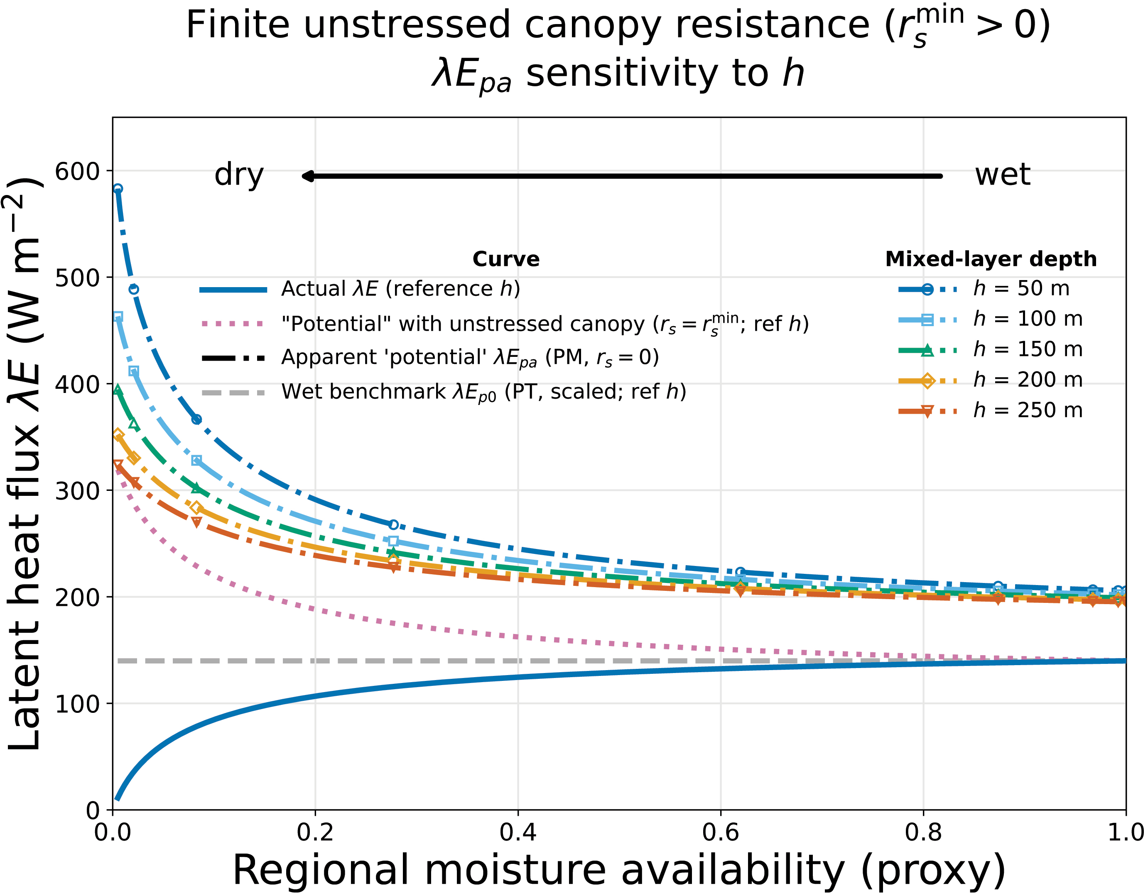
The exciting bit: CR emerges mechanically!
RESULT
Controlled drying sweep
•
Actual λE declines
surface resistance suppresses evaporation
•
Apparent potential rises
dry / warm air increases same-air demand
•
Coupling changes separation
shallower or stronger adjustment amplifies the split
Fig. 5 from Pettijohn (2026) in press., Advances in Water Resources
CR pattern emerges without site fitting.

Slide 7
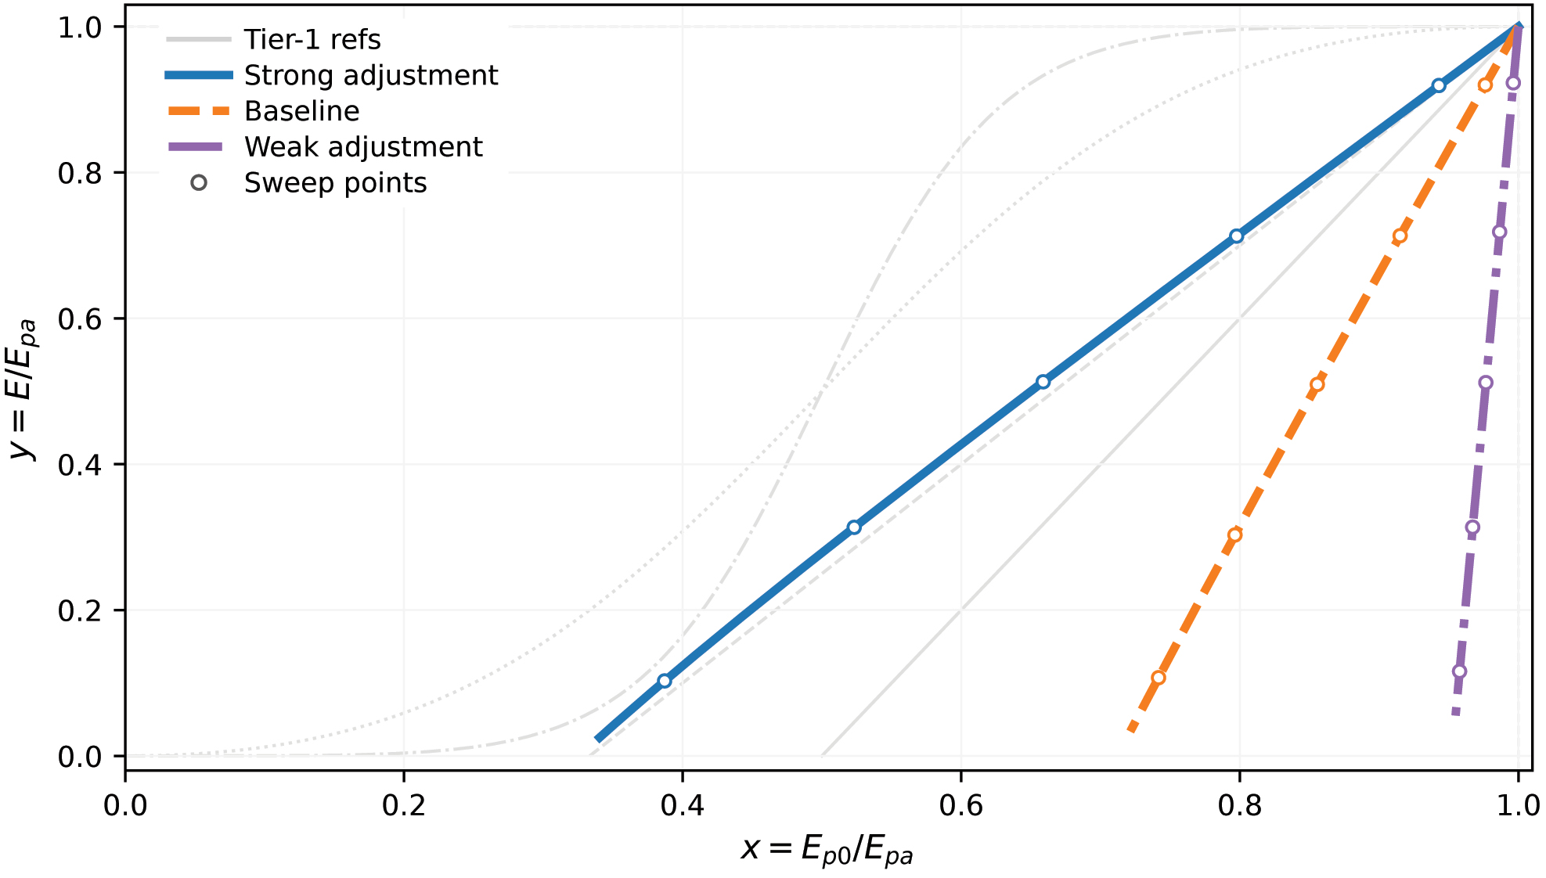
Overlay in the atlas: adjustment strength becomes geometry
SYNTHESIS
Fig. 4 from Pettijohn (2026) in press., Advances in Water Resources
How to read it
Strong
steeper, more asymmetric path
Baseline
intermediate geometry
Weak
near-vertical branch near x≈1
Under this closure, curve shape is a regime signature—not just a fitted curve choice.

Slide 8
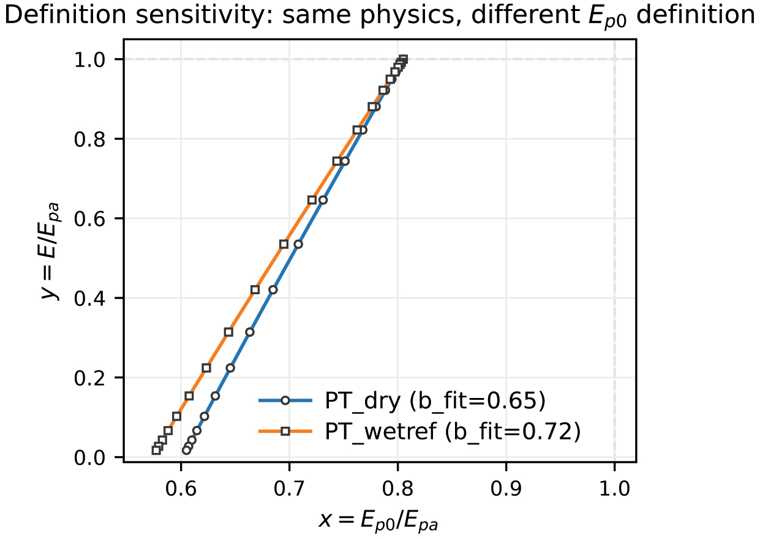
Wet-benchmark choices can remap the x-axis
DEFINITION CHECK
Practical audit
•
What is the same-air demand diagnostic?
Fig. 6 from Pettijohn (2026) in press., Advances in Water Resources
•
What is the wet-environment benchmark?
•
Are Eₚₐ and Eₚ₀ built from compatible assumptions?
Definition shifts can mimic changes in asymmetry or curvature—even when the physical trajectory is unchanged.
Audit first; interpret coupling second.
Same physics → different x-position if the benchmark changes.

Slide 9

WRAP-UP
Take-home: the atlas is a workflow, not a new formula
1
Geometry is not interchangeable
CR families remain distinguishable on common nondimensional axes.
2
Definition consistency controls x
Wet-benchmark choices can masquerade as asymmetry or curvature.
CR shape encodes adjustment strength
Pettijohn (2026) in press, Advances in Water Resources
3
Under the closure, geometry reflects coupling, ventilation, and time scales.
Part II: apply the atlas to NEON eddy-covariance tower data.
Thank you! Questions?

