Slide 1




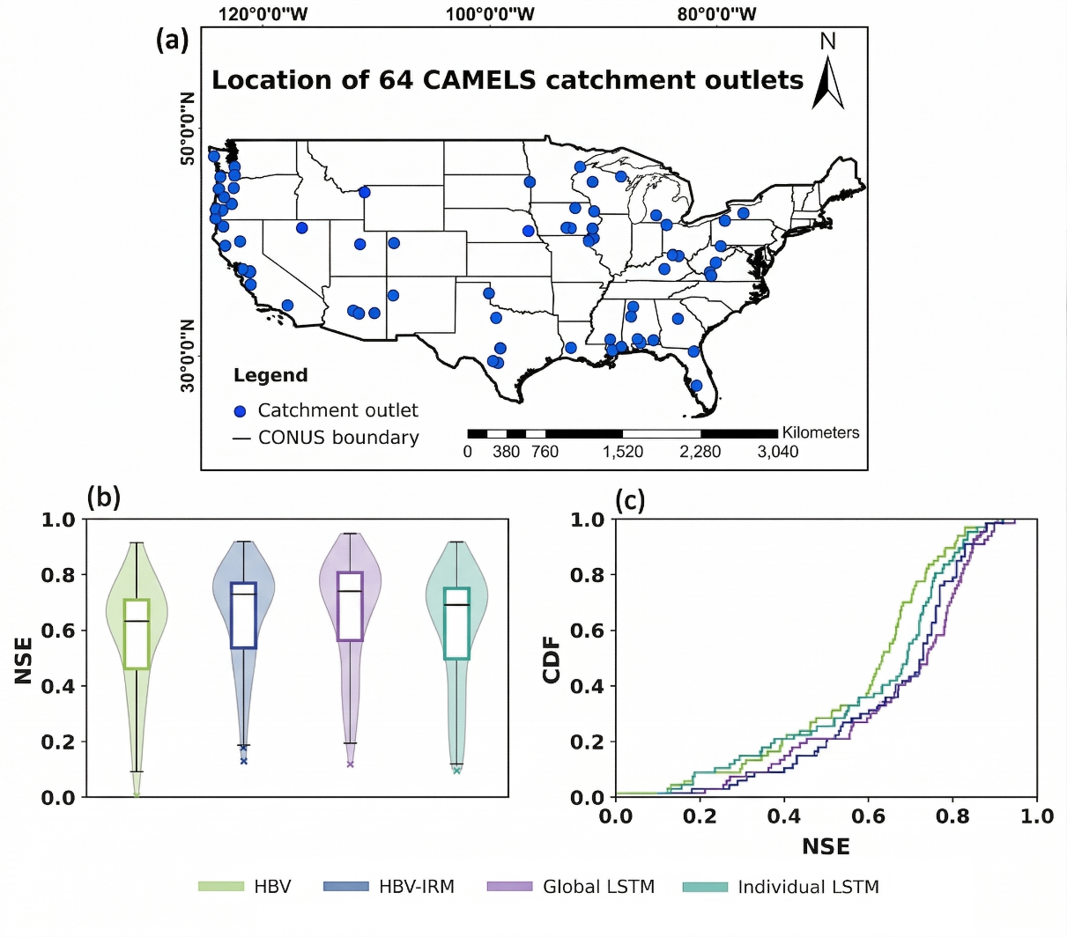
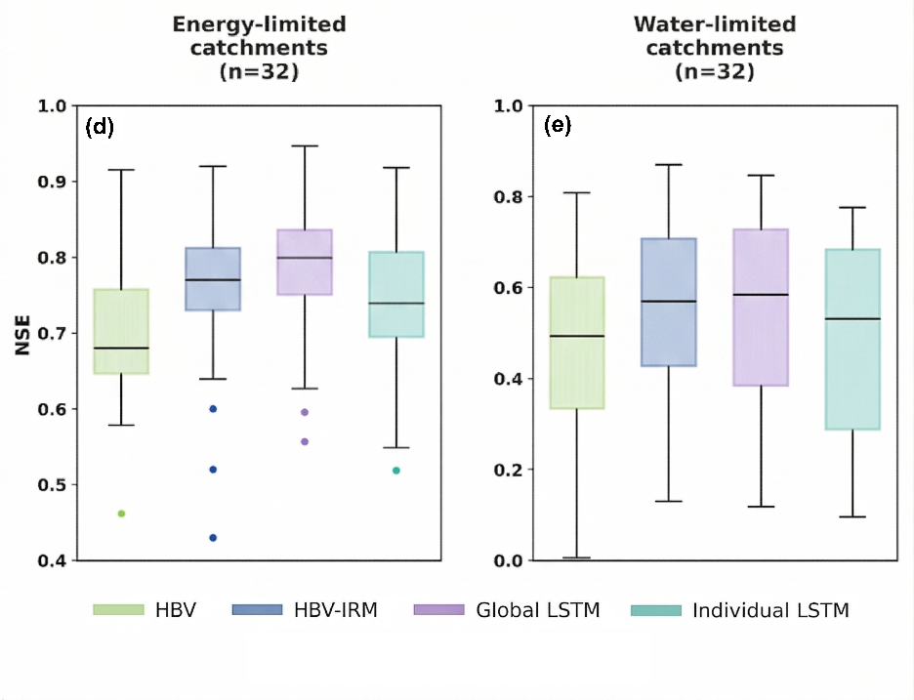
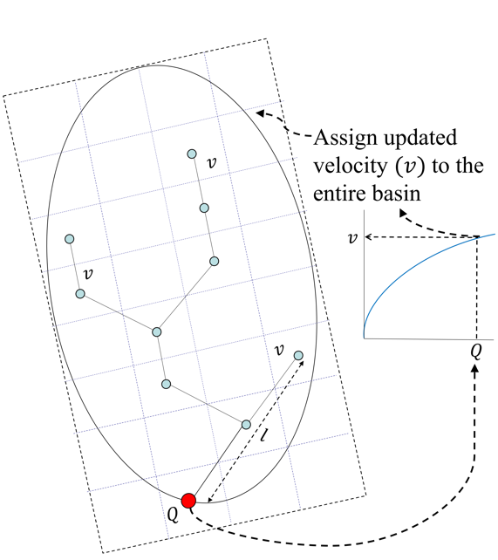
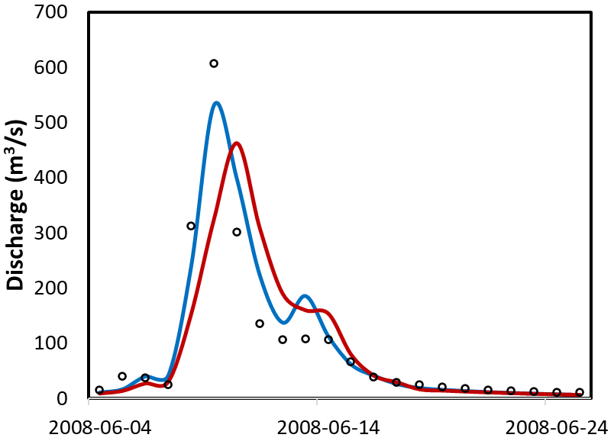

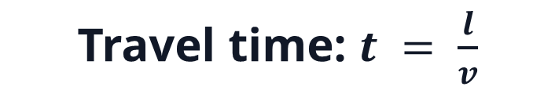
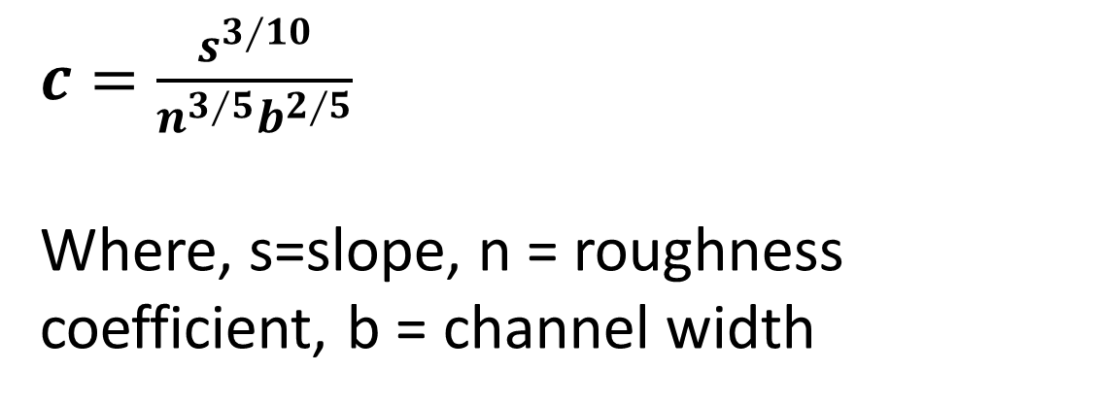





Do Process-Based Models Really Fall Short?
Rethinking Channel Routing to Bridge the Gap with Machine Learning Models
Ekant Sarkar¹*, Akshay Kadu¹,², Vijay Katari¹, Basudev Biswal¹
Abstract ID: EGU26-2852
¹ Department of Civil Engineering, Indian Institute of Technology Bombay, Mumbai, India ² Stantec ResourceNet Pvt. Ltd., Pune, India
Contact
Central question:
Can targeted fix to channel routing make a process-based model competitive with LSTM?
Why this study?
The HBV-IRM workflow
Performance against LSTM benchmarks
Where the routing fix matters most?
1
2
3
4
Because machine learning often outperforms
process-based hydrological models.
HBV gridded runoff
Route runoff to outlet using IRM
But why?
Our hypothesis
Inside the IRM
A large part of the process-based versus machine-learning performance gap arises from linear, time-invariant routing.
Start with initial velocity $v$
Let’s test whether better routing
can close the performance gap.
Travel time: $t = \frac{l}{v}$
But how?
Sum arrivals to provisional $Q$
Figure: Climate-regime boxplots.
Let’s take HBV and its routing module.
Original HBV routes runoff using a fixed triangular transfer function.
Replace this routing module with the Iterative Routing Model (IRM).
IRM accounts for variation of velocity with streamflow.
Figure: 64 CAMELS catchments, validation NSE distributions, and CDF comparison for HBV, HBV-IRM, global LSTM, and individual LSTM.
LSTM models show higher uncertainty in arid basins than HBV-IRM.
Update velocity
$v_{new}=c Q^{0.4}$
Key results
Check convergence:
Is $v_{new}=v$ ?
Median NSE across all catchments
HBV 0.65
HBV–IRM (this study) 0.72
Global LSTM 0.74
Individual LSTM 0.69
What climate-regime tells us?
If not converged, repeat routing with $v_{new}$
Accept converged $Q$
$c=\frac{s^{3∕10}}{n^{3∕5}b^{2∕5}}$
Where, s=slope, n = roughness coefficient, b = channel width
• HBV-IRM shows a higher lower-quartile in water-limited basins than both LSTM setups.
• Explicit routing physics remains useful when low-flow periods reduce the information available to data-driven models.
MAXBAS_{HBV} = 2.95 days
Roughness coefficient = 0.036
~78% of the performance gap between HBV-to-global-LSTM is closed by HBV-IRM.
Answer to the central question:
Yes, routing matters. Improving routing makes process-based models competitive with machine learning while remaining physically interpretable.
Selected references: Sarkar et al. (2026). Taming the non-linearity : An iterative conceptual routing model for improving flood peak prediction. Environmental Modelling and Software, 197, 106843. https://doi.org/10.1016/j.envsoft.2025.106843.
Sarkar et al. (2026). Fixing the Routing Module to Achieve Machine-Level Performance in Streamflow Prediction. Authorea. February 24, 2026. DOI: 10.22541/au.177196151.17762877/v1

