Slide 1
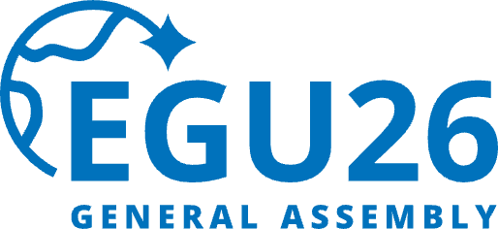


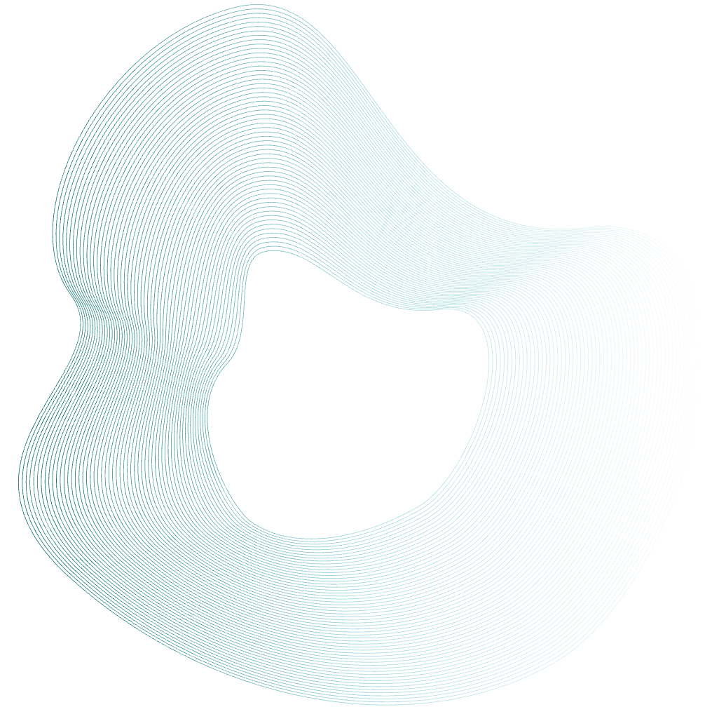



Integration of Anaerobic Digestion and Hydrothermal Liquefaction for Resource Recovery from Fish Waste Digestate
Department of Bioenvironmental Systems Engineering, NTU
Ting Yu HSU, Ya-Zhen Huang, Chihhao Fan
EGU26-2934 | ERE1.1
PICO 2-minute madness:
Tuesday, 05 May 2026, 09:01–09:03 at PICO spot 4
PICO viewing:
Tuesday, 05 May 2026, 09:09–10:15, Screen PICO 4.12
Abstract:
Our lab:
Email:

Slide 2

Table of Content
1. Introduction
2. Materials and Methods
3. Results and Discussion
1-1 Research background
1-2 Fish Waste Estimates in Taiwan
2-1 Experimental framework
2-2 Anaerobic Digestion
2-3 Hydrothermal Liquefaction
3-1 Bio-methane potential of fish waste
3-2 HTL products distribution
3-3 Composition of biocrude under different HTL conditions by GC-Mass
3-4 Thermal Decomposition Behavior of Biocrude Derived from Different HTL Conditions (TGA Analysis)
Conclusions/Implications & Future Perspectives

Slide 3
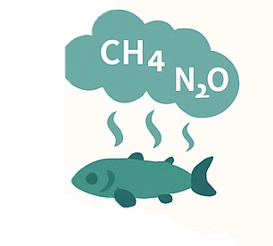





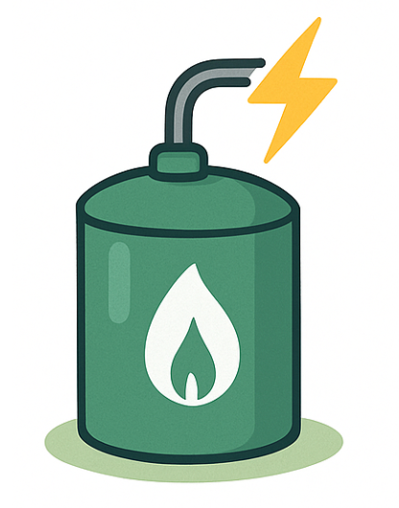

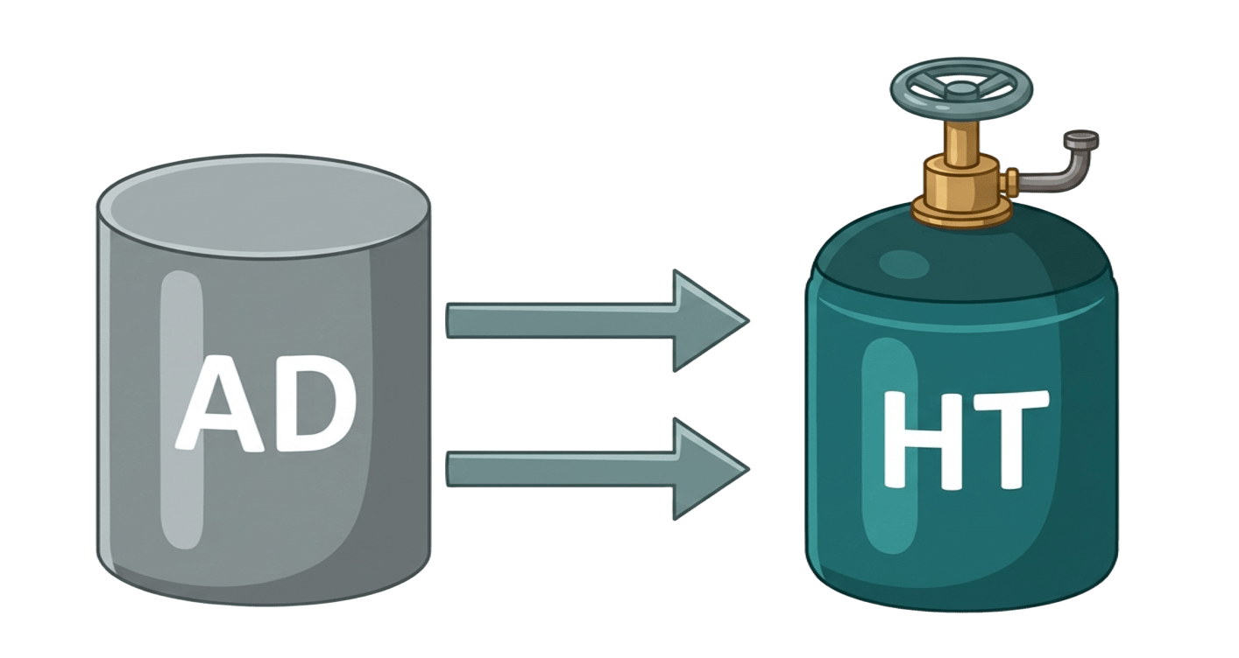
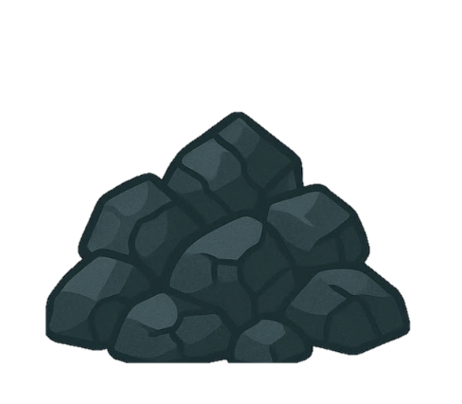


1. Introduction
2. Methods
3. Results & Discussion
1-1 Research background
Global food loss and waste account for approximately 8–10% of total greenhouse gas emissions.
Fish waste are characterized by high moisture, high protein, and high fat content.
Traditional Treatment Methods
Landfilling
Composting
Feed conversion
Greenhouse gas emissions
Odor issues
Vector-borne pathogen proliferation (causing intestinal and endemic diseases)
Low efficiency
High pollution
Ammonia volatilization and soil acidification
High production costs and low overall reuse rate
According to statistics from Taiwan’s wholesale fish markets, the annual amount of fish residue resources is approximately 207,325 tons.
AD + HT Integrated
System
Potential Advantages
Production of high value-added products (with agricultural application potential)
Pollution reduction
Carbon fixation
Energy recovery
Biogas
Hydrochar
Bio crude oil
Anaerobic
Digestion
Hydrothermal Treatment
Internal Water Resource Recycling
(Process water is collected and reused)
Process water

Slide 4
1. Introduction
2. Materials & Methods
3. Results & Discussion
1-2 Fish Waste Estimates in Taiwan
Approximately 70% of fish require processing before they are sold and consumed. During this process, a large amount of low-economic-value fish residues (FW) is generated, including scales, viscera, and bones. These parts account for more than 45% of the total fish body weight and are often discarded as waste.
Estimated Fish waste Generation from Three Common Farmed Species in Taiwan(MOA, 2024)
Species | Production(tons) | Scales (%) | Viscera (%) | Bones (%) | Estimated FW (tons)
吳郭魚 | 56,792 | 1.97 | 13.97 | 43.30 | 33,643
鱸魚 | 4,756 | 5.10 | 13.73 | 28.19 | 2,236
石斑魚 | 17,204 | 0.17 | 14.96 | 33.05 | 8,288
Total | 78,752 | - | - | - | 44,167
Estimated Annual Fish Waste Generation from Wholesale Markets in Taiwan (MOA, 2024)
Category | Quantity(tons)
Total transaction volume | 402,731
Scales | 9,719
Viscera | 57,268
Bones | 140,338
Total fish waste | 207,325
4
Data source: Fisheries Agency, Ministry of Agriculture (2024) , MOA’s 2024 Agricultural Waste Discharge Statistics and local fishermen’s associations & processing plants in southern Taiwan.

Slide 5

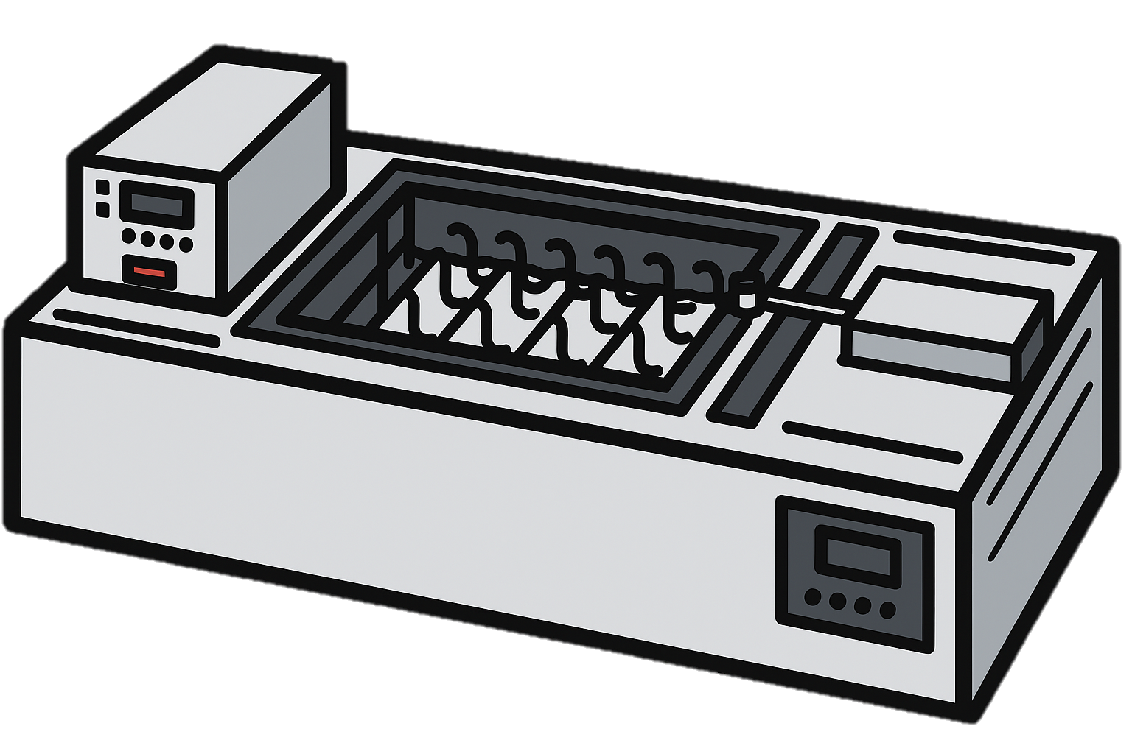
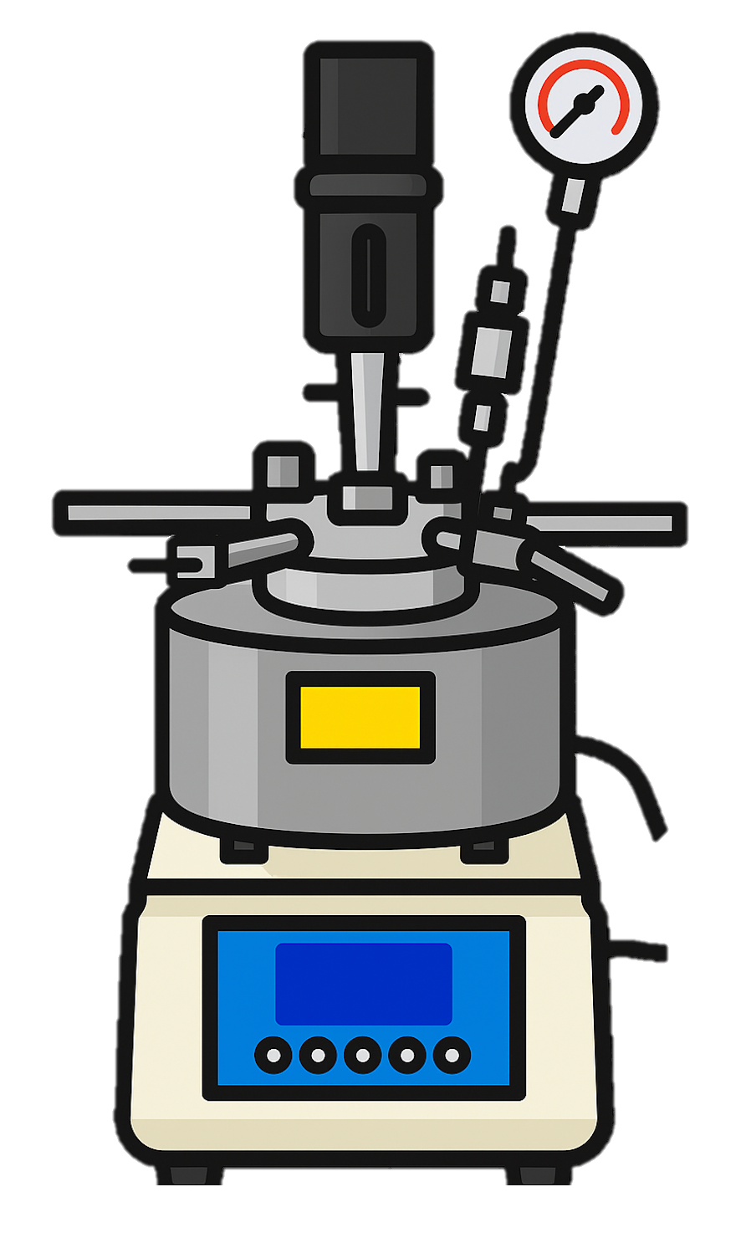

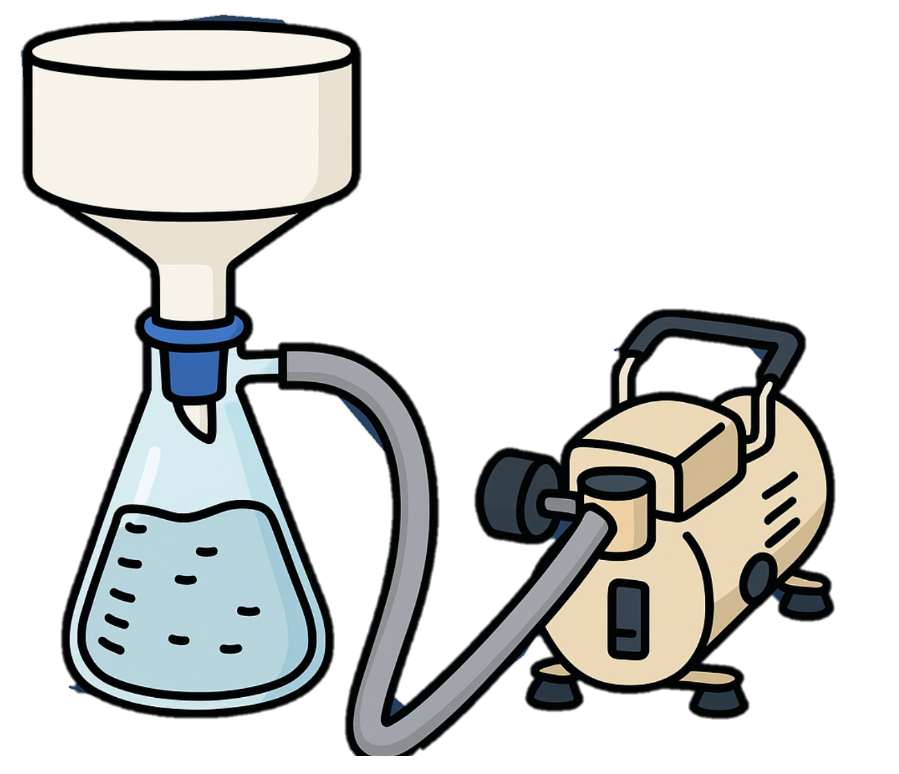

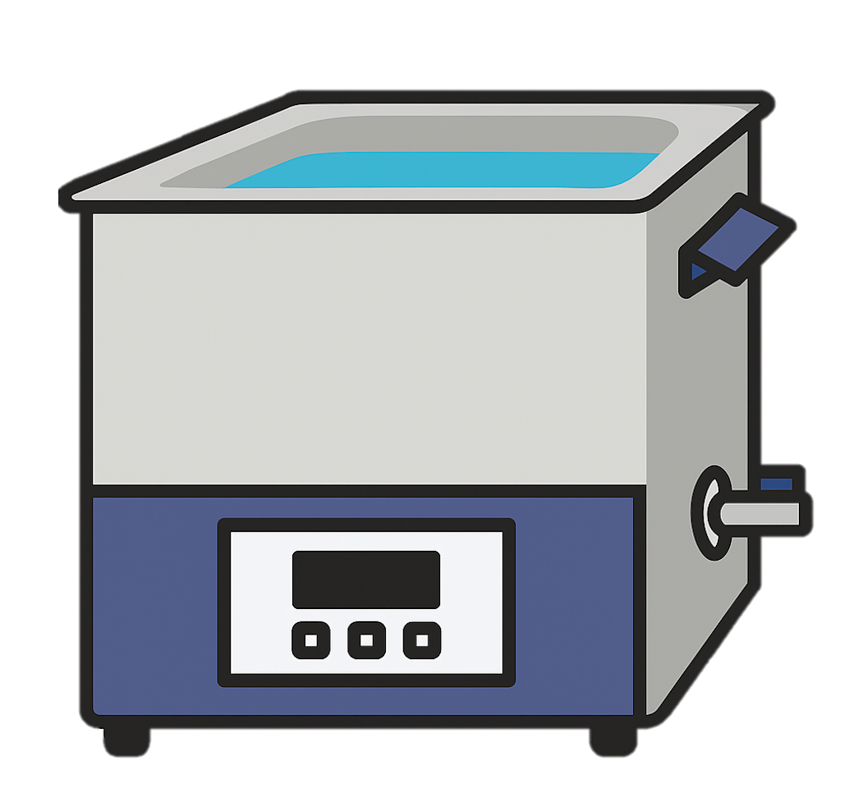

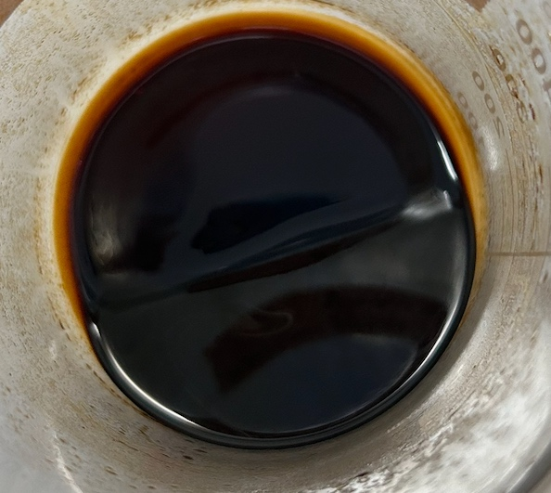
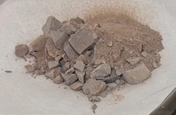
1. Introduction
2. Materials & Methods
3. Results & Discussion
2-1 Experimental framework
Anaerobic Digestion
Substrate
Temperature-controlled anaerobic digestion
AD product
Fish waste（fish viscera, bones, scales）
37 ± 1 °C
Biogas
+Sludge
Digestate
Hydrothermal Liquefaction
Vacuum filtration
Solid/ Liquid Separation
Aqueous phase
HT product-(4) Process water
Liquid
Organic phase
HTL conducted in a high-temperature, high-pressure reactor
Solid(hydrochar)
Rotary evaporator
(Evaporate and recover dichloromethane for reuse)
Organic solvent extraction
By Dichloromethane(DCM)
➔Repeated extraction
Organic solvent extraction
By Acetone＆sonication
Centrifugation
（Solid/ Liquid Separation
again)
Solid
liquid
HT product-(3) Bio-crude oil (extracted from aqueous phase)
HT product-
(1) Solid Residue
HT product- (2) Bio-crude oil (extracted from solid)
5

Slide 6
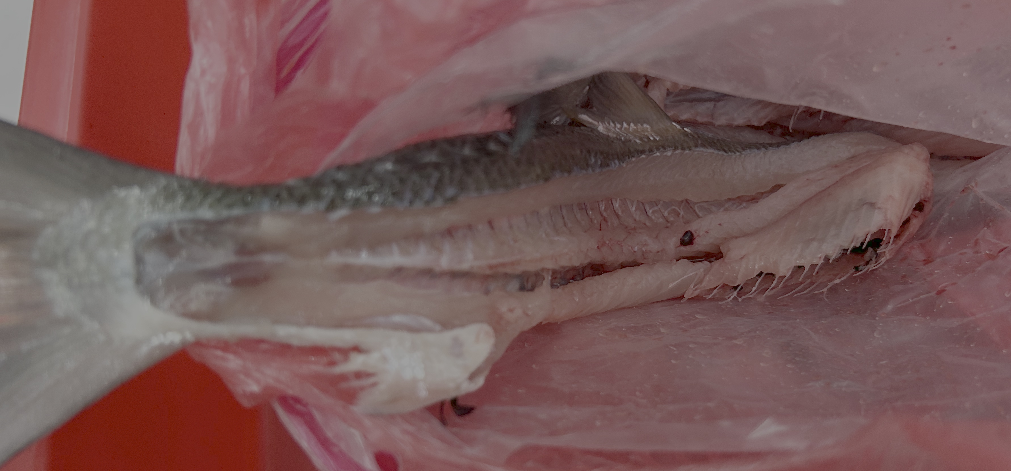
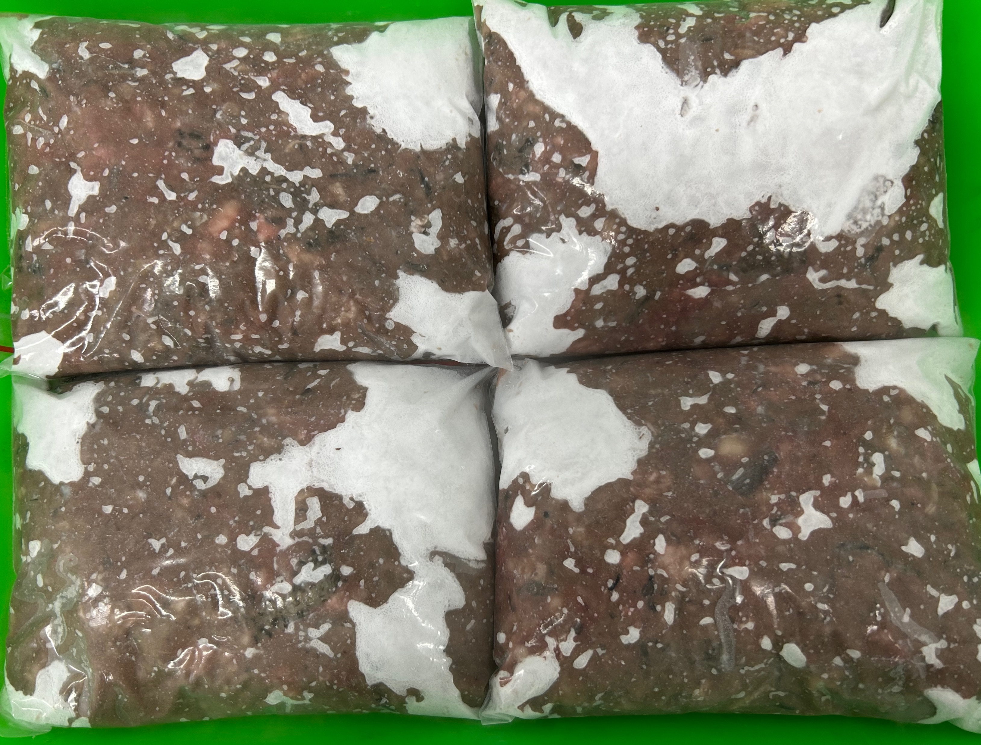

1. Introduction
2. Materials & Methods
3. Results & Discussion
2-2 Anerobic Digestion of fish waste
Material: Milkfish bones containing residual meat, milkfish scales and fish market-derived viscera waste
Grinding equipment: cleaver and blender
Final particle size:5mm~10mm
Co-digestion of fish waste and sludge at 37°C water bath for 30 days in 250 mL serum bottles.
Fish waste +Sludge(S+FW)：Three different substrate-to-inoculum ratios were used for anaerobic digestion, and the resulting digestate (liquid and solid fractions) was subsequently subjected to hydrothermal treatment in the next stage.
After blending, the samples were stored at −80°C.
Inoculum: sludge
In 37 ± 1 °C
Analysis(% wet) | Separate fish waste |  |  | Inoculum | Digestate
 | Fish bones(g) (flesh-attached) | Fish scales(g) | Fish viscera(g) | Sludge | From 1:1(S:I) | From 5:1(S:I) | From 10:1(S:I)
Moisture | 59.72 | 45.24 | 56.84 | 96.69 | 96.61 | 88.95 | 85.09
Total Solid(TS) | 40.28 | 54.76 | 43.16 | 3.31 | 3.39 | 11.05 | 14.91
Volatile Solid(VS) | 26.22 | 33.28 | 40.13 | 2.96 | 2.09 | 8.74 | 10.88
VS/TS | 65.09 | 60.77 | 92.98 | 89.43 | 61.65 | 79.10 | 72.97
Ash | 14.06 | 21.48 | 3.04 | 0.35 | 1.30 | 2.31 | 4.03
6

Slide 7
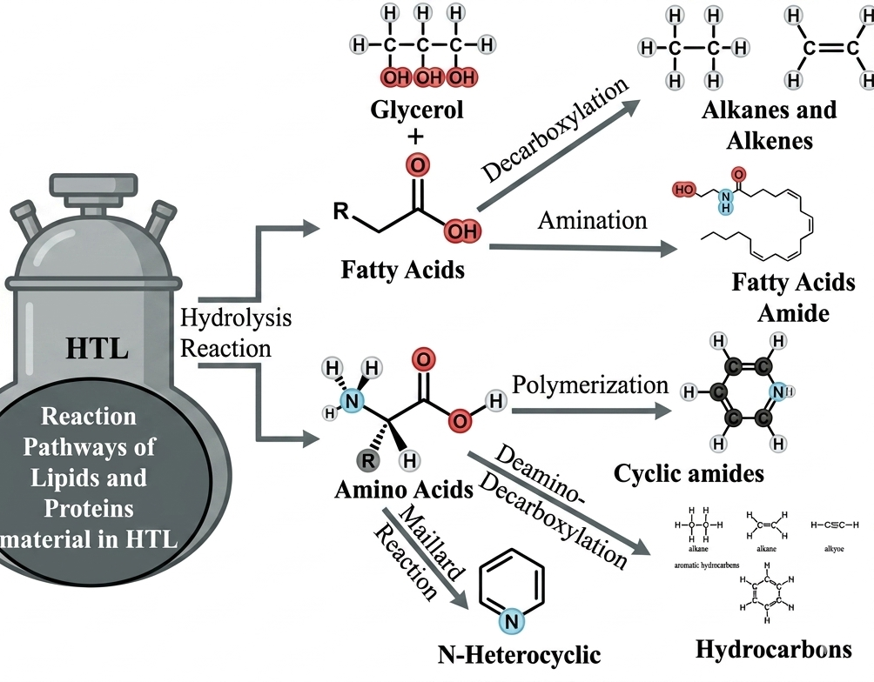
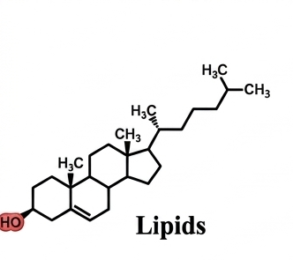
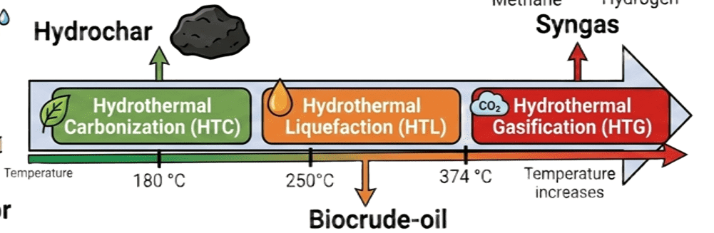
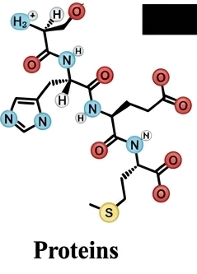
1. Introduction
2. Materials & Methods
3. Results & Discussion
2-3 Hydrothermal Liquefaction of fish waste digestate
Hydrothermal processes convert wet biomass into value-added products under high temperature and pressure.
They are classified into three types: Hydrothermal Carbonization (HTC), Hydrothermal Liquefaction (HTL), and Hydrothermal Gasification (HTG).
In this study, Hydrothermal Liquefaction (HTL) was applied to treat digestate derived from fish waste, including both liquid and solid fractions after anaerobic digestion.
Digestate of fish waste
Hydrothermal treatment
High temperature, high pressure reactor
Adapted from Usman et al. (2024).
Material (different S/I ratio digestate) | Water(ml) | HTL Treatment condition
 |  | Pressure (MPa) | Temperature(˚C) | Time(min)
1:1 | 50 | 5~15 | 250/275/300/325 | 30/60
5:1 | 100
10:1 | 150
Experimental conditions for HTL treatment
7

Slide 8
1. Introduction
2. Methods
3. Results & Discussion
3-1 Bio-methane potential of fish waste
Mix fish waste(fish scales+ fish viscera+ fish bones) by different S/I ratios
The S/I = 1:1 condition achieved the highest methane yield (around 140mL CH₄/g VS), significantly outperforming the 5:1 and 10:1 ratios, indicating more efficient biodegradation at higher inoculum levels.
Methane production rapidly increased between days 9–15, followed by a stable accumulation phase, suggesting the system reached steady anaerobic digestion.

Slide 9
1. Introduction
2. Methods
3. Results & Discussion
3-1 Bio-methane potential of fish waste
Separate fish waste by different S/I ratios

Slide 10
1. Introduction
2. Methods
3. Results & Discussion
3-2 HTL products distribution
Biocrude oil was the dominant product across all HTL conditions, accounting for the largest fraction of total products.
The majority of biocrude was derived from the solid phase, with a smaller but consistent contribution from the liquid phase.
Temperature had a stronger influence than reaction time on product distribution, indicating it is the key factor controlling HTL conversion.
325˚C,60min
300˚C,60min
275˚C,60min
250˚C,60min
325˚C,30min
300˚C,30min
275˚C,30min
250˚C,30min
250˚C, 275˚C, 300˚C, 325˚C,
30min 30min 30min 30min
250˚C, 275˚C, 300˚C, 325˚C,
60min 60min 60min 60min

Slide 11
1. Introduction
2. Methods
3. Results & Discussion
3-2 HTL products distribution
The 5:1 digestate consistently achieved the highest biocrude yield (45–57%), outperforming 1:1 and 10:1 conditions.
Increasing temperature slightly enhanced biocrude yield, particularly at 300–325˚C, while differences across conditions remained moderate.
Biocrude oil and solid residue exhibit an inverse relationship across different S/I ratios, reflecting variations in conversion efficiency.
250˚C, 30min 275˚C, 30min 300˚C, 30min 325˚C, 30min
250˚C, 30min 275˚C, 30min 300˚C, 30min 325˚C, 30min

Slide 12
1. Introduction
2. Methods
3. Results & Discussion
3-3 Composition of biocrude under different HTL conditions by GC-Mass
250˚C, 275˚C, 300˚C, 325˚C,
30min 30min 30min 30min
250˚C, 275˚C, 300˚C, 325˚C,
60min 60min 60min 60min
250˚C, 275˚C, 300˚C, 325˚C,
30min 30min 30min 30min
250˚C, 275˚C, 300˚C, 325˚C,
60min 60min 60min 60min

Slide 13
1. Introduction
2. Methods
3. Results & Discussion
3-4 Thermal Decomposition Behavior of Biocrude Derived from Different HTL Conditions (TGA Analysis)
DTG of biocrude extracted from solid residue
DTG of biocrude extracted from aqueous phase
275 °C-60min
300 °C/60min
250 °C/60min
325 °C/60min
275 °C/60min
300 °C/60min
325 °C/60min
DTG Characteristics
  All treatments show a dominant peak at 240-270 °C
Temperature-dependent DTG behavior
  100-150 °C: higher DTG intensity in high temperature treatments(300-325 °C)
  ➔increased light volatile compounds
  >300 °C : Higher DTG signal in low-temperature treatments(250-275 °C)
  ➔the presence of heavier and less degraded compounds
The biocrude exhibits good volatility and fuel potential(>500 °C low residue content)
DTG Characteristics
  All samples show a bimodal distribution
  Main peak: 140-170 °C
  Secondary peak: 200-280 °C
Higher temperature(325 °C) tends to increased heavy fraction formation(more complex molecular structures)
Heavy fractions (>300°C) remain limited in all samples
➔The biocrude exhibits good volatility and fuel potential(>500 °C low residue content)

Slide 14
1. Introduction
2. Methods
3. Results & Discussion
Conclusions
Implications & Future Perspectives
The integration of AD–HTL offers a viable pathway for fish waste valorization, achieving dual energy recovery through biogas and biocrude.
The S/I ratio plays a critical role in system performance: a 1:1 ratio maximizes methane production, while a 5:1 ratio is optimal for biocrude generation.
Increasing HTL temperatures to 300–325 °C promotes the breakdown of digestate, leading to higher biocrude yields and reduced waste solids.
The biocrude composition rich in lipid and protein derivatives—combined with its excellent volatility, shows its potential for further upgrading into renewable fuels.
The proposed integrated system provides a viable pathway for circular bioeconomy, enabling the effective management of high-nitrogen organic wastes.
Subsequent biocrude upgrading via denitrogenation is required to meet the standards of existing fuel infrastructure.
Future work will focus on aqueous phase valorization and nutrient recovery to establish a closed-loop system.
LCA and TEA are essential for assessing the environmental and economic viability of the process at an industrial scale.
These findings support the implementation of integrated AD-HTL systems in the fishery industry, addressing regional waste management while promoting energy self-sufficiency.

Slide 15
Thank You for Listening
Abstract:
Our lab:
Email:

