Slide 1
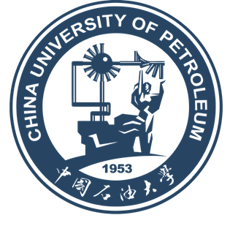
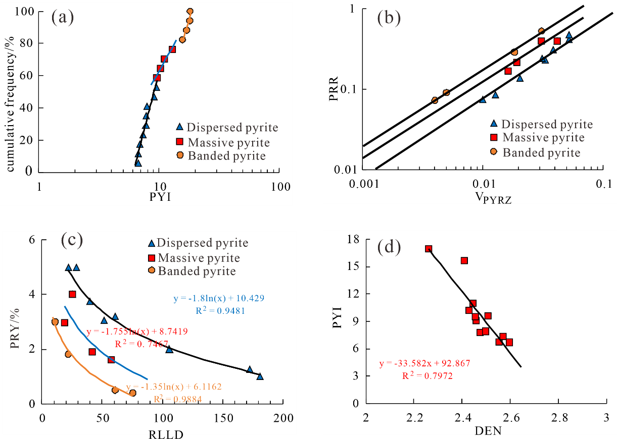
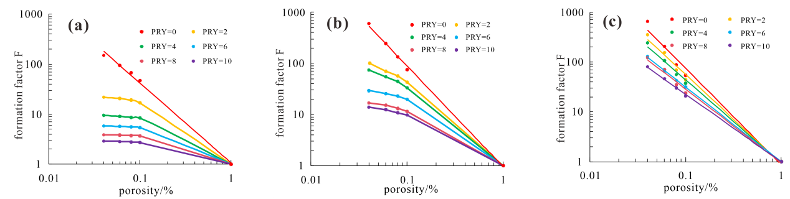
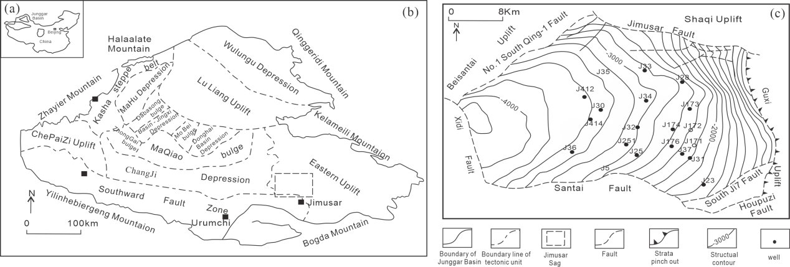
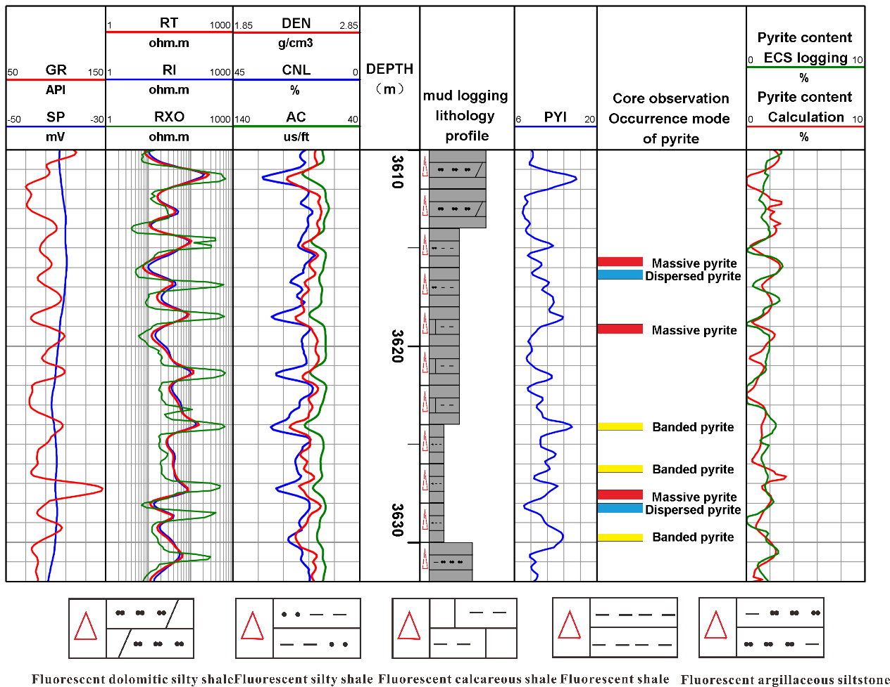
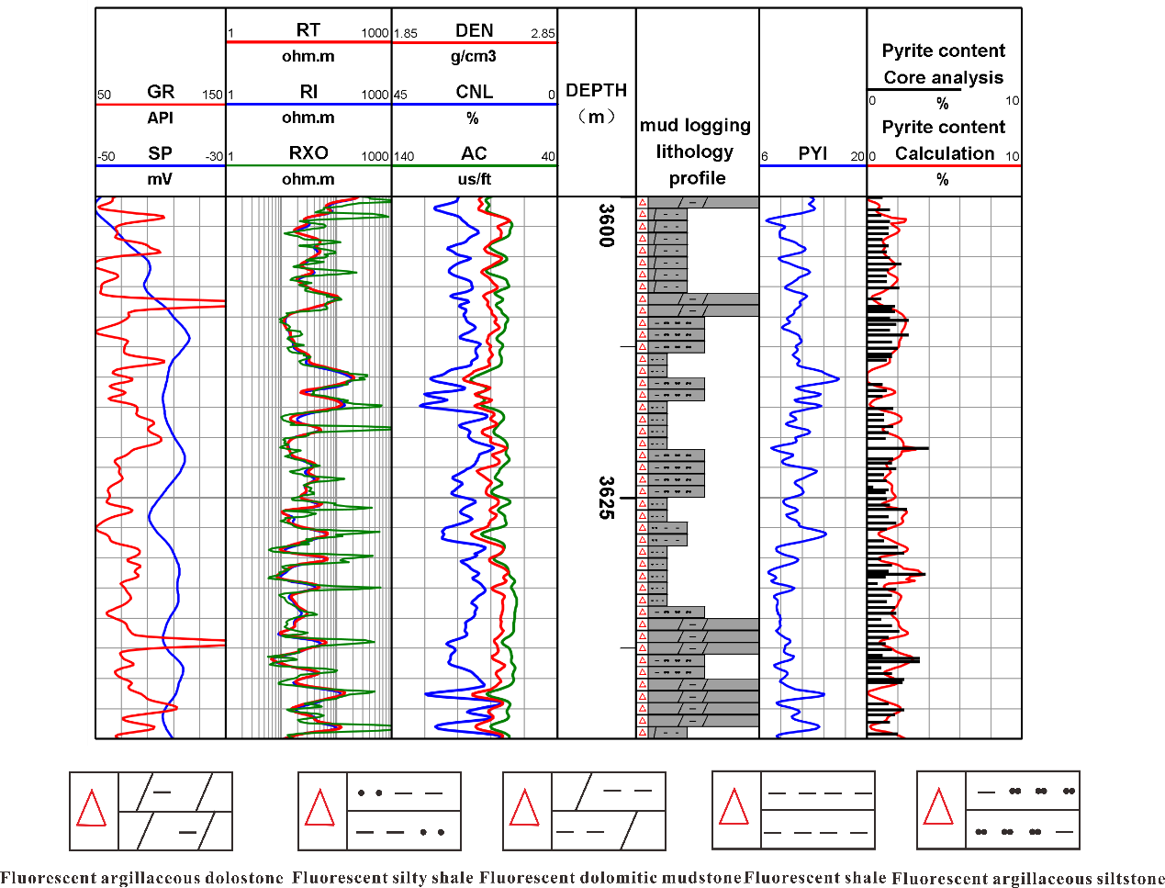
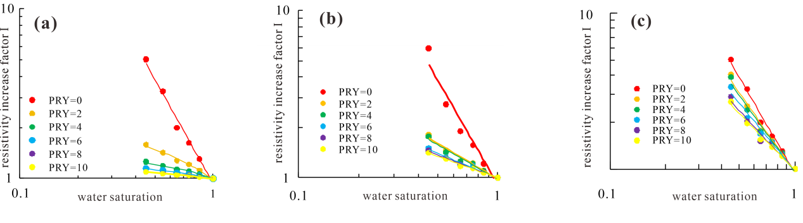
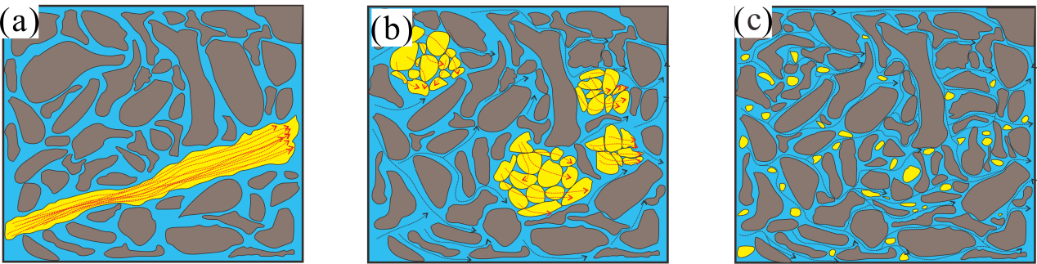
A Study on the Coupling Relationship Between Pyrite Occurrence Morphologies in Shale and Resistivity, and the Quantitative Calculation Method of Its Content Based on Numerical Simulation
Yingjie Liu ª (2412508275@qq.com), Dianshi Xiao ª,Zhuo Li ª
a. School of Geosciences, China University of Petroleum (East China), Qingdao 266580, China
I. Introduction
III. Pyrite effects on shale electrical properties
IV. Pyrite content estimation from well logs based on occurrence mode
Shale oil sweet spot evaluation based on logging data is the key to assessing reservoir development potential, and reservoir electrical characteristics lay a foundation for oil saturation interpretation. However, the electrical properties of subsurface rocks are a comprehensive response of mineral composition and pore fluids. As a high-conductivity mineral, pyrite can easily cause abnormally low reservoir resistivity, and its occurrence modes exert different degrees of influence on reservoir resistivity. Therefore, establishing a pyrite content calculation model considering occurrence modes can provide theoretical basis and technical support for revealing the influence mechanism of pyrite on shale rock-electrical relationships and improving the logging interpretation of shale oil-bearing potential.
Parameters such as PRR (Pyrite Resistivity Response coefficient), V_{PRYZ} (Volume Ratio conversion parameter of pyrite), and PYI (pyrite occurrence mode Index) are constructed. Combined with scanning electron microscope and density logging data, the PYI thresholds for different occurrence modes and the PYI prediction model are determined, and calculation models for pyrite content with different occurrence modes are established.
Dispersed pyrite particles are distributed in isolation and have a weak effect on resistivity, and the electrical relationship still conforms to Archie law. Massive pyrite forms a local conductive network, and the conductive mechanism is the parallel conduction of pore water and pyrite, which no longer follows the linear characteristics of Archie law. Banded pyrite can construct a continuous low-resistivity channel, and its conductive contribution far exceeds that of pore water, leading to the failure of Archie formula. Under the same pyrite content, the resistivity decreases most significantly from dispersed pyrite to banded pyrite.
V. Application
II. Geological setting
The verification results of actual wells show that the calculated values of the model are in good agreement with formation elemental logging data.
The Junggar Basin is an important petroleum-bearing basin in western China. The Jimusar sag is located in the western part of the Junggar Basin.

