Slide 1




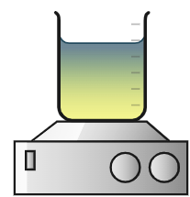



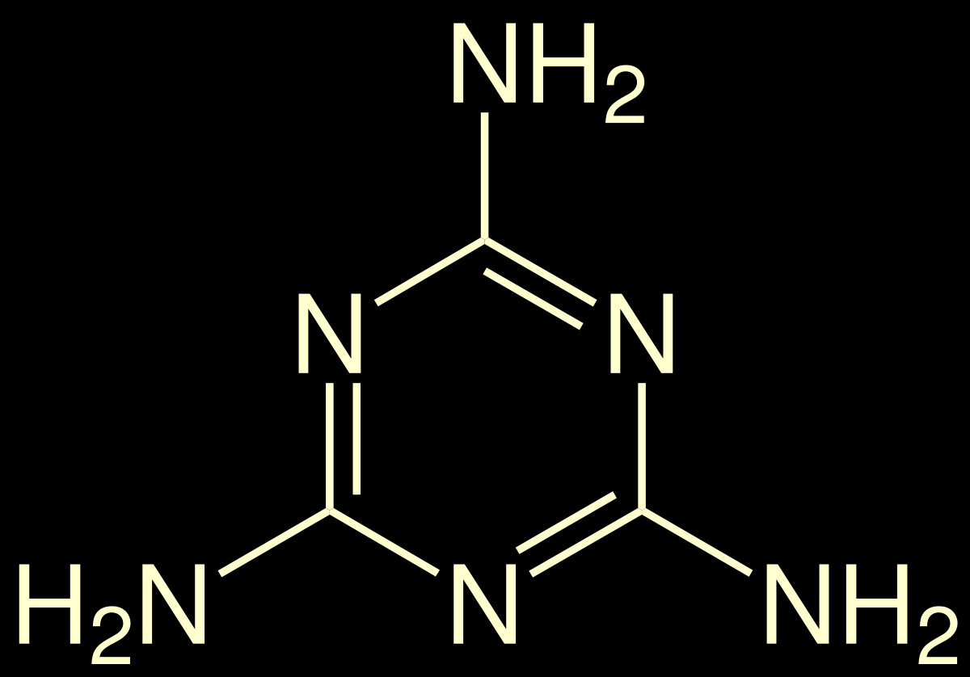
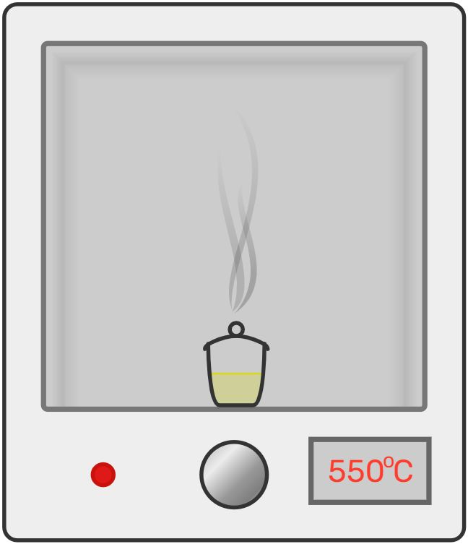
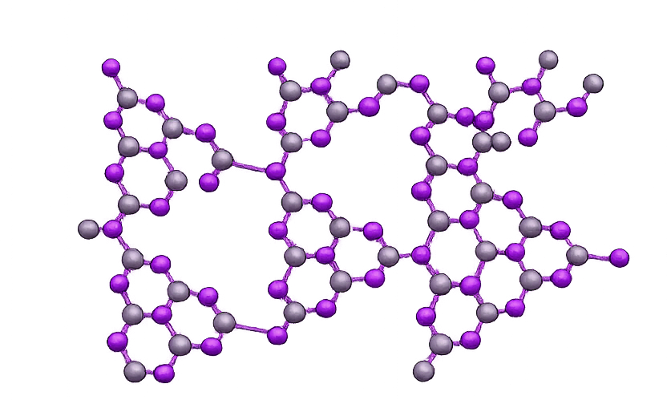


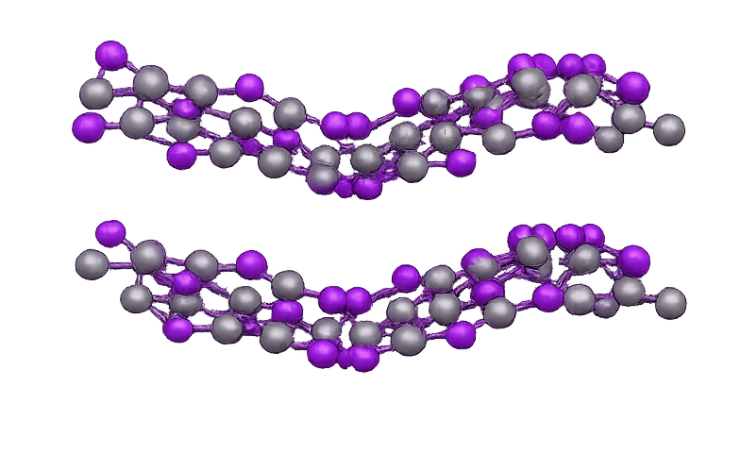
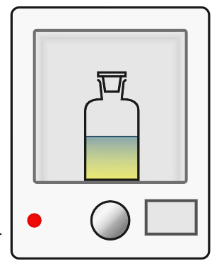

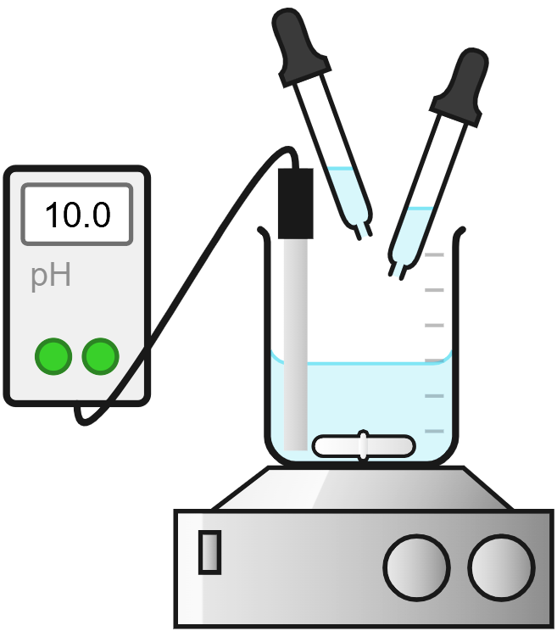
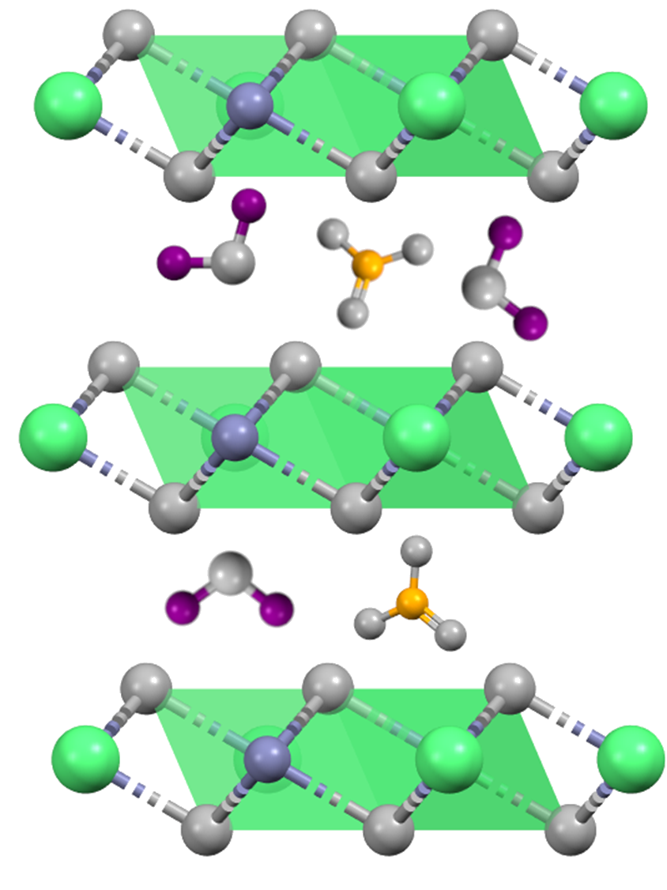
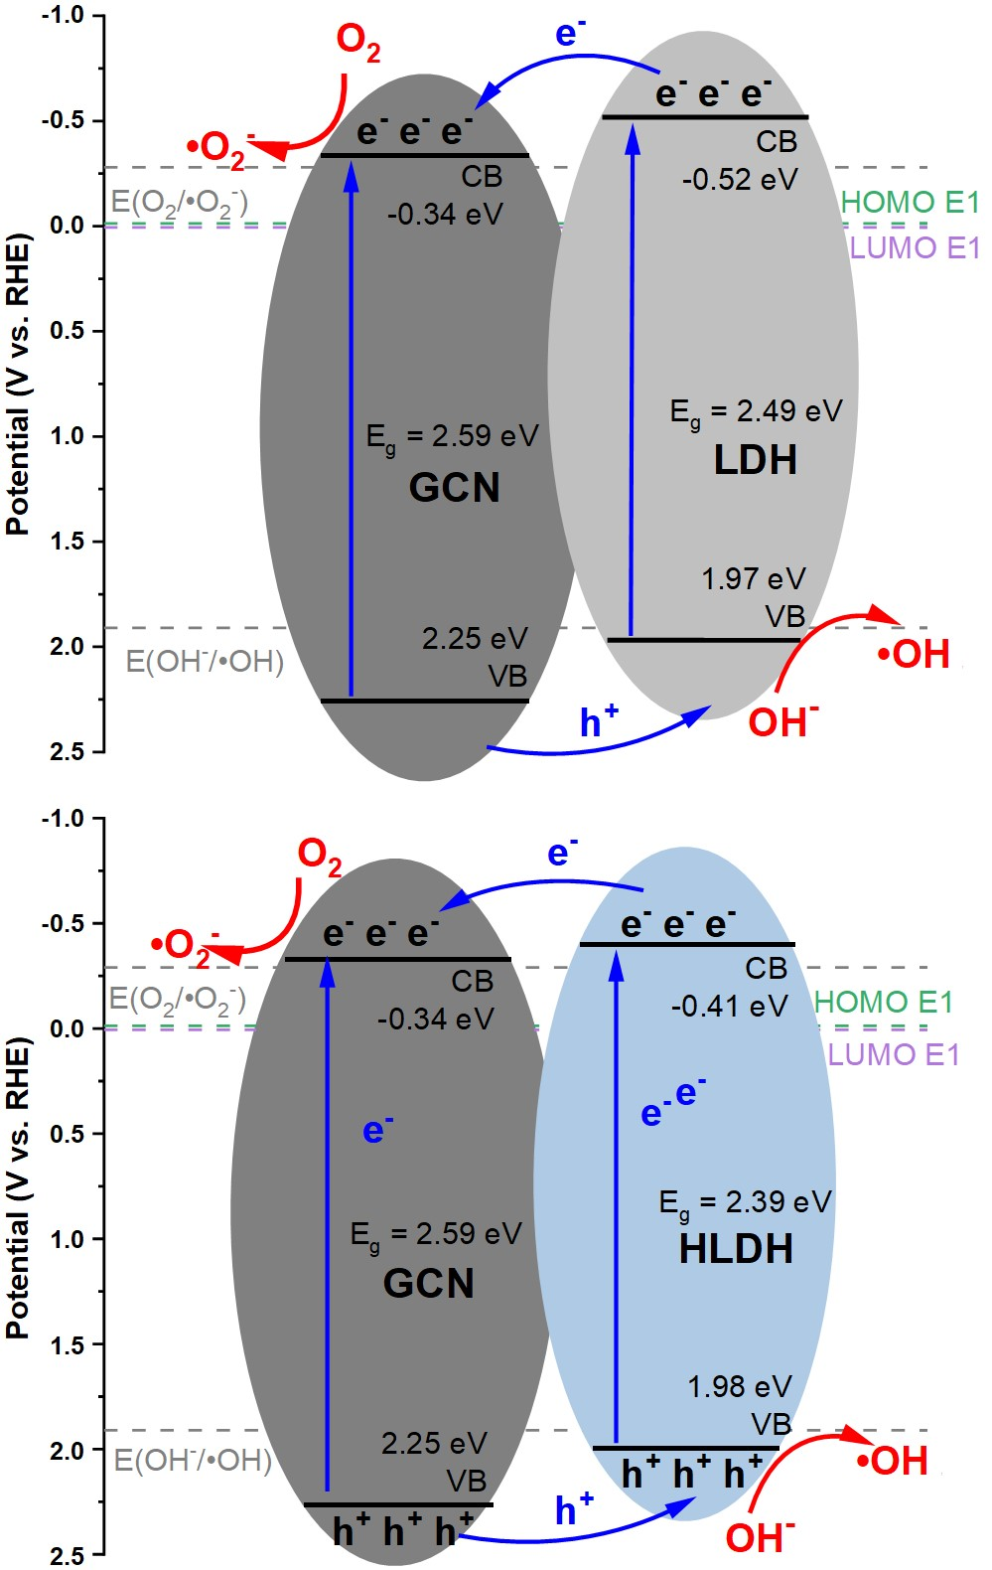
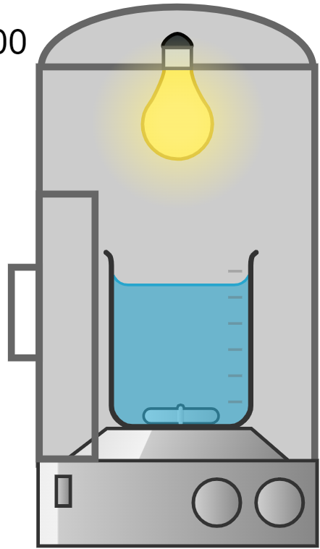
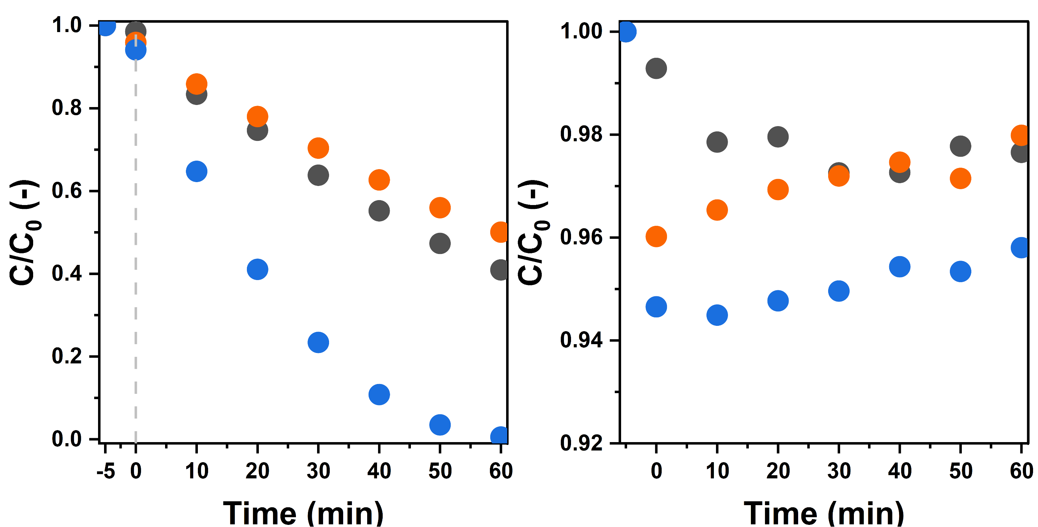

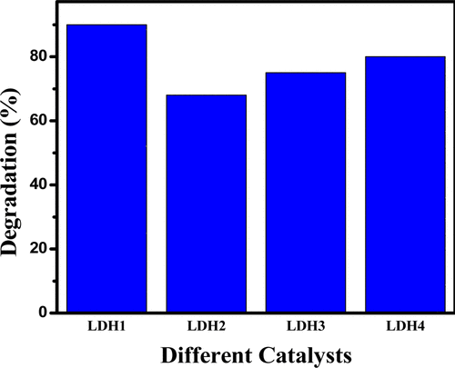
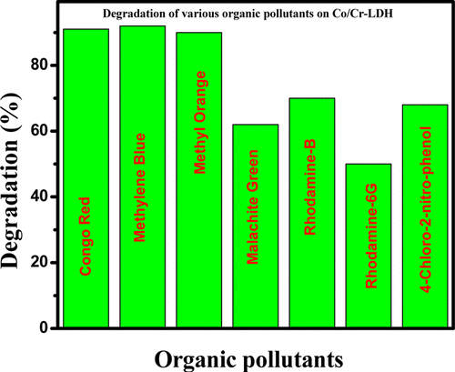



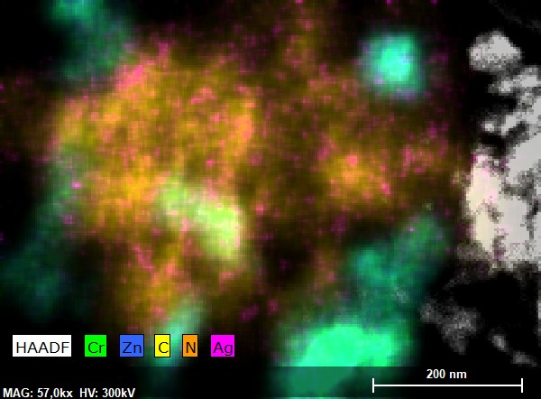
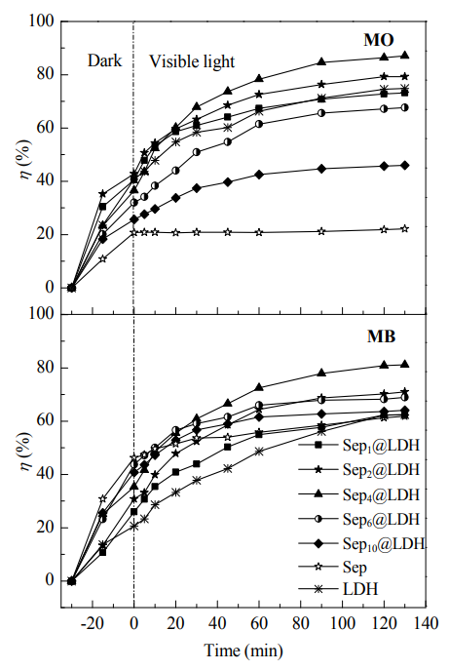
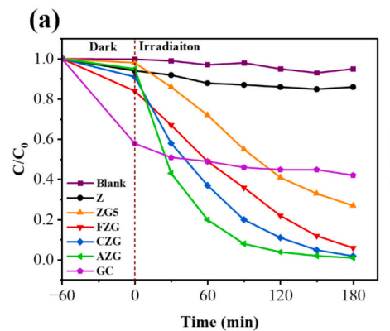
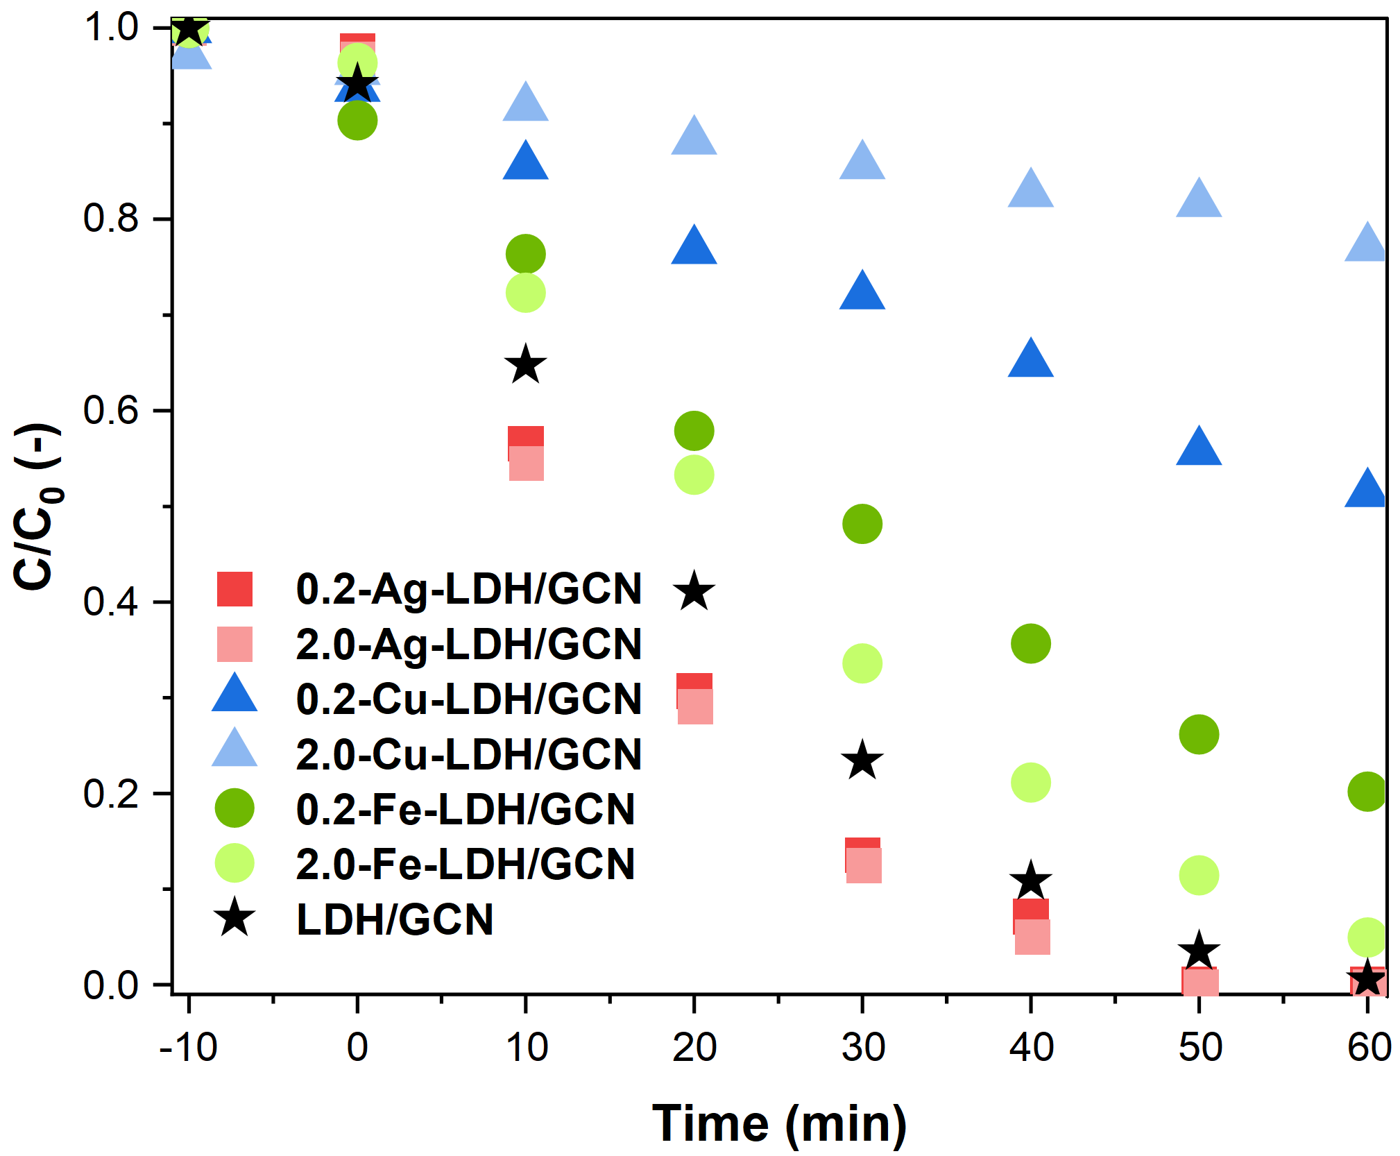


flaticon.com
chemix.org
emojidb.org
False Starts and Silver Linings: A Photocatalytic Journey with Layered Double Hydroxides
Anna Jędras¹, Jakub Matusik¹
¹Department of Mineralogy, Petrography and Geochemistry, Faculty of Geology, Geophysics and Environmental Protection, AGH University of Krakow, Poland
Background - photocatalysis
Graphitic carbon nitride
Visible-light active semiconductor combined with LDH = 💥 heterostructure 💥
☀️ Light generates electron–hole pairs
☀️ Reactive species degrade pollutants
☀️ Works under mild conditions (no extra chemicals)
☀️ Challenge: efficient materials needed
•OH
Synthesis
+
5 hours
•O₂ ⁻
Melamine
GCN
NaOH
NaCO₃
Zn/Cr
solution
NaOH
NaCO₃
Zn/Cr
solution
Layered double hydroxides
Synthesis
Pollutants
Coprecipitation
Hydtrothermal
TRPL spectra.
Photocurrent measurements in on-off cycles.
[M_{1-x}²⁺M_{x}³⁺(OH)₂]^{x+} (A^{n-})_{x/n} • mH₂O
NaOH
M^{II}/M^{III} solution
Methylene Blue (MB)
Coprecipitation
DI water with GCN
DI water with GCN
100ºC
Octahedra
Anions
Water
Safranin O (SO)
Experiments
🪨 Tunable layered structure
🪨 Positive surface charge
🪨 Reported as photocatalysts (literature)
🪨 Tested: Zn/Cr, Co/Cr, Cu/Cr, Ni/Cr
💡150 W LED lamp
💡50 mg/100 mL
💡E1 concentration: 1 ppm
💡5 min adsorption eq
💡1 h photocatalysis
💡Control experiments in the dark
DI water
Hydrothermal
Acid Blue 129 (AB)
Photocatalysis
Adsorption
Pollutant
Experiments
💡150 W LED lamp
💡80 mg/80 mL
💡SO and MB concentrations: 0.02 mM
💡AB concentration: 0.3 mM
💡0.5 h adsorption eq
💡1 h photocatalysis
💡Control experiments in the dark
Estrone (E1)
EDS maps of obtained heterostructures.
The proposed mechanisms driving the photodegradation of estrone by the GCN/LDH and GCN/HLDH heterojunctions.
https://doi.org/10.1021/ie403769b
MB 0.02 mM
SO 0.02 mM
AB 0.3 mM
🧠 Result: improved charge generation and separation = improved photocatalysis
Co/Cr
Ni/Cr
Cu/Cr
Zn/Cr
Metallic modifications
4.0-Ag-LDH/GCN
Synthesis
NaOH
NaCO₃
Zn/Cr/Me
solution
0.4-Ag-LDH/GCN
Photocatalytic degradation of MO over as-synthesized catalysts. Conditions: catalyst dose = 1 g/L, concentration of MO dye = 100 ppm, irradiation time = 3 h.
Degradation of various organic pollutants over LDH1. Conditions: catalyst dose = 1 g/L, concentration of each organic pollutant = 100 ppm, irradiation time = 3 h.
⚙️ Metal doping increased photocatalysis in the literature
Tested metals:
📉 Cu, Fe → decreased activity
🏆 Ag → strong enhancement
🧠 Result: <15% degradation, adsorption-dominated process
12.0
100ºC
Clay minerals as supports
DI water with GCN
EDS maps of Ag-LDH/GCN.
Experiments
💡0.5 h adsorption eq
💡1 h photocatalysis
💡Control experiments in the dark
https://doi.org/10.1016/j.susmat.2025.e01360
🪨 Clays improve dispersion & surface area
🪨 Tested: kaolinite, halloysite, montmorillonite
💡150 W LED lamp
💡80 mg/80 mL
💡MB concentration: 0.1 and 0.3 mM
💡AB concentration: 0.3 mM
Experiments
https://doi.org/10.1016/S1872-2067(18)63120-1
Synthesis
composites with 50% wt. of clay
💡150 W LED lamp
💡50 mg/100 mL
💡E1 concentration: 1 ppm
💡5 min adsorption eq
💡1 h photocatalysis
NaOH
Zn/Cr
solution
composites with 33% wt. of clay
MB 0.1 mM
MB 0.3 mM
AB 0.3 mM
9 materials:
LZNK1
LZNH1
LZNM1
LZNK2
LZNH2
LZNM2
LZNK3
LZNH3
LZNM3
composites with 20% wt. of clay
Relative concentration (C/C₀) over time for MB with a dosage of 500 mg/L.
💡Control experiments in the dark
🧠 Result: effective photodegradation, depentent on Ag loading
Conclusions
LDH ⚠️
DI water with clay
👉 LDHs alone are inefficient photocatalysts
👉 Adsorption can mislead interpretation
👉 Heterostructures (LDH/GCN) enabled real activity
👉 Ag modification → highly efficient system
+ Clay ❌
+ GCN ✅ Ag 🚀
Adsorption and photocatalytic degradation of co-existing MO and MB in equal concentration (each 20 mg∙L⁻¹) with 1.0 g·L⁻¹ catalyst loading.
🧠 Result: improved adsorption, photocatalysis still <10%
🚨Negative results led to the actual solution
get-qr.com emojidb.org flaticon.com chemix.org

