Slide 1

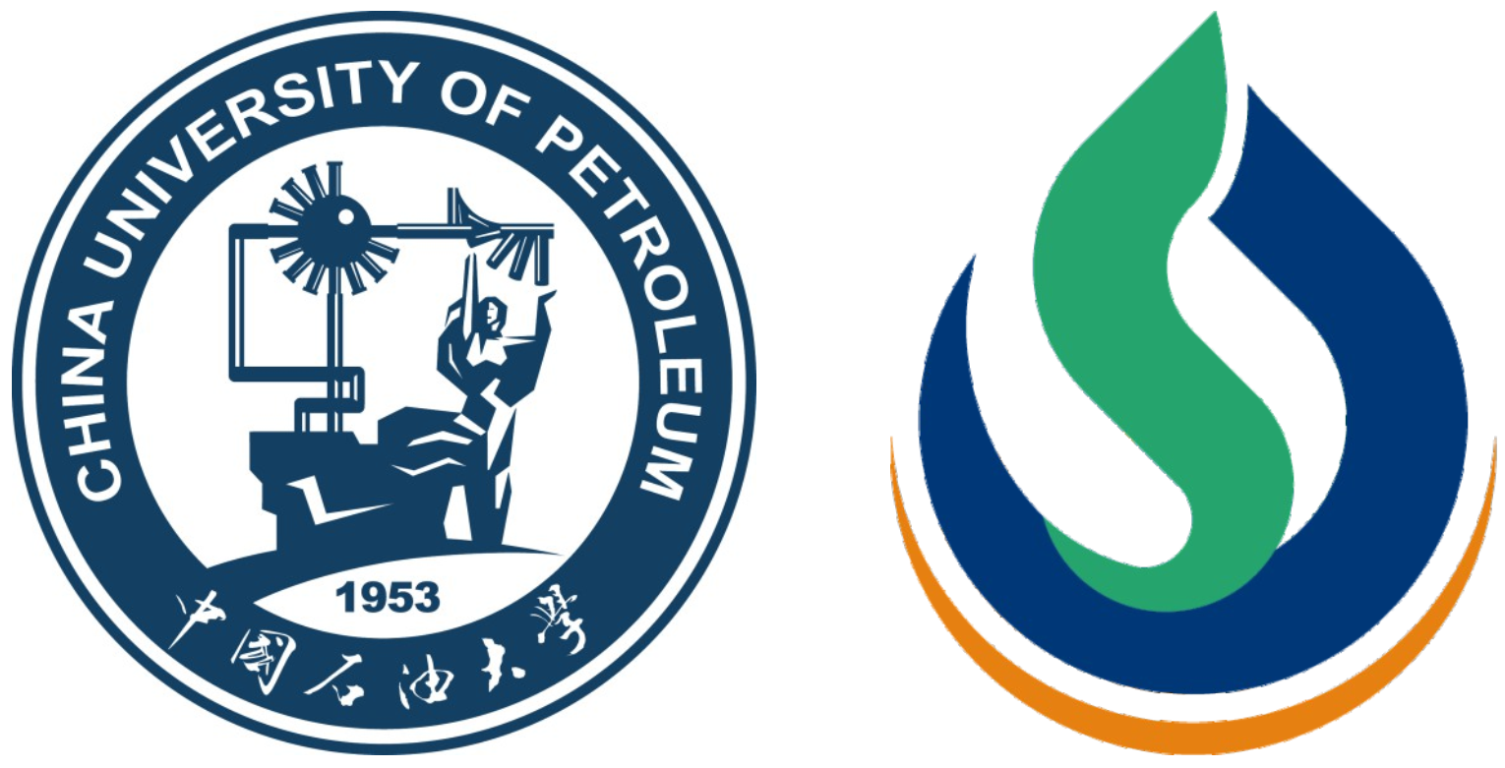
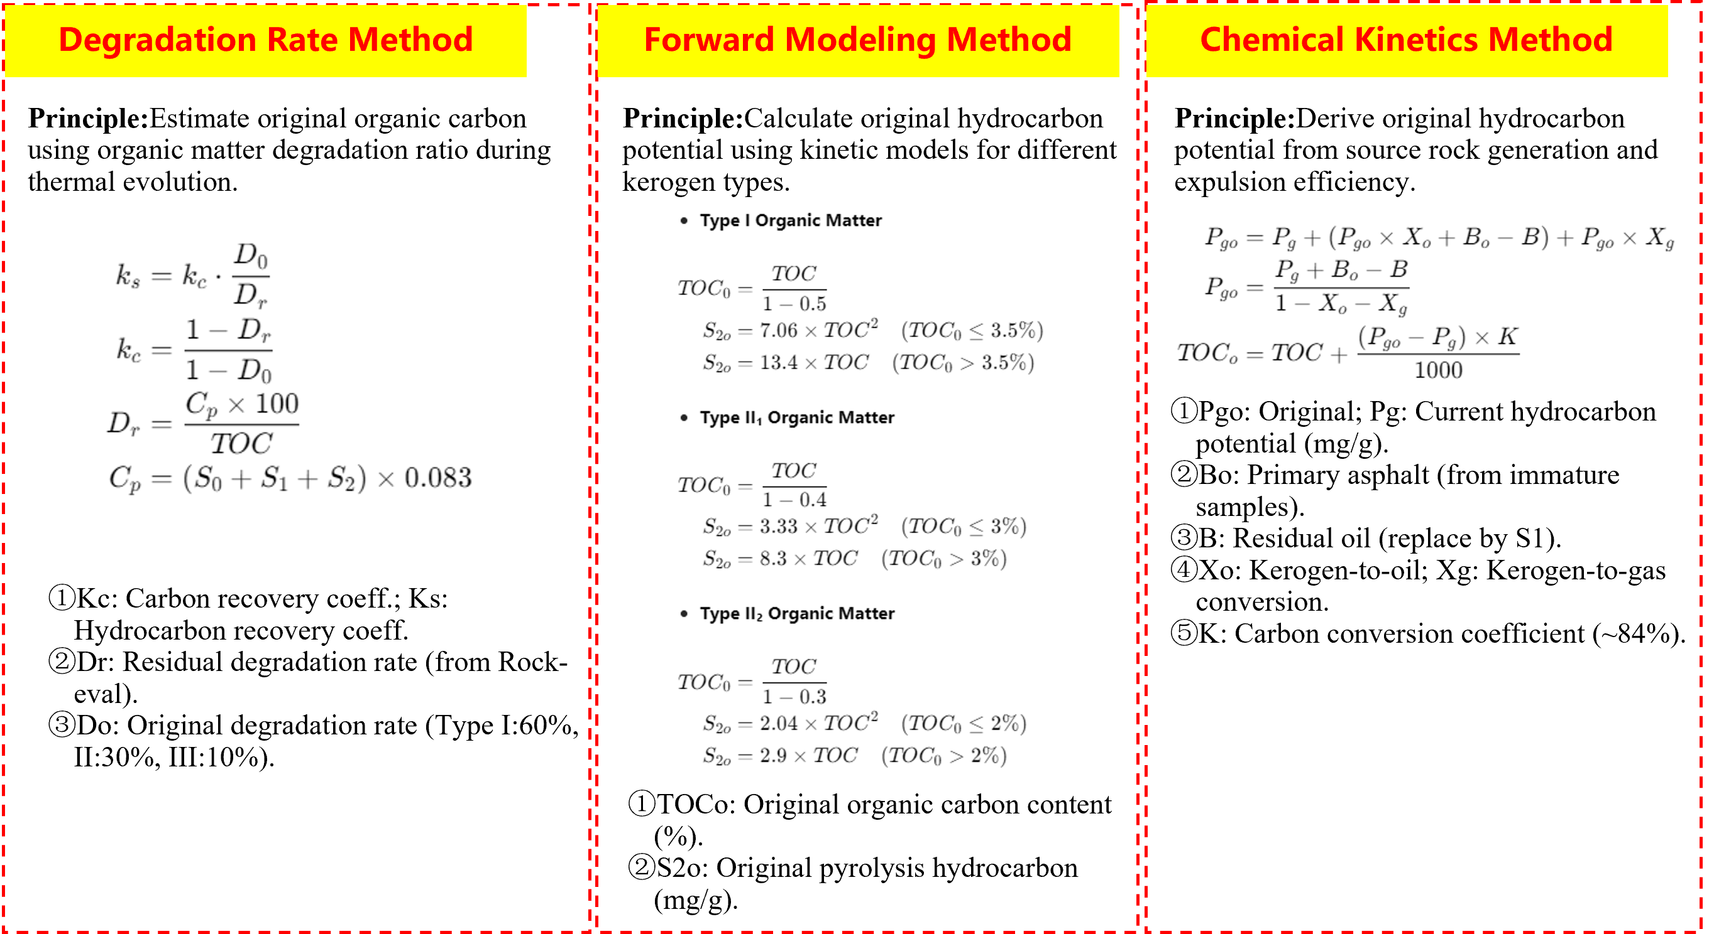
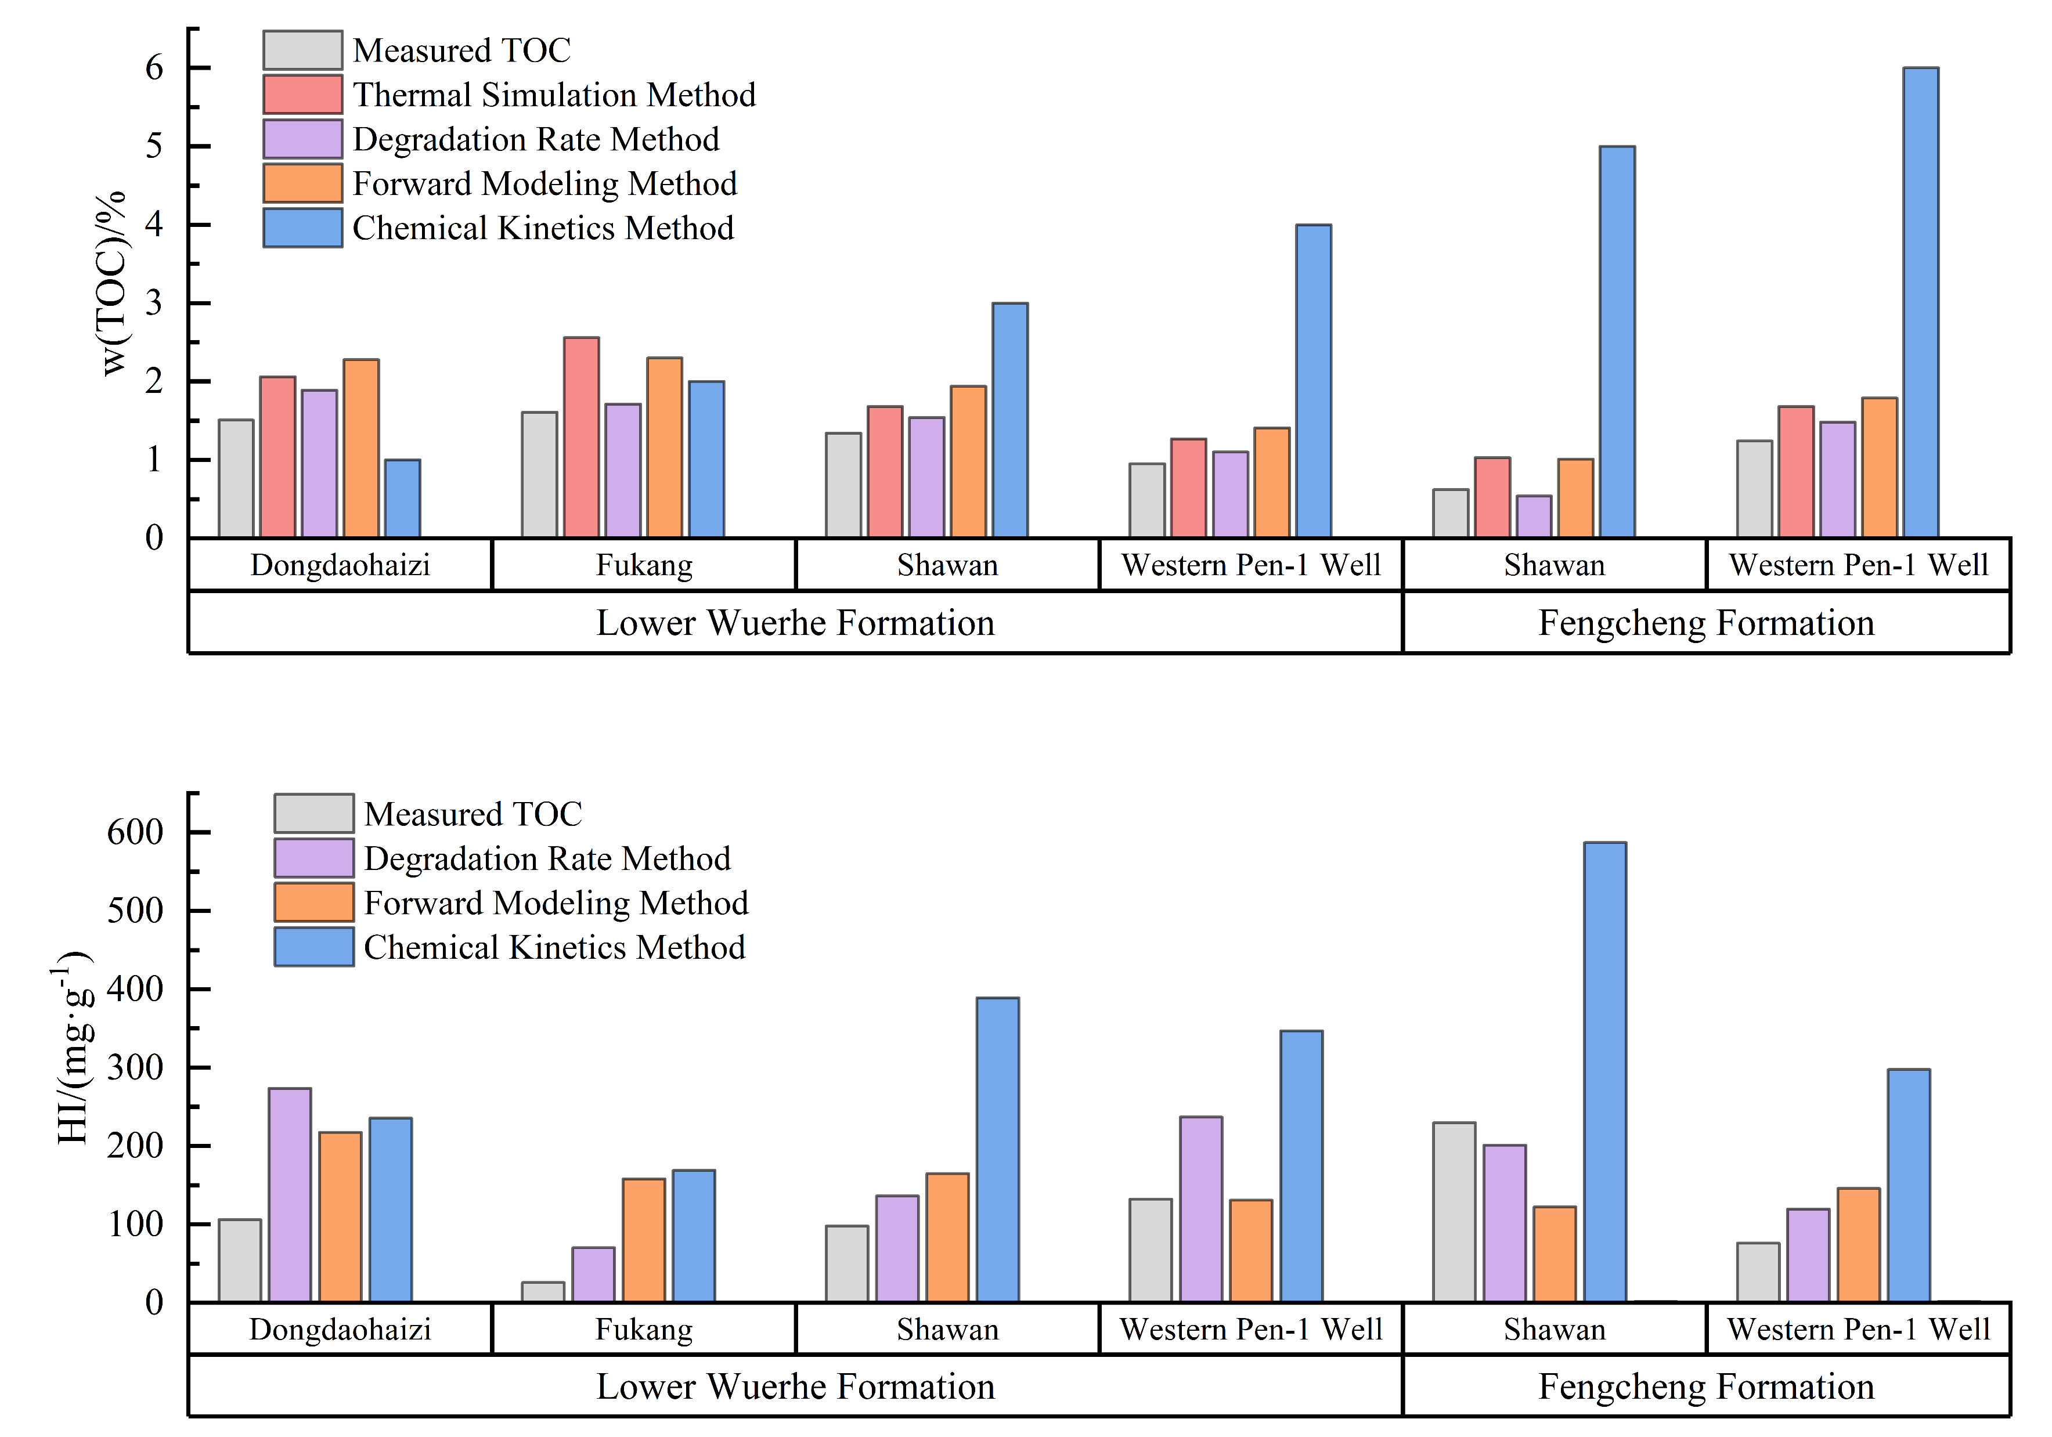
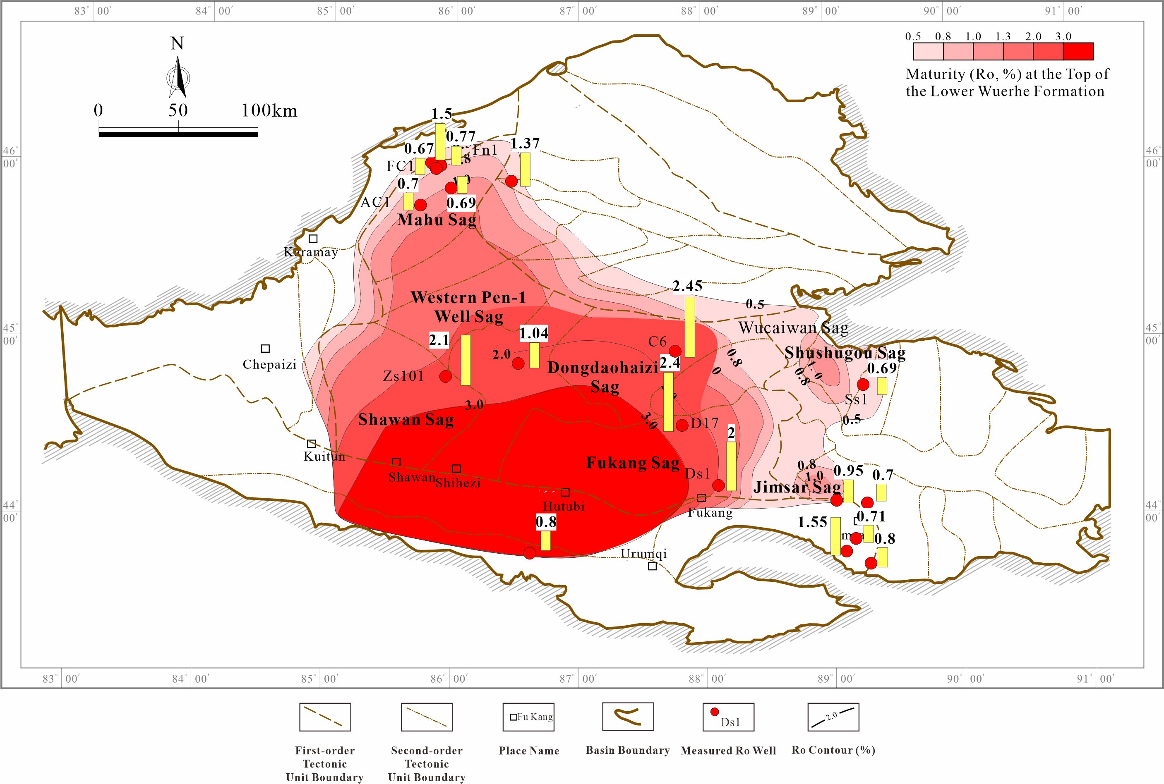
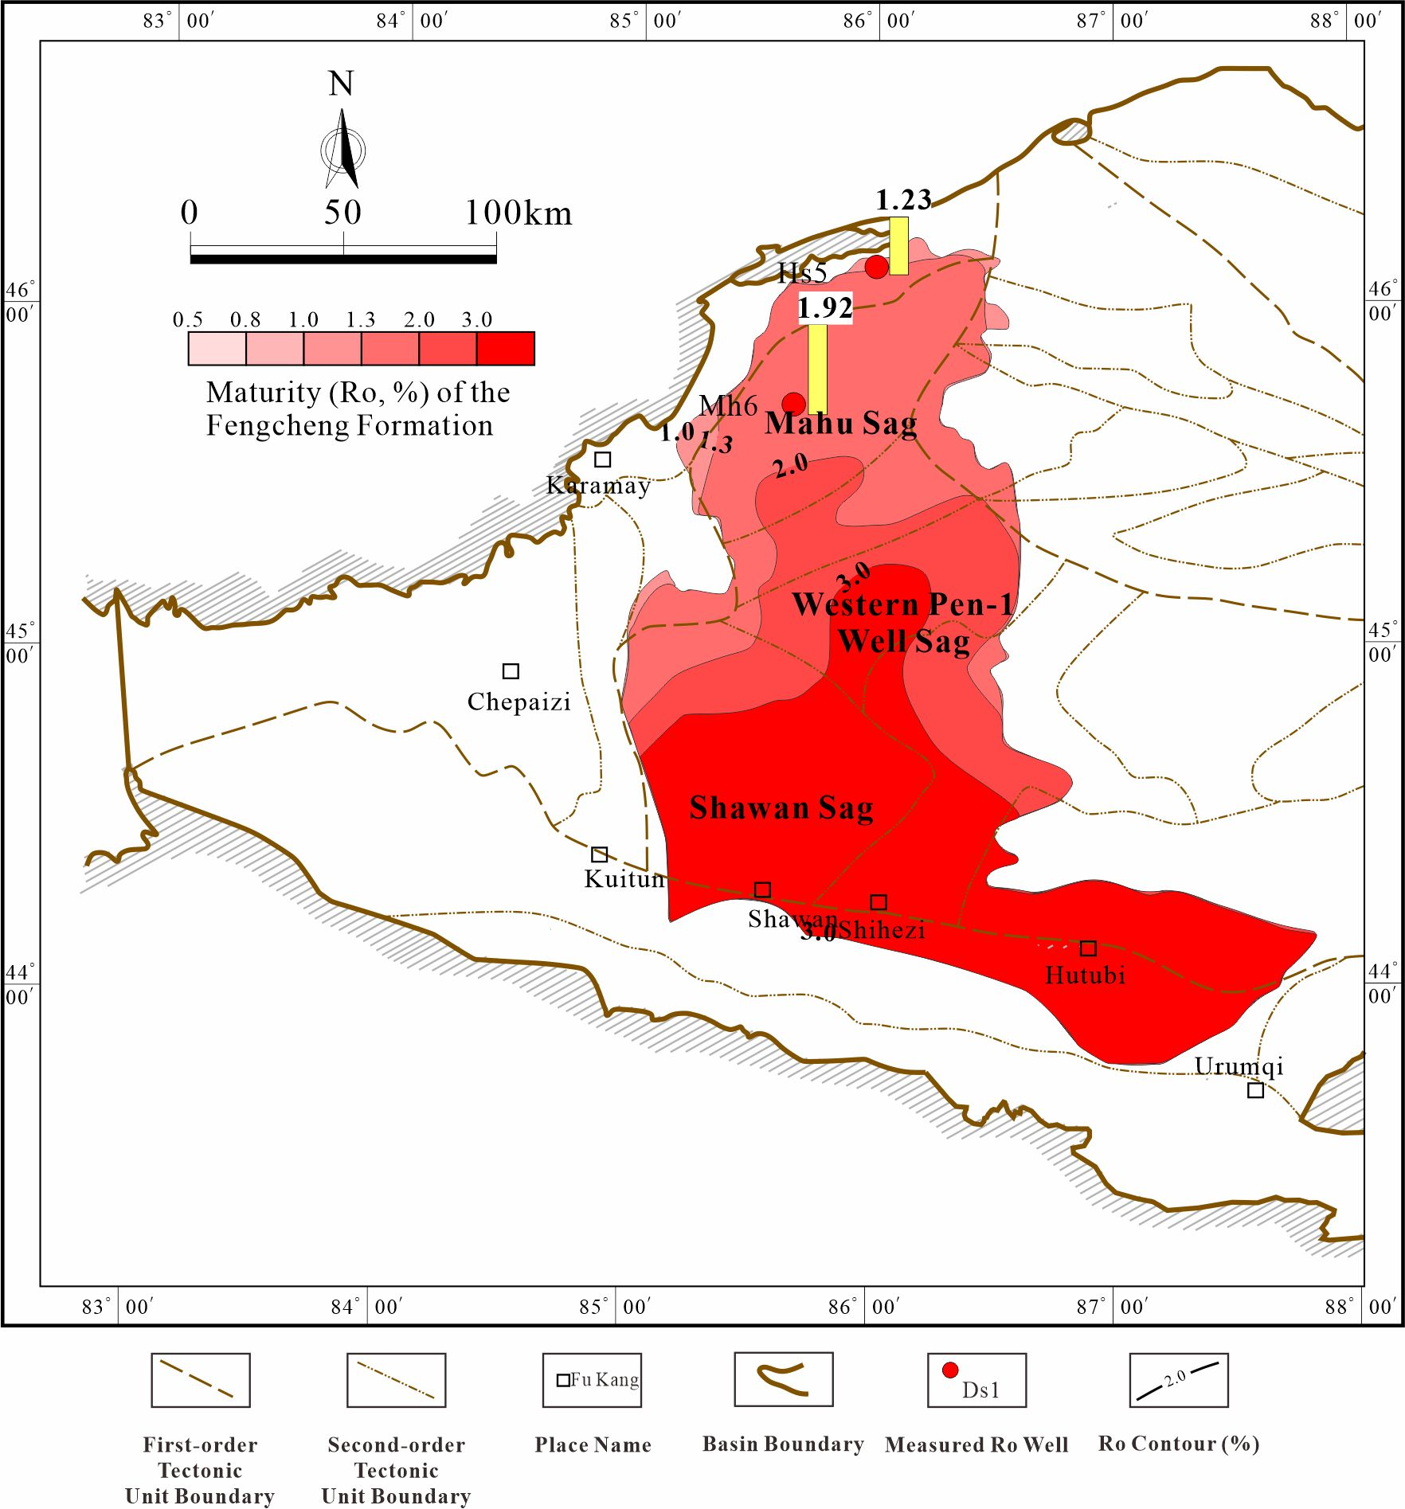
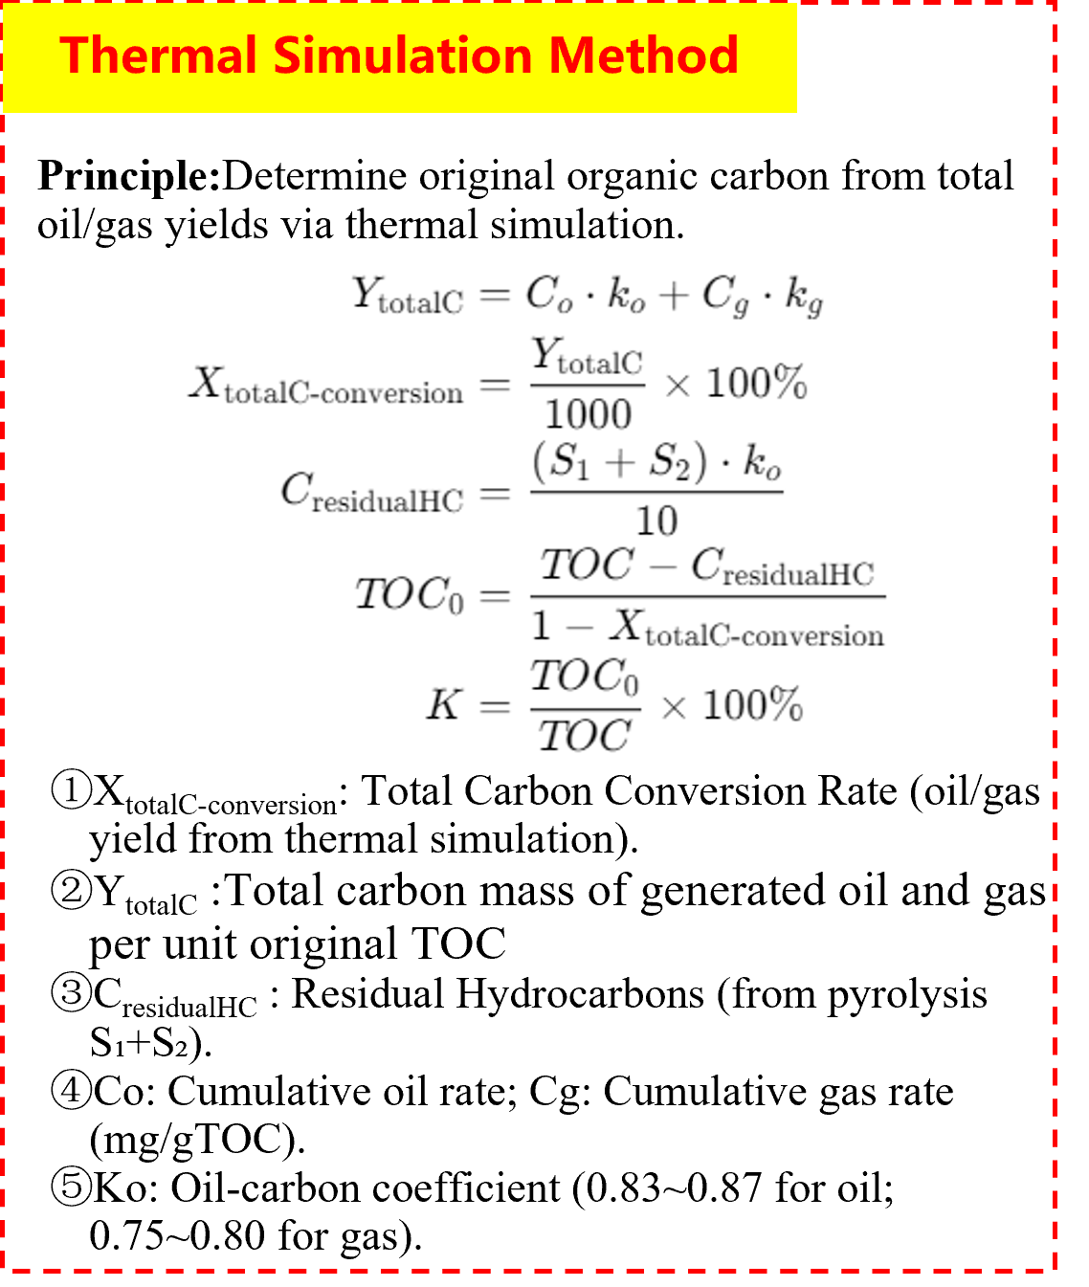
Restoration of Original Organic Carbon and Evaluation of Hydrocarbon Generation Potential for High-Mature to Overmature Source Rocks: A Case Study of the Permian Source Rocks in the Junggar Basin
Yuanfang Liu, Hua Liu, Bin Cheng
National Key Laboratory of Deep Oil and Gas, China University of Petroleum (East China), Qingdao 266580, P. R. China
Background
Results
The Junggar Basin is rich in oil and gas resources. Its Permian strata are mainly developed with two sets of source rocks, the Fengcheng Formation and the Lower Wuerhe Formation, which serve as the major hydrocarbon-supplying sequences. The source rocks in the basin interior have reached the high to over-mature stage.High to over-mature source rocks constitute an important material basis for deep hydrocarbon exploration in ancient petroliferous basins. However, after experiencing intense thermal evolution, extensive kerogen cracking and residual organic matter depletion occur. Conventional evaluation indicators become invalid, which greatly restricts the accurate assessment of the effectiveness and resource potential of source rocks (Figures 1 and 2).
It is necessary to carry out total organic carbon (TOC) reconstruction and method optimization for the source rocks in the study area.
Recovered original TOC comparisons show method suitability varies by sag and formation.
For the Lower Wuerhe Formation: degradation rate best matches thermal simulation in Dongdaohaizi Sag, forward modeling is optimal for Fukang Sag, and chemical kinetics fits Shawan and Western Pen-1 Well Sags.
For the Fengcheng Formation: forward modeling is invalid in Shawan Sag (recovery coefficient < 1), so chemical kinetics is preferred. In Western Pen-1 Well Sag, chemical kinetics slightly underestimates but is selected due to better alignment with source rock thermal evolution principles(Figure 5).
Fig 3 Formulas and Principles of Organic Carbon Recovery Methods
Fig 5 Bar graph comparing TOC and HI mean values for organic carbon recovery methods
Conclusions
Fig 1 Ro Contour Map of Source Rocks in the Lower Wuerhe Formation
Fig 2 Ro Contour Map of Source Rocks in Fengcheng Formation
Fig 4 Verification of Organic Carbon Recovery Results Using Thermal Simulation
Recovery results show that TOC, hydrocarbon generation potential and HI of the Fengcheng and Lower Wuerhe Formations are significantly improved.
The average TOC increases by 43% (to 2.30%) in the Fukang Sag (Lower Wuerhe Fm.), 67% (to 0.99%) in the Shawan Sag (Fengcheng Fm.), and ~20% in other sags.
This method constrains original organic richness in underexplored sags, addressing the high-over mature source rock evaluation challenge.
Methods
Different methods show large differences in recovery values for each sag, so an optimal recovery method needs to be selected. The original organic carbon recovered by the thermal simulation method is the most reliable, and its results can be used as a verification benchmark to evaluate the accuracy of recovery results from other methods (Figure 4).
The degradation rate method, forward modeling method and chemical kinetic method are adopted to reconstruct high–over mature source rocks.The principles and formulas of each method are as follows (Figure 3):

