Slide 1
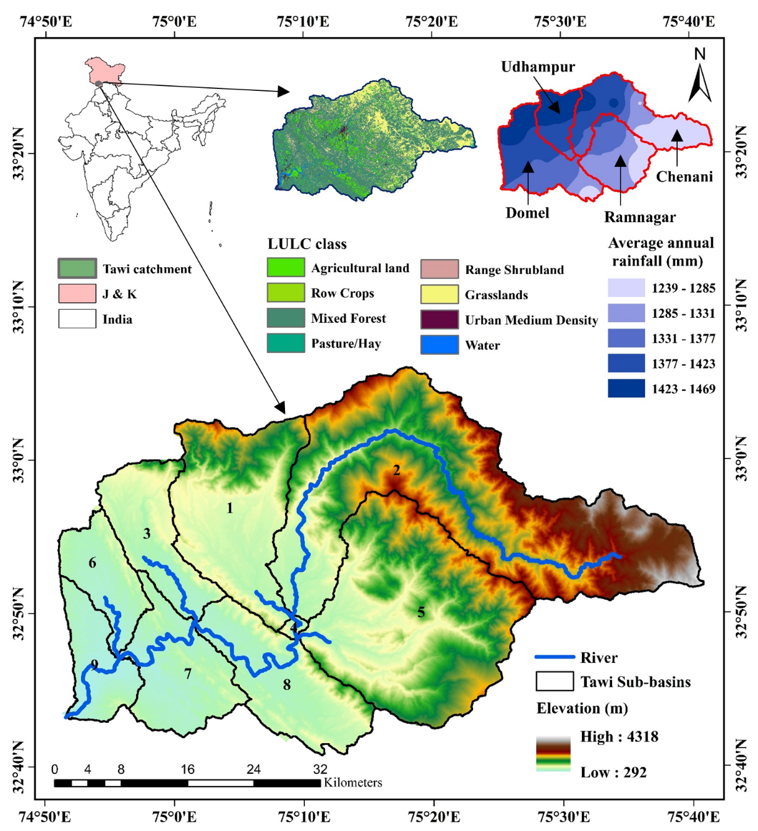
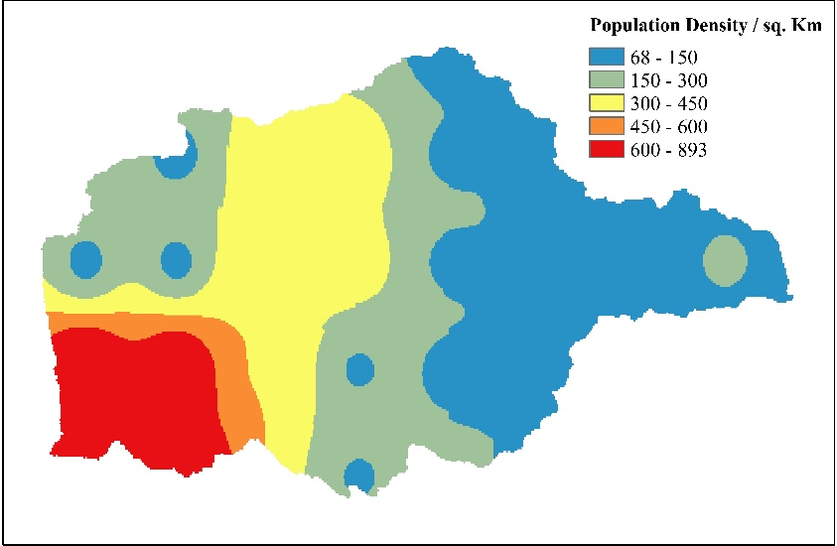
Introduction
Literature Review
Study Area
Objectives
Methodology
Results
Timeframe and Targets
Tawi River Basin is one of the major sub-basins of Chenab River in western parts of the Himalayas
The highest flood discharge -13552 m³/s (6th September 2014 which was 4.8 m higher than the danger level at Jammu).
Annual discharge is decreasing by 23 MCM per year, and water demand is rapidly growing due to urbanization and a population increase of 20% per decade (Kour et al., 2022).
Flashy nature of catchment owes to less ground water recharge.
Catchment composed of erodible soil strata
Population Distribution Map

Slide 2
Introduction
Literature Review
Study Area
Objective 2
Methodology
Results
Timeframe and Targets
Integrated assessment of hydro-meteorological extremes and water scarcity in the Tawi River catchment under climate change
Investigating the anticipated changes in hydro-meteorological extremes over the Tawi River basin in India, utilizing data from CMIP6 models for 2 ºC and 3 ºC global warming .
Analyzing the Spatio-temporal variability of water availability, specifically examining blue and green water resources in the context of a changing climate compared to a designated base period.
Examining the potential for future water scarcity and characterizing hydrological drought events within the Tawi River basin.
Utilization of FAHP (fuzzy analytic hierarchy process) to prioritize catchments within the Tawi River basin.

Slide 3
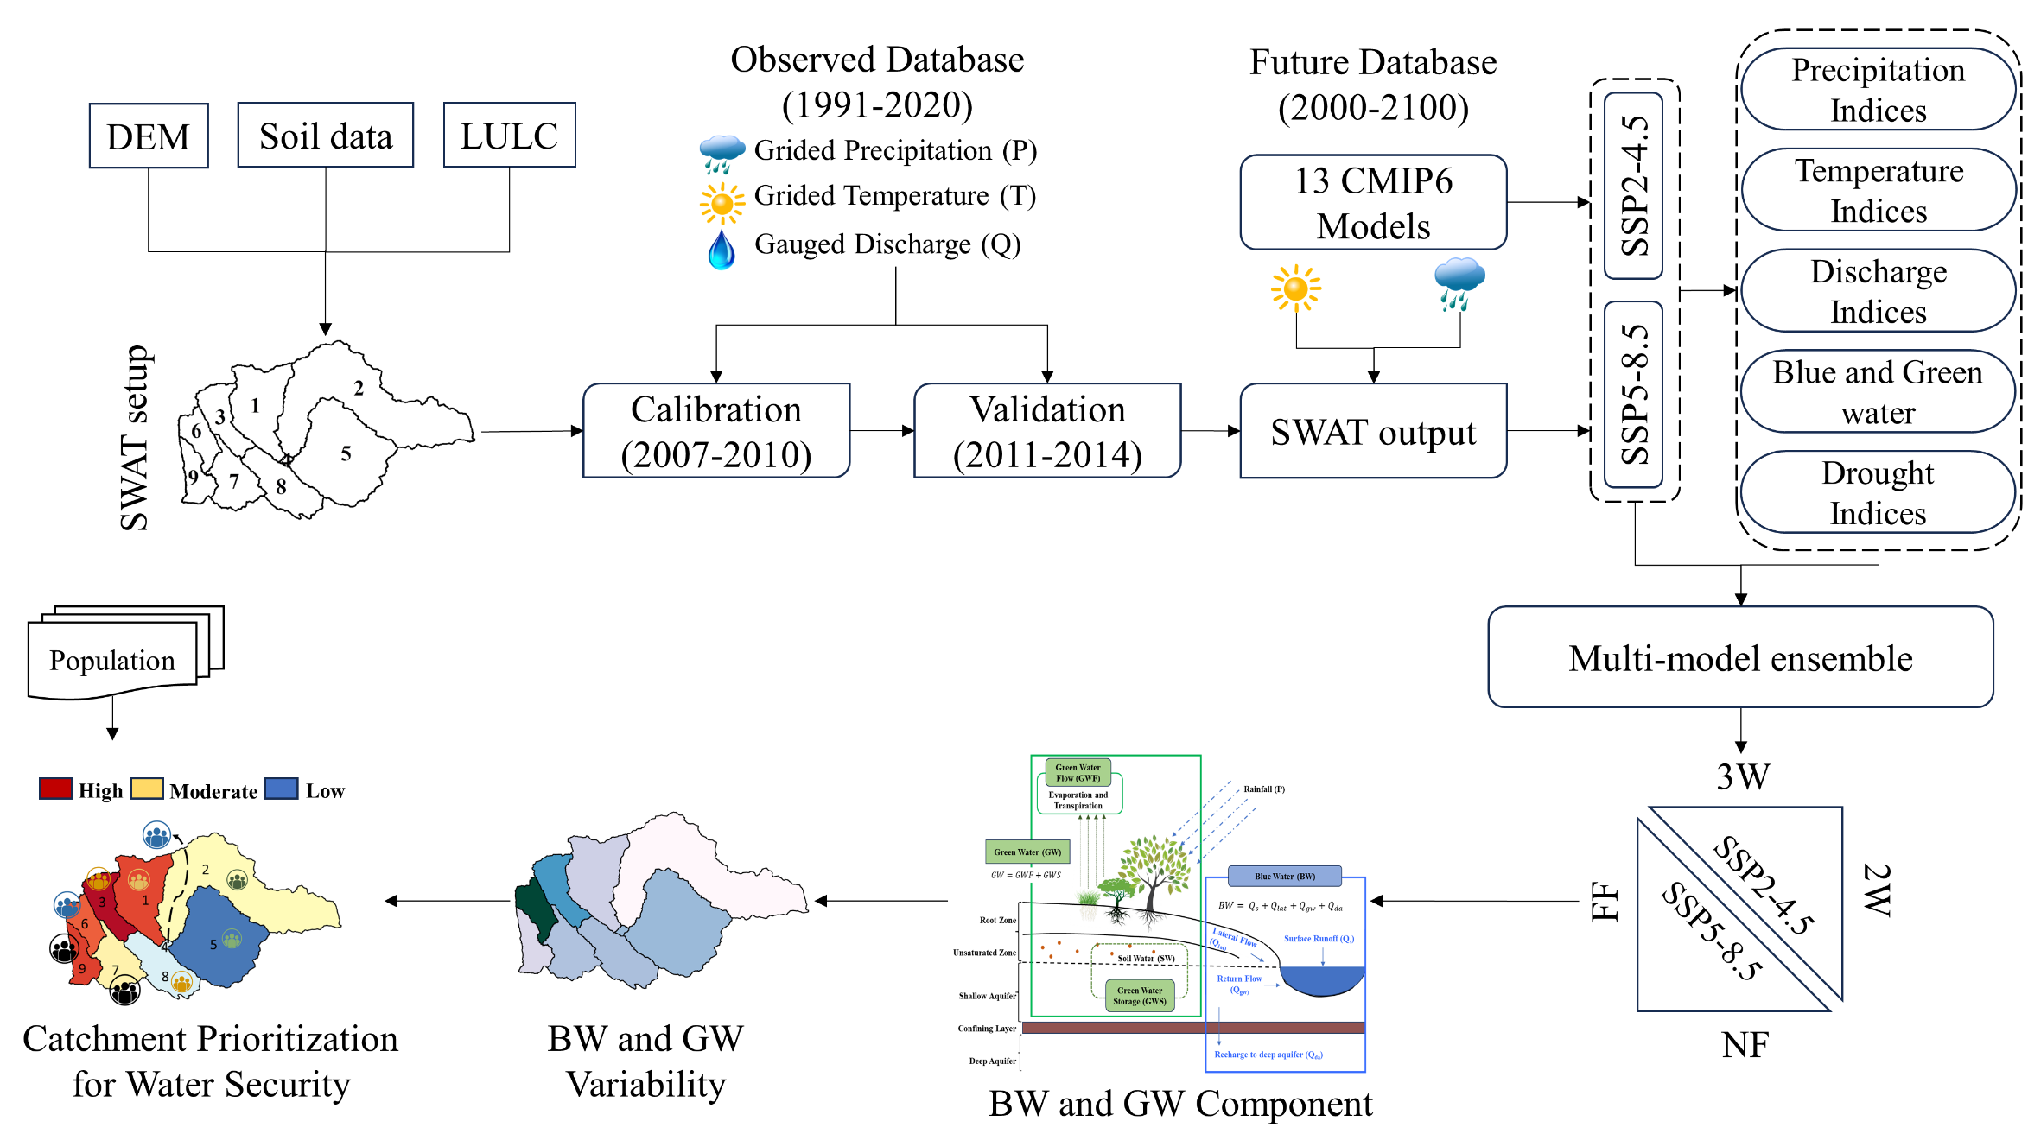
Introduction
Literature Review
Study Area
Objective 2
Methodology
Results
Timeframe and Targets
CMIP6: Coupled Model Intercomparison Project Phase 6
SSP2-4.5: Shared Socio-economic Pathways (Middle of the road scenario) & radiative forces ~4.5 W/m²
SSP5-8.5: Shared Socio-economic Pathways (fossil-fuel based development) & radiative forces ~8.5 W/m²
DEM: Digital Elevation Model
LULC: Land Use Land Class
2W: 2 ºC Warming
3W: 3 ºC Warming
NF: Near Future
FF: Far Future
BW: Blue Water
GW: Green Water

Slide 4
Introduction
Literature Review
Study Area
Objective 2
Methodology
Results
Timeframe and Targets
Datasets Used
S. No. | Datasets | Source | Spatial Resolution | Temporal Resolution
1 | Catchment boundary | Hydro-SHEDES | 90 m | -
2 | DEM | SRTM (NASA) | 30 m | -
3 | Soil cover | FAO | 0.9 km | -
4 | Land use classification | ESA (year 2020) | 10 m | -
5 | Meteorological data | IMD & TAMU (year 1979-2020) | 0.25º/ 26 km | Daily
6 | Future Climate Data | CMIP 6 (provided by Mishra et al. 2020) | 0.25º/ 26 km | Daily
7 | Discharge Data | CWC (year 1991-2018) | Jammu gauging station | Daily
8 | Future Population Data | SEDAC | 0.125º/ 13.8km | Decadal

Slide 5
Hydrometeorological extremes
Introduction
Literature Review
Study Area
Objective 2
Methodology
Results
Timeframe and Targets
Indices | Definition | Unit
PRCPTOT | Annual total precipitation on wet days | mm
CDD | Number of rainy days in a year (with rainfall intensity ≤ 1 mm/day) | days
CWD | Number of rainy days in a year (with rainfall intensity ≥ 2.5 mm/day) | days
R95p | Annual total precipitation when annual rainfall ≥ 95th percentile | mm
R99p | Annual total precipitation when annual rainfall ≥ 99th percentile | mm
R10 | Annual count of days when precipitation ≥ 10 mm | days
R20 | Annual count of days when precipitation ≥ 20 mm | days
Rx1day | Max 1-day precipitation amount | mm
Rx5day | Max 5-day precipitation amount | mm
TXx | Monthly maximum value of daily maximum temperature | (ºC)
TXn | Monthly minimum value of daily maximum temperature | (ºC)
TNx | Monthly maximum value of daily minimum temperature | (ºC)
TNn | Monthly minimum value of daily minimum temperature | (ºC)
Q95 | High flow (95th percentile value of streamflow) | m³/s
Q05 | Low flow (5th percentile value of streamflow) | m³/s
Various meteorological extremes developed by the Expert Team on Climate Change Detection and Indices (ETCCDI), as formulated by (Zhang et al. 2011).
Rainfall
Temperature
Discharge

Slide 6
Hydrometeorological extremes
Introduction
Literature Review
Study Area
Objective 2
Methodology
Results
Timeframe and Targets
Indices | Definition | Unit
PRCPTOT | Annual total precipitation on wet days | mm
CDD | Number of rainy days in a year (with rainfall intensity ≤ 1 mm/day) | days
CWD | Number of rainy days in a year (with rainfall intensity ≥ 2.5 mm/day) | days
R95p | Annual total precipitation when annual rainfall ≥ 95th percentile | mm
R99p | Annual total precipitation when annual rainfall ≥ 99th percentile | mm
R10 | Annual count of days when precipitation ≥ 10 mm | days
R20 | Annual count of days when precipitation ≥ 20 mm | days
Rx1day | Max 1-day precipitation amount | mm
Rx5day | Max 5-day precipitation amount | mm
TXx | Monthly maximum value of daily maximum temperature | (ºC)
TXn | Monthly minimum value of daily maximum temperature | (ºC)
TNx | Monthly maximum value of daily minimum temperature | (ºC)
TNn | Monthly minimum value of daily minimum temperature | (ºC)
Q95 | High flow (95th percentile value of streamflow) | m³/s
Q05 | Low flow (5th percentile value of streamflow) | m³/s
Various meteorological extremes developed by the Expert Team on Climate Change Detection and Indices (ETCCDI), as formulated by (Zhang et al. 2011).
Rainfall
Temperature
Discharge

Slide 7
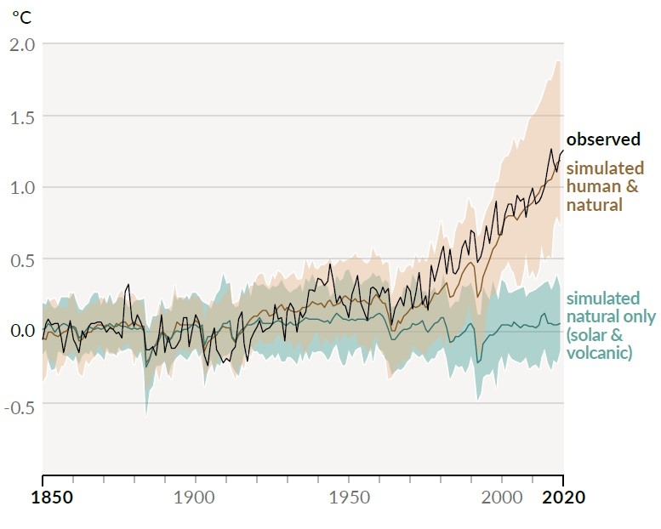
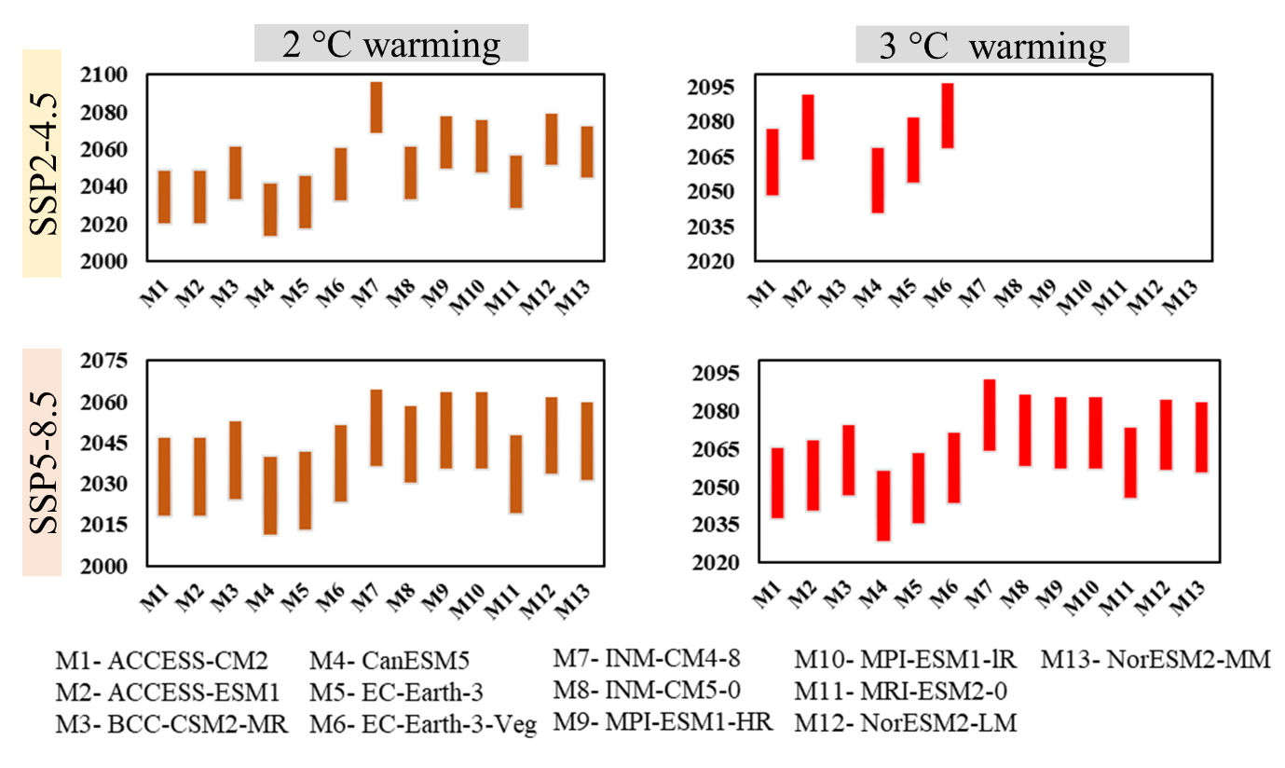
Global Warming Periods
Introduction
Literature Review
Study Area
Objective 2
Methodology
Results
Timeframe and Targets
13 CMIP6 models.
2ºC and 3ºC Warming of global temperature over Pre Industrial period (1850).
Equal weight multi model ensemble, arithmetic mean (AMME) was used.
Source: IPCC report AR6, 2021

Slide 8
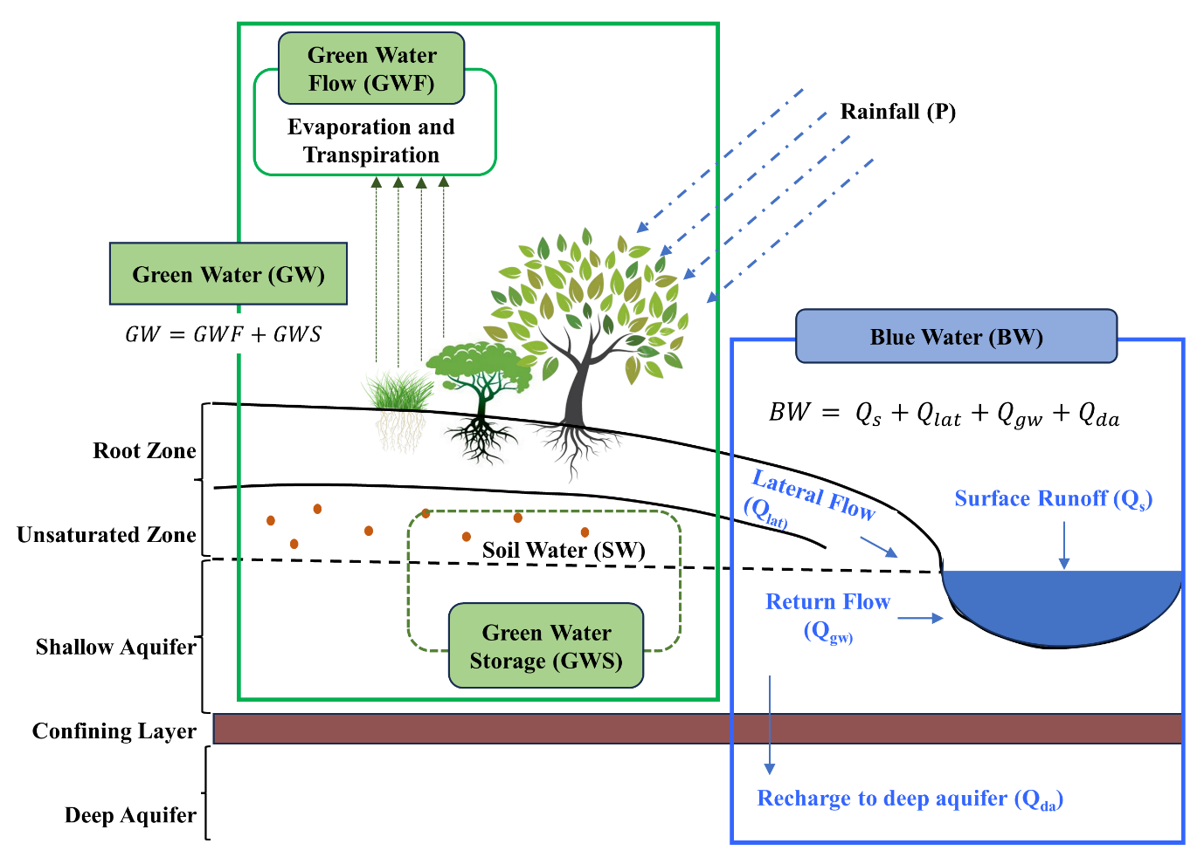
Blue and Green Water computation
Introduction
Literature Review
Study Area
Objective 2
Methodology
Results
Timeframe and Targets
Addressing water security by classifying fresh water resources into blue and green water
Blue Water: flowing through surface and subsurface medium which are stored in lakes, aquifers and manmade structures, that can be directly used for human consumption.
Green Water: water stored in unsaturated soil layer and vegetation canopy is classified as green water

Slide 9
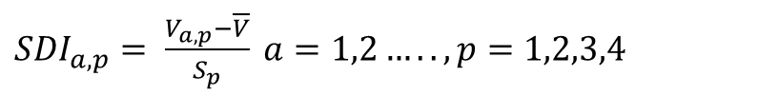
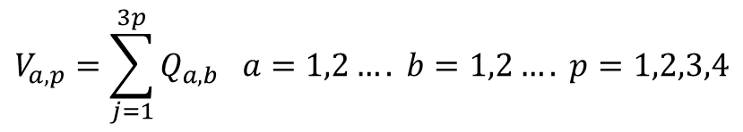
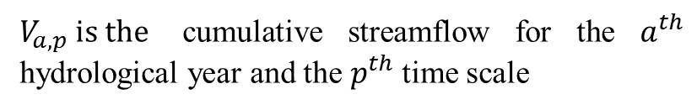
Drought Analysis Fuzzy Analytical Hierarchy Process (FAHP)
Introduction
Literature Review
Study Area
Objective 2
Methodology
Results
Timeframe and Targets
Hydrological Drought
Streamflow drought index (SDI)
More enhanced decision-making framework
FAHP can classify evaluation factors into target level, criterion level, and factor level
Widely-used multi-attribute decision-making methods
${SDI}_{a,p}= \frac{V_{a,p}−\overline{V}}{S_{p}} a=1,2….., p=1,2,3,4$
V and S_{p} are the long-term mean and standard deviation of cumulative streamflow
$$V_{a,p}=\sum_{j=1}^{3p}{Q_{a,b} a=1,2…. b=1,2….} p=1,2,3,4$$
Following eight attributes (or parameters) for prioritization
$V_{a,p} is the$ cumulative streamflow for the $a^{th}$ hydrological year and the $p^{th}$time scale
Rainfall
Average Temperature
Blue Water
Green water
Agricultural Area
Forest Area
Hydrological drought
Population Density
Description | Range
Non-drought | 0.0 ≤ Index value
Mild drought | -1.0 ≤ Index value < 0.0
Moderate drought | -1.5 ≤ Index value < -1.0
Severe drought | -2.0 ≤ Index value < -1.5
Extreme drought | Index value < -2.0

Slide 10
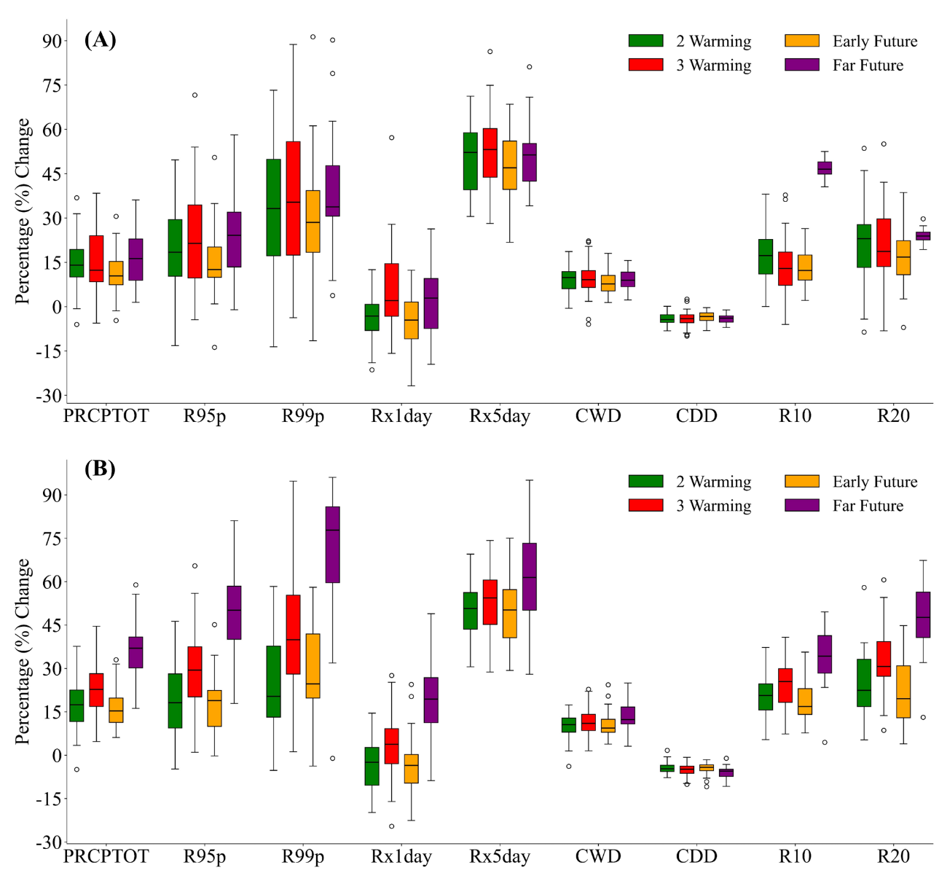
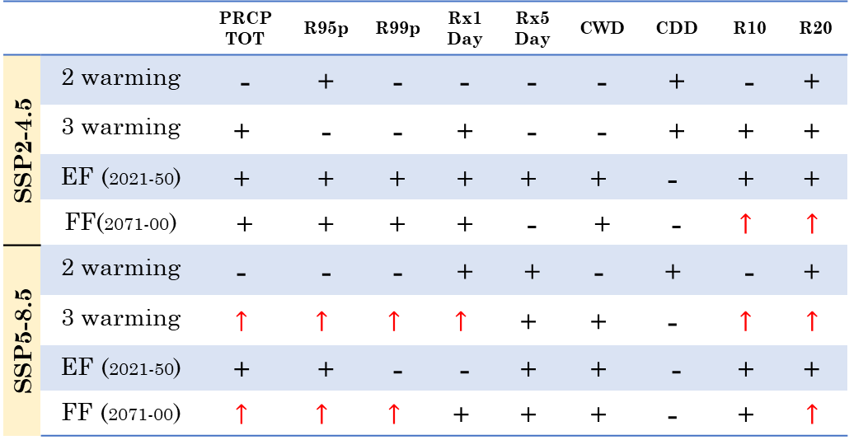
Introduction
Literature Review
Study Area
Objective 2
Methodology
Results
Timeframe and Targets
SWAT calibration and validation
Extreme Precipitation Indices
Calibration (2007-2010)
Validation (2011-2014)
 |  | PRCP TOT | R95p | R99p | Rx1 Day | Rx5 Day | CWD | CDD | R10 | R20
SSP2-4.5 | 2 warming | - | + | - | - | - | - | + | - | $$\text{+}$$
 | 3 warming | $$\text{+}$$ | - | - | + | - | - | + | $$\text{+}$$ | $$\text{+}$$
 | EF (2021-50) | $$\text{+}$$ | + | + | + | $$\text{+}$$ | $$\text{+}$$ | $$\text{−}$$ | $$\text{+}$$ | $$\text{+}$$
 | FF(2071-00) | + | + | + | + | - | + | - | $$↑$$ | $$↑$$
SSP5-8.5 | 2 warming | $$\text{−}$$ | - | - | + | + | $$\text{−}$$ | $$\text{+}$$ | - | $$\text{+}$$
 | 3 warming | $$↑$$ | $$↑$$ | $$↑$$ | $$↑$$ | $$\text{+}$$ | $$\text{+}$$ | $$\text{−}$$ | $$↑$$ | $$↑$$
 | EF (2021-50) | $$\text{+}$$ | + | - | - | $$\text{+}$$ | $$\text{+}$$ | - | $$\text{+}$$ | $$\text{+}$$
 | FF (2071-00) | $$↑$$ | $$↑$$ | $$↑$$ | $$\text{+}$$ | $$\text{+}$$ | $$\text{+}$$ | $$\text{−}$$ | $$\text{+}$$ | $$↑$$
Percentage change in future precipitation extremes w. r. t. base period (1991-2020): (A) SSP2-4.5 (B) SSP5-8.5
+ Positive trends ; - Negative trends ; $↑$ Significant positive trend (significance level 95%) ; $↓$ Significant negative trend (significance level 95%)

Slide 11
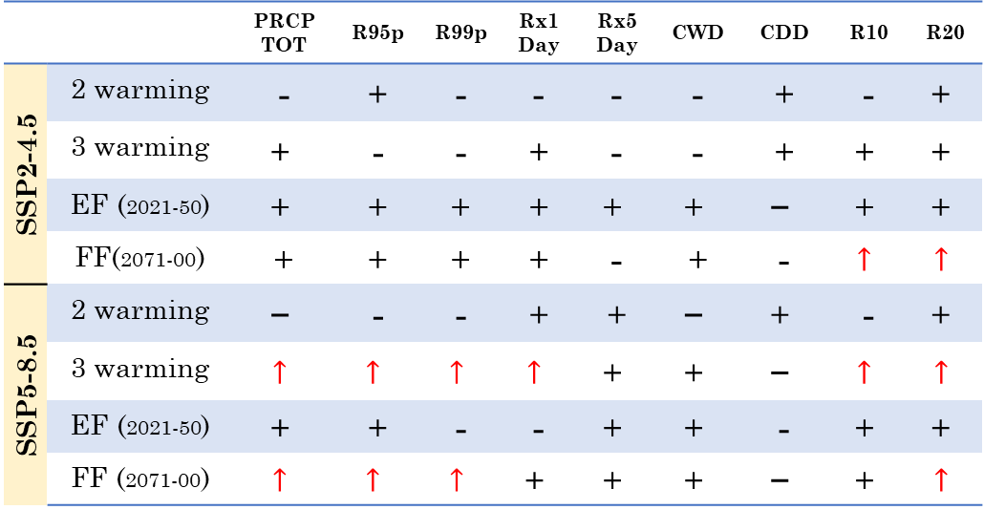
Introduction
Literature Review
Study Area
Objective 2
Methodology
Results
Timeframe and Targets
SWAT calibration and validation
Extreme Precipitation Indices
Calibration (2007-2010)
Validation (2011-2014)
 |  | PRCP TOT | R95p | R99p | Rx1 Day | Rx5 Day | CWD | CDD | R10 | R20
SSP2-4.5 | 2 warming | - | + | - | - | - | - | + | - | $$\text{+}$$
 | 3 warming | $$\text{+}$$ | - | - | + | - | - | + | $$\text{+}$$ | $$\text{+}$$
 | EF (2021-50) | $$\text{+}$$ | + | + | + | $$\text{+}$$ | $$\text{+}$$ | $$\text{−}$$ | $$\text{+}$$ | $$\text{+}$$
 | FF(2071-00) | + | + | + | + | - | + | - | $$↑$$ | $$↑$$
SSP5-8.5 | 2 warming | $$\text{−}$$ | - | - | + | + | $$\text{−}$$ | $$\text{+}$$ | - | $$\text{+}$$
 | 3 warming | $$↑$$ | $$↑$$ | $$↑$$ | $$↑$$ | $$\text{+}$$ | $$\text{+}$$ | $$\text{−}$$ | $$↑$$ | $$↑$$
 | EF (2021-50) | $$\text{+}$$ | + | - | - | $$\text{+}$$ | $$\text{+}$$ | - | $$\text{+}$$ | $$\text{+}$$
 | FF (2071-00) | $$↑$$ | $$↑$$ | $$↑$$ | $$\text{+}$$ | $$\text{+}$$ | $$\text{+}$$ | $$\text{−}$$ | $$\text{+}$$ | $$↑$$
Percentage change in future precipitation extremes w. r. t. base period (1991-2020): (A) SSP2-4.5 (B) SSP5-8.5
+ Positive trends ; - Negative trends ; $↑$ Significant positive trend (significance level 95%) ; $↓$ Significant negative trend (significance level 95%)

Slide 12
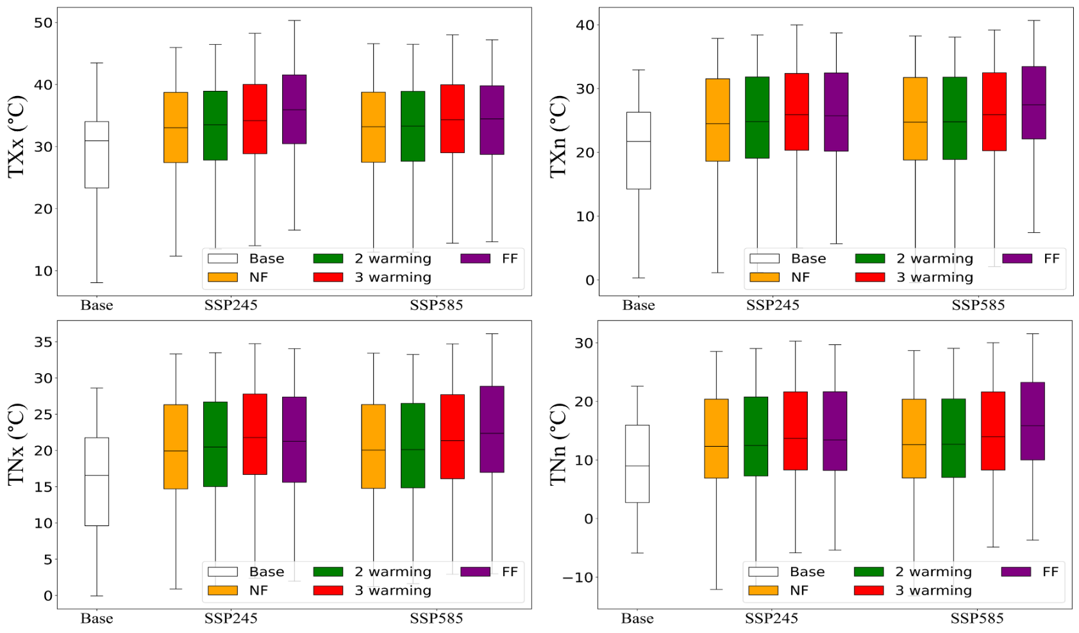
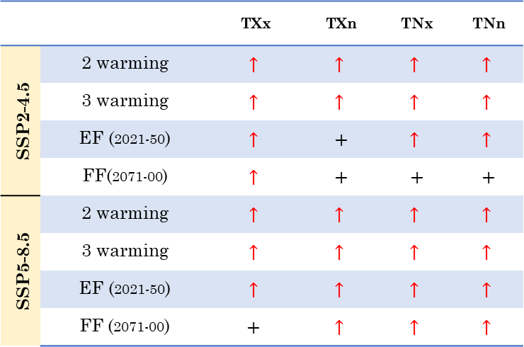
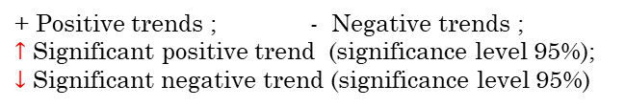
Introduction
Literature Review
Study Area
Objective 2
Methodology
Results
Timeframe and Targets
Extreme Temperature indices
The hottest days are expected to be notably warmer (up to 50 ºC) in the FF than that of the observed period (up to 43 ºC)
(A)
(B)
 |  | TXx | TXn | TNx | TNn
SSP2-4.5 | 2 warming | $$↑$$ | $$↑$$ | $$↑$$ | $$↑$$
 | 3 warming | $$↑$$ | $$↑$$ | $$↑$$ | $$↑$$
 | EF (2021-50) | $$↑$$ | + | $$↑$$ | $$↑$$
 | FF(2071-00) | $$↑$$ | + | + | +
SSP5-8.5 | 2 warming | $$↑$$ | $$↑$$ | $$↑$$ | $$↑$$
 | 3 warming | $$↑$$ | $$↑$$ | $$↑$$ | $$↑$$
 | EF (2021-50) | $$↑$$ | $$↑$$ | $$↑$$ | $$↑$$
 | FF (2071-00) | $$\text{+}$$ | $$↑$$ | $$↑$$ | $$↑$$
(C)
(D)
+ Positive trends ; - Negative trends ;
$↑$ Significant positive trend (significance level 95%); $↓$ Significant negative trend (significance level 95%)
Analyzing Intensity-Based Temperature Index Variations with Base Period
These trends suggest a warmer winter across the basin, with limited fluctuations in both maximum and minimum temperatures, resulting in more day-to-night temperature variation.
TXx : Monthly maximum value of daily maximum temperature ; TXn : Monthly minimum value of daily maximum temperature ; TNx : Monthly maximum value of daily minimum temperature ; TNn : Monthly maximum value of daily maximum temperature

Slide 13
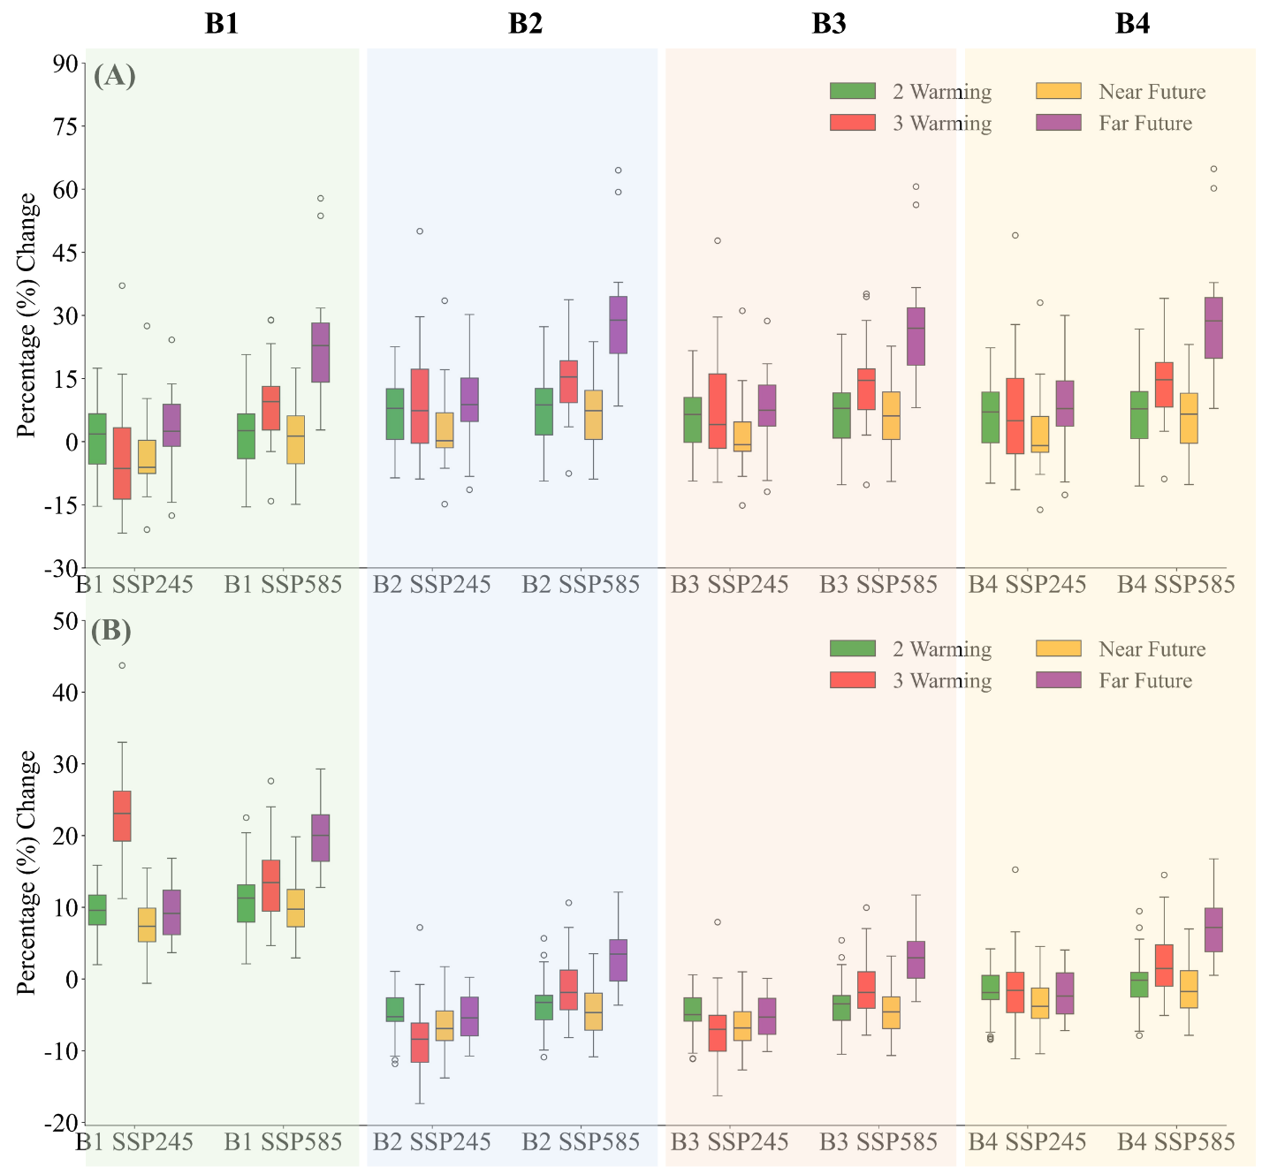
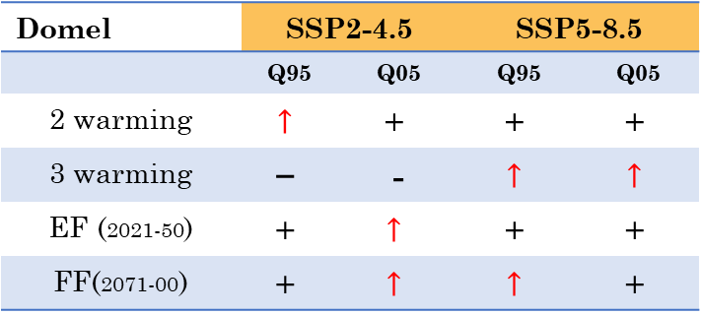
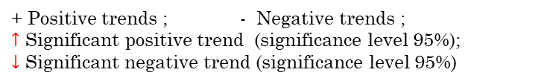
Introduction
Literature Review
Study Area
Objective 2
Methodology
Results
Timeframe and Targets
Extreme Annual Runoff
Udhampur
Chenani
Ramnagar
Domel
Q95 increases consistently, notably ~30% in Chenani and Domel under SSP5-8.5 in FF.
Q05 decrease for most subbasins, a maximum decline of 8.5% under SSP2-4.5
SSP2-4.5 showed Q95 in Udhampur decreased (~21.7%) in 3° C GWL
Domel | SSP2-4.5 |  | SSP5-8.5
 | Q95 | Q05 | Q95 | Q05
2 warming | $$↑$$ | $$\text{+}$$ | $$\text{+}$$ | $$\text{+}$$
3 warming | $$\text{−}$$ | - | $$↑$$ | $$↑$$
EF (2021-50) | $$\text{+}$$ | $$↑$$ | $$\text{+}$$ | $$\text{+}$$
FF(2071-00) | $$\text{+}$$ | $$↑$$ | $$↑$$ | $$\text{+}$$
+ Positive trends ; - Negative trends ;
$↑$ Significant positive trend (significance level 95%);
$↓$ Significant negative trend (significance level 95%)
Projected change in discharge w.r.t the base period (A) Annual high flow Q95 (B) Annual low flow Q05

Slide 14
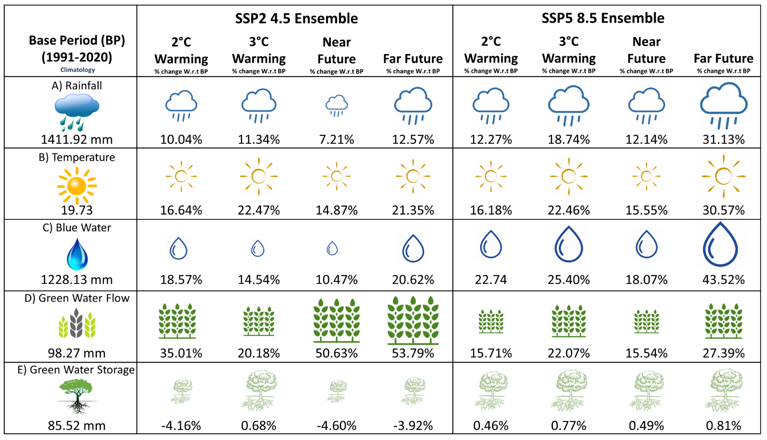
Introduction
Literature Review
Study Area
Objective 2
Methodology
Results
Timeframe and Targets
Catchment Scale Projections
The average annual BW in the catchment is also observed to increase, corresponding to increasing annual rainfall.

Slide 15
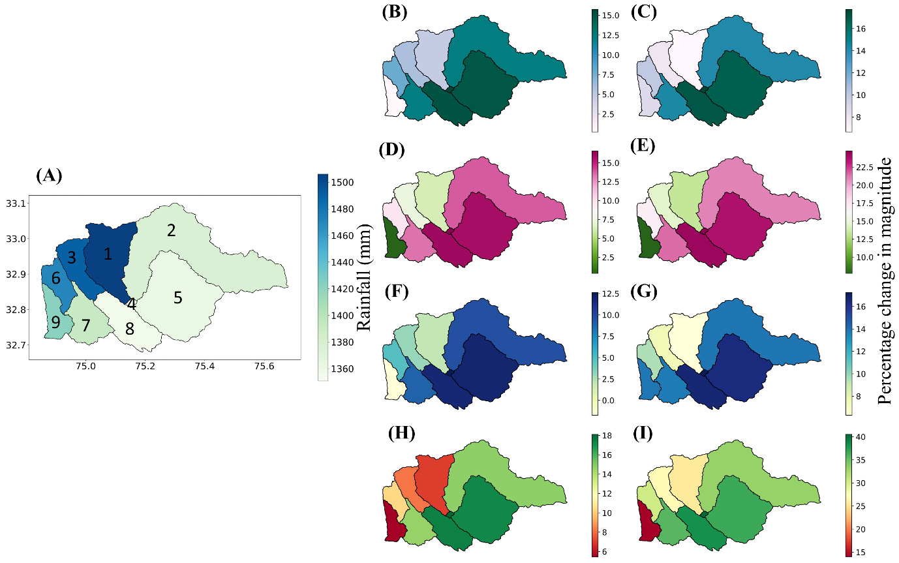
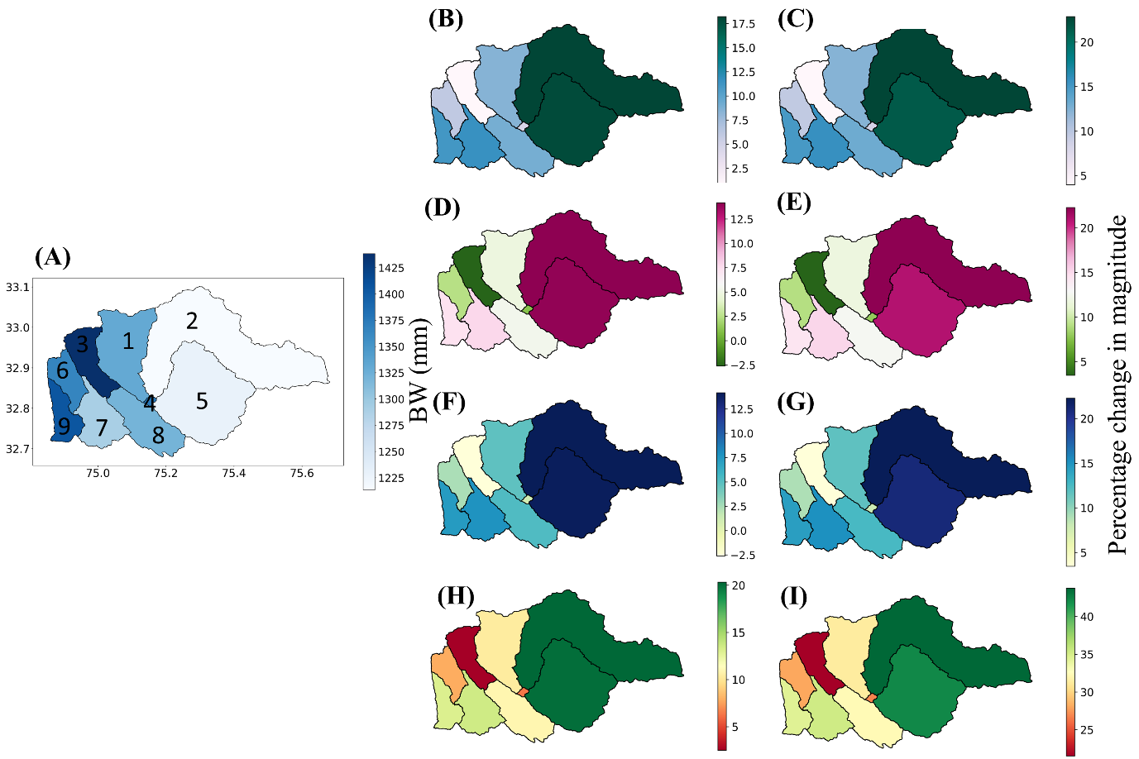


Introduction
Literature Review
Study Area
Objective 2
Methodology
Results
Timeframe and Targets
Sub-Catchment Scale Projections
Rainfall
SSP2-4.5
SSP5-8.5
Blue Water
SSP2-4.5
SSP5-8.5
2 °C
2 °C
3 °C
3 °C
NF
Base Period (1991-2020)
Base Period (1991-2020)
NF
FF
FF
Increased by 40.52%, 36.60%, and 38.16% in sub-basins 4, 5, and 8 during the FF under the SSP5-8.5 scenario.
Sub-basins 1, 3, 6 and 9 are observed where increase is minimum in each timeframes and under both SSPs.
Maximum increase in FF under SSP5-8.5.
However, the increase was substantially less in sub-basins 1, 3, 6, and 9 in 2 °C GWL and NF.

Slide 16


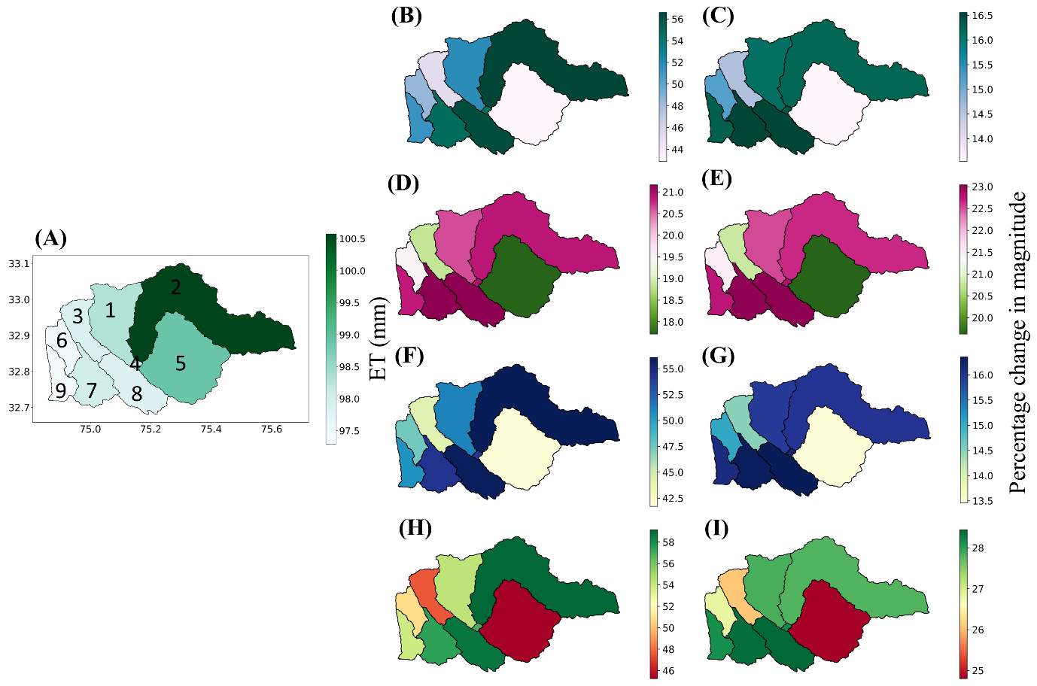
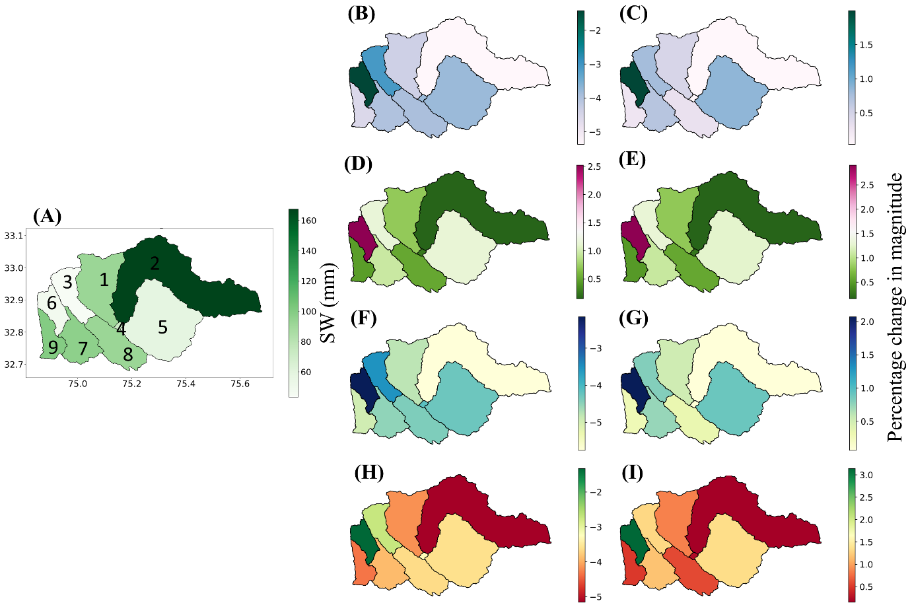
Introduction
Literature Review
Study Area
Objective 2
Methodology
Results
Timeframe and Targets
Sub-Catchment Scale Projections
Green Water Flow
SSP2-4.5
SSP5-8.5
Green Water Storage
SSP2-4.5
SSP5-8.5
2 °C
2 °C
3 °C
3 °C
NF
NF
Base Period (1991-2020)
Base Period (1991-2020)
FF
FF
The expected increase in GWF availability is more evident under SSP2-4.5 than under SSP5-8.5
The GWF component showed the highest growth in sub-basin 2 and the lowest in sub-basin.
Most of the subbasins projected a decrease in GWS within the range of -5%.
A very substantial increase of 3% was observed by the end of the century under SSP5-8.5

Slide 17
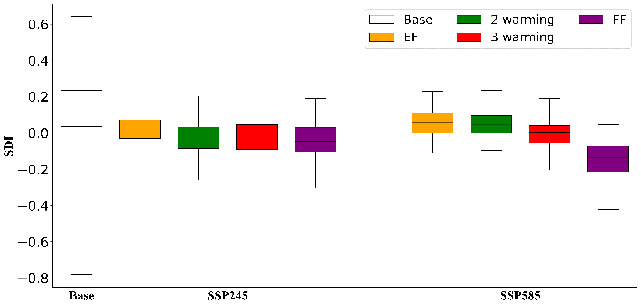
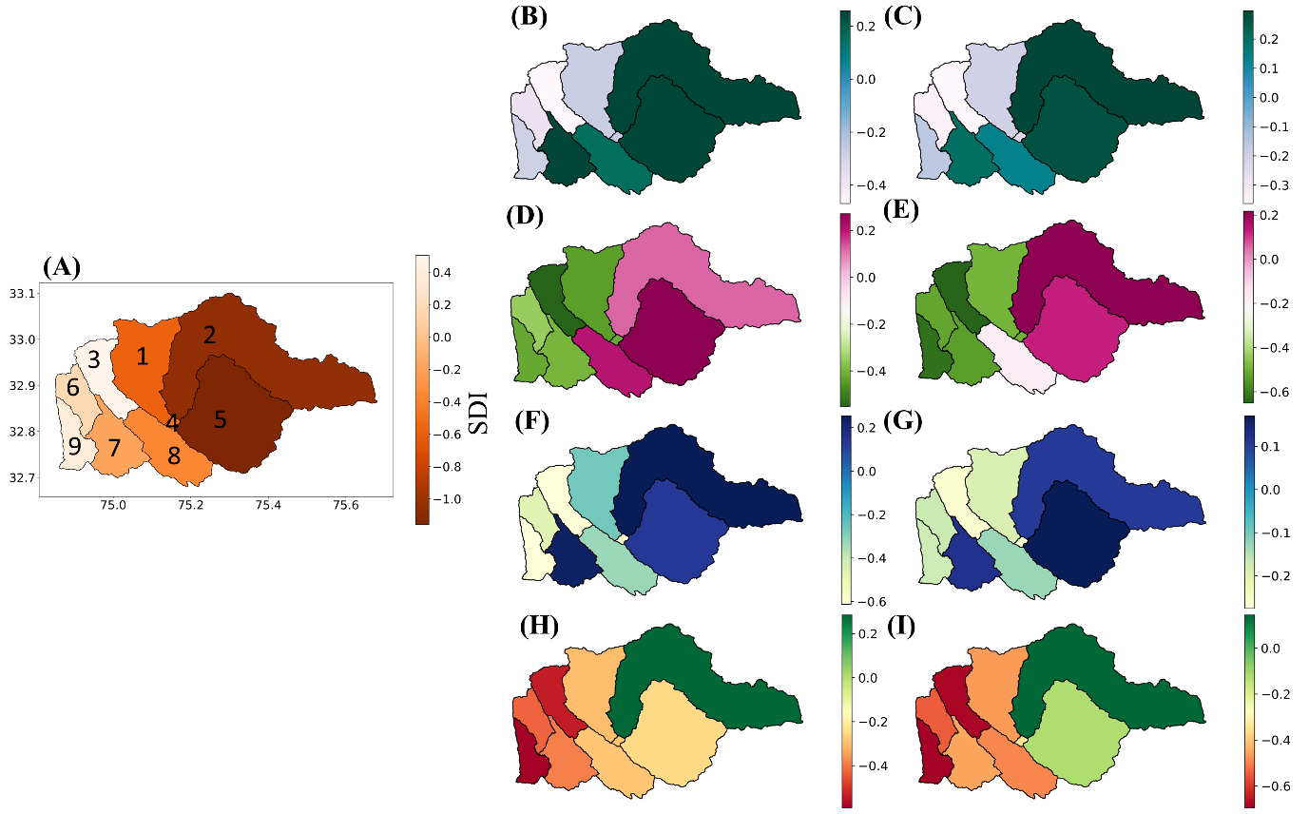

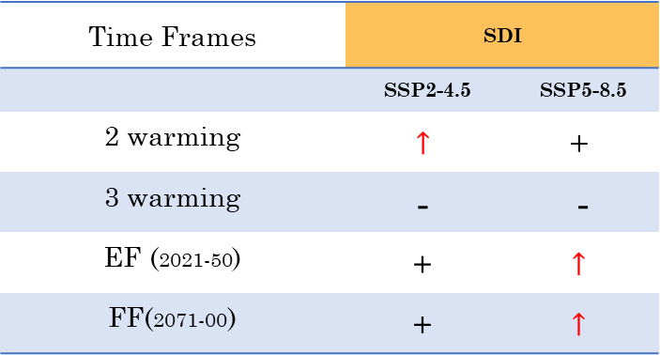
Introduction
Literature Review
Study Area
Objective 2
Methodology
Results
Timeframe and Targets
Catchment Scale
Sub-Catchment Scale
SSP2-4.5
SSP5-8.5
Drought Analysis
2 °C
3 °C
Temporal variation of hydrological drought SDI with respect to the base period
NF
Base Period (1991-2020)
Time Frames | SDI
 | SSP2-4.5 | SSP5-8.5
2 warming | $$↑$$ | $$\text{+}$$
3 warming | $$\text{−}$$ | -
EF (2021-50) | $$\text{+}$$ | $$↑$$
FF(2071-00) | $$\text{+}$$ | $$↑$$
FF
The SDI variability under both SSPs indicates the possibility of mild drought in the future, potentially causing water stress in the region.
+ Positive trends ; - Negative trends ;
$↑$ Significant positive trend (significance level 95%);
$↓$ Significant negative trend (significance level 95%)

Slide 18
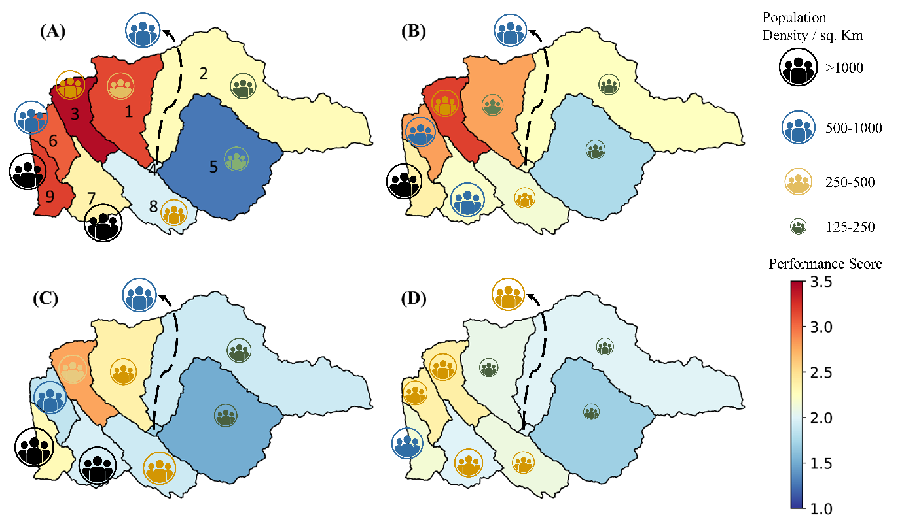
Introduction
Literature Review
Study Area
Objective 2
Methodology
Results
Timeframe and Targets
Prioritized catchments
SSP2-4.5
SSP5-8.5
The subbasins 1, 3, 6, and 9 were observed to be major regions that are impacted by water shortages under SSP2-4.5 in NF
NF
Performance Score (PS) | Priority Level
PS < 2 | Low Priority
2 ≤ PS < 3.5 | Moderate Priority
PS ≥ 3.5 | High Priority
FF
Prioritization of catchments in the Tawi River basin under climate change adaptation (A), (C) NF and FF for SSP2-4.5 (B), (D) NF and FF for SSP5-8.5

Slide 19
Introduction
Literature Review
Study Area
Objective 2
Methodology
Results
Timeframe and Targets
Conclusions
Climate Trends: Rainfall patterns shifting, intensifying, and warming temperatures observed. Annual discharge variations highlight the necessity for water management.
Future Water: Projections foresee increased water factors, except for green water storage, posing challenges for urban water scarcity. Addressing demand, enhancing efficiency, and sustainable planning are pivotal.
Water Scarcity: Future forecasts indicate heightened drought risks, necessitating proactive resource management to mitigate impacts.
Prioritization: Integrated approach using hydrological modeling and AHP effectively prioritizes catchments, offering valuable insights for preliminary assessments.
Adaptation Urgency: Catchment prioritization stresses urgent need for proactive measures amid varying vulnerability levels, safeguarding water resources and ensuring resilience to climate change.

