Slide 1
Thermo-hydro-mechanical-chemical modeling of synthetic wet gouges sheared at experimental seismic slip rates under different fluid drainage conditions
Advisor: Prof. Li-Wei Kuo
Presenter: Yu-Qing Huang

Slide 2
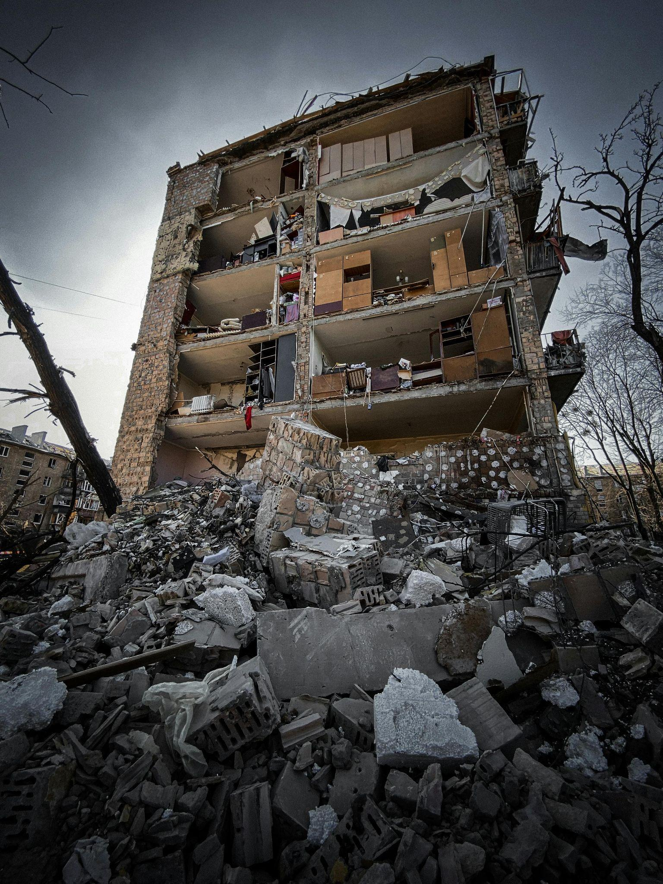
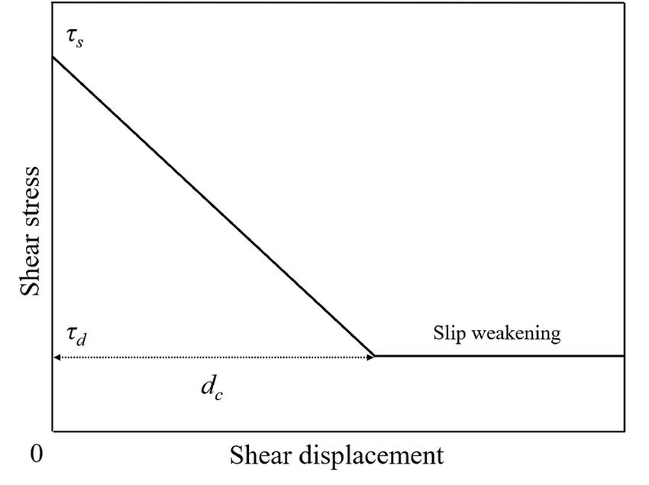
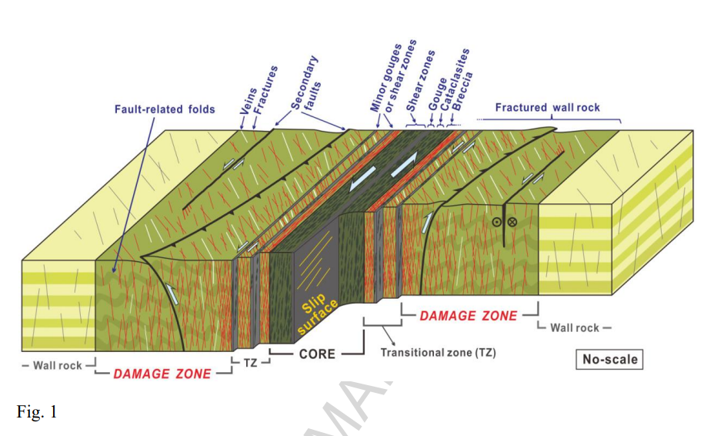
Background
weakening
Acceleration is generated -> resistance decreases
Principle slip zone (PSZ)
gouge
gouge
Dynamic Weakening Mechanism
?
Brittle fault
Choi et al., 2016

Slide 3
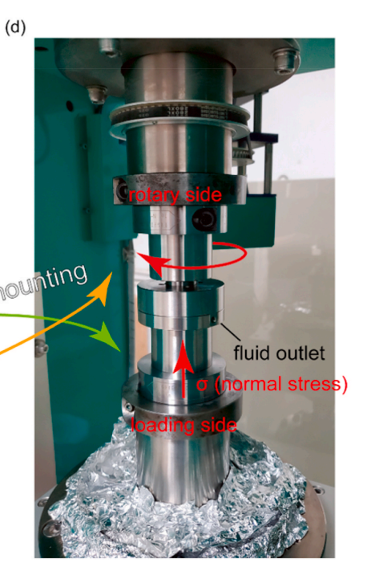
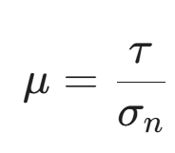
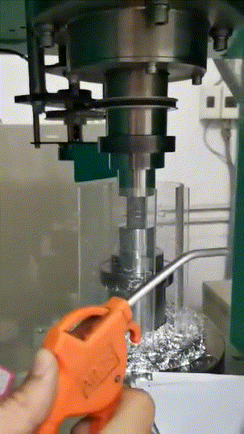
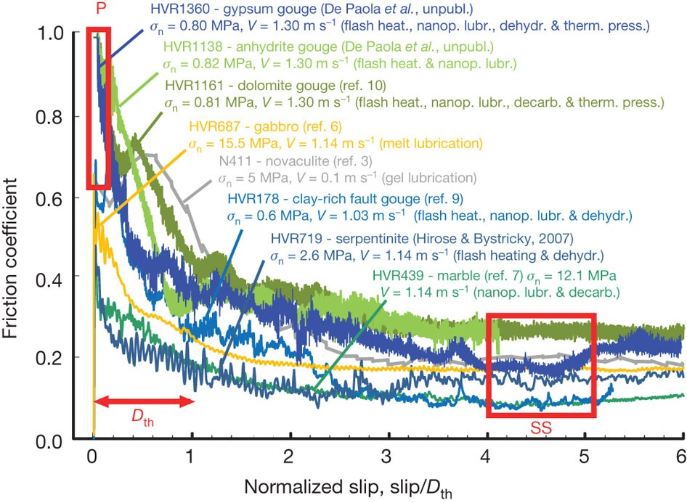
Rotary-shear experiment
apparent friction coefficient (μ)
Peak friction
Shear stress
Normal stress
assessing fault strength
applying experimental results to the interpretation of actual earthquake rupture processes
->dynamic weakening mechanism
Steady-state friction
low to high velocity rotary shear apparatus (LHVR)
Di Toro et al., 2011

Slide 4
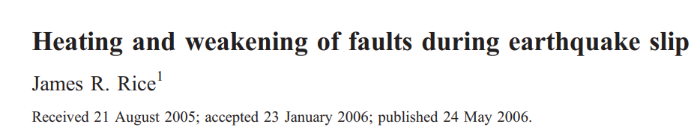
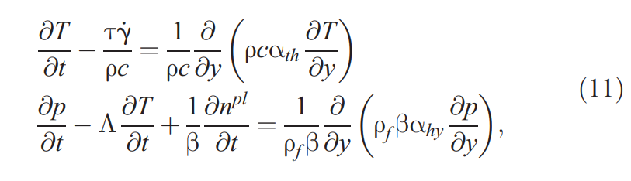
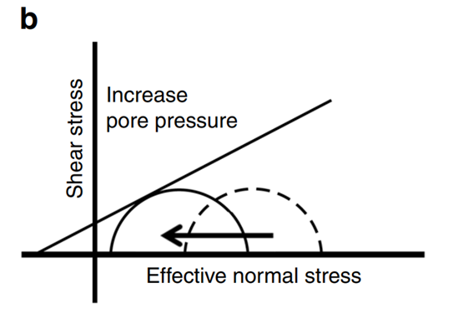
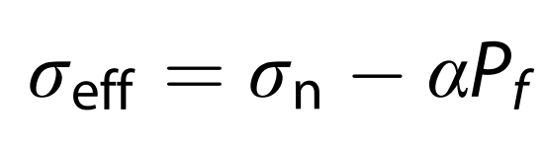
Thermal Pressurization
(Mohr-Coulomb failure equation)
Pore ​​fluid > Pore volume expansion rate
Grain
Pf
Pore fluid
thermal pressurization

Slide 5
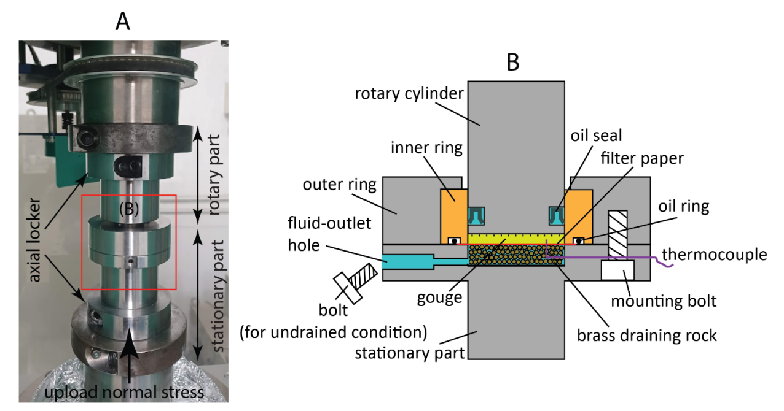
Information from experiments
Temperature (T) in gouge
apparent friction coefficient (μ)
gouge
T & Pf within PSZ ?

Slide 6
Establish a model to simulate T and Pf evolution
material properties;
μ, σn,
measured T
(from experiments)
Input and Constrained data
Geometry and Materials
model setting

Slide 7
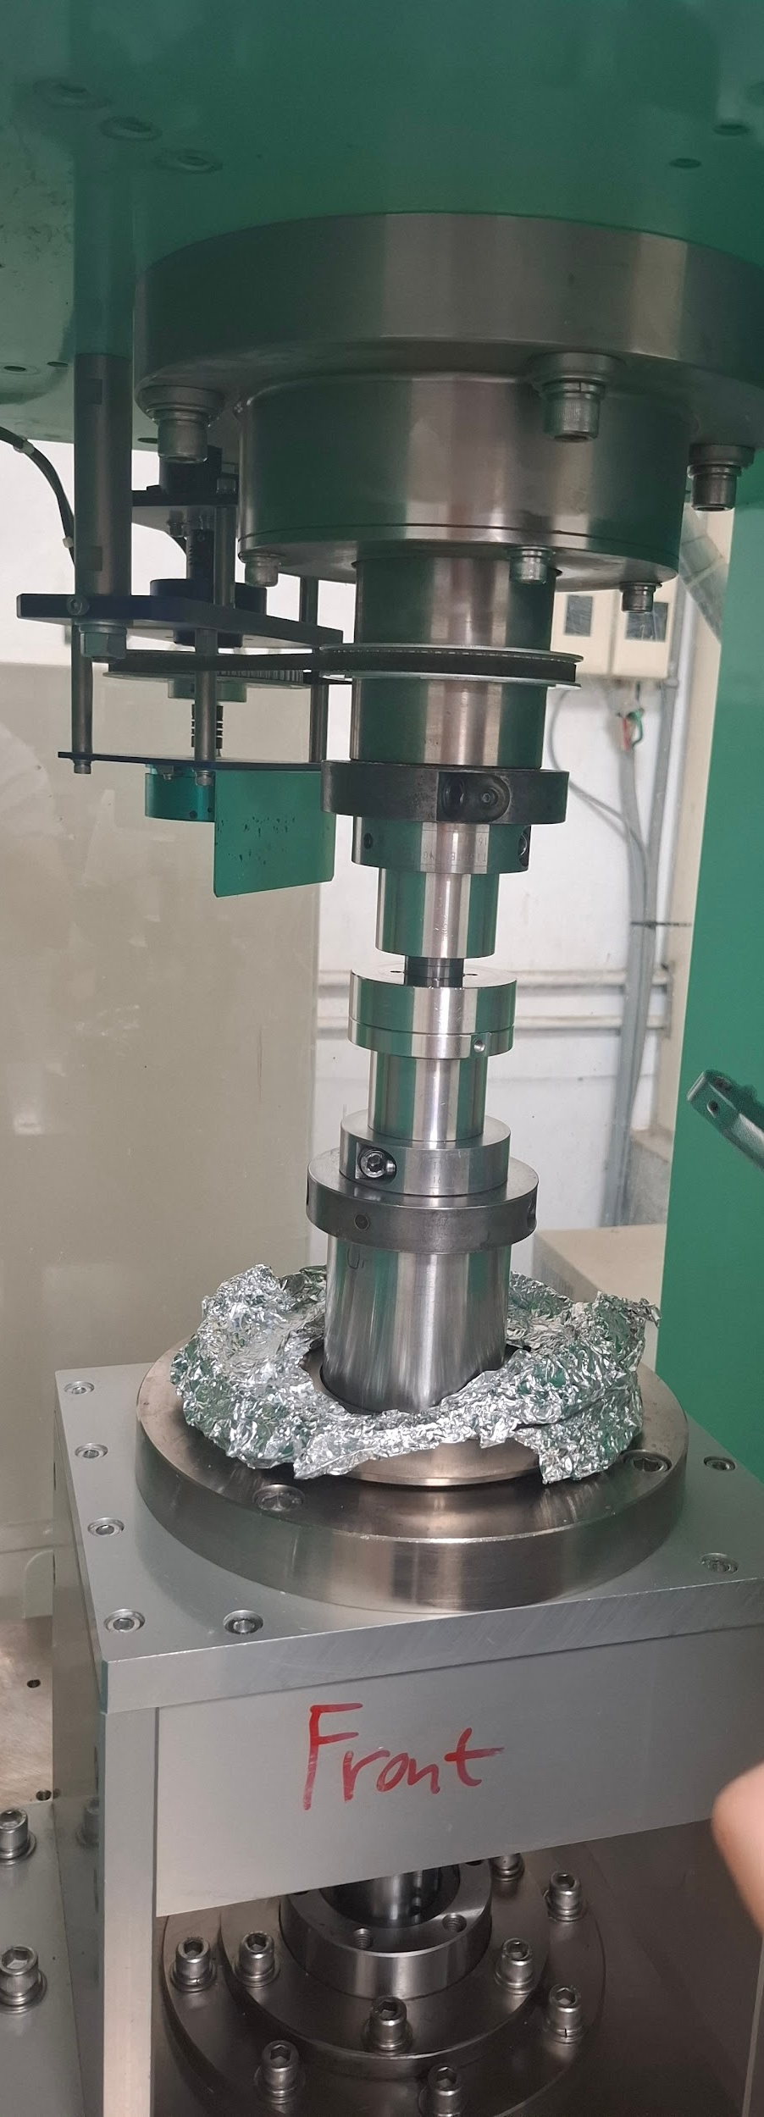
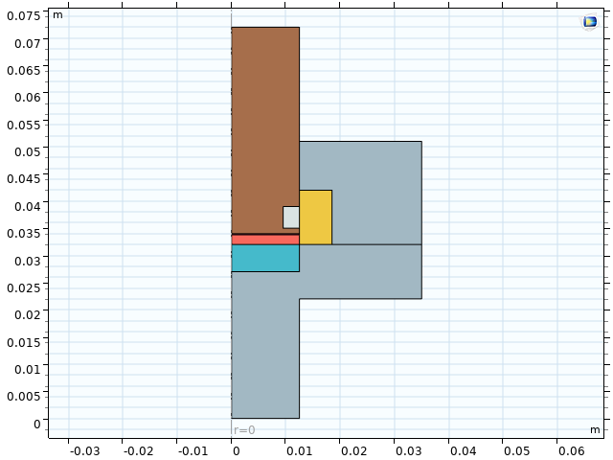
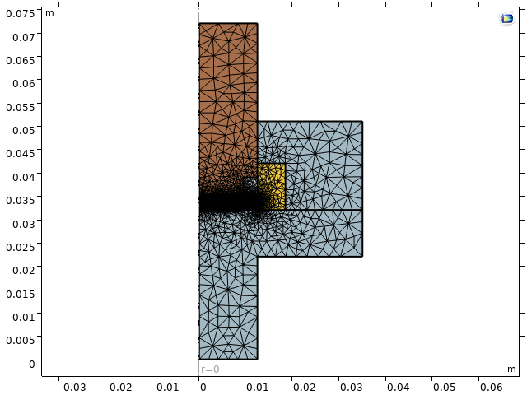
COMSOL 2D Axis-Symmetric THMC Model
Mesh distribution

Slide 8
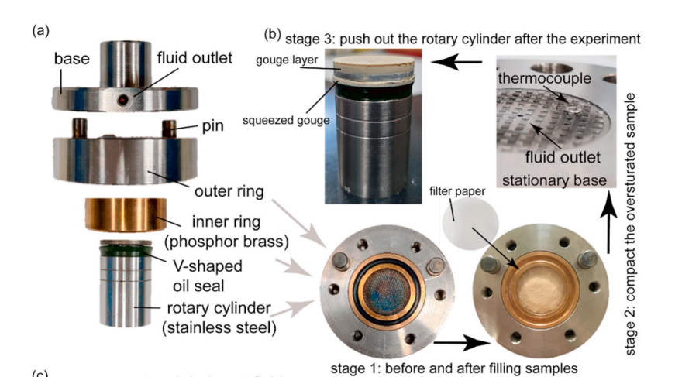
Fluid Drainage condition
Undrained condition:
strain occurs very rapidly
(e.g., at seismic slip rates)
low permeability
Drained condition:
sufficient time for pore fluid drainage
higher permeability
Kuo et al., 2021

Slide 9
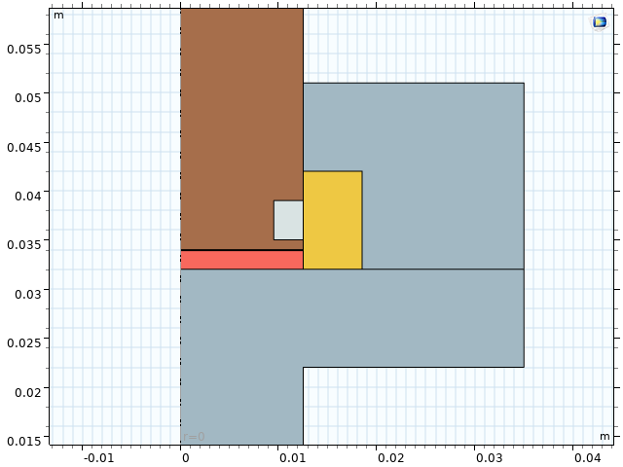
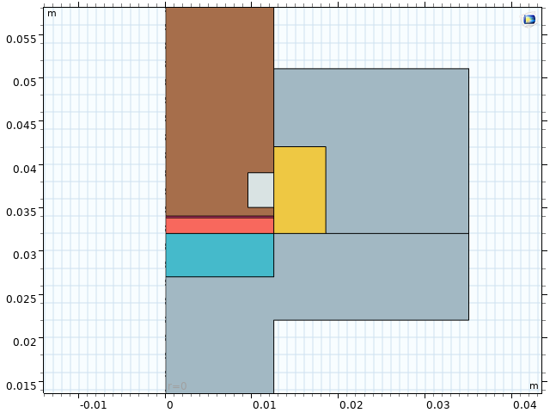
undrained condition
drained condition
tungsten
tungsten
stainless steel
stainless steel
rubber
rubber
PSZ
brass
PSZ
brass
gouge
gouge
porous brass

Slide 10
Build the THMC Model…
Thermal-Hydraulic-Mechanical-Chemical
material properties;
μ, σn,
measured T
(from experiments)
Input and Constrained data
governing equation;
boundary condition
THMC
model setting

Slide 11

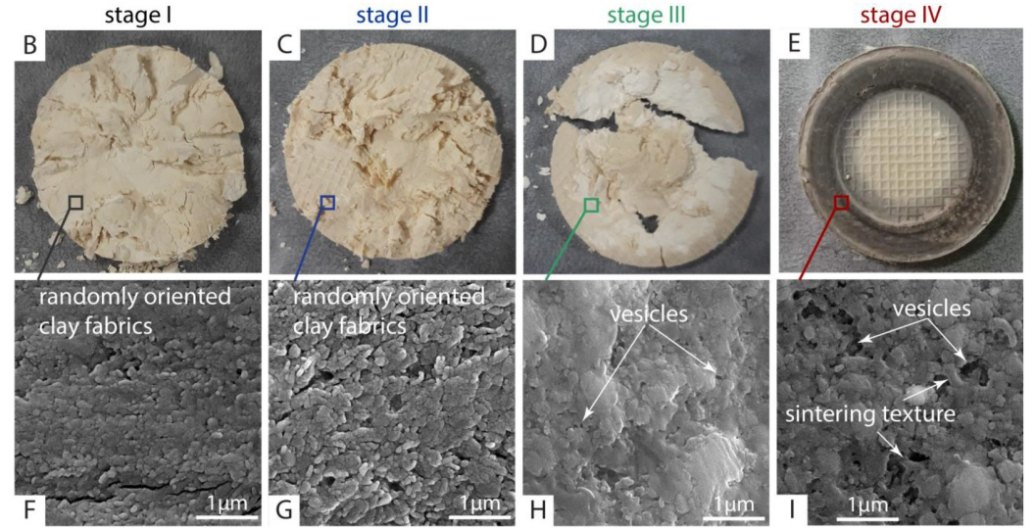
heat source Q（Thermal & Chemical）
Frictional heat
(heat source)
v(r) = ω⋅r
tungsten
stainless steel
VA<VB
PSZ
brass
gouge
r
ω
A
B
RPM (Revolutions Per Minute)

Slide 12
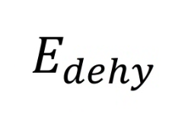
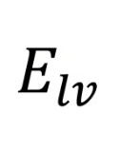
heat source Q（Thermal & Chemical）
v(r) = ω⋅r
Frictional heat
tungsten
stainless steel
PSZ
brass
gouge
Chemical endothermic reaction
vaporization

Slide 13


Mass source Qm (Hydraulic)
Qm is the addition or removal of fluid mass per unit volume per unit time
Derived from Rice (2006)
Rice (2006)
TP coefficient

Slide 14
Build the Model…
material properties;
μ, σn,
measured T
(from experiments)
Input and Constrained data
governing equation;
boundary condition
model setting
evolution of
T & Pf
within the
PSZ
Output (Physical Reconstruction)

Slide 15

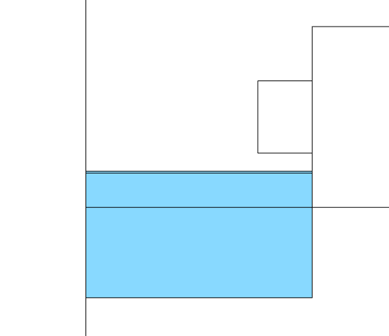
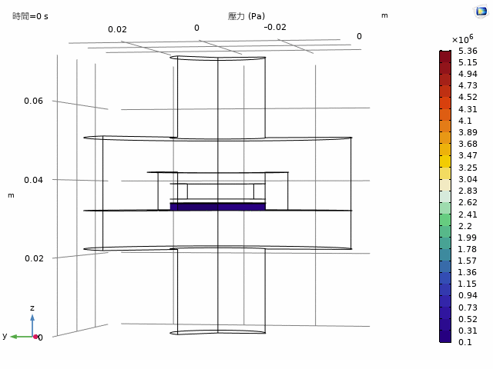
evolution of T & Pf
Temperature
Pore pressure
low to high velocity rotary shear apparatus (LHVR)

Slide 16
Experimental condition
material:
1. Kaolinite
2. Kaolinite + Illite + Quartz
condition:
slip rate: 1 m/s
σ = 10 MPa
undrained/drained
Temperature (T) was recorded
Kuo et al., 2021
Notes:
K‐ sheath thermocouple was inserted into the gouge layer ∼0.5 mm below the PSZ at 2/3 of the radius of the station base
The experimental shearing occurred in the upper part of the gouge layer. The PSZ formed as a 100 μm ‐ thick in the upper part of the 2 mm thick gouge layer.

Slide 17
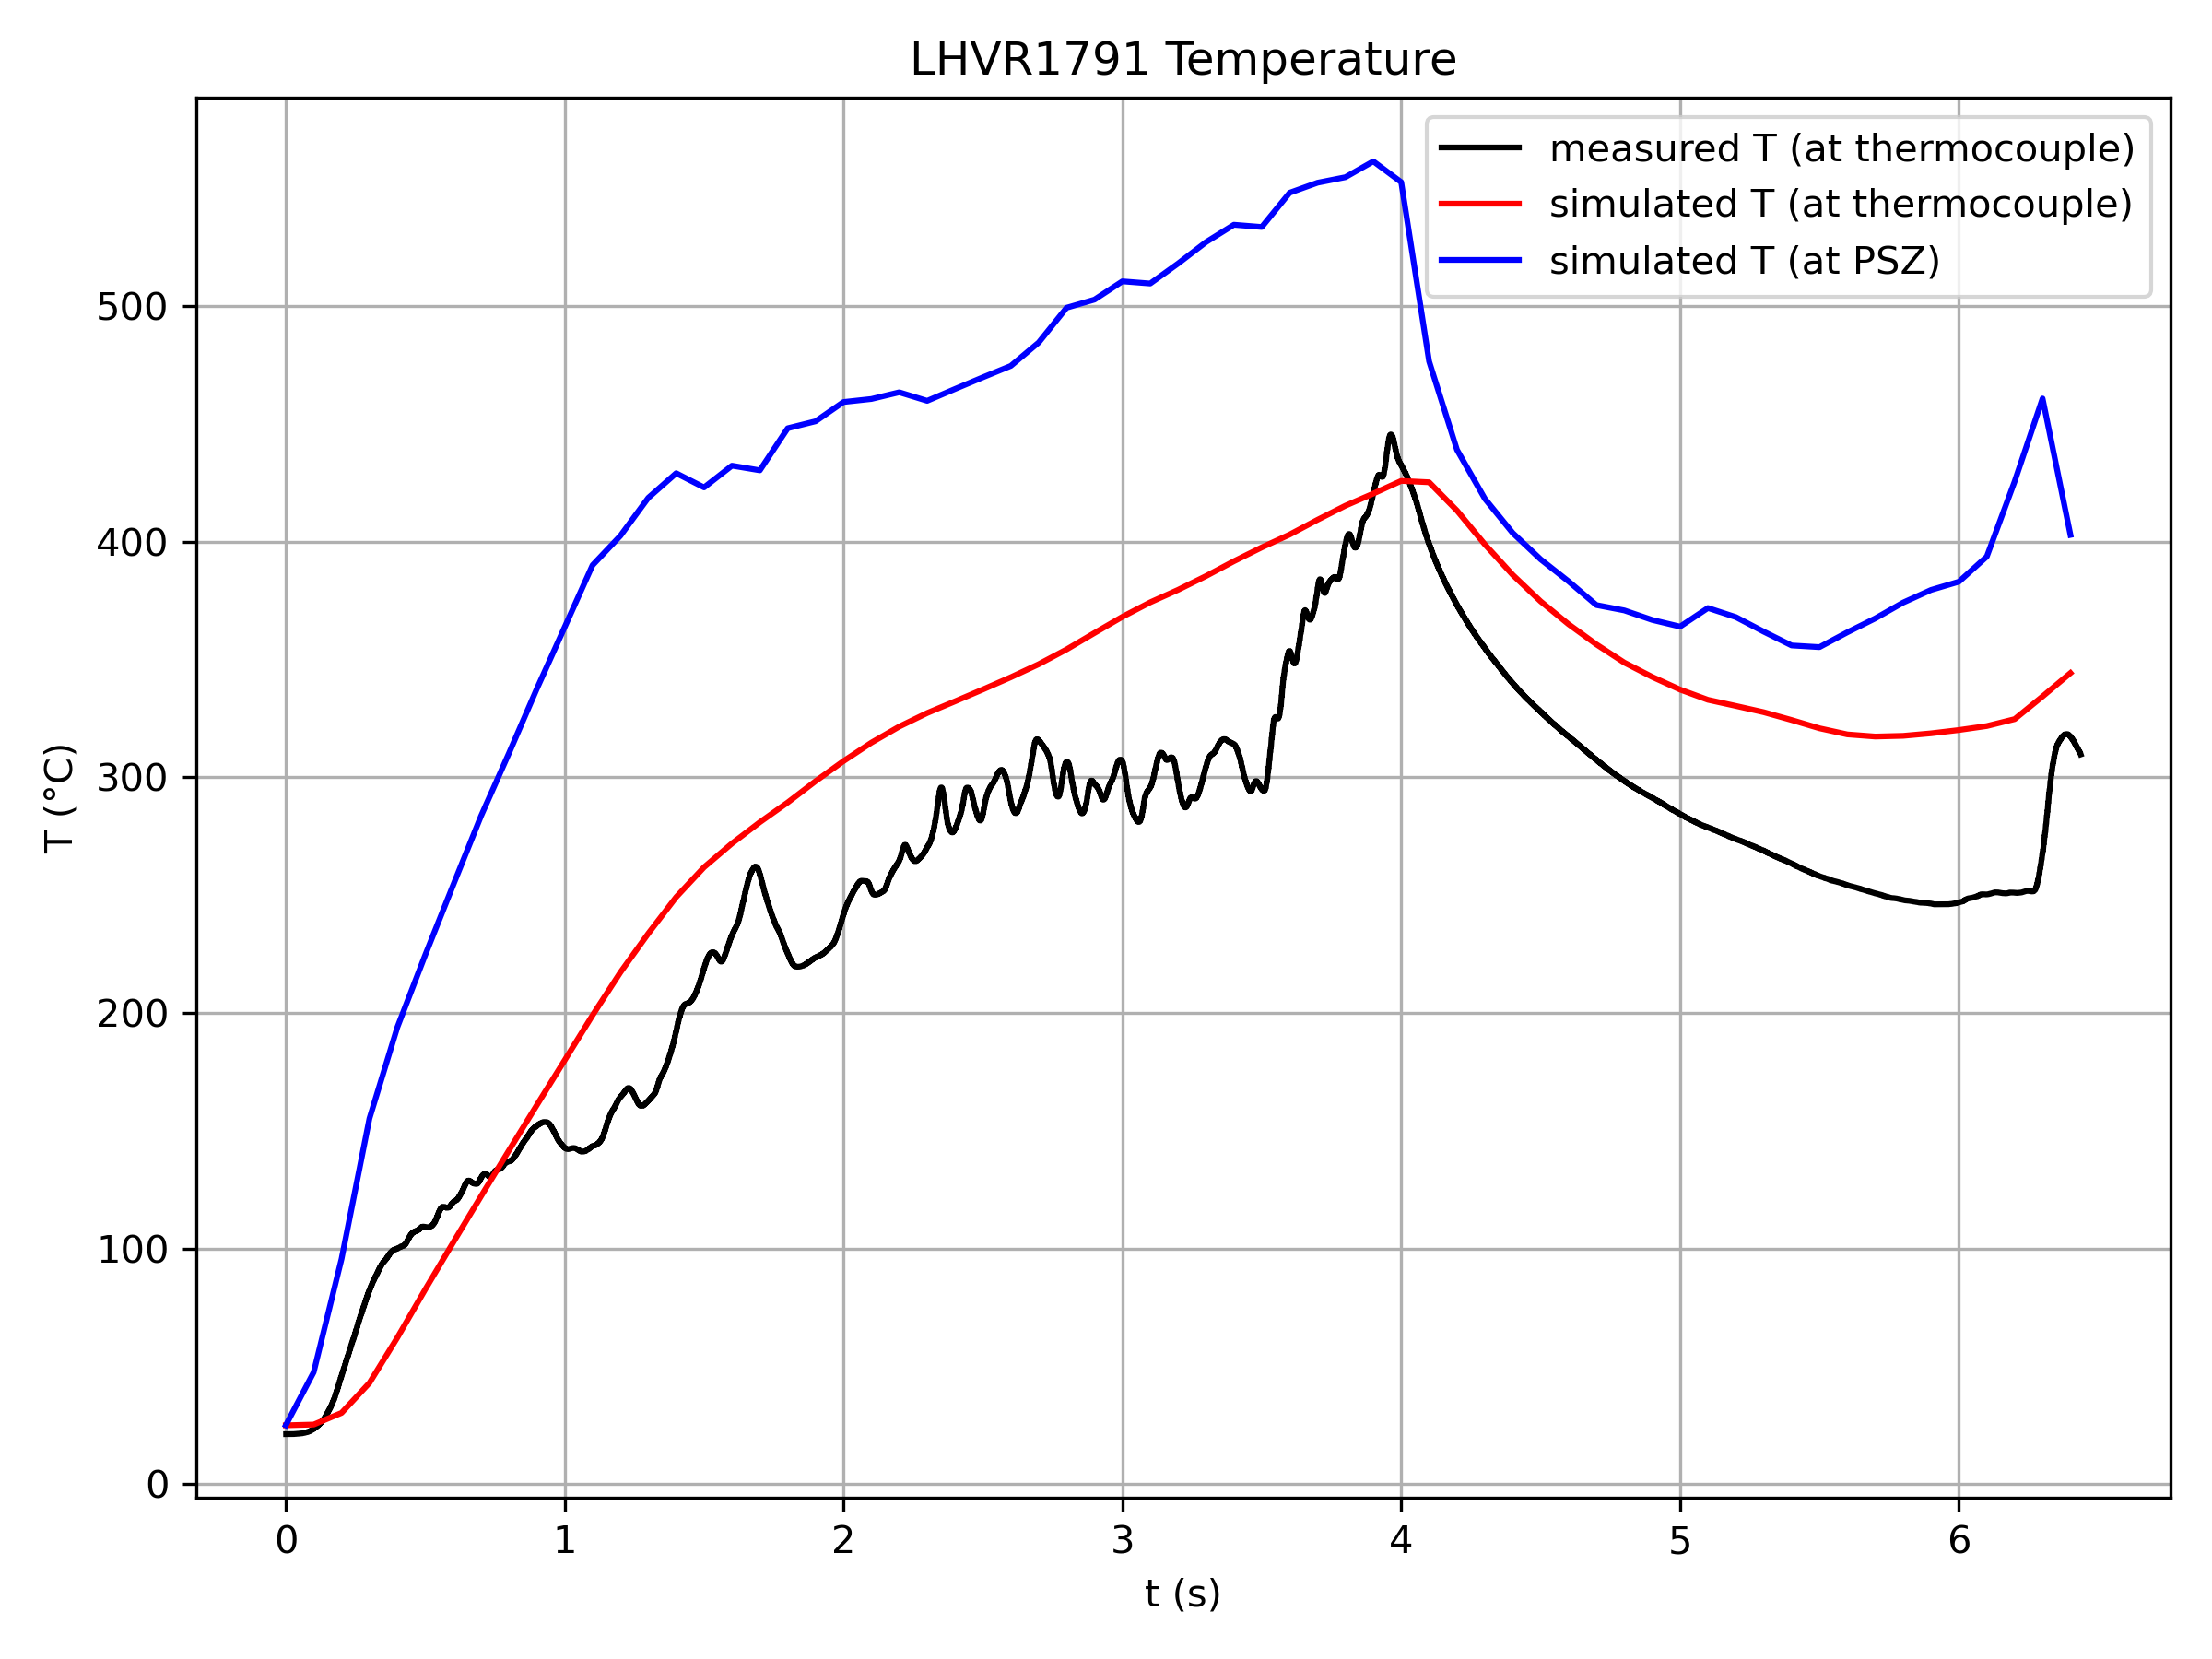
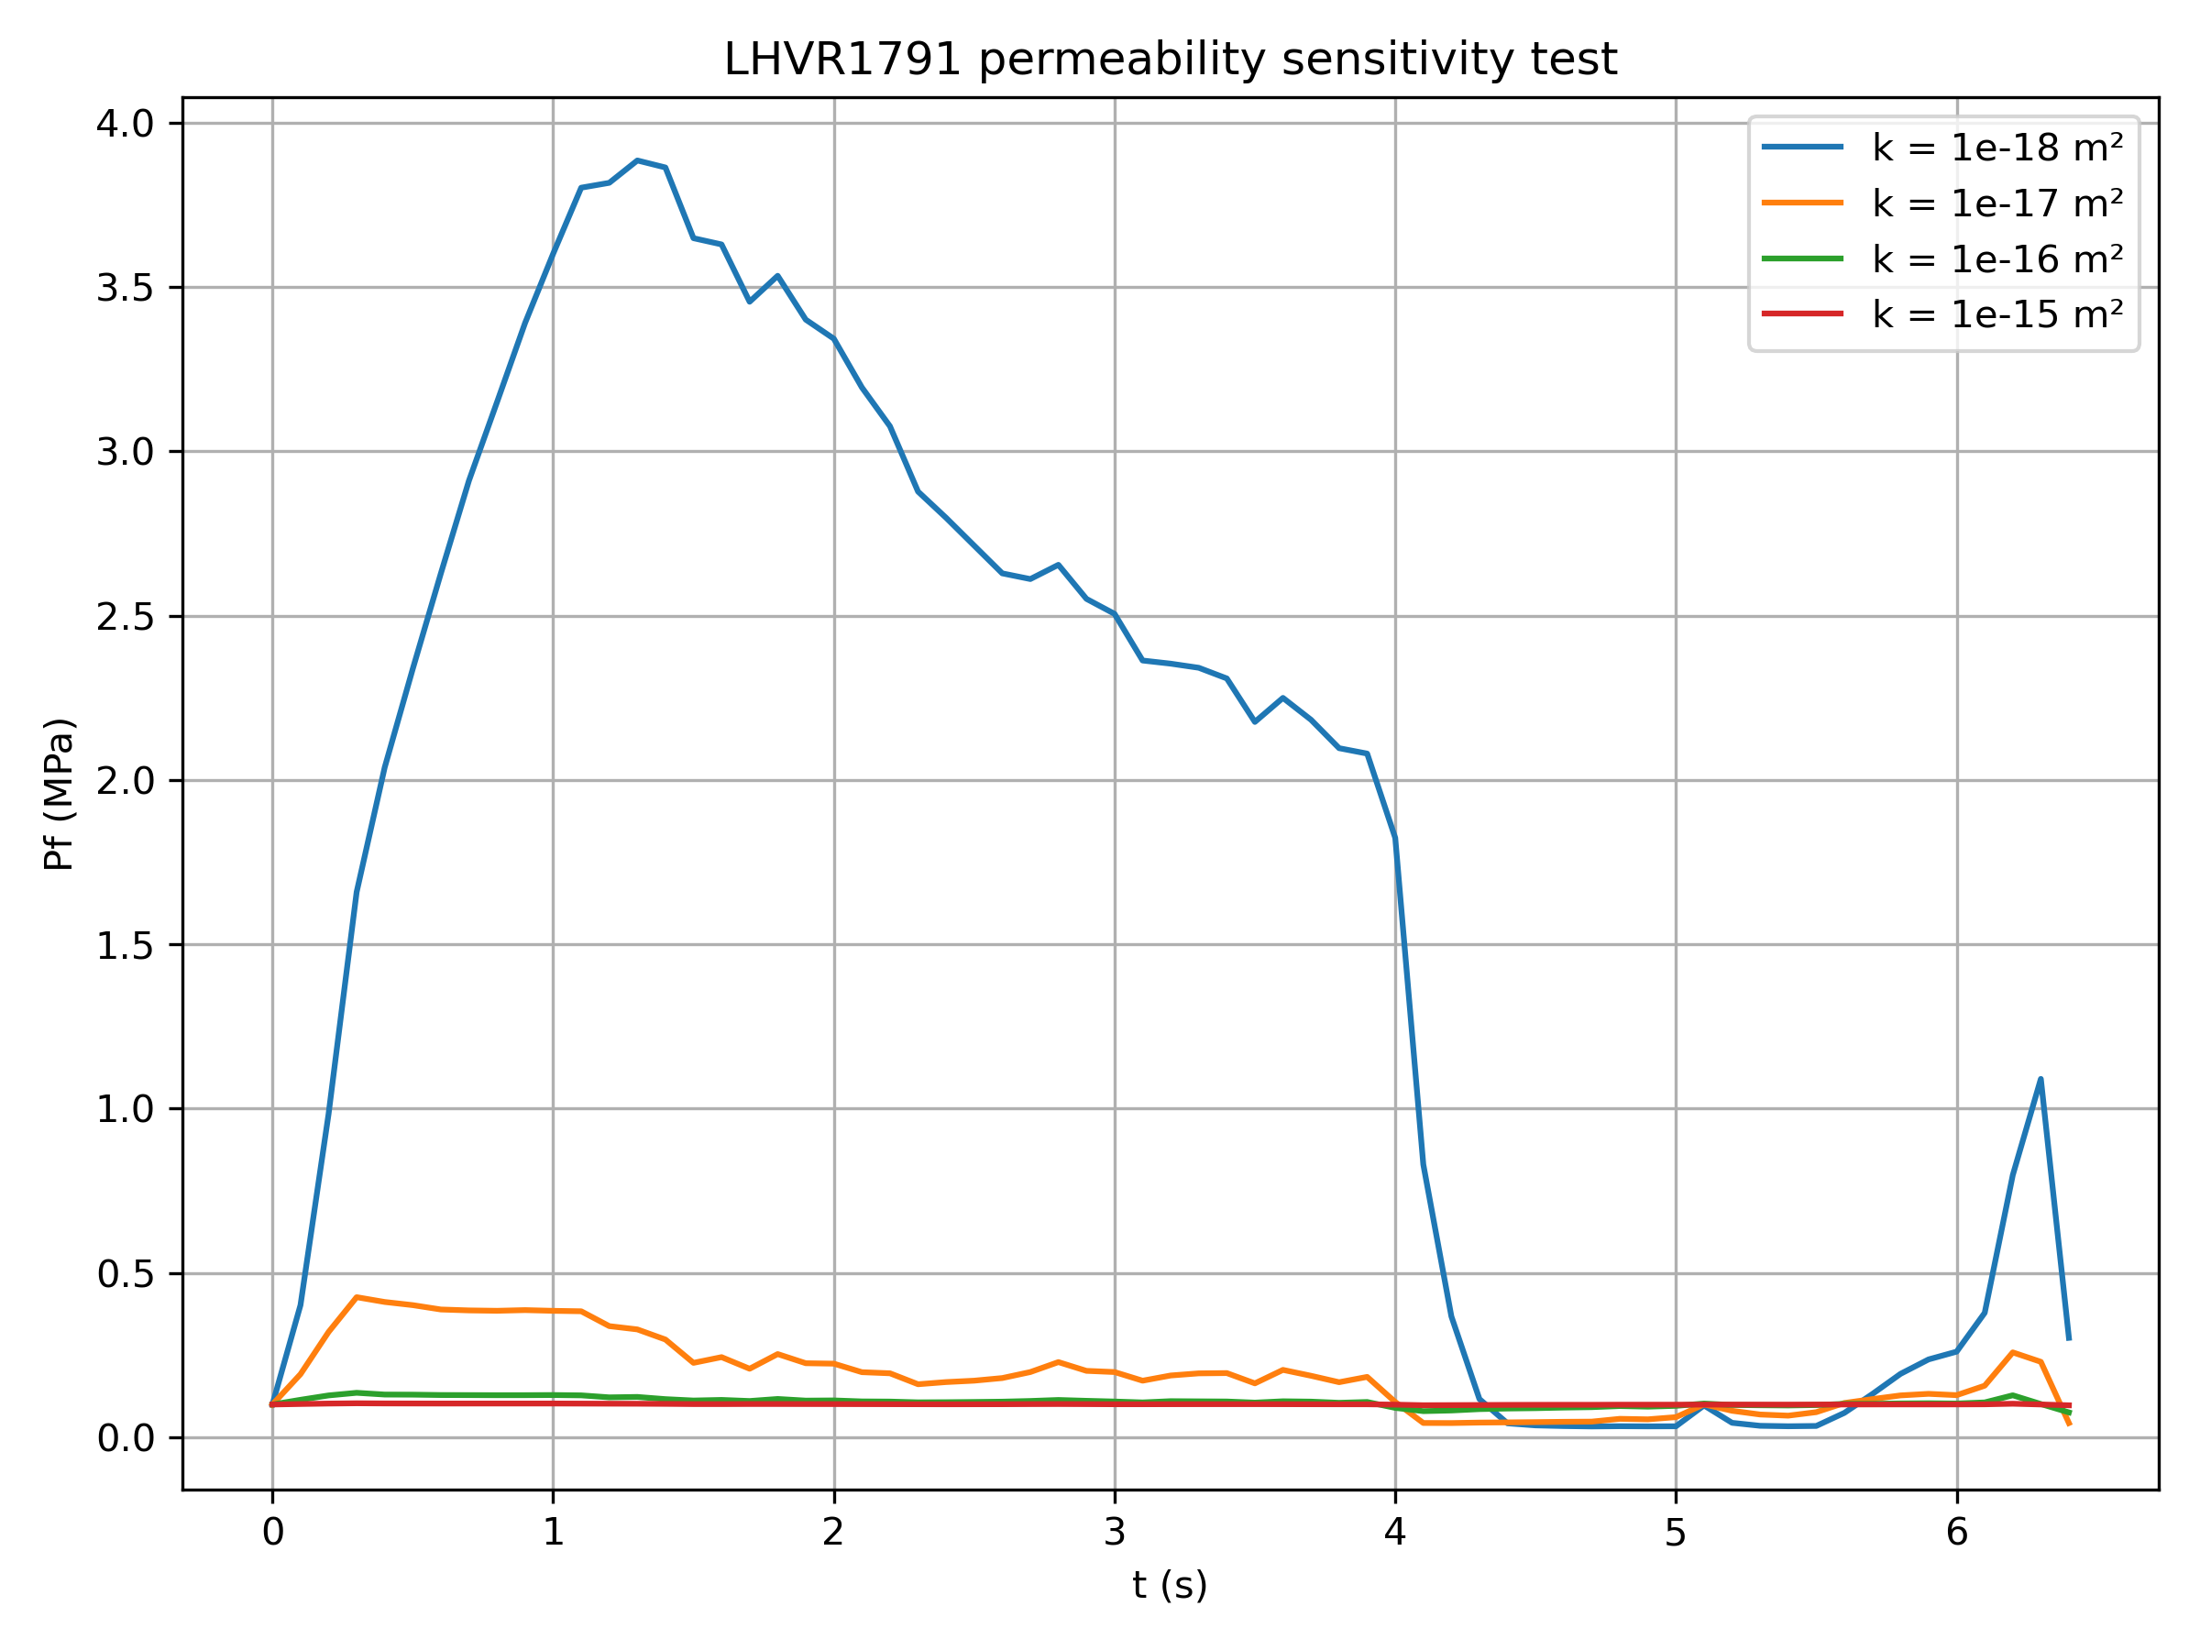
Results (K-drained)

Slide 18
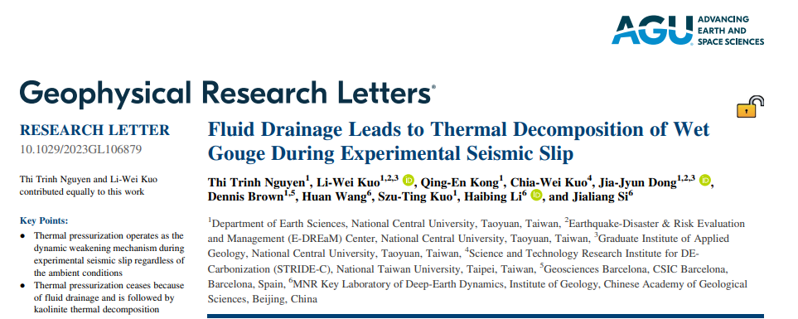
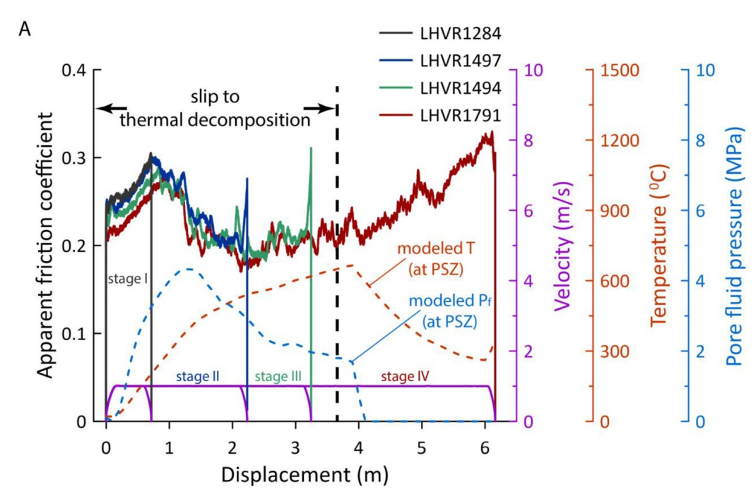
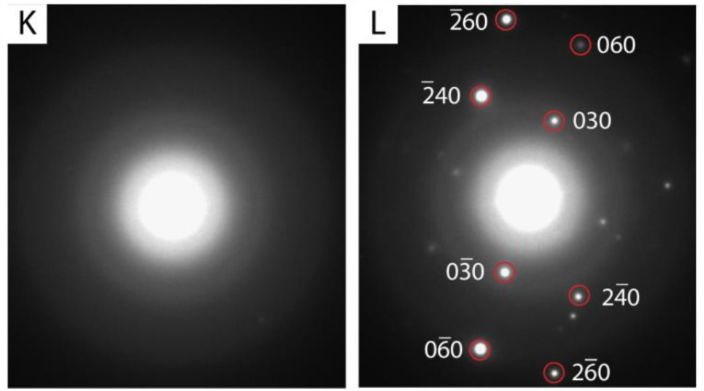
material: Kaolinite-drained
restrengthening
bright ring or mixed with bright spots:
presence of amorphous materials and metakaolin
thermal decomposition
Field‐emission SEM
selected area electron diffraction (SAED) pattern

Slide 19
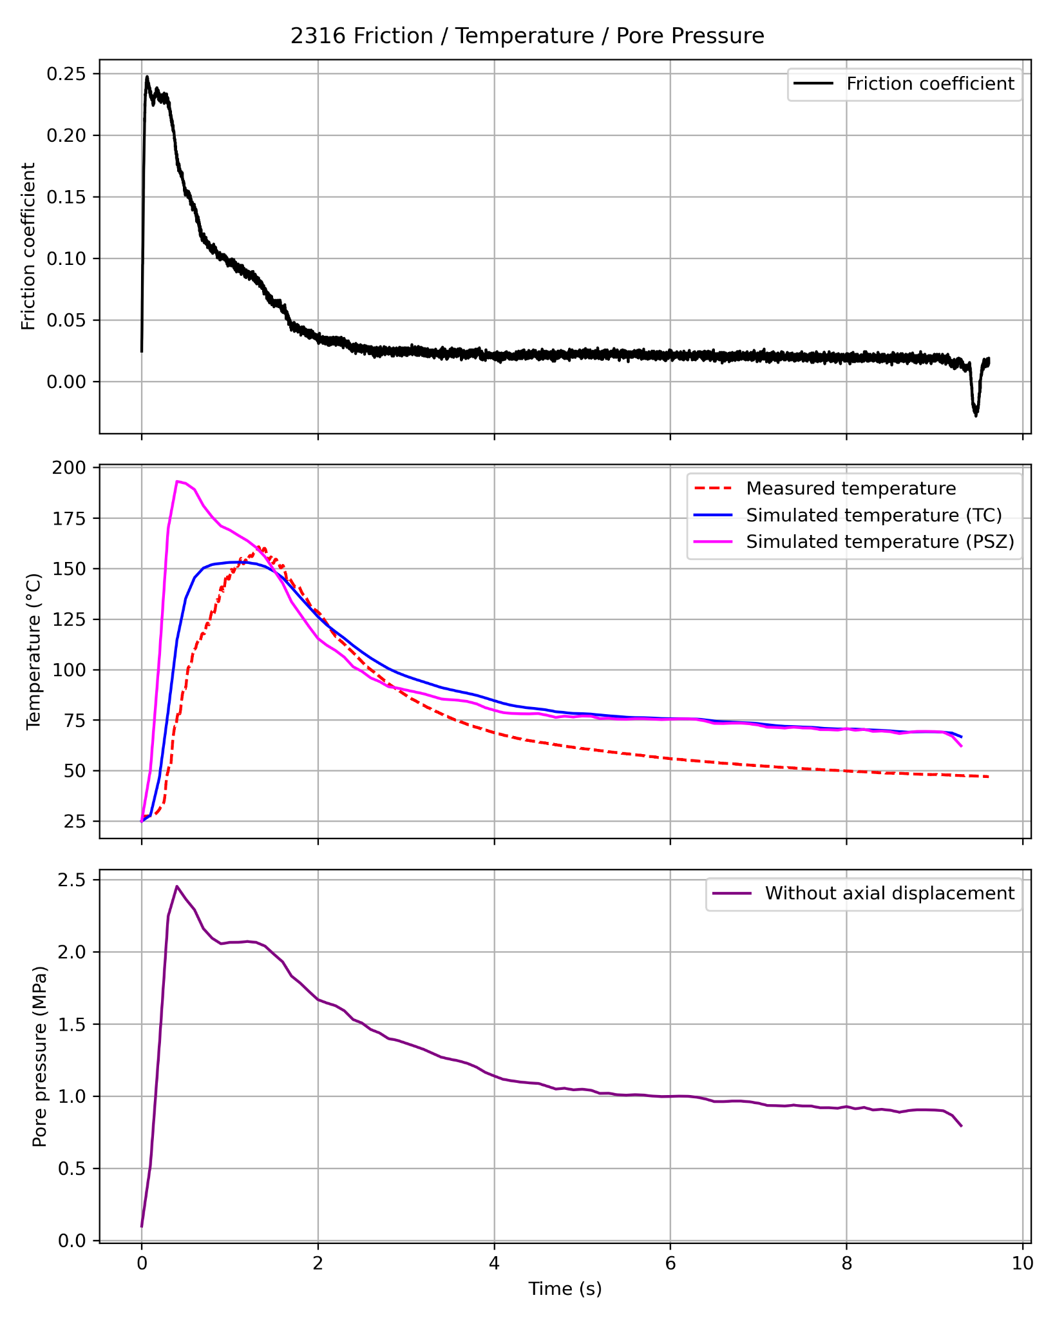
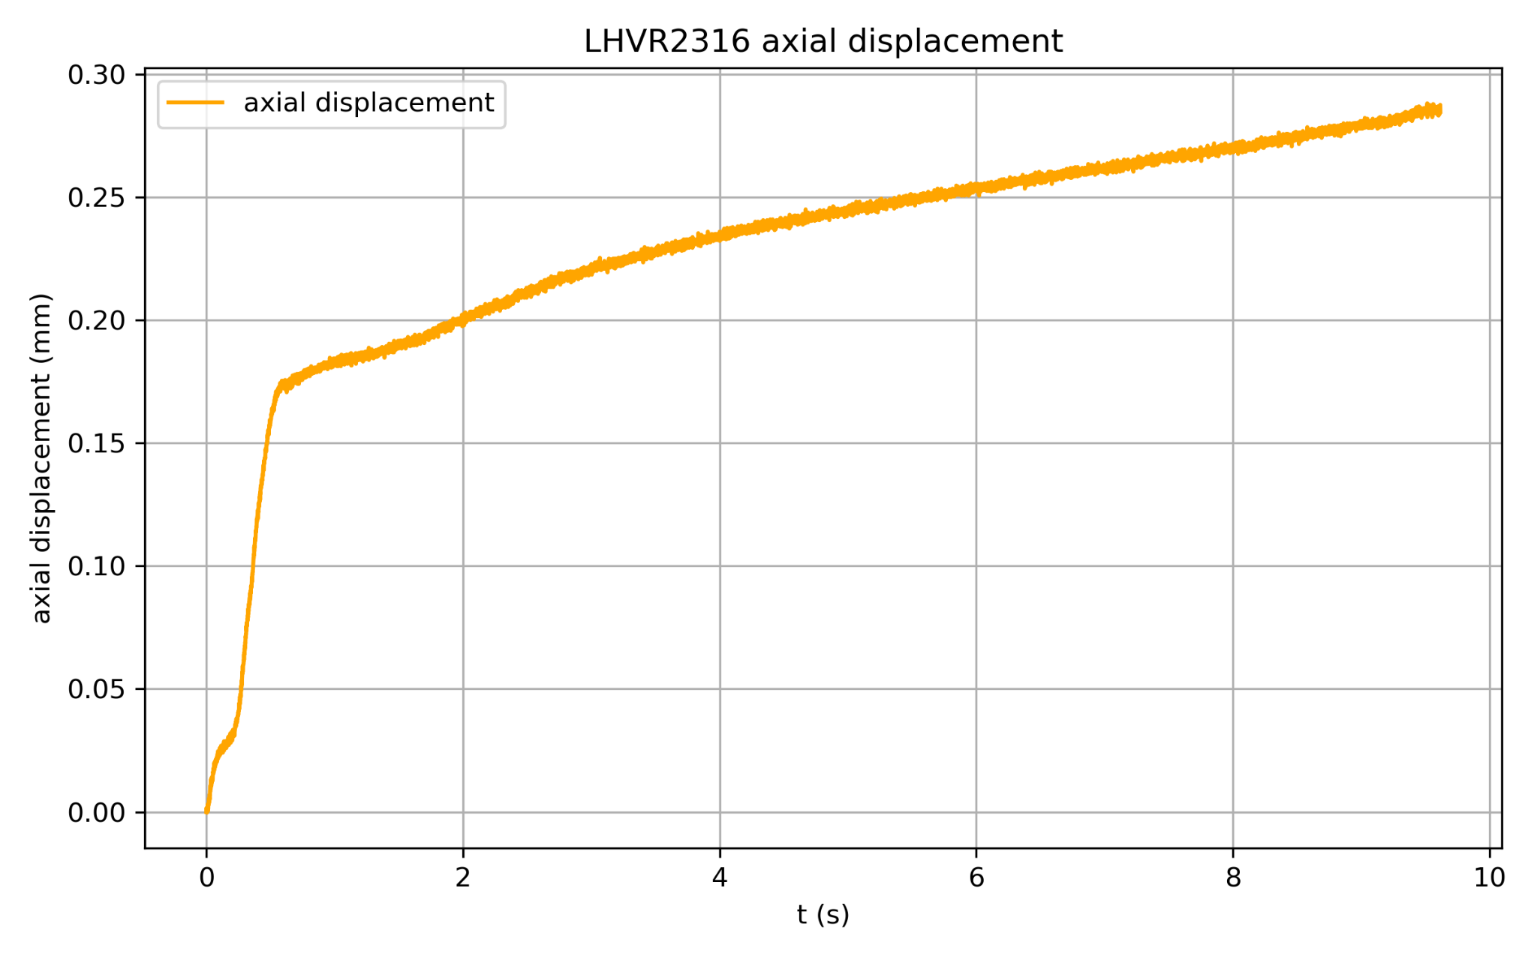
Results and discussion (mixed minerals-undrained)
Stage I : Shear-induced compaction
Larger contact area increases friction resistance
μ increased

Slide 20
Results and discussion (mixed minerals-undrained)
Stage II : Thermal pressurization
Higher T -> higher Pf
triggered thermal pressurization
μ decreased
Effective normal stress

Slide 21
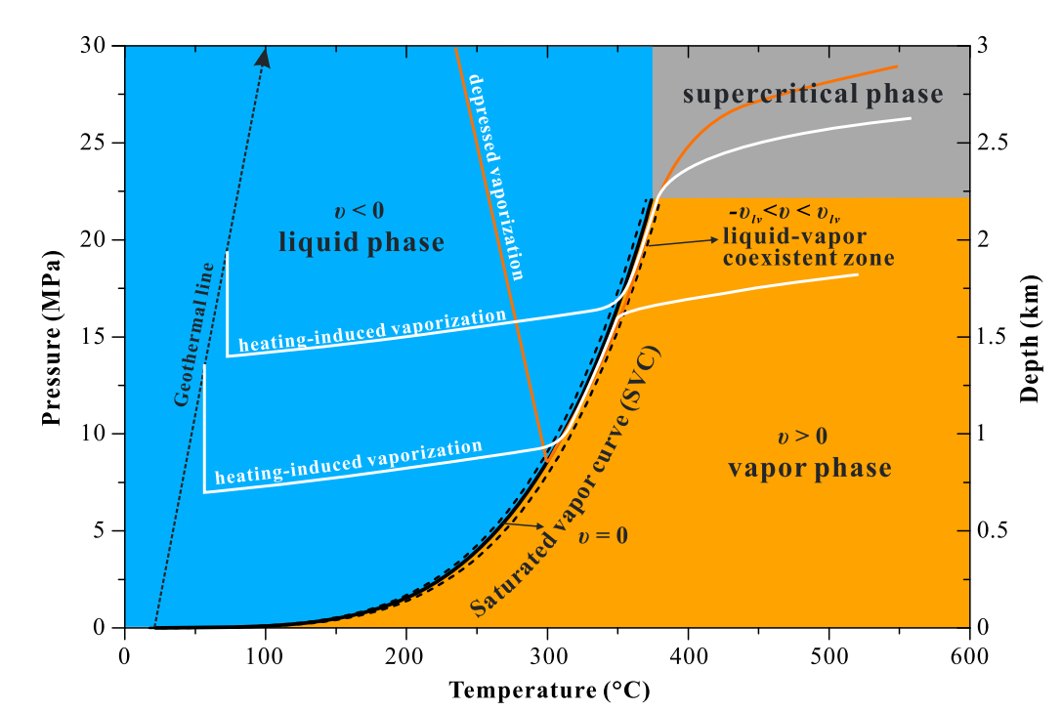
Results and discussion (mixed minerals-undrained)
Stage III : Temperature buffering
pore fluid undergoes a phase change from fluid to gas, it absorbs heat energy
limited further temperature rise

Slide 22
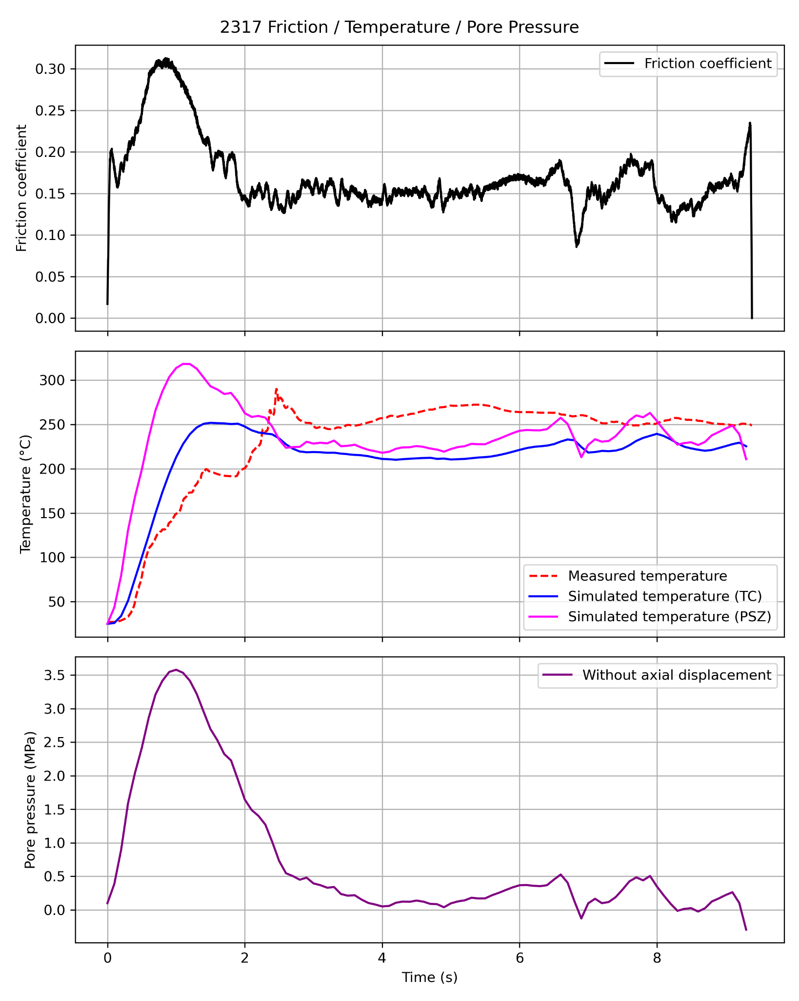
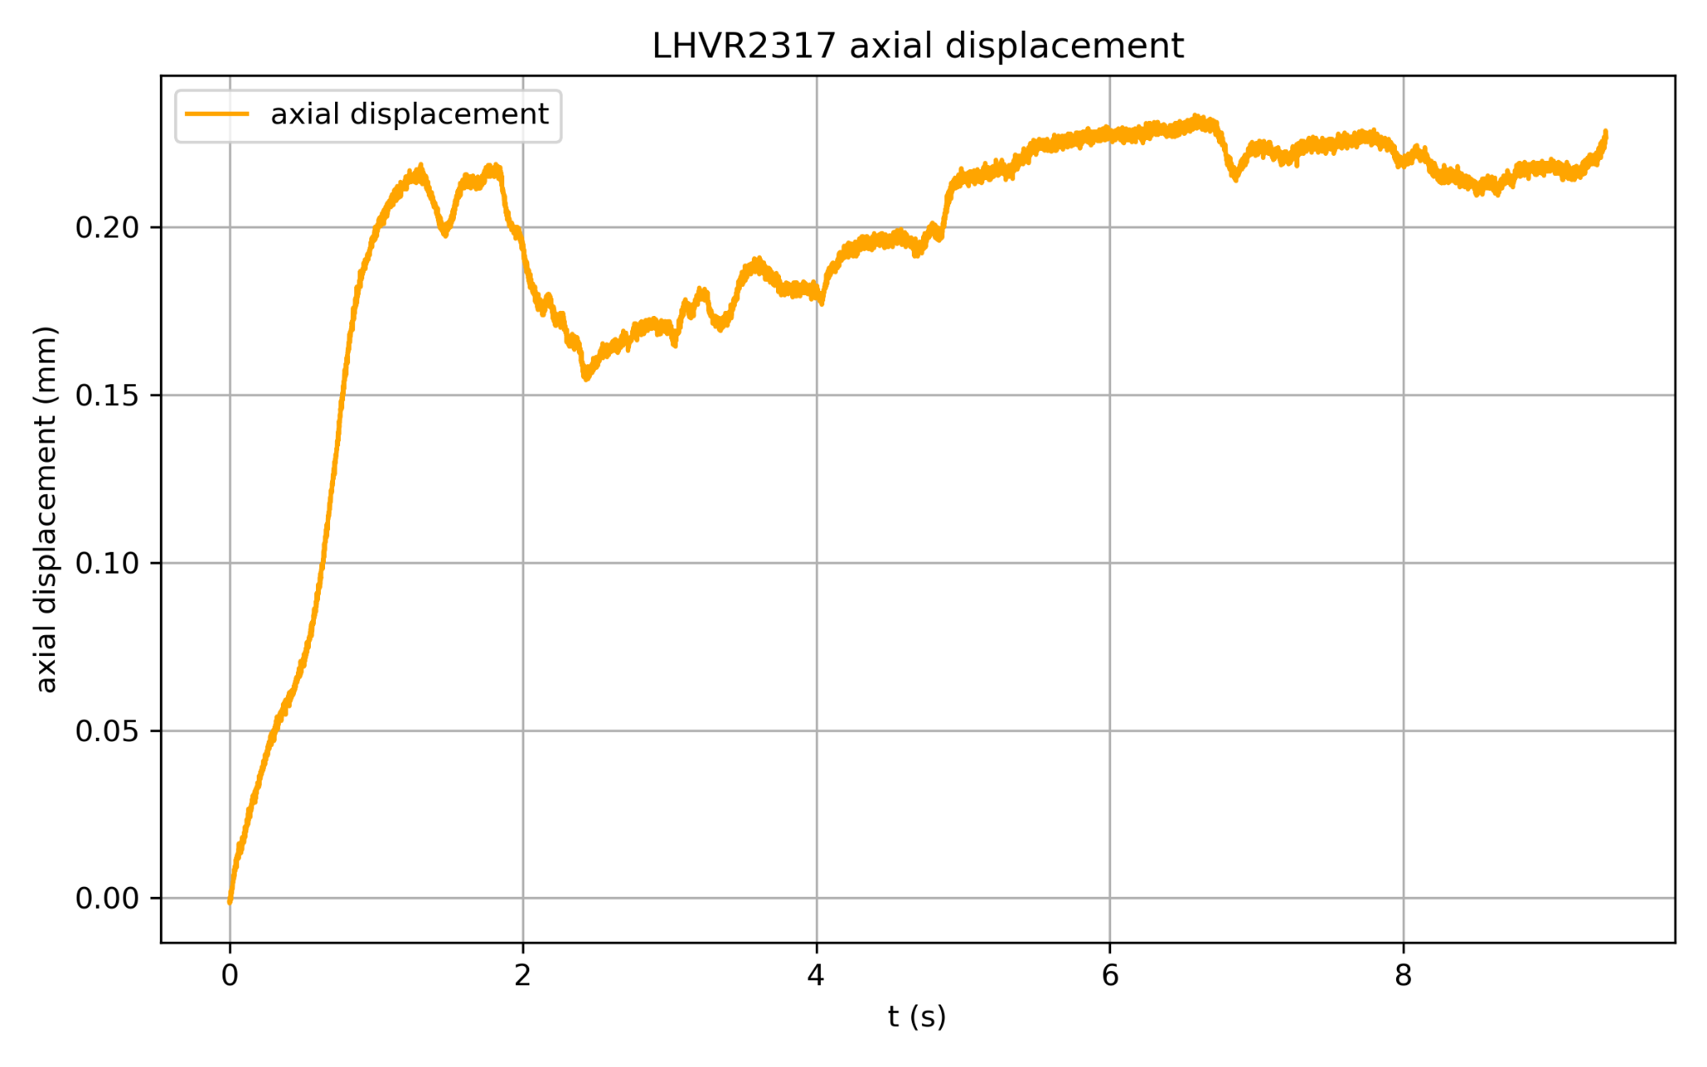
Results and discussion (mixed minerals-drained)
Stage I : Shear-induced compaction
Larger contact area increases friction resistance
μ increased

Slide 23
Results and discussion (mixed minerals-drained)
Stage II : Thermal pressurization
Higher T -> higher Pf
triggered thermal pressurization
μ decreased

Slide 24
Results and discussion (mixed minerals-drained)
Stage III : Thermal decomposition

Slide 25
Results and discussion (mixed minerals-drained)
Stage III : Thermal decomposition
Kaolinite + Illite + Quartz
Different Thermal decomposition temperature ranges
complex pulse characteristics of the later stage of slip

Slide 26


Discussion: Mass source (Hydraulic ＆ Mechanical)
Derived from Rice (2006)
Rice (2006)
TP coefficient

Slide 27
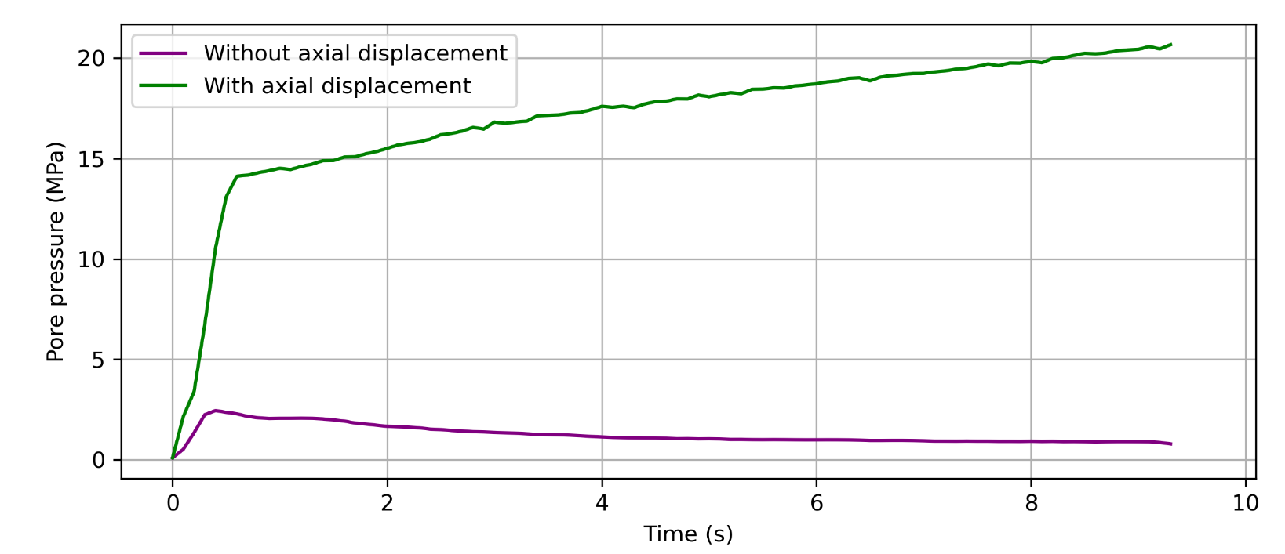
Undrained condition

Slide 28
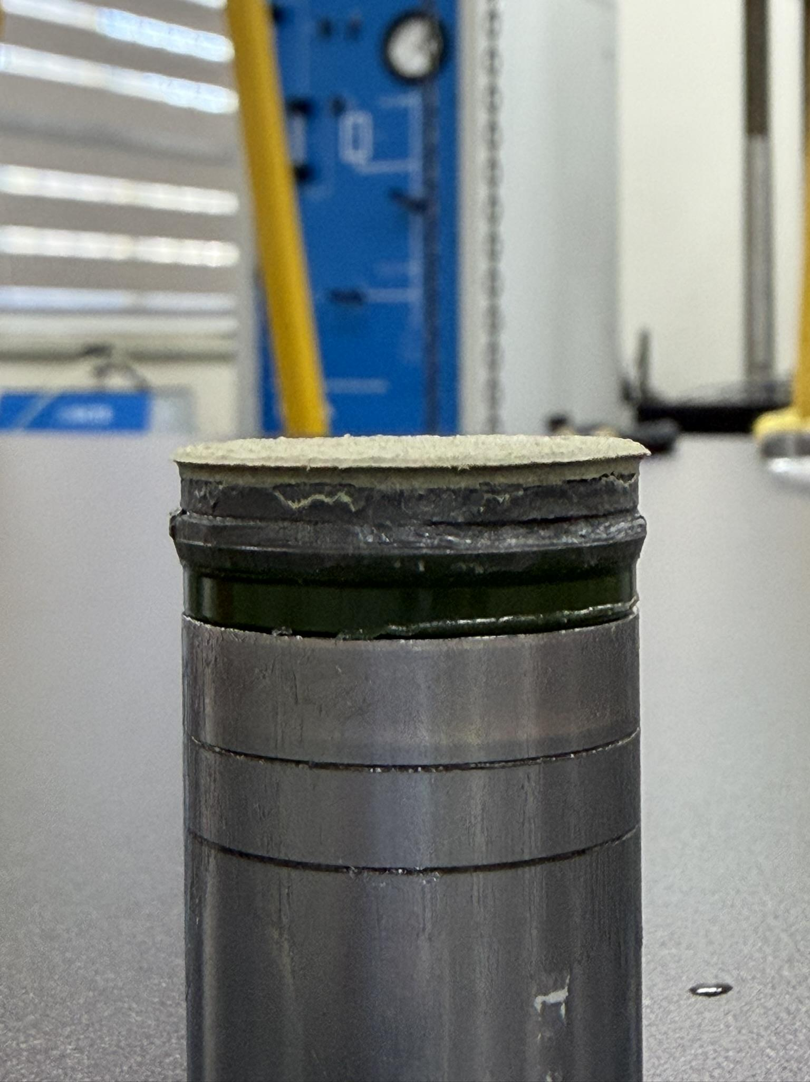
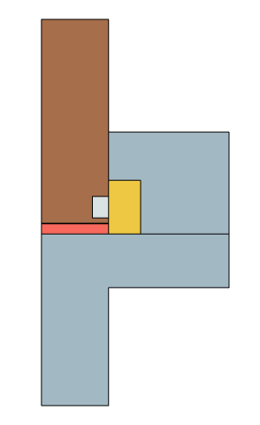
Undrained condition
Fake compaction value
Photo provided by 李孟沁
extrusion
gouge extrusion during slip
Abnormal compaction displacement value
Overestimating the displacement during compaction leads to an overestimation of the reduction in porosity.

Slide 29
Conclusion
Reconstructed unmeasurable T and Pf evolution within PSZ at the experimental scale.
The results of T and simulated Pf inferred that the main weakening mechanism of saturated fault gouge is thermal pressurization.
There is a strong correlation between frictional restrengthening and endothermic reaction of clay mineral thermal decomposition under drained condition.

Slide 30
Future work
If the problem of axial displacement can be overcome, the mechanical effects can be considered more comprehensively.
1. Develop a dynamic porosity evolution equation that simultaneously describes shear expansion and slurry loss to address numerical instabilities under undrained conditions.
2. Consider more complex solid-state mechanical fields to simulate the expansion of the pores, thus more accurately handling the coupling between strain and Pf.

Slide 31
References
Aretusini, S., et al. (2019). Fluidized gouges: A mechanism for low frictional strength of faults and their anomalous seismic behavior. Nature Communications. https://doi.org/10.1038/s41467-019-10504-3
Brantut, N., et al. (2011). Dehydration-induced destabilization of carbonate-bearing rocks during earthquakes. Nature. https://doi.org/10.1038/nature10284
Brantut, N., et al. (2008). Fast slip with inhibited temperature rise due to mineral dehydration: Evidence from experiments on gypsum. Geology. https://doi.org/10.1130/G25031A.1
Cardwell, R. K., et al. (1978). Frictional heating on a fault zone with finite thickness. Journal of Geophysical Research. https://doi.org/10.1029/JB083iB12p05994
Chen, J., et al. (2017). Vaporization of fault water during seismic slip. Journal of Geophysical Research: Solid Earth. https://doi.org/10.1002/2016JB013812
Di Toro, G., et al. (2011). Fault lubrication during earthquakes. Nature. https://doi.org/10.1038/nature09738
Di Toro, G., et al. (2004). Friction falls towards zero in quartz rock as slip velocity approaches seismic rates. Nature. https://doi.org/10.1038/nature02249
Di Toro, G., et al. (2006). Natural and experimental evidence of melt lubrication of faults during earthquakes. Science. https://doi.org/10.1126/science.1121012
Fuchs, S., et al. (2015). The thermal properties of sedimentary rocks: A review. The Leading Edge. https://doi.org/10.1190/tle34091107.1
Goldsby, D. L., & Tullis, T. E. (2011). Flash heating leads to low frictional strength of crustal rocks at earthquake slip rates. Science. https://doi.org/10.1126/science.1207902
Goldsby, D. L., & Tullis, T. E. (2002). Low frictional strength of quartz rocks at subseismic slip rates. Geophysical Research Letters. https://doi.org/10.1029/2002GL015240
Han, R., et al. (2011). Granular nanoparticles lubricate faults during seismic slip. Geology. https://doi.org/10.1130/G31842.1
Han, R., et al. (2010). Strong velocity weakening and powder lubrication of simulated carbonate faults at seismic slip rates. Journal of Geophysical Research. https://doi.org/10.1029/2009JB006788
Han, R., et al. (2007). Ultralow friction of carbonate faults caused by thermal decomposition. Science. https://doi.org/10.1126/science.1147802

Slide 32
References
Hirose, T., & Shimamoto, T. (2005). Growth of molten zone as a mechanism of slip weakening of simulated faults in gabbro during frictional melting. Journal of Geophysical Research. https://doi.org/10.1029/2004JB003007
Kim, K.-H., et al. (2018). Assessing whether the 2017 Mw 5.4 Pohang earthquake in South Korea was an induced event. Science. https://doi.org/10.1126/science.aat6081
Kung, Y. C. (2023). Numerical modeling of thermal-hydro-mechanical-chemical processes in fault zones during seismic slip. Master's thesis, National Central University.
Kuo, L. W., et al. (2021). Frictional strength and fluidization of water-saturated kaolinite gouges at seismic slip velocities. Journal of Structural Geology. https://doi.org/10.1016/j.jsg.2020.104251
Lachenbruch, A. H. (1980). Frictional heating, fluid pressure, and the resistance to fault motion. Journal of Geophysical Research. https://doi.org/10.1029/JB085iB11p06097
Nguyen, H., et al. (2024). Thermal and pore pressure evolution in clay-rich fault gouges during high-velocity slip. Journal of Geophysical Research: Solid Earth. https://doi.org/10.1029/2023JB027640
Noda, H., & Shimamoto, T. (2005). Numerical modeling of the thermal pressurization process with a finite thickness of the slip zone. Journal of Geophysical Research. https://doi.org/10.1029/2004JB003033
Rice, J. R. (2006). Heating and weakening of faults during earthquake slip. Journal of Geophysical Research. https://doi.org/10.1029/2005JB004006
Tanikawa, W., et al. (2009). Transport properties and dynamic processes in a fault zone from samples recovered from TCDP Hole B of the Taiwan Chelungpu Fault Drilling Project. Journal of Geophysical Research. https://doi.org/10.1029/2008JB005845
Wibberley, C. A. J., & Shimamoto, T. (2005). Earthquake slip weakening and asperities explained by thermal pressurization. Nature. https://doi.org/10.1038/nature03906
Yeo, I. W., et al. (2020). Causal mechanism of injection-induced earthquakes through the Mw 5.5 Pohang earthquake case study. Nature Communications. https://doi.org/10.1038/s41467-020-14383-x

