Slide 1




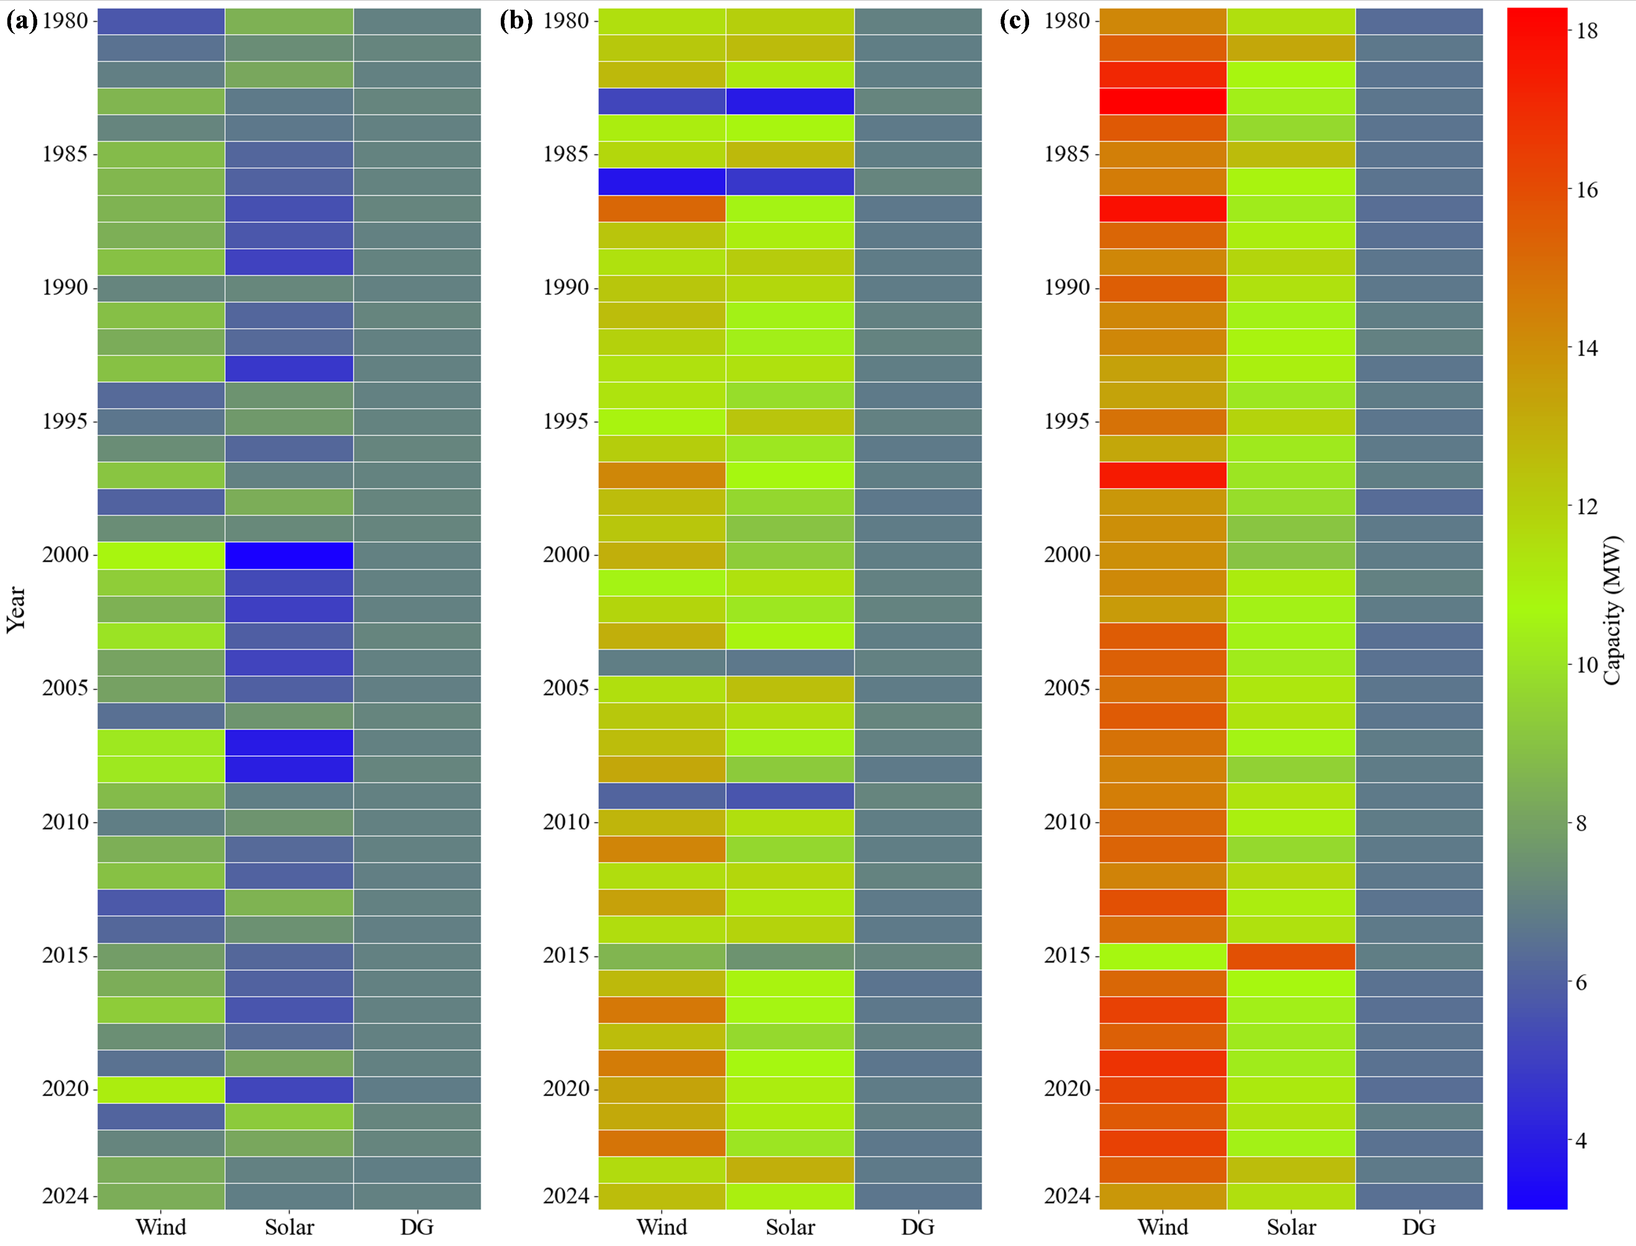
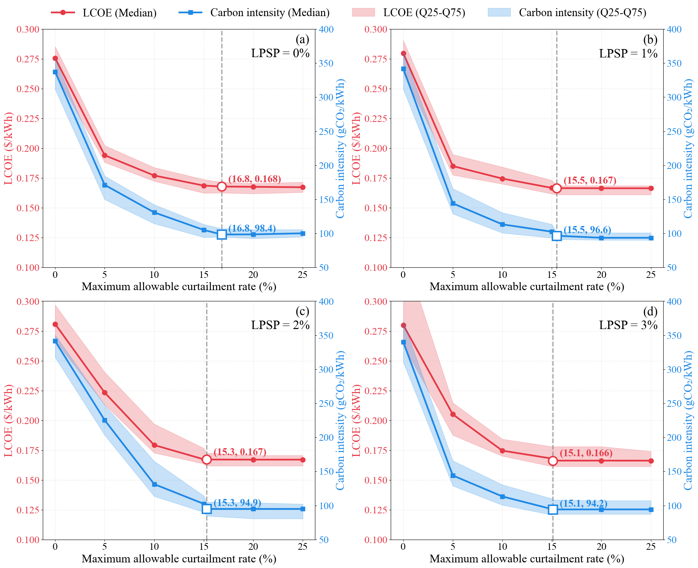

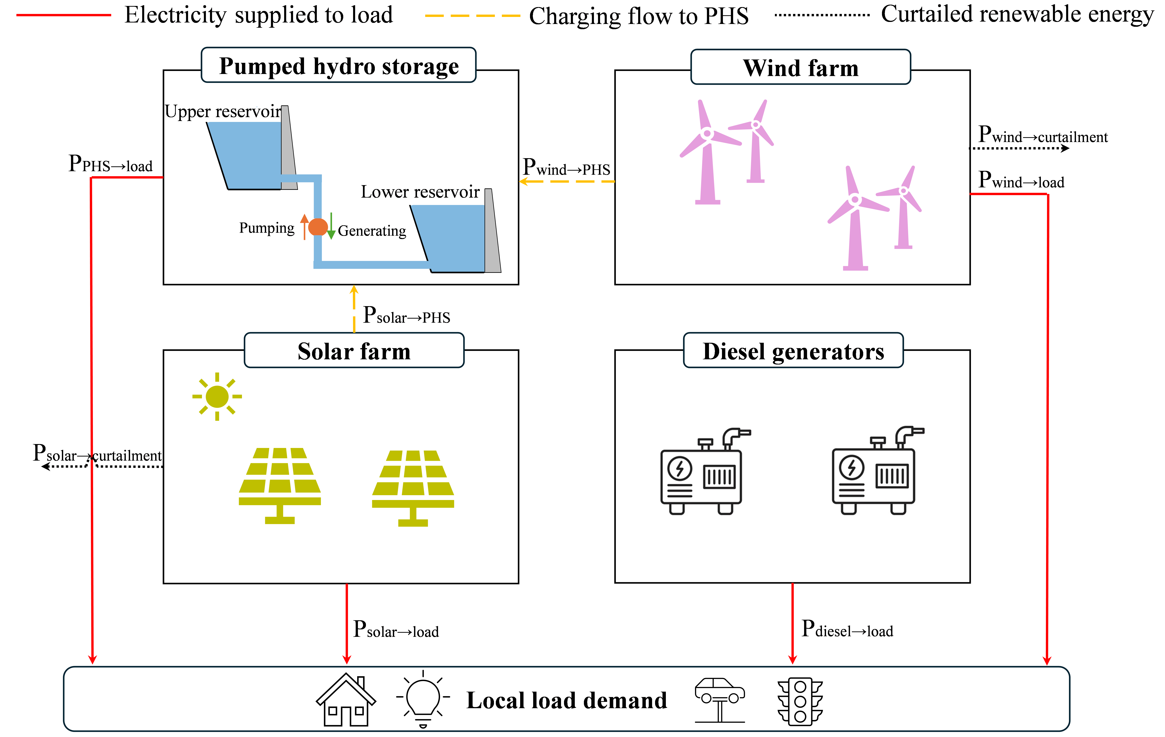
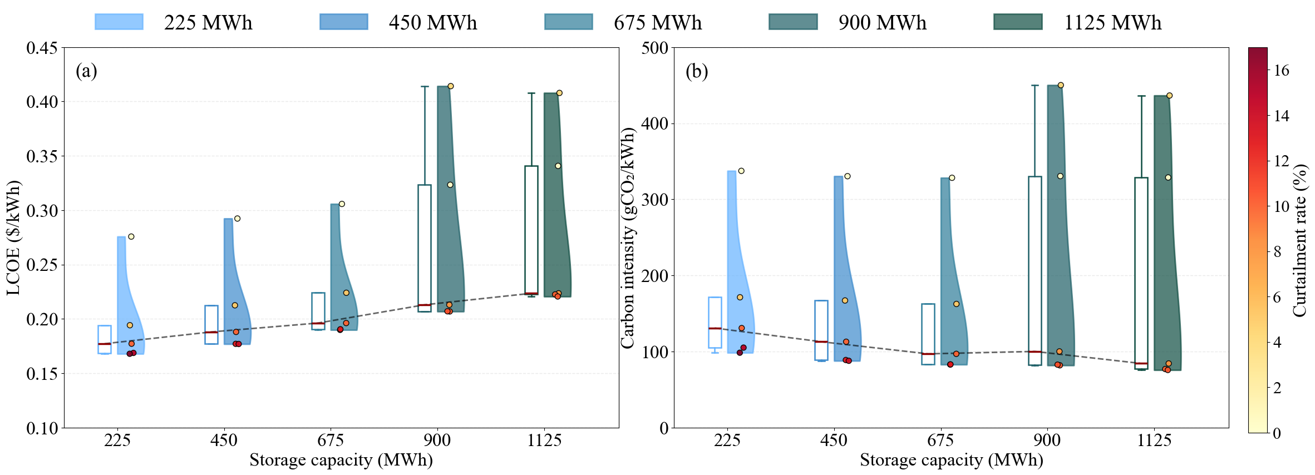
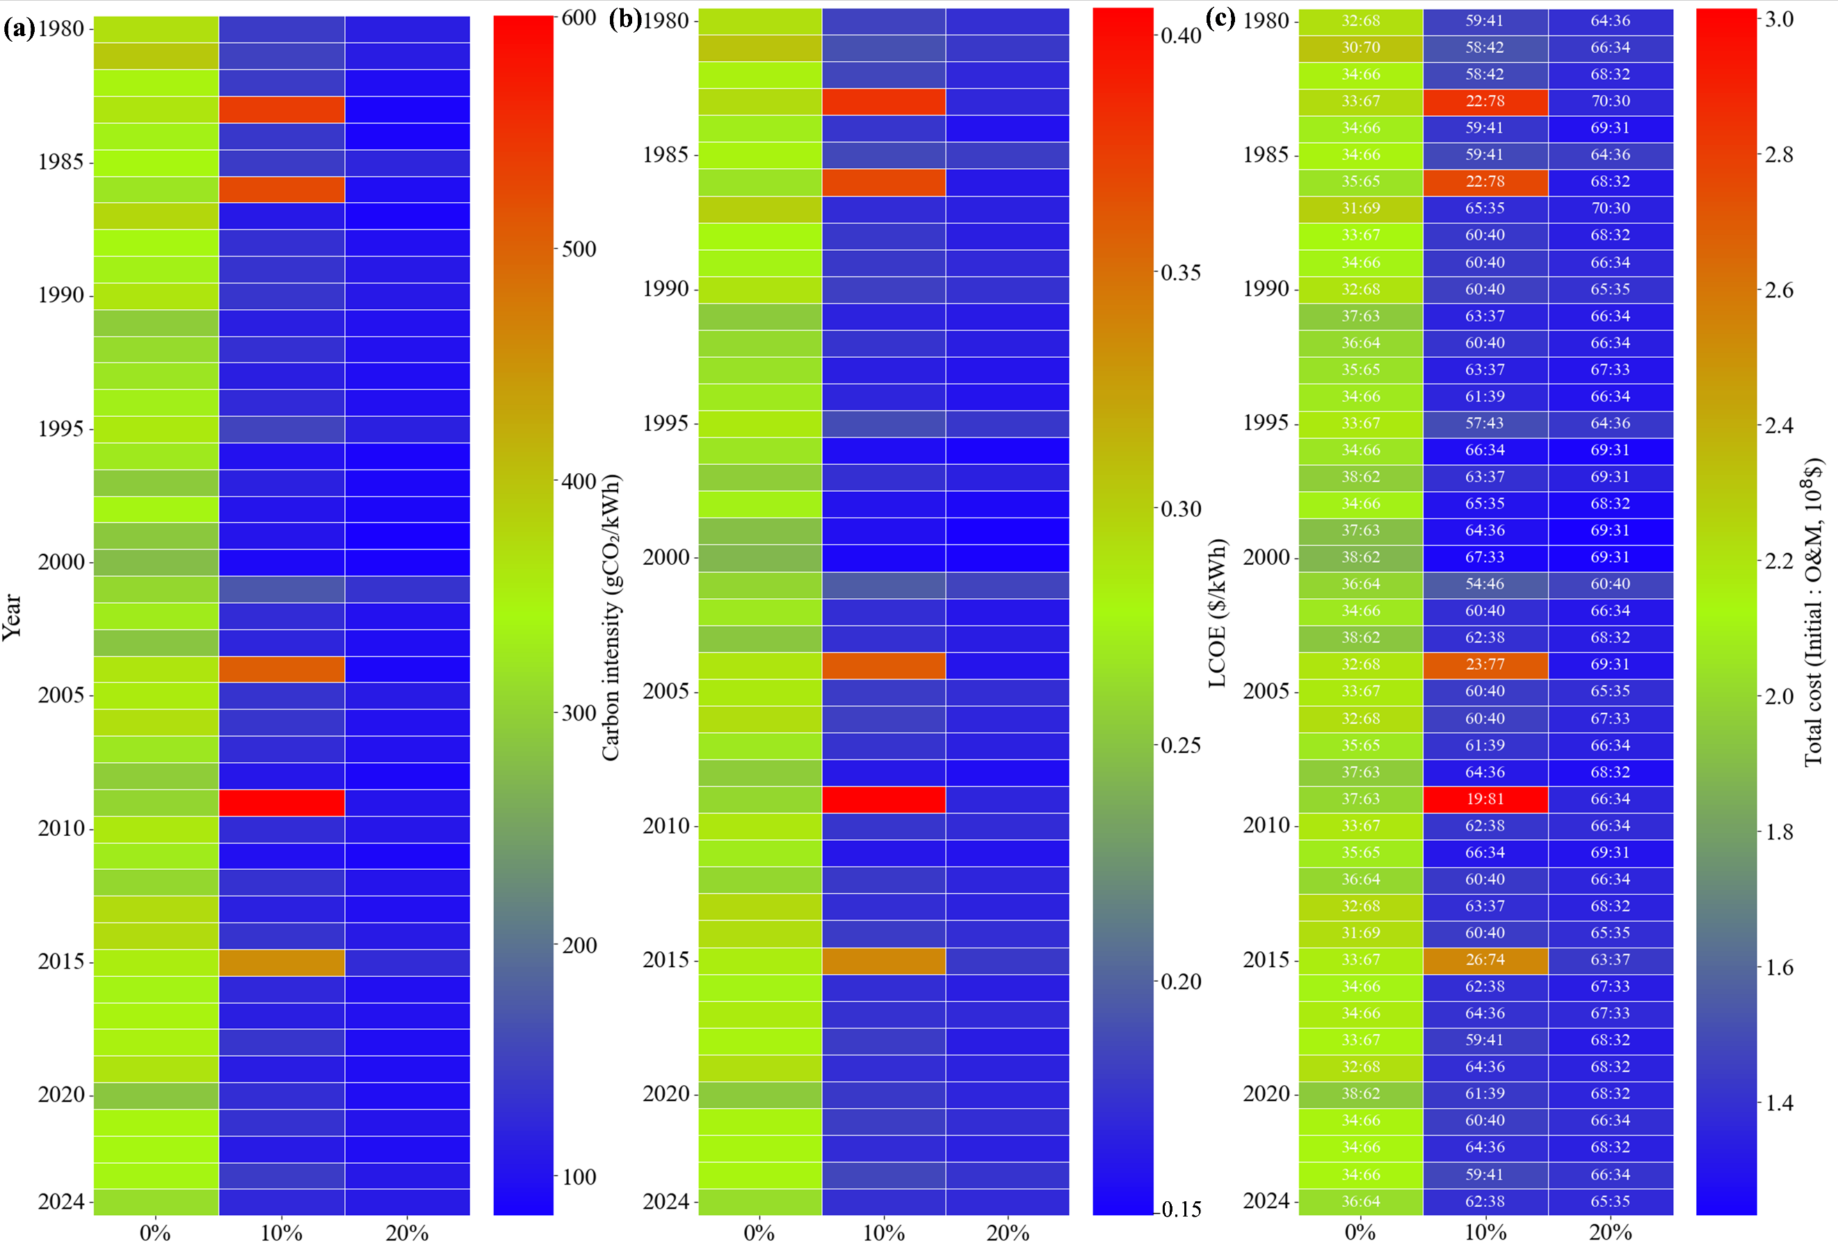
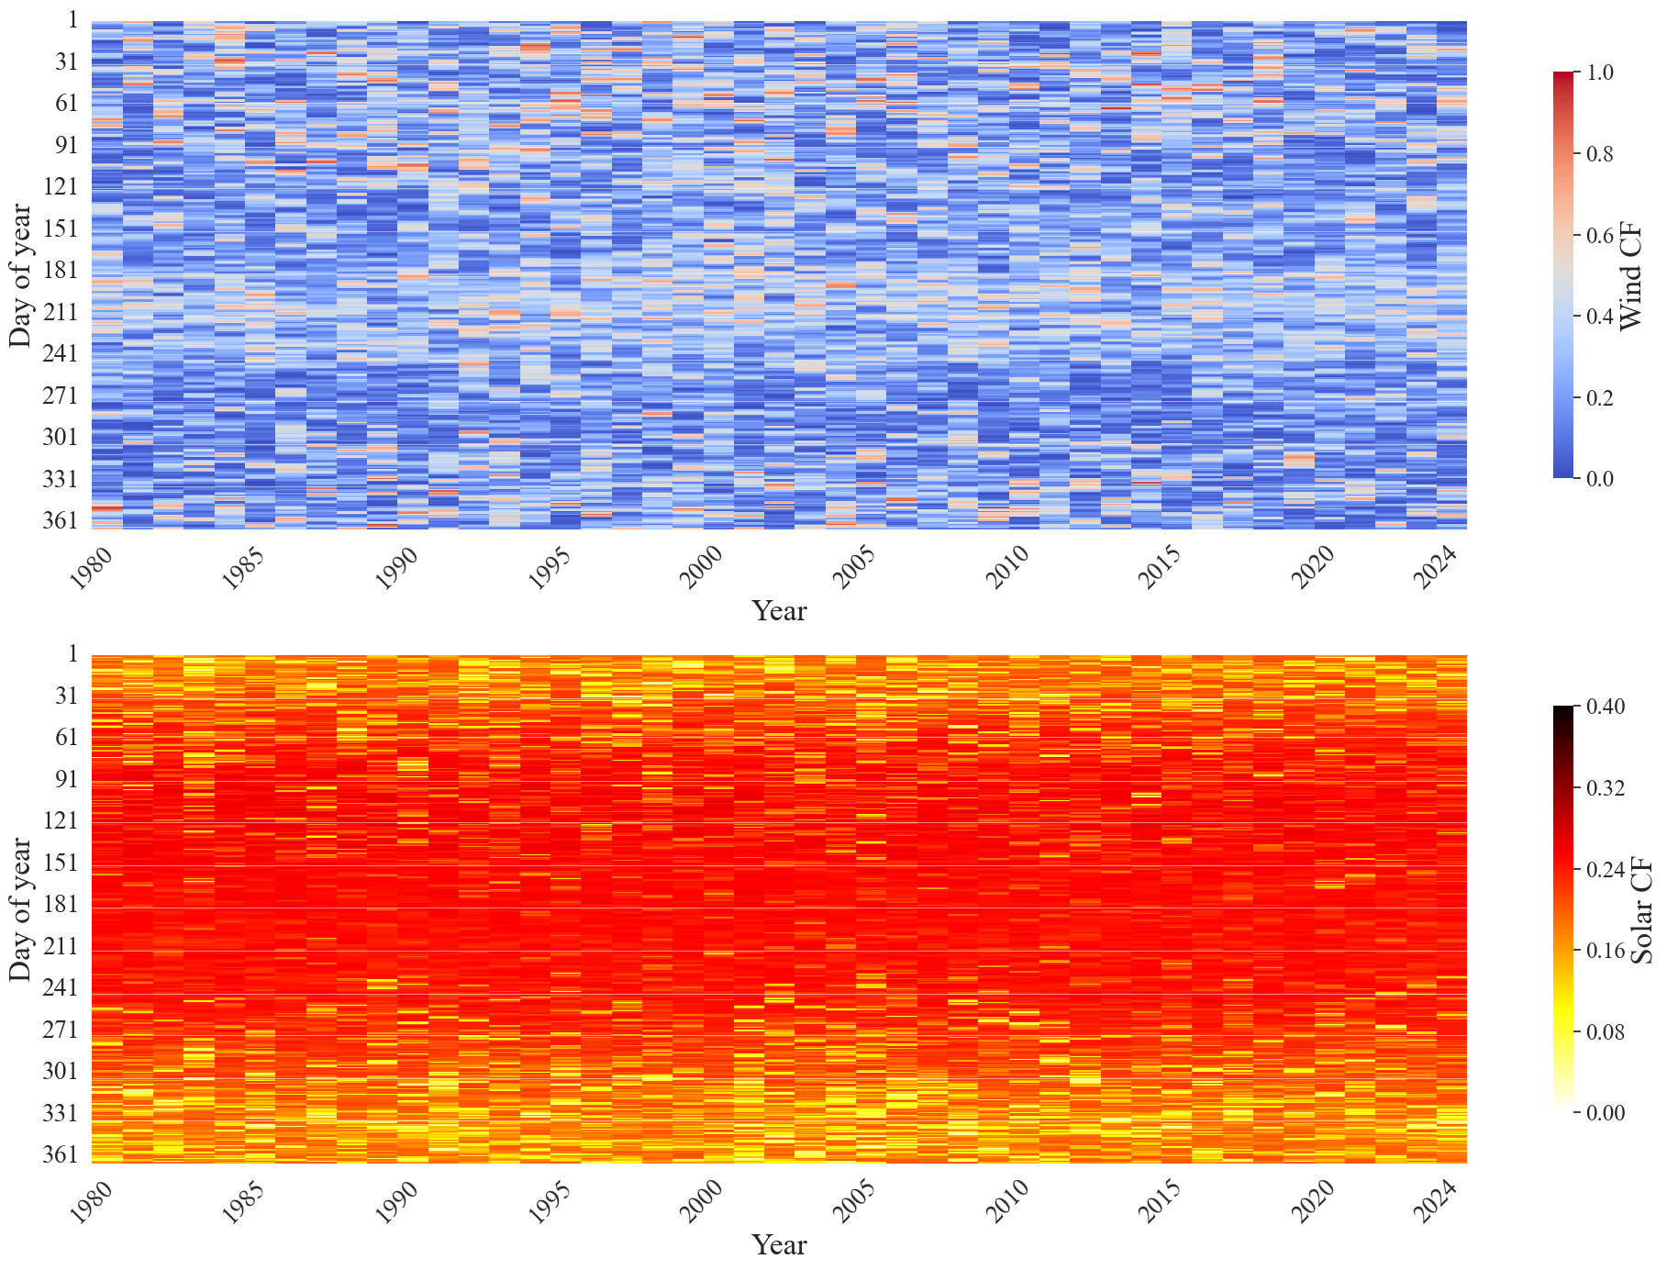
Multi–decadal climate variability and capacity planning
of off–grid hybrid renewable energy systems
Why is one weather year not enough for robust hybrid energy system design?
Acknowledgements:
The results reported here were obtained as part of project no. 2022/47/B/ST8/01113 funded by the Polish National Science Centre (Narodowe Centrum Nauki).
Scan for abstract
Yuting Cui¹ , Jakub Jurasz¹
¹Faculty of Environmental Engineering, Wroclaw University of Science and Technology, 50–377 Wroclaw, Poland
1. Introduction and research goal
4. Weather variability reshapes capacity planning and performance
5. Moderate curtailment captures most benefits
Off–grid hybrid systems are key to low–carbon electricity supply in remote areas.
Many planning studies rely on single–year renewable resource inputs, which can hide weather–driven planning bias.
We use 45 years of hourly wind and solar data to quantify capacity variability, curtailment marginal effects, and storage cost–emission trade–offs.
(a) 0% curtailment scenario
(b) 10% curtailment scenario
(c) 20% curtailment scenario
2. System and annual optimization setup
Fig. 5. Median LCOE and carbon intensity response to curtailment
Most cost–emission gains occur before about 15–20% allowable curtailment.
6. Storage expansion shifts the cost–emission balance
Fig. 1. Off–grid solar–wind–diesel–pumped hydro storage (PHS) system
Fig. 3. Annual optimal capacities under 0%, 10%, and 20% curtailment limits
Annual model co-optimizes wind, solar, diesel generators(DG), and PHS capacities.
Objective function: minimize the levelized cost of electricity (LCOE).
Wind and solar capacities vary across weather years; DG remains comparatively stable.
Relaxed curtailment enables larger renewable capacities.
3. Forty–five years of renewable resource variability
Day of year
Wind capacity factor
Day of year
Solar capacity factor
Fig. 2. Daily wind and solar capacity factors over 1980–2024
curtailment
curtailment
curtailment
Fig. 6. LCOE and carbon intensity distributions across PHS storage capacities
Wind and solar resources both show clear inter–annual variability.
Wind is more irregular, while solar is more seasonally structured.
Fig. 4. Inter–annual variation in carbon intensity, LCOE, and cost structure
Larger PHS lowers carbon intensity but raises LCOE.
Relaxed curtailment lowers LCOE and carbon intensity, but adverse weather years remain visible.
Further PHS expansion (>675MWh) yields limited carbon intensity gains at higher LCOE.
Take–home
messages
1. Single–year planning is not robust
2. Moderate curtailment captures most of the benefit
3. Storage expansion creates a cost–emission trade–off
Optimal capacities and performance vary widely across weather years. Multi–decadal assessment is essential.
Relaxing the curtailment to 15–20% captures most of the improvement in cost and emissions.
More storage lowers carbon intensity but raises the levelized cost of electricity. Balanced design is the key.

