Slide 1







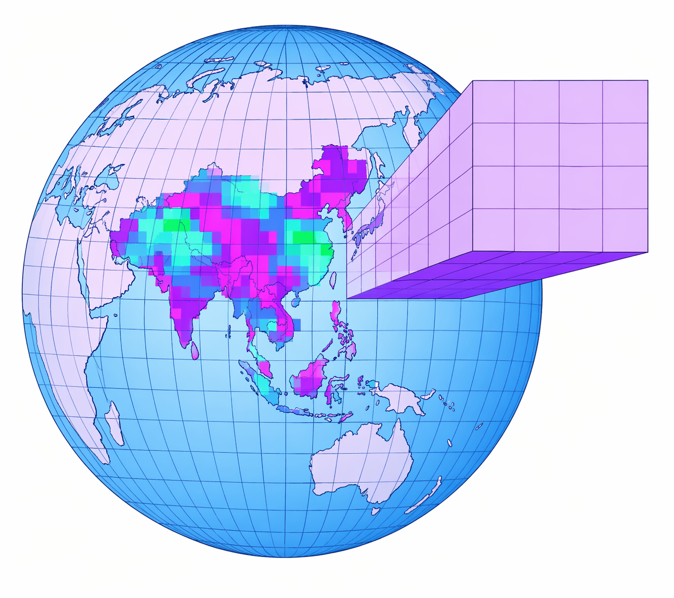

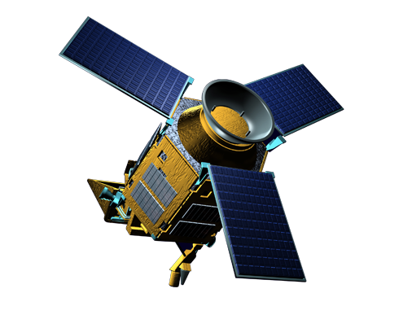























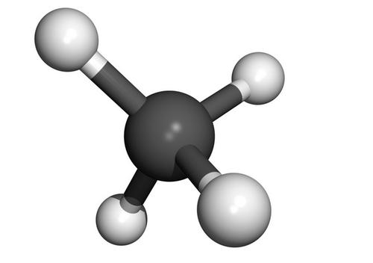
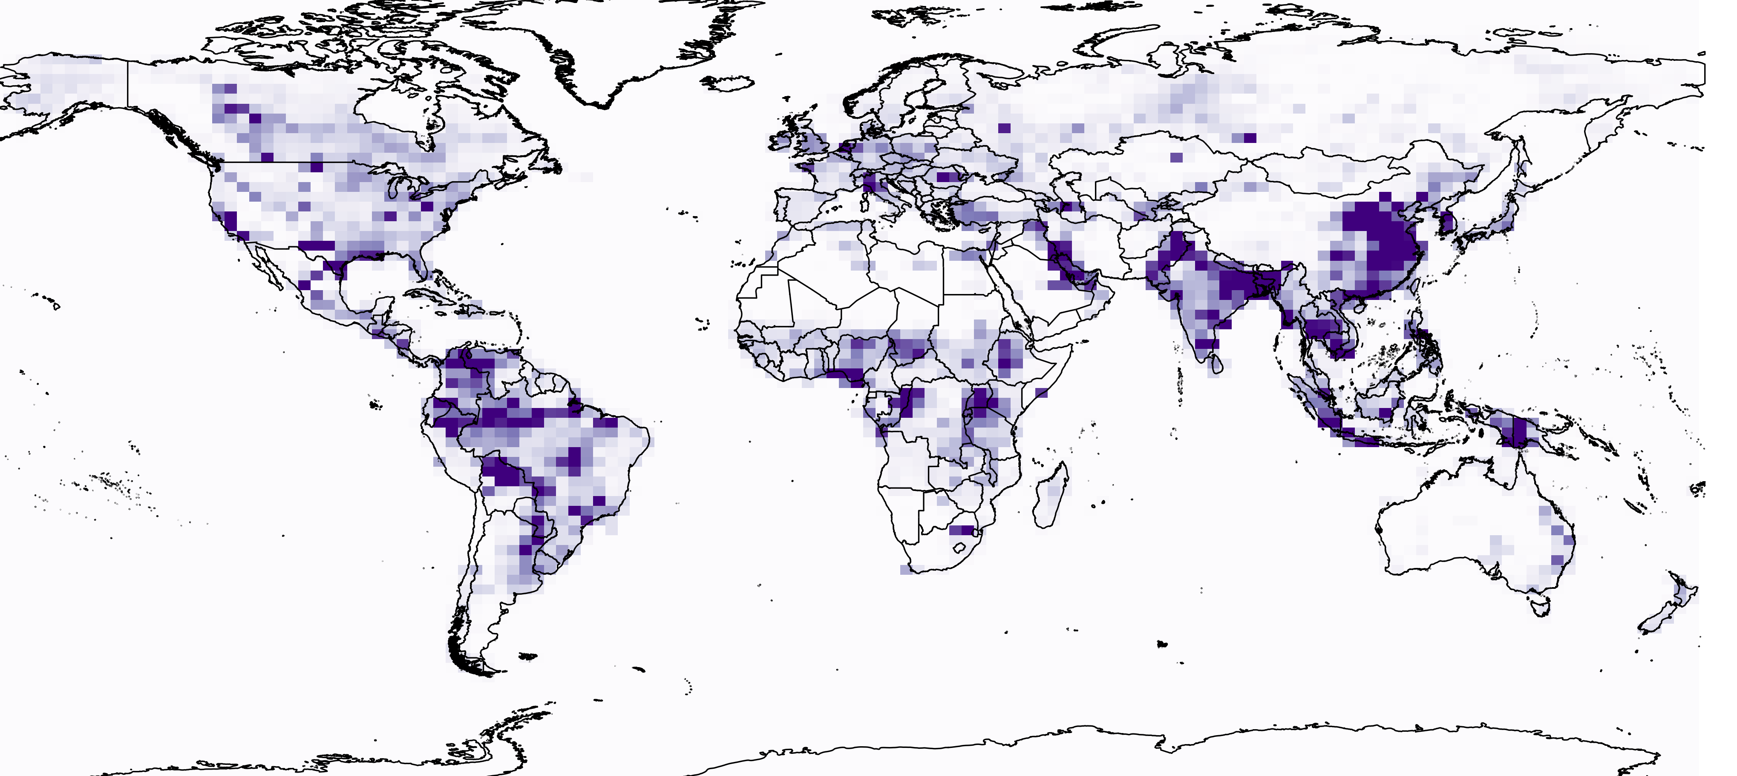
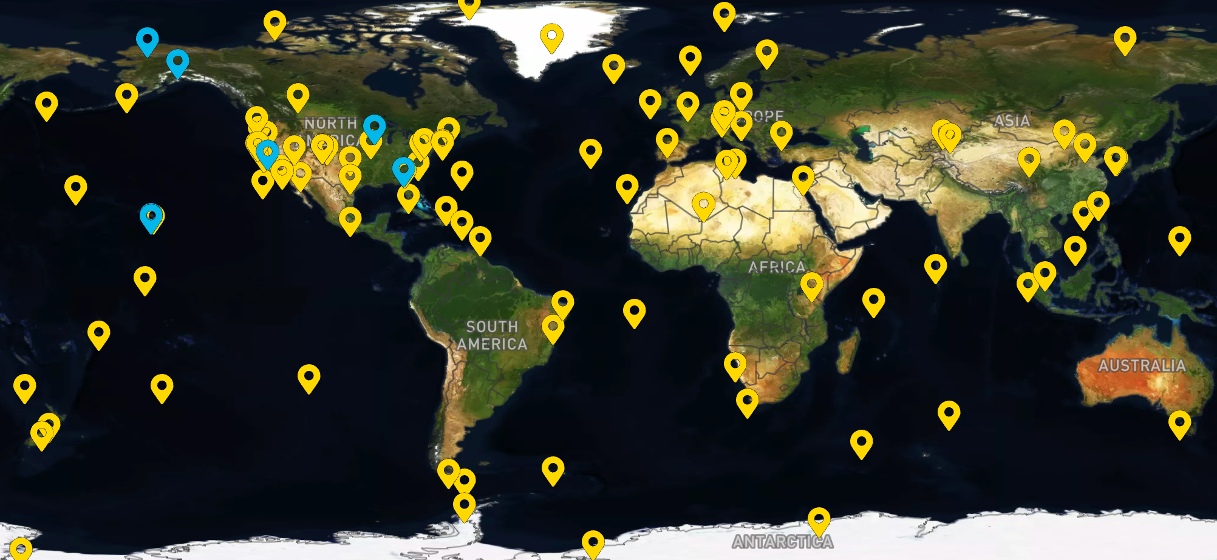
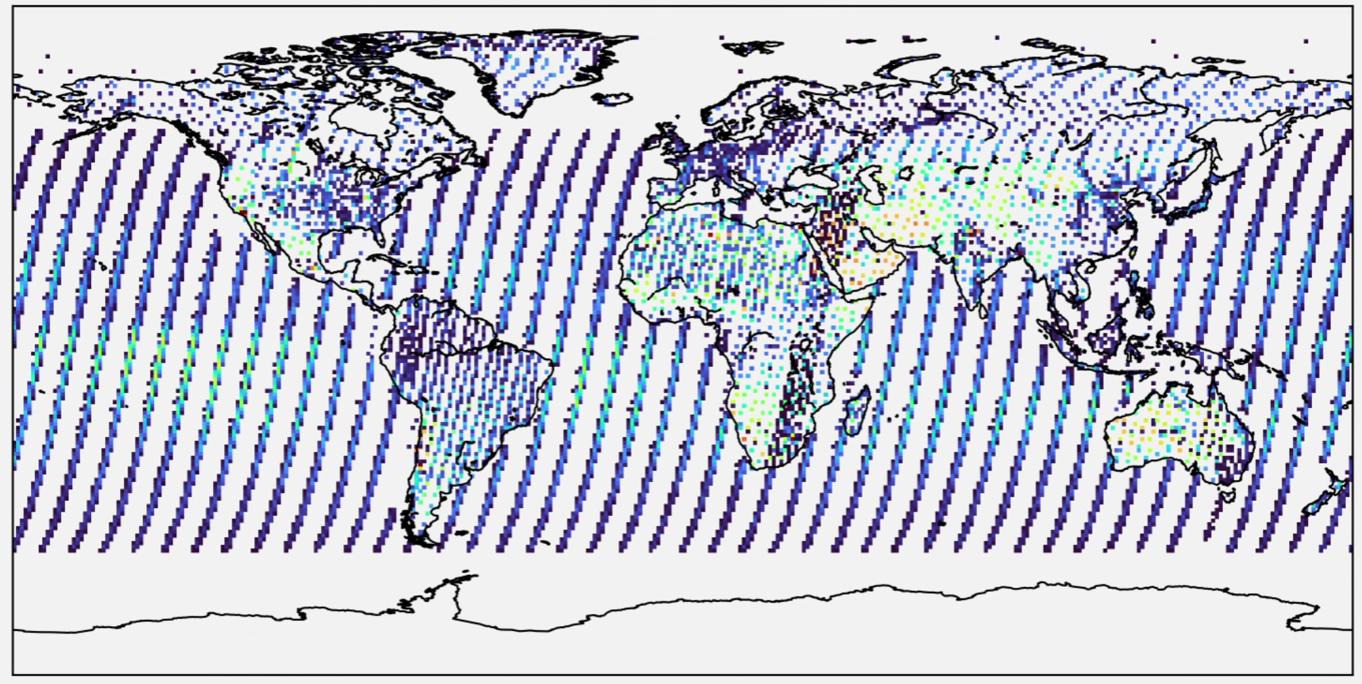

















Development and application of regional inversion systems for China:
methane emission tracking and mitigation
Yifan Li^{1,2}, Drew C. Pendergrass², Daniel J. Jacob², Yunxiao Tang², Jiaxin Qiu¹, Bo Zheng^{1*}
For further information, please contact: lyf22@mails.tsinghua.edu.cn
1 Tsinghua University, China 2 Harvard University, USA
Research motivation & Study objectives
Regional-scale methane emission inversion
Methane mitigation is critical for near-term climate control
Accurate regional estimates enable targeted mitigation
Yet current estimates remain highly uncertain and inconsistent
Ground-based inversion by collocated air pollutants
Satellite-based inversion by data assimilation
Method
Method
Observed CH₄
Weekly assimilation
LETKF algorithm
Simulated CH₄
Concentration
Emission flux
t: downwind site
b: background site
EnhC_{Gas} = Gas_{d} - Gas_{4,b}
EnhR= EnhC_{CH4} / EnhC_{CO}
τ_{gas}= 1/([OH] ∙ k_{gas})
CF = exp(t/τ_{CH4}) / exp(t /τ_{CO})
FR = EnhR ∙ CF ∙ M_{CH4}/M_{CO}
F_{CH4} = FR ∙ F_{CO,inv}
This study aims to:
Develop regional inversion frameworks
      → improve accuracy & reduce latency and cost
Apply to high-emission regions
      → quantify trends, identify drivers, and guide mitigation
CO
ΔCH₄ / ΔCO
ΔCH₄ / ΔCO
CH₄
CH₄
CO
Satellite
-based CO flux
TROPOMI
Bias-corrected
Well-mixed
Trajectory filter
Bias-corrected
boundary condition
CO
CH₄
CH₄
Optimized
posterior
(Next prior)
IterativeUpdate
Enhancement
concentration
CH₄ emissions
Prior input
Background
  Greenhouse gas with ～10-year lifetime
  Higher warming potential than CO₂
  Rapidly increasing atmospheric concentration
Downwind
Background
Applied to China
Energy
Agriculture
Waste
Wetlands
CH₄
Inconsistent sources
China’s CH₄ emissions (2000–2021)
Mean emission: 48.4 ± 13.8 Tg yr⁻¹
Emission trend: +1.1 ± 0.2 Tg yr⁻²
Socioeconomic development: +92.1 Tg
Declining Emission intensity: -78.1 Tg
Data assimilation: Local Ensemble Transform Kalman Filter
Sources:
Spatial distribution of emissions
Minimize: J(x) = (x - x^{b})^{T}(P^{b})⁻¹(x - x^{b}) + γ(y -H(x))^{T}R⁻¹(y - H(x))
Agriculture
& waste
Wetlands &
freshwater
600
State vector
(emis./conc.)
Prior error
ensemble spread
Obs.
Observation operator
maps x into observation space
Biomass burning
& biofuel
The U.S.
China
400
Fossil fuel
India
Emissions (t grid⁻¹)
Brazil
200
Applied to East Aisa
Sinks: Soil absorption / OH / Cl / ...
0
(Weekly, 0.5º × 0.625º)
Major challenges in regional inversion
China’s CH₄ emissions (2019–2024)
2019: 61.1 Tg → 2024: 66.8 Tg
Total: + 5.7 Tg & Livestock: +2.7 Tg
East 24%, South 21%, Southwest 18%
Limited observations
Complex framework
CH₄
Concentration
Observation
High-resolution
Nonlinear
Robustness & comparability: enabling long-term, large-scale inversion
Computational efficiency & transferability: applicable to observation-limited regions
Key factors:
Boudary conditions & Prior errors
Surface station
Number: 0 100 200 300 400
Model
Satellite (GOSAT)
Algorithm
Emission
Sparse and uneven spatial coverage
Discontinuous temporal coverage
Large biases and high background values
High uncertainty
Computationally expensive
Take
Home
Message
- China’s CH₄ emissions have increased by 2.3% yr⁻¹ since 2000,
driven by socioeconomic development.
- Single-site observations constrain large-scale emissions.
- A promising tool for synergistic non-co-emitted gases inversion.
- Livestock largely drives China’s CH₄ emission increase after 2019.
- We extend the global tool (CHEEREIO) to regional scales.
- Efficient LETKF enables near-real-time, high-precision, and
scalable inversion across regions.
Prior input uncertainty
High boundary errors
Meterology
Prior emissions
Atmospheric
condition
Related
Papers
Li, Y., Zheng, B.*. Tracking regional CH₄ emissions through collocated air pollution measurement: a pilot application and robustness analysis
in China. npj Climate and Atmospheric Science 2025, 8 (1), 127.
Li, Y., Pendergrass, D., Jacob, D., Tang, Y., Qiu, J., and Zheng, B.*: Shifting Drivers of China's Methane Emissions amid Economic Growth and
Mitigation between 2019–2024. EGUsphere [preprint], 2026.
Paper 1
Paper 2
Inconsistent spatiotemporal resoultion
Region
Geographical boundaries
Uncertainty with spatial heterogeneity
Notes:
https://www.egu26.eu/authors/presenters.html
1.978 m × 1.183 m

