Slide 1
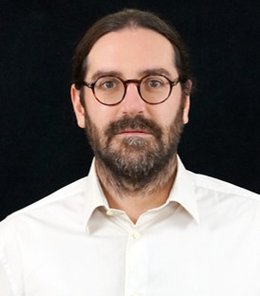





Definition of an erosion law for cohesive sediments from Gironde estuary using rheology
S. Jarny, G. Salloum, G. Gomit, L. Thomas

Slide 2
Introduction

Slide 3
Introduction
FRQ-ANR EMPHASE (Indirect effects of port and maritime activity: Hydrodynamics applied to sediment transport and the environment)
  Aims to characterise:
    bank erosion caused by shipping
    exchanges between the banks and the channel
  Objectives:
    improve scientific knowledges
    propose good practice in terms of navigation, regulation and governance.
  Targeting the Gironde estuary and the Saint-Laurent river
Characterize an erosion law for the cohesive sediment of the Gironde estuary

Slide 4
Materials and methods

Slide 5
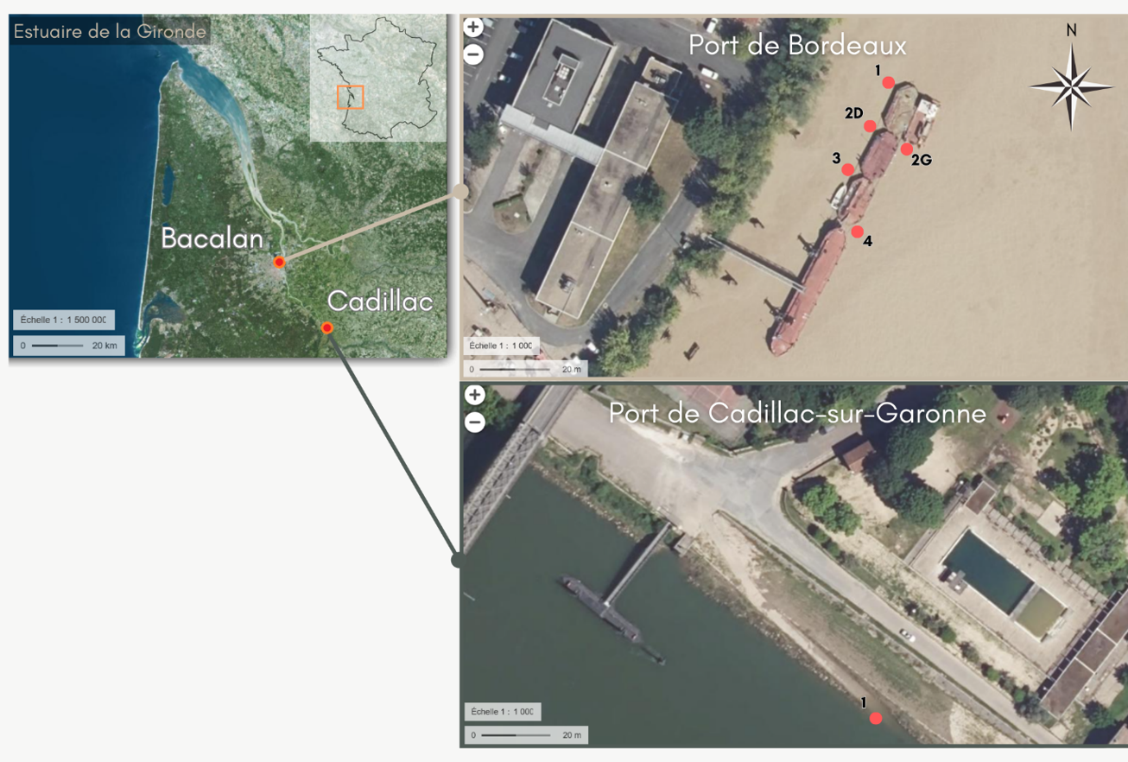
Materials
  Maps from geoportail.gouv.fr
Gironde estuary
Bacalan – Bordeaux harbour
Cadillac – Cadillac-sur-Garonne harbour
  2 study locations: Bordeaux harbour (Bacalan) and Cadillac-sur-Garonne harbour (Cadillac)
  Muddy sediments are sampled with a Van Veen grab for Bordeaux area and directly scooped up at low tide for Cadillac area
  Results from the Cadillac site only

Slide 6
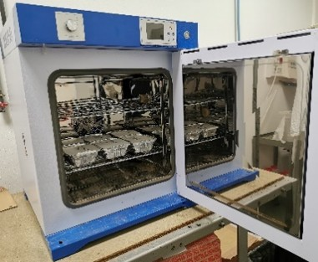
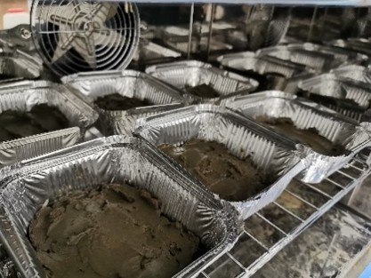
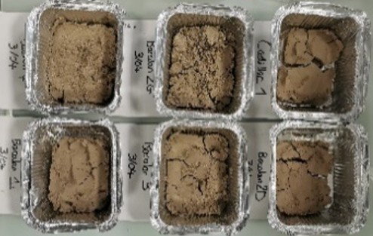
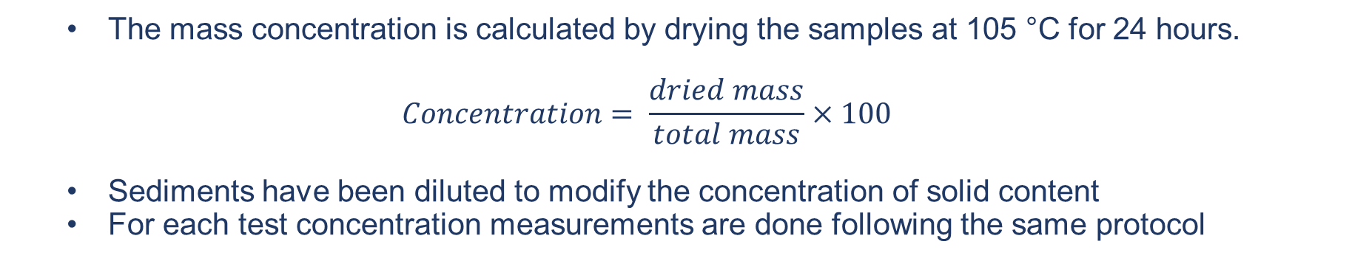
Concentration
  The mass concentration is calculated by drying the samples at 105 °C for 24 hours.
  $$Concentration= \frac{dried mass}{total mass}×100$$
  Sediments have been diluted to modify the concentration of solid content
  For each test concentration measurements are done following the same protocol
  Drying oven
  Diluted sediment
  Dried sediment

Slide 7
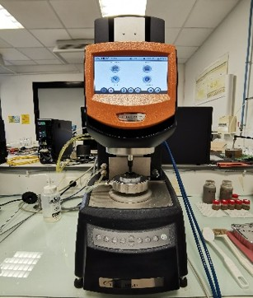
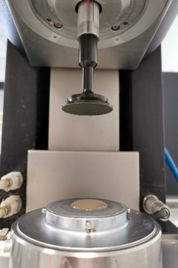
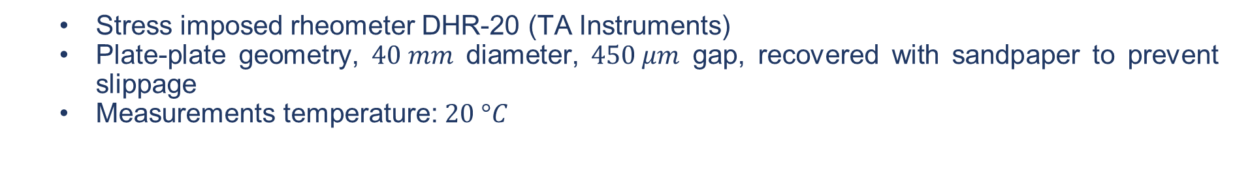
Rheological tests
  Stress imposed rheometer DHR-20 (TA Instruments)
  Plate-plate geometry, $40 mm$ diameter, $450 μm$ gap, recovered with sandpaper to prevent slippage
  Measurements temperature: $20 °C$
  DHR-20 rheometer
  Plate-plate geometry

Slide 8
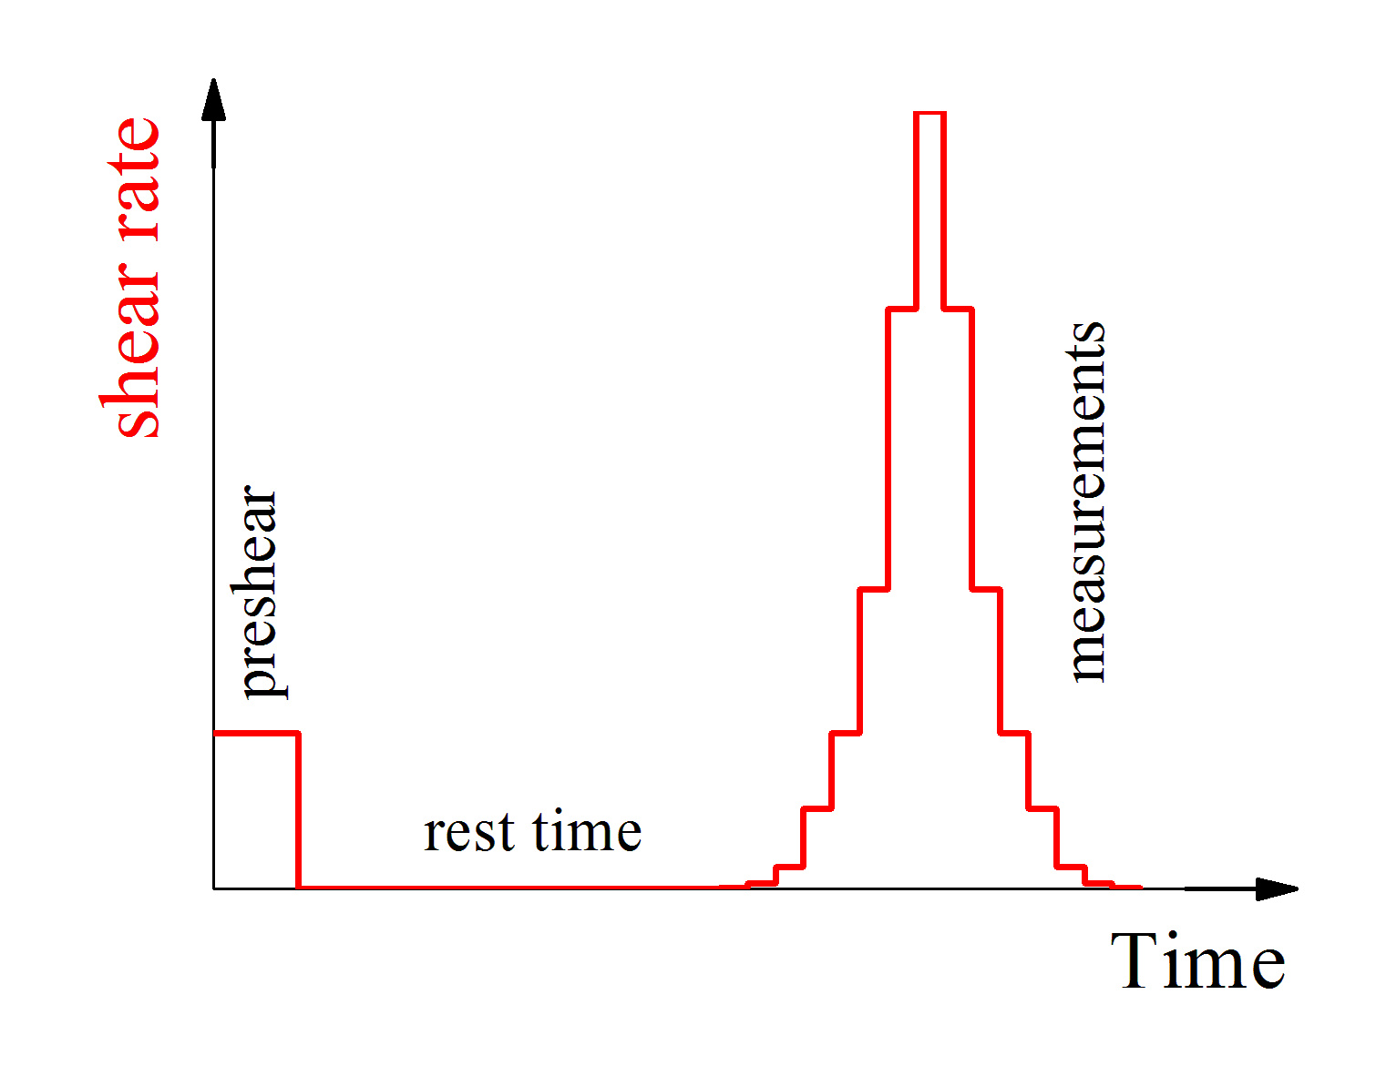
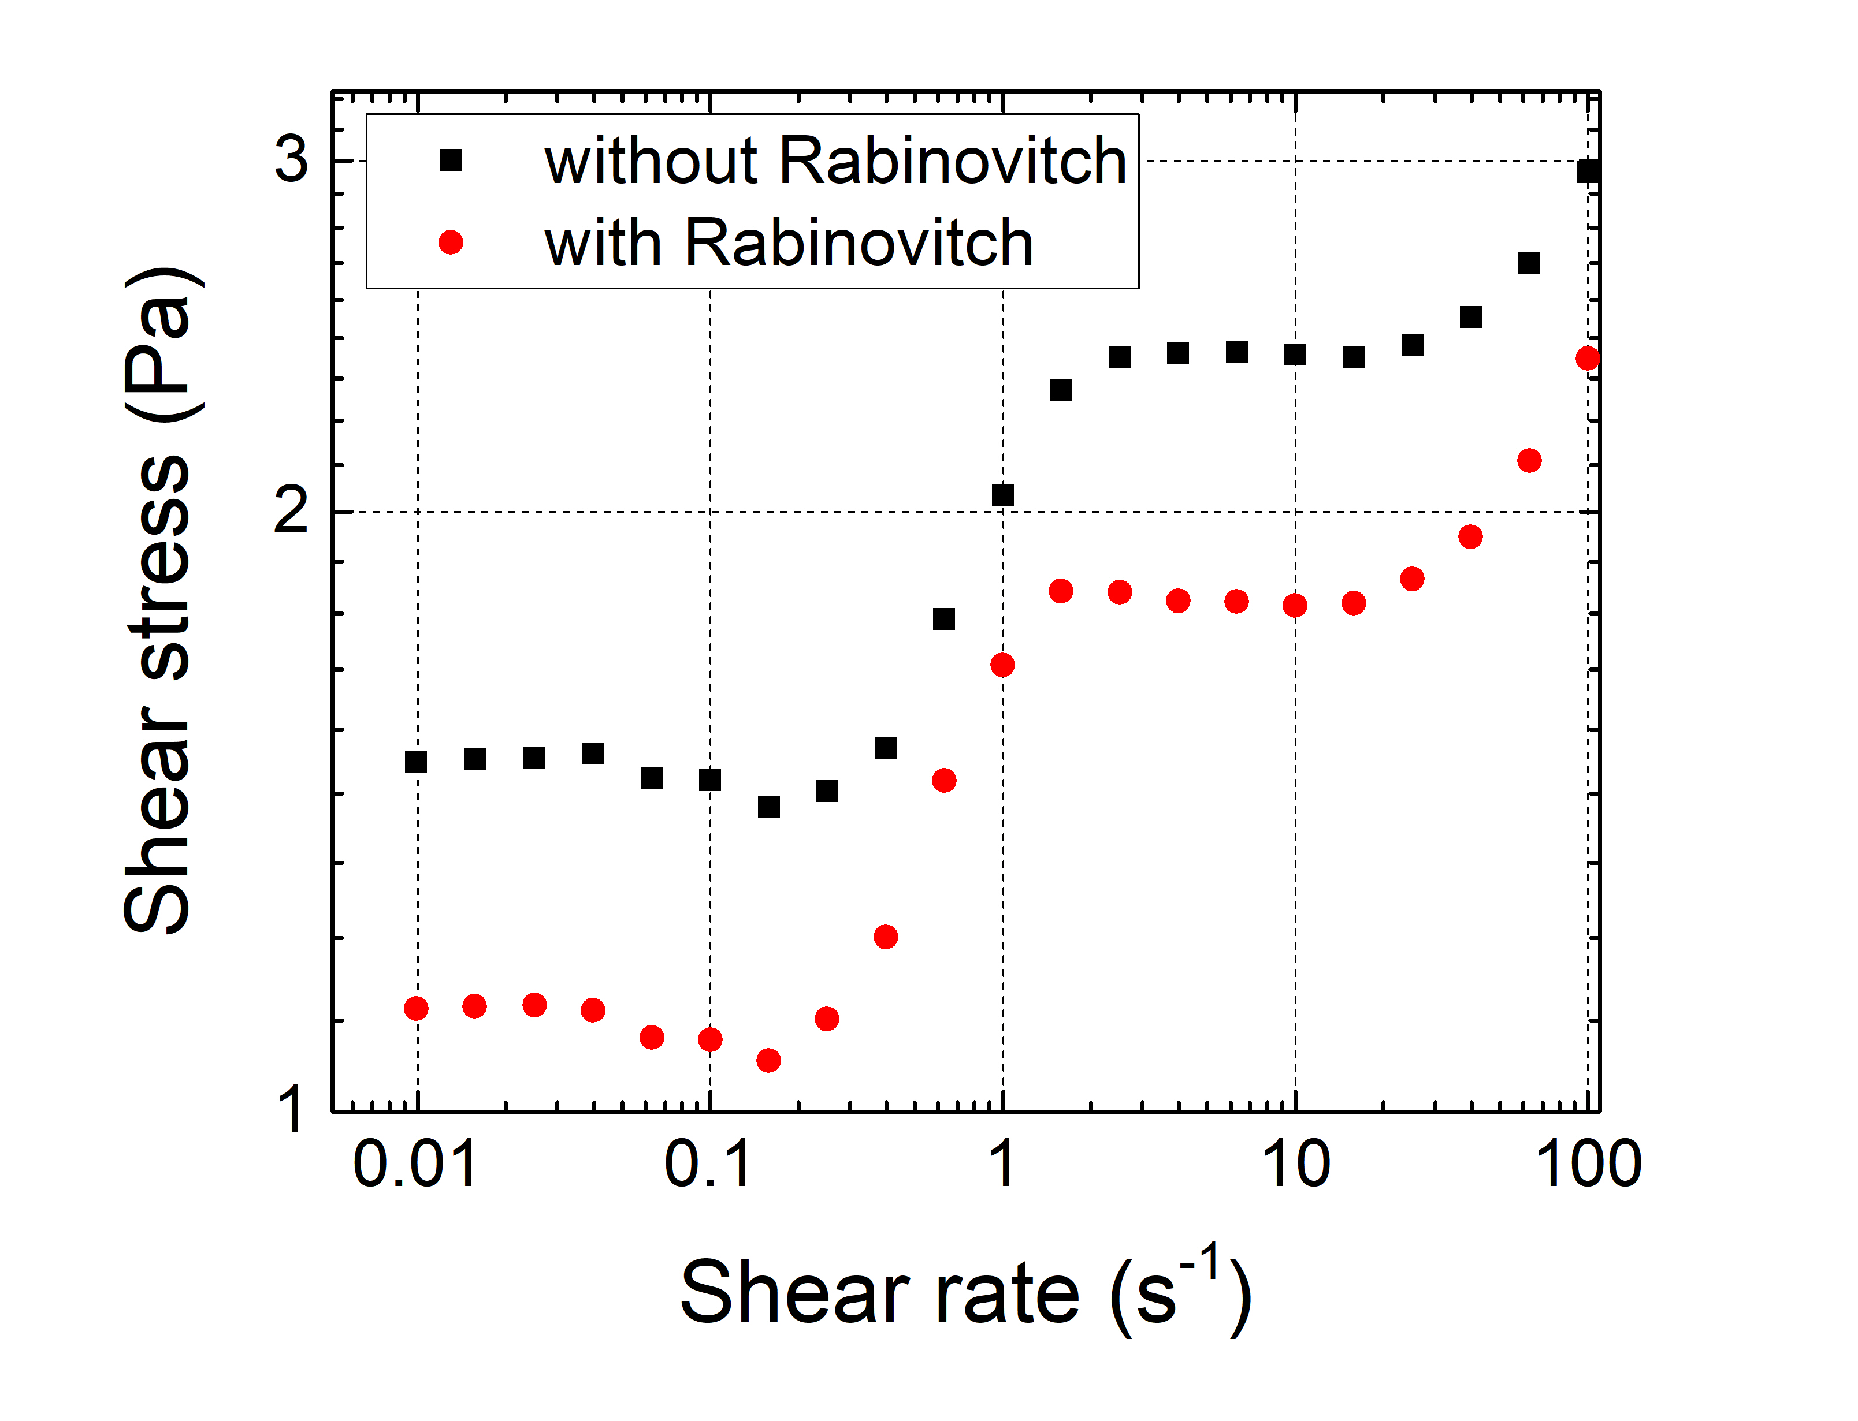
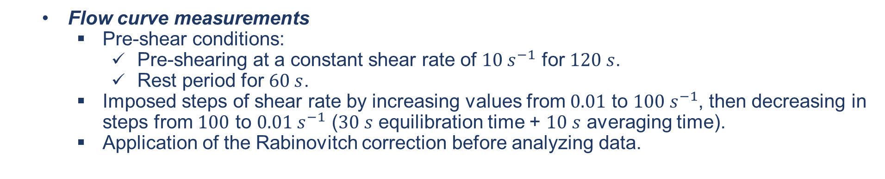
Rheological tests
  Flow curve measurements
    Pre-shear conditions:
      Pre-shearing at a constant shear rate of $10 s^{−1}$ for $120 s$.
      Rest period for $60 s$.
    Imposed steps of shear rate by increasing values from $0.01$ to $100 s^{−1}$, then decreasing in steps from $100$ to $0.01 s^{−1}$ ($30 s$ equilibration time + $10 s$ averaging time).
    Application of the Rabinovitch correction before analyzing data.

Slide 9
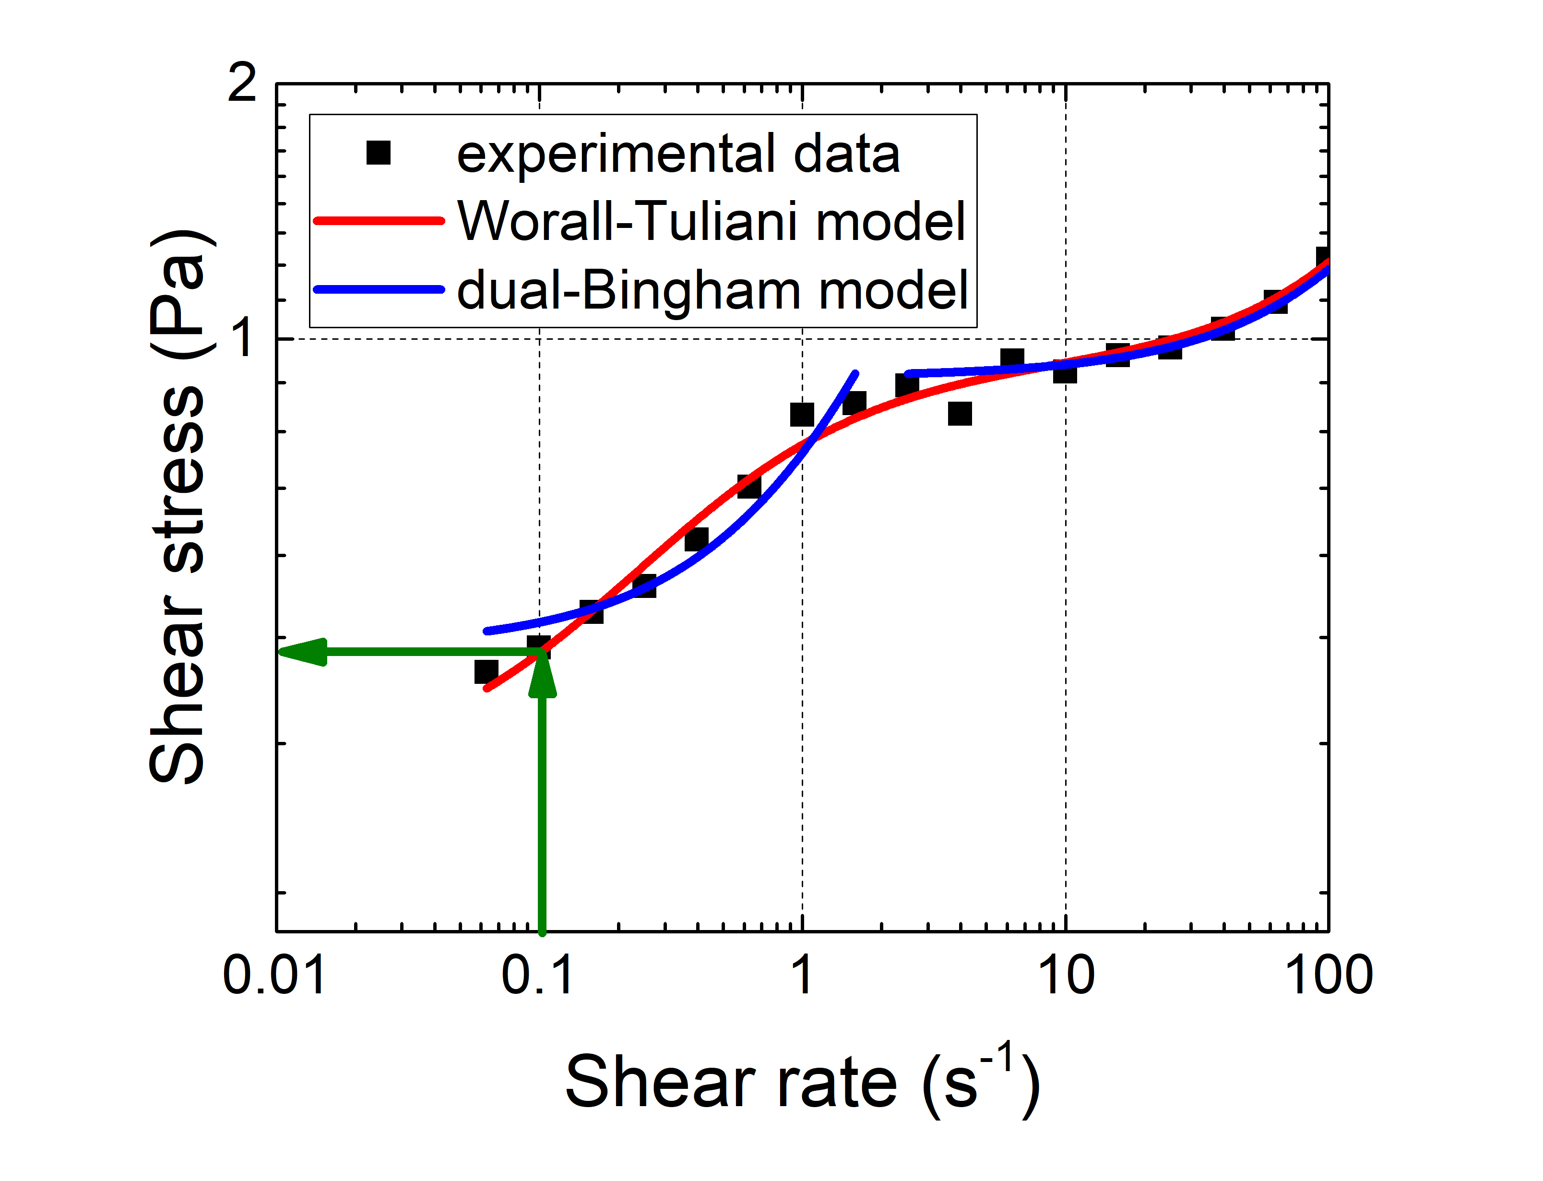
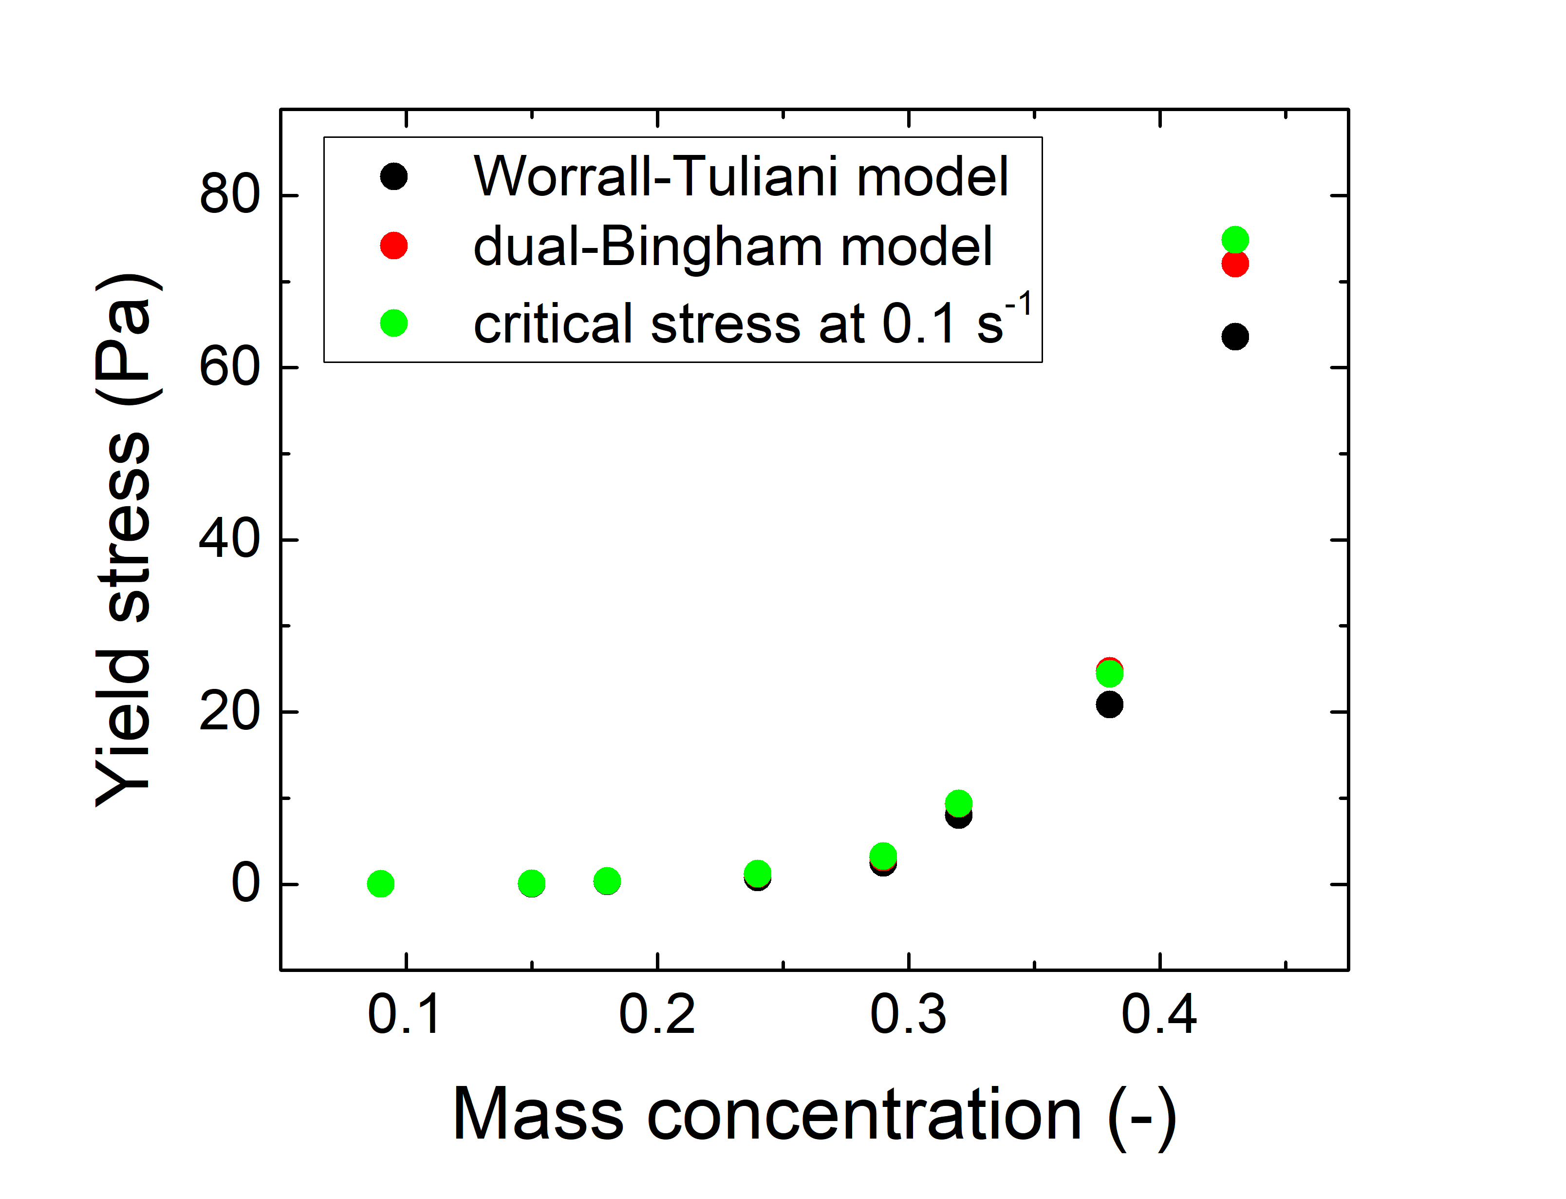
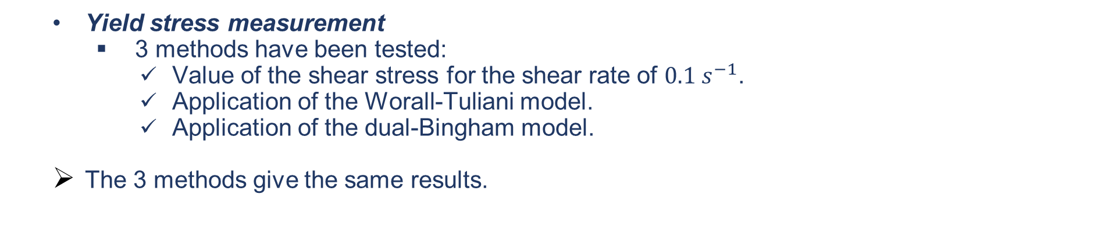
Rheological tests
  Yield stress measurement
    3 methods have been tested:
      Value of the shear stress for the shear rate of $0.1 s^{−1}$.
      Application of the Worall-Tuliani model.
      Application of the dual-Bingham model.
  The 3 methods give the same results.

Slide 10
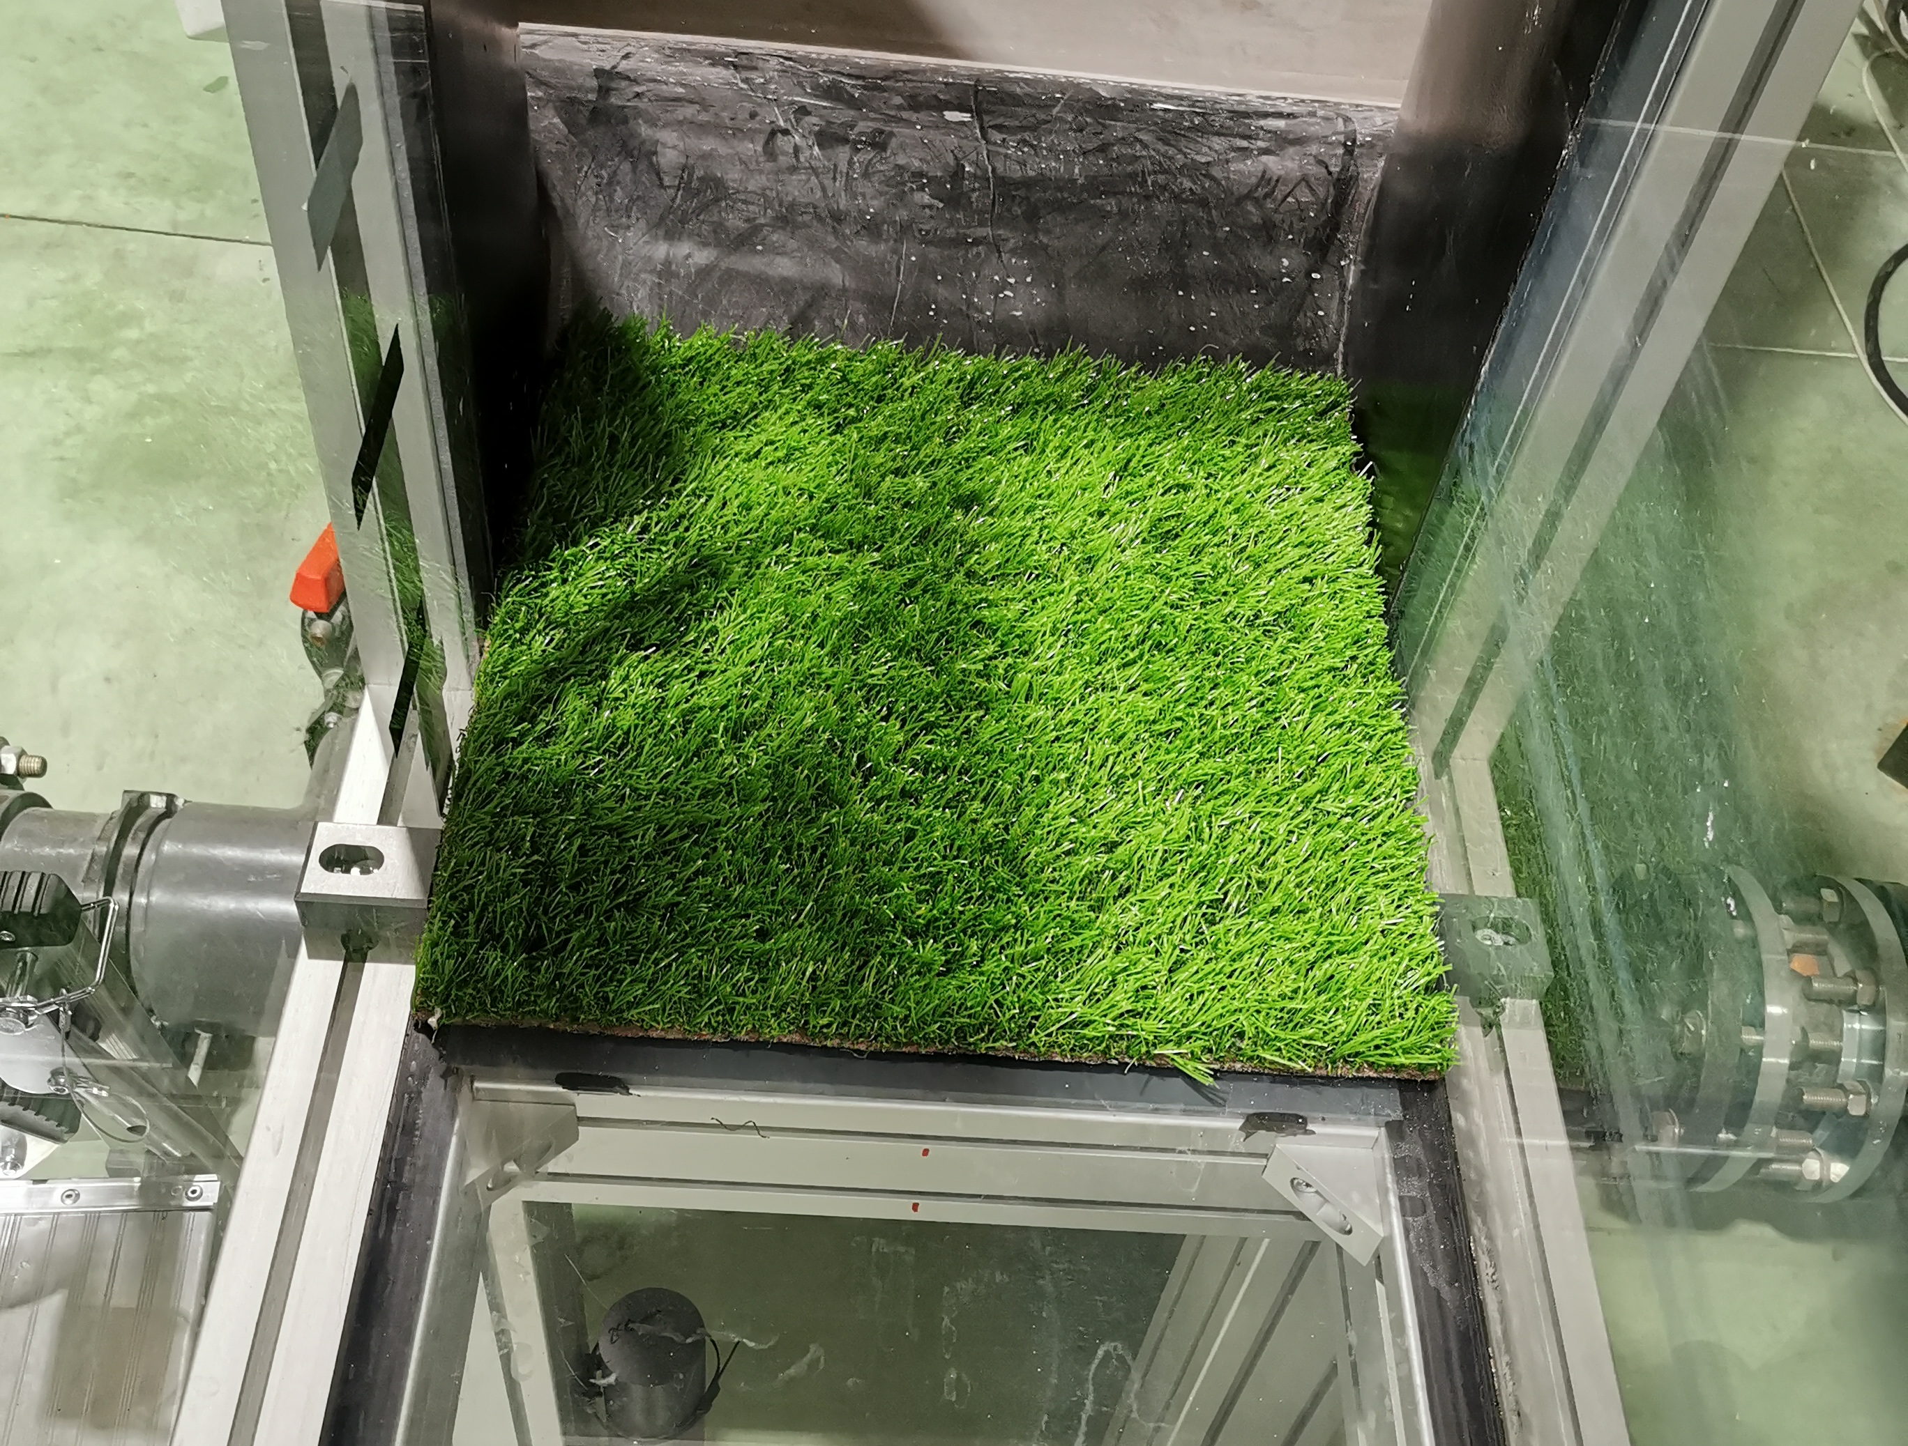
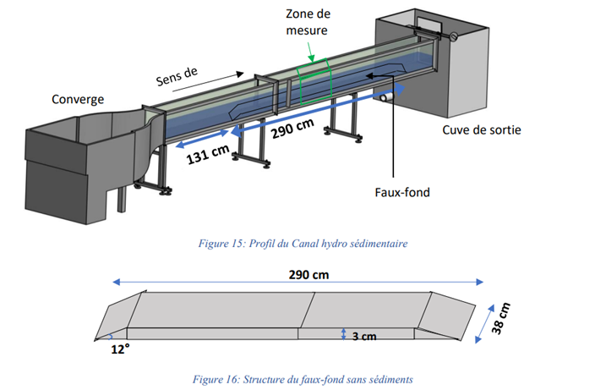
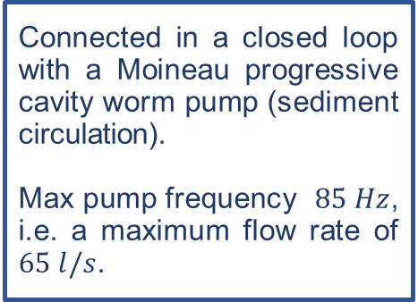
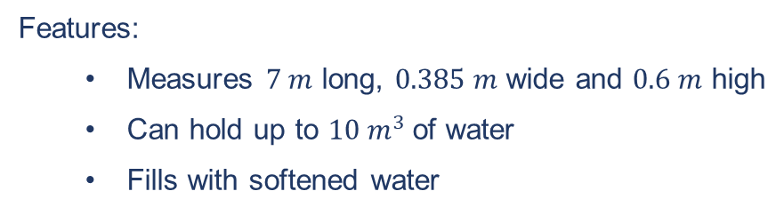
Erosion tests
  Hydro-sedimentary channel
  Connected in a closed loop with a Moineau progressive cavity worm pump (sediment circulation).
  Max pump frequency $85 Hz$, i.e. a maximum flow rate of $65 l/s$.
Roughness at the channel inlet to create a boundary layer developed in the measurement zone.
Measurement area
Flow direction
The convergent: fitted with a honeycomb and grids to calm and homogenise the flow.
Artificial false bottom made up of 2 plates and 2 ramps (upstream and downstream) of PMMA in the middle of the channel.
→ to create a cavity where sediment can be deposited
Features:
  Measures $7 m$ long, $0.385 m$ wide and $0.6 m$ high
  Can hold up to $10 m^{3}$of water
  Fills with softened water

Slide 11
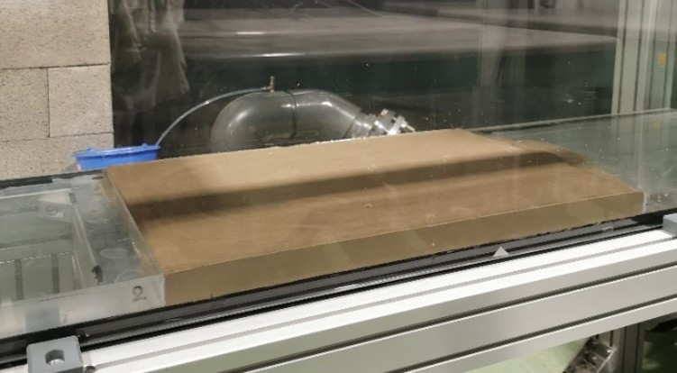
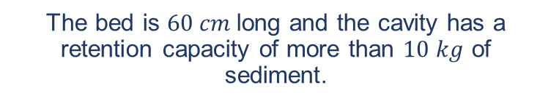
Erosion tests
  Critical erosion flow rate
    Homogenization of sediments beforehand to avoid the effects of compaction.
    Filling the channel to a water height of 25 cm above the bed.
    Increase pump frequency (2 Hz steps during 2 min) until particles are set in motion.
    Pump frequency is directly linked to the flow rate.
    The critical flow rate was defined visually for a global displacement of particles on the surface.
  The bed is $60 cm$long and the cavity has a retention capacity of more than $10 kg$ of sediment.
  The sedimentary bed must be smooth and flat
  → Imperfections influence erosion

Slide 12
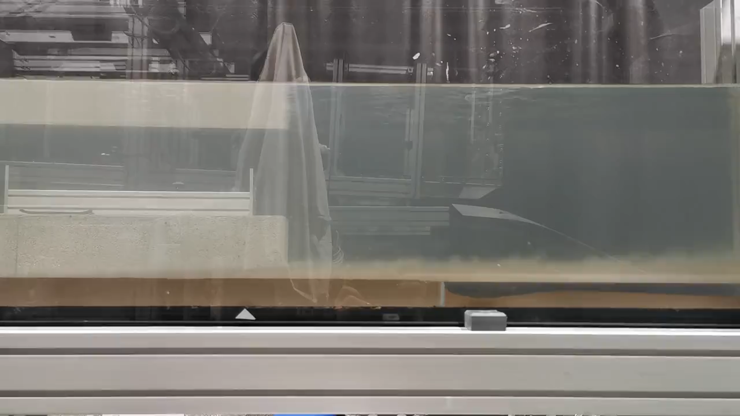
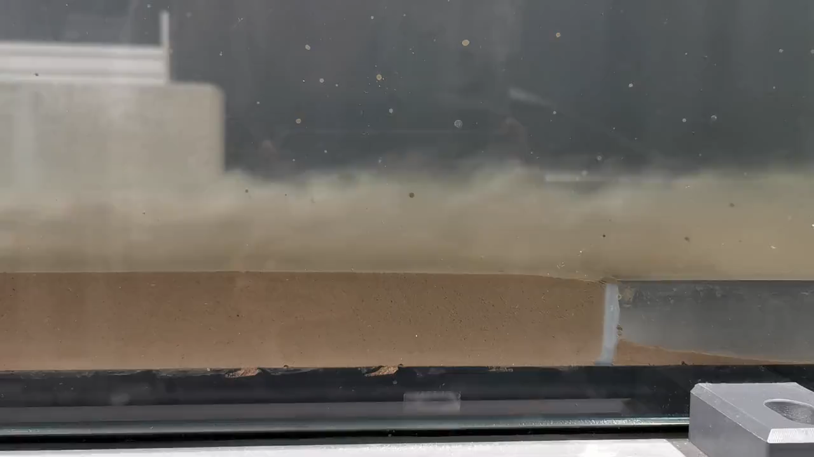

Erosion tests
  Erosion rate measurements
                Application of a constant flow rate, greater than the critical flow rate defined previously for each tested samples, for 45 minutes
      Different concentrations of sediment are tested
      Calculation of the erosion rate
  $$E=\frac{Eroded mass}{Surface area ×erosion time}$$

Slide 13
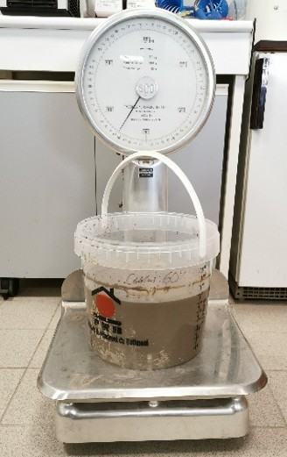

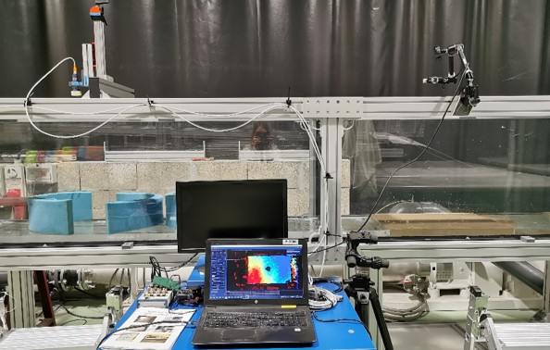
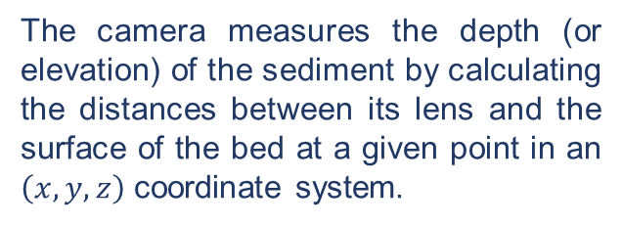

Erosion tests
  Erosion rate measurements
  2 methods of quantification:
    weighing the mass before and after the experiment
    measuring the deformation of the bed by recording images before and after the experiment using a 3D camera.
The camera measures the depth (or elevation) of the sediment by calculating the distances between its lens and the surface of the bed at a given point in an $\left(x,y,z\right)$ coordinate system.
Caméra 3D Intel RealSense 415
Intel RealSense Viewer software
Resolution = $1280 × 720 pixels$
Image processing using Matlab software
Weighing method

Slide 14
Results

Slide 15
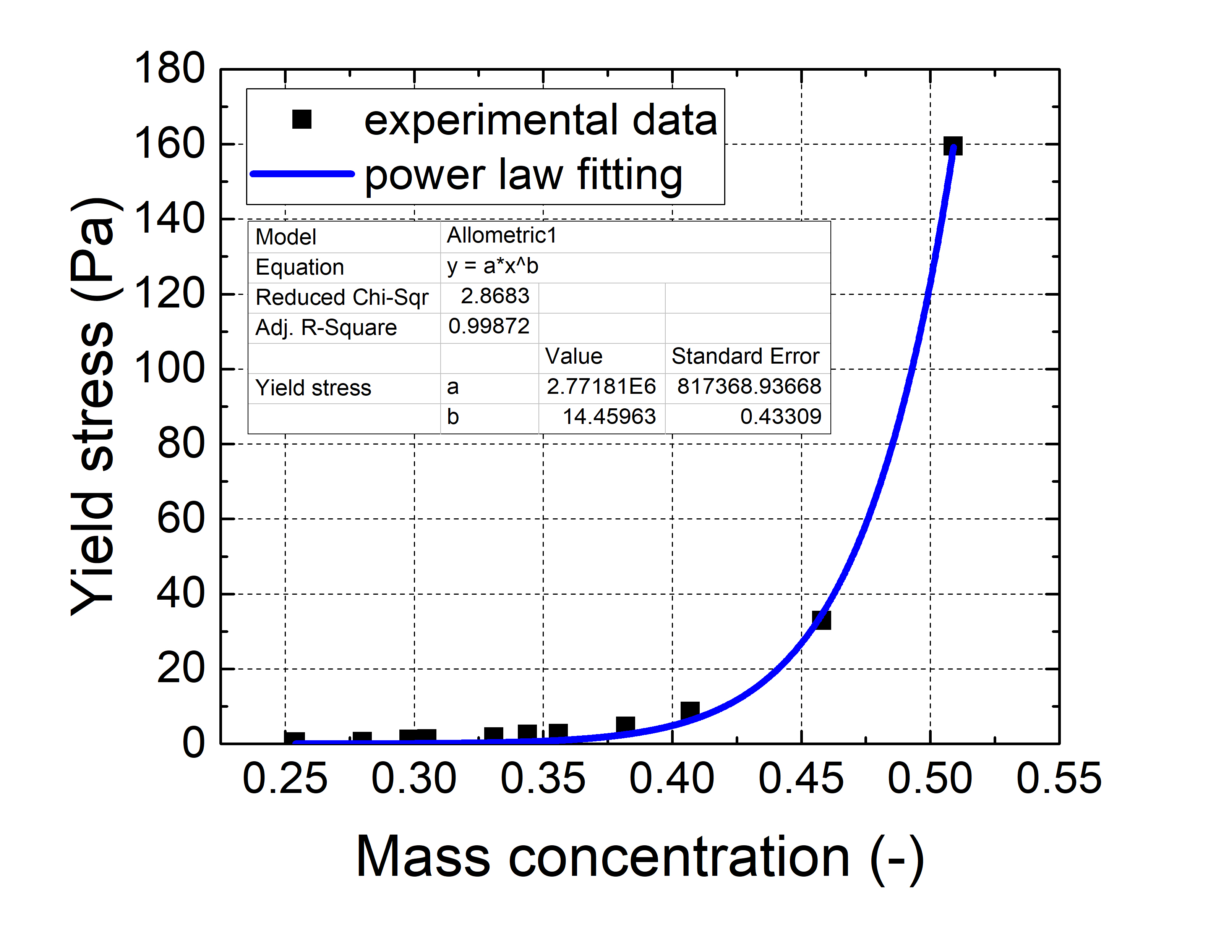
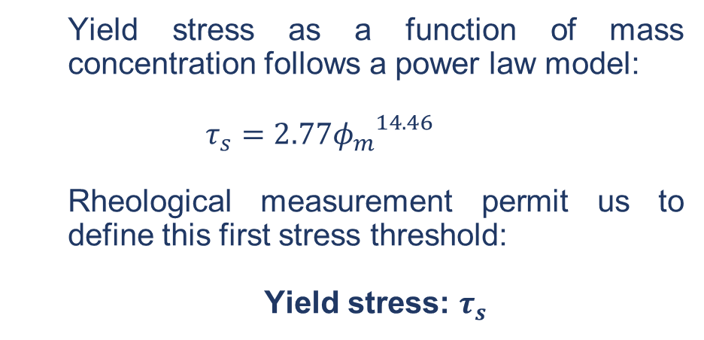
Rheological tests
  Yield stress as a function of mass concentration follows a power law model:
  $$τ_{s}=2.77{φ_{m}}^{14.46}$$
  Rheological measurement permit us to define this first stress threshold:
  Yield stress: $τ_{s}$

Slide 16
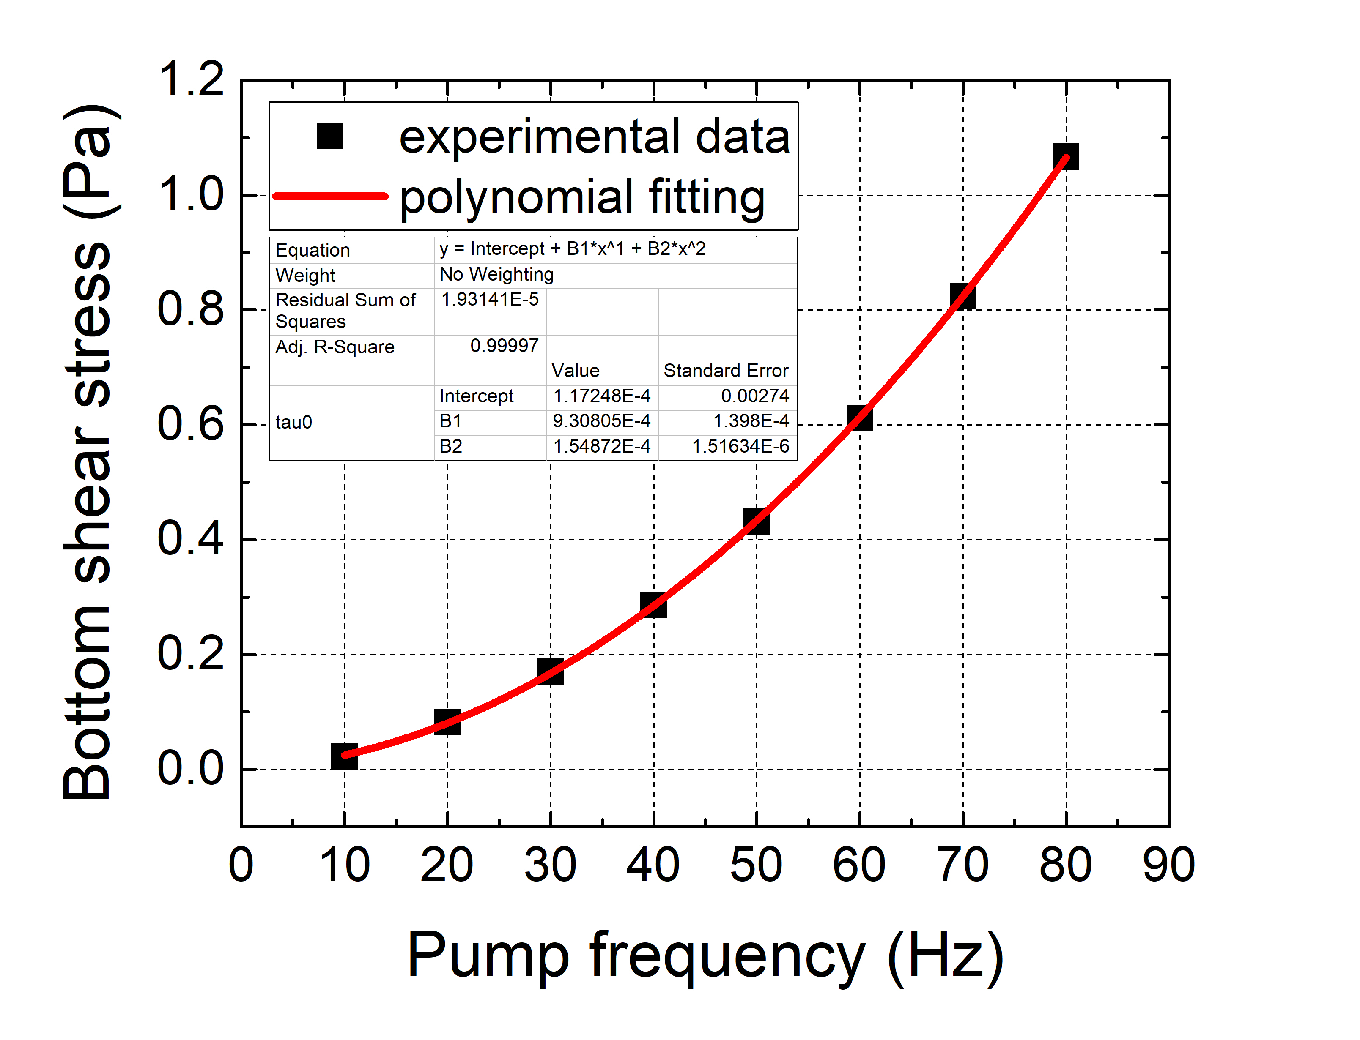
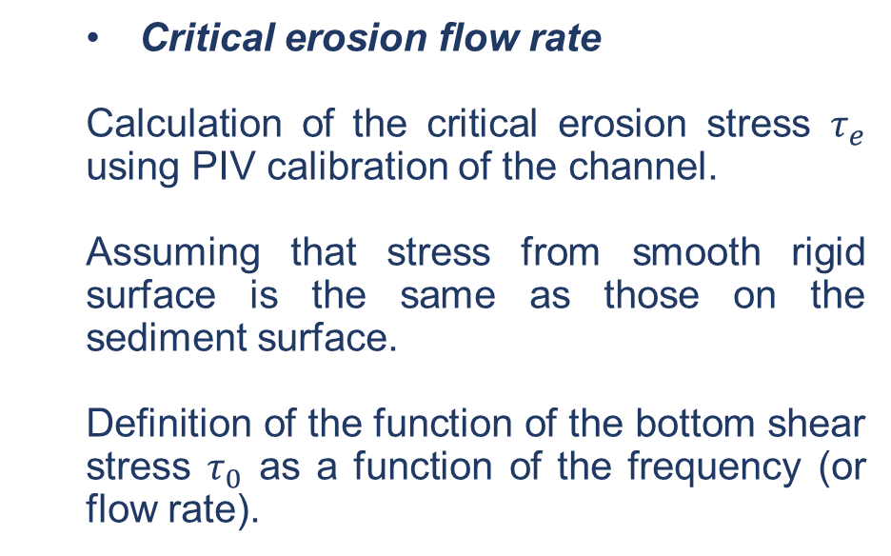
Erosion tests
  Critical erosion flow rate
  Calculation of the critical erosion stress $τ_{e}$ using PIV calibration of the channel.
  Assuming that stress from smooth rigid surface is the same as those on the sediment surface.
  Definition of the function of the bottom shear stress $τ_{0}$ as a function of the frequency (or flow rate).

Slide 17
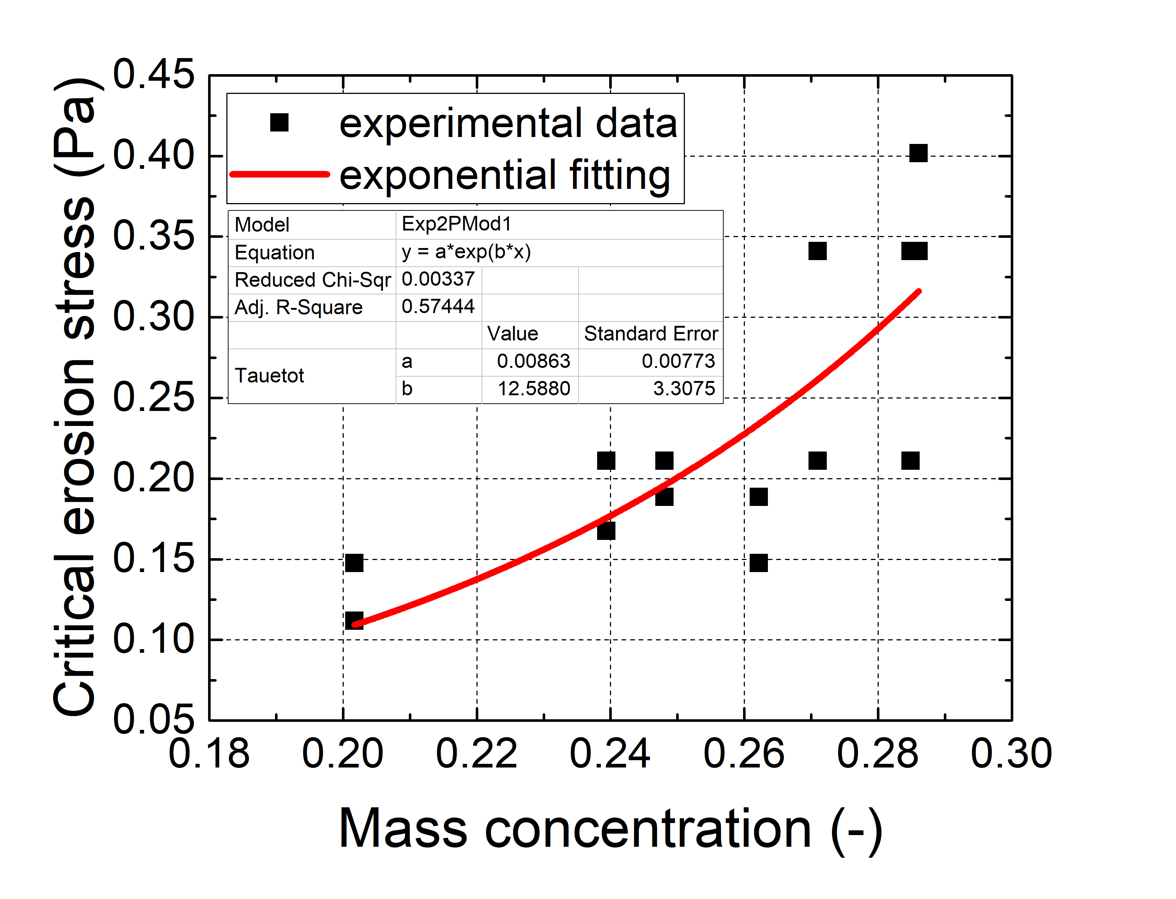
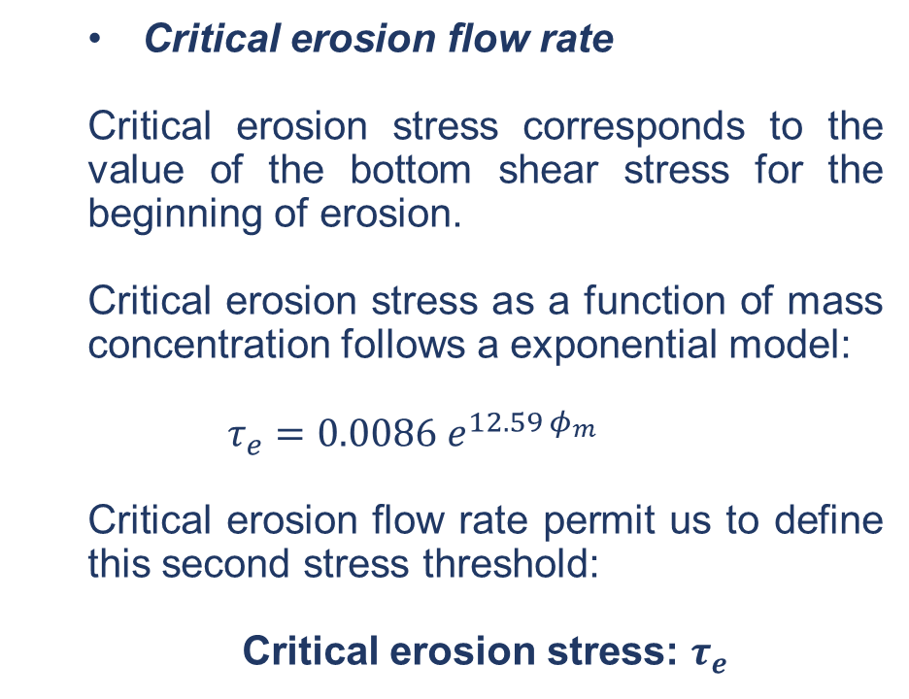
Erosion tests
  Critical erosion flow rate
  Critical erosion stress corresponds to the value of the bottom shear stress for the beginning of erosion.
  Critical erosion stress as a function of mass concentration follows a exponential model:
  $$τ_{e}=0.0086 e^{12.59 φ_{m}}$$
  Critical erosion flow rate permit us to define this second stress threshold:
  Critical erosion stress: $τ_{e}$

Slide 18
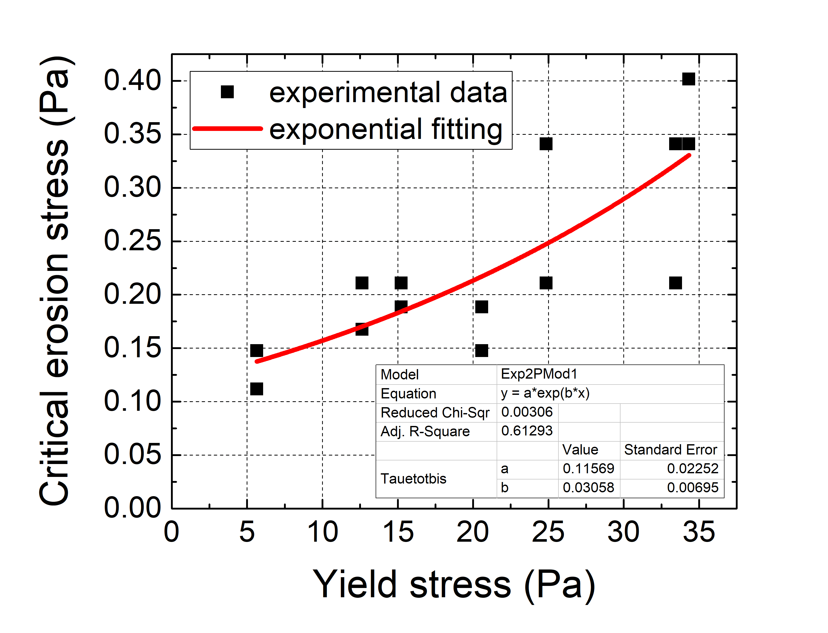
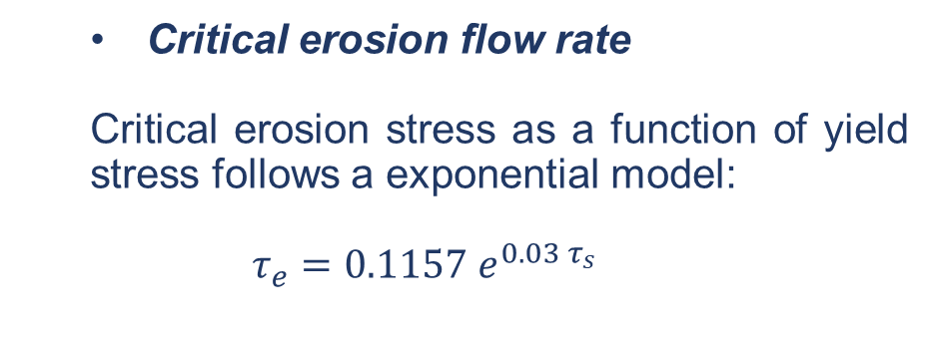
Erosion tests
  Critical erosion flow rate
  Critical erosion stress as a function of yield stress follows a exponential model:
  $$τ_{e}=0.1157 e^{0.03 τ_{s}}$$

Slide 19
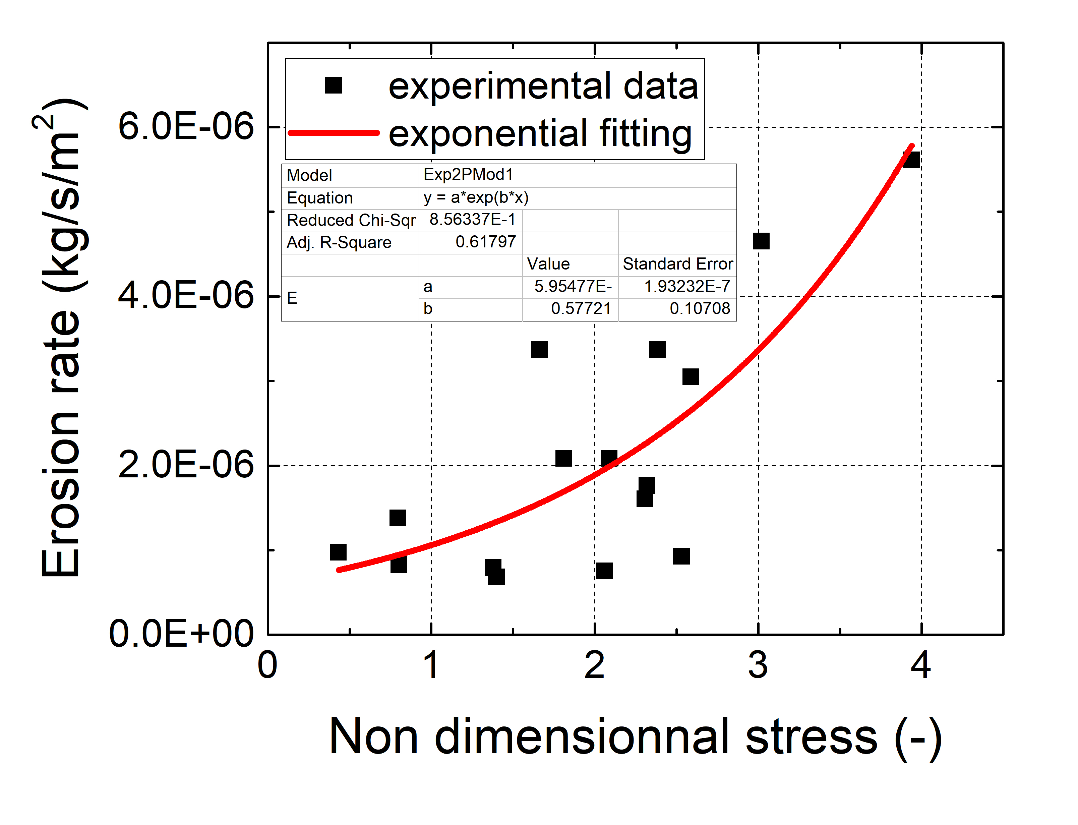
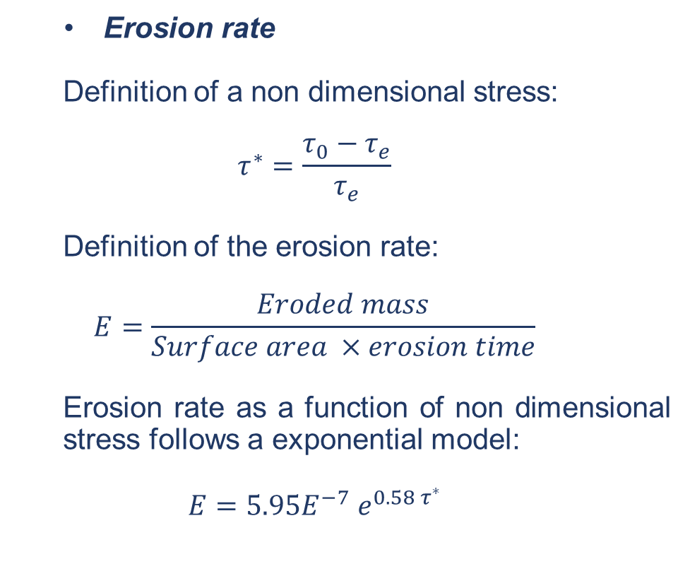
Erosion tests
  Erosion rate
    Definition of a non dimensional stress:
  $$τ^{∗}=\frac{τ_{0}−τ_{e}}{τ_{e}}$$
    Definition of the erosion rate:
  $$E=\frac{Eroded mass}{Surface area ×erosion time}$$
    Erosion rate as a function of non dimensional stress follows a exponential model:
  $$E=5.95E^{−7} e^{0.58 τ^{∗}}$$

Slide 20
Conclusions and perspectives

Slide 21

Conclusions
  Rheological characterization to define yield stresses of sediments.
  Measurements of critical erosion flow rate to define critical erosion stresses of sediments.
  Relation exists between the critical erosion stress and the yield stress.
  Definition of the erosion law of the sediments corresponding general models (Partheniades, Parchure, Mehta).
Perspectives
  Not succeed to define an erosion law including the yield stress of sediment.
  The 3D visualization can give much more information about the morphological evolution of the surface during erosion process.

