Slide 1
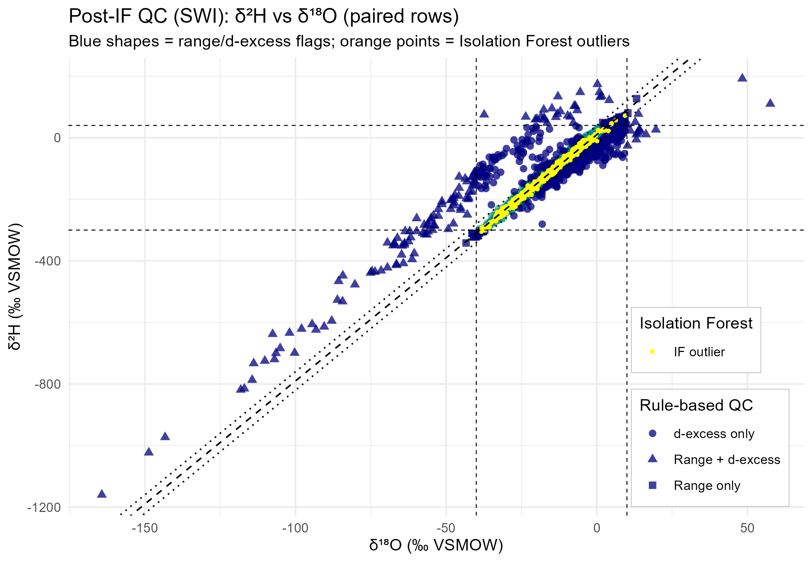
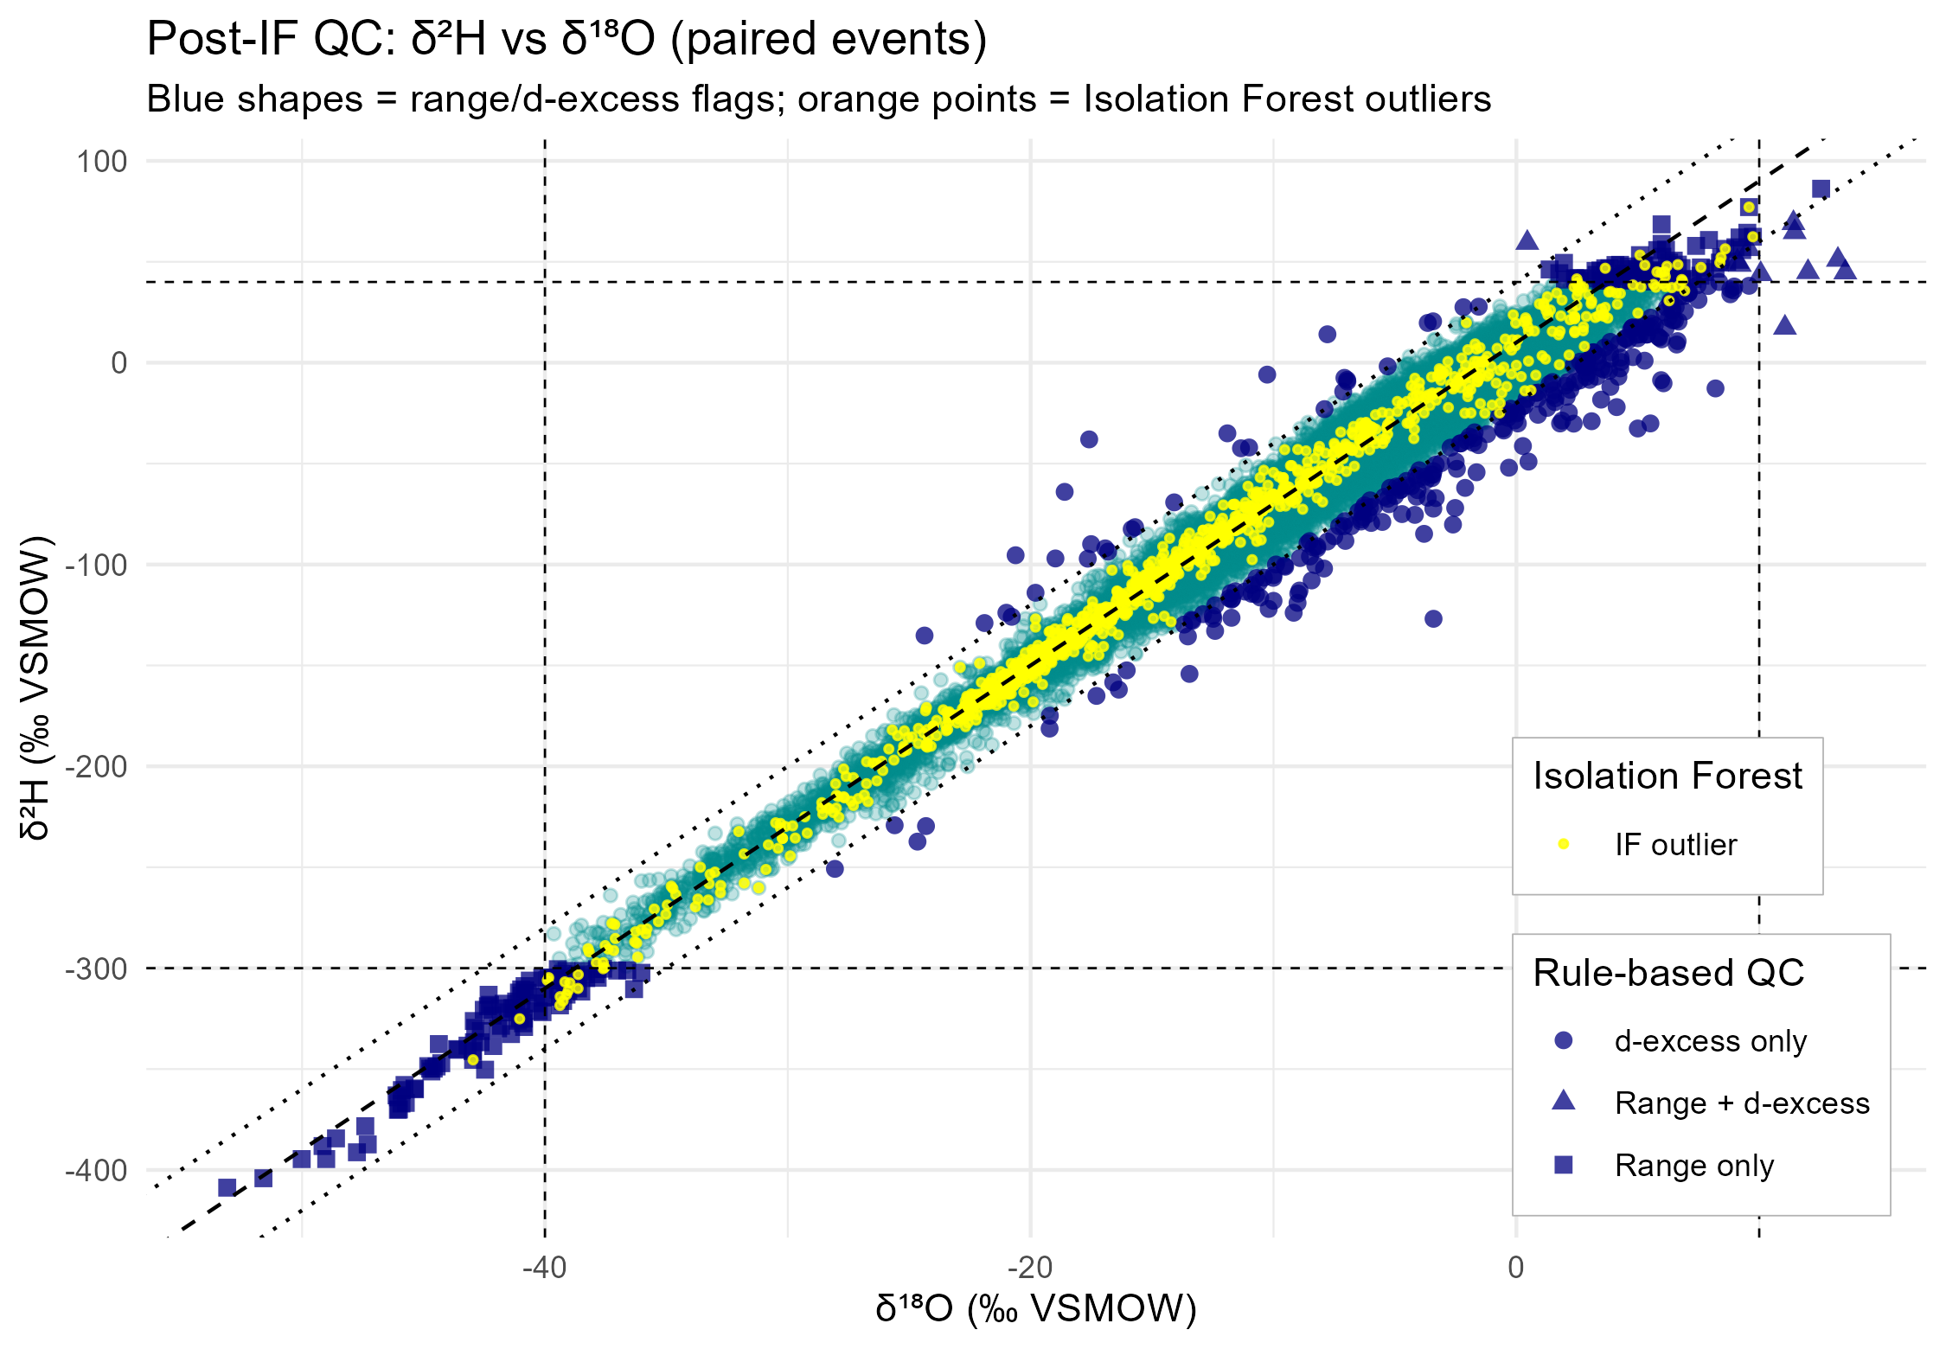
Data Preprocessing
Three-stage outlier detection applied independently to δ¹⁸O and δ²H (Range, d-excess, Isolation Forest). For the plots above:
Range only: Isotope value outside conservative physical limits
D-excess only: isotope value outside physical limits
Range + d-excess: both rule-based criteria violated
IF outlier: statistical anomaly detected via Isolation Forest

Slide 2
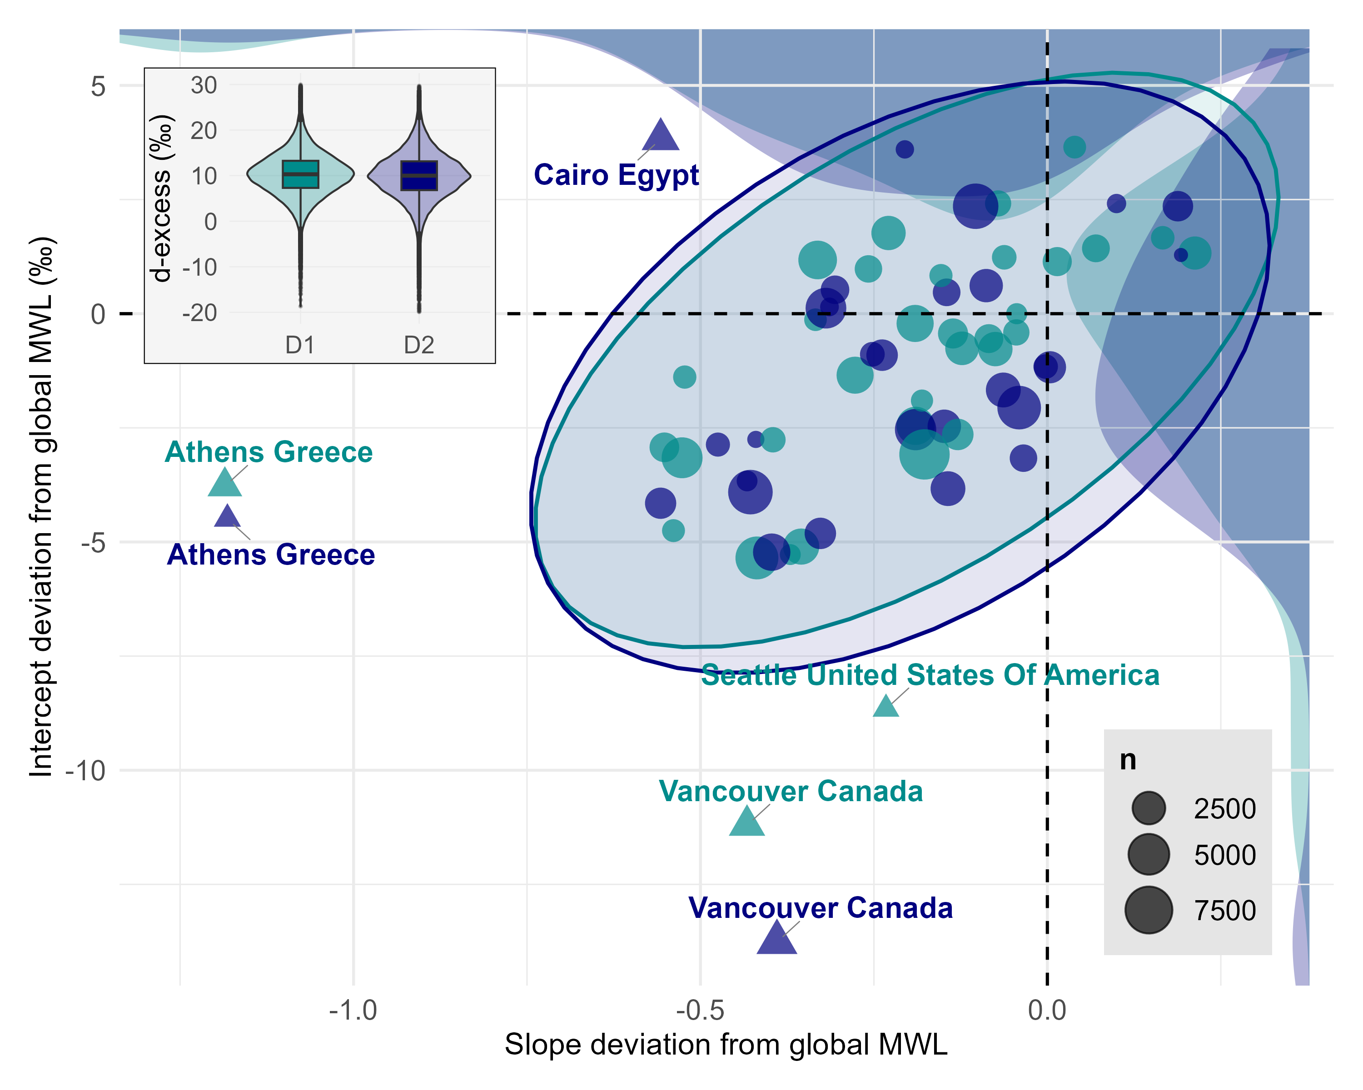
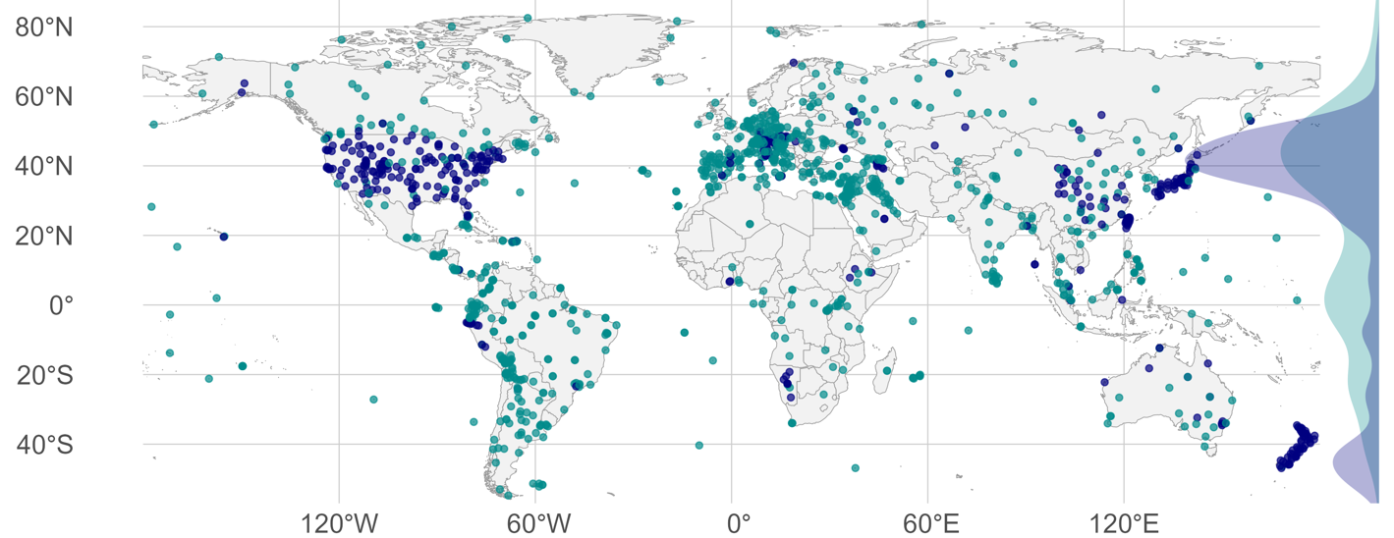
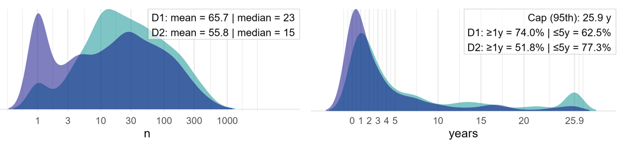
Dataset Comparison
Comparison between the IAEA‘s GNIP database and our compiled dataset including data provided via waterisotopes.org and further author contributions via private correspondance.

Slide 3
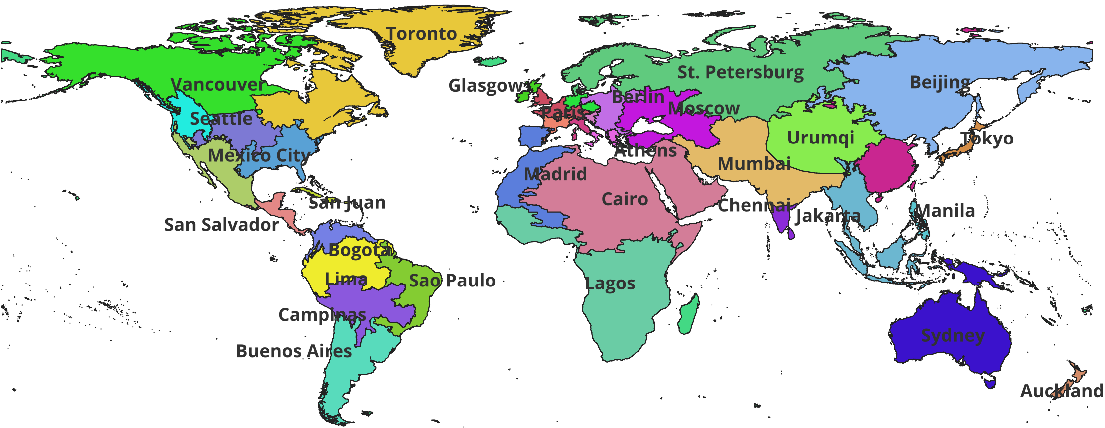
Dataset Comparison
Final isoscape models were trained using region one-hot encoding
Regions were created via SLICK superpixel clustering under minimum data constraints
Regions are named according to the largest city within their borders
Colors are just for separation

Slide 4
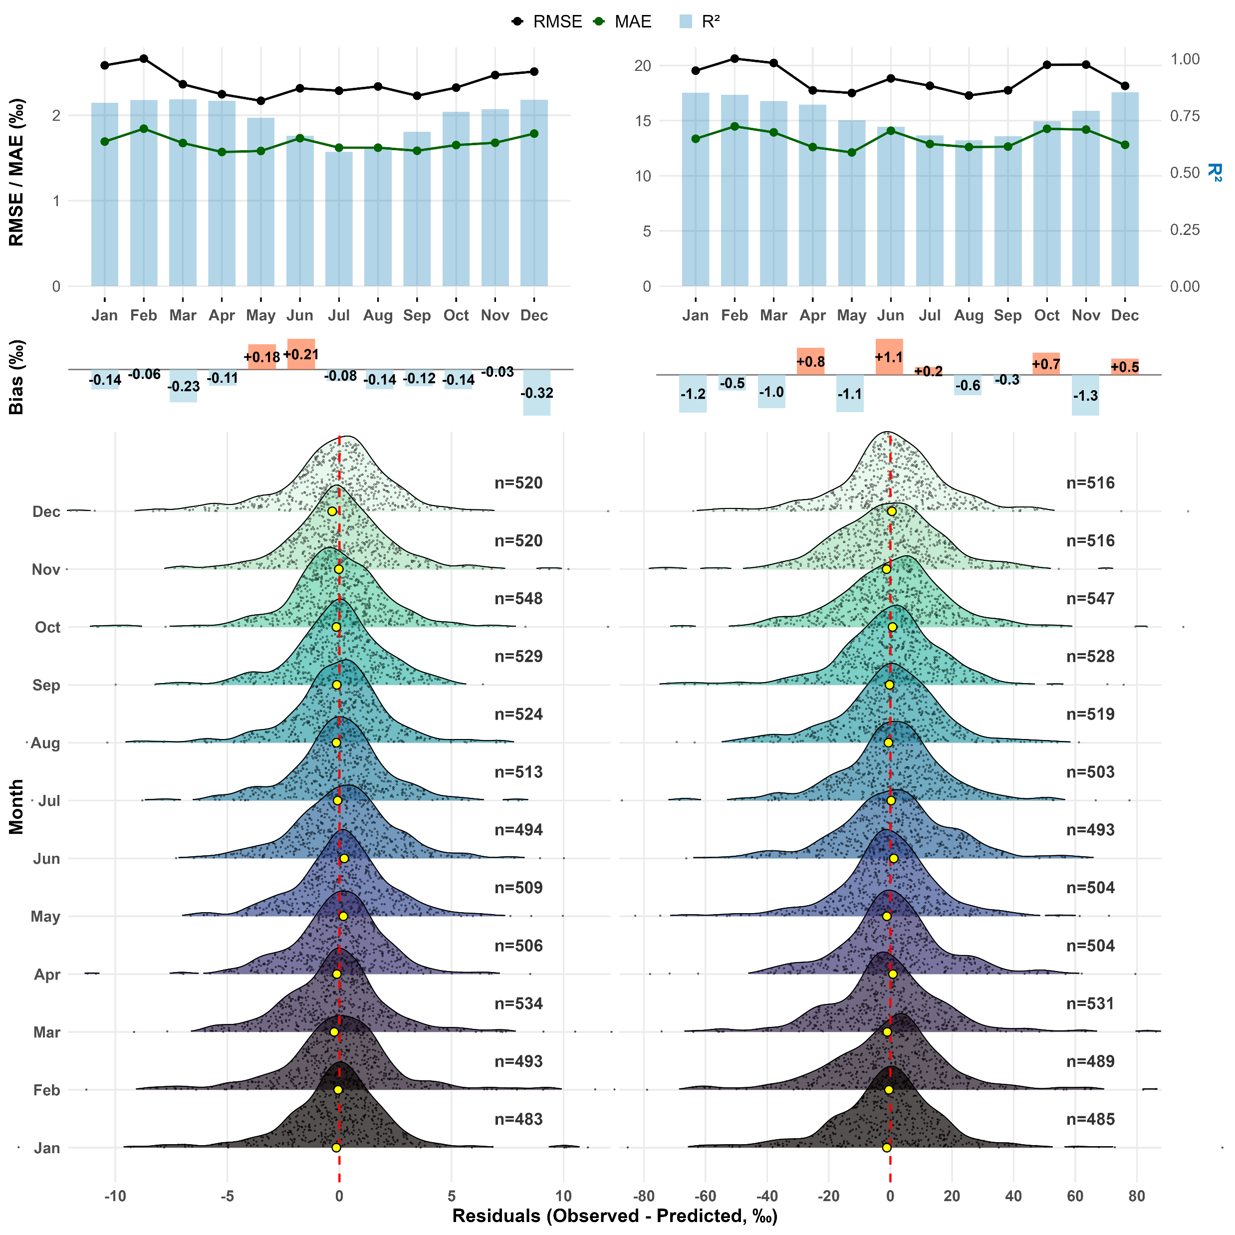
Results – Residuals I
Overall model performance metrics across 12 months.
Top panels show RMSE, MAE and R²
Center panels show mean signed bias
Bottom panels show residual distributions with the mean signed bias again indicated by the small yellow dots

Slide 5
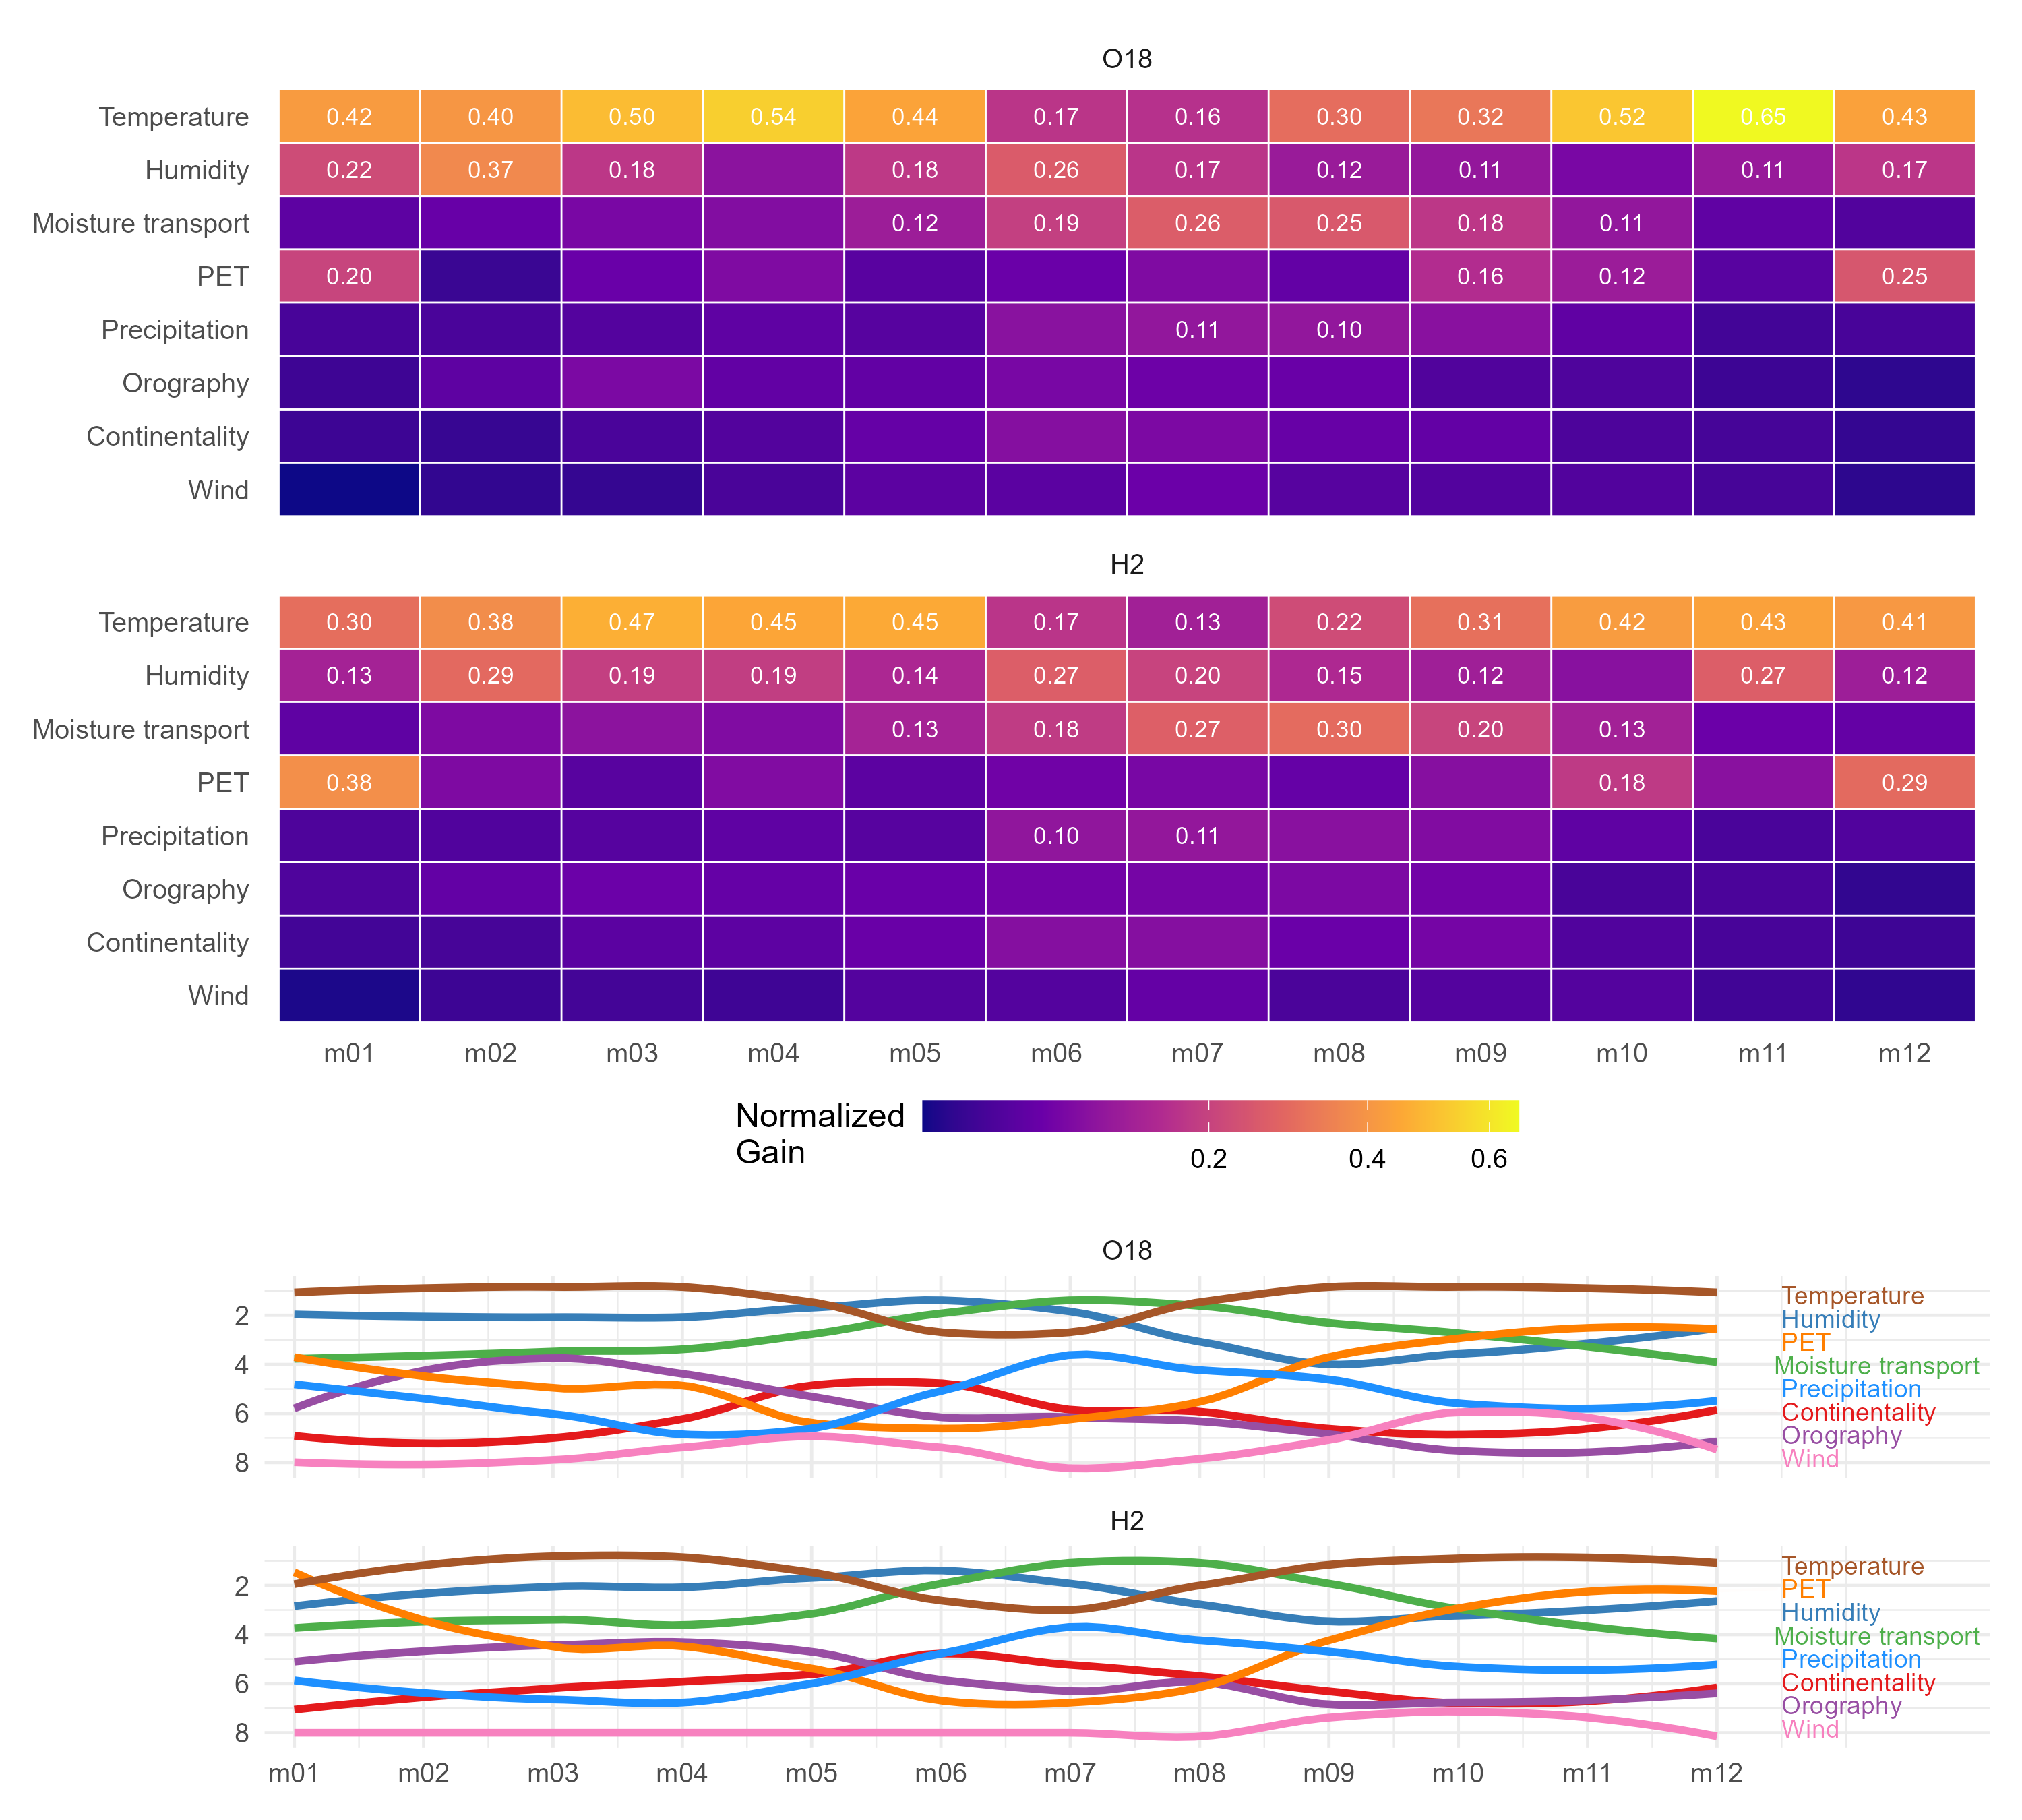
Results – Feature Importance
Grouped feature importance across all months. Temperature and humidity indicators dominate across all seasons

Slide 6
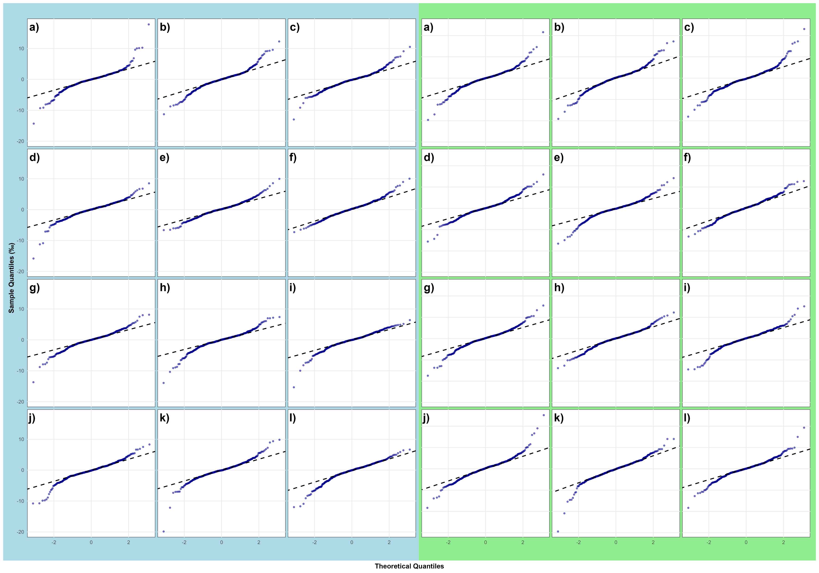
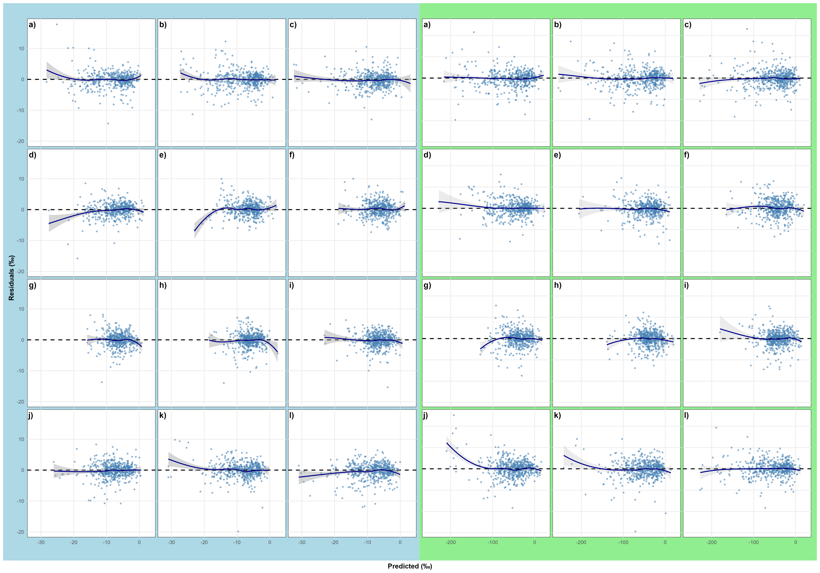
Results – Residuals II
Q-Q-Plots (left) and residuals vs predicted (right). Letters indicate months from a (January) to l (December) and background colors indicate the isotope (blue for δ¹⁸O and green for δ²H)

Slide 7
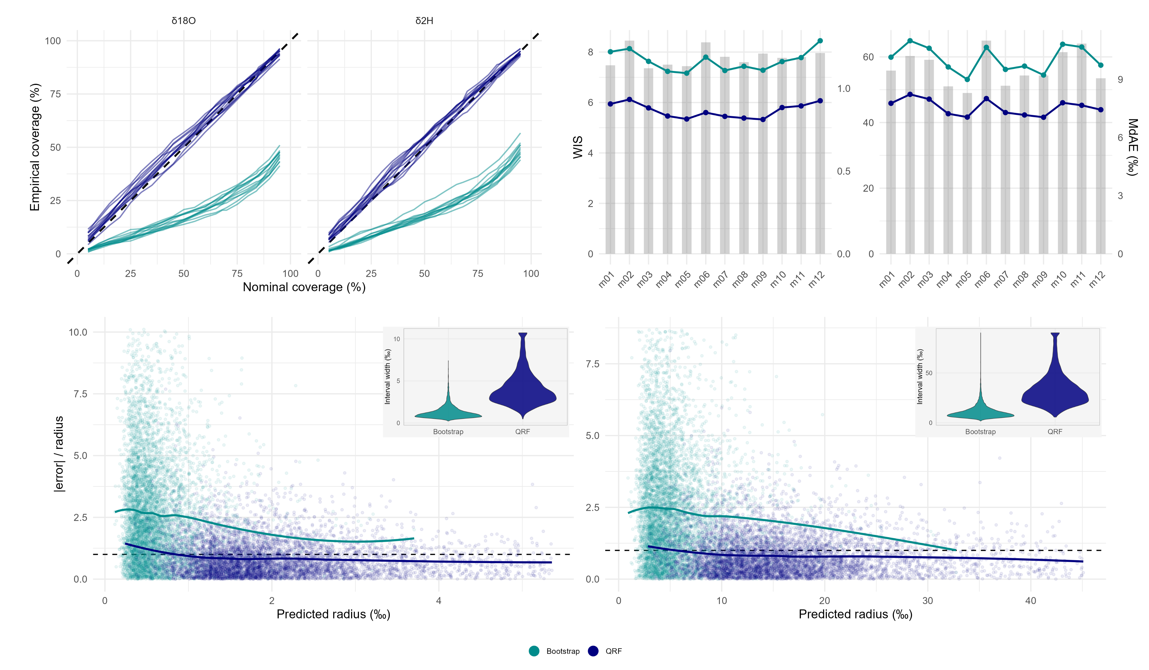
Results – Uncertainty I (metrics)
Uncertainty validation overview
Top-left, Coverage curves: Plots empirical coverage (fraction of observations falling within the predicted interval) vs. nominal coverage (the intented probability level (here 0.68)). Dashed 1:1 line indicates perfect calibration.
Top-right, Scoring rules: Plots the Weighted Interval Score (WIS) and the median absolute error (MdAE). Shows how the interval width (sharpness) and point-prediction accuracy co-vary across months (scaled for axis alignment)
Bottom, Error-to-Radius ratio vs. Predicted radius: The dashed horizontal line indicates perfect calibration. Lines are LOESS indicating trends. Violins show distribution of interval widths. How to read this: Ratio < 1 means the actual error was smaller than the predicted radius → the interval was wider than needed (conservative). Ratio > 1 means the actual error exceeded the predicted radius → the interval was too narrow (overconfident).
QRF = well calibrated (a little conservative)
Bootstrap = intervals are systematically to narrow (overconfident)

Slide 8
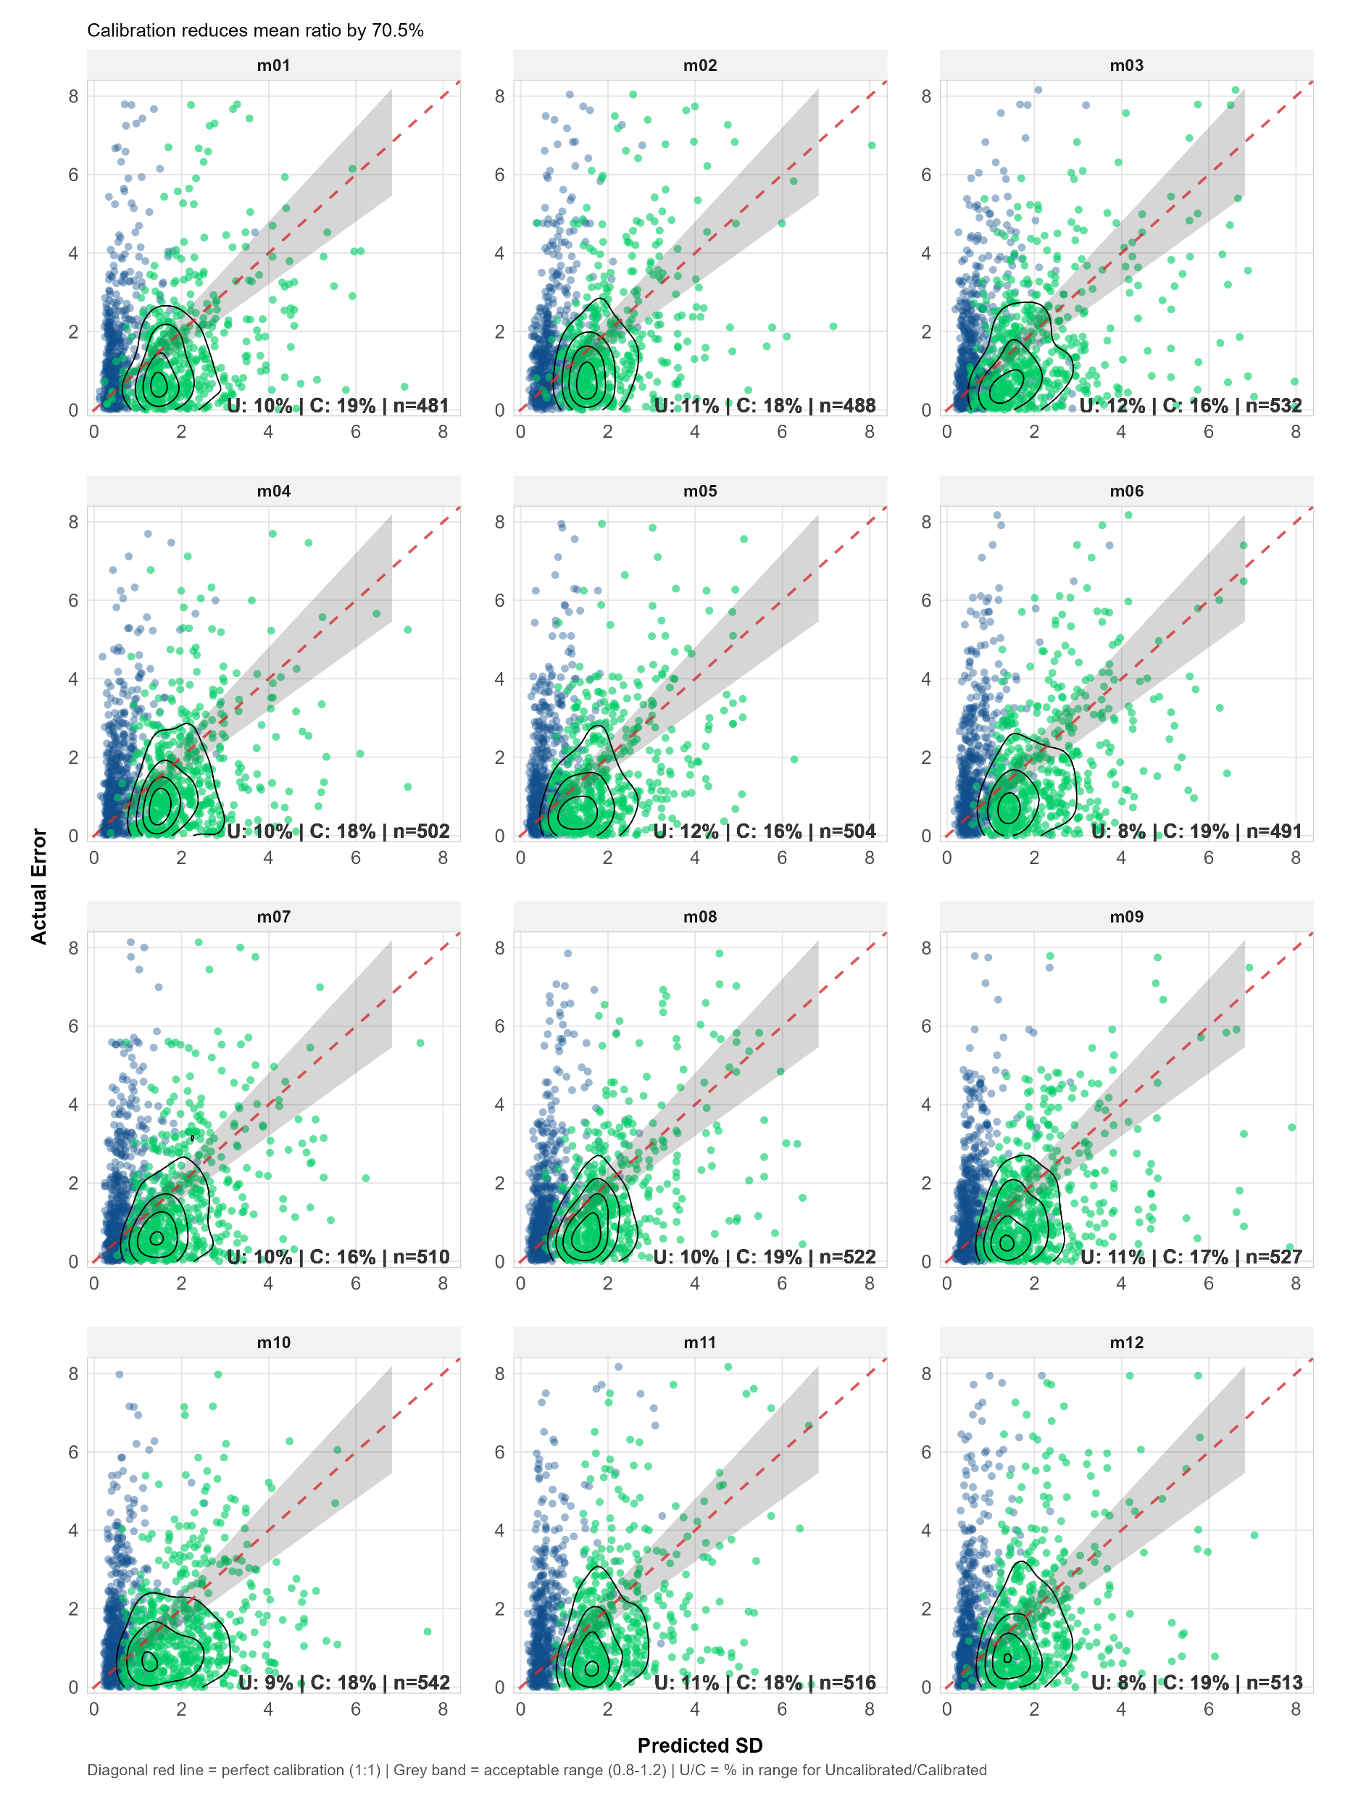
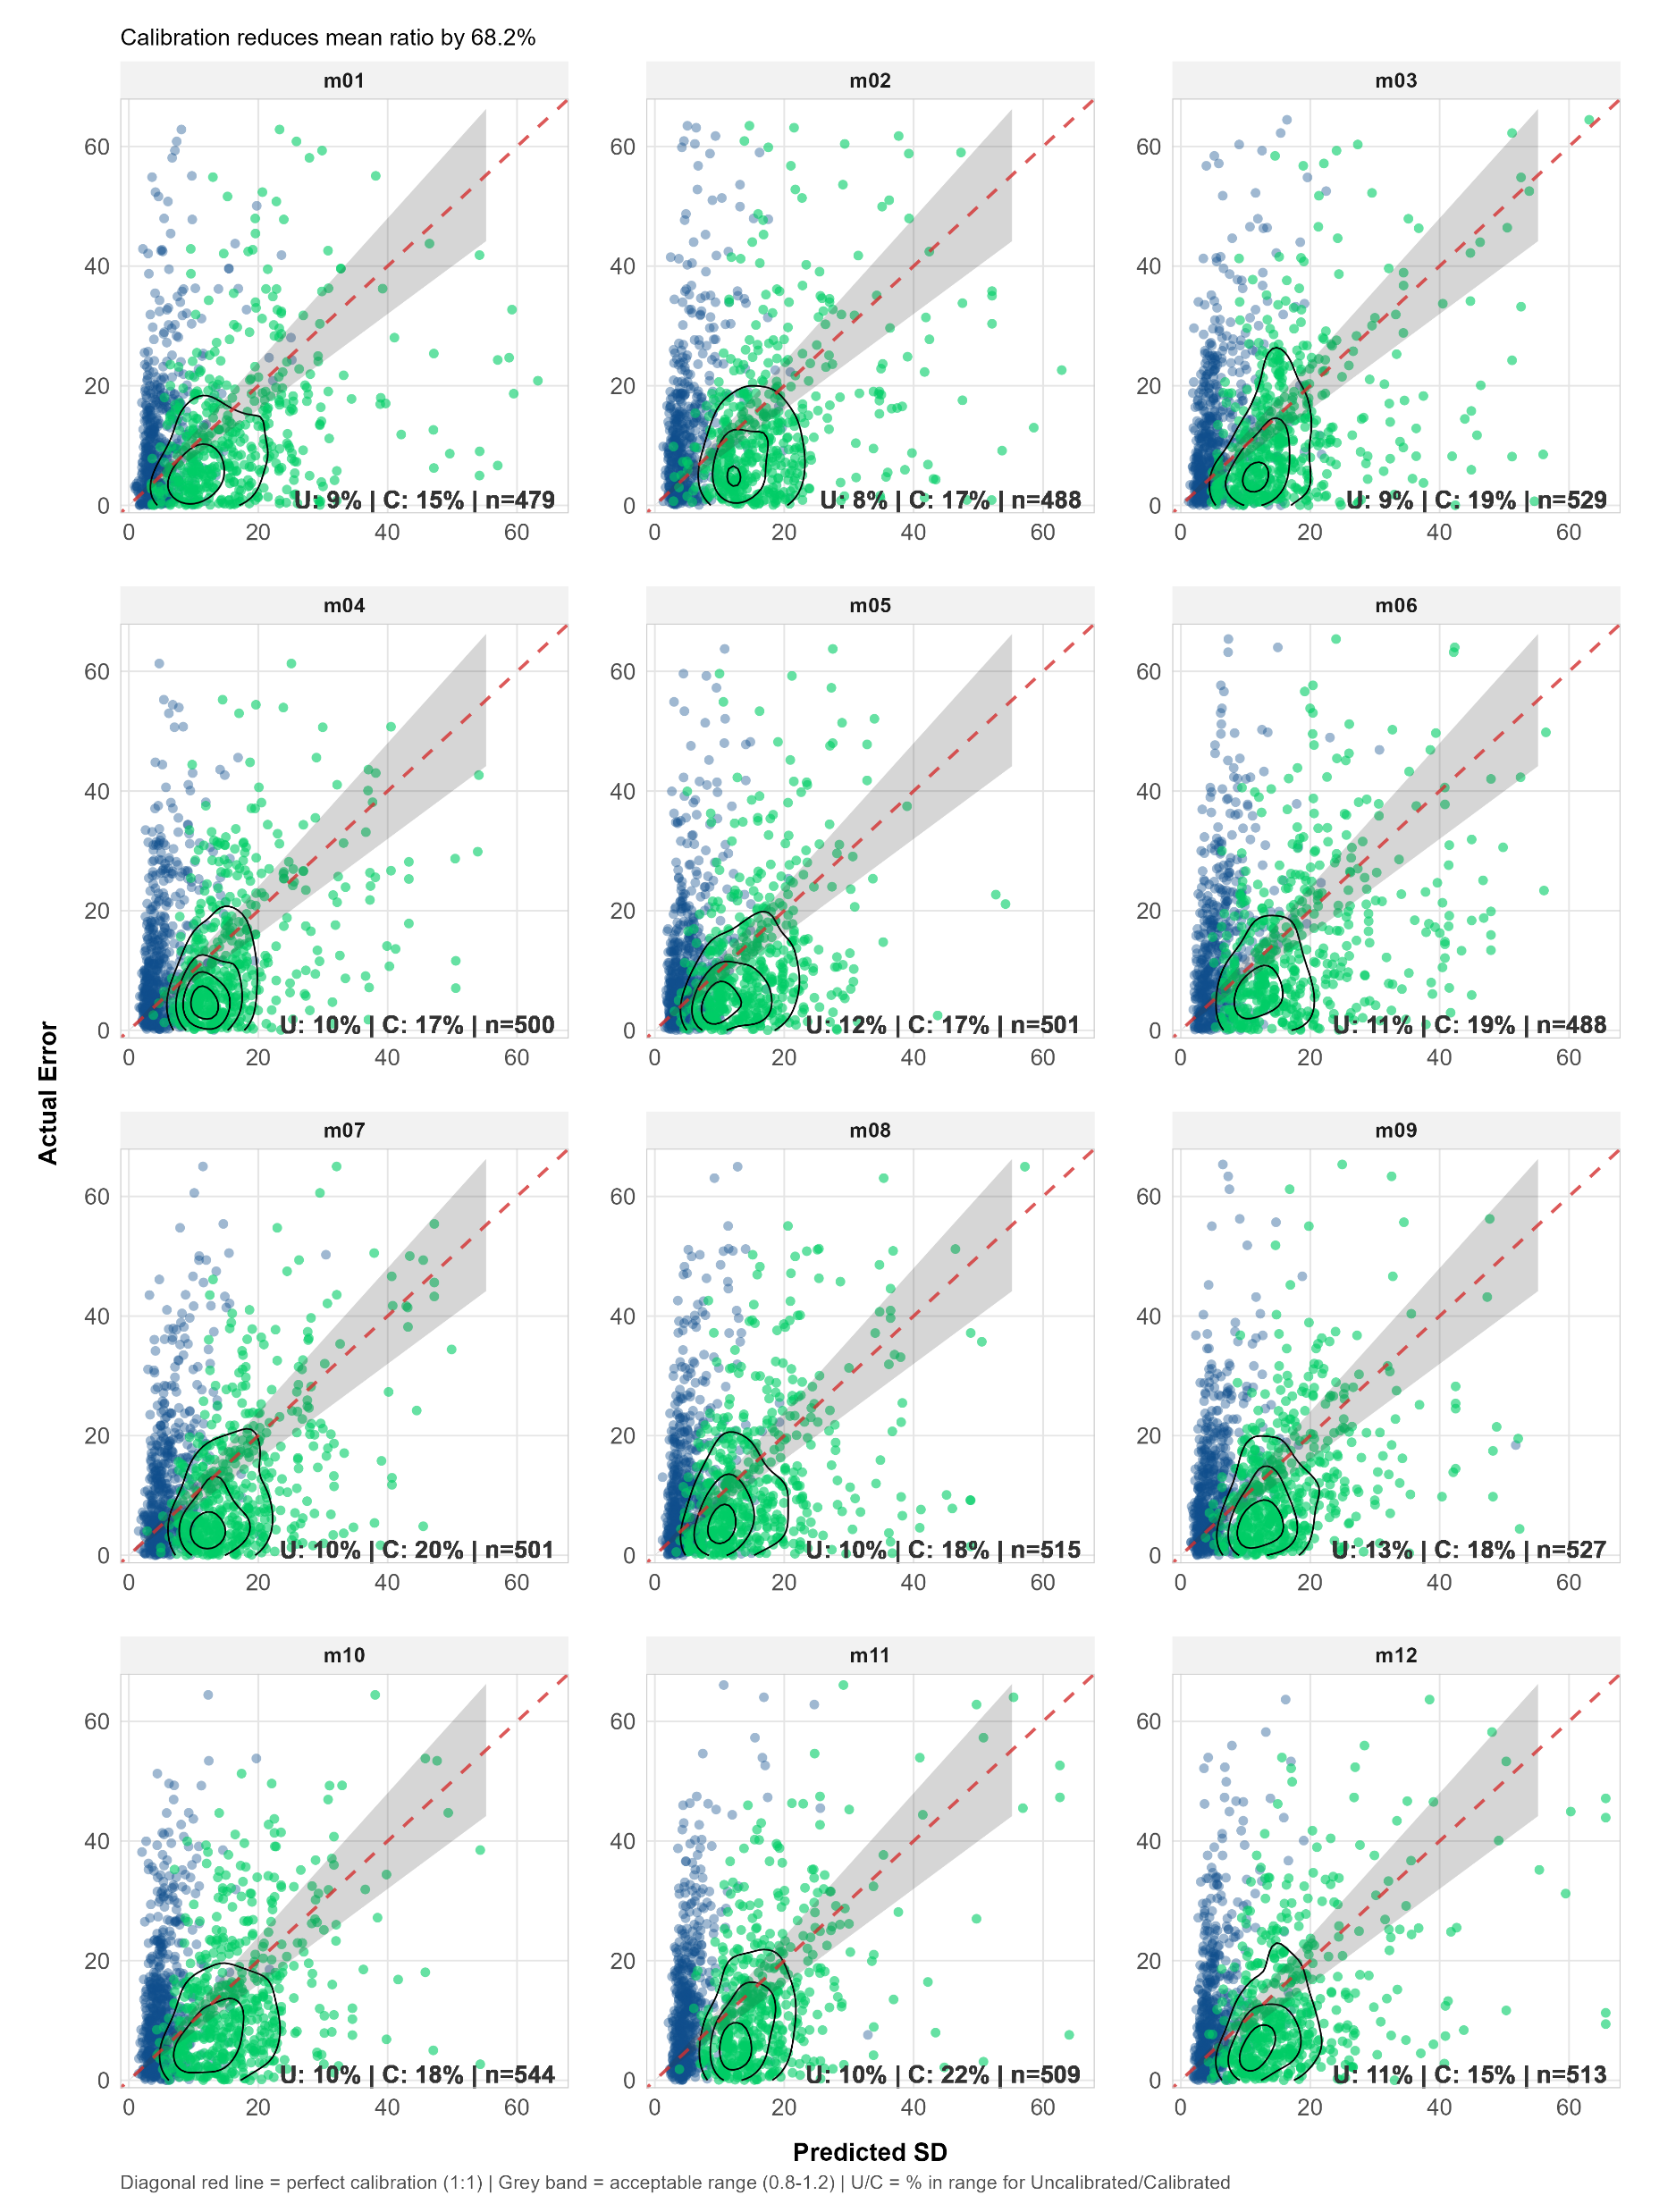
Results – Uncertainty II (scatter)
Reliability scatter plots:
Show the month-by-month effect of calibration (blue uncalibrated Bootstrap, green calibrated QRF)

Slide 9
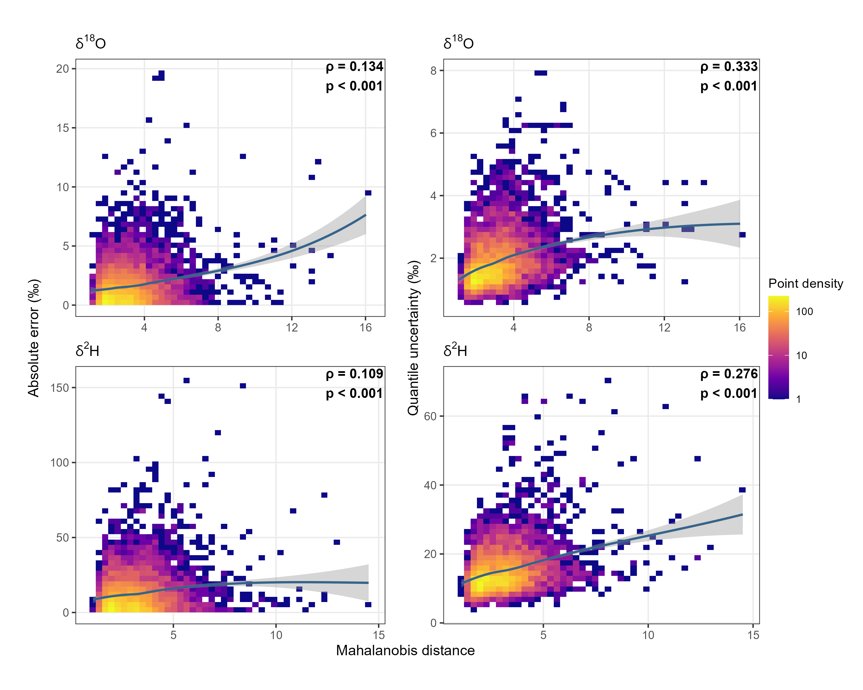
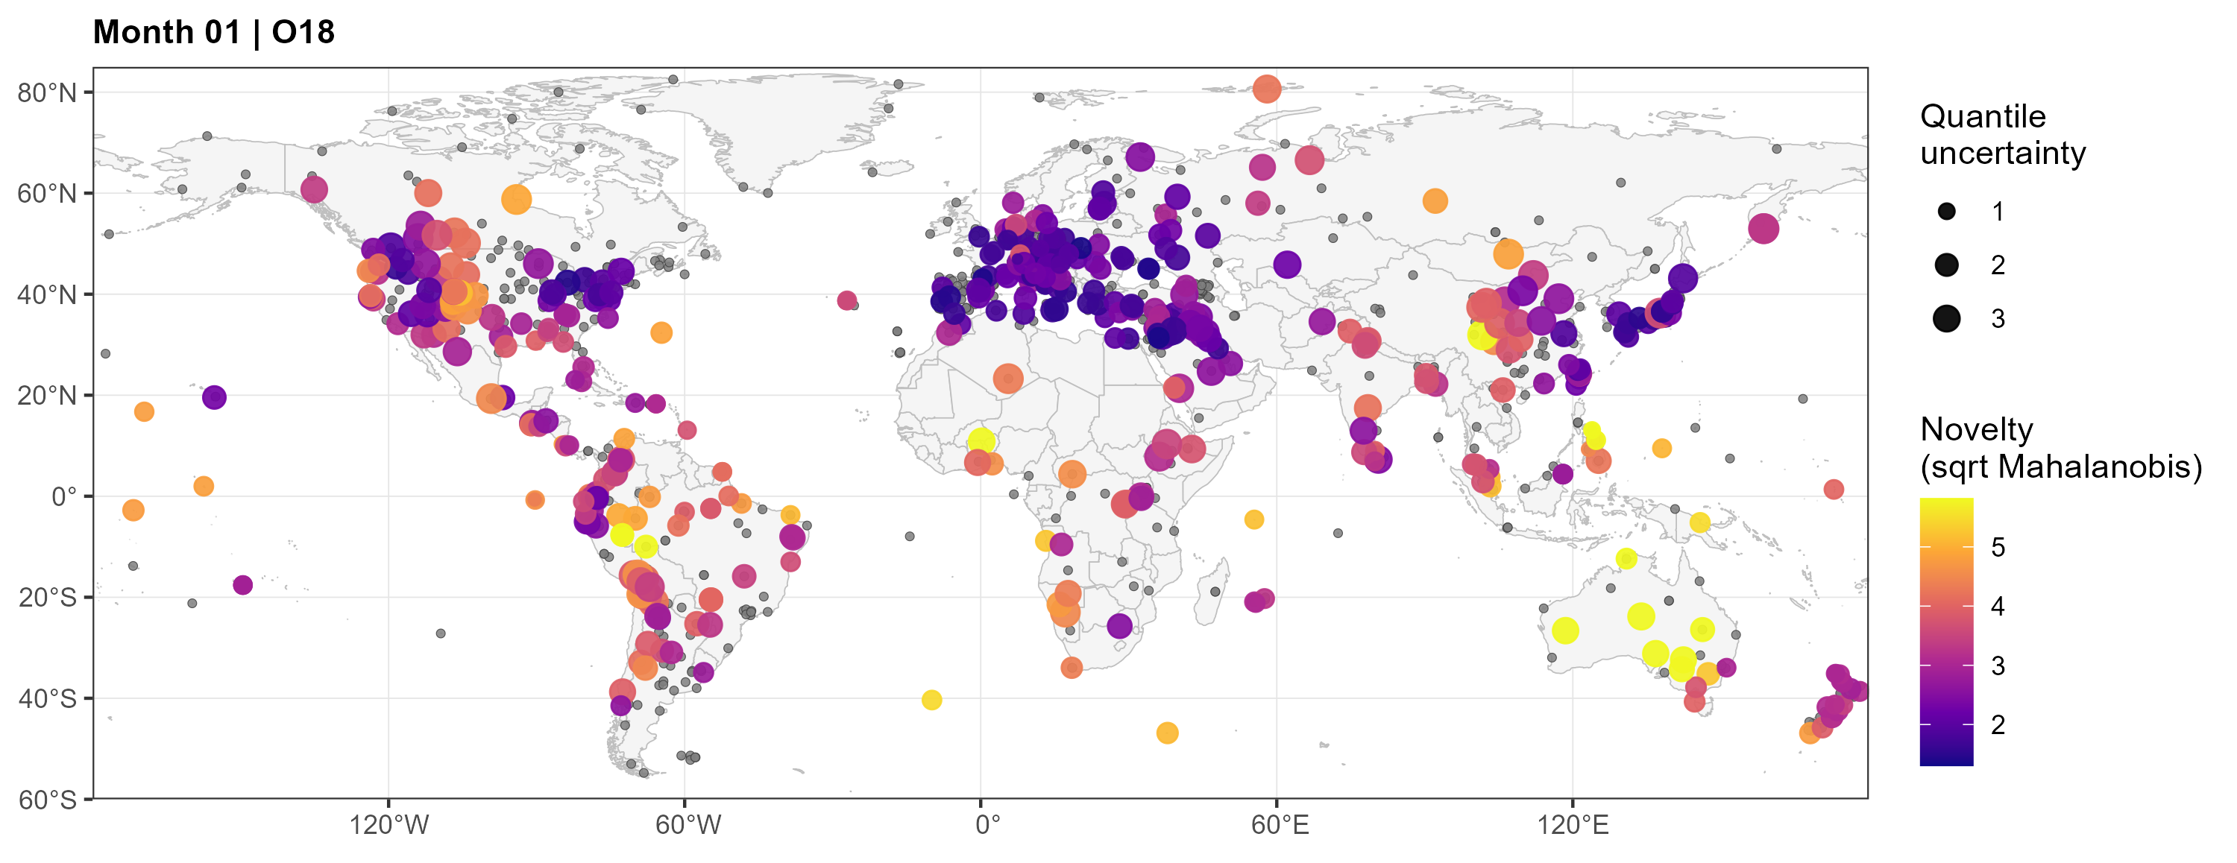
Results – Feature Space Analysis
Feature space novelty
Binned scatter (left): Feature-space novelty (Mahalanobis distance) against absolute prediction error (left) and quantile uncertainty (right). Uncertainty tracks novelty better than absolute error does.
Map (example): Test stations with colour (novelty) and size (uncertainty) encoding. Small grey dots are training stations. High novelty stations are consistently located in remote or data-sparse regions.

Slide 10
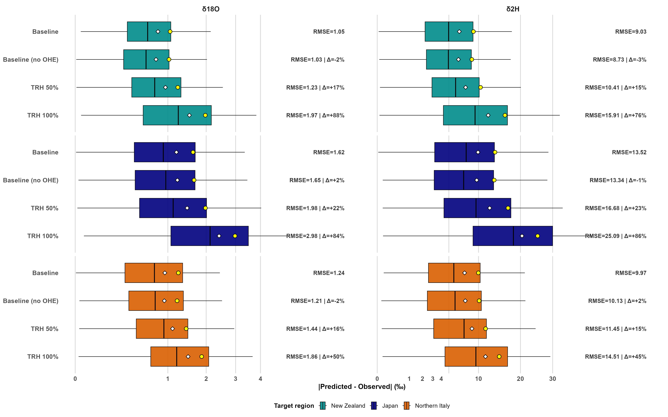
Results – Targeted Regional Holdouts I
Generalization was tested using regional holdout experiments. The plot shows the results for such experiments for Nea Zealand, Japan and Northern Italy. For each region the model ran once with 50% of the training data removed and once with 100% removed.
Reduced training data availability (- 50%) increased RMSE values by 15-23% compared to the single best model using one-hot region encoding. At 100% data removal RMSE increased by 45-88%.

Slide 11
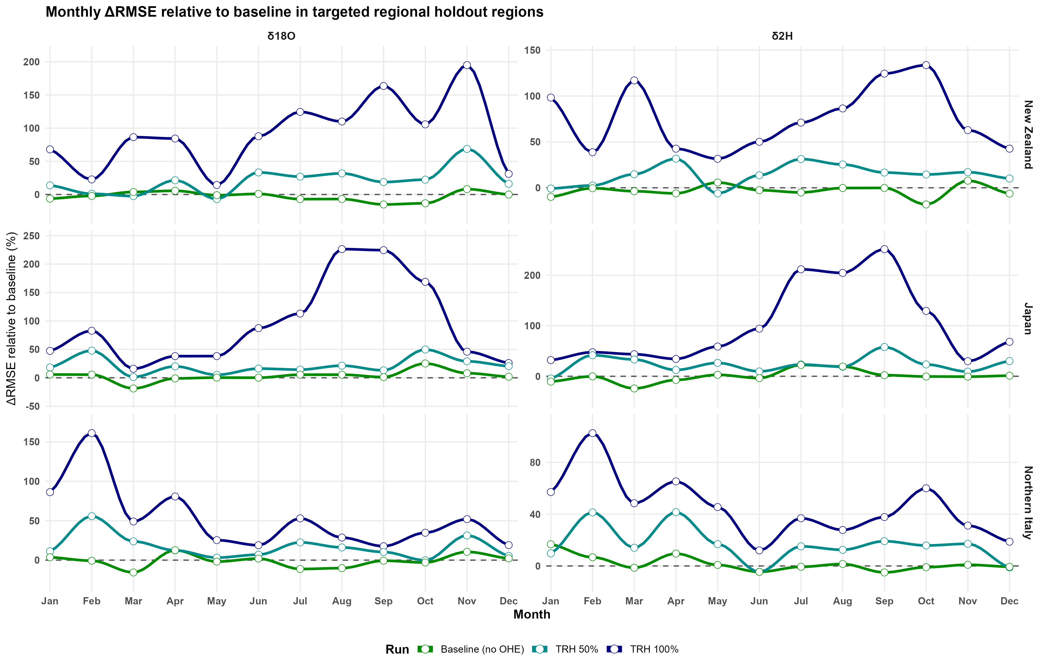
Results – Targeted Regional Holdouts II
Monthly model performance during holdout experiments.
Dashed horizontal line: Baseline RMSE (best model with region OHE)
Baseline (no OHE): Best model without region one-hot encoding
TRH 50%: 50% of regional SWI data removed
TRH 100%: 100% of regional SWI data removed

Slide 12
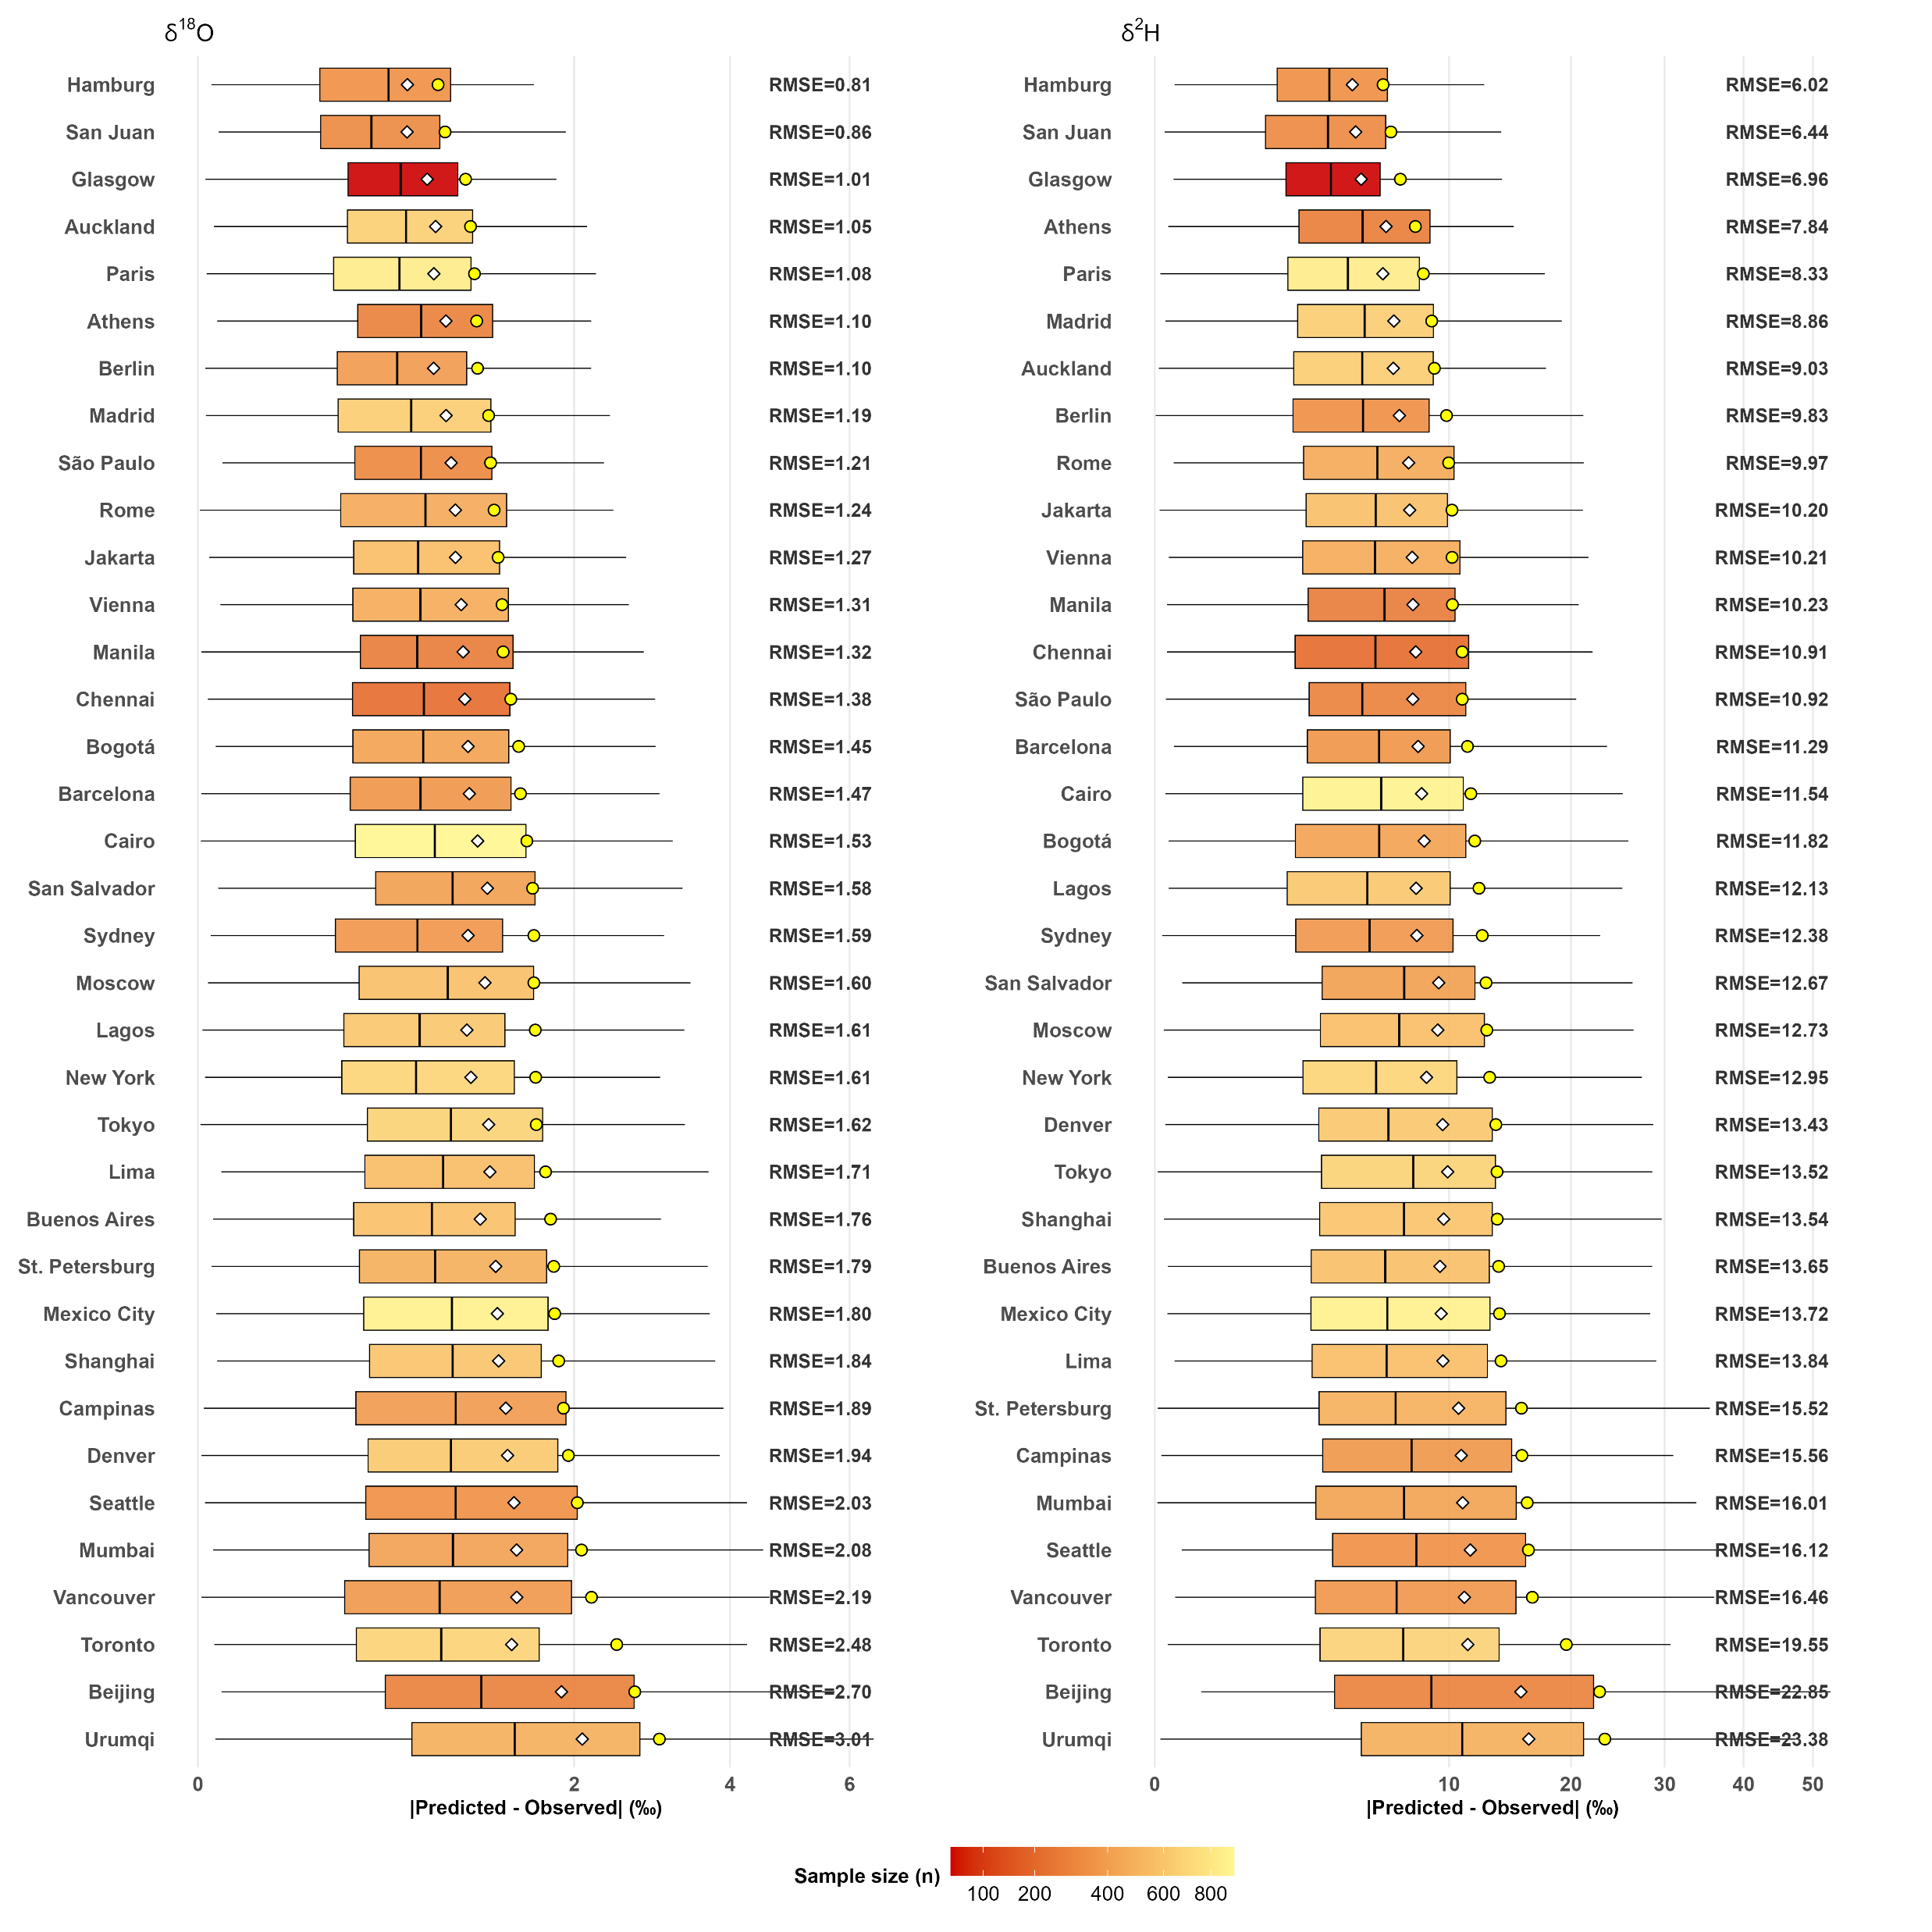
Results – Regional Performance
Map provides context for the regional modeling results
Regional RMSE values vary from 0.81 δ¹⁸O /6.02 δ²H (Hamburg region, from northern Germany to eastern Czechia) to 3.01 δ¹⁸O /23.38 δ²H (Urumqi region, south-western Mongolia to the Tibetan plateau)

Slide 13
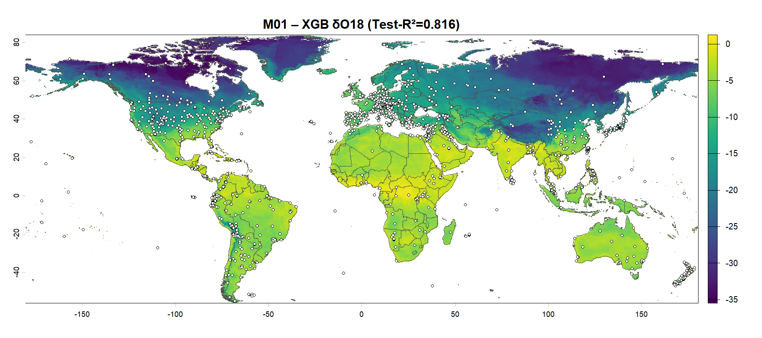
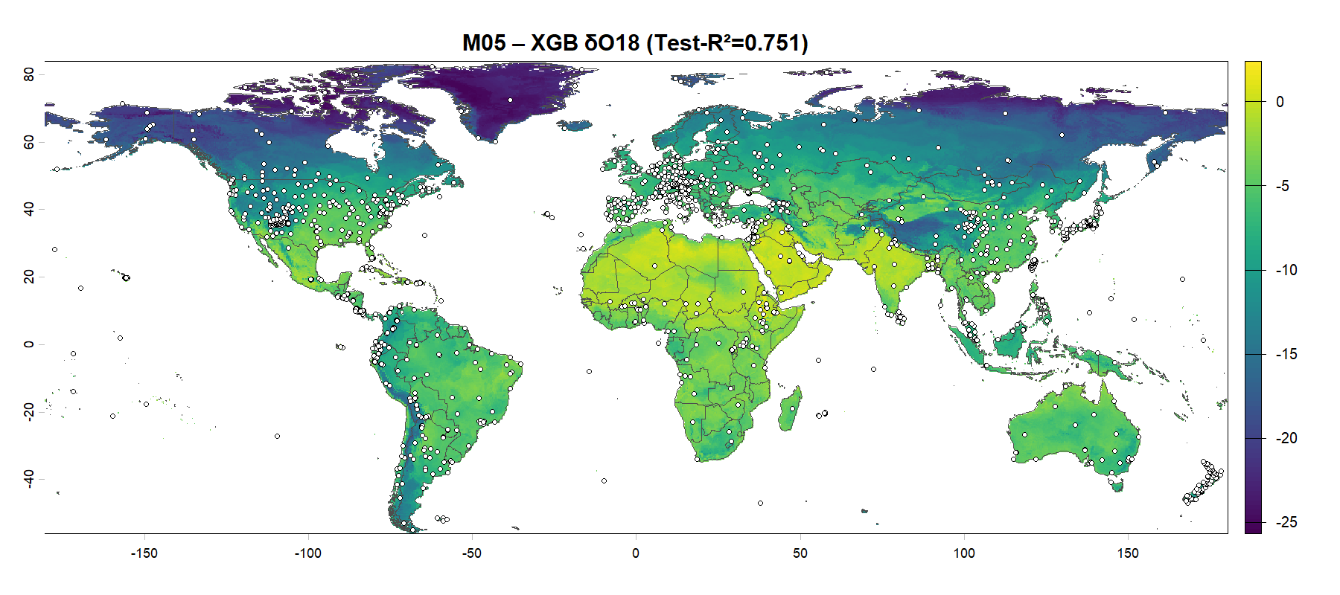
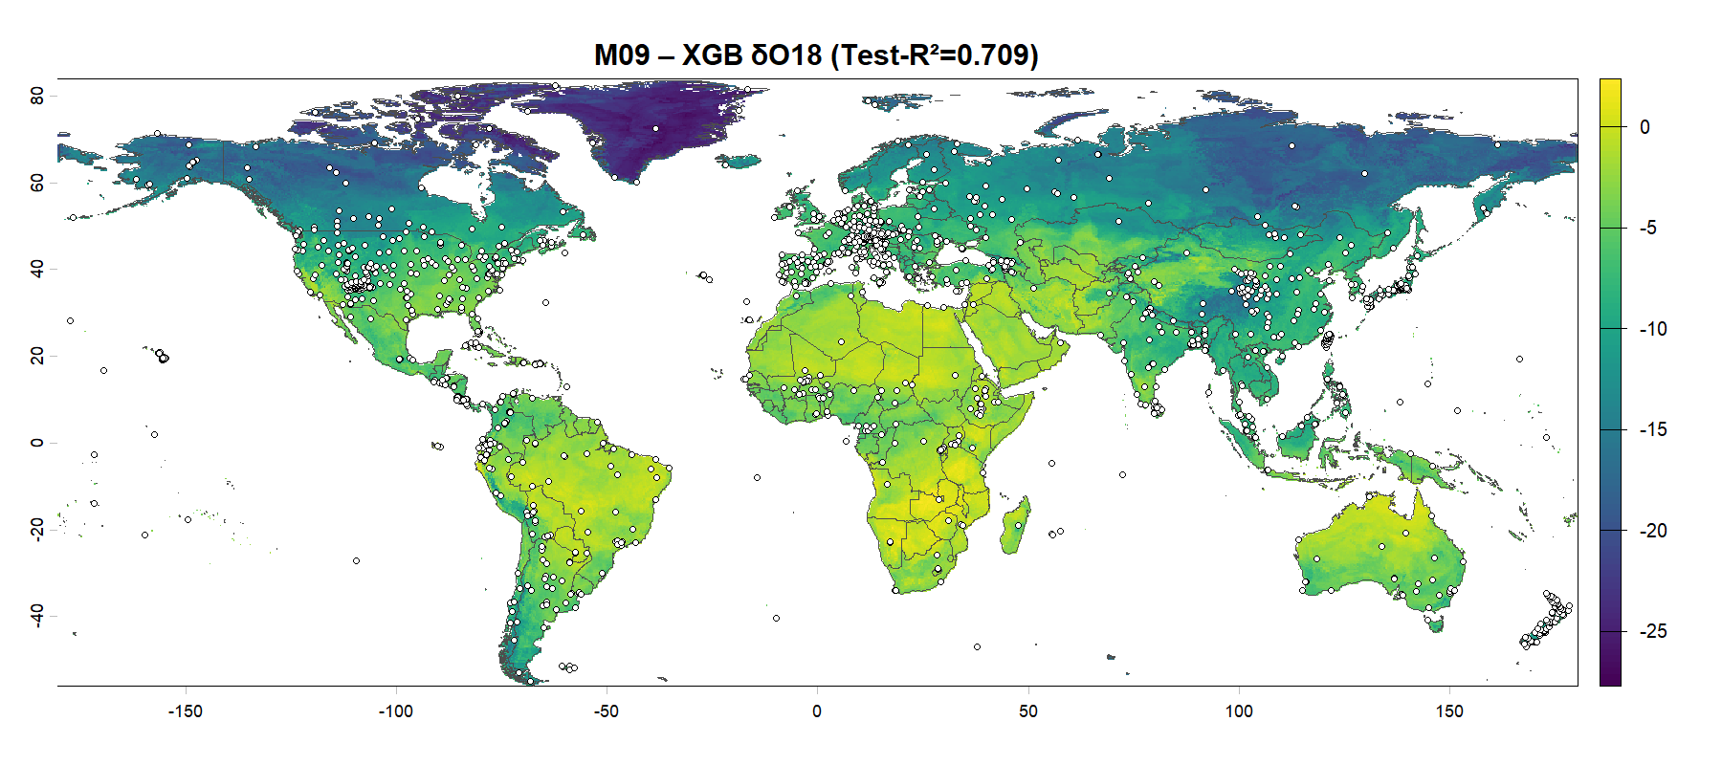

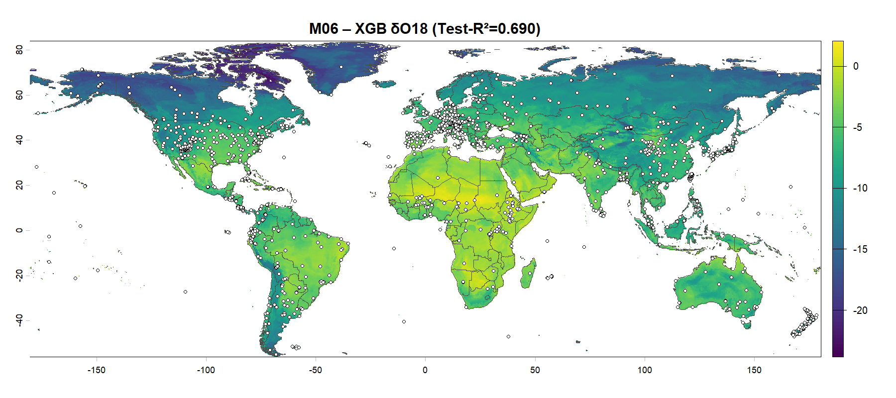
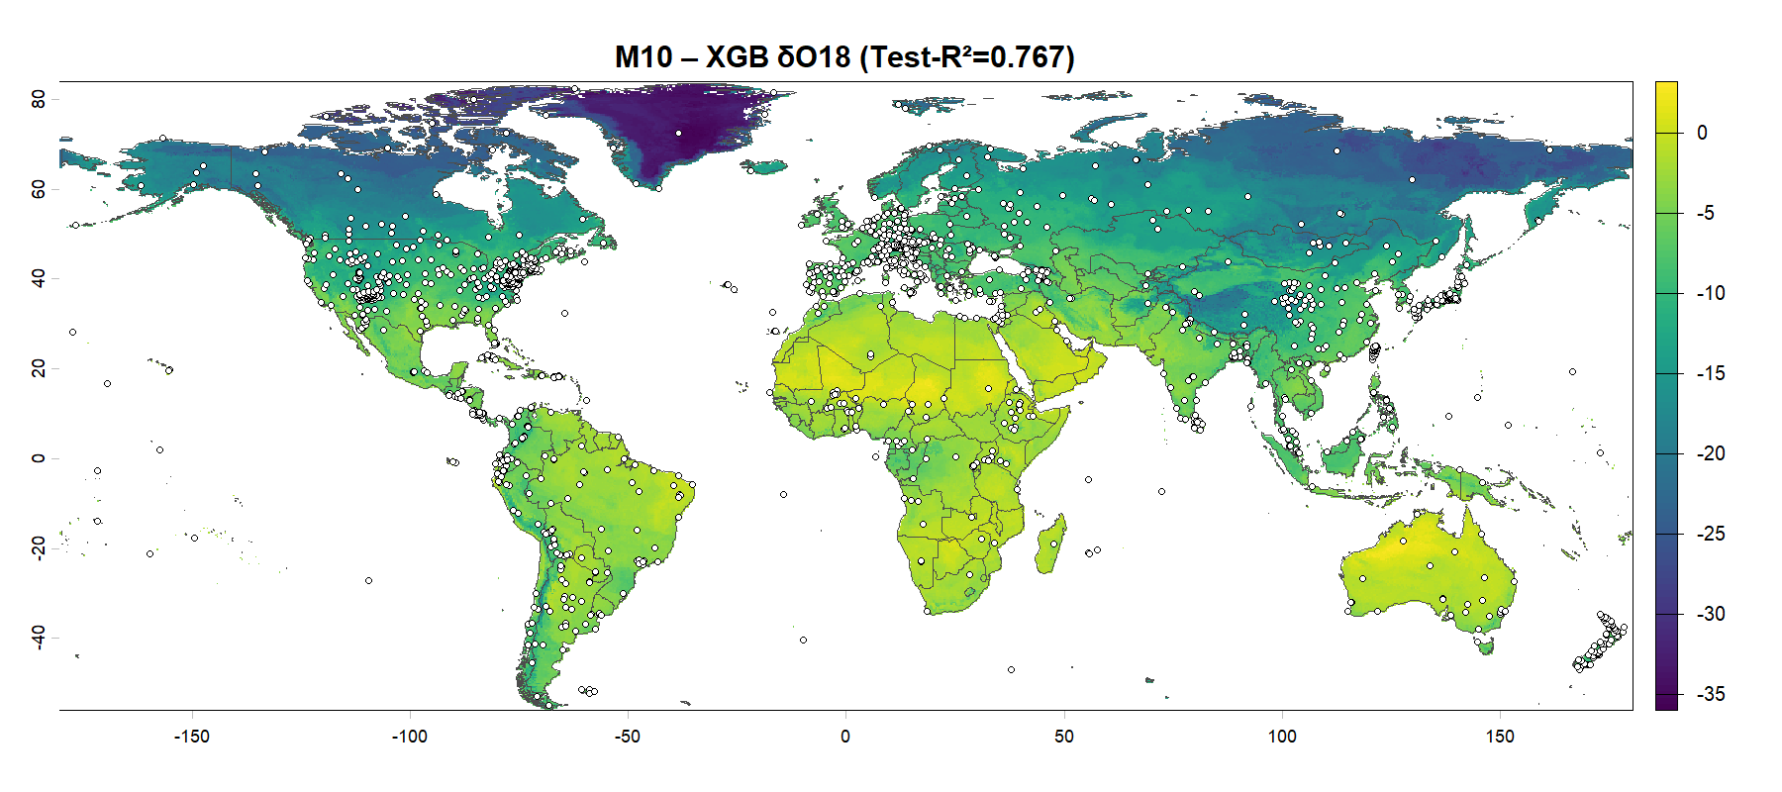
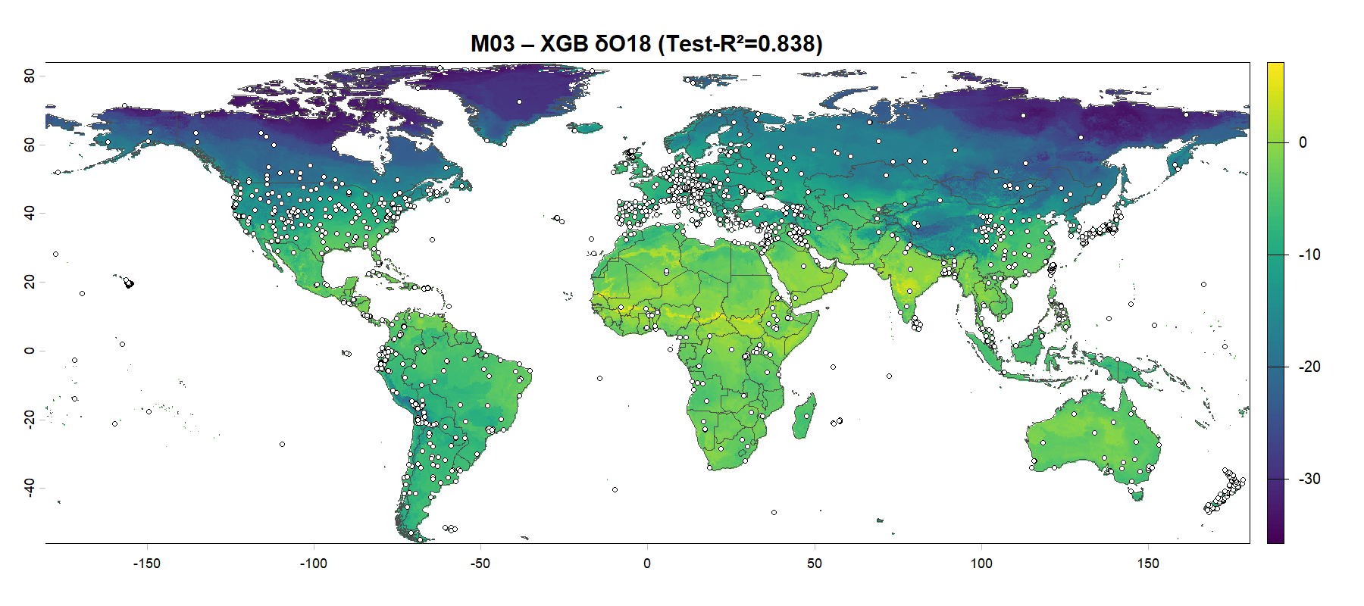
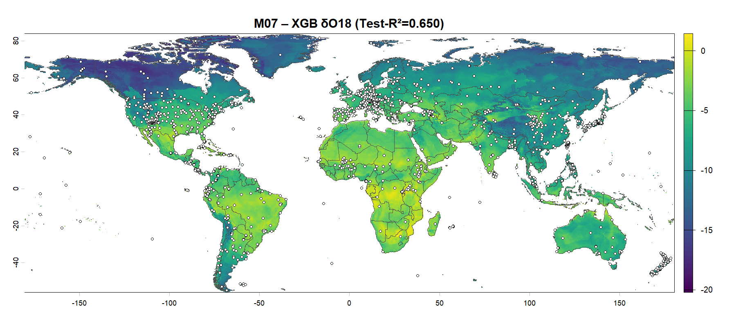
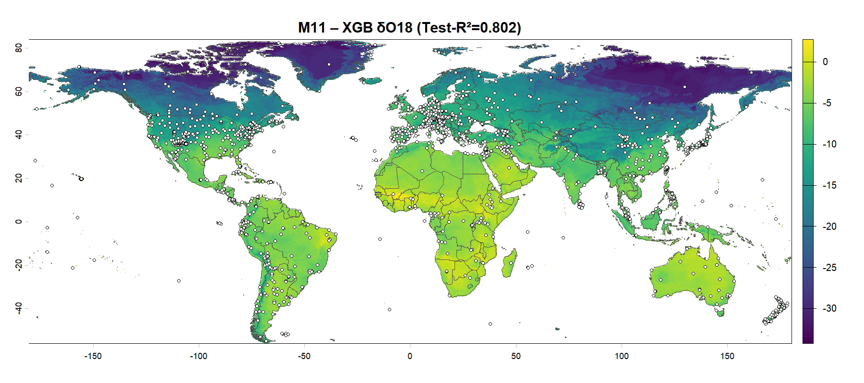
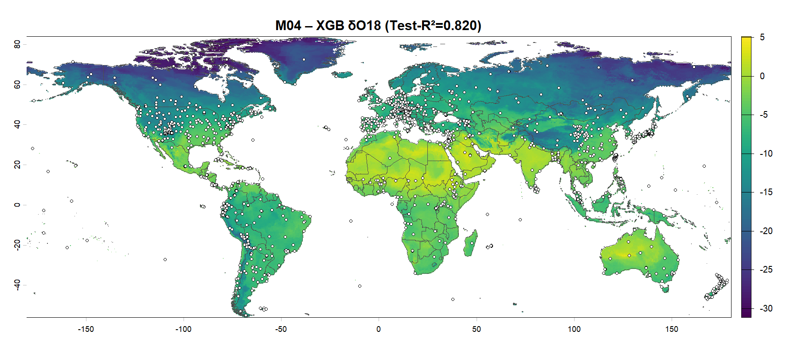
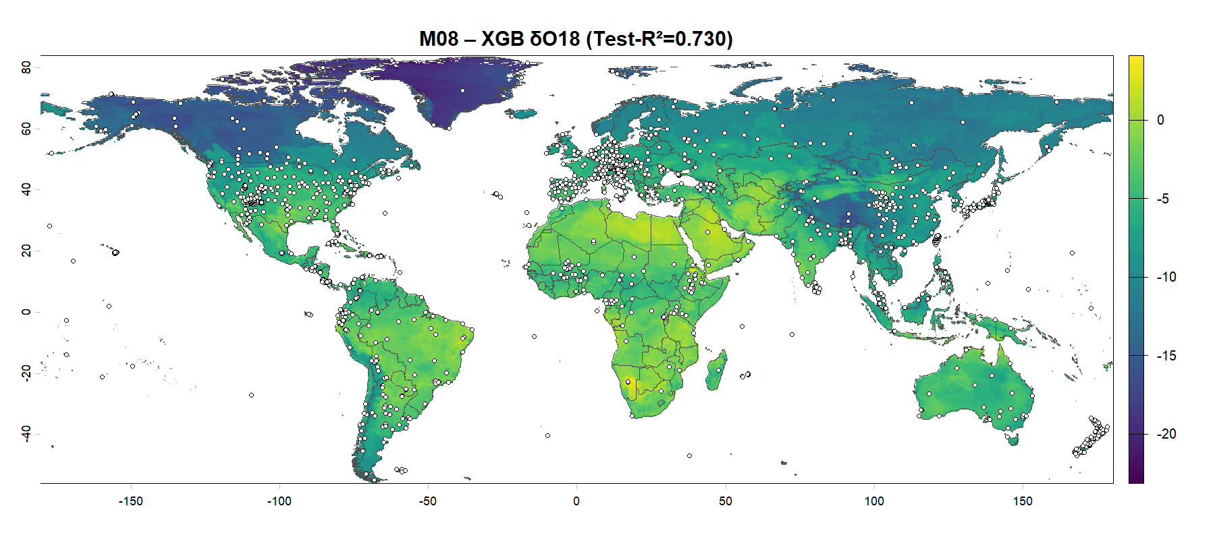

Results – Isoscapes for δ¹⁸O

Slide 14
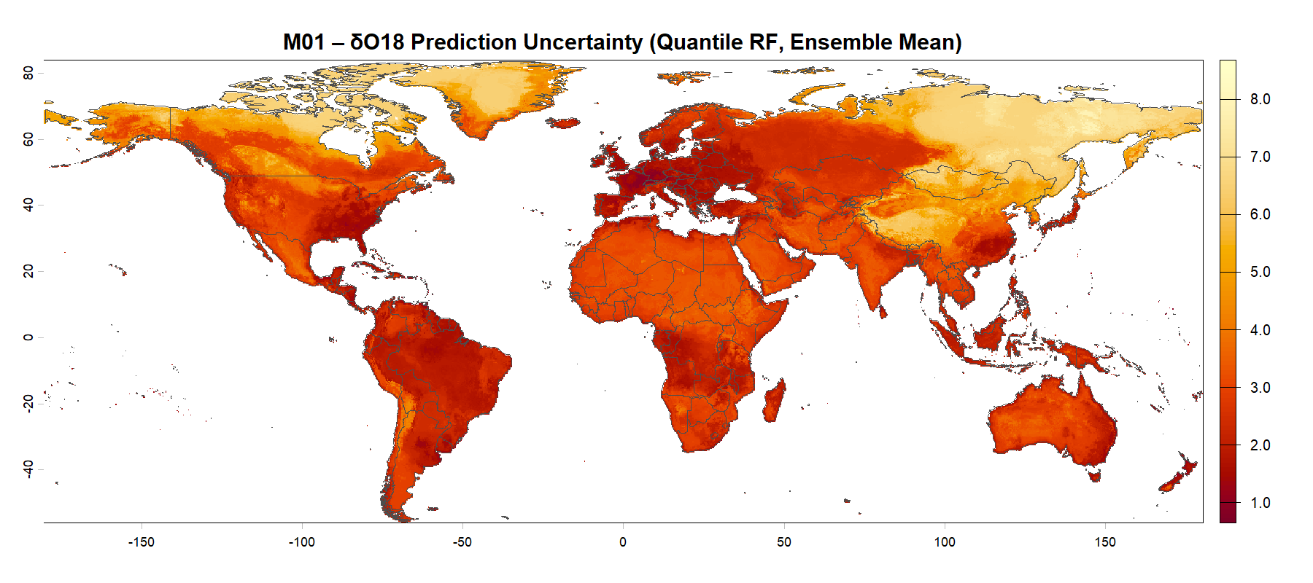
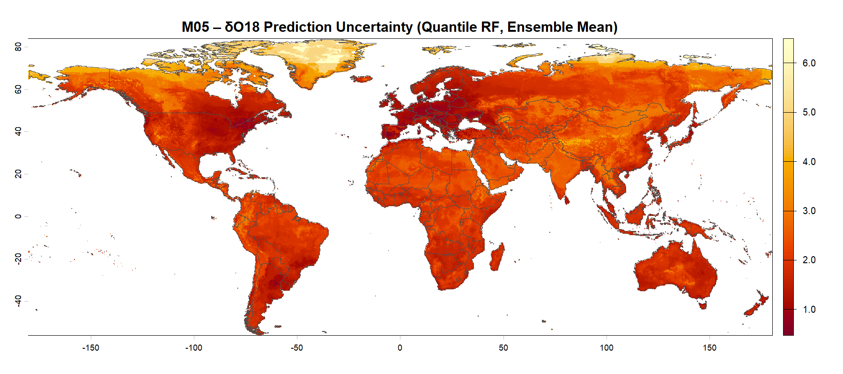
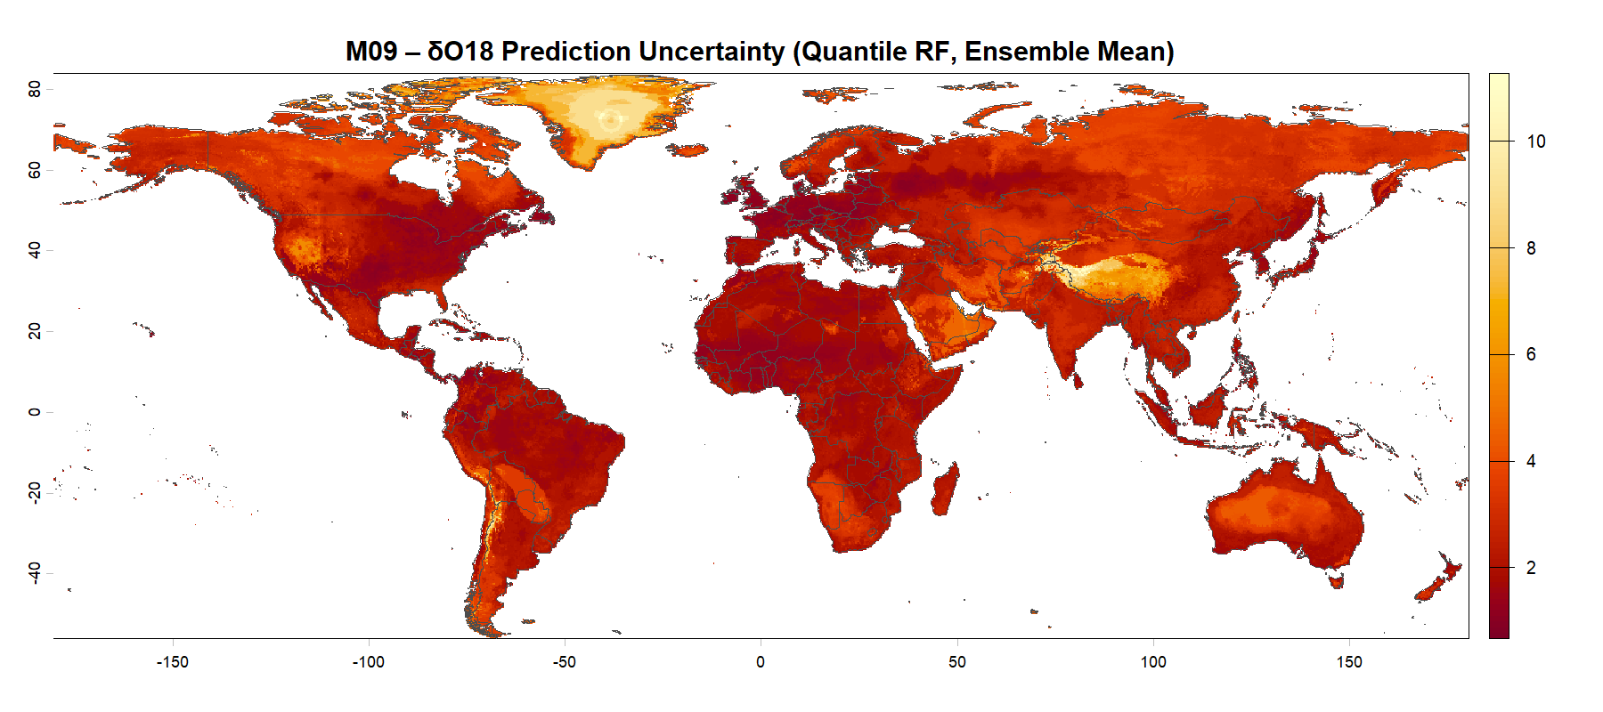
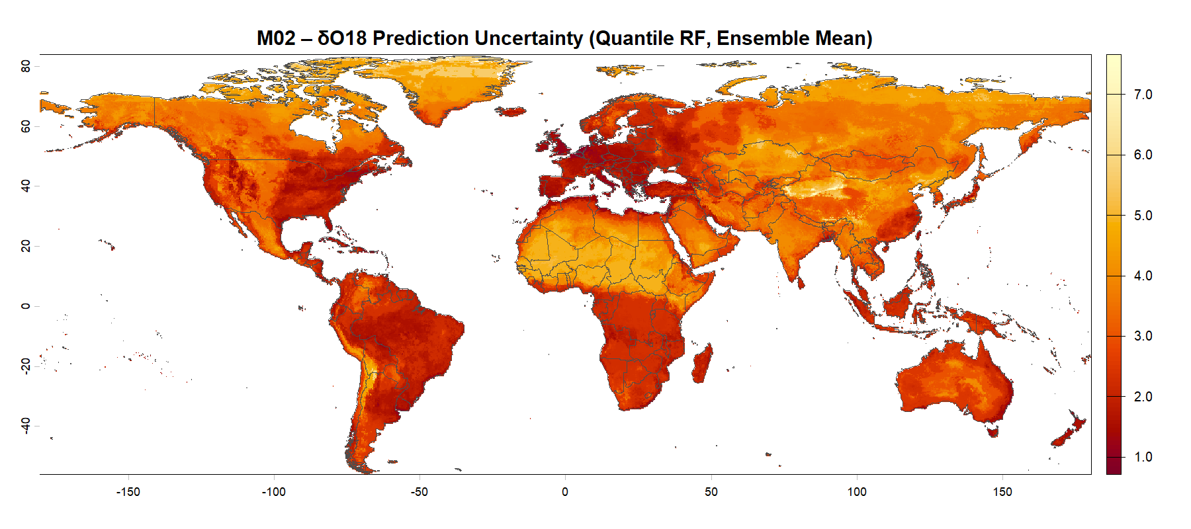
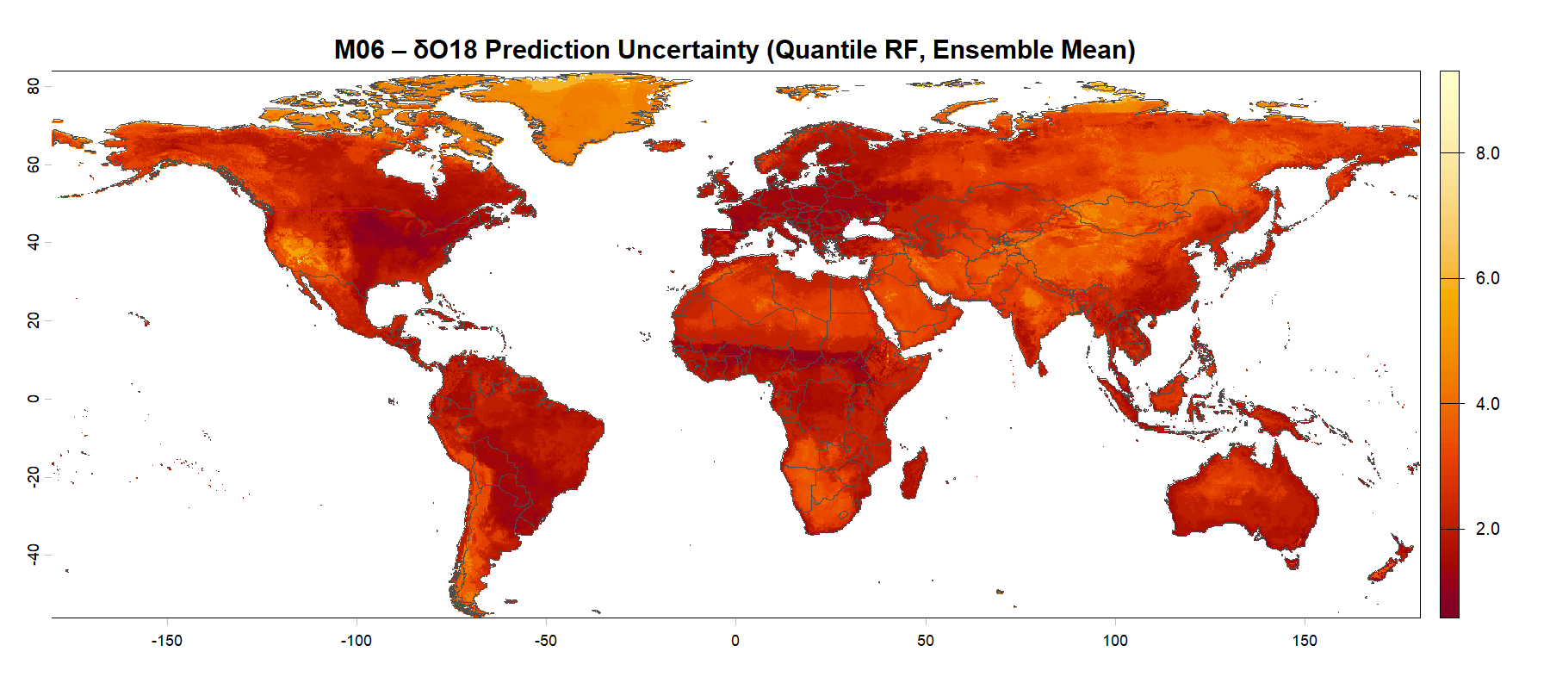
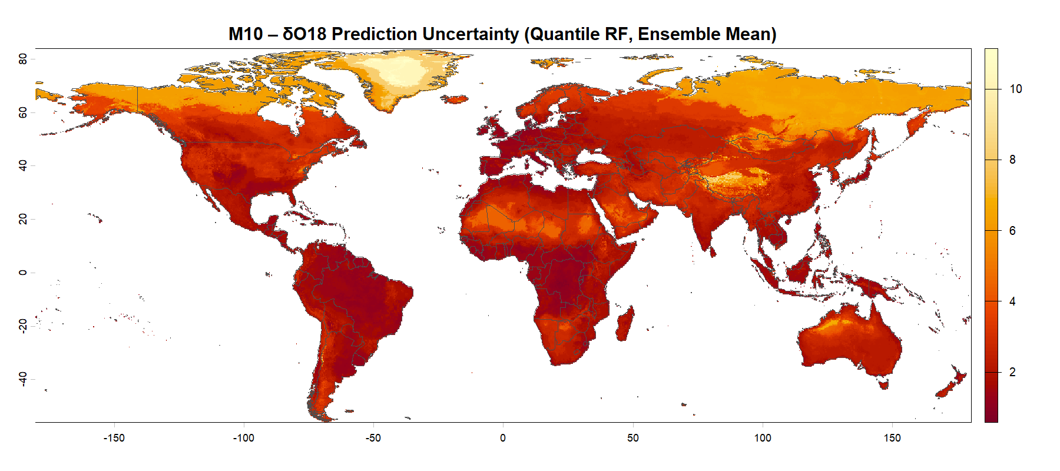
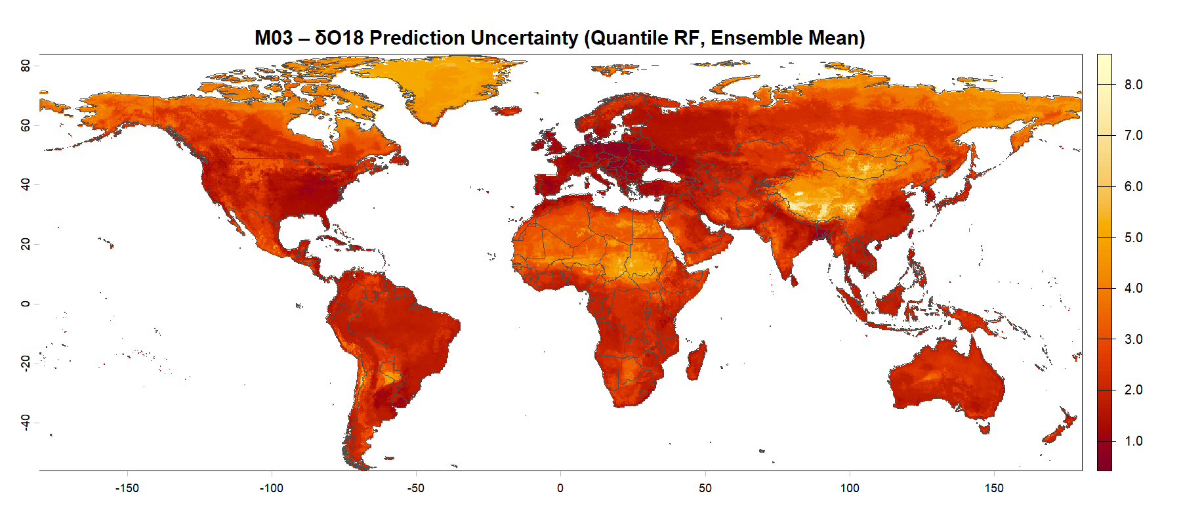
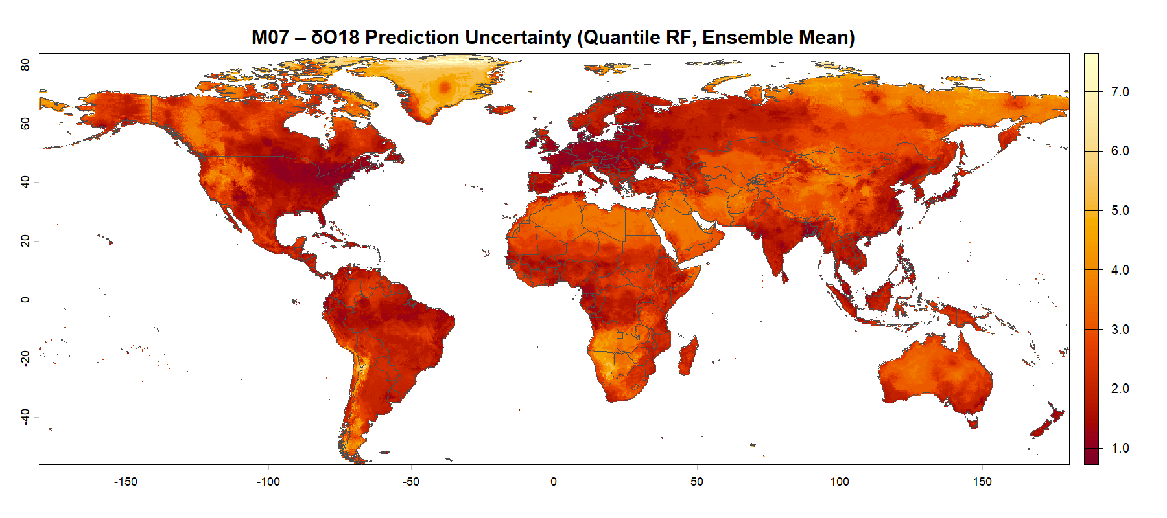
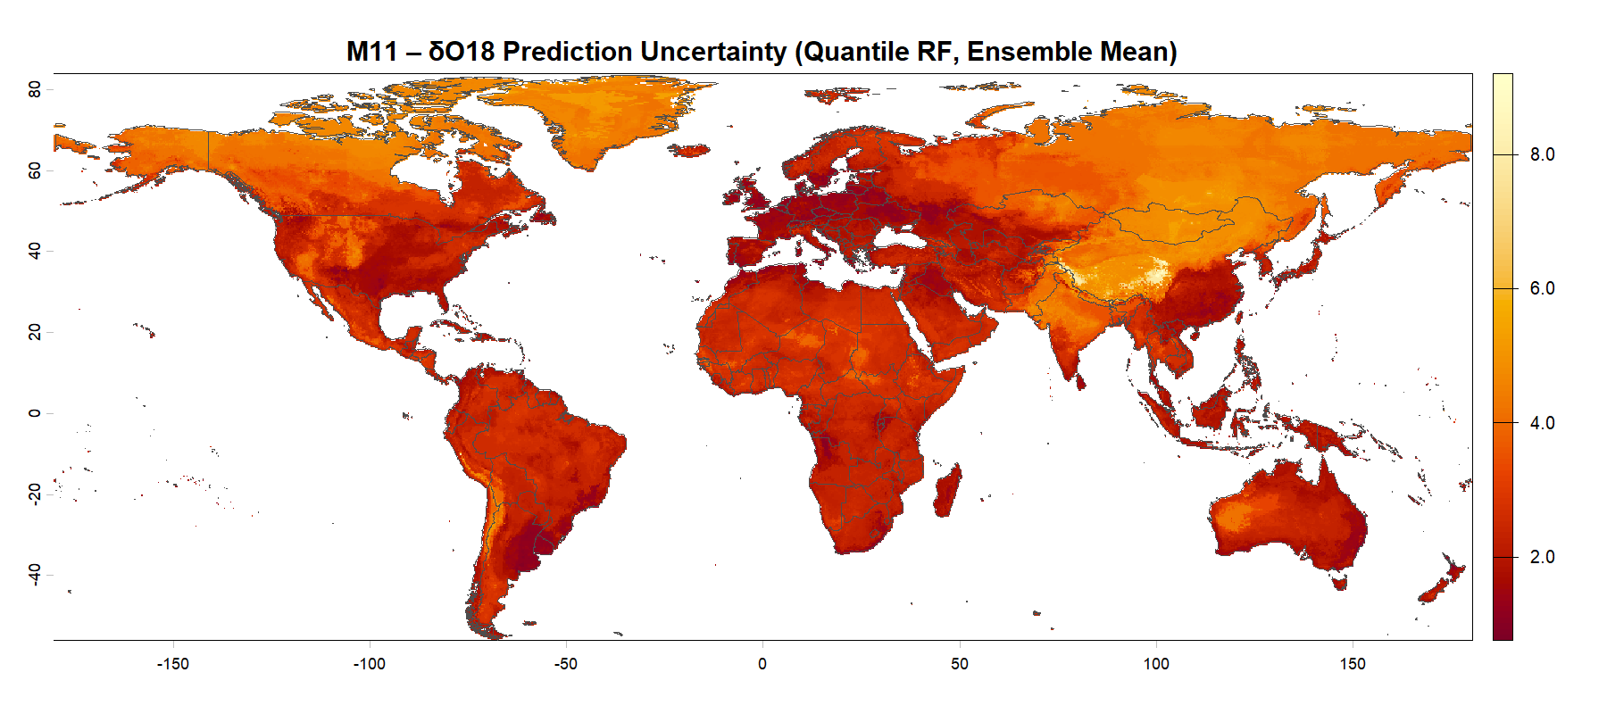
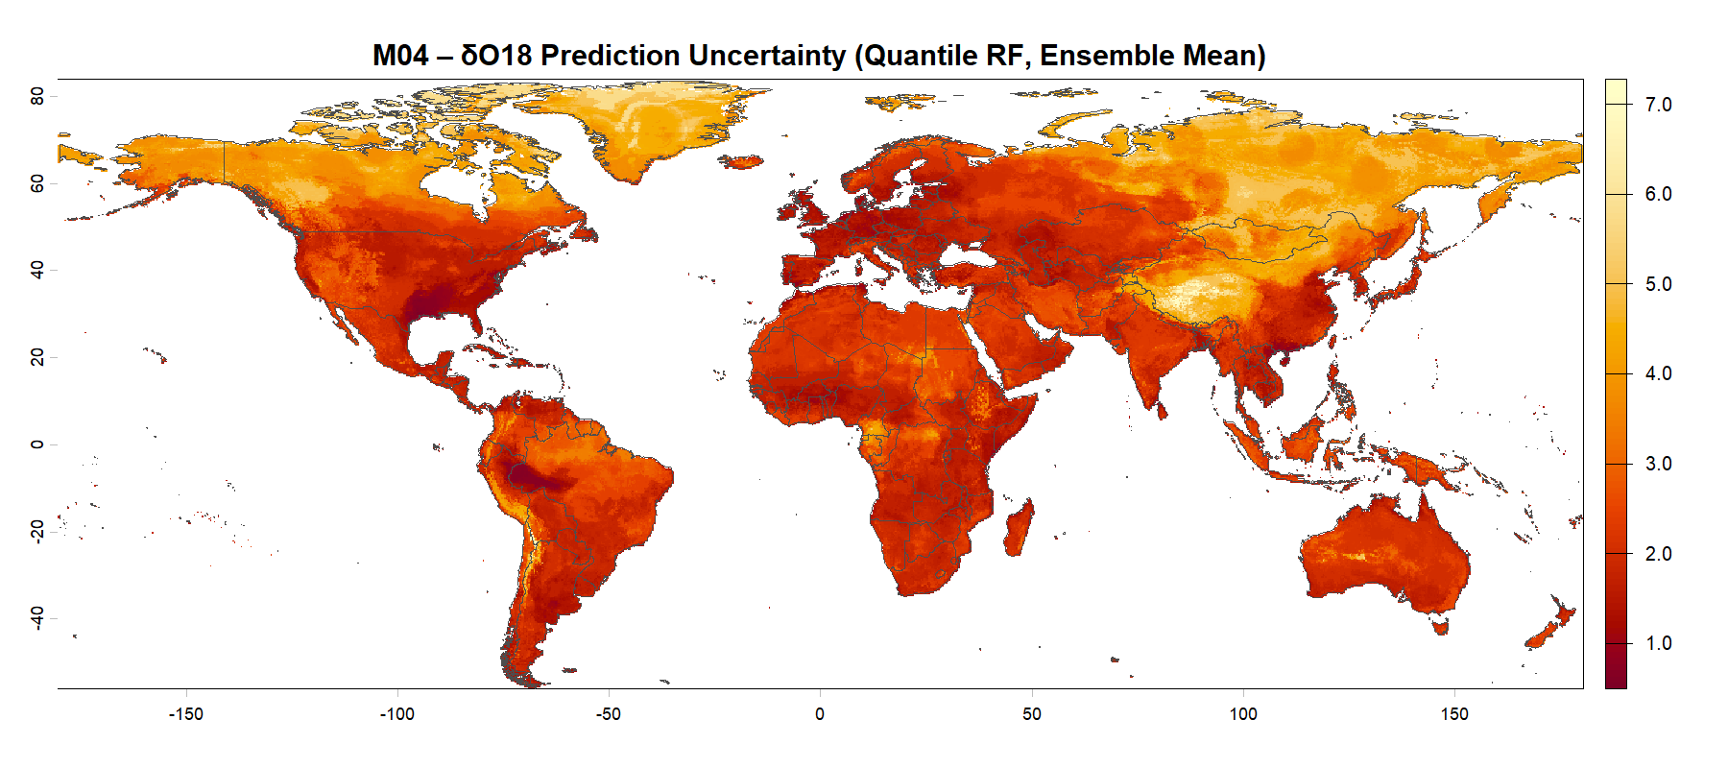
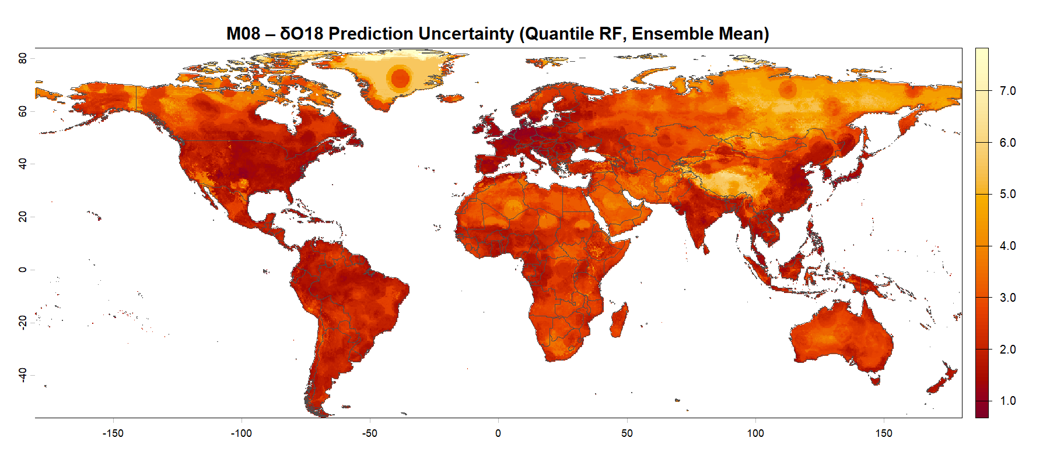
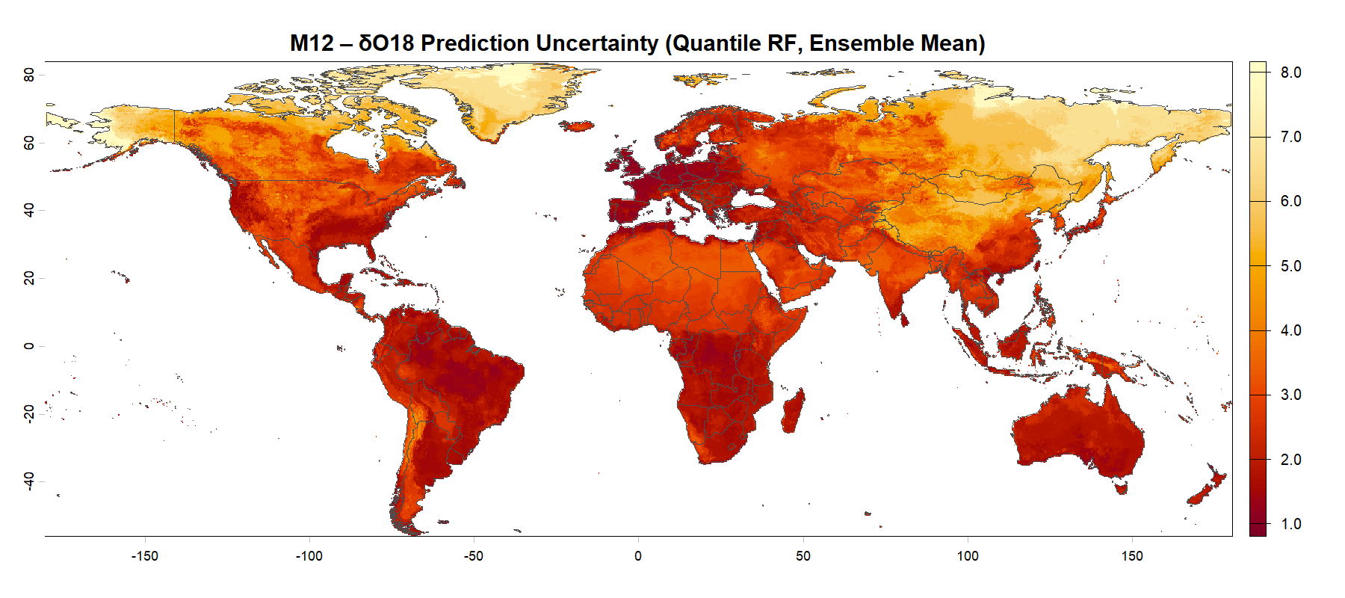
Results – Calibrated Uncertainties for δ¹⁸O

Slide 15
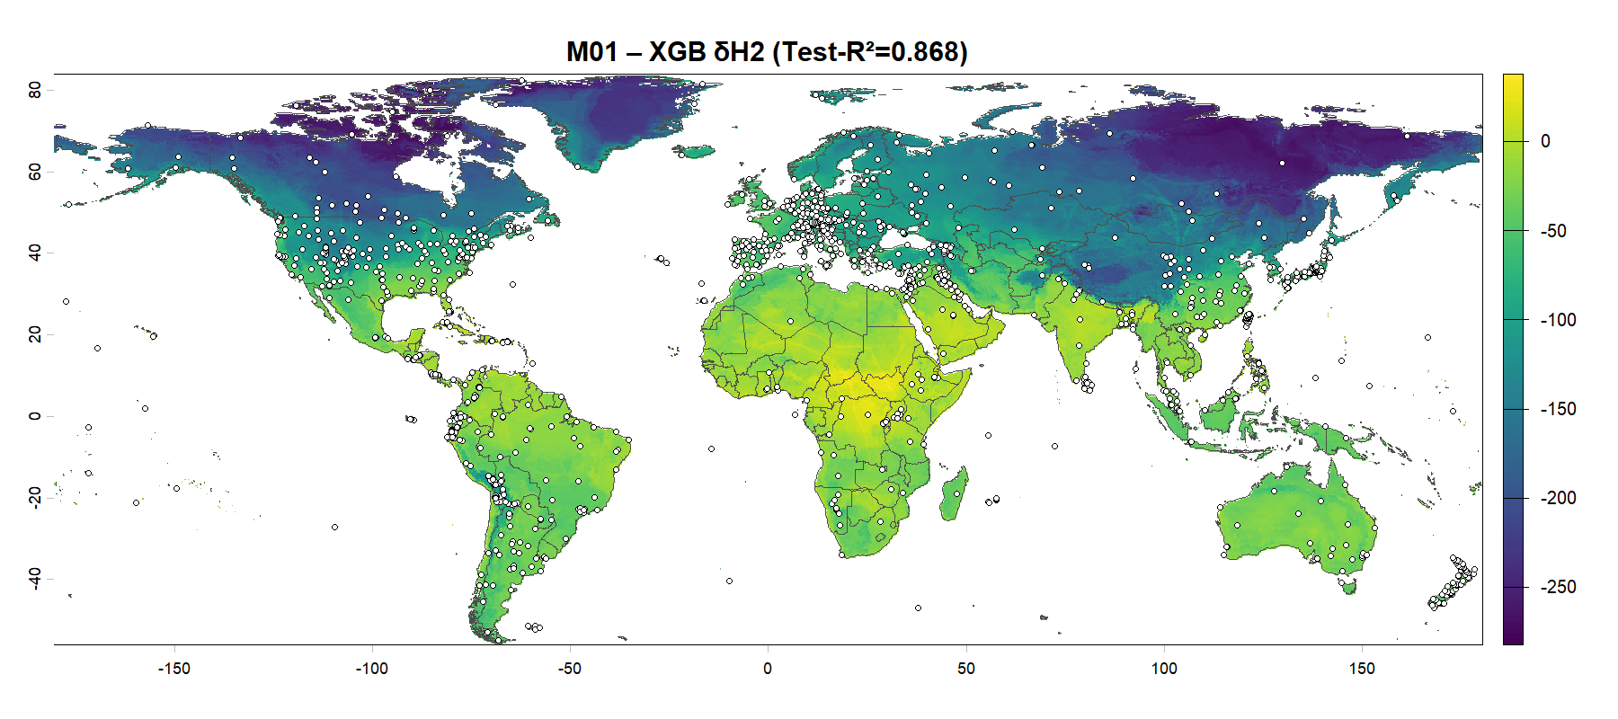
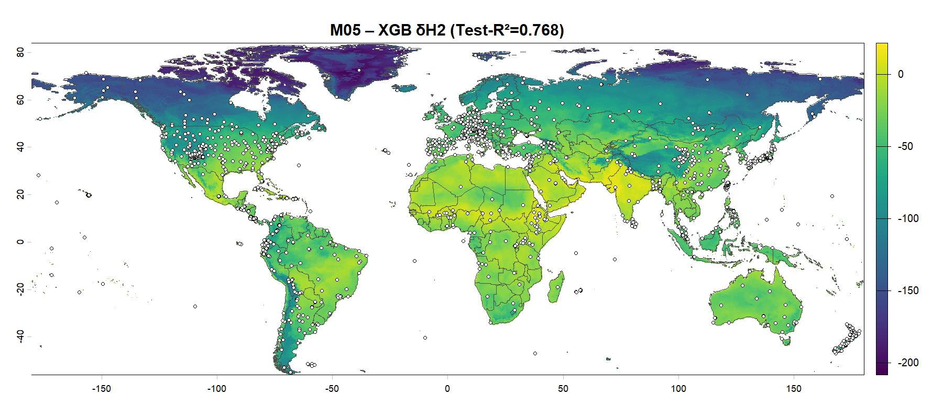


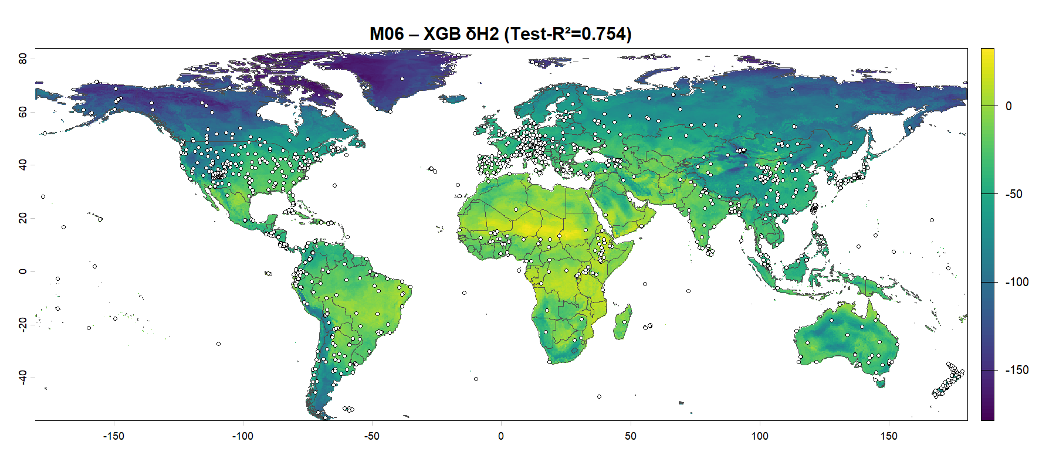
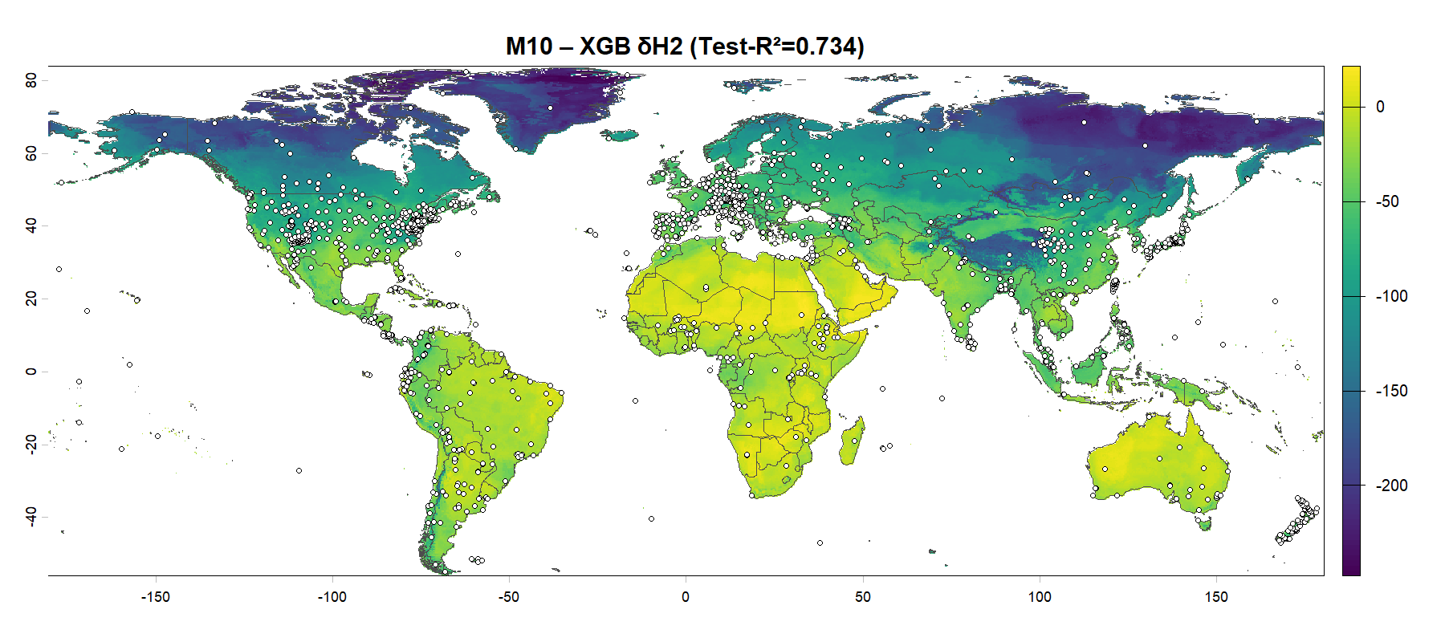
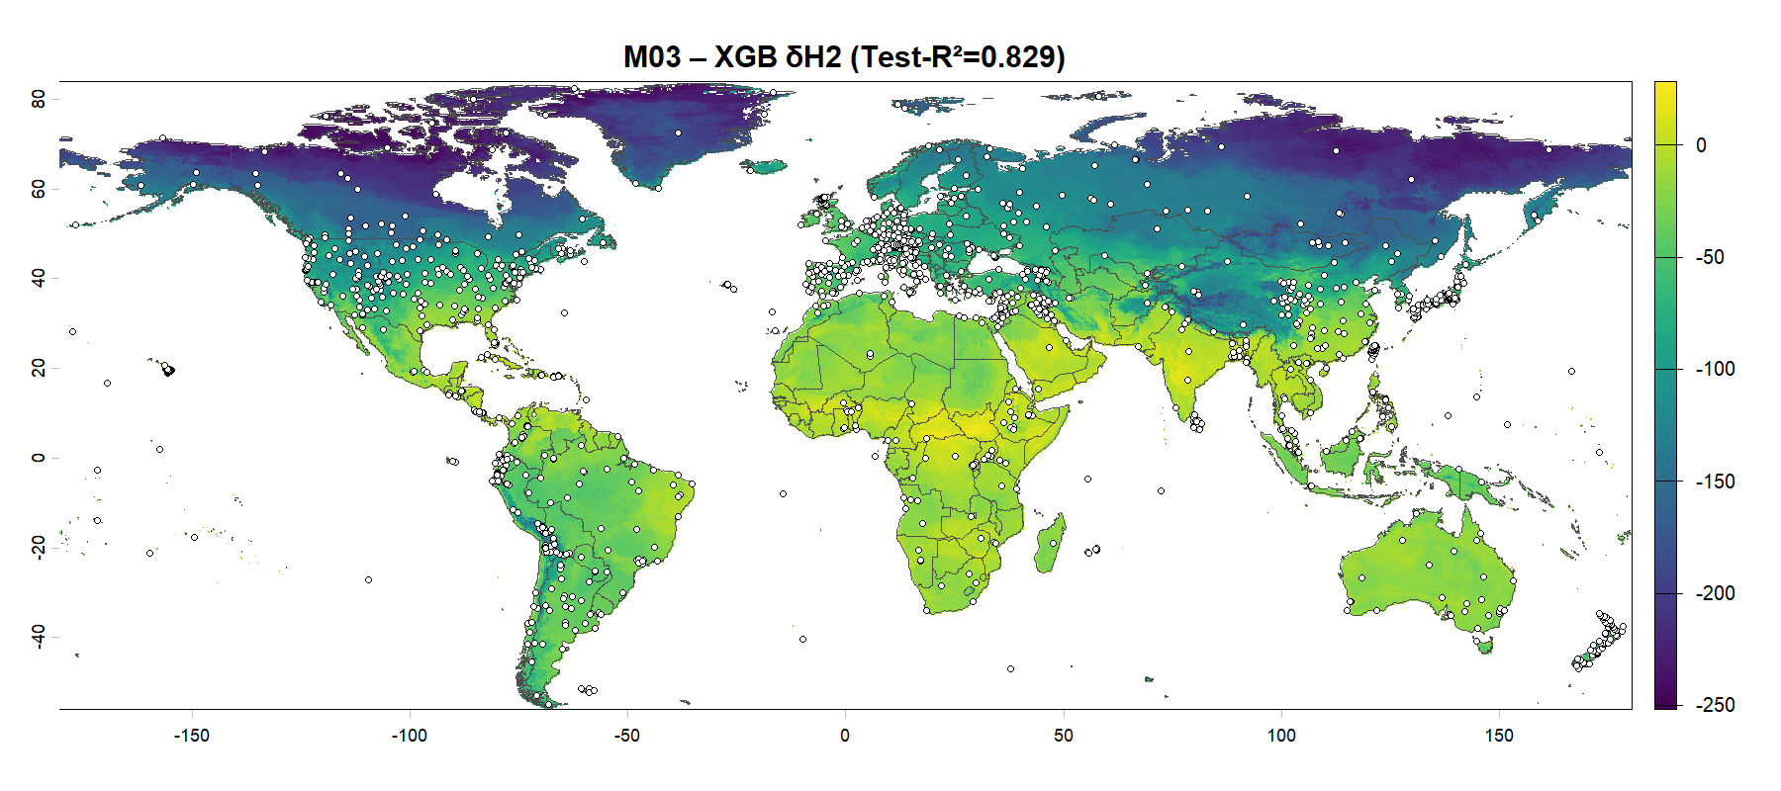
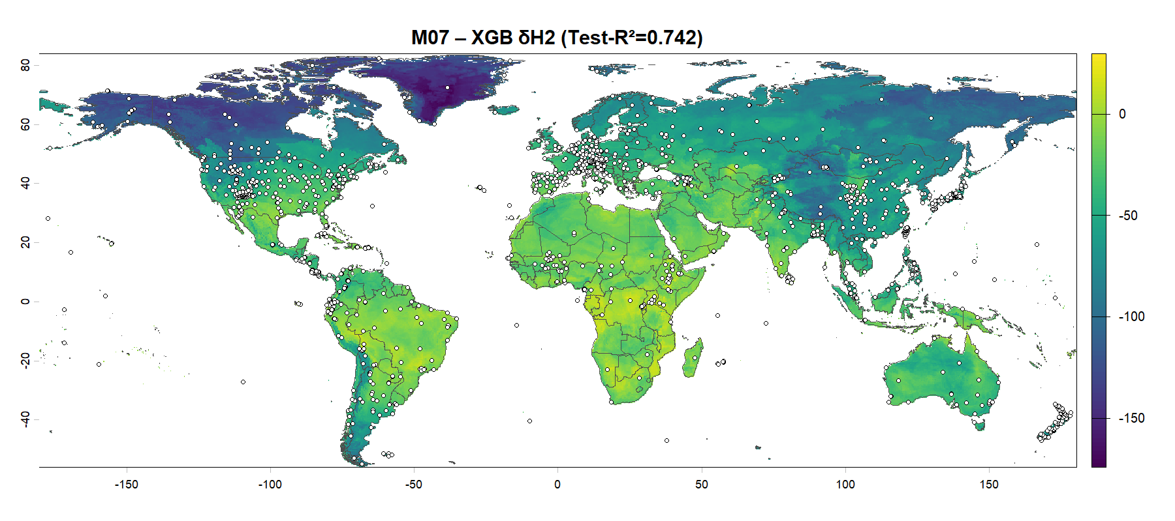
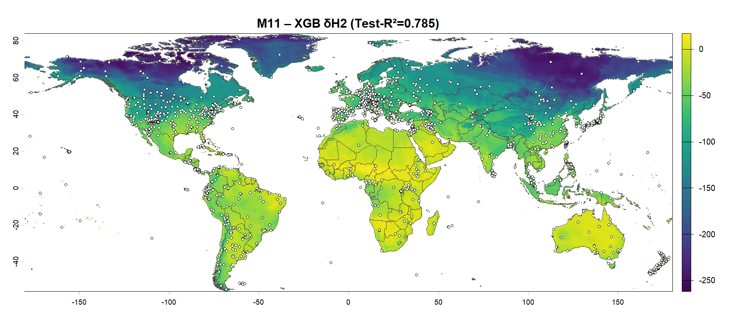
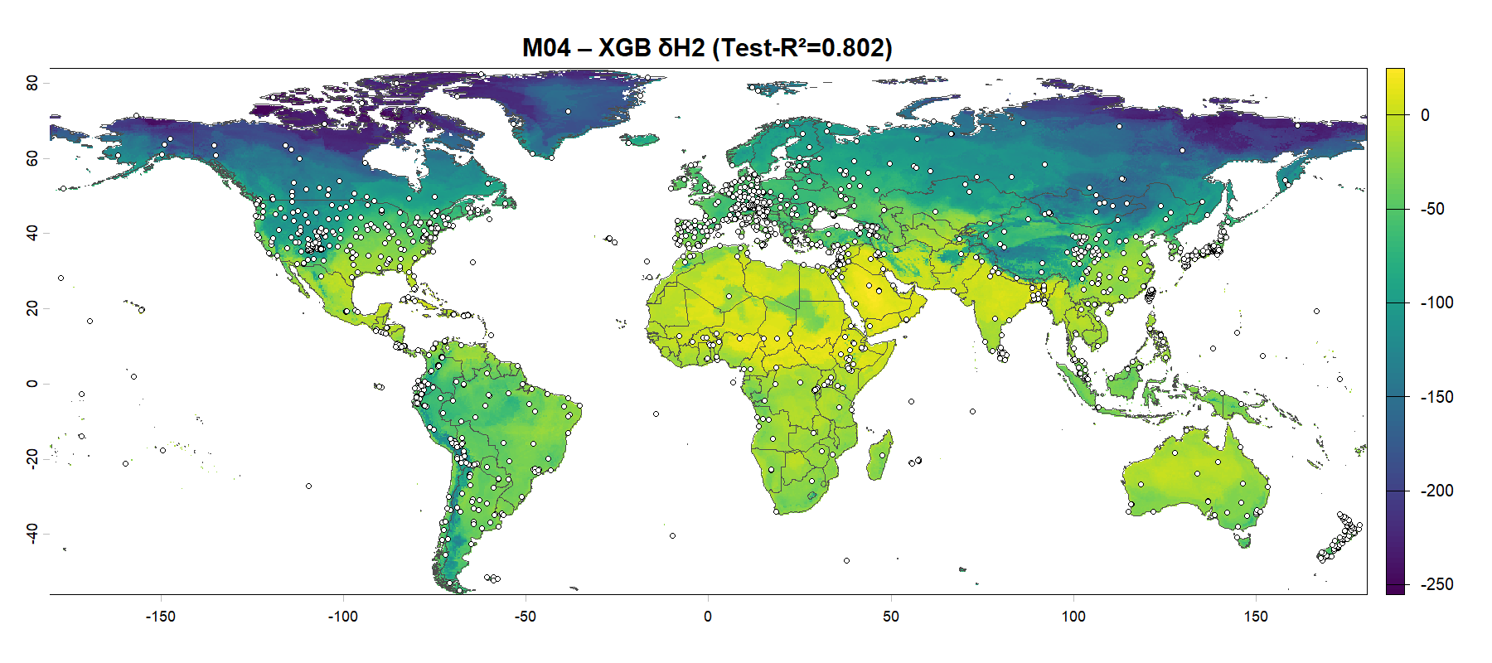
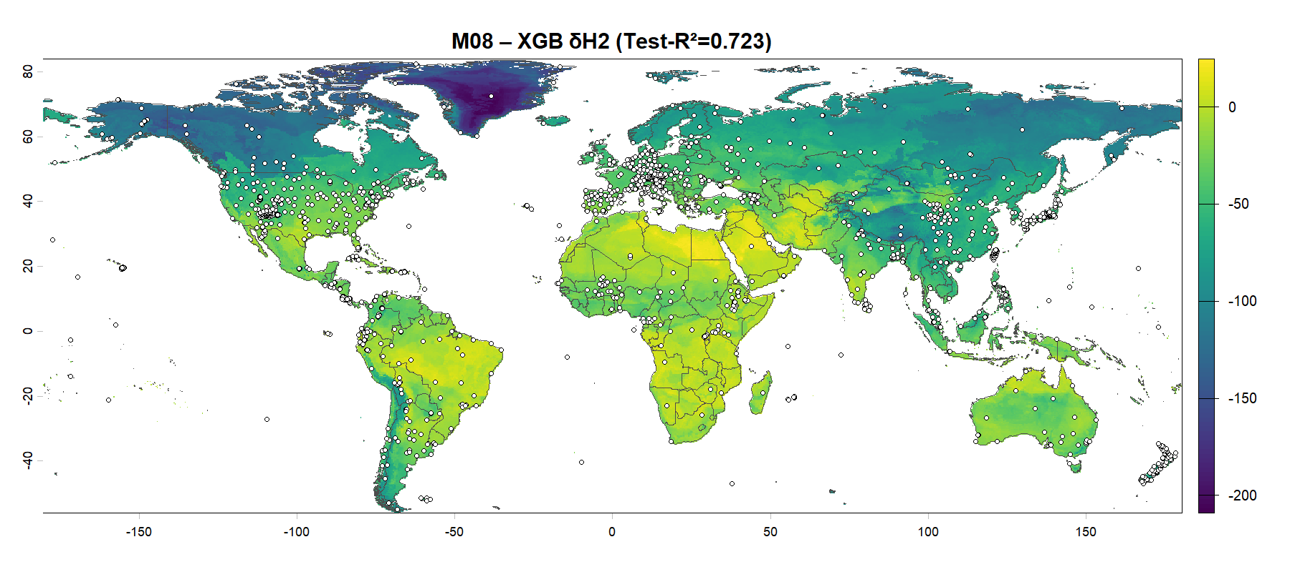

Results – Isoscapes for δ²H

Slide 16
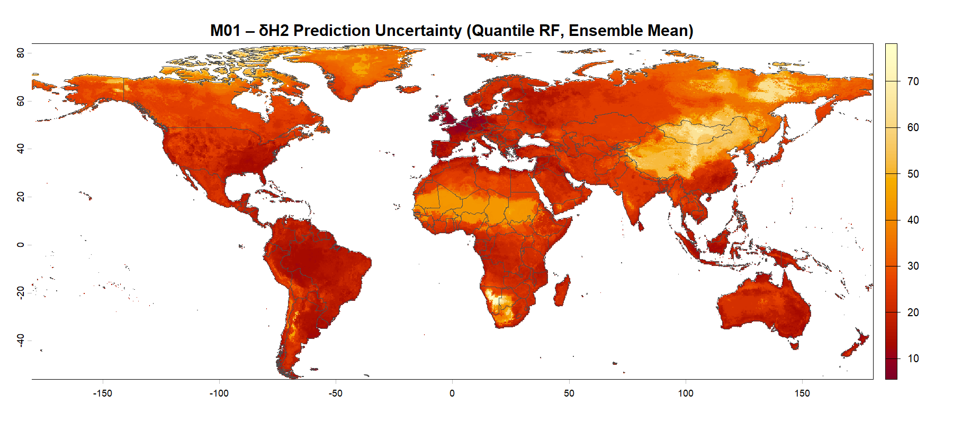











Results – Calibrated Uncertainties for δ²H

