Slide 1
The Copernicus Marine Service global ocean analysis and forecasting 1/12° high-resolution system. Recent changes and future evolution.
Jean-Michel Lellouche¹, Eric Greiner², Giovanni Ruggiero¹, Romain Bourdallé-Badie¹, Charles-Emmanuel Testut¹,
Olivier Le Galloudec¹, Mounir Benkiran¹, Stéphane Law Chune¹, Ergane Fouchet¹
¹Mercator Ocean International, Toulouse, France
²CLS, Ramonville Saint Agne, France

Slide 2
Outline
Quick overview of the global operational system : main components and some recent updates
Additional upgrades we are planning within the Copernicus Marine Service : first promising results

Slide 3
Components and main recent updates of the system
Since November 2022, within the framework of the Copernicus Marine Service, Mercator Ocean has been delivering real-time products (weekly analyses and daily 10-day forecasts) based on an updated version of the global high-resolution system at 1/12°, called GLO12.
Along track altimeter Sea Level Anomaly (SLA), sea surface temperature (SST), sea ice concentration (SIC) and in situ temperature and salinity (T/S) vertical profiles are assimilated in the model using a reduced-order Kalman filter method.
In addition, A 3D-Var scheme is used to better control the slowly evolving large-scale biases in T/S.
Main changes introduced in the system:
New version of NEMO ocean and sea ice models;
Higher spatial and temporal resolution (1/15° - 1 hour) atmospheric forcing;
Assimilation of L3 ODYSSEA SST product instead of L4 OSTIA gridded product;
New Mean Dynamic Topography for SLA assimilation;
Improved parametrization of the model error covariance deduced from the GLORYS12 reanalysis;
4D extension of the data assimilation scheme allowing a better spatiotemporal continuity of mesoscale structures;
Use of satellite-based monthly estimates of the Global Mean Sea Level to better constrain the ocean mass and the steric height.

Slide 4

Additional updates in the framework of the CMS
As part of the Copernicus Marine Service, it is essential to consider the feedback and needs of users to address any issues and continuously improve the system’s performance.
System
evolution
Feedback
loop
Analyse
User
feedback
In this context, the GLO12 system benefited in November 2025 from the introduction of wave forcing to improve dynamics and the system behaviour in the mixing layer depth.
During 2026, the GLO12 system will also benefit from several evolutions, such as:
daily analyses to improve forecast quality,
the assimilation of SWOT wide-swath observations to improve ocean currents and fronts.

Slide 5
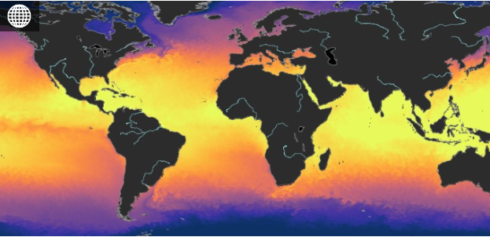
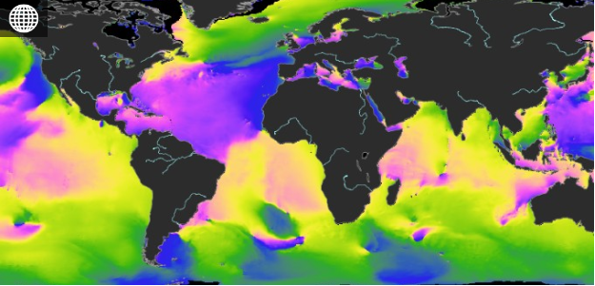
Introduction of wave forcing
Ocean current components
GLO12 (ocean)
GLOWAVE (waves)
Wave-induced Surface stress
Wave-induced Surface mixing
Wave-induced Stokes drift interactions
This involves three families of interaction processes :
net ocean surface stress corrected by wave budget,
surface turbulence driven by wave breaking,
interaction of ocean dynamics with Stokes currents.

Slide 6
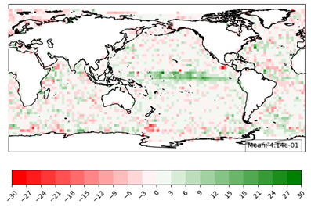
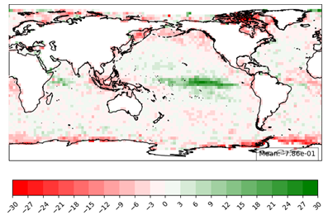
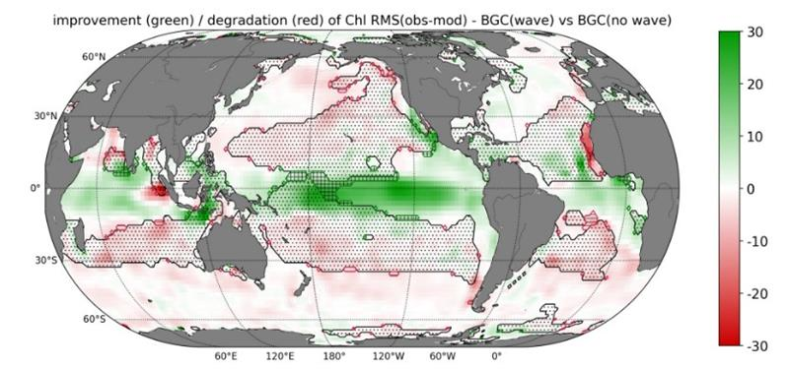
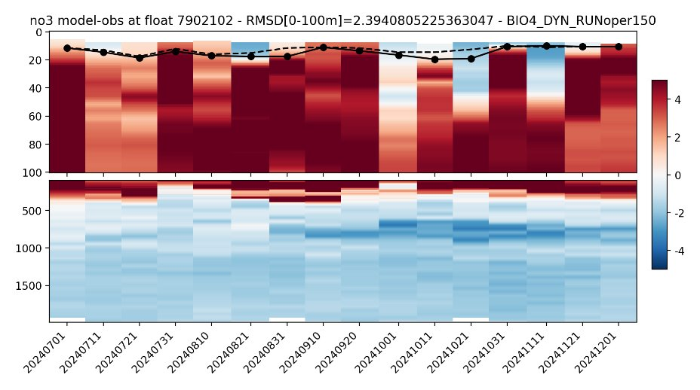
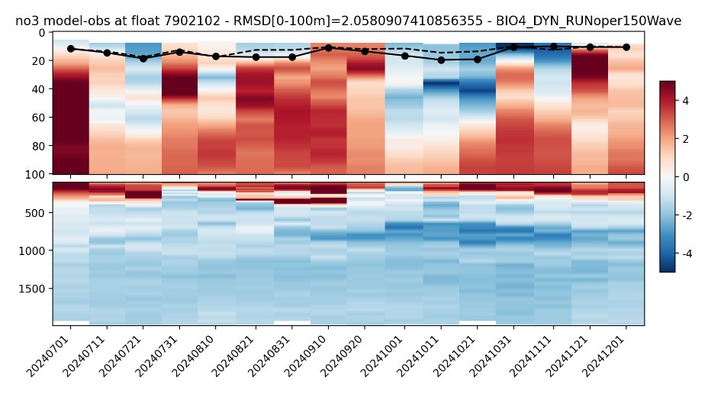
Introduction of wave forcing
Green : improvement
Red : degradation
RMSE % Score
% of improvement/degradation of the RMS of CHL normalized residuals (innovations normalized by observational error) for BGC simulation with vs without wave forcing ​
SSH
SST
Time series of the no3 difference (model – BGC Argo) Jul-Dec 2024
Without wave forcing
With wave forcing
Green : improvement
Red : degradation
Strong positive impact in the tropical Pacific

Slide 7
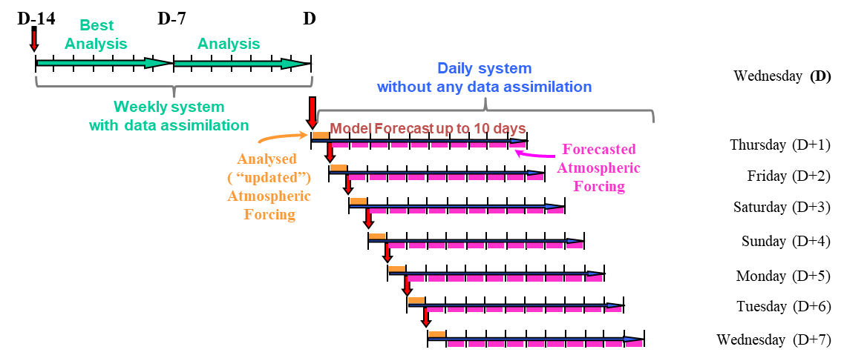
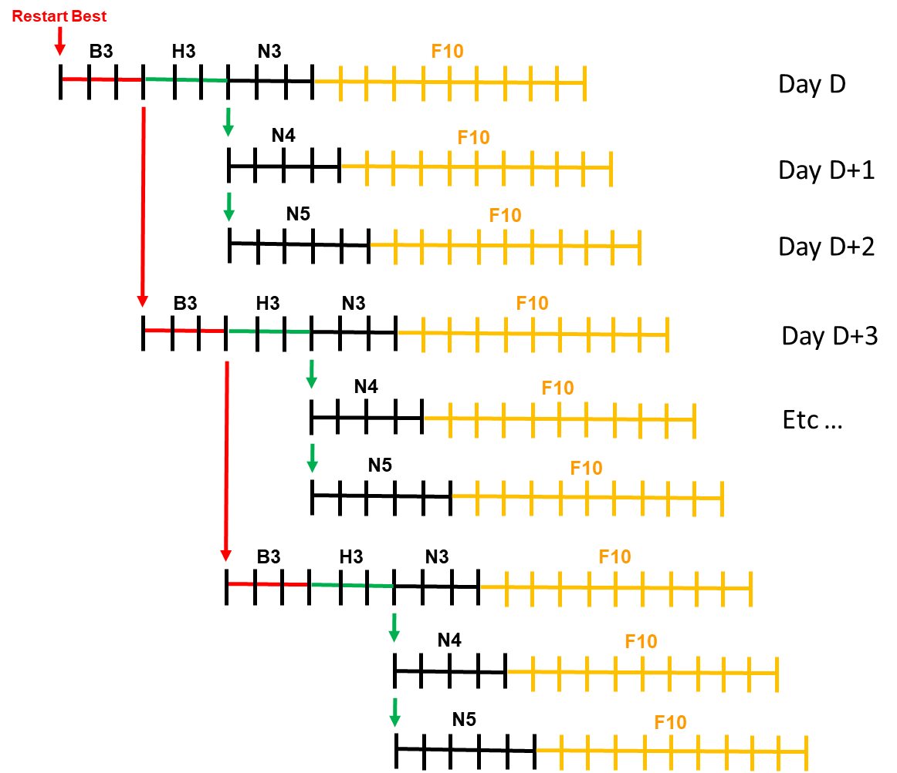
From weekly to daily analysis
Another major change in GLO12 is the switch from a weekly to a daily analysis, which will allow each daily 10-day forecasts to be initialized by an optimal state of the ocean, as close as possible to observations.
New scenario
(daily analysis + daily forecast)
B = best analysis
H = hindcast analysis
N = nowcast analysis
F10 = 10-day forecast
Current scenario
(weekly analysis + daily forecast)
PSY4
GLO12

Slide 8
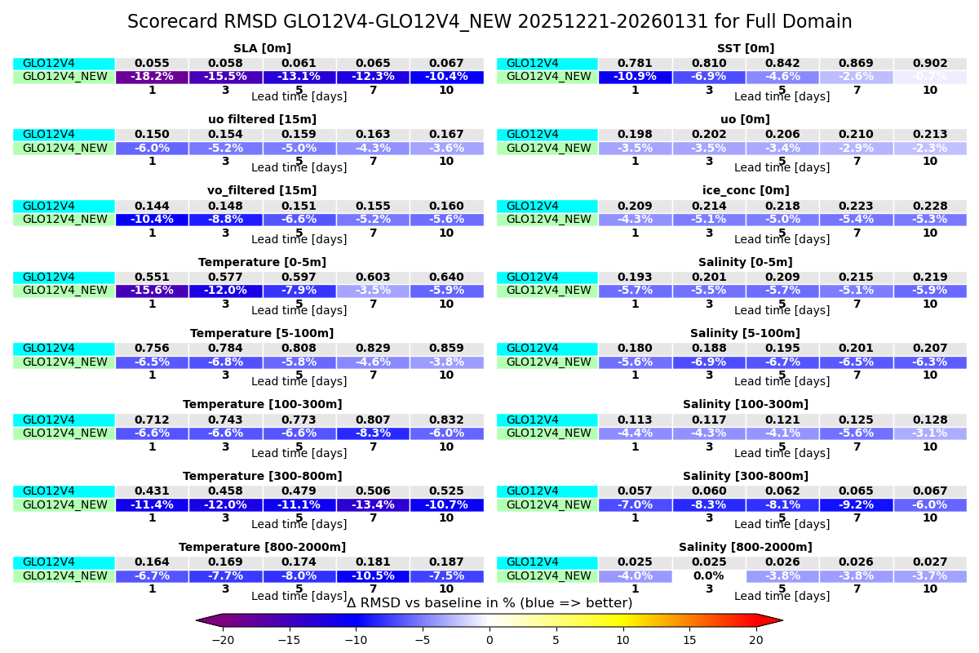
From weekly to daily analysis
RMSD improvement/degradation (in %): blue indicates better performance.
GLO12v4 (current system), GLO12v4_NEW (with daily analysis)

Slide 9
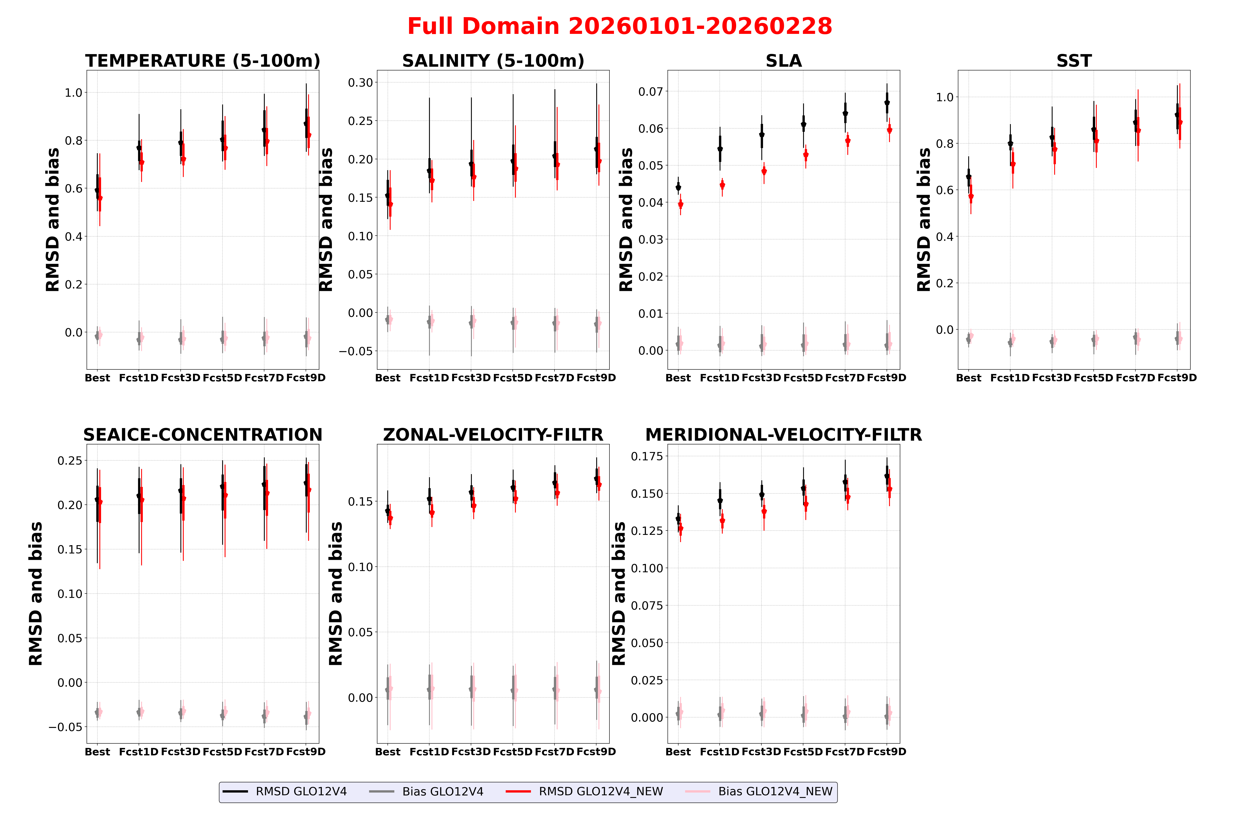
From weekly to daily analysis
Improved initial state and forecast score for all physical variables.
Ready to be integrated in the operational suite by late 2026 or early 2027.

Slide 10

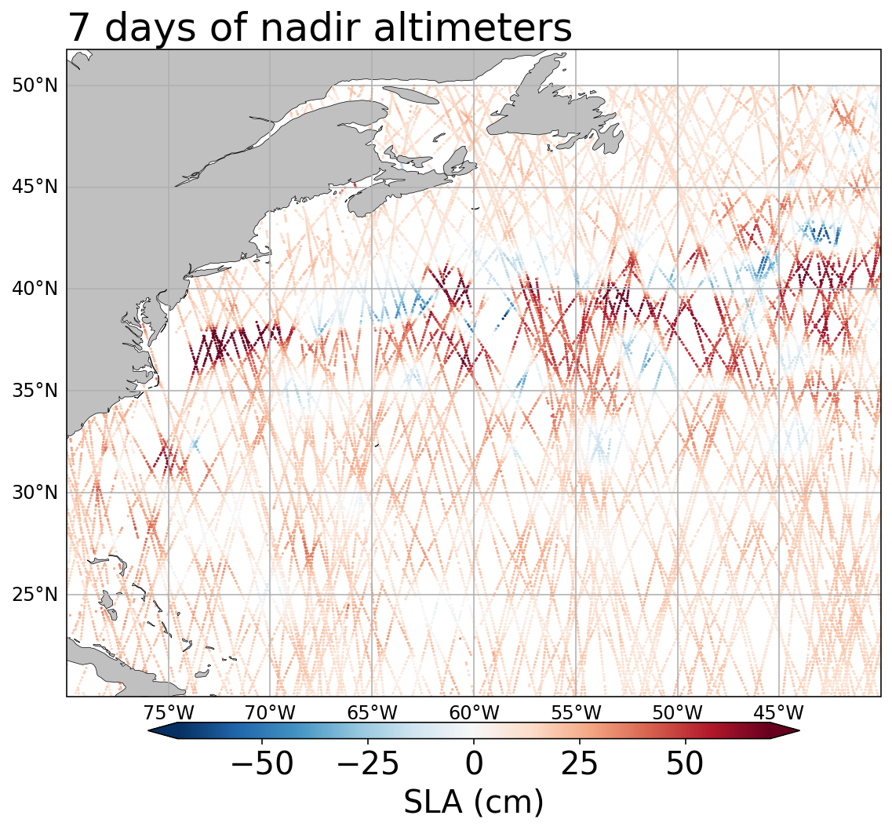
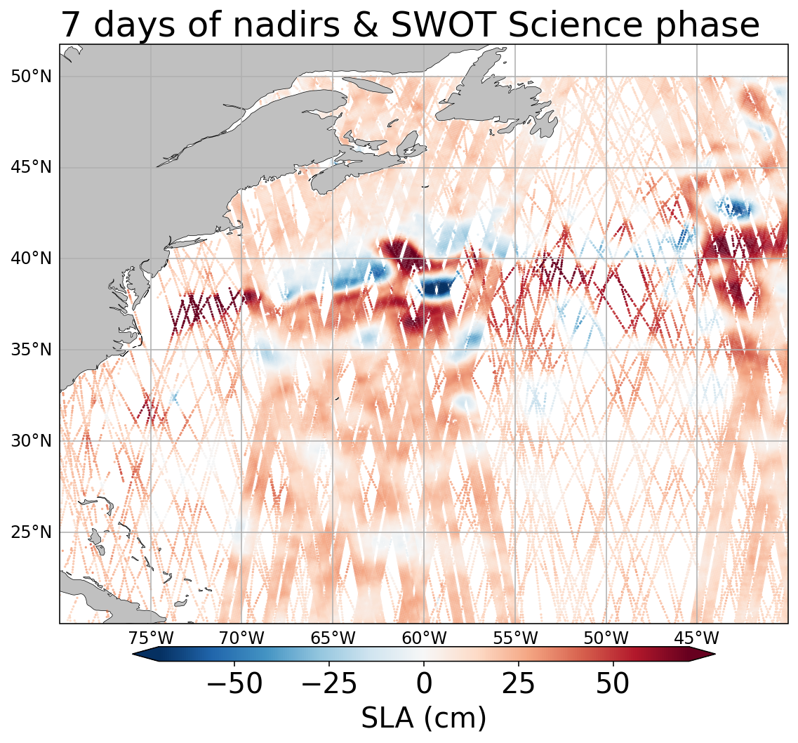

Assimilation of SWOT
GLO12 operational system
1/12° - analyses - 10-day forecasts
Currently assimilated SLA observations:
7 nadir altimeters
SWOT nadir
Upcoming updates:
Assimilation of SWOT swath observations
Objective
Evaluate the added value of SWOT data assimilation in the global ocean analysis and forecasting system GLO12

Slide 11
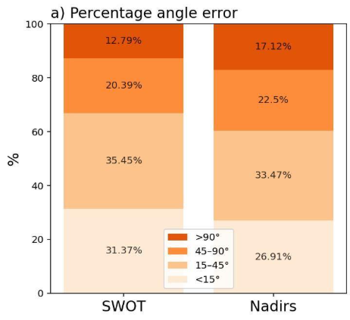
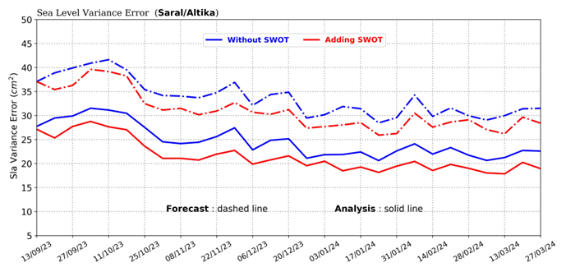
Assimilation of SWOT
Percentage error in the phase (angle) between surface drifter observations and model simulations with and without SWOT over the global ocean.
Evolution of error variance for Saral/Altika nadir altimeter.
Without SWOT assimilation in blue and with SWOT assimilation in red. Solid lines refer to analysis and dotted lines to forecast
-15%
-18%
Improvement of the performance in analysis and forecasting.
Ready to be integrated in the operational suite by late 2026 or early 2027.
Benkiran, M., Fouchet, E., Le Traon, P.-Y., Rémy, E., & Drillet, Y. (2026). SWOT and swath altimetry: A breakthrough for global ocean prediction. Geophysical Research Letters, 53, e2025GL115016. https://doi.org/10.1029/2025GL115016

Slide 12
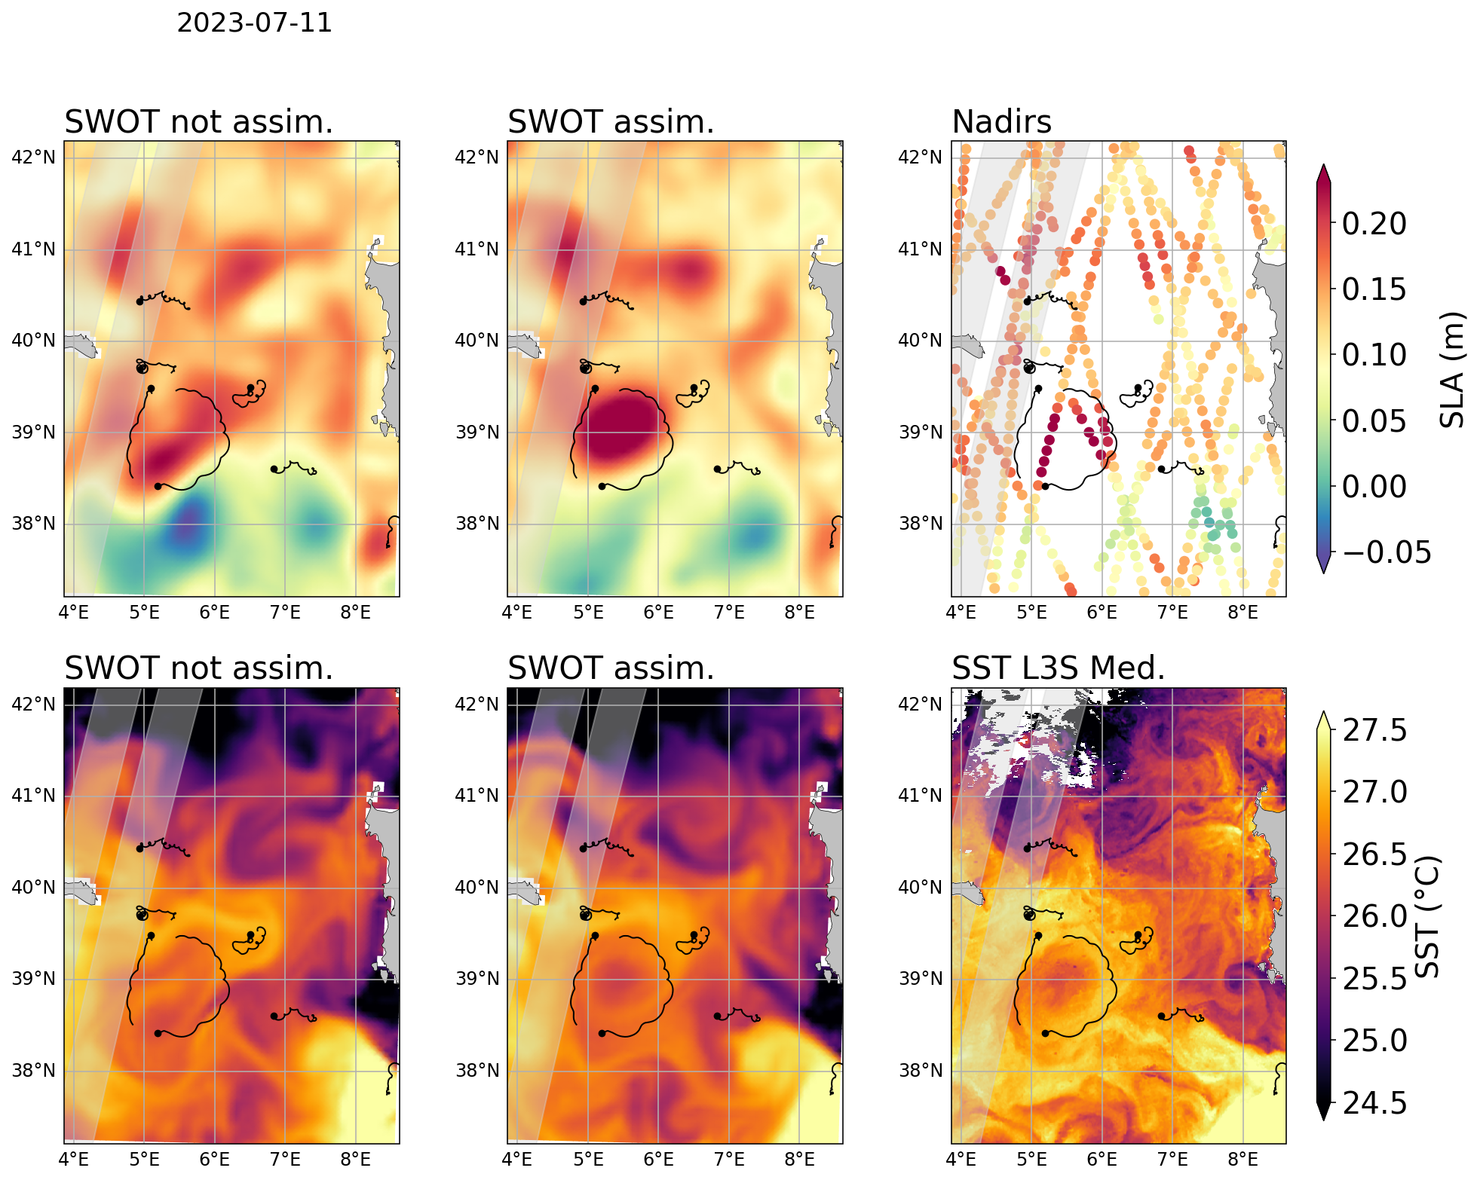
Assimilation of SWOT
Comparison to independent observations: Cal/Val drifters and HR SST
2023-07-11

Slide 13
Assimilation of SWOT
Comparison to independent observations: Cal/Val drifters and HR SST
2023-07-11

Slide 14
Assimilation of SWOT
Comparison to independent observations: Cal/Val drifters and HR SST
2023-07-11
SWOT assimilation improves mesoscale representation
More accurate locations & shapes of eddies and fronts
Crucial for operational applications !

Slide 15
Thank you
Any questions ?

