Slide 1


A cloud-native alternative correction for Landsat-8/9 C2 SR over inland waters
HS6.10
PICO 4.11
Shun Bi
Nanjing Institute of Geography & Limnology, Chinese Academy of Sciences (NIGLAS)
May 2026, EGU26

Slide 2
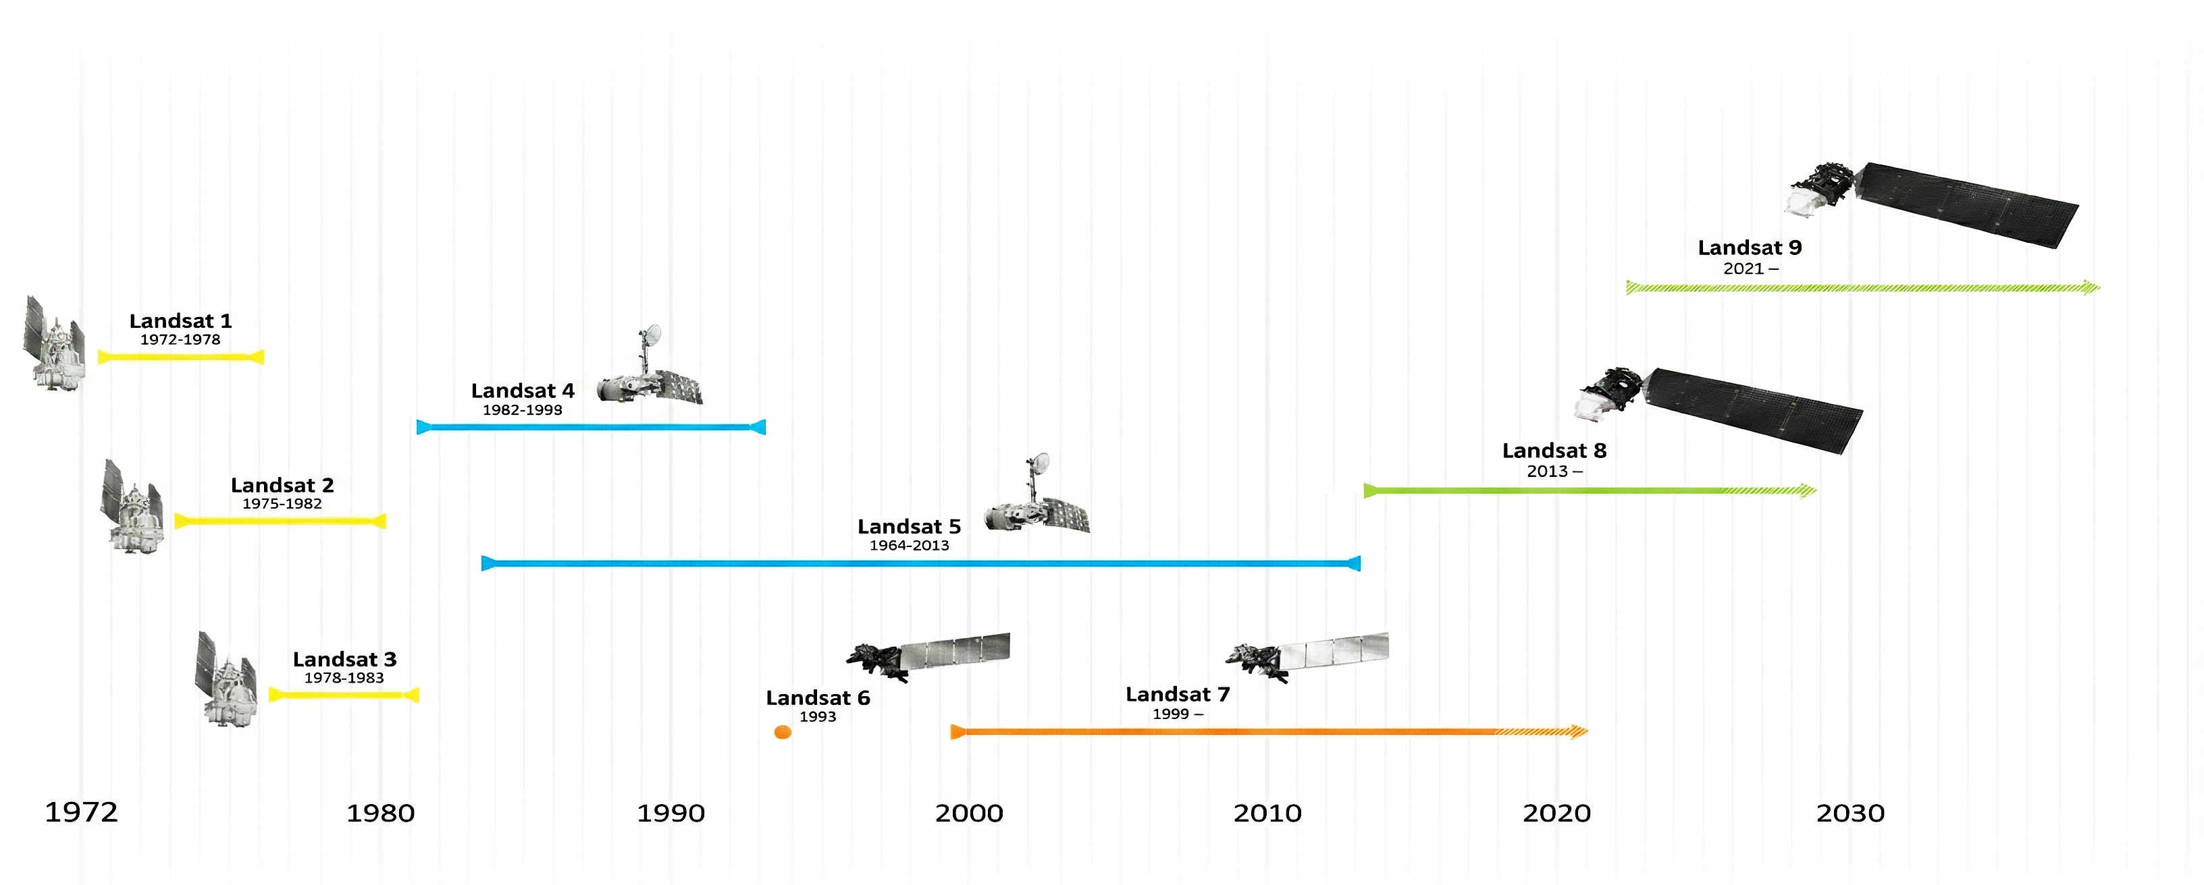
The Landsat Legacy
50+ years continuous record
30 m spatial resolution
Irreplaceable for global limnology
Prerequisite: radiometric consistency
MSS
TM
ETM+
OLI
GSFC, NASA (2013)
Notes:
16

Slide 3
The “Collection” Strategy for Landsat
What & Why?
Ensuring consistent calibration for pixel-level time-series analysis
The Evolution (C1 vs. C2)
Collection 1 (2016-2021)
Deprecated & Removed
Collection 2 (2020-Present)
Better geometry, cloud-native
Global Level-2 Surface Reflectance
New atmospheric correction strategy:
Landsat-4/5/7 → LEDAPS
Landsat-8/9 → LaSRC
Not designed for water pixels!!!
LEDAPS (Schmidt et al., 2013)
LaSRC (Vermote et al., 2018)

Slide 4
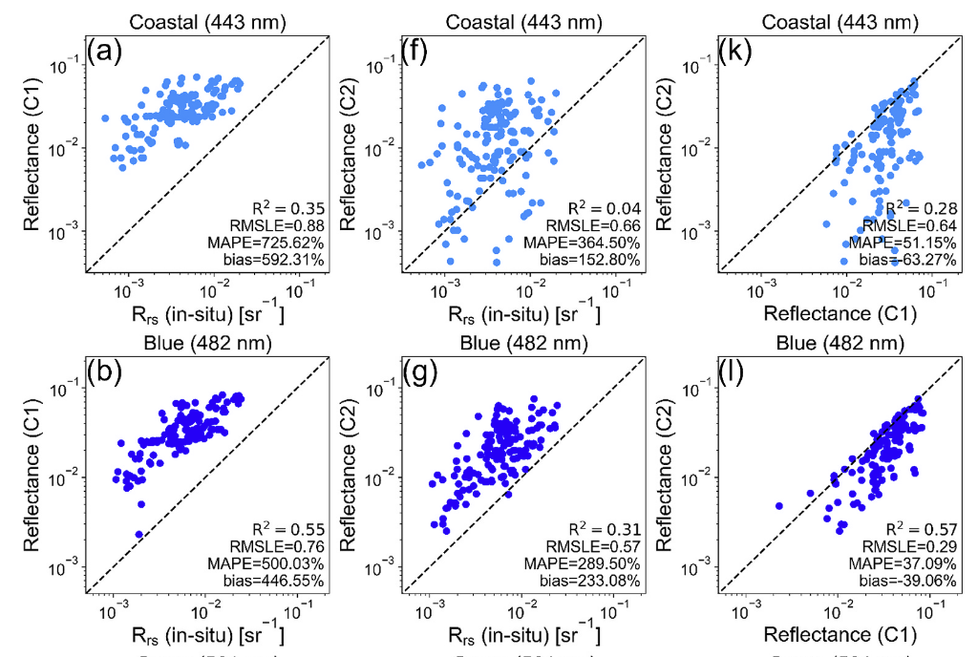
The challenge: LaSRC fails over water
Atmospheric correction are not for waters
Higher radiometric uncertainty
Severe in shortwave bands
C2 < C1 in water
In-situ vs. Landsat C1 & C2
Hu et al. (2025)

Slide 5
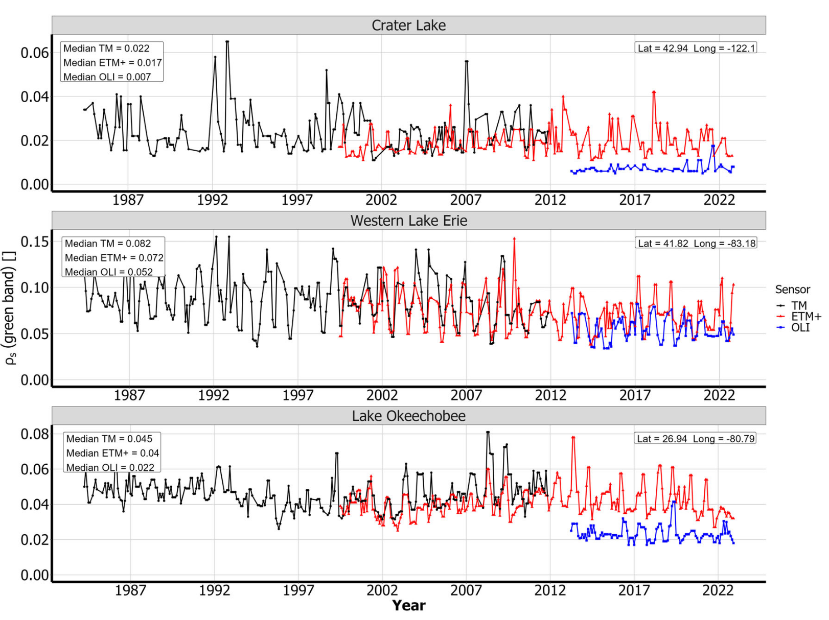
The challenge: LaSRC fails over water
Sharp radiometric discontinuity
Systematic negative bias in OLI
~50% difference in the green band
What went wrong in Collection 2 ???
Maciel et al. (2023)

Slide 6
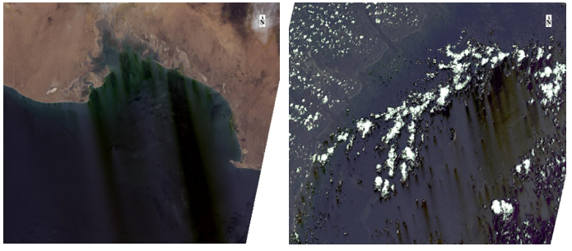
The Dark Side of Landsat C2
Dark Plume over Water (DPOW) in Landsat 8 (C2 SR)
USGS, Landsat C2 known issues

Slide 7
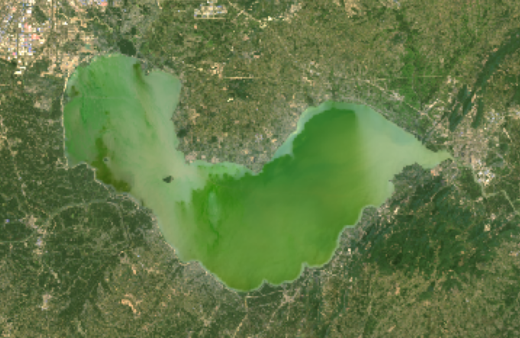
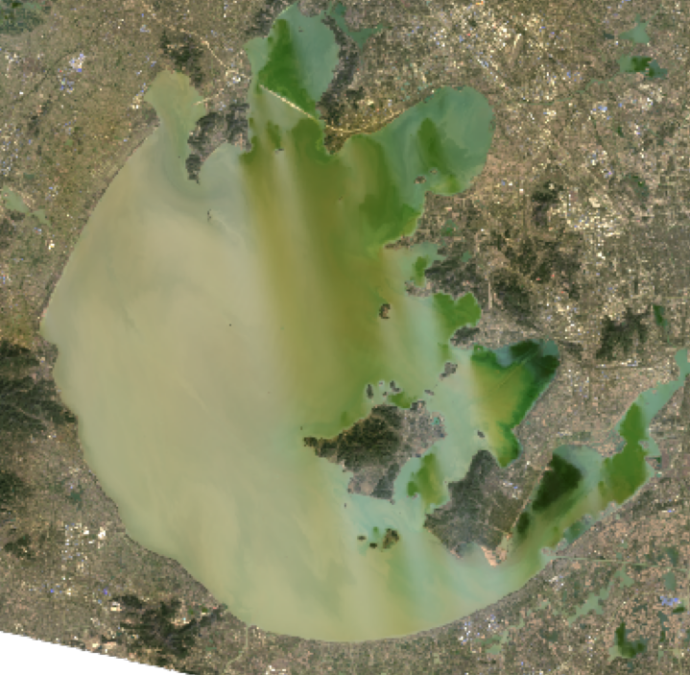
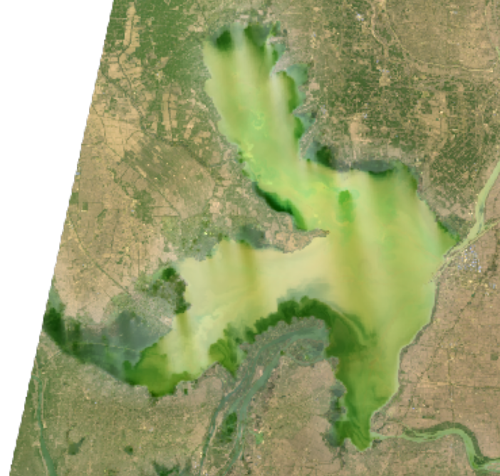
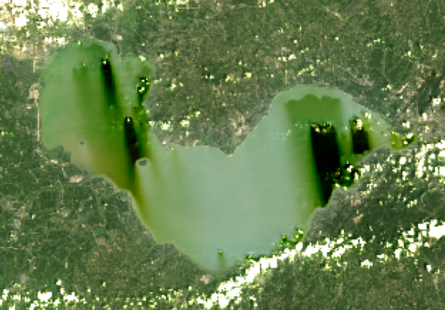
The Dark Side of Landsat C2
LC08_121038_20140501
LC08_119038_20210130
LC08_120037_20160225
LC08_121038_20190819
Dark Plume over Water (DPOW) in Landsat 8 (C2 SR)
Bi et al., (2026)

Slide 8
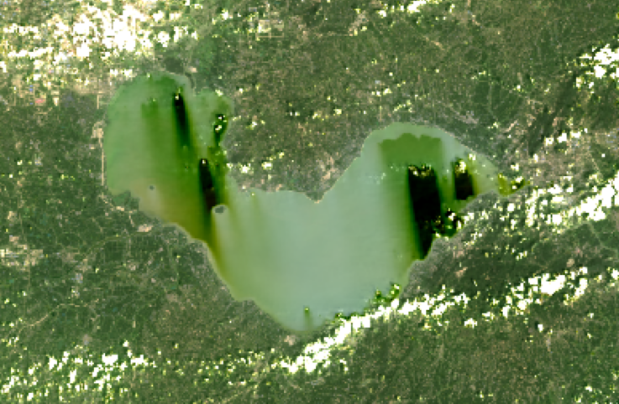
The Dark Side of Landsat C2
How this happened?
Wrongly extrapolated aerosol optical thickness from land/cloud/snow (any bright pixels) into water pixels (c.f. USGS website)
The path of extrapolation makes DPOW directional
Retrieved
Any solutions?
Extrapolated

Slide 9

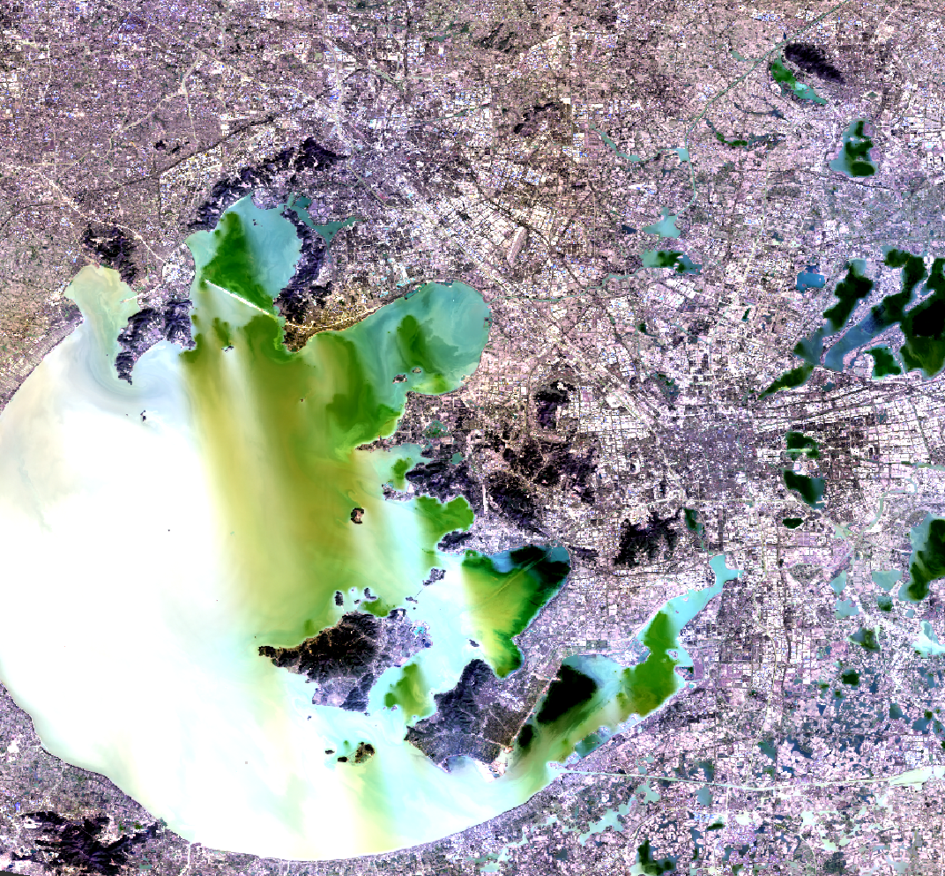
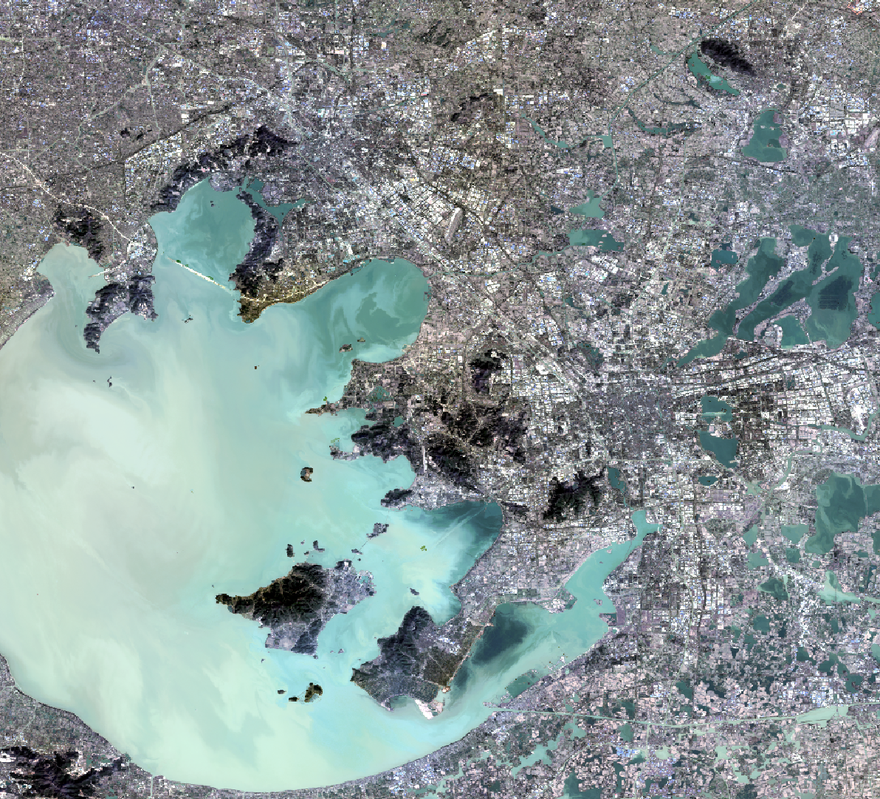
New solution: Cloud-Native Alternative Correction
Google Earth Engine
TOA Reflectance
(Input)
Extract high-quality water pixels
Random Forest (RF)
Training model
Time
Reference SR
(Target)
Corrected Surface Reflectance
(New SR)
Spatial-Temporal window
Bi et al., (2026)

Slide 10
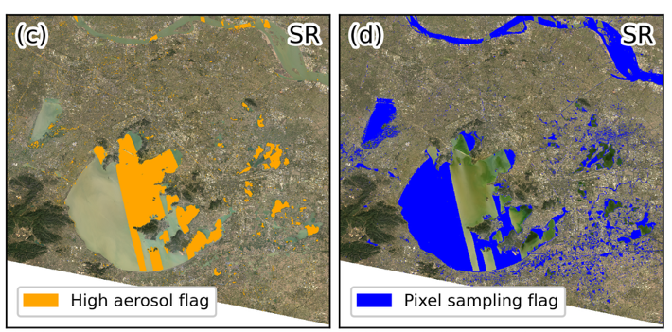
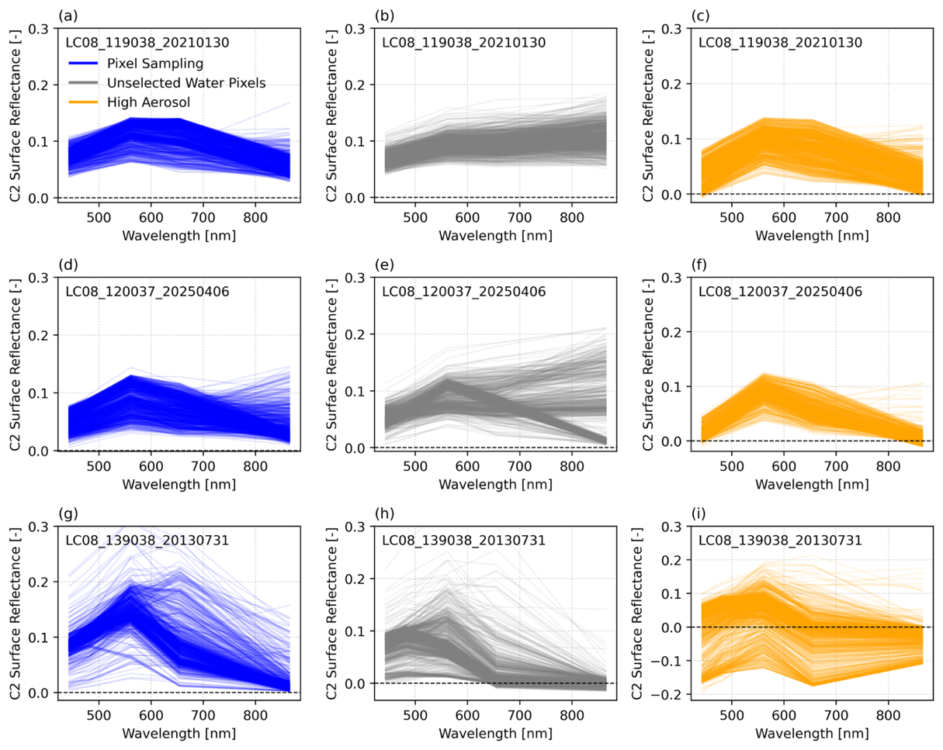
How to find the high-quality samples
Strict water masking
Aerosol filtering
Physics-based constraints
Samples from ±90 days window
≥ 10,000 samples retained
Affected by DPOW
For training
Unselected

Slide 11
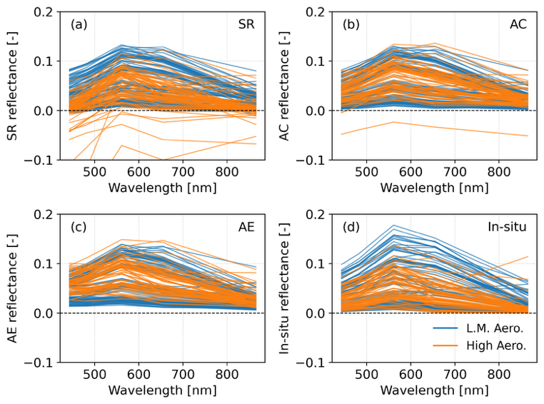
Accuracy assessment: radiometric
Original C2
New method
Validation data: GLORIA, A global in-situ dataset for inland waters
Benchmark method: ACOLITE, a state-of-art atmospheric correction method for inland waters
Spectral restoration:
C2: severe “blue depression” & negative values
ACOLITE: removes negative but overestimates
New method: restore natural spectral shape
ACOLITE
In-situ
GLORIA (Lehmann et al., 2023); ACOLITE (Vanhellemont 2019)

Slide 12
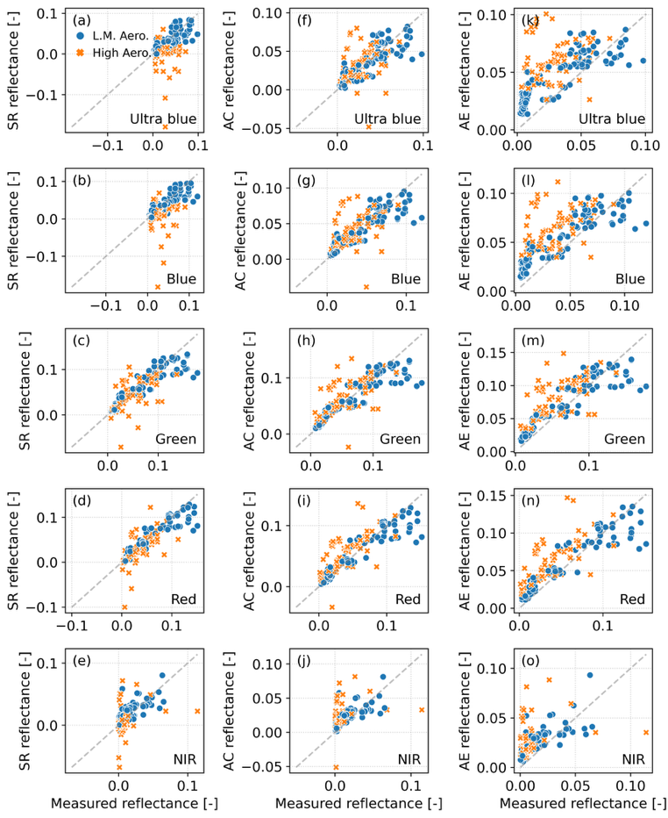
Accuracy assessment: radiometric
Original C2
New method
ACOLITE
SR shows frequent negative values (especially in high aerosol conditions)
Lowest RMSE (0.019 in ultra-blue), outperforming ACOLITE (0.029) and SR (0.031)

Slide 13
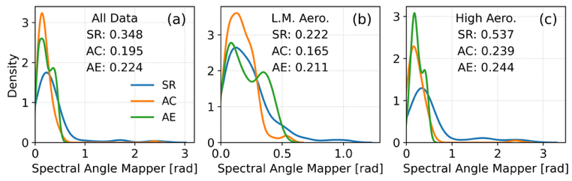
Accuracy assessment: radiometric
All data
Low-medium aerosol
High aerosol
Metric: Spectral Angle Mapper (SAM)
Lower value = better shape similarity
New method shows narrowest distribution (0.195) compared to C2 SR (0.348) and ACOLITE (0.224)

Slide 14
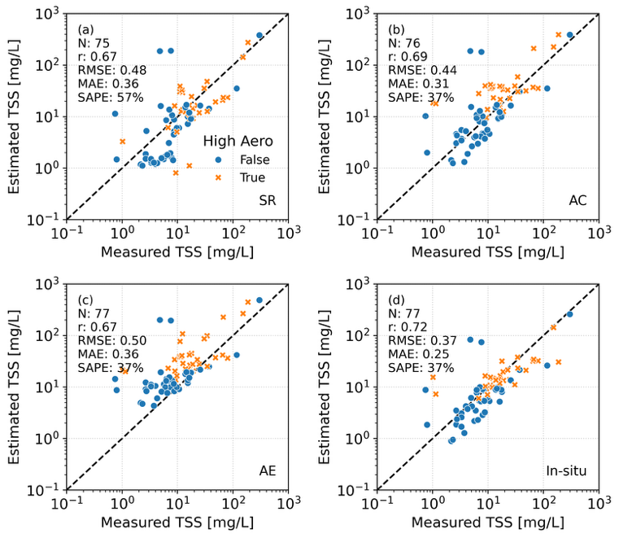
Accuracy assessment: TSS retrieval
Target: Total suspended solids
Algorithm: Novoa et al. (2017)
Performance (MAE):
In-situ spectra: 0.25 (baseline)
C2 SR: 0.48
ACOLITE: 0.36
New method: 0.31
Original C2
New method
ACOLITE
In-situ

Slide 15
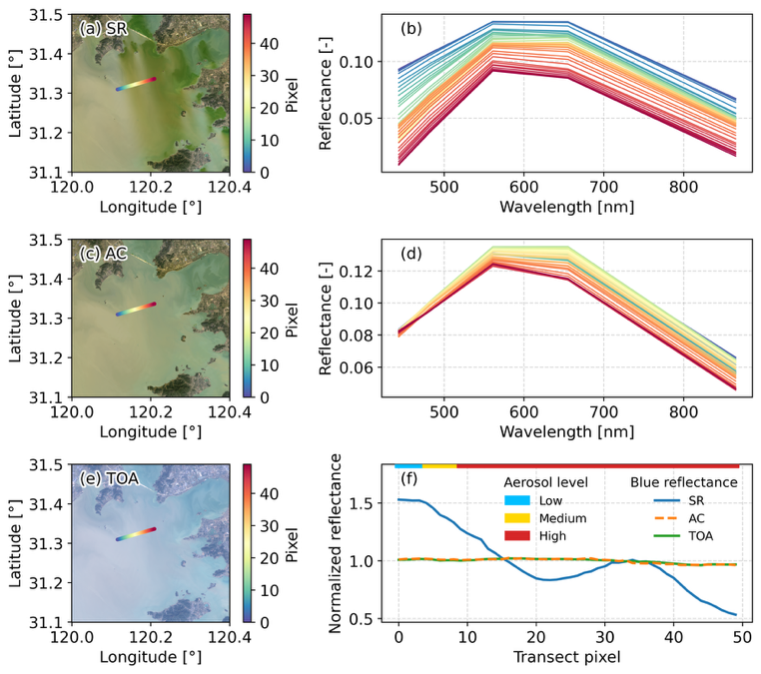
Restoring spatial continuity
Original C2
Lake Taihu
New method

Slide 16
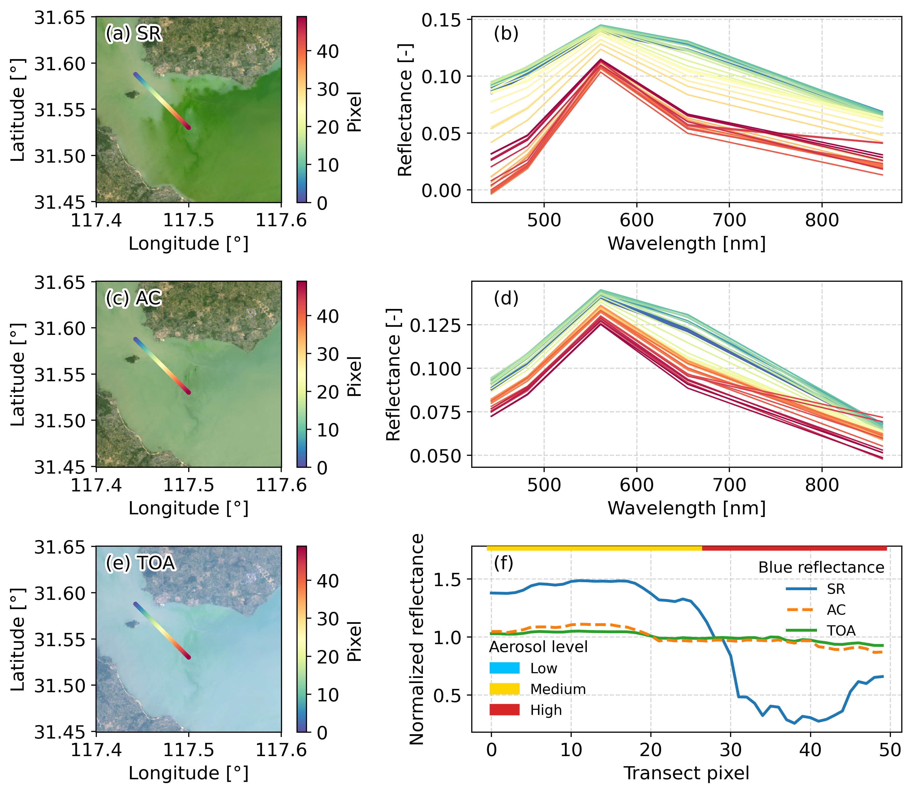
Restoring spatial continuity
Original C2
Lake Chaohu
New method

Slide 17
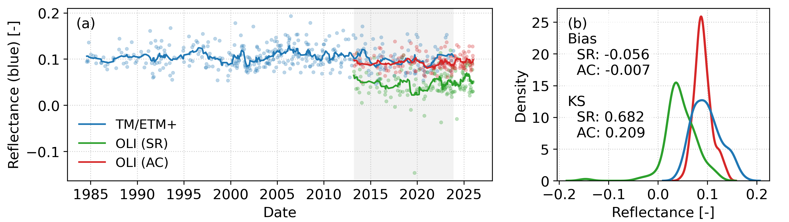
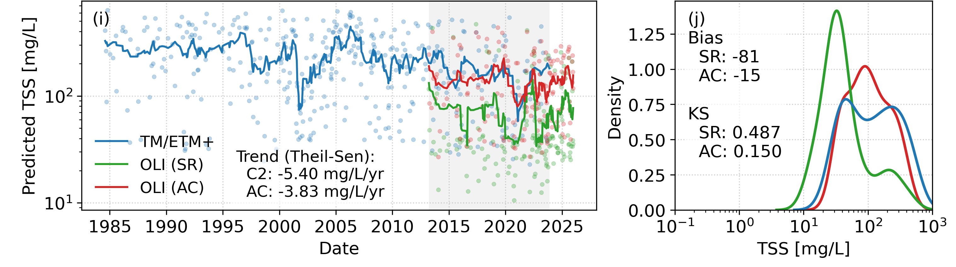
Restoring long-term consistency
KS: Kolmogorov-Smirnov
Lake Taihu (120.1719°, 31.3529°)

Slide 18
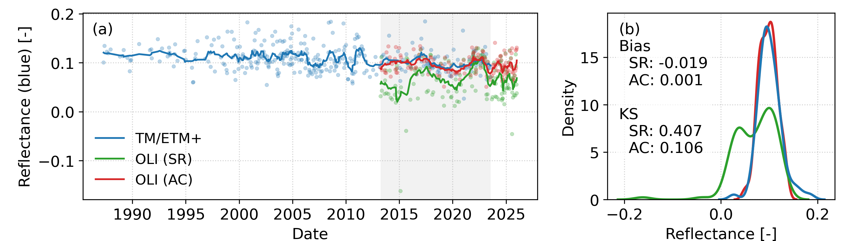
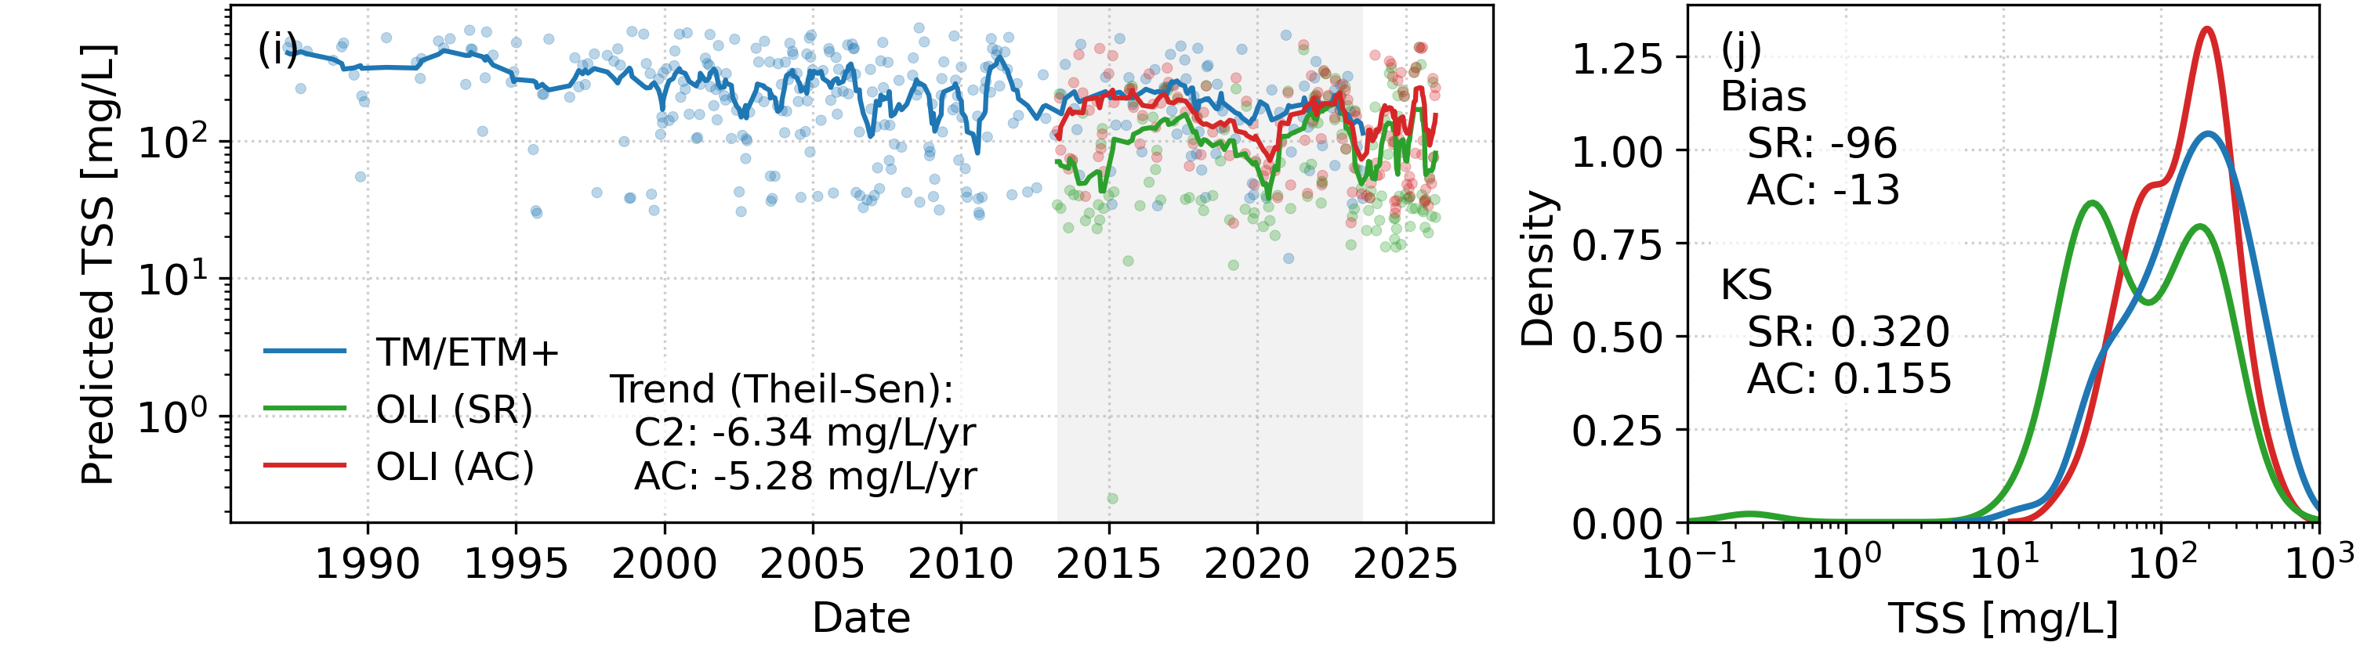
Restoring long-term consistency
KS: Kolmogorov-Smirnov
Lake Chaohu (117.5191°, 31.5266°)

Slide 19
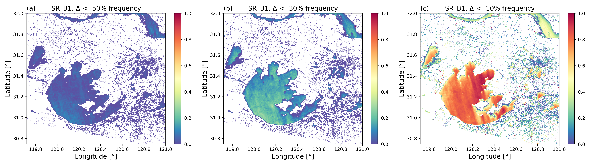
Frequency of DPOW impact

Slide 20
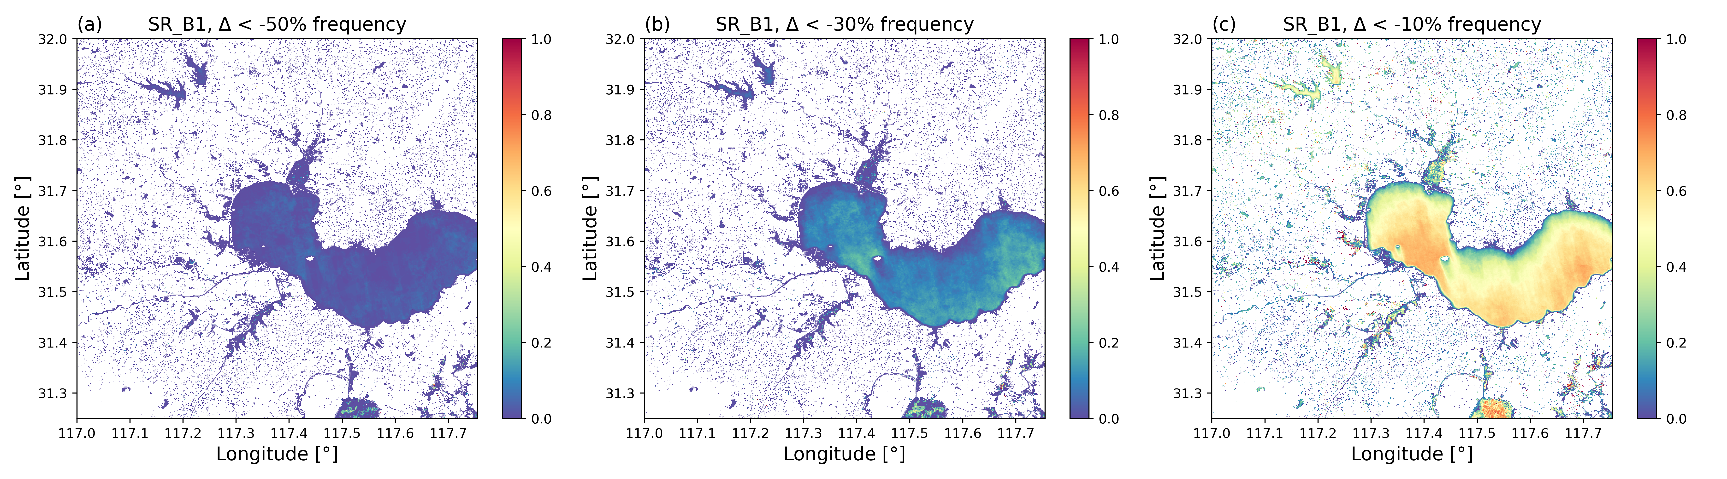
Frequency of DPOW impact

Slide 21
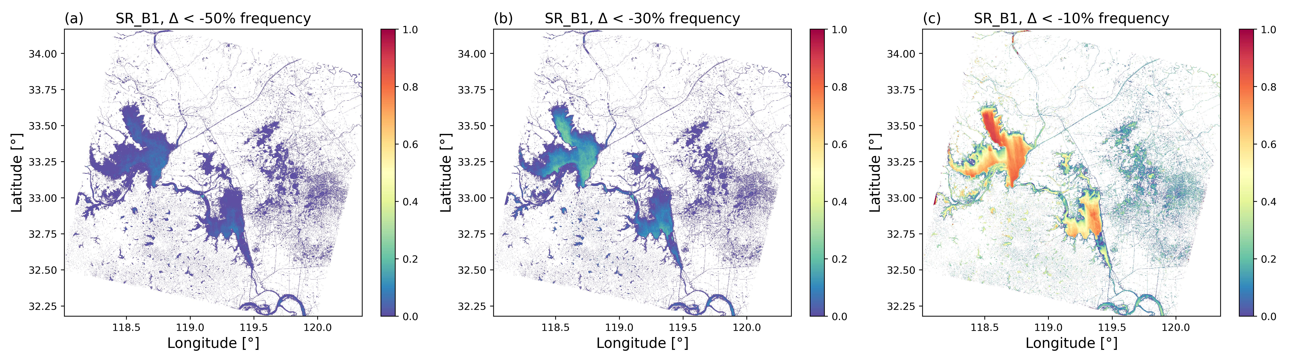
Frequency of DPOW impact

Slide 22
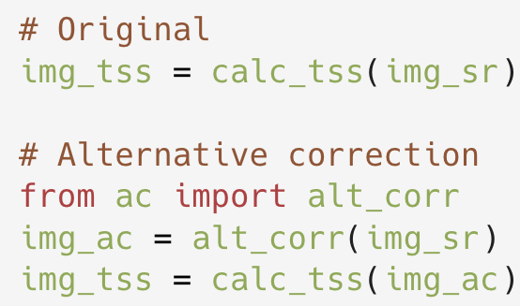

Conclusion & Take-home message
The problem: Collection 2 (LaSRC) introduces dark plume over water (DPOW) artifacts, breaking the 50-year consistency for inland waters
The solution: A data-driven and cloud-native approach leveraging GEE’s computational power
The impact: radiometric continuity restored & time-series secured
Open science: code available on Zenodo
Paper accepted: IEEE TGRS (10.1109/TGRS.2026.3684904)
Thank you! Questions?
Easy to apply: one-liner

