Slide 1
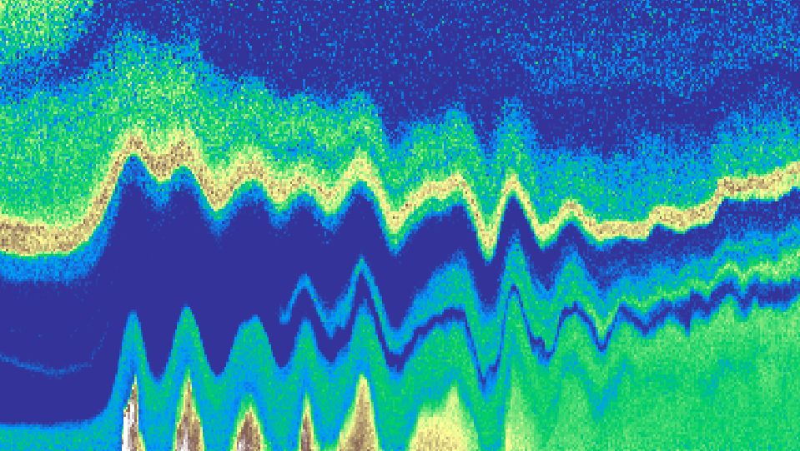
Atmospheric boundary-layer gravity waves in the Netherlands (Doppler) lidar observations at Cabauw atmospheric research station and North Sea wind farms
Steven Knoop and Jelle Assink
Royal Netherlands Meteorological Institute (KNMI)
EGU26-3806

Slide 2
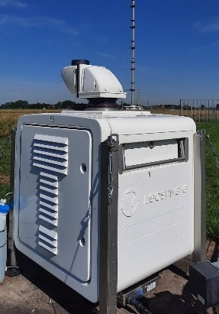
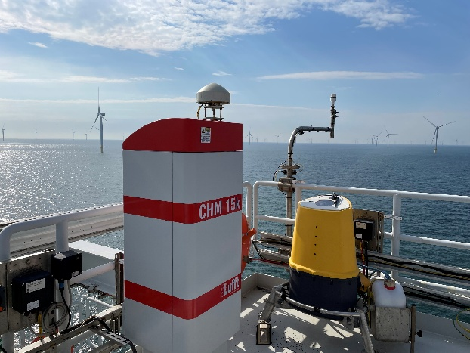
Summary
Tens of boundary-layer gravity waves observed (2018->now)
Mostly spring & summer (both onshore and offshore)
(Nocturnal) stable boundary layer; ducted gravity wave
Non-orographic, (cold) fronts
Operational synoptic network and research instruments
Doppler lidar: vertical velocity
Automatic lidar ceilometer: backscatter
Examples:
June 30, 2022 (onshore)
May 2, 2025 (offshore & onshore)

Slide 3
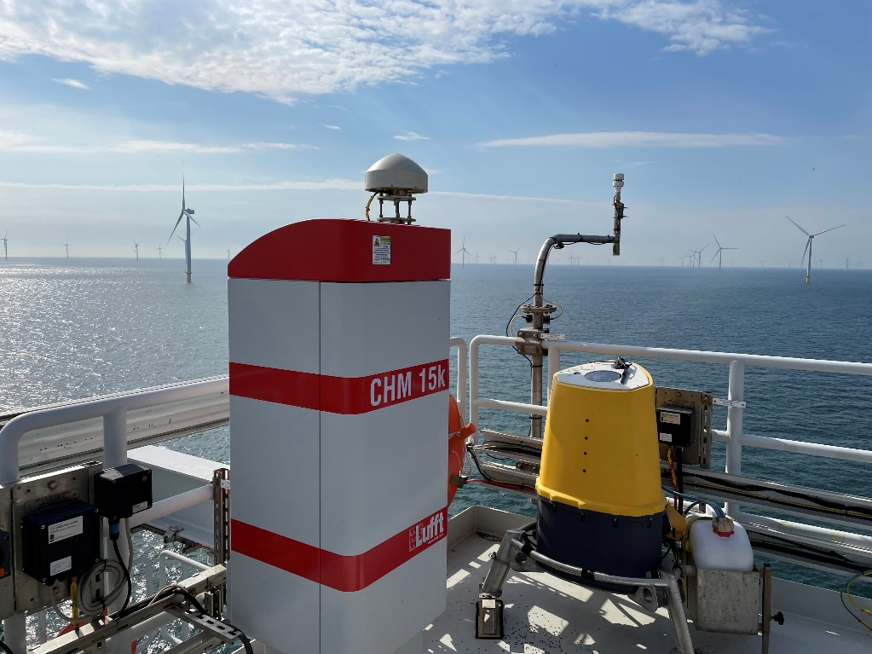



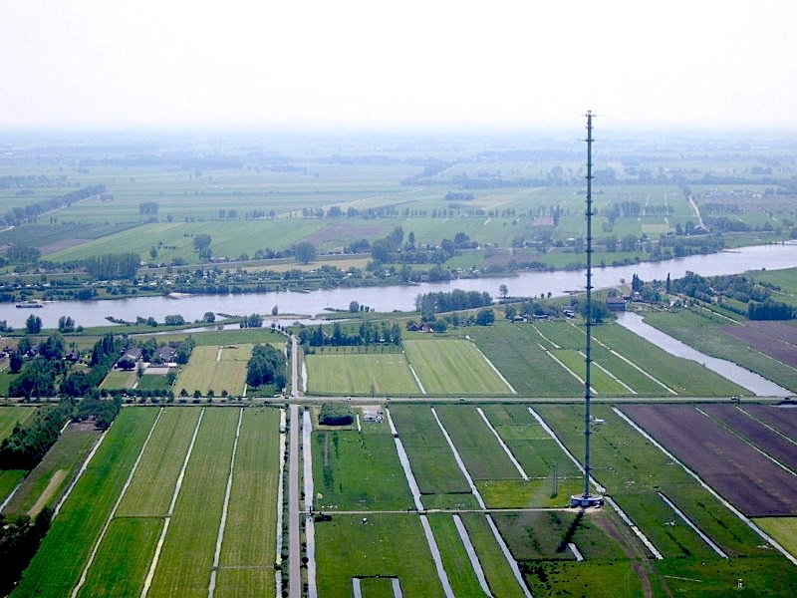
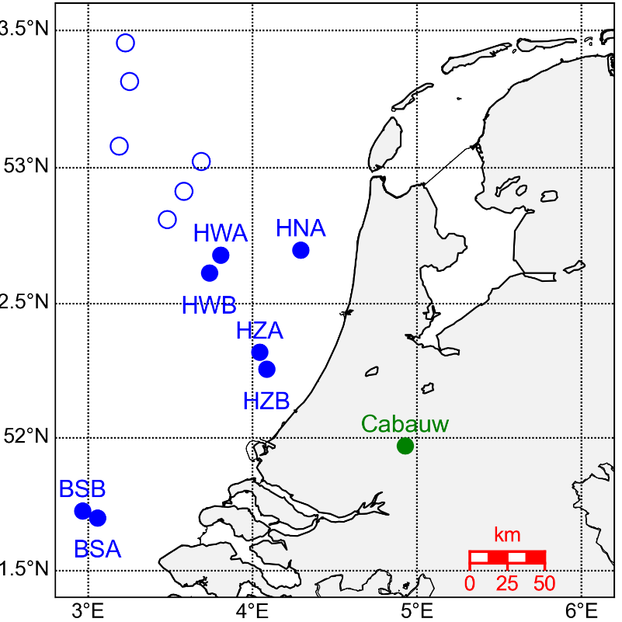
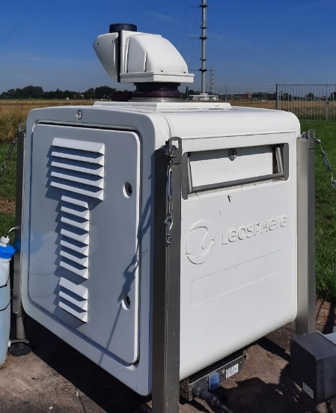
North Sea wind farms
+ KNMI synoptic network
Automatic weather stations
Weather radar
Microbarometer arrays
Cabauw atmospheric research station

Slide 4
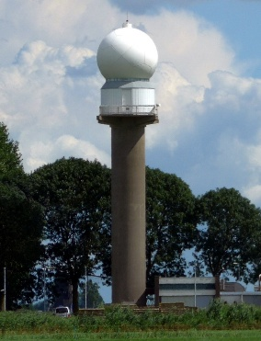
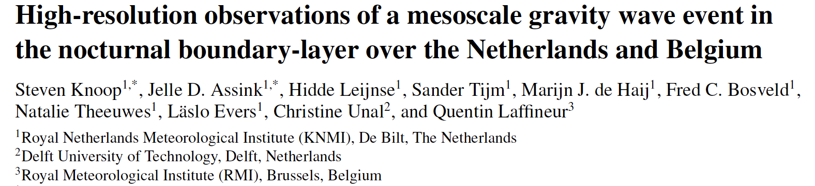
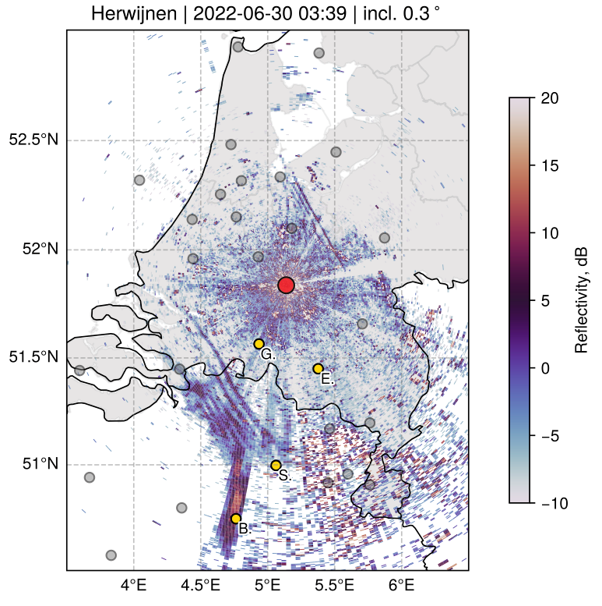
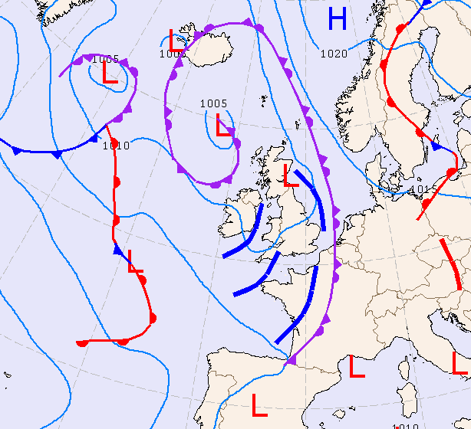

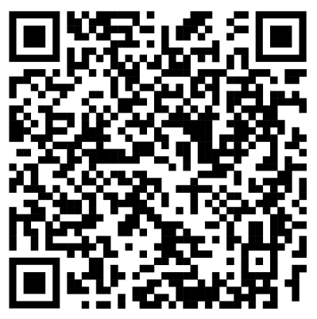
GW event I: June 30, 2022
weather radar
GW1
Preprint available:
GW2

Slide 5
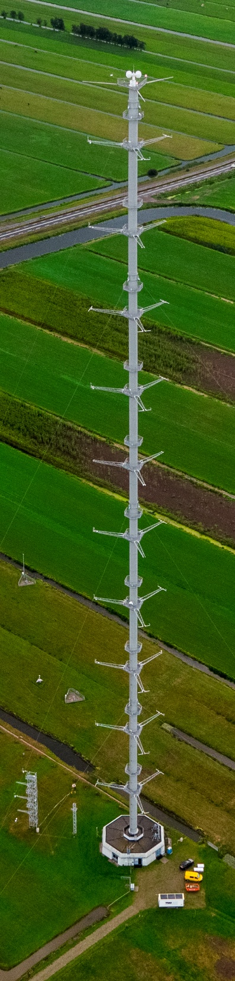
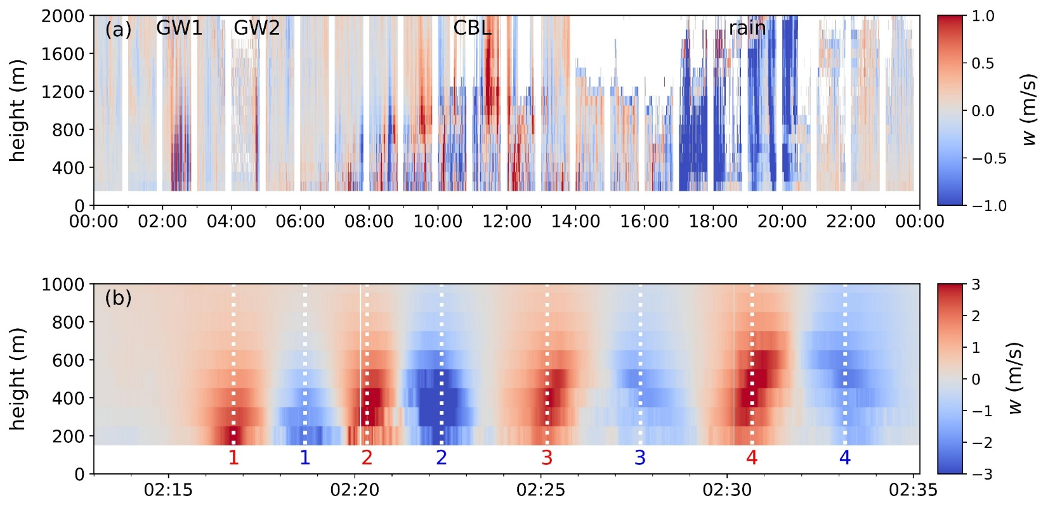
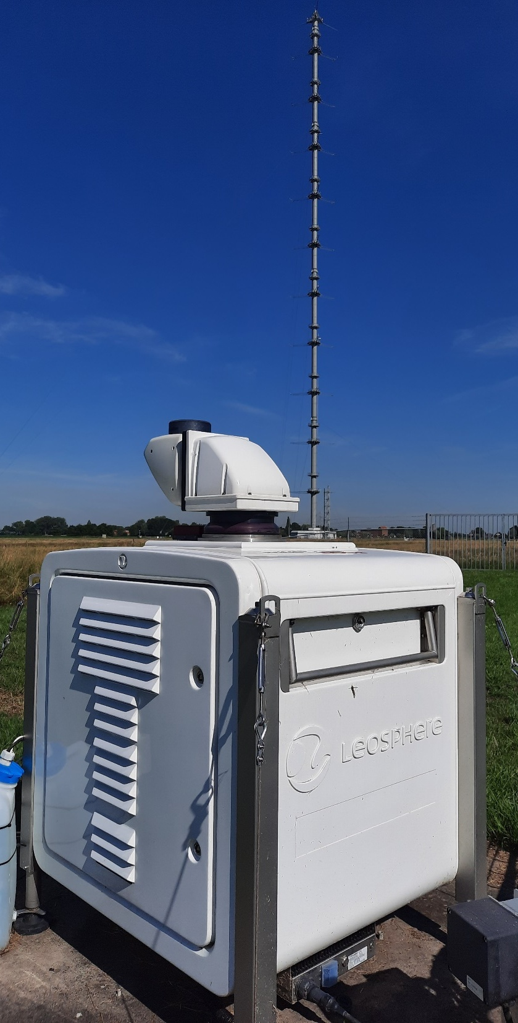
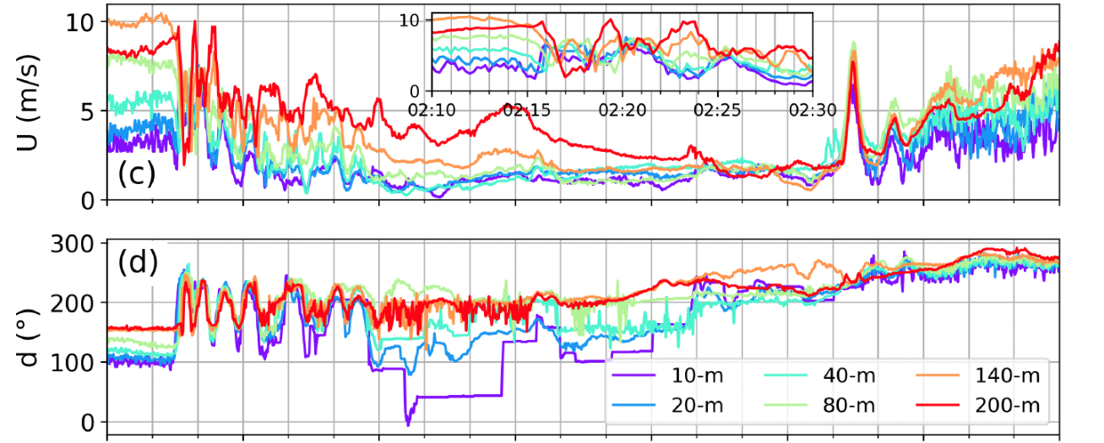
Vertical stare
@ 1s
Doppler lidar
(Windcube200S)
Tower in-situ

Slide 6
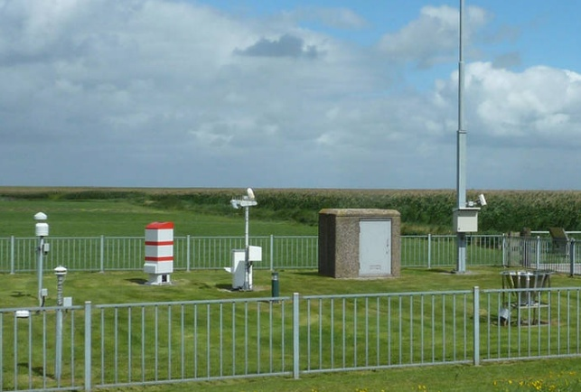
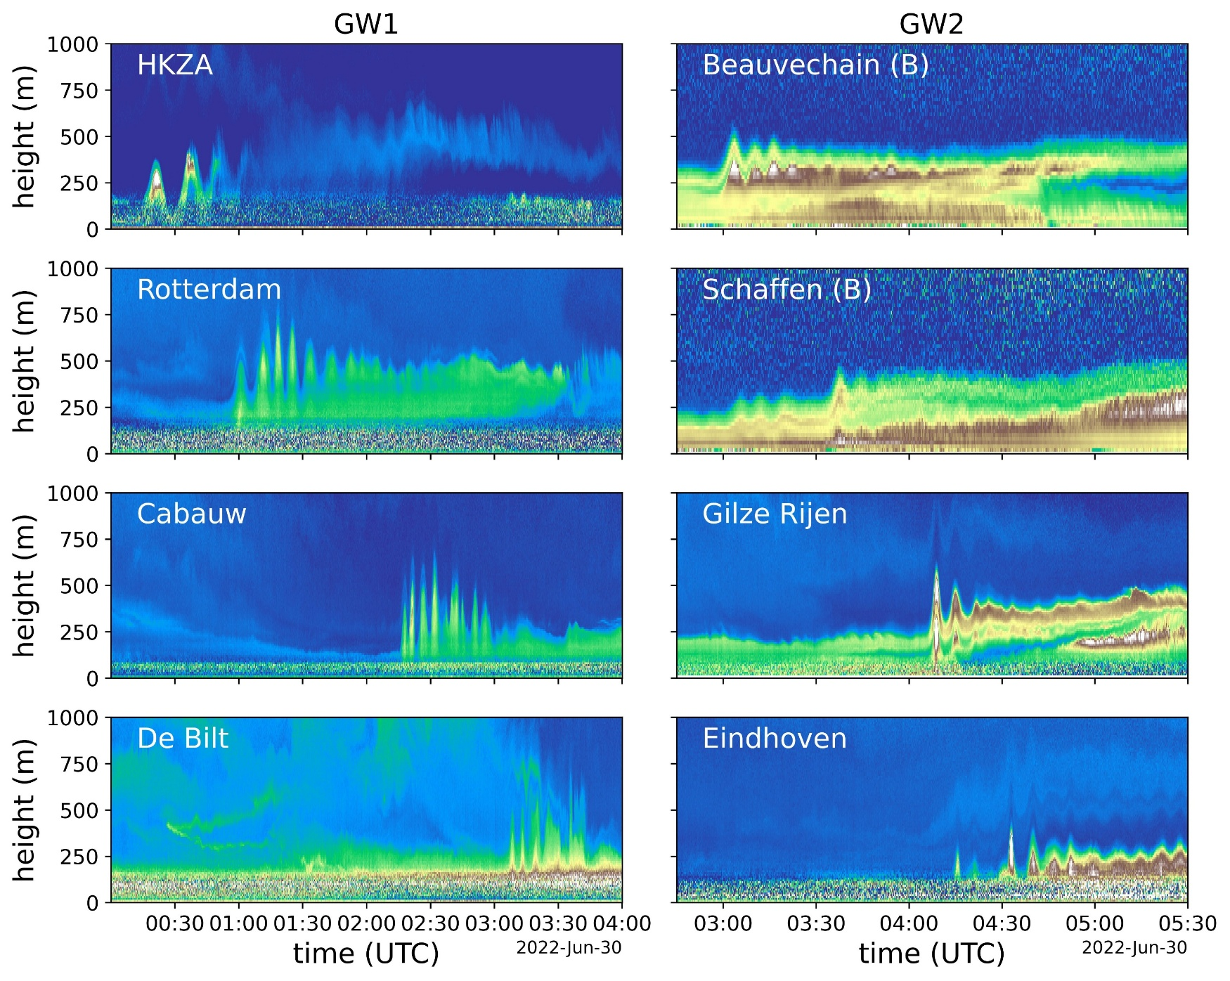
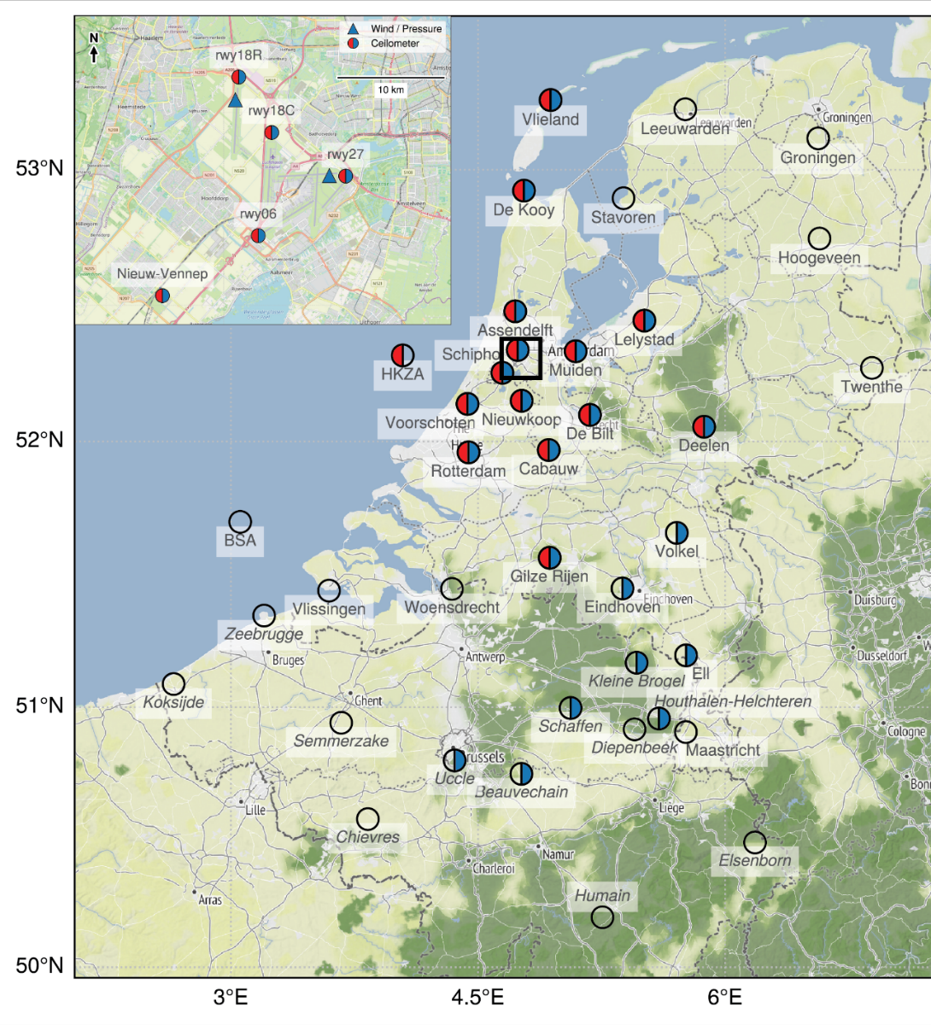
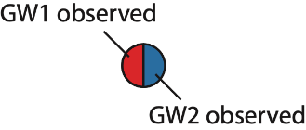
automatic lidar ceilometer (CHM15k)
Ceilometer
(backscatter lidar)
GW1
GW2

Slide 7

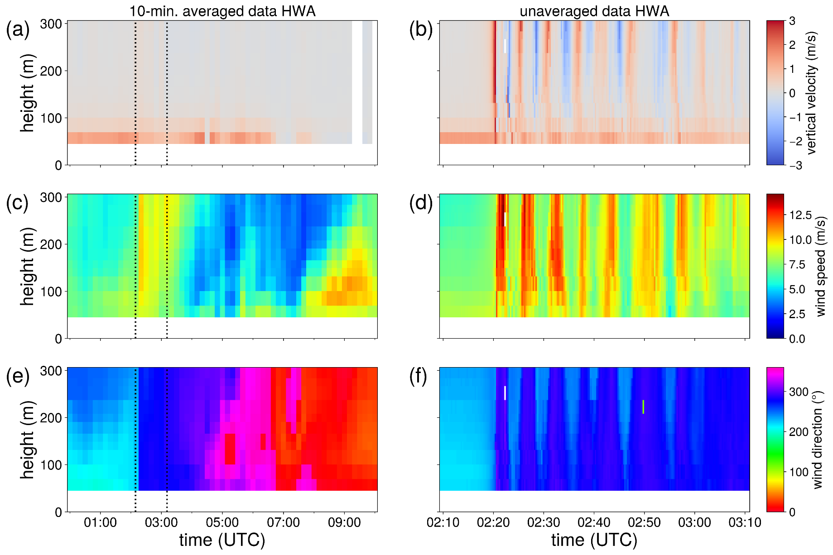

GW event II: May 2, 2025
VAD
BSA
wind lidar (ZX300M)

Slide 8
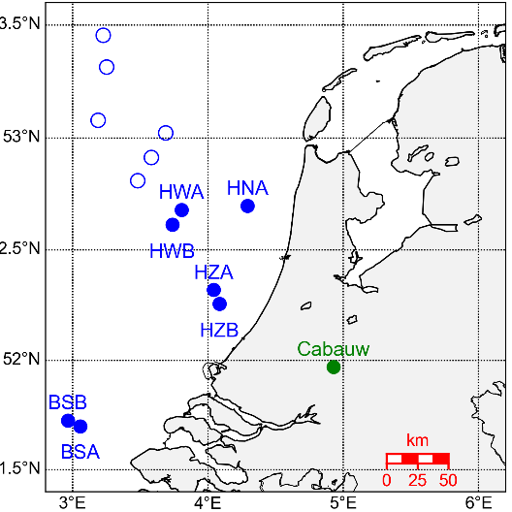
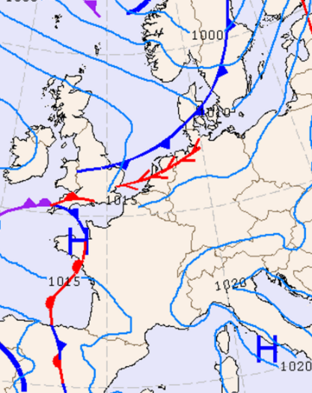
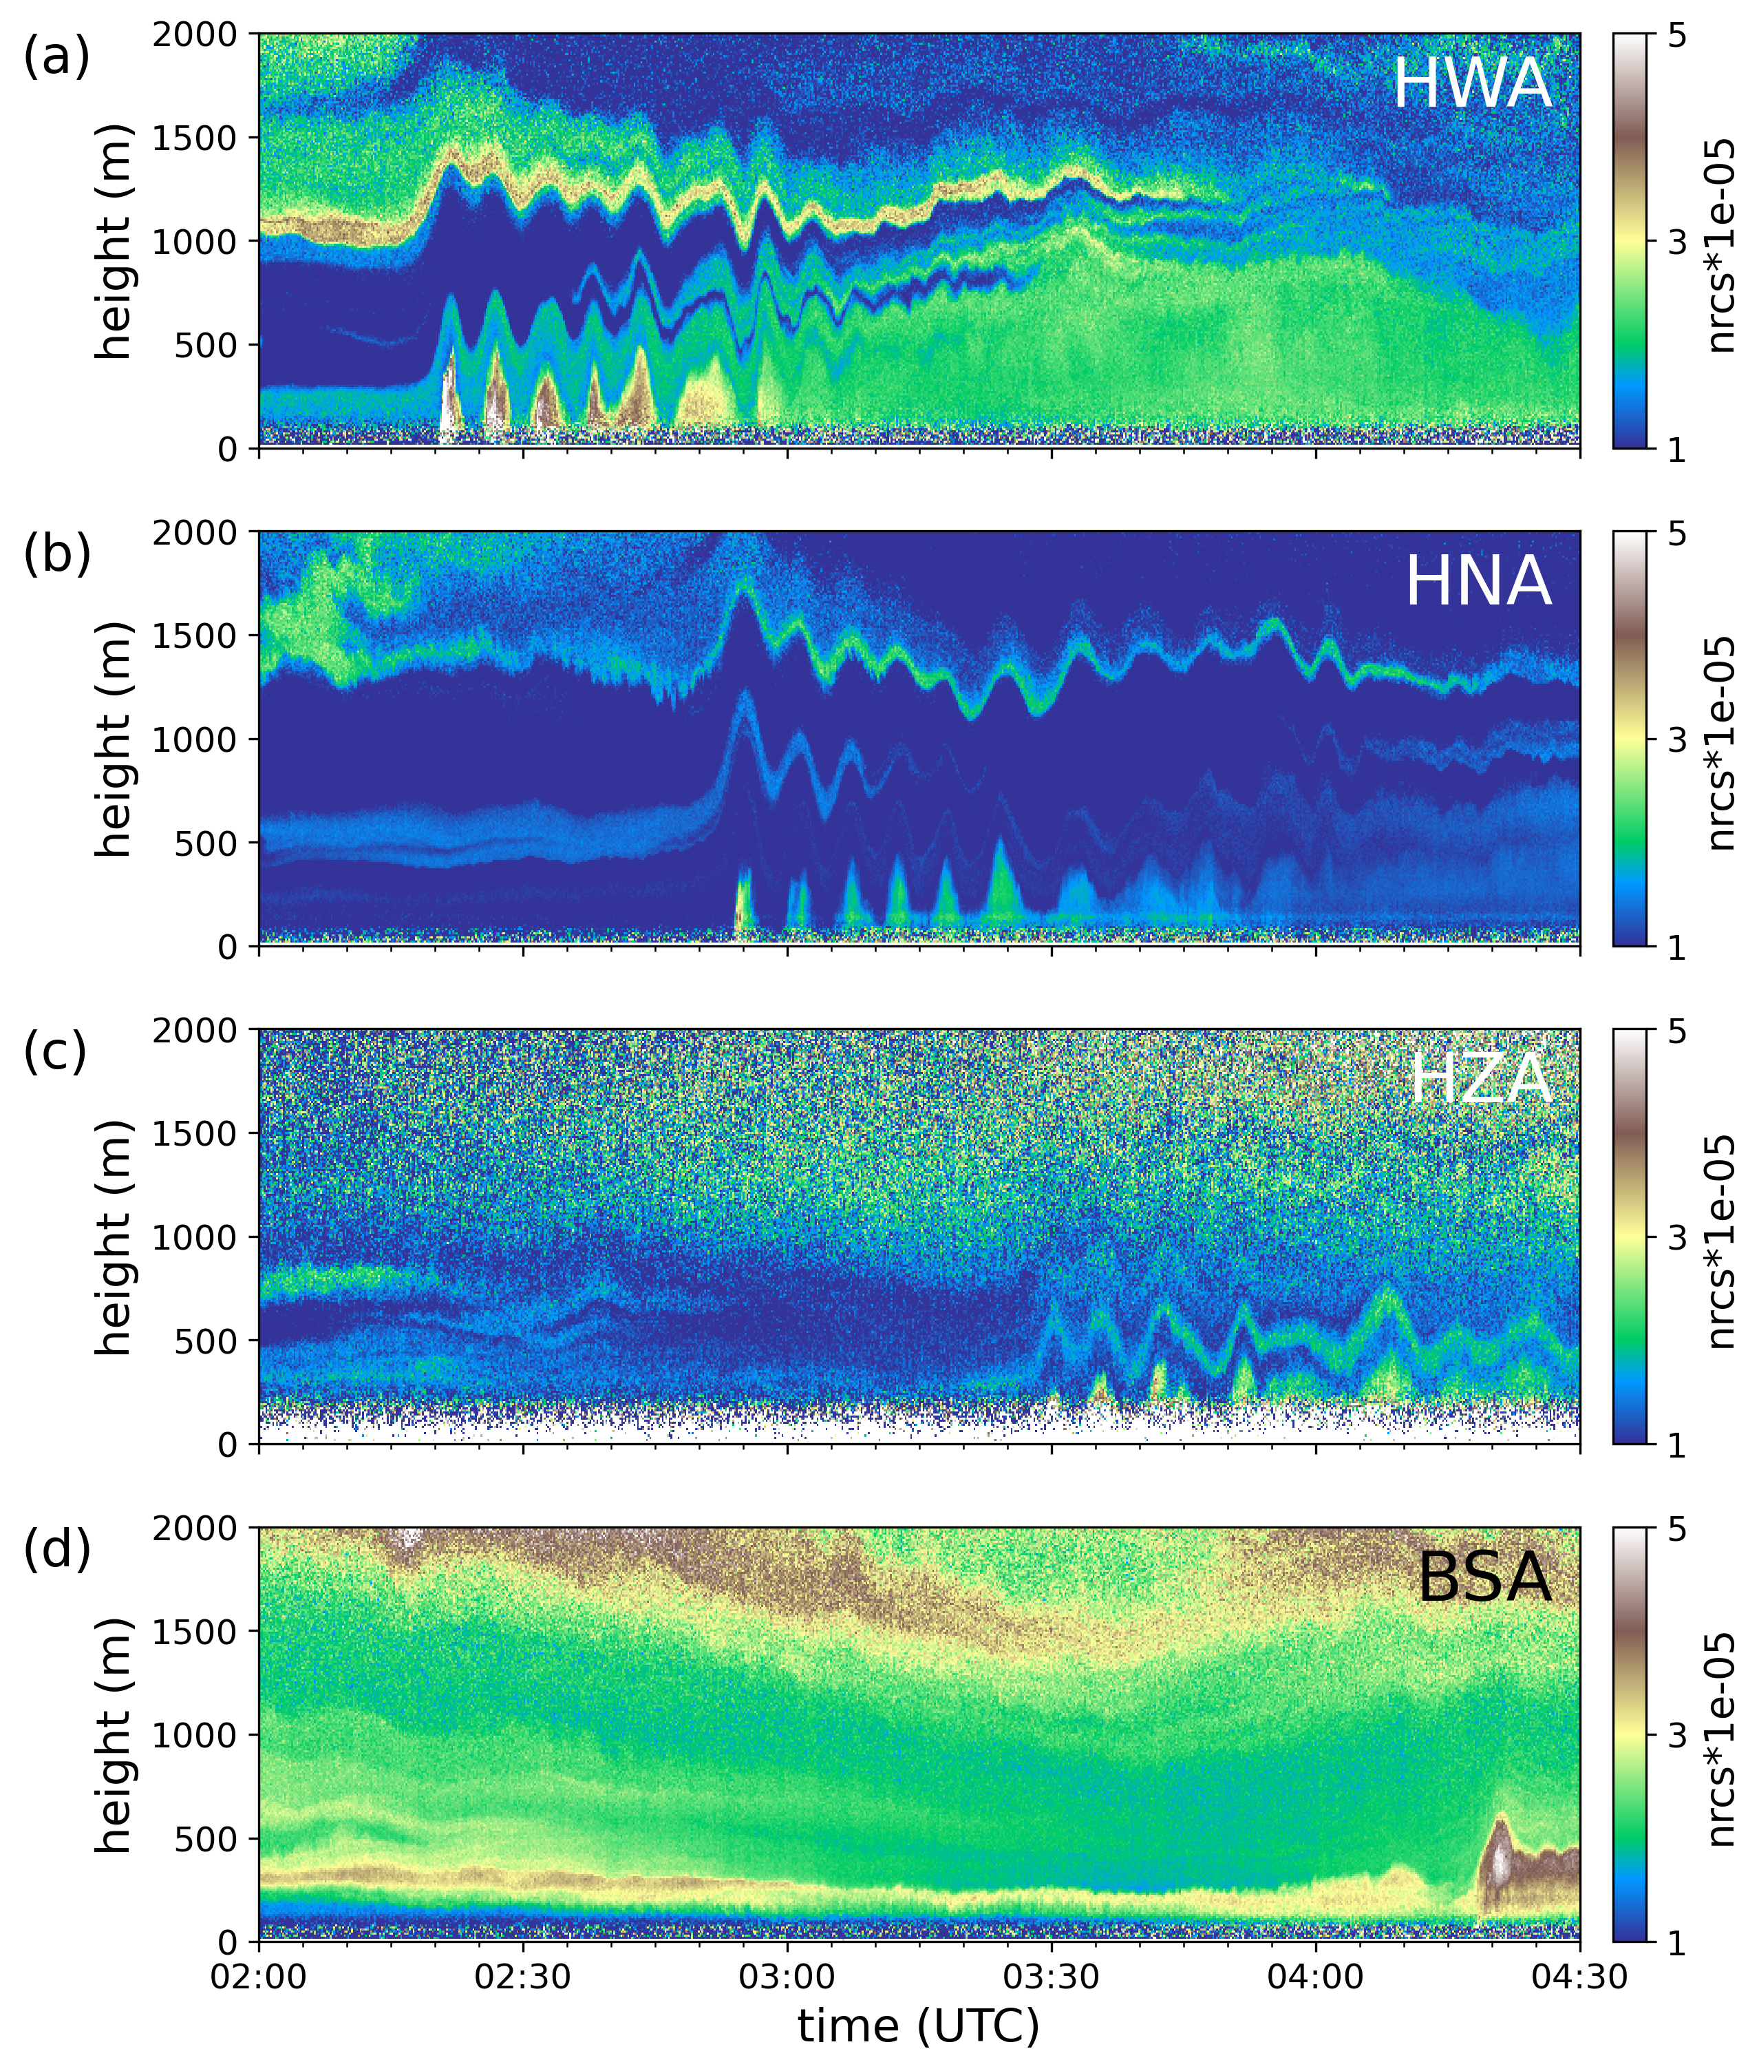

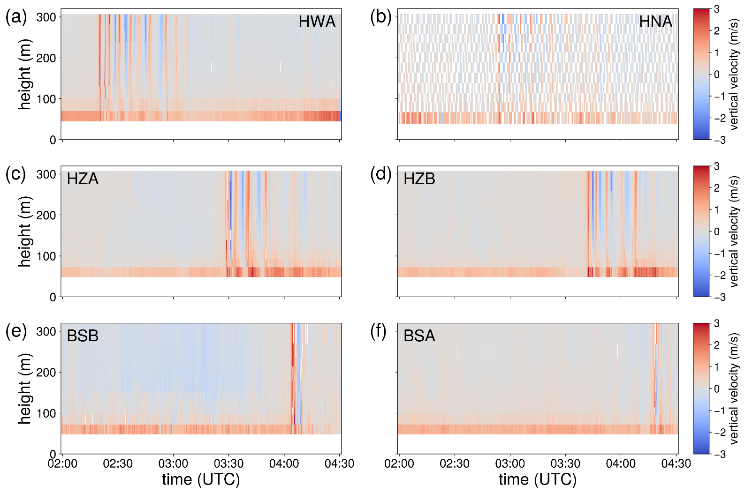
10m/s

Slide 9
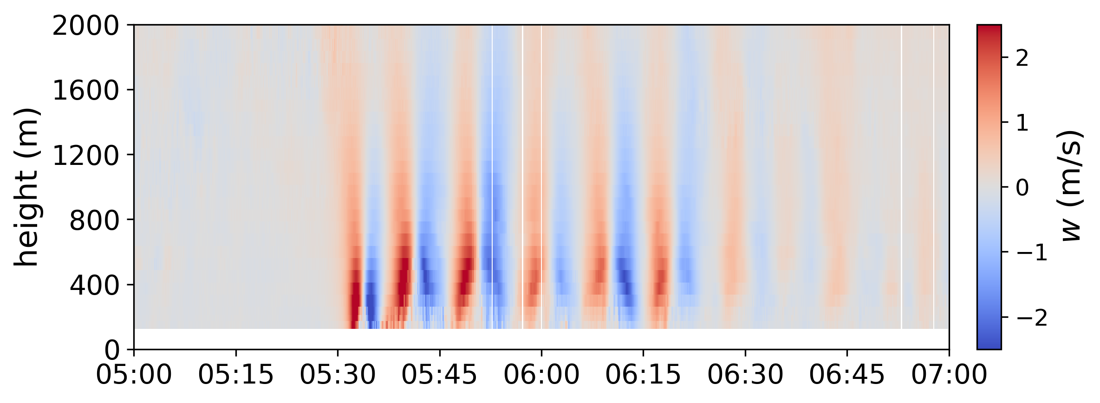

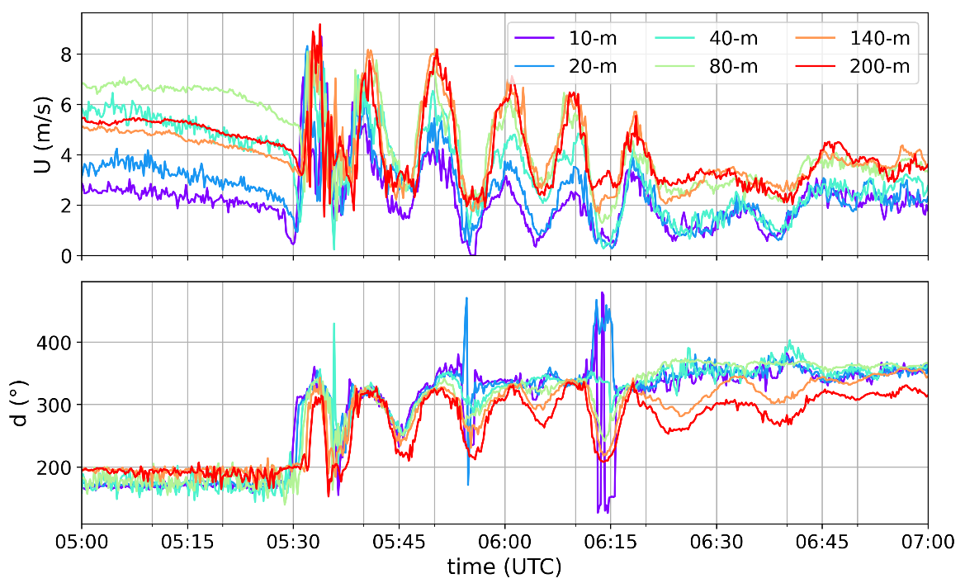
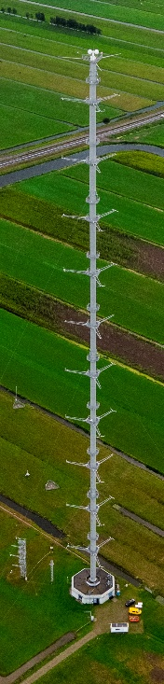
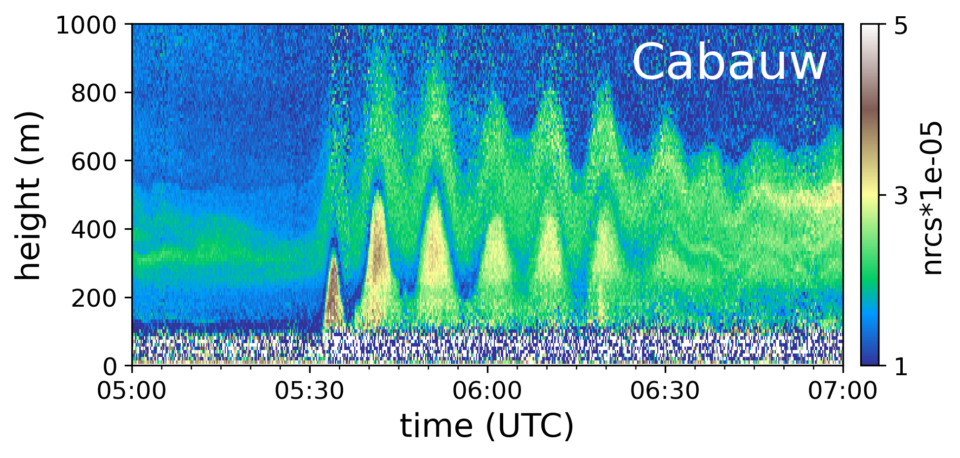
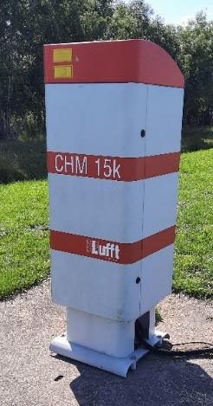
Cabauw atmospheric research station

Slide 10
Tens of boundary-layer gravity waves observed (2018->now)
Mostly spring & summer (both onshore and offshore)
(Nocturnal) stable boundary layer; ducted gravity wave
Non-orographic, (cold) fronts
Operational synoptic network and research instruments
Doppler lidar: vertical velocity
Automatic lidar ceilometer: backscatter
Examples:
June 30, 2022 (onshore)
May 2, 2025 (offshore & onshore)
Climatology
Test cases for high-resolution weather models
Impact wind energy
Preprint on June 2022 case
steven.knoop@knmi.nl
More observations and links to datasets in the Supplemental Material

Slide 12
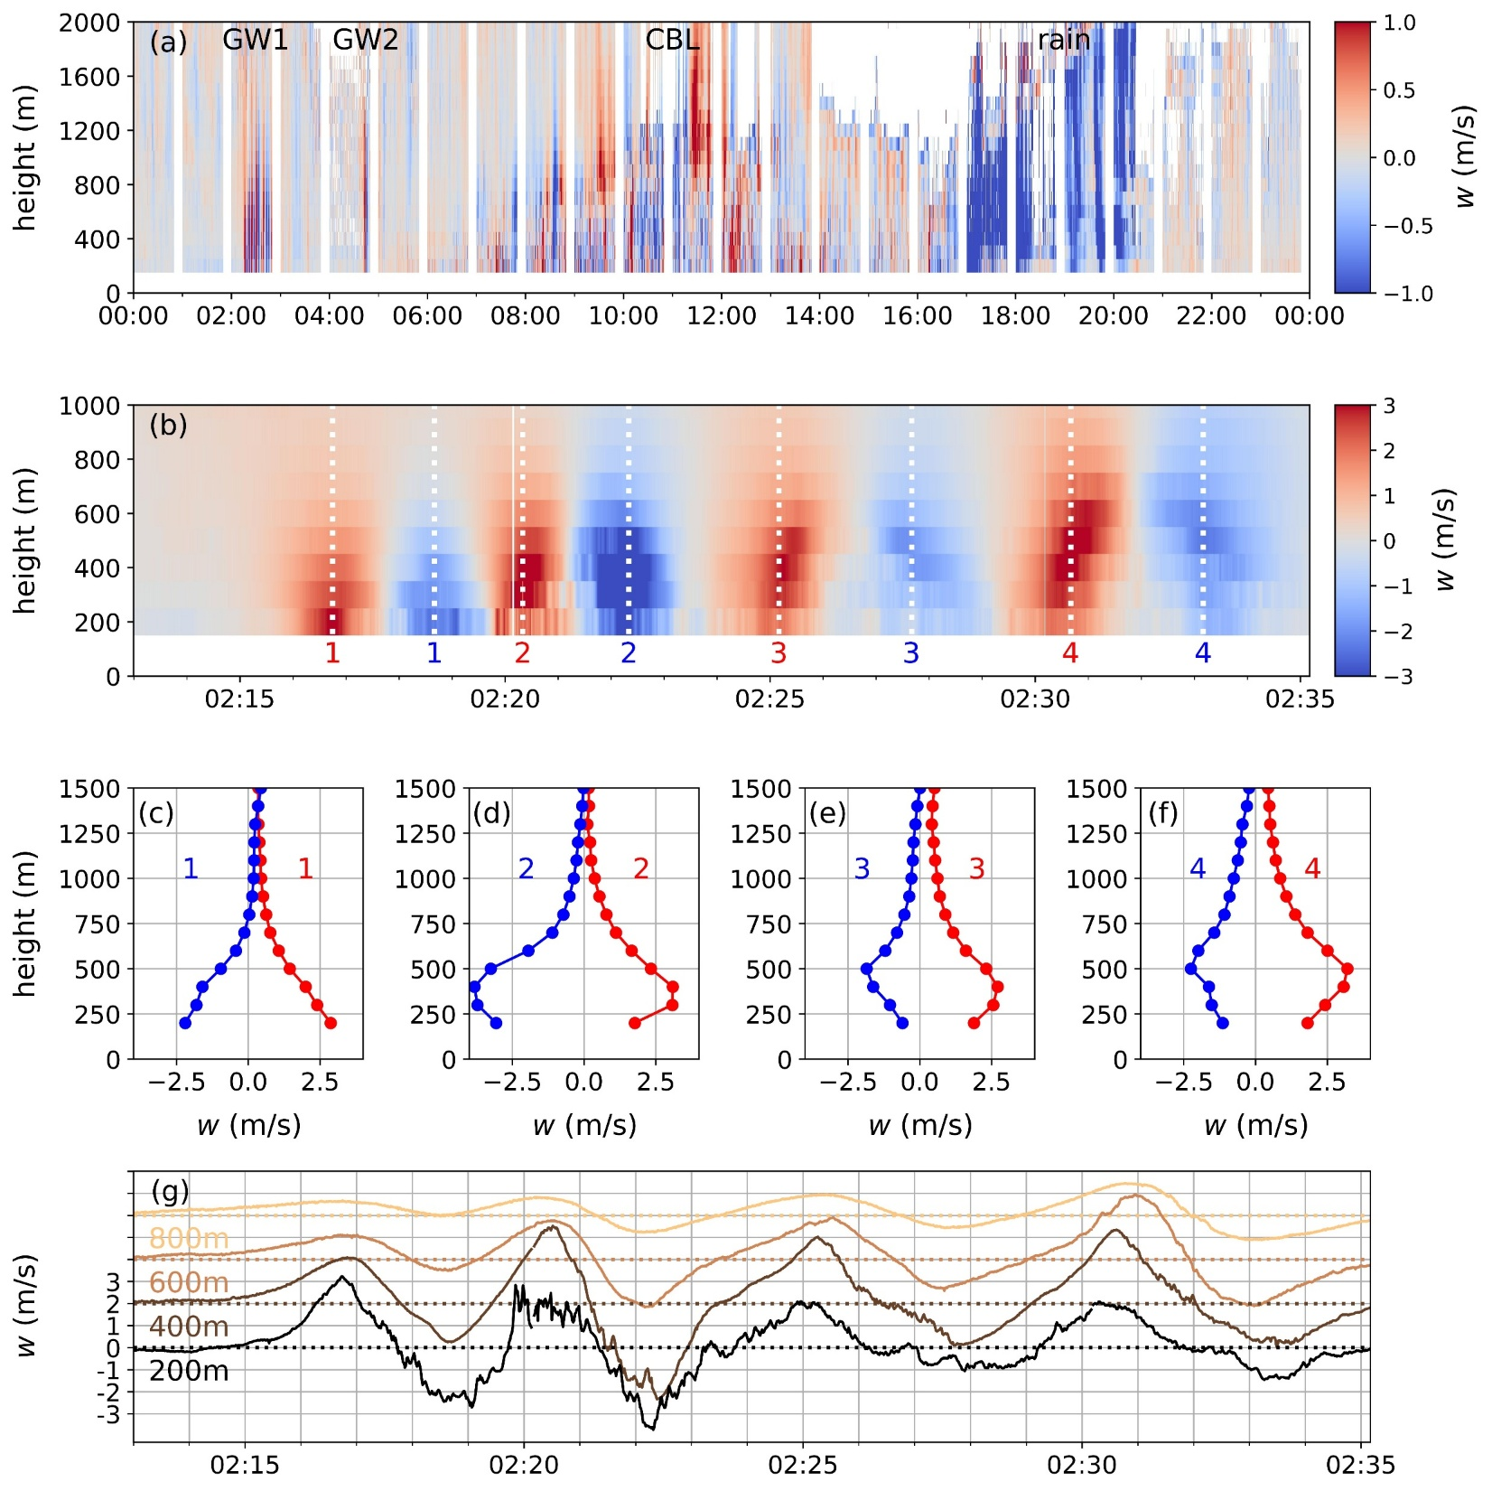

GW event I
June 2022
Cabauw

Slide 13
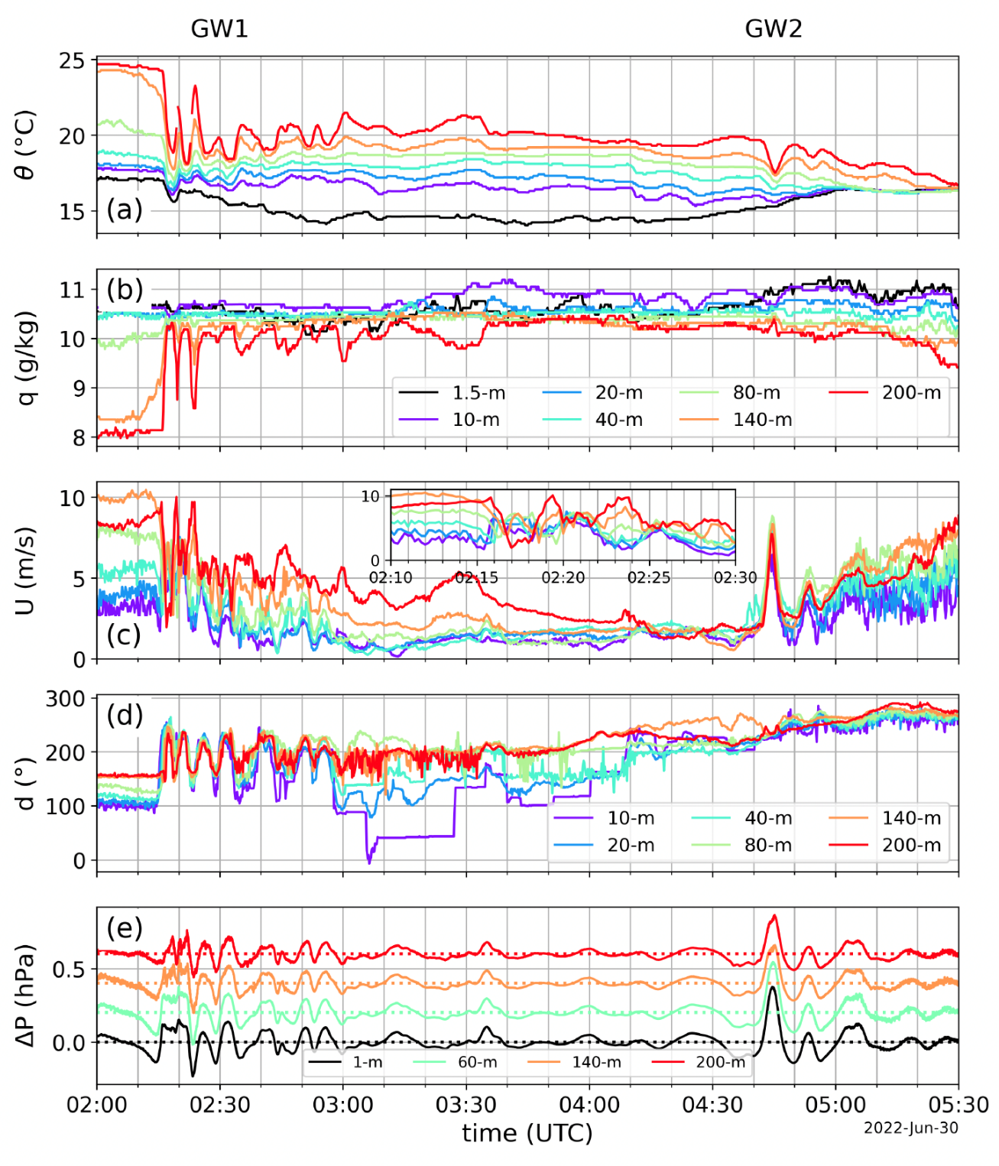
GW event I
June 2022
Cabauw

Slide 14
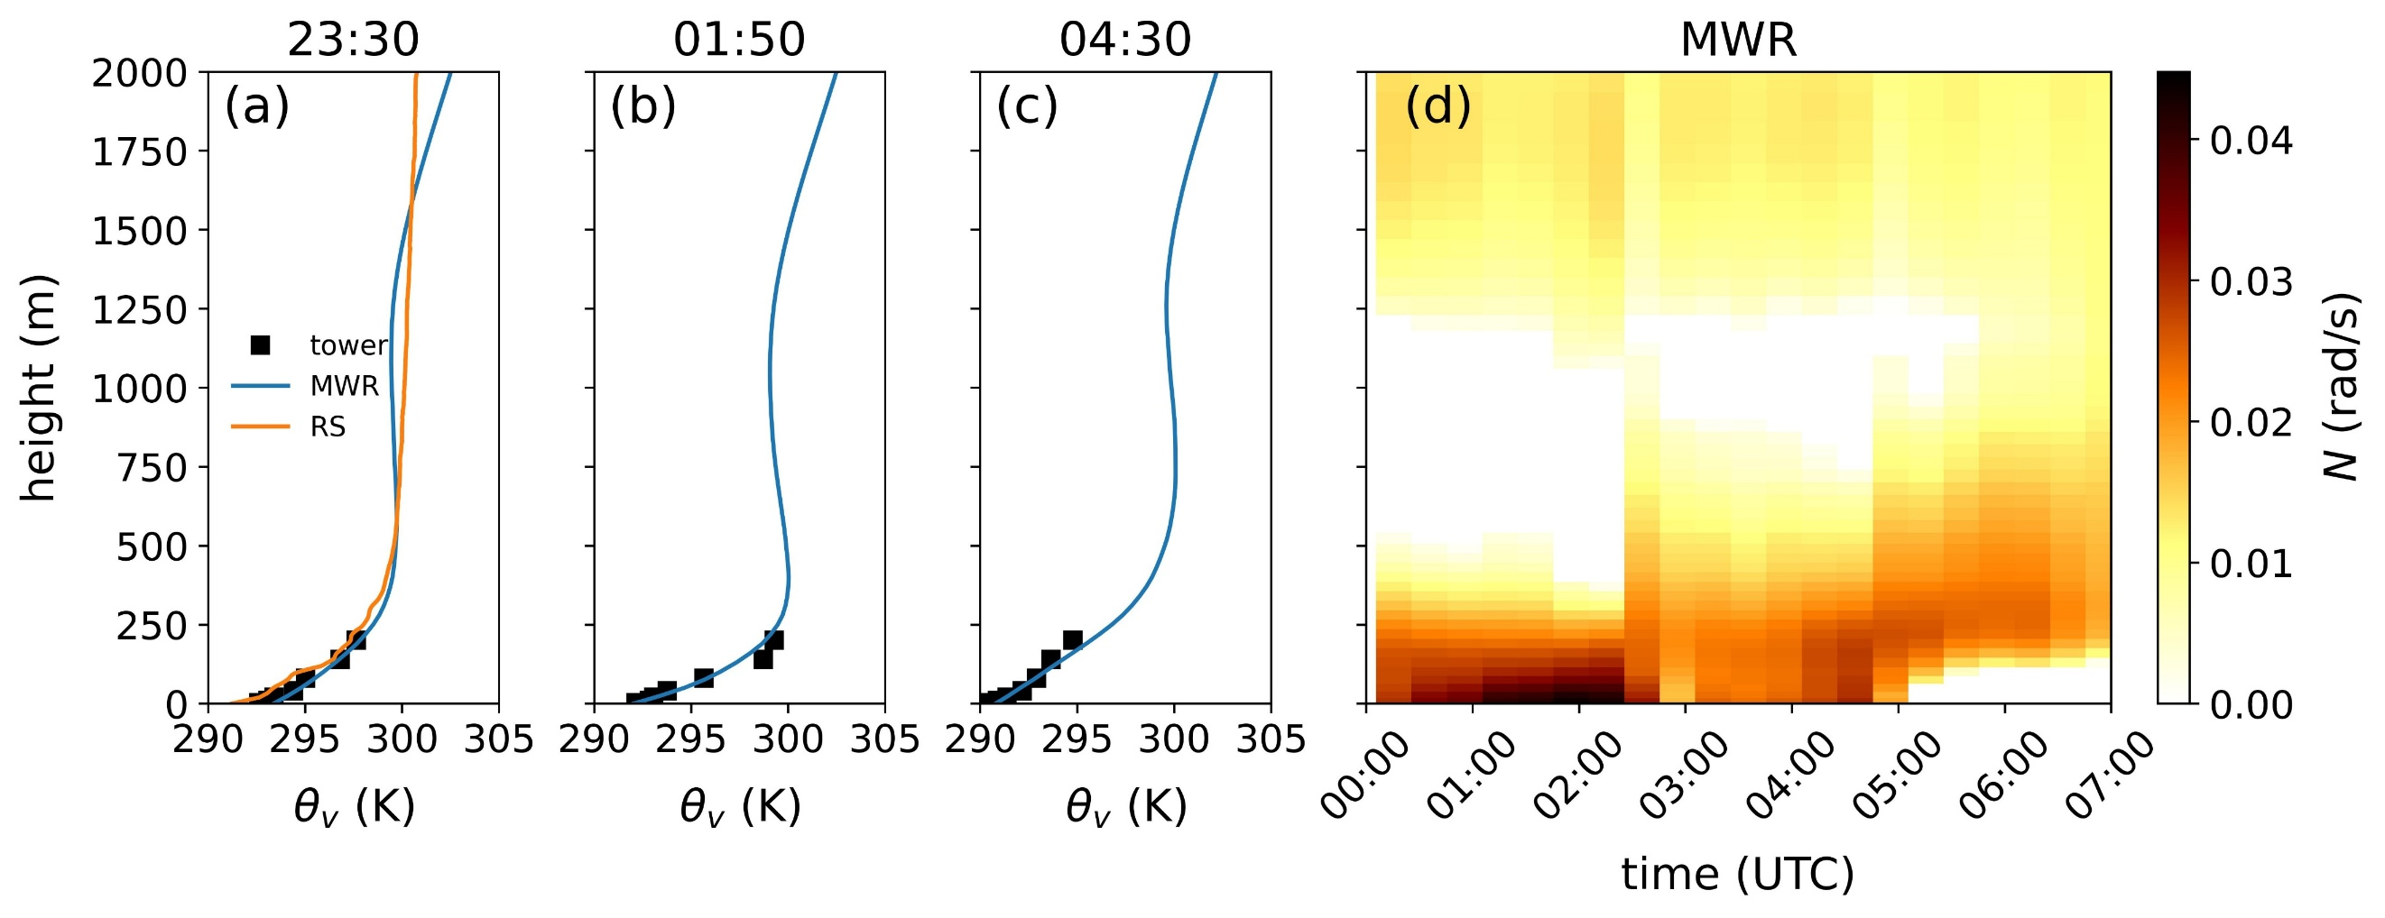
GW event I
June 2022
Cabauw
MWR: microwave radiometer
RS: radiosonde (De Bilt)

Slide 15
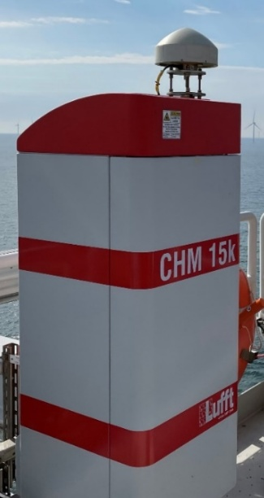
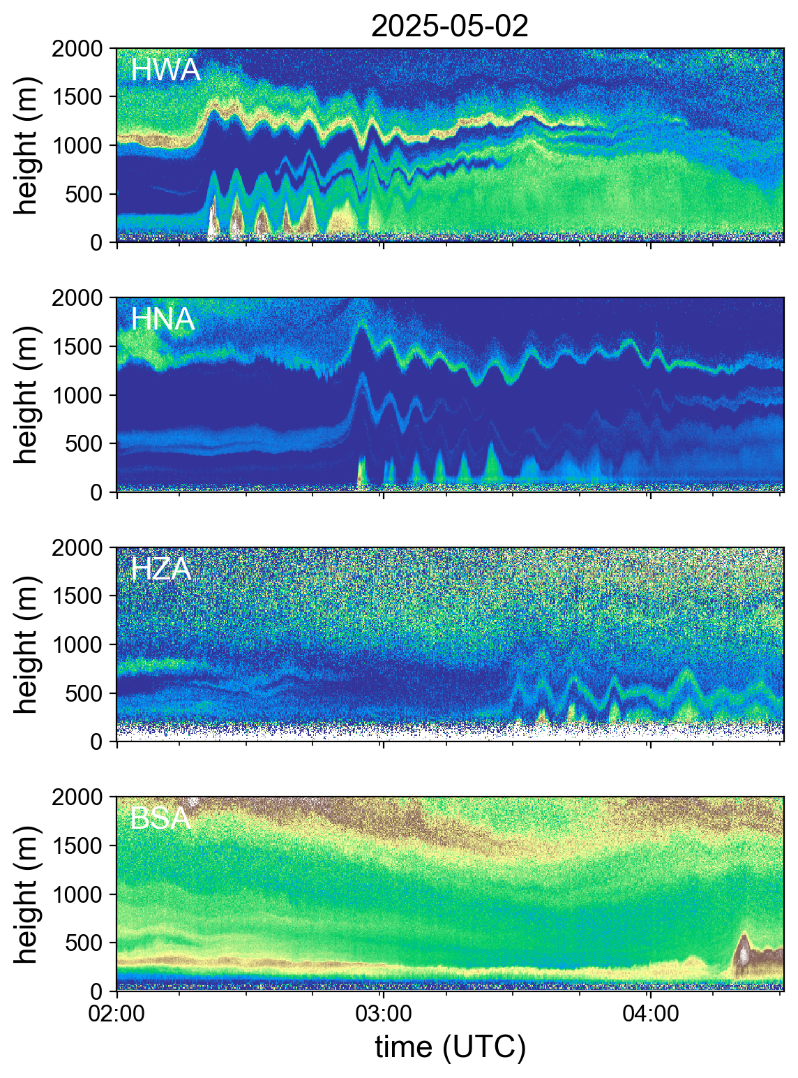
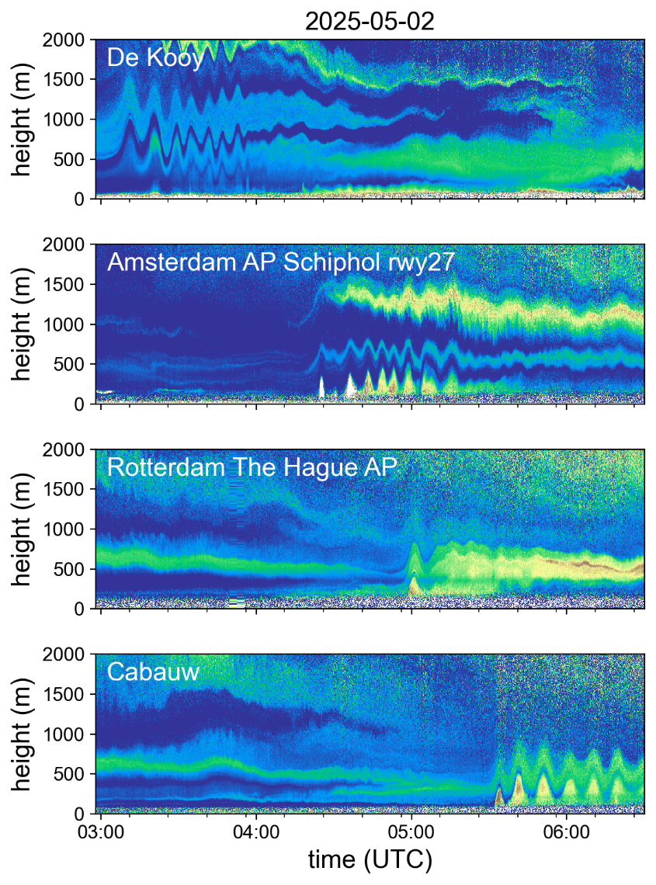
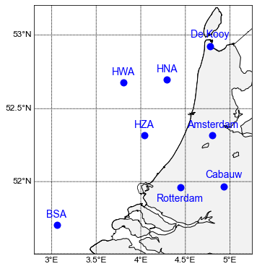
GW event II
May 2025

Slide 16
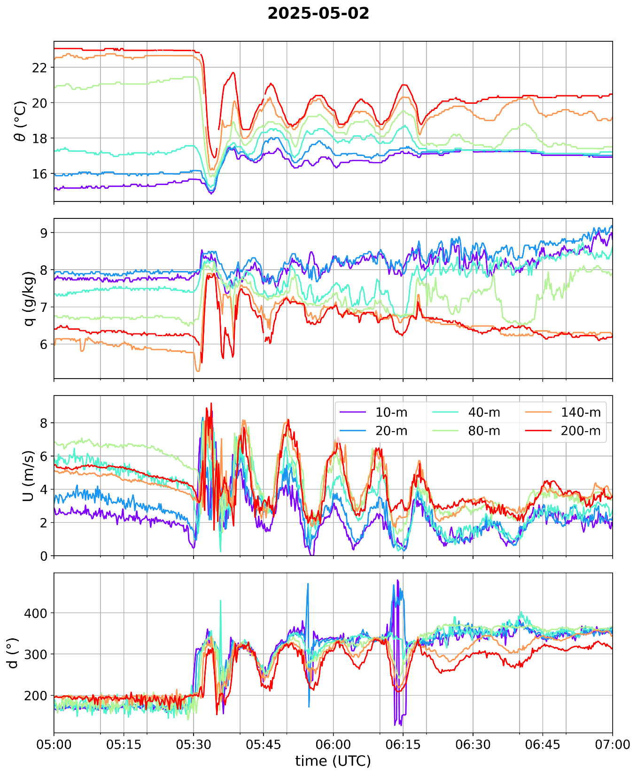
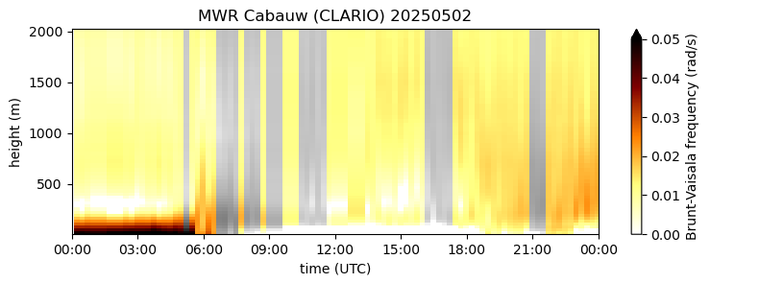
GW event II
May 2025
Cabauw

Slide 17

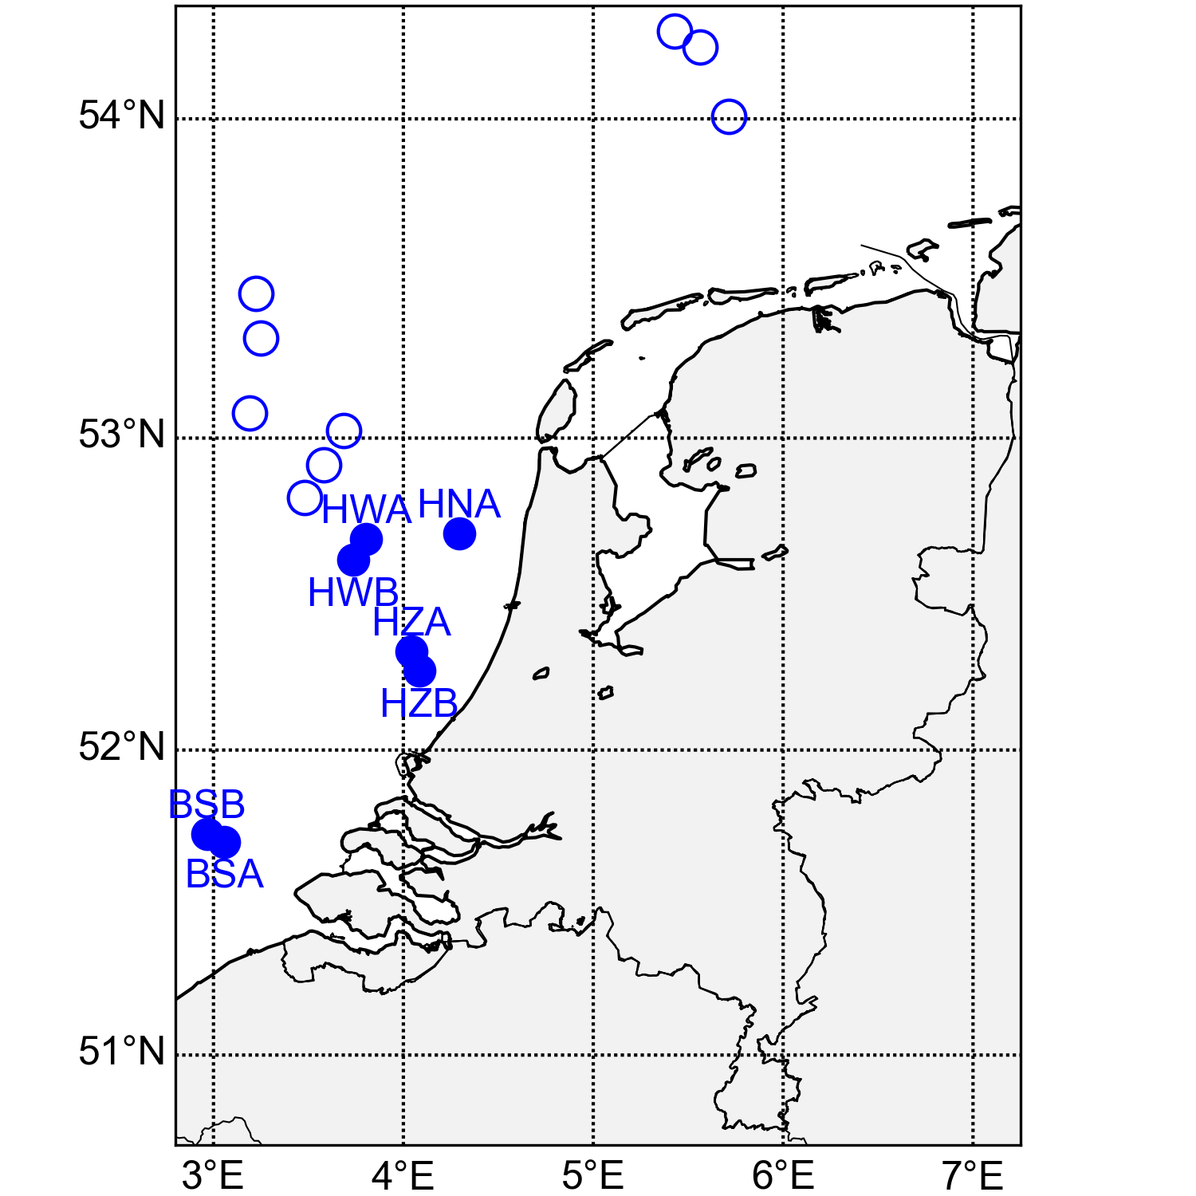
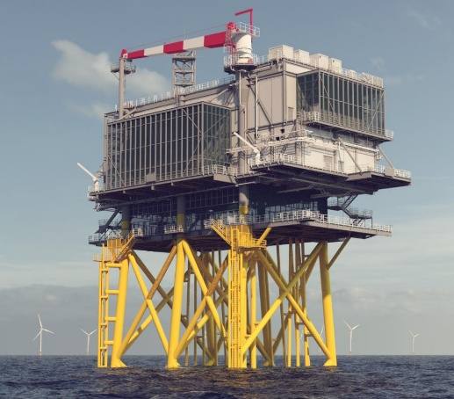

Borssele Alpha, Damian Napoles Soto (KNMI)
VAD
 | Start Doppler lidar | wind farm operational
BSA | 2019-7 | 2020-11
BSB | 2020-6 | 2020-11
HZA | 2022-4 | 2023-9
HZB | 2022-8 | 2023-9
HNA | 2022-12 | 2023-12
HWA | 2023-10 | -
HWB | 2025-07 | -
Doppler lidar:
ZX300M (ZX lidars)

Slide 18
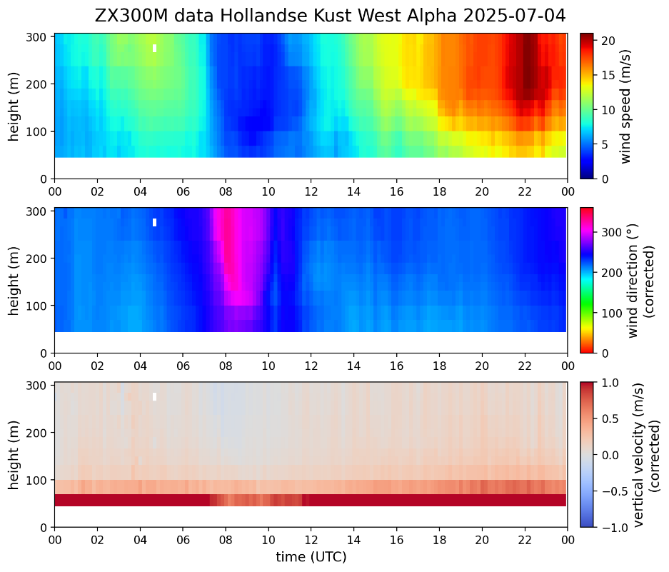
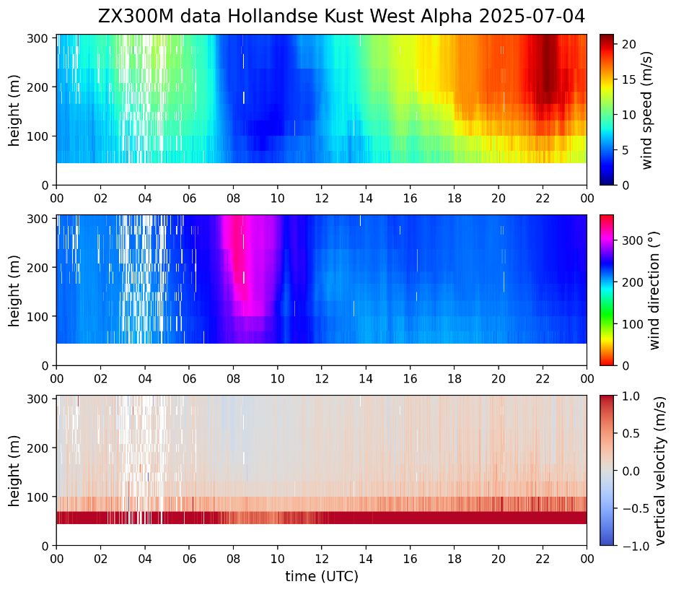
North Sea wind lidar data
2 datasets:
10-minute averaged data
Unaveraged data
45m
Data available on KNMI data platform:
https://dataplatform.knmi.nl/dataset/windlidar-nz-wp-platform-10min-1 (near-real time)
https://dataplatform.knmi.nl/dataset/windlidar-nz-wp-platform-1s-1 (daily)

Slide 19
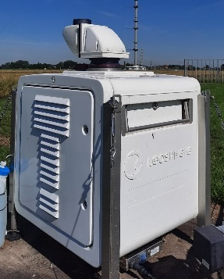
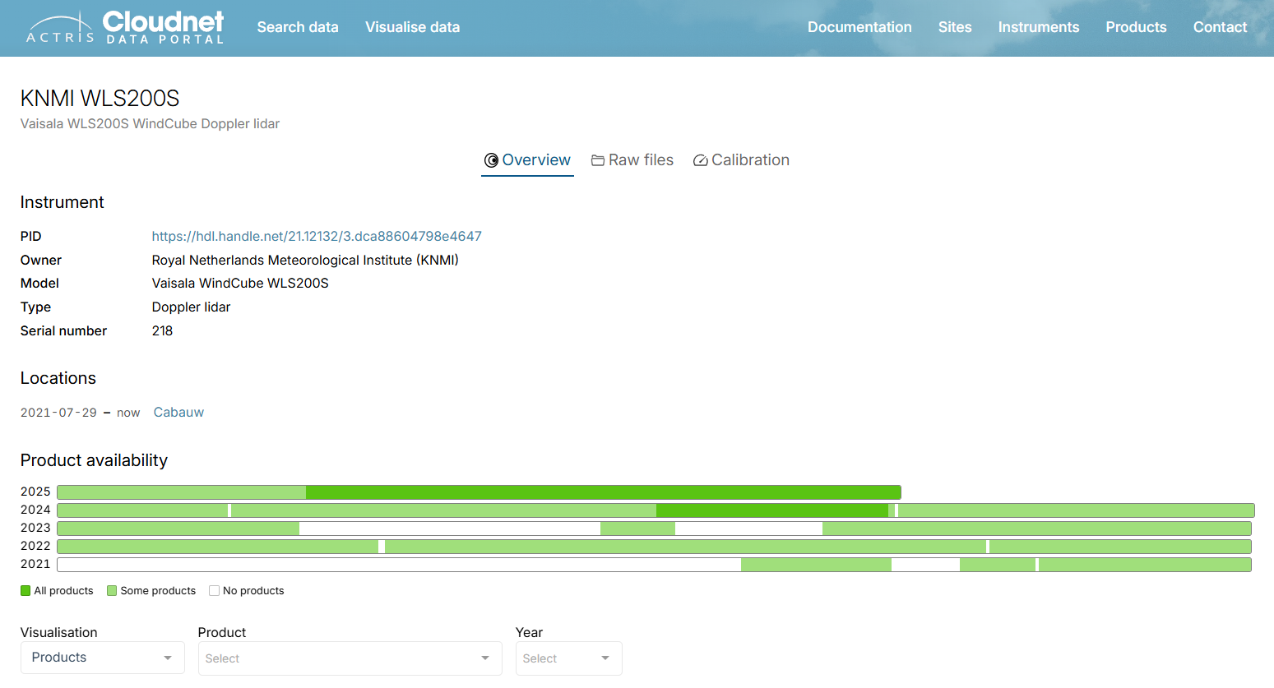
Windcube200S Cabauw
Instrument data available on:
ACTRIS Cloudnet (https://cloudnet.fmi.fi/)
https://cloudnet.fmi.fi/instrument/dca88604-798e-4647-a44d-ec61ea412301

Slide 20
KNMI ceilometer network data
2 datasets:
cloud base heights and backscatter profiles from CHM15k ceilometers in the KNMI observation network, 12 second instrument data: https://dataplatform.knmi.nl/dataset/ceilonet-chm15k-backsct-la1-t12s-v2-0
calibrated attenuated backscatter profiles from CHM15k ceilometers in the KNMI observation network, 5 minute averaged data: https://dataplatform.knmi.nl/dataset/ceilonet-chm15k-backsct-la1-t05-v2-0
For our boundary-layer gravity wave research, we use the 12 second instrument backscatter profile data.

Slide 21
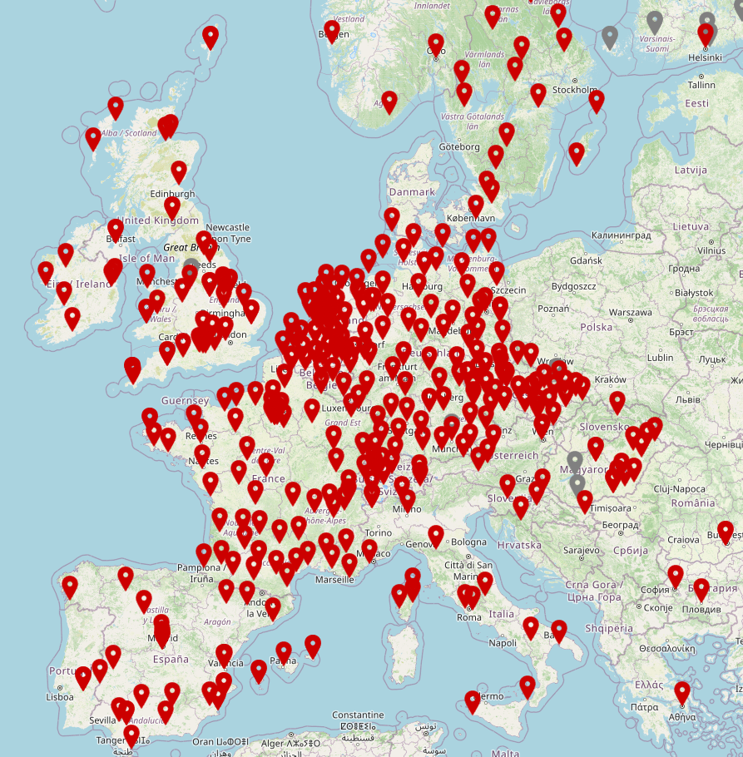
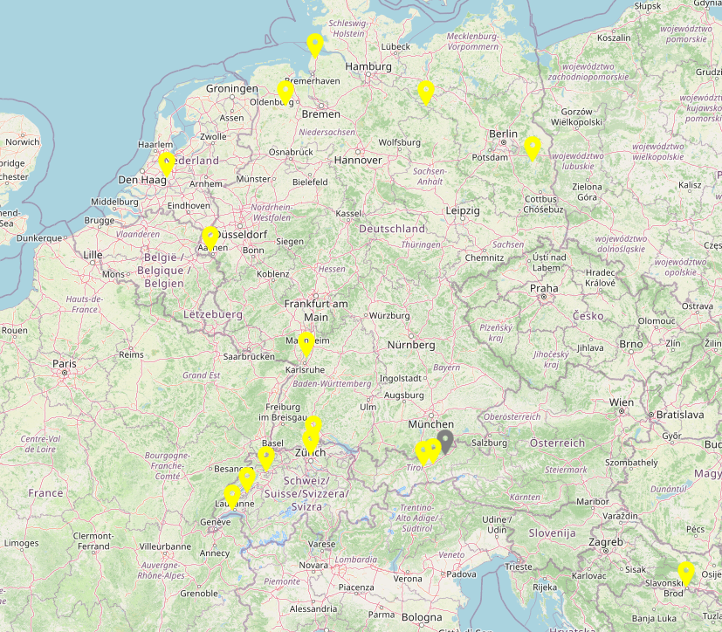
Eumetnet E-PROFILE network
KNMI ALC network and Doppler lidar Cabauw are part of E-PROFILE network
https://e-profile.eu/
Doppler lidars
automatic lidar ceilometers (ALC)

