Slide 1
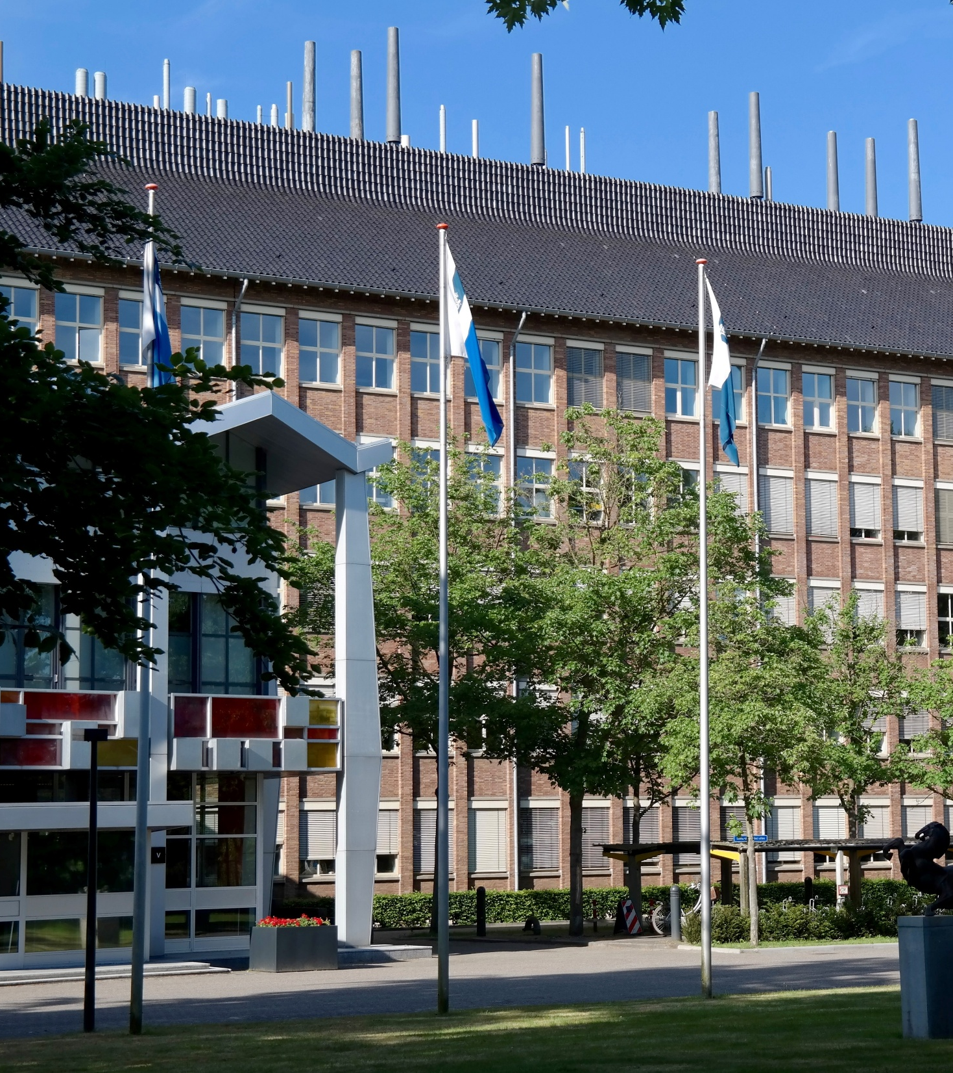
Expansion of the UFP measuring capabilities of the Dutch National Air Quality Monitoring Network - Appendix
Anneke Batenburg, Joost Wesseling, Dirk Wever, Sjoerd van Ratingen, Ernie Weijers, and Guus Stefess
← RIVM, Bilthoven, the Netherlands
anneke.batenburg@rivm.nl
EGU 2026, Vienna, 5 May 2026

Slide 2
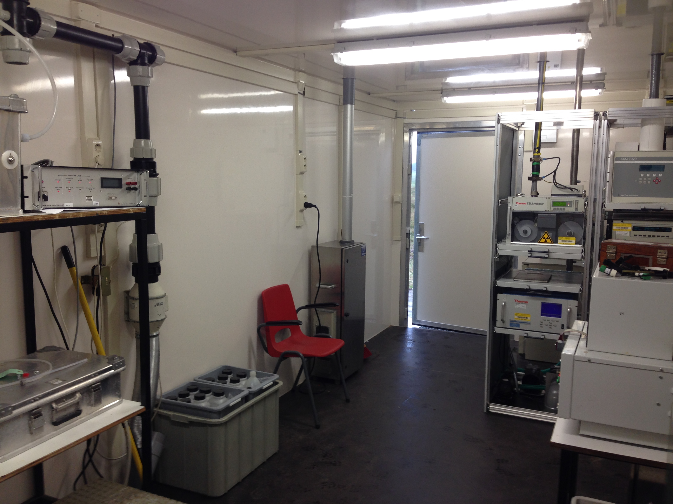
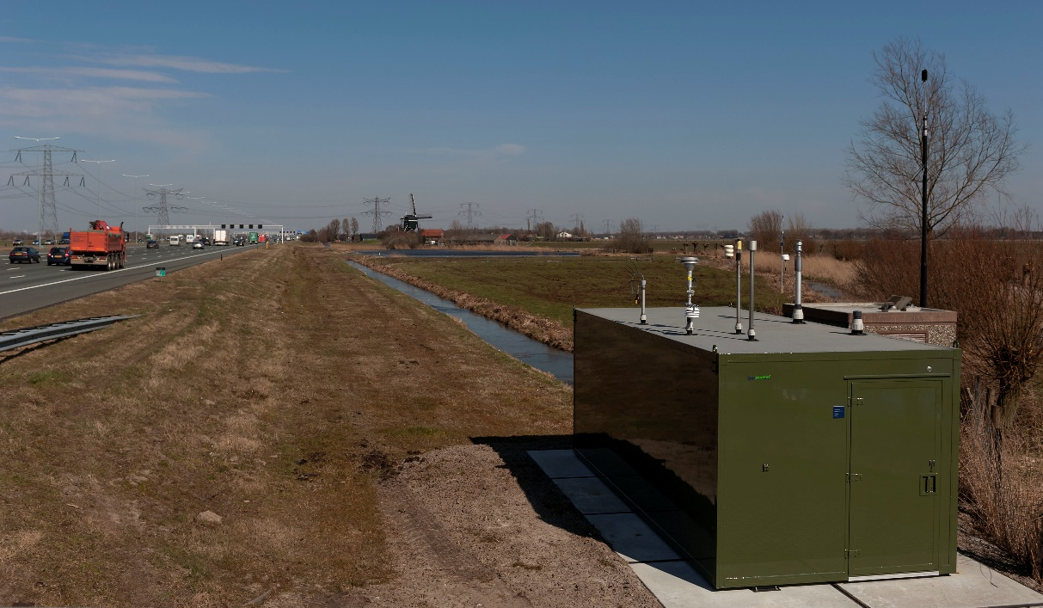
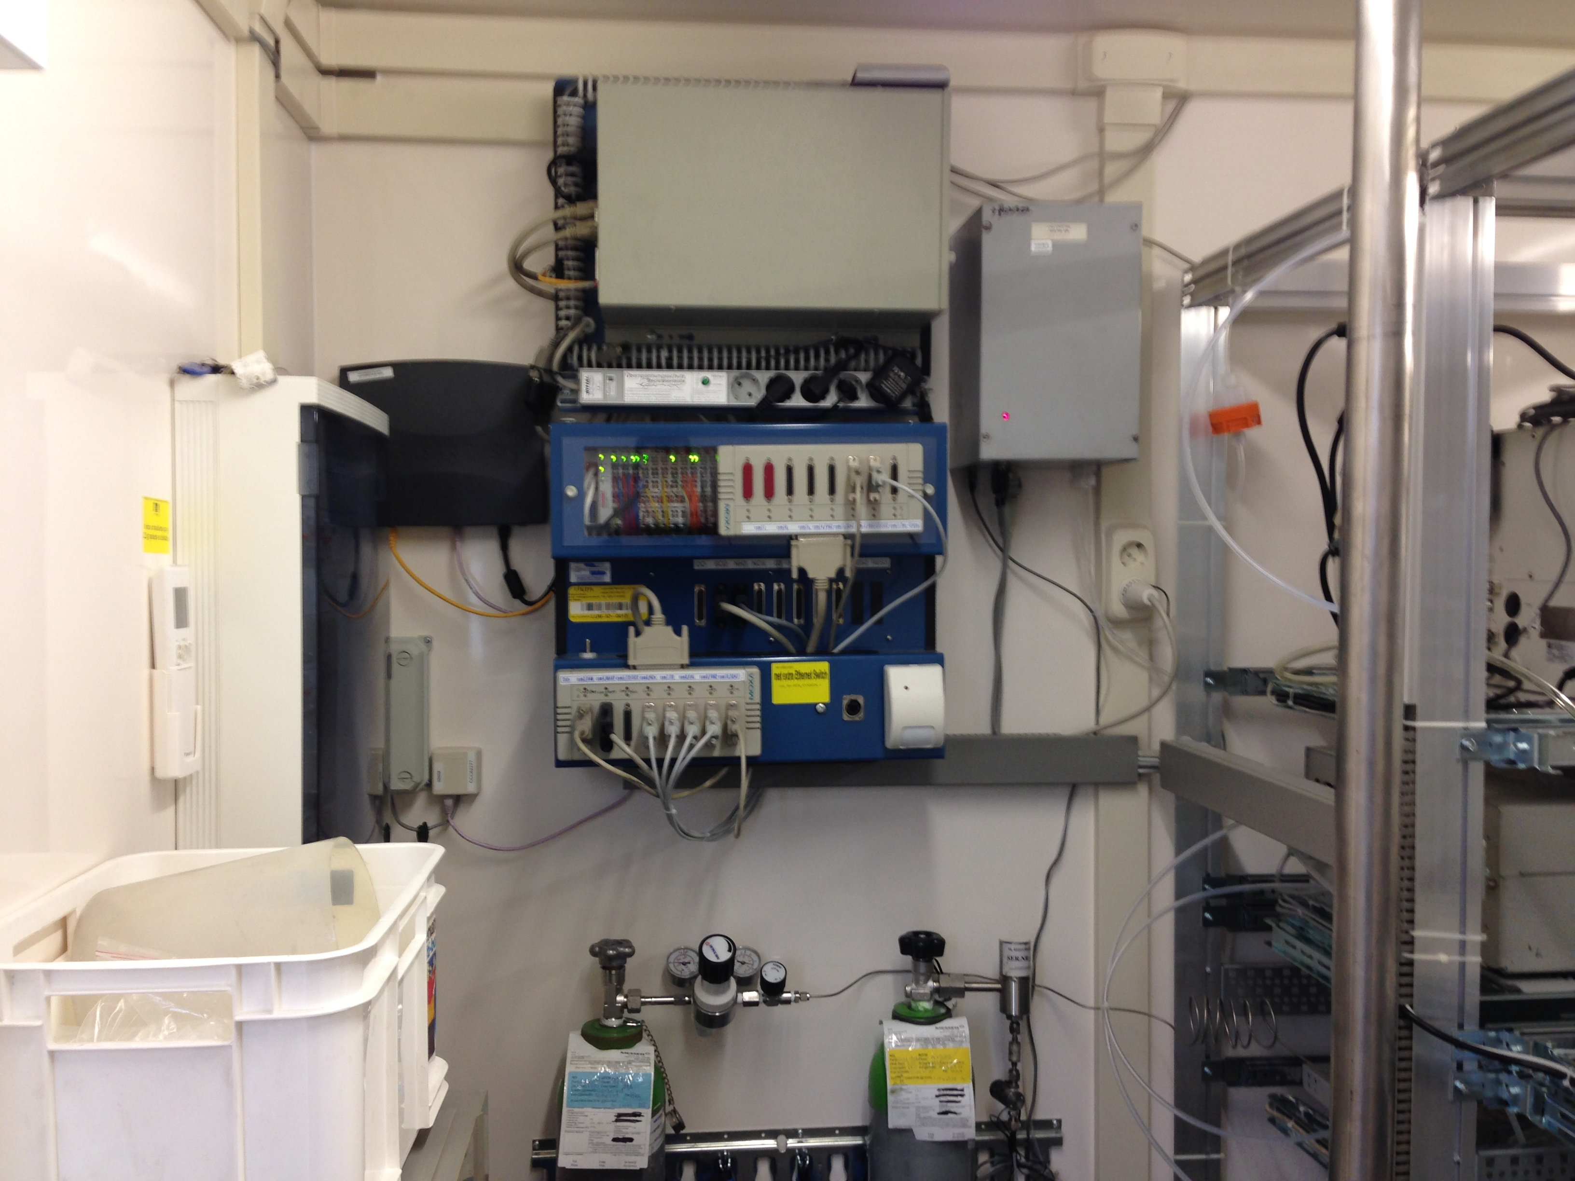
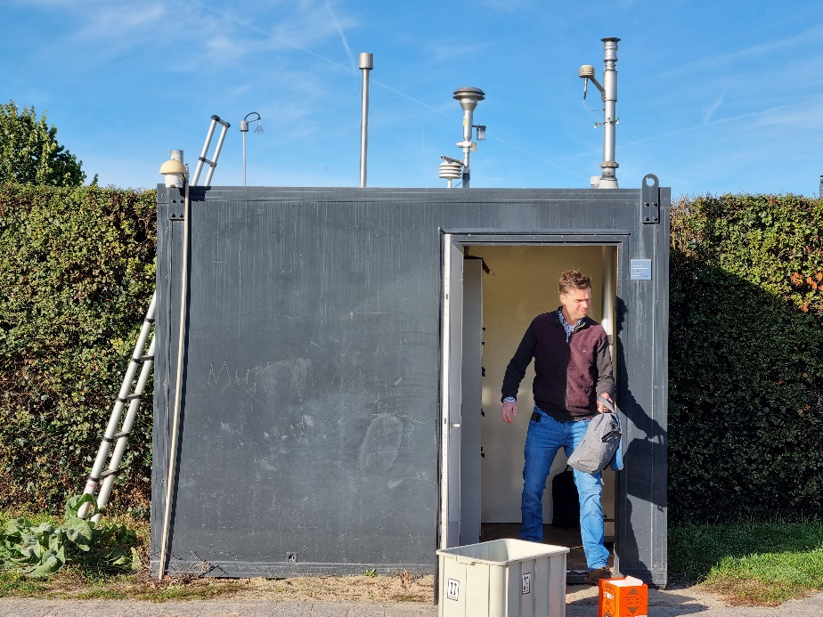
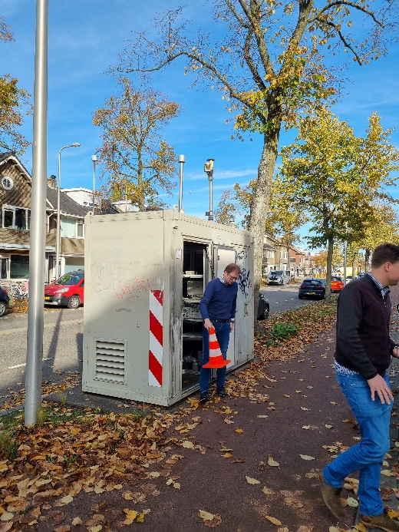
LML measurement cabins

Slide 3
Ongoing indicative UFP measurements in Utrecht province
Before acquiring the new CEN-compliant UFP counting equipment, RIVM has been measuring at three locations around Utrecht with older equipment. What follows are some of the preliminary results of those measurements. I’m not showing them in the main presentation due to time constraints.

Slide 4
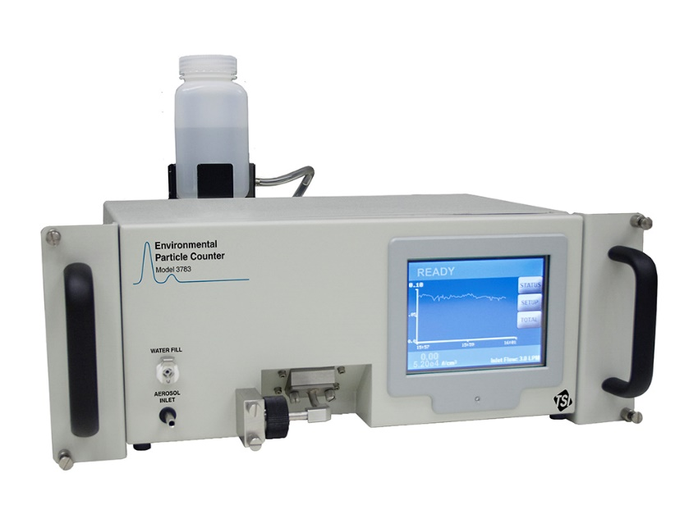
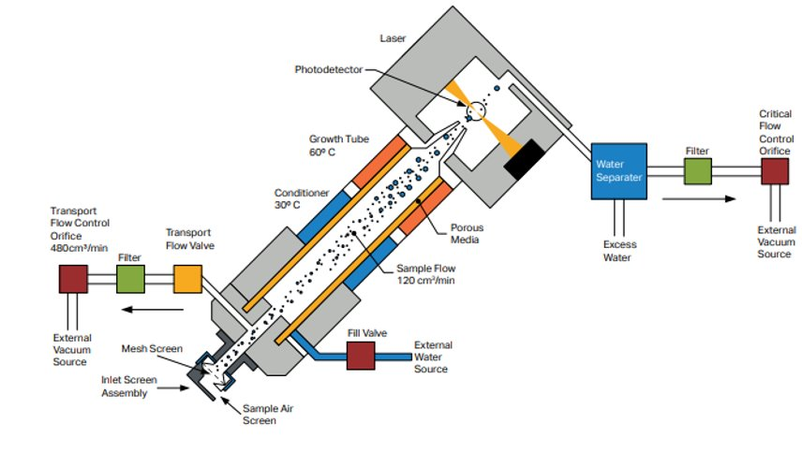
Equipment (current)
3: Optical detection
TSI EPC 3783
Older generation device
Water-based
D₅₀ = 7 nm
Not compliant with FprEN16976:2024
RIVM has 3
2: Ultrafine particles grow in water vapour
1: Inlet

Slide 5
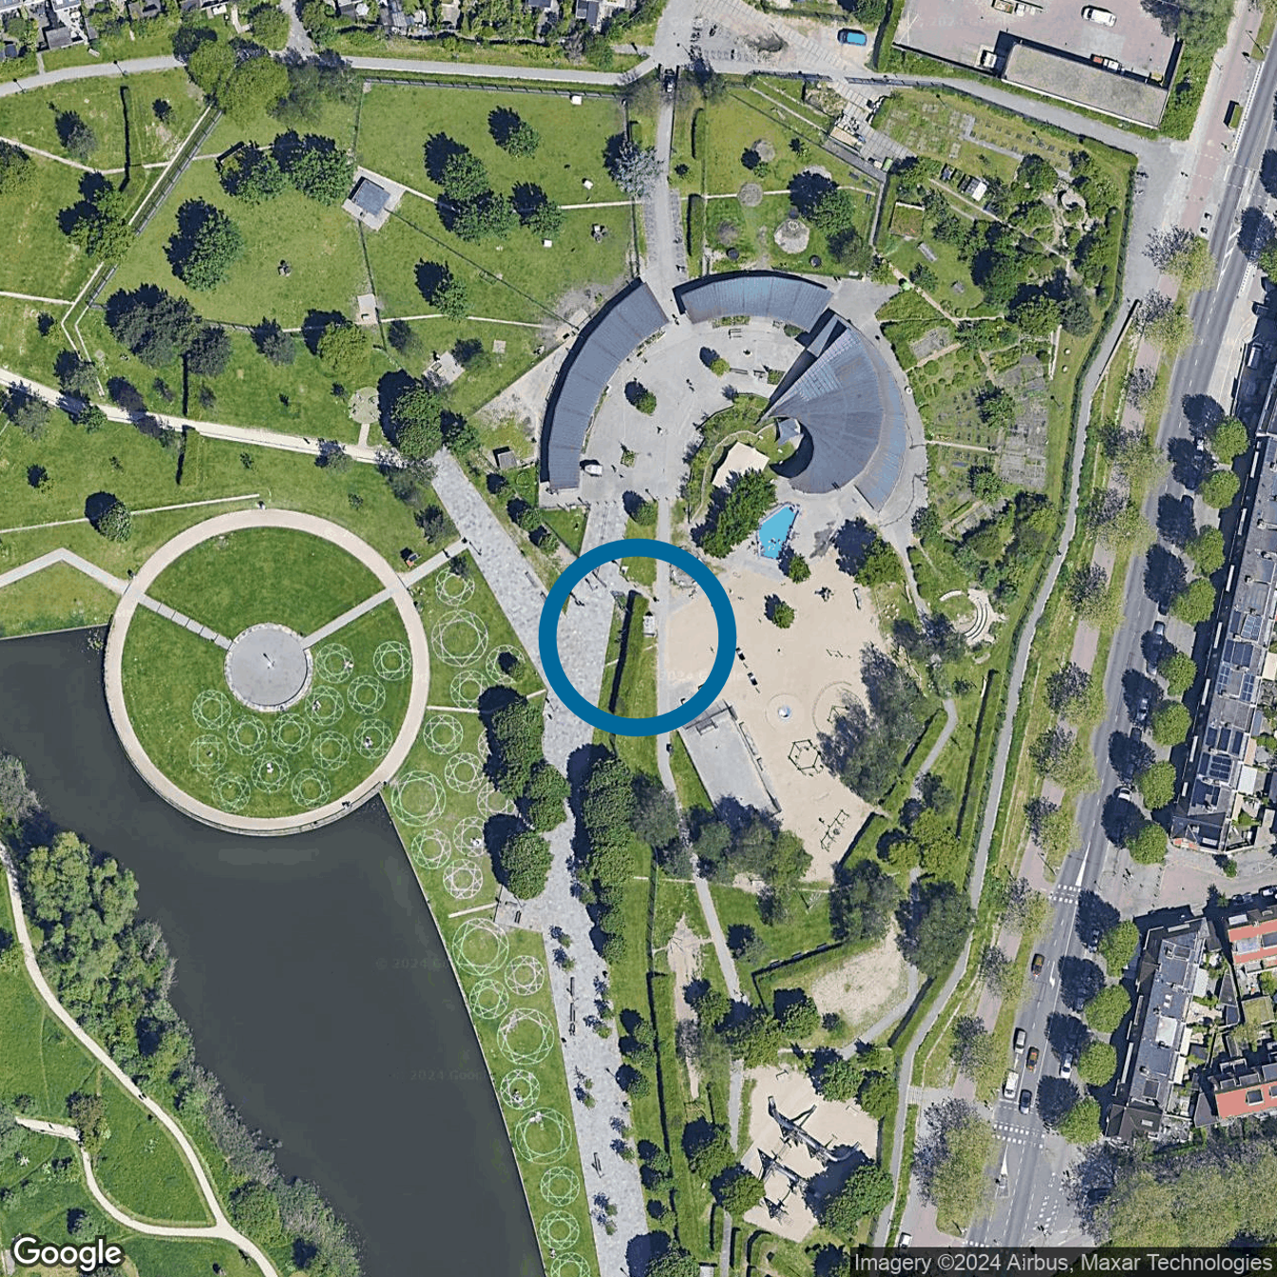
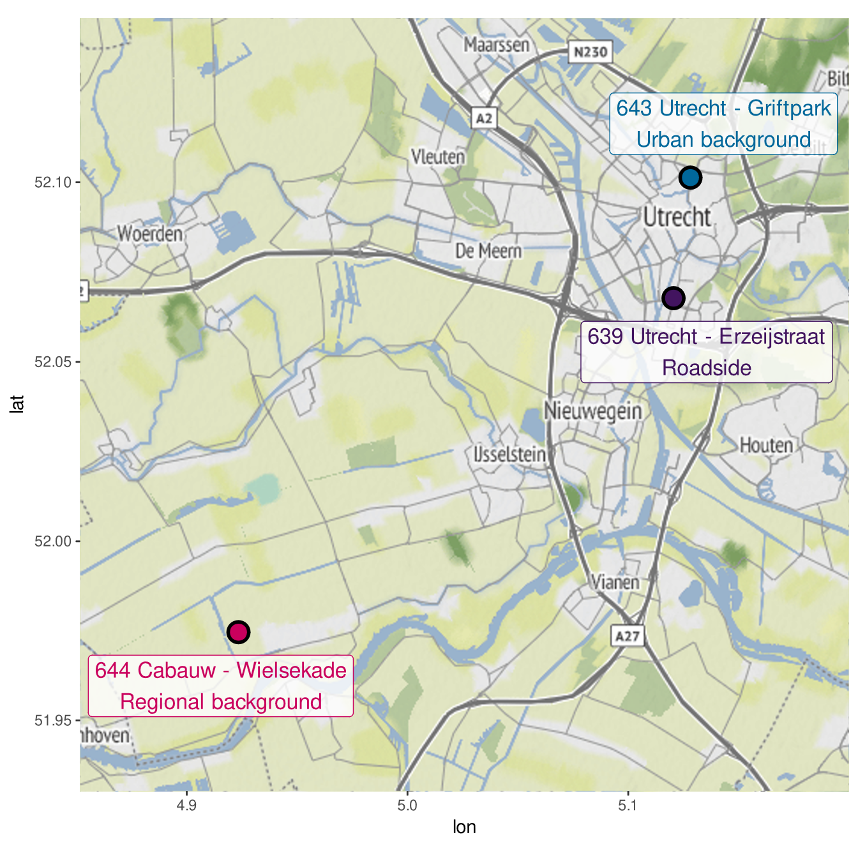
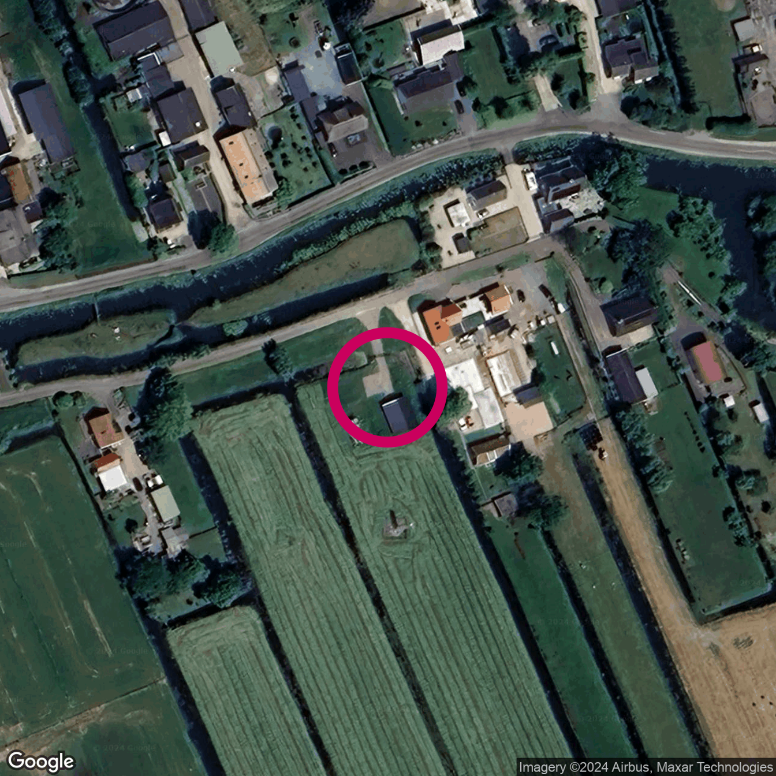
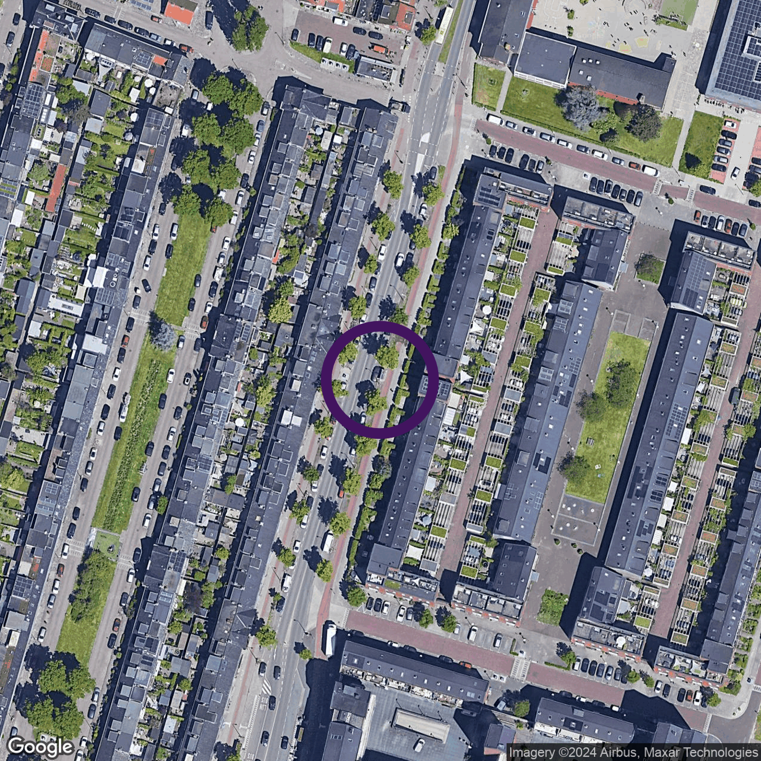
Measurement locations (current)

Slide 6
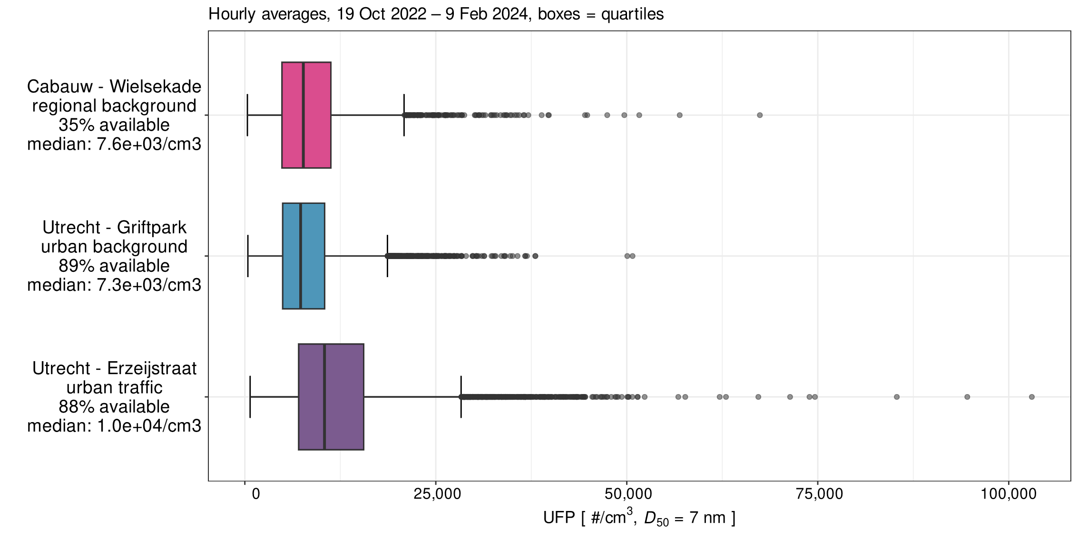
Preliminary results

Slide 7
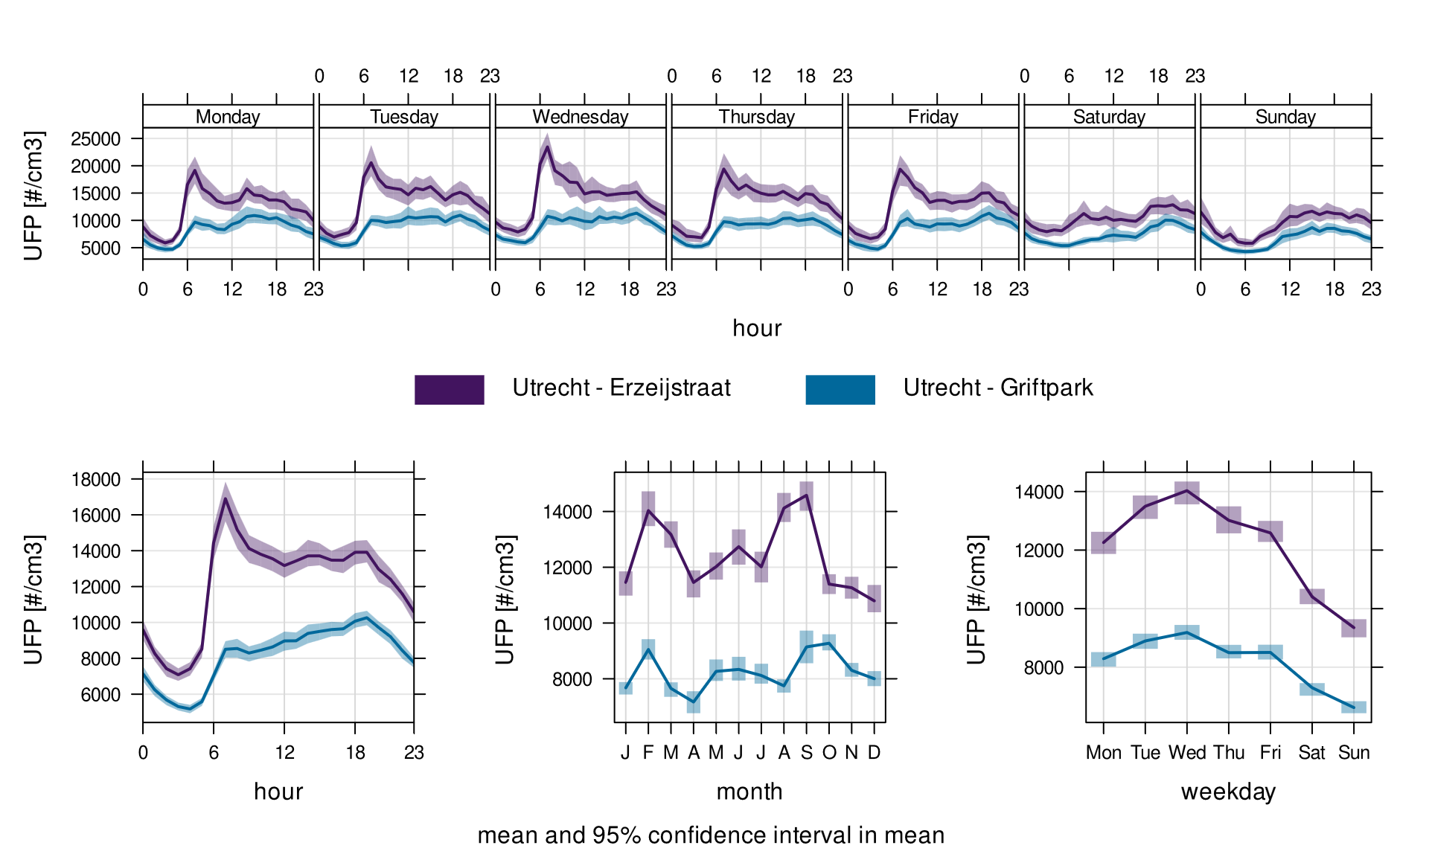
Preliminary results

Slide 8
Expansion of the UFP measuring capabilities of the Dutch National Air Quality Monitoring Network
Anneke Batenburg, Joost Wesseling, Dirk Wever, Sjoerd van Ratingen, Ernie Weijers, and Guus Stefess
← RIVM, Bilthoven, the Netherlands
anneke.batenburg@rivm.nl
EGU 2026, Vienna, 5 May 2026

Slide 9
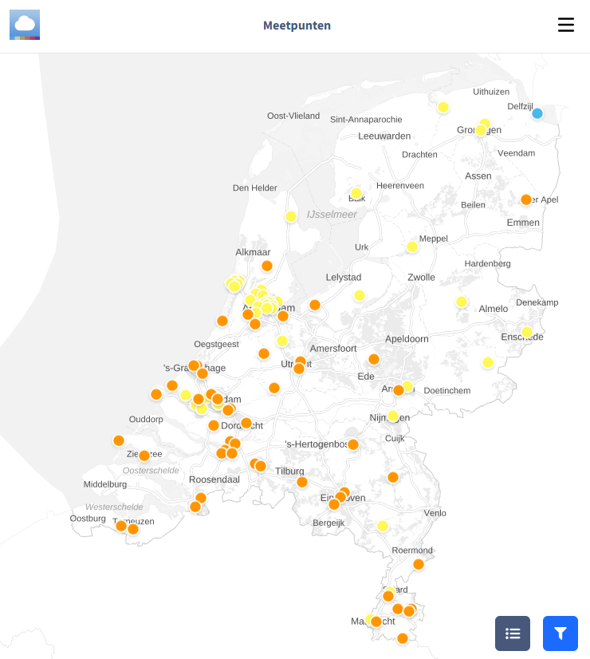
The existing network
> 50 locations by RIVM (“Landelijk Meetnet Luchtkwaliteit” = LML)
+ ≈ 50 locations by regional partners
Distributed over different types of environment (rural, urban, ...).
Components measured vary by location, focus on health.
https://www.luchtmeetnet.nl/

Slide 10

Timeline
Recommendation: measure UFP structurally within the LML
Sep 2021: National Health Council advisory report
End of 2021: Minister Of Infrastructure and Water Management asks RIVM for strategy
Dec 2022: RIVM publishes report with proposed monitoring strategy
Jan 2020: Minister for the Environment and Housing requests advice on UFP from National Health Council
2023-2024: tendering process for new UFP equipment
2025: Arrival of new equipment

Slide 11
Size and health effects of UFP
National Health Council, advisory report ” Risks of ultrafine particles in the outside air”, No. 2021/38

Slide 12
Timeline
Proposal for the modelling and measurement of ultrafine particles in the Netherlands
Sep 2021: National Health Council advisory report
End of 2021: Minister Of Infrastructure and Water Management asks RIVM for strategy
Dec 2022: RIVM publishes report with proposed monitoring strategy
Jan 2020: Minister for the Environment and Housing requests advice on UFP from National Health Council
2023-2024: tendering process for new UFP equipment
2025: Arrival of new equipment

Slide 13
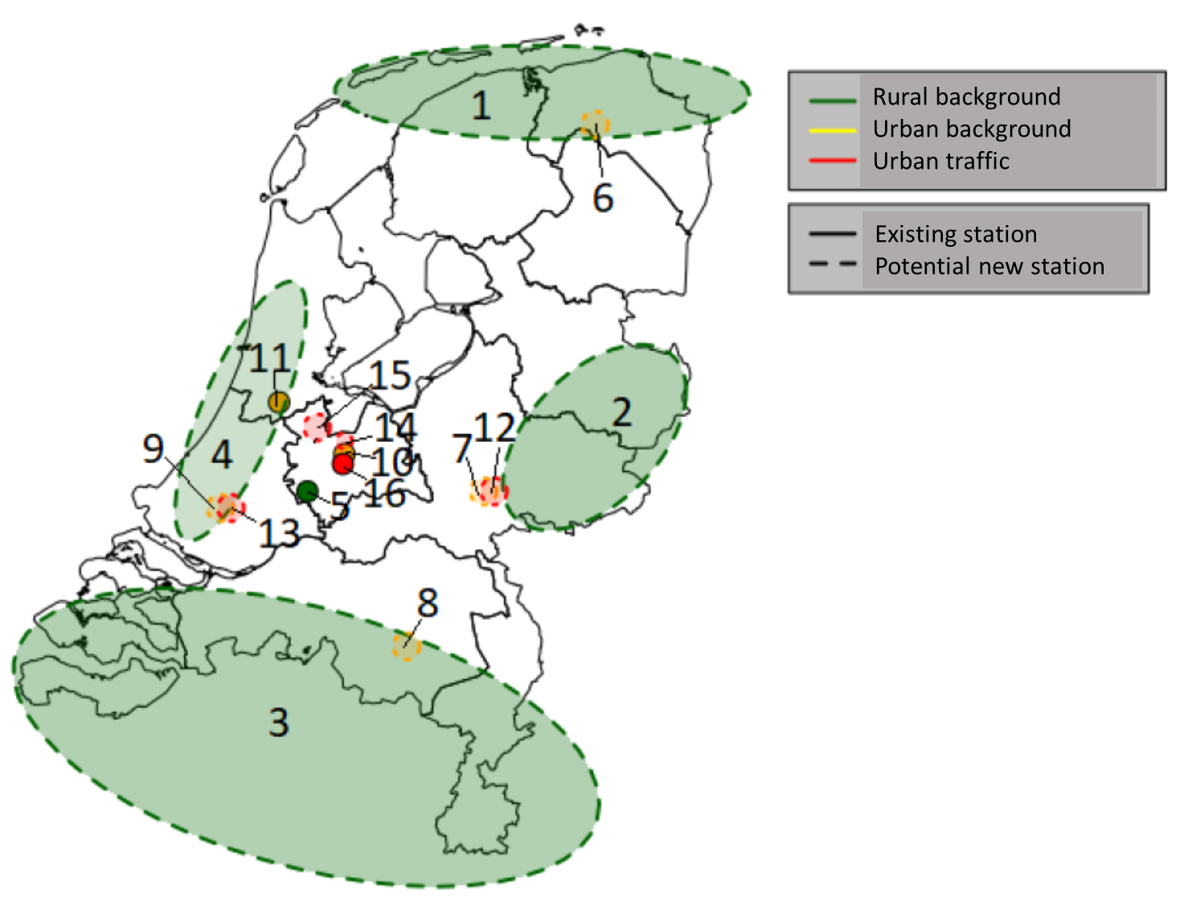
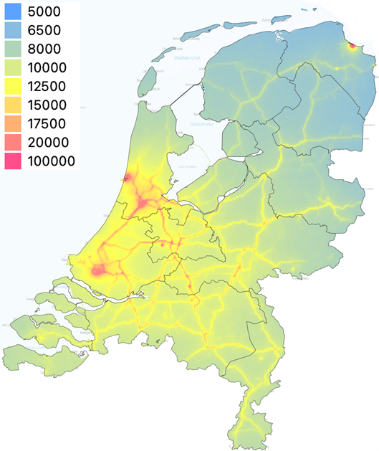
Monitoring strategy
Exploratory, to adjust as we go.
Highly indicative
First stage
Calibration of concentration map
Start with stationary rural background locations for geographical coverage (green circles)
Later stages
Urban background
Local contribution from “coupled” street stations
Multi-year trends
Mobile measurements near sources

Slide 14
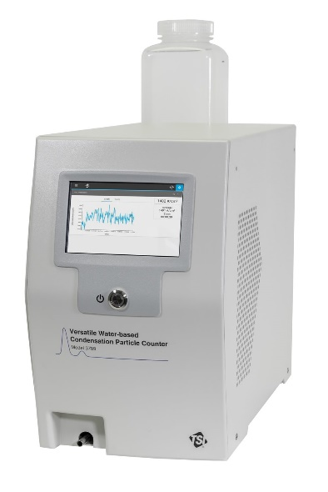
Timeline
Sep 2021: National Health Council advisory report
End of 2021: Minister Of Infrastructure and Water Management asks RIVM for strategy
Dec 2022: RIVM publishes report with proposed monitoring strategy
Jan 2020: Minister for the Environment and Housing requests advice on UFP from National Health Council
2023-2024: tendering process for new UFP equipment
2025: Arrival of new equipment

Slide 15
Condensation Particle Counter (CPC)
3: Optical detection
2: Working fluid vapour condenses on the ultrafine particles
1: Inlet

Slide 16

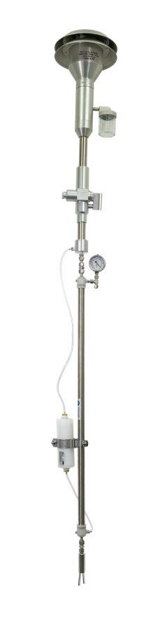
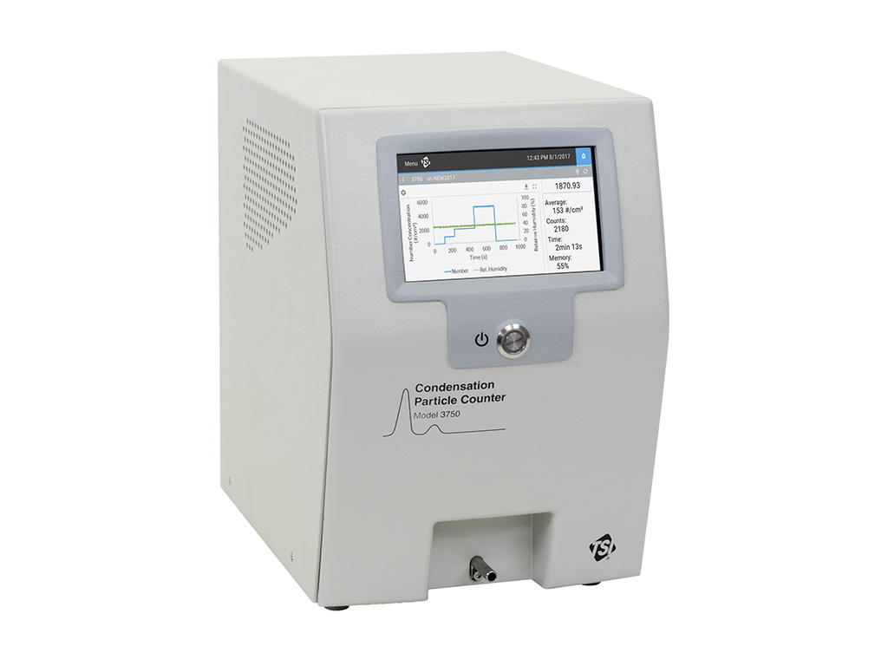
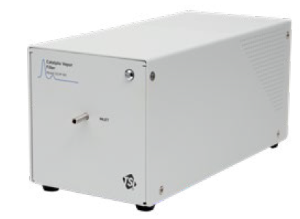
New CPCs
× 8
× 5
× 3
× 5
TSI 3750-CEN10
Butanol as working fluid
CEN/TS 16976:2024 compliant
TSI 3789
Water as working fluid

Slide 17
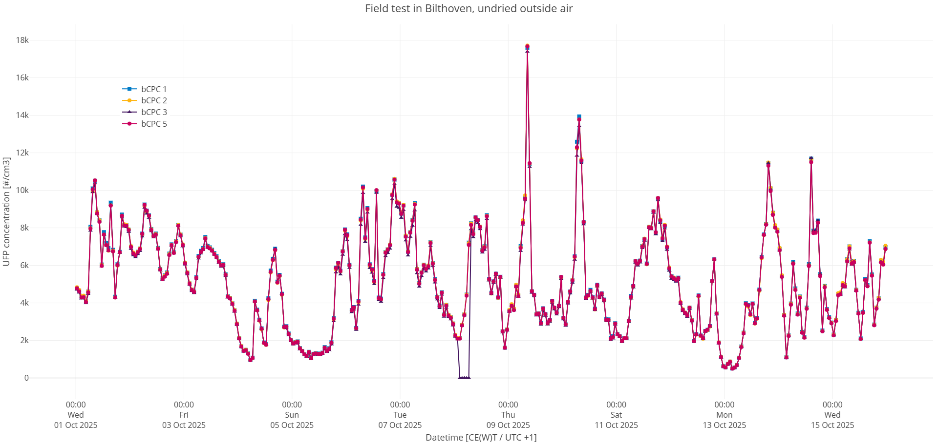
Field comparison of butanol-CPCs

Slide 18
Location shortlist
Water-CPCs still have some issues
5 working butanol-CPCs
  1 as lab standard
  4 deployable
Geographical coverage needed for concentration map/models

Slide 19
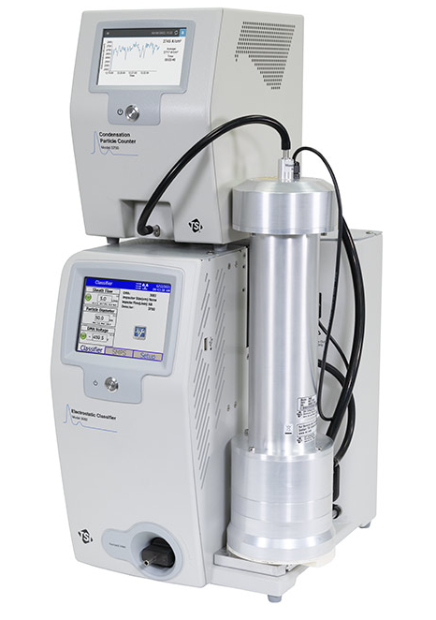
On the way:
sizing systems
× 2
TSI 3938W50-PP-CEN10 Scanning Mobility Particle Sizer (SMPS)
Mobility Particle Size Spectrometer (MPSS)
For measuring the size distribution of ultrafine particles at “supersites” according to the new EU Air Quality Directive (2024/2881)
CEN/TS 17434:2020 compliant
× 2

Slide 20
Questions / references / resources
Air quality data from the last hour: http://www.luchtmeetnet.nl/
Validated data: data.rivm.nl/data/luchtmeetnet/
Health council advisory report: www.healthcouncil.nl/documents/2021/09/15/risks-of-ultrafine-particles-in-the-outside-air
Proposed RIVM measurement strategy: www.rivm.nl/publicaties/voorstel-voor-meten-en-modelleren-van-ultrafijnstof-in-nederland
Empirical national UFP map using existing indicative measurements: www.rivm.nl/publicaties/empirical-modelling-of-ufp
Modelling particle dynamics using indicative UFP measurements as starting conditions: www.rivm.nl/publicaties/modelling-ultrafine-particle-dynamics-using-salsa

