Slide 1

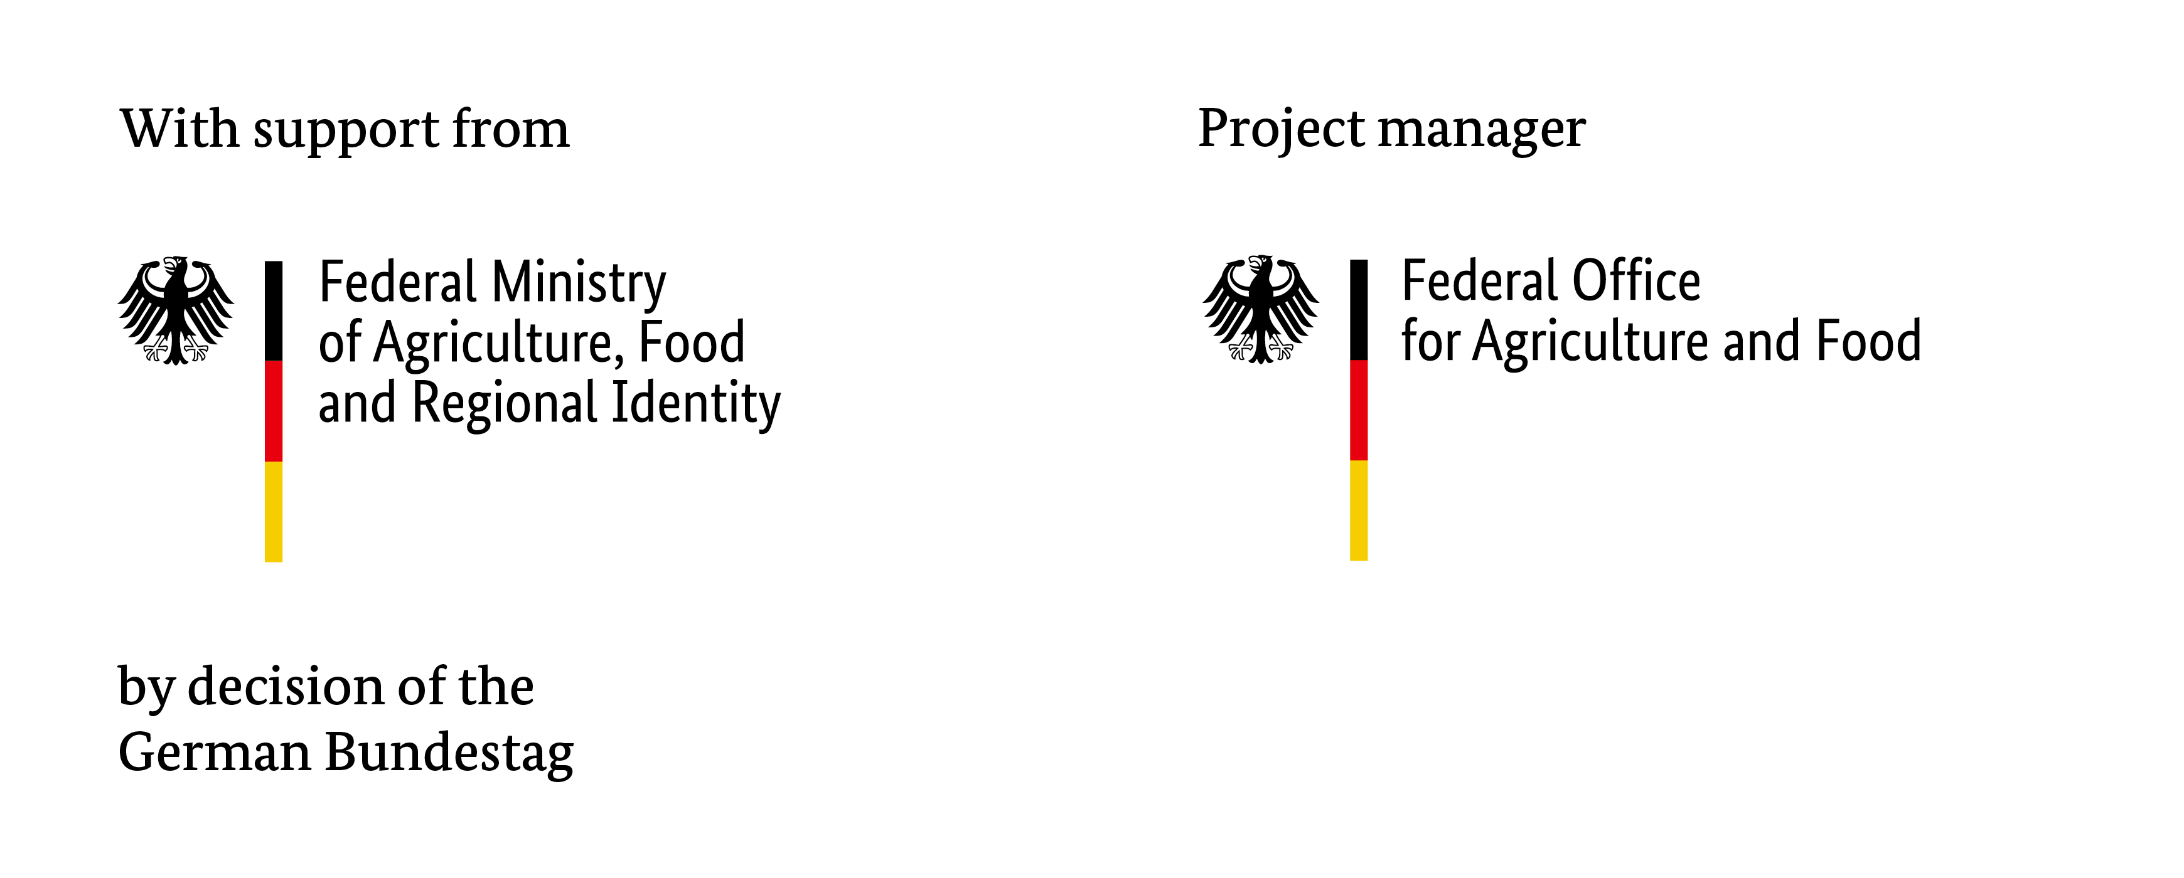

Mapping Temperature Data in Phenological Time uncovers
distinct Phases governing Leaf Senescence Timing
Thomas Ohnemus | EGU | 04.05.2026

Slide 2
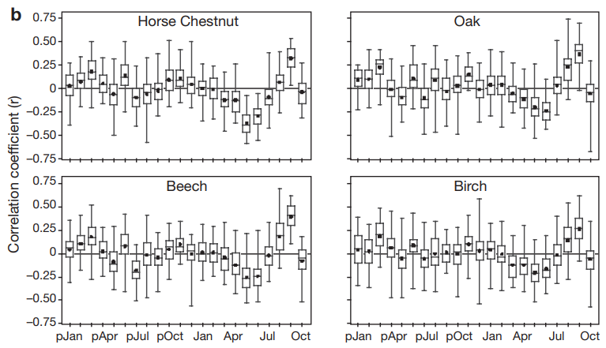
Studies investigate leaf senescence in calendar time uncover low dependence on temperature
after Estrella & Menzel 2006
delay
delay
advance
advance

Slide 3
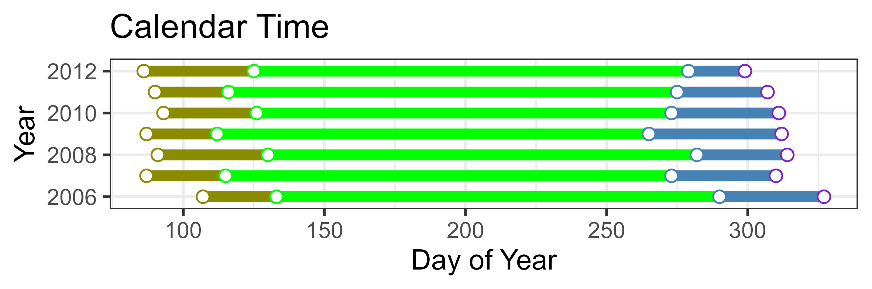
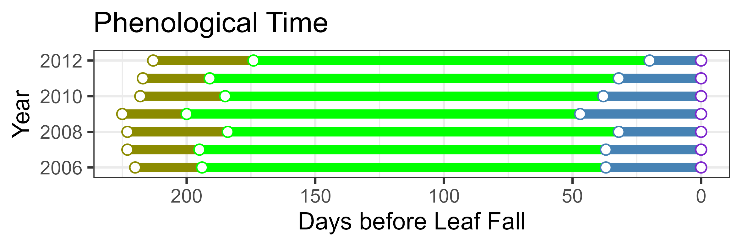
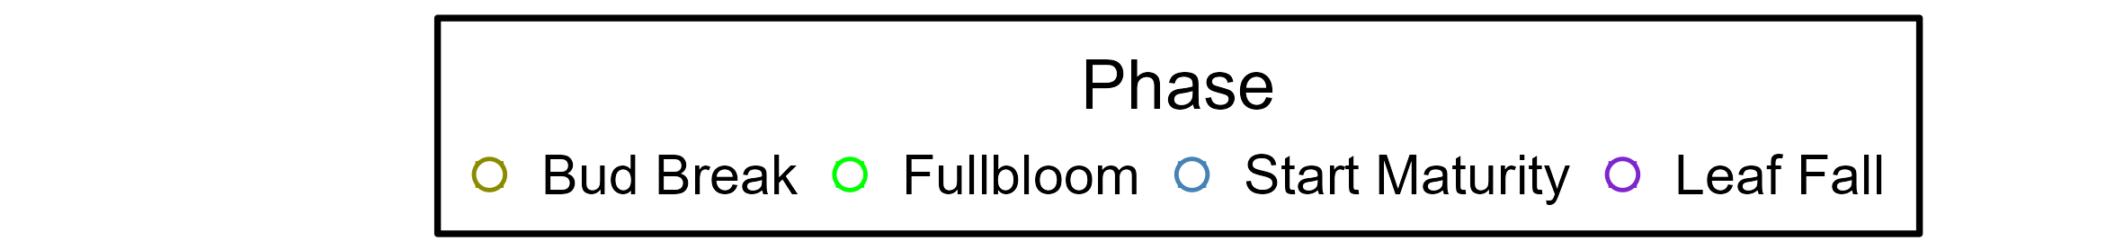
There is a substantial mismatch between calendar time and phenological time
Hypothesis:
Mapping data in phenological time should distill clearer temperature effects

Slide 4
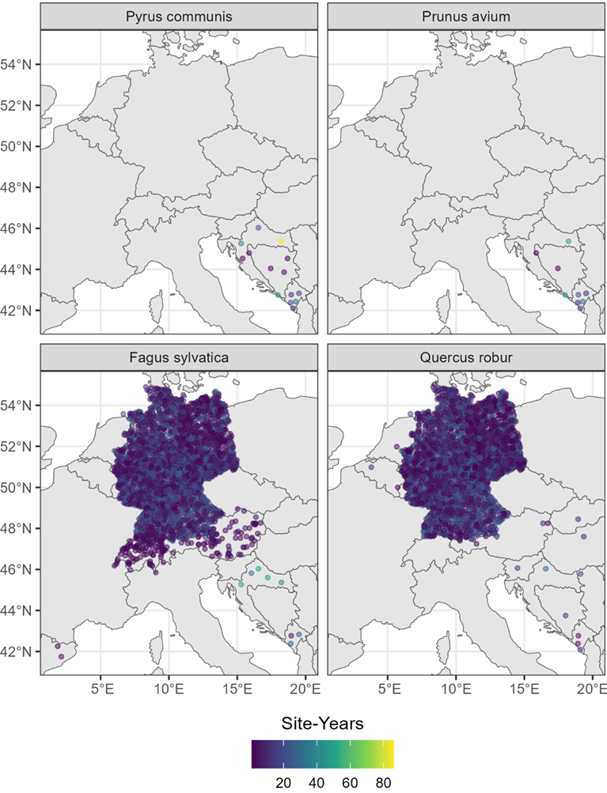
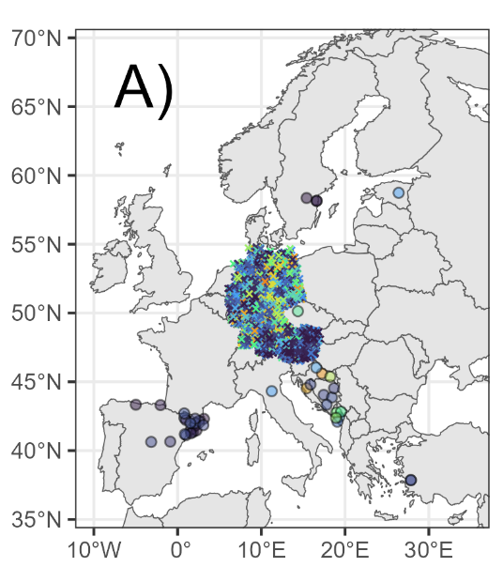
We conducted three investigations covering different cultivars, geographies and species
3
Apple
2
1

Slide 5
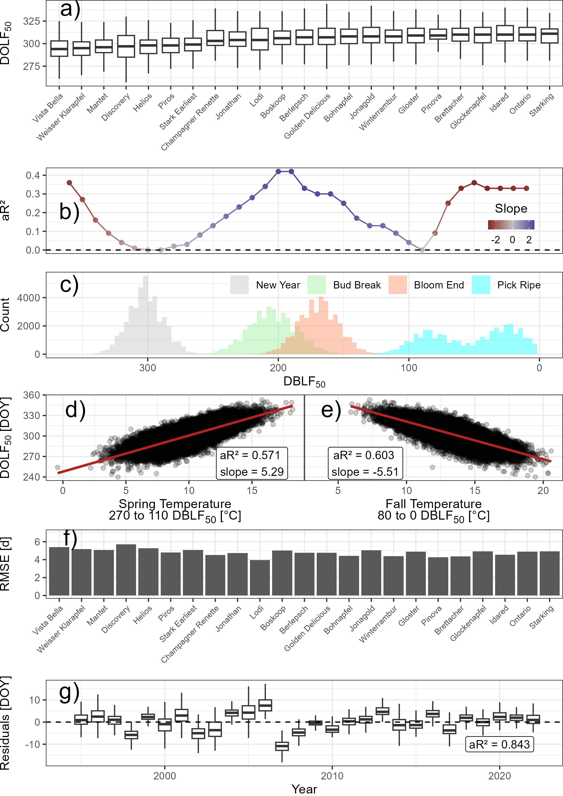
The spring and fall temperatures predict apple leaf fall timing in Germany well
advance
delay
advance

Slide 6
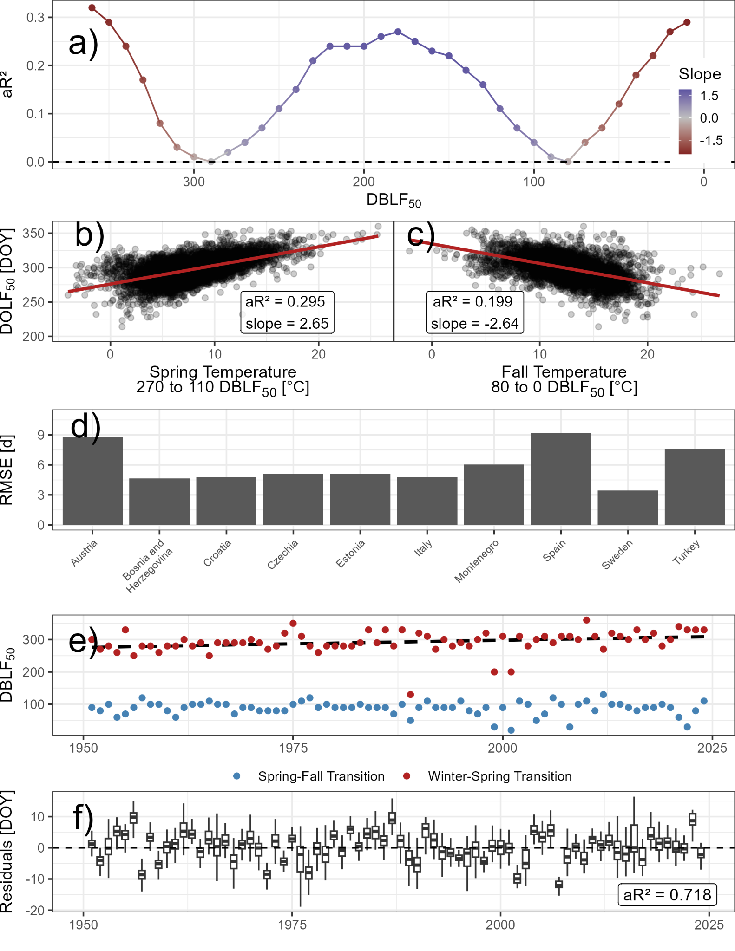
The spring and fall phases emerge consistently in apple across Europe
advance
delay
advance

Slide 7
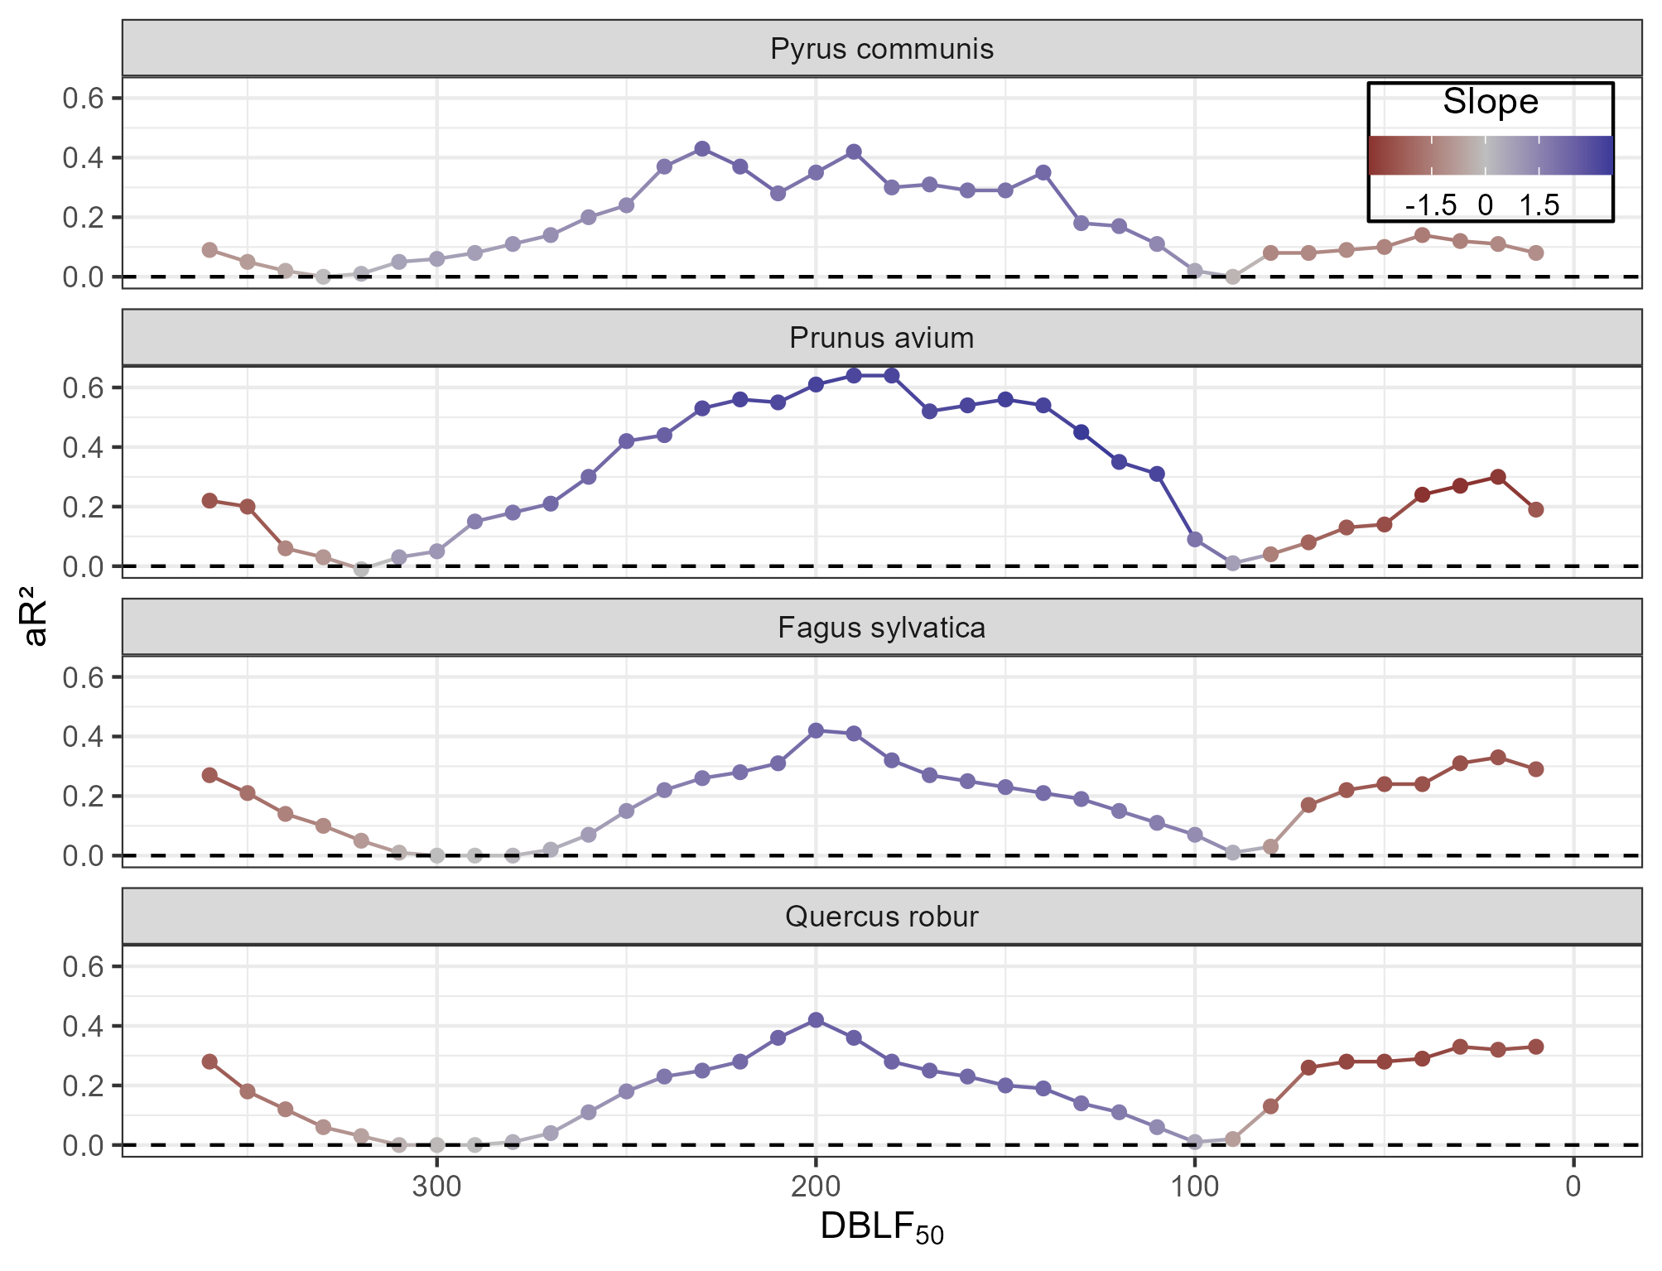
… and they do emerge across unrelated species, too
advance
delay
advance

Slide 8
Mapping temperature data in phenological instead of calendar time …
Shows the same relation between temperature and leaf fall timing
across (all?) apple cultivars
for apple across Europe
for another pome fruit, a stone fruit and deciduous forest trees throughout Europe
Suggests that mainly spring and fall temperatures determine leaf fall timing (R² > 0.7 for any investigation)
Uncovers irregular influences per year that need to be further studied
Could be the basis towards development of an unifying leaf senescence model across cultivars and species

