Slide 1
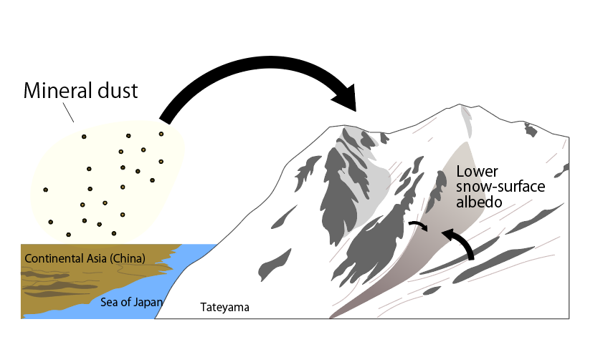
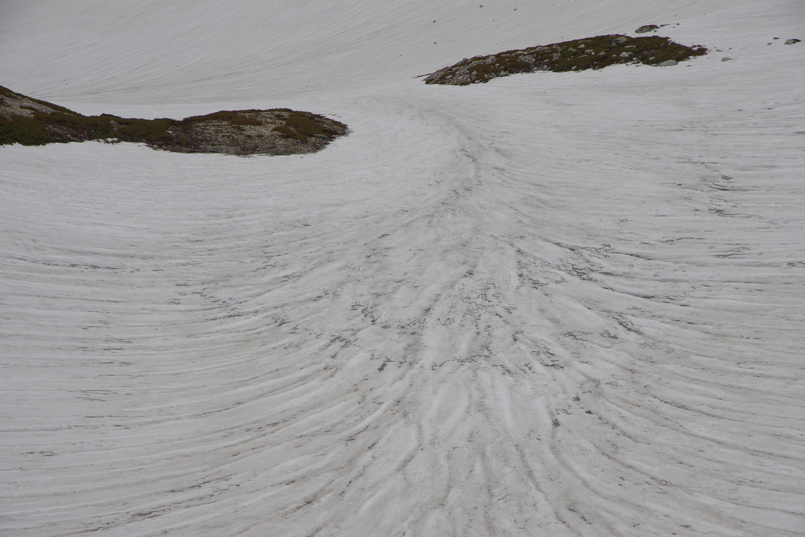
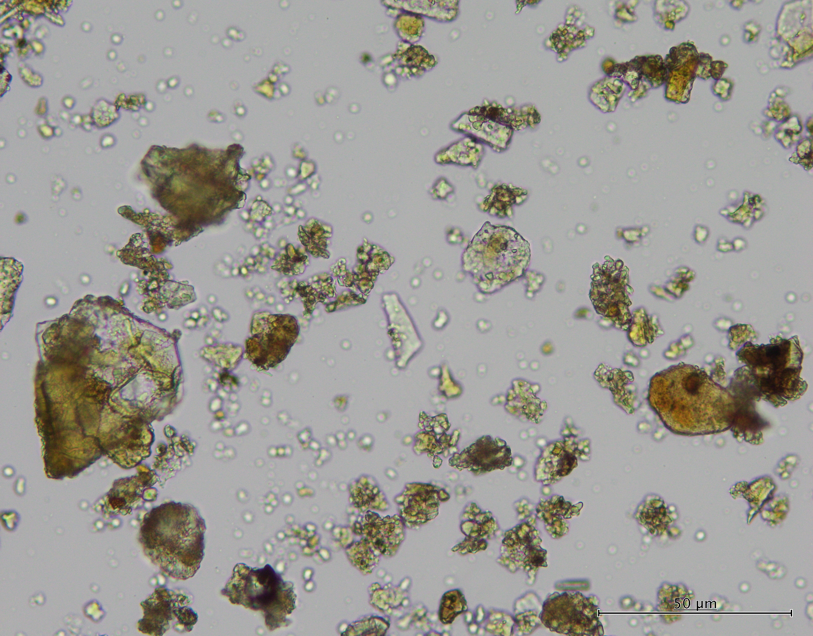
Seasonal variability of mineral dust composition on an alpine snowpack in the Tateyama Mountains, Japan
EGU26-3933 Pia Ataka
Mineral dust on snow and ice
→
① Long-range transport & deposition
Direct albedo reduction effect
Accelerates melting
Mineral Dust
② Short-range transport & deposition (from exposed ground)
50 μm
Dust source differences affect albedo, ecosystems, and melt predictions.
This study investigates seasonal variations in mineral dust composition on the Tateyama and evaluates the relative contributions of long-range and local dust
Notes:
Hello, my name is Pia Ataka from Chiba University.
Today, I will talk about seasonal variability of mineral dust composition on alpine snow in the Tateyama Mountains, Japan.
Mineral dust on snow and ice darkens the surface, reduces albedo, and accelerates melting.
Traditionally, this dust has been considered to be mainly derived from long-range transport, such as Asian dust.
However, in mountainous regions, locally derived mineral particles may also contribute as snowmelt progresses.
Differences in dust sources can affect snow surface albedo and melt processes.
This study aims to clarify the seasonal variations in mineral dust sources on alpine snow surfaces in central Japan.

Slide 2
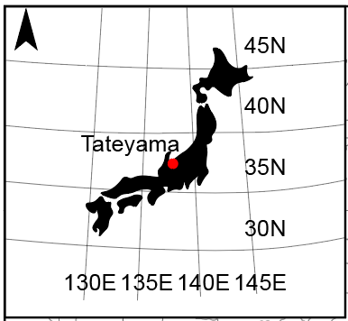
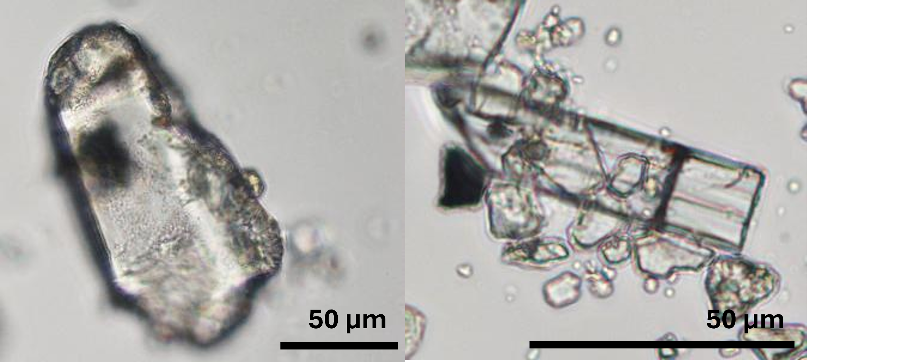
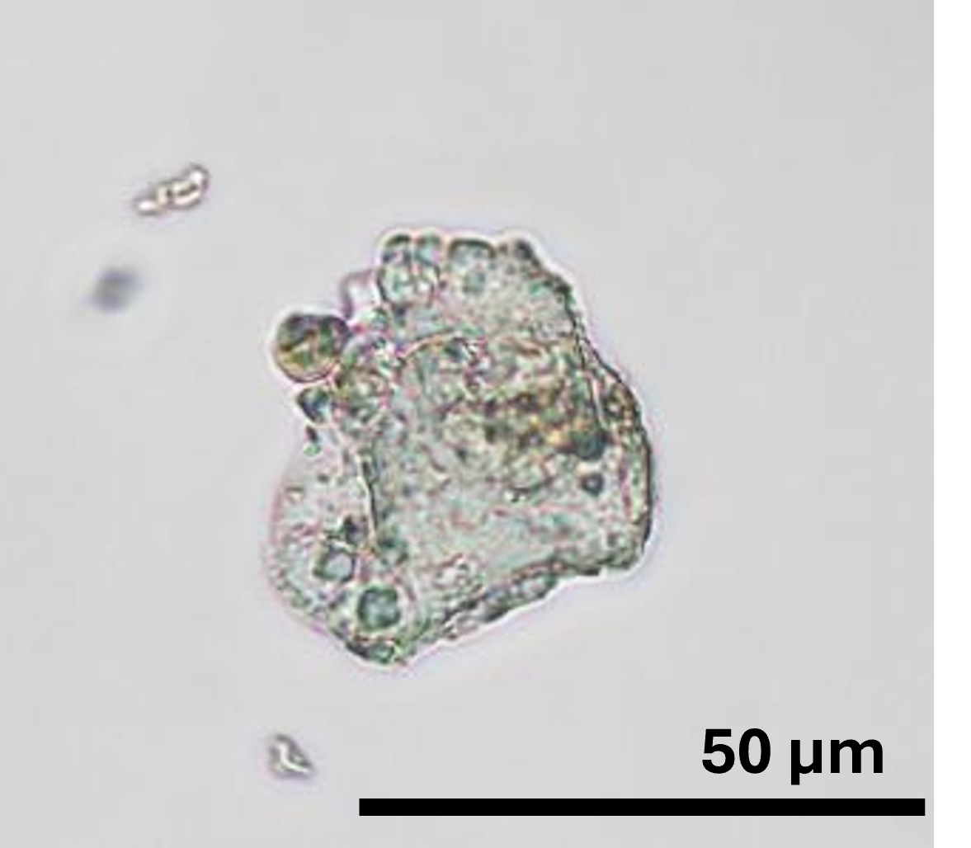
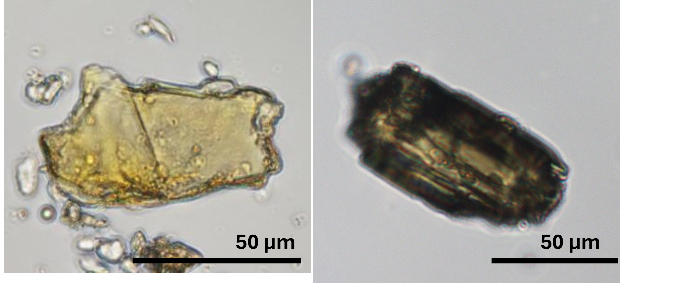
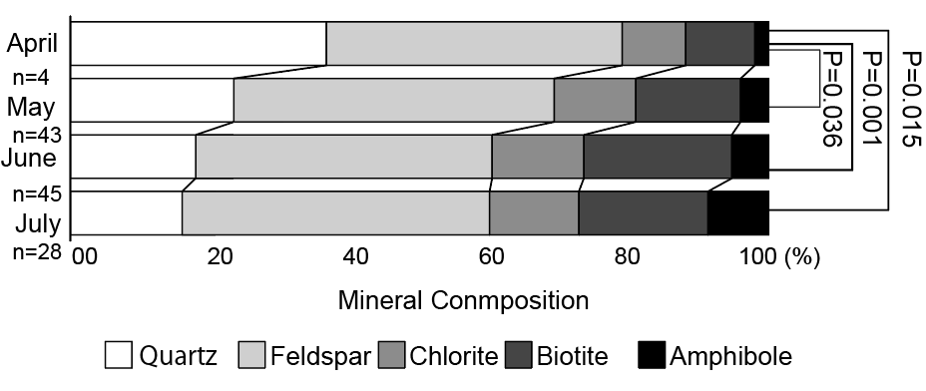
Seasonal change in mineral composition derived from X-ray diffraction (XRD)
Colorless minerals
Colored minerals
Tateyama, Toyama Prefecture, Japan
Feldspar
Chlorite
Amphibole
Quartz
Biotite
20 μｍ
April (n=4)
May (n=43)
June (n=45)
July (n=28)
00
20
40
60
80
100 (%)
Mineral composition
Colored minerals increase as the season progresses
Notes:
We collected snow samples across the study area in the Tateyama Mountains, Japan, from April, when Asian dust is transported, to July, during the snowmelt season. We observed a clear seasonal change in mineral composition. From April to July, the proportion of quartz decreased, while colored minerals such as chlorite, biotite, and amphibole increased.

Slide 3
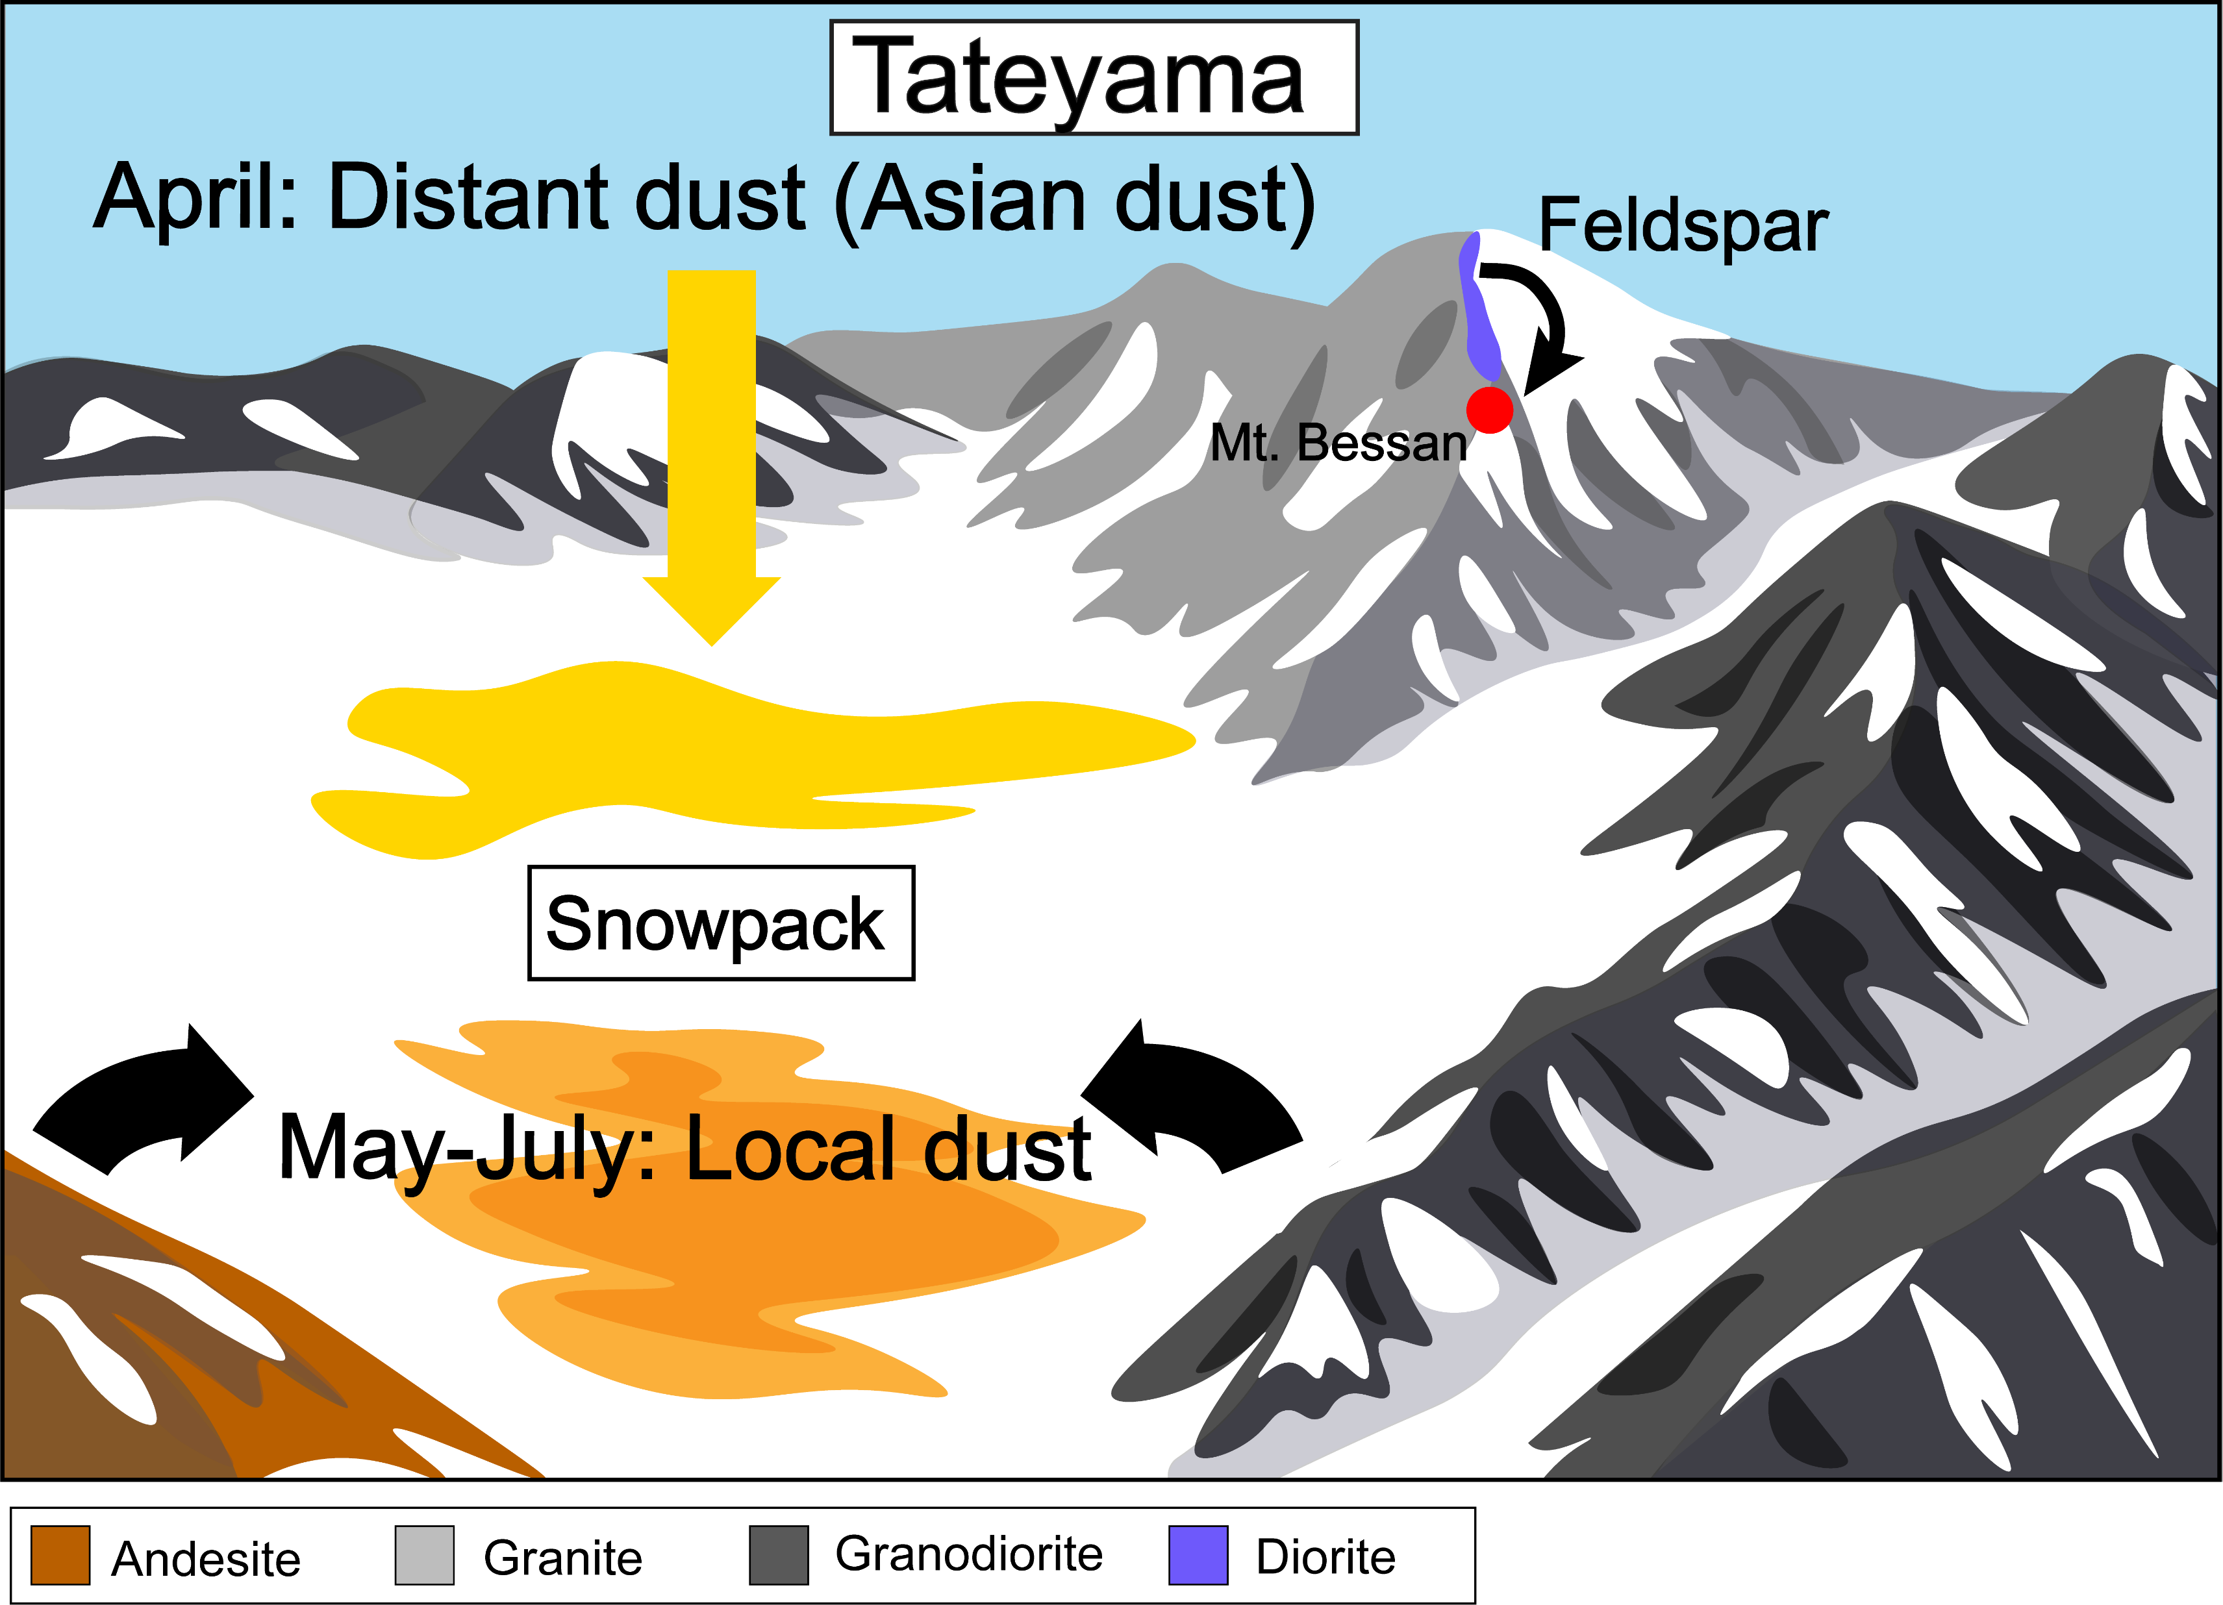
Seasonal change in mineral composition
Seasonal changes
Asian dust →locally derived mineral dust
The enrichment of colored minerals
Influence on snow surface albedo
Mineral dust composition on seasonal snow is highly variable in time, with potential implications for the surface energy balance of the snowpack.
Notes:
The observed seasonal shift in mineral composition suggests that long-range transported Asian dust dominated in April, whereas the contribution of locally derived dust increased from May to July.
The increase in colored minerals may enhance light absorption at the snow surface and reduce albedo.
Overall, mineral dust composition on seasonal snow is highly variable in time, with important implications for the surface energy balance of the snowpack.

Slide 4
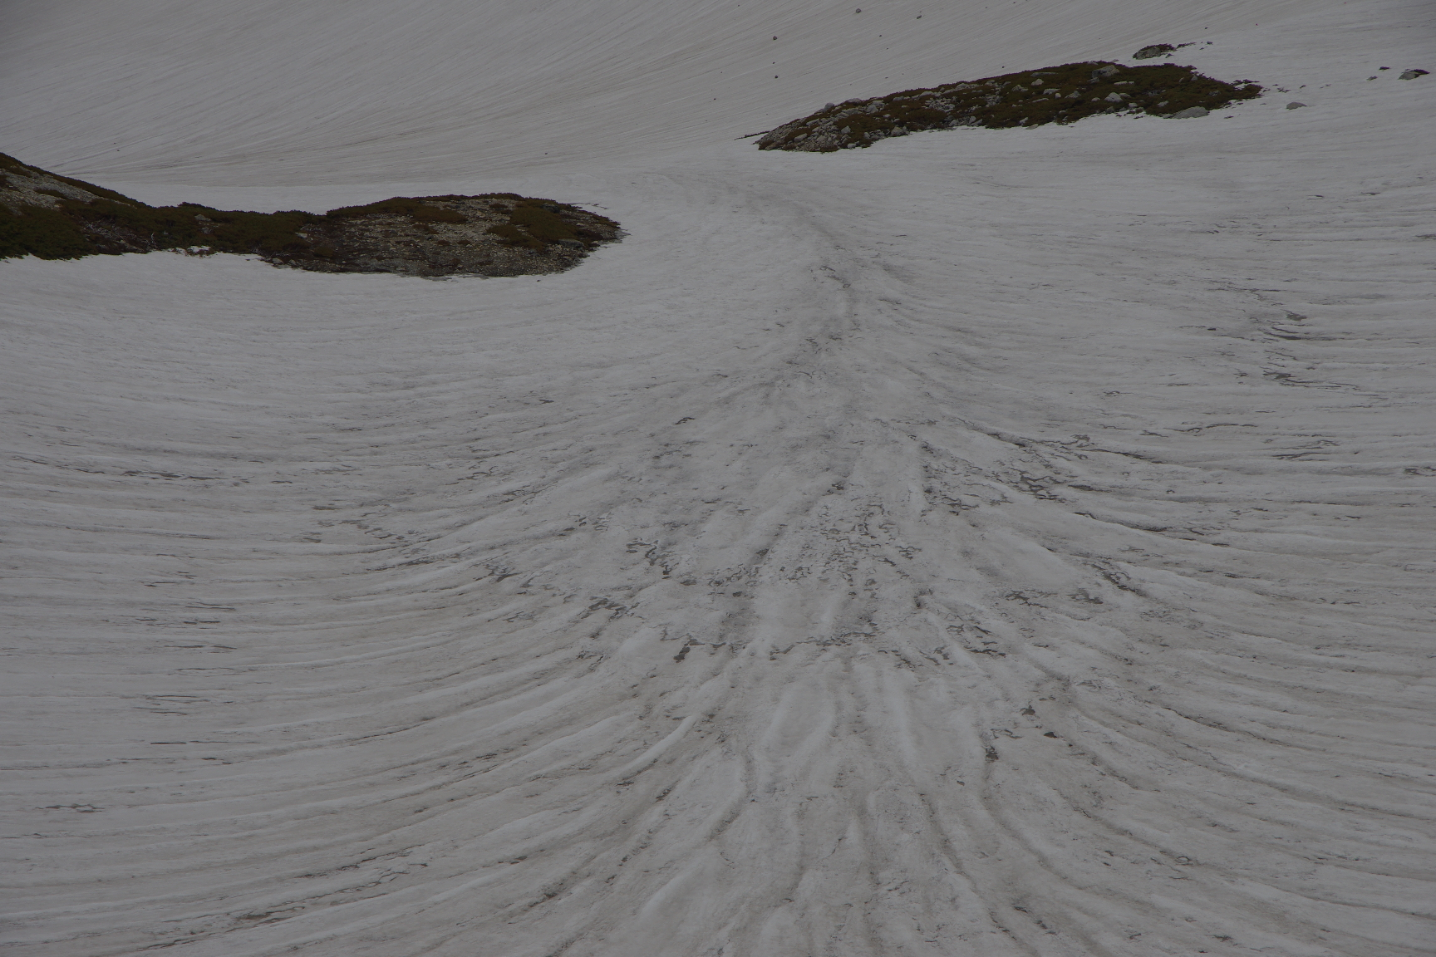
Seasonal variability of mineral dust composition on an alpine snowpack in the Tateyama Mountains, Japan
EGU26-3933
*Pia Ataka¹，Ryo Sugiyama¹，Furukawa Noboru¹，Nozomu Takeuchi¹ （1. Chiba University, Japan）
Notes:
Good morning. My name is Pia Ataka, a first-year master’s student at Chiba University.
Today, I will present our study on spatial and seasonal variations in mineral particles on snow surface at the Murodo Plateau in Tateyama, central Japan.
Temporal and spatial changes in mineral dust composition deposited on an alpine snowpack
The 40th International Symposium on the Okhotsk Sea & Polar Oceans 2026
variability of mineral dust composition on an alpine snowpack in the Tateyama Mountains, Japan

Slide 5
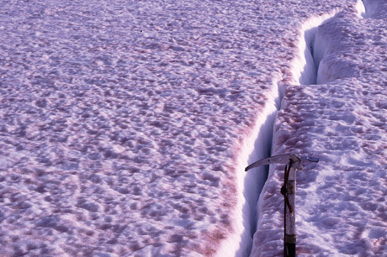
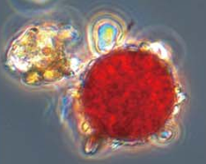
Introduction
1
Effects of Mineral Dust on Snow and Ice Surfaces
Indirect albedo reduction effect: Nutrient supply to snow algae, enhancing their growth
Direct albedo reduction effect
＋
Mineral Dust
Snow Algae Bloom
Mineral dust
Snow Algae
50 μm
20 μm
These impurities enhance glacier melt and contribute to sea-level rise. By reducing surface albedo, they accelerate global warming.
Notes:
In recent years, snow and ice have been decreasing due to global warming. However, snow and ice melt is driven not only by rising air temperature, but also by surface darkening.
One of the major causes of this darkening is light-absorbing impurities. Representative impurities include atmospheric mineral dust, snow algae living on snow and ice, and black carbon produced by human activities and wildfires.
When these impurities accumulate on glaciers, they enhance melting and can contribute to sea-level rise. On seasonal snow, they reduce surface albedo, accelerate snowmelt, and may also affect snow ecosystems.
In this study, we focus on mineral dust. Mineral dust is important because it affects snow and ice both directly and indirectly.
Mineral particles deposited on the snow surface directly reduce surface albedo by darkening the snow. Furthermore, mineral dust can supply nutrients to snow algae, promoting their growth and thereby indirectly reducing surface albedo.
Because of these combined effects, understanding mineral dust is critical for reducing uncertainties in snow and ice melt projections.
近年、地球温暖化により雪氷は減少しています。 しかし、雪氷の融解は気温上昇だけでなく、表面の暗色化によっても促進されます。
この暗色化の主な原因の一つが、光を吸収する不純物です。 代表的な不純物として、大気起源の鉱物ダスト、雪氷上に生息するスノーアルガ、そして人間活動や森林火災によって生じるブラックカーボンが挙げられます。
これらの不純物が氷河上に蓄積すると、融解を促進し、海面上昇に寄与する可能性があります。 また、季節積雪上では、表面アルベドを低下させ、融雪を加速させるとともに、雪氷生態系にも影響を与える可能性があります。
本研究では、鉱物ダストに着目します。 鉱物ダストは、雪氷に対して直接的および間接的に影響を及ぼすため重要です。
雪面に沈着した鉱物粒子は、雪を暗色化させることで直接的にアルベドを低下させます。 さらに、鉱物ダストはスノーアルガに栄養を供給し、その成長を促進することで、間接的にもアルベドを低下させます。
これらの影響を考慮すると、鉱物ダストの理解は、雪氷融解予測の不確実性を低減する上で重要です。

Slide 6
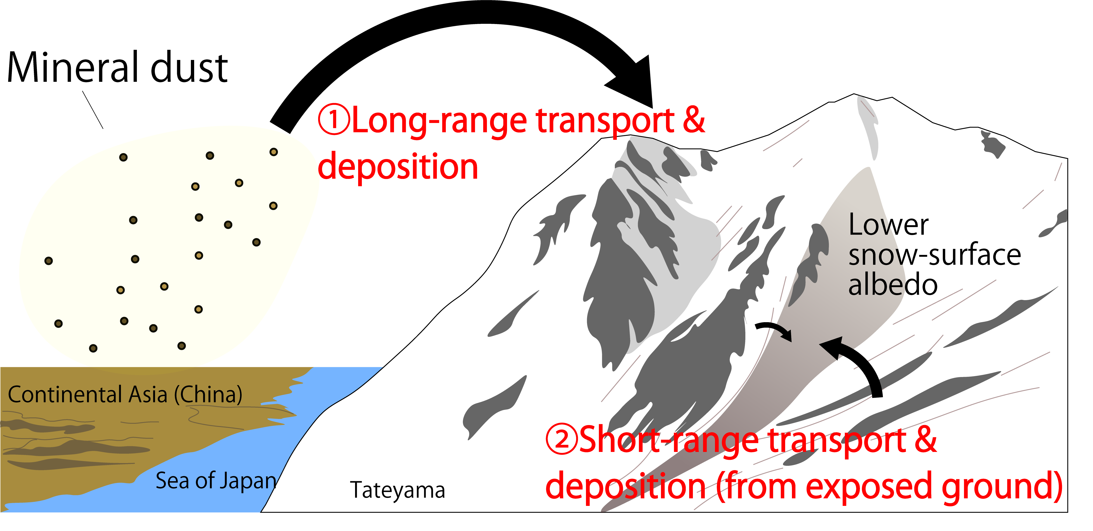
Introduction
2
Mineral dust on seasonal snow surfaces in mountainous regions of Japan
Source of Mineral dust
①Asian dust→Spring（Mainly April）
Hypothesis
② Locally derived mineral dust→？
② Short-range transport & deposition (from exposed ground)
Objective
This study investigates seasonal and spatial variations in mineral dust composition on the Tateyama and evaluates the relative contributions of long-range and local dust
Notes:
In particular, this study focuses on mineral dust deposited on seasonal snow in mountainous regions, where detailed investigations remain limited.
In Japanese alpine regions, mineral dust on snow surfaces has generally been considered to be dominated by Asian dust transported from the deserts of continental Asia.
However, we hypothesize that mineral dust derived from surrounding bedrock and surface materials may also contribute significantly to snow surface deposition.
Dust from different sources can have distinct mineralogical and optical properties, and such source variability may influence snow surface albedo and potentially affect snow ecosystem processes.
However, the detailed characteristics, sources, and deposition processes of mineral dust in these environments are still not fully understood.

Slide 7
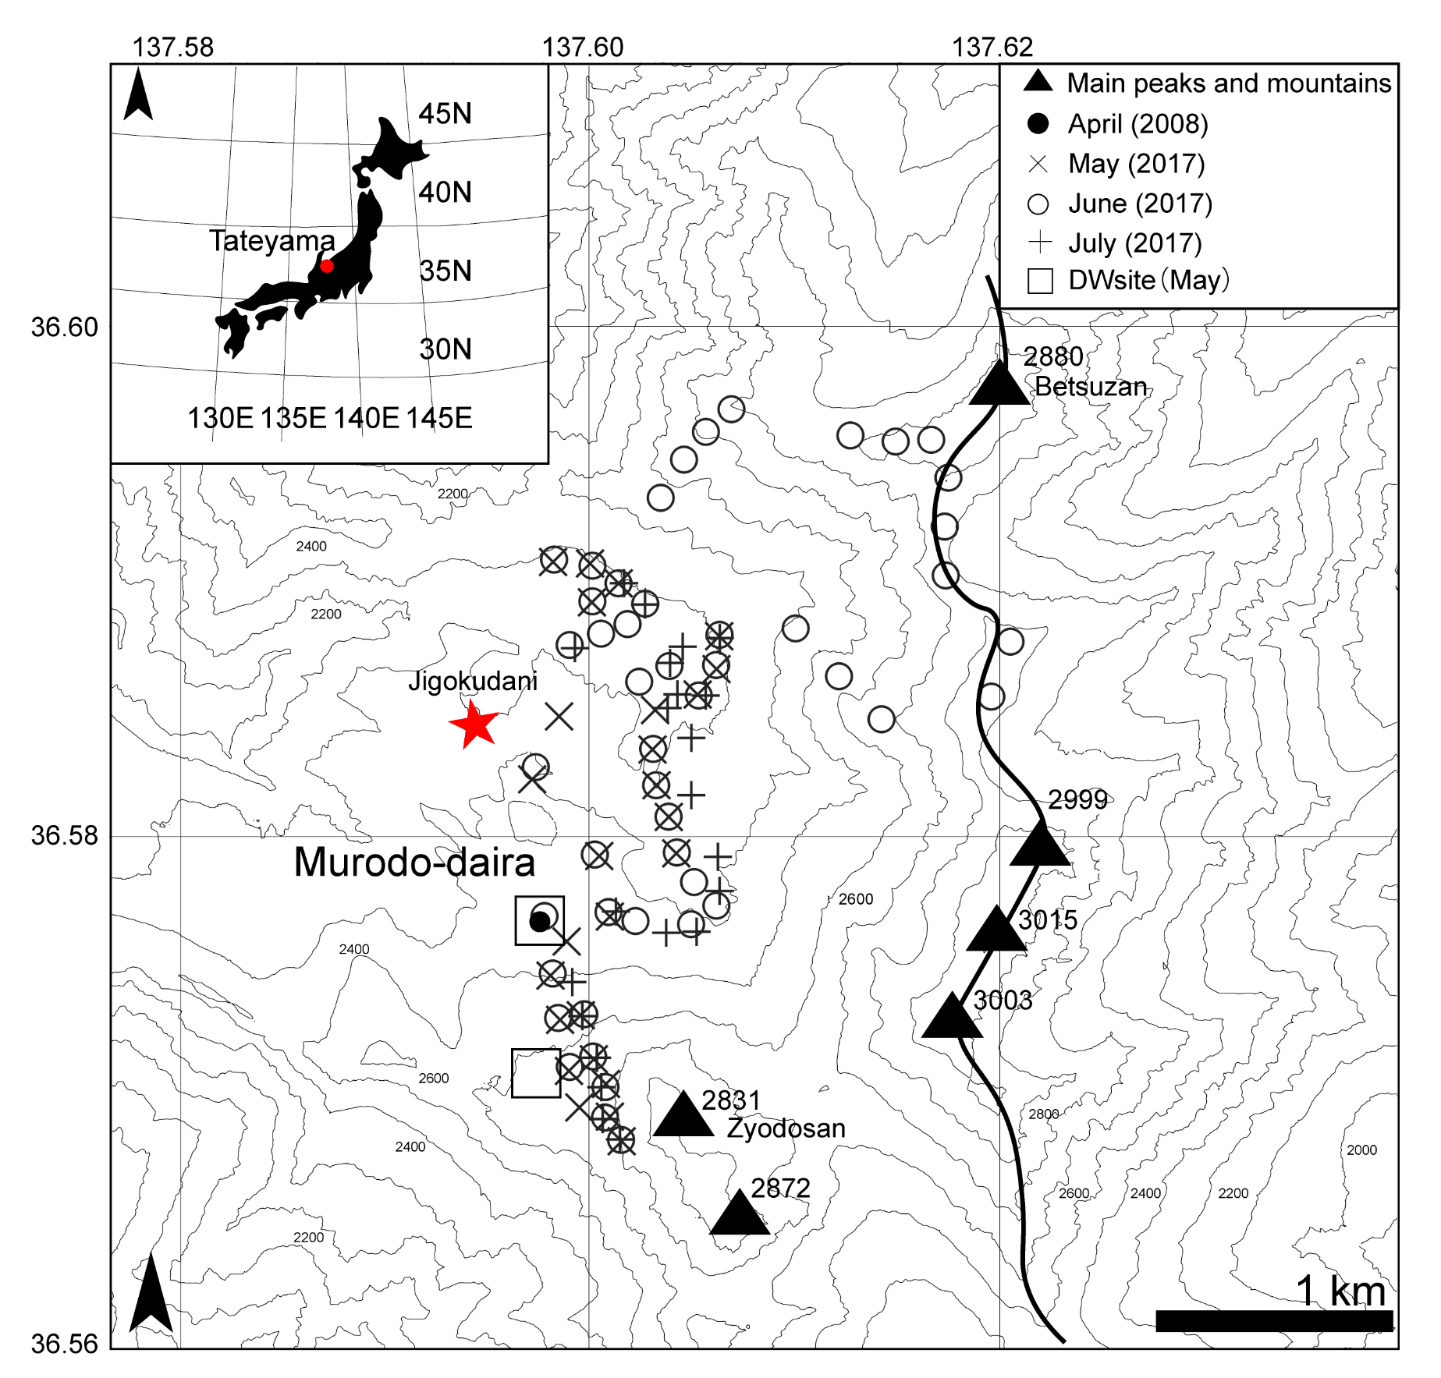
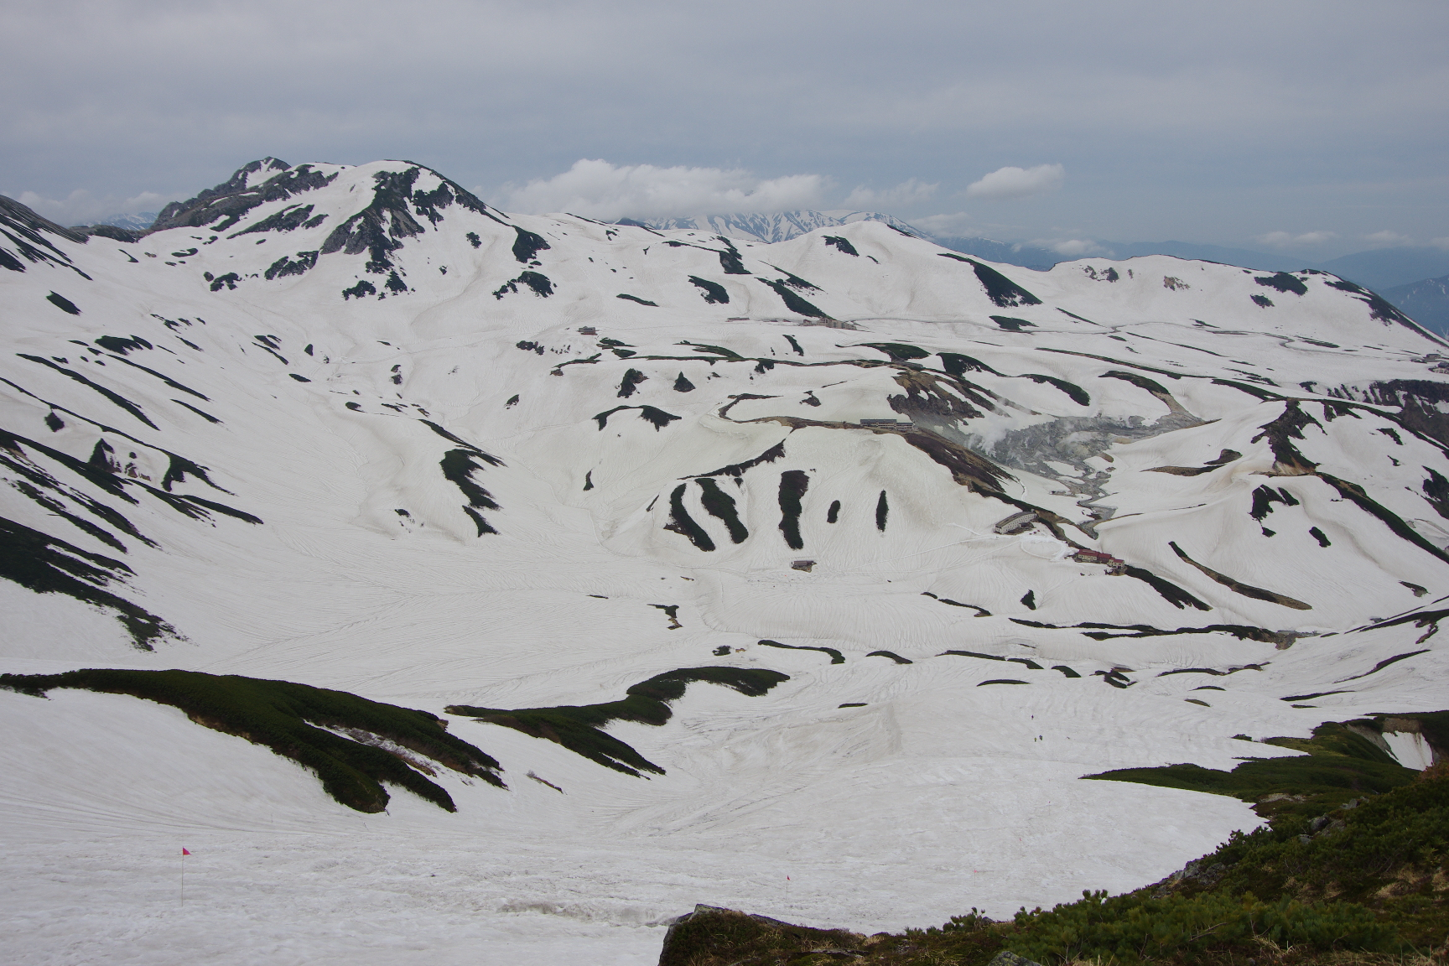
Study Site
3
Murodo-daira, Tateyama, Toyama Prefecture, Japan
Sampling periods May 27–28, June 16–18, and July 18–19, 2017; April 8, 2008
Snow samples collected by Takeuchi and Sugiyama (2019) were also used in this study.
Notes:
In this study, we focus on the Murodo-Plateau in Tateyama, located in central Japan, one of the heavy snowfall regions of the country. Murodo-Plateau is a relatively flat alpine basin surrounded by high mountain ridges.
The map on the right shows the sampling locations and topography. Field sampling was conducted across the Murodo-Plateau from May to July.
In addition, a dirty layer sample obtained from a snow pit observation in April was used as a representative Asian dust sample for comparison with the later months.

Slide 8
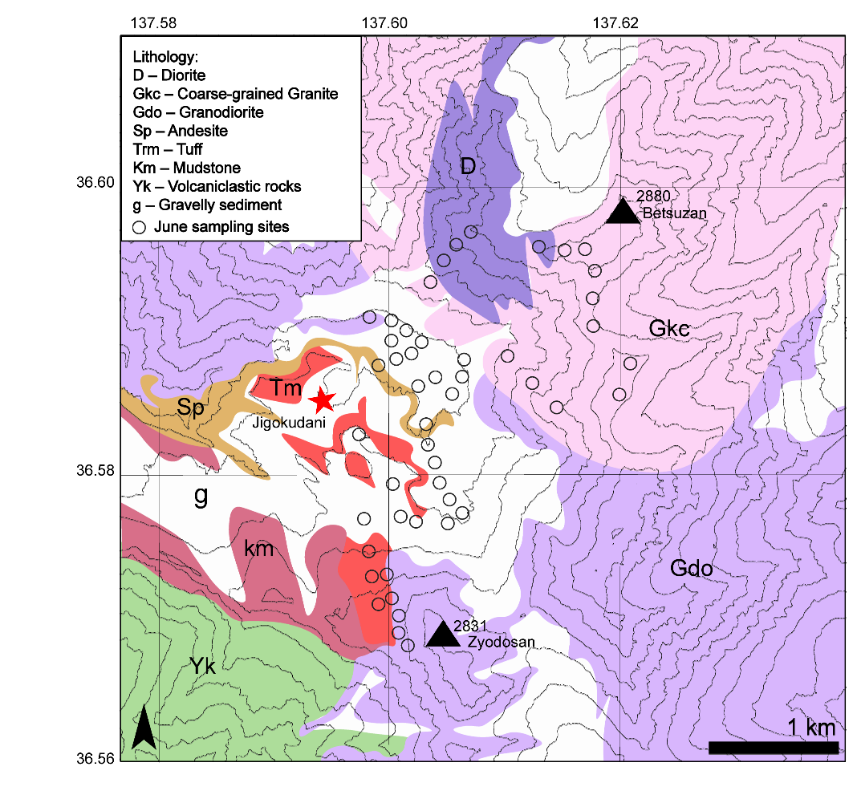
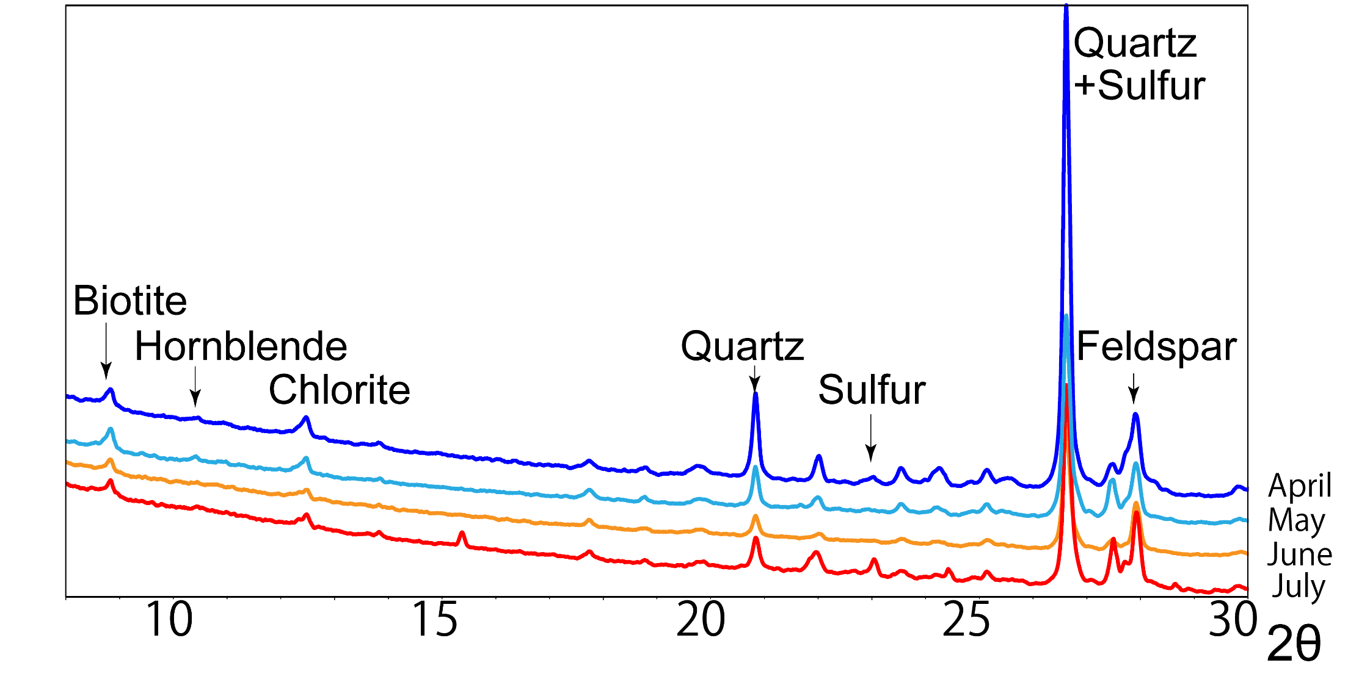
Study Site and Methods
4
Geology of the Murodo Plateau
Southwestern area: volcanic rocks
Other areas: plutonic rocks
Eastern area: diorite rich in plagioclase feldspar
Diorite
Sampling methods
May–July 2017: Surface snow (~1 cm depth)
April 2008: Snow layers
Analysis
XRD analysis
Volcanic
Plutonic
Notes:
First, I will explain the geological background of the study area. This map shows the lithology around the Murodo Plateau. Volcanic rocks are distributed in the southwestern area, whereas plutonic rocks dominate the other areas. In particular, the eastern part of the study area is characterized by plagioclase-rich diorite.
Next, I will describe the sampling methods. Surface snow samples were collected from May to July 2017 from the upper ~1 cm of the snow surface. For comparison（こんぺあすん）, a dirty-layer sample from pit observations in April 2008 was also analyzed.
Finally, I will explain the analytical methods. Mineral identification and semi-quantitative composition were determined using X-ray diffraction (XRD). In this method, minerals are identified from their characteristic diffraction peaks. After the XRD measurements, the mineral dust mass was also quantified.

Slide 9
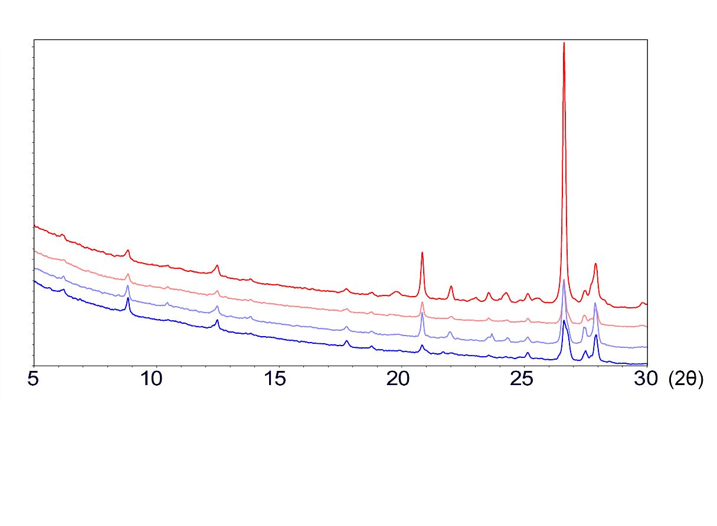
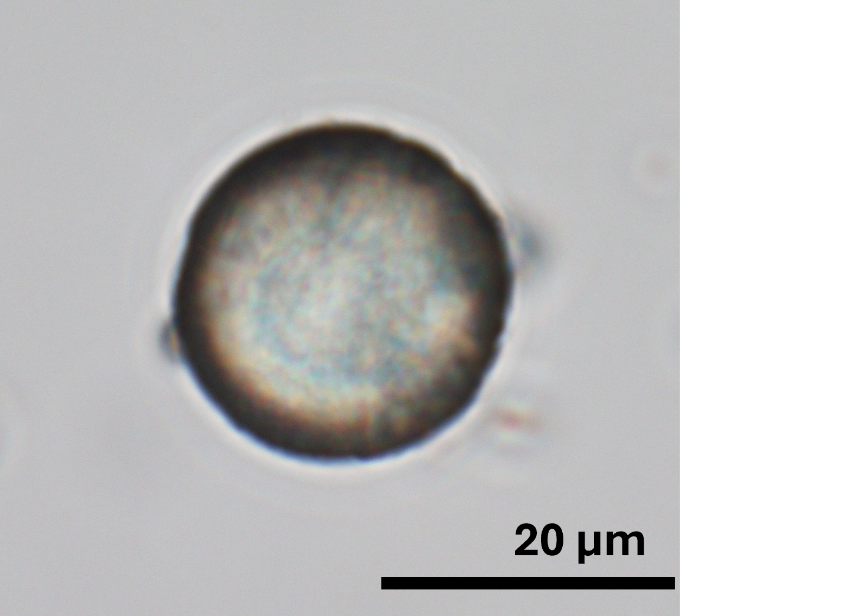
Result 1: XRD-based mineral identification
5
All samples commonly contained quartz, feldspar, chlorite, biotite, and amphibole.
※quartz peak partially overlapping with sulfur peak
Colored minerals
Colorless minerals
20 μｍ
Biotite
Optical microscope
Chlorite
Quartz
20 μｍ
Feldspar
Amphibole
50 μｍ
10 μｍ
Sulfur
April
May June
July
10 μｍ
Notes:
Now I will move to the results. Minerals are commonly classified into colorless and colored groups based on their light-absorbing（おぶぞーびんぐ） properties.
All samples contained both types of minerals: quartz and feldspar as colorless minerals, and biotite, amphibole, and chlorite as colored minerals.
Representative XRD patterns for each month are shown here. From the diffraction peaks, we identified these five silicate minerals in all samples. Optical and scanning electron microscopy observations further confirmed their presence.

Slide 10
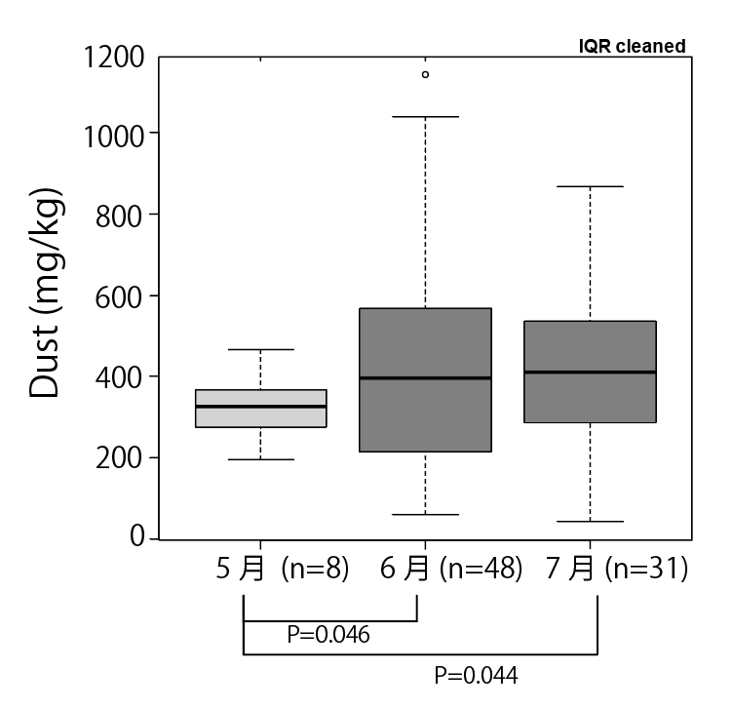
Result 2: Seasonal variation in mineral composition based on XRD
6
Seasonal variation in mean mineral composition
Relative peak intensity ratio = Peak intensity of each mineral / Total peak intensity of major minerals
Seasonal variation in mineral dust concentration
May (n=8)
June (n=48)
July (n=31)
MANOVA after ILR transformation
As the season progressed, colored minerals became increasingly concentrated in the snowpack.
Notes:
Now I will move on to the second result.
We found that the mineral composition of the snow surface changes seasonally.
(Pointing to the stacked bar chart) This figure shows the mean proportions of major minerals for each month.
The proportions were calculated using the relative peak intensity ratio, defined as the peak intensity of each mineral divided by the total peak intensity of the major minerals.
From April to July, the proportion of the colorless mineral quartz decreased, whereas the proportions of colored minerals—chlorite, biotite, and amphibole—increased.
Furthermore, the results of MANOVA indicate that the mineral composition differs significantly among seasons.
Mineral dust concentration also showed a significant increase from May to July.
Overall, colored minerals became increasingly enriched in the snowpack as the season progressed.
は無色鉱物が減少し有色鉱物が増加するといった季節変化見られることが分かりました．

Slide 11
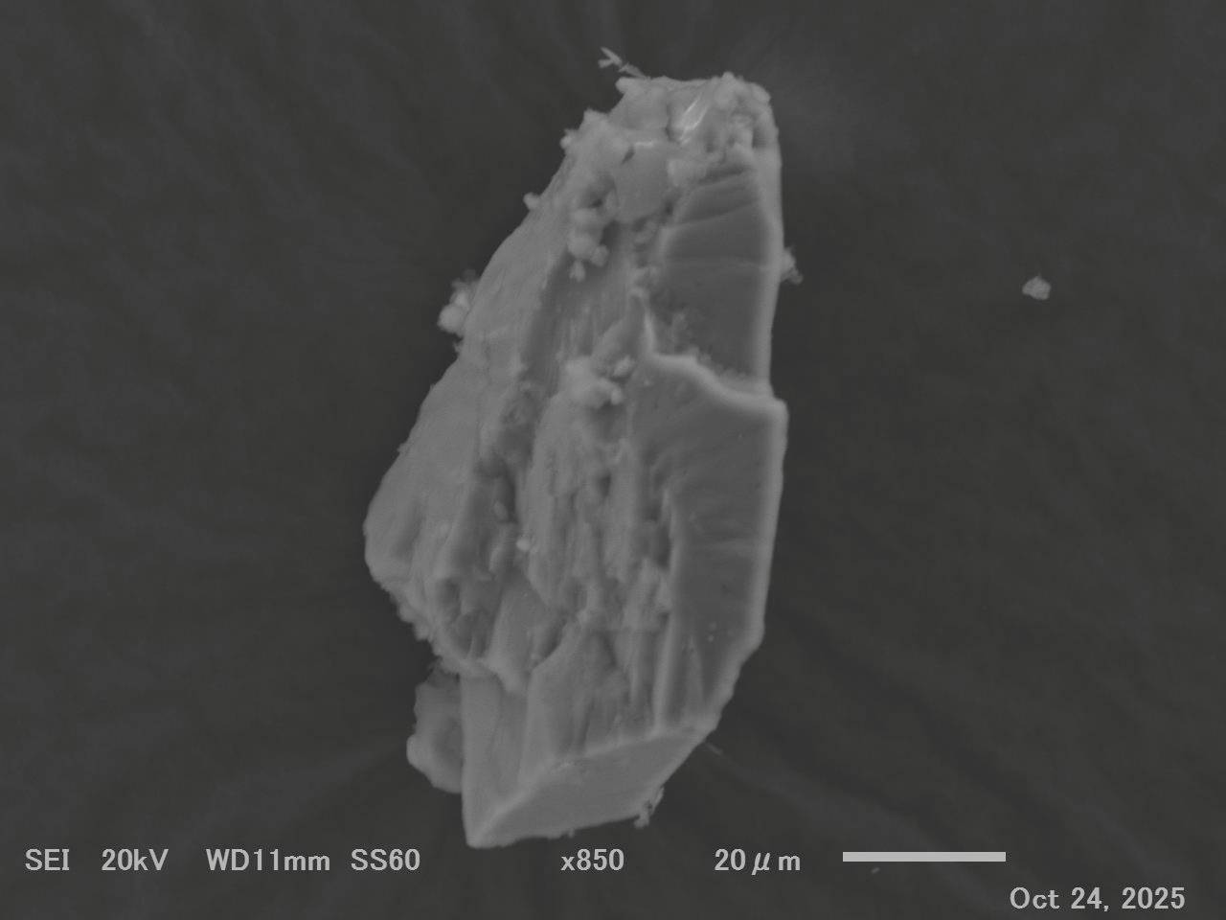
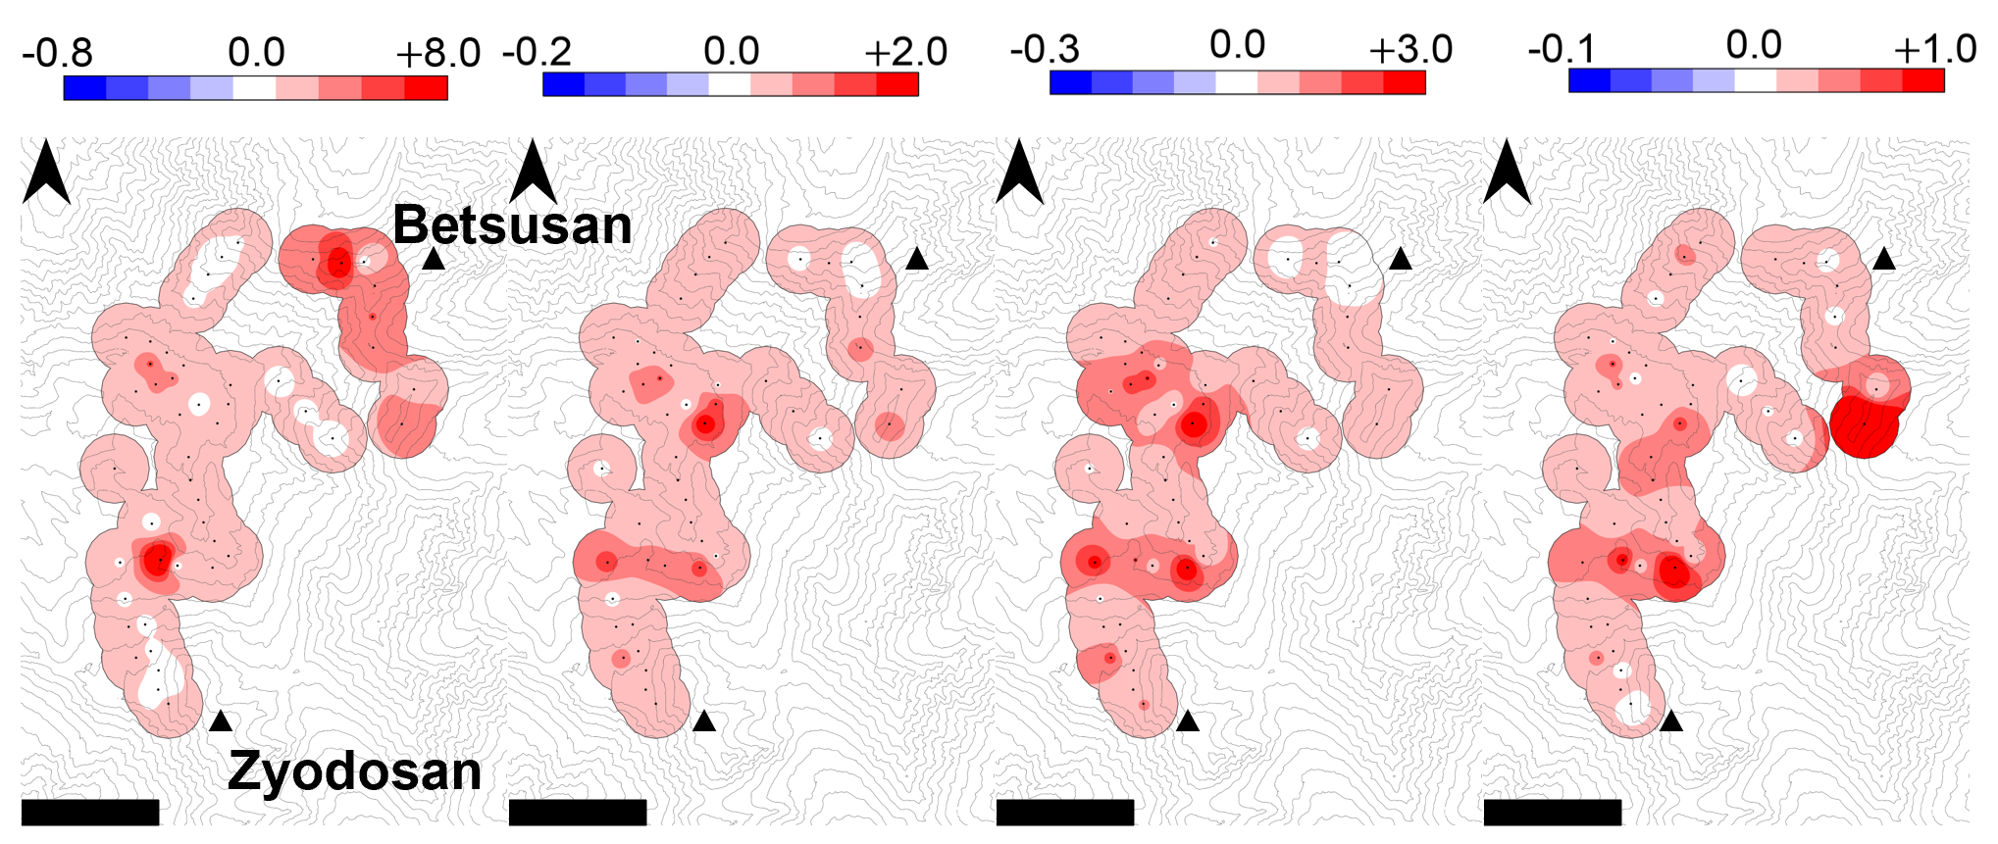
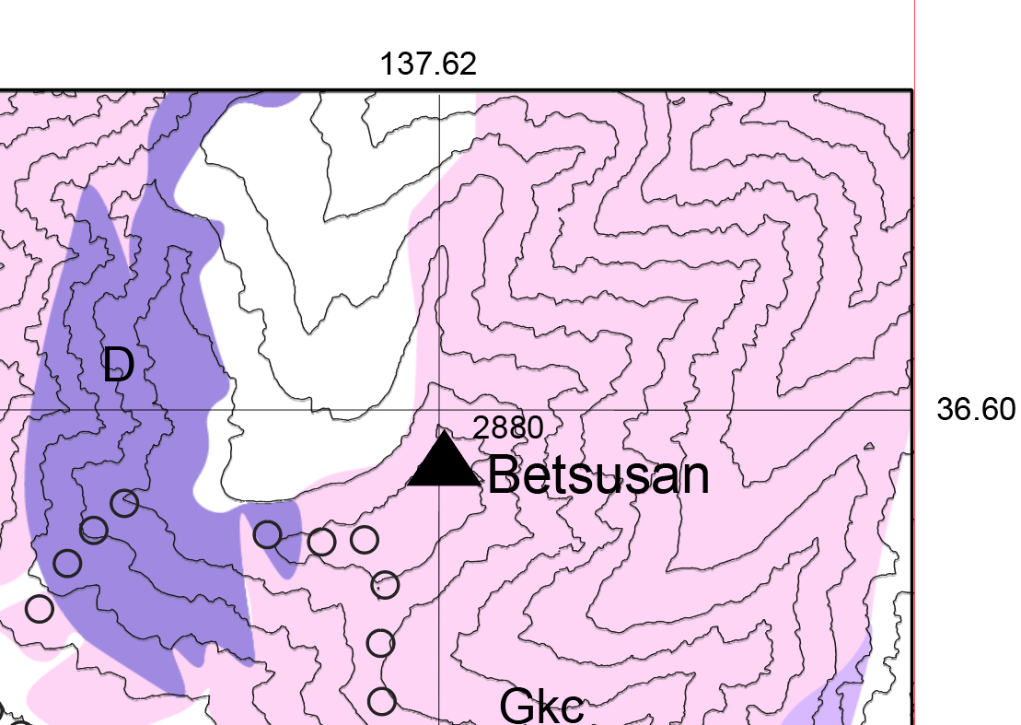
Result 3: Spatial distribution of XRD-derived mineral composition
7
Spatial distribution of mineral composition (June)
Feldspar
Difference in mineral-to-quartz peak ratios (April – June)
20 μｍ
Diorite
Feldspar
Chlorite
Biotite
Amphibole
The spatial variability in mineral composition was greater in June than in April. Mineral composition was not spatially uniform, with higher feldspar proportions observed on snow surfaces near the main ridge.
Notes:
Now I will move on to the final result.
This figure shows the spatial distribution of mineral composition on the snow surface.
At each sampling site, we calculated the mineral-to-quartz peak ratio from the XRD results and mapped the difference between April and June. The colors indicate changes in the mineral-to-quartz ratio from April to June, where red represents an increase and blue represents a decrease.
Overall, most samples show positive values, indicating an increase from April to June. However, the spatial patterns differ among minerals.
In particular, feldspar shows a pronounced increase near the eastern main ridge of the study area.
Moreover, these samples contained coarse feldspar grains larger than 50 micrometers.
This spatial pattern is consistent with the distribution of feldspar-rich diorite exposed around the study area.

Slide 12
Discussion
8
Seasonal changes
Asian dust →locally derived mineral dust
Spatial distribution
Multiple lithological sources
The enrichment of colored minerals
Influence of snow surface albedo
Mineral dust composition on seasonal snow is highly variable in both space and time, with potential implications for the surface energy balance of the snowpack.
Notes:
First, regarding the seasonal changes. The observed seasonal shift in mineral composition suggests that long-range transported Asian dust dominated in April, whereas the contribution of locally derived mineral dust increased from May to July.
Next, regarding the spatial distribution. Mineral composition in June generally increased relative to April, indicating a clear difference between the two periods. In the eastern part of the study area, we observed a pronounced increase in feldspar that cannot be explained by coarse Asian dust alone. This pattern is consistent with additional mineral dust input from nearby feldspar-rich diorite.
Moreover, spatial patterns varied among minerals, suggesting that locally derived dust was supplied from multiple lithological units surrounding the Murodo Plateau.
Finally, the seasonal trend is characterized by an increase in colored minerals, which may enhance light absorption at the snow surface and potentially reduce snow surface albedo.
Taken together, these results demonstrate that mineral dust composition on seasonal snow is highly variable in both space and time, with important implications for the surface energy balance of the snowpack.
Increasing contribution of locally derived dust Enrichment of feldspar and colored minerals

Slide 13
Conclusion
9
This study demonstrates that the composition and concentration of mineral dust on seasonal snow surfaces in the Tateyama alpine region change systematically through the melt season.
In early spring, colorless minerals derived from long-range transported Asian dust dominate, whereas during the melt season, colored minerals originating from nearby exposed bedrock become increasingly concentrated.
These results highlight the importance of considering not only long-range transported dust but also local geological conditions and seasonal changes in dust supply when evaluating snow radiative properties and melt processes.
Notes:
復旧次第図を修正

Slide 14
Future Outlook
10
This study
Long-range (Asian dust) VS Short range (local dust)
Differences in source influence mineral composition
Origin of local dust
Volcanic rock VS Plutonic rock
The proportion of colored and colorless minerals
Research challenges
More rigorously evaluate how lithological differences influence snow surface albedo.
200 μｍ
Volcanic
Plutonic
Notes:
Finally, I will discuss the future challenges of this study.
In this study, we showed that mineral dust deposited on seasonal snow originates from both long-range transported Asian dust and locally derived dust, and that differences in these sources influence mineral composition.
In future work, we plan to focus particularly on locally derived mineral dust, which remains poorly understood.
Local dust can be broadly classified into plutonic and volcanic sources. Because these bedrock types differ substantially in mineral composition, the proportions of colored and colorless minerals in deposited snow dust are also expected to vary.
Therefore, distinguishing the sources of local dust is important for evaluating the impact of mineral dust on snow surface albedo.
However, except for the localized increase in feldspar observed in the eastern part of the study area, clear regional contrasts were not evident across the Murodo Plateau.
This may be because the plateau acts as a depositional area for aeolian particles, leading to the mixing of locally derived dust from multiple lithological sources.
In future work, more targeted sampling near exposed bedrock, along ridgelines, and on the downwind sides of distinct lithological zones will allow a more rigorous evaluation of how bedrock differences influence snow surface albedo.
🔧 修正ポイント

