Slide 1

Learning from our local ground: Investigating Soil Health in Tetovo Through Biology and Mathematics
Renata Mersini Zulfiu¹* & Duygu Reçani¹
¹Maarif International Schools – North Macedonia
EGU General Assembly

Slide 2
1.Introduction
Soil is a key Earth resource strongly affected by human activities, especially in urban and semi-urban areas.
In Tetovo (North Macedonia), soil properties vary due to traffic pollution, land-use changes along the Pena River, and differences between green and built-up zones.

Slide 3
2. Aim
To examine and compare soil quality at three contrasting locations in Tetovo:
City park
Roadside near Marshal Tito Boulevard
Pena riverbank

Slide 4
3. Hypothesis
Soil properties will differ between locations, with roadside soil showing the strongest impact of human activity compared to park and riverbank soils.

Slide 5
4. Research Question
How does soil quality differ between a city park, a busy roadside, and a riverbank area?

Slide 6
5. Variables and materials
Variables
Materials
Independent: Location of soil sample
Dependent: pH, Texture, Soil water holding and infiltration capacity, Organic matter content, Soil color
Controlled: Soil amount, Water amount, Depth (5–10 cm), Tools.
Soil samples (3 × 500 g), pH strips, Distilled water, Measuring cylinder, Jars & containers, Sieve, Scale, White paper.

Slide 7
6. Method overview
Steps:
Soil collection
Drying & preparation
Soil color using the Munsell Soil Color Chart
Texture test
pH measurement
Soil water holding and infiltration capacity
Organic matter test

Slide 8
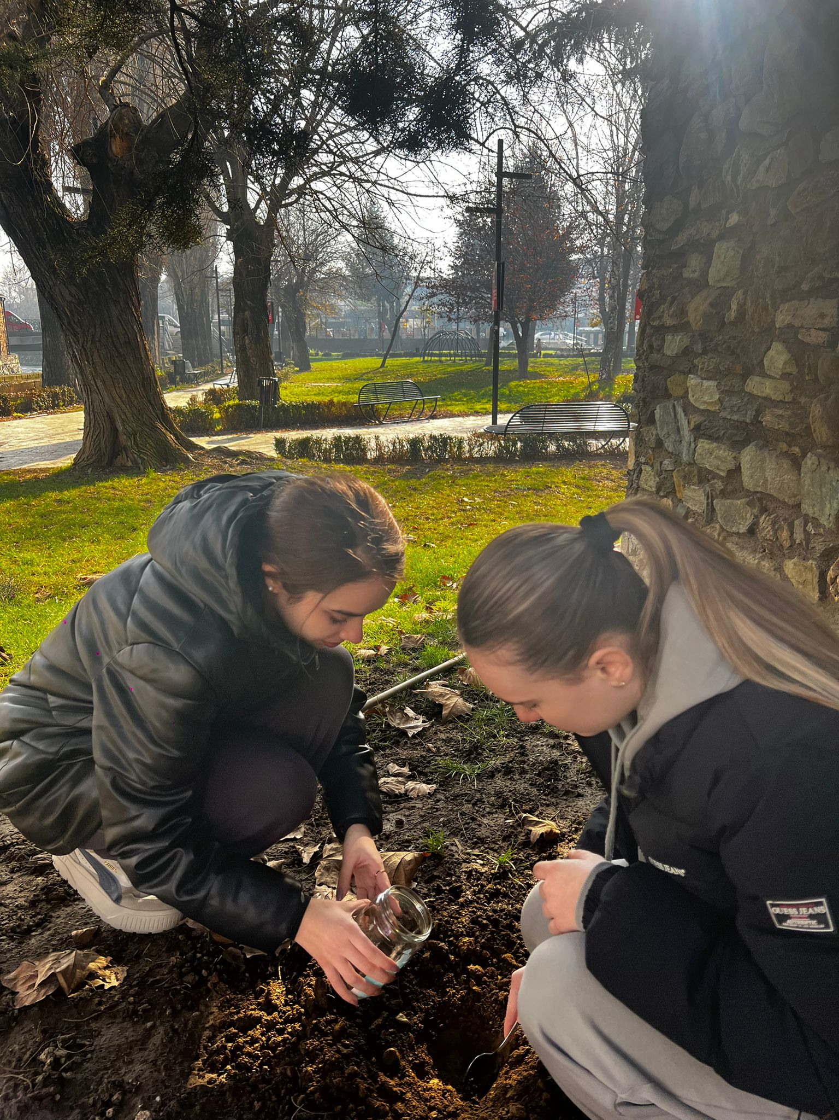
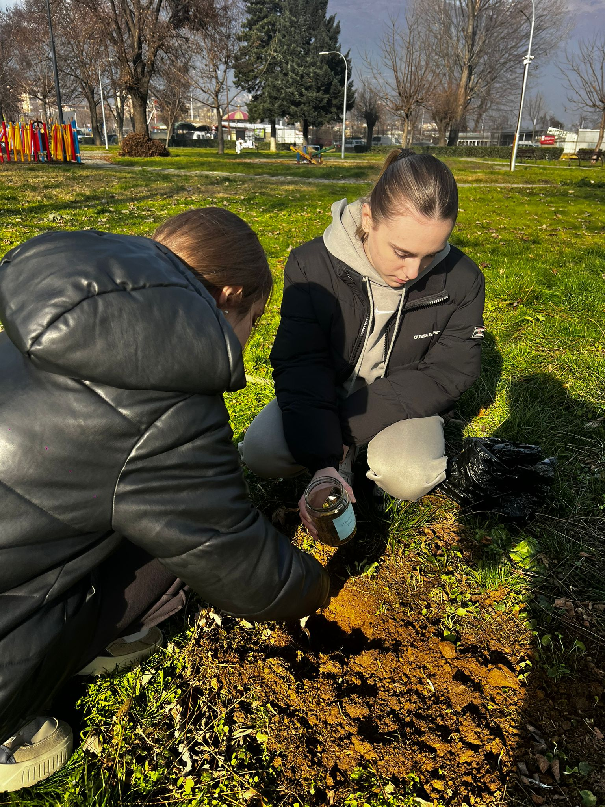
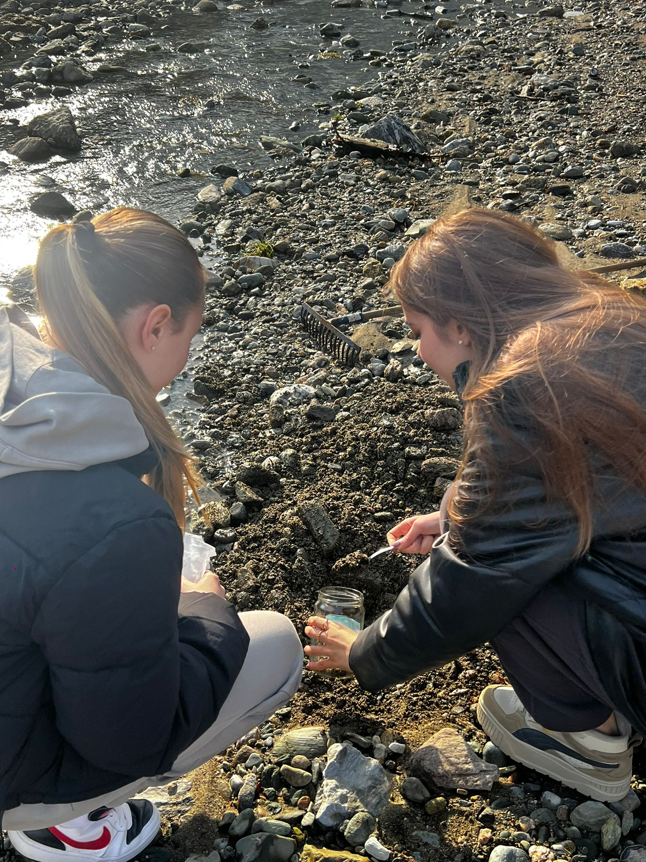
6. Method overview
Step 1: Soil sampling
Figure 1. Soil sampling in three locations

Slide 9
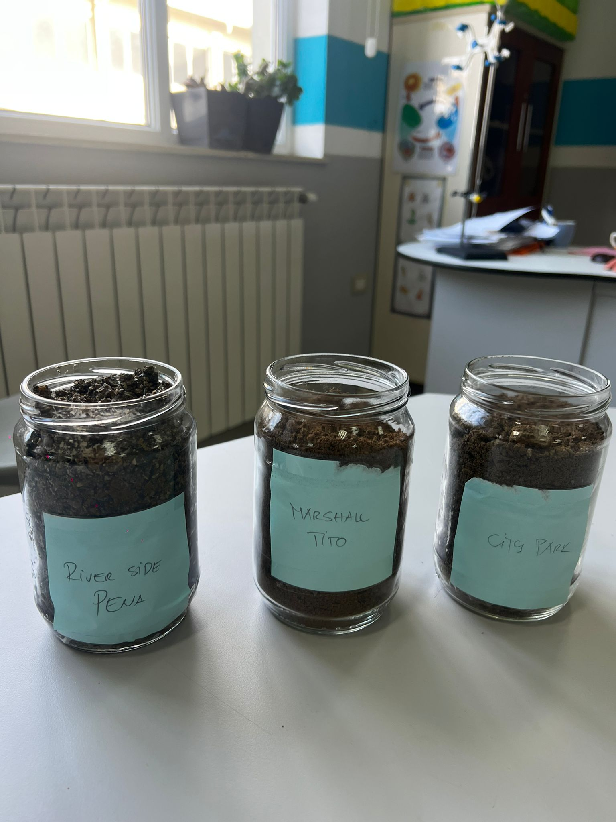
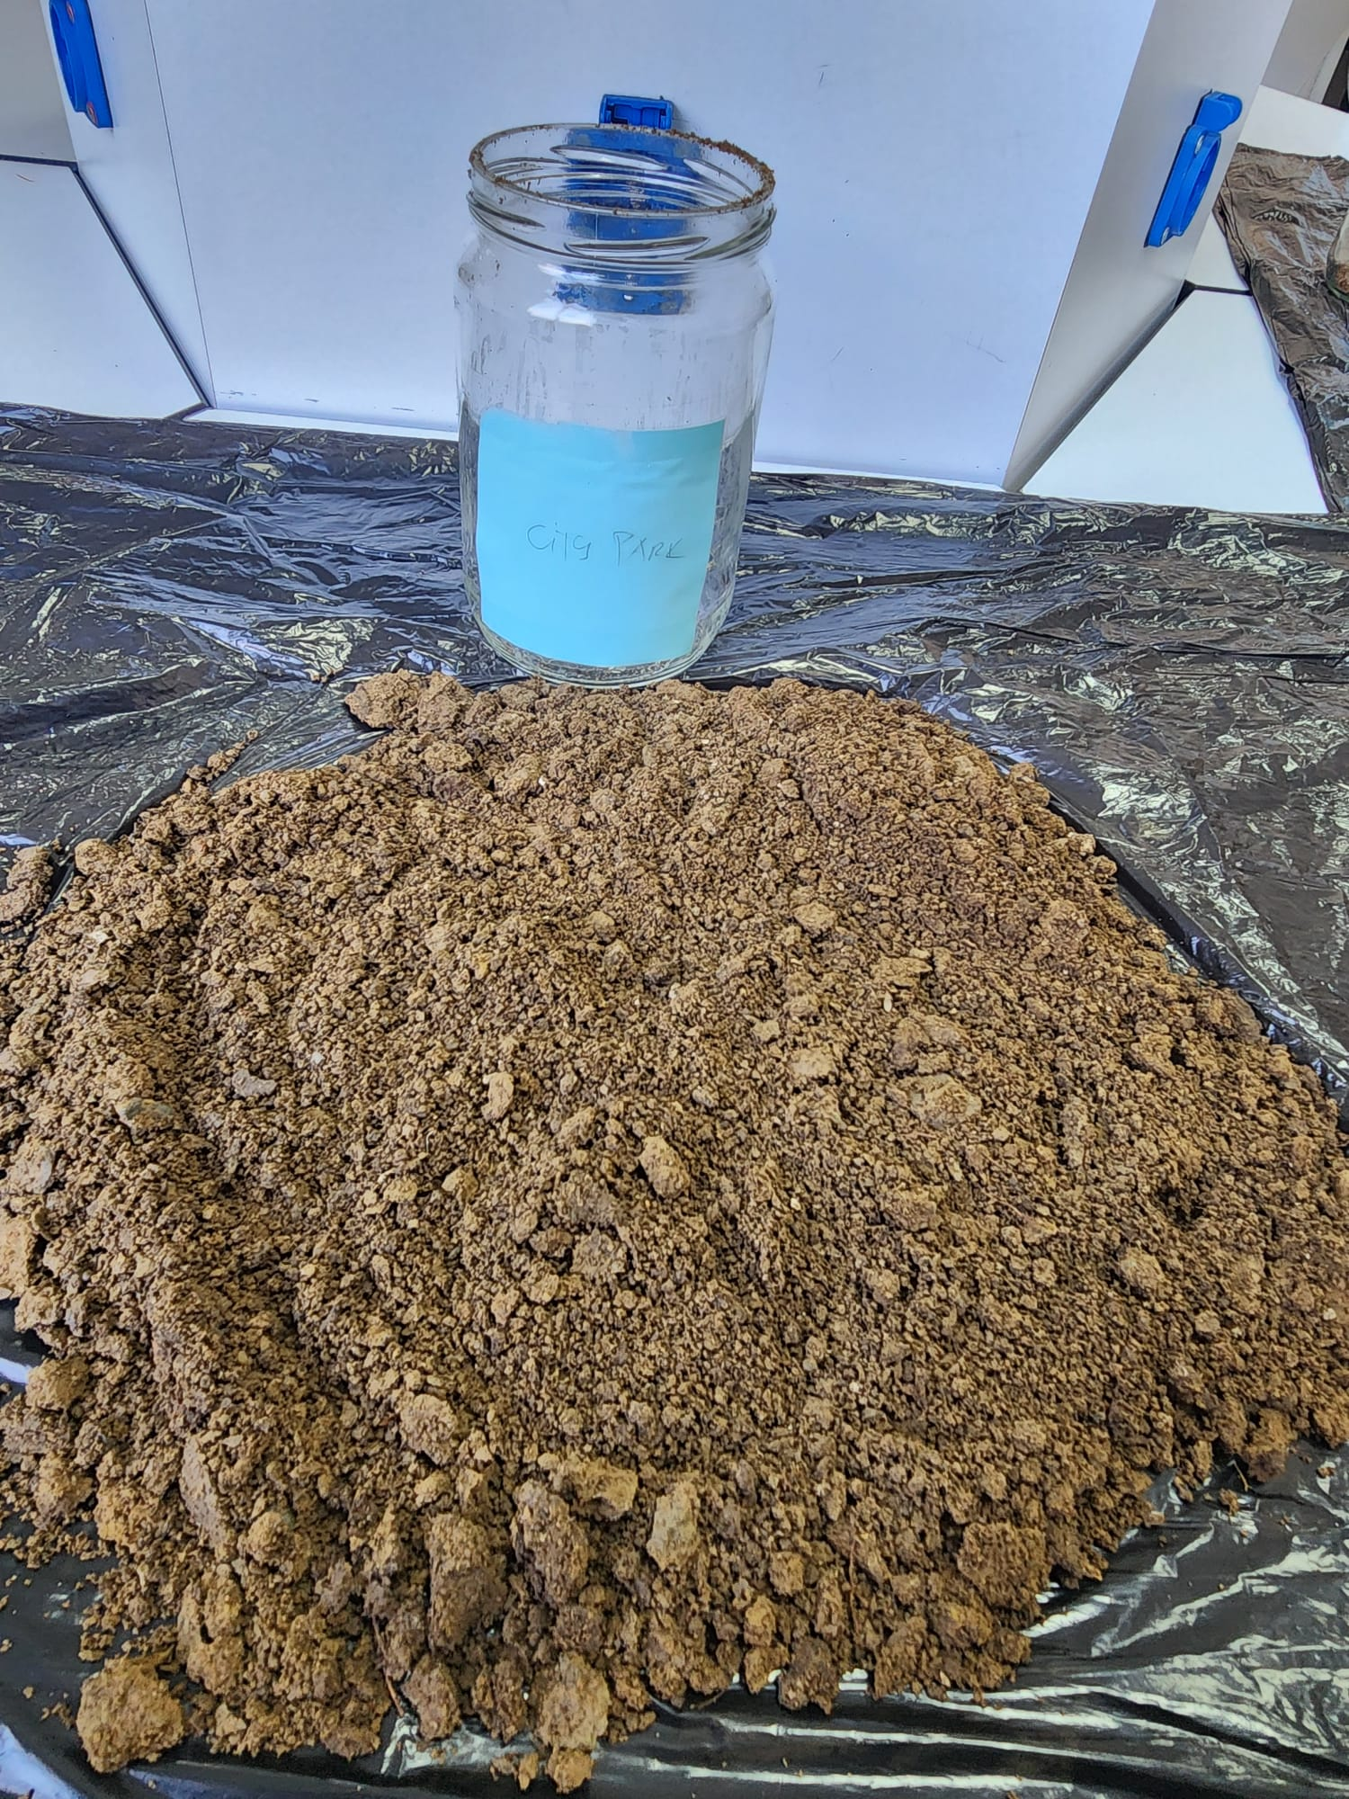
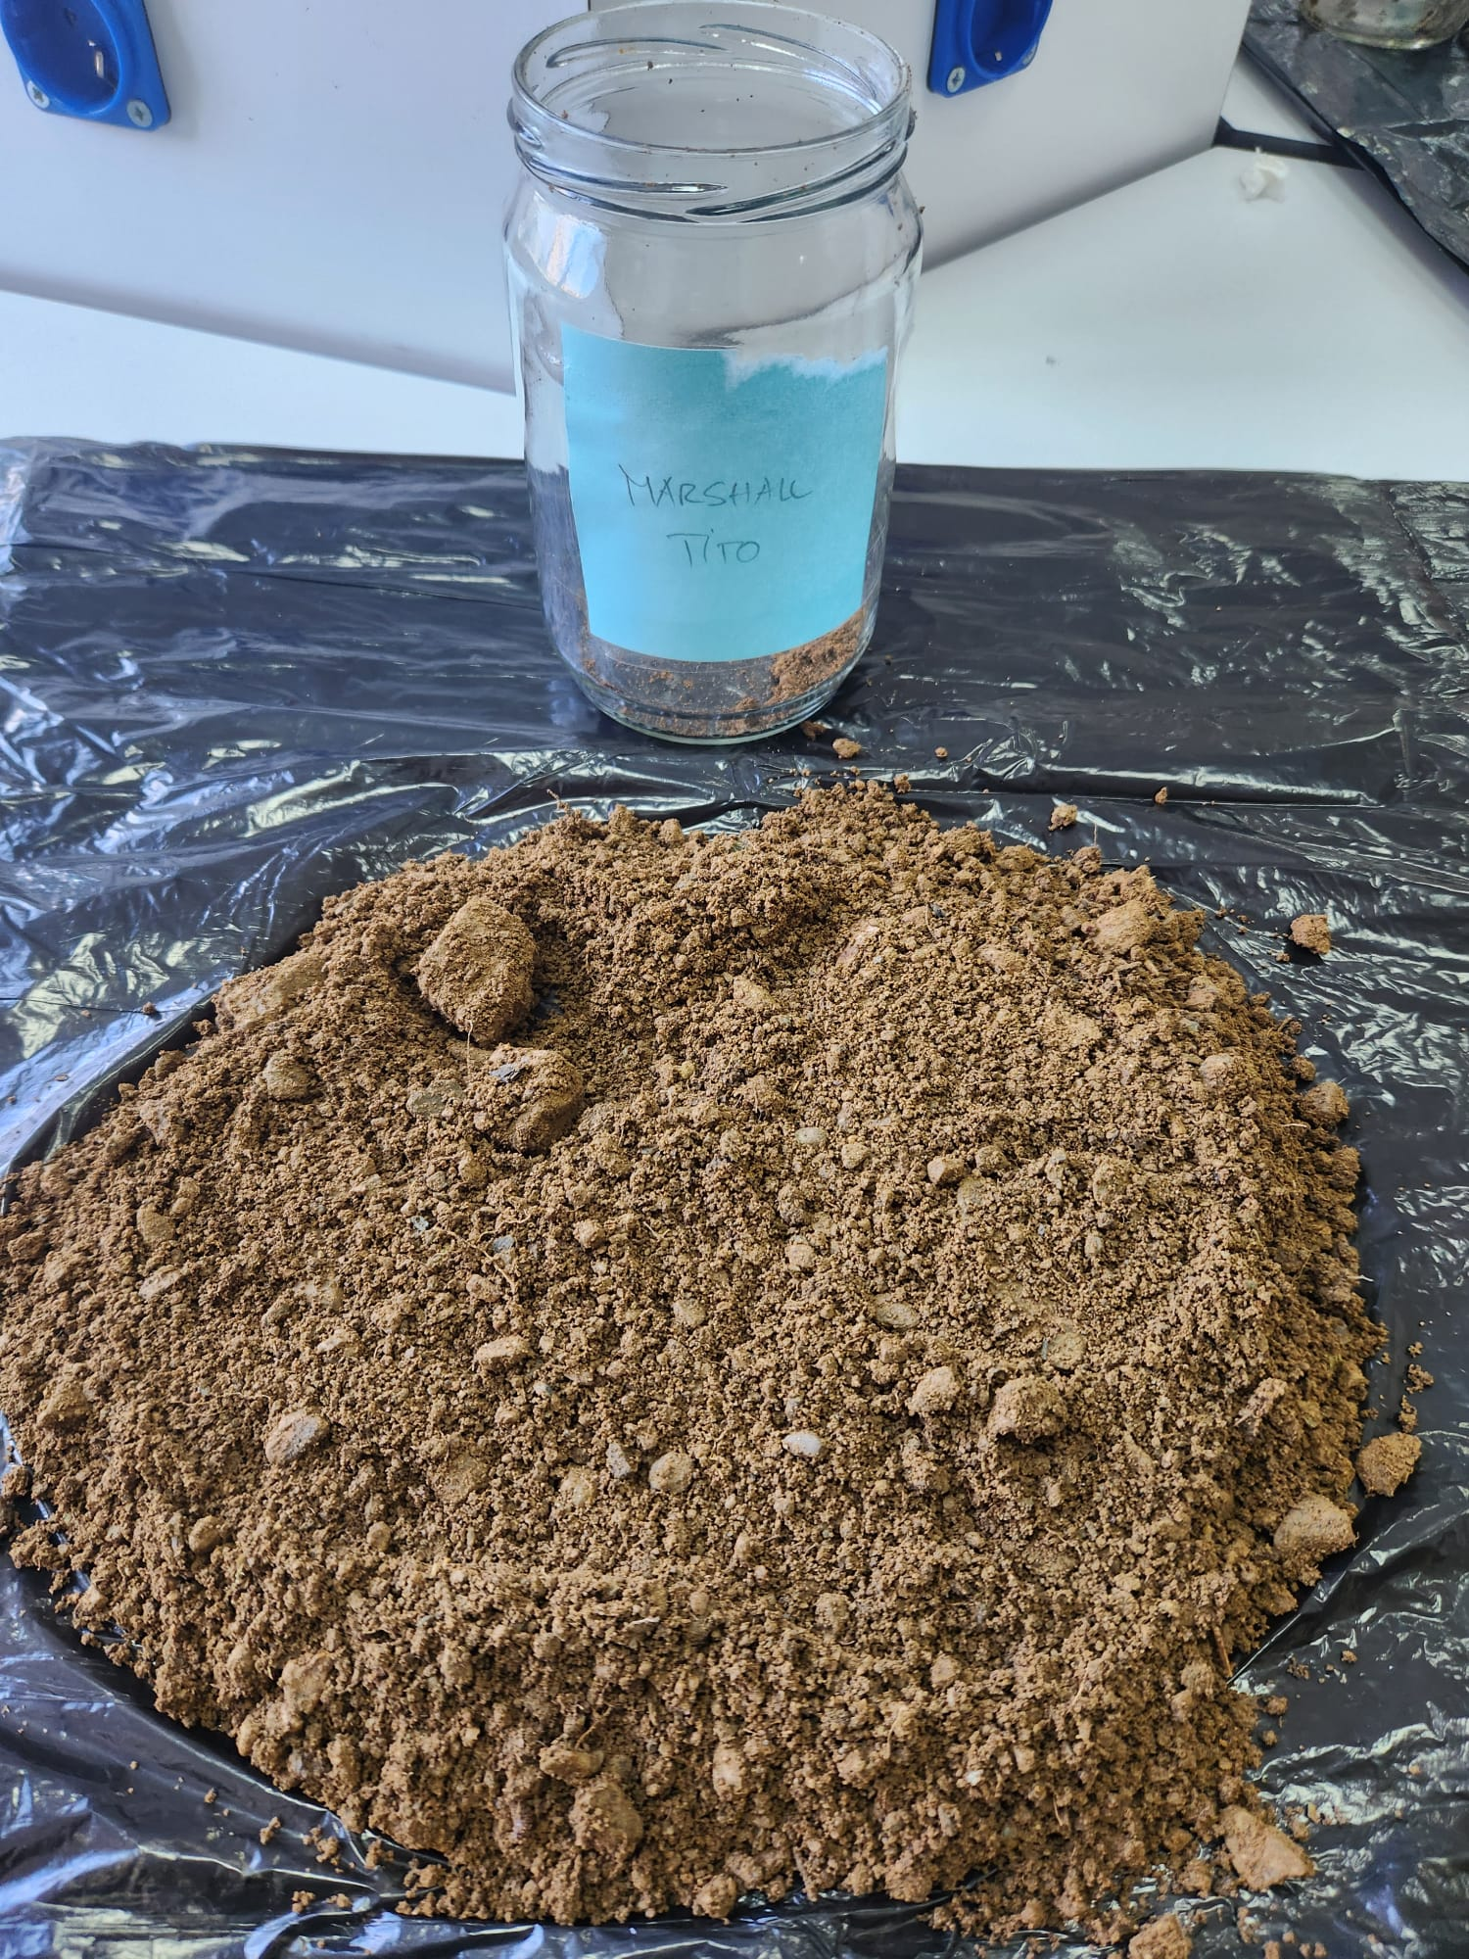
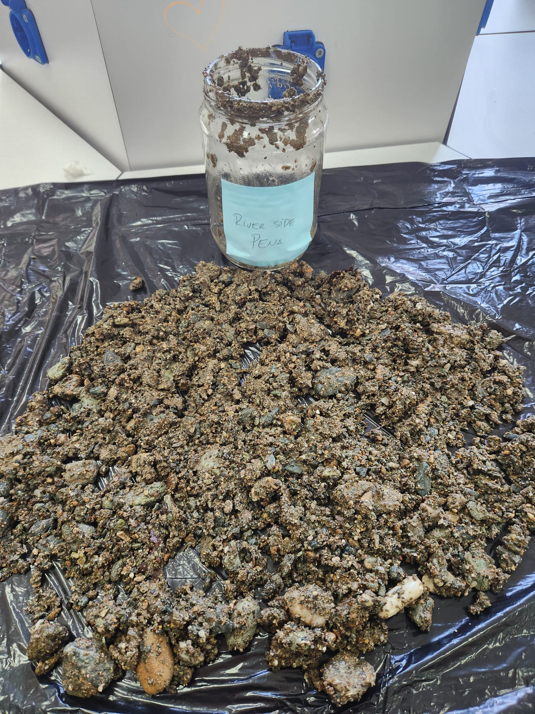
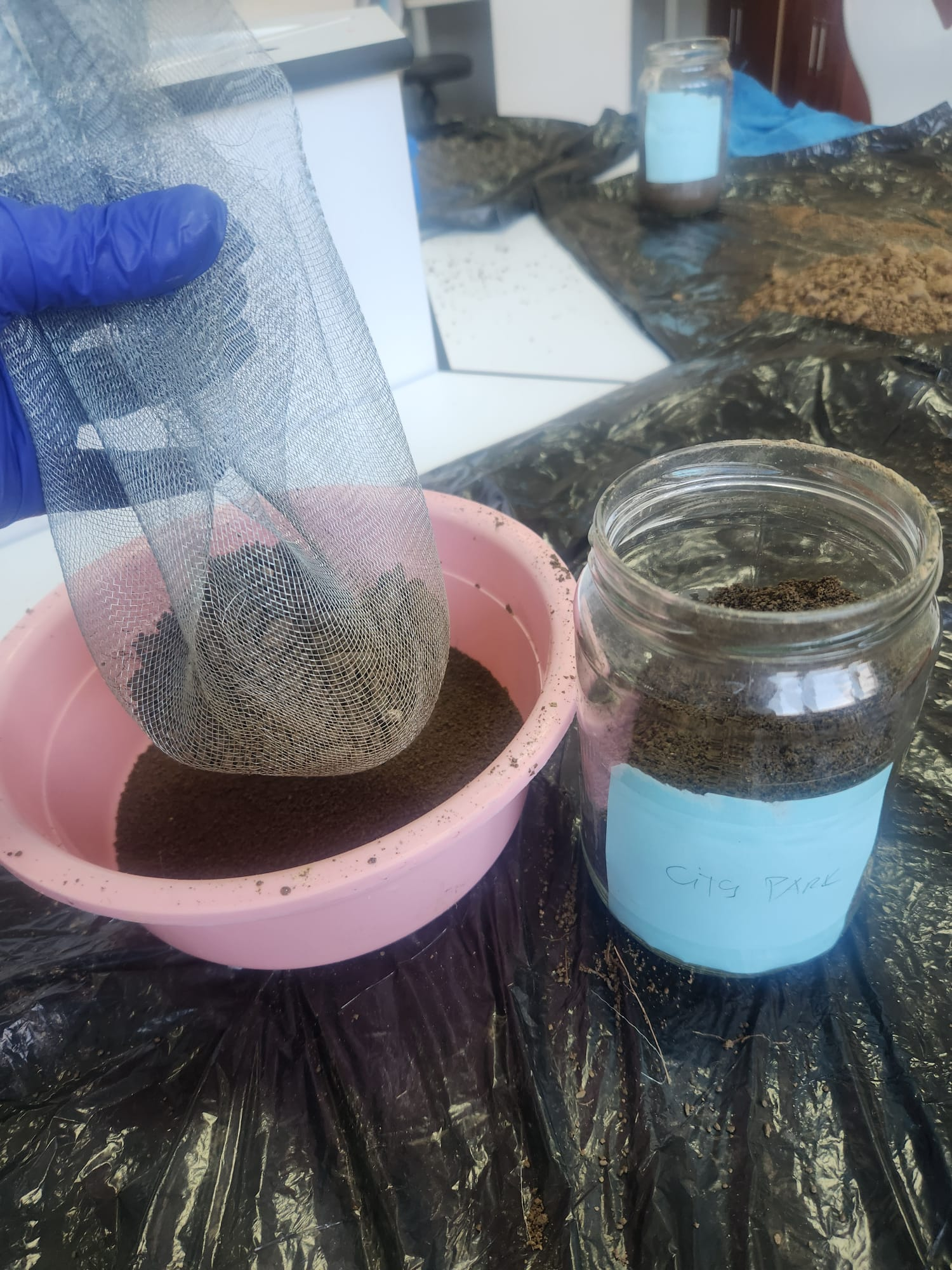
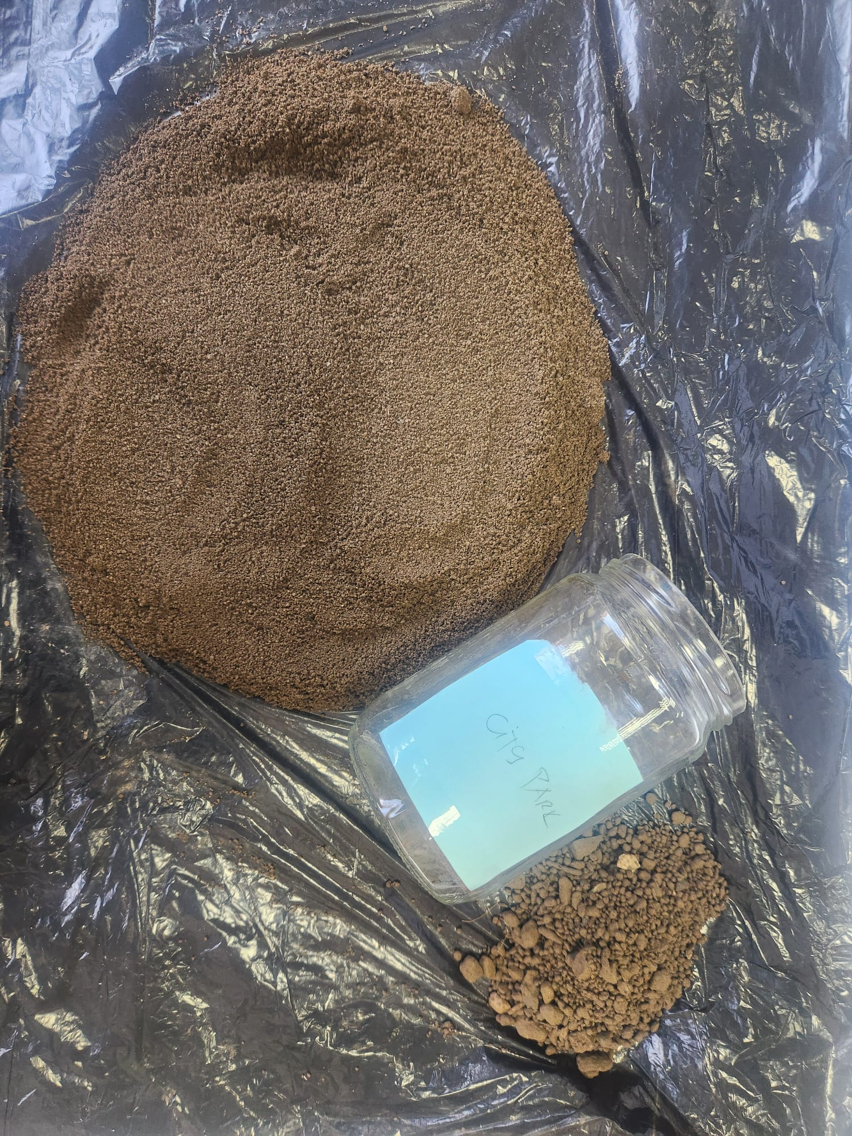
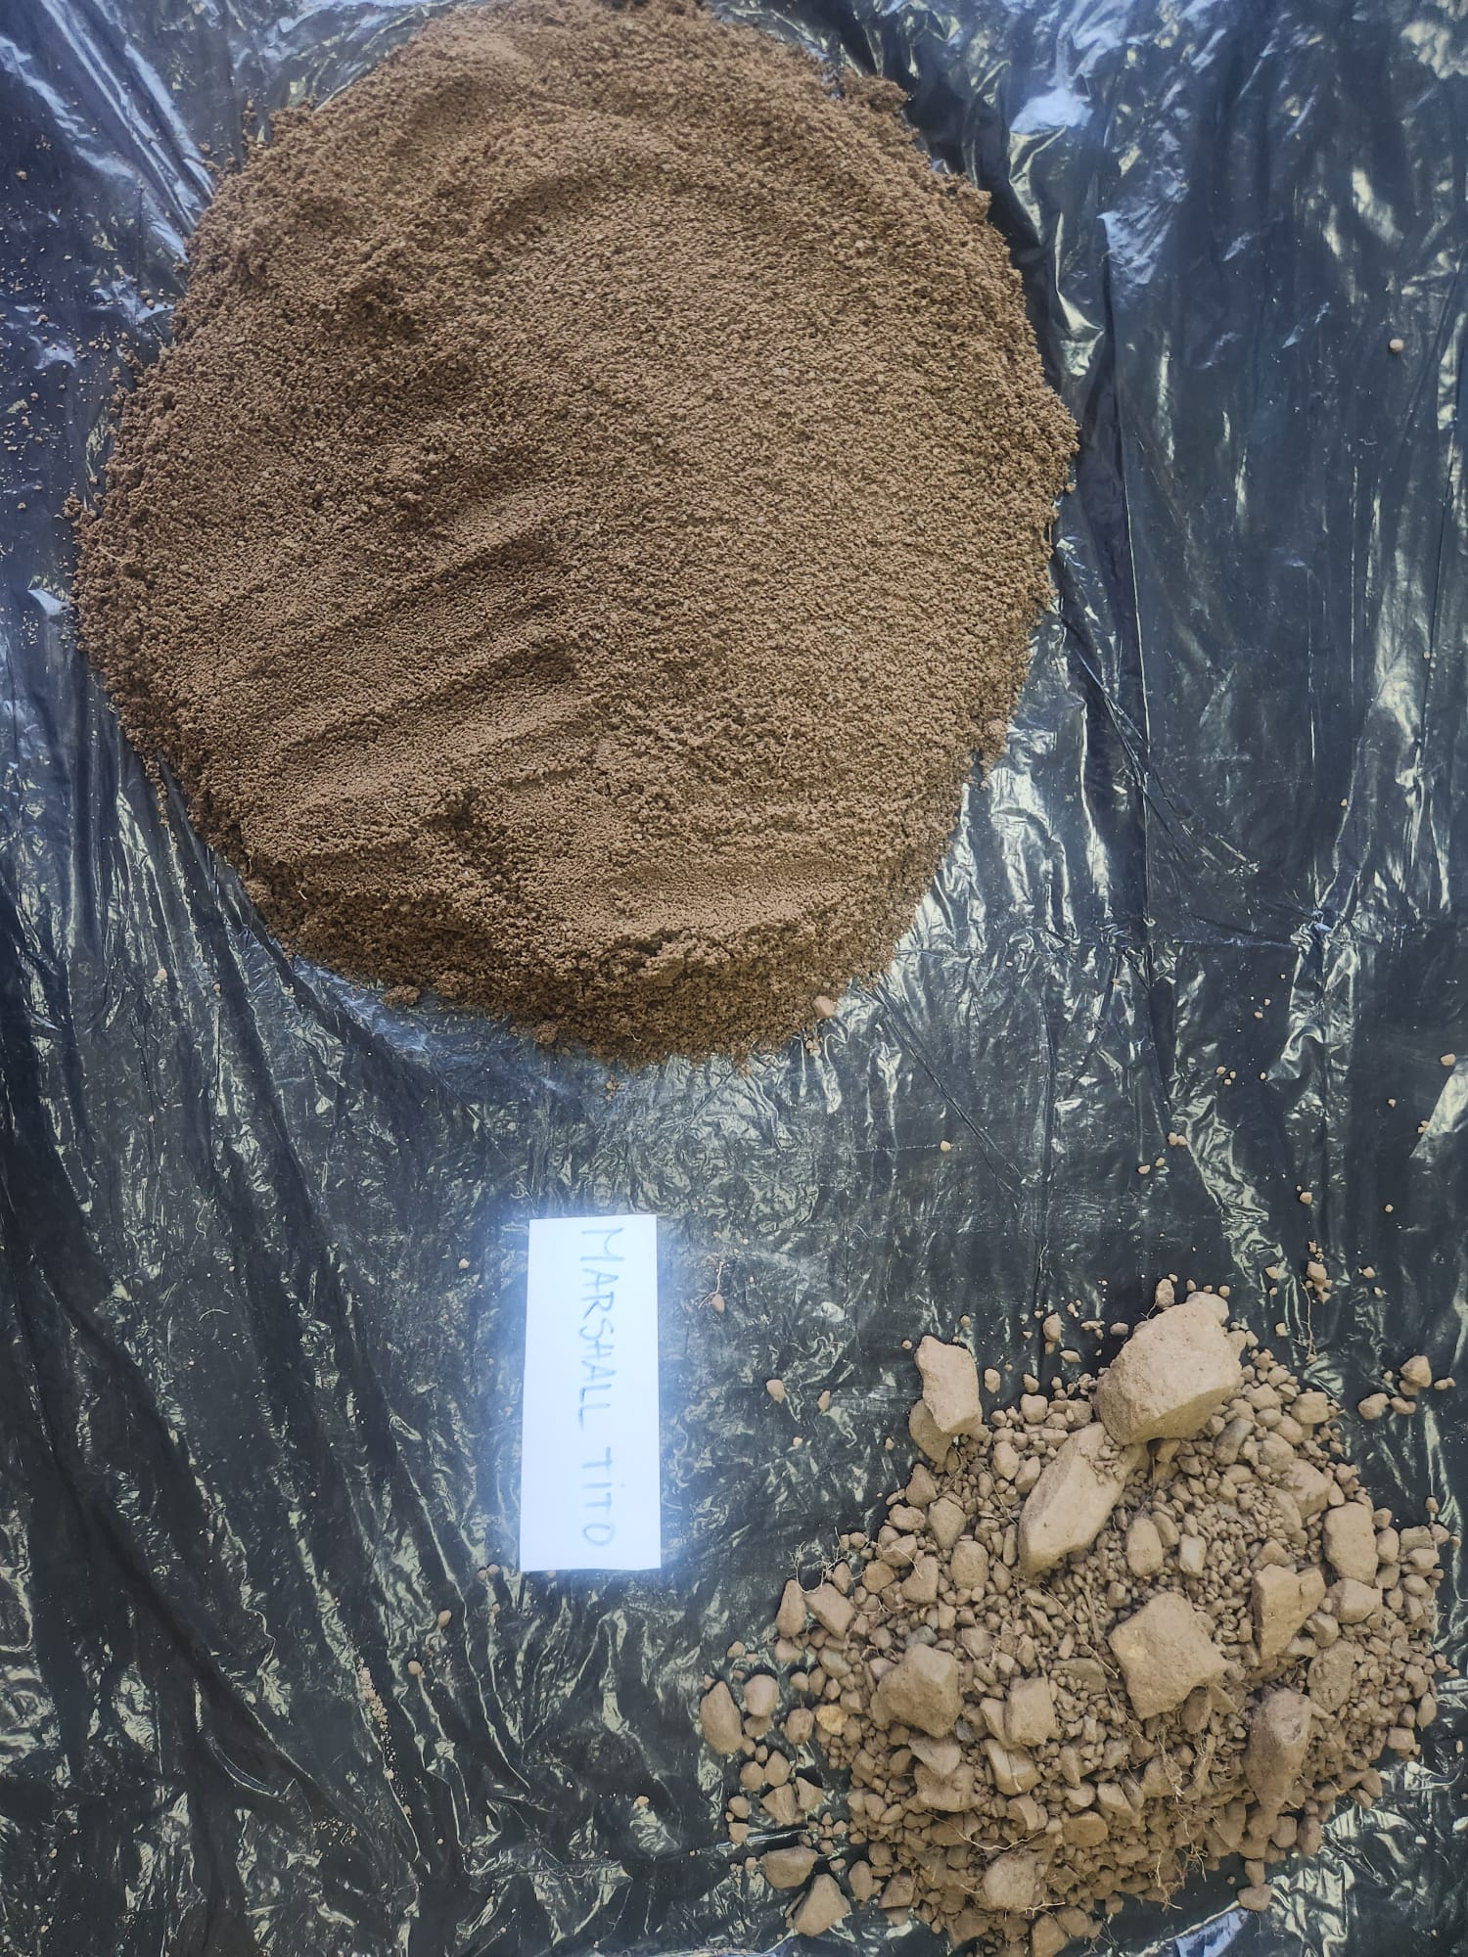
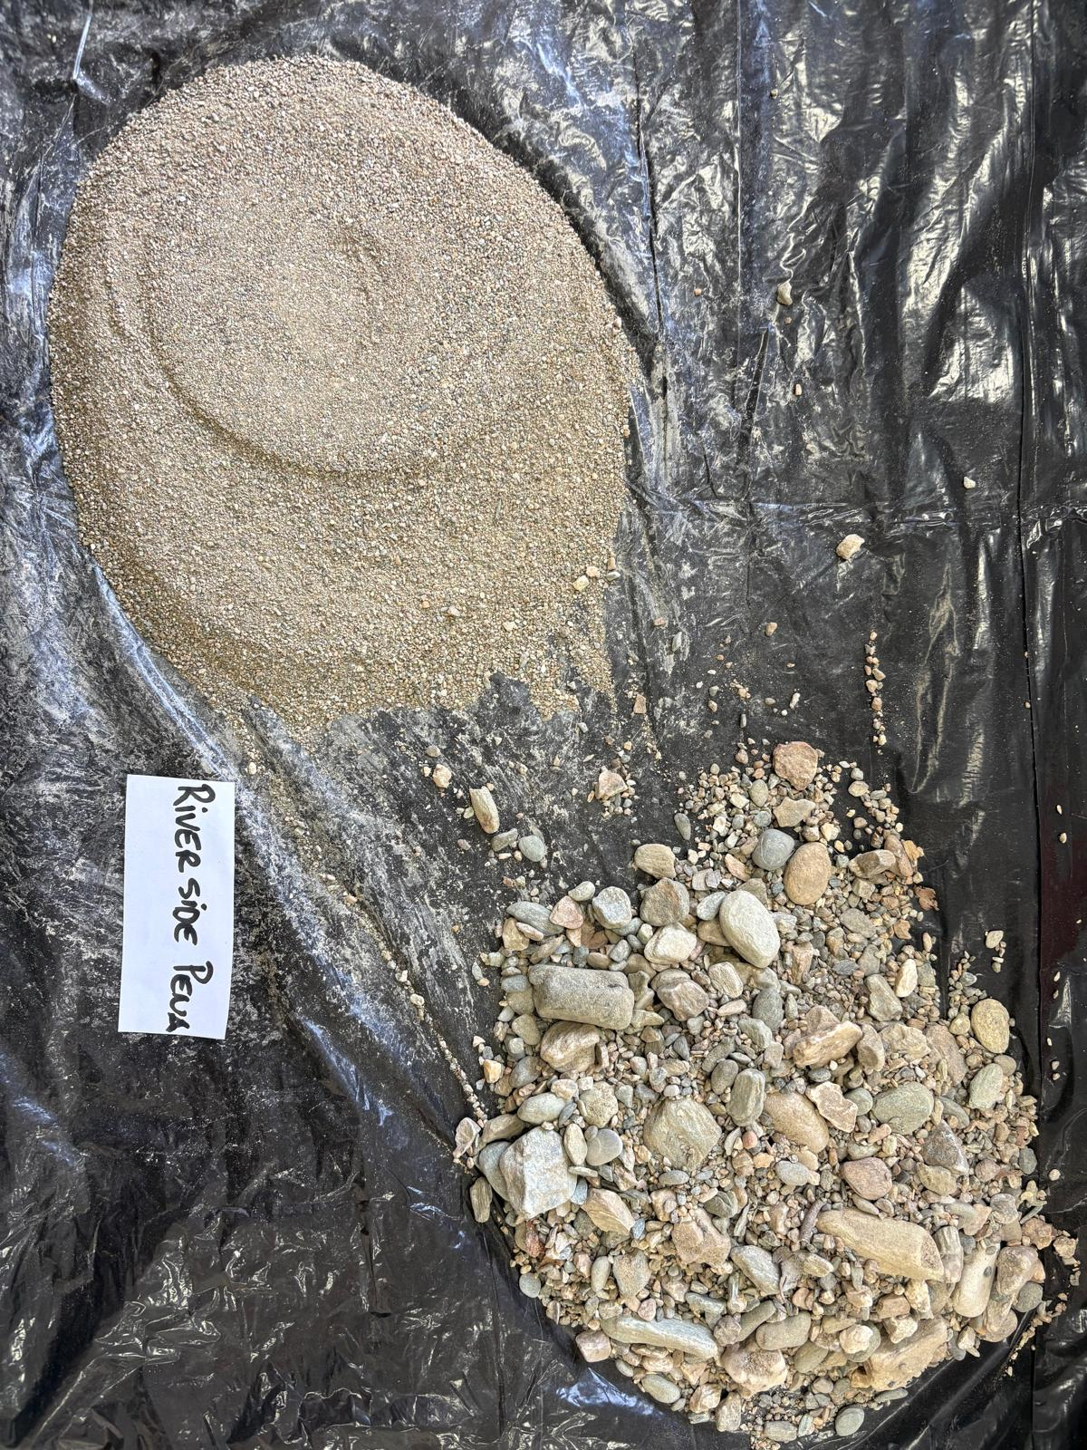
6. Method overview
Step 2: Drying & preparation
Figure 2. Soil drying and sieving

Slide 10
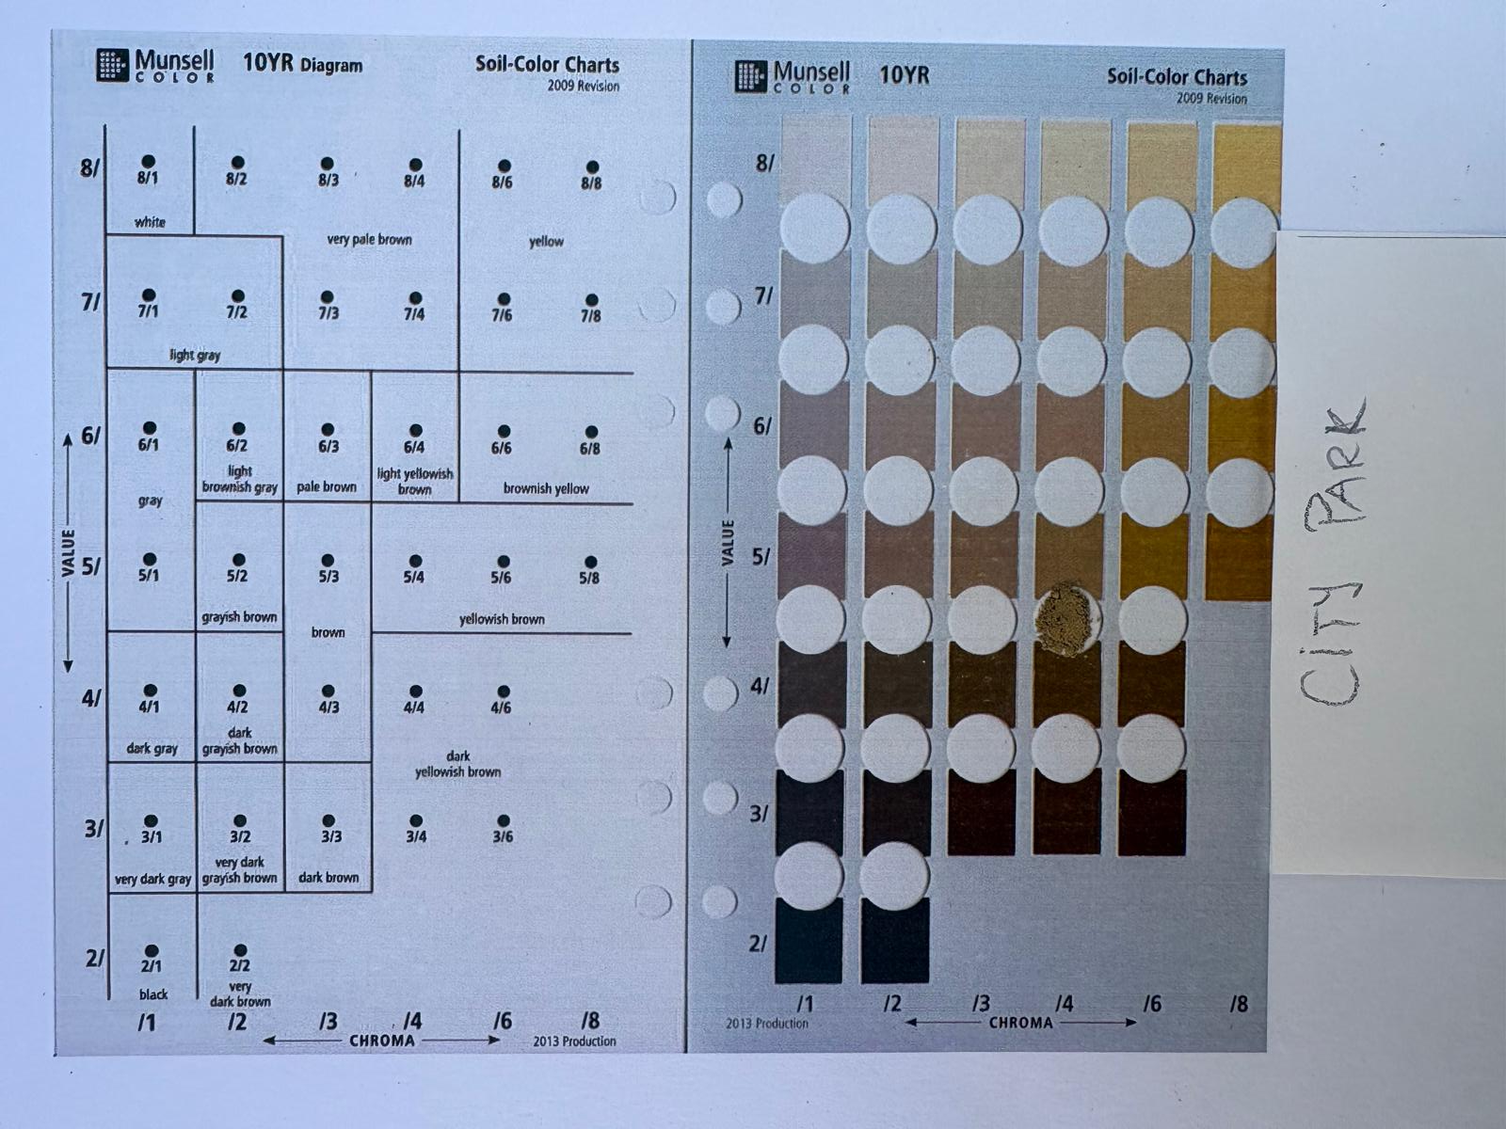
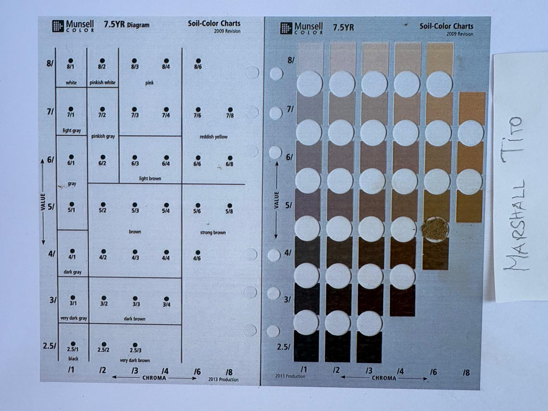
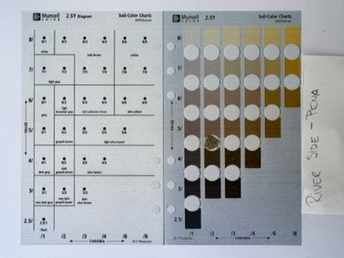
6. Method overview
Step 3: Color observation
Table 1. Comparison of Soil Color in Different Locations
Sample | Color observed
A. City park | Yellowish brown (Munsell approx. 5/4 10YR)
B. Roadside near Marshal Tito Boulevard | Strong brown (approx. 5/6 7,5YR)
C. Pena riverbank | Brown greyish (approx. 5/2 2.5Y)
Figure 3. Soil color observation using the printed Munsell chart

Slide 11
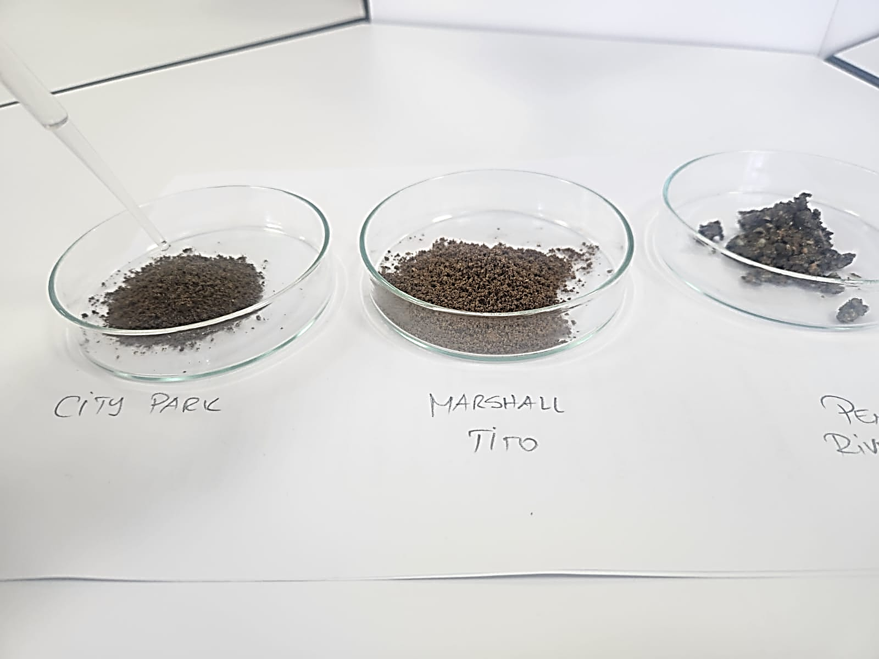
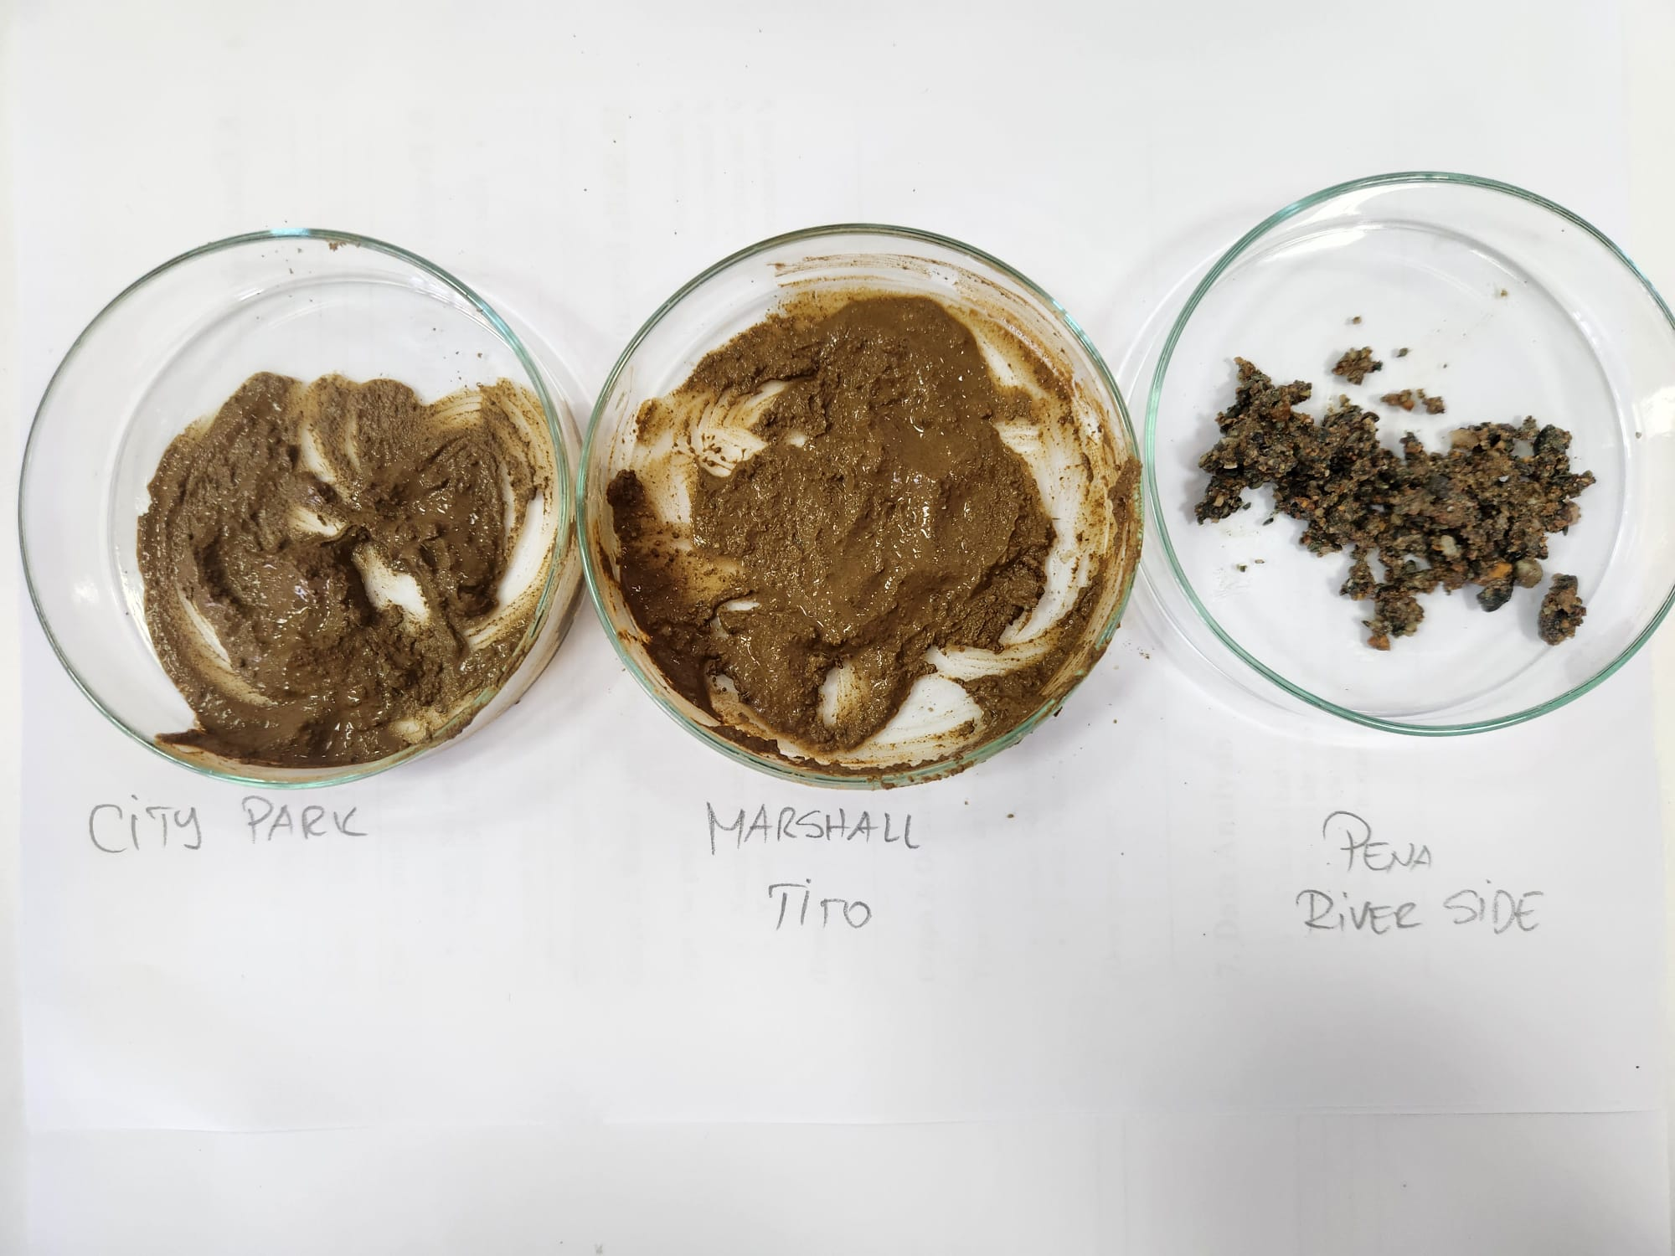
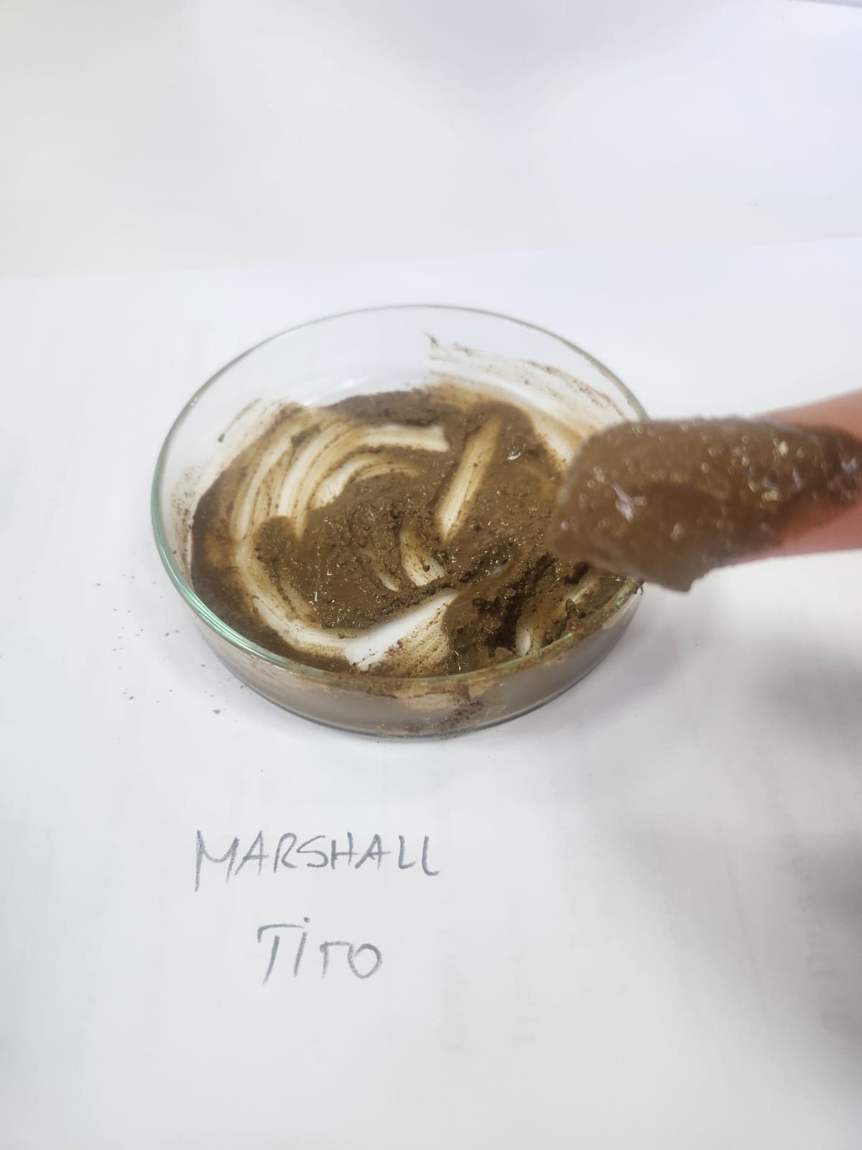
6. Method overview
Step 4: Texture test ( feel method )
Table 2. Comparison of Soil Texture in Different Locations
Sample | Gritty (Sand) | Smooth ( Silt) | Sticky (Clay) | Dominant Texture
A. City park | No | Yes | Yes | clayey
B. Roadside near Marshal Tito Boulevard | No | Yes | Yes | Slightly gritty and smooth clayey
C. Pena riverbank | Yes | No | No | sand
Figure 4. Soil texture test

Slide 12
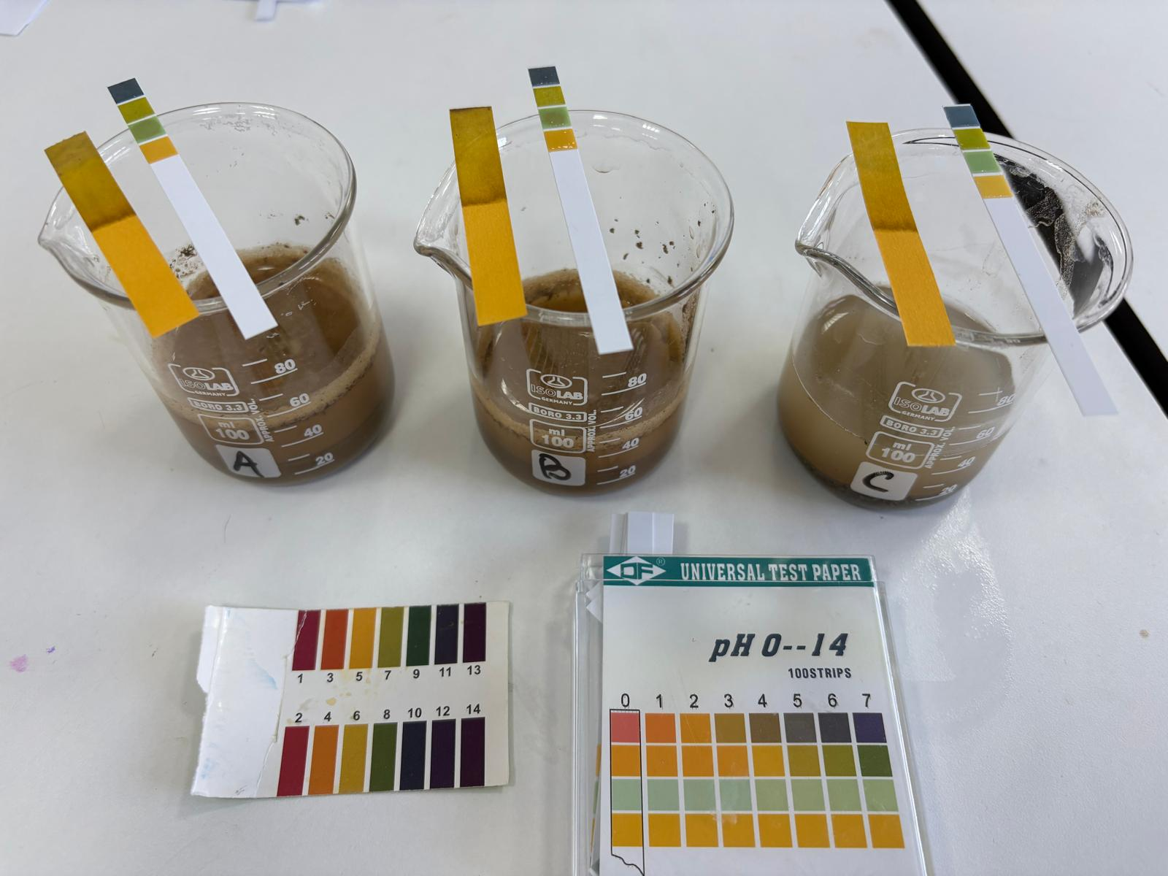
6. Method overview
Step 5: pH testing
Table 3. Comparison of Soil pH in Different Locations
Sample | pH Value | Type
A. City park | 5 | acidic
B. Roadside near Marshal Tito Boulevard | 6 | slightly acidic
C. Pena riverbank | 6 | slightly acidic
Figure 5. Soil pH test

Slide 13
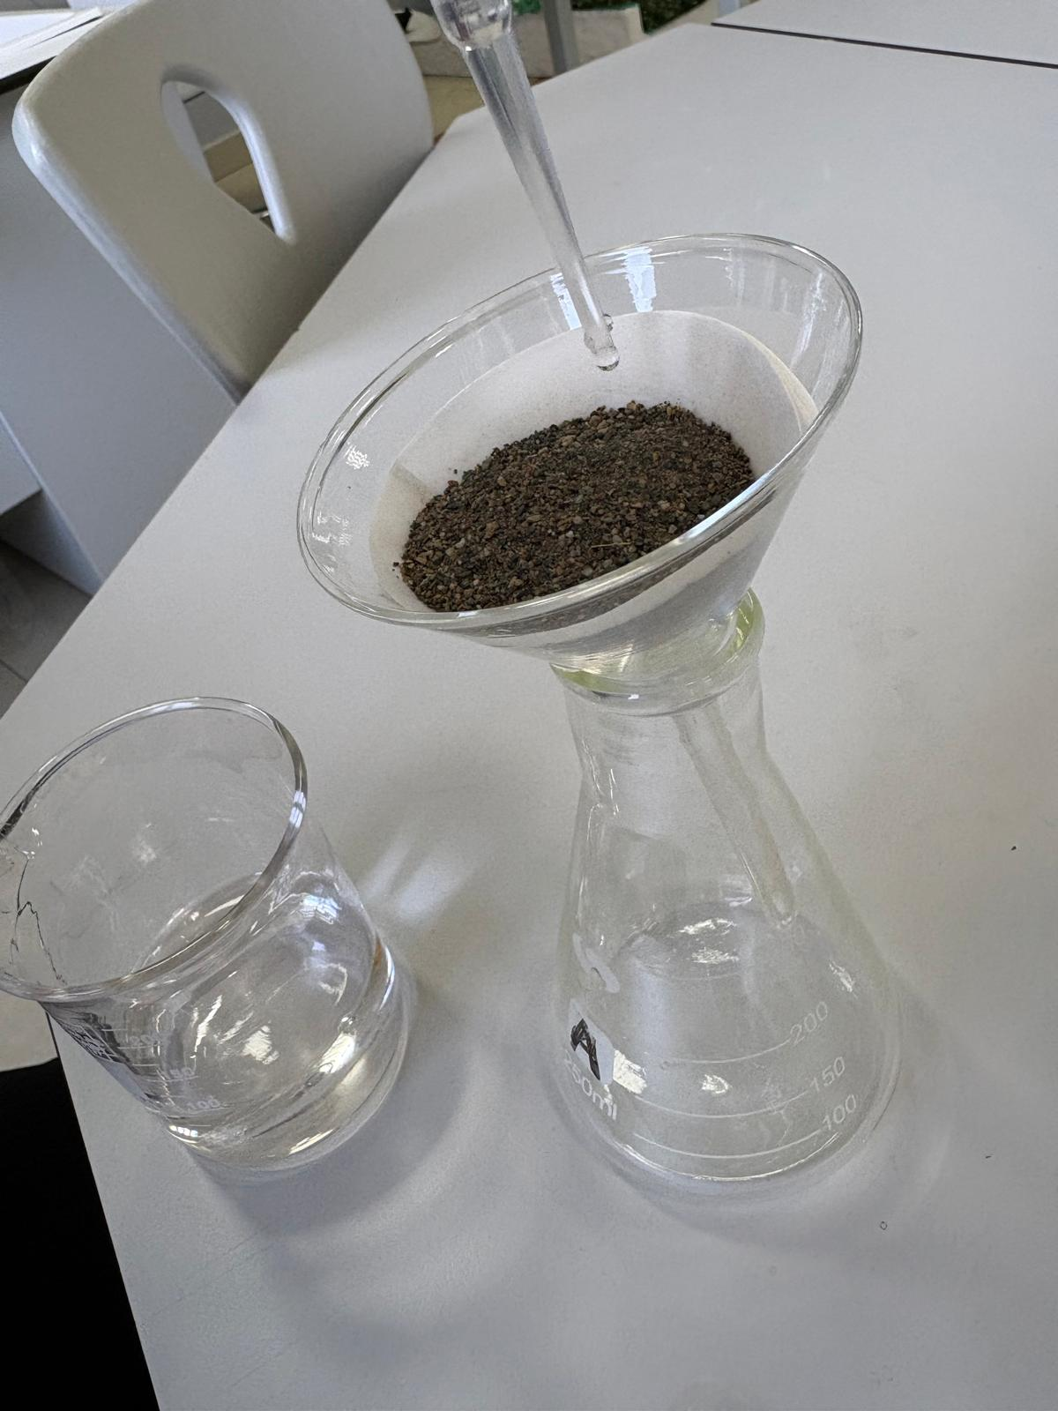
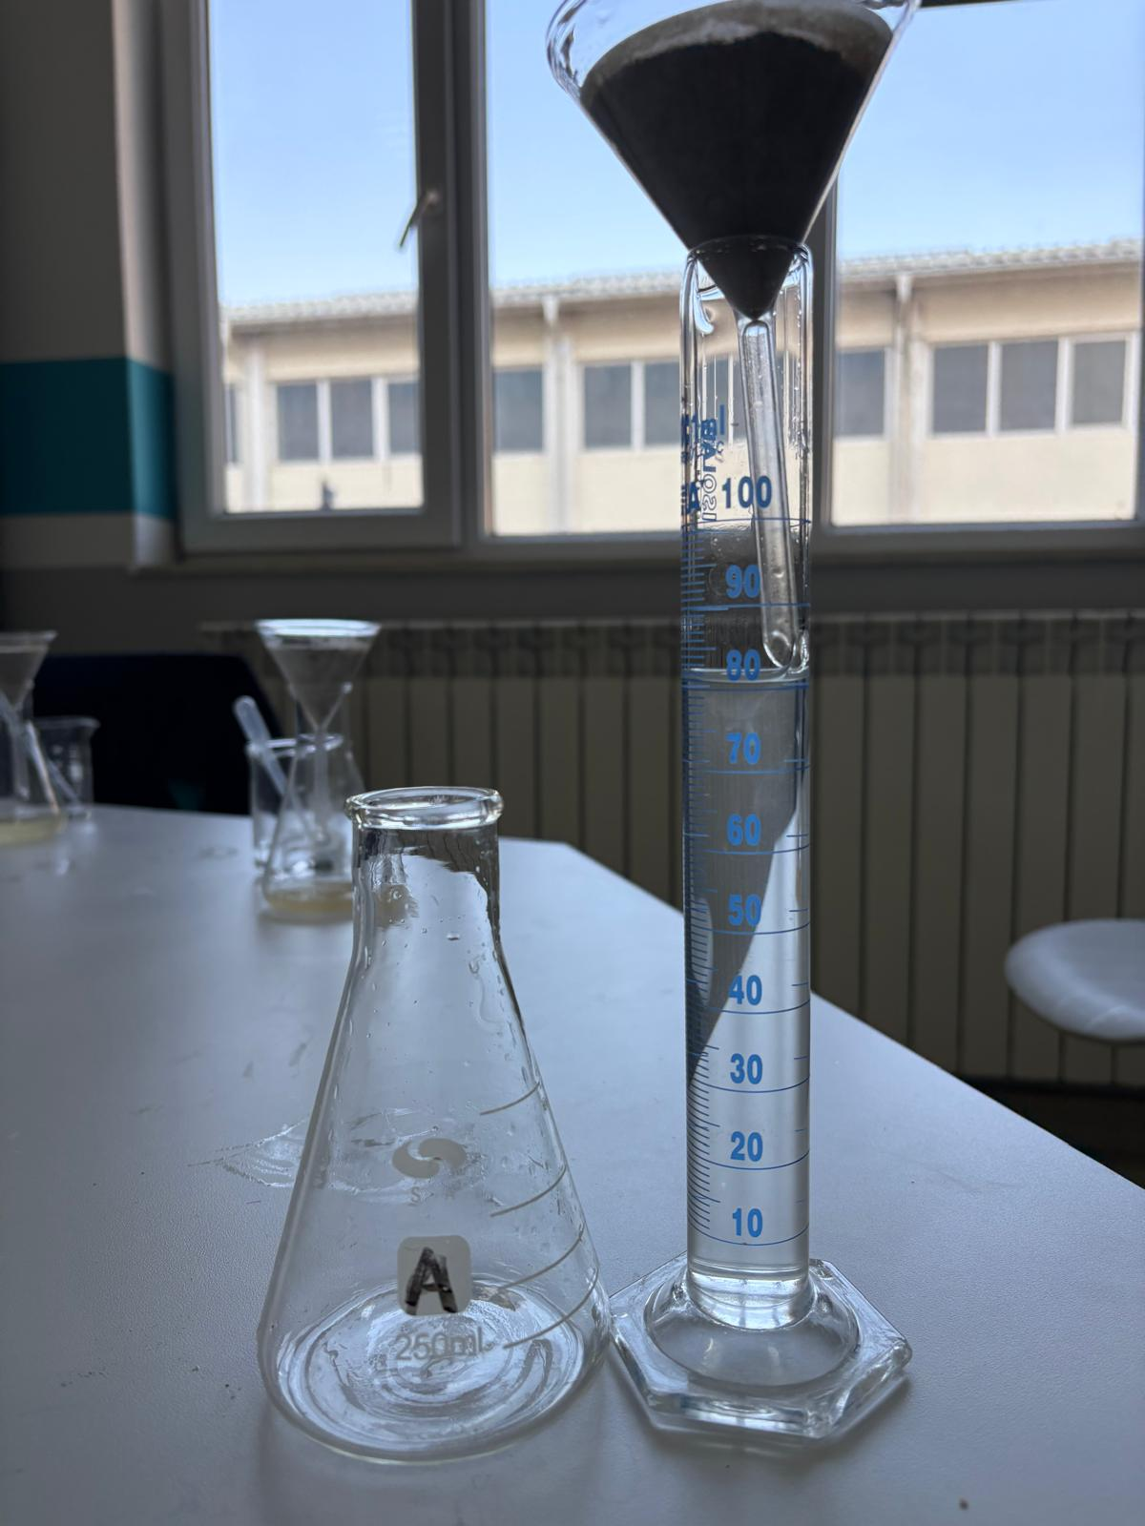
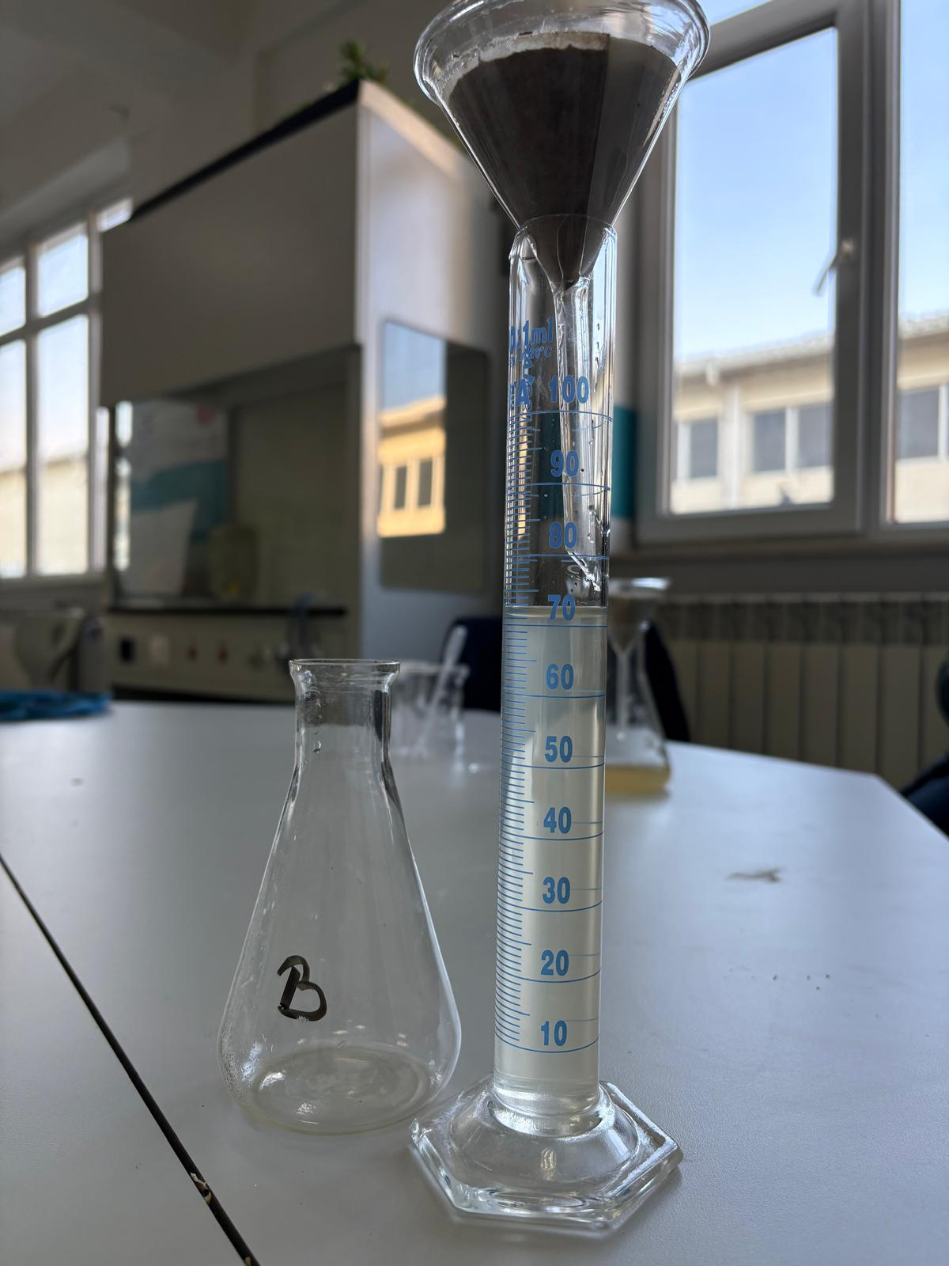
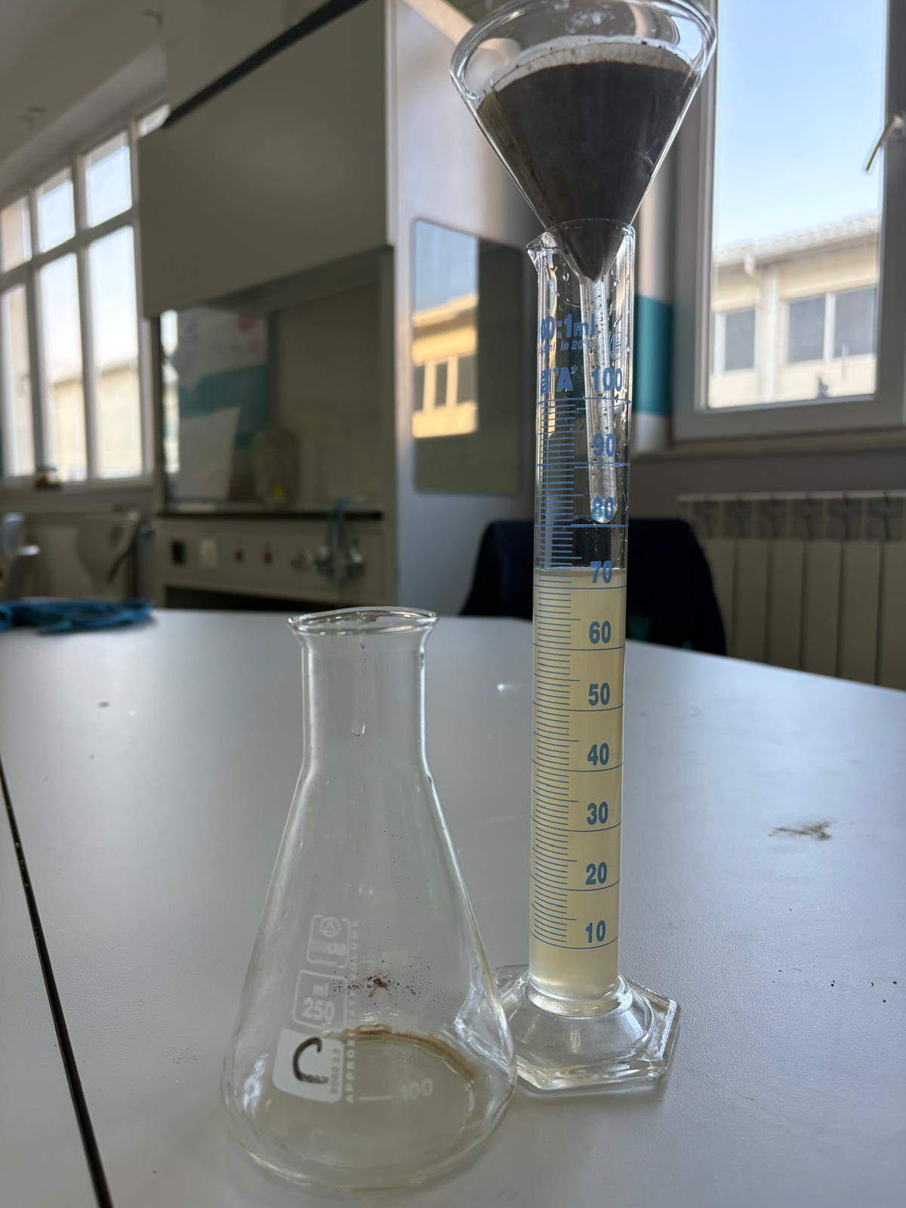
6. Method overview
Step 6: Soil water holding and infiltration capacity
Table 4. Comparison of Soil Water Holding and Infiltration in Different Locations
Sample | Soil Mass (g) | Water Volume (ml) | Retention of water (ml)
A. City park | 50 | 100 | 18
B. Roadside near Marshal Tito Boulevard | 50 | 100 | 28
C. Pena riverbank | 50 | 100 | 27
Figure 6. Measurement of soil water holding and infiltration capacity

Slide 14
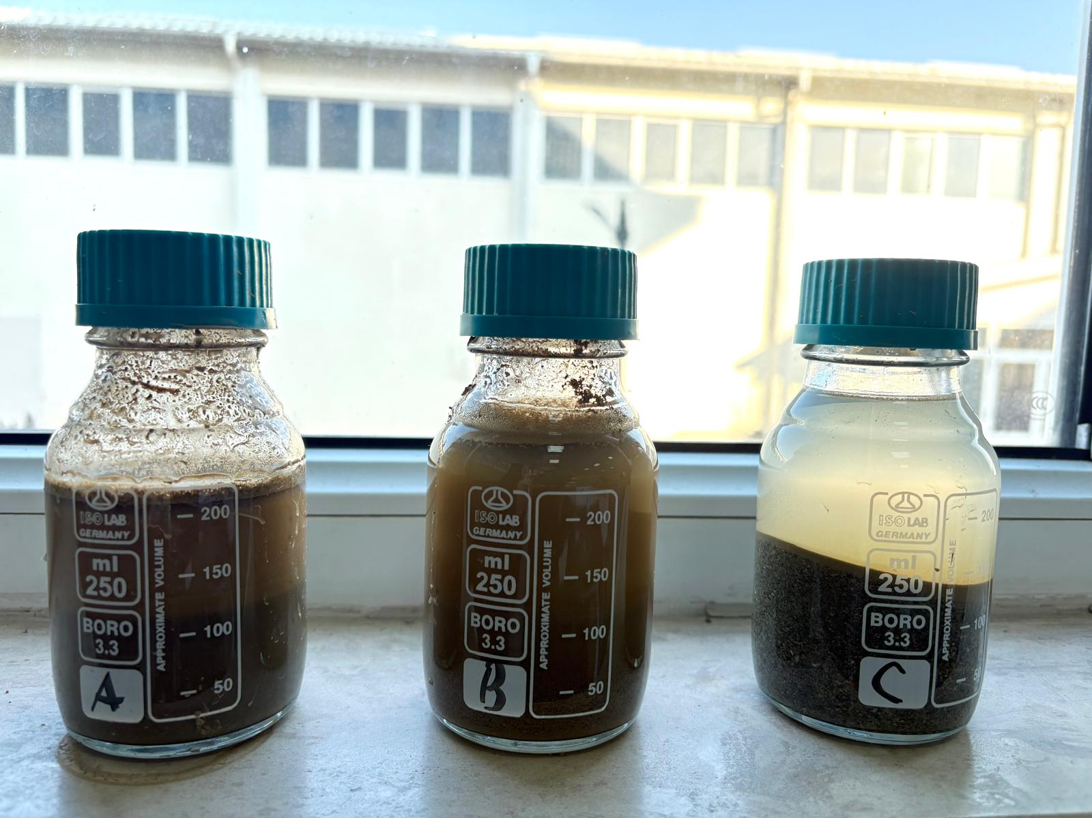
6. Method overview
Step 7: Organic matter content estimation
Table 5. Comparison of Soil Organic Matter Content in Different Locations
Sample | Thickness of Top Layer | Estimated Organic Matter
A. City park | Medium | Medium
B. Roadside near Marshal Tito Boulevard | High | High
C. Pena riverbank | Low | Low
Figure 7. The thickness of the top layer in the jars from different locations

Slide 15
7. Results
A = City park, B = Roadside Marshal Tito, C= Pena riverbank
Scale: 1 = Low, 2 = Medium, 3 = High
Figure 7 . Clustered column chart comparing soil pH values across locations
Figure 8 .Clustered column chart comparing soil water retention capacity
Figure 9. Clustered column chart comparing soil organic matter content
Table 6. Comparison between soil texture and color from the three locations
Sample | Texture | Color
A. City park | Clayey | Yellowish brown (Munsell approx. 5/4 10YR)
B. Roadside near Marshal Tito Boulevard | Slightly gritty and smooth clayey | Strong brown (approx. 5/6 7,5YR)
C. Pena riverbank | sandy | Brown greyish (approx. 5/2 2.5Y)

Slide 16
8. Mathematical Analysis of Soil Data
Measurements: mass (g), volume (ml), pH
Data recorded in tables
Comparison between samples
Graphs to visualize results
Estimation of proportions (jar test)

Slide 17
Discussion
Soil properties vary by location and environment
City park (clay) → low infiltration, moderate organic retention
Marshal Tito (roadside) → high organic matter, possible disturbance from traffic
Pena riverbank (sand) → high infiltration, low nutrient retention
All soils slightly acidic (pH 5–6) → generally suitable for plants
Water behavior influenced by texture (infiltration + retention)
Human activity impacts soil structure, especially near roads

Slide 18
Conclusion
The results partially support the initial hypothesis.
The city park soil showed moderate quality with good organic matter but lower water infiltration due to its clayey nature.
The riverbank soil had high infiltration but low organic content, indicating limited nutrient retention.
The roadside soil, although expected to be the lowest in quality, showed high organic matter, likely due to external inputs, but its structure suggests disturbance from human activity.

